Slide 1


Addressing Traumatic Brain Injury: Neurodiversity Among Youth
Karen McAvoy, PsyD
Brain Injury Educational Consulting Colorado, LLC
Notes:
David - Good afternoon, and welcome to today’s training Addressing Traumatic Brain Injury: Neurodiversity Among Youth
A few housekeeping notes before we get started.

Slide 2
Disclaimer and Funding Statement
This presentation was prepared for the Mountain Plains Mental health Technology Transfer Center (Mountain Plains MHTTC) under a cooperative agreement from the Substance Abuse and Mental Health Services Administration (SAMHSA). All materials appearing in this presentation, except that taken directly from copyrighted sources, are in the public domain and may be reproduced or copied without permission from SAMHSA or the authors. Citation of the source is appreciated. Do not reproduce or distribute this presentation for a fee without specific, written authorization from the Mountain Plains Mental Health Technology Transfer Center. For more information on obtaining copies of this presentation or the Strengthening Resilience: Promoting Positive Mental Health Among Indigenous Youth toolkit please email David Terry at david.v.terry@und.edu
At the time of this presentation, Meena Vythilingam served as SAMHSA Acting Assistant Secretary. The opinions expressed herein are the views of Karen McAvoy and do not reflect the official position of the Department of Health and Human Services (DHHS), or SAMHSA. No official support or endorsement of DHHS, SAMHSA, for the opinions described in this presentation is intended or should be inferred.
The work of the Mountain Plains MHTTC is supported by grant H79SM081792 from the Department of Health and Human Services, Substance Abuse and Mental Health Services Administration.
Notes:
David - Today’s presentation is provided free of charge by the Mountain Plains Mental Health Technology Transfer Center. Today’s presentation is available in the public domain and should Not be distributed for a fee without the express written permission of the Mountain Plains MHTTCs.
The views and opinions expressed during today’s presentation are those of our presenters and do not reflect the official position of the Department of Health and Human Services or SAMHSA. No official support or endorsement of DHHS or SAMHSA is intended or should be inferred. Please contact us with any questions you may have.

Slide 3

The Mountain Plains Mental Health Technology Transfer Center
The Mountain Plains Mental Health Technology Transfer Center (Mountain Plains MHTTC) provides training and technical assistance to individuals who serve persons with mental health concerns throughout Region 8 (Colorado, Montana, North Dakota, South Dakota, Utah and Wyoming).
We belong to the Technology Transfer Center (TTC) Network, a national network of training and technical assistance centers serving the needs of mental health, substance use and prevention providers. The work of the TTC Network is under a cooperative agreement by the Substance Abuse and Mental Health Service Administration (SAMHSA).
Notes:
David - The Mountain Plains Mental Health Technology Transfer Center is one of 12 centers that make up the larger MHTTC network. The MHTTC network is funded by the Substance Abuse and Mental Health Services Administration (SAMHSA) to provide training, resources, and technical assistance to individuals serving persons with mental health disorders. The Mountain Plains MHTTC serves the states of Colorado, Montana, North Dakota, South Dakota, Utah and Wyoming and has a particular focus on supporting providers working to meet the mental health needs of individuals living in rural communities. The Mountain Plains MHTTC is administered under a partnership between the University of North Dakota, and the Western Interstate Commission for Higher Education (WICHE). In our current grant year, the Mountain Plains MHTTC has received additional funding to support implementation of additional training and programs related to school mental health as well as provider well-being.

Slide 4
Notes:
David - The MHTTC Network is committed to aligning our training and actions to support affirming, respectful, and recovery-oriented language in all of our training and activities. We recognize the important role that person-first, culturally responsive, inclusive language plays in supporting the mental health and healing of all individuals. We encourage you to visit our National Coordinating Office’s program website to learn more.

Slide 5
Neurodiversity in Youth
Building Blocks of Brain Development
Karen McAvoy, PsyD
Brain Injury Educational Consulting Colorado, LLC
Notes:
David - Thank you again for joining us today. It is my pleasure to turn things over to Judy Dettmer with the National Association of State Head Injury Administrators to introduce our trainer today.

Slide 6
Department of Defense
One area of need among OEF/OIF Veterans is related to TBI and co-occurring mental health concerns. Military personnel serving in Iraq and Afghanistan are sustaining injuries while deployed (Terrio et al. 2009).
In fact, TBI has been identified as a "signature injury" of the recent conflicts (Tanielian and Jaycox, 2008).
Additionally, this cohort is reporting a variety of psychiatric symptoms as well, including those associated with posttraumatic stress disorder (PTSD), depression (Tanielian and Jaycox, 2008), and substance use disorder (Seal et al., 2011).
Notes:
Over the past few decades, we have come to learn a lot about the mental health and behavioral sequelae from 2 populations in particular. Because brain injury is not something that can be studied artificially in a laboratory, with people at least, we have learned a lot about brain injury from the people who are at higher risk to sustain brain injuries in their line of work. Brain injury became the “signature injury” in the Iraq and Afghanistan conflicts – with about 22% of our veterans returning from conflict with a traumatic brain injury. As a result, we also began to notice the increase in veterans reporting mental health disorders such as depression and PTSD, substance use disorder and increases in behavioral disorders.

Slide 7
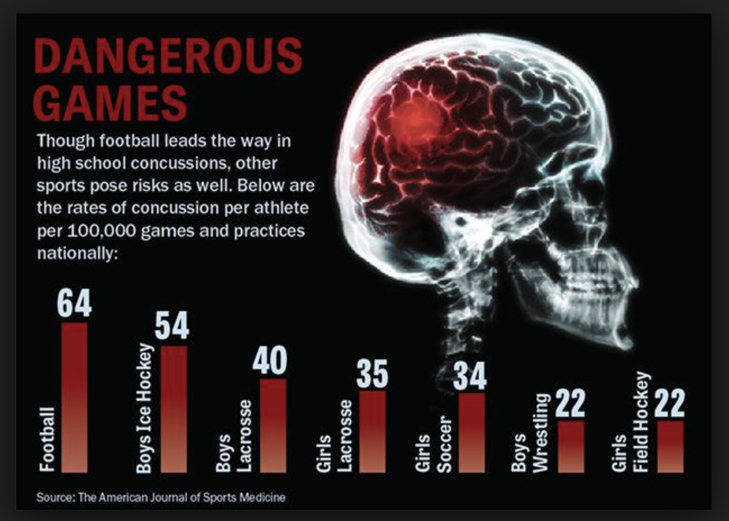
Concussions/Brain Injuries happen in sports
Sports as a Laboratory Assessment Model (SLAM) 2001
Notes:
The other group of people who sustain brain injuries as a routine part of their job are athletes. In the early 2000’s a term was even coined to describe the research that would sit back and watch and monitor the effects of brain injury on athletes as they sustained injuries in their regular practices and games – it was called SLAM – sports as a laboratory assessment model. We knew that sports would put an athlete at a higher risk to sustain a brain injury, even our teenagers and children, and football always has the highest number of concussions (known as a mild TBI) – although this graph shows that football is not the only sport that experiences concussions.

Slide 8
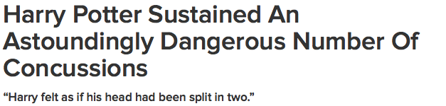
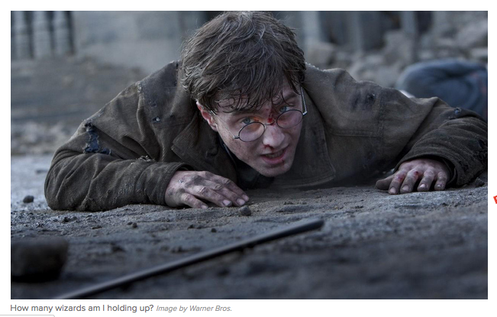
Brain Injuries happen in non-athletic ways too!
40%+ are getting concussions in non-sports related activities (Eagan-Brown, BrainSTEPS)
Notes:
As educators, we have become concerned with the number of students who sustain concussions in non-athletic endeavors – such as falls, motor vehicle accidents, etc. and we have learned over the last few decades that there are more students with brain injury than are being tracked by athletic monitoring, probably close to 50% of students that schools support in a school setting with concussion sustained their injury in a non-sports way. This means that we may be drastically under-accounting for concussion/brain injury in schools, especially mild brain injuries.

Slide 9
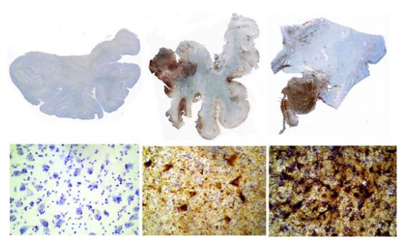
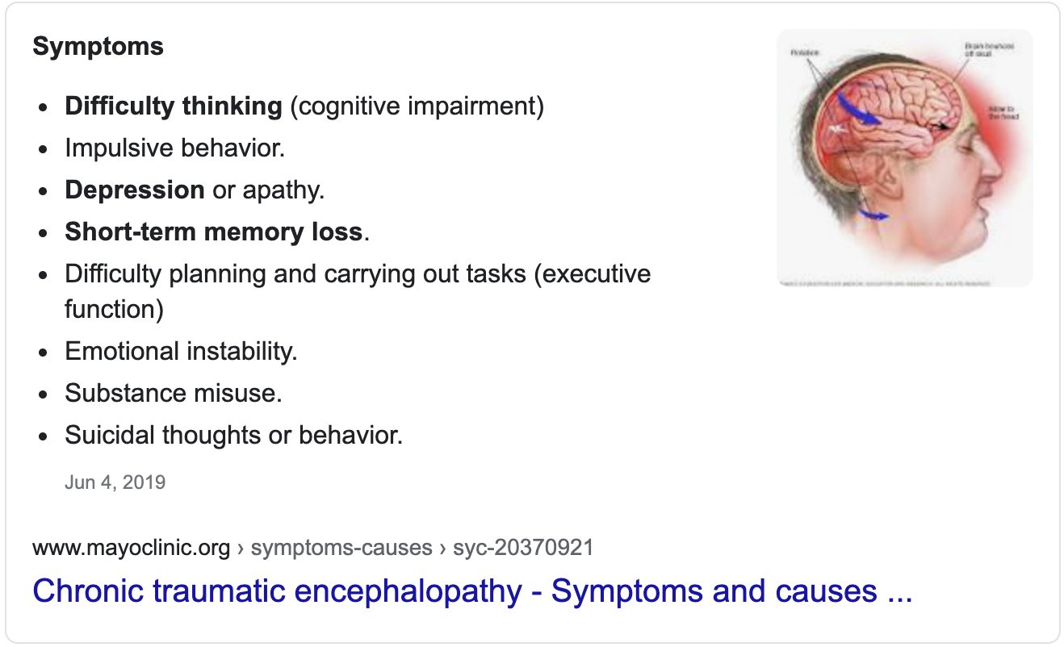
CTE (Chronic Traumatic Encephalopathy)
Source: Boston University Brain Bank: Images from Website, Dr. Ann McKee
Notes:
In the early 2000’s, research started to emerge that suggested a biochemical change in the brains of athletes who sustained hit after hit, even if those hits did not raise to the level of a diagnosis of concussion or brain injury (called subconcussive blows). Medical professionals were noticing behavioral, cognitive and emotional concerns in professional football players who had sustained numerous years of hits to the head. Unfortunately as a number of those athletes passed away, many of them from suicide, their brains showed on autopsy structural damage related to deposits of a protein called “tau” suspected to be linked to the onset of Alzheimer-like symptoms and impulsive behaviors, cognitive impairments and emotional lability. impacting behavior, cognition and emotion.
Even more alarm was raised when it was suspected that multiple hits to the head, even small (subconcussive) hits to the head could be related to the eventual deposits of “tau” proteins in the brain that were later found on autopsy. Besides the cellular changes seen in these slides above, many of the athletes were also displaying emotional, cognitive and behavioral issues like depression, aggression, suicidality, etc.
Even more alarm was raised when it was suspected that multiple hits to the head, even small (subconcussive) hits to the head could be related to the eventual deposits of “tau” proteins in the brain that were later found on autopsy. Besides the cellular changes seen in these slides above, many of the athletes were also displaying emotional, cognitive and behavioral issues like depression, aggression, suicidality, etc.
Even more alarm was raised when it was suspected that multiple hits to the head, even small (subconcussive) hits to the head could be related to the eventual deposits of “tau” proteins in the brain that were later found on autopsy. Besides the cellular changes seen in these slides above, many of the athletes were also displaying emotional, cognitive and behavioral issues like depression, aggression, suicidality, etc.

Slide 10
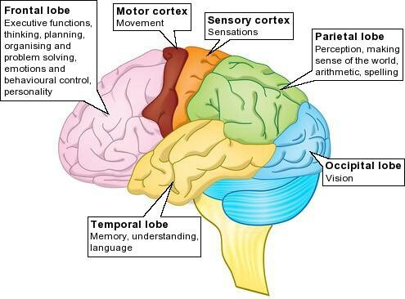
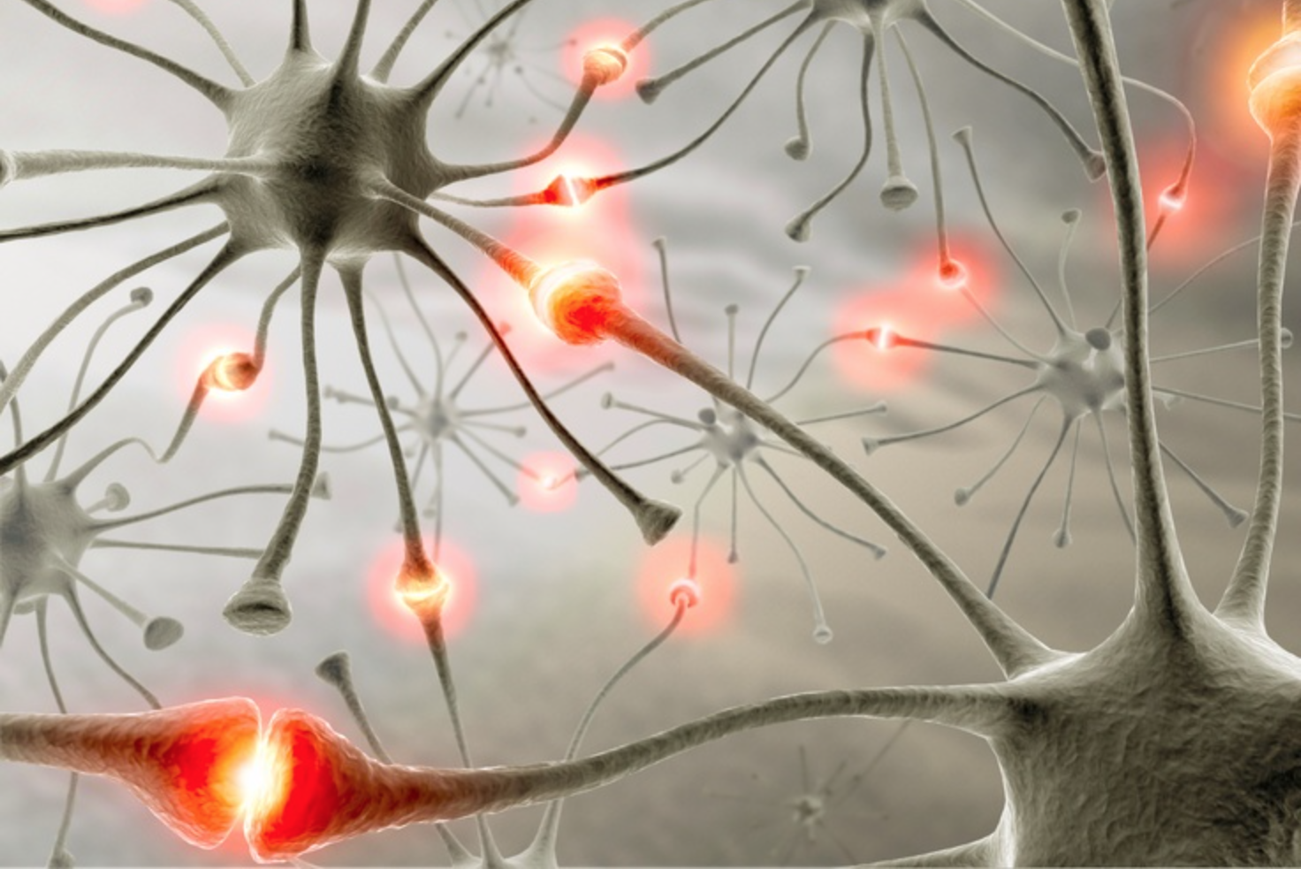
Structural and Biochemical
Notes:
While the deposits of tau seem suspiciously connected to emotional, cognitive and behavioral manifestations, the evidence of damage could not be seen in the brain until autopsy. We have come from a place in brain injury where we like to think about an area, a lobe in the brain, that is damaged being connected to predictable learning or behavioral outcomes. But over the last few decades, based upon all the work from the research with military and athletes, we have come to realize that brain injury is not just structural damage to the lobes of the brain. We have come to appreciate the amount of disruption that can be caused by cellular or electrical or biochemical disruptions in the brain.

Slide 11
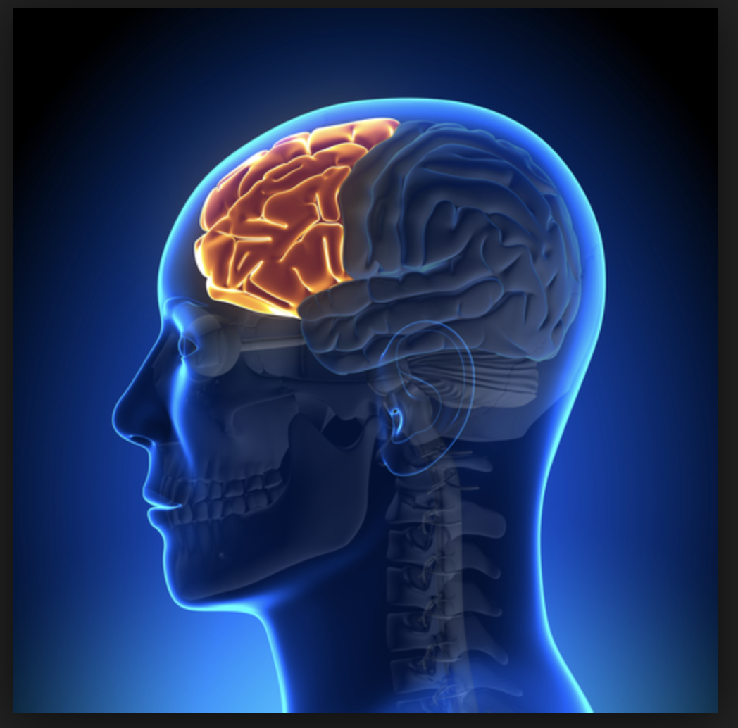

Slide 12
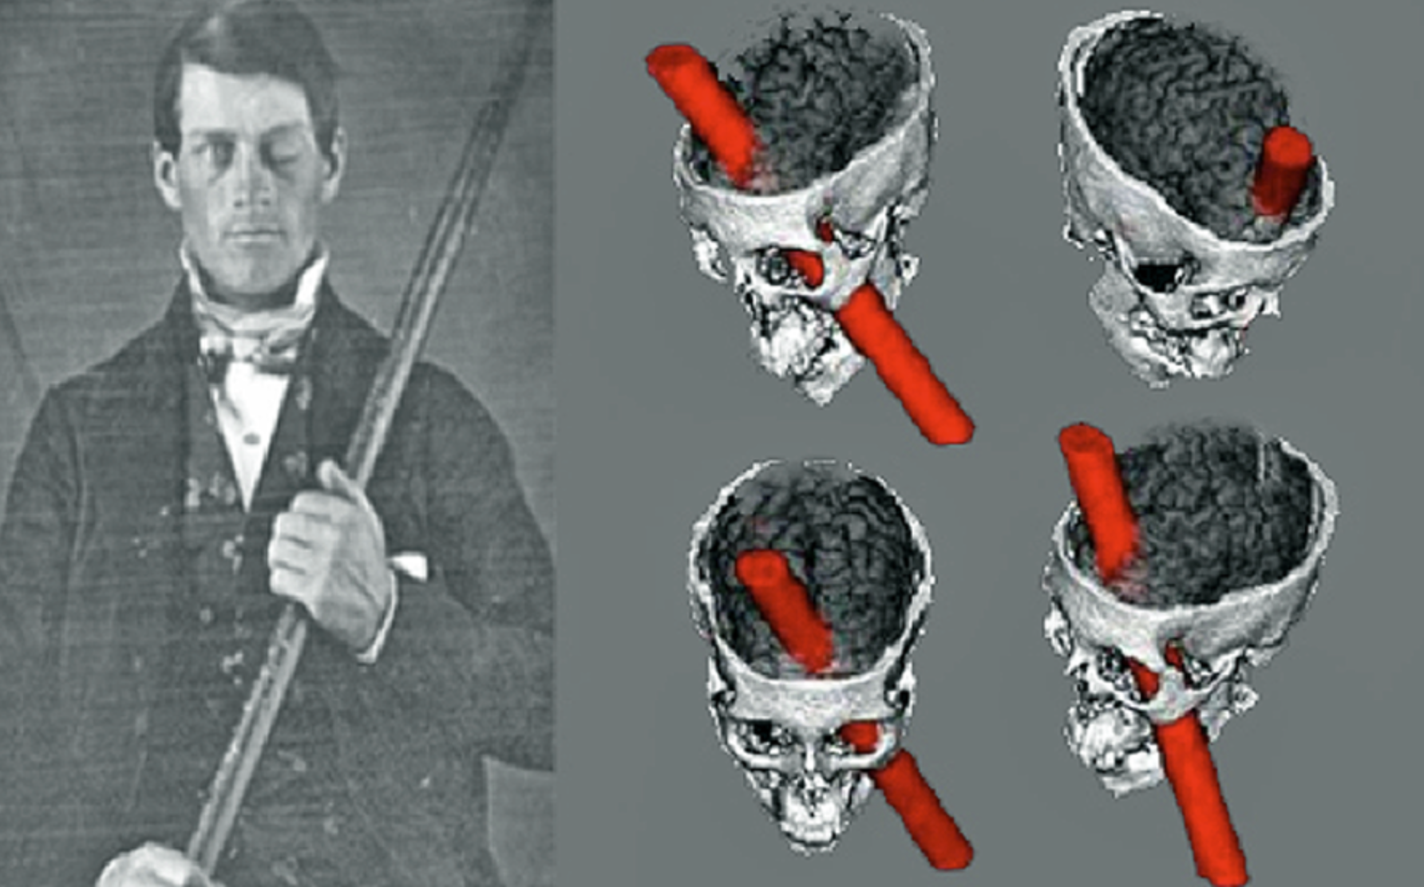

Slide 13

Software, not hardware, problem
Notes:
In essence, a brain injury can be both a hardware AND a software problem. And just because the outside of the computer does not have a scratch on it( that is the hardware), that does not mean that the electrical connectivity (that is the software) is working efficiently.

Slide 14
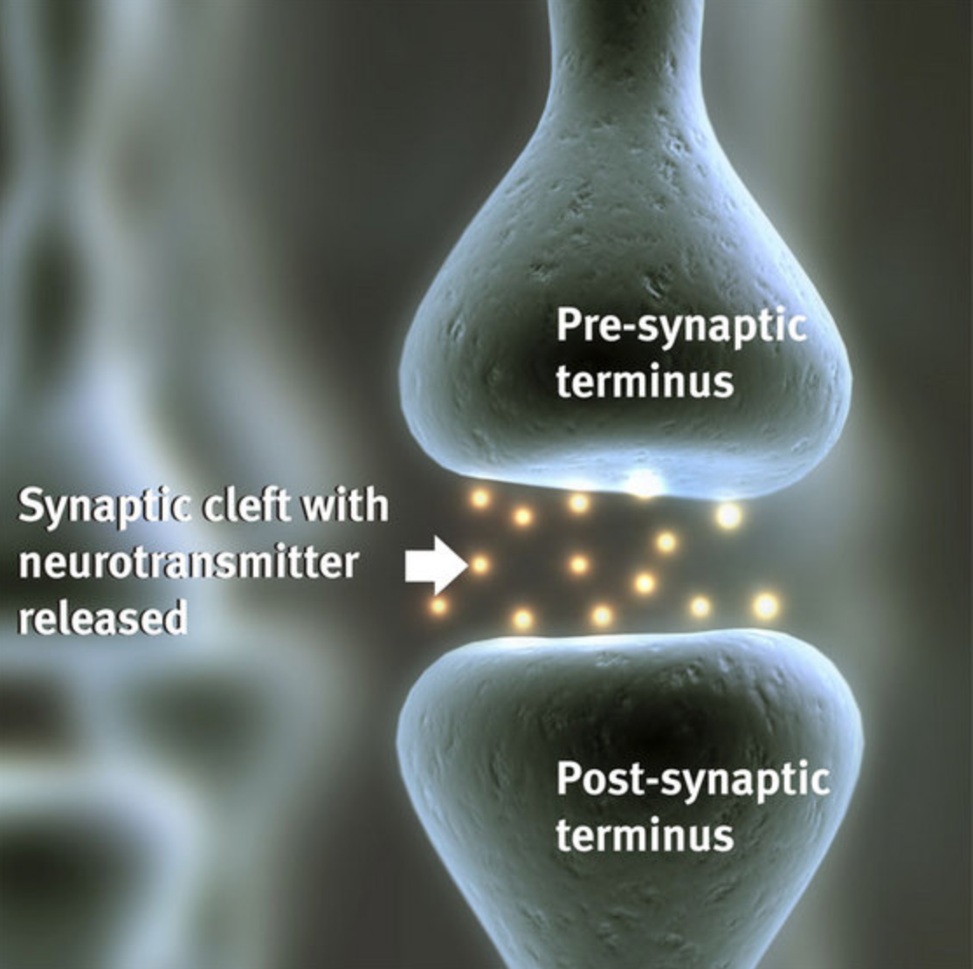
Axonal Shearing and biochemical dysfunction
Damage to individual nerve cells (neurons) and/or loss of connections among neurons which can lead to a breakdown of overall communication among neurons in the brain
This damage contributes to the Metabolic Imbalance
That is why many brain injuries, specifically mild to moderate brain injuries are not able to be detected on an MRI or CT scan
http://www.riken.jp/en/research/rikenresearch/highlights/4818/
Notes:
Damage or inefficient communication between the neurons – which is a biochemical and cellular disruption – can equally lead to serious cognitive, emotional, behavioral problems – even though this level of damage cannot be detected by an MRI or CT scan. MRI’s and CT scans cannot detect cellular injuries, which is why a ”normal” MRI or CT scan does not mean that a brain injury has not occurred or that there will be no consequences to an injury. When you look at the efficiency of brain cell communication, i.e. how much neurotransmitter is in the synaptic cleft at any given time, what does that sound like? That is our working theory behind mental health diagnoses … that is why our medications for depression or anxiety (SSRI’s) are based upon how much neurotransmitter can we kept in the synaptic cleft. SSRI’s work by keeping serotonin in the synaptic cleft for longer periods of time (they inhibit their uptake) which results in positive outcomes for depression and anxiety – and thus behaviors.

Slide 15
Symptoms = Functional problems
Physical:
Headache
Dizziness
Nausea
Light Sensitivity
Noise Sensitivity
Cognitive:
Difficulty concentrating
Difficulty remembering
Slow Processing Speed
Cognitive Fogginess
Emotional:
More emotional
Sad
Anxious
Angry
Sleep:
Fatigue
Drowsiness
Sleeping too much
Can’t fall or maintain sleep
Notes:
The symptoms that one experiences with a brain injury, even a mild brain injury, can lead to FUNCTIONAL problems -- not only physical symptoms but also cognitive, emotional and sleep/ energy symptoms.

Slide 16
Acquired Brain Injury:
An Acquired Brain Injury (ABI) covers ALL injuries to the brain that:
occur after birth
not heredity
not congenital
not degenerative
Includes:
non-traumatic
traumatic
Regardless of the cause of the brain injury, consequences of brain injury may be similar and the interventions may be the same.
Brain Injury Association of America
A Traumatic Brain Injury, TBI” is a particular type of acquired brain injury; it is the result of an external blow to the head. A TBI can result in either an:
open head injury
closed head injury
ABI
TBI:
Open or Closed

Slide 17
Types of Brain Injury or Impact
Brain Impact/Injury
Acquired Brain Injury (acquired after birth)
Traumatic
Non-Traumatic
Congenital (before birth/pre-natal)
e.g., Fetal Alcohol Spectrum Disorder, etc.
Notes:
hh

Slide 18

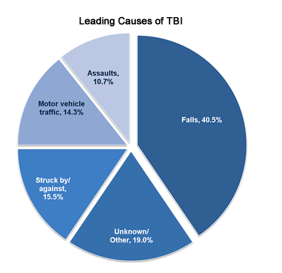
Acquired (Post-Birth) Brain Injury
Traumatic – External Force
Non-Traumatic – Internal Event
Illness (e.g., high fever)
Infections (e.g., meningitis, encephalitis)
Anoxic injuries (lack of oxygen; e.g., airway obstruction, near drowning)
Stroke or vascular events (lack of blood flow)
Brain tumors, malformations
Poisoning (e.g., ingestion, inhalation) – Substances?
Metabolic disorders (e.g., insulin shock)
It is estimated that 1,000–3,000 children in the US sustain Abusive Head Trauma each year.
Health.ny.gov
Source: Centers for Disease Control and Prevention. Nonfatal Traumatic Brain Injuries Related to Sports and Recreation Activities Among Persons Aged ≤19 Years — United States, 2001–2009. MMWR 2011; 60(39):1337–1342.
Notes:
According to the CDC, The leading causes of TBI are falls, being struck by or against --- which actually includes the high number of TBI’s or concussions that occur in collision sports now, motor vehicle accidents and assaults. A number of Assaults in the pediatric population refer to “shaken baby syndrome” which often leads to diffuse and significant brain damage in multiple areas – for example, the highest cause for cortical blindness is damage to the occipital lobe due to the brain hitting the back of the skull during shaking.

Slide 19
Congenital Brain Injury
Influences to the brain that occur during pregnancy or birth or as a result of genetic disorders
  Prenatal substance exposure
  Infections during pregnancy
  Hydrocephalus
  Microcephaly
  Neural tube deficits
  Chromosomal abnormalities
  Injuries as part of the birth process

Slide 20
Types of Traumatic Brain Injuries
Mild TBI (LOC <30 min; PTA< 24 hours) => also commonly called a concussion (on average= 80-85%)
Moderate TBI (LOC >30 min <24 hours; PTA 24 hours-7days) (on average = 13%)
Severe TBI (LOC > 24 hours; PTA more than 7 days) (on average = 2%)
The severity of the injury does not solely determine the impact on functioning
Notes:
The medical classifications of brain injury range from mild to moderate to severe. They are based upon presentation of certain factors at the time of the injury. It’s important to note that the majority of brain injuries (80+%) are considered mild (aka a concussion); however “mild” brain injury but does not necessarily mean “mild” outcome. The severity of the injury does not solely determine the impact on functioning behaviorally, emotionally or on learning – in the immediate or later in life.

Slide 21




What are the downstream consequences?
30% homeless
60%+ (average) in prisons/jail
HH has a better picture for here
60% substance abuse
60% mental health
Children’s Healthcare of Atlanta; Julie Haarbauer-Krupa, PhD &
CDC TBI in Prisons and Jails: An Unrecognized Problem
Notes:
And over the years, researchers have started to become concerned that mental health concerns, disruptive behaviors and substance abuse have a connection with brain injury. Studies that have surveyed the presence of a lifetime incidence of brain injury have been connected with higher incidences of criminal behavior, homelessness, substance abuse and mental health diagnoses. While these studies are retrospective, meaning they asked participants after the fact, and we cannot attribute behavior or mental health problems as a cause of the brain injury, the connection between brain injury and these areas of difficulty are concerning.

Slide 22


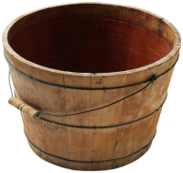
Can’t versus Won’t
Mitigating factors?
Treatment implications
TBI courts
Mental Health Courts
Problem-Solving courts

Slide 23
Brain Injury’s intersection with other conditions:
In a meta analysis, Shiroma (2010) found 60% of inmates report having experienced a head injury or TBI as compared to 8.5% in a general population reporting a history of TBI.
Prisoners who have had head injuries may also experience mental health problems such as severe depression and anxiety, substance use disorders, difficulty controlling anger, or suicidal thoughts and/or attempts.
Studies of prisoners’ self-reported health indicate that those with one or more head injuries have significantly higher levels of alcohol and/or drug use during the year preceding their current incarceration.
Notes:
Just a small snapshot of some of the research that shows a connection between a lifetime history of a brain injury and placement in jail, when compared to the general population (60+% compared to 8.5% in the general population). Inmates who sustained a head injury also had higher levels of mental health problems (depression, anxiety) and higher levels of substance and/or drug use.

Slide 24
Behavioral Health Symptoms in Kentucky Prisoners
(Walker, Hiller, Staton & Leukefeld, 2003)
Notes:
Additional research has shown that there seems to even be a dose response in which there are higher levels of depression, anxiety, behavior and cognitive problems when looking across no head injury versus 1 head injury versus multiple head injuries.

Slide 25

Substance Use:
By age 25: Those hospitalized with 1st TBI before age 6 are 3 times more likely to have a diagnosis of either alcohol or drug dependence
Natural History of TBI to Age 25 from the Christchurch Birth Cohort (McKinlay et al., 2008)
Children under 5 years of age who suffer a traumatic brain injury are over 3.6 times more likely to exhibit substance abuse as teenagers, compared with uninjured children
Zachary M. Weil, Kate Karelina. Traumatic Brain Injuries during Development: Implications for Alcohol Abuse. Frontiers in Behavioral Neuroscience, 2017; 11 DOI: 10.3389/fnbeh.2017.00135
Notes:
Regarding substance use, research shows that children who sustain their 1st TBI before the age of 6 are 3 times more likely to develop alcohol or drug dependence later in life.

Slide 26
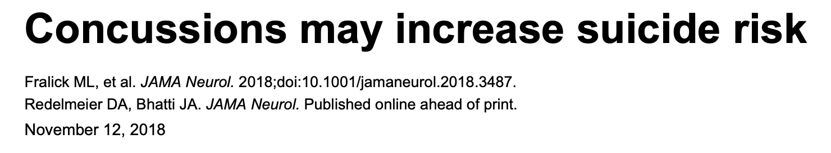
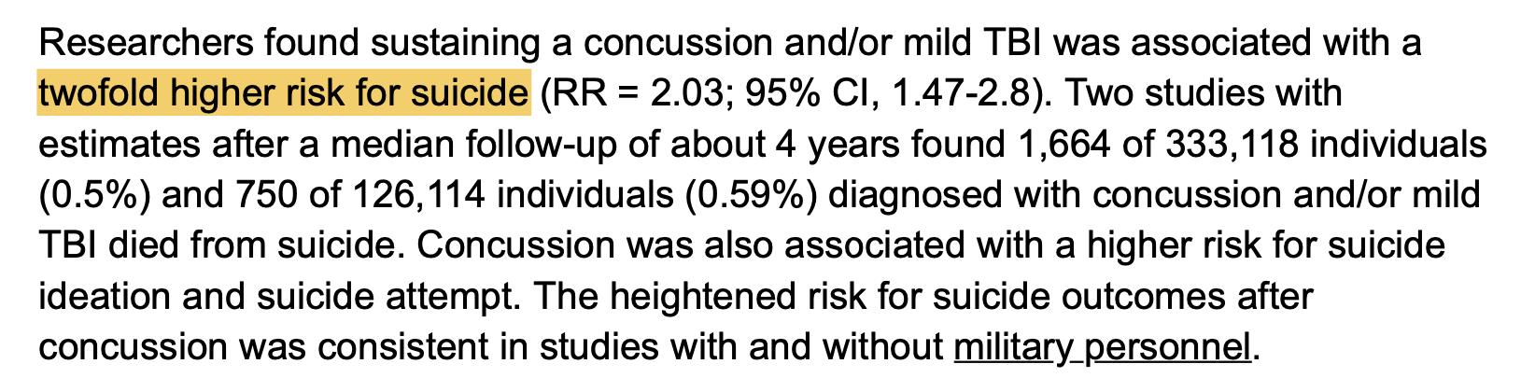
Mood Disorders:
Notes:
And when headlines such as these – Concussions may increase suicide risk – started to come out, many parents with children who played sports – or even children who never played sports but took a fall and sustained a concussion, or multiple concussions, became quite concerned. This study suggests a twofold higher risk for suicide in those who sustained a mild TBI.

Slide 27
Mood and anxiety disorders following pediatric traumatic brain injury: a prospective study
Luis CA, Mittenberg W. J Clin Exp Neuropsychol 2002;24:270-9.
Children (aged 6-15y) hospitalized in a general hospital n= 42 with mTBI versus n=35 orthopedic controls.
Prevalence of mood disorders at 6mo: mTBI group (35.7%), orthopedic group (11.4%).
Prevalence of anxiety disorders at 6 months: mTBI group (21.4%), orthopedic group (2.8%)
Notes:
We are not yet sure the connection between brain injury and mood disorders but clinicians who work with children who sustain brain injuries are very aware that depression and anxiety are commonly seen after a brain injury. When children with a brain injury were studied in comparison to children who sustained an orthopedic injury, there was a significant difference in mood disorders for the group of children who sustained the brain injury ruling out the development of mood disorders soley from sustaining an injury or having to be hospitalized for an injury. The type of injury seems to make a difference in the development of mood disorders.

Slide 28
A behavioral or mental health crisis happens – what is the cause?
Behavior or Mental Health Crisis Happens
Is it adolescence?
Is it alcohol use?
Is it depression?
Is it due to the brain injury?
Is it anxiety?
Is it ADHD?
Notes:
Because children and teenagers are complicated beings even without brain injuries, many parents and teachers find themselves asking themselves – if there is a behavioral or mental health crisis, is it due to depression, anxiety, ADHD or just plain adolescence? Once a brain injury enters the picture, that becomes one added component that parents and teachers worry and wonder about.

Slide 29
Anxiety
Tired/drained
Problems sleeping
Depression
Problems sleeping
Physical pains/dizziness
Can’t think
Stressed/anxious
Problems sleeping
Headache
Trouble concentrating/remembering
Fatigue
Physical aches and pains
Trouble concentrating/remembering
Irritability/Sadness
Lability of all emotions
Brain Injury
Fatigue
Notes:
Naturally one might go to analyzing symptoms to see if they can tell what might be leading to the cause of concern; unfortunately, the symptoms for brain injury and anxiety and depression are non-specific and shed little light on the etiology of the concerns.

Slide 30
Are emotional/behavioral issues biochemical or psychosocial following a brain injury?
Biochemical
Psychosocial
Notes:
So are emotional and behavioral issues after a brain injury a biochemical or psychosocial reaction?

Slide 31
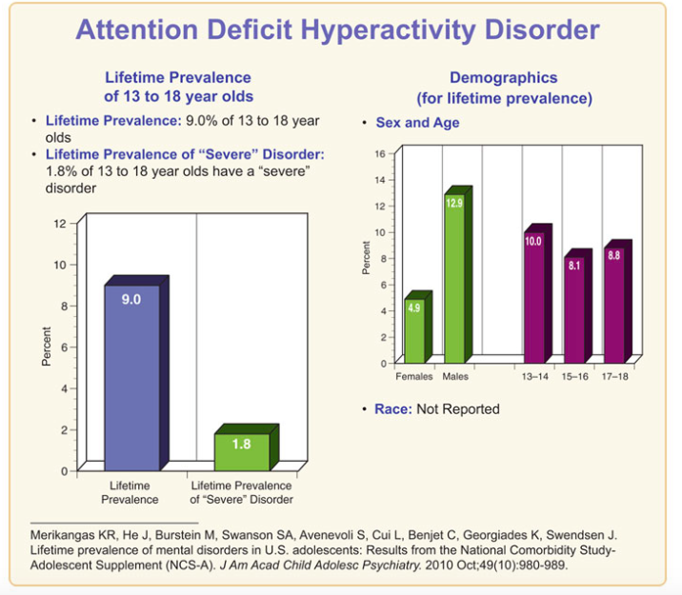

Attention Deficit Disorder:
Notes:
If one just looks at the rate of attentional problems in the general population, the National Institute of Mental Health identifies that 9% of adolescents between the ages of 13 and 18 will receive the diagnosis of ADHD

Slide 32
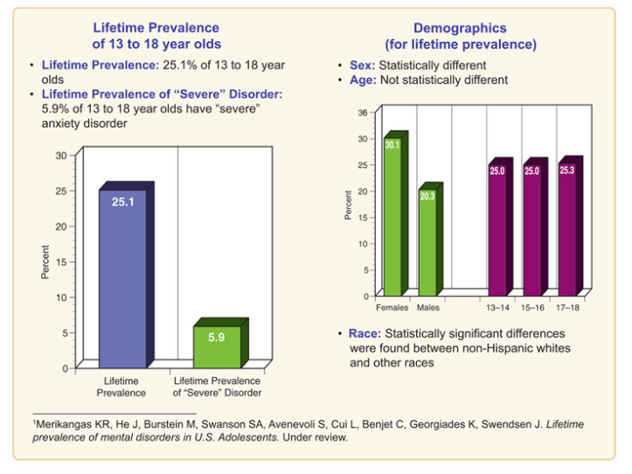
Anxiety:
Notes:
The National Institute of Mental Health identifies 25% of adolescents will receive a diagnosis of anxiety

Slide 33
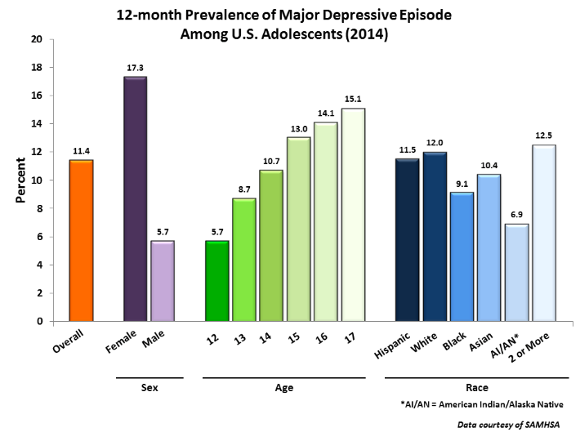
Depression:
Notes:
And sadly the SAMSHA data says that 11% of adolescents will receive the diagnosis of depression.

Slide 34

Alcohol
Alcohol is the drug of choice among youth, with:
  12% of 8th-graders
  22% of 10th-graders
  and 29% of 12th-graders reporting heavy episodic drinking.
Alcohol use during adolescence and young adulthood remains a prominent public health problem in the United States. National survey results indicate that:
  28.6 percent of 12th graders
  40.1 percent of college students reported binge drinking (i.e., consuming five or more drinks in a row).

Slide 35


Is it biochemical?
Biochemical
ADHD = 9%
Anxiety = 25%
Depression = 11%
Psychosocial
Source: National Institute of Mental Health
And
SAMSHA
“Kindling effect”
Notes:
When you think about a brain injury’s ability to disrupt the cellular communication between neurons, which is already tenuous in a teenager with cellular changes due to depression or anxiety or ADHD, it makes sense that brain injury, even a mild TBI like a concussion can exacerbate symptoms of depression, anxiety and attentional problems. A vulnerability model would suggest that if a teenager is predisposed to depression, anxiety or attentional problems (a vulnerable cellular system so to speak), that disruptions from the brain injury can exacerbate the underlying depression, anxiety and ADHD. There is a question of a kindling effect, where a weakened area is quick to ignite with even just what seems like an inconsequential injury. I have had numerous patients with brain injury tell me that depression or anxiety developed after a brain injury when there was no predisposition to the conditions prior to the brain injury. While biochemically I do not think we know the mechanism for this yet, biochemically we do know that the mechanism for mental health diagnoses are related to neurotransmitters in the synaptic cleft and we know that brain injuries impact the efficiency of the neurons and their ability to communicate biochemically, so I am humbled by and respectful of the connection, even though we don’t fully understand it yet.

Slide 36
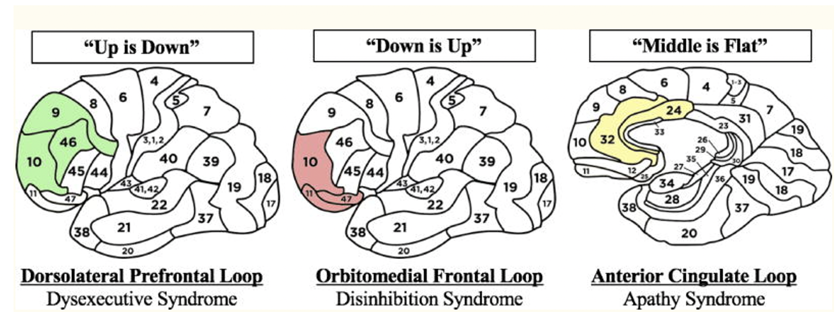
The Neuroanatomic Correlates of Syndromal Presentations after Traumatic Brain Injury
Damage to upper frontal lobes => decreased ability to act as executive => Trouble with:
Retrieving stored memories
Remembering word lists
Alternating between tasks
Manipulating abstractions
Inhibiting reflexive responses
Damage to lower frontal lobes => increased inappropriate behaviors. Trouble with:
Emotional lability
Impulsivity
Lack of social tact
Damage to middle frontal lobes => apathy
Trouble with:
Flattening of affect
Displays no passion
Displays no motivation
Peters, M.E., Moussawi, K. & Rao, V. Teaching Clinical Reasoning with an Example Mnemonic for the Neuropsychiatric Syndromes of Traumatic Brain Injury. Acad Psychiatry 42, 686–689 (2018). https://doi.org/10.1007/s40596-017-0831-0
Bonelli RM, Cummings JL. Frontal-subcortical circuitry and behavior. Dialogues Clin Neurosci. 2007;9(2):141–151.
Notes:
Peters et al published an article creating mnemonics to help us remember that injury to the upper frontal lobes will decrease one’s ability to act as an executive – poor memory, difficulty multi-tasking and difficulty with abstractions. “Up (as in the upper frontal lobes) results in “down” or decreased executive functioning. Injury to the lower frontal lobes may result in an increase in appropriate behaviors like impulsivity and emotional lability, therefore, “down” (as in the lower section) results in an “up” tick in inappropriate behaviors. And lastly, injury to the middle frontal lobes may result in apathy – a flattening of affect – “middle if flat”. This is just one example of how disruption of the circuitry – not necessarily even to the structure of the brain – can lead to psychiatric and behavioral manifestations.

Slide 37
Is it situational?
Biochemical
Psychosocial
“situational”
Notes:
One could also make an argument that a brain injury can bring on situational depression or anxiety. The brain injury has disrupted the child or adolescents life and routine so much – and has restricted so many FUN things, that the child gets depressed or anxious. Thinking back to the Luis study, the situation of being injured or hospitalized still showed a difference between children injured or hospitalized with an orthopedic injury versus a brain injury, but it does make sense that a student who has their life disrupted by a brain injury might become depressed or anxious.

Slide 38
Situational and Emotional Spin-off’s
Socially isolated
Missing out on important developmental events
Behind at school
Loss of independence
Perception of inadequacy
Decline of self-confidence
Notes:
Those emotional spin-off’s are understandable because a student with a brain injury often experiences significant life changes that make them feel different, socially isolated, falling behind academically or developmentally.

Slide 39
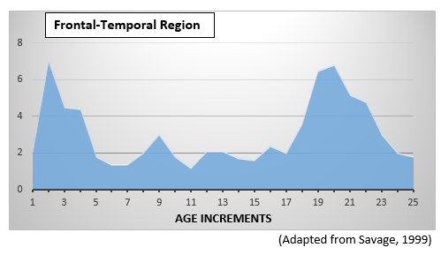
Maturation and Development:
Notes:
And just for good measure, lets throw in one more factor that cannot be overlooked in the child/adolescent population and that is maturation and development. This chart shows the myelination of the axons (again, the neurons or the cells in the brain) in the frontal lobe – the part of the brain believed to be primarily responsible for executive functioning (organization, planning, judgment…). There is a big spike of myelination in the early years and then again in the teenage years. The young brain is a moving target on a good day, absent a brain injury or depression or anxiety.

Slide 40
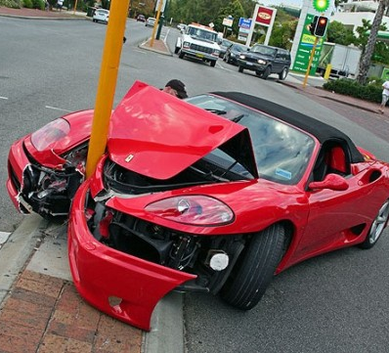
Executive Function:
“The teenage brain is like a Ferrari: it’s sleek, shiny, sexy, and fast, and it corners really well. But it also has really crappy brakes.”
Dawson/Guare-May 2012
Notes:
As the frontal lobes are just putting the finishing touches on executive functioning in the teenage/early adulthood years, and the ability to stop and make better behavioral choices is spotty on a good day, a brain injury can come along and make that developing skill even more difficult.

Slide 41
Perfect Storm:
Developmental
Brain injury, even a mild TBI like a concussion, is the great AMPLIFIER!
Biochemical
Psychosocial
Notes:
So it is the perfect storm – the amount of coordination that needs to occur between a child/adolescent who is typically developing and all of the psychosocial factors that are necessary to support him or her, together with the fluidity and healthiness of the biochemistry of the neurons places depression, anxiety and brain injury on an obvious collision course.

Slide 42
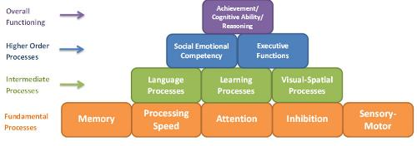
Building Blocks of Brain Development©
Colorado Brain Injury Steering Committee
Colorado Department of Education (CDE)
Neuroscience, research, neuro-cognitive processes and assessment
No ONE model of neurocognitive development
Simplistic framework that describes the complexity of neurocognitive functioning and inter-relatedness.
Simple way for parents and educators to understand the brain, and how learning and behavior can be affected
Neuroeducational model – multidisciplinary teams CAN do this.
If we understand the BRAIN, we understand learning and behavior

Slide 43

Building Blocks of Brain Development
Overall
Functioning
Achievement/ Cognitive Ability/ Reasoning
Social Emotional Competency
Executive Functions
Higher Order
Processes
Language Processes
Learning Processes
Visual-Spatial Processes
Intermediate
Processes
Fundamental
Processes
Memory
Processing Speed
Attention
Inhibition
Sensory-Motor
The Hierarchy of Neurocognitive Functioning © - created by Peter Thompson, Ph.D. 2013, adapted from the works of Miller 2007; Reitan and Wolfson 2004; Hale and Fiorello 2004.
The Building Blocks of Brain Development © – further adapted by the CO Brain Injury Steering Committee, 2016.

Slide 44
Building Blocks of Brain Development
Productive
Citizen
Overall
Functioning
Achievement/ Cognitive Ability/ Reasoning
Social Emotional Competency
Executive Functions
Complexities Increase with Brain Maturation
Higher Order
Processes
Language Processes
Learning Processes
Visual-Spatial Processes
Intermediate
Processes
Fundamental
Processes
Memory
Processing Speed
Attention
Inhibition
Sensory-Motor
The Hierarchy of Neurocognitive Functioning © - created by Peter Thompson, Ph.D. 2013, adapted from the works of Miller 2007; Reitan and Wolfson 2004; Hale and Fiorello 2004.
The Building Blocks of Brain Development © – further adapted by the CO Brain Injury Steering Committee, 2016.
The Hierarchy of Neurocognitive Functioning © - created by Peter Thompson, Ph.D. 2013, adapted from the works of Miller 2007; Reitan and Wolfson 2004; Hale and Fiorello 2004.
The Building Blocks of Brain Development © – further adapted by the CO Brain Injury Steering Committee, 2016.

Slide 45
Building Blocks of Brain Development
Achievement/ Cognitive Ability/ Reasoning
Achievement/ Cognitive Ability/ Reasoning
Social Emotional Competency
Executive Functions
Social Emotional Competency
Executive Functions
Language Processes
Learning Processes
Visual-Spatial Processes
Language Processes
Visual-Spatial Processes
Learning Processes
Memory
Processing Speed
Attention
Inhibition
Sensory-Motor
Memory
Processing Speed
Inhibition
Sensory-Motor
The Hierarchy of Neurocognitive Functioning © - created by Peter Thompson, Ph.D. 2013, adapted from the works of Miller 2007; Reitan and Wolfson 2004; Hale and Fiorello 2004.
The Building Blocks of Brain Development © – further adapted by the CO Brain Injury Steering Committee, 2016.
Notes:
All Building Blocks interact and even one gap in one building block can effect all of the others.

Slide 46
Building Blocks of Brain Development
3 Components:
1-Brain Processes
(Building Blocks)
2-Assessments
3-Strategies
ALIGNMENT
Notes:
The Building Blocks of Brain Development includes three important components –
the Building Blocks, which we just reviewed
Suggested nueroeducational assessment tools for each building block
And strategies or interventions to address deficits for each building block

Slide 47
Building Blocks of Brain Development
ASSESSMENTS
Overall
Functioning
Standardized Testing
Achievement
BASC-2
Social-Emotional
BRIEF-2
Executive Functions
Higher Order
Processes
CELF-5
Language
WJ-3
Learning
BEERY VMI
Visual-Spatial
Intermediate
Processes
Fundamental
Processes
WRAML-2
Memory
WISC-V
Processing Speed
NEPSY-2 Attention
STROOP Inhibition
OT/PT Consult
Sensory-Motor
The Hierarchy of Neurocognitive Functioning © - created by Peter Thompson, Ph.D. 2013, adapted from the works of Miller 2007; Reitan and Wolfson 2004; Hale and Fiorello 2004.
The Building Blocks of Brain Development © – further adapted by the CO Brain Injury Steering Committee, 2016.
www.cokidswithbraininjury.com
Notes:
The suggested neuroeducational assessments are commonly available in the school setting and/or are frequently part of training programs or practice for the various professional members of the multidisciplinary team. The assessments identified within the framework are just suggestions and are not endorsed by the Colorado Department of Education (CDE). This collection is not an exhaustive list and is always changing with revised editions and new tools being added each year. In an attempt to maintain this ever changing collection, the CDE and the Colorado Brain Injury Program have teamed to develop a website that provides a dynamic and user friendly way to access the Building Blocks of Brain Development framework. The Colorado Kids Brain Injury Resource Network website is available at: www.cokidswithbraininjury.com.
(click) This graphic only presents one assessment per building block due to space constraints. Please go to the Colorado Kids Brain Injury Resource Network for a broader collection.

Slide 48

www.COKidswithBrainInjury.com
Notes:
Have them use their devices to navigate to cokids to check out assessment on the matrix

Slide 49
Building Blocks of Brain Development
STRATEGIES/INTERVENTIONS
Overall
Functioning
Reading-Writing-Math Achievement
Why Try
Social-Emotional
Get Ready-Do-Done
Executive Functions
Higher Order
Processes
Role Play Language
Chunking Learning
Planners Visual-Spatial
Intermediate
Processes
Fundamental
Processes
Mnemonics Memory
Extra time Processing Speed
How Does Your Engine Run? Attention
Stop-Relax-Think
Inhibition
Weighted Vest
Sensory-Motor
The Hierarchy of Neurocognitive Functioning © - created by Peter Thompson, Ph.D. 2013, adapted from the works of Miller 2007; Reitan and Wolfson 2004; Hale and Fiorello 2004.
The Building Blocks of Brain Development © – further adapted by the CO Brain Injury Steering Committee, 2016.
http://www.cde.state.co.us/cdesped/sd-tbi
Notes:
While the online framework provides the neuroeducational evaluation tools, there is also a manual, available electronically for free. The manual defines and fully illustrates each building block. It is called the Brain Injury in Children and Youth: A Manual for Educators, and is available for free on the CDE website: http://www.cde.state.co.us/cdesped/sd-tbi and the CO Kids Brain Injury Resource Network: http://cokidswithbraininjury.com/). The manual provides a detailed explanation of how each building block may be affected in the school setting if a brain injury occurs. In addition, an extensive list of accommodations, strategies and interventions for each building block are provided in the manual.
(click) Again, this graphic only presents one strategy per building block due to space constraints. Please go to the manual for a broader collection.

Slide 50

http://www.cde.state.co.us/cdesped/SD-TBI.asp
Notes:
HH?
[Picture of the Brain Injury in Children and Youth: A Manual for Educators, and the web address for the CDE TBI website where it can be downloaded.]

Slide 51
Attention
Fundamental
Processes
Attention: The ability to sustain focus on the information necessary for learning or completing tasks
There are numerous types of attention: selective, sustained, shifting and divided attention. Being able to attend to a task, to shift from task to task and to ignore competing distractions so that one can stay focused on the original task at hand, explains why attention is a fundamental skill necessary for all levels of learning.
Inhibition is associated with this process in the brain – the inability to inhibit an impulse is often the underlying issue with ADHD
Used with permission: ©CDE
Notes:
The inability to inhibit an impulse is a problem with attention and is often the underlying issue with Attention Deficit Hyperactivity Disorder (“hyperactivity” is often more about the inability to stop acting upon every impulse that comes to mind).
Refer them to matrix. [We have included an extensive amount of information on these slides for your information. In addition, please see Brain Injury in Children and Youth: A Manual for Educators (on the CDE website at: http://www.cde.state.co.us/cdesped/SD-TBI.asp) for more information on these domains as well as potential intervention strategies.]
Attention and concentration is impacted much of the time in brain injury.
Attention and concentration involve holding information such as events, words and visuals in ones’ awareness. Following injury, the brain is generally not as alert and is less able to sustain focus or filter sensory information.
May look like ADHD – a word of caution: do not rush to an ADHD label…children with TBI may respond VERY differently to typical treatment of ADHD (i.e., stimulants).

Slide 52
Inhibition
Fundamental
Processes
Inhibition: The ability to inhibit, block or hold back an impulse.
Inhibition is associated with the attention process in the brain – it is the ability to inhibit an impulse, long enough to consider multiple thoughts and behavioral options so that a more adaptive behavioral choice can be made.
Inhibition – the inability to inhibit an impulse is often the underlying issue with ADHD
This process may be referred to as “mental brakes”, “a filter” or the ability to “think before you act”.
Used with permission: ©CDE
Notes:
We just added this domain, it is closely related the process of attention and is often the underlying issue with Attention Deficit Hyperactivity Disorder (“hyperactivity” is often more about the inability to stop acting upon every impulse that comes to mind).
Often times we see a dx of ADHD – but – a word of caution: do not rush to an ADHD label…children with TBI may respond VERY differently to typical treatment of ADHD (i.e., stimulants).
As the authors of the book, Smart but Scattered , share, “It is a fundamental skill that enables all other executive skills to develop. A child at the mercy of his impulses can’t initiate, sustain attention, plan, organize or problem solve effectively.”

Slide 53
Memory
Fundamental
Processes
Memory: The mental ability to store and retrieve words, facts, procedures, skills, concepts and experiences.
The general memory process is complex and entails memory creation, storage of information and retrieval. Additionally, there are several types of memory. For example, some primary types of memory are short-term, working, visual, auditory, procedural and declarative memory.
Damage to any brain area that assists in the formation, storage or retrieval of information can degrade overall memory performance. Due to the number of areas associated with the memory system, it is important to emphasize there are also numerous ways to impair or damage this process.
Notes:
Memory and learning involve the storage and organization of information for later use.
A crucial building block for learning.

Slide 54
Processing Speed
Fundamental
Processes
Processing Speed: How quickly information is received, processed, and/or outputted.
A common consequence of a brain injury is the slowing of information processing. Slowed information processing impacts a person’s ability to think efficiently and may hinder the effectiveness of other abilities such as memory. Although there are different reasons for slowed processing after an injury, one major reason is that the “wires” of the brain (neurons) can no longer communicate with each other efficiently.
Another reason for slowed processing speed is that the brain might have to re-route signals around the damaged area (takes longer).
Notes:
Processing speed is a mental function that is highly sensitive to brain injury. Teens are rarely aware of a decrease in their processing speed; rather, their experience is that they are confused or having a hard time understanding things unlike before the injury.

Slide 55
Sensory Motor
Fundamental
Processes
Sensory Processing: Perceiving and responding to what is seen, heard, smelled, tasted, felt and touched, as well as our sense of balance (vestibular) and our “position sense” (proprioception).
Generally speaking, the parietal lobe of the brain (top brain area) processes most sensory information and integrates it to construct a picture of one’s environment. Damage to the parietal lobe may interfere with body awareness, cause attention problems, and degrade the accurate processing of auditory, olfactory, taste, tactile, and visual information.
Fine Motor: Involves the use of small muscles of the hands to make smooth, coordinated or fine motions.
Gross Motor: Involves the coordinated use of the large muscles of the body.
Notes:
Children who have trouble perceiving and/or responding to sensory input obviously will be at a disadvantage when they have to integrate information coming from different sources.
Sheldon – while older gives us a good understanding of sensory issues as well as cognitive flexibility issues in this video clip.
Sensory issues cross many disability categories (i.e. Autism Spectrum Disorder, etc.)

Slide 56
Learning Processes
Intermediate
Processes
New Learning: The ability to learn new concepts and information.
Receiving and processing new information to create learning is a remarkably complex neurological phenomenon. A novel academic task requires several brain areas working in concert to produce understanding. Once new information is processed, the new information is sent to other areas of the brain so the information can be comprehended on a deeper level.
Notes:
The inability to benefit from new learning, and to build on that learning – especially in social situations and behaviorally.
A hallmark of a brain injury (and FASD) on a child’s performance is an “unevenness” in abilities across different settings, over time, and across different content areas.
Examples:
Across domains – i.e., a 10 year old may have typical abilities of in fine and gross motor areas but have the social-emotional regulation of a 5 yr old.
High abilities in expressive language and difficulties with receptive language
OR a student knows material on Tuesday but cannot retrieve the same information later that same week. (Memory/processing speed/anxiety – many things could be at play here)
This is often viewed as opposition.
We as educators may need to try “differently” rather than harder at reaching students and presenting information in such a way that students learn.

Slide 57
Visual-Spatial Processes
Intermediate
Processes
Visual-Spatial: The ability to generate, retain, retrieve and transform well-structured visual images.
Visual-spatial processes are largely associated with the occipital lobe of the brain, which is located at the back of the brain. When visual information is processed in the occipital lobe, it divides the information and sends it to the lower left part of the brain (temporal lobe) or to an upper part of the brain called the parietal lobe. Damage to the back and left side of the brain can degrade a person’s ability to process images of known objects. Injury to the back to upper regions of the brain may cause problems with spatial and location tasks.
Notes:
After a brain injury, the visual-spatial abilities are frequently more impacted than verbal and tend to remain at lower levels after recovery.

Slide 58
Language Processes
Intermediate
Processes
Language-Receptive: The ability to understand language.
Understanding spoken language is typically associated with the left hemisphere of the brain. Young children typically understand what is told to them (receptive language) before they can express themselves, but damage to the left side of the brain hinders their ability to understand language.
Language-Expressive: The ability to express one’s thoughts and feelings into words and sentences.
The ability to speak logically and express oneself using language involves the left hemisphere of the brain.
Social Pragmatics: Pragmatics are the verbal and nonverbal rules of social language and interactions.
The ability to follow social rules and using or altering communication for social purposes.
Notes:
Children’s language abilities are still developing and an injury to this area can have a significant impact on their receptive, expressive abilities and/or social pragmatic language as well as their academic performance.

Slide 59
Social Emotional
Competency
Higher Order
Processes
Social and Emotional: The awareness of social issues and one’s emotional status. Behavioral self-regulation, control and self- monitoring are also part of this domain.
The ability to interact successfully with other people and control one’s emotions involves a higher order cognitive skill set. There are two primary areas associated behavioral and emotional regulation.
1) The frontal cortex is implicated in pro-social behaviors. Specifically, the front part of the brain, near the eyes, assists with impulse control.
2) The limbic system. The limbic system is made of several smaller parts that are associated with creating all emotions. When these deep brain structures are damaged, it is common that the person develops severe emotional difficulties.
Notes:
Social emotional competency impacts many aspects of a students life – impulse control, regulation of behaviors and feelings, making and keeping friends, etc.
The negative impacts of this domain may have life altering effects, i.e., juvenile justice system involvement, substance abuse, high risk behaviors, etc.
There is an entire chapter dedicated to this domain in the manual (Brain Injury in Children and Youth: A Manual for Educators at: http://www.cde.state.co.us/cdesped/SD-TBI.asp)

Slide 60
Executive Functions:
Initiation
Higher Order
Processes
Initiation: The ability to independently start an action or activity.
Since the frontal regions of the brain are largely responsible for action and movement, it is not surprising these same areas are responsible for initiation. It is also not surprising that emotions help start actions, so the deeper emotional centers of the brain are implicated in initiation. A child’s inability to get tasks completed may be related to problems with initiation within the brain.
Notes:
Initiation issues may appear that the student is uninterested, unmotivated or oppositional when in reality the issue is difficulty knowing how to get started.

Slide 61
Executive Functions:
Mental Flexibility
Higher Order
Processes
Mental Flexibility: The ability to easily shift from one idea, train of thought, activity or way of looking at things.
Controlling the thoughts and actions of the brain falls under the function of the frontal lobe. Although there are different brain areas that also help with initiation, organization, planning and flexibility, these four “executive functions” are primarily regulated by the upper brain areas located behind the forehead. People with damage to the frontal lobe may become more rigid in their thinking and less adaptable to change.
Notes:
Mental flexibility also involves being able to change the approach to problem solving as the task changes or being able to successfully transition from one task to another.

Slide 62
Executive Functions:
Planning
Higher Order
Processes
Planning: The ability to set a goal, identify a sequence of actions to reach the goal and carry out that sequence of steps.
Planning is a future oriented process requiring forethought, estimation and problem solving. Similar to the same neurological structures involved with regulation, organization, and problem solving, the upper frontal lobe is intimately tied to planning.
Notes:
Students with planning issues may approach tasks impulsively which leads to difficulties in completing each step of the process.

Slide 63
Executive Functions:
Organization
Higher Order
Processes
Organization: The ability to create and maintain orderliness in thoughts, activities, materials and the physical environment.
The upper frontal region of the brain, behind the forehead, controls planning and organization of thoughts and activities. The ability to sequence thoughts in a logical fashion and translate those thoughts into action to organize a person’s environment involves communication between the frontal cortex and left hemisphere of the brain. Damage to the front and/or the left hemisphere of the brain may cause disorganized thinking and ordering of materials.
Notes:
Students who have difficulty paying attention to the most important features of their environment, logically organizing and planning their behavior, and following through often have grave difficulty behaving reasonably in situations which do not provide intense external support and structure.

Slide 64
Executive Functions:
Reasoning
Higher Order
Processes
Reasoning: The use of deliberate and controlled mental operations to solve novel and on the spot problems
Many aspects of reasoning are similar to the process of new learning. Reasoning is the foundation for problem solving and ultimately overall intelligence. Higher order reasoning involves the effective integration and processes of the entire cerebral (brain) structure. Since the frontal cortex is considered the “manager” of the brain, this region is typically needed in reasoning as it orchestrates how information is processed. However, many areas of the brain are needed for deep thinking.
Notes:
Reasoning involves the consideration of evidence and drawing of conclusions based on the exploration of all possibilities, consideration of positive and negative outcomes and combining knowledge from past experiences (Savage & Wolcott, 1994).

Slide 65
The Influence of Substance Use on Adolescent Brain Development
L. M. Squeglia, B.A., J. Jacobus, B.A., and S. F. Tapert, Ph.D.
Clin EEG Neurosci. 2009 Jan; 40(1): 31–38. doi: 10.1177/155005940904000110 https://www.ncbi.nlm.nih.gov/pmc/articles/PMC2827693/
The current literature suggests that heavy drinking during adolescence does have a subtle, but significant, deleterious effects on adolescent neurocognitive functioning. Studies have found that adolescent heavy drinkers exhibit decrements in memory ²⁴, attention and speeded information processing ^{25, 26}, and executive functioning ^{27–29}.
In a study comparing alcohol dependent and healthy control adolescents, Brown et al. ²⁴ found that drinkers recalled 10% less verbal and nonverbal information than controls, even after three weeks of monitored abstinence. A similar degree of reduction was found on attentional and speeded information processing tasks in abstinent adolescent drinkers ²⁵.
These findings are consistent with literature examining neurocognitive deficits in young heavy drinkers, which found similar decreases on attention and information processing, along with deficits in language competence and academic achievement ²⁶. Deficits in executive functioning, specifically in future planning, abstract reasoning strategies, and generation of new solutions to problems, have also been found ²⁷.

Slide 66
Case study
Overall
Functioning
Achievement/ Cognitive Ability/ Reasoning
A mental health/behavioral crisis happens
Social Emotional Competency
Executive Functions
Higher Order
Processes
Language Processes
Learning Processes
Visual-Spatial Processes
Intermediate
Processes
Fundamental
Processes
Memory
Processing Speed
Attention
Inhibition
Sensory-Motor
The Hierarchy of Neurocognitive Functioning © - created by Peter Thompson, Ph.D. 2013, adapted from the works of Miller 2007; Reitan and Wolfson 2004; Hale and Fiorello 2004.
The Building Blocks of Brain Development © – further adapted by the CO Brain Injury Steering Committee, 2016.

Slide 67
David-9th grade
IEP for Learning Disability and Speech Language since kindergarten
Both middle school and high school perceived his processing needs were greater than just a traditional learning or speech language disability
Came to the U.S. at age of 2 and placed with his adoptive family – we have no developmental records or prenatal history on Mom
Age of 8 years, fell off a trampoline hitting side of head, skull fracture
Diagnosed with ADHD at age 10
Sustained 2 concussions in recreational soccer
Notes:
IEP- pre separate TBI category when placed on IEP
The fall and TBI were documented in adoption records
PT ended before entered kinder. OT ended in 6th grade

Slide 68
David-Current Functioning
Academic Concerns:
Lots of organization issues-even with teacher and parent support
Difficulties paying attention- daydreams and is easily distracted
Difficulties understanding and remembering verbal information
Can express his answers verbally (in a disorganized manner) but cannot get thoughts down on paper
Emotional/Behavioral Concerns:
Doesn’t like going to school
Has had panic attacks
Gets belligerent verbally and aggressive physically
Expresses suicidal ideation occasionally
Parents concerned that he has been caught drinking at friends houses a few times; liquor is missing from the liquor cabinet. When confronted, David says - “I hate my life; I wish I was dead!” - a mental health crisis!
Notes:
Very well behaved and gets along well with peers and adults

Slide 69
Crisis Happens
Is it adolescence?
Is it alcohol?
Is it depression?
Is it marijuana?
Is it anxiety?
Is it ADHD?

Slide 70
David- Assessment Data
WISC-V (6th grade)
Verbal Comprehension 85
Visual Spatial 94
Fluid Reasoning 97
Working Memory 84
Auditory Working Memory 80
Processing Speed 76
NEPSY-II (9th grade)
Executive Functioning: attention, inhibition, mental flexibility, organization, planning of thoughts
Verbal: following directions, naming common objects
Memory: verbal memory
Sensory Motor: visuomotor precision
BRIEF-2: Areas of concern: Working Memory, Planning and Organization, Organization of Materials

Slide 71
David-Assessment Data
Woodcock Johnson-IV Academic
(9th grade)
Broad Reading=76
Letter Word Identification=80
Passage Comprehension=73
Reading Fluency=75
Broad Mathematics=69
Calculation=73
Applied Problems=64
Math Fluency=67
Clinical Evaluation of Language Fundamentals-V (9th grade)
Core Language Score=86
Receptive Language Index=88
Expressive Language Index=83
Language Content Index=91
Language Memory Index=82

Slide 72
Overall
Functioning
Achievement/ Cognitive Ability/ Reasoning
Social Emotional Competency
Executive Functions
Higher Order
Processes
Language Processes
Learning Processes
Visual-Spatial Processes
Intermediate
Processes
Fundamental
Processes
Memory
Processing Speed
Attention
Inhibition
Sensory-Motor
The Hierarchy of Neurocognitive Functioning © - created by Peter Thompson, Ph.D. 2013, adapted from the works of Miller 2007; Reitan and Wolfson 2004; Hale and Fiorello 2004.
The Building Blocks of Brain Development © – further adapted by the CO Brain Injury Steering Committee, 2016.

Slide 73
Executive DYSfunction:
Inability to delay gratification (wait) or inhibit impulses
Inability to manage time – no future thinking which results in poor planning, organization or initiation …
= leads to the inability to delay impulses, to consider other options and to make better behavioral or social decisions.
Attention
Memory
Social INcompetence:
Lack of ATTENTION to feedback in environment
Poor MEMORY
Poor LEARNING …
= leads to repetitive mistakes and the inability to make better behavioral choices
Achievement/ Cognitive Ability/ Reasoning
Social Emotional Competency
Executive Functions
Language Processes
Visual-Spatial Processes
Learning Processes
Processing Speed
Inhibition
Sensory-Motor
CO Brain Injury Steering Committee: Adapted from Miller, 2007; Reitan and Wolfson, 2004; Hale and Fiorello, 2004
Notes:
We know from the Building Blocks that if one of the Fundamental skills is shaky, or is knocked out of place, even temporarily, the higher order functioning of learning, social emotional competency and executive functioning come crashing down. After all, what is social emotional competency? – it is the ability to attend and learn and remember social norms well enough to make better decisions now and in the future. What is executive functioning? – it is the ability to delay impulses, plan, organize, problem solve and make good judgments. Social INcompetence and executive DYSfunction can be the manifestation, or at least exacerbation, of unstable fundamental skill deficits.

Slide 74
Is it Can’t or is it Won’t?
Can’t
Won’t
Notes:
Are we sure Johnny can really remember long division from Monday to Thursday? Can we really be sure that Sarah is just hitting her brother out of spite?

Slide 75
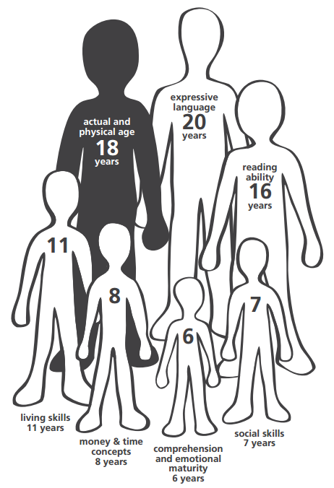

Unevenness
Notes:
Keep in mind that not all skills develop all at the same time. While a student may be chronologically 18 years old, their ability to regulate their emotions may be at a 6 year old level; their ability to be independent and safe at home may be at an 11 year level. And our children who have suffered trauma or TBI or our students who are born with neurodiversity such as ADHD or learning disabilities or are on the spectrum are even more at risk for uneven development – levels of unevenness need to be allowed for in even the typically developing child.

Slide 76
Drill it Down
A behavior happens
Overall
Functioning
Achievement/ Cognitive Ability/ Reasoning
Social Emotional Competency
Executive Functions
Higher Order
Processes
Language Processes
Learning Processes
Visual-Spatial Processes
Intermediate
Processes
Fundamental
Processes
Memory
Processing Speed
Attention
Inhibition
Sensory-Motor
The Hierarchy of Neurocognitive Functioning © - created by Peter Thompson, Ph.D. 2013, adapted from the works of Miller 2007; Reitan and Wolfson 2004; Hale and Fiorello 2004.
The Building Blocks of Brain Development © – further adapted by the CO Brain Injury Steering Committee, 2016.
Notes:
So what would happen if we did not assume that every child was just refusing to show us the behavior we wanted? What if before we call behavior we don’t like a “Won’t” and first explore the idea of whether it is the result of a fundamental skill deficit making it a “Can’t”?

Slide 77
Collaborative Problem Solving CPS
People Do Well If They Can This is the most important theme of Collaborative Problem Solving: the belief that if a person could do well, they would do well. In other words, if the person had the skills to exhibit adaptive behavior, he/she wouldn't be exhibiting challenging behavior. That’s because doing well is always preferable to not doing well.
What's Your Explanation?
Your explanation for challenging behavior has major implications for how you'll try to help. If you believe a person’s behavior is challenging because of lagging skills, then rewarding and punishing may not be the ideal approach. Solving those problems and teaching those skills would make better sense.
https://thinkkids.org/
Notes:
If we subscribe to the Collaborative Problem Solving model, then we start from a place that everyone WILL do well IF they CAN do well. CPS believes that no one wants to fail if they have the option to succeed.

Slide 78

What do you know (suspect) about your student?
Toxic stress?
Mental health issues?
FASD?
Traumatic Brain Injury or Non-Traumatic Brain Injury? Assault? In a gang?
Risky Behavior? Motor vehicle accident? Motorcycle accident? Falls?
A victim of domestic violence? The abuser? The victim of child abuse?
Substance Abuse?
Notes:
When you think about the students that give you the most “behavior” to work on, do you know if they have some of these potential disrupters? Could any of these factors be contributing to a fundamental building block being knocked out of place resulting in social INcompetence and Executive DYSfunction?

Slide 79
Now when a behavior happens… could it be a Can’t instead of a Won’t?
Overall
Functioning
Achievement/ Cognitive Ability/ Reasoning
Social Emotional Competency
Executive Functions
Higher Order
Processes
Language Processes
Learning Processes
Visual-Spatial Processes
Skill
Deficit
Intermediate
Processes
Fundamental
Processes
Memory
Processing Speed
Attention
Inhibition
Sensory-Motor
The Hierarchy of Neurocognitive Functioning © - created by Peter Thompson, Ph.D. 2013, adapted from the works of Miller 2007; Reitan and Wolfson 2004; Hale and Fiorello 2004.
The Building Blocks of Brain Development © – further adapted by the CO Brain Injury Steering Committee, 2016.
Notes:
Could it be a “Can’t” instead of “Won’t”? Could it be a Fundamental or Intermediate Process Skill deficit?

Slide 80


COKidswithbraininjury.com
https://www.cde.state.co.us/cdesped/tbi_manual_braininjury
Notes:
The 2 resources I will using to walk you through the process of figuring out can’t versus won’t come from the Colorado Department of Education. The COKidswithbrainjury.com website is a great resource for the Building Blocks of Brain Development and introduces educators and parents to ways they can “drill down” to the possible skill deficit at the core of the behavior problem. The Brain Injury in Children and Youth Manual for Educators aligns with the Building Blocks to pages and pages of interventions. You can download the full BI Manual for educators either right off the COKIDswithbrainjury.com website or from the CO Department of Education website at the link above.

Slide 81
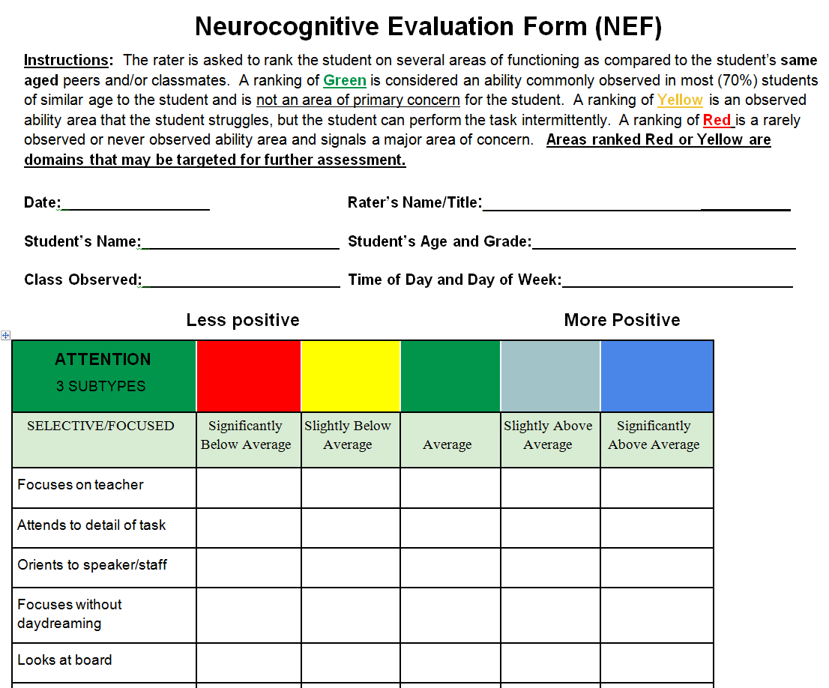
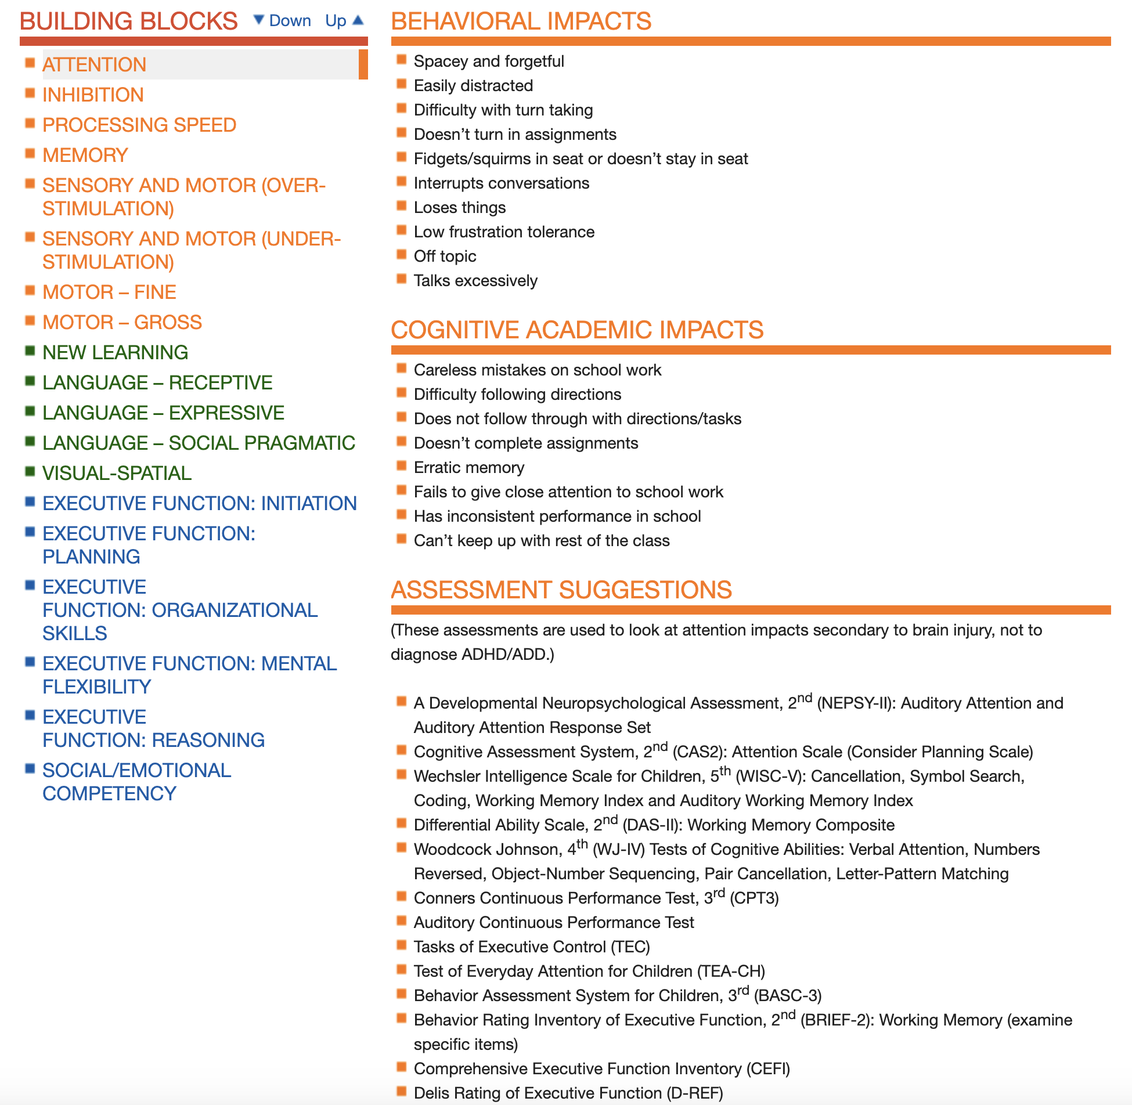
How do you drill it down?
Notes:
One way to drill down is to download the Neurocognitive Evaluation Form, the NEF, from the COKidswithbrainjury.com and see where your student falls when compared to other students you know. By simply answering where your student has strengths and weaknesses, the NEF will show you where your areas of concern cluster and will highlight a few building blocks that are especially in question. The COKidswithbrainijnury.com website also allows you and your multi-disciplinary school team to then pick parts of tests to further assess a possible weakness in the suspected building blocks of concern. These tests listed on the COKids website are all tests that can be given by school professionals in a school setting.

Slide 82



Is off-task while reviewing expectations:
Attention
Doesn't feel rules are fair and expresses feelings inappropriately Expressive /Pragmatic
Language
Can’t remember expectations:
Memory
Behavior:
Non-compliance
Doesn't read visual cues:
Visual-Spatial
Doesn't understand expectations: Receptive Language
No problem-solving skills:
Executive Dysfunction
Notes:
With the building blocks model, you now have so many possible variables to consider that may be impacting, or manifesting as, poor behavior. Now instead of thinking – behavior has happened, for example, Travis refuses to share the ball on the playground… which is frustrating and must be willful disobedience, you can now wonder … Did Travis understand the rules of the game? Did he not feel the rules were fair but could not express those injustices? Was Travis paying attention when the rules were explained? Even if he was, can he remember all the rules? Is Travis reading the facial expressions of the other kids appropriately? And does Travis have the skills to “work through” the problem and land on a win-win outcome? One way to assess whether Travis’ behaviors are a skill deficit rather than a choice is to get a sense of how Travis handles these same situations in various settings – like home vs school vs in the community.

Slide 83
Make sure you have attention before expectations
Is off-task while reviewing expectations:
Attention
Doesn't feel rules are fair and expresses feelings inappropriately Expressive /Pragmatic
Language
Teach appropriate ways to express verbal discontent
Write out/draw out steps to compensate for memory
Can’t remember expectations:
Memory
Behavior:
Non-compliance
Review expectations in visual, multi-modal fashion
May need to teach facial cues, non-verbal cues
Doesn't read visual cues:
Visual-Spatial
Doesn't understand expectations: Receptive Language
No problem-solving skills:
Executive Dysfunction
May need to teach Cog. Beh. Therapy skills CBT
Notes:
If you consider all these potential skill deficits, you now have options for TEACHING! If we assume that Travis is doing his very best to be successful at recess but he Can’t, now we have a place to start with teaching him how to be more successful. If you decide Travis did not understand the rules because of a receptive language deficit, you can teach and re-teach the rules. If you discover that Travis is acting out because he feels the rules are unfair, you can teach him ways to express that injustice. If attention is at play, you can make sure Travis is truly focused when teaching the rules and if memory is poor, you can help Travis find ways to remember the rules (mnemonics, visual steps). If Travis feels that each time Scott rushes toward him for the ball with an intense look on his face that looks like aggression to Travis, you can help Travis learn to categorize that look as ‘passion’ and not aggression. And finally, if negotiation needs to happen between Travis and Scott, cognitive behavior therapy skills can be taught to have the boys come to a win-win resolution.

Slide 84
The A B C’s – study behavior for a few days
Antecedent
What happens right before the behavior?
Behavior
In Math class, mid-morning…
Johnny puts his head on desk
Refuses to do work
Starts to yell, throw papers
Para removes him to hallway
Consequence
What happens right after the behavior?
Notes:
To apply the building blocks to our standard process of figuring out the function of the behavior (an FBA) and developing that into a Behavior Intervention Plan (a BIP), let’s apply Johnny’s behavior of refusing to do math work. Each day, a para professional takes Johnny to math class mid-morning. Each day, Johnny refuses to do work and he puts his head down on the desk. When the para tries to get him to comply, Johnny starts to yell, throw papers and eventually Johnny is removed to the hallway to calm down, and on many days, Johnny ends up back in the special education classroom for the remainder of math time. We all know the A,B,C’s of behavior. We see the behavior, we look for what happened right before the behavior (the antecedent) and what happens right after the behavior (the consequence).

Slide 85
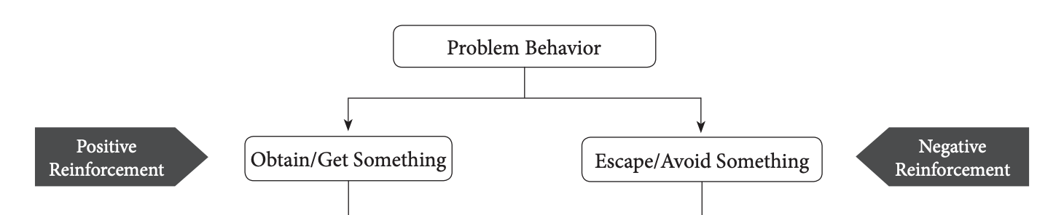

Functional Behavioral Assessment (FBA)
Source:http://pbismissouri.org/wp-content/uploads/2017/06/5.0-MO-SW-PBS-Tier-3-Workbook-Ch-5-FBA.pdf
Notes:
Most of us learned that FBA’s - or the function of behavior – breaks down to trying to get something or trying to avoid something

Slide 86
Limited perspective … Presupposes “Will”
To Gain
Behavior
In math class, mid-morning
To Avoid
Johnny puts his head on desk
Refuses to do work
Starts to yell, throw papers
Para removes him to hallway
Johnny gains attention
Johnny gains social currency with peers by getting out of class
Johnny controls teacher’s attention
Johnny gets out of doing math work
Notes:
In Johnny’s case, we could apply his behaviors to these ideas and come to the conclusion that Johnny may be trying to get teacher or peer attention or he’s trying to get out of having to do work. But both of those conclusions would lead us to the idea that Johnny COULD behave better and is simply choosing not to – that presupposes “will”

Slide 87
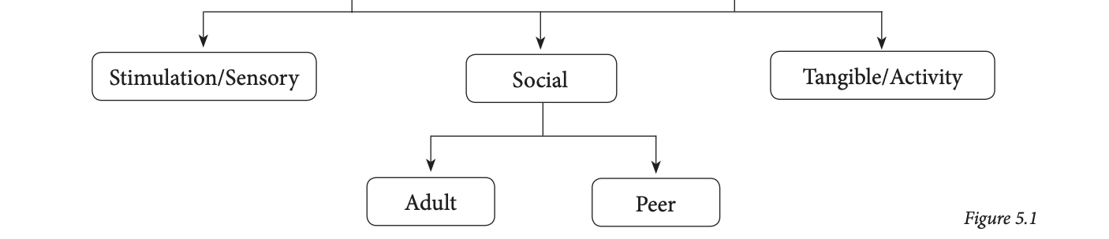
Applying the Building Blocks to FBA’s:
Source: http://pbismissouri.org/wp-content/uploads/2017/06/5.0-MO-SW-PBS-Tier-3-Workbook-Ch-5-FBA.pdf
Notes:
If you remember, FBA’s concepts of getting something or avoiding something break down even farther. A true FBA allows for consideration of getting or avoiding sensory stimulation, not just social or tangible rewards.

Slide 88
What if it’s not what it seems? What it it’s a “skill” deficit?
To gain something
To manipulate for power, attention or control
To gain pride
To save face
To maintain secrecy about skill deficits
To avoid something
To manipulate out of something that needs to be done
To decrease stimulation
To decrease pain
To decrease embarrassment
Notes:
And when you apply those concepts to our building blocks and to Johnny, it may be adaptive for Johnny to act out in math class because he wants to save face, he wants to remain prideful about his lack of math skills and he is embarrassed about being lost in math class. Johnny likely wants to decrease the stimulation from the teacher and para talking AT him, talking TO him, and making it obvious to all the other classmates that he cannot retain what he is learning in math.

Slide 89
Hypothesis of Function on Behavior
Behavior
In math class, mid-morning
Outcome
Johnny’s is “saving face/pride”
Johnny’s expressing frustration b/c he is lost in math
Johnny’s creating a diversion because he’s embarrassed that he is lost in math
Johnny is removing himself from:
Overstimulation
From failure
From embarrassment
Johnny puts his head on desk
Refuses to do work
Starts to yell, throw papers
Needs to be removed to hallway
Is Johnny tired (mental fatigue)?
Does he understand the directions to the work (receptive language deficit)?
Was he paying attention when it was taught (attention deficit)?
Did he learn the lesson but could not convert it into meaningful content (new learning/working memory deficit)?
Does he have the language necessary to let the teacher know he does not know how to start/do the work (expressive language)?
Notes:
So now when we apply the various hypotheses for why Johnny may be acting out in math class, we see we may have a few building blocks that are likely unstable and wobbly. Is it an attention problem or a memory problem? Is it a receptive or an expressive language problem?

Slide 90
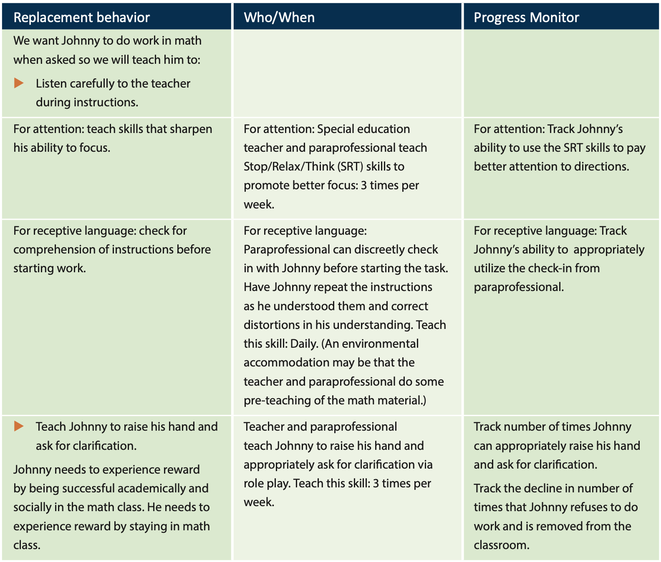
Applying the Building Blocks into BIP’s (Behavior Intervention Plan). What’s your best hypothesis?
Attention
Receptive Language
Notes:
Once we make our best guess about which one or 2 building blocks could be at play, we are now able to develop a Behavior Intervention Plan, a BIP, to teach TO that skill deficit and to hopefully help Johnny get back to being successful in math class. The beauty of a BIP, is that we as educators have many, many resources to help a student build better attention, to build better receptive language. Whether the attentional issues come from brain injury or from ADHD or from trauma, it matters less. The point is … we know how to help a student with attentional issues become more attentive.

Slide 91


Attention
Receptive Language
Notes:
And once you drill your FBA down to a few building blocks to focus on, the Brain Injury in Children and Youth Manual has pages and pages of interventions that align with each building block. In Johnny’s case, you can use any of these interventions for attention and receptive language to build your behavior intervention plan.

Slide 92
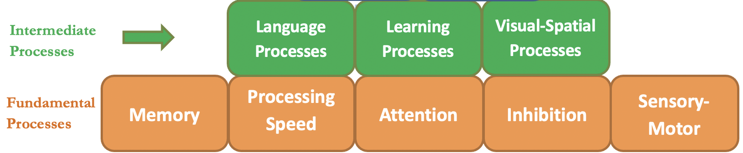
Behavior Intervention Plan:
The Behavior Intervention Plan (BIP) is the road map to changing the behavior. While the behavior is functional for Johnny in the short run it will not serve him well over time. If Johnny’s behavior continues, he will struggle to learn math, fail to keep pace with his peers, strain relationships with his teachers and begin (or perpetuate) a negative perception of himself.
Identify the problem behavior (the behavior that is dysfunctional for the adult but exquisitely adaptive for the student)
Understand the skill deficit underlying the behavior
Decide upon a replacement behavior (the desirable behavior for the adult)
A plan to teach the replacement behavior including:
  who/where/when
A timeframe to assess the success of the plan
A way to objectively assess the success of the plan
Notes:
The BIP becomes your roadmap to changing the behavior. While we now may have a better understanding of why Johnny does not participate in math class, the reality is, we need to help him find a way to be more successful in math class – for his future sake and for his relationships with peers and adults at school. So while the behavior in question may be exquisitely adaptive for the Johnny, it may not be adaptive for the adults or for his future. But as educators, we have now set ourselves up to TEACH Johnny, and we hope as a result of that, the behavior decreases. So in this case, the BIP consists of identifying the function of the behavior as a building block skill deficit, finding a replacement behavior, applying a plan to teach the replacement behavior and assessing it’s success objectively.

Slide 93
Behavior Intervention Plan (BIP) versus a Behavior Contract
BIP
TEACH
Contract
REWARDS/CONSEQUENCES
A plan to teach to a skill deficit to increase desired behaviors, to increase success and competence
You cannot assume our students with specific needs have the skills necessary to show you the behavior. TEACH it first (BIP), then reward it with a behavior contract
Once a desired behavior is taught, it can be strengthened with strong rewards (stickers or feelings of pride and competence) or removal of negatives (teacher/parent stops yelling or loss of the feelings of failure and incompetence)
A person cannot produce a behavior, no matter how big the carrot or stick, that has not yet been taught!
Notes:
The second mistake educators and parents make about behavior goes along with the first mistake - the assumption that all undesirable behavior is willful disobedience - by applying a behavior contract to undesirable behavior. A behavior contract is predicated on the assumption that the desired behavior is available to the student but he or she Won’t give it to you on demand. Naturally what follows is the attempt to give a bigger reward or a bigger punishment to get the child to give you the behavior you want. That is a behavior contract. In contrast, if you assume the behavior is a skill deficit, then naturally it follows that you need to TEACH the student the behavior before they can consistently give it to you. No matter how big your carrot is or how big your stick is, a person cannot produce behavior that they have not been taught!
There is a time and a place for behavior contracts. Once you have taught a student a skill on the BIP, that behavior can be strengthened with rewards and consequences on a behavior contract. Helping our students have better behavior can be robust when first you teach to the skill deficit with a BIP and then strengthen the newly learned behavior with a behavior contract. Both are necessary but they need to go in the correct order.

Slide 94
Setting Events:
Setting events refers to internal factors that can affect a student’s attention, motivation, mood, or comfort that ultimately disrupts their ability to learn or behave. The events are often unknown to the student occurring on a subconscious, unrecognizable level. As a result, these types of events often remain unknown to the adults observing the student’s external behavior as well.
Examples:
Hunger
Fatigue
Medication reactions
Pain
Trauma
Seizures
Gastrointestinal Problems
Metabolic Problems
Allergies
Anxiety
Sensory Overload
Sensory Underload
Dizziness
Ruminative/obsessive thoughts
Notes:
Lastly, what about setting events? Setting events refers to internal factors that can affect a student’s attention, motivation, mood, or comfort that ultimately disrupts their ability to learn and behave. The events are often unknown to the student occurring on a subconscious, unrecognizable level. As a result, these types of events often remain unknown to the adults observing the student’s external behavior as well. Many of our students with TBI or ABI or mental health/physical problems have combinations of pain and fatigue and sensory issues everyday. Some of them are on medications with side effects that make them feel even less “present”. Setting events are real-life factors that need to always be in the back of our minds with our students.

Slide 95
What if your hypothesis is wrong? Try again!
Replacement Behavior | Who/When | Progress Monitor
Johnny is exhausted by 10:15 AM (mental fatigue). This is not a skill deficit but a physical symptom that needs to be addressed with an environmental adjustment | In anticipation of fatigue, Johnny is asked to rest in bean bag chair at 10:00 am, right before math class | Note the length of time Johnny remains in Math class Note number of times Johnny can stay for the entire Math class
Mental Fatigue
Notes:
What if after we try some attention and receptive language interventions with Johnny, he still seems to melt down in math class? It could very well be a physical setting event such as mental fatigue and anticipating a break before he has a melt down is a humane intervention. The building blocks set us up for antecedent management instead of consequence-based management.

Slide 96
Behavior Management
Thus, behavior management techniques can be classified into two categories:
(1) consequent strategies, which are used after a behavior occurs in an effort to prevent the continuation and recurrence of a behavior or to reinforce a behavior --- this presupposes “will” and results in a behavior contract
(2) antecedent strategies, which are used before a behavior occurs in an effort to prevent or elicit a behavior, and --- this takes into account a skill deficit, setting events and results in a BIP.
Although both can be effective … in their own way, when applied at the right times.
Crisis Prevention instead of Crisis Management
Notes:
With students with neurodiversity, antecedent management is generally needed as we cannot assume that the issues that surround their neurodiversity haven’t contributed to unevenness and skill deficits. As an educator, this is where I always start.

Slide 97
Kids with typical development sometimes struggle with skill deficits too…
Kids with neurodiversity try to ”push the boundaries” and try to get away with things they don’t like to do sometimes too… That is about at “typical” as you can get!
Can’t
Won’t
Let’s assume all our students with various needs (brain injury, ADHD, trauma, on the spectrum, FASD, mental health, learning disabilities) and with “typical” needs WILL succeed if they CAN succeed…
And let’s take every opportunity to TEACH students behaviors we need them to know even if we think they are already old enough to know and produce those behaviors
Notes:
And remember … Kids with neurodiversity try to ”push the boundaries” and try to get away with things they don’t like to do sometimes too… That is about at “typical” as you can get! We need to celebrate their drive to be “typical” and allow them some space to have “won’t” behaviors!
Kids with typical development sometimes struggle with skill deficits too…we can’t forget that their development can be uneven as well and they may struggle with a “can’t” area of deficit that may need extra support.
So …Let’s assume all of our students with various needs (brain injury, ADHD, trauma, on the spectrum, FASD, mental health, learning disabilities) and with “typical” needs WILL succeed if they CAN succeed…
And let’s take every opportunity to TEACH students behaviors we need them to know even if we think they are already old enough to know and produce those behaviors

Slide 98
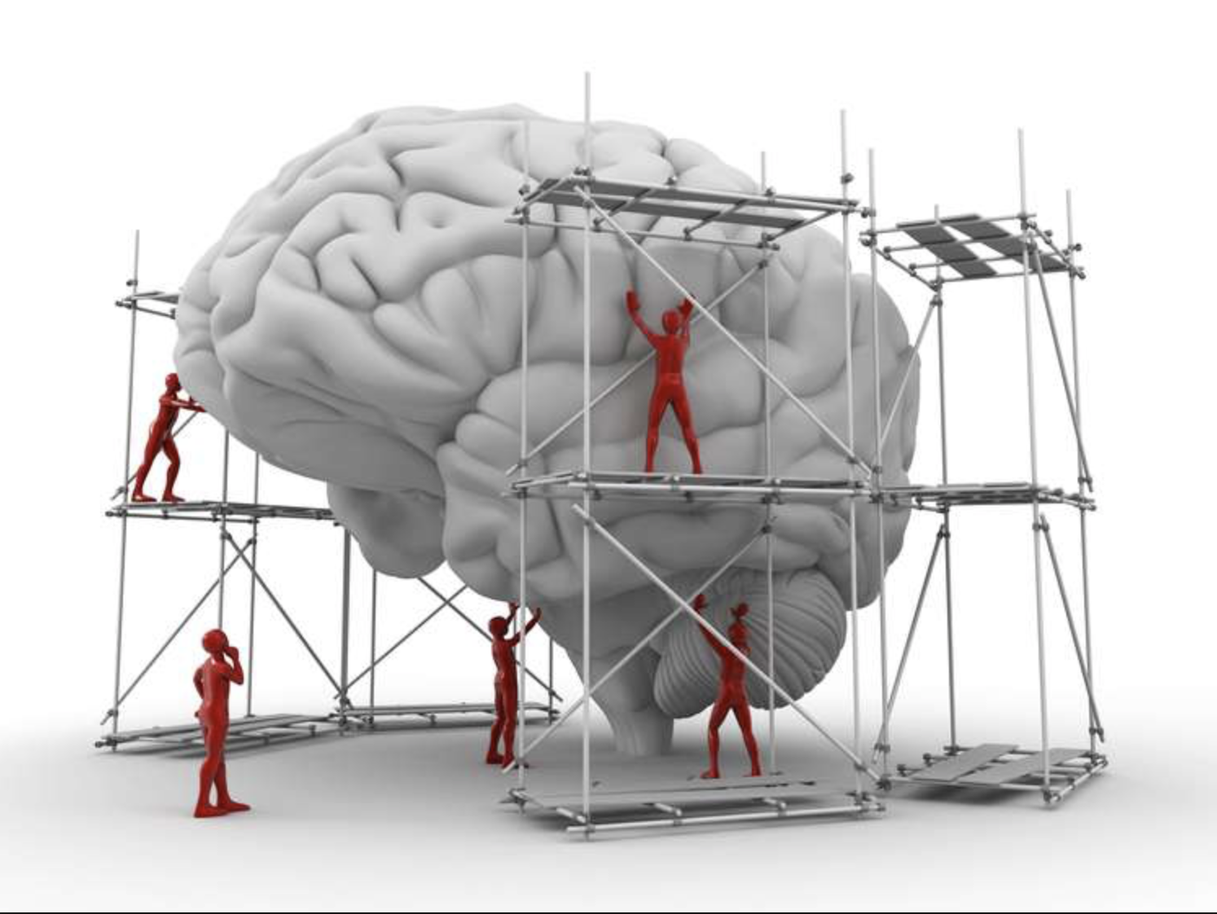
Questions?
Karen McAvoy, PsyD
Brain Injury Educational Consulting Colorado, LLC
Karen@GetSchooledOnConcussions.com

Slide 99
Brain injury Resources
Centers for Disease Control: https://www.cdc.gov/traumaticbraininjury
Website for Parents and Professionals: www.COKidswithbraininjury.com
Brain Injury Manual for Educators: http://www.cde.state.co.us/cdesped/SD-TBI.asp
Brain Check Survey: http://www.lobi.chhs.colostate.edu/index.aspx
Brainline & Brainline Kids - http://www.brainline.org/landing_pages/features/blkids.html
Greene (2016) Lost and Found: Helping Behaviorally Challenging Students (and, While You're At It, All the Others)
Dawson and Guare (2012) Coaching Students with Executive Skill Deficits
Dawson and Guare (2010) Executive Skills in Children and Adolescents

Slide 100
Alcohol use Resources
Brown SA, Tapert SF, Granholm E, Delis DC. Neurocognitive functioning of adolescents: effects of protracted alcohol use. Alcohol Clin Exp Res. 2000;24(2):164–171. [PubMed] [Google Scholar]
Tapert SF, Brown SA. Substance dependence, family history of alcohol dependence and neuropsychological functioning in adolescence. Addiction. 2000;95(7):1043–1053. [PubMed] [Google Scholar]
Tarter RE, Mezzich AC, Hsieh Y-C, Parks SM. Cognitive capacity in female adolescent substance abusers. Drug Alcohol Depen. 1995;39:15–21. [PubMed] [Google Scholar]
Giancola PR, Mezzich AC, Tarter RE. Executive cognitive functioning, temperament, and antisocial behavior in conduct disordered adolescent females. J Abnorm Psychol. 1998;107:629–641. [PubMed] [Google Scholar]
Giancola PR, Shoal GD, Mezzich AC. Constructive thinking, executive functioning, antisocial behavior, and drug use involvement in adolescent females with a substance use disorder. Exp Clin Psychopharmacol. 2001;9(2):215–227. [PubMed] [Google Scholar]
Moss HB, Kirisci L, Gordon HW, Tarter RE. A neuropsychologic profile of adolescent alcoholics. Alcohol Clin Exp Res. 1994;18:159–163. [PubMed] [Google Scholar]

