Slide 1
Healing the Returning Warrior: Keys to Understanding Unique Challenges and Strengths of American Indian, Alaska Native Veterans: Module One
Sean A Bear 1st, BA
National American Indian and Alaska Native MHTTC
Ray Daw, MA
Notes:
Hello everyone, and welcome to the Mental Health webinar series, brought to you by the National American Indian and Alaska Native MHTTC. I am Megan Dotson, and today we have Sean Bear and Ray Daw presenting on Healing the Returning Warrior: Keys to Understanding Unique Challenges and Strengths of American Indian, Alaska Native Veterans. This is the second section in a series which will be continuing over the next few months. All of our webinars are recorded, so if you ever miss a session, you can always go back and view it at a later date.

Slide 2
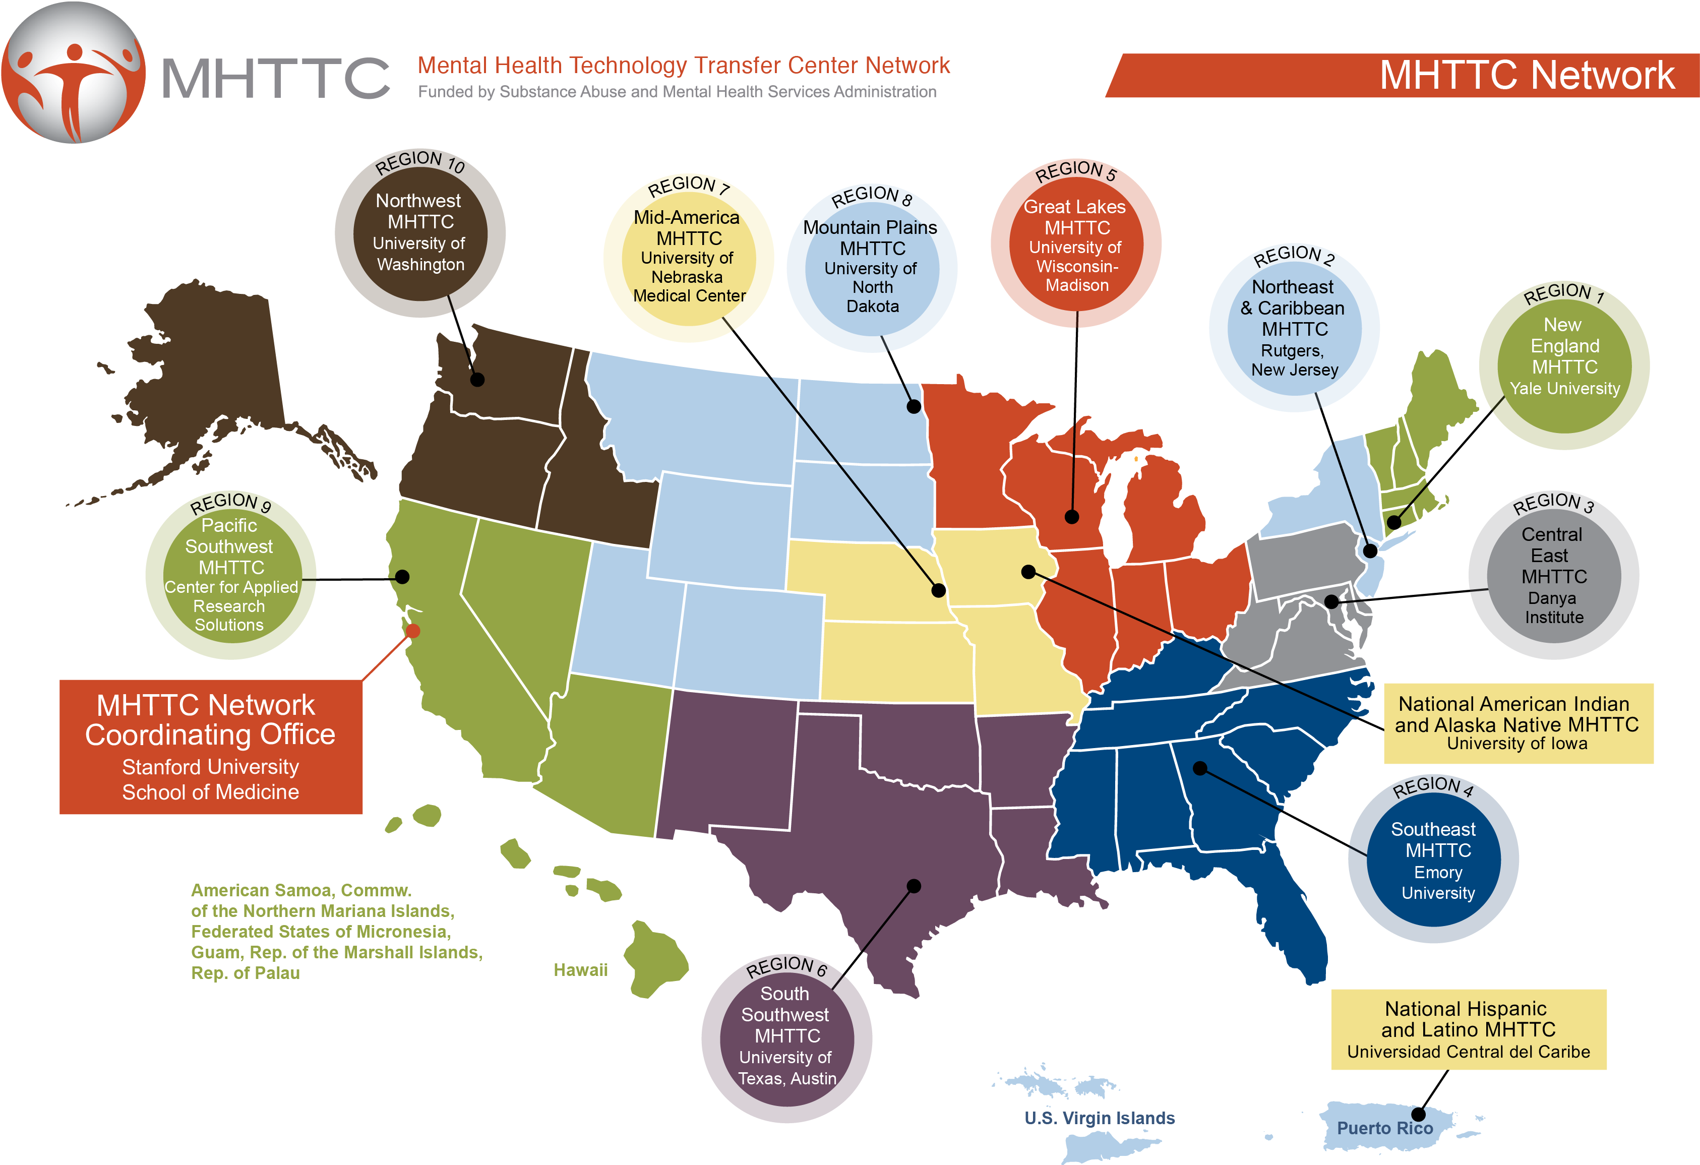
American Indian & Alaska Native Mental Health Webinar series
This webinar is provided by the National American Indian & Alaska Native MHTTC, a program funded by the Substance Abuse and Mental Health Services Administration (SAMHSA).
Notes:
This training series is brought to you by the National American Indian & Alaska Native Mental Health Technology Transfer Center. We are part of the MHTTC Network, which also includes 10 regional centers, a network coordinating office, and the National Hispanic and Latino MHTTC.

Slide 3
The National American Indian and Alaska Native Mental Health Technology Transfer Center is supported by a grant from CSAT/SAMHSA.
The content of this webinar is the creation of the presenter(s), and the opinions expressed do not necessarily reflect the views or policies of SAMHSA, HHS, or the American Indian & Alaska Native MHTTC.
Notes:
This project is supported by the Substance Abuse and Mental Health Services Administration (SAMHSA). The content is developed by the presenter(s), and the opinions expressed to not necessarily reflect the views or policies of SAMHSA, HHS, or the American Indian & Alaska Native MHTTC.

Slide 4
Webinar follow-up
CEUs are available upon request for $15 per session.
This session has been approved for 1.0 CEU’s by:
NAADAC: The National American Indian & Alaska Native MHTTC is a NAADAC (The Association for Addiction Professionals) certified educational provider, and this webinar has been pre-approved for 1.0 CEU.
To obtain CEUs for this session, please email:
natasha-peterson@uiowa.edu
Participants are responsible for submitting state specific requests under the guidelines of their individual state.
Presentation handouts:
A handout of this slideshow presentation will also be available by download
Notes:
In the next couple of days, we will send out a follow-up email to everyone who attended which includes a link to the recording, the handouts of the slides, and a CEU request form. Our Center is a NAADAC certified educational provider, and we’d be happy to provide you with CEUs for a $15 fee.

Slide 5
Webinar follow-up
Evaluation: SAMHSA’s GPRA
This webinar is provided by the National American Indian & Alaska Native MHTTC, a program funded by the Substance Abuse and Mental Health Services Administration (SAMHSA).
Participation in our evaluation lets SAMHSA know:
How many people attended our webinar
How satisfied you are with our webinar
How useful our webinars are to you
You will find a link to the GPRA survey in the chat box. If you are not able to complete the GPRA directly following the webinar, we will send an email to you with the survey link. Please take a few minutes to give us your feedback on this webinar. You can skip any questions that you do not want to answer, and your participation in this survey is voluntary. Through the use of a coding system, your responses will be kept confidential and it will not be possible to link your responses to you.
We appreciate your response and look forward to hearing from you.
Notes:
Immediately following today’s webinar, you will be redirected to our GPRA evaluation. This survey takes just a few minutes to complete, and asks about your satisfaction with the event. This feedback is critical to our future work, and we value your opinion and would greatly appreciate your time in sharing your thoughts with us.

Slide 6
Adobe Connect Overview
Participant overview:
To alternate between full screen mode, please click on the full screen button on the top right of the presentation pod. (It looks like 4 arrows pointing out)
To ask questions or share comments, please type them into the chat pod and hit “Enter.”
Notes:
You will be muted for the duration of this webinar. Please use the chat pod to share your questions and comments, and we will address questions at appropriate points during the presentation.

Slide 7
Today’s Speaker
Ray Daw, MA is Navajo , originally from Houck, Arizona. Graduated from boarding school and UNM. He has been in the behavioral health field for about 35 years working with the Navajo Nation, non-profits and most recently in Alaska. His work in behavioral health has been heavily towards developing Native trauma-appropriate approaches that are healing and effective in tribal behavioral health prevention, Intervention, and treatment services.
Notes:
Our first speaker is Ray Daw, a member of our Advisory Council and one of our major consultants. Ray has been in the behavioral health field for about 35 years working with the Navajo Nation, non-profits and most recently in Alaska. His work in behavioral health has been heavily towards developing Native trauma-appropriate approaches that are healing and effective in tribal behavioral health prevention, Intervention, and treatment services.

Slide 8
Today’s Speaker
Sean A. Bear, 1st, earned his B.A. from Buena Vista University in 2002, majoring in psychology/human services. He also studied mental health counseling at Drake University for 2 years. He is a member of the Meskwaki Tribe, in Tama, Iowa, and has worked with Native Americans with substance abuse issues for many years. He is an Army Veteran of 9 years, and was honorary discharged from the 82nd Airborne.
Mr. Bear has worked as an Administrator/Counselor in EAP, as a counselor in adolescent behavioral disorder programs, substance abuse, and in-home family therapy. He has experience in building holistic, Native American based curriculum, and implementing these curricula/programs in substance abuse treatment and prevention program.
Notes:
We also have Sean Bear, the Co-Director of our MHTTC. Mr. Bear has worked as an Administrator/Counselor in EAP, as a counselor in adolescent behavioral disorder programs, substance abuse, and in-home family therapy. He has experience in building holistic, Native American based curriculum, and implementing these curricula/programs in substance abuse treatment and prevention program, and he is also an Army Veteran of 9 years, and was honorably discharged from the 82nd Airborne.
Thank you so much, Sean and Ray, for your work on this project and for sharing this with us today. I’ll pass this over to you at this time.

Slide 9
Healing the Returning Warrior: Keys to Understanding Unique Challenges and Strengths of American Indian, Alaska Native Veterans: Module One
Sean A Bear 1st, BA
National American Indian and Alaska Native MHTTC
Ray Daw, MA
Notes:
We began this project as a means of assisting those working with Native Veterans to better understanding the unique challenges that are comprised while assisting with Trauma and PTSD,

Slide 10
Overview of the Training
5 Modules are designed for a 2.5 day training
Historical Overview of Natives in Warfare, Military
Trauma, Historical Trauma, and PTSD
Approaches to Assessment and Treatment
Traditional Beliefs & Healing Practices
Healing The Healer

Slide 11
Module One Objectives
1. Describe the history of Native warriors
2. Describe characteristics of Native warriors
3. Describe the history of Native soldiers
4. Describe characteristics of Native soldiers

Slide 12
Objective 1: Describe the history Native warriors
Purpose: This module will offer opportunity for tribal veterans and communities to recount their ancestral stories and traditional warrior practices.

Slide 13
Objective: describe the history Native warriors
Pre-colonization conflict between tribal groups is not well-described in contemporary literature. However, within tribal oral accounts are numerous verbal stories of incidences of conflict.
Tribal conflicts tended to be small scale and occurred when tribal resources were encroached upon by incoming or neighboring tribal groups.

Slide 14
Historical Overview
Pre-Contact Warfare
Young men were trained in martial arts early.
Tribes developed ceremonies that healed, physically, emotionally, socially, and spiritually
Contemporary understanding of traditional warrior practices is very limited
Limited Warfare for Certain reasons, small-scale
Story: Face to Face confrontations

Slide 15
Historical Overview
With some tribes, males and females given “warrior” names early in life.
Boys wrestled to become skilled and agile
Weapons were learned early in life

Slide 16
Historical Overview
Precontact History of Native Americans; most Native American Indian tribes used small-scale guerilla warfare. This was seen and documented as early as 1528 with the Apalachee’s resistance to Spanish.
Hand-to-Hand combat was the norm and created rules of conduct for Native warriors that were strictly followed.

Slide 17
Objective 2: Describe characteristics of Native warriors
Purpose: to discuss what traditional characteristics of Native warriors were.

Slide 18
Pre-Colonization Reasons Natives fought
Defense of tribal lands
Defense of tribe/family
Family warrior history
Tribal warrior traditions
Excelling as warrior
Loyalty to tribe

Slide 19
Warrior Attributes
Taking of body parts (scalps) was not Traditionally acceptable, but was a French bounty system.
Opponents often respected for bravery and abilities
Bravery and martial skills highly regarded within tribes
Maintaining physical abilities always important

Slide 20
Peace Leaders
Tribes commonly had war leaders and peace leaders
Peace leaders sought to maintain peace with neighbors
Peace leaders sought to resolve conflicts fairly
Peace leaders were highly respected

Slide 21
Warrior/Relative
Attributes associated with conflict, like anger or harming others, were discouraged in family settings.
Compassion for families and community
Concern for family and community

Slide 22
Objective 3: Describe the history of Native soldiers
Purpose: discuss how Native warriors have fought alongside Europeans, since the beginning of European colonization.

Slide 23
Historical Overview
Native Americans have played an integral part of the U.S. Military Conflicts since before it became America
Colonists had recruited allies from Native tribes during the Pequot War (1634-1638)

Slide 24
Historical Overview
1622- Europeans enlisted the help of Natives to integrate their fighting methods. The birth of Rangers. “Rogers’ Rangers”
1676- Benjamin Church designed his forces to emulate the Native tactics, in which he became the First Captain of the First Ranger Force in the Americas.
Knowlton Rangers is accredited the First Official Ranger Unit for the US.

Slide 25
Historical Overview
Different approaches to conflict and warfare
The Thin Red Line: in European warfare, armies would line up, as French and British soldiers were taught.
Soldiers lined up in rows shooting at each other.
Heavy casualties were the result
European battles were fought in open fields and were not accustomed to fighting in forests and certain terrains.

Slide 26
Guerrilla Warfare
“Little War”
Use of Ambushes, Sabotage, Raids, Petty War, Hit-n-Runs, Mobility, normally in the use of Larger, less mobile Military forces.
Causes fear, disorientation, confusion, exhaustion, chaos, havoc among enemy forces making them less efficient
Came to be utilized in the shaping of Special Operation within the Military and Insurgencies.
Notes:
Native’s were seen as cowards, because “Approach like foxes, fight like lions, and disappear like birds”
Over time, the fighting tactics of natives gained respect

Slide 27
Abenaki
The Abenaki tribe of Maine and Vermont, were a peaceful people, whom practiced the ways of healing. They did not want war or be part of it. Some had even left the area sooner, so as not to be caught in it, with the hopes of returning one day when it became more peaceful.
They had very strong medicines of healing, one of which was the bear-dance.

Slide 28
Native ways used against Natives
October 4, 1759 - An Abenaki village whom had converted to Catholicism, living around the area of St. Francis mission (Maine), was raided by more than 200 hundred of Roger’s Rangers. 80 killed, including 24 women and children.

Slide 29
Historical Overview
During the first 60 years of the 1700’s while war between the French and British military, both sides had used Natives as scouts, sharpshooters(snipers), and skirmishers (Reconnaissance, Patrols, and Ambushes)
“They Approach like foxes, fight like lions, and disappear like birds.“ French Missionary

Slide 30
Historical Overview
King Williams War (1689-1697) is considered the First of the French and Indian wars as the French and British utilized Natives to fight the other. “Fight for the Americas”
Both sides were utilizing the Natives to fight with their own tactics in order to cause chaos among the enemy
By the end of the Revolutionary war, Native fighting tactics were seen as superior to those of the British and French, as they realized that the natives were not undisciplined, but could move as a unit, slow and silent, or with speed while going into the battle, but also with Ferocity in battle.

Slide 31
Historical Overview
Under Thomas Jefferson, the first recognized United States of American treaty with the Delaware. This brought trade and a military alliance.
After this, nearly every treaty with the Natives would include that they would be bound to fight against other Natives in order to guarantee boundaries.
By exploiting the Natives through treaties, allies for the fight for the frontier were made.
It was under Thomas Jefferson that the Indian Removal and Relocation began, which includes the Trail of Tears.

Slide 32
Historical Overview
Native American Indians served with the U.S. Military and Cavalry against other natives in several wars.
1812- Under Andrew Jackson, an all Cherokee Regiment was created to fight against the Muskogee Creek.
1815-1861 Military Assistance Clause was added to guarantee that Natives would assist the U.S. Military against other Natives.
This would allow Native guerilla fighting techniques to be utilized against other tribes, as they knew the areas and the tactics of the peoples.

Slide 33
Congressional Medal of Honor
This is awarded “for conspicuous gallantry and intrepidity at the risk of life, above and beyond the call of duty, in actual combat against an armed enemy force.”
Of 3,469 awarded, 29 have been to Native Americans
1869- First Native American Indian Recipient of the Congressional Medal of Honor was Co-Rux-Te-Cod-Ish, Pawnee

Slide 34
Indian Scouting Service
In 1886, a bill was passed to establish the Indian Scouting Service (ISS)
Battalion of Pawnee Scouts
Scouts were used in Texas- Seminole
Southern Plains- Ponca, Osage, Otoes
Apache Scouts- late 1870’s
From their Value- Came the Scouts, Cavalry, and Sharpshooters in 1891, 2,000 Natives were placed in the regular Armed forces.
ISS was disbanded in 1943

Slide 35
1917
17,000 Native Americans had entered the Military. During past conflicts with Natives, stereotypes began in which Natives were to have natural instincts and being fierce warriors, which was a great fit for service as scouts.
These beliefs and practices continued on into Vietnam, being placed in the most dangerous duties.
Gen. John Blackjack Pershing, used Apache scouts in pursuit of Pancho Villa.
Many were in the 358th Infantry, Dominated the 36th Infantry Div., and the all-Native American Echo Company of the 142nd infantry

Slide 36
WWI
13,000 Native Americans fought in WWI without US citizenship
Some Natives who fought in WWI did so in hopes that their people would get citizenship

Slide 37
WWI
A survey was conducted after World War One. Of those responding, their branch of service and duties are identified.

Slide 38
Choctaw Code Talkers of WWI
During World War I, the Germans had not been able to break the code of the Choctaw & Cherokee Code talkers.
After the success of the Choctaw Code Talkers, they wanted to see if this would work with other tribes.
In WWII Code Talkers utilizing different Native American Languages were used in both major fronts

Slide 39
Pearl Harbor Attack
December 7, 1941. Honolulu, Hawaii
Surprise attack by the Japanese, lead to 40% more Natives joining the Military voluntarily than had been drafted

Slide 40
U.S. Army Special Forces
In 1942, the first Special Service Force was formed, combined of Canadian and Americans that would gain fame in Vietnam
The Special Forces would utilize the Indian Scouting Service’s Crossed-Arrow Insignia.

Slide 41
WWII
Raising of the flag in Iwo Jima- 1945
One of the flag raisers, Ira Hayes, of whom is left out in some historical monuments, which was of Native descent (Pima, Gila River Indian Reservation)
Notes:
This is actually a picture of the second flag that was raised approximately 90 minutes earlier, but was too small to see from further away.
WWII is when the Navajo code talkers

Slide 42
Korean War
It is reported that with the Korean war that military did not keep records of Natives who served, but it is estimated around 10,000 and fell under colored peoples.
194 Native Americans are reported to have died in battle.

Slide 43
Natives in Vietnam
It is estimated that approximately 42,000 – 82,000 Native men and women served during the War in Vietnam.
90% of Native Americans who were in Vietnam volunteered
1 of 4 eligible Native people served (Smithsonian)
226 died and 5 received the Medal of Honor
Notes:
In Vietnam, this is regarded as the American War.

Slide 44
Objective 4: Describe characteristics of Native soldiers
Purpose: Create understanding of Native warrior practices and European warfare practices.

Slide 45
Reasons Natives join the military services
Patriotism to US
Loyalty to tribe
Defense of country
Defense of tribe/family
Family warrior history
Family history of military service
Tribal warrior traditions, being successful
Excelling as warrior/soldier (better than others)

Slide 46
Each soldier has his/her reason(s)
What does the veteran, or active duty soldier, describe as his/her reason(s) for being in the military?
How does he/she view their role in the military?
If a veteran, does he/she view their discharge?
Does the veteran describe family military history?

Slide 47
Follow-up
National MHTTC can do introductory presentations with tribal leaders and providers on the Veterans Wellness Curriculum
National MHTTC can adapt the Veterans Wellness Curriculum to be tribally-specific with tribal leaders, providers, and tribal veterans.
National MHTTC can provide local training with tribal co-trainers that be up to 2.5 days.
National MHTTC can do trainer-of-trainers to develop tribal trainers to incorporate the modules within tribal systems, courts, etc.

Slide 48
Can we answer your questions?
Thank YOU
Learning Collaborative available for further discussion of this curriculum:
This Friday, January 17, 12 pm EST, 11 am CST, 10 am MST, 9 am PST, 8 am AST
For more information, please contact Megan Dotson: megan-dotson@uiowa.edu
Other questions?
Contact Sean Bear: sean-bear@uiowa.edu, Ray Daw: rayadaw@aol.com

