Slide 1
The Importance of Resiliency During the COVID-19 Pandemic
Ken Winters, PhD
Daniel V. Foster, Psy.D., MSCP
Notes:
Welcome to the MHTTC webinar series. I am Elleh Driscoll broadcasting from Iowa City , Iowa, and today we have Dr. Daniel Foster and Dr. Ken Winters presenting The Importance of Resiliency During the COVID-19 Pandemic. I would like to give a warm welcome to everyone joining us today, please feel free to introduce yourselves and tell us where you are from in the chat!

Slide 2
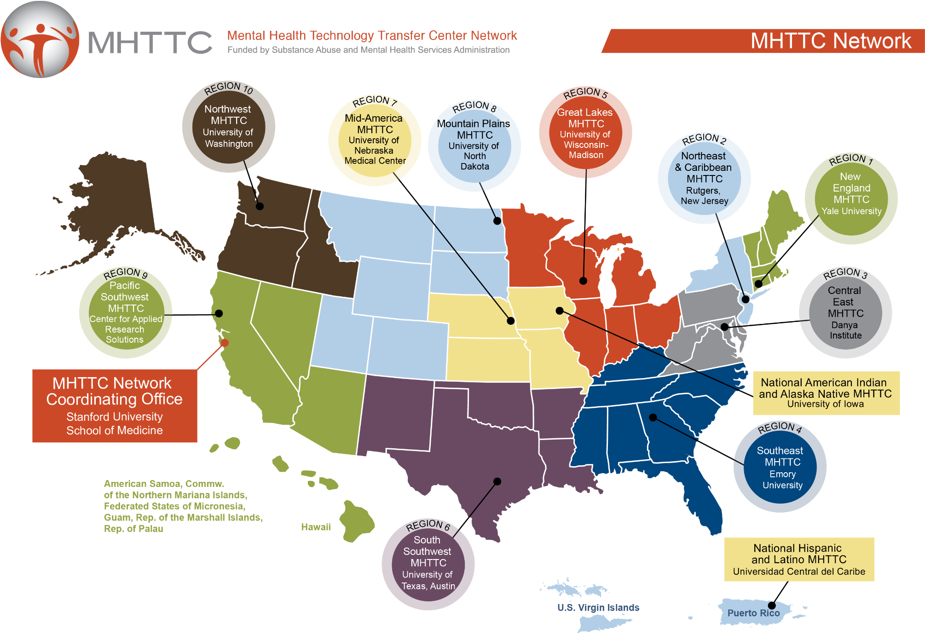
American Indian & Alaska Native Mental Health Webinar series
This webinar is provided by the National American Indian & Alaska Native MHTTC, a program funded by the Substance Abuse and Mental Health Services Administration (SAMHSA).
Notes:
This training series is brought to you by the National American Indian & Alaska Native Mental Health Technology Transfer Center. We are part of the MHTTC Network, which is located out of Ioaw City, Iowa.

Slide 3
The National American Indian and Alaska Native Addiction Technology Transfer Center is supported by a grant from CSAT/SAMHSA.
The content of this webinar is the creation of the presenter(s), and the opinions expressed do not necessarily reflect the views or policies of SAMHSA, HHS, or the American Indian & Alaska Native ATTC.
Notes:
This project is supported by SAMHSA. The content is developed by the presenter, and the opinions expressed do not necessarily reflect the views or policies of SAMHSA, HHS, or the American Indian & Alaska Native ATTC.

Slide 4
Webinar follow-up
CEUs are available upon request. We are currently waiving any fees for CEUs during quarantine.
This session has been approved for 1.0 CEU’s by:
NAADAC: The National American Indian & Alaska Native MHTTC is a NAADAC (The Association for Addiction Professionals) certified educational provider, and this webinar has been pre-approved for 1.0 CEU.
Participants are responsible for submitting state specific requests under the guidelines of their individual state.
Presentation handouts:
A handout of this slideshow presentation will also be available by download
Notes:
In the next couple of days, we will send out a follow-up email to everyone who attended which includes a link to the recording, the handouts of the slides, and a CEU request form. Our Center is a NAADAC certified educational provider, and we’d be happy to provide you with CEUs. We are currently waiving any fees for CEUs during the pandemic, and when we send out our follow-up email, it will contain instructions on ordering your certificate.

Slide 5
Webinar follow-up
Evaluation: SAMHSA’s GPRA
This webinar is provided by the National American Indian & Alaska Native MHTTC, a program funded by the Substance Abuse and Mental Health Services Administration (SAMHSA).
Participation in our evaluation lets SAMHSA know:
How many people attended our webinar
How satisfied you are with our webinar
How useful our webinars are to you
You will find a link to the GPRA survey in the chat box. If you are not able to complete the GPRA directly following the webinar, we will send an email to you with the survey link. Please take a few minutes to give us your feedback on this webinar. You can skip any questions that you do not want to answer, and your participation in this survey is voluntary. Through the use of a coding system, your responses will be kept confidential and it will not be possible to link your responses to you.
We appreciate your response and look forward to hearing from you.
Notes:
You will be redirected to our GPRA survey evaluation at the end of this session. This survey takes just a few minutes to complete and asks about your satisfaction with the event. This feedback is critical to our future work, and we value your opinion and would greatly appreciate your time in sharing your thoughts with us.

Slide 6
Zoom Overview
Participant overview:
You will need to click on the “Chat” icon to open up the chat on the right side of the screen.
To ask questions or share comments, please type them into the chat pod and hit “Enter.”
Notes:
You will be muted for the duration of this webinar. You can use the chat feature to share where you are from and make comments about the presentation if you would like. Please use the Q & A box to ask questions for our presenter and we will address questions at the end of the presentation.

Slide 7
Today’s Speakers
Daniel V. Foster, Psy.D., MSCP served as an Army Sergeant, 1969-71. He graduated from Willamette University, Salem OR, then on to his Doctorate (PsyD) from Baylor University in 1980. He received an MS in Clinical Psychopharmacology in 2011. He was the first National Director of the Bureau of Prisons Drug Abuse Programs. His final 23 years, he served with the Indian Health Service at two locations, in Montana and South Dakota. He served in various supervisory, management and administrative roles with the BOP and IHS. He and his wife, a Ph.D. in psychology and American Indian, adopted numerous children, including special needs children. They contributed to the development of American Indian Graduate Education in Clinical Psychology. They live a Traditional and Ceremonial Life in contemporary times.
Ken Winters, PhD has been a consultant to the National American Indian Alaska Native Technology Transfer Center for several years. He is a Senior Scientist at the Oregon Research Institute (MN location). Previously he was a Professor in the Department of Psychiatry at the University of Minnesota, where he founded and directed the Center for Adolescent Substance Abuse Research for 25 years. His primary research interests are adolescent health, with a focus of substance abuse and co-existing mental and behavioral disorders.
Notes:
And with that, I would like to give it over our presenters! Thank you so much for joining us!

