Slide 1
Evoking Power in Seasons of Uncertainty.
MOTIVATIONAL INTERVIEWING

Slide 2
Overview
Review of the Basics of MI (“Lightning Round.”)
Investigation of literature and practice-based evidence regarding the utility of Motivational Interviewing in sustaining the necessary conditions for clients to engage their ambivalence in a good way.

Slide 3
MI LIGHTINING ROUND
Practitioner’s Definition
Motivational Interviewing is a person-centered counseling style for addressing the common problem of ambivalence about change.
MI p29

Slide 4
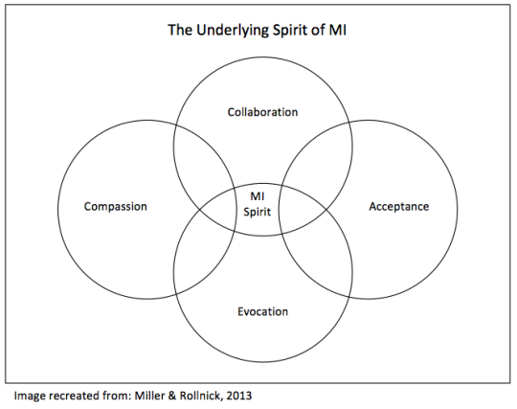
MI p22, MI p17
z
The Spirit of Motivational Interviewing

Slide 5
z
When you talk to the people don’t just talk to them you talk to their spirit, that is how you are gonna reach them, that is where they will change, that is where they will heal, talk with their spirit.
Gene Tagaban. Storyteller, Tlingit citizen (above)

Slide 6
4 Basic “Moves” in MI
z

Slide 7
Linear
z

Slide 8
Recursive

Slide 9
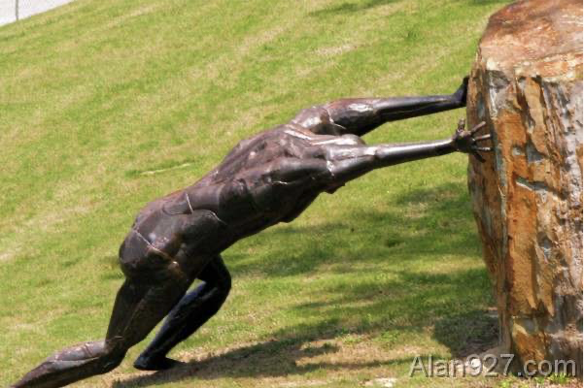
“Resistant” no more, still.
Discord talk
Slide credit: Bill Miller
Sustain talk

Slide 10
z
TAKING STEPS
ACTIVATION
COMMITMENT
NEED
REASONS
ABILITY
DESIRE

Slide 11
Also of note…
MI is not the Stages of Change. Fun fact!
No more decisional balance (Miller and Rose 2015.)
Low empathy may actually be toxic (Gaume et al 2015)
Who is making the argument for change in this? (MITI 4.2.1 Ernst et al)
Cuddling the Problem—we don’t have to do it anymore!
Rein in the Righting Reflex. It sneaks up on us.

Slide 12
Reviewing the recommendations…
Diagram Credit: Denise Ernst
With complements to Denise Ernst PhD

Slide 13
But does it apply right now? Who has time to ambivilate?
Discussion?
z

Slide 14
What are the responses to a sudden trauma and/or existential threat?
(like those of 2020 for example?)

Slide 15
Vs…
z

Slide 16
…OUT.
Peace…

Slide 17
(im not here im not here look over at that human with the camera im not here im not here)
z

Slide 18
Discuss?
Here’s my thought: it doesn’t really change much.
The Spirit of MI portion of Miller and Rollnick evolved in this way.

Slide 19
Support is in the literature
Modification of motivational interviewing for use with people with mild intellectual disability and challenging behavior. Frielink, et al. J of Intel & Dev Dis, 2013

Slide 20
z
The Spirit of Motivational Interviewing

Slide 21
The Spirit of Motivational Interviewing
z
Discussion: has your practice of these two aspects of spirit of MI changed in your reflection? (in 2020?)
Compassion
Collaboration

Slide 22
“speak with their spirit.”
z
What do you imagine yourself saying to a client in crisis:
?
a
affirmation
Accurate empathy
Absolute worth
there'
(there’s only 4 in the text)
autonomy

Slide 23
The Spirit of MI, not new.
z
acceptance
collaboration
compassion

Slide 24
Effective modifications to MI actions:
Closed and open questions are appropriate.
Allow client to control how they prefer to communicate. Elicit maximum appropriate choices from client about their communication.
Short sentences, simple language, concrete and clear.
• Check for understanding both immediately after presenting information and also after a short time delay.
It is appropriate to utilize these modifications with clientele undergoing stressful adversity.

Slide 25
(slide here for participant reference) Please view. Imagine how you’d enage each person in the spirit of MI.
video demonstration: 10-Meter Tower
Has 2020 been noticeably different with your clients?
With your staff/colleagues?
What have you noticed?

Slide 26
Evocation – Unique to MI
z
acceptance
collaboration
compassion
This is where the OARS become EARS.

Slide 27
Conclusion
May we continue to work toward these ideals of person-centered approaches, even in these times.
May we know our limits, and know when to apply these principles of Compasson, Acceptance, Community to ourselves.
And maybe even give ourselves a break here and there.

Slide 28
Thank you!
z
Your time and attention are a privilege to share.

Slide 29
For Further Reading
Communication with individuals with intellectual disabilities and psychiatric disabilities: A summary of the literature. Schalick, et al. Mich Retirement Research Center, 2012
Modification of motivational interviewing for use with people with mild intellectual disability and challenging behavior. Frielink, et al. J of Intel & Dev Dis, 2013
Magill M, Gaume J, Apodaca TR, Walthers J, Mastroleo NR, Borsari B, Longabaugh R. The technical hypothesis of motivational interviewing: a meta-analysis of MI's key causal model. J Consult Clin Psychol. 2014 Dec;82(6):973-83. doi: 10.1037/a0036833. Epub 2014 May 19. PMID: 24841862; PMCID: PMC4237697.
Miller, William R., and Stephen Rollnick. Motivational Interviewing: Helping People Change. 3rd ed. New York, NY: Guilford Press, 2013.

