Slide 1


Effective Accommodations for Struggling Students
Erin Briley, M.S., NCSP
Mountain Plains MHTTC Trainer

Slide 2
Disclaimer and Funding Statement
This presentation was prepared for the Mountain Plains Mental Health Technology Transfer Center (Mountain Plains MHTTC) under a cooperative agreement from the Substance Abuse and Mental Health Services Administration (SAMHSA). All material appearing in this presentation, except that taken directly from copyrighted sources, is in the public domain and may be reproduced or copied without permission from SAMHSA or the authors. Citation of the source is appreciated. Do not reproduce or distribute this presentation for a fee without specific, written authorization from the Mountain Plains MHTTC. For more information on obtaining copies of this presentation please email swinfield@wiche.edu.
At the time of this presentation, Tom Coderre served as acting SAMHSA Assistant Secretary. The opinions expressed herein are the views of Erin Briley and do not reflect the official position of the Department of Health and Human Services (DHHS), or SAMHSA. No official support or endorsement of DHHS, SAMHSA, for the opinions described in this presentation is intended or should be inferred.
The work of the Mountain Plains MHTTC is supported by grant H79SM081792 from the Department of Health and Human Services, Substance Abuse and Mental Health Services Administration.

Slide 3

The Mountain Plains Mental Health Technology Transfer Center
The Mountain Plains Mental Health Technology Transfer Center (Mountain Plains MHTTC) provides training and technical assistance to individuals who serve persons with mental health concerns throughout Region 8 (Colorado, Montana, North Dakota, South Dakota, Utah and Wyoming).
We belong to the Technology Transfer Center (TTC) Network, a national network of training and technical assistance centers serving the needs of mental health, substance use and prevention providers. The work of the TTC Network is under a cooperative agreement by the Substance Abuse and Mental Health Service Administration (SAMHSA).

Slide 5
Differentiated Instruction
“Adaptations”. Best teaching practices to help all students with differing abilities in the same class understand presented material.
Maximizes instruction for all students
Uses several different avenues for all to learn the same material
Doesn’t change or reduce goal’s learning expectations
Doesn’t change curriculum or content of what’s taught

Slide 6
What are Accommodations?
Change made to teaching/testing to provide access to information & create equal opportunity to demonstrate knowledge and skills
Doesn’t change curriculum, content, or goal’s learning expectations
Changes how content is taught, accessed, and/or assessed via presentation, response, timing, or setting
End result/product is the same as those without accommodations
Needs based. Typically intended to reduce or eliminate effects of student’s disability (504/IEP), but not always (RTI/MTSS)
Delivered in addition to differentiated instruction

Slide 7
Importance of Accommodations
If specifically listed on the IEP/504 plan, then team believes stated accommodations are necessary to access the curriculum
All Section 504 & IEP accommodations are civil rights protected & need to be implemented at all times stated on the plan

Slide 8
What are Interventions?
Targeted strategy used to change a student’s learning outcomes.
Doesn’t change curriculum or content of what’s taught
Teaches new skill, build fluency, encourage generalization
Should be scientifically researched or evidenced based
Linked to assessment, planning, and data collection to determine student growth and inform instructional decision-making.
Delivered in addition to differentiated instruction. Used with RTI/MTSS

Slide 9
What are Modifications?
A change in WHAT the student is expected to learn and/or demonstrate.
Changes the general education curriculum, content, grade level standards, assessments to create a learning environment for a specific student
Alterations change, lower, reduce learning expectations for demonstration of learning outcomes (e.g., course of study, test prep, location, timing, scheduling, expectations, student response, ...)
Delivered in addition to differentiated instruction
Most often associated with IDEA/IEP

Slide 10
 | Differentiation | Accommodation | Intervention | Modification
What | Good teaching practices | Provides access | Skill building | Alters learning objectives
Similarity | n/a | Changes how content is taught made accessible, &/or assessed
Difference | Does NOT change expectation of mastery or what student learns. Course/activity objectives remain intact |  |  | Changes mastery expectation. Objectives modified to meet needs
Examples | Clarifying questions, scaffolding, rephrasing, chunking information, preferential seating, using formative assessment to make instructional changes. Refer to “Guidelines for Nine Types of Curriculum Adaptations” | Listening to audio version of text while reading along, assistive technology; extended time; shortened assignments. Quality vs quantity. Refer to “Accommodation Types” | Targeted instruction based on skill deficit, increasing time, reducing group size, increasing intensity, narrowing focus | Reading a shorter, or more simplified version of the text. Learn less material. Revising tests to make them easier (e.g., crossing out half of response choices). Individualized expectations

Slide 11
Best Practices in Using Accommodations
Is there a need? Goal is always independence. Least restrictive
Document the need, accommodation use, & effects
Use routinely so student is familiar with & can independently use
Other guiding questions recommended by CODOE²:
Has student already had access to grade-level content & differentiated instruction using universal design principles?
Has student already received evidence-based instruction with multi-modal opportunities?
Was instruction provided by a highly qualified teacher?

Slide 12
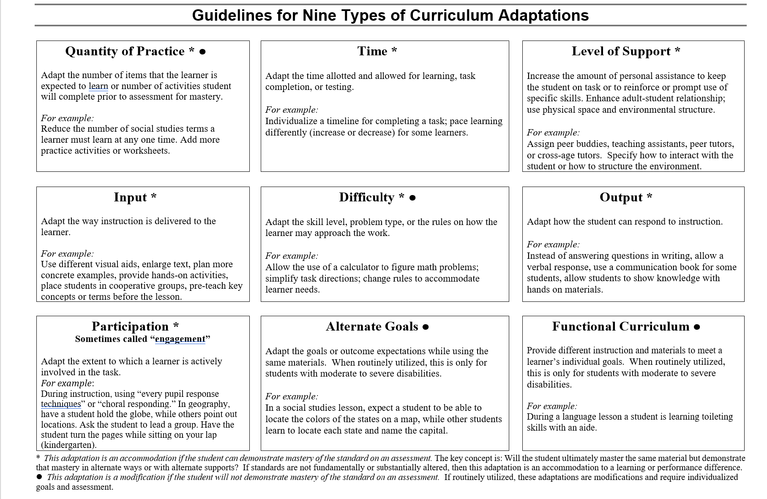
Substantially altered by Diana Browning Wright with permission from Jeff Sprague, Ph.D. from an original by DeSchenes, C., Ebeling, D., & Sprague, J. (1994). Adapting Curriculum & Instruction in Inclusive Classrooms: A Teachers Desk Reference. ISDDCSCI Publication. Diana Browning Wright, Teaching & Learning 2005

Slide 13
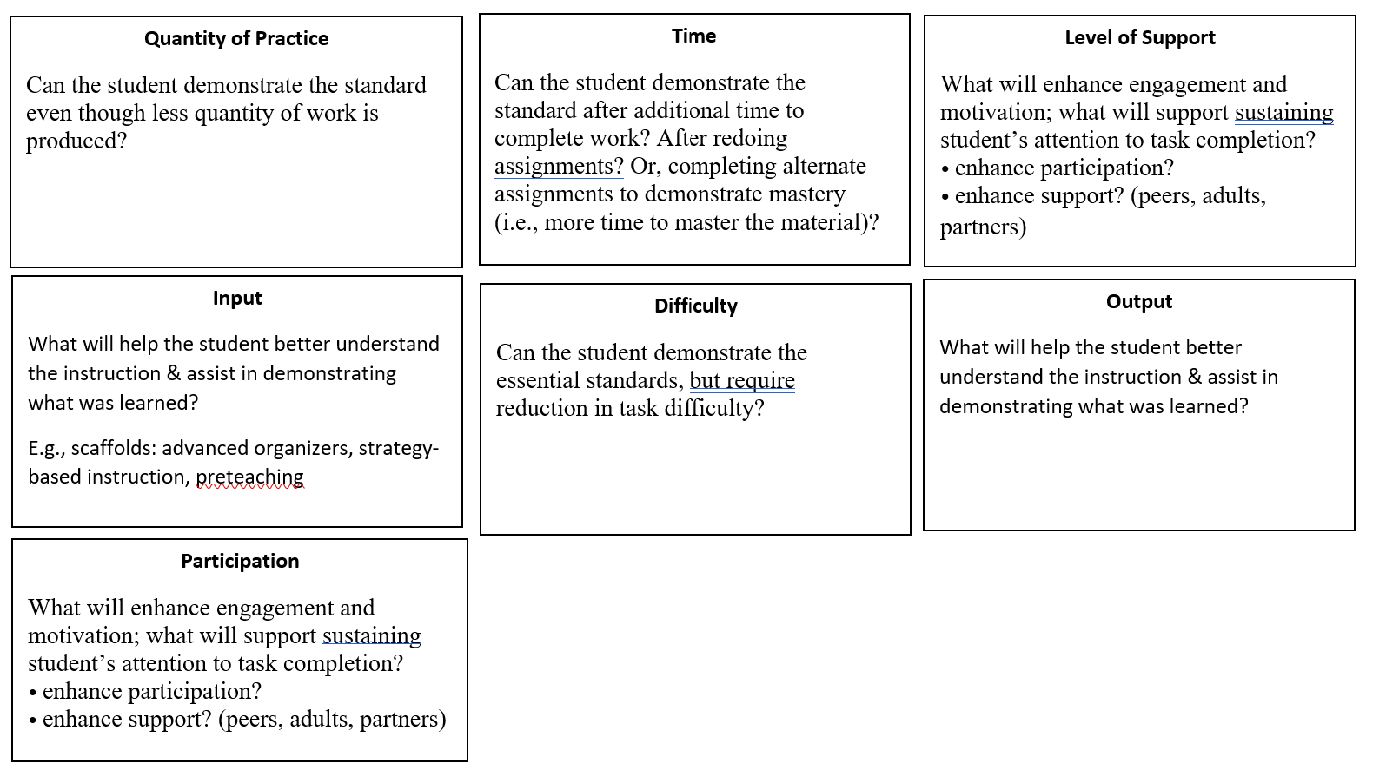
Nine Curriculum Adaptions Guiding Questions⁶

Slide 14
Learning Styles Theory Disclaimer
Learning Styles theories suggest people learn more effectively dependent on the way instruction is delivered (e.g., visually, auditorily, kinesthetically).
Concerns:
Many models (70+) and lacks randomized research designs to show mesh of learning styles & teaching styles ^{1,3}
Tends to classify people into fixed ways of thinking^{1,3}
Researchers from diverse specialties results in differences interpreting evidence & theories ¹
Doesn’t take into account culturally-based differences ⁴
Limited evidence suggests focusing on EBPs would be more cost-efficient, time-efficient, and more productive ^{1,3}

Slide 15
Accommodations and Assessment
Need based
Documented in formal plan (e.g., IEP, 504, RtI/MTSS, ELA, literacy plans, etc.)
Regularly monitored for effectiveness
Accommodations implemented typically must be used routinely during instruction

Slide 16
Common Learning Styles
Visual Better able to make sense of new information if visual cues used Views things through “mind’s eye” when trying to remember things | Auditory Better able to make sense new information through listening (aural) and speaking (verbal)
Kinesthetic Better able to make sense of new information through tactual representations Experience knowledge through actions either by “doing” or getting personally involved with the learning process. | Read/Write Tend to learn best through words Able to translate abstract concepts into words and essays Drawn to expression through writing, reading, and internet searches

Slide 17
Common Strategies for Visual Learners
Use visual aids & display key concepts (charts, tables, diagrams)
Allow to draw pictures or diagram; use graphic organizers
Provide visual analogies and metaphors to help with visual imagery. Encourage visualization by using phrases such as, "Picture this“
Color code by highlighting to emphasize key points in text.
Have student write out detailed explanations when learning information presented in diagrams or illustrations
Studying: Make flashcards of important vocab/concepts. Highlight key points. Limit amount of information per card so the mind can take a mental "picture" of the information.

Slide 18
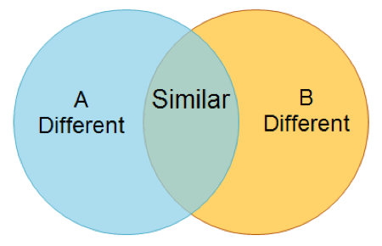
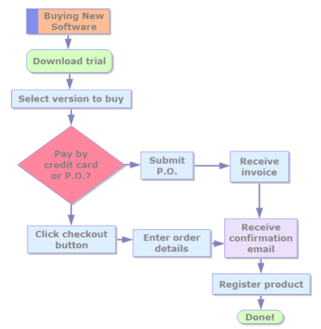
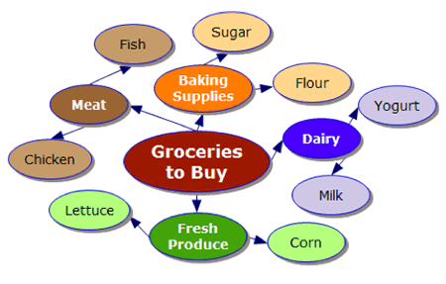
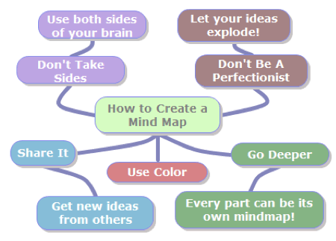
Graphic Organizers. A Visual Thinking Tool
Presents information through several modalities (text & visuals)
Graphic organizers are helpful because they:
- breaks down complex information into smaller bits. Easier to digest.
- organizes thoughts & helps with planning
- demonstrates relationships & connects to prior knowledge
Venn Diagrams–
Comparisons & similarities
Flow Chart – Clarifies steps needed for process
Concept Map – Brainstorm & planning
Mind Map – Shows associated topics related to main idea
Images retrieved from ldaamerica.org

Slide 19
Signs of Visual Processing Difficulties
Difficulty storing & recalling visual information.
Turns head to read; holds paper at odd angles; closes one eye while working
Reversal/inversion/transposing of letters/#s (not developmental)
Difficulty understanding pictures
Struggles to cut or paste
When writing: misaligns letters; letters collide; irregular spacing; letters not on line; many erasures; forms letters poorly; slow & laborious handwriting
When reading: Loses place, skips lines, rereads lines, omits words

Slide 20
Strategies for Visual Processing Difficulty
Reduce work quantity when visual processing skills are involved or allow more time to complete tasks
Have student visualize steps before carrying them out
Repeat and explain visual assignments to ensure what was visualized was correctly processed
Supplement visual tasks with verbal cues when possible
Use concrete materials to assist comprehension of new concepts
Change assignments so there aren’t as many close visual activities

Slide 21
Common Strategies for Auditory Learners
Reread notes/assignments out loud; explain notes & assignments to peers
During lectures, have students repeat back new concepts & ask them questions to ensure comprehension
Encourage conversations to reinforce new concepts
Reinforce learning with videos or audiotapes
Show or provide lists of key words
Studying: reread & rewrite notes; listen to recorded notes; use acronyms or mnemonic strategies

Slide 22
Signs of Auditory Processing Difficulties
Difficulty understanding or misinterpreting verbal information
Confused by figurative language; literal interpretation
Difficulty remembering & following spoken multiple-step directions
May process thoughts & ideas slowly & have difficulty explaining
Difficulty finding the right words to use when speaking
Poor receptive/expressive vocabulary
Relies heavily on picture clues or written directions

Slide 23
Strategies for Auditory Processing Difficulties
Reduce work quantity or give more time to complete tasks.
Give directions in time-ordered sequence with words to make sequence clear. E.g., first, next, …
Supplement verbal directions with visual cues. Display key concepts
Summarize & restate using simpler, more concrete terms. Ensure comprehension before work begins
Preferential seating away from auditory distractions (e.g., noisy peers, AC)
Seat next to peer able to help with verbal directions and instructions
Have student recite, restate, and summarize key information and ideas to self
Have student explain and talk about what they are learning

Slide 24
Common Strategies for Kinesthetic Learners
Hands on activities with physically active learning
Class demonstrations and field work outside of the classroom
Incorporate movement (e.g., pace when studying) or have student act out events
Frequent breaks to account for difficulty staying still
Redo lab experiments or projects
Use pictures that illustrate ideas
Use real life examples studies to better explain abstract concepts

Slide 25
Common Learning Styles – Read/Write
Allow time to process information read as well as when writing information down
Reword main ideas & principles for deeper understanding
Organize diagrams, charts, graphic organizers into statements
Studying: write & rewrite words & notes

Slide 26
Other Common Learning Differences
Memory (visual/auditory short-term, working, long-term, sequential, rote)
Attention (selective, sustained, shifting, divided)
Expression

Slide 27
Memory Subtypes and Signs of Difficulty
1. Short-term memory (visual/auditory)- storing & retaining information for a limited time. Needed it in math as you proceed through each step
2. Working Memory- hold several facts in memory temporarily while solving a problem or performing a task. E.g., read each word until the end of a paragraph & then understand full content
3. Long-term memory: retrieve information of things learned in the past. Information retained by reviewing over time becomes part of knowledge.
4. Sequential memory: recall stimuli in order of presentation. Effect’s ability to read & spell because one must perceive letters in sequence & remember the word represented by that sequence of letters.
5. Rote memory: ability to learn certain information as automatic response such as the multiplication tables, spelling rules, etc.

Slide 28
Strategies for Memory Difficulties
Don’t penalize spelling, just correct
Strengthen note-taking skills
Provide visual & auditory cues to guide to relevant features. E.g., when lecturing, provide visual cues (overviews, written lecture outlines) to assist attending to key points or teaching how to listen & look for behaviors that signal important information (i.e., raised voice, repetition)
Organize information to make it easier to recall from long-term memory (i.e., word webs to link key information about a concept studied in class).
Graphic organizers. Cluster ideas & words that go together to help make related ideas more meaningful & easier to retrieve.
Seat next to another who is able to help with multiple step directions.

Slide 29

Mnemonic Strategies, A Memory Tool
Keywords- links word to remember with something familiar. The linkage is the part of the word (initial sound/rhyming element) similar to the key word.
Rhymes: 30 days past September…
Others: imagery, chunking, songs
Acronyms & Acrostics: “Every Good Boy Does Fine” for order of piano keys or “Because Elephants Can Always Understand Small Elephants” to remember the spelling of the word “because”.
https://www.linguasorb.com/blog/vocabulary-mnemonics

Slide 30
Attention Subtypes and Signs of Difficulty
1. Focused/Selective Attention – Distractible; Inattentive to details; Makes careless mistakes; Forgetful & disorganized; Tends to be messy or lose things
2. Sustained Attention - Difficulty recalling information & following through on instructions; Difficulty paying attention for a long periods; Mind appears to go blank; Seems to lose place in tasks; Incomplete assignments, chores, work
3. Shifting Attention - Difficulty stopping 1 activity & starting another; Gets stuck (e.g., video games); Difficulty performing tasks when situation changes
4. Divided Attention - Difficulty attending to more than 1 thing at a time; Easily absorbed into one task; Over-focuses on certain stimuli to the exclusion of other relevant information
5. Attentional Capacity - Avoids activities that require a lot of mental effort or have too many details; Seems to get overwhelmed with difficult tasks.

Slide 31
Strategies for Attentional Difficulties
Calendar weekly, use a daily checklist, & provide written instructions to refer to (!)
Shorten tasks, build in breaks, & establish periodic checks for long-term projects (!)
Reduce distractions
Ensure pre-writing strategies (brainstorming mapping) & proofing/editing
Use a peer to redirect or guide the student in difficult subject areas
Establish a signal for a reminder to refocus during listening periods.
Use color to highlight salient information to increase accuracy
Ensure tasks are developmentally appropriate or enough time is given to complete (!)
Provide brief, global instructions, instead of lengthy instructions.

Slide 32
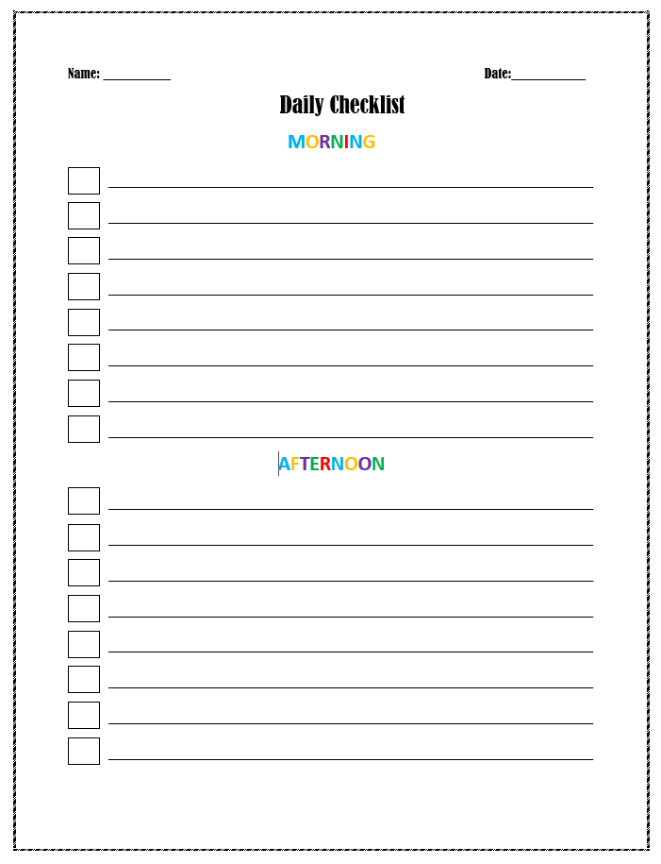
Created by Erin Briley, M.S., NCSP

Slide 33
Takeaways
Students benefit from learning via multiple types of presentation modalities
Teach style to content
Teach for understanding & connect new concepts to prior knowledge (compare, contrast, draw connections)
Build upon interests to increase motivation
Purpose of this training is not to advocate for grouping students by learning styles but rather to encourage multi-modal teaching styles & supplement instruction with accommodations to aid in conceptualization as appropriate

Slide 34
Resources
Blank Curriculum Adaptation/Accommodation Plans
http://www.pent.ca.gov/acc/accom_toc.html
Graphic Organizers
https://graphicorganizer.net/ (Graphic Organizer maker)
http://www.pent.ca.gov/acc/accom_toc.html
http://www.readwritethink.org/files/resources/printouts/persuasion%20map.pdf
Learning Style Quizzes
https://kids.lovetoknow.com/wiki/Learning_Style_Test_for_Children
https://kids.lovetoknow.com/wiki/Multiple_Intelligence_Test_for_Children

Slide 35
Bibliography
Coffield, F., Moseley, D., Hall, E., & Ecclestone, K. (2004). Learning styles and pedagogy in post-16 learning. A systematic and critical review. London: Learning and Skills Research Centre. Retrieved from https://www.researchgate.net/publication/232929341_Learning_styles_and_pedagogy_in_post_16_education_a_critical_and_systematic_review
Colorado Department of Education (September 2015). 2015-16 Colorado Instructional Accommodations Manual: A Guide to the Selection and Implementation of Accommodations for Students with a Disability. Retrieved from https://www.cde.state.co.us/cdesped/Accommodations
Pashler, H., McDaniel, M., Rohrer, D., & Bjork, R. (2008). Learning Styles: Concepts and Evidence. Psychological Science in the Public Interest, 9(3), 105–119. https://doi.org/10.1111/j.1539-6053.2009.01038.x
Smith, M. K. (2001, 2010). ‘David A. Kolb on experiential learning’, The encyclopedia of pedagogy and informal education. Retrieved from https://infed.org/mobi/david-a-kolb-on-experiential-learning/
Wright, Diana Browning (2005). Accommodations and Modifications: Differentiating Instruction and Promoting Staff Implementation in the Era of High Standards. Retrieved from http://www.pent.ca.gov/acc/accom_toc.html
Wright, Diana Browning (2003). Hierarchical Differentiated Supports/Accommodations/Modifications. Retrieved from http://www.pent.ca.gov/acc/hierarchicaldiffsupports.pdf

Slide 36

Stay Connected
mhttcnetwork.org/centers/mountain-plains-mhttc/home
@Mountain-Plains-MHTTC
@MPMHTTC
mhttcnetwork.org/centers/mountain-plains-mhttc/subscribe-our-mailing-list

