Slide 1


Farming and Faith Supports: Cultivating Spiritual Resilience in Challenging Times
Presented by:
Corey Smith, PhD
Sean Brotherson, PhD
Monica McConkey, LPC
Bishop William “Bill” Tesch

Slide 2
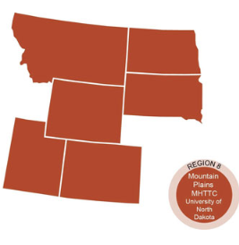
The Mountain Plains Mental Health Technology Transfer Center
Provides training and technical assistance on evidence based practices to the mental health providers of Region 8 (North Dakota, South Dakota, Montana, Wyoming, Colorado, and Utah). We are funded by the Substance Abuse and Mental Health Service Administration (SAMHSA)
Co-hosted by:
The University of North Dakota
and
The Western Interstate Commission for Higher Education (WICHE)

Slide 3
Disclaimer
This presentation was prepared for the Mountain Plains Mental Health Technology Transfer Center (TTC) Network under a cooperative agreement from the Substance Abuse and Mental Health Services Administration (SAMHSA). All material appearing in this presentation, except that taken directly from copyrighted sources, is in the public domain and may be reproduced or copied without permission from SAMHSA or the authors. Citation of the source is appreciated. Do not reproduce or distribute this presentation for a fee without specific, written authorization from the Mountain Plains Mental Health Technology Transfer Center. For more information on obtaining copies of this presentation, call 701-777-6367.
At the time of this presentation, Elinore F. McCance-Katz, served as SAMHSA Assistant Secretary. The opinions expressed herein are the views of Corey Smith, Sean Brotherson, Monica McConkey and William Tesch and do not reflect the official position of the Department of Health and Human Services (DHHS), SAMHSA. No official support or endorsement of DHHS, SAMHSA, for the opinions described in this Presentation is intended or should be inferred.

Slide 4
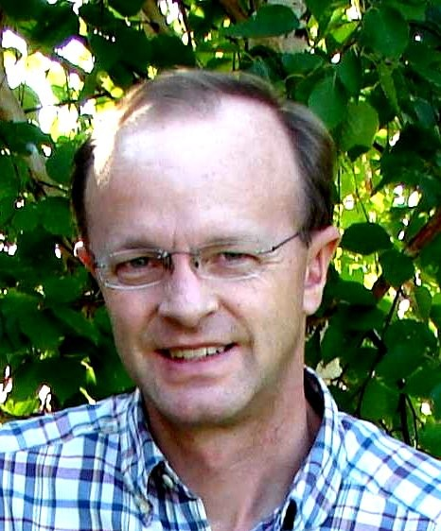
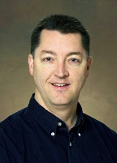

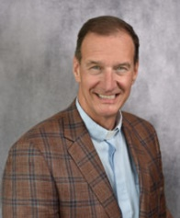
Today’s Panelists
Dr. Corey Smith, PhD
Assistant professor, University of North Dakota School of Medicine and Health Sciences.
Sean Brotherson, PhD
Professor and Extension Family Science Specialist, North Dakota State University
Monica McConkey, LPC
Rural Mental Health Specialist, Owner: Eyes on the Horizon Consulting
Bishop Bill Tesch
Bishop of the Northwestern Minnesota Synod of the Evangelical Lutheran Church in America
Notes:
Dr. Corey Smith is an associate professor at the University of North Dakota’s School of Medicine and Health Sciences. Dr. Smith’s teaching and research focuses on finding low-cost sustainable solutions to address health disparities for rural and medically underserved populations.
Dr. Sean Brotherson is a professor and extension family science specialist at North Dakota State University. Dr. Brotherson’s research and publications primarily focus on finding ways to effectively support rural farm families through effective stress management and increasing wellness.
Monica McConkey is a licensed professional counselor and has over 25 years of experience in the behavior health field as a counselor, program supervisor and administrator. Ms. McConkey grew up on a farm in Northwest Minnesota and currently works as one of two rural mental health specialists addressing the mental health needs of farmers in the state of Minnesota.
Bishop William “Bill” Tesch is currently serving as the Bishop of the Northwestern Minnesota Synod of the Evangelical Luther Church. Prior to his appointment as Bishop, Bishop Tesch has served as a spiritual leader in rural and urban communities in South Dakota and holds the rank of Colonel in the South Dakota Air National Guard.

Slide 5
Agenda
Introduction: Challenging Times for Agriculture
How Stress Affects Health
Impact of Farm Crisis on Population Health
Perspective of Public Health
Spirituality Integral to Health
Definition of Spirituality
What is Spiritual Resilience?
…

Slide 6
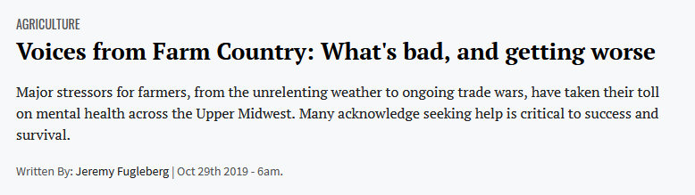

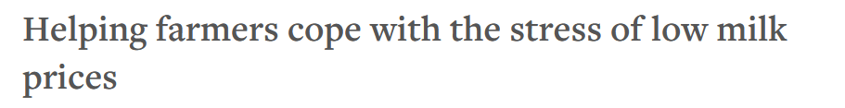

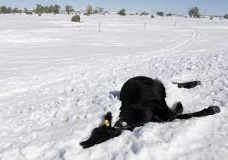
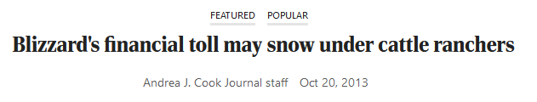
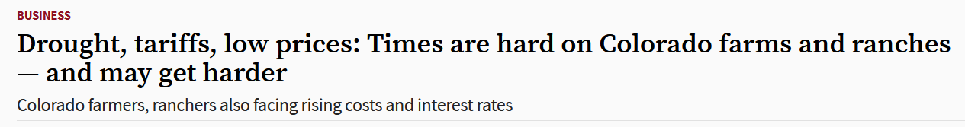
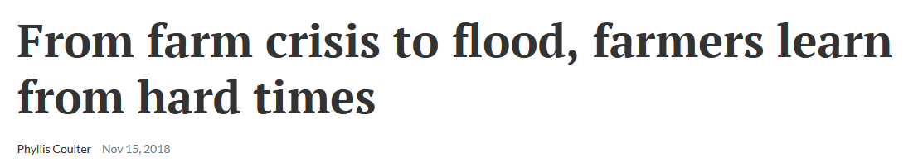
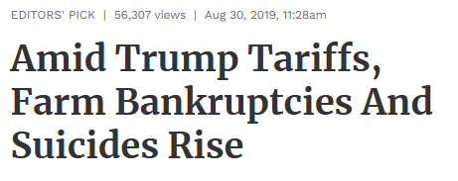
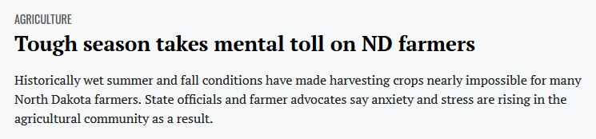
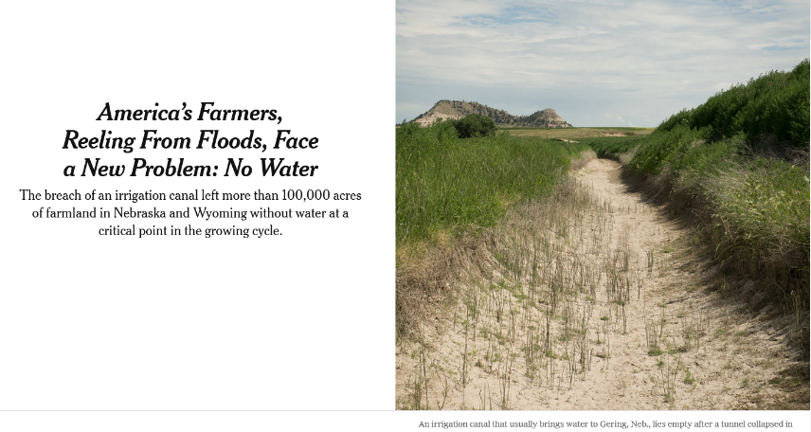
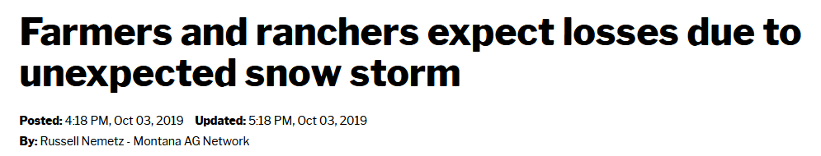
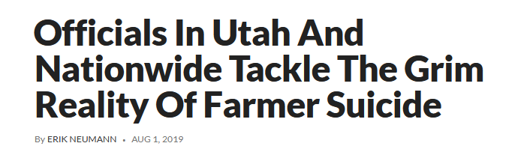


Challenging Times for Agriculture

Slide 7
Challenging Times for Agriculture
S-T-R-E-S-S

Slide 8
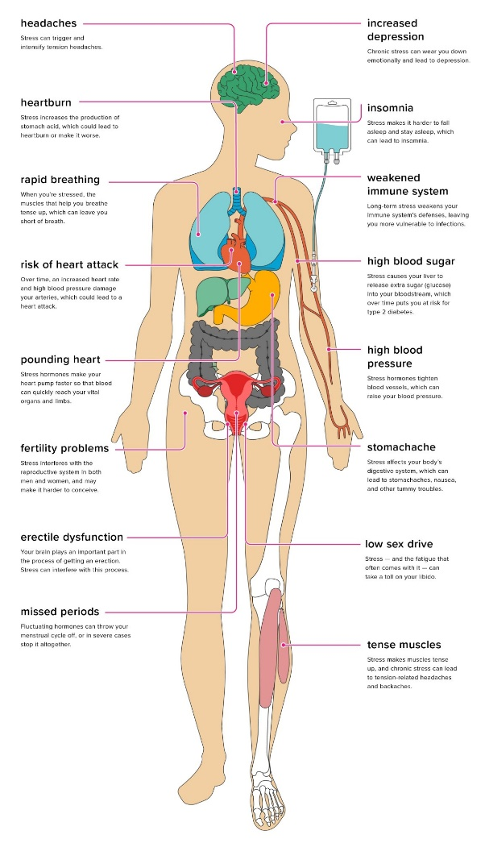
How Stress Affects Health
Subjectively experienced
Activates neuroendocrine systems which disrupt bodily homeostasis
Results in physical, mental, emotional, and spiritual manifestations
Increases risk for injury, disease, and death
Image courtesy of healthline.com

Slide 9
Impact of Farm Stress on Population Health
Physical Illness and symptoms
  Respiratory disorders (Hoppin et al, 2014)
  Chronic disease
Injuries
  100 US agricultural workers suffer lost worktime due to injury each day
  2017: 416 farmers and farm workers died from a work-related injury, resulting in a fatality rate of 20.4 deaths per 100,000 workers (Accessed on 1/30/20: https://www.cdc.gov/niosh/topics/aginjury/default.html)
Mental health
  Depressive symptoms in agricultural workers (Range: 9.8 – 24%) (Onwuameze et al., 2013; Scarth et al., 2000)
Suicide
  2016: 43.2 per 100,000 among male farmers, ranchers, and other agricultural managers vs. 27.4 per 100,000 for males across all occupations (Peterson et al., 2020)

Slide 10
What is Public Health?
“…an organized community effort to address the public interest in health by applying scientific and technical knowledge to prevent disease and promote health.”
Source: Institute of Medicine, 1988

Slide 11
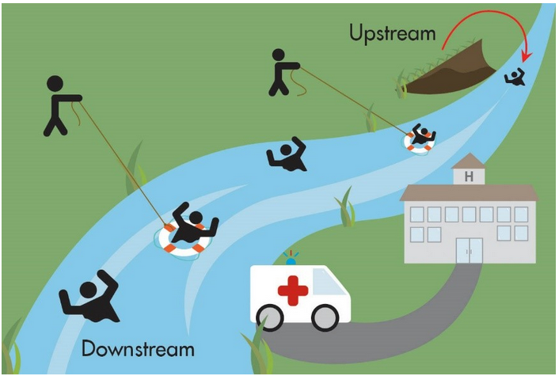
A Public Health Parable
Many upstream challenges
Ineffectiveness of downstream actions
Spiritual practice as an upstream response
Source: https://hqc.sk.ca/news-and-events/hqc-blog/what-makes-us-healthy-exploring-the-determinants-of-health-in-saskatchewan

Slide 12
Spirituality Integral to Health
Physical health (Caudill et al., 1987; Highfield, 1992; Levin, 1994; Levin & Vanderpool, 1989,1991; Nichols & Hunt, 2011)
Mental health (Bergin et al., 1987; Brown et al., 2007; Chamberlain & Zika, 1992; Hackney & Sanders, 2003; Levin & Chatters, 1998; Masters & Bergin, 1992; Payne et al., 1991;Swinton, 2001 )
Recovery from addiction (Alexander, 1994; Brown et al., 1988; Carroll, 1993; Emrick et al., 1993; Gelderloos et al., 1991; Waisberg & Porter, 1994)
Life satisfaction and well-being (Chamberlain & Zika, 1992; Ellison et al., 1989; Ellison, 1991; Emmons et al., 1998; Emmons, 1999; Hackney & Sanders, 2003; Moreira-Almeida et al, 2006; Poloma & Pendleton, 1989, 1991; Witter et al., 1985)
Spiritual
Occupational
Intellectual
Emotional
Physical
Social
Environmental

Slide 13
A Definition of Spirituality
Offers connection through relationship with…
  … a Higher Power or force beyond ourselves
  … people and the world around us
Anchored in set of beliefs, values and commitments
Expressed through rituals or spiritual practices
Enables us to derive meaning and purpose for our lives

Slide 14
What do we mean by Spiritual Resilience?
…the capacity to adhere to a set of core personal values that reflect beliefs in the sacred, or, what gives ultimate meaning and purpose in life.
Adapted from: Yeung & Martin, 2013

Slide 15

Farming and Faith Supports: Cultivating Spiritual Resilience in Challenging Times
Sean Brotherson, NDSU Extension
February 3, 2020

Slide 16
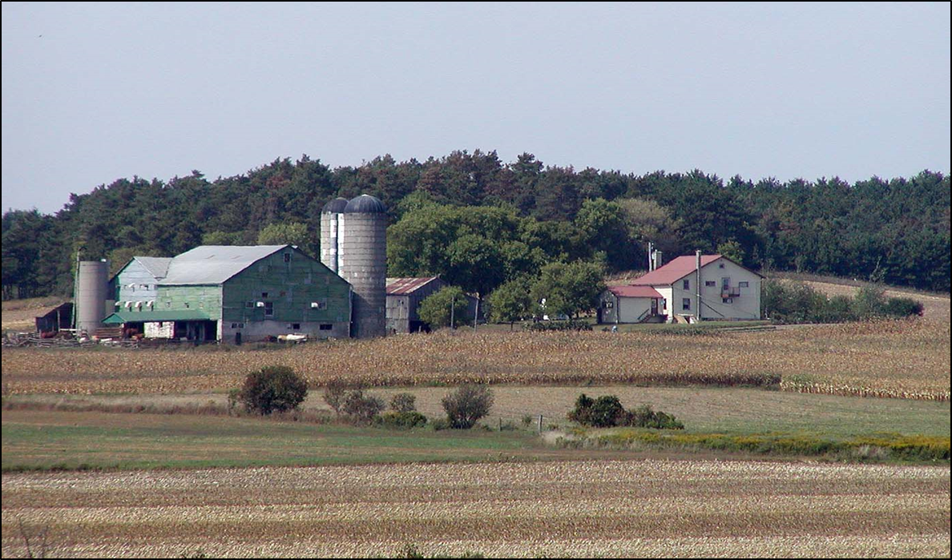
Farming – A Stressful Occupation

Slide 17
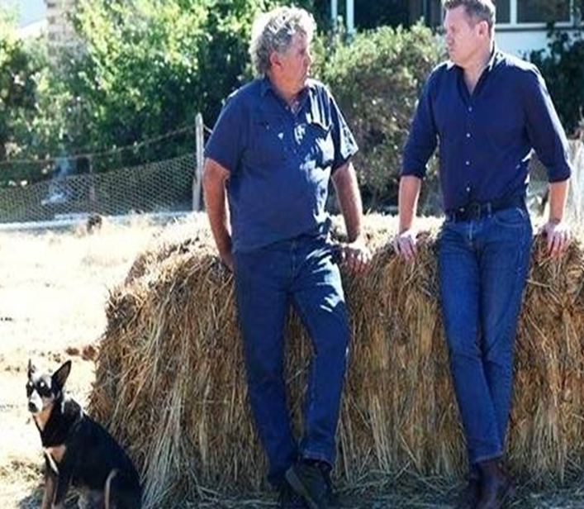
Unique Farm/Ranch Stresses
Commodity prices – drop by 1/3
Weather – moisture; drought
Finances – operating loans, etc.
Family and Relationships – strain
Succession planning . . .
A Storm of Stress!
Notes:
What are those factors that

Slide 18
Key Sources of Rural Stress
Net farm/ranch income decline
Debt/asset ratio – meeting debt payments
Cash flow on the operation
Arranging financing
Complicated or strained decision making when under stress
Ability to meet family living expenses
Long hours, two or three jobs, balancing work and family
Sense of inadequacy due to economic difficulties
Facing the challenge of having to leave the farm (generational legacy)
Notes:
What are those factors that

Slide 19

Why is Rural Stress
Hard on Individuals?
Individual levels of stress are linked to how a person perceives the source of stress – their orientation to the stressor.
Many persons see it not as a change of job, but as a loss of self.
Many practice the 11th Commandment orientation – “Thou shalt farm!” (has been called the “agrarian imperative”)
Notes:
What are those factors that

Slide 20
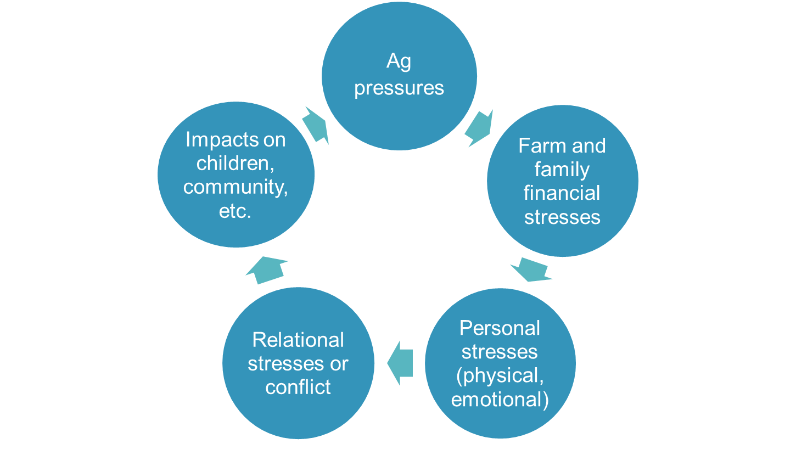
A Model of Rural Stress Impacts

Slide 21
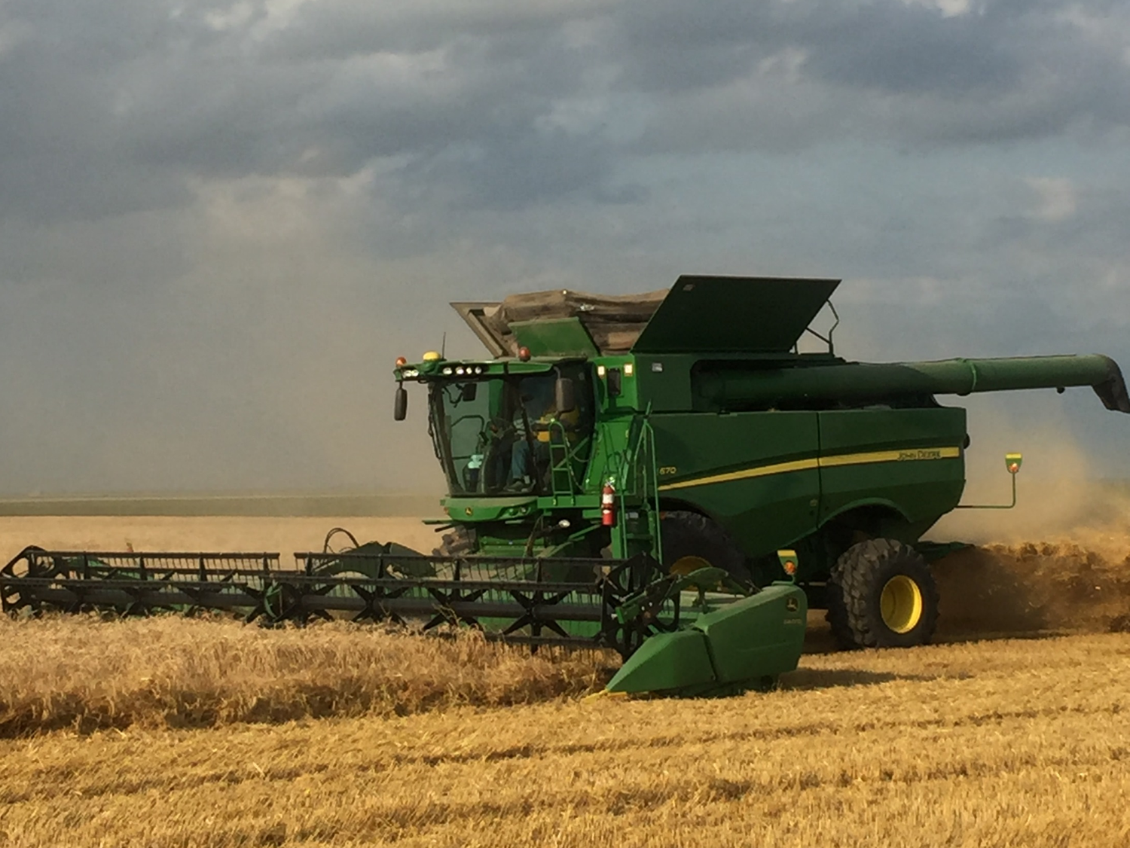
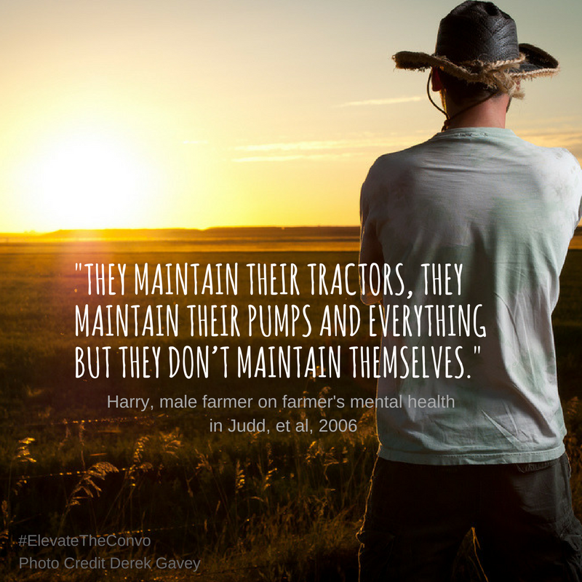
Which Matters More?
Tractor vs. Farmer Maintenance
Notes:
What are those factors that

Slide 22
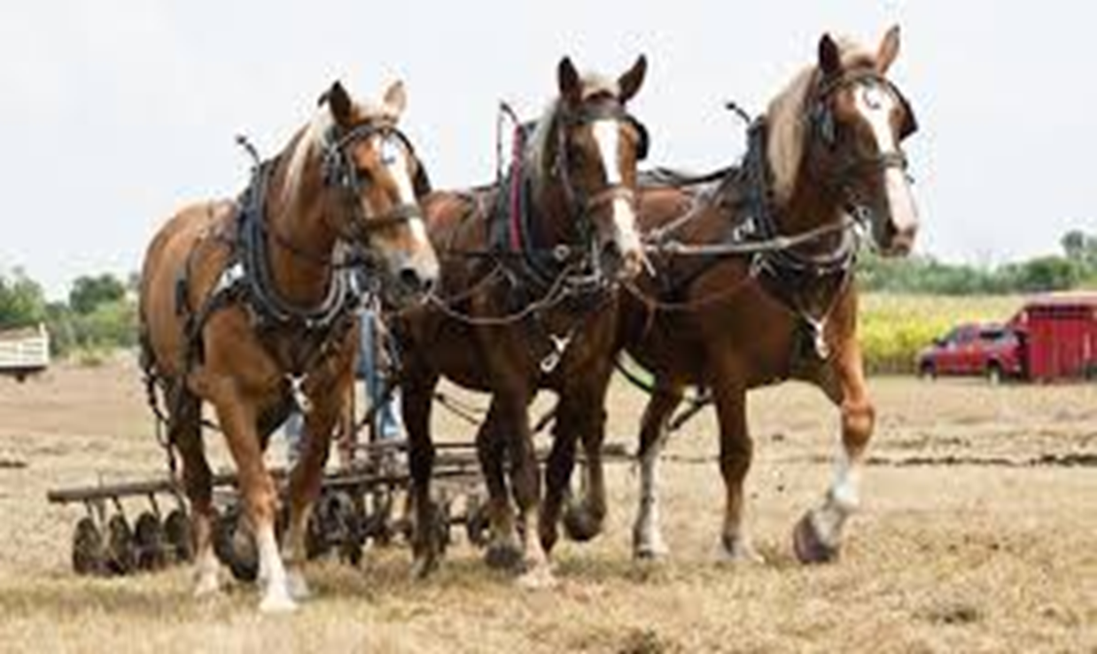
Health as a Key Asset
Health is your most important asset as a farmer, rancher or agricultural worker.
Then – farmer and farmworker health and safety is the most important priority in managing any farm or ranch operation.
Good health management is good farm management – reduce stress, improve wellness.
Notes:
What are those factors that

Slide 23
Rural Stress and Help-Seeking
Notes:
What are those factors that

Slide 24
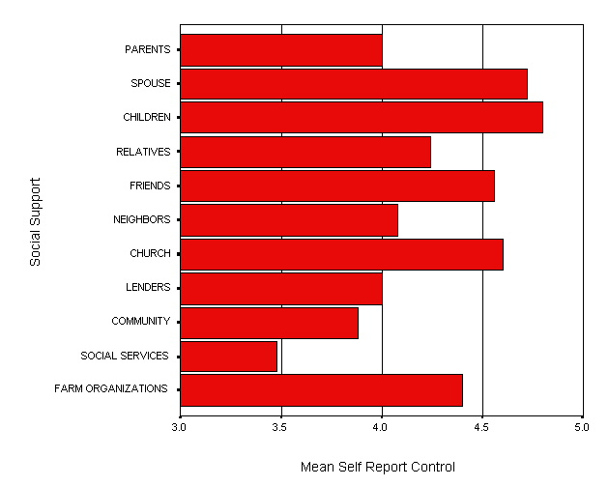
Farm Stress and Social Support
[Insert quotes from news stories]
Notes:
What are those factors that

Slide 25

Case Study #1 –
The “Bootstraps” Campaign
Small, simple, easy resources needed
“Bootstraps” wallet insert created
“You don’t have to go it alone.”
Where to get help – resource listing
Partnership – Lutheran Social Services, ND Farmers Union, NDSU Extension
50,000 copies printed, distribution ongoing
Notes:
What are those factors that

Slide 26
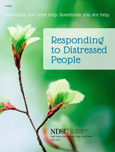
Case Study #2 –
Farm and Faith Coalition
Record moisture stress in upper Midwest farm county
Farm and Faith Coalition meeting – diverse groups – Fall 2019
Day of Prayer and Fasting – statewide in Latter-day Saint faith community
Sharing of resources
Notes:
What are those factors that

Slide 27

Faith as a Protective Factor
Protective factors are conditions or attributes in individuals, families, communities, or the larger society that mitigate or eliminate risk in families and communities, thereby increasing the health and well-being of children and families. - US Dept of Health and Human Services
Protective factors are personal or environmental characteristics that help protect people from suicide.
  Cultural, religious, or personal beliefs that discourage suicide – Suicide Prevention Resource Center
This Photo by Unknown Author is licensed under CC BY-NC-ND

Slide 28

Community Collaboration from a Mental Health Perspective
Multi-Agency
Diverse
Recognized
Shared

Slide 29

Rural Churches as Centers of Spiritual Resiliency
Accompanying People Experiencing Farm Related Stress

Slide 30
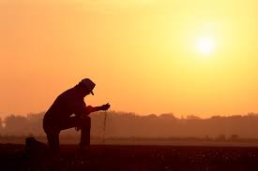
Spiritual Issues
Powerlessness
Loss of Purpose
Shame / Guilt
Isolation
Hopelessness / Despair

Slide 31
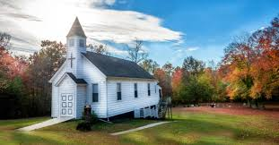
Spiritual Resiliency Resources
Faith Practice and Mental Health
Communities Overcoming Isolation
Empowerment through small acts of kindness
Pastoral Ministry and Confidentiality
Affirmation of a deeper purpose

