Slide 1
Riding the Wave of Stress, Trauma, & Grief to Enhance Self-Care
Presented by:
Dr. Tami De Coteau, PhD
Licensed Clinical Psychologist
DeCoteau Trauma-Informed Care & Practice, PLLC
www.decoteaupsychology.com
Notes:
David

Slide 2
Disclaimer and Funding Statement
This presentation was prepared for the Mountain Plains Mental health Technology Transfer Center (Mountain Plains MHTTC) under a cooperative agreement from the Substance Abuse and Mental Health Services Administration (SAMHSA). All materials appearing in this presentation, except that taken directly from copyrighted sources, are in the public domain and may be reproduced or copied without permission from SAMHSA or the authors. Citation of the source is appreciated. Do not reproduce or distribute this presentation for a fee without specific, written authorization from the Mountain Plains Mental Health Technology Transfer Center. For more information on obtaining copies of this presentation or the Strengthening Resilience: Promoting Positive Mental Health Among Indigenous Youth toolkit please email David Terry at david.v.terry@und.edu
At the time of this presentation, Meena Vythilingam served as SAMHSA Acting Assistant Secretary. The opinions expressed herein are the views of Tami De Coteau and do not reflect the official position of the Department of Health and Human Services (DHHS), or SAMHSA. No official support or endorsement of DHHS, SAMHSA, for the opinions described in this presentation is intended or should be inferred.
The work of the Mountain Plains MHTTC is supported by grant H79SM081792 from the Department of Health and Human Services, Substance Abuse and Mental Health Services Administration.
Notes:
David

Slide 3

The Mountain Plains Mental Health Technology Transfer Center
The Mountain Plains Mental Health Technology Transfer Center (Mountain Plains MHTTC) provides training and technical assistance to individuals who serve persons with mental health concerns throughout Region 8 (Colorado, Montana, North Dakota, South Dakota, Utah and Wyoming).
We belong to the Technology Transfer Center (TTC) Network, a national network of training and technical assistance centers serving the needs of mental health, substance use and prevention providers. The work of the TTC Network is under a cooperative agreement by the Substance Abuse and Mental Health Service Administration (SAMHSA).
Notes:
David
The MHTTC has $1,435,000 in funding for fiscal year 3 to include a main mental health grant, school supplement, and well-being for provider supplement.
will cover to here

Slide 4
Notes:
David

Slide 5
Riding the Wave of Stress, Trauma, & Grief to Enhance Self-Care
Presented by:
Dr. Tami De Coteau, PhD
Licensed Clinical Psychologist
DeCoteau Trauma-Informed Care & Practice, PLLC
www.decoteaupsychology.com
Notes:
David

Slide 6
The current combination of stress (work) + threat (COVID19) + reduced support (public) + lack of control & predictability (constantly changing environment/information) create the “Perfect Storm” for stress and illness.

Slide 7
Stress and Trauma
Working with people in crisis causes ongoing exposure to stress and traumatic stress
Reactions to stress and trauma are normal
They must be addressed regularly
Failure to address them as a part of our work can cause secondary trauma

Slide 8
Emotional Exhaustion, Compassion Fatigue & Burnout
Emotional Exhaustion: Chronic state of physical and emotional depletion that results from excessive demands and continuous stress.
Compassion Fatigue: Gradual lessening of compassion over time.
Burnout: Long term exhaustion and diminished interest in work. Feeling overwhelmed by chronicity and complexity of problems in a working environment
“Life-management” problems that do not represent a “disorder”
Notes:
EE – a feeling of being emotionally overextended and exhausted from one’s work. It is manifested by both physical fatigue and a sense of feeling emotionally drained.

Slide 9
What is Secondary Traumatic Exposure?
Exposure to traumatic material when working with traumatized individuals
Exposures range from a single episode to frequent and high intensity
Traumatic situations are not a direct threat to helpers themselves
Exposure is common among:
  Trauma counselor
  Rescue workers
  Humanitarian/crisis intervention workers

Slide 10
Grief: A natural and normal reaction to
loss and change. It affects ALL aspects of our selves: the physical, emotional, psychological, behavioral, and spiritual aspects.

Slide 11
When does grief occur?
It occurs when something or someone which we have been dependent upon is no longer present; the loss of something/someone we care about.
*death of a loved one *divorce *separation, *moving
*losing a job *physical disability

Slide 12
For whom do people grieve? We mostly grieve for ourselves.
Perhaps an important cultural difference for Native Americans is our tendency to grief for others; community; ancestors;
mother earth, etc.

Slide 13
What Does Stress Look & Feel Like?
  Withdrawal
  Exhaustion
  Loss of empathy or compassion
  Substance use
  Sleep problems
  Relationship problems
  Difficulty with memory or concentration
  Irritable/angry mood
  Changes in diet or appetite
  Feeling keyed up or on edge, restless
  Sad, depressed or anxious
  Dissatisfaction with job
  Resistance to change
  Defensiveness
  Reduction in work performance
  Addictions – drugs, alcohol, gambling, sex, porn, risk-seeking behavior, etc.
Notes:
Feelings don’t just happen in the brain. Not something we just thing. But the brain is connected to the body and sends messages back and forth.

Slide 14
PHYSICAL
EMOTIONAL
PHYSIOLOGICAL
• headaches
• dizziness
• exhaustion
• muscular aches
• loss of appetite
• insomnia
• anger
• sadness
• anxiety
• sense of helplessness
• shock
• numbness
• yearning
• relief
• guilt
• sense of depersonalization
• lack of concentration
• search for the meaning of life or death
• dreams of the deceased
• preoccupation with thoughts of the deceased

Slide 15
BEHAVIORAL
SPIRITUAL
Because grief is such a unique reaction, the intensity, pattern, time frames and resolution will vary for every individual.
• crying
• change of relationships
• avoiding reminders
• carrying reminders
• withdrawal
• over-activity
• moodiness
• apathy
• embracing one’s faith
• questioning one’s faith
• reliance upon God
• anger toward God
• coming to grips with one’s own mortality
• searching for the meaning of life

Slide 16
So often a person is overwhelmed with the sense that they are "losing it" or going crazy. Being able to define the “waves” of grief can help give someone the "permission" he or she needs to feel what they're feeling.

Slide 17
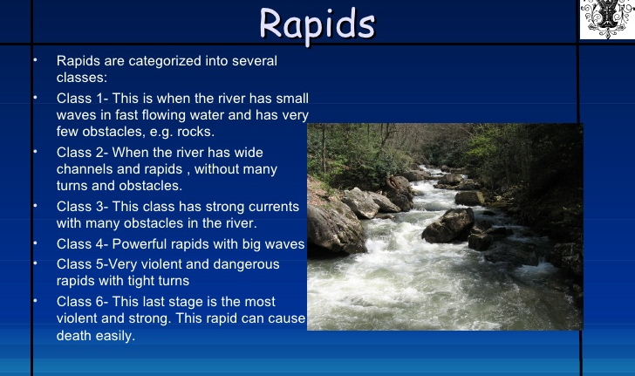

Slide 18
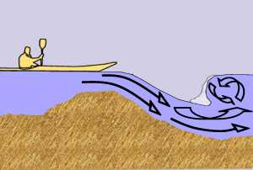
Don’t get stuck in a HOLE!
“relax” thru the rapids

Slide 19
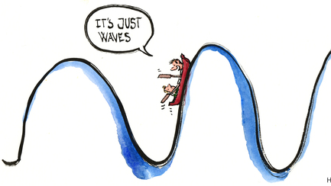

Slide 20
Coping in a Nutshell
Support Your Body:
  Sleep – 9 to 10 hours of uninterrupted sleep each night. Follow a sleep routine. Shut off the electronics!
  Food – Nourish your body with healthy foods. Avoid junk food and energy drinks.
  Water – hydration improves sleep quality and attention!
  Exercise – Move your body every day for 30 minutes.
    Lift something heavy
    Use weighted items
Support Yourself:
  Connection – Spend time with people who care about you.
  Ask for help – Ever body needs help sometimes.
  Talk to a professional – Talk to a counselor if your symptoms are messing up your life or bothering you quite a bit.

Slide 21
Dealing Effectively With Stress
    Nutrition
    Hydration
    Sleep
    Routine medical checkups and screening
    Take necessary medications/vitamins daily
    Daily movement and stretching
    Reduce intake of processed food, soda, alcohol and caffeine
    Debrief with co-workers. Have a place to share frustrations and receive support from people who understand.
    Participate in hobbies and fun activities with family and friends
    Socialize outside of work
    Practice mindfulness, meditation, (prayer, yoga, fishing, ceremony, nature)
    Imagine washing off or dumping all the stress from each day and replace it with positive thoughts and feelings.
    Set boundaries and take time off when you need it
    Think long term – the meaning and purpose of law enforcement work
    Try to reduce stress in other areas, and don’t take on new stress (minimize)
    Recognize that stress and stress responses are normal
    Know when to get help

Slide 22
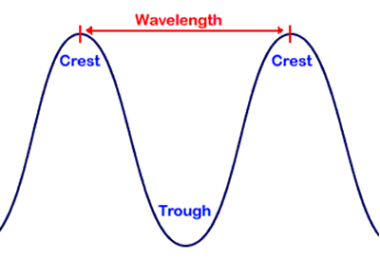
Let your waves come and go
“Trust the process”

Slide 23
1. Identify Wave Intensity
(Class 1-6)
2. List emotions inside the wave
3. Identify restorative activity between waves

Slide 24

Notes:
Thomasine

Slide 25
Thank you for joining!
Notes:
David

