Slide 1
Developing and Supporting Boundaries You Need
Sarri Gilman, LMFT
Sarrigilman.com

Slide 2
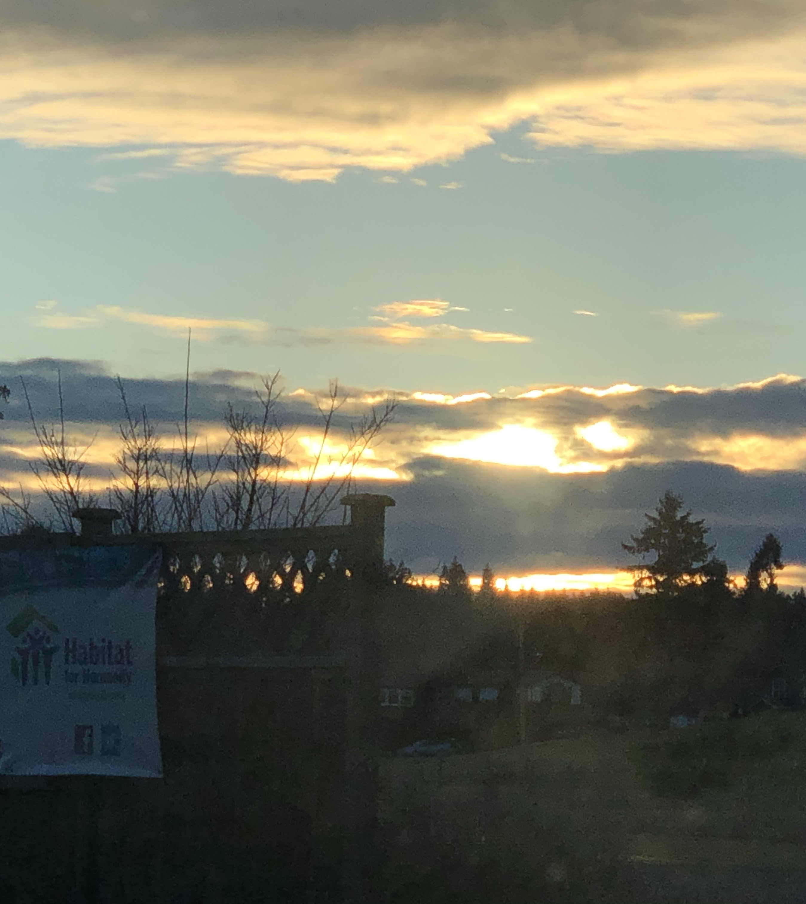
Developing boundary expertise
Takes time and being
Intentional.
You grow these skills.
It is an awareness practice.
I am going to cover a lot today and
If you want to dive deep into
Boundary Recovery,
I have a deep online course. 20% off code TEXAS
Sarrigilman.com
I also teach therapists how to help
people grow these skills. Email me if
are interested in a deep training.
Sarri@sarrigilman.com

Slide 3
What are boundaries?

Slide 4
Developmental Steps for Understanding Boundaries
Self-Care + 7 patterns
Emotions
Relationships
Extreme Boundary Challenges

Slide 5
Signals from Your Compass
What happens when you don’t listen to your Yes and No?
Symptoms You May Experience:
Not Sleeping
Running Away
Drinking
High-Risk Behavior
Depression/Anxiety (not always about your Yes and No, but it can be)
List some symptoms you get when you ignore your Yes and No.

Slide 6
Always consequences with Yes and NO
Easiest way to make a decision.

Slide 7
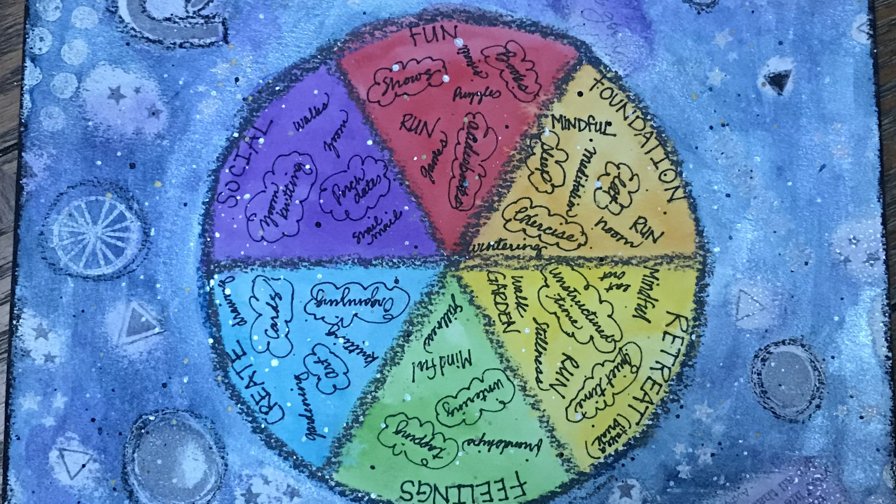
In this series, I’ve talked about self-care and it is the foundation of boundary growth.

Slide 8
What are the Seven Patterns?
As we grow up with input, we adopt a pattern

Slide 9
Emotional Minefields
Use the chart below to describe a situation when saying Yes or No was emotional and hard for you.
Four ways you can get stuck by an emotion: Complete these sentences using your situation from the chart.
I can’t____________________________________________ __________________________________________________
I feel guilty about_________________________________ __________________________________________________ I should___________________________________________ __________________________________________________
I am afraid________________________________________ __________________________________________________ .

Slide 10
Emotional Cyclone
You are not crazy. Setting boundaries can be very emotional.
Your feelings, as well as other people’s feelings, can make setting boundaries difficult.
Anger
Rage
Disappointment
Frustration
Resentment
Grief
Yes and No are not emotions.
Boundaries are not emotions.
Emotions will not guide you through the cyclone.
Yes and No are the guidance.

Slide 11
Other people…
Do not maintain your boundary.
Show you how strong your boundary needs to be.
Will try to manipulate your boundary.
Are Boundaries Part of Your Job?
Are boundaries an issue for your clients? If so, how?
How can you remind and encourage people that it is ok to have boundaries?
Do boundaries at your work tend to be clear, or are they unclear or undefined? What factors influence your answer?
When boundaries are being pushed at work, do you feel free to talk about the boundary? Is that conversation accepted at work? Is it encouraged?
Is boundary assistance available for you when you need it? What would that be?
Do you give boundary assistance to others at work? If so, how? If not, what impedes your ability to provide that support?

Slide 12
Extreme Boundary Challenges
Six Extreme Challenges
Trauma and stress
People struggling in addiction
People with mental health distortions
Health conditions
Wealth and power
Authority
Death/loss *
Most people recognize that they have one or more extreme boundary challenges. Which ones are you experiencing now or in recent years?
An extreme boundary challenger is someone who may push boundaries all the time. Who in your life is an extreme boundary challenger?

Slide 13
Steps for Extreme Challenges
Be aware of yourself and what you need.
Know your Yes and No; be aware of your boundaries.
Take care of your feelings.
Define your responsibilities. (Challengers dump responsibilities onto others.) Be very clear about your financial responsibilities.
Define your time boundary.
Protect access to yourself.
Draw a spider here:
Be a spider when you are in an extreme challenge.
Create a web of other resources.
Know, and stick to, your limits.
Anticipate that your limits will be pushed.

Slide 14
How do you grow boundary expertise Speak your truth
Get used to speaking truthfully about what is true for you
This is not about laying judgements on other people - it’s not about “them” it is about knowing what is true for you

Slide 15
Create clear contracts with everyone
Unclear
Clear
You feel taken advantage of
You don’t remember agreeing to what is happening
You “thought” the other person would do something a certain way and they didn’t
You feel stuck
Things are in writing
You know what you are paying or getting paid and when
You respond and people know what to expect in terms of response
Notes:
Create clear contracts with people. (glasses contract)This is how you build trust. I am known as a the boundary queen or boundary badass because I am incredibly clear with people about what our deal is. And I am accountable to my end of the deal.. I bring clarity to every person I do business with. I don’t wait for that to come from others. I initiate clarity.
Share stories. Explain how to recognzie things are unclear and move to clarity.

Slide 16
Boundary experts want to know and respect the boundaries of other people.
Ask other people what works for them as well
Notice the expectations or judgements you hear in your head about other people and their boundaries
Try to find what wins for you as well
Notes:
You want to know how other people move. Next slide carpet laying story at xmas

Slide 17
Experts can navigate very tricky situations where the boundaries are messy.
People and situations can be really messy. If it is safe, talk it through with someone in confidence. (not always possible)
Be very clear about your boundaries in messy situations
There is history, power issues, gossip, over-stepping
High drama situations
Notice if you are getting pulled into a riptide
Notes:
Recognize or predict that this is messy or high drama, or tricky. Then figuring out what boundaries you need to take care of you in the situiation. A few years ago I was working with a team that was dealing with a mess- it wasn’t a mess for me because I maintain my boundaries and I clearly point them out. I also don’t allow people to pull me in. We are dive in deep on this on our Boundaries and relationship next time.

Slide 18
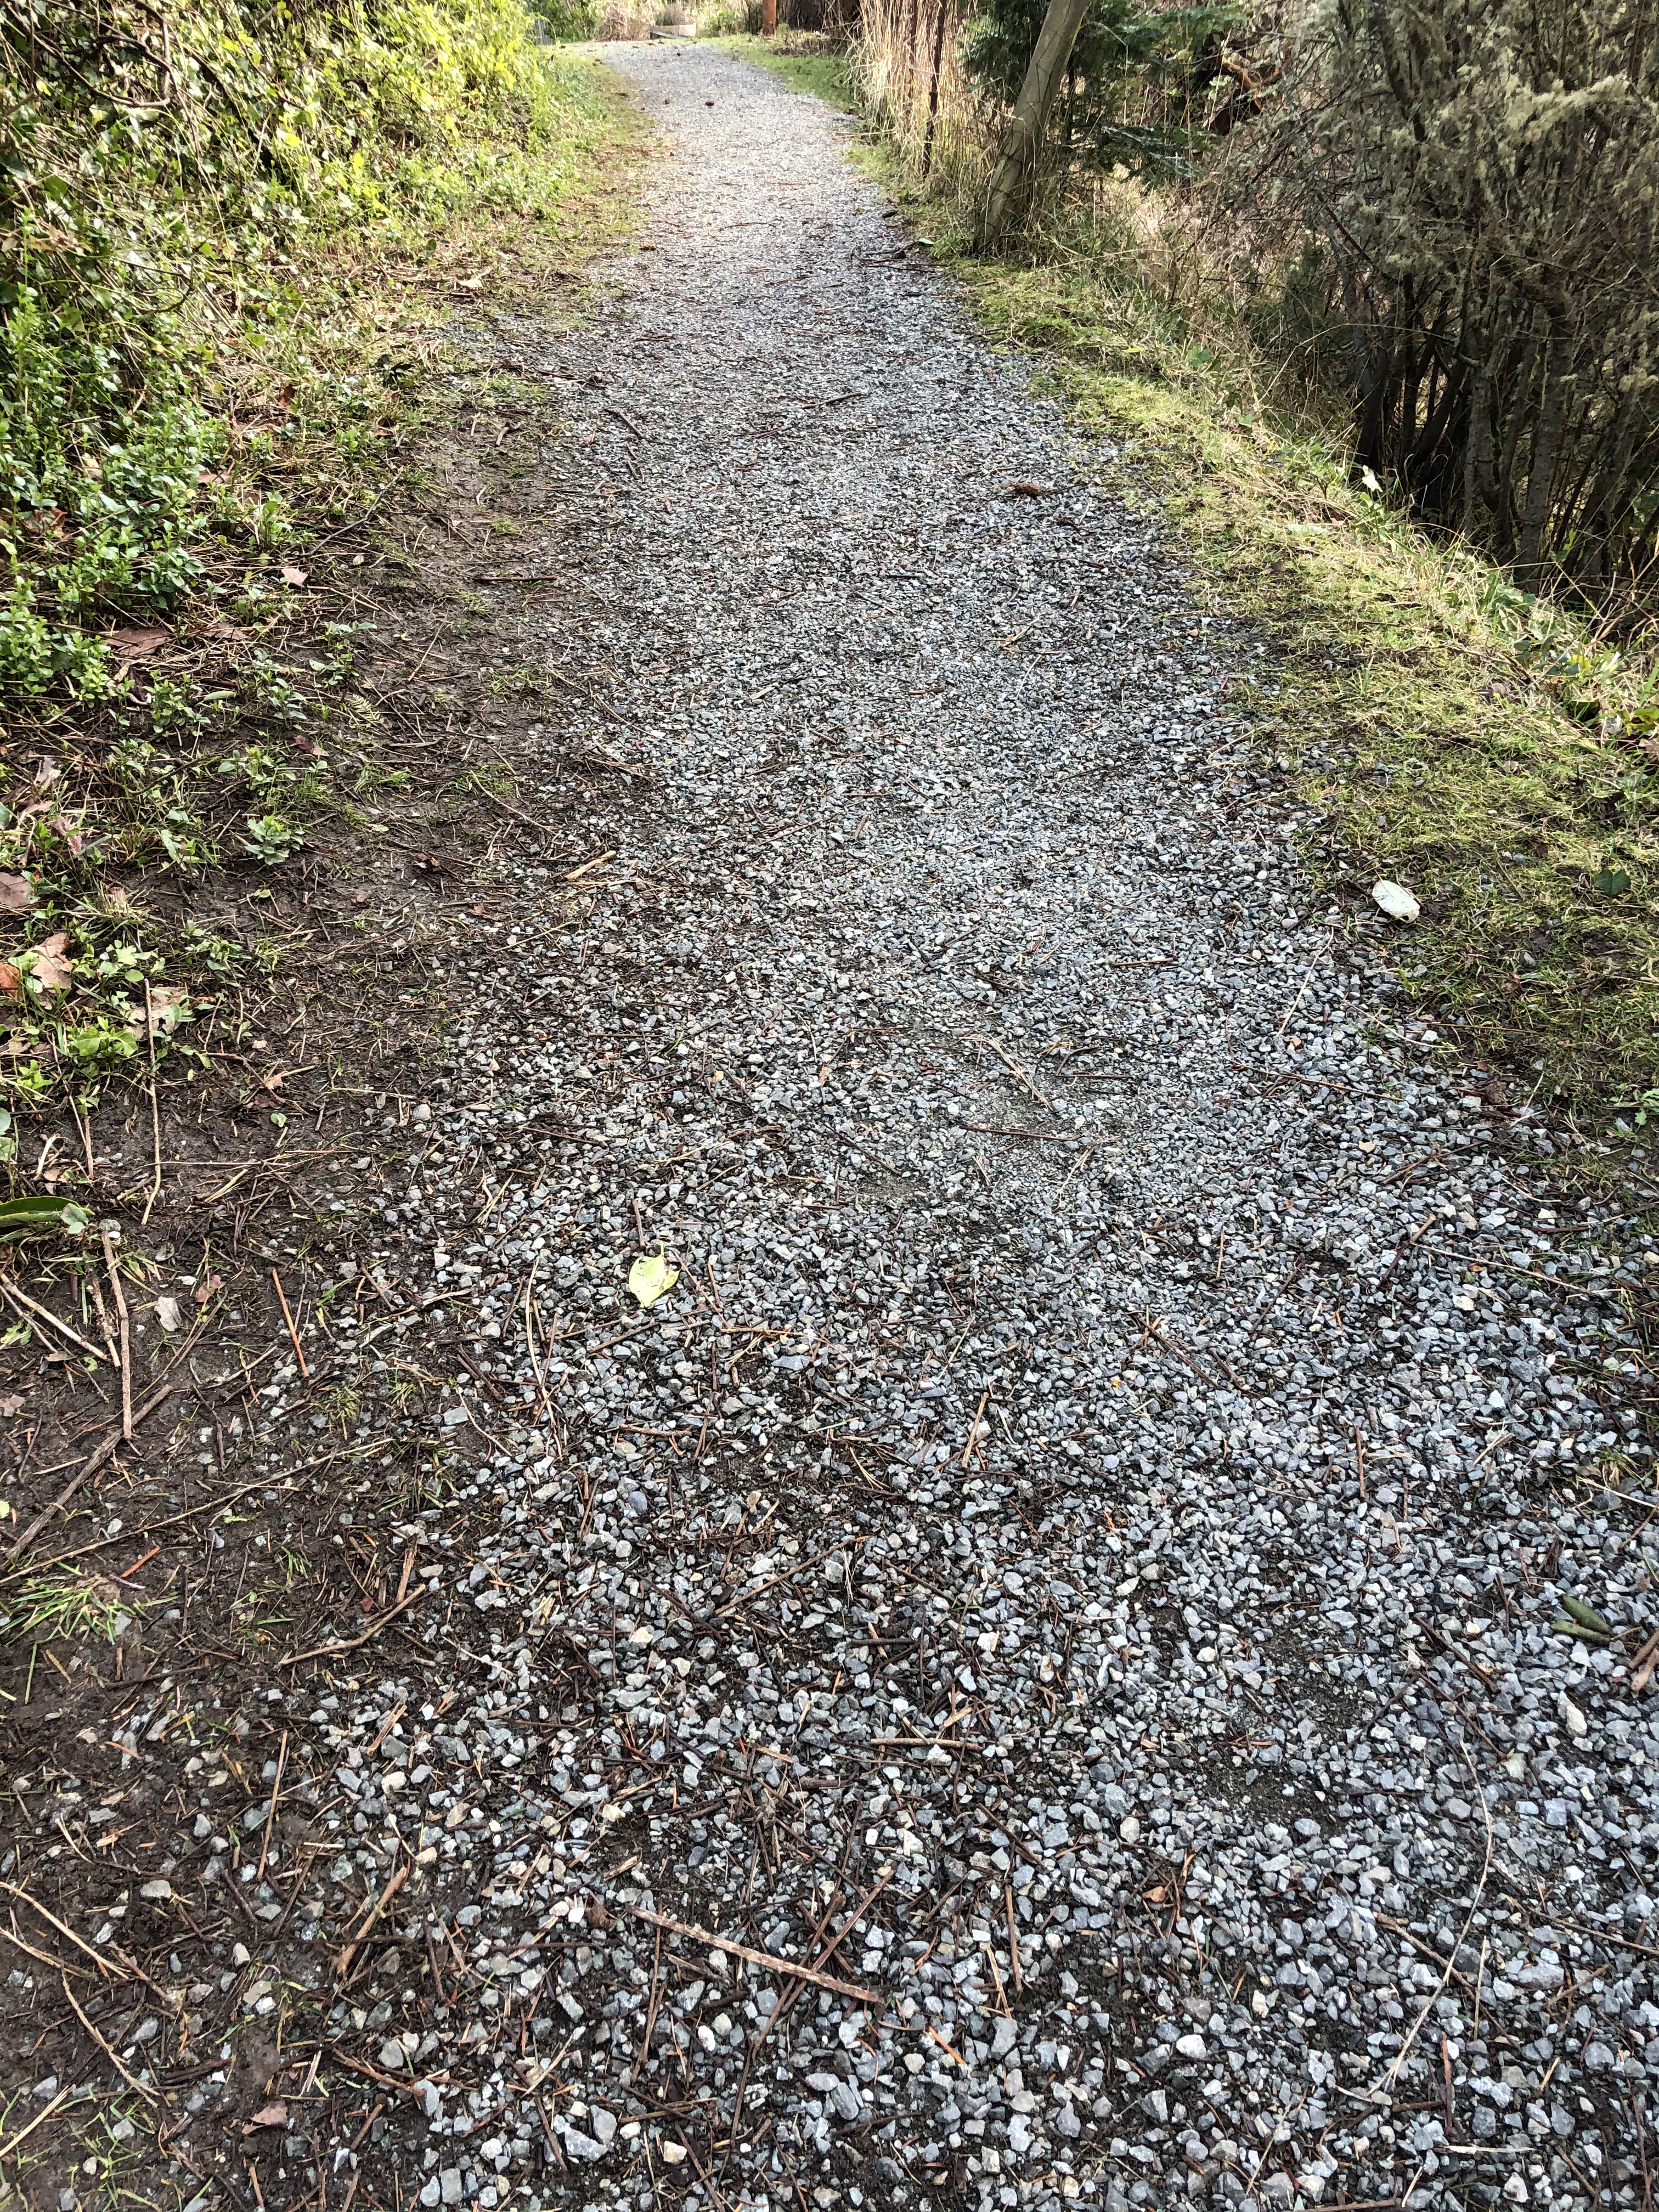
YOU CAN GET a Free Boundary Tip each week
By email, sign up on my website. www.sarrigilman.com
Use the discount code TEXAS to get 20% off on the complete Transform Your Boundaries Course Bundle. Please do not share these slides these are for your private use. Take good care, Sarri

Slide 19
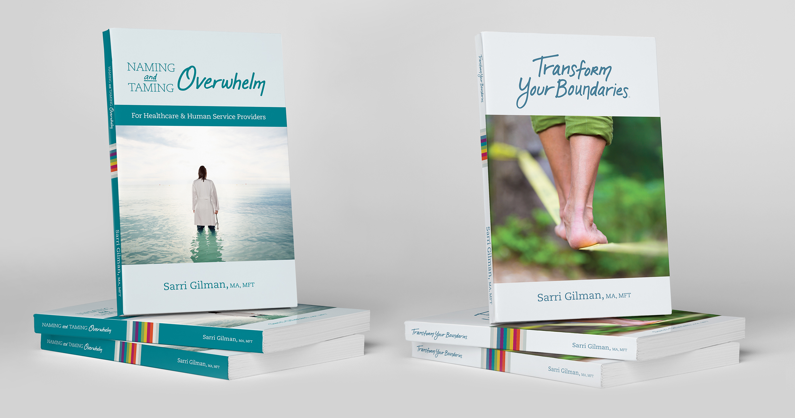

Slide 20
Thank You!
Discover more at www.SarriGilman.com
sarri@sarrigilman.com

