Slide 1


Enhancing Schoolwide SEL from Distance to In-Person Learning:
A Framework in Action
Dr. Troy Loker
Qualified Mental Health Professional
Certified School Psychologist
Portland Public Schools

Slide 2
Disclaimer and Funding Statement
This presentation was prepared for the Mountain Plains Mental Health Technology Center(Mountain Plains MHTTC) under a cooperative agreement from the Substance Abuse and Mental Health Services Administration (SAMHSA). All material appearing in this presentation, except that taken directly from copyrighted sources, is in the public domain and may be reproduced or copied without permission from SAMHSA or the authors. Citation of the source is appreciated. Do not reproduce or distribute this presentation for a fee without specific, written authorization from the Mountain Plains MHTTC. For more information on obtaining copies of this presentation please email swinfield@wiche.edu.
At the time of this presentation, Tom Coderre served as acting SAMHSA Assistant Secretary.
The opinions expressed herein are the views of Troy Loker, PhD, and do not reflect the official position of the Department of Health and Human Services (DHHS), or SAMHSA. No official support or endorsement of DHHS, SAMHSA, for the opinions described in this presentation is intended or should be inferred.
The work of the Mountain Plains MHTTC is supported by grant H79SM081792 from the Department of Health and Human Services, Substance Abuse and Mental Health Services Administration.

Slide 3
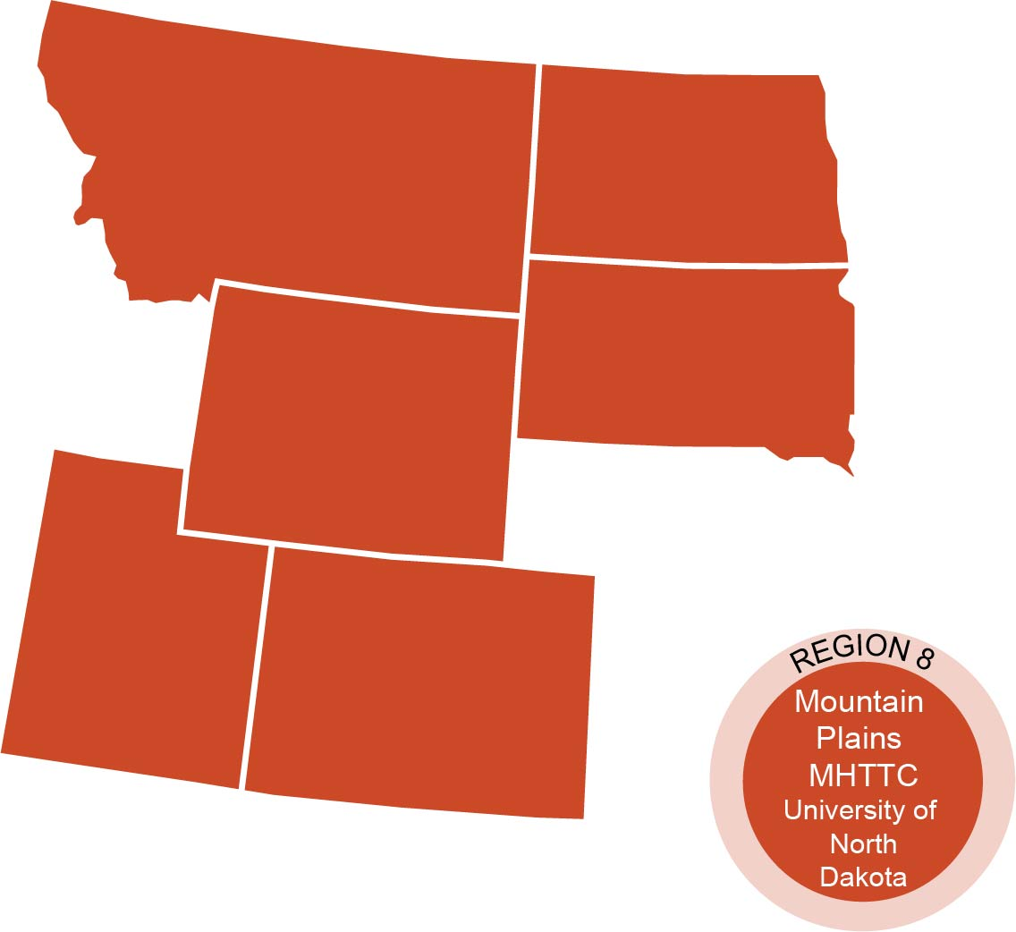
The Mountain Plains Mental Health Technology Transfer Center
The Mountain Plains Mental Health Technology Transfer Center (Mountain Plains MHTTC) provides training and technical assistance to individuals who serve persons with mental health concerns throughout Region 8 (Colorado, Montana, North Dakota, South Dakota, Utah and Wyoming).
We belong to the Technology Transfer Center (TTC) Network, a national network of training and technical assistance centers serving the needs of mental health, substance use and prevention providers. The work of the TTC Network is under a cooperative agreement by the Substance Abuse and Mental Health Service Administration (SAMHSA).

Slide 4

Stay Connected
mhttcnetwork.org/centers/mountain-plains-mhttc/home
@Mountain-Plains-MHTTC
@MPMHTTC
mhttcnetwork.org/centers/mountain-plains-mhttc/subscribe-our-mailing-list

Slide 6
Today’s Learning Objectives
Learn how the elements of the Guide to Schoolwide SEL and CASEL Rubric can facilitate implementation.
Learn from current examples of school-wide SEL implementation efforts, from comprehensive distance learning and hybrid learning.
Identify strategies and resources that multi-disciplinary school staff can utilize to begin planning their schools' improvement efforts.

Slide 7
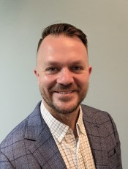
Today’s Lens
A bit about my background
  Personal
  Educational
  Professional
Practitioner Perspective
Systems-focused
Growth Mindset
What is your
lens today?

Slide 8

Guide and Rubric to Schoolwide SEL

Slide 9
Schoolwide Social Emotional Learning (SEL)
“Schoolwide SEL engages the entire school community in creating caring, motivating, and equitable learning environments that promote social, emotional, and academic growth.”
Purpose of implementing Schoolwide SEL is for students to:
  excel academically,
  build stronger relationships,
  and lead happier, healthier, more fulfilling lives.
(CASEL) https://schoolguide.casel.org/

Slide 10
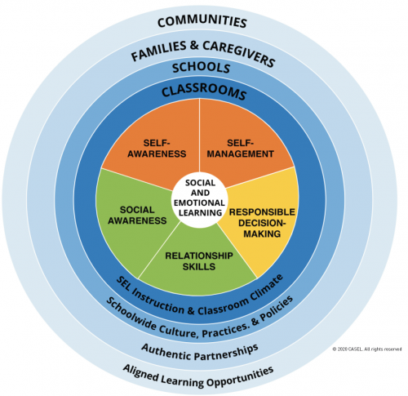
CASEL: Core of Social Emotional Learning
Core Competencies

Slide 11
What role do schools play in promoting SEL?
“In partnership with families and communities, schools play a critical role in supporting young people’s social and emotional development.
This goes beyond teaching a set of skills to embedding SEL into every aspect of daily school life (Meyers et al., 2018).”
(CASEL) https://schoolguide.casel.org/what-is-sel/what-is-sel/

Slide 12



In Action: Bringing the Core of SEL to our Schools
Our
CORE VALUES

Slide 13
Equity and SEL
“SEL can be a powerful lever for creating caring, just, inclusive, and healthy communities that support all individuals in reaching their fullest potential.”
SEL:
Is relevant for all students
Addresses systemic improvements
Elevates student voice, agency, and engagement
Supports adult self-reflection and self-awareness
Includes relationships and partnerships at its core
https://schoolguide.casel.org/what-is-sel/equity-and-sel/

Slide 14
1. Build foundational support and plan for SEL
2. Strengthen adult SEL competencies and capacity
3. Promote SEL for Students
4. Practice continuous improvement
Focus Areas:
Framework for
Enhancing Schoolwide SEL
(CASEL) https://schoolguide.casel.org/what-is-sel/what-is-sel/

Slide 15
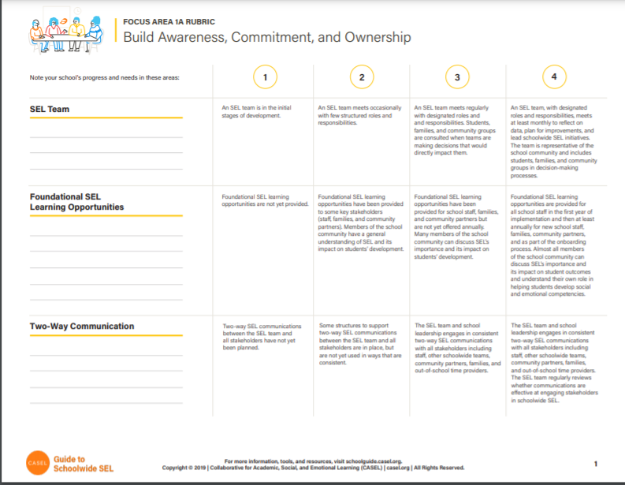
CASEL Rubric for Schoolwide SEL
23 Item Rubric
1a) Build Awareness, Commitment, and Ownership (3 Items)
2) Strengthen Adult SEL Competencies and Capacity (4 Items)
3) Promote SEL for Students (11 Items)
4) Practice Continuous Improvement (2 Items)
1b) Create a Shared Plan (3 Items)
Downloadable PDF: https://schoolguide.casel.org/uploads/sites/2/2020/04/Blank-Rubric-Template-3.30.20.pdf

Slide 16
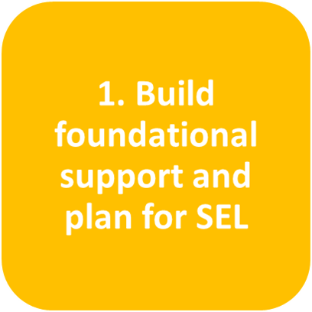

Slide 17
SEL Team
RUBRIC RATINGS
An SEL Team is in initial stages of development
An SEL team meets occasionally with few structured roles and responsibilities
An SEL team meets regularly with designated roles and responsibilities. Students, families, and community groups are consulted when teams are making decisions that would directly impact them.
An SEL team, with designated roles and responsibilities, meets at least monthly to reflect on data, plan for improvements, and lead schoolwide SEL initiatives. The team is representative of the school community and includes students, families, and community groups in decision-making processes.

Slide 18
In Action: Reflection Process
STRENGTHS
What is your school already doing to support this?
AREAS for IMPROVEMENT
What does your school need for further success?
Meet on a regular (weekly) basis
Designated responsibilities (spreadsheet of tiered program/activity leads)
We have admin, SEL members, instructional coach, and teacher represented
Coordinates with related School Climate teams (e.g., Equity, Student Council)
Need to revisit team meeting roles (i.e., facilitator, time keeper, etc.)
Increasing inclusion of students, families, and community partners in decision-making processes

Slide 19
Tools for Continuous Improvement:
SEL Team
Deeper dive learning opportunities and tools are provided by CASEL in key areas for each rubric item.
For SEL Team, these include:
Assemble an SEL Team
Define team member roles and responsibilities
Build a strong team dynamic

Slide 20
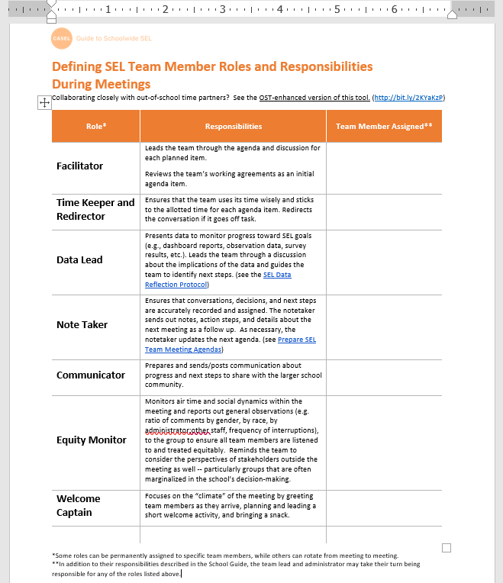
Defining Team Member Roles and Responsibilities
Downloadable Word document for defining SEL Team Member Meeting Roles/Responsibilities
Facilitator
Time Keeper & Redirector
Data Lead
Note Taker
Communicator
Equity Monitor
Welcome Captain
https://schoolguide.casel.org/uploads/sites/2/2018/12/Defining-Team-Member-Roles-and-Responsibilities_4.1.20.docx

Slide 21
Foundational SEL Learning
Opportunities
RUBRIC RATINGS
Foundational SEL learning opportunities are not yet provided.
Foundational SEL learning opportunities have been provided to some key stakeholders (staff, families, and community partners). Members of the school community have a general understanding of SEL and its impact on students’ development.
Foundational SEL learning opportunities have been provided for school staff, families, and community partners but are not yet offered annually. Many members of the school community can discuss SEL’s importance and its impact on students’ development.
Foundational SEL learning opportunities are provided for all school staff in the first year of implementation and then at least annually for new school staff, families, community partners, and as part of the onboarding process. Almost all members of the school community can discuss SEL’s importance and its impact on student outcomes and understand their own role in helping students develop social and emotional competencies.

Slide 22
Two-Way Communication
RUBRIC RATINGS
Two-way SEL communications between the SEL team and all stakeholders have not yet been planned.
Some structures to support two-way SEL communications between the SEL team and all stakeholders are in place, but are not yet used in ways that are consistent.
The SEL team and school leadership engages in consistent two-way SEL communications with all stakeholders including staff, other schoolwide teams, community partners, families, and out-of-school time providers.
The SEL team and school leadership engages in consistent two-way SEL communications with all stakeholders including staff, other schoolwide teams, community partners, families, and out-of-school time providers. The SEL team regularly reviews whether communications are effective at engaging stakeholders in schoolwide SEL.

Slide 23
Shared Vision
RUBRIC RATINGS
A shared vision for schoolwide SEL has not yet been developed.
The SEL team has begun engaging stakeholders, including students, families, staff, and community members, as collaborators for developing a shared vision for schoolwide SEL.
The SEL team collaborated with a group of stakeholders who are representative of the school community to develop a shared vision for schoolwide SEL that has been communicated to the entire school community.
The SEL team collaborated with a group of stakeholders who are representative of the school community to develop a shared vision for schoolwide SEL. The shared vision has been communicated to the entire school community, informs planning and implementation, and is revisited regularly.

Slide 24
Planning
RUBRIC RATINGS
The SEL team is beginning to assess needs and resources.
The SEL team has assessed needs and resources, and begun identifying S.M.A.R.T.I.E. goals and action steps
The SEL team has assessed needs and resources, and developed a one-year (at minimum) SEL implementation plan with S.M.A.R.T.I.E. goals, action steps, and assigned ownership.
The SEL team has assessed needs and resources and developed a one-year (at minimum) SEL implementation plan with S.M.A.R.T.I.E. goals, action steps, and assigned ownership. This plan is fully integrated with other schoolwide priorities and plans. The team reviews their goals and the plan regularly to monitor implementation and make necessary adjustments.

Slide 25
Resources
RUBRIC RATINGS
Funding for schoolwide SEL has not yet been discussed and prioritized.
The SEL team is identifying funding and resources to support schoolwide SEL.
There is a one-year budget for SEL resources that includes funding for professional learning and materials needed to support SEL instruction. The school has allocated staff time for engaging in SEL-related activities including professional learning.
There is a stable long-term budget for SEL resources, including professional learning, materials, and staffing. The school has allocated staff time for engaging in SEL-related activities including professional learning.

Slide 26
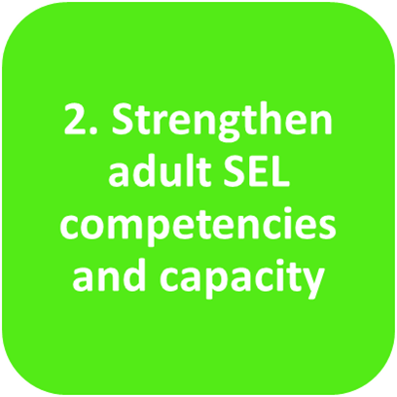

Slide 27
Adult SEL and Cultural Competence
Staff do not yet have opportunities to reflect on and develop their own social, emotional, and cultural competencies.
Meaningful opportunities for staff to develop their own social, emotional, and cultural competencies are offered at least once per year.
Meaningful opportunities for staff to reflect on and develop their own social, emotional, and cultural competencies are available multiple times throughout the year. These opportunities include structured activities that support staff in practicing self-care and examining their mindsets and biases.
Meaningful opportunities for staff to reflect on and develop their own social, emotional, and cultural competencies are built into regular staff meetings and part of the school’s overall professional learning strategy. These opportunities include structured activities to support staff in practicing self-care and examining their mindsets and biases. The SEL team regularly reviews data related to adult SEL and cultural competence to plan ongoing support.

Slide 28
In Action: Reflection Process
STRENGTHS
What is your school already doing to support this?
AREAS for IMPROVEMENT
What does your school need for further success?
Staff Wellness team meeting biweekly
Staff Wellness opens at the beginning of every staff meeting
Staff Equity team leads “brave space” and brain-based equity book study discussions during every staff meeting
Growth mindset embedded into school culture
Nature of COVID-19 distancing impacted social connectedness; school climate data indicates need for improvement

Slide 29
Adult SEL and Cultural Competence
Staff Wellness team meetings
  QMHP and KG, 3rd, and 5th grade teachers
  Weekly to Biweekly
  Check-ins, discussing needs of the team/building and deciding what can be presented during weekly staff meetings
  Adding new outdoor gaming opportunity for staff

Slide 30

Adult SEL and Cultural Competence
Sample slide from Staff meeting

Slide 31
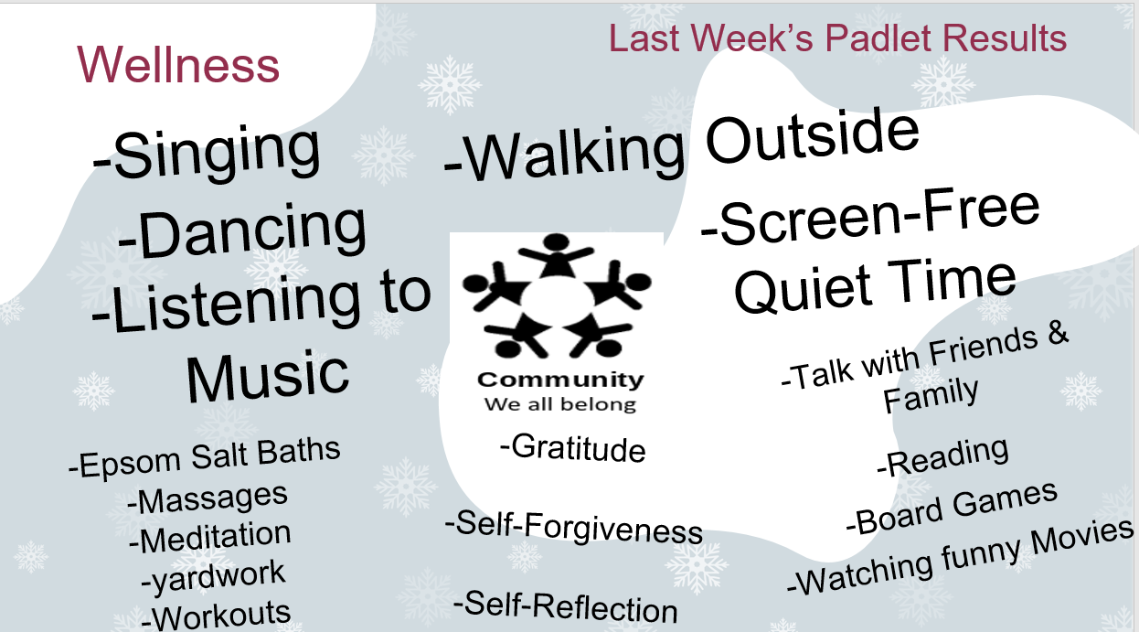
Adult SEL and Cultural Competence
Sample slide from Staff meeting

Slide 32
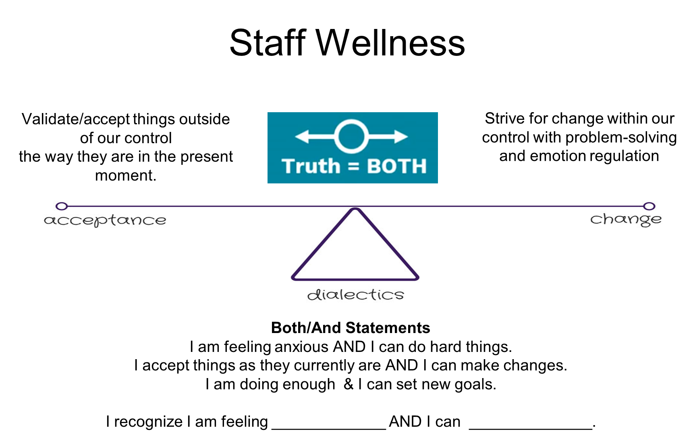
Adult SEL and Cultural Competence
Sample slide from Staff meeting

Slide 33

Adult SEL and Cultural Competence
Equity Team
  AP and multi-disciplinary instructional staff
  Weekly team meetings
  Utilizes “brave space” and “courageous conversation” norms
  Plans weekly staff meeting PD and small group discussions often centered around book study
    Culturally Responsive Teaching and The Brain: Promoting Authentic Engagement and Rigor Among Culturally and Linguistically Diverse Students by Zaretta Hammond

Slide 34

Adult SEL and Cultural Competence
Sample slide from Staff meeting

Slide 35
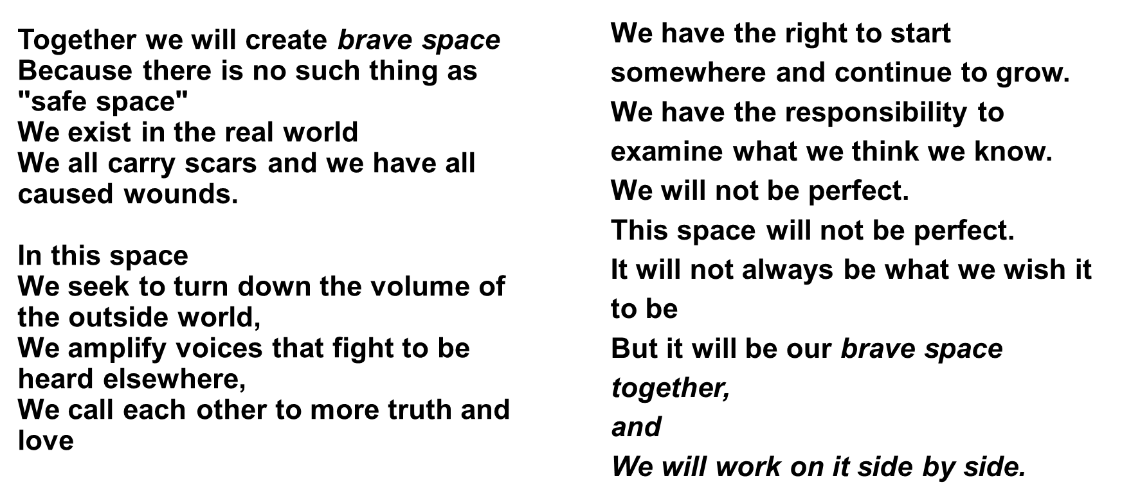
Adult SEL and Cultural Competence
Sample slide from Staff meeting

Slide 36
CASEL Tools for Continuous Improvement:
Adult SEL and Cultural Competence
Deeper dive learning opportunities and tools are provided by CASEL in key areas for each rubric item.
For Adult SEL and Cultural Competence, these include:
Building a Professional Learning Plan
Reflecting on Personal SEL Skills
Examining Biases for Cultural Competence
Growth Mindset for Staff
Self-Care and Re-Energizing
Brain-Based Model for Workplace Collaboration

Slide 37
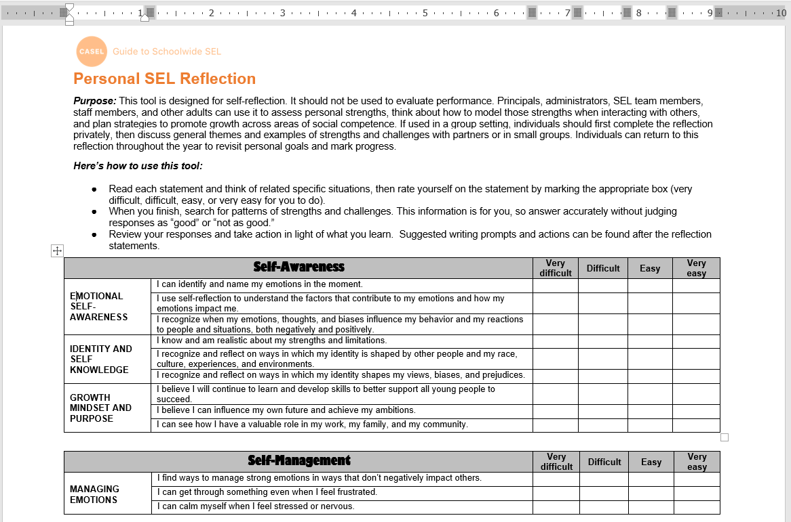
Reflecting on Personal SEL Skills
CASEL’s downloadable Word document for a Personal SEL Reflection
Provides concrete examples of various SEL components
Assess personal strengths in 5 Core Competency areas
Prompts staff to consider ways to model strengths when interacting with staff and students
Provides ideas for ways to develop further across core competence domains
https://schoolguide.casel.org/uploads/sites/2/2018/12/2021.3.24_Personal-SEL-Reflection-1.docx

Slide 38
Staff Modeling of SEL
Leadership and/or staff have not yet prioritized modeling social, emotional, and cultural competencies in their interactions.
The SEL team is developing an approach to support leadership and staff in modeling social, emotional, and cultural competencies in their language and interactions with other staff, students, families, and community partners.
Leadership and staff regularly model social, emotional, and cultural competencies in their language and interactions with most staff, students, families, and community partners. Staff efforts and contributions are sometimes acknowledged.
Leadership and staff regularly model social, emotional, and cultural competencies in their language and interactions with other staff, students, families, and community partners. School leaders and the SEL team have built supportive relationships with staff and regularly acknowledge staff efforts and contributions.

Slide 39
Tools for Continuous Improvement:
Staff Modeling of SEL
Deeper dive learning opportunities and tools are provided by CASEL in key areas for each rubric item.
For Staff Modeling of SEL, these include:
Model SEL for Students
Model for Staff
Practices for Leaders

Slide 40
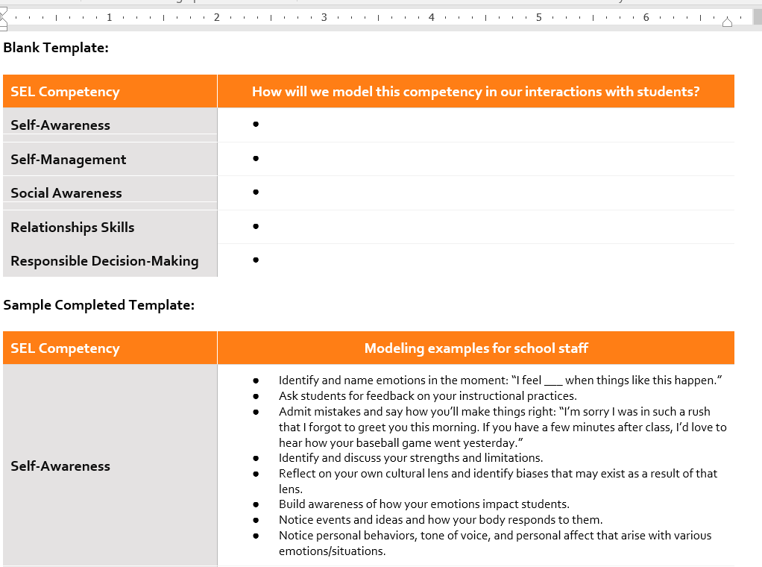
Model SEL for Students
CASEL’s downloadable Word document for a intentional planning around Modeling SEL for Students
Ideal for following up on after Personal SEL Reflection
Reinforces connection between self-care and promoting SEL with students
https://schoolguide.casel.org/uploads/sites/2/2018/12/2021.3.24_Personal-SEL-Reflection-1.docx

Slide 41
Professional Learning to Strengthen
Staff Expertise
Staff do not yet engage in high-quality SEL-related professional learning to develop their skills for cultivating supportive, equitable learning environments and promoting SEL.
Some staff engage in high quality professional learning to develop their skills for cultivating supportive, equitable learning environments and promoting SEL for students.
Staff engage in high-quality professional learning multiple times throughout the year to develop their skills for cultivating supportive, equitable learning environments and promoting SEL for students. These professional learning opportunities are aligned to the school’s SEL goals and scaffolded to support staff based on their roles and current knowledge of SEL.
Staff engage in high-quality and ongoing professional learning, including receiving coaching and feedback. These professional learning opportunities develop their skills for cultivating supportive, equitable learning environments and promoting SEL for students; are aligned to the school’s SEL goals; and scaffolded to support staff based on their roles and current knowledge of SEL. The SEL team collects staff feedback to shape an effective approach to ongoing support and coaching.

Slide 42
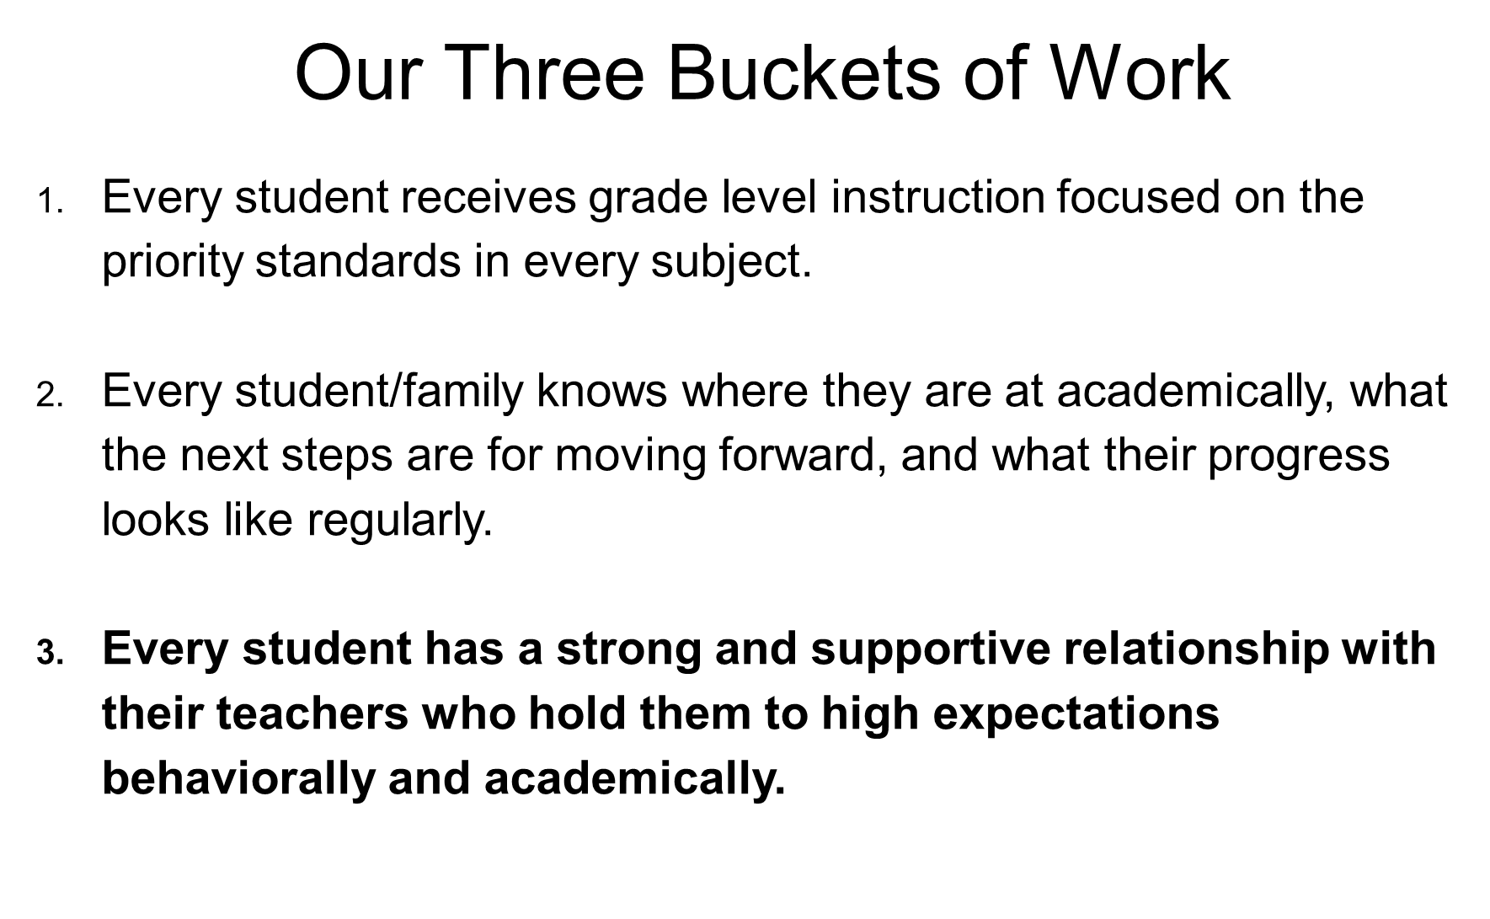
Professional Learning to Strengthen
Staff Expertise
Sample slide from Staff meeting

Slide 43
Staff Collaboration
Staff do not yet have opportunities to build collaborative relationships.
Staff have dedicated time for collaboration, and have developed norms or shared agreements to guide collaboration.
The SEL team and school leadership regularly reviews their approach for fostering community, shared purpose, and collaboration among staff. Staff have dedicated time for collaboration. Staff norms or shared agreements guide respectful interactions, effective collaboration, and an inclusive staff culture.
The SEL team and school leadership intentionally foster a sense of community and shared purpose among staff, including using data on staff perceptions to improve the work climate. Staff have dedicated time to learn from each other, share best practices, and collaboratively problem-solve around SEL implementation challenges. Staff norms or shared agreements guide respectful interactions, effective collaboration, and an inclusive staff culture.

Slide 44
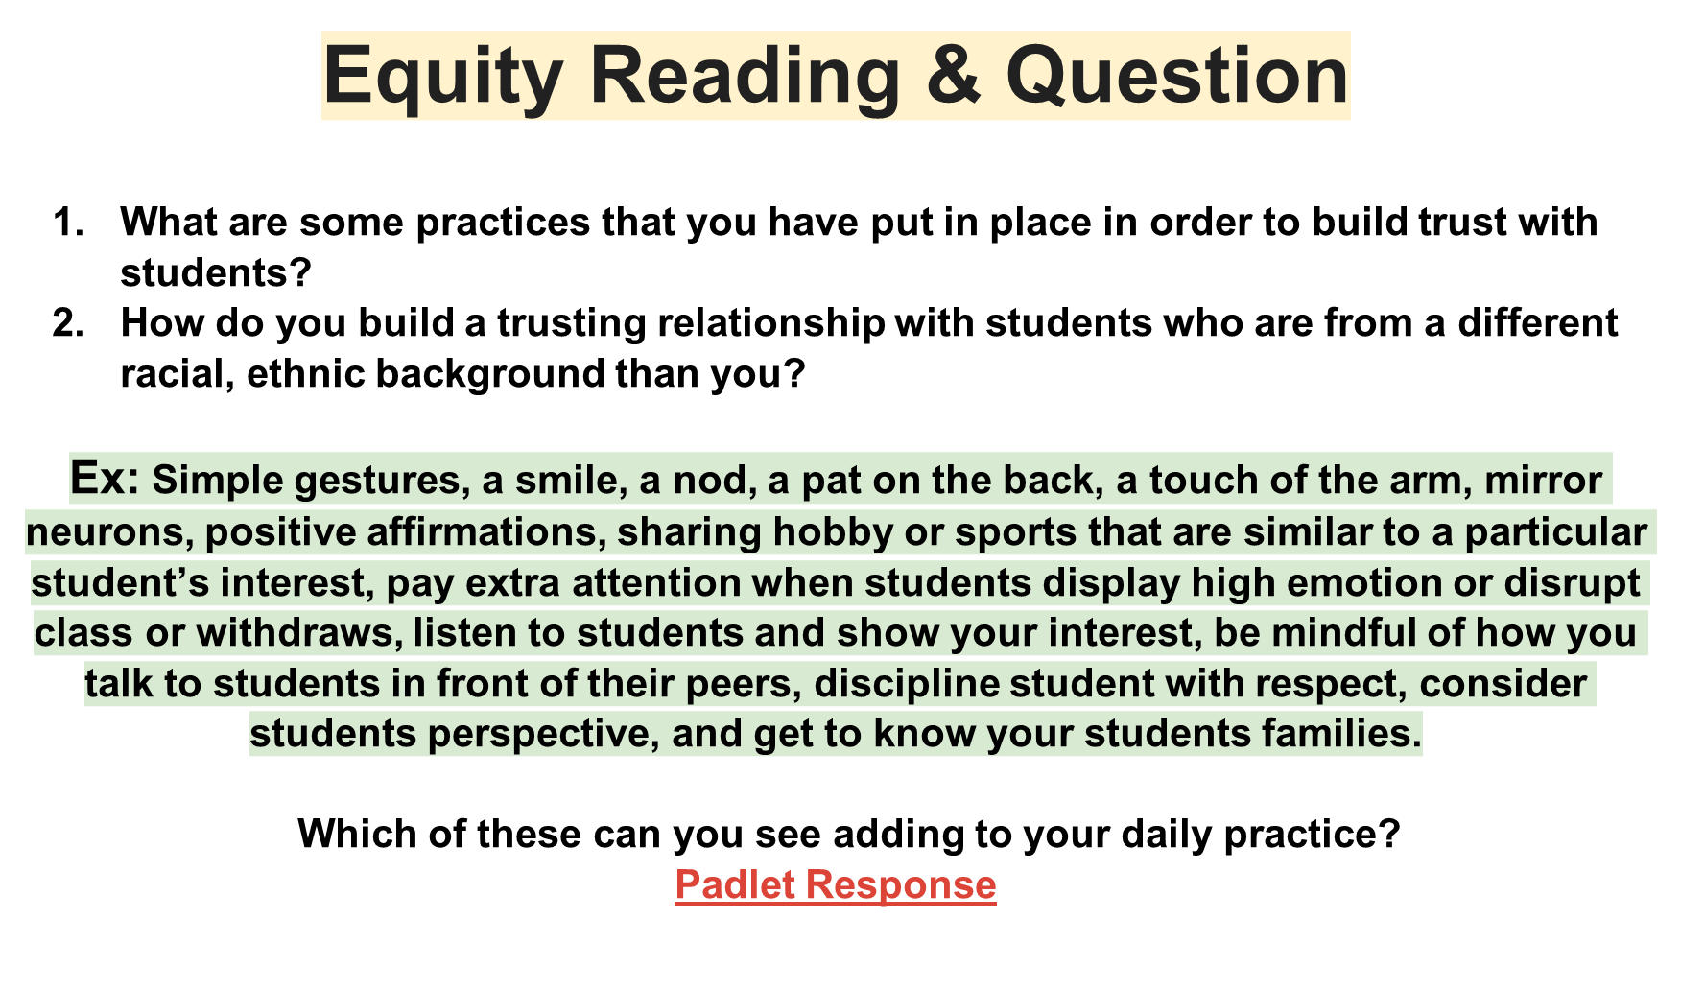
Staff Collaboration
Sample slide from Staff meeting

Slide 45
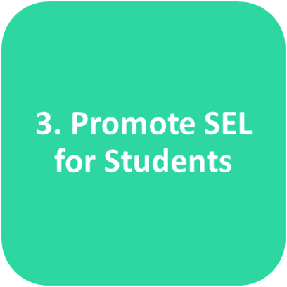

Slide 46
Supportive Classroom
Environment
Teachers have not yet prioritized the use of inclusive, relationship-centered, and culturally responsive practices to create supportive classroom environments.
Teachers have prioritized and planned to build inclusive, relationship-centered, and culturally responsive practices to create supportive classroom environments. Classroom shared agreements have been collaboratively developed in some classrooms.
Some teachers use inclusive, relationship-centered, and culturally responsive practices to create supportive classroom environments. Strategies are developmentally appropriate and focus on meeting the needs of all students. Shared agreements are collaboratively developed and modeled by most adults and students.
Teachers use inclusive, relationship-centered, and culturally responsive practices to create supportive classroom environments. Strategies are developmentally appropriate and focus on creating a community of learners that supports, honors, and acknowledges the cultural assets, contributions, and needs of all students. Shared agreements are collaboratively developed, consistently modeled by adults and students, and woven into daily routines and practices.

Slide 47
In Action: Reflection Process
STRENGTHS
What is your school already doing to support this?
AREAS for IMPROVEMENT
What does your school need for further success?
Daily Morning Community Meetings (and recently added Closing Community Meetings)
Shared agreements created in classrooms
Bringing staff meeting equity/SEL learning into classrooms
Carefully planned classroom/school routines for return to safe in-person learning
Room to increase structured use of CASEL 3 signature practices
Continued need to more effectively inclusive, relationship-centered, and culturally responsive practices

Slide 48
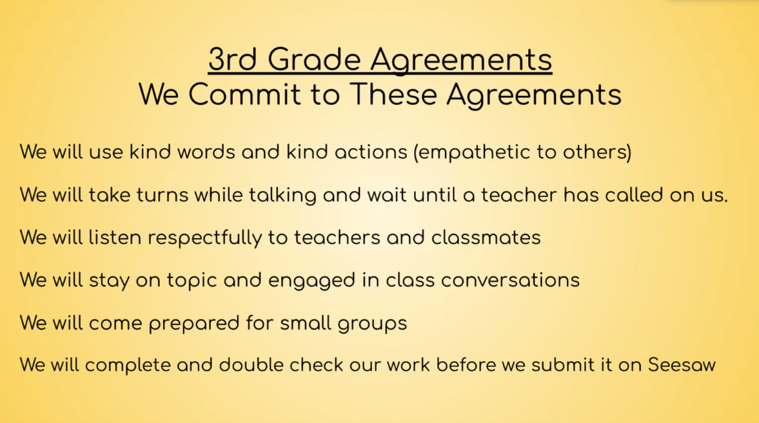
Morning (and Closing) Community Meetings
Daily 30 minutes to help build sense of belonging and trusting relationships
Provides overview of academic content and helps clarify expectations/routines
CASEL 3 Signature Practices of Warm Welcome, Engaging Activity, and Optimistic Closure
Sample slide from classroom meeting
https://schoolguide.casel.org/resource/three-signature-sel-practices-for-the-classroom/

Slide 49
Explicit SEL Instruction
The school has not yet dedicated time for students to learn about, reflect on, and discuss SEL competencies through developmentally appropriate and culturally responsive instruction.
Some students have dedicated time during the school day to learn about, reflect on, and discuss SEL competencies through developmentally appropriate and culturally responsive instruction.
All students have dedicated time during the school day to learn about, reflect on, and discuss SEL competencies through developmentally appropriate and culturally responsive instruction. SEL instruction is provided by teachers; is sequenced with connected and coordinated activities; uses active forms of learning; focuses on developing social and emotional skills; and explicitly targets specific SEL goals.
All students have dedicated time during the school day to learn about, reflect on, and discuss SEL competencies through developmentally appropriate and culturally responsive instruction. SEL instruction is provided by teachers; is sequenced with connected and coordinated activities; uses active forms of learning; focuses on developing social and emotional skills; and explicitly targets specific SEL goals. SEL instruction is connected to other opportunities for practicing and reflecting on SEL competencies throughout the day.

Slide 50
Explicit SEL Instruction
In Action: Reflection Process
STRENGTHS
What is your school already doing to support this?
AREAS for IMPROVEMENT
What does your school need for further success?
All students have dedicated time for explicit SEL instruction
Sequenced and connected instruction
Instruction provided with active forms of learning, in culturally-responsive approach
Language being used across the day
Combination of teacher-led, SEL team-member led, and co-facilitation; opportunity for further teacher ownership

Slide 51
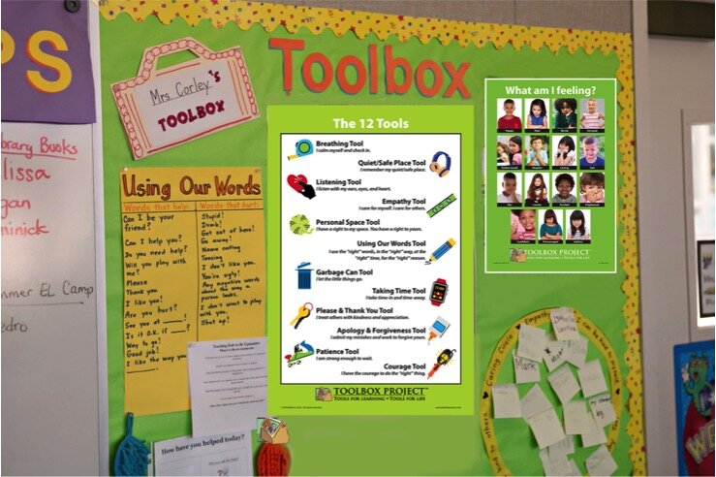
Explicit SEL Instruction
Toolbox Project
“A strength/asset-based vocabulary shared among children, educators, and parents that gives children their own solutions using the 12 strategies and practices of Toolbox Project.”
https://toolboxproject.com/packages

Slide 52
Explicit SEL Instruction
Curriculum tied to our school Core Values
Each sequenced week:
  Learning target for Tool of the week shared with teachers
  Lesson Slide Deck shared with all staff
  Recorded Mini-Lesson posted to school YouTube page
  Seesaw lesson & activity posted to classrooms for asynchronous learning
  SEL Update included in weekly message shared by Principal to families, including home-school connection letters
  Librarian records and shares related Read-Alouds

Slide 53
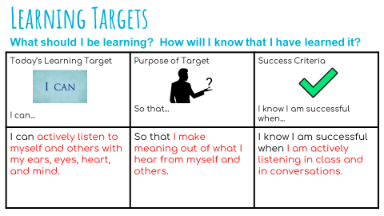
Explicit SEL Instruction
Sample slide from SEL lesson

Slide 54
Evidence-based SEL Programs and Practices
The SEL team is in the process of collaboratively selecting an evidence-based program aligned to the school’s vision and goals, and cultural and linguistic strengths.
The school is beginning to provide professional learning around evidence-based SEL program and practices aligned to the school’s SEL vision and goals, and cultural and linguistic strengths.
The school is implementing with fidelity an evidence-based SEL program and practices across some grade levels, and providing ongoing implementation support to staff. Program and practices are aligned to the school’s SEL vision and goals, and are culturally and linguistically-responsive to students.
The school is implementing with fidelity an evidence-based SEL program and practices across all grade levels, and providing ongoing implementation support to staff. Program and practices are aligned to the school’s SEL vision and goals, and are culturally- and linguistically-responsive to students. The SEL team regularly uses data on fidelity of implementation to inform planning.

Slide 55
SEL-Integrated Instruction
Teachers have not yet prioritized the integration of SEL into instruction.
SEL standards/goals are embedded in academic learning in some classrooms. Some teachers use classroom discussion and collaborative structures to engage students, and encourage students to connect their perspectives and experiences to instruction
SEL standards/goals are clearly embedded in academic learning. All teachers use classroom discussions and collaborative structures to engage students. Teachers encourage students to connect their perspectives and experiences to instruction
SEL standards/goals are clearly embedded in academic learning, and students regularly share their perspectives on how social and emotional competencies connect to what they’re learning. Teachers actively engage students in co-constructing knowledge and making meaning of content through classroom discussions and collaborative structures. Teachers use intentional strategies to foster student ownership over their learning, including connecting their perspectives and experiences to instruction.

Slide 56
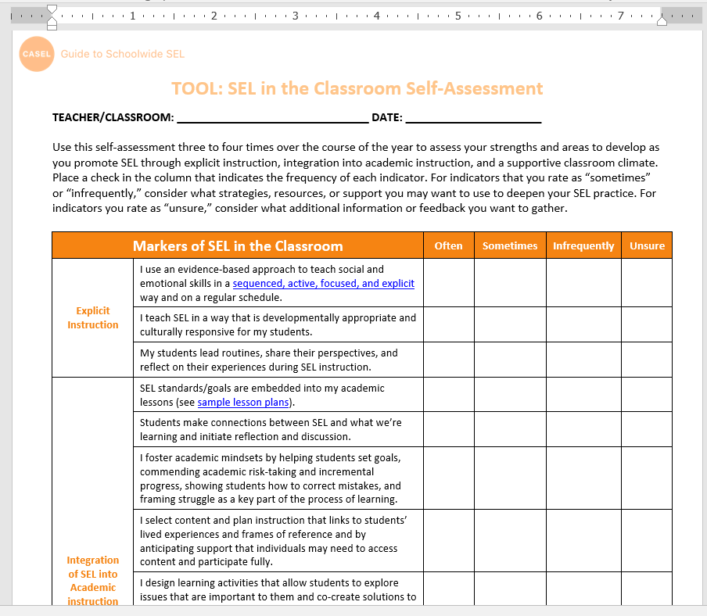
SEL Integrated Instruction
CASEL’s downloadable Word document for self-assessment of SEL integrated instructional practices. Aims to support:
“Fostering academic mindsets
Aligning SEL and academic objectives
Using interactive instructional practices and structures to promote SEL.” (CASEL)
https://schoolguide.casel.org/uploads/sites/2/2018/12/2021.3.24_Personal-SEL-Reflection-1.docx

Slide 57
Student Voice and Engagement
Students do not yet have opportunities to take on leadership and decision-making roles.
Some students have opportunities to take on more traditional leadership roles such as student council, patrols, or leading morning announcements.
Students are offered many opportunities to take on leadership and decision-making roles that inform SEL initiatives, instructional practices, and school climate. Students have opportunities to lead activities, solutions, and projects to improve their classrooms, school and the broader community.
Staff honor and elevate a broad range of student perspectives and experiences by engaging them as leaders, problem solvers and decision-makers, offering ways for students to shape SEL initiatives, instructional practices, and school climate. Students regularly initiate and lead activities, solutions, and projects to improve their classrooms, school and the broader community.

Slide 58
Student Voice and Engagement
In Action: Reflection Process
STRENGTHS
What is your school already doing to support this?
AREAS for IMPROVEMENT
What does your school need for further success?
Monthly Classroom goal setting
Weekly Student Council meetings assisting with school climate projects and elevating student voice/engagement
A need for more opportunities leaders, problem solvers and decision-makers

Slide 59
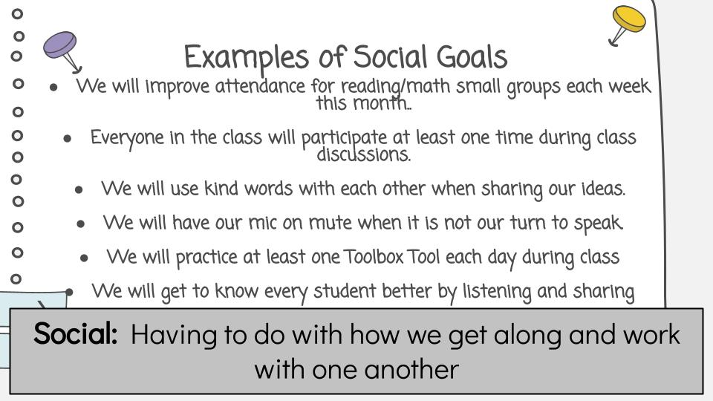
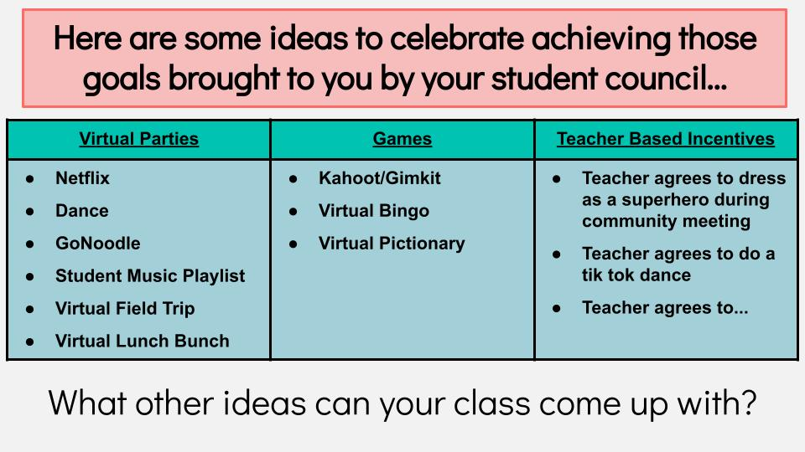
Student Voice and Engagement
Monthly Community Goal Setting, Planning, and Celebrating
Sample slide from SEL lesson
Sample slide from SEL lesson

Slide 60
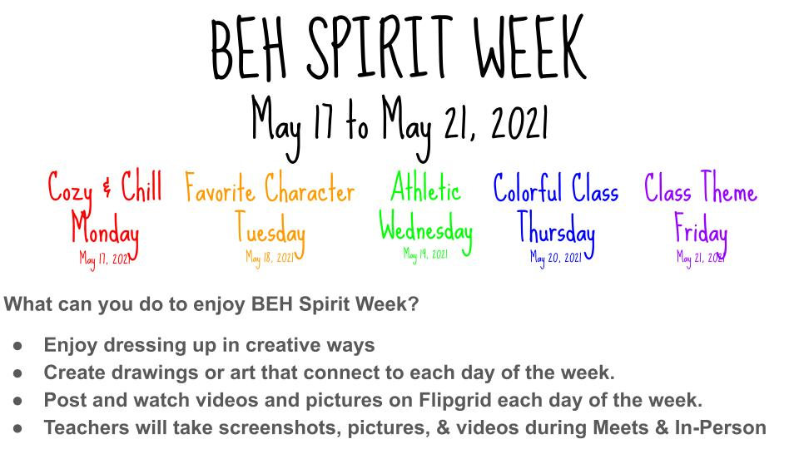
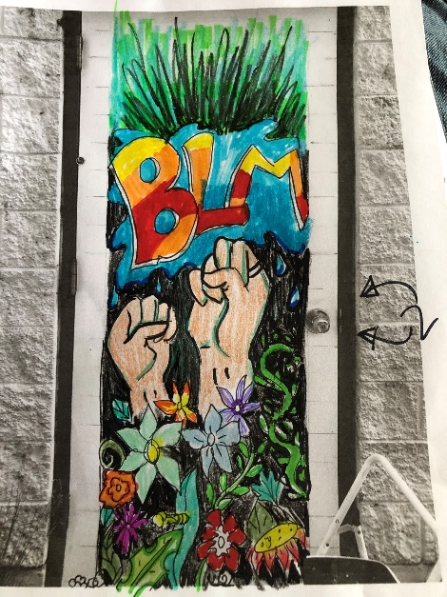
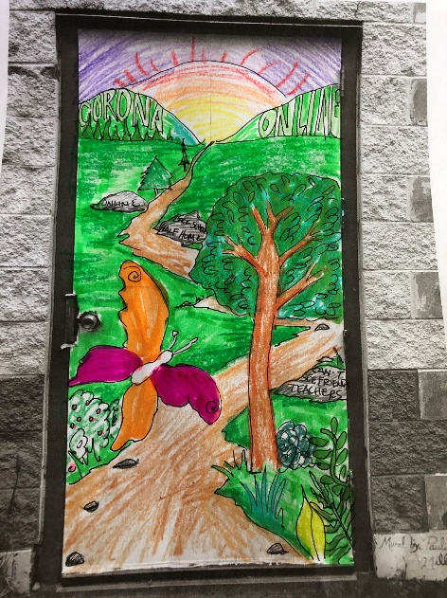
Student Voice and Engagement
Student Council
  Assisted with launch of Hybrid learning
  Discussed how to make spirit week more inclusive while allowing both individual expression and community building.
  Took leadership role planning two 5th grade mural projects designed to reflect this unprecedented school year.

Slide 61
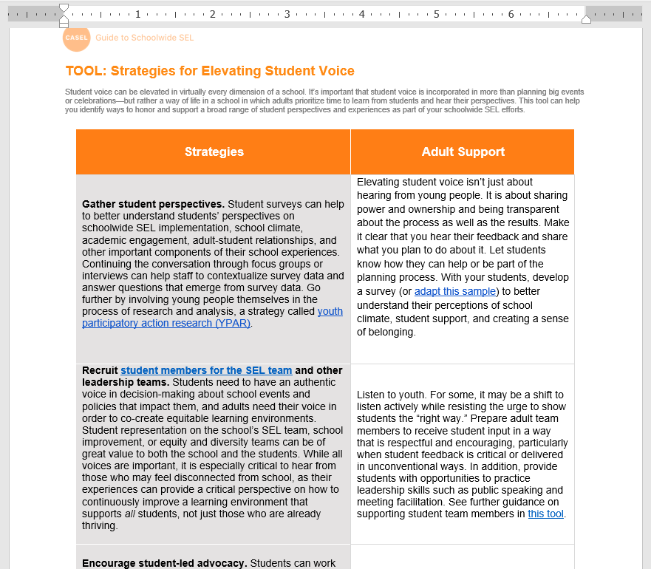
Student Voice and Engagement
CASEL’s downloadable Word document for elevating student voice offers many strategies.
Gathering student perspectives
Recruiting student members for SEL Team/Leadership teams
Student-led advocacy
Build student-centered classrooms
Involve students in teaching about SEL
Student-led conferences
https://schoolguide.casel.org/uploads/sites/2/2020/10/Strategies-for-Elevating-Student-Voice.docx

Slide 62
School Climate
The SEL team has not yet prioritized school climate efforts.
The SEL team is beginning to plan school climate improvement efforts. Schoolwide norms and shared agreements have been collaboratively developed and aligned to the school’s SEL vision.
The SEL team meets regularly to plan school climate improvement efforts and is beginning to collect climate data. Schoolwide norms, shared agreements, routines, and procedures support the school’s SEL vision and climate.
The SEL team regularly assesses climate (through observational data, surveys, etc.) and meets regularly to plan improvement efforts based on data. Schoolwide norms, shared agreements, routines, and procedures support the school’s SEL vision and climate.

Slide 63

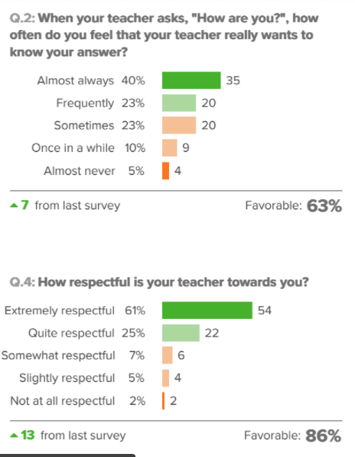
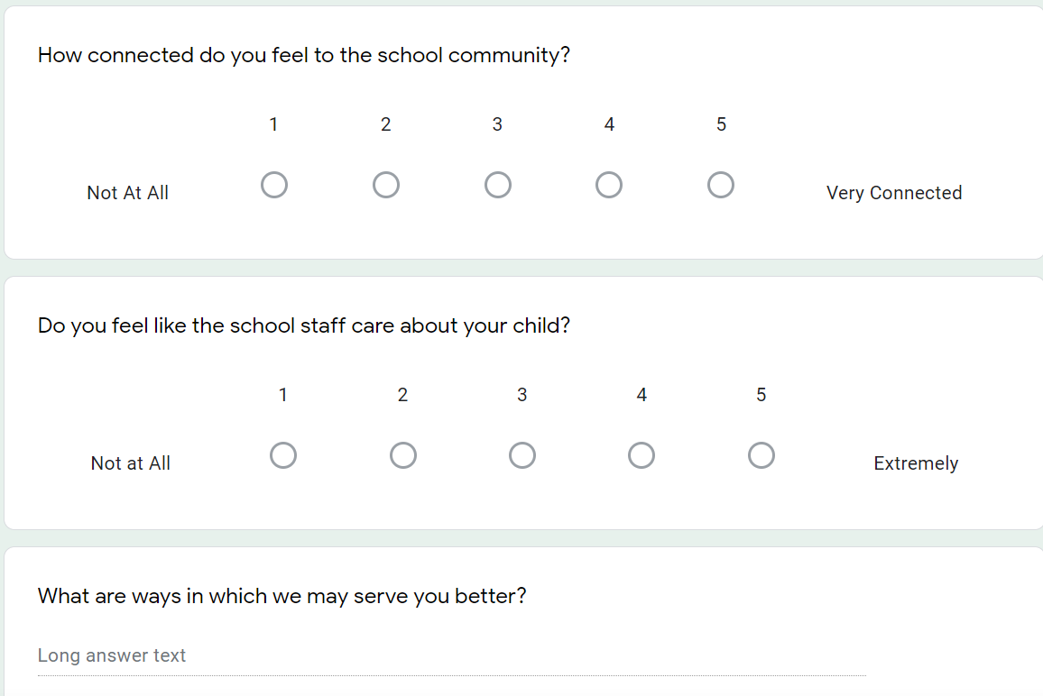
School Climate
Informal and formal survey data collected overtime

Slide 64
Cultural Responsiveness
Leadership and staff are not yet familiar with their students’ cultural backgrounds, life circumstances, or the local community context.
Leadership and staff are familiar with most of their students’ cultural backgrounds, life circumstances, and the local community context.
Leadership and staff are familiar with students’ cultural backgrounds, life circumstances, and the local community context. Instructional materials offer diverse representations of culture, race, gender, and other identities. SEL practices provide opportunities for some students to learn about cultural differences.
Leadership and staff are deeply knowledgeable about students’ lived experiences, cultural backgrounds, and the local community context. Instructional materials offer diverse representations of culture, race, gender, and other identities. SEL practices provide opportunities for students to learn about cultural differences, explore and celebrate their own social and cultural identities, and collaboratively develop inclusive and equitable learning environments.

Slide 65
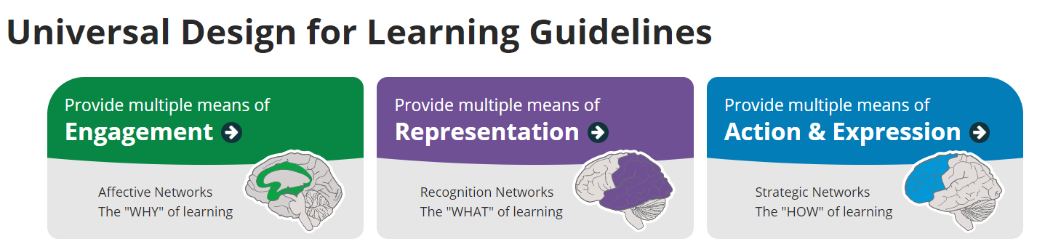

Cultural Responsiveness
https://udlguidelines.cast.org/
Leverage UDL for culturally responsive practice
  Alternatives for everyone
  Designed from beginning
  Access for everyone

Slide 66
Student Support
A continuum of supports is not yet available to students.
A continuum of supports is partially in place. The SEL team is considering ways to create common language and align student supports with schoolwide SEL goals and priorities.
The school provides a continuum of supports to meet the academic, social, emotional, and behavioral needs of all students. The SEL team is taking steps to create common language and align all student supports and related programs and initiatives with schoolwide SEL goals and priorities.
The school provides a continuum of supports that meet the academic, social, emotional, and behavioral needs of all students. The SEL team has created common language and aligned all student supports and related programs and initiatives with schoolwide SEL goals and priorities. Each year, the SEL team takes stock of all supports and is strategic about how to improve integration in the coming year.

Slide 67
Discipline Policies and Practices
Discipline policies and practices have not yet been reviewed to determine how well they align with SEL.
Discipline policies and practices are being reviewed for their alignment with SEL. Data have been reviewed to determine if policies and practices have been applied equitably.
The school has identified discipline policies and practices that support SEL and are restorative, instructive, and developmentally appropriate. Data are reviewed frequently to determine if policies and practices have been applied equitably.
Discipline policies and practices promote SEL, including providing opportunities for students to reflect, problem solve, and build positive relationships. These policies and practices take into account students’ developmental stages, cultural backgrounds, and individual differences. Data demonstrates that these practices are used consistently and equitably in the classroom and throughout the school.

Slide 68
Family Partnerships
School staff do not yet communicate with families about SEL.
School staff provide updates to families about the school’s efforts to promote SEL for students.
School staff regularly communicates with and invites feedback from families about the school’s efforts to promote students’ SEL.
School staff have multiple avenues for ongoing two-way communication with families, inviting families to understand, experience, inform, and support the social and emotional development of their students in partnership with the school. This partnership includes family participation on the SEL team and meaningful opportunities to learn more about and contribute to SEL in the school.

Slide 69
In Action: Reflection Process
STRENGTHS
What is your school already doing to support this?
AREAS for IMPROVEMENT
What does your school need for further success?
Weekly Principal’s message emailed and posted to website
Monthly Coffee Chats for families
Monthly PTA meetings
Monthly SITE Council meetings
Weekly class newsletters
Warm greetings in-person
Inviting families to understand, experience, inform, and support the social and emotional development of their students
Family participation on SEL team

Slide 70
Community Partnerships
The school has not yet developed community partnerships to support schoolwide SEL.
The school has developed community partnerships that support schoolwide SEL. Community partners and schools have begun to become familiar with one another’s approach to SEL.
The school has developed community partnerships that support schoolwide SEL. Community partners and schools are familiar with one another’s approach to SEL and are working to align priorities, language, and practices across settings.
The school has developed strategic and aligned community partnerships to support schoolwide SEL. The school and community partners are familiar with one another’s approach to SEL and have worked to align and integrate supports where possible. These partnerships lead to increased student and family access to a broad range of community services and expand the professional learning opportunities for SEL.

Slide 71
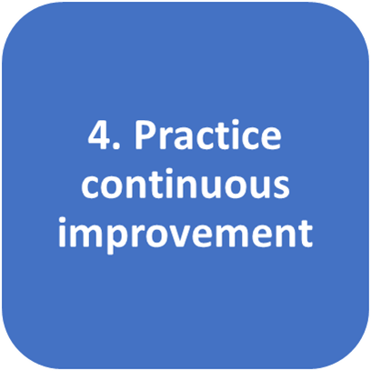

Slide 72
Resources to Drive High Quality Continuous Improvement
The SEL team does not yet use implementation data and disaggregated outcome data to track progress toward SEL goals and monitor outcomes. Staff do not yet have the time and skills necessary to engage in cycles of continuous improvement.
The SEL team has begun to use some implementation and disaggregated outcome data to track progress toward SEL goals and monitor outcomes. Staff are developing the skills necessary to engage in cycles of continuous improvement.
The SEL team uses a full range of implementation and disaggregated outcome data to track progress toward SEL goals and monitor outcomes. Staff have the time and skills necessary to engage in cycles of continuous improvement.
The SEL team uses a full range of implementation data and disaggregated outcome data to track progress toward SEL goals and monitor outcomes. Staff are highly-skilled at data reflection and planning, and have dedicated time and resources to engage meaningfully in regular cycles of continuous improvement.

Slide 73
Systems to Promote
Continuous Improvement
The SEL team has not yet identified a structured and ongoing process to collect, reflect on, and use data to inform school-level decisions.
The SEL team is in the early stages of identifying a structured and ongoing process to collect, reflect on, and use data to inform school-level decisions.
The SEL team has a structured, ongoing process to collect, reflect on, and use data to inform school level decisions. This process is used at strategic times (e.g., the beginning and end of each year), but does not yet happen consistently at each team meeting. The team communicates with and includes staff in this process on an annual basis.
The SEL team uses a structured, ongoing process to collect, reflect on, and use implementation and outcome data to inform school level decisions during each meeting. The team is empowered to lead staff in this process by regularly (at least quarterly) communicating their findings and creating opportunities to use data to drive continuous improvement at the school, classroom, family, and community level.

Slide 74
1. Build foundational support and plan for SEL
2. Strengthen adult SEL competencies and capacity
3. Promote SEL for Students
4. Practice continuous improvement
Thank you for joining.
What are your wonderings?
What are your next steps?
(CASEL) https://schoolguide.casel.org/what-is-sel/what-is-sel/

Slide 75
References and Further Reading
CASEL. (n.d.) The CASEL Guide to Schoolwide Social and Emotional Learning. https://schoolguide.casel.org/
Meyers, D. C., Domitrovich, C. E., Dissi, R., Trejo, J., & Greenberg, M. T. (2019). Supporting systemic social and emotional learning with a schoolwide implementation model. Evaluation and program planning, 73, 53-61.
Oberle, E., Domitrovich, C. E., Meyers, D. C., & Weissberg, R. P. (2016). Establishing systemic social and emotional learning approaches in schools: A framework for schoolwide implementation. Cambridge Journal of Education, 46(3), 277-297

Slide 76
References and Further Reading, Cont.
Jones, S., Bailey, R., Brush, K., & Kahn, J. (2017). Kernels of practice for SEL: Low-cost, low-burden strategies. New York, NY: The Wallace Foundation. https://www.liftscommunityhub.com/s/Kernels-of-Practice-for-SEL.pdf
Jones, S., Bailey, R., Brush, K., & Kahn, J. (2018). Preparing for effective SEL implementation. Harvard Graduate School of Education Easel Lab. Available from Wallace Foundation website: https://www. wallacefoundation.org/knowledgecenter/Documents/Preparing-for-Effective-SEL-Implementation.pdf

