Slide 1
Module 1
An Introduction to Motivational Interviewing
Notes:
Say: Welcome to this training series on motivational interviewing or MI. Throughout the six modules in this series you will learn what MI is, when and where MI can be used, how to embody the spirit of MI, the processes of MI, how to apply the foundational skills of MI, and how to use MI skills to meet someone wherever they are in their change process. Today we’re going to focus on an introduction to MI.

Slide 2
Notes:
Say: Before we get started, let’s clarify the language that we will be using throughout the training. We will be using the term “person making the change”. In your work settings, you might refer to this person as a job seeker, resident, client, etc. We want to use a general term like “person making the change” to encourage us to think about change as a universal experience. All of us have made changes, considered changes, successfully changed, or maybe not so successfully changed. The universality of change supports many of the concepts you will learn about in the modules of this training.
We are also using the terms “practitioner” or “provider” throughout to identify the person helping the person making the change. In your work settings, you may be referred to as therapist, clinician, employment specialist, case manager, peer specialist, or other job title. The terms practitioner and provider are intended to be inclusive of anyone supporting the person making the change.

Slide 3
Notes:
Say: Let’s start by doing some introductions. Some of you may already know each other, but please introduce yourself, share your role in the organization, describe any previous experience with MI, and talk about what you hope to get out of this series on motivational interviewing. I can start … [introduce yourself, your role in the agency, and why you think learning MI is important for your agency].

Slide 4
Module Objectives
1
2
3
4
Define Motivational Interviewing (MI) and its use in behavioral health services
Identify the intersection of MI and professional values
Describe the role of providers in facilitating change
Recognize the righting reflex and its impact
Notes:
Say: Today’s module will provide you with an introduction to motivational interviewing.
One of the things you’ll notice is that while eventually we will get to training on the use of specific “techniques”, what we’re talking about today and in the next module are the qualities and characteristics of the practitioner that help facilitate change. These are arguably as important as the specific techniques. Being good at the techniques in the absence of these practitioner characteristics won’t result in the positive outcomes associated with MI. These qualities and characteristics support what is referred to in MI as the spirit. Without this “spirit” or way of being, practitioners are simply practicing and implementing techniques, which you will see are important but not sufficient in the change process. This module, and the following module, provides an overview of these critical components of motivational interviewing.
At the end of this module, you will be able to:
Define motivational interviewing (MI) and its use in behavioral health services,
Identify the intersection of MI and professional values,
Describe the role of providers in facilitating change - including examining your own communication styles, and
Recognize the righting reflex and its unintended impacts.

Slide 5
0
Without follow-up, practice and feedback, most practitioners have
proficiency in MI after just attending a workshop
clinical trials
Motivational
Interviewing is now being taught in over different languages
200
43
MI has been applied and studied for over
30
years
1200
published studies
Notes:
Say: I want to begin by providing you with some background on motivational interviewing. MI is an evidence-based practice that has been used in a variety of settings to assist individuals in making behavior changes and achieving goals. It focuses on exploring and resolving ambivalence and is geared toward understanding and enhancing internal motivations that facilitate change.
Since 1990, there have been over 1200 published studies on MI as well as over 200 randomized clinical trials. The research reflects a variety of practice settings, modalities, behavior changes, and professions, including behavioral health services. MI was originally developed by William R. Miller and Stephen Rollnick about 30 years ago for use in the addictions field, specifically around smoking cessation. It began, in part, as an alternative to the traditional directive and sometimes confrontational approaches used in substance use treatment. It has grown since then to support people making changes in a variety of settings. Let’s look at some of the programs and services where MI is used.

Slide 6
Motivational Interviewing can be used in a variety of settings.
Notes:
Core Message: Motivational interviewing can be used in most, if not all, behavioral health settings.
Say: Motivational interviewing is practiced in many behavioral healthcare settings and offers an effective framework for behavioral health services that assist individuals in achieving goals and making changes. It works because it’s goal directed, person-centered, and incorporates many of the values that promote recovery and wellness for individuals participating in behavioral health services.
Motivational interviewing can be implemented in:
Supported Employment and Supported Education
Supportive Housing
Substance Use Treatment
Illness Management and Recovery
Assertive Community Treatment
Inpatient and Outpatient Mental Health Services
And many others.
[Insert an example of how motivational interviewing can be helpful in your setting or the setting your trainees are in. See below for some examples to help get you thinking.]
Examples:
Supported Employment and Supported Education are services designed to assist individuals in attaining career goals. MI is used in SE and SEd to assess and develop readiness and resolve ambivalence around career goals.
Assertive Community Treatment and housing teams provide support around community living and treatment goals and assist in resolving ambivalence around goals such as medication choices, housing situations, community involvement, etc.
Illness Management and Recovery is a curriculum-based intervention that supports goal achievement as well as helping people learn to manage aspects of their condition to maximize recovery. The focus is on achievement of recovery goals and MI is an approach used extensively to facilitate progress toward individual goals.

Slide 7
Values
MI is consistent with the goals, values and principles of many helping professions
Person-centered
Strengths-based
Collaborative
Goal focused
Positive Focus/Optimism
Notes:
Say: Motivational interviewing is aligned with the goals, values, and principles of many helping professions.
Motivational interviewing is:
Person-centered: As you will see, MI focuses on the person’s goals and desires and the practitioner elicits from the person their own reasons for change.
Strengths-based: As practitioners, we look for and assist the person making the change in identifying their strengths, skills, and positive attributes. We move away from looking solely at the person’s deficits or problems and instead focus on what abilities and supports they have that will contribute to successful change.
Collaborative: Practitioners using MI value collaboration and partnership with the person making the change. In MI, the person is the expert on themselves and we assist in guiding them towards change.
Goal-focused: MI is focused on the goals and desires of the person making the change.
Positive Focus & Optimism: MI practitioners bring positivity to their work and are optimistic and hopeful that the person is able to make their desired change.
We all had reasons for choosing the careers that we have in the helping professions. Our values along with the values of our respective professions may have guided us in a particular occupational direction.
Do: Ask participants:
What are some of your professional values or what is important to you in a career?
What are some additional values of your respective profession that are not be included above?
How do your own career values as well as your profession's values relate to MI?

Slide 8
ACTIVITY
My Recent Change
Pair up with a partner.
Talk about a successful recent change you personally made.
Who supported you? How did they help you make the change?
3 minutes each to share
Important: Choose something you feel comfortable sharing with the entire group!
Notes:
Core Message: We are all working on making changes. Change is universal.
Say: Now that you know MI focuses on making changes, I’d like for you to think about a change you’ve made. For this activity, please pair up with a partner. With your partner, please talk about a successful change you recently made in your life. If you can’t think of something recent, think about the last successful change you made. Just have a natural conversation with your partner about this change, but be sure to talk about who supported you and how they helped you make the change. Each of you will have 3 minutes to share. After the first 3 minutes, you will switch so that your partner can share. Remember, you should focus on something real in your life that you successfully changed, not on a change that a person in your services has made. Chose something you feel comfortable sharing in this group as we will continue to reflect back on this change throughout the trainings.
Do: Following the activity, ask participants:
What was it like to talk about this recent successful change?
How was it to share something about your life with someone that you may not know well?
What was it like listening to the person talk about their change?
Who supported you and how did they helped you make the change? – make sure to ask this question
Trainer notes: You want to highlight that talking about change may be uncomfortable or uneasy, especially if you are discussing a personal change with someone you just met and with whom you do not already have a good relationship. If these points do not come up in the discussion, you will want to raise them and ask participants to think about what it might feel like for someone else who might feel uncomfortable or uneasy sharing this information.
You will reflect back on this activity throughout the training. Continue to connect the content back to this initial activity.

Slide 9
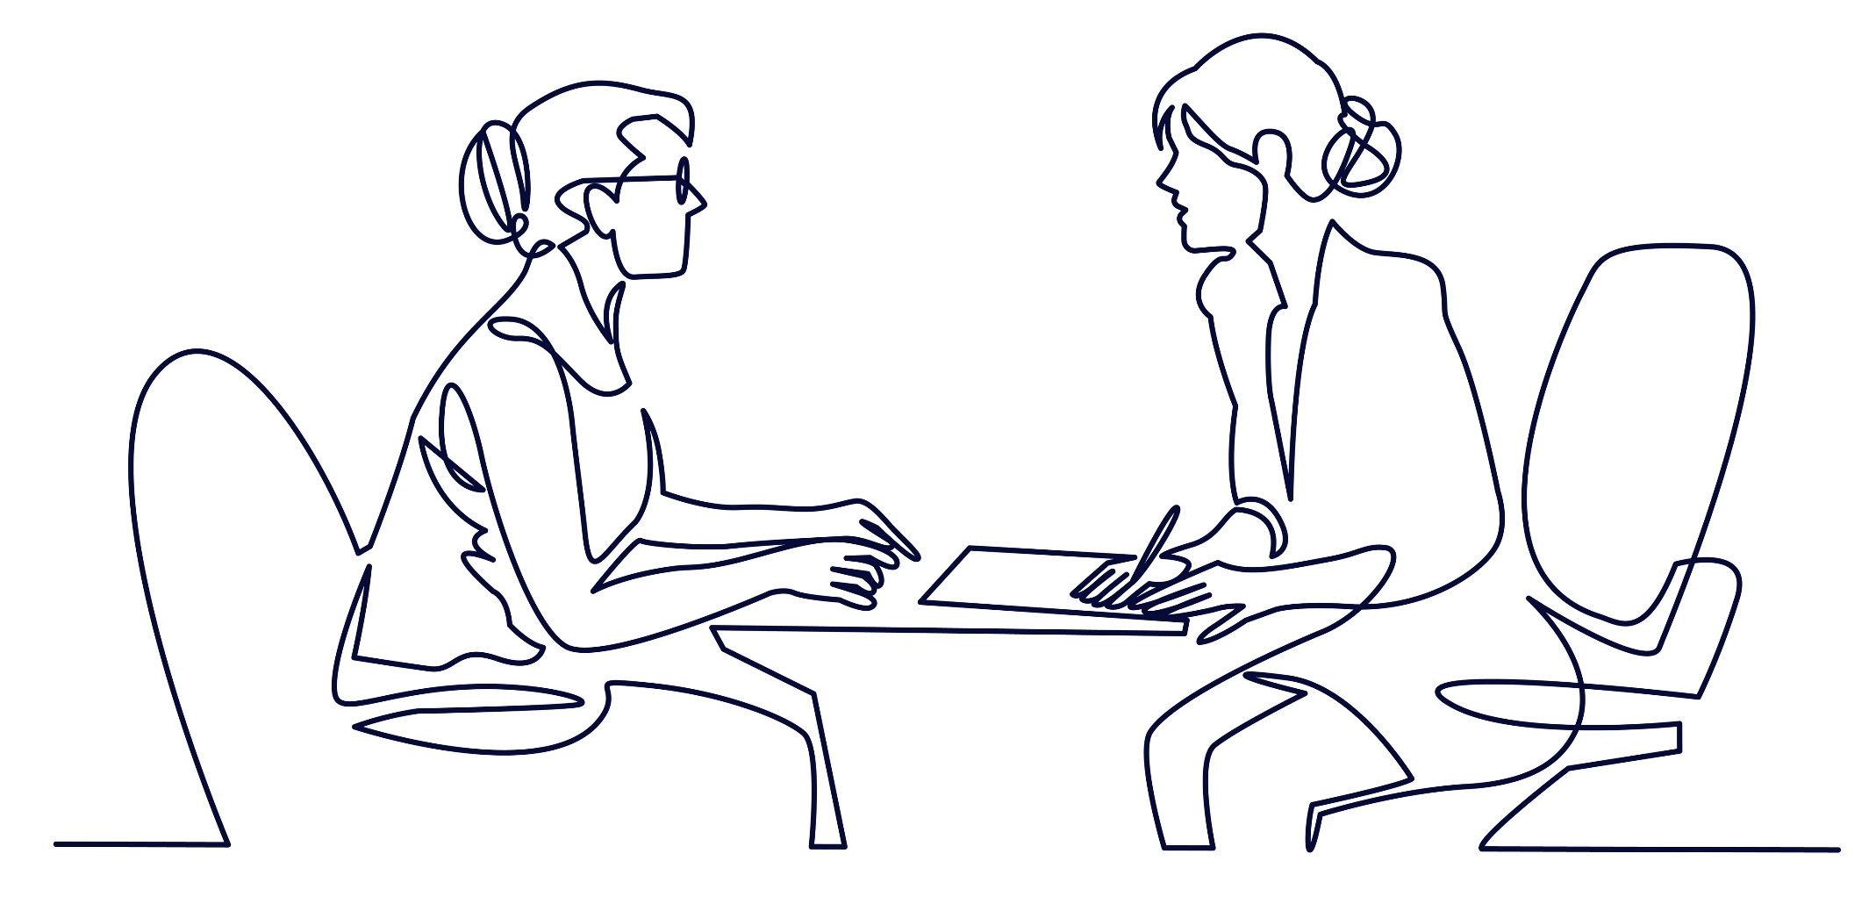
“
“
MI is a collaborative conversation style for strengthening a person’s own motivation and commitment to change.
Notes:
Core Message: Motivational interviewing is a style of engaging with someone to support them in making a change.
Say: In that activity I asked you to reflect on a change in your life to get you thinking about the processes and elements related to making a change – to start thinking about what helps and what gets in the way of change. Motivational interviewing, as we’ve discussed, is focused on behavior change and a style of engaging with another person to help them build within themselves motivation and a commitment to change. We know that telling people to change and pushing people to make a change often results in the opposite effect we want. Instead of changing they often push back against the change. Motivational interviewing takes a different approach.
The technical definition of MI is “…a collaborative, goal-oriented style of communication with particular attention to the language of change. It is designed to strengthen personal motivation for and commitment to a specific goal by eliciting and exploring the person’s own reasons for change within an atmosphere of acceptance and compassion” (Miller & Rollnick, 2012, p. 29). What’s most important in both the definition you see on the slide and the technical definition is that they both focus on MI being:
Collaborative,
A way and style of communicating, and
An approach to build motivation for change within the person.

Slide 10
MI is a collaborative, goal-oriented style of communication with particular attention to the language of change. It is designed to strengthen personal motivation for and commitment to a specific goal by eliciting and exploring the person’s own reasons for change within an atmosphere of acceptance and compassion. Miller WR & Rollnick S (2012). Motivational interviewing: Helping people change (3rd ed). New York: Guilford.
Notes:
Core Message: Motivational Interviewing is a style of engaging with someone to support them in making a change. (continued)
Say:
What’s included in the technical definition, but not captured in the previous definition, is an emphasis on MI being goal-oriented and focused on specific behavior change. Using an MI approach, you can help someone focus in on a specific area they want to change. Sometimes people know what they want to change or “should” change, but they may feel ambivalent about making the change. Other times people may not know exactly what they want to change and you will need to work collaboratively with them to elicit this information.

Slide 11
Target Behaviors
Actions that move toward change
Goals and behaviors are interdependent
Notes:
Core Message: Without a target behavior, MI is just client centered counseling.
Say: The fact that motivational interviewing is goal-directed is a critical element and one that differentiates it from client centered counseling. You must work with the individual to identify a desired behavioral outcome. Target behaviors are those actions that move someone toward this change. This gives your collaboration a destination and a strategy of how to get there.
For people who don’t yet know what their desired outcome is, you may not be directly asking them about their target behavior. Instead you may ask things like, “what would you like to work on?”, “what is important to you?”, or “what is currently getting in the way?”. You may need to elicit discrepancy between their current behavior and their overall goals and values.
Do: Ask participants:
What are examples of goals you typically work on with people?
What are typical target behaviors for people you work with?
What are some of the goals people have?”
For example, a person may have a goal of getting a job and a target behavior might be writing a resume or any other activity that moves them toward this goal.

Slide 12
Role of Providers
Notes:
Say: Based on what you already know about MI, you can see that you play a key role in supporting others to make their desired changes. I mentioned at the beginning that the techniques and skills are only one part of MI. The other important part is the spirit which is embodied and communicated through you. The style you bring to the collaboration has a big impact on the process and outcomes. Let’s explore the role that providers play in facilitating change and the characteristics and qualities of practitioners that convey the spirit of MI.

Slide 13
ACTIVITY
Qualities and Characteristics
Return to last partner
You and your partner will each have 3 minutes for the following:
Think about the change(s) you discussed earlier with your partner
Identify what qualities and characteristics of the person who helped you contributed to your change process.
Take notes and write down the qualities and characteristics your partner identifies.
Be prepared to share with larger group.
Notes:
Core Message: Certain personal characteristics and qualities that we find naturally supportive and conducive to change make up MI.
Say: Certain personal characteristics and qualities that we find naturally supportive and conducive to change make up the spirit of MI. Let’s explore this by revisiting the activity you completed with your partner earlier. You were asked to identify who supported you and how they helped you make the change you discussed. For this activity, I’d like you to discuss with your partner, what qualities or characteristics about the person(s) were helpful in supporting your change. Write down the characteristics you each share about those who supported you. You will each have 3 minutes to share and then you will switch.
Do: Following the activity, do the following:
1. Have participants volunteer to read some of the characteristics they wrote down. After, each person reads their partner's responses, reflect back some of the answers. (Write down the responses on white board, flip chart, or chalk board—if not available, just use your own paper and write down as people state their responses.)
2. After all the characteristics have been shared, read the responses aloud. Highlight as you read each response how that can apply in an MI context. Make the link between what is naturally supportive in everyone’s lives and how those same qualities are supportive when working with people making changes in your work. In processing this activity, you will want to highlight that MI is more than just a set of techniques, the practitioners’ qualities and characteristics are equally important. An example of what to highlight may be, "It sounds like people identified characteristics like listening and not giving advice versus just telling you what to do." Emphasize that these are not skill or technique related.
Trainer notes: This activity highlights that there is more to MI than just a set of techniques that practitioners use with people making a change. We are getting into the qualities of effective practitioners and beginning our discussion of the spirit of MI, which will occur in more detail in Module 2.
Some of the answers that you will get should help you connect to the spirit of MI and the four element - partnership, acceptance, evocation, and compassion that comprise the spirit. You can also use the responses when referring to the different communication styles on the next slides. Refer the participants back to the qualities and characteristics they identified in this activity as you begin to talk about communication styles and each of the factors of the spirit of MI. Keep your list of the characteristics identified so you can refer to the specific qualities and characteristics related to each factor of the spirit of MI in Module 2.

Slide 14
Communication Styles
Guiding
Directing
Following
Best For MI
Notes:
Core Message: Different styles are appropriate for different settings and situations. MI is most conducive to a guiding style of communication.
Say: Now that we’ve identified some key individual characteristics that support the change process, let’s look at the role of different communication styles and how they contribute to facilitating change.
Miller and Rollnick describe these three communication styles of helpers on a continuum. As you can see, on the far left of this continuum is a directing style. A directing style is used to provide information or instruction and involves telling the other person what they should do. An example might be a nurse explaining how to take a medication properly or a physical therapist describing how to do a particular stretch. At the other end of this continuum is a following style. A following style is characterized by just listening to the person without introducing any information or asking any questions and allowing the person to lead the conversation. An example of this style can be seen when a practitioner “hears out” a person who is expressing strong emotions --whether that is sadness, anger, excitement or other strong feelings. The practitioner is listening with the intent of following and understanding what is being shared. In the middle is a guiding style. This guiding style is best suited for MI. A guiding style of communication conveys the message that the person is able to make the change and the provider is there to support the individual, but not by telling them how to change or bringing a specific agenda. In the guiding style you are not just passively listening or taking control of the conversation. Although there may be times when a directive or following style is appropriate or needed in a given situation, MI typically uses a guiding style of communication.
Miller and Rollnick provide this helpful analogy: “Imagine going to another country and hiring a guide to help you. It is not the guide’s job to order you when to arrive, where to go, and what to see or do. Neither does a good guide simply follow you around wherever you happen to wander. A skillful guide is a good listener and also offers guidance where needed.”
Let's review the communication style you tend to use in order to better understand and assess your strengths and possible areas of growth. There are a variety of methods to assess your communication style. Once you know what your style is and how you may be coming across to people you are working with, it is easier to adjust and modify as needed to match the circumstance. Between the end of this session and our next meeting, I’ll ask you to complete an online assessment, but for now let’s do a brief activity.
Do: Ask participants:
How would your colleagues and the people participating in your services describe you using five verbs that illustrate your communication style?
After the activity, do the following:
Ask a couple of participants to read their list. Write out or just restate the verbs that people are sharing.
Refer back to the list of helper characteristics they identified in the earlier activity. Pull out and identify the characteristics that correspond to the verbs they are describing in this activity.
Tell participants to keep their list handy as they will be referring to it again in the next slide.

Slide 15
Directing, Guiding or Following?
Administer
Prescribe
Encourage
Be with
Shadow
Assist
Collaborate
Advice giving
Direct
Accompany
Observe
Confront
Prescribe
Elicit
Support
Manage
Notes:
Core Message: There is value in assessing and adjusting our communication styles to better facilitate change discussions with individuals.
Say: You just identified some of the verbs that describe your style. Looking at the list here, what other verbs did you identify that are not listed here? The verbs listed represent a directing, guiding, or following style. Let's see if you can identify which ones support which style. Let's also see what category the verbs you each identified fall into.
Do: Review the verbs on this slide. Ask participants which style each verb represents. Next, have the participants read to you the verbs that they identified in the previous activity. Ask where these verbs belong. Emphasize during the exercise the importance of self-assessment in order to gain a better understanding of your communication style.
Administer - directing Direct - directing
Prescribe - directing Accompany - guiding
Encourage - guiding Observe - following
Be with - following Confront - directing
Shadow - following Prescribe - directing
Assist - guiding Elicit - guiding
Collaborate - guiding Support - guiding
Advice giving - directing Manage - directing
Say: The way we communicate and approach people greatly impacts the change process. Many of us were trained to be directive and "fix what is wrong" for people, but when people are considering making a change and potentially feeling ambivalent or conflicted about the change, this style is not the most helpful. Similarly, a following style is also often not helpful. It’s good to continue to assess your style. You may want to ask those you’re supporting to provide input regarding their experience of your style. If the verbs are too directive or too passive, you may want to do some reflecting to determine how to have a more guiding style.

Slide 16
Forcing Change
Sustain Talk Keeping things the same Maintaining the status quo
Response to pressure to change
Discord A disconnect Not moving together towards the same goal
Response to not feeling understood or feeling judged
Indicates A shift in approach is needed
You can help by understanding motivations for change.
Notes:
Core message: The individual who is considering a change is the expert! Practitioners are there to guide the person.
Say: As we just discussed, the directing style often doesn’t have the intended effect when we use it to try to encourage someone to make a change. This is especially true when the person feels ambivalent, or both wants to make the change and doesn’t want to make the change at the same time. Instead, directing can have the opposite effect and the person can become less likely to make the change. You may have heard this referred to as resistance, when it appears the person is resisting your pressure to change. In motivational interviewing we have moved away from the term resistance because of the negative connotation associated with it and instead moved toward addressing the two components related to ambivalence, sustain talk and discord.
Sustain talk is an argument for keeping things the same or maintaining the status quo. Sustain talk can be expressions of wanting to keep things as they are, reasons why they need to stay the same, or concerns about not being able to change. This can occur in response to the provider pushing and urging for change.
Discord is associated with the interpersonal behavior between the practitioner and the person making a change and reflects a disconnect in the working relationship. This can occur if the person doesn’t feel understood, feels they are being judged, or doesn’t feel there is good collaboration. Discord indicates that the practitioner and the person are not on the same page and moving together toward the identified goal.
Sustain talk and discord may be indicators that the provider is moving faster than the person toward the change. Think about the change(s) you identified earlier. Did you feel any ambivalence about making that change? What happened when you felt someone was pushing you too hard or telling you what you needed to do?
Sustain talk and discord should not be viewed as problem behaviors on the part of the person making the change but rather an indication that the provider may need to shift their approach and work to come alongside the person making the change and remind them that they are the expert in their change process. We will talk more about sustain talk and discord in later sessions.
Remember that there is little you can do to make someone change. You can, however, help the person better understand their own motivations for change.

Slide 17
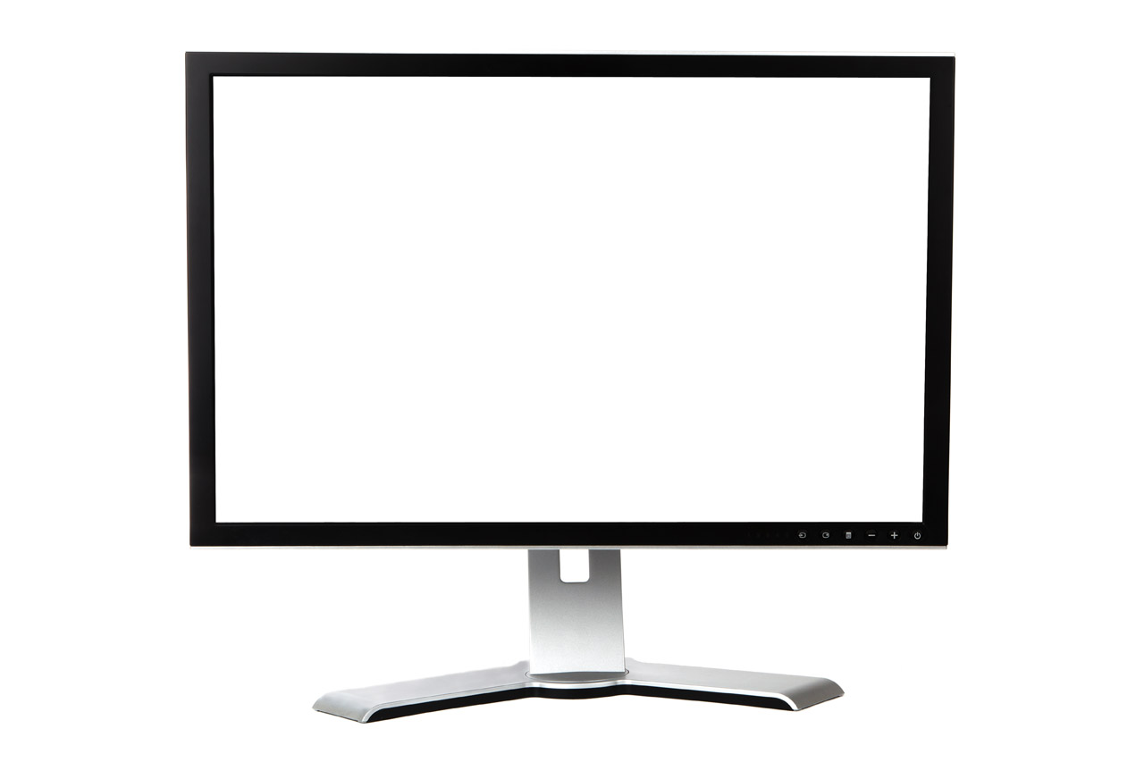
https://www.youtube.com/watch?list=PL1UDVLmMXEEdIVofbgt4d6sLAe5pulbPC&v=d2t9y5bptz0&feature=youtu.be
Notes:
Core Message: Practitioners are often too quick to try and "fix" the problem.
Say: Despite understanding that we can’t make someone change, it’s often very hard for us to not want to use our experience and expertise to try to fix or solve a person’s problem. In MI we refer to this urge to tell the person how they should change (and using the directing approach), the righting reflex.
The righting reflex is when providers want to make things right or step in by telling the person how they should change their behavior. To try to make this happen we may argue, persuade, or prod the person to make the change. Unfortunately, this often leads to the person arguing against the change (that is, sustain talk) and possibly discord.
Let’s watch a brief video clip of an exchange between a practitioner and a person considering making a change. As we watch, write down any words or phrases you hear that sound like the righting reflex. They may sound like advice, judgement, or directives.
Do: Play the video clip for the participants. During the video, write down words that sound like advice or sound judgmental. After the video clip is over, ask participants:
What did you hear Amy (the provider) say that indicated she was having a righting reflex?
What was the impact of the righting reflex on Doretha (the person considering the change)?
What are some examples of times in the past when you have exhibited the righting reflex?
What are some of the problems that arise if practitioners are too quick to jump in and fix or offer solutions to the problem?
Say: Even though your intentions may be good and you may think that you’re helping the person by providing good advice or helping to fix the situation, you have to recognize that change needs to come from within the person. Motivational interviewing provides an approach that can help you avoid the righting reflex and support the building of intrinsic motivation within the individual making the change.
Link to Video
https://youtu.be/d2t9y5bptz0?list=PL1UDVLmMXEEdIVofbgt4d6sLAe5pulbPC

Slide 18
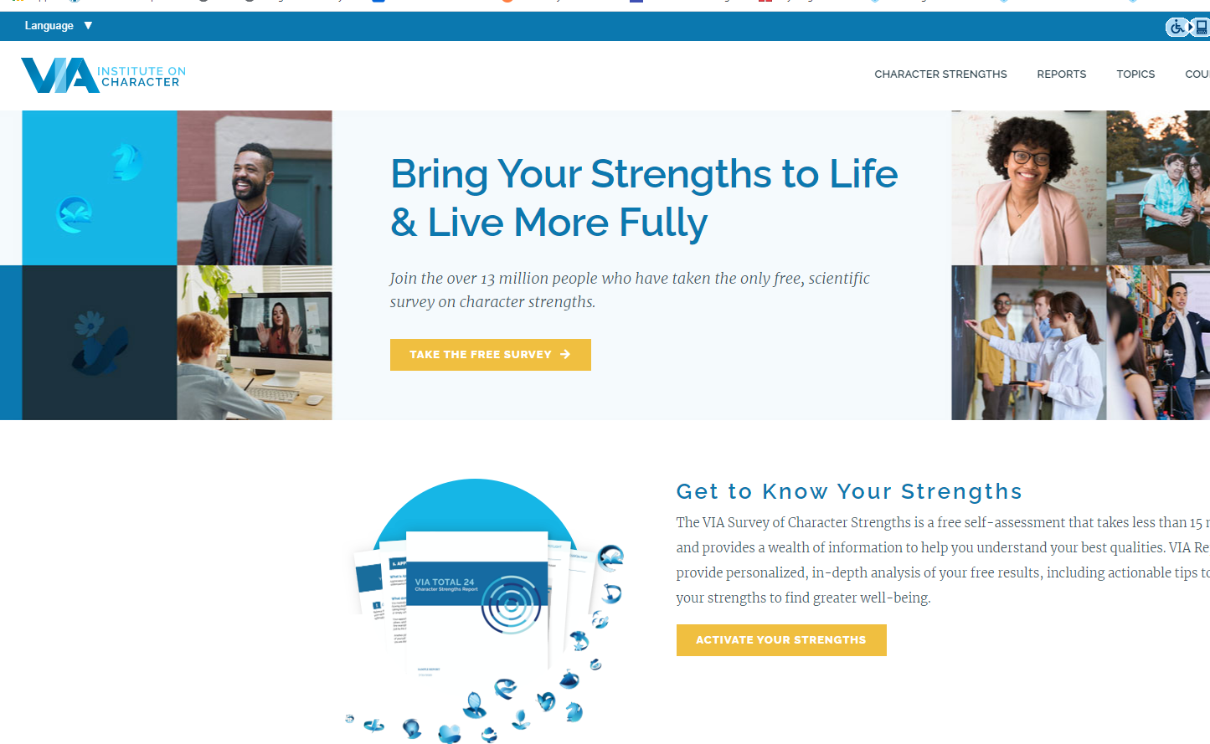
https://www.viacharacter.org/
Notes:
Say: We learned in this module that your communication style and how you engage with someone is critical to MI. For this module’s learning application, please take a very brief online assessment of your character strengths. We will further review the results and discuss how to use these results to inform and modify your style to be more inline with the guiding approach during the next session. The goal of this assignment is to better understand your strengths so that you can expand on them while also identifying things you may want to change.
Do: Ask participants to take the above self-assessment prior to the next session. Explain to participants that the assessment takes no more than 10 minutes, and they will receive a brief overview of their top character strengths. For a fee, they can order additional reports, but for these purposes the information on the top character strengths is sufficient and available for free - there is no need to purchase any additional information. Ask participants to print out the report or write down their signature strengths and some of their middle and lesser strengths and bring them to the next session.

Slide 19
SUMMARY
Module 1
Collaborative
Supportive
Conversational
Guiding
An approach to help people considering change
Strengthens motivation and commitment for change
Helps examine ambivalence towards change
Develop a guiding style of communication
Resist the “righting reflex”
Notes:
Say: So far we have defined motivational interviewing as a collaborative conversational approach to helping people make changes. It helps strengthen their own motivation and commitment for change and begins the conversation to build confidence and a plan to support change. MI specifically helps people examine their ambivalence toward change.
We examined and took a closer look at communication styles and identified the most conducive style to supporting and encouraging change.
We saw that practitioners may be quick to offer solutions and suggestions to individuals making a change, but that while well intentioned, this strategy may generate discord and sustain talk. MI is an approach to facilitate change and offer a counter to the righting reflex. MI emphasizes that the practitioner's role is not one of expert but one of guide.
In the next session, we’ll dive deeper into the spirit of MI and the four elements that comprise the spirit.

Slide 20
Questions?
Notes:
Say: What questions or comments do you have?

