Slide 1



Module 3
The Processes of Motivational Interviewing
Notes:
Say: During the last session we talked about the spirit of MI and how critical embodying the spirit is. During this module we will begin to build on the spirit and talk about the processes of MI and specifically the methods used in MI. Let’s start with a brief review of the last module.

Slide 2

REVIEW
Module 2
MI is a collaborative approach, power is shared
We respect the person and their freedom of choice
The needs of the person making the change are most important, avoid judgement
The individual making the change has the motivation and resources to do so
Partnership
Acceptance
Compassion
Evocation
Notes:
Say: During the last session we discussed the four factors that make up the spirit of MI. The first factor is partnership or doing ‘with’ and not ‘for’ or ‘to’ someone. There is a collaborative approach used in MI and power is shared. The practitioner values the person’s expertise about themselves and recognizes that the person making the change is the expert in their own life.
The second factor is acceptance which conveys we respect the person and their freedom of choice. It’s made up of four components:
Absolute Worth or believing that the person making the change has inherent worth and that they deserve respect and to be treated with dignity.
Empathy or seeking to understand the person making the change's point of view, experiences, and emotions, including any deeper meanings that may not be explicitly stated.
Autonomy or respecting that the person making the change is in control of the change and the change process. The practitioner accepts and respects the person’s decisions.
Affirmation or recognizing and highlighting the strengths and positive characteristics of the person making the change, particularly the things that relate to and may support the change they are considering.
The third factor is compassion and refers to the needs of the person making the change being first and foremost. Practitioners seek to understand the person's values and experiences without judgment. We do this even if these conflict with our own ideas about the change and what we think is best for the person.
The fourth factor is evocation in which the practitioner elicits from the person making a change the reasons for the change and ideas about how the change will happen. This conveys to the person that you know they have the resources and motivation within themselves to be successful.
Embracing these factors will facilitate and support the person making a change. They are a critical component of motivational interviewing.
Do: Ask participants:
What was the most important thing you took away from Module 2?
How did your work with participants change based on what you learned in Module 2?
What questions do you have about what was covered in Module 2?

Slide 3

ACTIVITY
Taste of Motivational Interviewing
Describe your experience using the taste of MI.
What information were you able to gather from the conversation?
How did this experience compare to other conversations you’ve had with them?
How did this experience help to convey the spirit of MI?
Notes:
Say: At the end of the last module we experienced a taste of MI and asked you to try the activity with someone you’re providing services to. You were to note your experience using the approach and how the exchange was similar or different from other conversations you’ve had with the person.
Do: Ask participants:
Describe your experience using the taste of MI with someone you work with.
What information were you able to gather from the conversation?
How did this experience compare to other conversations you’ve had with them?
How did this experience help to convey the spirit of MI?

Slide 4

Module Objectives
1
2
3
4
Define the four processes of motivational interviewing
Differentiate between sustain talk and change talk
Practice assessing motivation for change using the DARN-CAT
Develop strategies for moving from change talk to planning
Notes:
Say: Today we’re going to begin talking about the structure of motivational interviewing and the processes and methods it uses. You'll notice that the processes and methods overlap and fit with the spirit. They need to be used together for motivational interviewing to be effective.
At the end of this module, you will be able to:
Define the four processes of motivational interviewing
Differentiate between sustain talk and change talk
Practice assessing motivation for change using the DARN-CAT
Develop strategies for moving from change talk to planning

Slide 5
WHY?
Notes:
Core Message: Motivation for change comes from the person’s ‘why’.
Say: As providers we are often very skilled at helping people think about how to make changes. We can help connect people with resources, we can provide information, and develop a goal plan. Sometimes, however, we forget to ask people about their ‘why’ for the change. We don’t always ask about the meaning behind the change or the reasons someone wants to make a change. Getting at this why is critically important in helping to build internal motivation. The four key processes that we’ll talk about today help to get at someone’s ‘why’.
You can think about this in your own life. If I ask you how you do your job you may tell me about the skills you use or the activities you do. If I ask you why you do your job you’re likely to share internal and external motivations for your work. For example, you may say you want to help people, an internal reason, or it helps to pay the bills, an external reason. Either way your ‘why’ is about who you are and your values. These are your motivations for continuing in your work. If there is a mismatch between your values and your actions, you may consider making a change and this move to align your values or your ‘why’ with your actions creates motivation for change.
Do: Ask participants:
Why are you here today?
Why do you care about learning MI?
Why is it important to do you’re your work today?
How does your why align with your values?
After the activity, ask for volunteers to discuss their responses. Make the connection to why this type of discussion might be helpful with individuals who are making a change?
Trainer notes: People’s reasons for change are related to their why. Their why needs to be clear before we move into the how.

Slide 6
Engaging
Focusing
Evoking
Planning
4 Key Processes in MI
Notes:
Say: Helping people identify their why and build their motivation for change is supported by the four key processes of MI. The processes help make your work with the individual making a change strategic and purposeful. These processes follow a logical sequence, as each builds on the one before, but they also overlap, and you will likely circle back to previous processes throughout the helping relationship. Often in our work we focus heavily on the planning process – the how. We focus on the actions the person will take to make a change. As we review each of the processes in the upcoming slides, you’ll see how important it is that you also focus on the other processes as well.
As we discuss each of these processes, think about a person or people that you have, or are, supporting to make a change and see if you can identify actions you’ve taken that represent the difference processes.

Slide 7

Engaging
Listening, showing empathy, being person-centered, seeking to understand other’s perspective
Notes:
Core Message: Effective engagement helps to create and build a trusting relationship.
Say: The first process we’ll talk about is engaging. Engaging involves listening, showing empathy, being person-centered, and seeking to understand the person’s perspective. This approach helps to create a working alliance and build trust. Engaging is a necessary first step as it creates the relational foundation for your work.
Engaging includes both a communication style and the spirit of MI. Engaging aligns with the spirit as it helps to create a successful partnership and convey acceptance. Engaging also highlights some of the things providers should avoid. Providers want to listen empathically without trying to “fix” or find solutions. In other words, you want to resist the righting reflex we talked about in Module 2. You also want to resist using a directing style, like we talked about in Module 1. In terms of a communication style, while focused on engaging, practitioners should avoid fact gathering. This is a time when the practitioner is just connecting with the individual and building that relationship. Replace questions or fact gathering with reflections – which we’ll talk more about in Modules 4 and 5.
Think about these questions related to engagement:
How comfortable is the person when talking to me?
Do I understand the person’s perspective and concerns?
How supportive am I being?
Do: Ask participants:
Think about a time when you started a new voluntary activity – it could be a sports club, a book club, another mutual interest club, activity, or association, a religious or spiritual community, or a support group or therapy. After the first time you went, what contributed to your decision to return?
As the group identifies these factors, write them down. Refer to these factors as part of the discussion of the next slide when you review the five factors that promote engagement.
Trainer notes: If the group is unable to identify factors that helped them decide to return, use an example of your own. A possible example is starting yoga classes for the first time. The factors that contributed to wanting to return might include friendly, welcoming staff/teachers, not feeling judged, teachers being genuinely interested in helping you understand the poses, a clean and relaxing environment, a water cooler, etc.

Slide 8

Goals and Desires
Importance
Expectations
Positivity
Hope
Factors That Promote Engagement
Notes:
Core Message: Effective engagement encourages the person making a change to connect with you and makes it more likely they will return to continue the process.
Say: There are several factors that promote engagement and encourage the person making a change to connect with you and be willing to open up. Perhaps you identified some of these factors in the previous activity. Let’s take a look.
Miller and Rollnick identify five basic strategies that can facilitate engagement:
Goals and Desires: You want to convey to the person that you are interested in supporting them in a change they want to make. You acknowledge they are the expert in their change, and they will take the lead in this process. You will guide them, but not direct them. In order to do this, you need to understand the person’s goals and desires. Why is the person coming to see you now? What do they want out of their work with you? Ask and listen to the person describe their goals and what they wish to change and accomplish.
Importance: You can further build an alliance with the person by understanding the importance of the goal for the person making the change and letting them know that their goal is important to you as well.
Expectations: Provide the person with some sense of what they can expect from their work with you. Orient them to the process and make certain to describe both your and the person’s roles and responsibilities. This will help ensure that you are both on the same page which can facilitate engagement.
Positivity: Look for what you can genuinely appreciate and comment positively on related to the person making the change.
Offer Hope: Present a hopeful picture of the changes you believe the person can make and how you can support them in making the change. Optimism and positivity are similar in that they both convey that you believe in the person’s ability to achieve their goal or make their desired change.
Finally, consider offering the person a cup of coffee. This isn’t one of the factors that Miller and Rollnick identify but this concrete action can communicate a level of welcome and care that can be quite powerful and support engagement. Of course, it doesn’t have to be a cup of coffee – but thinking about a concrete way to show you value and appreciate the person and that you are there for them can help build your partnership.
Do: Return to the list of factors identified in the previous exercise, ask participants:
In what ways do the factors you identified as supporting your connection to a new activity align with the factors that promote engagement?
Facilitate a brief discussion about the factors and how they can support building engagement.

Slide 9

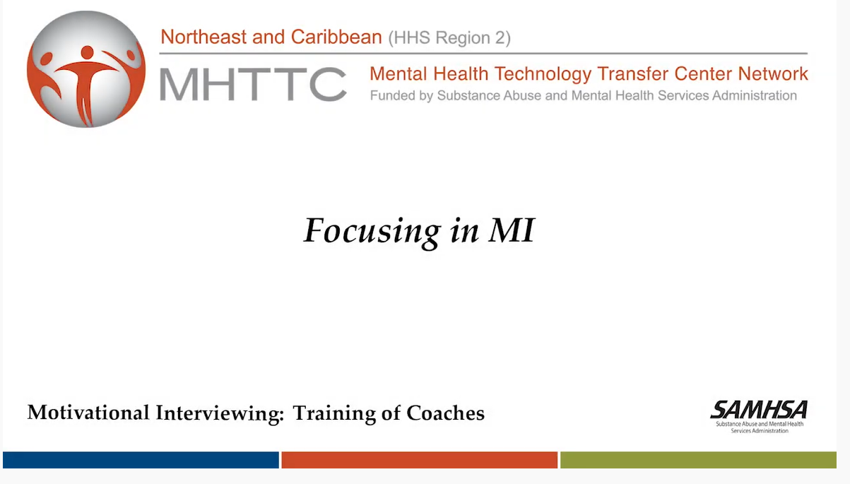
https://www.youtube.com/watch?list=PL1UDVLmMXEEdIVofbgt4d6sLAe5pulbPC&v=3WmsuZ_X8HE&feature=youtu.be
Notes:
Core Message: Focusing helps to clarify the person’s change goal.
Say: Next we’re going to discuss the process of focusing. The purpose of focusing is to clarify and hone in on the person’s goal for change. This helps set a clear direction or target for your work together. Remember that it is up to the person what it is they would like to focus on. The practitioner should respect the person’s autonomy and be there as a partner.
Think about the following questions:
What are the person’s goals for change?
Are we working together with a common purpose?
Do I have different ideas about what this person should focus on?
Do I have a clear sense of where we are going? Does the person?
In the process of focusing, you will work with the person to explore their target behavior. Sometimes the person knows exactly what they want to change and sometimes they need to go through some more exploration. A common pitfall at this stage can be to jump too quickly to identifying the change and how it can be made. If a practitioner brings their own agenda into this process it can unintentionally direct the focusing process away from the individual’s own desired change. Make sure to allow time and space to help the person decide what is important to them and where they want to focus in your work together. If the person identifies several areas for change, you can help by assisting the person to prioritize those areas and identify a place to begin.
Having a strong relational foundation that you’ve built through engaging will be very important in the focusing process. If trust and a strong working alliance aren’t there, focusing and the following processes will not be successful.
Do: Watch the video clip on focusing, then ask participants:
What is the target behavior?
How do we know this is the target behavior?
What are some of the ways that Ken is helping PJ to focus?
Video link:
https://youtu.be/3WmsuZ_X8HE?list=PL1UDVLmMXEEdIVofbgt4d6sLAe5pulbPC

Slide 10
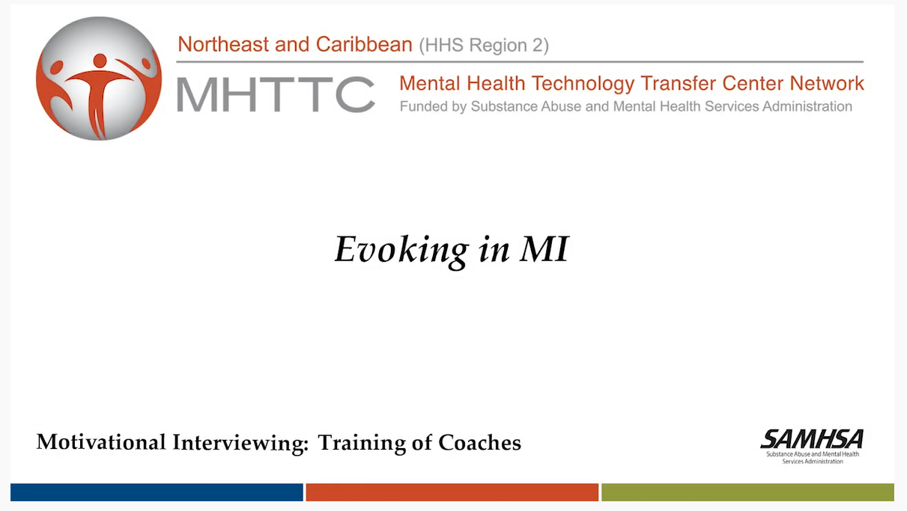
https://youtu.be/IrRKArUyNM4?list=PL1UDVLmMXEEdIVofbgt4d6sLAe5pulbPC
Notes:
Core Message: Evoking draws out the person’s own motivation for change.
Say: Now that the person is focused on a change goal, the next process is evoking. Evoking elicits the person’s own intrinsic motivations and ideas for change. The provider helps the person identify why they might change - identifying and putting into their own words the reasons for change. The provider wants to listen closely to what the person is sharing to be able to hear words and phrases that suggest a desire, willingness, need, or ability to change. When you hear these things, you’ll want to reinforce them to help build motivation for change. The provider should also listen for words and phrases that suggest ambivalence, reluctance, fear, or lack of confidence about the change.
In the next slide and in the upcoming modules, we are going to go over useful techniques that will help you draw out information during this evoking process and what to do when the person is talking against making the change. But before we get to those, let’s watch a brief video to demonstrate what evoking can look like in a discussion with someone.
Do: Ask for participants to look for examples of evoking and motivations that are identified.
What did Ken say or do to help evoke PJ’s motivations for change?
What did PJ say that let you know she was sharing motivations?
What motivations did PJ share?
Video Link:
https://youtu.be/IrRKArUyNM4?list=PL1UDVLmMXEEdIVofbgt4d6sLAe5pulbPC

Slide 11

Sustain Talk
Keeping things the same
Maintaining the status quo
Response to pressure to change
Discord
A disconnect
Not moving together towards the same goal
Response to not feeling understood or feeling judged
Indicates
A shift in approach is needed
Change Talk – Sustain Talk
You can help by understanding motivations for change.
Notes:
Say: In the video we just watched, we talked about how you recognized the person’s motivations for making a change. People use various words and phrases to convey their reasons for making a change. Sometimes they also share reasons against making a change or for keeping things the same. In motivational interviewing these are referred to as change talk and sustain talk. Making a change is difficult and often we have reasons for changing and reasons for maintaining the status quo. This can sometimes feel like an internal tug of war. How the practitioner responds to both change talk and sustain talk can impact the likelihood of the change occurring.

Slide 12

Message: Change talk is any talk in the direction of change.
Change Talk
Any talk that suggests movement toward or supports change of the target behavior.
When heard, acknowledge, reinforce and summarize the change talk.
Notes:
Core Message: Change talk is any talk in the direction of change.
Say: Change talk is any talk from the person that favors movement toward or supports change of their target behavior. Change talk can express the person’s desires, ability, reasons, and need to change. It can also convey their optimism about making a change and the benefits of succeeding in this change.
The practitioner should acknowledge, reinforce, and summarize change talk when they hear it. For example, if a person who has been considering going back to school but has also expressed ambivalence about it shares that their new job has a requirement that they obtain their bachelor’s degree, the practitioner can highlight this person’s change talk. They could say: “It sounds like you might be thinking about returning to school sooner than expected because of the expectations of your new job”.

Slide 13
Preparatory Change Talk -- DARN
D
Desire to change (want, like to, wish)
A
Ability to change (can, could)
R
Reasons to change (if..then)
N
Need to change (need, have to, got to)
Notes:
Say: There are two types of change talk. The first is preparatory change talk or discussion of the person’s desire, ability, reason, and need to change. Also know in MI by the acronym DARN. It’s important to understand the different types of change talk so you can recognize them when you hear them.
D is the person’s desire to change. Desire for change can be identified by use of words like want, like to, or wish. It can sound like: “I want to reduce my bad cholesterol”; “I would like to get a better job”; “I wish I were more comfortable around people”; or “I hope to get A’s and B’s in school next year”. While desire for change is important, it is not absolutely necessary for change. People can make changes because they have to, even if they don’t want to.
A is the person’s belief in their ability to make the change. When someone conveys their ability to change they may use words like can, could, able to, or possible. For example, you may hear things like, “I can get a job”; “I could quit drinking”; or “It’s possible for me to be in a romantic relationship”. Ability language suggests that the person believes that the change is possible for them to achieve.
R is the person’s reasons for change. The reasons may sound like a rationale, justification, or motive for making the change. Reasons often come in the form of if/then statements. For example, “If I went back to school, then I could probably get a higher paying job”; “If I stop smoking, I will be able to save the money I’m spending on cigarettes”; or “If I lose weight, I will be able to have better control over my diabetes”.
N is the person’s need to change and highlights the overall importance or the person’s urgency to change. Need statements don’t say speciﬁcally why change is important but instead convey a general level of need. You may hear words like I need to, have to, or can’t keep. For example, people may say things like, “I’ve got to get a new job”; “I can’t keep going on in this relationship”; or “I must stop using drugs”.
You want to be listening for this change talk and reinforcing it as you hear it.

Slide 14
Preparatory Change Talk -- DARN
D
I want to reduce my bad cholesterol.
A
I can get a job.
R
If I went back to school, then I could
probably get a higher paying job.
N
I’ve got to get a new job.
Notes:
Say: There are two types of change talk. The first is preparatory change talk or discussion of the person’s desire, ability, reason, and need to change. Also know in MI with the acronym DARN. It’s important to understand the different types of change talk so you can recognize them when you hear them.
D is the person’s desire to change. Desire for change can be identified by use of words like want, like to, or wish. It can sound like: “I want to reduce my bad cholesterol”; “I would like to get a better job”; “I wish I were more comfortable around people”; or “I hope to get A’s and B’s in school next year”. While desire for change is important, it is not absolutely necessary for change. People can make changes because they have to, even if they don’t want to.
A is the person’s belief in their ability to make the change. When someone conveys their ability to change they may use words like can, could, able to, or possible. For example, you may hear things like, “I can get a job”; “I could quit drinking”; or “It’s possible for me to be in a romantic relationship”. Ability language suggests that the person believes that the change is possible for them to achieve.
R is the person’s reasons for change. The reasons may sound like a rationale, justification, or motive for making the change. Reasons often come in the form of if/then statements. For example, “If I went back to school, then I could probably get a higher paying job”; “If I stop smoking, I will be able to save the money I’m spending on cigarettes”; or “If I lose weight, I will be able to have better control over my diabetes”.
N is the person’s need to change and highlights the overall importance or the person’s urgency to change. Need statements don’t say speciﬁcally why change is important but instead convey a general level of need. You may hear words like I need to, have to, or can’t keep. For example, people may say things like, “I’ve got to get a new job”; “I can’t keep going on in this relationship”; or “I must stop using drugs”.
You want to be listening for this change talk and reinforcing it as you hear it.

Slide 15

ACTIVITY
DARN Ruler
One Volunteer
Think about a change you are considering making.
Take out the DARN ruler handout.
Scale of 1 to 10, with 1 being the lowest and 10 the highest, what is your desire to make the change? (D)
What is your ability to make the change? (A)
How strong are your reasons for change? (R)
How strong is you need for change? (N)
The item with the lowest score may be the area holding you back!
Notes:
Say: It can also be helpful to gauge where people are in their change process as it relates to desire, ability, reason, and need. The DARN Ruler activity can help you understand where a person is regarding their motivation and identify activities to help deepen their commitment to change.
Now let’s do an activity. I’m going to demonstrate the activity with one participant, while you complete the activity along with us.
Do: Ask for one volunteer to do this with you while the others complete the steps for themselves while in their seats. Ask participants to think about a change they are considering making. This should be a change they are still debating making, not one they’ve already committed to making.
Take out the DARN ruler.
On a scale from 1 to 10, with 1 being the lowest and 10 the highest, what is your desire to make the change? Mark your score on the ruler designating it with a D.
What is your ability to make the change? Mark your score with an A.
How strong are your reasons for change? Mark your score with an R.
How strong is your need for change? Mark your score with an N.
The item with the lowest score may be the area that is holding you back from making the change. Explore this area further by asking:
You identified that you were a (number) on the (indicate the area that was lowest)…
Why did you not choose a (number lower than the number they indicated)?
Why did you not choose a (number one number higher than they indicated)?
What would it take to get you to a (number one number higher than they indicated).
Say: The first and third questions are intended to elicit change talk, while the second allows the person to express fears or concerns about the change.
The area with the lowest score may be why you haven’t made the change yet. Probing these scores can help identify skills or knowledge gaps that can be further explored. For example, if the low score is related to ABILITY, the person may not feel they can make the change. You could address this by asking the individual to talk about how they have made successful changes in the past and how some of these same skills could apply to this change. If the low score is related to REASON, the person may not see a clear connection between making the change and a desired outcome. Explore connections between the possible change and outcomes the person is motivated towards.
Trainer notes: Refer participants to the resources section of their manual for a copy of the DARN ruler.

Slide 16
Mobilizing Change Talk -- CAT
Builds on Preparatory Change Talk
C
Commitment Language
A
Activation
T
Taking Steps
Notes:
Say: The components of DARN represent preparatory change talk, there is also mobilizing change talk. Mobilizing change talk builds on preparatory change talk and includes commitment language, activation language, and taking steps. In MI these go by the acronym CAT. Just like with preparatory change talk, it’s important to be able to recognize mobilizing change talk so you can reinforce it.
Commitment language is words and phrases that indicate the person has the intention or has made the decision to make the change. Commitment language can sound like I will, I am going to, I intend to statements – “I will submit applications for a new job” or “I intend to drink tea instead of coffee in the morning to reduce the amount of caffeine I drink”.
Activation language conveys the person’s willingness and readiness to change. Activation language can sound like I am ready, planning, prepared, and/or willing to make the change. You might hear statements like, “I’m ready to lose weight” or “I’m prepared to stop drinking”.
Taking Steps refers to particular actions that the person has taken in the recent past that are linked to the target change or moving toward the target change. These sound like specific steps a person has taken. For example, this might sound like, “I went to the grocery and bought health foods and then threw out the junk food in my cabinets” (for someone who is working to lose weight) or “I collected applications from stores in town” (for someone who is interested in getting a job).
Whereas DARN statements tend to be shared more when someone is still deciding to make a change, CAT statements suggest that the person is ready to take action.

Slide 17
Mobilizing Change Talk -- CAT
Builds on Preparatory Change Talk
C
I will submit applications for a new job.
A
I’m ready to lose weight.
T
I collected applications from stores in town.
Notes:
Say: The components of DARN represent preparatory change talk, there is also mobilizing change talk. Mobilizing change talk builds on preparatory change talk and includes commitment language, activation language, and taking steps. In MI these go by the acronym CAT. Just like with preparatory change talk, it’s important to be able to recognize mobilizing change talk so you can reinforce it.
Commitment language is words and phrases that indicate the person has the intention or has made the decision to make the change. Commitment language can sound like I will, I am going to, I intend to statements – “I will submit applications for a new job” or “I intend to drink tea instead of coffee in the morning to reduce the amount of caffeine I drink”.
Activation language conveys the person’s willingness and readiness to change. Activation language can sound like I am ready, planning, prepared, and/or willing to make the change. You might hear statements like, “I’m ready to lose weight” or “I’m prepared to stop drinking”.
Taking Steps refers to particular actions that the person has taken in the recent past that are linked to the target change or moving toward the target change. These sound like specific steps a person has taken. For example, this might sound like, “I went to the grocery and bought health foods and then threw out the junk food in my cabinets” (for someone who is working to lose weight) or “I collected applications from stores in town” (for someone who is interested in getting a job).
Whereas DARN statements tend to be shared more when someone is still deciding to make a change, CAT statements suggest that the person is ready to take action.

Slide 18
ACTIVITY
Recognizing DARN-CAT Talk
Which part of the DARN-CAT is being conveyed? Why?
I think I could quit.
I’ve got to do something about my drinking.
I want to recover from my illness.
I want to get my kids back, and I can’t do that unless I quit drinking.
I’d like to have better control of my drinking.
I’m going to stop using.
I am ready to lose weight.
I redid my resume yesterday.
Notes:
Say: Now that we looked at the DARN preparatory change talk and the CAT mobilizing change talk, let’s do a brief activity to see if you can identify what type of change talk is being shared. Look closely at the verbs being used as these will help you to identifying the type of change talk.
Do: Read each of the statements on the slide and ask participants to indicate which part of the DARN-CAT is being conveyed. During the activity, ask participants to identify what about the statement let them know what type of change talk it is.
I think I could quit - Ability
I’ve got to do something about my drinking - Need
I want to recover from my illness - Desire
I want to get my kids back, and I can’t do that unless I quit drinking – Reason (this might initially look like desire, but getting the kids back is actually the reason)
I’d like to have better control of my drinking - Desire
I’m going to stop using – Commitment language
I am ready to lose weight – Activation language
I redid my resume yesterday – Take steps

Slide 19

Desire to Stay the Same
Inability to Change
Reasons to Stay the Same
Need to Stay the Same
Commitment to Stay the Same
Sustain Talk
Notes:
Core Message: Sustain talk is any language in favor of staying the same or against change.
Say: The opposite of change talk is sustain talk. Sustain talk is language that suggests not changing or staying the same. Sustain talk conveys a:
Desire to stay the same or maintain the status quo. The person may not be interested in making a change. They may enjoy or want to continue their current behavior.
Inability to change. The person may have a real or perceived belief that they can’t change. They may want to make the change, but think they’re unable or not ready.
Reasons to stay the same or maintain the status quo. While the person may have some desire to change, they may not want to disrupt their life or they may perceive other undesirable consequences of making the change. They may also have positive reasons to continue the current behavior.
Need to stay the same or not change. The person may not see a need to make a change.
Commitment to stay the same or not change. The person may express a commitment to continue their current behavior and not make a change.
Change talk and sustain talk are often intertwined with each other. This can represent the ambivalence they’re experiencing. Generally speaking, you want to avoid reinforcing or following-up on sustain talk.

Slide 20

Discord
Signals to the practitioner that different strategies may be best for where the person is in their change process.
Discord – Not being in agreement about next steps
Notes:
Say: Discord is a normal reaction when feeling pressured or challenged to do something you are ambivalent about. Discord usually manifests as, “yes, but statements”. As practitioners, it is useful to view discord as feedback from the person to help us better understand and identify the types of strategies that might best help the person move toward their change goals. The practitioner may need to move back to evoking and use reflective listening skills. Discord can be viewed as the practitioner and the person making the change not being in agreement about next steps.

Slide 21

Change Plan
Techniques:
Ask about the change – “how will this make your life better?”
Key questions – “what might be the next step?”
Pregnant pause – allowing person time to think
Troubleshooting – exploring obstacles and options
Individuals need to be ready to make a change plan.
Notes:
Say: Planning is the fourth process in MI. Planning includes the person making the change developing a commitment to change and creating a change plan. People with specific change plans are more likely to follow through with the change. Providers want to listen for change talk and help to strengthen the change talk to facilitate movement to the planning stage. Planning is not something done just once, it is an on-going process that you will need to revisit over time.
To help mobilize change talk in the direction of planning you can try some of these techniques:
Ask the person questions about the change. For example, “how will this change make your life better?” or “what will your life look like after making this change?”. These questions may help the person visualize the impact of the change.
Key questions are questions that ask in a non-committal way what the person could do to make the change. For example, ”what might be the next step?”; “what do you think you’ll do?”; or “should we talk about some possibilities?”. These key questions help people to think about next steps.
Pregnant pause is a strategy to use silence to allow the person time to think and reflect. Don’t be too quick to fill the silence. It can encourage the person to provide the information themselves and not expect you to fill in the gaps.
Troubleshooting is an opportunity to explore the possible obstacles the person might encounter and plan for strategies to address these obstacles. Ask questions about what the person thinks might get in the way of their success. Discussing potential challenges and how the person can respond, also encourages mobilizing change talk which can lead to planning.
You have to be careful with moving too quickly to planning though, if you try to develop a change plan before the person is ready, you’ll need to move back to engaging and evoking to strengthen the relationship and evoke more change talk. Also, be careful during the planning process to resist the righting reflex and make sure to emphasize autonomy.

Slide 22
ACTIVITY
Practicing the DARN Ruler
Prior to our next meeting ….
Identify someone you are working with who is considering making a change or stuck moving forward. Practice using the DARN ruler with them by:
Asking what change they are considering
Define DARN and what each area means
Together go through the DARN process
When finished, ask for their reflections
What did YOU learn through the experience? Be prepared to discuss with group next session.
Notes:
Say: We learned about using the DARN ruler to gauge motivation to change today.
For the learning application, please do the following:
Identify someone you’re working with who is considering making a change or has been stuck in moving forward with a change. Practice using the DARN ruler with them. Ask the person what change they are considering? Prior to getting started, define what DARN stands for and what each area means. Then go through the process that we used earlier. Review the slide on the DARN ruler to remind yourself of the process.
After going through the process, ask the person for their reflections on what they learned by going through this process. Also note what you learned from the experience. Be prepared to discuss your experience during the next session.

Slide 23
SUMMARY
Module 3
Engaging
Focusing
Evoking
Planning
MI process follows a logical sequence
Each MI step builds on another, there is overlap
Build on change talk to enhance internal motivation
Notice sustain talk
Move individual towards making a change plan when THEY are ready
Notes:
Say: We’ve covered a lot of material today. Building on the spirit of MI that we covered in the previous module, we talked this time about the processes of motivational interviewing. These are the methods that in combination with the spirit help move a person toward change. The four processes are engaging, focusing, evoking, and planning. Remember that while these processes can follow a logical sequence and build on each other, they also overlap and they are recursive and you will likely circle back to previous processes throughout your work together. We also reviewed change talk and sustain talk, how to recognize them when you hear them, and how to build on change talk to enhance internal motivation and move toward making a change plan. Also, remember that we can often jump too quickly to planning and if you do it can cause the person to push back against the change or injure your relationship. If this happens you can go back to engaging and evoking to help enhance your partnership and build more change talk.

Slide 24

Questions?
Notes:
Say: What questions or comments do you have?

