Slide 1
Delivery & Tailoring Instructions
Prior to delivering, get information from audience about their current struggles and needs. Use that information to decide what should be tailored
To tailor, you can change the following:
Hook & Transition metaphors
Your “Who I Am” slide & credibility slides (referent, information, positive expert power)
Any of the background intro slides (if Module 1 has already been delivered)
The order of the slides (before activities)
Activities (based on time frame)
Knowledge Check questions
Discussion Questions
To make changes to the Activities, Knowledge Check Questions, and Discussion Questions, you can:
Hide the activities you do not want to do
Replace the knowledge check section of each final activity slide with the proper knowledge check question(s)
Delete whichever discussion questions you choose not to provide. Make sure these questions are provided in a follow up forum/document/delivered in-person by school staff after at least 1 week of practice.

Slide 2
Delivery & Tailoring Instructions
Make sure the tailoring is done to fit within the appropriate time frame
The structure and design of the powerpoint is actually based on a combination of successful TedTalks (that involved audience participation) and research on how to present to adults
This includes the Hook, Transition, Who I Am, and Audience Benefit slides
Limited text
Use of imagery
MINIMIZE reading text on slide; research indicates this actually disrupts audience comprehension
Set expectation for participation at the outset

Slide 3
Delivery & Tailoring Instructions
Things to remember
Expert power can be negative if audience portrays a) you are leveraging your expertise in one domain into another, b) if your expertise appears outdated, c) your expertise is impersonal (i.e., not recognizing the audience’s perspective), and d) if they portray you as having something to gain
What is comfortable for us, the presenter, is maybe not engaging for the audience.
Charismatic power is something; you are acting for your audience and that is encouraged. People will buy-in if you seem bought-in. Find the charisma personality that you can put on confidently.
Sell the “Why”, not the “what” or “how”. Those are ARC and the modules. But the “Why” is most important

Slide 4
Delivery & Tailoring Instructions
SPECIAL INSTRUCTIONS FOR THIS MODULE (HIDE ONLY AFTER READING)
This module will require a great deal of modification to fit your audience
The teacher focus is only an example. Much of the commentary can remain the same but you may need to make some adjustments to images and examples beforehand
This is important in order get buy in from different professions; they need to know that the information to learn in ARC is relevant to their roles, identity, and will immediately be effective

Slide 5
Adult Resilience Curriculum (ARC) for Educators
Module 0: ARC Introduction

Slide 6
Disclaimer
This presentation was prepared for the MHTTC Network under a cooperative agreement from the Substance Abuse and Mental Health Services Administration (SAMHSA). All material appearing in this presentation, except that taken directly from copyrighted sources, is in the public domain and may be reproduced or copied without permission from SAMHSA or the authors. Citation of the source is appreciated. Do not reproduce or distribute this presentation for a fee without specific, written authorization from the MHTTC Network Coordinating Office. This presentation will be recorded and posted on our website.
At the time of this presentation, Tom Coderre served as Acting Assistant Secretary for Mental Health and Substance Use at the Substance Abuse and Mental Health Services Administration (SAMHSA). The opinions expressed herein are the views of the speakers and do not reflect the official position of the Department of Health and Human Services (DHHS), or SAMHSA. No official support or endorsement of DHHS, SAMHSA, for the opinions described in this presentation is intended or should be inferred.
This work is supported by grants under Funding Opportunity Announcement (FOA) No. SM-18-015 from the DHHS, SAMHSA.

Slide 8
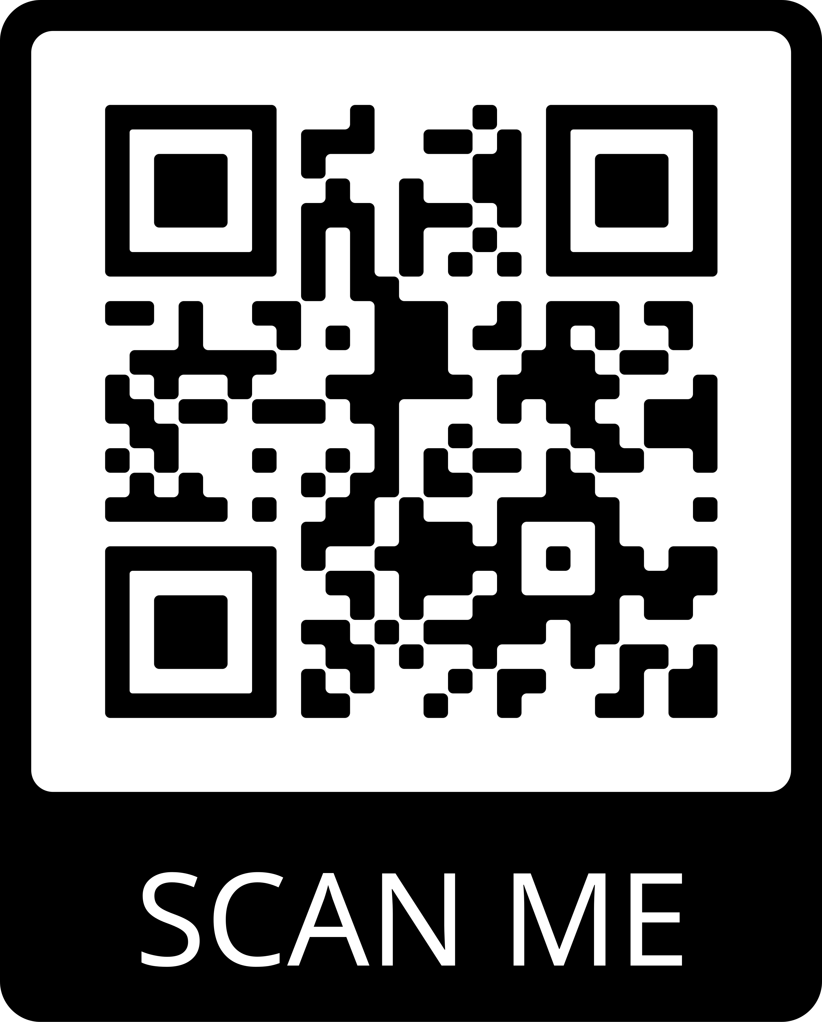
Connect With Us
JOIN OUR MAILING LIST:
FOLLOW US ON SOCIAL MEDIA:
/MidAmericaMHTTC
@MidAmericaMHTTC
/company/MidAmericaMHTTC
EMAIL: midamerica@mhttcnetwork.org WEBSITE: mhttcnetwork.org/midamerica

Slide 9
Flight safety instructions…
Notes:
Whenever you get on a plane, flight teams are required to provide flight safety instructions. These instructions have largely remained the same with only slight adjustments over the last several decades. One of the most important parts is how to manage the oxygen masks in an emergency. And the first step is always—put on your own mask before assisting others.

Slide 10
How do we best support our students?
Notes:
*Adjust background image with one that represents the clientele of the professional audience you are working with*
*Change the word “students” to whatever clientele is served*
So in the field of education/REPLACE, how do we best support our students?

Slide 11
by supporting the adults that work with them.
Notes:
*Adjust background image with one that represents the professional audience you are working with*
…by supporting the adults—the professionals—who work with them. If you will allow me to divert a little from the metaphor, they are not so much the passengers on an airplane but instead the flight attendants. In turbulent times, they are the ones we go to and watch to see how they are responding. And when they remain calm, follow safety steps, and work together, the passengers can be secure in their own safety.

Slide 12
The Adult Resilience Curriculum (ARC)
Notes:
That is what the ARC is about. It is a transtheoretical, comprehensive yet flexible curriculum designed to promote well-being (and thereby enhance people’s capacity for resilience). Originally developed in 2013 by Dr. Clayton Cook and Dr. Gail Joseph for pre-service and in-service teachers. In this space, the goal was to build upon the strengths of existing programs, while trying to make it more accessible and feasible for real-world professionals. It has since expanded beyond teachers because the principles and supports and concepts are universal. It is not meant to replace mental health services or support for professionals but is meant to provide a foundation for people.

Slide 13
Acknowledgements
This framework and its supporting research is the result of ongoing collaboration between the University of Washington, University of Minnesota, and community partnerships. The following individuals are co-developers of the ARC:
Clayton Cook, PhD
Gail Joseph, PhD
Aria Fiat, PhD
Andrew Thayer, PhD

Slide 14
How did we get here?
18 million children
exhibit
social, emotional, & behavioral problems
70 – 80%
of children receive school-based services
Notes:
*This slide is available but stats generally do not motivate people. This is here only for support if needed and thus hidden initially.*

Slide 15
Educators support student mental health and social-emotional learning through…
Warm, supportive interactions
Positive emotion coaching
Modeling healthy coping behaviors
Creating safe environments
Effective instructional practices
Evidence-based interventions
Notes:
*These slides are to help create buy-in if needed and may not be effective for this intro module.*

Slide 16
Supporting Student Mental Health During COViD
How do we ensure that students benefit from these key ingredients during the switch to online/blended learning?
1
Regular Check-Ins
2
3
4
Modeling healthy coping
Best practices
Striving for Equity
Notes:
*COVID specific and should be included only if still addressing those concerns*
How do we make sure the “key active ingredients” that are so important for students don’t get lost when we switch to online or blended learning?
A discussion about what these “frontline” efforts look like during COViD
Checking-in on students letting them know we’re there for the
making sure they know we care about them as people
conveying empathy, warmth, and understanding
devoting extra attention to the students that may be more difficult to reach or connect to
health/safety (mental & physical) > anything else
Modeling healthy behaviors as they relate to online learning, but also coping with stress and difficult emotions
Acknowledging what kids are missing out on (or might be) by not being in school (or at least not in the traditional sense)
Connecting to peers, learning from others, diversity of perspectives, a safe environment, meals, structure and predictability, adult care and atteniton
Helping kids find healthy ways of getting their needs met in our new reality
Thinking about best practices in online and hybrid approaches to learning
Does NOT involve staring at a computer screen all day
Recognizing challenges with equity: not all students will have access to the same supports at home, so how can we level the playing field as much as possible
Evidence-based interventions
How do we differentiate instruction via blended learning or online models, and ensure kids with more needs don’t fall through the cracks
How do we migrate evidence-based academic and SEB interventions to an online format

Slide 17
MTSS/Educator stress
If educators are overly stressed, trying to implement school-based mental health supports and SEL is like building a house on a crumbling foundation.
Notes:
*Incorporate this slide only if the slides on educators supporting SEL developing for children is included*
Educators are the ones delivering universal, targeted, and intensive supports to students
If educators are stressed out and burnt out, it’s like trying to build a house without a solid foundation
In schools, teachers represent the frontline providers of universal prevention programs. We focus on efforts to increase teachers’ classroom practices to promote students’ social, emotional, and behavioral functioning. These practices have been shown to have short-term and long-term preventative effects.

Slide 18
Sources of educator stress (pre & post COVID)
efforts to improve educator wellbeing
administrative demands
challenging student behaviors
Notes:
*Only include if addressing COVID*
Educators have a difficult job. While they may be engaged in efforts to improve their well-being, they have incredible demands placed upon them. They have administrative demands to attend to, challenging student behaivors…

Slide 19
Sources of educator stress (pre & post COVID)
educational inequities
insufficient funding & resources
policy & accountability measures
efforts to improve educator wellbeing
administrative demands
challenging student behaviors
not enough time!
Notes:
*Only include if addressing COVID*
…insufficient funding and resources, as well as related policy demands that ineffectively allocate attention and funds to inappropriate practices, all the while time is being taxed

Slide 20
Sources of educator stress (pre & post COVID)
worries about loved ones
personal health concerns
frustrated parents
de-funding of schools
distance learning
efforts to improve educator wellbeing
educational inequities
insufficient funding & resources
policy & accountability measures
administrative demands
challenging student behaviors
not enough time!
Notes:
*Only include if addressing COVID*
And then COVID threw more onto the scale

Slide 21
A PUBLIC HEALTH CRISIS
AN ETHICAL RESPONSABILITY
IMPACTS STUDENT OUTCOMES
Teacher stress and burnout is common, and reactive approaches are insufficient.
We have a duty to help promote healthy school, family, and community environments.
Teacher stress impacts delivery of evidence-based instruction and behavioral supports.
AFFECTS SCHOOL CLIMATE
A PUBLIC HEALTH CRISIS
A PUBLIC HEALTH CRISIS
Teacher stress and burnout is common, and reactive approaches are insufficient.
Teacher stress and burnout is common, and reactive approaches are insufficient.
Teacher stress and burnout is common, and reactive approaches are insufficient.
Notes:
*Replace this slide with data from your professional audience. These images can easily be reproduced using the Icons feature in PowerPoint or similar presentation software. Replace all instances of educators and stress with appropriate references, including in the script below*
We all know stress is an issue. Burnout and attrition in teachers are concerns. It is not a stretch to say that stress and burnout are a public health crisis within education. And yet, our systems—and by systems, I mean institutions, policies, supports, and even cultural practices—remain ineffective, often too reactionary, or completely miss the mark. If we value supporting the health of our educators, and not just because of the detrimental outcomes that result if we don’t but also because we simply value supporting people to be well—then we can do better. So why does it seem like we’re still struggling uphill to reduce this problem and support educator well-being?

Slide 22
There is no such thing as a “one size fits all” approach to well-being.
Notes:
Well, first, too often organizations try to slap a one-size-fits-all solution to the problem and then wonder why more people are not reaping benefits. We don’t have the solution for how to solve the problem of teacher stress & burnout
There IS NO one size fits all solution and the issue is COMPLEX. It is a mixture of personal histories and circumstances, personal assets, but also systemic barriers and inadequacies and ineffeciencies.
In ARC, what we can offer is insight from a decade of researching stress & well-being that gives a certain perspective, skill set, and environmental support and guidance that is flexible to each person.

Slide 23
It’s crucial that when addressing the social-emotional competence of students and educators, we do so not in a vacuum, but in the larger socio-political context.
Notes:
*This is a very educator focused slide. It should be adjusted though to fit your professional*
Another failing is that efforts sometimes do not provide adequate recognition of the context in which people live. Not just their immediate environment but also the chronosystem—the culture and times in which they live.
http://www.ascd.org/publications/newsletters/education-update/oct19/vol61/num10/How-to-Be-an-Antiracist-Educator.aspx
Goal:
we must address the SEC of students and teachers within the larger socio-political context
integrating culturally responsive and SEL practices to ensure equitable student outcomes
this work is REALLY HARD; to do it, educators need to ensure they are caring for themselves
Antecedents:
events such as the recent killings of George Floyd & Breonna Taylor by police officers, that underscore a long history of violence and anti-Black racism
discriminatory practices in schools that lead to discipline disproportionality for Black, indigenous, and students of color
school policies that put gender diverse and sexual minority students at risk
ICE and recent political changes that threaten students whose families are undocumented
Behaviors:
Recognition of the longstanding inequities in education and the racial trauma schools have long engendered
Acknowledgment of privilege and White Supremacy in education
Awareness of the need to discuss equity and culturally responsive practices
Acknowledgement that the educator workforce is overwhelmingly white, middle SES, heterosexual and cis-gender female -- which often doesn’t match the student populations we’re serving
Consequences:
Cognitive dissonance → discomfort with talking about race, identity, and difference in our nation's classrooms
Minoritized students and educators are usually either expected to do the brunt of the race and equity work or who are likely struggling silently
Educators increasingly committed to antiracism work and to preparing our young people to be antiracist, but uncertainty about how to do so

Slide 24
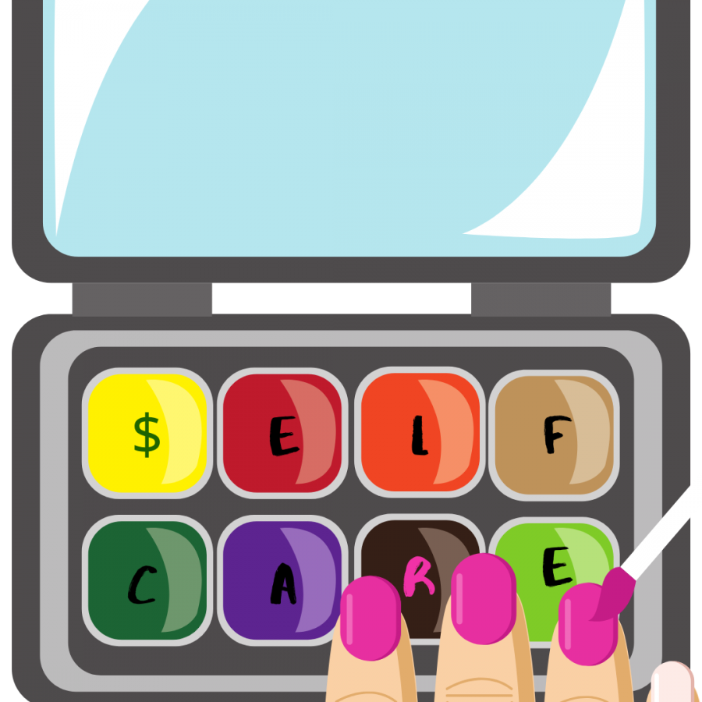
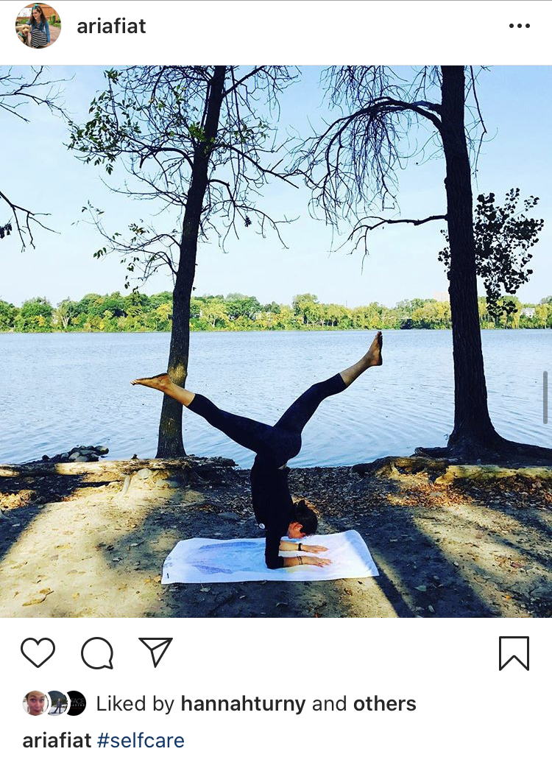
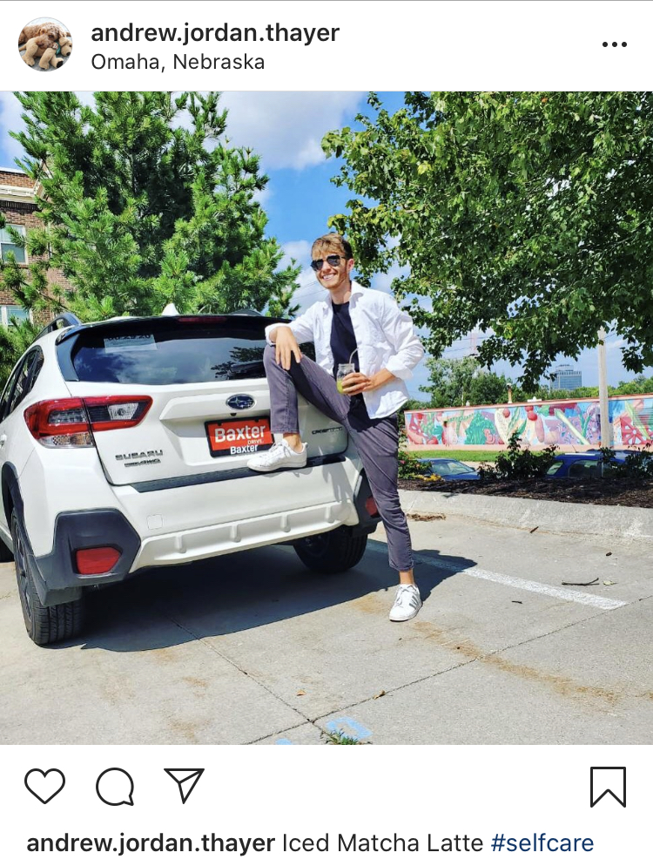
Reflections on the idea of self care
Notes:
Instead, a general mainstream culture of #self-care has arisen and been adopted all over. Although this is has the right spirit, there are serious issues with this self-care culture. We have a white paper along with ARC that you are welcome to read. In short, self-care used to be a term to describe practices people had to take because their health systems failed them. In other words, it was a direct recognition that our institutions failed people for a variety of reasons. And now that term has been co-opted to be a lifestyle choice and a demonstration of status and privilege. It’s about the more than 1.4 million photos hashtagged #selfcare by millenials on Instagram, the skinny white women doing yoga poses, legs in bubble baths, non-caffeinated-non-dairy hot drinks, green juice in mason jars. It’s well-intended but ultimately a consumption-focused version of self-care marketed to people that is devoid of any real model of well-being.
*The information below is left over and may be of interest in a live presentation if time.*
the term “self-care” has been co-opted
originally a medical concept: what doctors prescribed to patients as a way to improve health by engaging in good habits under supervision of a professional
during the Civil rights and Women’s rights movements, it turned into a politically charged term meaning “to actively push back against systems that break you down and institutional ways of not being cared for” (because healthy was -- and largely still is -- a privilege to white males
Audre Lorde: “Caring for myself is not self-indulgence, it is self-preservation, and that is an act of political warfare.' - a way of insisting that she mattered in a violent and oppressive culture
What it has become: a carefully curated lifestyle choice to show off and a demonstration of status and privilege
more than 1.4 million photos hashtagged #selfcare by millenials on Instagram
skinny white women doing yoga poses, legs in bubble baths, non-caffeinated-non-dairy hot drinks, green juice in mason jars
millenials spending more money than any other generation on “self care” in the form of workout regiments, diet plans, and life coaches
https://thetylt.com/culture/self-care-culture#:~:text=Indulging%20in%20a%20long%20bath,examples%20of%20self%2Dcare%20culture.
https://thethirty.whowhatwear.com/self-care-status-symbol
https://thriveglobal.com/stories/self-care-culture-mental-health-college/
self-care culture is replacing regard for mental health care with “obsessive consumerism”
companies are profiting off of what many refer to as “self-care culture.”
easy for people to buy into this phenomenon when looking for a quick way to maintain mental health
“Why pay 20 dollars — or more, if you don’t have health insurance — in (therapy) copays every week when you can solve your problems with fizzy bath bars and lavender shampoo? Better yet, throw on your pink fuzzy slippers and pour yourself a glass of cheap wine. Because millennials, “this is self-care.” “

Slide 25
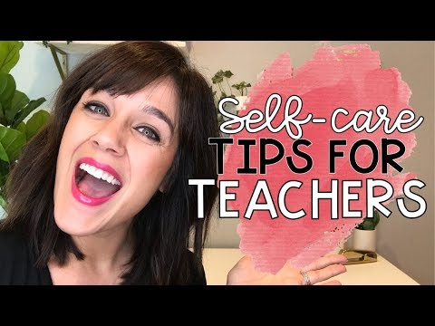
Self care video
What are your initial reactions to this video?
Notes:
*only show this as an example of this self-care culture that is well-intended but again, devoid of any real philosophy of a well life and instead pushes very narrowly focused specific practices*
SHOW first minute
https://www.youtube.com/watch?v=YKS1MoDSe70
though treating yourself to a starbucks or a manicure might momentarily improve your mental state, labeling these things as “self care” have diminished the term’s original meaning and purpose
self-care culture is also replacing regard for mental health care with “obsessive consumerism”
leading people to believe that a bath bomb and a coffee drink can replace the working on mental health - a quick fix
companies are using self-care as a marketing ploy and making money off of it
you can buy self-care nail decals and cute “self-care kits”
a line of massage chairs has the tagline “the science of self-care”

Slide 26
“
Self care is important, yes, and so is community care. People cannot self care themselves out of issues that need community support. One without the other can strain and create imbalance.
Self care is important, yes, and so is community care. People cannot self care themselves out of issues that need community support. One without the other can create strain and imbalance.
“
Notes:
One positive aspect of this self-care culture is its emphasis on sharing practices with others to create community. In truth, there are things we simply cannot self-care out of and we need our community support, and we also need our community to mobilize. Well-being is both an individual and societal effort.
For example, when you suggest self care to another person, consider the community it takes to support that person in doing that. Some examples include:
A workplace that supports taking a day off to get more time to self
Help navigating the medical system to get a doctor’s appointment
Someone to watch their dog or their kids to e able to go out and do something

Slide 27
ARC Logic Model
Healthy teacher-student relationships
Outcomes
Proximal
Decreased Stress
Increased healthy habits
Increased subjective wellbeing
Intermediate
Higher quality educator-student interactions
Improved implementation of evidence-based practices
Effective classroom management
Distal
Educator retention
Increased student achievement and SEL outcomes
Improved health
Teachers’ social/ emotional competence and wellbeing
Students’ social, emotional, and academic outcomes
Adult Resilience Curriculum
Effective classroom management
Healthy classroom climate
Effective SEL implementation
school/community context factors
Notes:
*This is a school-based example for teachers. The figure will need to be changed depending on the profession. ALSO NOTE!!!! THERE ARE IMAGES UNDER THE GREEN TEXT BOXES THAT DISAPPEAR USING ANIMATIONS! Change those too*
And that’s what separates ARC. ARC is grounded in a particular model, or perspective, of well-being that draws from various practices and philosophies in order to distill individual and societal practices down into those with the most research for their effectiveness, with sound theory, and are robust to individual and cultural differences. These are also directly linked to proximal, immediate, and long term outcomes. In this way, even the smallest of acts that we take can snowball and address bigger sources of stress. Most importantly, these individual acts, and the changes in environment it suggests to people and communities, can change your community factors. This is the balance needed between individual and community or systems changes needed.

Slide 28
PHYSICAL
Wellness is a holistic integration of physical, mental, and spiritual well-being, fueling the body, engaging the mind, and nurturing the spirit.
(Stoewen, 2017)
EMOTIONAL
PROFESSIONAL
SOCIAL
WELLBEING
SPIRITUAL
Notes:
It defines wellness, or well-being, along multiple dimensions. It’s not strictly focused on feeling good and being stress free but instead addresses well-being along several dimensions and recognizes that sometimes we need to focus on only some of these dimensions. We cannot do it all and we can do our best regardless.
*Old information below. May be of interest for live presentations but the above suffices*.
8 Dimensions of Wellness, (UMD) University of Maryland’s Your Guide to Living Well. [Last accessed June 27, 2017]. Available from: https://umwellness.wordpress.com/8-dimensions-of-wellness/
(stoewen, 2017)
“Wellness is a holistic integration of physical, mental, and spiritual well-being, fueling the body, engaging the mind, and nurturing the spirit (1). Although it always includes striving for health, it’s more about living life fully (1), and is “a lifestyle and a personalized approach to living life in a way that… allows you to become the best kind of person that your potentials, circumstances, and fate will allow””
What does it mean to live well?
How do we conceptualize wellbeing
physical
caring for your body to stay healthy now and in the future
emotional
understanding and respecting your feelings, values, and attitudes
appreciating the feelings of others
responding to your emotions in a constructive way
feeling positive and enthusiastic about your life
spiritual
finding purpose, value, and meaning in your life (can include religion/spirituality but doesn’t have to)
participating in activities that are consistent with your beliefs and values
social
maintaining healthy relationships, enjoying being with others, developing friendships and intimate relations, caring about others, letting others care about you
contributing to your community
professional
participating in work that provides personal satisfaction and life enrichment that is consistent with your values, goals, and lifestyle
contributing your unique gifts, skills, and talents to work that is meaningful and rewarding
Burnout happens when one or more of these aspects of your life is out of whack. Spending too much time at work and not enough on social? Not recognizing your own emotional and physical health? Burnout.

Slide 29
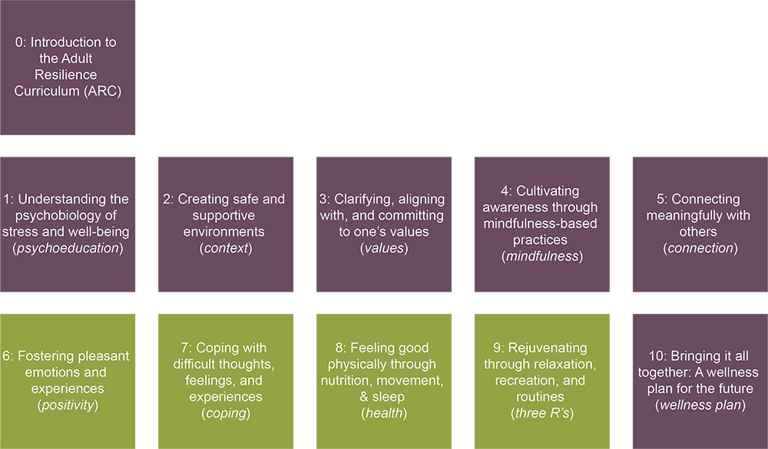
The ARC Modules
Notes:
So what is included in ARC? Well, first, it has 10 modules, not including this intro module. Those modules include a mix of didactic information—things you may already know, things you may not know, and perhaps perspectives or insights you hadn’t considered yet—and they also come with practices. We will talk more about how to go through these modules in a moment.
The purpose is the basic knowledge building module. This is important and everyone needs to start there. Afterward, there are 4 core modules. These are considered core because the concepts and skills in this modules underpin all the other modules, and we also truly believe in ARC that if you can keep these 4 things going in your life that, more often than not, you will be supporting your well-being.
The green modules are supplementary. This does not mean, though, they are less important. Instead, they mean that the core modules actually feed into them. You need to know the concepts and practices in the core to really get why the supplemental modules are so commonly talked about and you need the core to be successful in those supplemental. Since they are supplemental, you do not have to go through any of them, nor do you need to go through them in order. But we highly recommend it.
The last module is required, no matter how many modules you go through or in what order. It is your final send off after ARC.

Slide 30
An integrative
approach
Dialectical Behavior
Therapy
(DBT)
Cognitive Behavioral Therapy
(CBT)
Positive Psychology
(PERMA)
Integrative approaches involve distilling effective interventions into overlapping active ingredients and blending them in intentional ways to create additive, synergistic effects.
Acceptance & Commitment Therapy
(ACT)
Notes:
You may find it important to know just where the practices come from. Recently, a researcher published work on a massive project to synthesize—merge—the literature of the fairly recent movement in psychology called positive psychology, which was a movement to use what we know about people’s psychological health to not simply treat difficulties but promote strengths and thriving in life. This researcher found over 90 different topics and techniques within “well-being” and “resilience” yet when looking at the active ingredients, the things that made these treatments or practices actually work—they were largely the same.
ARC then focuses on only those components that have research support, and draws from 3 prominent models of therapy and a philosophy about what it means to live well that we think is largely agreeable with people from all sorts of backgrounds.
*Left over information below. May be interesting in a live presentation*
Cognitive Behavior Therapy (CBT)
Approach that addresses the interconnection between thoughts, feelings, and behavior
Cognitive restructuring, emotion regulation skills, problem solving, to increase helpful ways of thinking about current circumstances
Acceptance and Commitment Therapy (ACT)
Increase psychological flexibility and behave in a way that is consistent with one’s values
Dialectical Behavior Therapy (DBT)
Teaches people how to live in the moment, cope healthily with distress, regulate emotions, and improve relationships with others
Positive Psychology
Cultivating strengths, desirable cognitions & emotions, and healthy relationships through skill training and establishing routines
How to make seemingly normal life more meaningful
P – Positive Emotion
E – Engagement
R – Relationships
M – Meaning
A – Accomplishments

Slide 31
Research in Support of the ARC
Compared to matched controls, teachers who participated in the ARC reported:
Frye, M. S. (2015). Promoting caregiver and child resilience: The ACHIEVER Adult Resilience Curriculum (Doctoral dissertation).
Cook, C. R., Miller, F. G., Fiat, A. E. , Renshaw, T., Frye, M., Joseph, G., & Decano, P. (2017). Promoting secondary teachers’ well‐being and intentions to implement evidence‐based practices: randomized evaluation of the achiever resilience curriculum. Psychology in the Schools, 54(1), 13-28.
Christian, E. (2017). The Effectiveness of the ACHIEVER Adult Resilience Curriculum in Promoting Teacher Wellbeing.
Fiat, A. E., Larson, M., & Cook, C. R. (2017, July). Targeting teacher stress to enhance the delivery of classroom evidence-based practices. Symposium at the 39th Annual, International School Psychology Association Conference Manchester, UK.
Larson, M., Cook, C. R., Fiat, A. E., & Lyon, A. R. (2018). Stressed teachers don’t make good implementers: Examining the interplay between stress reduction and intervention fidelity. School Mental Health, 10(1), 61-76.
Fiat, A. E., Christian, E., Thayer, A.J., & Cook, C. R. (2018, February). Strategies to help teachers combat burnout and increase resilience. Mini-skills session presented at the National Association of School Psychologists Annual Convention, Chicago, IL.
Fiat, A. E., Thayer, A. J., Frank, S., Larson, M. F., & Cook, C. R. (2019, April). Enhancing teacher wellbeing as a school-wide strategy for optimizing student outcomes: A systematic literature review of teacher resiliency training programs. Paper presented at the American Education Research Association Annual Meeting, Toronto, Canada.
Self-efficacy
Job satisfaction
Subjective wellbeing
Hours of nightly sleep
Intentions to implement
Implementation of EBPs
Emotional exhaustion
Perceived stress
Notes:
*Use only if it seems the audience needs to see research support*
Teacher wellbeing and implementation of evidence-based classroom practices are both topics worthy of scientific inquiry, yet few research studies have linked these two areas of research. Moreover, few studies to date have experimentally examined the impact of interventions designed to promote aspects of teacher wellbeing.
Notable-High social validity: Teachers felt the ARC was reasonable, acceptable, and likely effective
Teachers indicated they wanted to continue exercising, eating well, engaging in good sleep practice, clarifying values and committing to them, practicing gratitude, and identifying unhelpful thoughts and adjusting them to be more helpful
From Elementary dataset: Some data to suggest higher-quality teacher-student interactions were associated with higher subjective wellbeing as well as lower emotional exhaustion

Slide 32
Basic Steps for Proceeding Through ARC
Notes:
In order to be successful, let’s talk about how to use ARC including the general structure of the modules, tasks that need to be completed, and tips to be successful.

Slide 33
Get a Practice Partner (PP)/Team
Active Ingredient 1
Notes:
The first major ingredient for success is to get a practice partner. If you are going through the modules on your own, this can be another colleague, a life partner, family member, friend. Someone whom you are willing to give permission to check in on you, encourage your efforts, and maybe even problem-solve when you hit barriers.
If using ARC in your organization or in a team, you can still have a dedicated practice partner. Or organize into teams where you all are each other support and accountability partner. It is critical that you feel safe in this team.
One participant in a trial of ARC found that keeping a journal for these meetings with their PP really helped. They could take notes during the module, jot down reflections during their practice, and then bring things up during the meeting. It is not required but we encourage it in ARC.

Slide 34
Experiential Learning
Active Ingredient 2
Gather all materials
Complete the didactic portion
Complete at least 1 activity
Complete knowledge check questions
Live facilitation
Video facilitation
Complete your action plan
(at least 1 after didactic) Check in with PP/Team using Discussion Questions
(Optional) Try any incomplete activities
Proceed with your action plan
Notes:
Here you can see the flow of each module. Before each module, you will have some materials to gather such as the various activities. These are hosted on the website, and each module comes with a guide so you know for sure what to download.
Then there is the didactic portion which can be delivered with a live facilitator or over video. This portion of each module is to make sure that you have the understanding of why certain concepts, skills, and practices are being discussed. Even if you are already familiar with the ideas of the module, you may learn about them with a different perspective or insight. So it is important that you complete these with minimal distractions. After the didactic portion there will be a collection of activities for you to select from that address some component of the module. Some of these activities are a one-time reflection type practice, some are a little more involved at the time, and others challenge you to do things until your next meeting. Sometimes these activities are completed in session if there is live facilitation and time.
There are also knowledge check questions. Complete these on your own or with your PP/Team immediately following the didactic portion. Sometimes these are completed in session.
And following that is an action plan which is one of the most important parts so we will actually zoom in on that in a moment.
With the action plan in place, the next challenge is follow through with it. If you wrote in to try some of the skills or practices in the module, or find some way to apply a concept in a way that fits into your life, this is now that time. Most of the work of ARC is done in the time not in the module. During this time, you can also return to some of the other activities with the module and complete them if they can help you.
Finally, at least 1 week after the main part of the module is complete and you are a week into your action plan, meet with your PP or Team to review your progress, answer discussion questions that come with each module, and use that time to problem-solve any issues you have with that module’s content.

Slide 35
Active Ingredient 3
Structured Time
Gather all materials
~ repeat every 2-4 weeks
~ morning of module
Main module content
~ 60 minutes through to action plan
Exploration
~ discussion about 1 week later
Discussion
Notes:
Let’s be honest. If we do not have the time dedicated to ARC, we are likely to be distracted. Here is the rough time commitments. A majority of the content is delivered the same day. How long it takes depends on your set up but on average it will take 60 minutes.
Immediately afterward is at least a 1 week period we encourage you to dedicate to the module’s content. Allow yourself to focus on that for at least 1 week and see how it felt. If you liked the content and noticed an improvement, even slightly, note that in the discussion. You won’t be able to do everything in your life all the time nor with the amount of focus you will dedicate now during each module but you can figure out how to focus attention on most of the things most of the time.
After that minimum 1 week period, meeting and discussing happens which takes a variable amount of time.
This whole process repeats generally 2-4 weeks. After the discussion, if there is time before the next module, incorporate any changes from the discussion time into your practice. If you are going through ARC on your own, we recommend at least a 2 week space between sessions.

Slide 36
Active Ingredient 4
Evidence-based Action Planning
Notes:
And the last and one of the most critical components of ARC: the action plan. To be clear, having a practice partner or team, completing all the experiential steps of the modules, and keeping a structured time are all important. This one is the one that often gets pushed aside, though, so we want to emphasize it.
We all begin efforts to improve ourselves with the best of intentions. If only that were enough. What often gets in the way of our best intentions are barriers and how we view struggles and even failures.
In ARC, we use an action planning strategy after each module that is grounded in research on how to help support people’s health actions. It has a very specific structure and is meant to target the very things that hold us up. You will learn about the structure in Module 1. And it is important that this action plan be completed as it will guide your intentions for the rest of the module.

Slide 37
What questions do we have?

