Slide 1
Delivery & Tailoring Instructions
Prior to delivering, get information from audience about their current struggles and needs. Use that information to decide what should be tailored
To tailor, you can change the following:
Hook & Transition metaphors
Your “Who I Am” slide & credibility slides (referent, information, positive expert power)
Any of the background intro slides (if Module 1 has already been delivered)
The order of the slides (before activities)
Activities (based on time frame)
Knowledge Check questions
Discussion Questions
To make changes to the Activities, Knowledge Check Questions, and Discussion Questions, you can:
Hide the activities you do not want to do
Replace the knowledge check section of each final activity slide with the proper knowledge check question(s)
Delete whichever discussion questions you choose not to provide. Make sure these questions are provided in a follow up forum/document/delivered in-person by school staff after at least 1 week of practice.

Slide 2
Delivery & Tailoring Instructions
Make sure the tailoring is done to fit within the appropriate time frame
The structure and design of the powerpoint is actually based on a combination of successful TedTalks (that involved audience participation) and research on how to present to adults
This includes the Hook, Transition, Who I Am, and Audience Benefit slides
Limited text
Use of imagery
MINIMIZE reading text on slide; research indicates this actually disrupts audience comprehension
Set expectation for participation at the outset

Slide 3
Delivery & Tailoring Instructions
Things to remember
Expert power can be negative if audience portrays a) you are leveraging your expertise in one domain into another, b) if your expertise appears outdated, c) your expertise is impersonal (i.e., not recognizing the audience’s perspective), and d) if they portray you as having something to gain
What is comfortable for us, the presenter, is maybe not engaging for the audience.
Charismatic power is something; you are acting for your audience and that is encouraged. People will buy-in if you seem bought-in. Find the charisma personality that you can put on confidently.
Sell the “Why”, not the “what” or “how”. Those are ARC and the modules. But the “Why” is most important

Slide 4
Adult Resilience Curriculum (ARC) for Educators
Module 1: Understanding the Psychobiology of Stress & Wellbeing

Slide 5
Disclaimer
This presentation was prepared for the MHTTC Network under a cooperative agreement from the Substance Abuse and Mental Health Services Administration (SAMHSA). All material appearing in this presentation, except that taken directly from copyrighted sources, is in the public domain and may be reproduced or copied without permission from SAMHSA or the authors. Citation of the source is appreciated. Do not reproduce or distribute this presentation for a fee without specific, written authorization from the MHTTC Network Coordinating Office. This presentation will be recorded and posted on our website.
At the time of this presentation, Tom Coderre served as Acting Assistant Secretary for Mental Health and Substance Use at the Substance Abuse and Mental Health Services Administration (SAMHSA). The opinions expressed herein are the views of the speakers and do not reflect the official position of the Department of Health and Human Services (DHHS), or SAMHSA. No official support or endorsement of DHHS, SAMHSA, for the opinions described in this presentation is intended or should be inferred.
This work is supported by grants under Funding Opportunity Announcement (FOA) No. SM-18-015 from the DHHS, SAMHSA.

Slide 7
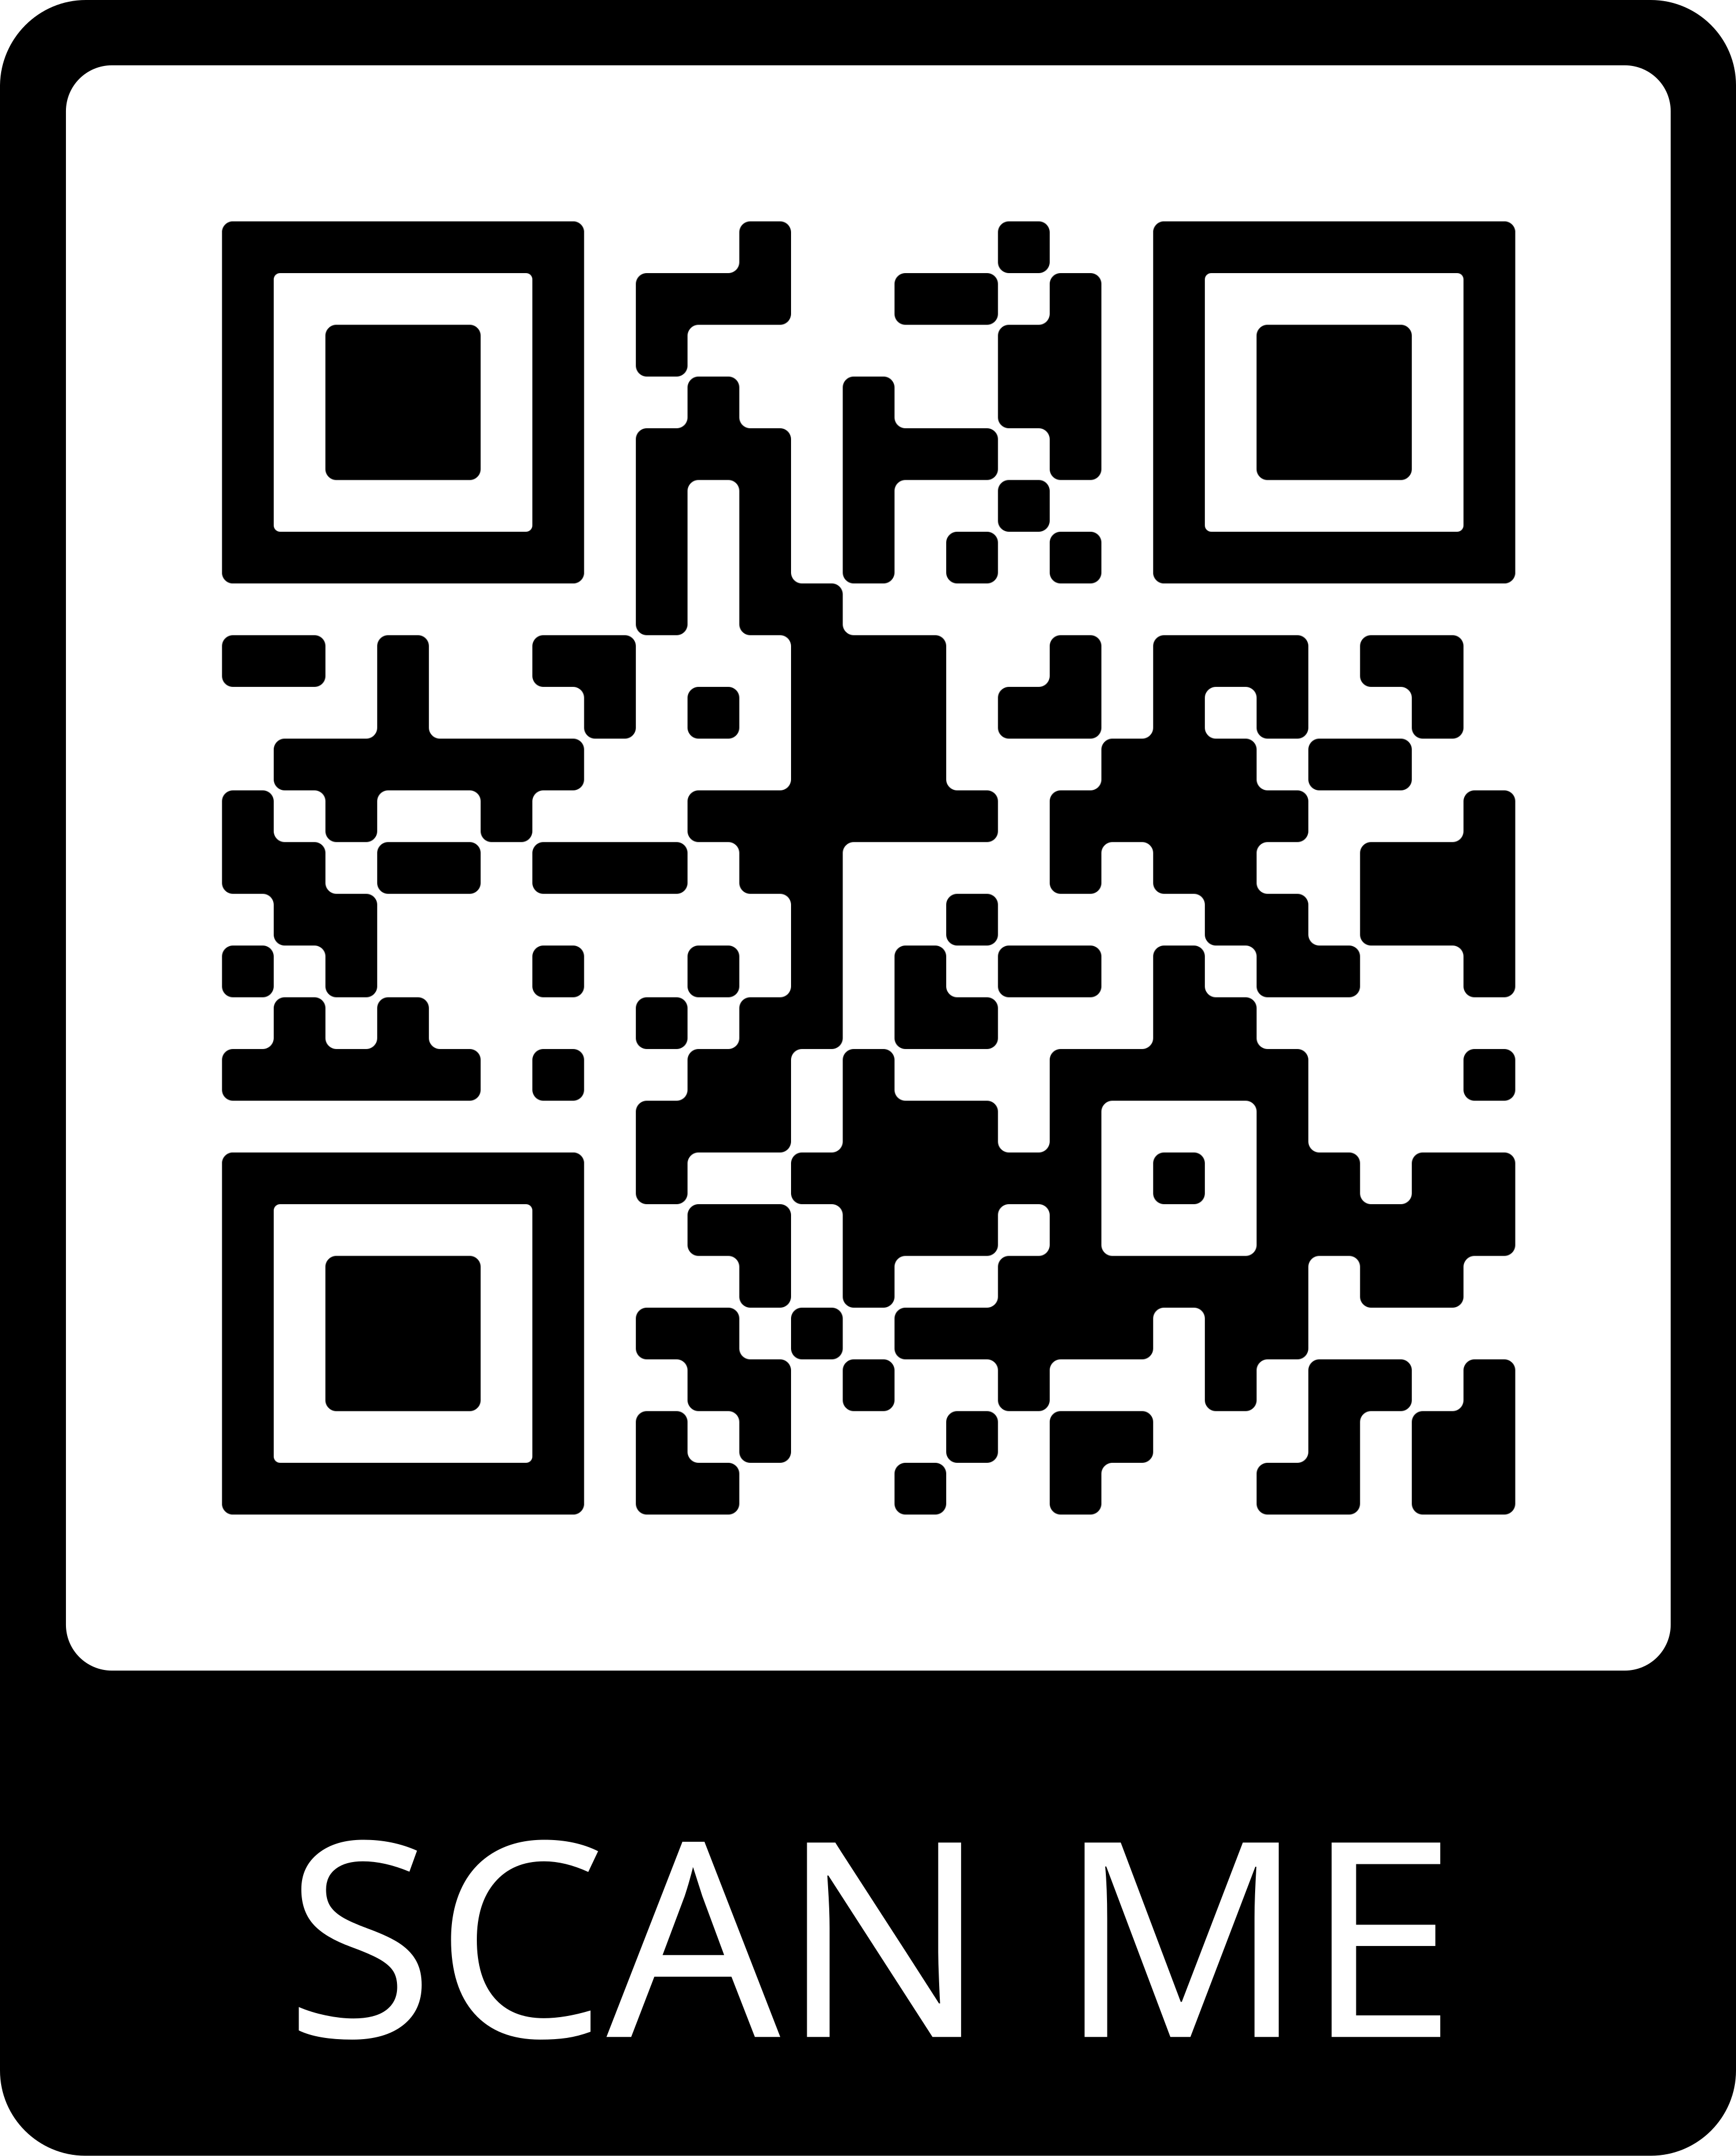
Connect With Us
JOIN OUR MAILING LIST:
FOLLOW US ON SOCIAL MEDIA:
/MidAmericaMHTTC
@MidAmericaMHTTC
/company/MidAmericaMHTTC
EMAIL: midamerica@mhttcnetwork.org WEBSITE: mhttcnetwork.org/midamerica

Slide 8
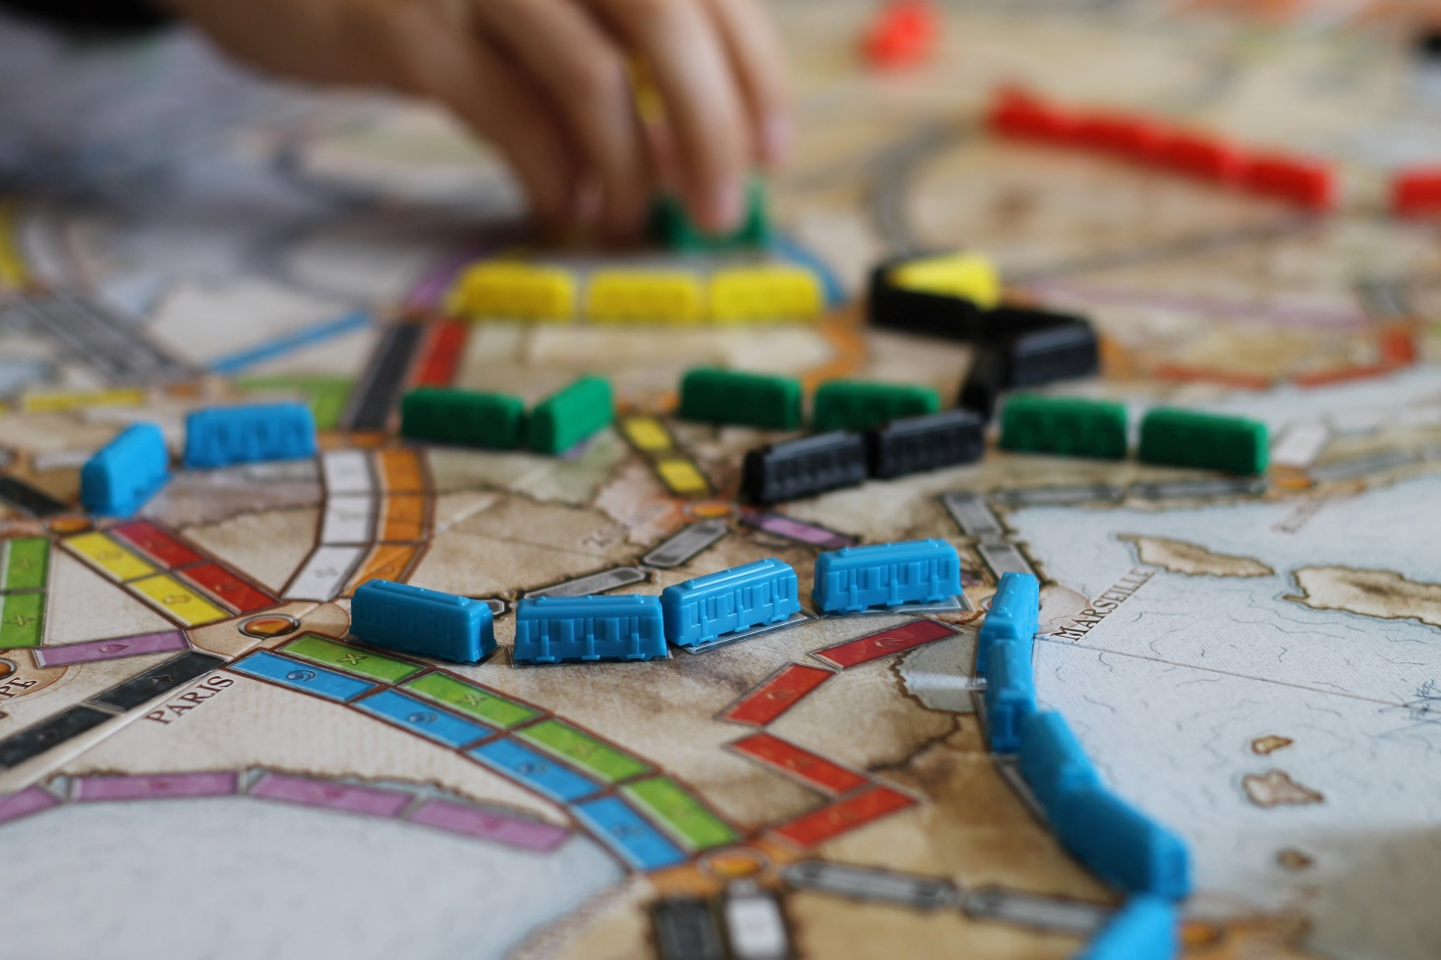
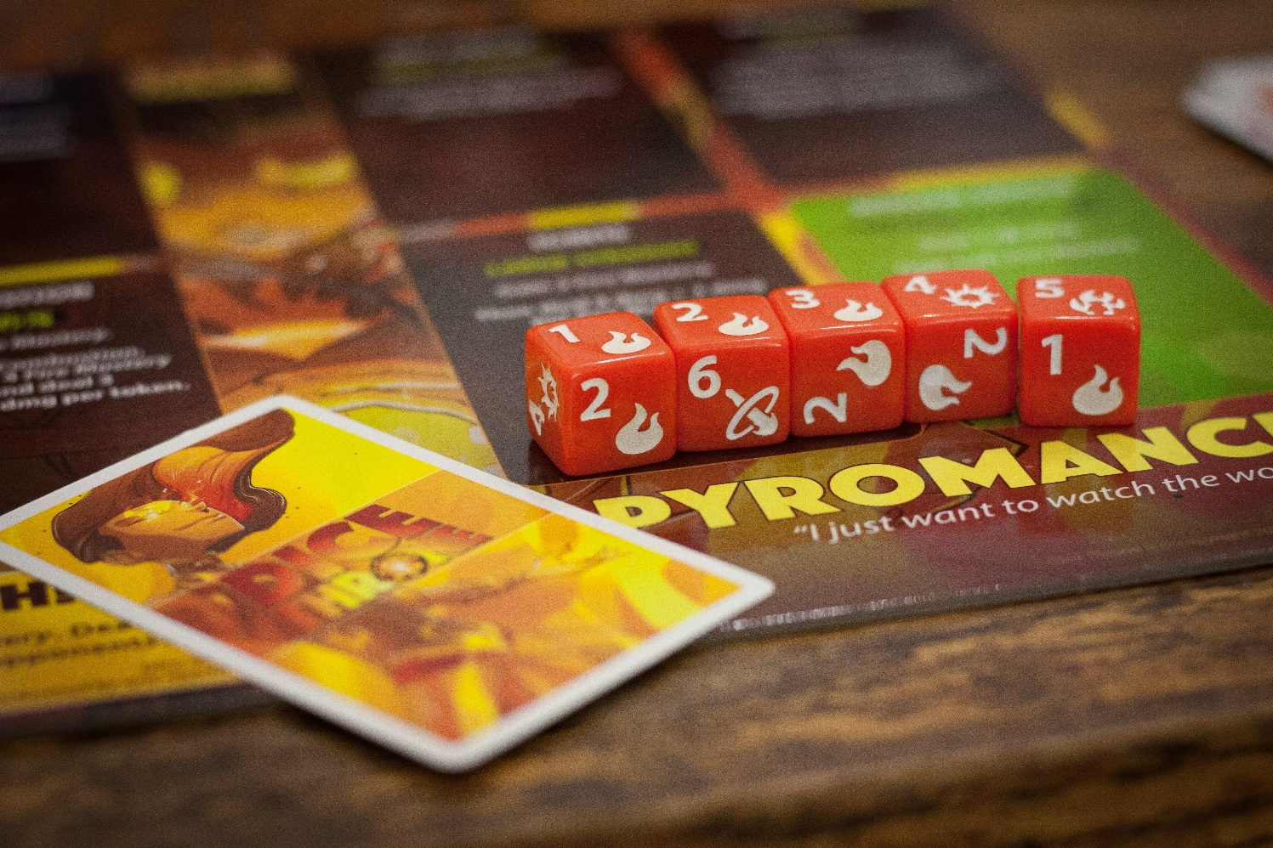
Notes:
For a time, being referred to as a “nerd” was socially demeaning. It meant you were an outcast, with potentially eccentric interests, lacked confidence, and meant you were inept in particular ways. This meaning has slowly changed, though, as more people embraced the label and typical “nerd culture” hobbies became mainstream. The meaning has changed. I define it as “an enthusiastic, intense passion for an interest typically born from pure enjoyment, amazement, or value in that interest”.
Quite literally anything can be a nerdy interest now. And anyone can, too. Teachers, I think, have been some of the leaders in this change—many have embraced the common stereotype associated with being a teacher while also breaking down the boundaries of that stereotype. I once saw an otherwise quiet teacher in an urban school start freestyle rapping during an assembly and people were blown away.
One of the biggest changes, I think, is the rise of board games as a popular past time. They’ve always been around—the classics like Monopoly, Sorry, Jenga, and even Chess. But now, there are so many games out there, entire genres have had to be created to define games by their themes and mechanics. There really is something out there for everyone that people can play and have their attention be captured.

Slide 9
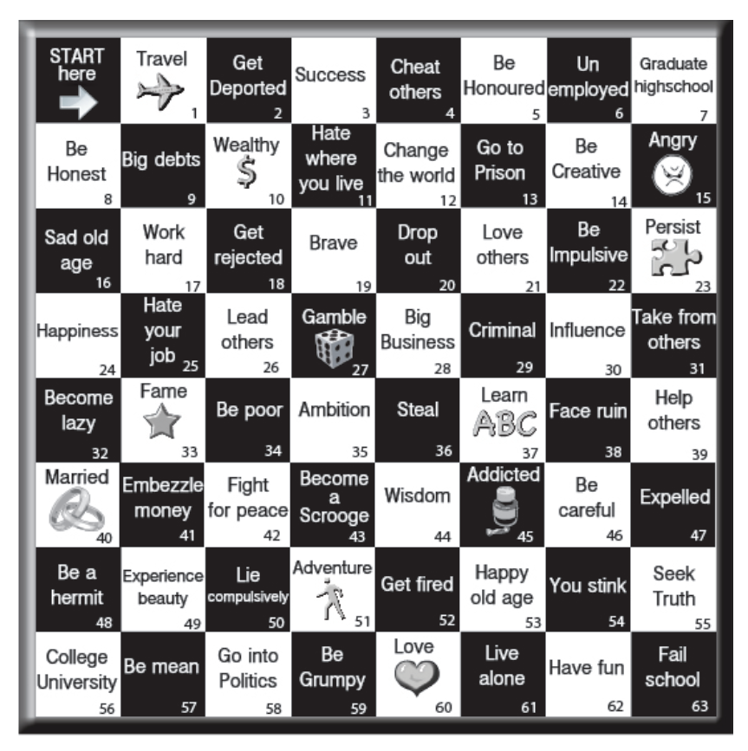
Notes:
One of the key principles of a good board game is finding the right balance between player skill and chance. If a game leans to heavily toward player skill and sacrifices space for chance to change the flow of the game, then the game becomes “solved” and offers no novelty for replayability. There is no excitement, no wonder, no motivation to keep playing the game. On the flipside, if the game leans too heavily toward chance, then there are no real stakes at play, no decisions to be made, no way for someone to exert control over the situation. Good games find this balance based on the “mood” the game is striving to achieve.
In a game, this balance between player control and chance is what creates fun. But in the real world…

Slide 10
Notes:
…it can be stressful
*insert a heading at the top of this image to assist with contextualizing the discussion. For example, if presented during the COVID19 pandemic, place “COVID19” in white text at the top in fog*
This is more what life is like. We are on a windy path where we can see only a little ways ahead of us. Sometimes the fog is clearer, sometimes thicker. But anything beyond that fog? It’s really just our best guess. It’s all a bit uncertain. And then life throws a little bit of chance at us. The fog gets crazy thick and the entire road cannot be seen. In these moments, we have a couple options. Turn back, or go forward. If we choose to go forward, there are a couple things we need to make sure we suddenly don’t drive off a cliff. Having a compass or GPS to point us in the right direction is helpful. Knowing how to take it slow and easy through the fog also helps rather than flooring it. Making sure we are in a reliable and well-adjusted vehicle is a must. And we have to trust that road itself is in good condition and doesn’t completely derail us.

Slide 11
The Adult Resilience Curriculum (ARC)
Notes:
*Review from module 1*
*Delete if Module 1 has been delivered*
A transtheoretical, comprehensive yet flexible curriculum designed to promote wellbeing (and thereby enhance people’s capacity for resilience)
Originally developed in 2013 by Dr. Clayton Cook and Dr. Gail Joseph for pre-service and in-service teachers
Builds upon the strengths of existing programs, while trying to make it more accessible and feasible for real-world professionals
Expanded to include university students in a range of care-giving professions
NOT designed to replace mental health services or treatment

Slide 12
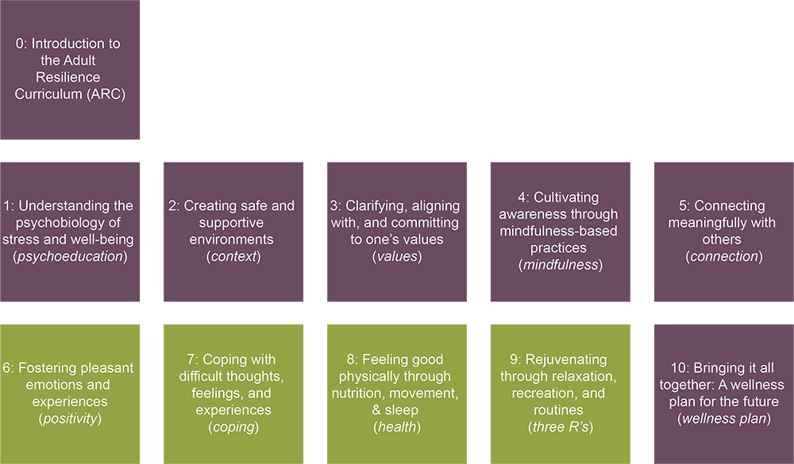
The ARC Modules
Notes:
We are starting off with foundational knowledge to understand just what stress is and how our well-being balances out that stress. Some of this information may be new to you and some may be old knowledge. However, even if the knowledge is old, the perspective and insight might be new. Once we are all caught up on the most recent understanding of stress and how we can respond to it, the following modules get a little bit more relevancy. For example, it will make more sense to how commonly encouraged practices like mindfulness or setting up routines directly address actual causes of stress.

Slide 13
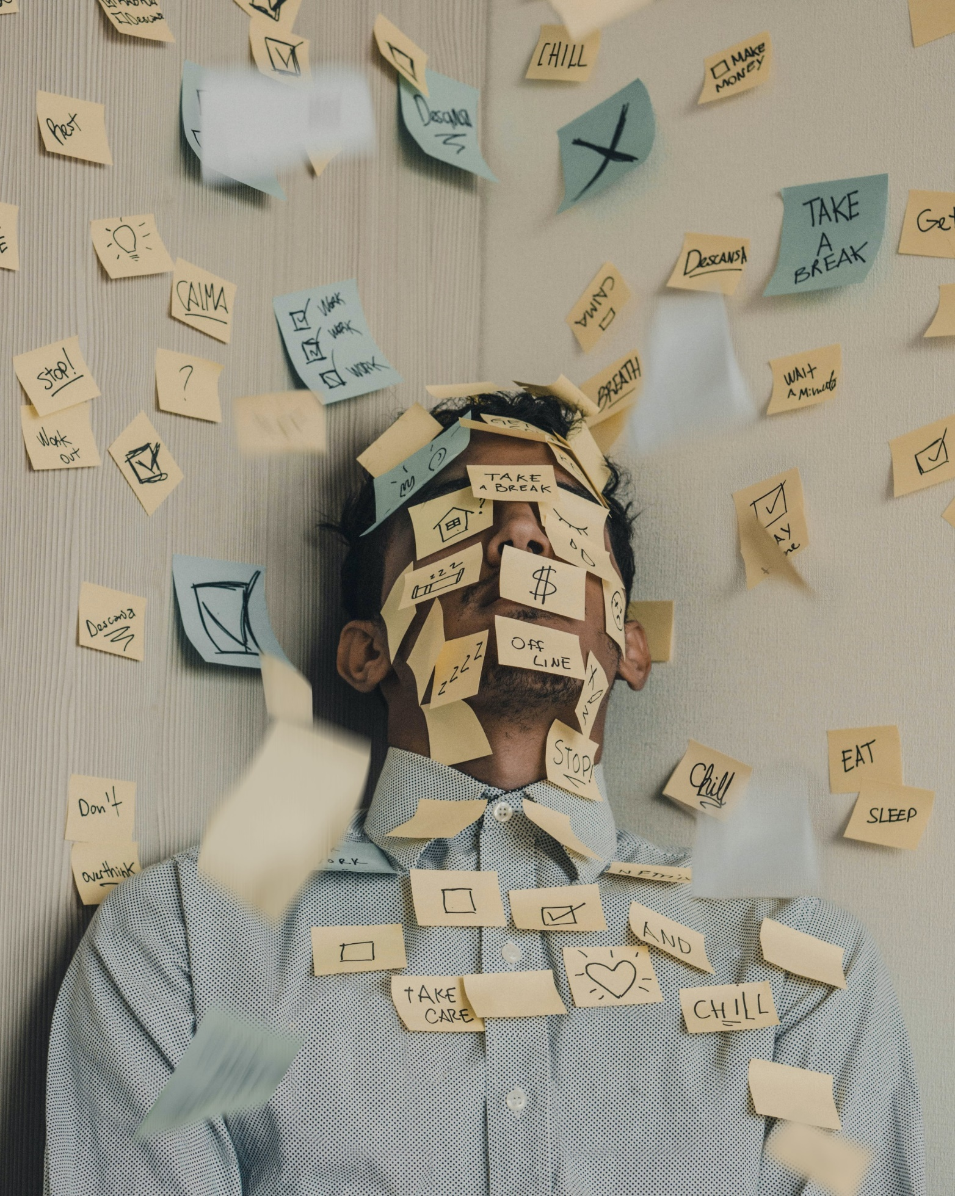
MODULE 1: Understanding the Psychobiology of Stress & Wellbeing
Notes:
With that, let’s get into the discussion for today. Stress, well-being, resilience—these have all become buzzwords and we completely recognize that some of you may be absolutely sick of hearing them. And sometimes they have been pitched to educators in bad faith—as if simply KNOWING things about stress and well-being is enough.
Consider this module the down payment. It provides a particular framework for understanding the relationship between stress and well-being, and that framework guides the why the rest of the ARC content exists, and how these things they work.

Slide 14
Psychoeducation
Our Hopes for Today
Define stress & articulate both its detrimental & optimal effects on
our performance & life.
Define the dimensions of wellbeing and resilience and connect them to identities as educators.
Set an initial intention for how you plan to use this training and what you hope to get out of it.
Notes:
Each module starts off with our hopes for what to get out of today. This includes learner objectives as well as reminders of the activity components discussed in the intro module.

Slide 15
Psychoeducation
STRESS:
An unavoidable fact of life
In the eye of the beholder
Can be adaptive
Can affect health/wellbeing
Notes:
Let’s get the obvious out of the way: stress is inevitable. We will talk a little bit more about why but I would be willing to bet everyone knows this is true. We all have stress. In fact, just hearing the word “stress” probably causes irritable stress for some.
Another perhaps known fact of stress is that it is relative. For some, certain situations cause a rise in stress. Others are not stressed by certain situations at all. And even those that get stressed by the same situation, we all have different resistance levels and so respond slightly different. What this means, of course, is that there is no normal stress that fits everyone.
The perhaps more interesting fact is that stress is adaptive. It serves an adaptive function. Which means it is actually good for us. Yes, it can affect our health and well-being. But it can also propel us. We will talk more in a second about that.

Slide 16
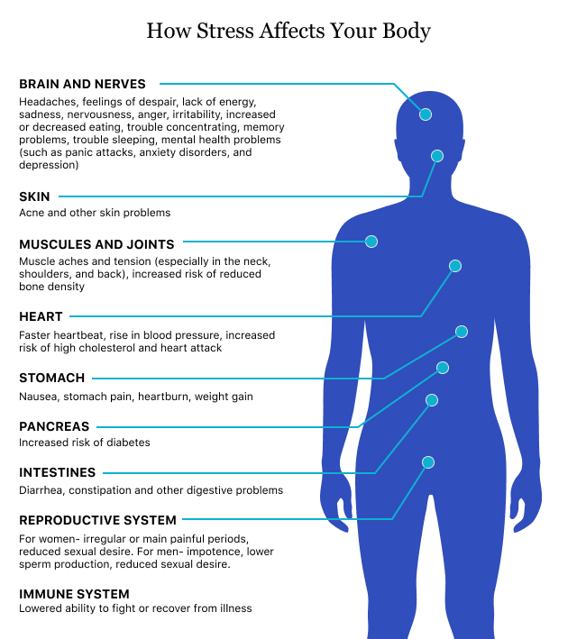
Psychoeducation
Key Terms
Fight-flight-freeze
Amygdala & frontal lobe
Homeostatic balance
Sympathetic nervous system
Parasympathetic nervous system
Drugwatch.com
Notes:
Let’s focus first on that adaptability strength of stress. You are probably familiar with the fight-flight-freeze response. It is an automatic fire alarm in our brain that starts ringing in response to a “thing” in our environment. Btw, our environment can mean both our physical, external environment—so what’s outside of us—but also our internal, verbal environment—basically just our thoughts. Our thoughts alone are enough to stress. We’ll talk more about that shortly.
So, where is the FFF response located? It’s the limbic system connecting all sorts of parts of our brain and nervous system. First, our thalmus gets information. It’s a bit like a data scientist. It gets a bunch of auditory, visual, and other sensory/memory information. It analyzes it and then sends the information somewhere. The information can get dumped down to the amygdala. And it moves fast, almost like a slide. That amygdala is an alarm. It starts ringing loudly. And that alerts our sympathetic nervous system, which is a bit like a security guard. It gets the body primed and ready to go.
Meanwhile, this data also gets sent to the frontal lobe at the front part of the brain. This is a slower process, like the data has to go up several flights of stairs. The frontal lobe is like a CEO. It gets data and has to determine how to allocate resources appropriately, or if the information is even worth an alarm. If not, it has to shut off that amygdala and use our parasympathetic nervous system, which calms us down.

Slide 17
Notes:
So stress is all relative. We see something fuzzy in the distance and we are uncertain of what it is. Our thalmus sends this uncertain data interpretation to the amygdala to prime the body while our frontal cortext—where we think—has to work to determine if the uncertain “thing” we are seeing is really a threat.
This process, though, is why it is so difficult to “think straight” while stressed or angry or worried. The thinking part of our brain is mechanically slower. It just is. No way around that without practice to speed it up and calm our alarm systems.

Slide 18
Why Do Zebra’s Not Get Ulcers?
According to Robert Sapolsky
Unlike zebras, humans can generate stress by anticipating it (whether or not it has occurred or is merited).
We don’t have to experience something to be stressed out by it (perceived stress).
Notes:
What’s interesting is humans, as we said, respond to both external AND internal environments. Zebras do not get ulcers. Why? Because the moment a threat in their immediate physical environment is removed, or if they determine that threat is not a true threat, they are no longer bother.
But humans, well, we can ruminate. We can drum up thoughts and feelings and memories that cause experiences. We quite literally simulate, like a computer, scenarios in our brain. And the thalmus can’t tell the difference between a real or simulated “thing”. Which is why we can get stressed while anticipating something bad. It’s not the thing that stresses us, it is the thought that stresses us. And then we might get stressed about the fact that we’re stressed!

Slide 19
This was our normal even before COVID. Our minds are drawn everywhere
Notes:
*keep this only if COVID remains a contextual factor to be addressed*
*Adlib and acknowledge that we were constantly getting tons of information in modern day life, and then COVID increased everything*

Slide 20
Affects of Chronic Stress
cognitive (mind)
physiological
(body)
Anxiety, restlessness, lack of motivation, memory problems, irritability/anger, sadness/depression
Headaches, muscle tension or pain, weakness or fatigue, stomach/digestive issues, sleep problems
behavioral
(actions)
Emotional outbursts, avoiding important activities, overeating or undereating, social withdrawal, substance use
Allostatic load – the wear and tear on the body that accumulates when individuals are exposed to chronic stress
Notes:
There are definitely issues with this constant perceived stress. Although people experience stress differently—as it is, again, all relative—there are very common experiences.
Whatever you experience, we all have a limit to the allostatic load we can stand

Slide 21
Avoidance
Notes:
So what do we do with stress? Well, our minds tend to perseverate on the uncontrollable factors, or we ignore ways in which factors that seem uncontrollable can actually be modified to our benefit.
Instead, we tend to avoid. There is substantial evidence that avoidance is the root of most mental health difficulties. Remember that humans have a unique ability to self-induce stress through purely mental imagery and anticipation. Our thoughts, just like a perceived physical thing, can result in just as powerful a stress response. So we often try to control those experiences by avoiding them. We avoid uncomfortable situations, uncomfortable conversations, uncomfortable emotions, and even thoughts—we ask ourselves “where did that thought come from” and become distressed by it.
Yet avoidance doesn’t really address any of the issues that are leading to that stress. And so we remain stuck, buried under a load. The trick, then, is to recognize that there are very active things we can do with our physical environment AND our internal, thought and emotion environment, to make things better.

Slide 22
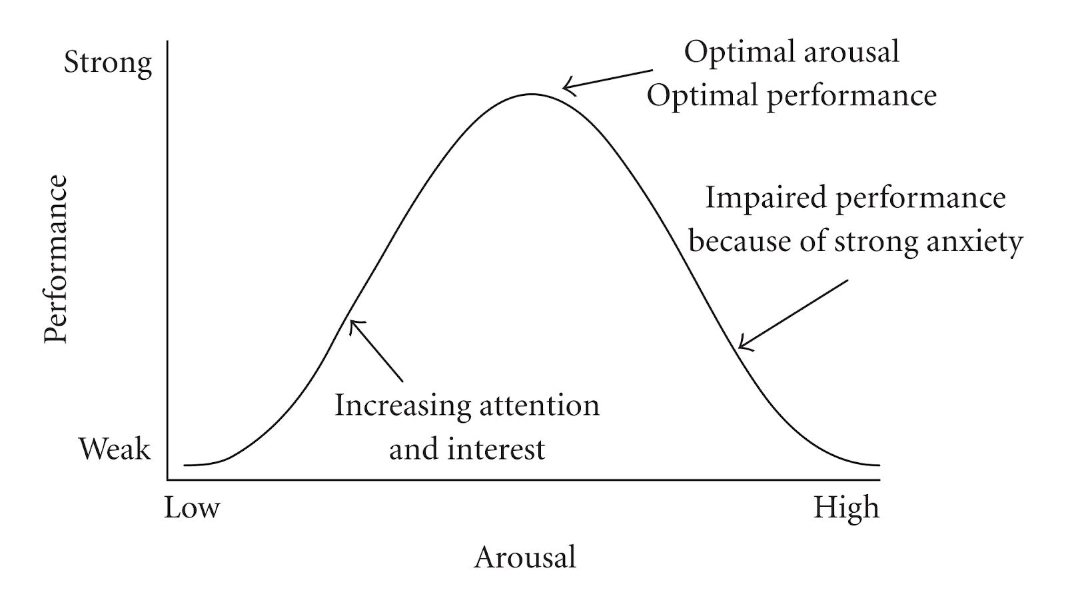
The Yerkes-Dotson Curve
Shows the relationship between stress and human performance.
Notes:
Because stress is not all bad. Look at this curve. It shows how stress, i.e., arousal, affects our performance in, well, nearly anything.
And here, again, seems to be where mainstream American culture struggles, even under ordinary circumstances. We either burn ourselves out because we are caught in turbulent times and environments, or we have little arousal and engagement with life, and therefore low performance, because we are completely avoiding situations that peak our stress. Even though it seems counter-intuitive, our peak is when we hit the goldilocks principle: not too much stress and not too little—just right

Slide 23
Good News!
While you can’t avoid stress, you can focus on skills and strategies that enhance your wellbeing, which in turn boosts your capacity for resilience.
This is way more effective than trying to avoid stress.
Notes:
The good news is that while you can’t avoid stress, you can focus on skills and strategies and changes in our environment that enhance your well-being.
This is way more effective than trying to avoid stress.

Slide 24
Subjective Wellbeing
Diener, 2000
The perception of how good one’s life is overall (life satisfaction), combined with their propensity to experience life in a positive way (positive affect).
Resilience
Masten, 2015
A person’s capacity to survive and bounce back from life’s ups and downs, curve balls, and stressors. It’s “ordinary magic”.
Notes:
As mentioned, well-being and resilience have become buzz words and may ring hollow. Let’s break them down in ARC to their purest definitions.
*Read the definitions*
Why care about definitions? Because it is important to be clear what well-being resilience are and what they are not

Slide 25
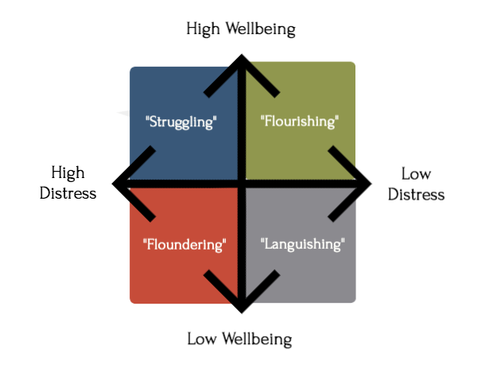
The Dual-Factor Model of Mental Health
Provides a more holistic understanding of mental health, stress, and wellbeing!
Wellness and distress are not mutually exclusive, opposite states of being
Notes:
Well-being is not the opposite of stress. It is entirely separate. At any point in life, we can fluctuate between these dimensions.
At any point, we might have high well-being, doing everything we can to take care of ourselves and living within supportive environments that let us thrive, with little distress. We are pushed to our max. We are flourishing. We can also find ourselves in situations where we are still doing everything we can to take care of ourselves, but the stressors in our lives are also high. We are not overwhelmed but we are struggling. Some of us might find ourselves here today.
It is possible to be floundering, with all that we do for our well-being dropped from our lives and being overwhelmed by the stressors.
And other times we may have little stressors, but we are not pursuing a well life. We are languishing.
The idea is that these are not types of people. These are times in people’s lives. We can always move from one grouping to another and we are never stuck.

Slide 26
BASIC NEEDS
Macrosystem
Exosystem
Microsystem
Ecological Systems
Theory
community/district
Adults (like kids) exist within environments.
Factors at the “systems level” interact with individuals to produce outcomes.
Sometimes the best way to affect well-being is from the outside (systems) in.
society at large
HEALTH/SAFETY
LEARNING/DEVELOPMENT
school
educator
RELATIONSHIPS
Notes:
*This is a very educator-specific slide. Change the label to match context*
As for resilience, we cannot discuss the actions a person takes to be resilient without acknowledging the environment they are in. Resilience is a dynamic process between a person and their environment. It is the actions we take to care for ourselves when our environment pushes back, and it is the actions we take to change our environment when our environment is detrimental. Unfortunately, resilience has been thrown around so much that it seems to mean “dealing with whatever”. That is not true. Sometimes the most resilient thing we can do is to remove toxins.
To truly be resilient, we need to learn to master effective individual practices while also contributing to systemic changes.

Slide 27
LET’S APPLY IT!
Let’s do a
Parking Lot Activity.
Our Parking Lot
Put everything you DO NOT have control over here
What is going on in your life?
Whatever remains, put here…
Notes:
So let’s spend a time doing what I call the “Parking Lot” activity. We know there are things we cannot control that are contributing to our stress. And focusing on those things is avoiding the work we know we need to do to improve things for ourselves.
Take out a piece of paper or pull up a blank document if on your computer. On the top of your page, for the next minute, list everything that is stressing you out. These are private events for a lot of us so I encourage you keep it private for now. Make sure it is a list, maybe two columns,.
*Give them 1 minute*
Okay, would anyone be willing to share out? Again, it’s okay if not since a lot of this might be private and it can sometimes help to hear others dealing with similar circumstances. What I am looking for, though, is to give people space to focus exclusively on everything you feel like you have control over. No answer is wrong.
*Allow 2-3 minutes to share out. Validate everything and make sure no one corrects someone and says “You can control that” or similar. It’s a purposeful “worry” time*
Great. Now everyone, I want you to draw two squares next to each other on the bottom half of your page. Label the left one “Parking Lot” and the other “highway”.
*Give time*
Now, draw lines from everything that you do not have control over to the parking lot. If you have options for colors, make these lines red.
*Give time*
For everything else, draw green or maybe blue lines to the Highway
*Give time*
In ARC, we are going to focus on the things we can control that are stressing us out. Those are free to move for us and we are going to get some momentum going. But we’ll also devote some reflection to our Parking Lot and see what’s parked there that maybe actually can move to the highway.

Slide 28
Action Plan System
Plan
System
Notes:
To finish up, let’s put our plan in place for our commitment to Well-being and proceeding through the ARC modules. This process is going to repeated for every module so that it becomes a system of support. Let’s walk through it. Open up on the individual action planning document that comes with this module.
This is a research-supported method for action planning. It allows us to dream for something better and take proactive steps toward whatever holds us up. I am going to let you read through the first page and complete it. For this first plan, I ask that you focus overall on your plan for engaging with the rest of ARC. Why do it? What benefits might you have? What’s important to you? And what barriers on your highway, that you have control over, might stop you? What will you do about it? Go ahead and work through it.
*Give about 5 minutes to complete*
To double-check that it makes sense, I want to ask someone to share their plan real quick
*Have someone share and make adjustments if needed*
Great job. Save this plan. It’s like a public statement to yourself. We will come back to it at the end.

Slide 29
What questions do we have at this point?

Slide 30
DISCUSSION
QUESTIONS
1
How would you rate your overall stress level?
2
How can you tell that you are stressed? What are the telltale signs in your body? What about thoughts or actions that tell you that you are stressed?
3
How satisfied are you with your current practices aimed at improving your wellbeing?
4
What factors within your microsystem and exosystem support your capacity for resilience?
Notes:
These are to be reflected upon 1-2 weeks after the session but CAN be done in session if time

