Slide 1
Delivery & Tailoring Instructions
Prior to delivering, get information from audience about their current struggles and needs. Use that information to decide what should be tailored
To tailor, you can change the following:
Hook & Transition metaphors
Your “Who I Am” slide & credibility slides (referent, information, positive expert power)
Any of the background intro slides (if Module 1 has already been delivered)
The order of the slides (before activities)
Activities (based on time frame)
Knowledge Check questions
Discussion Questions
To make changes to the Activities, Knowledge Check Questions, and Discussion Questions, you can:
Hide the activities you do not want to do
Replace the knowledge check section of each final activity slide with the proper knowledge check question(s)
Delete whichever discussion questions you choose not to provide. Make sure these questions are provided in a follow up forum/document/delivered in-person by school staff after at least 1 week of practice.

Slide 2
Delivery & Tailoring Instructions
Make sure the tailoring is done to fit within the appropriate time frame
The structure and design of the powerpoint is actually based on a combination of successful TedTalks (that involved audience participation) and research on how to present to adults
This includes the Hook, Transition, Who I Am, and Audience Benefit slides
Limited text
Use of imagery
MINIMIZE reading text on slide; research indicates this actually disrupts audience comprehension
Set expectation for participation at the outset

Slide 3
Delivery & Tailoring Instructions
Things to remember
Expert power can be negative if audience portrays a) you are leveraging your expertise in one domain into another, b) if your expertise appears outdated, c) your expertise is impersonal (i.e., not recognizing the audience’s perspective), and d) if they portray you as having something to gain
What is comfortable for us, the presenter, is maybe not engaging for the audience.
Charismatic power is something; you are acting for your audience and that is encouraged. People will buy-in if you seem bought-in. Find the charisma personality that you can put on confidently.
Sell the “Why”, not the “what” or “how”. Those are ARC and the modules. But the “Why” is most important

Slide 4
Adult Resilience Curriculum (ARC) for Educators
Module 2: Creating Safe and Supportive Environments

Slide 5
Disclaimer
This presentation was prepared for the MHTTC Network under a cooperative agreement from the Substance Abuse and Mental Health Services Administration (SAMHSA). All material appearing in this presentation, except that taken directly from copyrighted sources, is in the public domain and may be reproduced or copied without permission from SAMHSA or the authors. Citation of the source is appreciated. Do not reproduce or distribute this presentation for a fee without specific, written authorization from the MHTTC Network Coordinating Office. This presentation will be recorded and posted on our website.
At the time of this presentation, Tom Coderre served as Acting Assistant Secretary for Mental Health and Substance Use at the Substance Abuse and Mental Health Services Administration (SAMHSA). The opinions expressed herein are the views of the speakers and do not reflect the official position of the Department of Health and Human Services (DHHS), or SAMHSA. No official support or endorsement of DHHS, SAMHSA, for the opinions described in this presentation is intended or should be inferred.
This work is supported by grants under Funding Opportunity Announcement (FOA) No. SM-18-015 from the DHHS, SAMHSA.

Slide 7
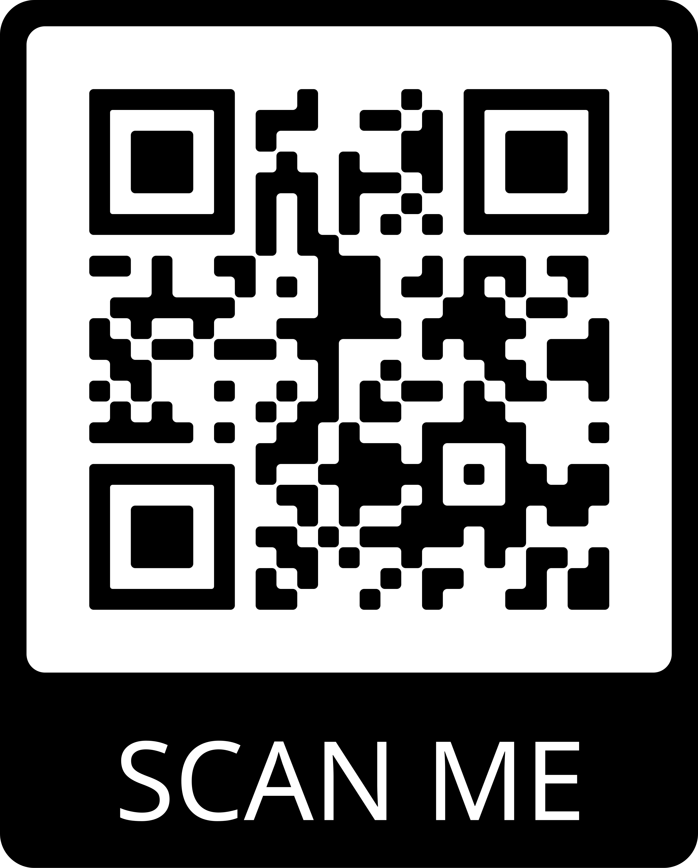
Connect With Us
JOIN OUR MAILING LIST:
FOLLOW US ON SOCIAL MEDIA:
/MidAmericaMHTTC
@MidAmericaMHTTC
/company/MidAmericaMHTTC
EMAIL: midamerica@mhttcnetwork.org WEBSITE: mhttcnetwork.org/midamerica

Slide 8
Notes:
The Hook
*Use or replace with your own metaphor that expresses how structure limits behavior*
When was the last time you floated a long a river? What was it like? Did you flow in a straight line straight down the middle? Did you bounce around?
*insert brief personal reflection about your experience on rivers*
Notice that the path you take down a river depends on a few things. It depends on the speed of the water, the width and depth of the river itself, and even how the river weaves along its bank. When floating down a river, you have some freedom where to go but not total freedom. You might got sloshed around or pushed in directions you do not necessarily want to go. If the water is fast, you might get there quickly or it might take you some time to get where you want to go. If the river suddenly turns left, you also have to turn left. And if the water runs low, you might get beached.

Slide 9
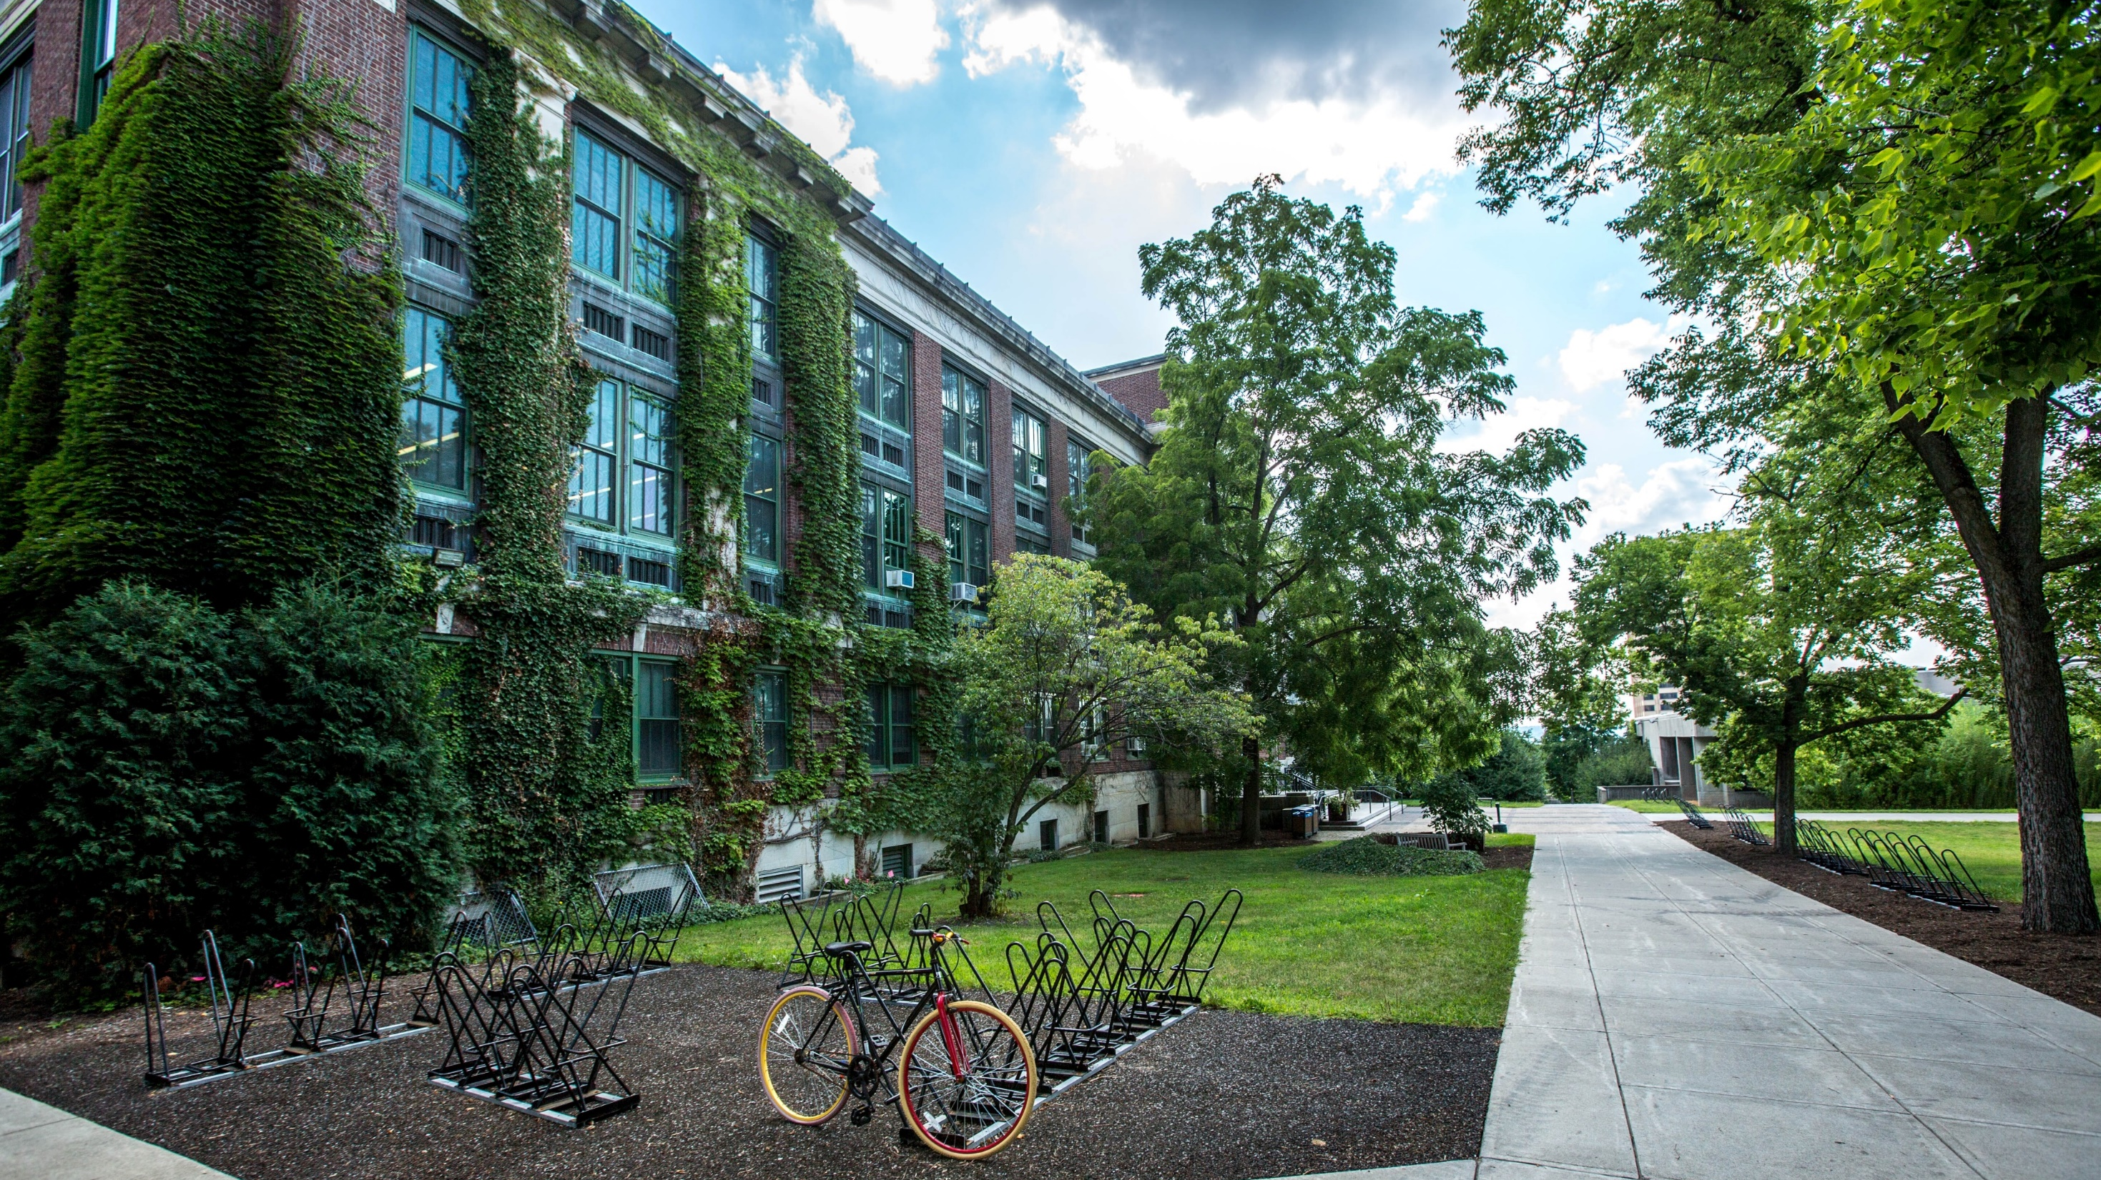
Your school is a river
Notes:
The Transition
Your school is like a river. It comes with its own structure. It has its own resource flow, its own channels and directions, its own goal it is heading toward. When it comes to well-being practices, staff have some freedom in what they do and the extent they can do them with fidelity, they are ultimately bound by the school. This means both physically, financially and materially, and culturally

Slide 10
Sources of Educator Stress
efforts to improve educator wellbeing
administrative demands
challenging student behaviors
Notes:
The Transition
*Review from module 1* *Delete if not addressing COViD or adjust to make it fit the context of the school/district*
These things are draining school resource and restricting the flow of your river, which makes it difficult for staff to have the freedom to engage in efforts to improve their well-being
Current new factors that heighten teacher stress:
COVID
Health
Economic ramifications
socio/cultural/poloitical concerns (clash/upheaval) and equity
High expectations: graduate all students college or career ready, differentiation for diverse student populations, manage behaviors, teach SocEmo skills, promote mental health, maintain connections with families, and use evidence based practices

Slide 11
Sources of Educator Stress
educational inequities
insufficient funding & resources
policy & accountability measures
efforts to improve educator wellbeing
administrative demands
challenging student behaviors
not enough time!
Notes:
The Transition
*Review from module 1* *Delete if not addressing COViD or adjust to make it fit the context of the school/district*
Current new factors that heighten teacher stress:
COVID
Health
Economic ramifications
socio/cultural/poloitical concerns (clash/upheaval) and equity
High expectations: graduate all students college or career ready, differentiation for diverse student populations, manage behaviors, teach SocEmo skills, promote mental health, maintain connections with families, and use evidence based practices
BUT teacher SEC is not well supported in training or practice. SEC-the skills of self-awareness, self-management, social awareness, relationship skills and responsible decision making

Slide 12
Sources of Educator Stress
worries about loved ones
personal health concerns
frustrated parents
de-funding of schools
distance learning
efforts to improve educator wellbeing
educational inequities
insufficient funding & resources
policy & accountability measures
administrative demands
challenging student behaviors
not enough time!
Notes:
The Transition
*Review from module 1* *Delete if not addressing COViD or adjust to make it fit the context of the school/district*
Current new factors that heighten teacher stress:
COVID
Health
Economic ramifications
socio/cultural/poloitical concerns (clash/upheaval) and equity
High expectations: graduate all students college or career ready, differentiation for diverse student populations, manage behaviors, teach SocEmo skills, promote mental health, maintain connections with families, and use evidence based practices
BUT teacher SEC is not well supported in training or practice. SEC-the skills of self-awareness, self-management, social awareness, relationship skills and responsible decision making

Slide 13
COVID-19
Notes:
The Transition
*Delete if not addressing COViD or adjust to make it fit the context of the school/district*
It has created uncertainty where there used to be a little bit. It has created adversity where there were not challenges, and has added adversity to where it was always difficult. And people…kids, parents, and most certainly educators, are feeling that stress and uncertainty
In our game of life, sometimes we have no choice over what happens in our life. It’s this same shared experience that we just had that fuels people’s drive to create a more egalitarian society. And that same reality, that there are things beyond our control, plays into our daily lives and experiences. For some of us, we capitulate to that lack of control. We throw our hands up and say, no more. I am done.
And others find empowerment in those situations and find ways to make meaning from them.
I was speaking with a teacher yesterday that was seriously contemplating walking out of his job because, in his words, “spending 6 hours in front of a screen, with so much out of your control, sucks.”
And to be clear, he wasn’t against remote learning. He actually incorporated technology and online activities a great deal already. For him, it was that he felt like he had no control to do otherwise. Losing that sense of agency and not finding otherways to exercise agency left him demotivated.

Slide 14
How are you?
Notes:
The Transition
*Delete if not addressing COViD or adjust to make it fit the context of the school/district*

Slide 15
The Adult Resilience Curriculum (ARC)
Notes:
*Review from module 1*
*Delete if Module 1 has been delivered*
A transtheoretical, comprehensive yet flexible curriculum designed to promote wellbeing (and thereby enhance people’s capacity for resilience)
Originally developed in 2013 by Dr. Clayton Cook and Dr. Gail Joseph for pre-service and in-service teachers
Builds upon the strengths of existing programs, while trying to make it more accessible and feasible for real-world professionals
Expanded to include university students in a range of care-giving professions
NOT designed to replace mental health services or treatment

Slide 16
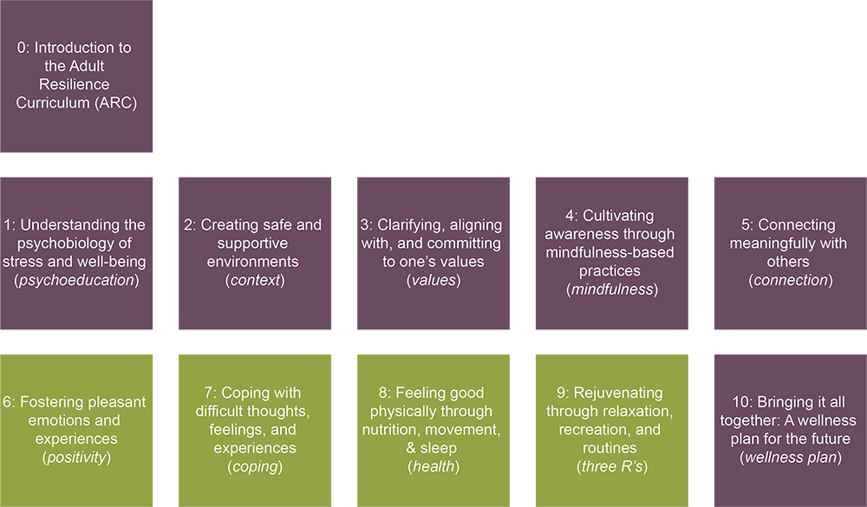
The ARC Modules
Notes:
So what is included in ARC? Well, first, it has 10 modules, not including an intro module, or “module 0”. Those modules include a mix of didactic information—things you may already know, things you may not know, and perhaps perspectives or insights you hadn’t considered yet—and they also come with practices. We will talk more about how to go through these modules in a moment.
The green modules are supplementary. This does not mean, though, they are less important. Instead, they mean that the core modules provide the foundational skills for enhancing well-being ad the supplemental skills build off those.

Slide 17
Context
Our Hopes for Today
Understand the basics of implementation science and practice
Discuss key features of a safe and supportive environment for teacher well-being
Engage in open conversation about the key features within your current school environment to identify strengths and weaknesses, and address any concerns and barriers
Create a school prioritization plan to create an environment that reduces stressors, emphasizes teacher wellness, and supports implementation.
Notes:
The Audience Benefit
Before we start, it’s important to know that this is ideal. Given the stress of this year, and in discussion with Kami, we thought the most appropriate and, honestly, respectful thing with your time is to explore what we value and would want ideally for the westside educators, including yourself, and then figure out what is feasible. So we are going to talk a bit about critical ideas of imp sci and features of supportive school environments for educators. We are going to talk about the barriers currently and in general that you experience. And then prioritization plan is, again, modeled off of ideal circumstances and we can instead talk about how to tailor and support things going forward for this year.

Slide 18
What are you wanting from today?
Notes:
The Audience Benefit
*Variant of magic wand*
When I am working with children, adults, or parents, there comes a point where they are on the precipice. My practice group and I refer it to the rubicon. They are telling us they want to improve and that motivation is dripping. To focus on that aspiration, we ask our “magic wand” question. It helps us realize what it is that we are envisioning and it gives them that little bit of a bump to “cross that rubicon”. I like to ask a modified version of this for school leaders. As I have shared with you my/our goals, it’s important that you all get the floor to share what you want. So, I am really interested in knowing, “If you closed this zoom meeting and suddenly your concerns about your staff’s well-being were fixed, how would you know? What would it look like in your schools?”
What about well-being do you value?

Slide 19
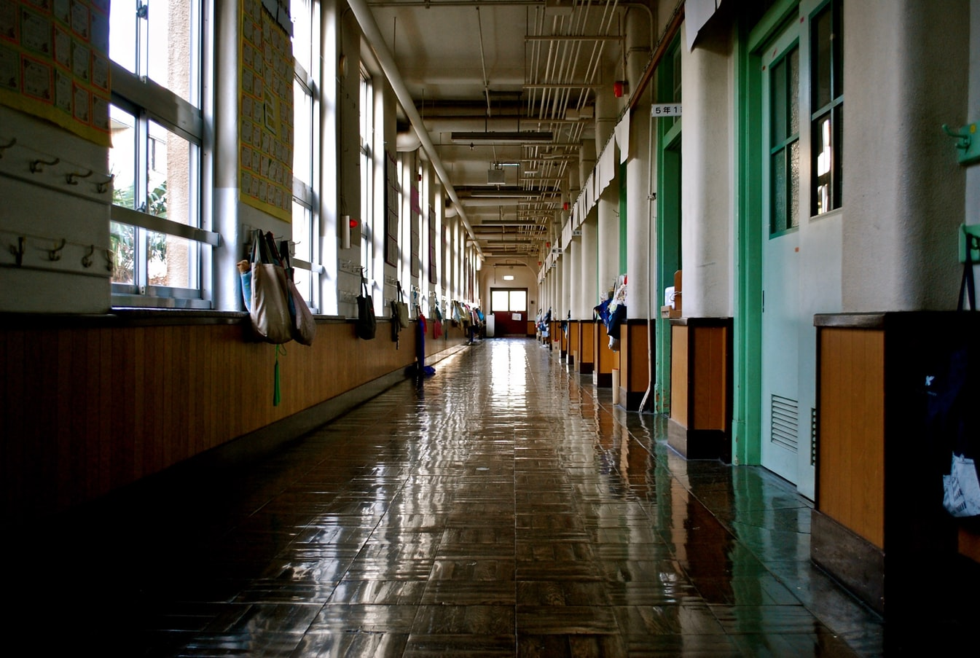
MODULE 2: Creating Safe and Supportive Environments
Notes:
As we mentioned before, ARC focuses on developing your own internal capacity for wellness to buttress against stress. But we also recognize that in education, as well as other industries, it is irresponsible to encourage personal growth without acknowledging the very real environmental and contextual constraints placed on people.

Slide 20
Key Features/Characteristics
Implementation Overload
School & Implementation Climate
Psychological Safety
Focus on-Prioritize Work
Educational Support
Rewards & Recognition
Data Support
Follow Up Support
Integration
Notes:
There are 3 things we want to consider within your school context. We have spent time digging into what is most critical for schools to address and have identified these 3 things that, interestingly, schools share with many other organizations too like Big Tech:
Implementation overload – having individuals AND the whole school system inundated with implementation initiatives
School & Implementation Climate – in general, developing a good molar (general) climate as well as one that is successful in implementation of effective practices (you can have a good climate school that also fails at implementing practices so these are distinct)
Psychological Safety – work by Amy Edmundson on what makes organizations effective at the individual, team, and whole org level

Slide 21
Context
What do students need from teachers to succeed?
Notes:
*Okay to read slide first*
*Give time to generate answers and match to answers below*
Teachers who allocate time and attention to teach and revisit expectations,
teachers who model the expectations,
who model and give feedback,
who give reinforcement,
recognizes and show appreciation for efforts,
respond consistently, calmly and with empathy when students struggle

Slide 22
Context
Context
What do teachers need from their leaders to succeed?
Notes:
*Okay to read slide first*
*Give time to generate answers and match to answers below*
*Make it clear these are the SAME EXACT ENVIRONMENTAL SUPPORTS, THIS IS THE RIVER FOR ADULTS (or your own metaphor)*
Leaders should:
Prioritize a subset of work to avoid overwhelming teachers
Allocates time and attention to teach and revisit expectations
Models the thing
Monitors and gives feedback to teachers about the thing
Provides proactive support and reminders to encourage people to do it
Recognizes and rewards staff for energy and effort to do the thing
Responds consistently, calmly, and with empathy → turn into learning opportunities
** Same environment we hope teachers create for students, from a leadership perspective, this is what leadership can focus on to create a healthy, supportive environment for teachers

Slide 23
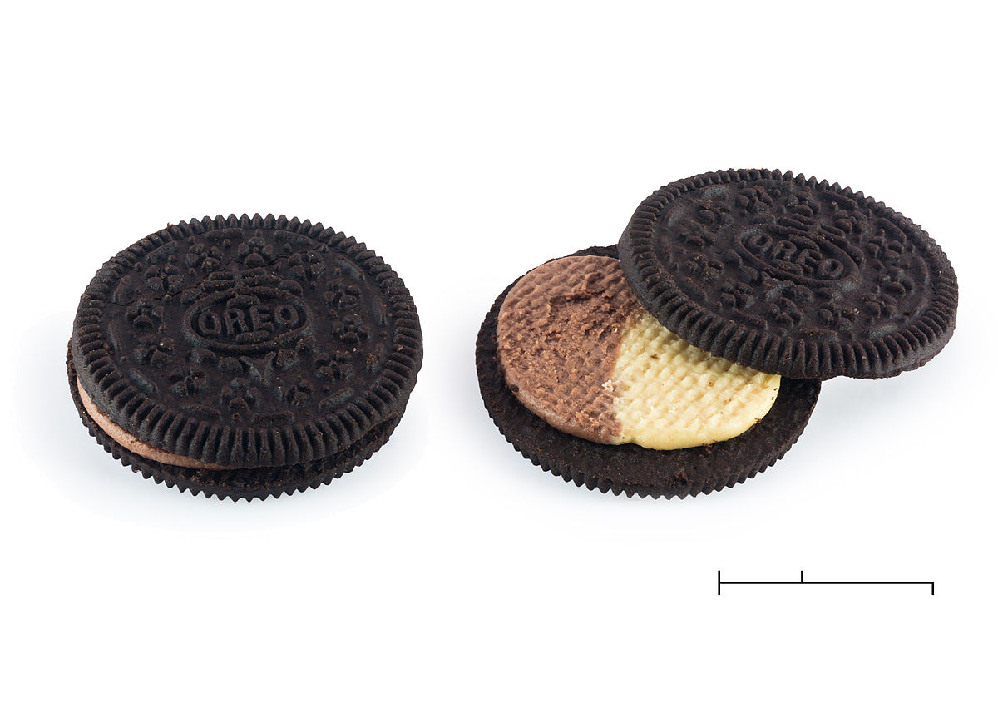
Context
Did you know there are 85+ different varieties of Oreo?
Notes:
*Replace with an example of your own for novelty and how novelty can be fun in some domains but terrible in schools*
I am a sucker for novelty. And in graduate school, I hosted monthly oreo competitions. I purchased packs of 2-3 flavors a month and had a program wide rating system. People could come into my office at any time, try a new oreo flavor, and leave a ranking and see what the program as a whole enjoyed.
This was a fun experiment.
But it is considerably less fun for educators when “things” become the oreo and they are subjected to new things constantly. What happens when people engage in this flavor of the month approach?

Slide 24
Notes:
*This is the cost of novelty, it costs motivation and buy-in in the long run for every subsequent initiative*
They loose buy-in and motivation to do the thing itself.
They become overloaded with too many implementation efforts.

Slide 25
Context
Implementation Overload Costs
- Financial Capital
- Cultural Capital
- Material Capital
- Positive Psychology Capital
- Implementation Efforts
- Student Outcomes
Notes:
Here is a common experience for educators: implementation overload (we want to prevent this)
Ex. a school system that had over 100 implementation efforts
Causes increased stress, burnout, and turnover (negative outcomes that undermine educator wellbeing and performance)
Plate metaphor:
Buffet - get a full plate but there are so many other things out there to do
Some educators have overly full plates; so much is being piled on to their plate, leading to stress and burnout
Means educators thinly implement everything, which means that students get almost nothing
We need people to feel like they can feasibly and competently take on work
Portion-control problem: must have the right portions and the right stuff on the plate
To avoid these determintal outcomes, we want to focus, for now, on two things: developing a healthy implementation climate, and developing psychological safety in the school

Slide 26
LET’S APPLY IT!
Let’s do an activity to understand The Costs of Overload.
Record your school’s number of students.
Program A: 75% of students with 40% effectiveness at 60% fidelity.
Program B: 50% of students with 90% effectiveness at 60% fidelity.
Program C: 25% of students with 60% effectiveness at 60% fidelity.
Program D: 10% of students with 80% effectiveness at 60% fidelity.
What is the overall effectiveness as you add programs?
Notes:
Say your school has 1000 students.

Slide 27
Equations
Basic
Students Served = 1000 * Program Reach * Effectiveness * Fidelity
Implementation Overload
Students Served = 1000 * Program Reach * Effectiveness * (.6-.1*# of programs)fidelity
Example: Program A
Students Served = 1000 * .75* .4* (.6-.1*# of programs)fidelity
Notes:
Base students served is 180
If you add just one more program, it is now only reaching 150

Slide 28
Equations
Program B
Students Served = 1000 * Program Reach * Effectiveness * (.6-.1*# of programs)fidelity
Program C
Students Served = 1000 * Program Reach * Effectiveness * (.6-.1*# of programs)fidelity
Program D
Students Served = 1000 * Program Reach * Effectiveness * (.6-.1*# of programs)fidelity
Notes:
Program B: 50% of students with 90% effectiveness at full fidelity.
Program C: 25% of students with 60% effectiveness at full fidelity.
Program D: 10% of students with 80% effectiveness at full fidelity.

Slide 29
LET’S APPLY IT!
Let’s do an activity to understand The Costs of Overload.
Record your school’s number of students.
Program A: 75% of students with 40% effectiveness at 60% fidelity.
Program B: 50% of students with 90% effectiveness at 60% fidelity.
Program C: 25% of students with 60% effectiveness at 60% fidelity.
Program D: 10% of students with 80% effectiveness at 60% fidelity.
What is the overall effectiveness as you add programs?
Check for Understanding
Why is it important for school leadership to engage in prioritization? What can happen if schools fail to prioritize?
REFLECT & DISCUSS.
As a school, how full is your plate? Other than ARC, what practices would you need to prioritize and receive support for to create a little more room on your school’s plate?
Notes:
Okay, first, let’s check on what we’ve talked about
*Read your selected comprehension check question & prompt discussion*
Read the reflect and discuss. Let’s get down to the grit. We know our educators are overwhelmed. We know we need to support their well-being. And we know we have limited ways to prioritize and provide that space. We can also recognize that there are a lot of inefficiencies and unnecessary initiatives. So let’s start with this: let’s say that, even with making participation with the ARC module optional, we still want to prioritize overall well-being. There are still things yoru schools can do in this time to help that out (things that we will talk about later). So it’s a given that we prioritize this.
What else is absolutely necessary to prioritize right now? If you pictured you had a limited slot of school initiaves, maybe 4, and you already have well-being filling one of those slots, what would the other 3 be and what does that mean that you would have to, temporarily, remove?

Slide 30
Implementation
the process of putting systems of support in place to promote adult behavior change to adopt, deliver, and sustain known effective “THINGS” that have been shown to achieve specific outcomes of interest
Notes:
Defining implementation and what it means
What are the things?
Programs (e.g., SW-PBIS; SEL curriculum)
Practices (e.g., positive greetings at the door)
Principles (e.g., equity, early intervention)
Procedures (e.g., screening for behavior)
Products (e.g., FastBridge)
Policies (e.g., alternatives to suspension)
Processes (e.g., problem-solving process)
And what is implementation science?
It is identifying, developing, and refining the supports in an ongoing basis for what is needed right now, in this moment, in this context

Slide 31
Dissemination.
Implementation
Notes:
Difference between Dissemination & Implementation
Dissemination
Intentional, active process of identifying target audiences and tailoring communication strategies to increase awareness and understanding of a “thing” and to motivate its use in policy, practice, and individual choices.
Newsletters, manuals, publications, books, websites
What do we know about dissemination? Train to hope? Does it work? The internet is a fantastic case study. We now have more information available than ever before. Have long standing historical problems in society and education been solved with more access?
Implementation
Deliberate, iterative process of integrating effective “things” into routine practice through facilitating behavior change.
Policy, leadership, training, hiring, coaching, audit and feedback, continuous improvement cycles

Slide 32
Notes:
Point of implementation
Saying something is important doesn’t matter. Don’t tell me your values
Show me how you act, where you put your time, what you spend your money on, and where you direct your attention and I will tell you your values

Slide 33
Notes:
So while a majority of ARC focuses on that individual behavior, this is our opportunity for the school system to reach down from the top and provide the structure needed to focus on this.

Slide 34
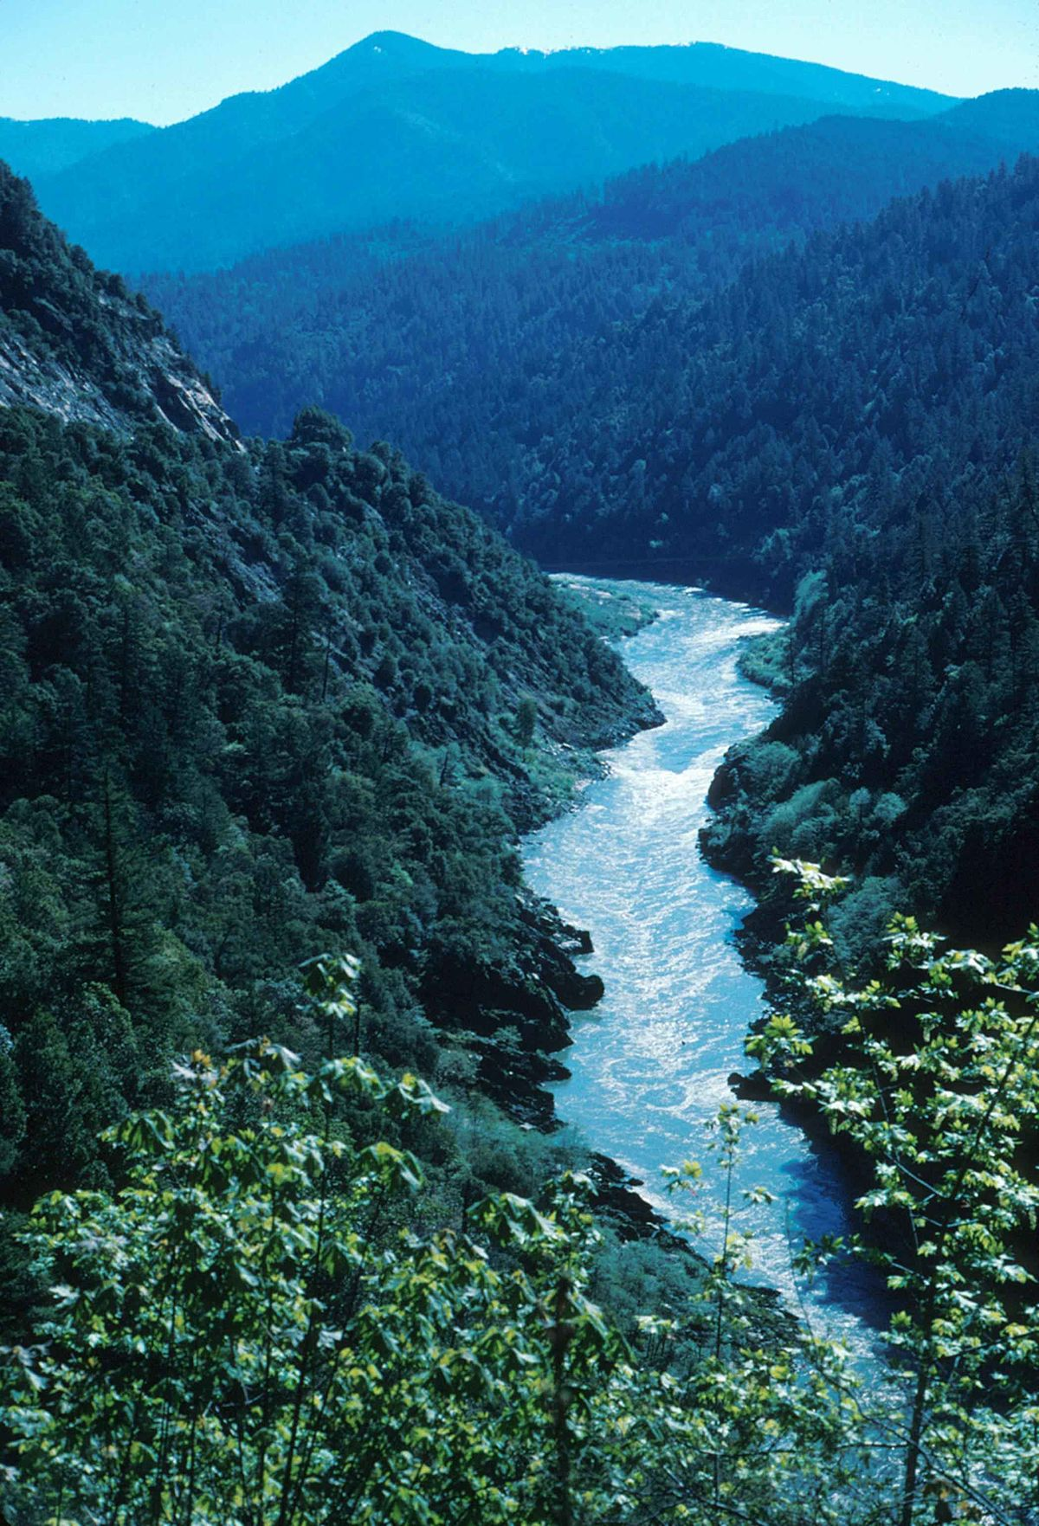
That Which Gets Allocated Gets Implemented
What are general barriers in education?
What needs to be allocated in order to create and support a culture of well-being in your school(s)?
Notes:
Ask question
Affirm responses
“Great, keep those in mind for your school(s) while we talk about two key characteristics of schools we need to develop in order to address those barriers
The first is what is called implementation climate
The second is psychological safety
Both of these things are sort of amorphous/cloudy ideas that are nonetheless important to a school’s culture”

Slide 35
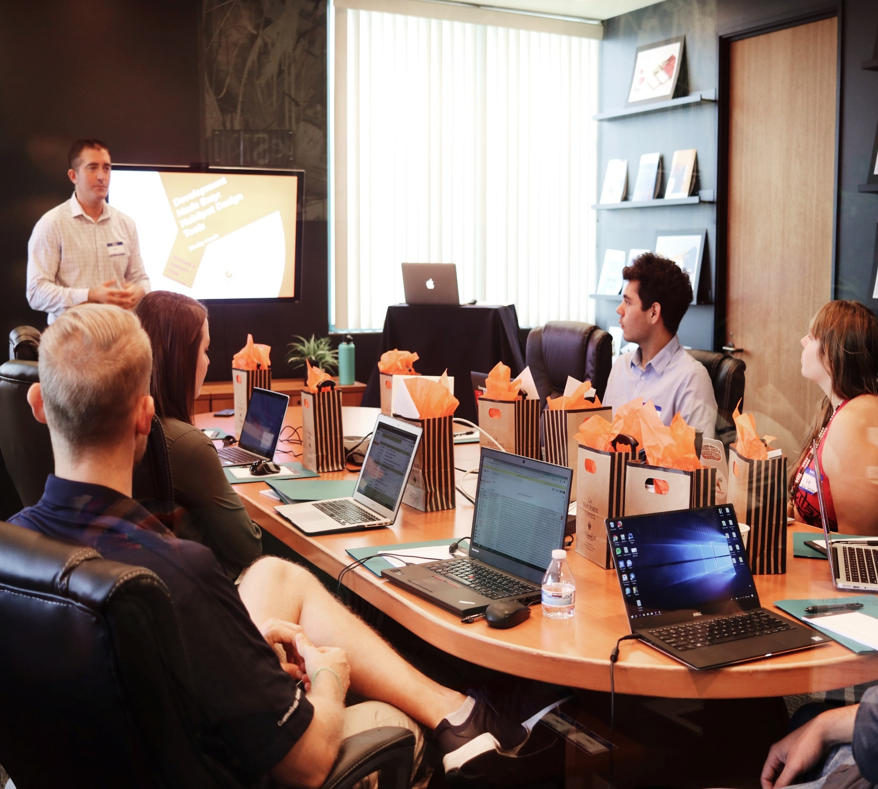
School Implementation Climate
Focus on/Prioritize Work
Educational Support
Rewards & Recognition
Data Support
Follow Up Support
Integration
Notes:
Ask: Define school climate for me. When you experience a school’s climate (yours or one you visit), what do you see?
Defining culture and climate & why we are focusing on climate
Organizational culture is a set of values, beliefs, behaviors, customs and attitudes that govern how people behave within organizations.
Organizational climate is about the the perception and feeling of each regarding the culture of a particular organization.
For Prioritizing
Step 1: Prioritization
Make sure what people are expected to implement them doesn’t burn them out
Leadership activity
Step 2: Protect time
For what you want people to do
Time for people to be able to learn and apply
A system-level value activity; if a system values something, the would protect time for that activity
For educational support
Professional Development
Target areas where people feel low self efficacy
Mobilize important areas for PD- teachers must be able to have a voice to talk clearly and professionally about their needs for PD
When teachers don’t feel confident and competent to meet the needs of teachers
Feel more stressed and burned out
Feel less successful in their job
Key areas of need for PD
Proactive classroom guidance strategies
Establishing, maintaining, and restoring relationships with students who are different from them
mOdels and concrete practices to differentiate supports for different students
What else? (open to the audience)
For rewards/recognition
Rewards are material/financial incentives which are sometimes difficult to provide in school so they need to get creative (e.g., heated parking lot)
Recognition are social rewards including nominations, prizes, celebration parties. Something that draws upon social praise/reinforcement
For Data Support
We track what we want to have improved. If we care about well-being, a school will then implement and regularly track data related to well-being (subjective perceptions, behavioral frequencies)
For Follow Up Support
Organizations with strong Follow Up Support ensure that their staff are receiving ongoing support and adjustments made to their implementation
For Integration
Well-being language and practices are integrated throughout the day. It may start off as a segmented practice, something you do 1x a month (perhaps as you are doing with this training), and integration means that it is checked regularly, part of daily communication, etc.

Slide 36
LET’S APPLY IT!
Let’s get an idea of your Implementation Climate.
Open the document titled “ARC_Module-2-Imp-Climate-Handout”
For each of the 6 components of implementation climate, give yourself a quick knee-jerk rating from 1-5.
For each component, identify a feasible action step to improve that component.
Check for Understanding
How do climate and culture differ and why do we need to focus on implementation climate specifically?
REFLECT & DISCUSS.
What is your school’s greatest climate strength? How can you use that to improve implementation climate?
Notes:
*Adjust comprehension check/reflect & discuss questions as appropriate)

Slide 37
Take Risks
Openness to Feedback
Intentional Effort for Collegial Relationships
Regular Demonstration of Fallibility
All Staff Have Input
How do we promote psychological safety in schools?
Notes:
Lots of research in business and healthcare sector***
Belief that one will not be punished, negatively judged, or ____ when they speak up or admit to a shortcoming -- not enough not just to be physically harmed
If people do feel like they’re going to be punished if they make a mistake or use their voice or admitting a weakness
Cliques develop
Shuts down collaboration
Limits productivity
→ critical ingredients to a well-functioning school
How do we promote psych safety:
Support people to take risks, try new things and make mistakes; admitting mistakes together creates learning opportunities
Create a culture of openness to feedback
Where people are asking and requesting feedback
Working together on the skills necessary for giving and receiving feedback; what are the skills to do this in a supportive, non-judgmental way and how do you receive feedback
Create intentional opportunities for people to build healthy relationships
Emphasis on adults getting to know one another better
People reserving and protecting space for humility and to admit fallibility (leaders and key decision makers)
Identify shortcomings, recognize opportunities for growth
Modeling that it’s okay to do this, instead of guarding against it
Allowing people to have voice and input
Active process - solicit voice and input
Critically for leaders to do this so people feel like they can say things and not be judged or punished
When people feel psychologically safe, their wellbeing goes up and performance improves***
***Citations for this slide:

Slide 38
LET’S APPLY IT!
Let’s do an activity to make
Space for Vulnerability.
With your practice partner, practice soliciting and receiving feedback.
Now switch roles, giving some feedback to your partner.
Discuss what went well and what was difficult about this.
Share insight with the group.
Check for Understanding
What are the characteristics of a healthy and supportive environment for teachers and students?
REFLECT & DISCUSS.
What could your workplace’s leadership do to promote a safe and supportive environment? What could you do to contribute to a safe and supportive environment for others?
Notes:
Components of effective feedback (take notes!):
Ask for permission to provide feedback first
Be specific, just like you would with a student but not condescending. The goal is to provide support, not criticize or “one up” the other person so no need to be confusing
Empathize. Providing any kind of feedback is going to be a wave of emotion for your both. But by practicing empathy and giving space for those emotions without reacting, you create a psychologically safe space for colleagues to express themselves and then be receptive to your feedback
Don’t wait for specific time, provide feedback promptly
But do it privately. Feedback is an intimate process and we need to respect that
Performance, not personality
Make it bidirectional by asking for feedback about how you can help your colleague
Follow up
Do NOT use the sandwich method

Slide 39
QUESTIONS TO
CHECK FOR UNDERSTANDING
1
Why is it important for school leadership to engage in prioritization? What can happen if schools fail to prioritize?
2
What are the characteristics of a healthy and supportive environment for teachers and students?
3
In what industries has psychological safety been researched and developed within organizations, and what are its main features?
Notes:
More questions you can prompt with

Slide 40
In-Session Activities
full plate vs. ideal plate
overload cost
practice feedback
school prioritization plan
Notes:
We did the practice feedback activity.
The full plate vs ideal plate is a tested strategy for helping teachers reflect on their personal overload
Overload cost is a school wide simple calculation
We have practicing feedback
And then school prioritization plan which is critical and not something we would do here in this session. But we can provide a protocol

Slide 41
Action Plan
Decide
Imagine
Obstacle
Plan
Notes:
This is MCII
Decide on which action(s) you will take for each module you completed in training
Imagine the best outcome of each action
What are the obstacles that would prevent you from engaging in each action?
Write out this statement: I will ___(list your chosen actions). If __(obstacle)_ appears, I will __(goal-driven solution)__.

Slide 42
What questions do we have at this point?

Slide 43
Well-being Prioritization Plan
SEE HANDOUT
Notes:
Establish Centralized Dissemination and Implementation Team who will ‘own’ the well-being work (to include MHTTC trainers, district leads, and program eval volunteers)
Establish a coaching team at each school site
Brand the work. Name it to create common language in the system regarding the well-being work (e.g., Westside Culture of Well-being)
Prioritize the work by identifying main outcomes of interest right now and all initiatives schools are doing. Which ones are effective? Which ones are being implemented with fidelity? Which ones are being communicated as “important” but not well supported? This needs to be prioritized.
Survey existing data system to identify gaps in tools that are needed to facilitate MTSS (e.g., school climate, progress monitoring and universal screening).
Gather baseline data to serve a reference point to evaluate impact of the ARC effort
Develop a plan for disseminating information about the work to stakeholders inside and outside the school district. Share this branding and official commitment with schools so that they know what they are to prioritize this year. This sends a clear signal about what staff need to focus on as well as the plan for how this will be achieved
AT EACH SCHOOL: Identify appropriate social & material rewards; Create unique space for vulnerability

Slide 44
Individual Action Planning
Complete Action Plan
Notes:
Action Planning is a critical step whenever we try to start something new for ourselves. It helps us identify our barriers, our strengths, and how we can recover from setbacks when they enevitably happen.
Please complete the Action Plan form that is linked with this lesson.
Take care,

Slide 45
DISCUSSION
QUESTIONS
1
What is your school’s greatest climate strength? How can you use that to improve overall climate and safety?
2
What strategies and supports have you used to prioritize your own wellbeing within your school? How can those be supported by the environment?
What could your school’s leadership do to promote a safe and supportive environment? What could you do to contribute to a safe and supportive environment for other educators?
3
4
As a school, how full is your plate? Other than ARC, what practices would you need to prioritize and receive support for to create a little more room on your school’s plate?
Notes:
Module X – Check for Understanding Questions

