Slide 1
National AI/AN Mental Health TTC
Social-Emotional Learning
Melody Redbird-Post, Anadarko Public Schools
David Sullivan, Special Programs Director, Anadarko Public Schools
Melissa Isaac, Education Director, Saginaw Chippewa Indian Tribe

Slide 2
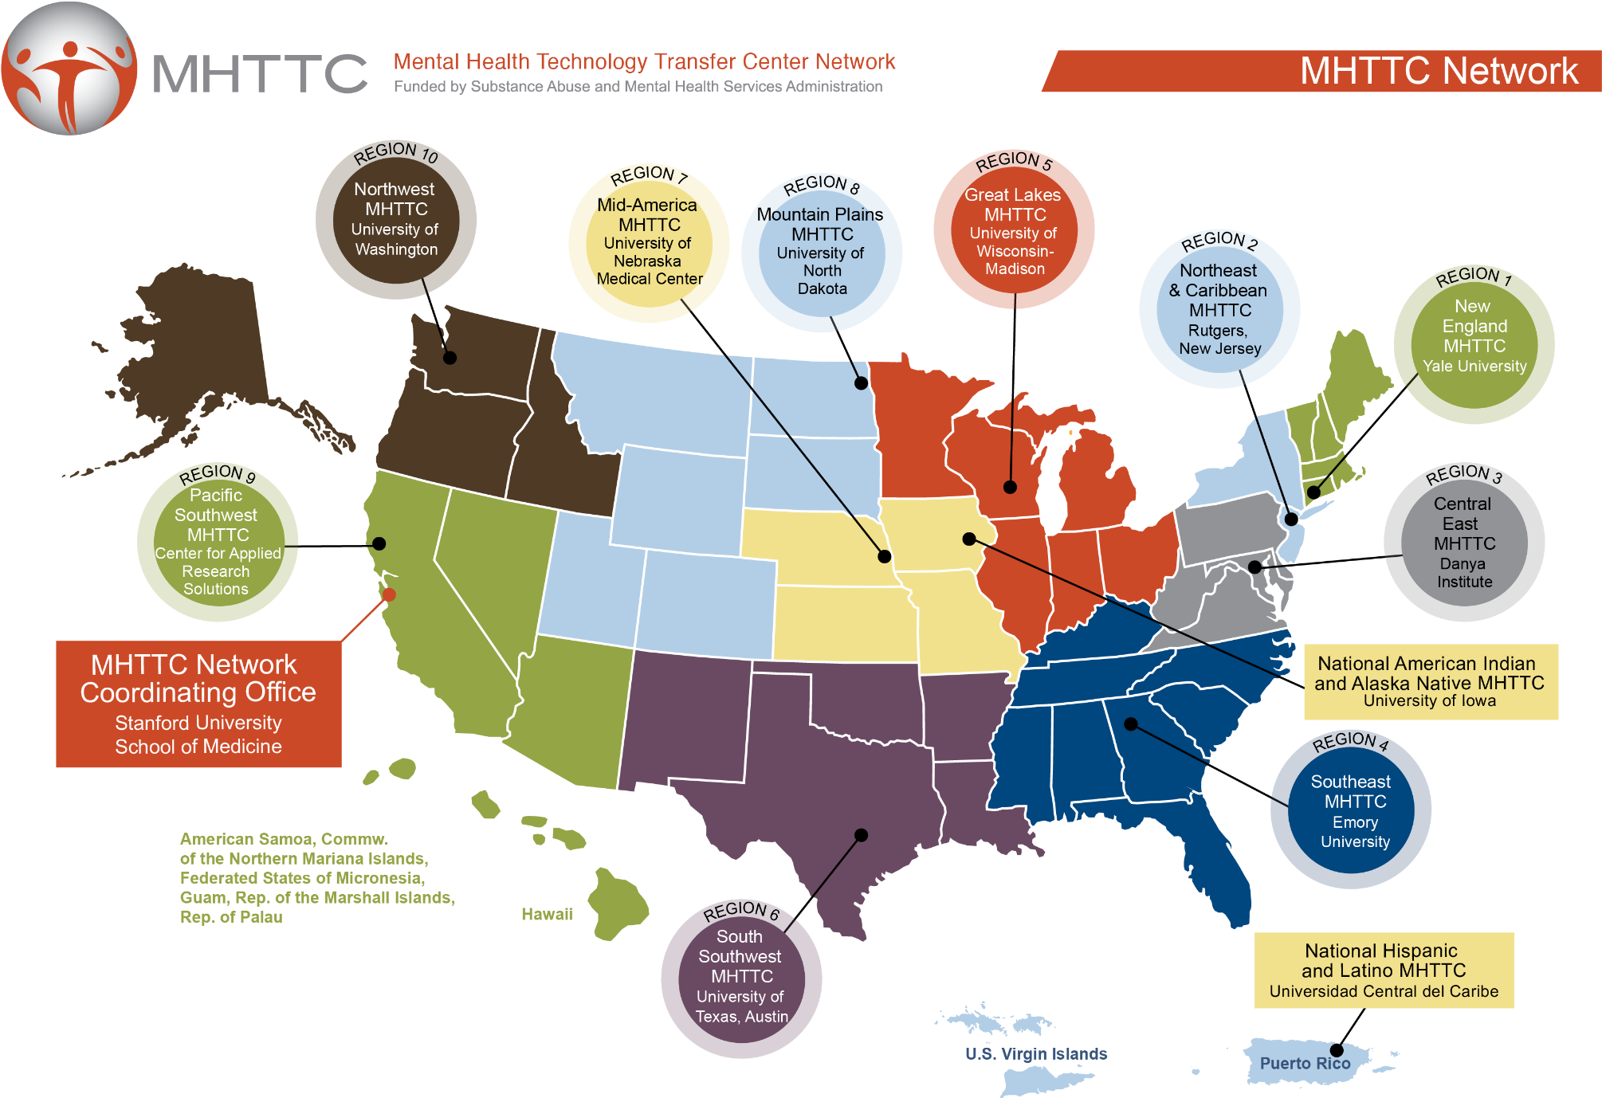
American Indian & Alaska Native Mental Health Technology Transfer Center K-12 School Mental Health Supplement Project
Notes:
This event is brought to you by the National American Indian & Alaska Native Mental Health Technology Transfer Center, under the K-12 School Mental Health Supplement Project. We are located at the University of Iowa and part of a National MHTTC Network serving AI/AN across the US and Alaska. We provide TA for AI/AN to tribal communities and schools and well as having several ongoing initiatives and projects for AI/AN communities.

Slide 3
The National American Indian and Alaska Native Mental Health Technology Transfer Center is supported by a grant from the Substance Abuse and Mental Health Services Administration (SAMHSA).
The content of this event is the creation of the presenter(s), and the opinions expressed do not necessarily reflect the views or policies of SAMHSA, HHS, or the American Indian & Alaska Native MHTTC.
Notes:
This project is supported by SAMHSA. The content is developed by the presenter, and the opinions expressed do not necessarily reflect the views or policies of SAMHSA, HHS, or the American Indian & Alaska Native MHTTC.

Slide 4
Land Acknowledgement
We would like to take this time to acknowledge the land and pay respect to the Indigenous Nations whose homelands were forcibly taken over and inhabited.
Past and present, we want to honor the land itself and the people who have stewarded it throughout the generations.
This calls us to commit to forever learn how to be better stewards of these lands through action, advocacy, support, and education.
We acknowledge the painful history of genocide and forced occupation of Native American territories, and we respect the many diverse indigenous people connected to this land on which we gather from time immemorial.
While injustices are still being committed against Indigenous people on Turtle Island, today we say thank you to those that stand with Indigenous peoples and acknowledge that land reparations must be made to allow healing for our Indigenous peoples and to mother earth, herself.
Dekibaota, Elleh Driscoll, Meskwaki and Winnebago Nations
Ttakimaweakwe, Keely Driscoll, Meskwaki and Winnebago Nations
Keokuk, Sean A. Bear, 1^{st.} Meskwaki Nation
Notes:
Although we are gathered virtually today, we want to take the time to acknowledge the land and pay respect to the Indigenous Nations whose homelands were forcibly taken and inhabited. Please take a moment to read this land acknowledgment which was created by three members of our team: Elleh and Keely Driscoll and Sean Bear.

Slide 5
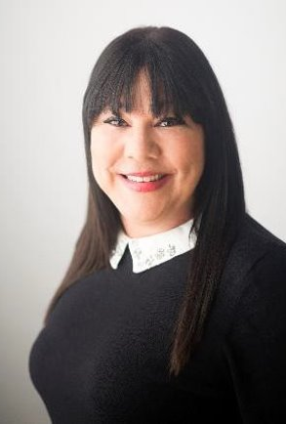
Host: Teresa Brewington
Teresa Brewington is the Program Manager for the National American Indian & Alaska Native Mental Health TTC – K- 12 School Supplement. She is an enrolled member of the Coharie Tribe and a descendent of the Lumbee Tribe. She holds a Master’s in Educational Leadership, a Master’s in Business Administration, and has 36 credit hours towards a Master’s in Counseling. She has held positions as a director at several mental health agencies and worked as a school guidance counselor serving mostly Hispanic/Latino students. She has also served as a foster care agency supervisor, where she worked directly with the Salt River Pima Indian Community placing Native American children in foster homes. Her last position was as the Elementary School Principal for Native children at the Meskwaki Settlement, located in Iowa, where she currently resides.

Slide 6
Julia Bollwitt
Julia Bollwitt is a graduate of the University of Iowa’s Clinical Mental Health Counseling program as of May 2021. Her practice includes DBT interventions with veteran and LGBTQ populations with special interest in Substance Use Disorder treatment. She completed her undergraduate degree at Ball State University in Psychology with minors in Genders Studies and Counseling Psychology. At the Native Center for Behavioral Health, Julia assists with projects and grants with the MHTTC K-12 initiative.
Notes:
Julia is a research associate from the University of Iowa and has been assisting on MHTTC K-12 projects for the past year. She holds a bachelors degree in Psychology from Ball State University and a Masters in Clinical Mental Health Counseling from the University of Iowa.

Slide 7
Kate Pruess
Kate Pruess is currently a Master’s Student at the University of Iowa in the School Counseling Graduate Program. She completed her undergraduate degree at Iowa State University in Spring 2020 in Child, Adult, and Family Services with a minor in Psychology. At the Native Center for Behavioral Health, Kate assists with projects and grants pertaining to the K-12 School Mental Health Initiative.
Notes:
Kate is a graduate research assistant from the University of Iowa and has been with the MHTTC k-12 initiative since February 2021. Kate holds a bachelor’s degree in Child, Adult, and Family services with a minor in psychology from Iowa State University and she is currently working on her Master’s in School Counseling at the University of Iowa.

Slide 8
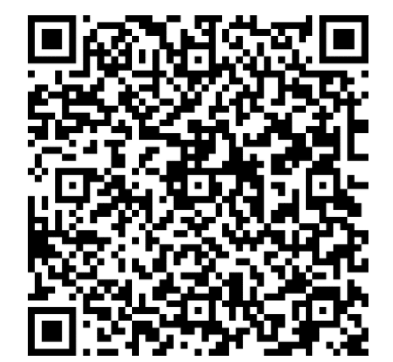
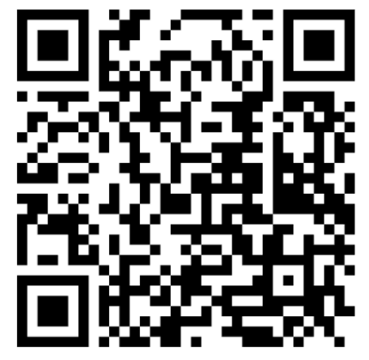
About National AI/AN MHTTC K -12
Program Manager for National AI/AN School Mental Health Contact Information:
teresa-brewington@uiowa.edu
K thru 12 Program Information
K-12 Program guide (006).pdf
https://uiowa.qualtrics.com/jfe/form/SV_9XOxrEwk4RwamTX
Notes:
We are the National American Indian and Alaska Native MHTTC K-12 Supplement Grant. This program and many others are offered through our center located in Iowa City, Iowa but serving across the U.S. Here you will find contact information for myself, the program manager as well as our Program Guide for our other services and Technical Assistance request form. Please reach out to us with any interest in these programs.

Slide 9
Title
Notes:
Following today’s event, we will send out a follow-up email to which will include, links to the presentation slides and recording, if applicable, information about how to request and receive CEUs, and the link to our evaluation survey, or GPRA.

Slide 10
Today’s Expert Panel

Slide 11
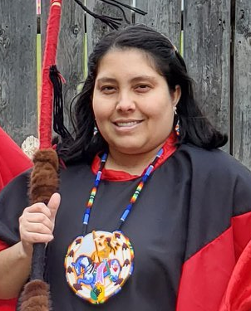
Melody Redbird-Post
Melody Redbird-Post, Ph.D., is an enrolled member of the Kiowa Tribe. She has a Doctorate in Instructional Leadership and Academic Curriculum, a Master’s in Education: Early Childhood Education, a Bachelor’s in Administrative Leadership, and a dissertation on Curriculum Development in Indigenous Early Childhood Language Immersion Programs. Dr. Redbird-Post has served in various capacities within the early care and education systems of Tribal communities including Child Care and Development Fund (CCDF) and Head Start programs, and she provides training and technical assistance as part of ICF’s Early Education Services. She brings 12+ years of experience in Tribal program administration, 14+ years of experience in implementing family engagement practices in Tribal programs, Tribal communities, early childhood and K-12 school settings and 15+ years of experience in Tribal education program implementation. She currently serves on the Anadarko Public Schools Indian Education Parent Committee and resides in Anadarko, Oklahoma with her husband, their five children and three dogs.
Notes:
Melody Redbird Post is an enrolled member of the Kiowa tribe with a doctorate in instructional leadership and academic curriculum and masters in education and bachelors in administrative leadership. She has worked extensively with the K-12 grant and continues to support our projects.

Slide 12
Melissa Isaac
Melissa Isaac is Anishinaabe. She is sturgeon clan and a citizen of the Saginaw Chippewa Indian Tribe of Michigan. Melissa is wife to Nathan Isaac and the mother of their four children.
Melissa is the Director of Education for her Tribe’s education system. Melissa also serves as the Giigdokwe for the Confederation of Michigan Tribal Education Departments (CMTED). CMTED brings the educational leaders of the 12 federally recognized tribes in Michigan together to collaborate, share ideas and advocate for the Anishinaabek learners in the State of Michigan. They are actively involved in education reform with the Michigan Department of Education.
Melissa was selected by Governor Gretchen Whitmer's administration to serve on both the Return to School Advisory Council which created the MI Safe Schools: Michigan’s 2020-21 Return to School Roadmap and the Student Recovery Advisory Council of Michigan which created the MI Blueprint for Comprehensive Student Recovery.
Notes:
Today’s speaker is Victoria Marie (Iron Plume Woman). Victoria has worked with our K-12 projects throughout 2021. She has brought her expertise in youth engagement, movement, meditation, and healing through all kinds of medicine. She is an enrolled tribal member of the Sisseton-Wahpeton Oyate, mother, artist, and founder of Indigenous Lotus. Victoria is joining us today from the Twin Cities in Minnesota and will continue to lead K-12 projects with our center. Welcome, Victoria! Thank you for being here today.

Slide 13
David Sullivan
David Sullivan (Kiowa-Choctaw) has served in education as a community leader, collective action network officer, federal consultant, community trainer, district administrator, world language teacher, student equity advocate, and systemic impact leader working for intercultural, intergenerational communication between parents, students, elders, community organizations and tribal governments for over 27 years.
The focus of his work centers on systemic literacy, holistic thinking, systemic impact leadership, family/community strengthening, indigenous language revitalization and partnership formation. Mr. Sullivan has carried out this work in various capacities in Oklahoma and the nation through multiple grassroots community coalitions, the University of Oklahoma American Indian Institute, the Anadarko Public Schools and numerous partnership-based projects.
Notes:
Today’s speaker is Victoria Marie (Iron Plume Woman). Victoria has worked with our K-12 projects throughout 2021. She has brought her expertise in youth engagement, movement, meditation, and healing through all kinds of medicine. She is an enrolled tribal member of the Sisseton-Wahpeton Oyate, mother, artist, and founder of Indigenous Lotus. Victoria is joining us today from the Twin Cities in Minnesota and will continue to lead K-12 projects with our center. Welcome, Victoria! Thank you for being here today.

Slide 14
Social Emotional Learning
Navigating the New Normal: American Indian and Alaska Native Communities Reopening

Slide 15
Objectives
Define Social Emotional Learning (SEL) components
Identify ways to implement SEL in 2021-2022
Predict SEL in students after 2020-2021 school year

Slide 16
Components of SEL

Slide 17
What is Social Emotional Learning?
The process through which all young people and adults acquire and apply the knowledge, skills, and attitudes to:
Develop healthy identities
Manage emotions
Achieve personal and collective goals
Feel and show empathy for others
Establish and maintain supportive relationships, and
Make responsible and caring decisions.
As defined by the Collaborative for Academic, Social, and Emotional Learning (CASEL)

Slide 18
What is Social Emotional Learning?
SEL advances educational equity and excellence through authentic school-family-community partnerships to establish learning environments and experiences that feature trusting and collaborative relationships, rigorous and meaningful curriculum and instruction, and ongoing evaluation.
SEL can help address various forms of inequity and empower young people and adults to co-create thriving schools and contribute to safe, healthy, and just communities.
From the Collaborative for Academic, Social, and Emotional Learning (CASEL)

Slide 20
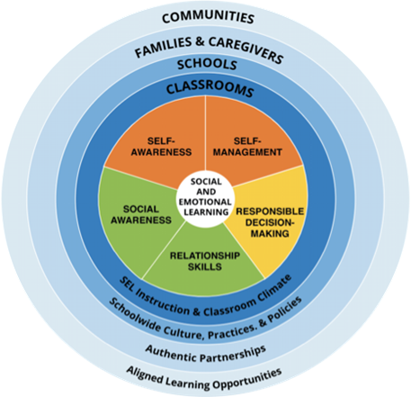
CASEL Framework
Five broad and interrelated areas of competence:
Self-awareness
Self-management
Social awareness
Relationship skills
Responsible decision-making

Slide 21
Cultural Relevance and SEL
Many SEL programs have been developed over the last two decades; increasing research evidence shows that such programs can support development of the whole child and lead to improved academic achievement, employment, health, and well-being.
However, because student learning and identity are shaped by cultural practice(s), situated life experiences, and many other variables converging in any context of social interaction (Gutierrez & Rogoff, 2003), the development and expression of social-emotional skills are affected by factors such as social-historic context, including epistemic beliefs (i.e., about the nature of knowledge) and power dynamics (Bang & Medin, 2010).

Slide 22
Ways to Implement Social Emotional Learning

Slide 23
Implementing SEL
CASEL recommends the following implementation focus areas:
Building foundational support and plan
Strengthen adult SEL competencies and capacity
Promot SEL for students
Reflect on data for continuous improvement From the Collaborative for Academic, Social, and Emotional Learning (CASEL)

Slide 24
Implementing Culturally Responsive SEL
To effectively incorporate Native culture and Native language into SEL frameworks, researchers propose adopting an interdisciplinary lens—specifically, culturally relevant pedagogy (CRP) (Ladson-Billings, 1995; 2014) and culturally sustaining pedagogy (CSP) (Paris & Alim, 2014).
From: Mahfouz, J., & Anthony-Stevens, V. (2020). Why Trouble SEL? The Need for Cultural Relevance in SEL. Occasional Paper Series, 2020 (43). Retrieved from https://educate.bankstreet.edu/occasional-paper-series/vol2020/iss43/6

Slide 25
Implementing Culturally Responsive SEL
Applying a cultural lens enables educators to recognize that the social-emotional needs of Indigenous youth are intertwined with social-historical context and require community collaboration.
From: Mahfouz, J., & Anthony-Stevens, V. (2020). Why Trouble SEL? The Need for Cultural Relevance in SEL. Occasional Paper Series, 2020 (43). Retrieved from https://educate.bankstreet.edu/occasional-paper-series/vol2020/iss43/6

Slide 26
Culturally Sustaining/Revitalizing Pedagogy (CSRP)
Culturally sustaining/revitalizing pedagogy (CSRP) is an approach for supporting the unique social and political needs of Indigenous youth (McCarty & Lee, 2014).
CSRP is
“an expression of sovereignty that prioritizes local communities’ expressed interests, resources, and needs and embraces community-driven Indigenous language and culture education practices.”
an applied framework for instructional design, curriculum, and student/family services that recognizes “asymmetrical power relations and legacies of colonization” (McCarty & Lee, 2014, p. 8).
From: Mahfouz, J., & Anthony-Stevens, V. (2020). Why Trouble SEL? The Need for Cultural Relevance in SEL. Occasional Paper Series, 2020 (43). Retrieved from https://educate.bankstreet.edu/occasional-paper-series/vol2020/iss43/6

Slide 27
Implementing Culturally Responsive SEL
“Deep attention to cultural practice, at both the micro and macro levels, enables educators to develop a better understanding of the nuances of Indigenous cultural and linguistic practices (which have been tied to the land for centuries) and to center Indigenous knowledge as sources of well-being and healing. This requires recognition of the distinct epistemologies and histories that define our differences and equitable partnership with Indigenous educators and leaders.”
From: Mahfouz, J., & Anthony-Stevens, V. (2020). Why Trouble SEL? The Need for Cultural Relevance in SEL. Occasional Paper Series, 2020 (43). Retrieved from https://educate.bankstreet.edu/occasional-paper-series/vol2020/iss43/6

Slide 28
Implementing Culturally Responsive SEL
Integrating Native language and culture into culturally responsive SEL achieves the following:
Connects academic concepts with students’ cultural knowledge,
Creates space for students to reflect on their own lives and society on their terms,
Supports cultural competence by investing time and resources to support students to learn about their own and other cultures, and
Pursues social justice through critiques of discourses of oppression.
From: Mahfouz, J., & Anthony-Stevens, V. (2020). Why Trouble SEL? The Need for Cultural Relevance in SEL. Occasional Paper Series, 2020 (43). Retrieved from https://educate.bankstreet.edu/occasional-paper-series/vol2020/iss43/6

Slide 29
Predicting Social Emotional Learning in Students

Slide 30
Culturally Relevant SEL for Students
Culturally relevant approaches involve tailoring SEL delivery to:
The cultural norms of local communities and families,
The current generation of youth
Specific races/ethnicities, and
The social/political climate
From: Mahfouz, J., & Anthony-Stevens, V. (2020). Why Trouble SEL? The Need for Cultural Relevance in SEL. Occasional Paper Series, 2020 (43). Retrieved from https://educate.bankstreet.edu/occasional-paper-series/vol2020/iss43/6

Slide 31
Culturally Relevant SEL for Students
School professionals could intentionally dialogue with students to identify specific strengths and resources that enable them to remain engaged in the educational system despite significant oppression and obstacles.
Teachers and school administrators can determine how the implementation of SEL at their schools is informed by the lived experiences of their students.
Educators must have the courage to engage in honest self-reflection about personal biases, which may elicit uncomfortable emotions about inequity.
From: Mahfouz, J., & Anthony-Stevens, V. (2020). Why Trouble SEL? The Need for Cultural Relevance in SEL. Occasional Paper Series, 2020 (43). Retrieved from https://educate.bankstreet.edu/occasional-paper-series/vol2020/iss43/6

Slide 32
SEL Critical Practices for Reopening Schools
Practice #1: Take time to cultivate and deepen relationships, build partnerships, and plan for SEL
How?
Prioritize relationships that haven’t been established, engage in two-way communication, and build coalitions to effectively plan for supportive and equitable learning environments that promote social, emotional, and academic learning for all students.
From: CASEL

Slide 33
SEL Critical Practices for Reopening Schools
A safe, supportive, and equitable learning environment will call on adults to:
Engage in practices that affirm diverse social and cultural identities;
Cultivate a sense of belonging and community;
Provide structures for physical and emotional safety;
Use engaging, relevant, and culturally responsive instruction built on an understanding of how children and adolescents grow and develop socially, emotionally, and academically;
Create space for student voice and agency;
- Offer frequent opportunities for students to discuss and practice anti-racism and develop collaborative solutions to address inequities
- Provide tiered supports that meet the needs of all students.

Slide 34
Resources

Slide 35
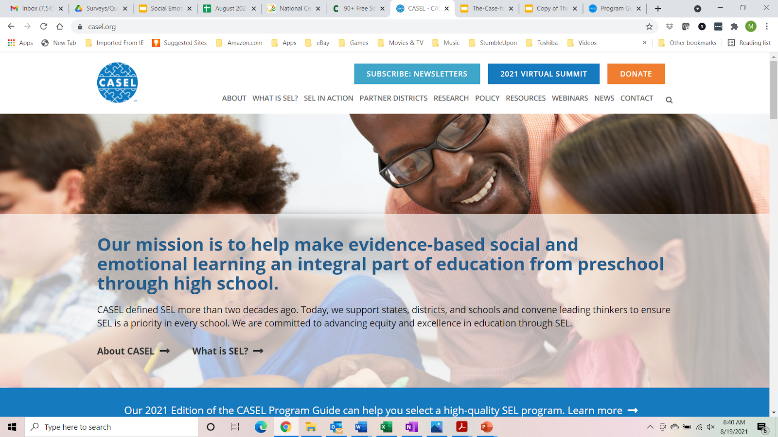
Collaborative for Academic, Social, and Emotional Learning
A source for knowledge about high-quality, evidence-based social and emotional learning (SEL) with resources that support educators to enhance the experience and outcomes for students ages pre-K through 12th grade.
Link: https://casel.org/

Slide 36
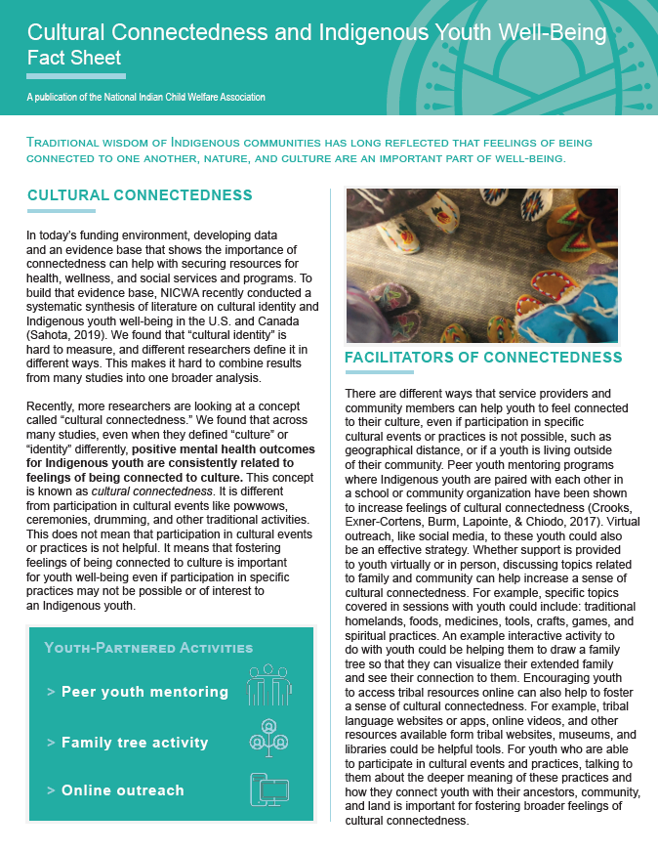
Cultural Connectedness and Indigenous Youth Well-Being Fact Sheet
A resource developed by the National Indian Child Welfare Association to support families, educators, and program leaders in understanding ways to incorporate Native culture into programs and curricula.
Link: https://www.nicwa.org/caseworkers/

Slide 37
National Center for Pyramid Model Innovations
Assists in implementing the Pyramid Model for Supporting Social Emotional Competence in Infants and Young Children in early intervention and early education programs with a focus on promoting the social, emotional, and behavioral outcomes of young children ages birth to five, reducing the use of inappropriate discipline practices, promoting family engagement, using data for decision-making, integrating early childhood and infant mental health consultation and fostering inclusion.
Link: https://challengingbehavior.cbcs.usf.edu/index.html

Slide 38
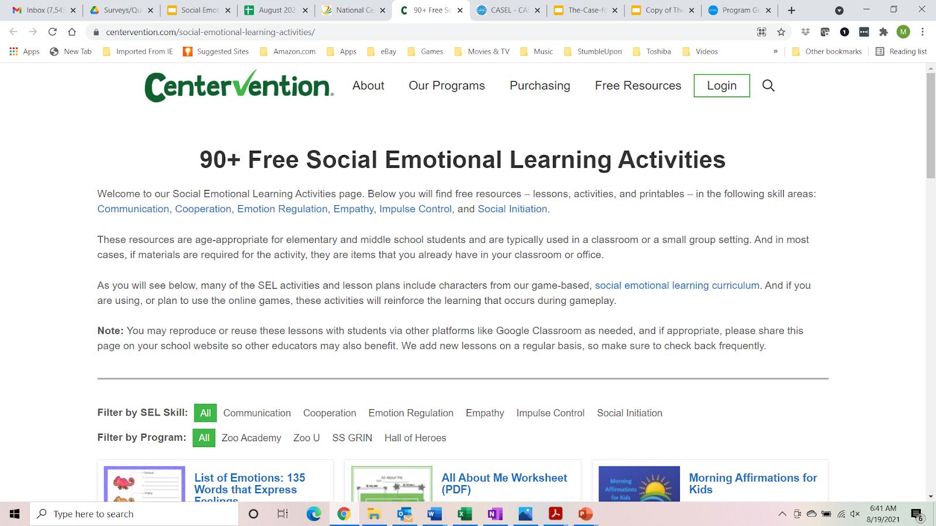
Centervention
90+ free social emotional learning activities appropriate for elementary and middle school students in the following skill areas: communication, cooperation, emotion regulation, empathy, impulse control, and social initiation.
Link: https://www.centervention.com/social-emotional-learning-activities/

Slide 39
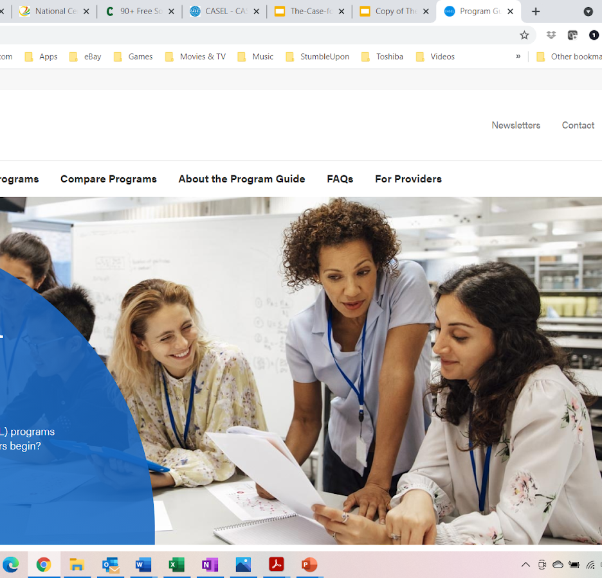
SEL Program Guide
CASEL has developed a Program Guide to support school districts and educators in selecting high quality, evidence based SEL programs.
These programs can then be further adapted through culturally responsive practices and culturally sustaining pedagogy to meet the needs of the students’ and the surrounding Tribal communities.
Link: https://pg.casel.org/

Slide 40
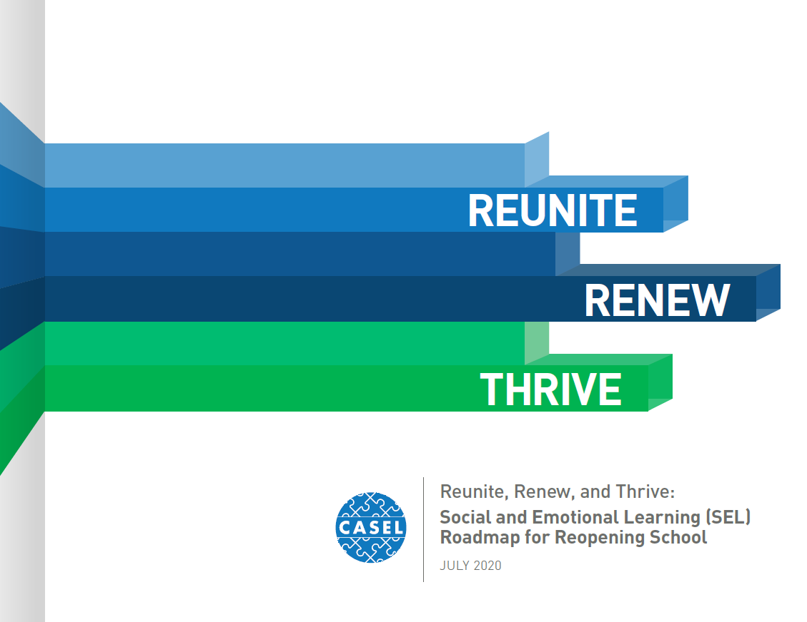
SEL Roadmap for Reopening Schools
Social Emotional Learning Roadmap for Reopening Schools from CASEL is a collaborative resource guide intended to support school districts, school staff, and educators in recovering from the pandemic and addressing inequity by centering on relationships and building on existing strengths of the school community.
Link: https://bit.ly/SELforReopening

Slide 41
Questions or comments?
Special Announcement : NCBH MHTTC K-12 is partnered with Native American Fatherhood & Families Association

