Slide 1
Adult Resilience Curriculum (ARC)
Wellness

Slide 2
Delivery & Tailoring Instructions
Prior to delivering, get information from audience about their current struggles and needs. Use that information to decide what should be tailored
To tailor, you can change the following:
Hook & Transition metaphors
Your “Who I Am” slide & credibility slides (referent, information, positive expert power)
Any of the background intro slides (if Module 1 has already been delivered)
The order of the slides (before activities)
Activities (based on time frame)
Knowledge Check questions
Discussion Questions
To make changes to the Activities, Knowledge Check Questions, and Discussion Questions, you can:
Hide the activities you do not want to do
Replace the knowledge check section of each final activity slide with the proper knowledge check question(s)
Delete whichever discussion questions you choose not to provide. Make sure these questions are provided in a follow up forum/document/delivered in-person by a member of the healthcare professional team after at least 1 week of practice.

Slide 3
Delivery & Tailoring Instructions
Make sure the tailoring is done to fit within the appropriate time frame
The structure and design of the powerpoint is actually based on a combination of successful TedTalks (that involved audience participation) and research on how to present to adults
This includes the Hook, Transition, Who I Am, and Audience Benefit slides
Limited text
Use of imagery
MINIMIZE reading text on slide; research indicates this actually disrupts audience comprehension
Set expectation for participation at the outset

Slide 4
Delivery & Tailoring Instructions
Things to remember
Expert power can be negative if audience portrays a) you are leveraging your expertise in one domain into another, b) if your expertise appears outdated, c) your expertise is impersonal (i.e., not recognizing the audience’s perspective), and d) if they portray you as having something to gain
What is comfortable for us, the presenter, is maybe not engaging for the audience.
Charismatic power is something; you are acting for your audience and that is encouraged. People will buy-in if you seem bought-in. Find the charisma personality that you can put on confidently.
Sell the “Why”, not the “what” or “how”. Those are ARC and the modules. But the “Why” is most important

Slide 5
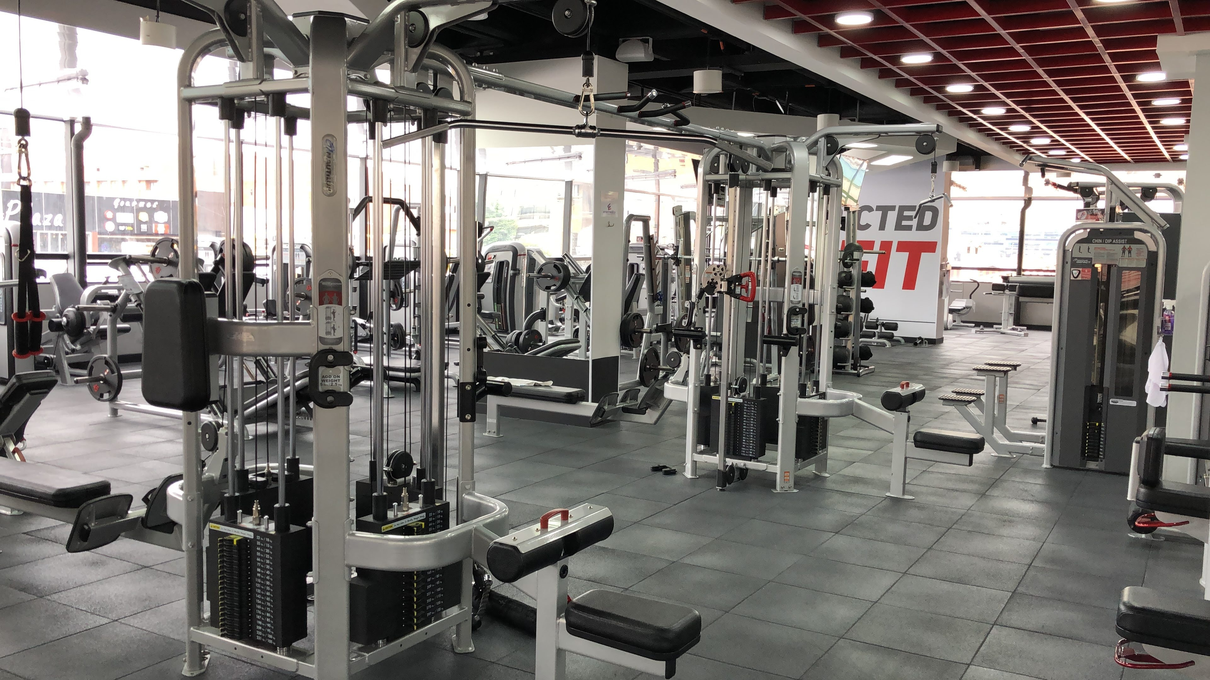
Notes:
The Hook
Ah yes. The gym. In the pre-COVID days, there was a common American ritual. Every year, on January 2nd, the gym would suddenly be filled with people all with a similar purpose: working out. People might have slightly different motivations and goals: increase their fitness, feel stronger, lose weight, etcetera. But regardless of what was driving them, you could read the determination across the sea of faces at the gym.

Slide 6
Notes:
The Transition
And for the second part of the ritual: the slow trickling out of these same once highly motivated people until the gym is empty again. Interestingly, the US has one of the highest gym memberships per capita, yet a very low relative usage. For some reason or another these once highly motivated people just stop going. Perhaps time gets the best of them, they feel uncomfortable, they aren’t making the progress they want as quickly as possible, maybe the motivator wasn’t strong enough, or they’re just bored of the gym. Maybe it just wasn’t for them.
And the third part of the ritual, with the gyms empty, is everyone starts making jokes about their failed new year's resolution. We connect over our shared difficulties in keeping those resolutions. Yes, this is wonderful validation when we struggle and it does keep our sanity in check a bit. We all have tried things and failed. And failure is a great teacher. There is nothing shameful about it.
What if the ritual looked a little bit different. What if the ritual started with everyone setting a strong intention for getting active? What if the second part wasn’t the emptying of gyms but the continued use of them or outdoor hiking or bike riding or rollerblading or whatever your preferred activity? And what if the third part wasn’t commiserating over failed resolutions but the shared excitement of success for everyone? If we are all so motivated at one point, what keeps us from sticking with it?

Slide 7
Notes:
The Transition
The simple truth is that most of us do not have a realistic plan. Let’s throw out the old idea that people need some x amount of magical motivation juice to be successful in whatever your goals are. What actually helps us be successful is a solid plan.
A plan that clearly defines our goals, our objectives along the way, what skills we have, what skills we need to learn, and most critically, what supports we need when we run into barriers. And a plan that rewards us for sticking to it in the day-to-day so that we actually reach our goals.
as we start this final module in ARC, we will put together our own personal plan for well-being

Slide 8
WHO WE ARE
Christian Klepper, PsyD, LP
Faculty Trainer
Notes:
Who I Am
*Replace with your photo, change name(s), make sure to highlight your credentials (expert), your area of expertise (expert, informational power)*

Slide 9
WHO WE ARE
Hannah West,
PhD, BCBA
Regional Trainer
Notes:
Who I Am (This is an example)
*Replace with your photo, change name(s), make sure to highlight your credentials (expert), your area of expertise (expert, informational power)*

Slide 10
The Adult Resilience Curriculum (ARC)
Notes:
As a quick reminder, the Adult Resilience Curriculum – or ARC – is transtheoretical and comprehensive, yet flexible. The ARC was originally developed in 2013 by Dr. Clayton Cook and Dr. Gail Joseph for pre-service and in-service teachers. It is designed to promote wellbeing and enhance people’s capacity for resilience. It builds upon the strengths of existing programs, while trying to make the content more accessible and feasible for real-world professionals in various disciplines. This curriculum is NOT designed to replace mental health services or treatment.

Slide 11
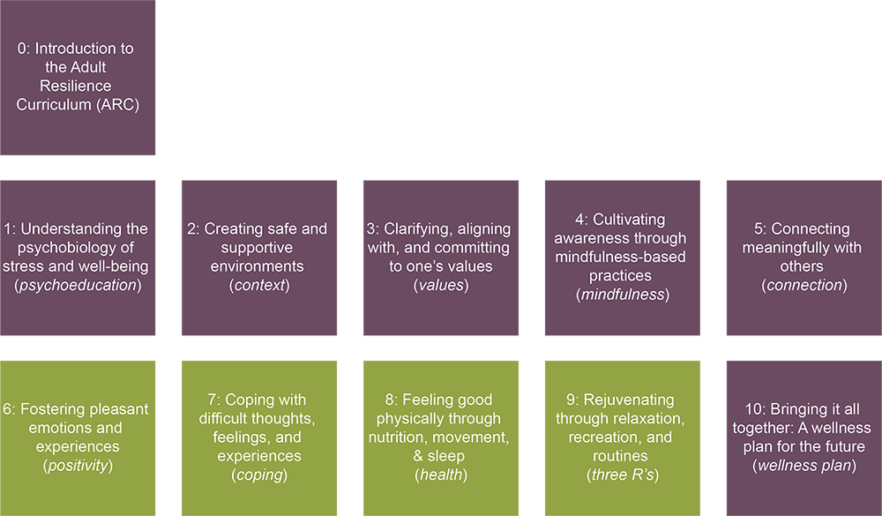
The ARC Modules
Notes:
We’ve made it. At this point, whether you went through only the core, some of the supplemental modules, or the entirety of ARC, it has all culminated to this point. Each module served as a dedicated time to learn something new, remember something you already knew, and try behavioral experiments to see which modules resonate most with you right now.
And now we get to bring it all together and determine what we most need for our future.

Slide 12
Wellness Plan
Our Hopes for Today
Review learned wellness concepts, skills, and strategies
Identify most useful concepts, skills, and strategies for your own personal wellness
Create and commit to an ongoing plan for wellness
Notes:
This is a brief module. There will be time to review each module and its recommended strategies, finding which one(s) you need most, and then create a wellness plan that will guide your immediate changes.
Not on screen is our true ultimate hope; at this point, having gone through ARC, we hope you have a clearer idea of what you can do for yourself, for your community, and even what it can do for you. Underpinning all of that is the basic assumption that we are ready to go and make some changes for ourselves and for each other.

Slide 13
MODULE 10: Bringing It All Together: A Wellness Plan for the Future
Notes:
So let’s pause here. Right now, rate yourself from 1-10 on how willing you are to implement changes in your life to improve your well-being. Also, rate from 1-10 how much you think those changes, if implemented, will actually improve your life?
We’ll return to these numbers soon.
*Have them write them down, in a submission form, or some kind of poll. Make sure it’s anonymous but make sure they all do it*

Slide 14
Wellness Plan Components
Module Review
Wellness is Action & Ongoing
Wellness Plan
Notes:
Let’s keep things simple for this module. Here is our approach for today, with most of our time given to the plan itself.

Slide 15
ARC Module Review
Notes:
Here is the full ARC. Let’s summarize each module with a brief takeaway.
Module 1: stress is normal and actually necessary for optimal performance, so the goal of well-being isn’t the complete elimination of stress but the proper balance
In module 2: our behaviors are limited by our environment, so we need our environment to expand and be supportive. We can individually help contribute to a supportive environment through our actions and beliefs that create healthy cultures and climates.
In module 3: values are our compass when our journey in life gets windy and when we get lost—even day-to-day—we can clarify our values to get some direction again
In module 4: mindfulness is that space between you and your actions, you and your thoughts. Through both traditional meditation practices and active practices, you can get a little bit more freedom of choice back instead of immediately reacting.
In module 5: as adults, the types of relationships we have are just as vital as the number, if not more important
In module 6: our minds are not naturally focused on pleasant experiences, so we must intentionally build them
In module 7: Difficult thoughts, feelings, and experiences are natural and informative, but can be overwhelming if we let them. We can use time-tested cognitive-behavioral and emotional strategies to keep us afloat in these moments
In module 8: quality sleep, good nutrition, and physical activity remain three of the most important things you can do for yourself. However, it might take a change in our approach and finding what works for us to get these in line.
In module 9: when our days are overwhelming with work and responsibilities, or if we are “checked out” with little going on, building routines that protect time for us to challenge ourselves and also relax and process our life keeps us grounded.

Slide 16
Wellness is Ongoing
Notes:
Like values, well-being is ongoing. We can’t even really max it out and we often have to make changes to our practice to fit our current needs. As we said at the beginning of ARC, there is no one-size-fits-all for well-being. That means everyone has their own approach, AND that even you will emphasize different things at different times in your life. There is not expectation that you do ALL these things all the time.
So you might get by well with focusing on just the core.

Slide 17
Wellness is Ongoing
Notes:
Or maybe you feel irritable and moody. You engage in a lot of healthy practices and you are doing all the things your doctor says in terms of sleep, nutrition, and relaxation but something doesn’t click. It could be that your work environment simply isn’t supporting you, which is causing a rift between you and your professional and personal values, and hampering your relationships. You are finding yourself on autopilot and not necessarily noticing and honoring your emotions and experiences.
In that case, you may want to focus on these.

Slide 18
Wellness is Ongoing
Notes:
This could be if you are generally emotionally centered and are having a good time but your routine is off and you find yourself sleeping sporadically, not eating well, and feeling a little sluggish.

Slide 19
Wellness is Ongoing
Notes:
Perhaps you feel well connected, with strong routines, good health practices, and feel safe and secure at work. But life feel’s sort of bland and you are passing time just to pass time. Perhaps then you will want to focus on these things.

Slide 20
Wellness is Ongoing
Notes:
And here might be someone who has pleasant emotions and is aware of them, and generally takes care of themselves. But they feel lonely and are afraid to interact with others in and out of work. By reconnecting with values and learning coping skills to deal with that uncomfortableness, they can start to pursue healthy and safe relationships with others that they truly do want despite that fear

Slide 21
Wellness Plan
“Failing to plan is planning to fail.”
-Sir Winston Churchill
-Benjamin Franklin
-Alan Lakein
-Some dude on the Internet
Notes:
At this point, having done all the modules, you should be familiar with and used to planning—action planning, lesson planning, activity planning. It’s all strategies to set intentions.
This quote—failing to plan is planning to fail—pops up in all sorts of contexts, so much that it is almost cliche at this point yet no one seems to know who first uttered it. Now, we should not be concerned about failing—failing is a natural part of life and a learning opportunity. But we need to fail from effort, not lack of effort. And too often, we give up right before we really need to put in that work.
We are finishing with a final reflection. The rest of this session is to identify which modules we liked best, including the strategies, which modules we might need most now and in the near future, and set intentions to implement strategies for the time being.

Slide 22
Recommendations
Complete the wellness plan
Notes:
Before we begin, let’s look at those numbers you wrote down for your willingness to implement changes in yourself and in your environment, and how much you think these changes will actually improve your well-being.
For those of you that scored yourselves from 8-10, you are in the “ready to go” stage and can dive right into the exercise.
For those of you that scored from a 5-7, as you go through the exercise ask yourself what you need from yourself, your work environment, and your colleagues to get you into that 8-10 “ready to go” stage.
And for those of you in the 1-4 range, complete the exercise and try to find just one ongoing change you are going to make that feels most feasible for you. Later on, you can return to this and see if there is more you want to add.

Slide 23
Recommendations
Complete the wellness plan
Engage in the plan
Notes:
After you complete your plan, the most important thing you can do is engage in it. Put your plan into action.

Slide 24
Recommendations
Complete the wellness plan
Engage in the plan
Modify plan as needs & wants change
Notes:
And then modify your plan if and when you need to. Remember, well-being is not a checklist. You may need to reevaluate and readdress components of your plan regularly. And that is good!
Thank you again for watching and engaging with this lesson. Take care.

