Slide 1
Adult Resilience Curriculum (ARC)
Connecting meaningfully with others

Slide 2
Delivery & Tailoring Instructions
Prior to delivering, get information from audience about their current struggles and needs. Use that information to decide what should be tailored
To tailor, you can change the following:
Hook & Transition metaphors
Your “Who I Am” slide & credibility slides (referent, information, positive expert power)
Any of the background intro slides (if Module 1 has already been delivered)
The order of the slides (before activities)
Activities (based on time frame)
Knowledge Check questions
Discussion Questions
To make changes to the Activities, Knowledge Check Questions, and Discussion Questions, you can:
Hide the activities you do not want to do
Replace the knowledge check section of each final activity slide with the proper knowledge check question(s)
Delete whichever discussion questions you choose not to provide. Make sure these questions are provided in a follow up forum/document/delivered in-person by a member of the healthcare professional team after at least 1 week of practice.

Slide 3
Delivery & Tailoring Instructions
Make sure the tailoring is done to fit within the appropriate time frame
The structure and design of the powerpoint is actually based on a combination of successful TedTalks (that involved audience participation) and research on how to present to adults
This includes the Hook, Transition, Who I Am, and Audience Benefit slides
Limited text
Use of imagery
MINIMIZE reading text on slide; research indicates this actually disrupts audience comprehension
Set expectation for participation at the outset

Slide 4
Delivery & Tailoring Instructions
Things to remember
Expert power can be negative if audience portrays a) you are leveraging your expertise in one domain into another, b) if your expertise appears outdated, c) your expertise is impersonal (i.e., not recognizing the audience’s perspective), and d) if they portray you as having something to gain
What is comfortable for us, the presenter, is maybe not engaging for the audience.
Charismatic power is something; you are acting for your audience and that is encouraged. People will buy-in if you seem bought-in. Find the charisma personality that you can put on confidently.
Sell the “Why”, not the “what” or “how”. Those are ARC and the modules. But the “Why” is most important

Slide 5
Notes:
The Hook
*Use or replace with your own metaphor or concept that illustrates connection*
Let’s begin to think about connections by focusing on trees.
Notice this single tree. It stands rooted and alone. It has all the sunlight it could need, ample soil and nutrients, and is glowing with a vibrant green. What words come to your mind when looking at it?
*Pause* for 4-5 seconds
Do you notice thoughts such as “strong” or “resilient” or even “alone” or “independent”? Trees like this are iconic. We can picture them on top of a hill, maybe with someone sitting under it with a blanket reading a book or playing an instrument while the sun sets in the background. It’s evocative.
*Pause* for 2 seconds

Slide 6
Notes:
The Hook
*Use or replace with your own metaphor or concept that illustrates connection*
In contrast to the image of a single tree, is the image of a path within a group of trees. What do you notice about these trees? What thoughts do you have?
*Pause* for 4-5 seconds
Some of you might be thinking “cozy” whereas others think the opposite, “claustrophobic.” Some of you might be concerned about what’s in the forest you can’t see, what bugs or animals are waiting.
Some of you might be feeling lost and unsure where to go. You might also be noticing thoughts like “competing” or “survival of the fittest.” Those are common reactions.
Forests have been depicted in writing and media as a sort of wild place, where nature presides, and everything is looking out for itself. There is limited soil and sunlight, so trees have to compete for resources, siphoning off nutrients from one another and striving to get taller and taller in order to take up more of the sunlight in order to survive.

Slide 7
Notes:
What is surprising is how inaccurate this is. Historically, trees have enjoyed a bit of spiritual importance and reverence for people.

Slide 8
Notes:
Beliefs such as trees being able to talk and feel or that they have a form of intelligence unknown to humans.

Slide 9
Notes:
Remarkably, decades of research indicate less of a Darwinian, survival-of-the-fittest nature to trees and instead a far more communal one.

Slide 10
Notes:
For lack of a better word, they do seem to talk to each other. We do not yet know the mechanism for how this works beyond some shallow electrical pulses and hormonal shifts,
While this notion may further our ideas of trees as magical, there is science behind this.

Slide 11
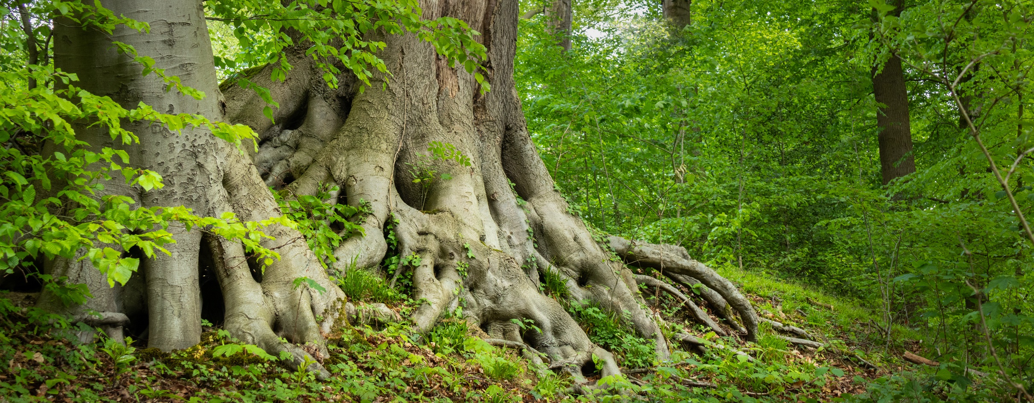
Notes:
The research indicates that trees can form bonds with other trees, with root and fungal systems that overlap and feed into one another. And these overlapping root and fungal systems can be traced all through the ground.

Slide 12
Notes:
Some trees can be connected over large distances. Within these systems, nutrients are shared. There even appears to be some mechanism where, if one tree within the connection gets sick with a disease rot, the other connected trees can send surplus nutrients to help the tree recover.

Slide 13
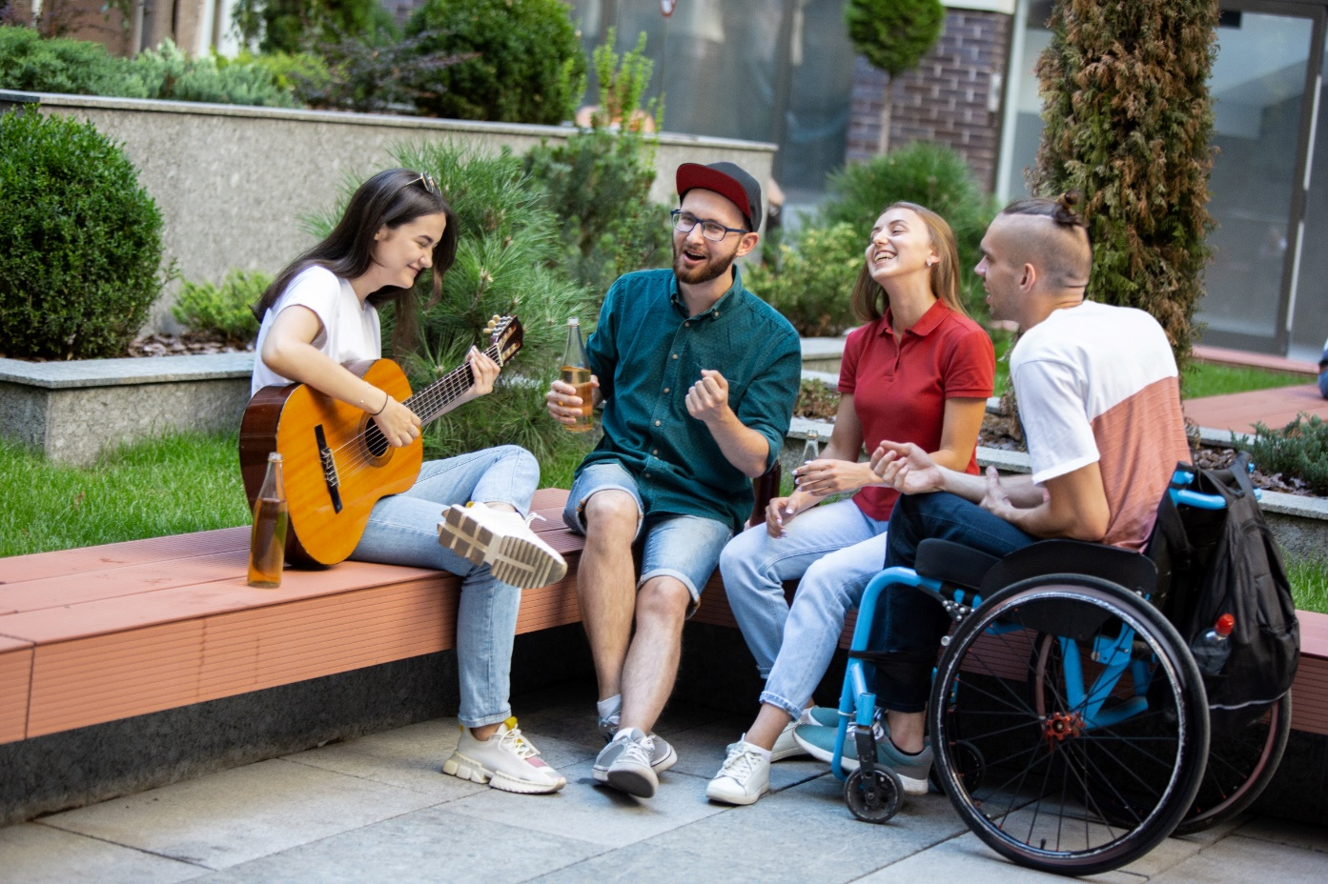
Notes:
Humans share this same predisposition to help, support, and connect with others in their community.
They provide the emotional, social, and sometimes experiential resources needed for us to thrive.
Nearly every culture and theory of human flourishing places connection through relationships as an integral element to life.

Slide 14
Notes:
Look at your average teenager. What are they focused on? It’s likely not their school, work, or chores. For many, it’s who likes them, who doesn’t, who laughs at their jokes, who enjoys the same music, etc. There is a real need to belong that develops in teens and that need has a bit of wisdom to it. I often think teens have more figured out that we give them credit for.

Slide 15
Notes:
We all experience this need for connection differently. There is no magical number of connections needed to be successful.
However, we do know that adults tend to thrive when they enjoy certain types of relationships.

Slide 16
WHO WE ARE
Christian Klepper, PsyD, LP
Faculty Trainer
Notes:
Who I Am
*Replace with your photo, change name(s), make sure to highlight your credentials (expert), your area of expertise (expert, informational power)*

Slide 17
WHO WE ARE
Hannah West,
PhD, BCBA
Regional Trainer
Notes:
Who I Am (This is an example)
*Replace with your photo, change name(s), make sure to highlight your credentials (expert), your area of expertise (expert, informational power)*

Slide 18
The Adult Resilience Curriculum (ARC)
Notes:
As a quick reminder, the Adult Resilience Curriculum – or ARC – is transtheoretical and comprehensive, yet flexible. The ARC was originally developed in 2013 by Dr. Clayton Cook and Dr. Gail Joseph for pre-service and in-service teachers. It is designed to promote wellbeing and enhance people’s capacity for resilience. It builds upon the strengths of existing programs, while trying to make the content more accessible and feasible for real-world professionals in various disciplines. This curriculum is NOT designed to replace mental health services or treatment.

Slide 19
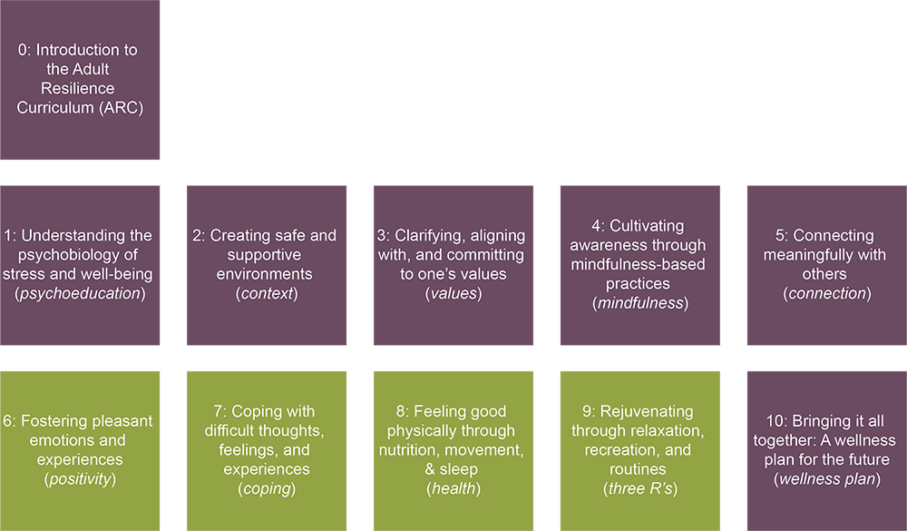
The ARC Modules
Notes:
The ARC program is broken into 10 modules, preceded by a brief, introductory module 0. Modules 1 through 5 and module 10 make up the "core" modules. Modules 6 through 9 are supplementary and provide additional opportunities to learn and practice resiliency skills. Finally, the 10th module brings the curriculum together. It is required at the end, regardless of if you do any or all of the supplementary modules.

Slide 20
MODULE 5: Connecting Meaningfully with Others
Notes:
What is the goal
In this module, we will talk about 5 adult-focused relationship types and provide some guidance around effective relationships to pursue. This module will also finish off the core modules of ARC and at this point you may be able to see how the core modules—which include knowledge of stress, supportive environments, values, mindfulness, and now connection—all work together. Relationships integrate with all of them.
For example, we might realize that certain relationships are stressful for us. In that case, we may need to repair that relationship, or practice some mindfulness to get distance from that initial stress response and try to determine what about that relationship causes stress. Similarly, we can fall back on our connections with others as ways to address feelings of isolation or even powerlessness.
How we build our relationships immediately impacts our social environment which will dictate, to some degree, the freedom we have in making decisions that promote our well-being. And underpinning all of this is that interplay between mindfulness and values when we interact with others.

Slide 21
Our Hopes for Today
Connection
Distinguish effective and ineffective social support and discuss how to advocate for your needs
Identify feasible ways to provide service to others
Identify potential mentors and role models and set action plans for building and/or improving those relationships
Notes:
We will focus on four components during this module including how to identify and build helpful social supports, how providing large and small services to others can give a sense of community and belonging, how engaging in mentorship relationships help navigate the demands of personal and professional life, and how continuous reflection on role models who embody the values and actions we aspire toward can inspire us

Slide 22
Connection Components
Helpful Social Supports
Service to Others
Mentorship
Role Models
Notes:
We hope that by spending time in this module you will see how connections can help with your well-being.
We are all in different stages with connections in our life. You may have already developed some of these connections. You may need to establish others. Some of your connections may be waning while others are thriving. Whatever stage you are at, we want to go over these types of relationships and provide some strategies and guidance around developing them, and then give you the freedom until your next module to focus on developing these with intention.

Slide 23
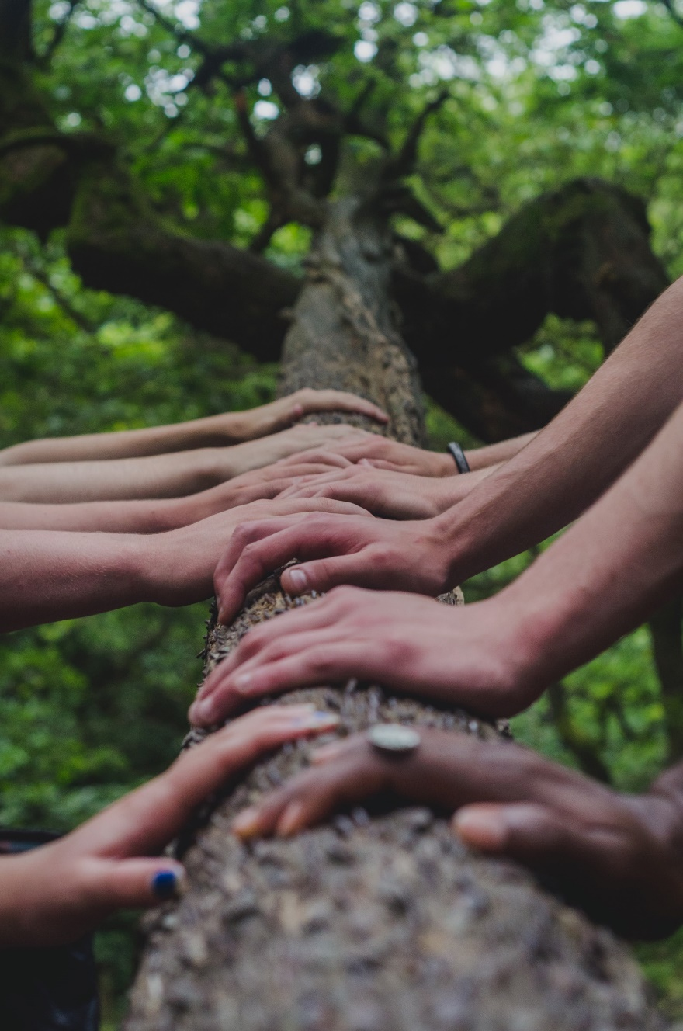
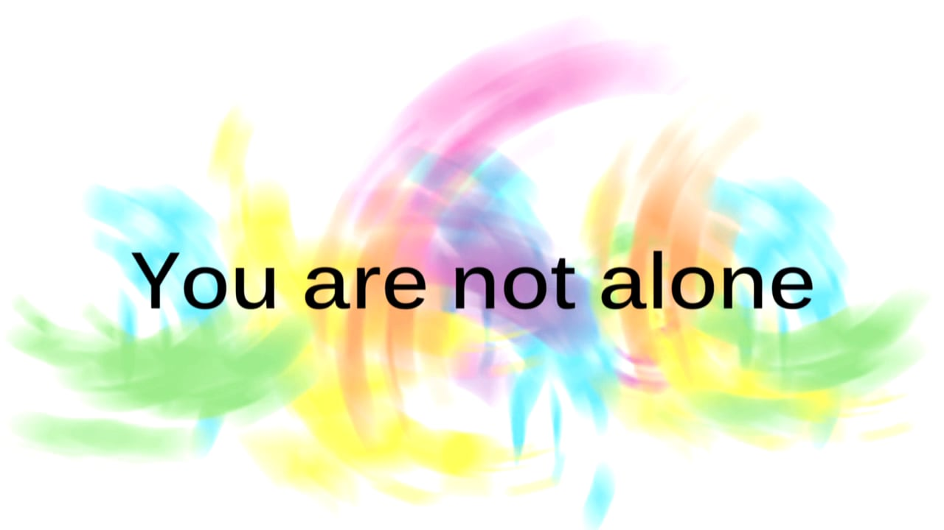
1. Discerning Effective Support from Ineffective
Effective
Support
Ineffective
Support
Notes:
Asserting your needs: Effective vs Ineffective support
Let’s begin by talking about effective vs. ineffective support. We've all received bad advice before. You might go to a friend about financial woes and they suggest betting or YOLO’ing your savings in Vegas, when really you were just looking for some empathy. This is an example of ineffective support.

Slide 24
Four Types
Emotional support
Esteem support
Informational support
Tangible support
Effective
Support
Notes:
Effective support can be broken into 4 types: emotional support (which provides validation and empathy), esteem support (also provides validation and brings out your ability to inspire yourself), informational support (provides advice when asked, or asks for permission before providing advice or offering assistance), and tangible support (gives you resources, removes a stressor). These all work but we all need different amounts and for different things.

Slide 25
Four Types
Emotional support
Esteem support
Informational support
Tangible support
Effective
Support
Notes:
Effective support can be broken into 4 types: emotional support (which provides validation and empathy), esteem support (also provides validation and brings out your ability to inspire yourself), informational support (provides advice when asked, or asks for permission before providing advice or offering assistance), and tangible support (gives you resources, removes a stressor). These all work but we all need different amounts and for different things.

Slide 26
Four Types
Emotional support
Esteem support
Informational support
Tangible support
Effective
Support
Notes:
Effective support can be broken into 4 types: emotional support (which provides validation and empathy), esteem support (also provides validation and brings out your ability to inspire yourself), informational support (provides advice when asked, or asks for permission before providing advice or offering assistance), and tangible support (gives you resources, removes a stressor). These all work but we all need different amounts and for different things.

Slide 27
Four Types
Emotional support
Esteem support
Informational support
Tangible support
Effective
Support
Notes:
Effective support can be broken into 4 types: emotional support (which provides validation and empathy), esteem support (also provides validation and brings out your ability to inspire yourself), informational support (provides advice when asked, or asks for permission before providing advice or offering assistance), and tangible support (gives you resources, removes a stressor). These all work but we all need different amounts and for different things.

Slide 28
66%-80% of adults lack effective support
Notes:
Some research indicates that between 66-80% of adults do not receive support needed from partners, friends, or family. This includes both not receiving ANY support, as well as not receiving the right kind, aka ineffective support.

Slide 29
From whom do I receive?
Emotional support
Esteem support
Informational support
Tangible support
Notes:
It is perfectly reasonable and encouraged to reflect on your social network and identify who is better at which types and seek those individuals out when appropriate. And when receiving that social support, remind the individual that you are there for them too. Connections remain healthy when both receive and contribute.
This is why peer supervision can be such an important avenue for seeking professional support. Sharing experiences of stress, compassion fatigue, and vicarious trauma with other providers offers social support and normalization of experiences. This normalization lessens the impact and helps providers maintain their objectivity.

Slide 30
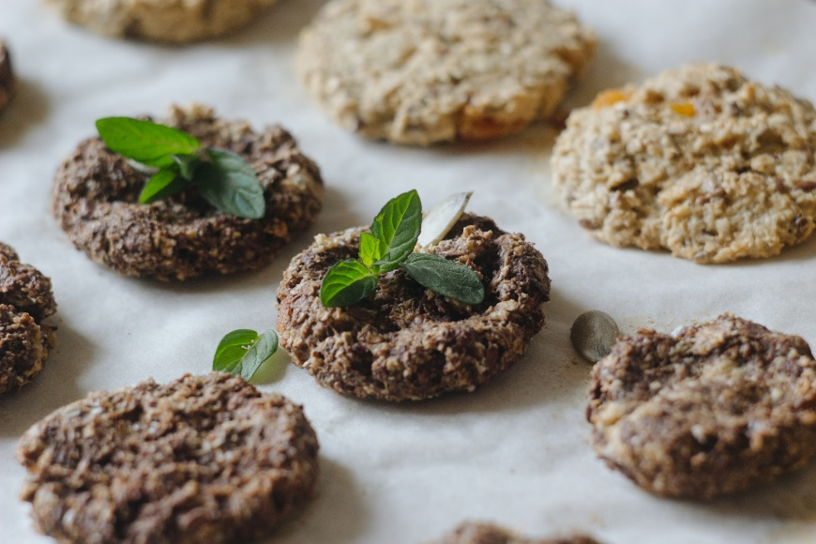
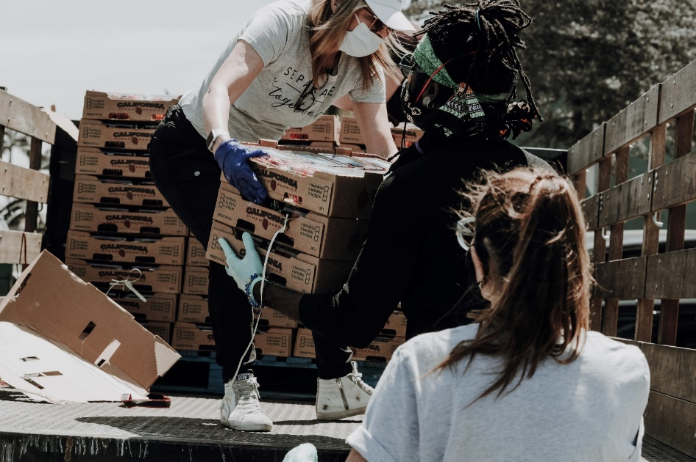
2. Connecting Through Community
Notes:
Doing good deeds or watching others do good deeds can cause elevation in ourselves. It has a “biomarker”—a way to tell when that elevation and awe are being experienced.
While doing or observing good deeds, our chests expand and heat up around our hearts. This is because doing and witnessing good deeds—especially those with no apparent gain (altruism)—stimulates the vagus nerve which regulates the heart. We are not yet sure why this connection exists except that it simply does. Humans literally feel their hearts through community.

Slide 31
Greater happiness when servicing others …
Pay for a meal
Bake food for someone
Provide extra large tip
Pay specific attention to someone
Write surprise note for someone
Let someone merge in traffic
Research by Sonja Lyubomirsky, UC Riverside
Notes:
Sonja Lyubomirsky, a UC Riverside professor, has studied the effects of service to others using randomly-controlled trials of various designs. Her research has demonstrated that servicing others leads to greater happiness. Here are a few examples of how to provide service to others.

Slide 32
Micro-services in the workplace
Writing surprise notes
Bringing snacks for colleagues
Swapping clean up duties
Others...
Notes:
We encourage individuals to start first pursuing micro-services to others much like the examples from earlier; micro-services take little time and financial resources but are done intentionally in order to create goodness in your environment. After micro-services turn into habits, you can focus your attention to other services.

Slide 33
Mindfulness
Value
Service
Swap clean up to allow colleague to collaborate with another professional
Be a supportive colleague
Write a note of gratitude
Notes:
When selecting a service you want to try, connect it with your values. This gives it more purpose for you which can help with the motivational aspect of setting habits and sticking to them. And then practice mindfulness when in the moment so that you can fully experience and reflect upon that service—whether that service is writing a note or spending 1-on-1 time with a colleague or collaborator.
Healthcare professionals engage in one of the most important services to others every day when they care for and work with their patients. Altruism and serving the greater good are core values of this profession, and research demonstrates that emphasis on these values as a group can offset feelings of isolation and burnout.

Slide 34
3. Find Yourself a Mentor
Notes:
Have you ever had the thought that most adults have no idea what they’re doing? Isn’t it strange to leave childhood—childhood with its structured rules, expectations, and “right” answers-- only to step into the adult world where there’s no clear path and no “right” answers.
It’s not easy. The lack of a clear playbook means that every day we are headed into uncertainty. That is risky. And when faced with risk, we want reassurance. We might find it within a self-help book or from a tv show.
Or we might avoid that risk by refusing to engage with life--we might only stick with the things we know or only do things that make us comfortable. This is a normal response, and these strategies are meant to keep us safe, but they may not lead to the most fulfilling life.

Slide 35
Mentorship
Mentor and Mentee
Mentor is competent in area Mentee wants to develop
Notes:
Instead, research and cross-generational/cross-cultural wisdom have identified a critical element to navigating the ambiguity of adulthood. There is a way to build greater self-concept and self-efficacy, develop new skills, set better routines and habits, access additional social or tangible resources, develop a stronger social network, and improve resiliency: this critical element is a mentor.
Mentorship is a very specific kind of relationship. It is defined by two actors, the mentee and mentor. The mentor is competent and capable in some aspect of life, and the mentee considers themselves less competent in that aspect and looking to grow.

Slide 36
Mentors
Instruct
Advise
Provide feedback
Progress monitor
Notes:
A mentoring relationship exists along a spectrum. At its most basic level, the mentor and mentee engage in ongoing discussion and interaction with the purpose of helping the mentee develop skills in a specific area of life. The mentor is expected to instruct, advise, and provide feedback to the mentee through evaluation and progress monitoring. For example, a mentee might have the goal of improving their flexibility with adapting evidence-based practices to their patients’ unique circumstances without diluting the effectiveness of that practice. This is a tough skill and something that a mentor can evaluate, monitoring, model, and even help identify barriers to the process. Another example could be that a mentee needs help leaving work at work, and a mentor facilitate that balance

Slide 37
Mentees
Are vulnerable
Open to learning and growing
Notes:
Being a Mentee is putting oneself in an inherently vulnerable position—there is a power differential that exists because of the discrepancy in competencies. In order for mentorship to work, mentees should be open to learning and growing in the areas that they are seeking mentorship.

Slide 38
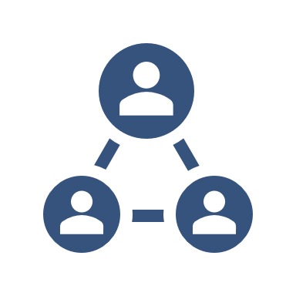
Mentorship Network
Notes:
System constraints often place mentors in difficult positions in which they have to manage too many responsibilities and are unable to devote time to the relationship. That is why mentor networks are vital. Draw inspiration and learn from multiple mentors who cross different areas of life: work, family, self-development, spirituality, and others. We recommend having at least two mentors in your health care setting, perhaps one that helps with professional well-being, and another that emulates well-being in their personal life that you are wanting to improve. This provides you more opportunity for learning and support, gives you multiple examples to merge and create your own professional identity, and helps you develop stronger collegial relationships.

Slide 39
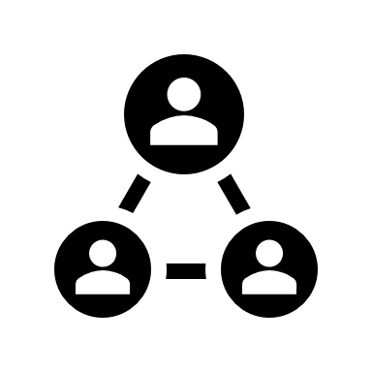
Activity
building a mentorship (part 1)
Notes:
Whether formally structured or not in your workplace, you can start a mentorship relationship at any time. We’ve included an activity with this module that can assist you in identifying areas that mentorship may be helpful with suggestions as to how to begin the mentorship relationship.

Slide 40
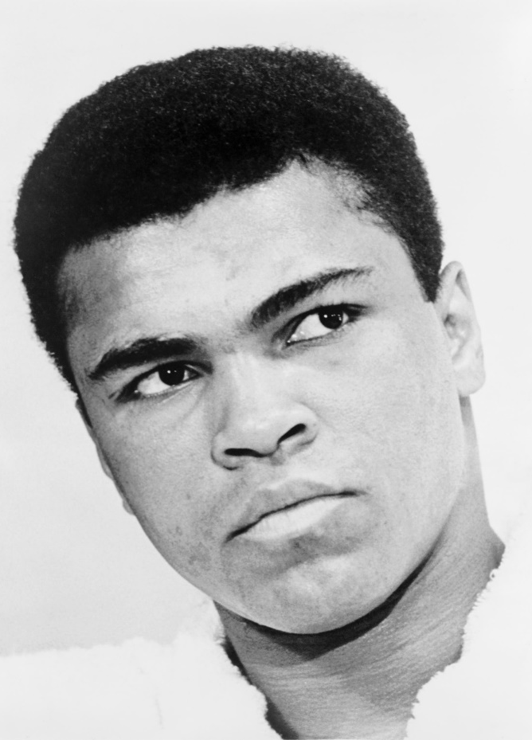
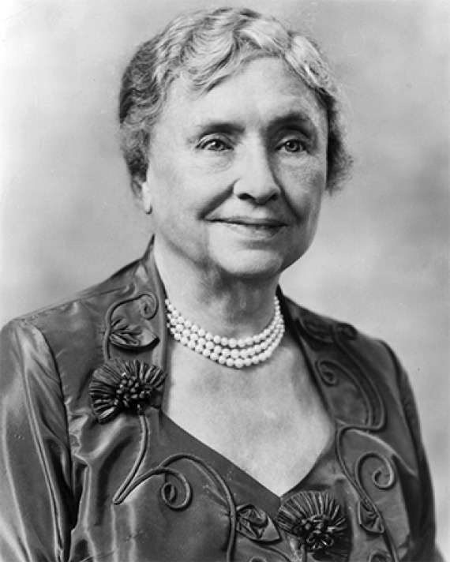
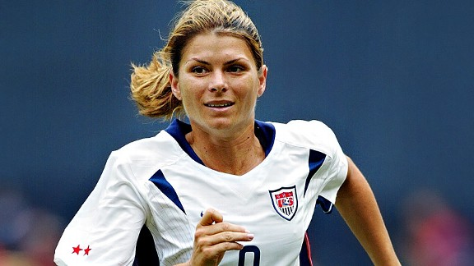
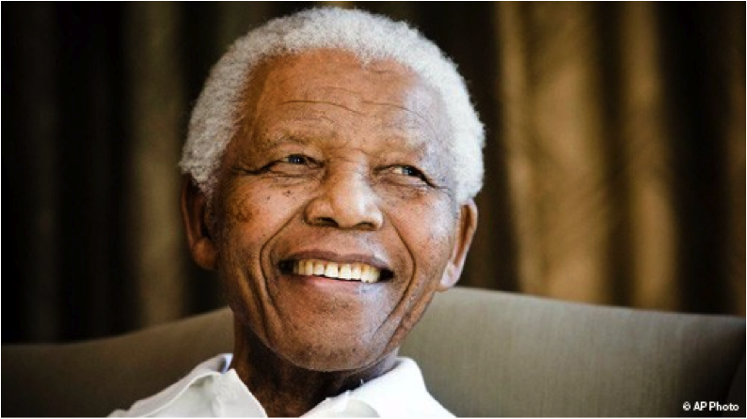
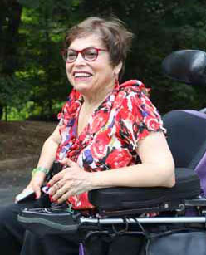
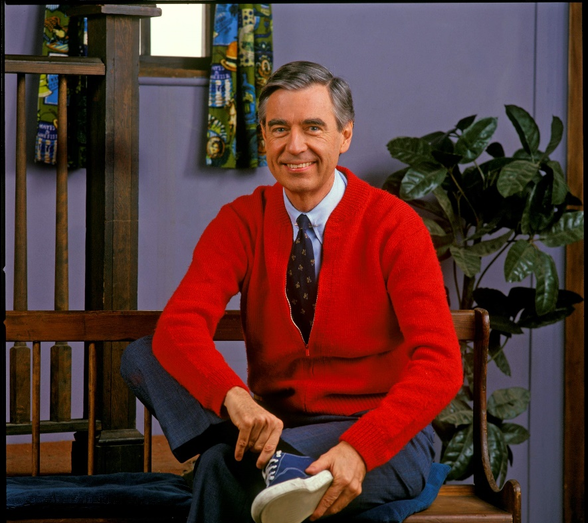
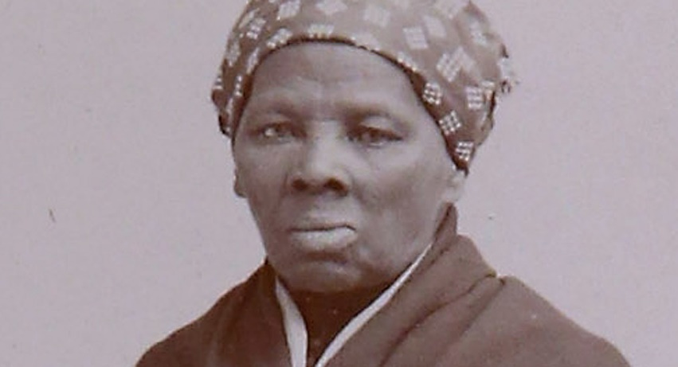
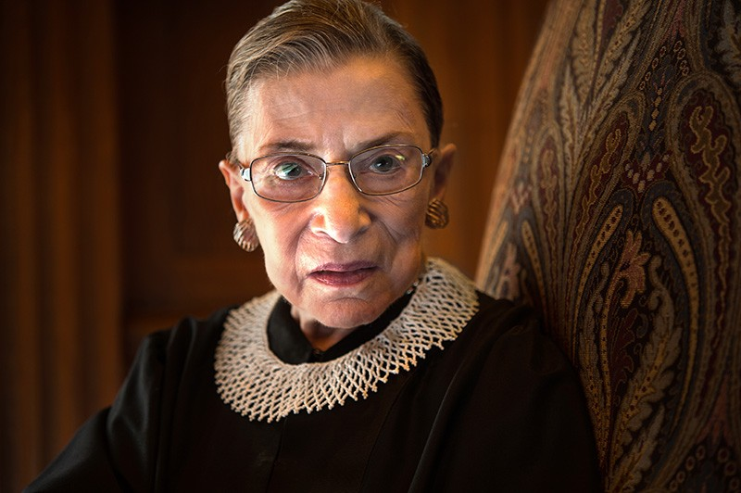
4. Finding our role models
Notes:
Finding our role models.
*change pictures for role models*
Role models are similar to mentors and the two can overlap. However, role models are not usually directly involved in your personal growth. Rather, role models are people who enact the values we ourselves hold.
We see their values in action and it inspires us, even from a distance.
Our role models come from many sources:
Someone with a media presence or another public figure;
a colleague;
Or a family member, friend, or acquaintance.

Slide 41
4. Finding our role models
Strive to actualize your values
Show consistency
Have a passion for values
Notes:
A good role model is one who strives to actualize values, shows consistency, and has a passion or conviction for values

Slide 42
Do not make a social comparison
that makes you criticize yourself
Notes:
It’s important to note that with role models, we may fall into the social comparison trap-- in other words, our internal critic may tell us that “we’re not good enough” or “as good as” our role model. This is normal--just try to hold that thought lightly.
Consider the sushi train metaphor from our previous module, and ask yourself—is this a helpful thought for me right now? If not, consider telling the sushi chef in your mind “no thank you”, and grab a plate of something else.

Slide 43
Role models should INSPIRE and EMPOWER you
Notes:
Your role models should inspire and empower you to pursue your values

Slide 44
Role Models
Justice Ruth Bader Ginsburg
Judith Heumann
Notes:
*Describe your role models and replace their images. The script below is an example*
Two of my role models are Judith Heumann and Justice Ruth Bader Ginsburg. Both are fierce advocates for the rights and dignity of all people. To me, they represent determination, courage, and lifelong learning. Both are sources of inspiration and motivation for me to continue moving in the direction of my values when challenges arise.
Two of my role models are Muhammad Ali and Peter Parker from the Spiderman comics. I admire Ali not for his physical prowess although that was phenomenal. What I have always admired of Ali was his complete and total conviction. Watch an interview with him and you see and feel his spirit. He has a passion for what he believes is right and a confidence that is undeniable. Peter Parker, on the other hand, is filled with self-doubt and guilt and a burden to do what he feels is his responsibility. And in most incarnations of the character, he remains humble, guided by his morals, a compassionate friend and lover, interested in the world, and has a general optimism.

Slide 45
Connecting Meaningfully Activities
coal and diamonds
fill-a-bucket
building a mentorship (part 1)
Notes:
We have included three activities with this lesson to help with connecting meaningfully with others

Slide 46
Connecting Meaningfully Activities
coal and diamonds
Notes:
Coal and Diamond can help you identify what type of social support you need in different areas in your life. Through this activity you may gain clarity for which areas in your life you may need to find social support.

Slide 47
Connecting Meaningfully Activities
coal and diamonds
fill-a-bucket
Notes:
Fill-a-bucket is designed to help you focus on your giving to others and recognizing which acts of giving “fill you up” and which “deplete you.”

Slide 48
Connecting Meaningfully Activities
coal and diamonds
fill-a-bucket
building a mentorship (part 1)
Notes:
Building Mentorship is a tool for considering where you may benefit from mentorship and guides you to seek out this type of social support.

Slide 49
Recommendations
Complete activity
Notes:
We recommend three next steps to take this information and apply it to your own well-being. First, please choose and complete at least one of the accompanying activities to connect meaningfully with others
Do this so that you can experience how this process, the ongoing engagements in helpful social supports, acts of service, and mentorship relationships can inspire us.

Slide 50
Recommendations
Complete activity
Identify one of the 5 connections to improve
Notes:
Our second recommendation is that you take any one of these practices and teach it to your practice partner—whether that is a colleague, spouse, friend, or family member. Whoever you selected. Go over the activity with them too, and then work to use the strategy in everyday life. Get practice being intentional about your relationships.

Slide 51
Recommendations
Complete activity
Identify one of the 5 connections to improve
Create individual action plan for that connection
Notes:
The third and final step is to set an intentional action plan of your own. Action Planning is a critical step whenever we try to start something new. It helps us identify our barriers, our strengths, and how we can recover from setbacks when they inevitably happen.
Thank you again for watching and engaging with this lesson. Take care.

