Slide 1
Adult Resilience Curriculum (ARC)
Coping

Slide 2
Delivery & Tailoring Instructions
Prior to delivering, get information from audience about their current struggles and needs. Use that information to decide what should be tailored
To tailor, you can change the following:
Hook & Transition metaphors
Your “Who I Am” slide & credibility slides (referent, information, positive expert power)
Any of the background intro slides (if Module 1 has already been delivered)
The order of the slides (before activities)
Activities (based on time frame)
Knowledge Check questions
Discussion Questions
To make changes to the Activities, Knowledge Check Questions, and Discussion Questions, you can:
Hide the activities you do not want to do
Replace the knowledge check section of each final activity slide with the proper knowledge check question(s)
Delete whichever discussion questions you choose not to provide. Make sure these questions are provided in a follow up forum/document/delivered in-person by a member of the healthcare professional team after at least 1 week of practice.

Slide 3
Delivery & Tailoring Instructions
Make sure the tailoring is done to fit within the appropriate time frame
The structure and design of the powerpoint is actually based on a combination of successful TedTalks (that involved audience participation) and research on how to present to adults
This includes the Hook, Transition, Who I Am, and Audience Benefit slides
Limited text
Use of imagery
MINIMIZE reading text on slide; research indicates this actually disrupts audience comprehension
Set expectation for participation at the outset

Slide 4
Delivery & Tailoring Instructions
Things to remember
Expert power can be negative if audience portrays a) you are leveraging your expertise in one domain into another, b) if your expertise appears outdated, c) your expertise is impersonal (i.e., not recognizing the audience’s perspective), and d) if they portray you as having something to gain
What is comfortable for us, the presenter, is maybe not engaging for the audience.
Charismatic power is something; you are acting for your audience and that is encouraged. People will buy-in if you seem bought-in. Find the charisma personality that you can put on confidently.
Sell the “Why”, not the “what” or “how”. Those are ARC and the modules. But the “Why” is most important

Slide 5
Notes:
The Hook
*Use or replace with your own metaphor or concept that illustrates difficult emotions/experiences*
As we launch into today’s module, I would like you to imagine an image of a sailboat out on the ocean or a large body of water. You might find that an image from a book or movie pops into your head. Or perhaps you have been around sailboats in real life. I’d like you to visualize the structure of the boat – all the different parts that enable its strength and power. Visualize the colors of the hull, the sails, and the ropes. Next, take a moment to picture the people on the boat who make up its crew. Who is there? What are they like? Finally, imagine the environment surrounding the boat. Are the waves gentle and calm? Or big and strong? Are the winds quiet and soft? Or strong and swift? What about the weather? Is it warm and sunny? Cool and rainy? Foggy? And now imagine what it would feel like to be a part of this scene that you’ve painted in your imagination.
I’d like you now to imagine this boat that you’re in, moving at a steady, pleasant pace, on a pre-charted route, toward a desired location. You feel comfortable and at-ease in this sailboat. The weather is cooperating and you are soaking up the beauty of your surroundings. Things are good.

Slide 6
Notes:
The Transition
But suddenly, the scene changes in what feels like a moment’s notice. The winds pick up and aggressively switch direction, forcing you to change course. Cold rain starts to pelt down on your body and you notice you are soaked and freezing. The waves rise and begin to violently toss your boat around. You become aware of the water’s great depths, the unknown creatures that lurk below, and what might happen if you were to fall out of the boat. You feel seasick and terrified. You are suddenly so consumed with keeping the boat from overturning that you almost forget to keep moving. To make matters worse, the sky darkens and the fog thickens. It becomes more and more difficult to see where you are going. You wonder how you will possibly get out of this storm and make it to safety.

Slide 7
Notes:
The Transition
And then, you remember that you actually have the tools to make it through this. You look around and see your crew, the people who are there to help support you and keep you safe. You pull out your compass, which guides you in the direction of your true north. In the distance, through the thick of fog and darkness, you see a lighthouse, which reminds you of where you are striving to go. And you remember that should you need to buy yourself some time to decide the best course of action, you have an anchor to help you stay stable and keep you from drifting.
Most people have heard the expression, “Life isn’t always smooth sailing.” But take a moment to reflect on what this truly means. It’s not just the idea that things get wavy sometimes. It’s the idea that even in discomfort – when life is giving us motion sickness – we can find a way to cope and keep moving forward. That while we can forecast what might happen, we cannot know what lies ahead and we must be okay with that. It’s the notion that the winds can change at any moment, throwing us off course and rupturing our plans. That we must be ready to pivot at any moment and chart a new path. It’s the recognition that storms will come and go, and the only thing we can control is our own actions. That things aren't always fun and comfortable, but we make a conscious decision to stay on the boat and keep moving forward. And finally, it’s the realization that we all need a guiding light to make it through the dark of night, a strong internal compass for when the fog gets thick, and something to anchor us while we pause and figure out what to do next.
Throughout this module, we will be discussing strategies to help you cope when you start to experience difficult thoughts, emotions, or experiences. You can come back to the imagery presented in this sailing metaphor if that helps you.

Slide 8
WHO WE ARE
Christian Klepper, PsyD, LP
Faculty Trainer
Notes:
Who I Am
*Replace with your photo, change name(s), make sure to highlight your credentials (expert), your area of expertise (expert, informational power)*

Slide 9
WHO WE ARE
Hannah West,
PhD, BCBA
Regional Trainer
Notes:
Who I Am (This is an example)
*Replace with your photo, change name(s), make sure to highlight your credentials (expert), your area of expertise (expert, informational power)*

Slide 10
The Adult Resilience Curriculum (ARC)
Notes:
As a quick reminder, the Adult Resilience Curriculum – or ARC – is transtheoretical and comprehensive, yet flexible. The ARC was originally developed in 2013 by Dr. Clayton Cook and Dr. Gail Joseph for pre-service and in-service teachers. It is designed to promote wellbeing and enhance people’s capacity for resilience. It builds upon the strengths of existing programs, while trying to make the content more accessible and feasible for real-world professionals in various disciplines. This curriculum is NOT designed to replace mental health services or treatment.

Slide 11
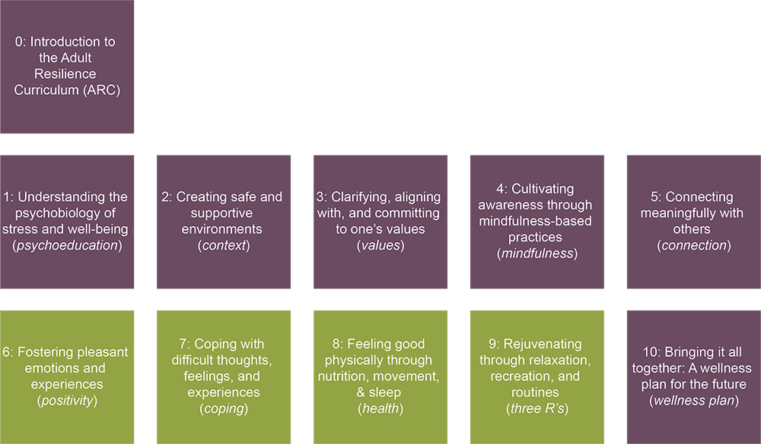
The ARC Modules
Notes:
The ARC program is broken into 10 modules, preceded by a brief, introductory module 0. Modules 1 through 5 and module 10 make up the "core" modules. Modules 6 through 9 are supplementary and provide additional opportunities to learn and practice resiliency skills. Finally, the 10th module brings the curriculum together. It is required at the end, regardless of if you do any or all of the supplementary modules.
This module—the second of the supplemental modules—focuses on coping with difficult thoughts, feelings, and experiences.
Most of the other modules we have covered so far focus on the ingredients for cultivating wellness. However, difficult thoughts, feelings, and experiences are an inevitable part of life. We can't expect to feel joy or excitement or pleasure all the time, nor would that make for a very meaningful life. This module is about learning the skills to cope with life's challenges so we can move forward in the direction of our values. It is not about suppressing our painful emotions or avoiding hard experiences.
This module builds upon all of the core modules in critical ways. We will ask you to recall what you learned about the psychobiology of stress, because some of the strategies are geared at restoring homeostatic balance – or balancing our bodily systems. We will talk about the importance of our environment and connection to others in the context of coping with hard things. Many of the strategies we will teach and practice are rooted in mindfulness – that present-focused, non-judgmental, intentional way of paying attention to ourselves and the world around us. And all of these strategies are in service of moving us toward our values.

Slide 12
Coping
Our Hopes for Today
Understand how emotions work and what purpose they serve.
Learn and apply various strategies to reduce suffering in the face of difficult emotions, thoughts, and experiences.
Create an action plan for how to cope with difficult thoughts, emotions and experiences now and in the future.
Notes:
We have three hopes for today. First, we hope for you to understand how emotions work and what purpose they serve. Second, we hope you learn and apply various strategies to reduce suffering in the face of difficult emotions, thoughts, and experiences, especially in the work place. Not only will you learn about them, we want to make sure we have time to practice. Finally, we would like you to create an action plan for how to cope with difficult thoughts, emotions, and experiences in the future.

Slide 13
MODULE 7: Coping with Difficult Thoughts, Feelings, and Experiences
Notes:
For some of you, this may be the most important module if you’ve noticed recently you are having several difficult experiences. And we hope it gives you some guidance to not fall victim to those experiences.

Slide 14
Coping Components
Thought defusion
Thought reframing
Understanding Emotion Regulation
Acceptance
Overcoming Intense Emotions
Responding to Unhelpful
Thoughts
Orienting Towards Values
Wave
skill
AND
skill
Soothing through the 5 senses
IMPROVE the moment
TIPP
skill
Notes:
There are five primary components to this module. They include: Understanding emotion regulation, Acceptance, Overcoming intense emotions, Responding to unhelpful thoughts, and Orienting towards values. The middle three components each have subcomponents.

Slide 15
What are Emotions?
“
Emotion only lasts in our bodies for about 90 seconds. After that, the physical reaction dissipates, UNLESS our cognitive brain kicks in and starts connecting our [emotions] with past events.
- Jill Bolte Taylor
A subjective experience
Neither good nor bad
Created by integrating bodily reactions and cognitive reactions
Essential to being human
“
Notes:
Let’s quickly review basics. What are emotions? They are subjective – or personal- experiences. They are not facts. This also means that they aren’t good or bad, right or wrong, accurate or inaccurate.
Emotions are there to help us by giving us information by blending our thoughts with our bodily experiences. They are like messages that we receive on our cell phones. They clue us into what is happening around us or what we need. Some emotions might feel pleasant and others unpleasant and challenging. All our emotions are valid and important information for us.
Jill Bolte Taylor did some research and found out emotions only last 90 seconds. You may be thinking, hold up, I have woken up some days and just been fuming all day long. In actuality, the emotion has passed. Now you are just reacting to the thoughts and behaviors that emotion brought up.

Slide 16
“
Emotions are complex. To limit them to ‘positive vibes only’ is to reduce what you allow yourself to feel. After all, to heal it, you have to feel it! And that’s healthier and more strongly associated with well being than is positive vibing through life.
- Elayne Daniels, Psychologist & Yoga Teacher
“
Notes:
You may have heard the terms "positive" and "negative" used to refer to emotions. Certainly, some emotions feel more pleasant than others. But all emotions are valid and important. The notion of "good vibes only" is very problematic for this reason, and counteractive to wellness and resilience. It is unrealistic, and quite frankly, unhealthy, to expect only emotions that feel good. Can you imagine a patient telling you about their pain and you responding with "good vibes only"? That would be extremely insensitive to that pain. It's also contrary to living a meaningful life. Instead, we will focus on how to respond to challenging emotions in a way that feels helpful, productive, and moves you closer to your values.

Slide 17
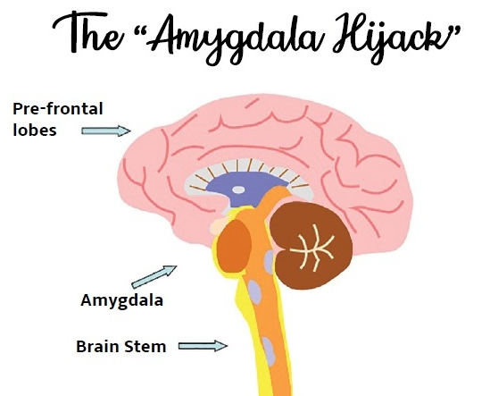
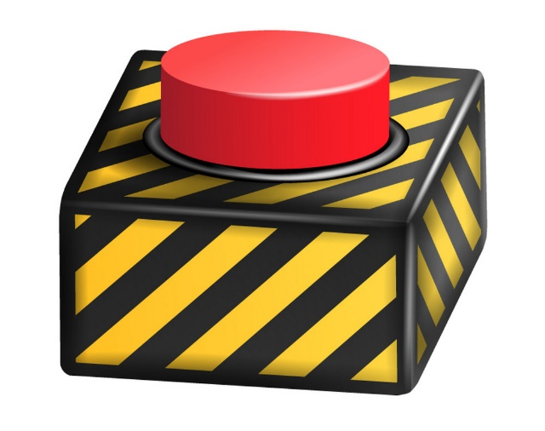
Emotion Regulation
Mindfulness is the only antidote to the amygdala hijack.
Emotions are like an avalanche – it’s important to make an intentional effort to address them at the beginning rather than waiting until they gain too much momentum and can overpower us.
NZ Farm Life Media
Knowing what your buttons/triggers are is key to coping with difficult emotions.
Notes:
So all emotions—including the unpleasant ones-- are valid and important. And at the same time, some emotions can challenge our ability to do what matters most.
Like an avalanche—that starts out small but gains power and momentum over time—emotions can snowball out of control and start to impair our functioning. This happens when the "amygdala" - the emotional center of our brain – gets hijacked by something emotionally triggering, and instead of coping with it, we respond in a way that makes our feelings or the situation worse. Emotions are only problematic when they strip us of our agency, when we start to think/behave irrationally, and when we no longer engage in actions that align with our values.
In the healthcare profession, this can turn into compassion fatigue. Compassion fatigue is physical and emotional exhaustion that can reduce the ability to feel empathy and compassion for others. It has elements of both burnout and secondary traumatic stress. Basically, the traumatic stress related to the constant exposure to emotionally-charged material leads to feelings of emotional exhaustion, depersonalization, and a reduced sense of personal accomplishment. Healthcare professionals are at increased risk of compassion fatigue due to the nature of their workplace.
The best way to deal with the "amygdala hijack" is through mindfulness. When we take a step back, breathe, and notice our bodies, we are now taping into our thinking brain. Remembering this is key to using the skills presented throughout this module. We can also use mindfulness to start to recognize what our "buttons" or "triggers" are for difficult emotions. Simply taking stock of this can help us when emotions get charged up.

Slide 18
“
To experience peace does not mean that your life is always blissful. It means that you are capable of tapping into a blissful state of mind amidst the normal chaos of a hectic life.
- Jill Bolte Taylor
“
Notes:
It might sound counterintuitive, but the first step of gaining control of difficult thoughts, feelings, or experiences is by not trying to control them at all. When we practice acceptance, we are NOT trying to avoid our emotions or internal experiences, NOR are we trying to change our emotions into something else. Rather, we choose to acknowledge and pay attention to how we feel without judging ourselves or trying to change our emotions. We also accept the idea that we cannot change the facts. For example, COVID happened and maybe you've been seeing the effects of this illness on your patients, or noticing how the increased safety protocols have negatively impacted the social supports they have. Maybe it's impacted how you interact with your own family and friends in order to keep them safe. That SUCKS. You don't have to like it, but accepting that you may not be able to see them again until things are in a different place can actually help ease your suffering. Pain is an inevitable part of life, but suffering is optional. Acceptance helps us keep pain from turning into suffering. It also helps us not get stuck in a mental rut, so we can continue engaging in values-based action.

Slide 19
Embracing the Waves
Notes:
What happens if we try to control rather than accept our emotions? Well, when was the last time you tried to hold a plastic beach ball under water? What happens? It pops back up and probably nearly hits you in the face! We sometimes try to do the same with unpleasant or challenging emotions – trying so hard to push them down that we end up struggling and getting hit in the face unexpectedly. Or we can simply acknowledge that it's there, maybe be a little curious about it and give it some attention, but not letting it consume all your energy. This is what folks mean when they say having acceptance.
Emotions are like waves – they come and go. They vary in terms of intensity. They reach a high point, but then they evaporate. Acceptance is learning to surf those waves, instead of continuously swimming against the riptide and getting knocked down. But how do you ride the waves? It might look like letting yourself have a good cry, or even simply naming the way you are feeling in a way that's non-judgmental, such as saying “I am feeling sadness” rather than saying “I am sad”. It also means not acting on impulses to do something that you think will make the situation better in the moment (because these responses aren’t usually mindful or values-driven, and they can make things worse in the long run).

Slide 20
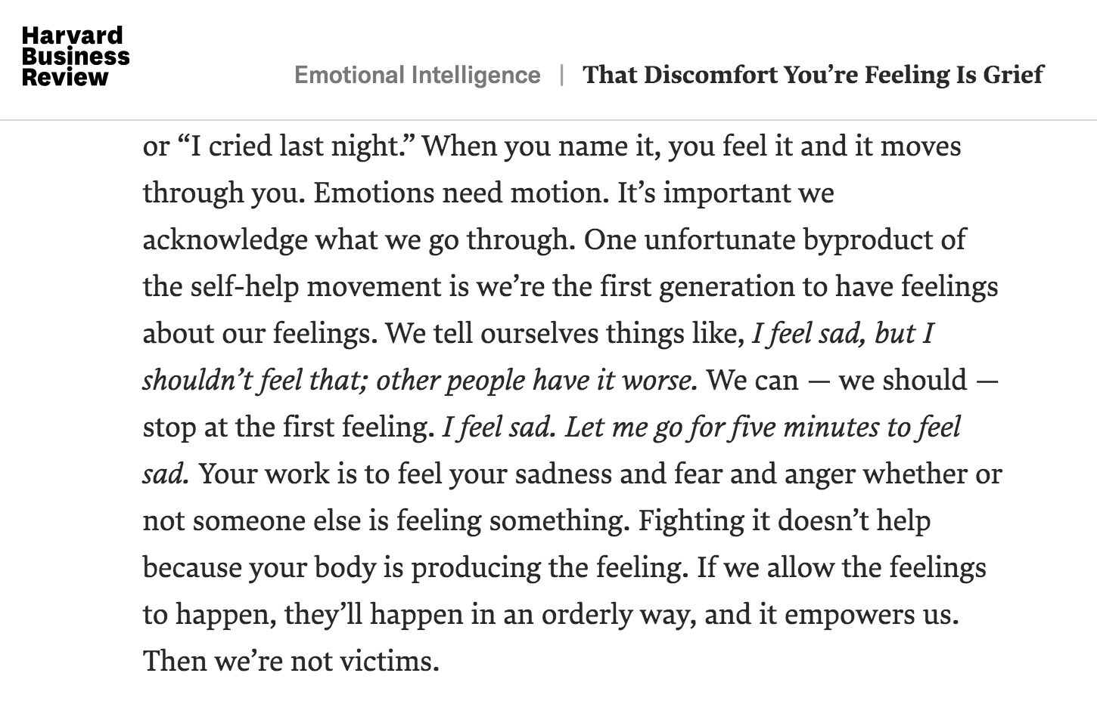
Aware of inner experience
Name what’s happening
Describe using an emotion
Notes:
AND is a way that we can practice mindfully surfing emotional waves. Our minds are often quick to judge difficult emotions, then react to them. This is part of the "amygdala hijack". The AND skill enables us to a) be mindful of our emotions, b) accurately identify them, and c) not react to the label itself but feel it. Quickly recall a difficult time for you this year, month, even today. To be aware of our inner experience, we first do NOT name the emotion but instead bring out attention to where we experience whatever emotion it might be. This is step 1 of being mindful with emotions. Do you feel something in your chest, head, shoulders, knees, toes?
Then name the sensation itself. Much like mindfulness, we are not labeling but describing the sensation. Think-- pressure, itchiness, throbbing, etc.
Only after we have named our experiences do we then categorize it with the emotional label. Stressed. Worried. Frustrated. What you have done is, instead of labeling your experience first and THEN acting, like saying "I am frustrated" and then stomping off, you are acting first by being mindful and directing your attention, and THEN finishing up with the label. We've reversed the process.

Slide 21
Overcoming Intense Emotions
Notes:
In some cases, we experience emotional situations (or crises) that are so intense that practicing acceptance alone is not sufficient to help us cope. In these circumstances, the situation or your reaction to it may feel as though it's outweighing your ability to cope. This can happen in response to events in our own lives. But often, as healthcare professionals, we experience these emotional crises in response to our patients' experience of intense perceived stress or trauma. Emotional exhaustion can occur when a practitioner's emotional resources are depleted by the chronic needs, demands, and expectations of their clients and organizations. In these moments, it's helpful to rely on what we call "crisis survival skills"
Today, we'll review three crisis survival skills you can use: IMPROVE the moment, soothing through the five senses, and TIPP.

Slide 22
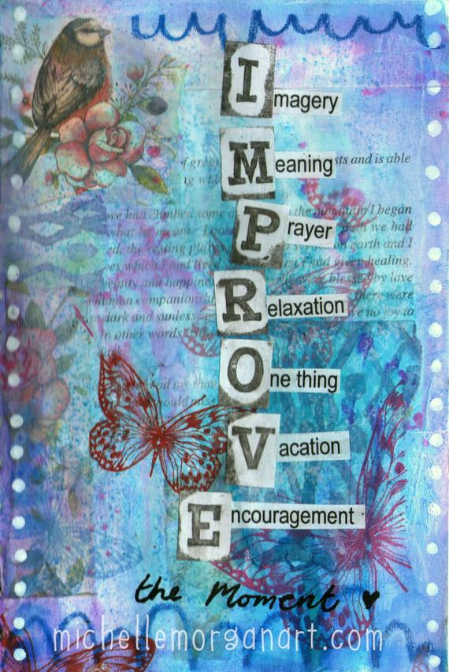
IMPROVE the Moment
“
In some ways suffering ceases to be suffering at the moment it finds a meaning, such as the meaning of a sacrifice.
- Viktor E. Frankl
“
Notes:
IMPROVE the moment is an acronym for seven strategies that help us calm our nervous system and make meaning during a challenging circumstance or experience. Viktor Frankl was a German Jewish psychotherapist who wrote about his experiences surviving in a Nazi concentration camp during WW2. In his book Man's Search for Meaning, he wrote about how suffering ceases to be suffering when we can find meaning in our experience. This idea forms the backbone of the IMRPOVE skill, which includes these seven components:
The first component is Imagery. It's about taking yourself to a calm place in your mind or imagining the situation turning out better than expected. Next we have meaning – creating or finding meaning from the current situation or finding purpose or value to your pain. The third component is prayer. This can mean praying to a higher power, becoming aware of your connection to others and the universe, or tuning into a meditative moment. The 'R' stands for relaxation. You can utilize progressive muscle relaxation, guided meditation, or breathing. 'O' stands for One thing at a time. It's about mindfully focusing your attention on what you’re doing in that moment, on one step at a time, which helps to settle your mind. "Vacation" is about taking a brief breather from the task at hand or what’s on your mind. This could be a walk around the neighborhood, going to a favorite spot, doing a fun activity, or simply going under the covers for 5 minutes. And finally "E" stands for Encouragement. Talk yourself through the crisis like you would a good friend, by tell yourself helpful statements and good advice.

Slide 23
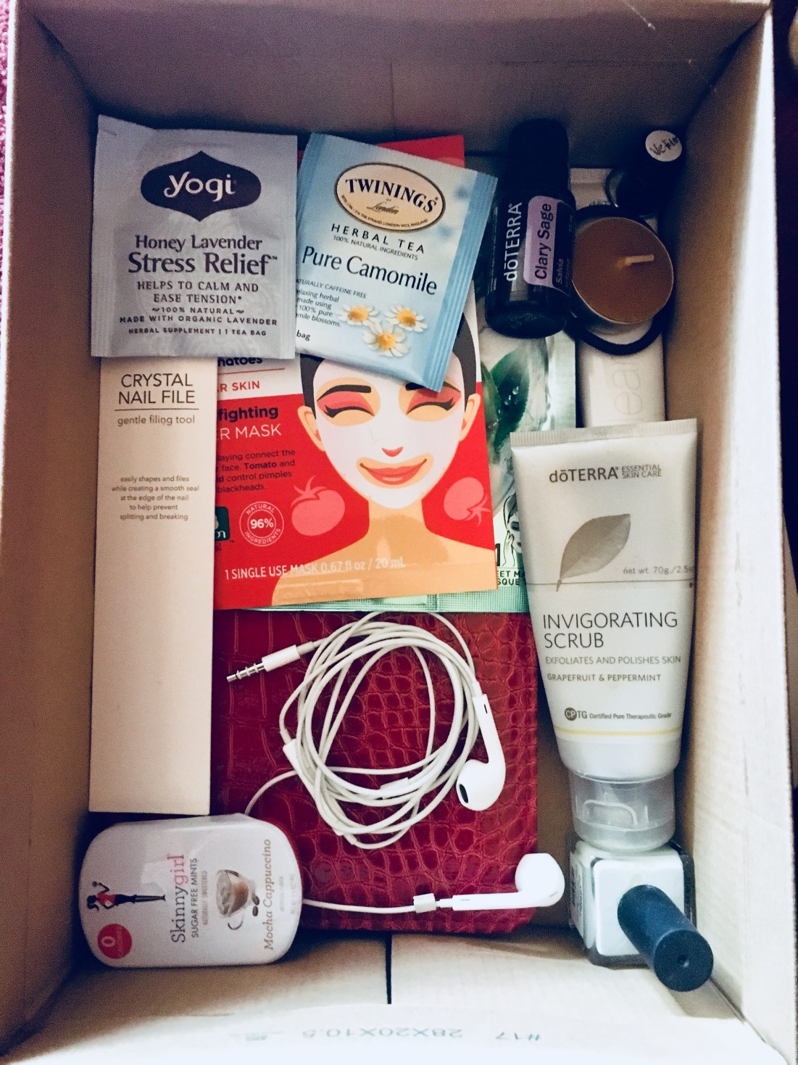
Soothing Through the Five Senses
HEAR
TOUCH
TASTE
SEE
SMELL
Creativityintherapy.con
Notes:
Another powerful strategy in a crisis or when experiencing intense emotions is to self-soothe by stimulating your five senses. It can be helpful to create your own self-soothing kit with several ready-to-go tools to stimulate each of the senses. Keep your kit in a reliable place or make an extra one to keep at work.
This is also a great project to do with patients or clients. As I go through some ideas, make note of things you might include in your own self-soothing kit. Creativity is encouraged!Small square of fuzzy, furry, or soft material
For vision, you might look at...
Photos of favorite people
Postcards of happy memories or somewhere you want to go in the future
A small print of favorite artwork
Affirmation cards with images and quotes
Art supplies and paper
Glitter jar
Funny pictures
An album with favorite pictures on phone
For touch, you might grasp or hold...
Clay, playdough or putty
Fidget toy
Puff balls or pom poms
Worry stone
Small square of fuzzy, furry, or soft material
Stress ball
Hand lotion
Tactile beads
Feather or soft brush to rub along your arm
Nail file and nail polish
Rubber band to snap on wrist or stretch
Magnet toys
For sound, you might...
Create a soothing playlist on your phone
Listen to nature sounds app
Listen to bells, chimes, or mini gong (or a soundtrack of them)
Listen to white noise or use nature sounds app/machine
For taste, you might eat...
Chocolate
Lollipops or other hard candies
Sour candy
Mints
Gum
Tea or hot chocolate
Crunchy snack
For smell, you might try...
Scented lotion or spray
Candle
Aromatherapy oils
Small jar of spices, cinnamon sticks, cloves or dried lavender
Incense sticks
http://creativityintherapy.com/2016/05/create-a-sensory-self-soothing-kit/

Slide 24
TIPP (During an Emotional Crisis)
Temperature
Intense exercise
Paced breathing
Paired muscle relaxation
Notes:
TIPP is another acronym. It includes four strategies to help hit the "reset" button on our bodies when we are physiologically aroused during a crisis. Again, this occurs when the amygdala gets hijacked and sends messages to our body to get ready to fight, flee, or freeze.
Temperature
During a crisis, our body tends to feel hot. Changing your body temperature by splashing cold water on your face, standing in front of the AC, squeezing an ice cube, or eating/drinking something cold can help cool you down both emotionally and physically.
Intense Exercise
Doing an intense activity to match your feelings can help give an outlet to excess anxious energy. This might include running around the block, doing jumping jacks until you are worn out, or running up and down some stairs. Increasing oxygen flow in your body helps decrease stress levels.
Paced Breathing
Slow, deep breathing soothes the nervous system and increases oxygen flow. Breathe out longer than you are breathing in. One of my favorite paced breathing exercises is square breathing, where you inhale for four counts, hold for four counts, exhale for four counts, and hold for four counts.
Paired Muscle Relaxation
When you tighten a muscle and then allow it to rest, it will be more relaxed than it was before you tightened it. Relaxed muscles require less oxygen, so your heart rate and breathing will naturally slow down. Muscle relaxation also helps with being mindfully aware of your body.
Let's try an activity called PACED BREATHING, using the 4-7-8 technique
empty the lungs of air
breathe in quietly through the nose for 4 seconds
hold the breath for a count of 7 seconds
exhale forcefully through the mouth, pursing the lips and making a “whoosh” sound, for 8 seconds
repeat the cycle up to 4 times

Slide 25
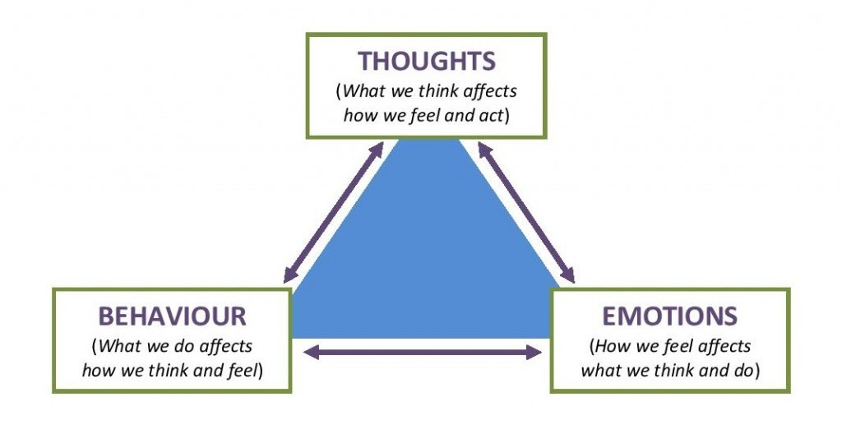
Responding to Unhelpful Thoughts
Thought Defusion
Thought Reframing
Notes:
Ways to approach unhelpful thoughts
Look at your hand right now, or foot, or arm or leg. Notice any details such as callouses or scars, curves and shape. And answer this question: how do you know you are not your hand, foot, arm, leg?
The simplest answer is you can see it. You can observe it. If you somehow lost it, you would still exist. At best, it is only a part of your body experience.
If that’s true, what about your thoughts? If you can think about thinking, if you can notice a thought and say to yourself, “Whoa, where did that thought come?” or “That was a sad thought”, then you are observing it. You are able to notice it. You might not be able to physically see it, but you can still notice it. And in that case, you are not your thoughts. At best we can describe them. Helpful thoughts. Unhelpful thoughts. But they are not us. Our thoughts can certainly impact our feelings and actions, and our feelings and actions can impact our thoughts. And since they are not us but more like bubbles from your brain popping up here and there, then we can do something about the types of thoughts we have. We have two strategies: defusion, and reframing.

Slide 26
Thought Defusion vs. Thought Reframing
Remembering that you’re
not your thoughts
Simply noticing your thoughts without getting caught up
Letting thoughts come and go, like leaves on a stream
Creating a space between yourself, your thoughts, and your actions
Noticing patterns of thinking that are negative or unhelpful
Question faulty or inaccurate ways of thinking about things
Reframing the thought to be more positive, helpful or balanced
Observing how changing your thoughts can change how you feel and what you do
Notes:
Practicing these skills
Let's start with thought reframing, as it is the more "old school" cognitive-behavior method that can be really effective for some people. Thought reframing involves a few basic steps: 1) become aware of your thought patterns, either through mindful practice or using something like a thought record where you can quite literally, like an exercise journal or to-do list, track the pattern of your thoughts; then 2) find evidence if that thought is accurate or not accurate to the real world, then 3) practice replacing it with a new thought that is more accurate or helpful, and 4) pay real close attention to how you feel after. True optimists are great at this; even if having a negative thought is accurate, like "Most of my patients don't listen to my recommendations", thought reframe finds a more helpful thought, such as "Something about my recommendations may have left my patient feeling at least a little comforted." And that can help you figure out what changes to make. Optimism and thought reframing isn’t about saying everything will be alright, but finding a more accurate and helpful reframe.
Thought defusion is a bit different. It is recognizing that words and our thought behaviors are weird and do not always make sense. But we buy into them. We forget that we are not our thoughts. For example, if it's your first year practicing and you think to yourself "I am shy and inexperienced", you are likely to be an unengaging healthcare professional, which is only going to make you stressed out. Thought defusion is instead thinking, "I am having the thought that I am shy and inexperienced." It may be true; it may not be. Doesn't really matter. The point is that you are not your thought, and once you get from that thought and can see it for what it is, you can think more clearly about what matters to you and what behaviors you need to do to get there. One of the easiest ways to defuse from a thought is to repeat it aloud nonstop. Seems odd, almost like this would make it worse, but it is actually quite interesting. Let's experience it together. Label your emotion that you are feeling right now. Let's say it's stressed.. Now repeat that word out loud at the pace of about .5 second. It may sound weird and you may laugh. That's okay, keep saying it aloud
*Give them time for about 20-40 seconds, prompting them to speed up multiple times throughout*
You may notice that it became hard to say, or you forgot what you were saying, or you noticed you were still saying a word but it sounded weird or foreign to you. That's because the brain stops retrieving the meaning of that word and just the sound of it. That moment of freedom is you getting distance from a thought to know what it really is; it's a made up combination of sounds that has no real meaning and does not define you.

Slide 27
Orienting Towards Values
Ask yourself:
“Am I letting my emotions drive my decisions or am I in the driver’s seat, using my values as a compass to direct me?”
Notes:
Thought reframing and defusing to get to values
Some of you might find one or more helpful than the other and it can actually be useful to use both. Why? Because you are making language work for you in service of your values. Yes, if teaching is a challenge, and you also associate challenge with "bad" then having that thought can be really unhelpful. But if you reframe the thought of "challenge" as "worthwhile" or "good", then challenging is no longer something to be stressed out about. Or if you are thinking, "I am really sad today", you can practice defusion by saying to yourself, "I am having the feeling of sadness. And I can still teach even while feeling sad." Boom, you are now back in line with values again.

Slide 28
Activities for Practicing Coping
emotional observer
urge surfing
progressive muscle relaxation
paced breathing
theory A/ theory B
speech exercises
Notes:
There are six activities associated with this lesson for you to consider practicing.
The first activity is Emotional Observer. Quickly recall a difficult time for you this year, month, even today. To be aware of our inner experience, we first do NOT name the emotion but instead bring our attention to where we experience whatever emotion it might be. This is step 1 of being mindful with emotions. Do you feel something in your chest, head, shoulders, knees, toes?
Recall that being an emotional observer is a strategy to help you regulate your emotions and feel less distress. The idea is that you first become aware of your internal self, as if you are another person watching what is happening inside you. This starts with mindfulness, by paying attention on purpose, non-judgmentally. Then, you name what's going on in your body as if you are telling a doctor about medical symptoms. For example, you might name that your stomach feels like it’s tied in knots, or that your chest is tight, or that your face feels hot and prickly. Finally, you choose emotion words to describe what you are feeling. In this case, it could be worried or sad or angry.
To practice this, I want you to recall a recent experience that was upsetting or difficult for you. Try to bring forth the details of that experience, so that it becomes real again. (pause). Now, become aware of what you feel in your body. As you do this, remember that mindfulness entails paying attention, on purpose, without judgment (pause).
Then, name what you feel physically. You might feel a stomach tied in knots, a tight chest, a hot face, shaky hands, a heavy body, a racing heart... (pause). Finally, choose the emotion word (or words) that best describes how you are feeling about the situation or experience.
The second activity is urge surfing. An urge is a strong desire or craving to act impulsively and out of habit. An urge occurs right before a behavior and is experienced as an intense physical and emotional experience. Urges get triggered by an event, a thought, feeling, memory, or image and pull us towards automatic ways of responding. Urges can feel like waves, they rise in intensity and tug and pull us towards using old behaviors that may provide us a temporary relief, but often lead to negative consequences in the long run. Rather than struggling and fighting an urge, we can ride it by staying present and mindful, noticing the moment it peaks and the moment it crashes.
Urges are temporary. So, you don’t have to act on them for them to change and morph. Whenever you feel the impulse or have the nagging thought, bring your attention to your breathing and bodily sensations, and stay curious and present in the current moment. Urge surfing is a mindfulness technique used to get through an urge without acting on destructive impulses. When you notice an urge, rather than fighting against it, imagine you are on a surfboard riding with it. Notice the shifting sensations, how they rise and fall, come and go.
To practice this skill, you will sit still for one minute. It is likely that an urge will arise to itch or shift in your chair. Resist this urge and practice surfing it instead by practicing be mindful and still. Remember, urge surfing is just like riding a wave. Urges come and go and we don't need to act on them.
In progressive muscle relaxation, you tense a group of muscles as you breathe in, and you relax them as you breathe out. You mindfully concentrate on areas of your body in a certain order to relax them. When your body is physically relaxed, stress and anxiety get released. When you're first starting out with this exercise, it can help to use a recording of instructions.
Paced breathing is slow, deep breathing into your belly. With normal breathing, you take about 12 to 14 breaths per minute. By comparison, with paced breathing you take only 5 to 7 breaths per minute. That translates to one breath every 10-12 seconds. With paced breathing, you generally want your exhale to be longer than your inhale. Paced breathing slows the activity in your central nervous system and decreases your emotional reactivity by triggering a relaxation response.
The fifth activity is Theory A/Theory B. Cognitive restructuring takes time, practice, and a bit of objectivity. We have to recognize that, over time and repeating thought patterns, our brains have become structured to think and react in certain ways. Interestingly, these thoughts are not always accurate to the outside world, or they may be accurate but they keep us from living the type of life we want. To determine if they are right, we can engage in a little experiment.
In short, we create two theories about our problem. Theory A is how we currently understand the world. Maybe that theory is “Things are never getting better.” Strong theory. But since we know our thoughts are biased to be negative, we need to first make sure we really understand this thought. We can look for evidence that it is true but also evidence that it isn’t true. We also need to consider what we need in case theory A is true. Last, we think clearly about just what theory A, if it’s true, means for us in our lives, and how we want to handle that truth. Then, we have to detach from that thought like a detective, propose a new theory about the world, and build that theory out. Maybe the theory is “Things will get better slowly”. We do the same process to build this theory. And then we test both theories out by continuing to collect more data. This is cognitive reframing—taking a thought that seems so real and true, and treating it as a guess about the world. Our brains make predictions, after all. And predictions are not always right.
Finally, speech exercises is an activity to help you get distance from a thought, observe it, and create a new way to relate to that thought. Once we have a new relation, we don’t need try to avoid it or let it stress us. We can simply accept it.
Select a thought that has been difficult for you lately. Maybe it’s, “Things are never going to get better.” Rather than relating to that thought and fusing with it so that it feels so personal to us, we can use our own words to mess with the thought and recognize that it is, indeed, just a thought and is not helpful.
These exercises are all based in language because, it turns out, for all the good language does us, it can also make things difficult. The first one is quite simple and is using language more accurately. It teaches us not to get swept up in a thought, but to use language to help us notice the thought. The other two are a little more fun. The first one is the opposite of the defusion strategy earlier. Rather than say the thought really fast over and over, you are going to say it extremely slowly and only a few times. Notice how your mind reacts to saying this thought aloud slowly, and even your emotional reaction. The last one has you creating a new relationship with the word by saying it in a silly way.
You can decide on which exercise you want to incorporate into your own life.

Slide 29
Recommendations
Complete one activity
Notes:
We recommend three next steps to take this information and apply it to your own well-being. First, please choose and complete at least one or a combination of the accompanying activities to practice dealing with difficult thoughts, feelings, or situations.

Slide 30
Recommendations
Complete one activity
Identify one or more practices for coping with difficult experiences that you will practice
Notes:
We recommend three next steps to take this information and apply it to your own well-being. First, please choose and complete at least one of the accompanying activities.

Slide 31
Recommendations
Complete one activity
Identify one or more practices for coping with difficult experiences that you will practice
Create an individual action plan for that connection
Notes:
The third and final step is to set an intentional action plan of your own. Action Planning is a critical step whenever we try to start something new. It helps us identify our barriers, our strengths, and how we can recover from setbacks when they inevitably happen.
Thank you again for watching and engaging with this lesson. Take care.

