Slide 1
Adult Resilience Curriculum (ARC)
Coping with difficult thoughts, feelings, and experiences

Slide 2
Delivery & Tailoring Instructions
Prior to delivering, get information from audience about their current struggles and needs. Use that information to decide what should be tailored
To tailor, you can change the following:
Hook & Transition metaphors
Your “Who I Am” slide & credibility slides (referent, information, positive expert power)
Any of the background intro slides (if Module 1 has already been delivered)
The order of the slides (before activities)
Activities (based on time frame)
Knowledge Check questions
Discussion Questions
To make changes to the Activities, Knowledge Check Questions, and Discussion Questions, you can:
Hide the activities you do not want to do
Replace the knowledge check section of each final activity slide with the proper knowledge check question(s)
Delete whichever discussion questions you choose not to provide. Make sure these questions are provided in a follow up forum/document/delivered in-person by a member of the healthcare professional team after at least 1 week of practice.

Slide 3
Delivery & Tailoring Instructions
Make sure the tailoring is done to fit within the appropriate time frame
The structure and design of the powerpoint is actually based on a combination of successful TedTalks (that involved audience participation) and research on how to present to adults
This includes the Hook, Transition, Who I Am, and Audience Benefit slides
Limited text
Use of imagery
MINIMIZE reading text on slide; research indicates this actually disrupts audience comprehension
Set expectation for participation at the outset

Slide 4
Delivery & Tailoring Instructions
Things to remember
Expert power can be negative if audience portrays a) you are leveraging your expertise in one domain into another, b) if your expertise appears outdated, c) your expertise is impersonal (i.e., not recognizing the audience’s perspective), and d) if they portray you as having something to gain
What is comfortable for us, the presenter, is maybe not engaging for the audience.
Charismatic power is something; you are acting for your audience and that is encouraged. People will buy-in if you seem bought-in. Find the charisma personality that you can put on confidently.
Sell the “Why”, not the “what” or “how”. Those are ARC and the modules. But the “Why” is most important

Slide 5
Notes:
The Hook
Do you remember when you were a child and your parents or caregivers would nag you to eat your vegetables? Think about a vegetable that you really hated growing up – like brussels sprouts—because what kid likes brussels sprouts? Some lucky kids may have managed to sneak a few pieces of the disgusting veggie under the table to their dog. But if your parents were strict, you may have had to choke down every last mushy bite. And you know it was mushy, because if you were a child of the 80s or 90s, brussels sprouts were always boiled or microwaved from frozen. Blech. Mushy green balls that smell like farts.
Eventually, you grew up and got to make your own decisions about what food you would indulge in. More than likely, brussels sprouts did not make your shortlist. In fact, you may have even decided to avoid them entirely, under the premise that they are gross and you hate them.

Slide 6
Notes:
The Transition
But then, as an adult, maybe you noticed something interesting. Brussels sprouts started popping up in trendy restaurants and on food blogs. More and more people started singing the praises of these weird mini green cabbages. Except this time, instead of being prepared like the mushy balls you were given as a kid, they were served crispy and roasted, with a drizzle of olive oil or a dusting of parmesan cheese. Maybe one day you were brave or curious enough to try these new brussels sprouts...and maybe you actually loved them!
Even though these new brussels sprouts were technically the same brussels sprouts you ate as a child, eating them felt like a completely different experience. Instead of choking them down because you were forcefully instructed that you had to, or reminded how good it was for you, you did so because it felt good and brought enjoyment.

Slide 7
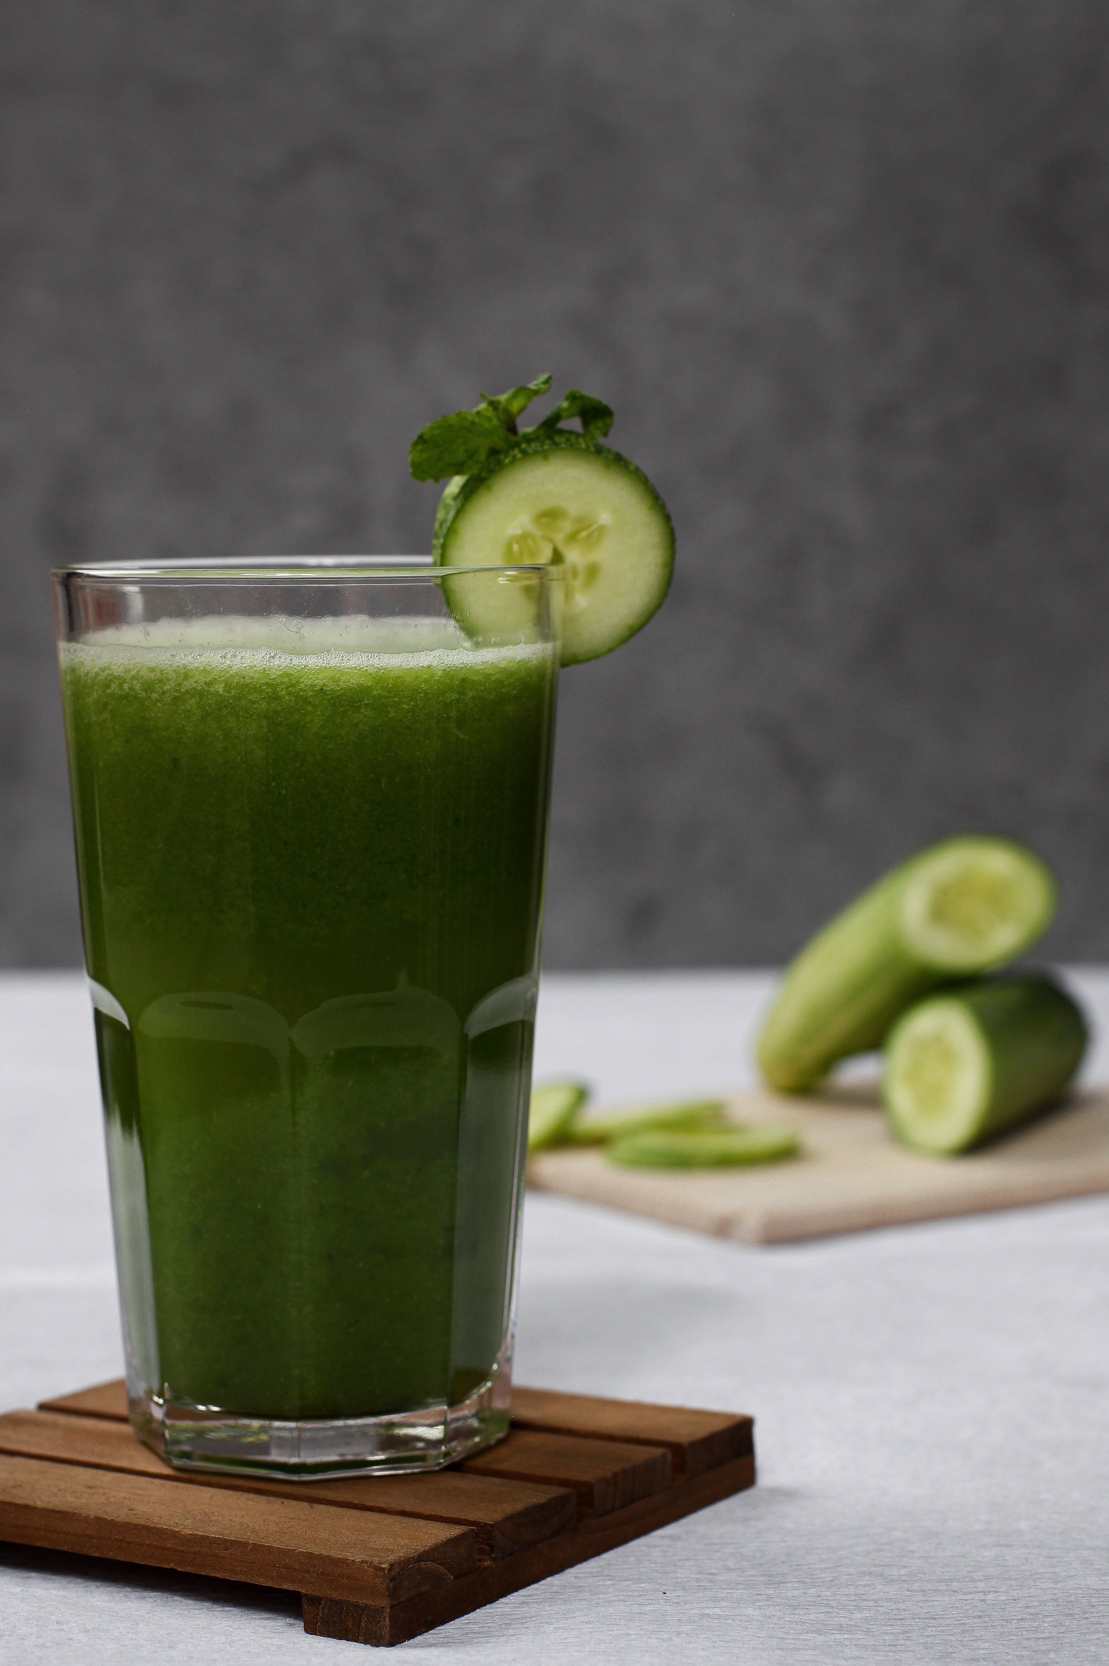
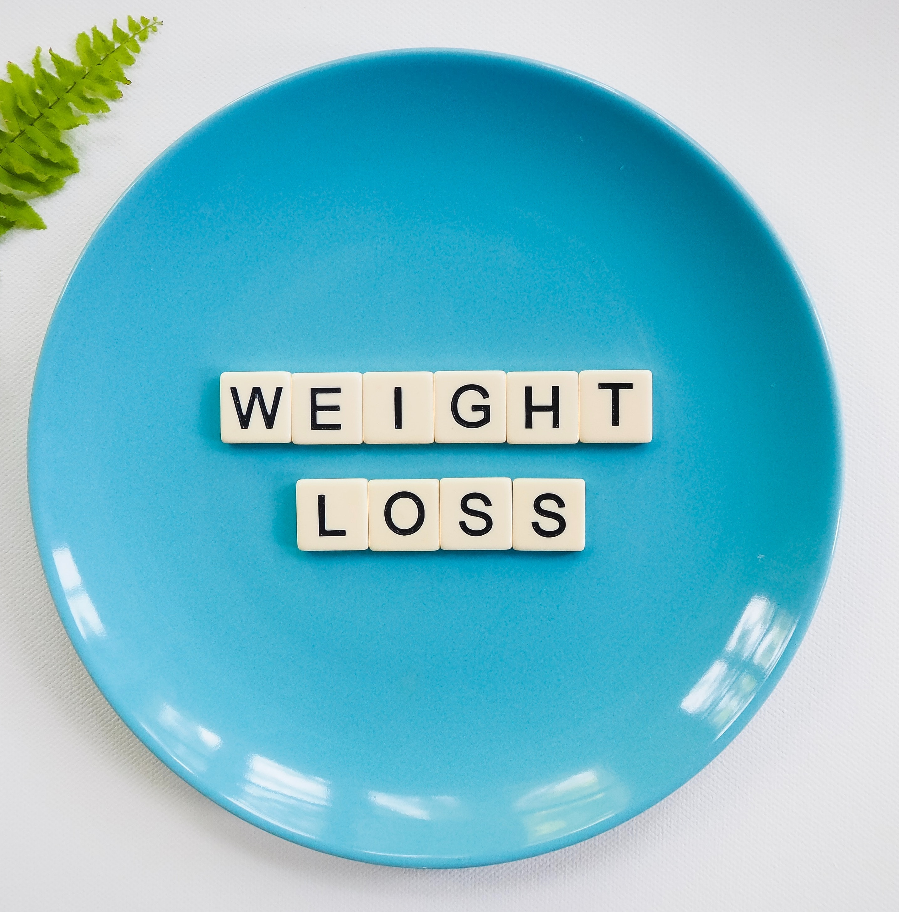
VS.
Notes:
The Transition
Mushy boiled brussels sprouts are a good metaphor for the things we do because we're told they're "good for us." Things like juice cleanses and fad diets. Like taking an early morning workout class even though you hate it or spending 30 miserable minutes on a treadmill so you can check off that you did it. Like dragging yourself out of bed at 5 am each day because you've been told it's "what productive people do." These things can feel forced and unpleasant with an air of rigidity. They can also feel inauthentic to who we are, not to mention that we are unlikely to keep up these routines when they don’t align with who we are.
In contrast, the crispy, caramelized and yummy brussels sprouts symbolize the things we do that take into account our preferences, what matters to us, and what feels good. They are flexible and personalized. They are things like experimenting with new recipes and flavor palates as a family, slowing down and savoring your food, or aiming to eat meals with all the colors of the rainbow. Like taking your dog on a beautiful hike, having a spontaneous dance party to your favorite album, or doing some gentle stretches after you wake up. Like reading or journaling at night instead of watching TV, doing a relaxing guided meditation before bed, or playing an energizing song to help you wake up in the morning.
The point is that while both kinds of brussels sprouts serve the same function – to give us nutrients – the experience of eating them can be so radically different... just as our experience of taking care of ourselves physically can be radically different, depending on our outlook and approach. In this module, we will be discussing how nutrition, movement, and healthy sleep can serve as tools to enhance our mental and physical well-being. We will not be regurgitating guidelines for what you should eat, how much you should "workout," and how many hours of sleep you need. Instead, we will focus on how you can approach nutrition, movement, and sleep in a way that feels good, is values-aligned, and will be more likely be maintained over time.

Slide 8
WHO WE ARE
Christian Klepper, PsyD, LP
Faculty Trainer
Notes:
Who I Am
*Replace with your photo, change name(s), make sure to highlight your credentials (expert), your area of expertise (expert, informational power)*

Slide 9
WHO WE ARE
Hannah West,
PhD, BCBA
Regional Trainer
Notes:
Who I Am (This is an example)
*Replace with your photo, change name(s), make sure to highlight your credentials (expert), your area of expertise (expert, informational power)*

Slide 10
The Adult Resilience Curriculum (ARC)
Notes:
As a quick reminder, the Adult Resilience Curriculum – or ARC – is transtheoretical and comprehensive, yet flexible. The ARC was originally developed in 2013 by Dr. Clayton Cook and Dr. Gail Joseph for pre-service and in-service teachers. It is designed to promote wellbeing and enhance people’s capacity for resilience. It builds upon the strengths of existing programs, while trying to make the content more accessible and feasible for real-world professionals in various disciplines. This curriculum is NOT designed to replace mental health services or treatment.

Slide 11
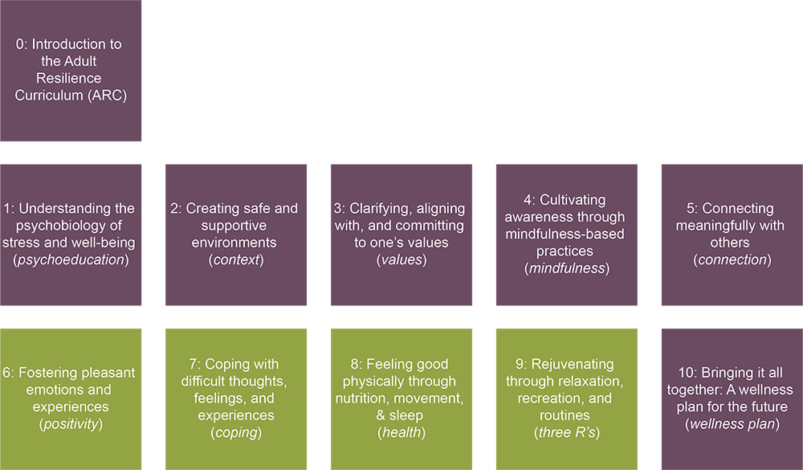
The ARC Modules
Notes:
The ARC program is broken into 10 modules, preceded by a brief, introductory module 0. Modules 1 through 5 and module 10 make up the "core" modules. Modules 6 through 9 are supplementary and provide additional opportunities to learn and practice resiliency skills. Finally, the 10th module brings the curriculum together. It is required at the end, regardless of if you do any or all of the supplementary modules.

Slide 12
Health
Our Hopes for Today
Reconceptualize the importance of nutrition, movement, and quality sleep for well-being.
Learn and apply strategies for moving, eating, and sleeping in ways that promote mental and physical health.
Create an action plan to improve your health habits, now and in the future.
Notes:
We have three primary goals for today. First, we hope to help you reconceptualize the importance of nutrition, movement, and quality sleep for well-being. Next, we hope you learn and apply new strategies around movement, eating, and sleeping that promote mental and physical health. Finally, we hope you can create an action plan to improve your health-related behaviors in the present and future.

Slide 13
MODULE 8: Feeling Good Physically through Nutrition, Movement, and Quality Sleep
Notes:
With that said, let's get started with module 8: feeling good physical through nutrition, movement, and quality sleep.

Slide 14
Health Components
Mindful Eating
Joyful Movement
Restful Sleep
Notes:
The three components featured in this module are mindful eating, joyful movement, and restful sleep. Notice that there is no mention of things like "diet" or "exercise." That is intentional. In this module, as in all the others, we avoid being prescriptive – as in, telling you things that you "must" do to be a (quote unquote) "healthy person." Aside from the fact that prescribed practices are not always feasible, appropriate, or sensitive to individual and cultural differences, being told "how to be healthy" from someone you barely know is a poor driver of growth and change.
As with all the other modules, this module is about you being in charge and making wellness decisions that align with what matters to YOU. Keep in mind that when we do offer recommendations, they are merely suggested ideas. When in doubt, bring it back to the concepts of values, mindfulness, and connection that we learned about in previous modules, and consider all of this in the context of yourself and your environment.

Slide 15
If food is feeling stressful, then it’s not actually promoting health.
If your thoughts/behaviors around food, exercise, and/or your body regularly consume your thoughts, you may consider seeking help.
Mindful eating is about making healthy food choices from a place of nourishment, pleasure, and connection. It’s about savoring. Mindful eating is also joyful and intuitive.
Notes:
Take a moment to reflect about the messages you have received over the years about food and eating. Chances are, you have heard your fair share of opinions about what you SHOULD and SHOULDN'T eat to "be healthy," "lose weight," or "get fit." You may have received numerous conflicting messages from family members, health care providers, or popular culture. At best, this is stressful and confusing. At worst, you may have developed a complicated relationship with food and eating that you are still grappling with today.
The last four decades have seen drastic shifts in which food groups are considered "good" and which are to be avoided. Fad diets and unusual food trends quickly become popularized, and then fade into the background once a new trend picks up. Now, while we enjoy avocado toast as much as any Millennial, we want to divorce "health and wellness" from the notion of eating specific things. This is the what. Instead, we want to focus on the why and the how. The why is personal and is linked to your values. Do you want to feel good? Live longer? Set a healthy example for your children?
As for the how, we advocate for mindful eating. This means applying the principles that we learned in the mindfulness module to our eating habits and behaviors, principles like paying attention, being present and intentional, noticing our bodies, and not judging. How many times have you downed your food in five minutes while multitasking, polished off a bag of chips without even noticing it, or judged yourself for what you ate? These are signals that it's time to bring more mindful awareness to your eating. Mindful eating is also intuitive and joyful. It's intuitive because we are listening to the wisdom of our bodies when they tell us what kind of nourishment we need, when we are hungry, and when to stop eating. Diets or meal plans that encourage overriding your body's natural hunger and satiety cues and that leave you with strong cravings for certain food groups are NOT mindful eating.
And mindful eating is joyful because it is also about pleasure and connection. There's a qualitative difference between eating alone at your desk while multitasking and sharing a meal with a friend or colleague – even if it's over Zoom! And remember that if eating or thoughts about food are feeling stressful, it's not actually promoting your health. If your thoughts and behaviors around food, exercise and/or your body are taking up a lot of headspace and detracting from your quality of life, then it might be a sign to reach out and ask for some support.

Slide 16
Mindful Eating
No hard & fast rules for what you should eat, but aim for balance & moderation
Strive for flexible structure
Regular meal times
Flexible meal prep
Loose guidelines for meal planning
Be wary of food trends like diets and ”clean eating” (often a marketing tactic)
Remember that food has a value beyond nutrition (e.g., cultural value, traditions)
Recall that a "healthy body" looks different across individuals and cultures
Don’t judge yourself or others for food choices
Dietary concerns? Consult a doctor.
Notes:
In case there is still some confusion about what constitutes mindful eating, we've compiled some tips and tricks here.
To reiterate what was said before, there are no hard and fast rules for what you should eat. Instead, strive for balance and moderation by eating a healthy variety. There is no need to be rigid around meals, but having some degree of routine or consistency can be helpful, as long as you keep it flexible. This might involve keeping regular meal times and engaging in some level of planning around your meals.
Next, be wary of food trends like fad diets or "clean eating" that can be a powerful marketing ploy aimed at vulnerable consumers. Food companies can put just about anything in fancy packaging, label it as the newest trend, and drive up the prices. Not only are these trends rarely rooted in science and occasionally harmful for your health, they can also be elitist and exacerbate food system inequities on a global scale. Currently, more than 50 million people in the United States are estimated to be experiencing food insecurity, which has been heightened due to the COVID-19 pandemic.
Keep in mind that food has value beyond nutrition. Often, food is a way to share our culture, connect to those around us, or make others feel cared for. Foods that some people flag as "unhealthy" may hold cultural or familial meaning for others. Part of eating mindfully is recognizing the role of food to honor these traditions.
It should go without saying, but judging yourself or others for food choices is the antithesis of mindful eating. No matter one's body shape or the numbers on a scale, everyone deserves to eat in a way that brings joy and makes them feel nourished. Exactly what that entails will vary depending on an individual's values, background, biology, experiences, and access to nutritious foods. Moreover, what constitutes a "healthy body" is largely subjective. And metrics like Body Mass Index or BMI —while somewhat useful from a medical standpoint—do not reflect external factors, such as stress and trauma, that impact how bodies metabolize food and energy.
Lastly, if you do have specific dietary concerns or needs, it would be best to consult your doctor. They can help you navigate making changes in a healthy way or refer you to a registered dietician for nutritional counseling.

Slide 17
Joyful Movement
Centers pleasure & emphasizes mindfulness
Feels good physically and mentally
About appreciating your body for what it can do
Makes you more likely to regularly move
ALL kinds of movement are valid
Inclusive
Connects to your values
Can be forced & tedious
Feels compulsory
Often about manipulating or changing your body
Certain activities more valued than others
Can be ableist
Working
Out
vs.
Notes:
Let's recall our brussels sprouts metaphor from the beginning. On the left, we have the soggy, mushy, smelly brussels sprouts I was forced to choke down as a kid. And on the right, we have the crispy, garlicky, savory brussels sprouts that I can't get enough of. Both have similar health benefits, but one allows for much greater enjoyment. (CLICK 1)
For many people, adopting the mindset of "working out" can feel like brussels sprouts prepared the gross way. (CLICK 2) Despite the amazing physical health benefits, many people will say working out or exercising feels more like a punishing chore than a pleasurable activity and a tool for taking care of your body. This is especially true among people who have any history of trying to use exercise for a weight loss tool or as a way to “burn off” excess calories. In this regard, it can feel like a tedious and compulsory means to an end that is more about manipulating your body than feeling good or having fun. People might spend the whole workout waiting for it to be over or thinking about something else entirely. Which we know is NOT mindful.
Many people will also say they experience guilt or shame for not liking to exercise. Guilt and shame are generally NOT motivating factors. In fact, they often result in greater avoidance. Another problem with the mindset of "working out" is that certain types activities are deemed more valuable than others. For example, you might say a 5-mile run is superior to a short walk with friends, especially if you compare them on calories burned or average heart rate. However, a five-mile run may not be feasible, accessible, or appropriate for everyone. Not to mention, some people just hate running. (CLICK 3, CLICK 4, CLICK 5)
In contrast, joyful movement centers pleasure while emphasizing mindfulness. In other words, when engaged in joyful movement, people are paying attention to what they're doing, on purpose, and without judgement. Rather than focusing on your body's shortcomings, idealizing others' bodies, or fantasizing about what you'll be able to do in the future, joyful movement involves appreciating and celebrating what your body is capable of in the present. As nutritionist Rachel Hartley puts it, “You deserve to move your body without trying to manipulate it and to challenge your body without trying to change it.” Because joyful movement feels good physically and mentally, you feel rewarded for doing it and are more likely to keep it up. This does NOT mean that joyful movement is easy. In fact, people engaging in joyful movement appreciate the feeling of being appropriately challenged. The difference is that it is not painful or forced.
Another benefit of the joyful movement approach is that ALL kinds of movement are valid and no activities that get you moving are inferior to others. Do you want to run five miles because you love it and it feels amazing? Great! Does it feel more accessible to take a stroll with a friend instead? Also great! Because any person at any level of fitness and physical ability can find some movement that feels good to them and gets their blood flowing, joyful movement is inclusive. And finally, unlike "working out," which is fairly prescriptive and general, joyful movement is about being active in a way that connects you to your values. Because values vary from person to person, you might find joy in activities that others dislike and vice versa.

Slide 18
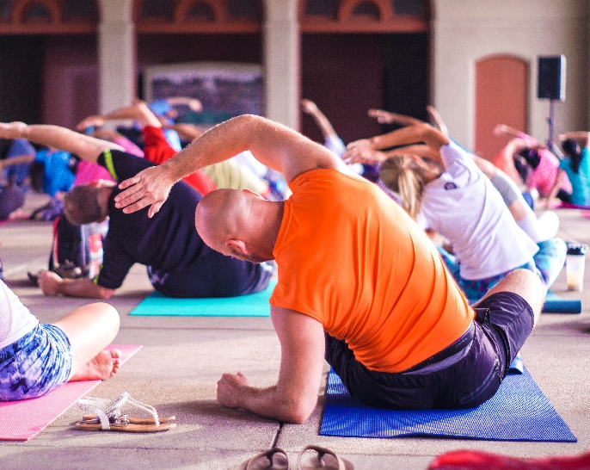
Joyful Movement
Think outside the box
Be willing to experiment
Consider free online videos/apps
Aim for loose structure
Embrace mini-movement
Connect it to your values
Notes:
Hopefully by now you are clear on the difference between "working out" and engaging in joyful movement. Now let's discuss some tips for finding activities that constitute joyful movement for you.
(CLICK 1)
1) Think outside the box. (PAUSE) The activities that come to mind when you think about "exercise" -- be it lifting weights or going on a run – can constitute joyful movement for some people. However, we encourage you to consider activities that aren’t usually deemed “exercise." Skateboarding, chopping wood, playing ping pong, or jamming out to a favorite playlist are examples of activities that get your body moving but that tend to be overlooked.
(CLICK 2)
2) Be willing to experiment. (PAUSE) What is something you've always wanted to try or that captures your interest? Ballroom dancing? Martial arts? Mountain biking? Are you willing to be vulnerable and put yourself out there with the possibility of discovering something amazing? Our friend Jeff, an assistant professor of school psychology, decided he wanted to try figure skating at the age of thirty, despite having never been on the ice. Jeff completely fell in love with the sport. Four years later, he continues to skate every day and participates in national competitions. In all the videos of him skating, he looks absolutely blissful. So stay open and curious. Many studios offer free trials so you can test the waters before making a commitment.
(CLICK 3)
3) Consider free (or low cost) online apps or videos that allow you to stream classes in the comfort of your home. (PAUSE) This is both economical and COVID-safe. I recently did a twenty minute "90's dance party" class and it was a blast. The best part is that nobody is watching you! You can also invite friends to join you via Zoom. A few of us have recently started a weekly "yoga and tea" party on Zoom, were we do a short recorded yoga class together, after which we sit and chat and enjoy a cup of tea. Involving friends is also a great way to stay accountable and prioritize joyful movement.
(CLICK 4)
4) Aim for loose structure. (PAUSE) Carving out time in your day or week to engage in joyful movement is super important, as is having some sort of a plan for what you will do. But flexibility is key. The "working out" mindset is rigid and prescriptive – dictating that you need to accomplish X amount of something at a certain level of intensity. This can create distress if we don't achieve those goals. With joyful movement, be flexible enough to respond to your body's needs. Perhaps you substitute the high energy fitness class you had planned with some gentle stretching because you're feeling more fatigued than usual. Being flexible also allows for spontaneity. Maybe you forego the yoga class because a friend invites you snowshoeing or to join a game of pickup dodgeball instead.
(CLICK 5)
5) Embrace mini-movement. (PAUSE) For people who feel like they have very little free time and little bandwidth to take on anything new, the idea of mini-movement can be revolutionary. Mini-movement is the idea of doing short spurts of high energy activity over the course of a day. It could be anything from putting on a favorite song and having a mini dance party to 5 minutes of office yoga to running up and down the stairs. There's also a great 7-minute fitness app that provides a large variety of movements and exercises you can do in seven minutes or less. Amazingly, research has shown that these mini-movements can be just as beneficial for mental health. And if scattered throughout the day and week, they often add up to what you'd be doing if you spent more concentrated time moving.
(CLICK 6)
6) Connect it to your values. (PAUSE) You can supercharge the power of joyful movement by connecting it with the things you care about. Do you care about the environment? Help clean up the trails while you go on a hike. Bike to work instead of driving. Plant a garden. Do you value helping others? Participate in a race that benefits a charity you care about. Volunteer to coach for an organization like Girls on the Run. Is family at the core of your values? Go play with your kids at the park. Do a family-friendly fitness class. Take your dog on a long walk. Try to learn an activity that your partner enjoys, even if you're not great at it. When we engage in actions that align with our values, we feel happier and we are more likely to sustain those behavior changes over time.

Slide 19
Joyful Movement
is also…
Intuitive – connect with and listen to your body
Mindful – stay present in the movement you choose
(even in discomfort)
Tips for Moving Mindfully:
Get in sync with your breath
Observe what’s happening in your body
Tune into your surroundings
Notice what you feel like after
Notes:
In addition to being joyful, we also want to ensure our movement is intuitive and mindful. (PAUSE) Movement that is intuitive occurs when you connect with your body and its internal cues, which helps you to determine what type of movement you need, for how long, and at what intensity. For example, you might notice that you're feeling sluggish, so some high intensity energizing activities would help you feel more alert. Or, you might identify that you feel tense and high-strung, in which case some deep stretches and gentle flowing movement could help relieve stress. Moving intuitively also means listening to your body when it needs a break. Very often, stress fractures, pulled tendons, and other injuries resulting from overuse occur because people ignore and override their bodies' messages during exercise by continuing to push themselves. Moving intuitively helps to prevent these kinds of injuries by helping you listen to your body.
(PAUSE)
Moving mindfully, of course, means being present and non-judgmental in whatever movement you choose to do. This includes staying present and attentive through mild discomfort, such as when your muscles start to fatigue or your breathing quickens during aerobic activity. In fact, when you keep your movement mindful, you realize that discomfort is not only okay, but something to be embraced, because it means that you are growing! If you are someone who has difficulty moving mindfully, here are some tips to keep in mind:
Get in sync with your breath. (PAUSE)
Observe what’s happening in your body. (PAUSE)
Tune into your surroundings. (PAUSE)
Notice what you feel like afterward. (PAUSE)

Slide 20
When it comes to physical and mental health, all movement counts. Your body doesn’t know whether you’re in a gym or not, wearing fancy Lululemon workout clothes or not – it just knows you’re moving.
How can you introduce movement in a more pleasurable, appealing way?
“
Self care is important, yes, and so is community care. People cannot self care themselves out of issues that need community support. One without the other can create strain and imbalance.
“
- Rachel Hartley
Notes:
We've spoken at length about joyful movement, so I'll wrap it up with this quote by nutritionist Rachel Hartley: "When it comes to physical and mental health, all movement counts. Your body doesn’t know whether you’re in a gym or not, wearing fancy Lululemon workout clothes or not – it just knows you’re moving."
(CLICK)
So, take a few moments and reflect about how you could introduce movement into your life in a more pleasurable and appealing way. (PAUSE)

Slide 21
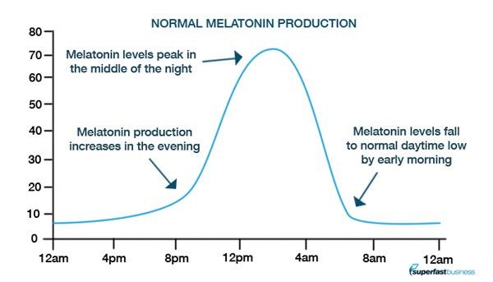
Restful Sleep
"If sleep doesn't serve some vital function, it is the biggest mistake evolution ever made.”
- Dr. Allan Rechtshaffen
Notes:
Now that we have talked about eating and about movement, we are going to spend some time talking about sleep. It probably does not come as a surprise that good sleep is incredibly important for health and well-being. Poor sleep puts people at significantly greater risk for problems like obesity, heart disease, stroke, type 2 diabetes, inflammation, and a weakened immune system. Poor sleep is also associated with depression, interpersonal conflict, impaired productivity and concentration, and emotional dysregulation. Essentially, sleep is important for everything in life.
As a healthcare professional, you have likely witnessed the effects that poor sleep has on the social-emotional functioning and health of patients. But chances are you have also experienced it firsthand. Despite preaching the importance of restful sleep for others, many of us as healthcare professionals still have difficulty getting adequate, high quality sleep. Situational factors can get in the way of good sleep, including having too many responsibilities, too little time, and taking the stress from work home with us.
In fact, sleep deprivation has been reported by many health professionals as one contributor to feelings of being overwhelmed and burnt out. (Rossi et al., 2020). Research has long supported the importance of using biobehavioral strategies, such as maintaining physical health, balanced nutrition, adequate sleep, exercise, or recreation to serve to buffer the effects of occupational fatigue and burnout (O’Halloran & O’Halloran, 2001; Pearlman, 1999; Zimering, Munroe, & Gulliver, 2003). In a recent study of burnout in intensive care personnel at a large hospital during the COVID-19 pandemic, one author recommendation was the use of wearable sensors that can monitor fatigue, stress, and sleep biomarkers and communicate this information to clinical unit managers so they can intervene as needed (Sasangohar et al., 2020).
In addition to sleep deprivation, other habits and behaviors can interfere with our bodies' natural circadian rhythms. When this occurs, we refer to it as poor sleep hygiene. It is generally recommended that adults get at least 7 hours of sleep per night. But quality and consistency are just as important as number of hours.

Slide 22
Sleep Hygiene Tips
avoid naps during the day
relaxing bedtime routine
limit stimulation before bed
consistent sleep/wake schedule
good sleep environment
screens
away + limit light exposure
quiet your mind
Pro Tips: Don’t try to go to sleep until you’re sleepy. Only set 1 alarm in the morning.
Notes:
Practicing good sleep hygiene can help promote consistent and high quality sleep. Good sleep hygiene looks a little different for everyone, but let's go over some general tips. (CLICK 1)
The first tip is to turn off screens and put away electronic devices at least 1 hour before bed. Electronics emit blue light that messes with your body's circadian clock by interfering with melatonin production. Melatonin is a natural hormone your body produces at night that helps you feel sleepy and drowsy. Any kind of artificial light messes with melatonin, but blue light is the most powerful disrupter. With that said, try to limit any kind of artificial light about an hour before bed so your body can start to produce the melatonin you need to fall asleep within a reasonable amount of time. (CLICK 2)
Tip number two is to maintain a consistent sleep/wake schedule, even on weekends. This can dramatically improve your sleep quality at night, as well as your energy level during the day. This is because it helps preserve the timing of your body's internal clock, which makes it easier to fall asleep, stay asleep, and wake up feeling alert and ready to go. People with irregular sleep/wake schedules report more irritability, drowsiness, mood swings, concentration and memory problems, headaches, and restlessness. It's reasonable to want to sleep in a little later on the weekends. However, in order not to mess with your circadian rhythm, try to keep your weekend bedtimes and waketimes within one hour of your weekday times. (CLICK 3)
Tip number three is to establish a relaxing bedtime routine. Having a routine that's the same each night helps your body learn that it's time to wind down and makes it easier to fall asleep. Your routine could include doing gentle stretches, meditating, journaling, or listening to calming music. Several meditation apps also have sleep stories or meditations that you can listen to. But if you are going to use an app, just be mindful of the blue light and limit the time you spend looking at the screen. Some people find it calming to read before bed. This is okay under two conditions: (1) the material is not so stimulating that you lie awake thinking about it after, and (2) you read on a cozy chair or couch rather than IN your bed. (CLICK 4)
The fourth tip is simple: to the extent possible, avoid taking naps during the day. Unless, of course, you are the parent of a newborn baby, in which case sleep when you can! Naps interfere with your body's natural circadian rhythm and make it harder to fall asleep at night, which throws off your sleep cycle entirely. If you are finding yourself frequently needing naps during the day, this may be a sign that your circadian clock is thrown off and requires a reset. You are likely going to bed too late—in which case gradually move your bedtime earlier, or getting poor quality sleep at night—in which case return to these sleep hygiene tips. (CLICK 5)
Tip number six is to limit stimulation within about two hours of bedtime. This includes stimulating substances, such as caffeine, nicotine, and alcohol, big meals, and exercise. Small snacks, water, and gentle stretches are okay. You should also try to avoid anything that's cognitively or emotionally very stimulating. That could include stressful work-related tasks, highly emotional conversations, and video games. All of these situations are highly arousing and can make it difficult to fall asleep. (CLICK 6)
The seventh tip is to create a good sleep environment and to use stimulus control. Optimal conditions for sleep are complete darkness and cool air temperature (around 65 degrees F). Some people find it helpful to use blackout curtains if they get a lot of external light in their bedroom. Stimulus control means that your brain and body associate being in bed with falling asleep. It helps make it possible for you to fall asleep within minutes of laying down in your bed. In order to achieve stimulus control, it is strongly recommended that you use your bed for sleep only. In other words, don't do work in your bed, watch TV in your bed, eat in your bed, or hang out in your bed. If you lay down to go to sleep, and after 20 minutes you are still awake, get out of bed (but stay in your room) and do something boring and low energy, like folding underwear. Once you notice yourself getting sleepy, go back in bed to try again. (CLICK 7)
Tip eight is to quiet your mind before bed. To do this, you might consider taking deep breaths or doing a brief meditative practice. You can do this on your own or use a guided recording.
And finally, here are a few extra pro tips: Don't try to go to sleep until you are sleepy. If your bedtime is too late, try moving it up gradually instead all at once. And only set one alarm in the morning for the time that you actually need to wake up. (PAUSE). Lastly, keep in mind that restful sleep actually begins in the morning. Expose yourself to bright light and happy music in the morning to help wake yourself up. Some brief energizing movement can also be really helpful. These strategies will help to reset your body's internal sleep/wake rhythm.

Slide 23
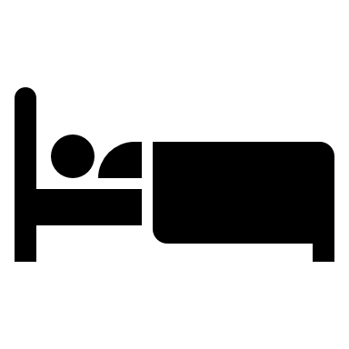
In-Session Activities
practice mindful eating
practice joyful movement
set goals for sleep
Notes:
We have included three activities with this lesson to help with feeling good physically, through nutrition, movement, and sleep.
Practicing mindful eating can increase our awareness of our own hunger cues, help us be aware of our personal habits, increase our enjoyment of food, and encourage exploration.
Practicing joyful movement guides you to engage in non-judgemental dancing exercise and helps you identify other joyful movement options you may want to do regularly.
Setting goals for sleep guides you through a basic process used in sleep studies to help individuals with chronic sleep problems, including insomnia, improve their sleeping environment and routine enough to improve quality of sleep, quantity of sleep, or both.

Slide 24
Recommendations
Complete one activity
Notes:
We recommend three next steps to take this information and apply it to your own well-being. First, please choose and complete at least one of the accompanying activities to practice mindful eating, practice joyful movement, or set goals for sleep.

Slide 25
Recommendations
Complete one activity
Identify one of the 3 habits to improve & share
Notes:
Our second recommendation is that you take any one of these practices and teach it to your practice partner—whether that is a colleague, spouse, friend, or family member. Whoever you selected. Go over the activity with them too, and then work to use the strategy in everyday life. Practice making your eating more mindful, your movement more joyful, or your sleep more restful.

Slide 26
Recommendations
Complete one activity
Identify one of the 3 habits to improve & share
Create individual action plan for that habit
Notes:
The third and final step is to set an intentional action plan of your own. Action Planning is a critical step whenever we try to start something new. It helps us identify our barriers, our strengths, and how we can recover from setbacks when they inevitably happen.
Thank you again for watching and engaging with this lesson. Take care.

