Slide 1
Adult Resilience Curriculum (ARC)
Three R's

Slide 2
Delivery & Tailoring Instructions
Prior to delivering, get information from audience about their current struggles and needs. Use that information to decide what should be tailored
To tailor, you can change the following:
Hook & Transition metaphors
Your “Who I Am” slide & credibility slides (referent, information, positive expert power)
Any of the background intro slides (if Module 1 has already been delivered)
The order of the slides (before activities)
Activities (based on time frame)
Knowledge Check questions
Discussion Questions
To make changes to the Activities, Knowledge Check Questions, and Discussion Questions, you can:
Hide the activities you do not want to do
Replace the knowledge check section of each final activity slide with the proper knowledge check question(s)
Delete whichever discussion questions you choose not to provide. Make sure these questions are provided in a follow up forum/document/delivered in-person by a member of the healthcare professional team after at least 1 week of practice.

Slide 3
Delivery & Tailoring Instructions
Make sure the tailoring is done to fit within the appropriate time frame
The structure and design of the powerpoint is actually based on a combination of successful TedTalks (that involved audience participation) and research on how to present to adults
This includes the Hook, Transition, Who I Am, and Audience Benefit slides
Limited text
Use of imagery
MINIMIZE reading text on slide; research indicates this actually disrupts audience comprehension
Set expectation for participation at the outset

Slide 4
Delivery & Tailoring Instructions
Things to remember
Expert power can be negative if audience portrays a) you are leveraging your expertise in one domain into another, b) if your expertise appears outdated, c) your expertise is impersonal (i.e., not recognizing the audience’s perspective), and d) if they portray you as having something to gain
What is comfortable for us, the presenter, is maybe not engaging for the audience.
Charismatic power is something; you are acting for your audience and that is encouraged. People will buy-in if you seem bought-in. Find the charisma personality that you can put on confidently.
Sell the “Why”, not the “what” or “how”. Those are ARC and the modules. But the “Why” is most important

Slide 5
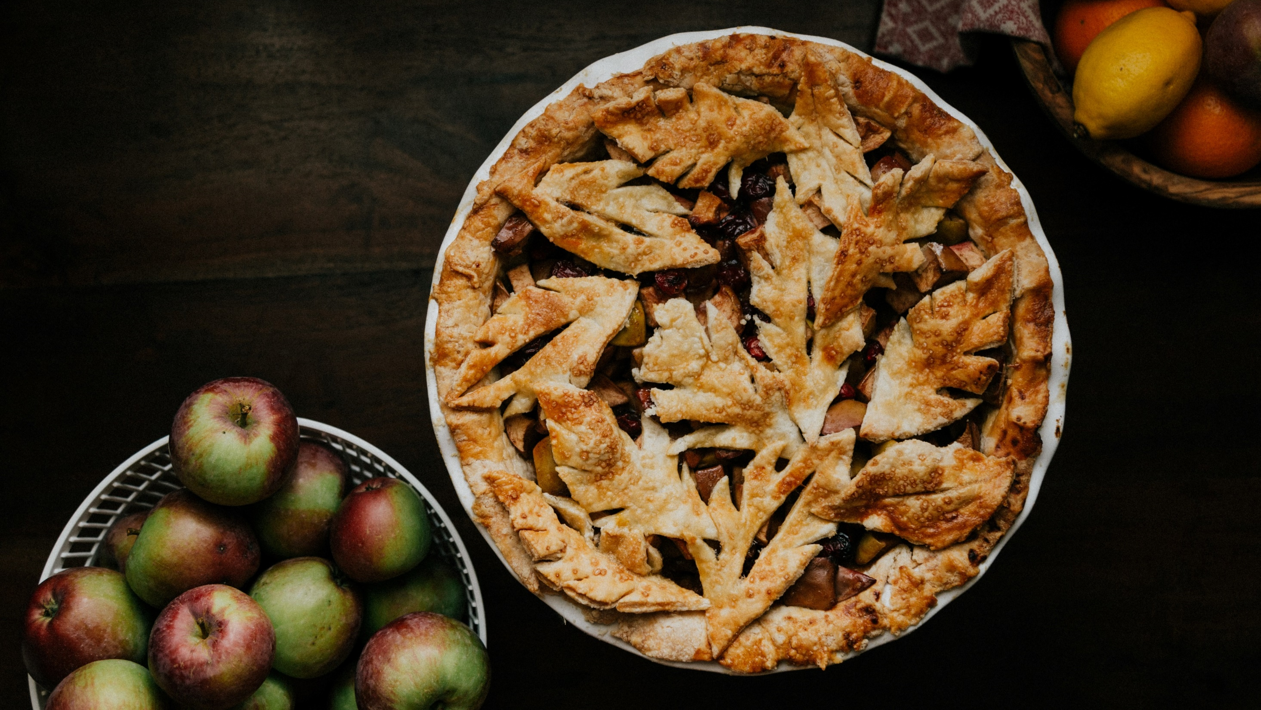
Notes:
The Hook
Pies can be a challenging to make. We can select from a huge variety of potential fillings, and everyone has their own preference for filling-to-crust ratio. Some people do not even like the crust! Toss in the fact that you have to bake it properly in order to make sure it has structure, and there are so many ways it can go wrong.
But so many ways it can go right, too. It all comes down to the baker’s personal preference and approach to find the right ingredients to include, the right recipe to follow, and to know when it’s necessary to go off-script and improvise upon the recipe.

Slide 6
Notes:
The Transition
Well-being is similar. We need the right mixture of ingredients that fits our current wants and needs, and to combine them in just the right way following a recipe that ensures that a well-being pie of some sort emerges. We can definitely go off-script from the recipe when mixing things together, but we have to be careful. It becomes really easy, if we aren’t intentional and thoughtful about it, to add too much of one ingredient, or to combine ingredients at the wrong time.
This module is going to draw attention to three particular ingredients: leisure activities, relaxation activities, and recreational activities. It discusses why all three are important and how easy it is for us, if we are not cognizant about it, to engage in one of those activities so much that our other activities get pushed out. Even if an activity on its own seems good—much like when making a pie having a lot of sugar for sweetness seems like a good idea—when we consider it relative to the whole well-being pie, it might actually be counterproductive.
To make sure we get a good balance of activities, we can follow routines, like a recipe, which help to ensure that the basic structure is there. We can improvise off that routine at any time and return back to it when we need to.

Slide 7
WHO WE ARE
Christian Klepper, PsyD, LP
Faculty Trainer
Notes:
Who I Am
*Replace with your photo, change name(s), make sure to highlight your credentials (expert), your area of expertise (expert, informational power)*

Slide 8
WHO WE ARE
Hannah West,
PhD, BCBA
Regional Trainer
Notes:
Who I Am (This is an example)
*Replace with your photo, change name(s), make sure to highlight your credentials (expert), your area of expertise (expert, informational power)*

Slide 9
The Adult Resilience Curriculum (ARC)
Notes:
As a quick reminder, the Adult Resilience Curriculum – or ARC – is transtheoretical and comprehensive, yet flexible. The ARC was originally developed in 2013 by Dr. Clayton Cook and Dr. Gail Joseph for pre-service and in-service teachers. It is designed to promote wellbeing and enhance people’s capacity for resilience. It builds upon the strengths of existing programs, while trying to make the content more accessible and feasible for real-world professionals in various disciplines. This curriculum is NOT designed to replace mental health services or treatment. to replace mental health services or treatment

Slide 10
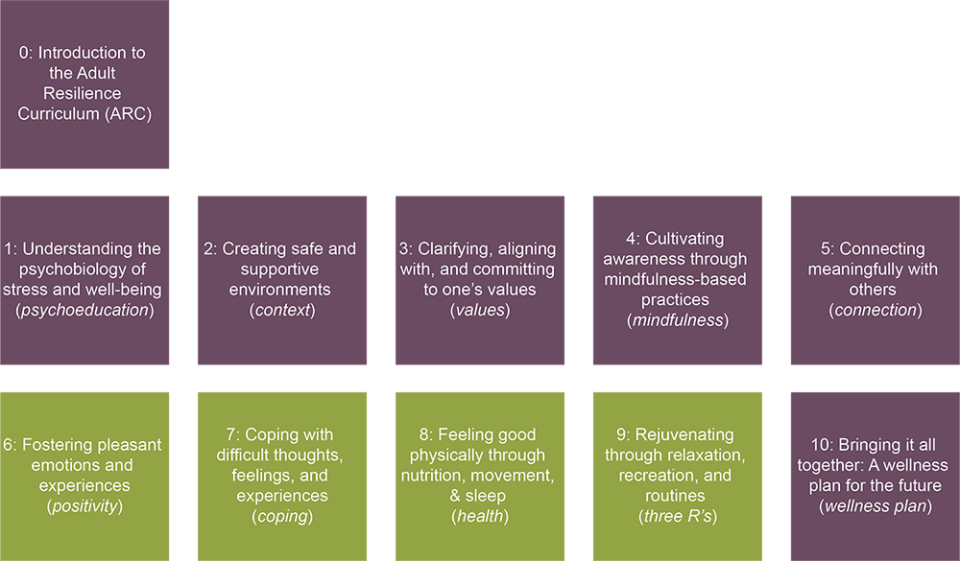
The ARC Modules
Notes:
This is the last of the supplemental modules, and like all the others, it is meant to enhance and support your practices. I like to think of this module as the foil, or balance, to all the other modules. Whereas all the other modules are focused on practices, cognitive-behavioral skills, and even philosophies for well-being, this module encourages us to lighten the load a bit and to remember to live a little.

Slide 11
Our Hopes for Today
Three R’s
Define the difference between relaxation, leisure, and recreation, and categorize different activities accordingly
Analyze your own personal routine to identify ways to modify it to your own benefit
Plan for routine changes in order to create more vitality in life
Notes:
Although it may seem like a simple thing, we are going to start with definitions about recreation and relaxation, and how relaxation is quite different to leisure, which many of us already incorporate into our lives. It's recreation and true relaxation that are more commonly difficult to keep in our lives.
Once we’re clear on definitions, then we will spend a little bit of time analyzing your own routines and then plan for those changes to routine that will help automate everything.

Slide 12
MODULE 9: Rejuvenating Through Relaxation, Recreation, and Routines
Notes:
As we said, many of us already have leisure activities. Yet, with our time constantly being pressed, we often drop recreation and truly relaxing activities that are just as vital to our well-being. Since we know that this is a common experience for people, it is safe to say that it isn’t an issue with willpower or motivation. Instead, it is that our general routine is not appropriate for our needs, or we have an inconsistent routine for our lives—in which case, do we have a routine at all?

Slide 13
Three R's Components
Environment Support for Well-being
Recreation & Leisure
Relaxation
Routines
Microhabits
Approaches to Time
Notes:
This module has several components to cover when thinking about recreation, relaxation, and supportive routines. Some of these are going to be about that importance of clarity in our definitions when talking about recreation or relaxation, whereas other components are more about perspectives or orientations toward time and mindsets needed to be successful in this area of our lives.

Slide 14
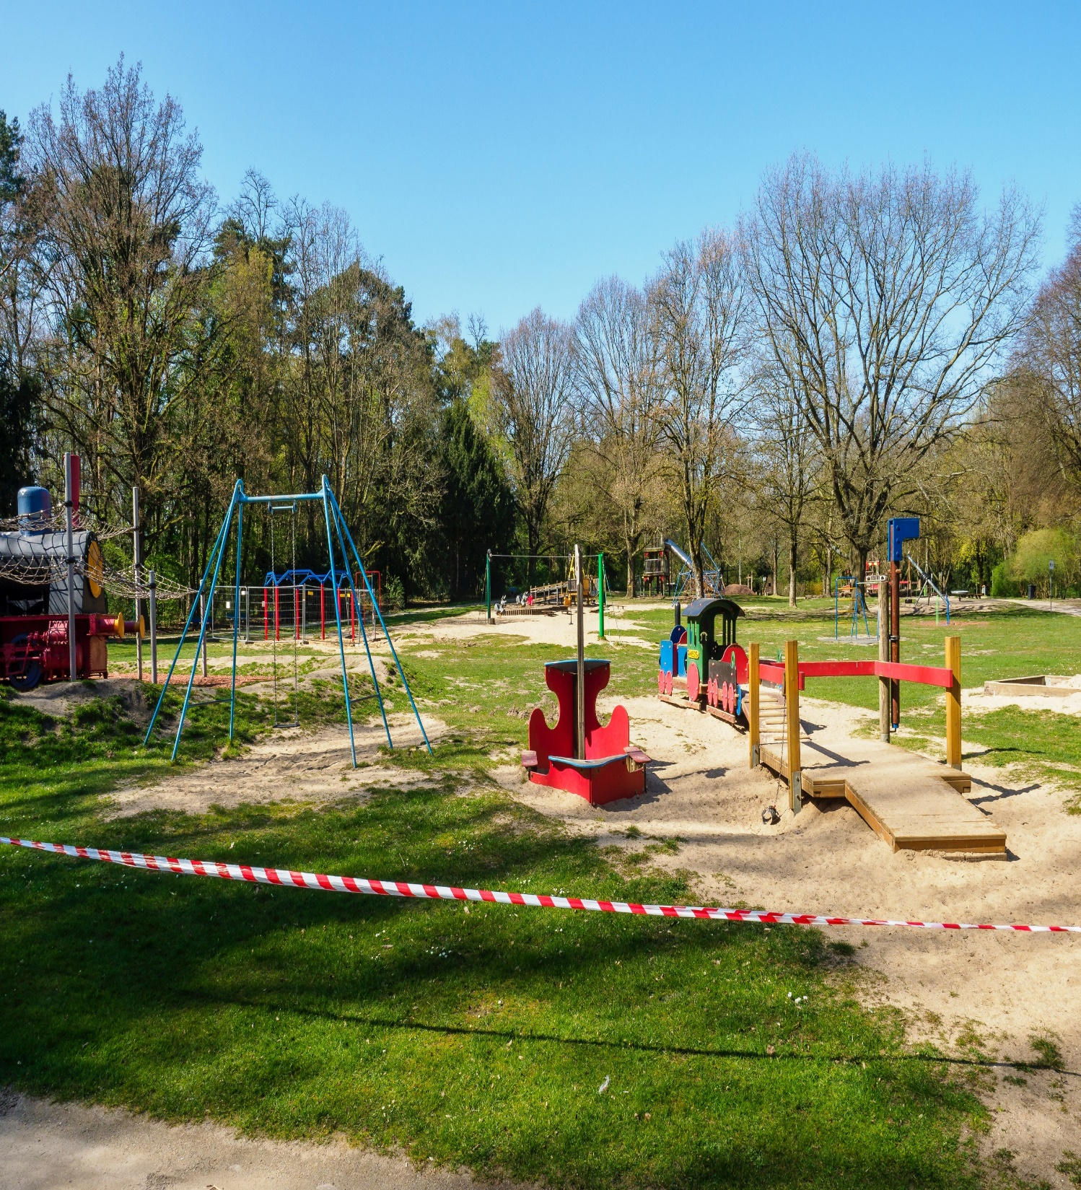
Environmental Support for Well-being
What is your playground?
Notes:
To start, we’re returning briefly to our discussion about the importance of the environment toward our well-being. In the Context module, we spoke about how environment creates the space for us to engage in well-being practices. If our space and time is clogged, and resources drained, we have little flexibility and freedom to engage in well-being. So our environment sets the possibility for well-being.
Our environment also sets the need for well-being. Dr. Bruce Alexander and his team set up a really interesting set of studies several years ago. They fueled rats' addiction to various substances and then split them into two groups. Both groups had unlimited access to the substance they were addicted to. But one group of rats was in a park of sorts—they have trees, sand, logs, toys, and other rats to play with. The other group had none of this. Which group of rats do you think continued to access the addictive substance? Those with a desolate evironment.
This study has been modified and replicated for decades with rats and people, and specifically for addiction treatment. Results vary but all generally support the idea that if the environment lacks means of engagement, people and animals exhibit unhelpful behaviors. And, of course, when stressed we tend to be more easily swayed by our emotions. If we don’t feel like doing something, even though we know it’s good for us (like getting out and doing a hobby we normally enjoy), we don’t.
The thing about the rats that thrived in their little rat parks is that they were primed for success by their environment. They were perfectly set-up to interact with others and play with their toys. Their baseline was a fun and supportive environment. And we can do the same. By making sure our environment is structured with helpful routines, and that we regularly relax and also have fun with recreational activities, even if we’re in a funk for a bit, we can recover.

Slide 15
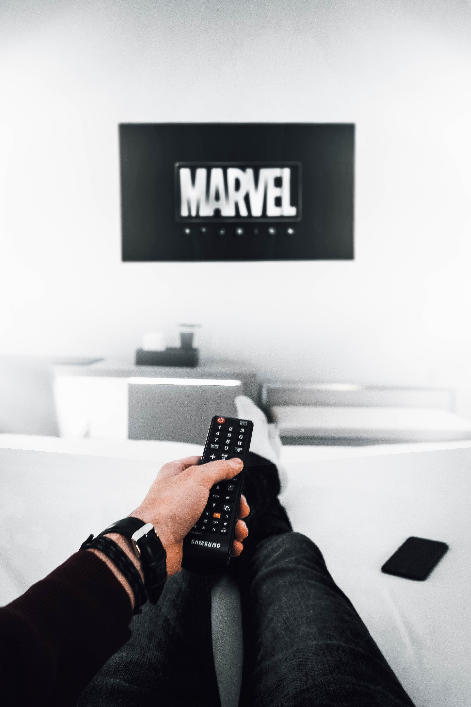
Recreation & Leisure
Recreation
Leisure
Notes:
What are some of your favorite hobbies, or things that you used to enjoy? Did they have an element of growth to them, like you were trying to master them? Or were they more for pleasure with no end goal in mind?
The first type of hobby is called recreation, like a recreational sport. The key characteristic of a recreational activity is this growth aspect. They give us a sense of accomplishment, and are often tied to some value because it’s that value that keeps us doing the thing when it gets hard. This is very different from a hobby where we care more about performing well—showing off or maybe even turning a profit with the skill. In those cases, people are likely to quit as soon as they start to struggle.
Nearly anything can be recreational. Sports, learning a new language, cooking, DIY projects, book clubs, brewing coffee, etc.
But in a fast-paced culture, filled with work, family, and other obligations, too much time spent on recreation can feel overwhelming. In order to obtain more balance, we set aside time for leisure. To be clear, most people seem to fall into one of two camps: too little recreation, or too much recreation.
Leisure is time free from obligations or “shoulds.” Typically, it does not include cooking, eating, cleaning things up, or any task that has a sense of urgency or completion to it. But some of those activities can be leisure. Are you cooking because you have to? Or are you cooking because you want to mix some ingredients and see what happens? Many recreational activities can be leisure depending on your intent with the activity. And many recreational activities become leisure activities once we are satisfied with our growth. The key is the lack of obligation, the guilt-free permission to do the activity without concern about other tasks and responsibilities.
One thing to be weary of is that leisure activities can turn into avoidance. An example is the increase in screen time for the average American. People are watching TV and playing video games more than ever, which can be leisure activities for many, but for others these activities turn into avoidance and distraction techniques. In those instances, their actual function runs counter to our well-being.

Slide 16
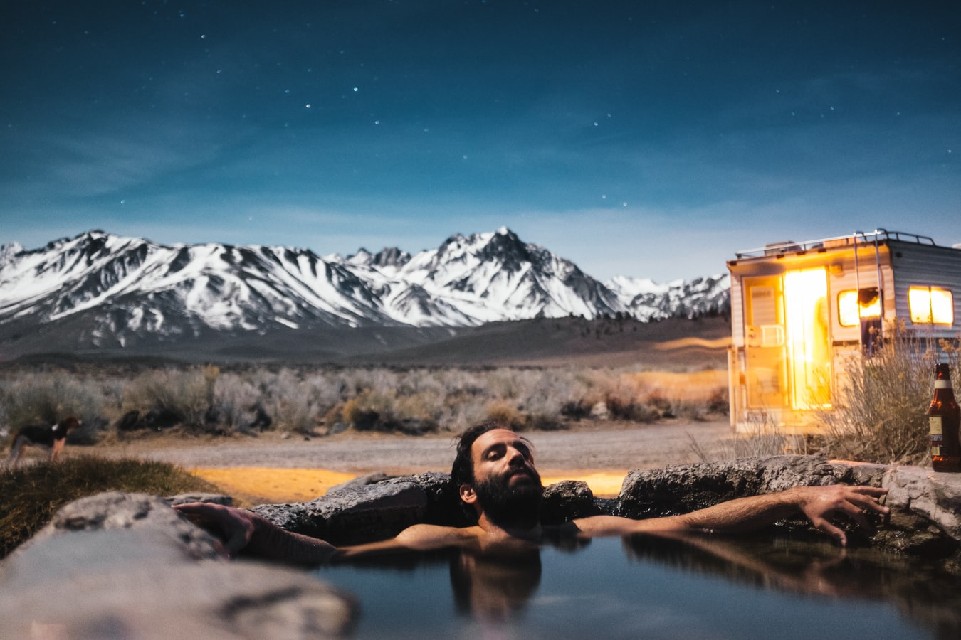
Relaxation
Relaxation is purposeful
Potential Activities
-- Yoga --
-- Meditation --
-- Mindful exercises --
-- Massage --
-- Passive music listening--
-- Sensory experiences --
-Aromatherapy--
--Steam rooms--
--Weighted blankets--
Notes:
Give yourself time to relax. This is different than recreation and leisure. It is similar to leisure in that it can be very soothing and is guilt-free. And it is similar to recreation in that there is purpose and intent behind the activity
The purpose of relaxation activities is to give your mind and body a rest. The distinction is easy using non-examples. Some people find watching TV or reading a book “relaxing.” But this is not relaxing in the sense we mean. Those are leisure activities. Guilt-free, pleasurable activities. But they do not give our minds and body time to rest, process the wear and tear from our days, and refresh. Ever watched a show but still felt like your mind was racing the whole time? Or maybe you went for a walk and came home only to still be ruminating on a thought or you were irritable? Your mind and body were still revved up and not present.
Think of relaxation like turning off your computer; if you let it go to sleep mode, it still has to hold and process all your opened tabs and applications running. But if you shut it down completely, it can stop processing and reboot, which is sometimes needed to update software and clean out your computer
Relaxation is time dedicated to giving the body and mind a chance to offload that stress. Activities include:
Types of Yoga
Meditating
Mindful walking/exercising
Getting a massage
Listen to soothing music (try instrumental)
Sensory experiences
Aromatherapy (lavender is a research-based scent for relaxation)
Steam room
Weighted blanket

Slide 17
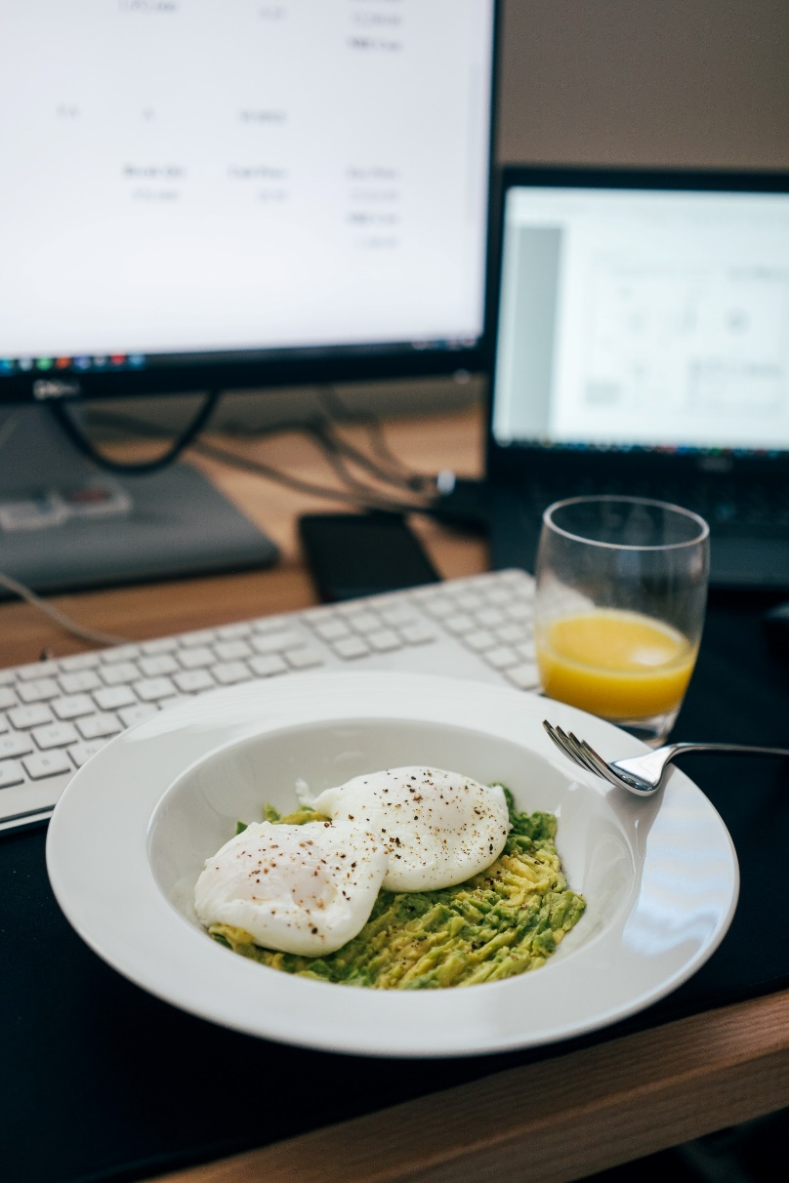
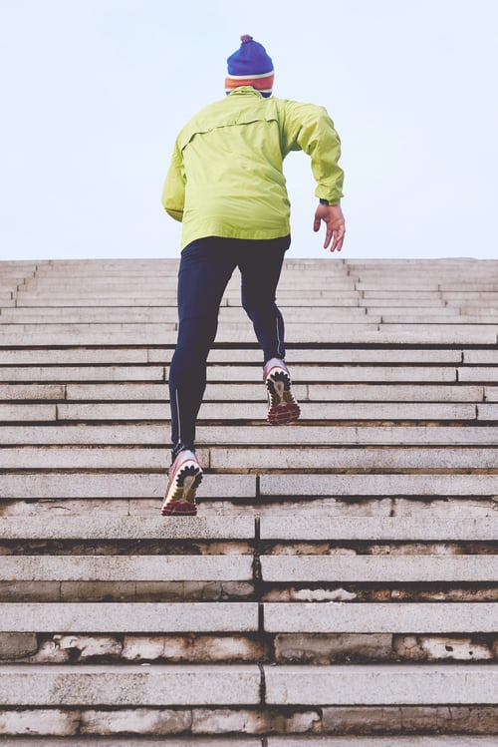
Routines
Notes:
Finding time to engage in recreational and relaxation activities can feel challenging amidst our already busy schedules. Many of us may not feel motivated to engage in them either. A common belief is that motivation is needed before an action. However, that is not true. Motivation is fleeting--it comes and goes. What people experience as motivation is often the combination of habit and a supportive environment. We can use this to our advantage by creating routines.
Routines might feel like a constraint and another obligation. We like to think of them as nets. If your scale is unbalanced and tipped toward stress, even if you add in well-being practices, they’ll slide off the scale unless you do a lot, which is unsustainable. Routines cast a net around your habits so they do not fall. You can still be creative and change up the activities that you add, and can be strategic about when to break from that routine.
You may be thinking, “I have to schedule in my relaxation and leisure time? My sleep?” Yes and no. You pick what you schedule and the schedule gives you the support to push back against the stress of life. For example, you may not do much relaxation right now. That’s okay. A routine that schedules it in, even when you're not feeling motivated, helps you get into practice and develop the habit. Once it becomes a habit, you will feel the motivation to set aside relaxation activities and can be flexible when to do it, allowing you to then focus on having a routine with other practices.

Slide 18
Microhabits
The compound interest of your life
Notes:
The best way to set up a routine with practices is to start with microhabits.
Most healthcare professions are achievement-focused people. This is both a strength and also a burden to our well-being. High achievers often have lofty aspirations for self-improvement. But big goals — such as “meditate for an hour every day,” or “read more” — are often more burdensome than they are sustainable. So, start small by focusing on “microhabits” — more achievable behaviors that you build over long periods of time. These habits should be ridiculously small, like meditating for 30 seconds or reading a paragraph each night. To minimize effort, piggyback on a daily task. Perform your new action at the same time as (or right before) something you already do every day. Read that one paragraph while brushing your teeth. Meditate while waiting for your coffee to brew. Then, track your progress, but keep it simple. Try using a “yes list” where you write down the desired action, and under each date simply note a "Y" or an "N" to indicate if you completed the task. Once you’ve accrued several weeks of "Y"s, you can increase your microhabit by a small increment, say 10%. Continue these tiny, incremental adjustments until the new habit is part of your muscle memory. By starting small, you can achieve big results.
So with recreation, if you had a hobby of yours fall to the side, build it back in. Try it for 10 minutes every other day (depending on the hobby). Haven’t done some relaxation lately? Give yourself just 3 minutes every night before bed to sit in silence.

Slide 19
Approaches to Time
Commodity
Process
Notes:
We've gone over some concrete strategies and new ways of thinking or organizing your life. And there is one more thing to talk about that is the foundation for this whole discussion, something that is implied and we want to bring into the light for reflection. That “thing” is how view time. This is a tricky subject, as cultures view time quite differently. In order to be culturally-responsive and flexible, we are going to finish the lesson portion of this module discussing two views of time and how those views might influence how we approach our Three R’s.
Some cultures, like most mainstream Western cultures, tend to view time as a commodity. It is structured, finite, and meant to be used efficiently. Airline scheduling is a great example of a commodity perspective. There are only so many flight slots and everything has to be planned accordingly to run smoothly. Information is displayed on a computer, with the very screen space itself is treated like a commodity with flight times divided into equal rows of information. Our goal here is to meet our flight deadline. If you take off late, the pilots will speed up the flight to get your there on time, even if that increases wear and tear on the plane itself. Everything is about order and efficiency, even if that sacrifices other things.
Other cultures view time as a process, something that is ongoing and flexible. Look at this hourglass. It is less precise than the flight times. We do not know the time of day, hour, minute that this hourglass is tracking. We don’t even know how much time the hourglass represents—could be 60 seconds or 60 minutes. But it represents SOME amount of time.
Mainstream Western work culture, especially those in healthcare with many back-to-back appointments each day, imposes a structure to our time--we have our work time, and our free time. This can be further complicated by the addition of insurance procedures and reliance on "billable time" that heavily impacts the way we view our time. This doesn’t allow for a more process-focused, flexible view of time which may be more beneficial for our mental health. And in some instances, we may actually want that commodity perspective because that benefits our professional and financial well-being.
We’re suggesting a bit of a mainstream cultural shift that finds some harmony between these two dominant perspectives. For some of us, we may become stressed if we are not engaging in the most “optimal” practices, or our routine isn’t “optimal” and therefore we stress ourselves out. In this instance, it may help to adopt a process-focused view of time; get engaged in something, be reflective, and do not worry about how long you are engaged with it. Just be. For others, they may actually not be thriving because their routine isn’t optimized. They may find themselves engaged in activities that are passive or bring little value, and they may benefit from answering the question, “Just how do I want to be using my time?”. So we don’t recommend either view, but instead be aware of the ways in which culture and society impose particular views of time onto us, and for us to advocate for when one perspective is more beneficial for us than another.

Slide 20
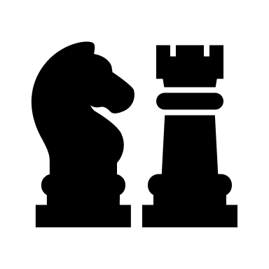
In-Session Activities
Game of life
weekly activity mapping & rating
Notes:
There are two activities associated with this lesson for you to consider practicing. The first activity is called Game of Life. In this activity the game board represents your destiny. It is randomly chosen for you. But then, you get the opportunity to choose your outcomes. So many people go through life as if everything is a roll of the dice. But we can find little bits of choice in between the things we cannot control. How can you take control of your recreational, relaxation, and leisure time?
The second activity is weekly activity mapping and rating. How do you spend your time? This activity helps you track what you are doing and how it makes you feel.

Slide 21
Recommendations
Complete activity
Notes:
We recommend three next steps to take this information and apply it to your own well-being. First, please choose and complete at least one of the accompanying activities to identify your values. Do this so that you can experience how choosing relaxation, recreational, and leisure time can actually be incredibly helpful and beneficial to your overall well-being.

Slide 22
Recommendations
Complete activity
Teach an activity
Notes:
Our second recommendation is that you take any one of these practices and teach it to your practice partner—whether that is a colleague, spouse, friend, or family member. Whoever you selected. Go over the activity with them too, and then work to use the strategy in everyday life.

Slide 23
Recommendations
Complete activity
Teach an activity
Create individual action plan
Notes:
The third and final step is to set an intentional action plan of your own. Action Planning is a critical step whenever we try to start something new. It helps us identify our barriers, our strengths, and how we can recover from setbacks when they inevitably happen.
Thank you again for watching and engaging with this lesson. Take care.

