Slide 1
Adult Resilience Curriculum (ARC)
Fostering Pleasant Emotions & Experiences

Slide 2
Delivery & Tailoring Instructions
Prior to delivering, get information from audience about their current struggles and needs. Use that information to decide what should be tailored
To tailor, you can change the following:
Hook & Transition metaphors
Your “Who I Am” slide & credibility slides (referent, information, positive expert power)
Any of the background intro slides (if Module 1 has already been delivered)
The order of the slides (before activities)
Activities (based on time frame)
Knowledge Check questions
Discussion Questions
To make changes to the Activities, Knowledge Check Questions, and Discussion Questions, you can:
Hide the activities you do not want to do
Replace the knowledge check section of each final activity slide with the proper knowledge check question(s)
Delete whichever discussion questions you choose not to provide. Make sure these questions are provided in a follow up forum/document/delivered in-person by a member of the healthcare professional team after at least 1 week of practice.

Slide 3
Delivery & Tailoring Instructions
Make sure the tailoring is done to fit within the appropriate time frame
The structure and design of the powerpoint is actually based on a combination of successful TedTalks (that involved audience participation) and research on how to present to adults
This includes the Hook, Transition, Who I Am, and Audience Benefit slides
Limited text
Use of imagery
MINIMIZE reading text on slide; research indicates this actually disrupts audience comprehension
Set expectation for participation at the outset

Slide 4
Delivery & Tailoring Instructions
Things to remember
Expert power can be negative if audience portrays a) you are leveraging your expertise in one domain into another, b) if your expertise appears outdated, c) your expertise is impersonal (i.e., not recognizing the audience’s perspective), and d) if they portray you as having something to gain
What is comfortable for us, the presenter, is maybe not engaging for the audience.
Charismatic power is something; you are acting for your audience and that is encouraged. People will buy-in if you seem bought-in. Find the charisma personality that you can put on confidently.
Sell the “Why”, not the “what” or “how”. Those are ARC and the modules. But the “Why” is most important

Slide 5
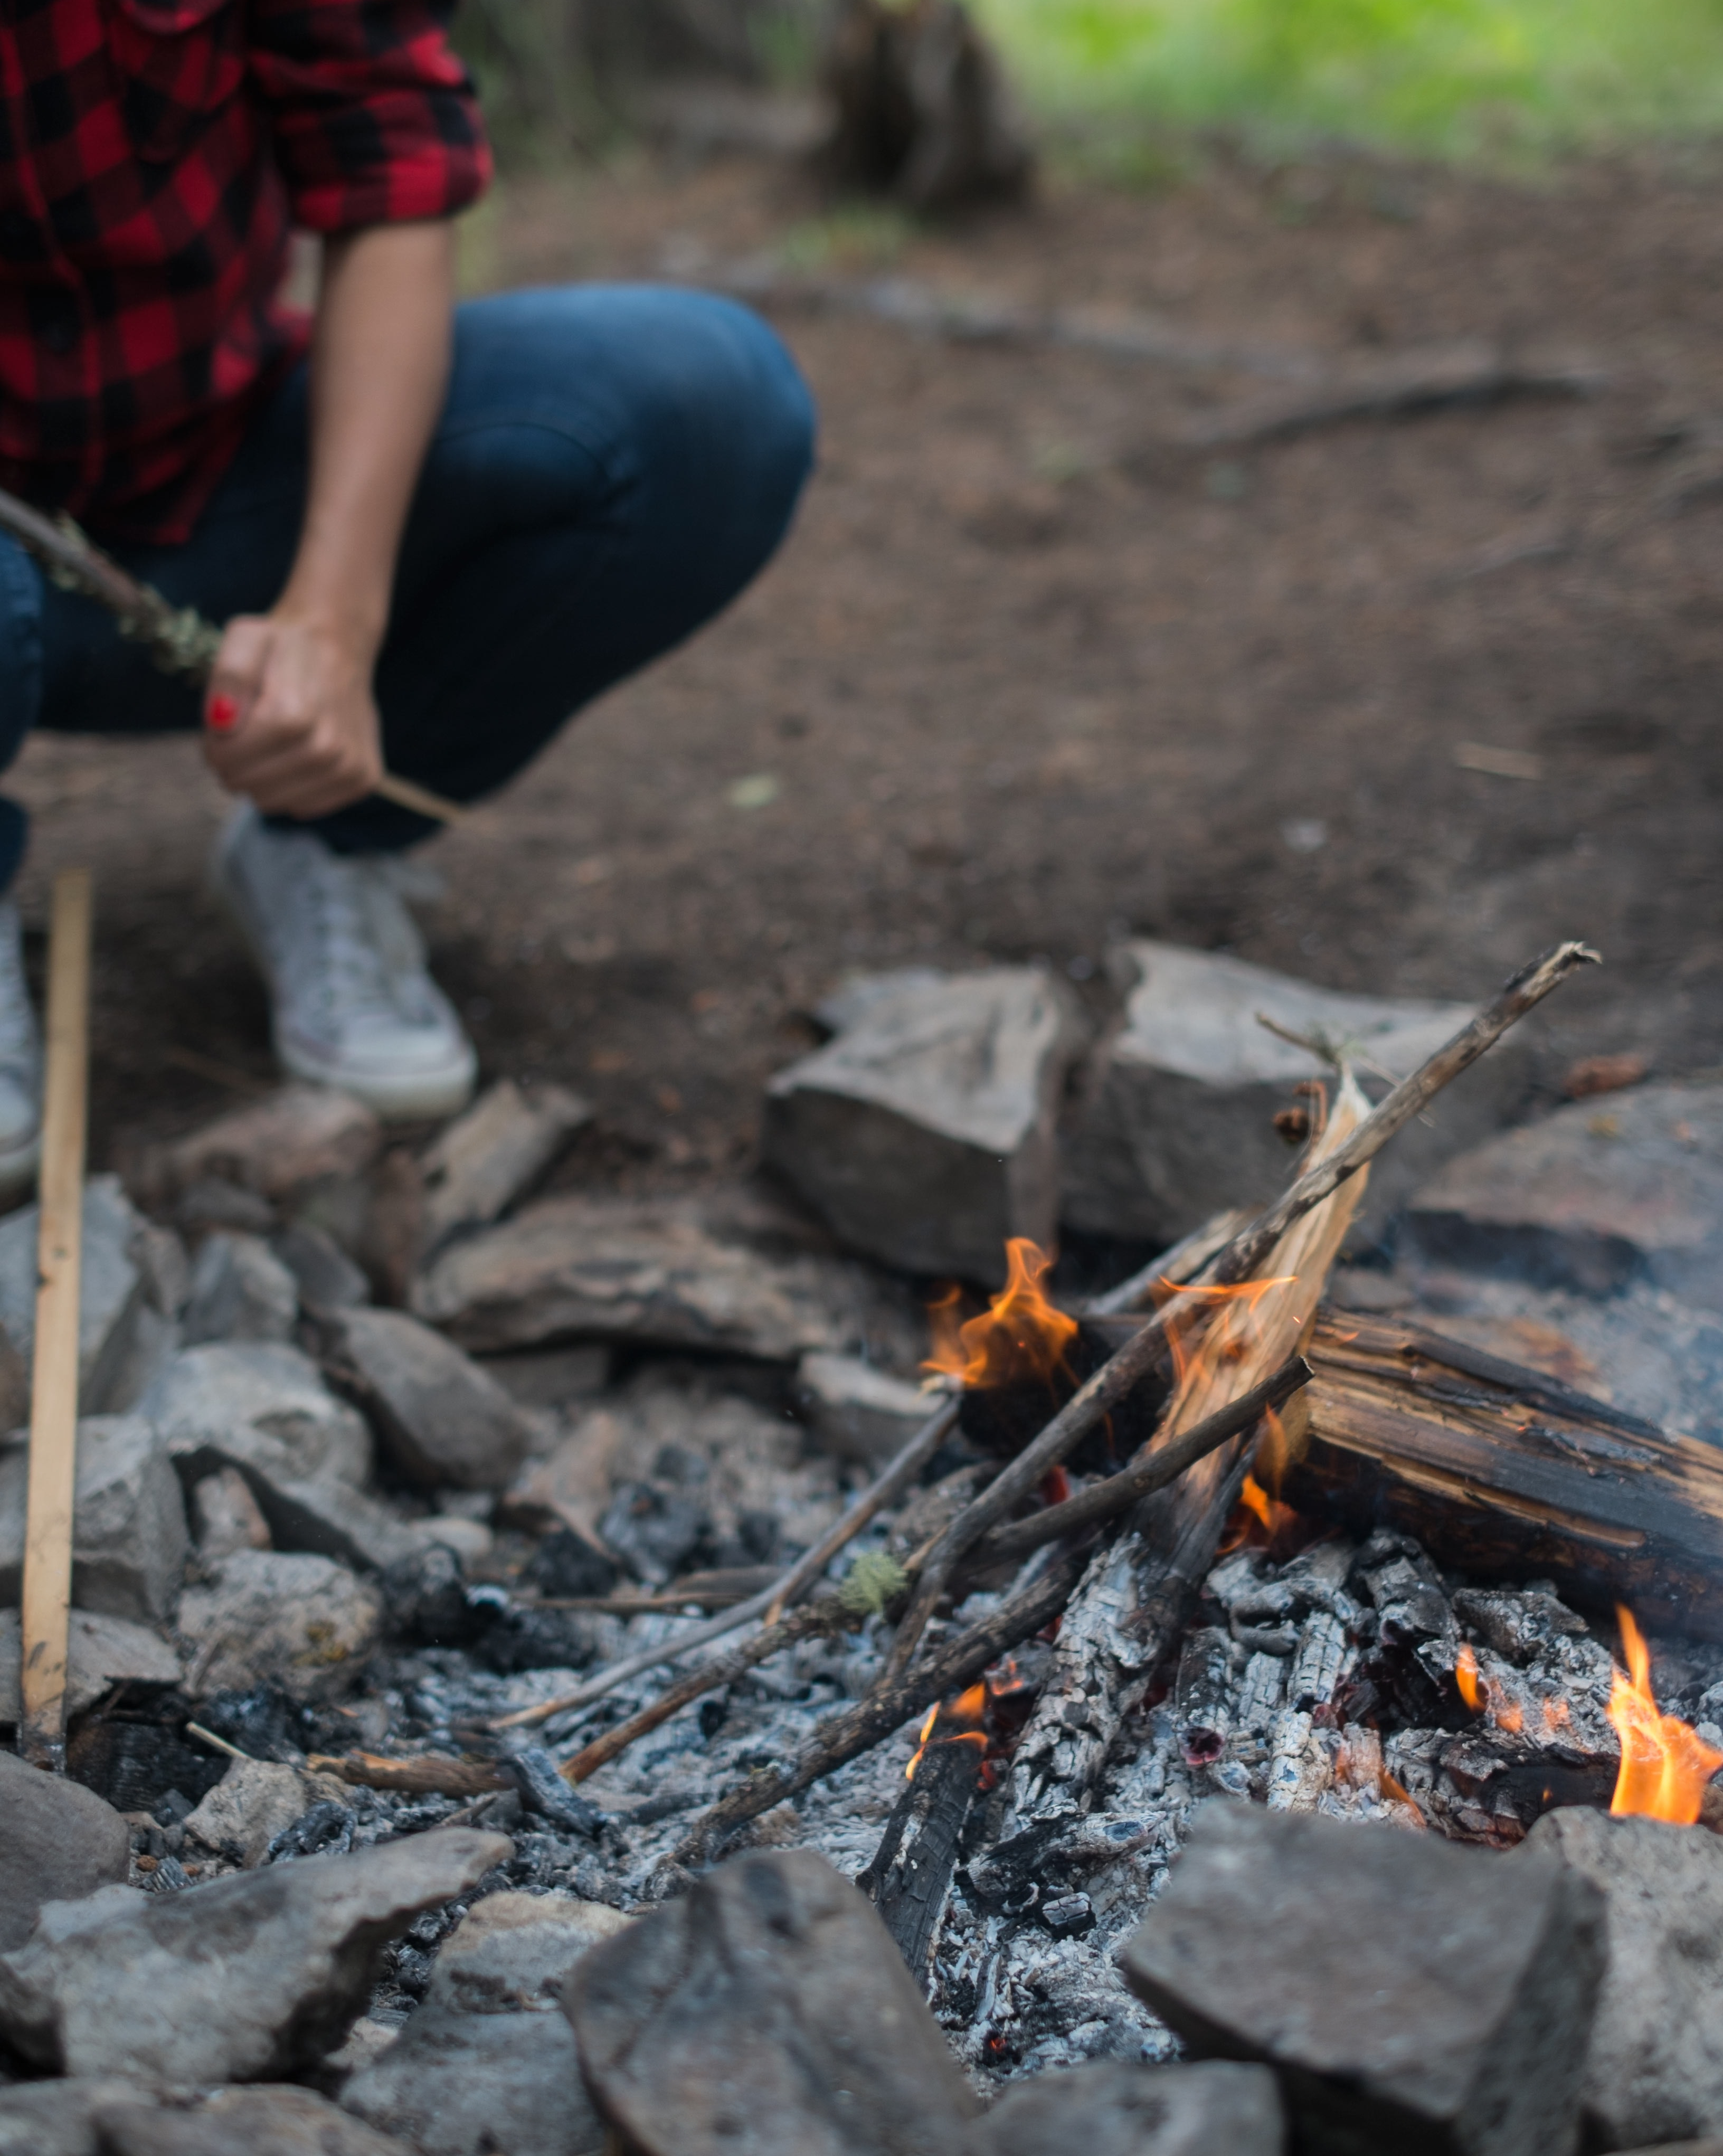
Notes:
The Hook
*Use or replace with your own metaphor or concept that illustrates connection*
I have always loved campfires. To this day, the smell of burning wood sends cascades of positive memories, of people sitting around together, chatting, singing, roasting marshmallows, feeling...joyful. In addition to the joy of sitting around a campfire, there is something very special about the act of building one. Unlike the fancy electric fireplaces or gas firepits, starting a campfire requires intention, patience, and skill.

Slide 6
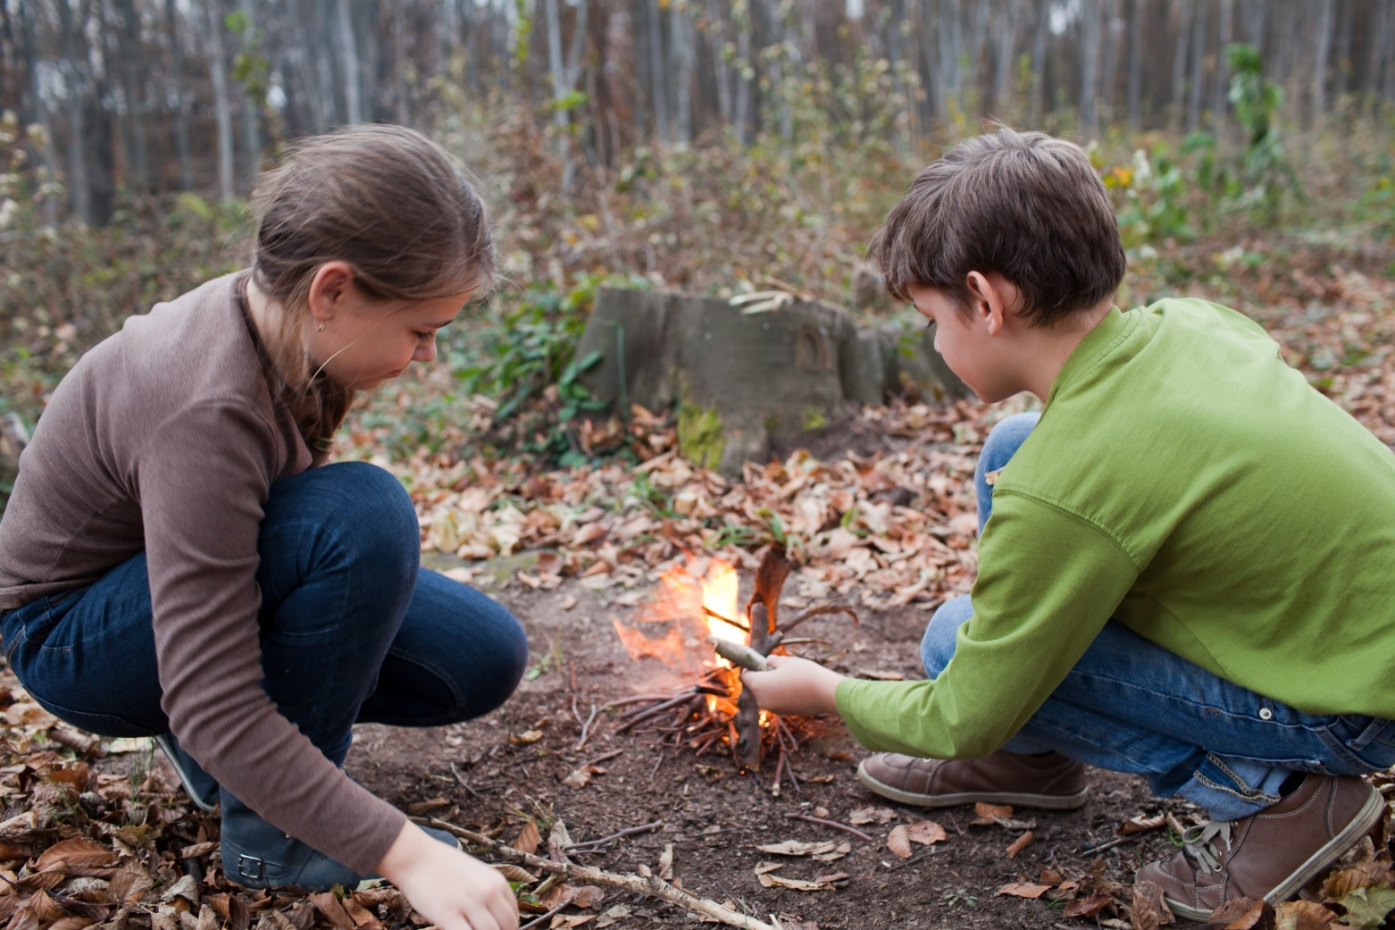
Notes:
I first learned to build a fire as a kid. I would spend hours going out and gathering the right kind of sticks and kindling. I'd then use the sticks to build a pyramid, with kindling down below. And I'd work the flint stone until I had sparks. Eventually, I'd have a roaring, cackling, campfire to enjoy. But it took time and effort to get there.

Slide 7
Notes:
When we see people sitting around a campfire, we might think about the experience, but we usually don't think about the effort or intentionality that it took to build the fire.
This is of course, just a metaphor. For me, campfires evoke pleasant emotions like joy, comfort, and fun. But more importantly, pleasant emotions are like campfires; you need the right materials, focus, and nurture to build a roaring fire that lasts.
What starts as a small spark can build and spread with time and attention. It begins to not only warm you but those around you, just as a campfire warms you and those with you.

Slide 8
Notes:
The Transition
Have you ever been around someone, or maybe you are that person, that seems to illuminate with positive energy that elevates others around them? Do you think that is natural or something practiced? I argue that it is something they intentionally practice until it has become habit.
Of course, certain conditions lend themselves better to building that positive affect, just like certain conditions lend themselves better to effectively building a campfire. Damp wood, lack of resources, and wind can make it trickier. Nevertheless, it's still possible—and arguably more important—to succeed when faced with these conditions.
As a society, we want the electric firepit equivalent of pleasant emotions. We want to be able to hit a button and have roaring flames of happiness instantly. We want it without thinking. But we all know it’s not this easy. Cultivating pleasant emotions requires intention, patience, and commitment.
** Pause **
And while there are certain conditions that can get in the way, like hardship or trauma, pleasant emotions can generally be cultivated under most circumstances. In fact, difficult circumstances are often when we rely on pleasant emotions the most.

Slide 9
WHO WE ARE
Christian Klepper, PsyD, LP
Faculty Trainer
Notes:
Who I Am
*Replace with your photo, change name(s), make sure to highlight your credentials (expert), your area of expertise (expert, informational power)*

Slide 10
WHO WE ARE
Hannah West,
PhD, BCBA
Regional Trainer
Notes:
Who I Am (This is an example)
*Replace with your photo, change name(s), make sure to highlight your credentials (expert), your area of expertise (expert, informational power)*

Slide 11
The Adult Resilience Curriculum (ARC)
Notes:
As a quick reminder, the Adult Resilience Curriculum – or ARC – is transtheoretical and comprehensive, yet flexible. The ARC was originally developed in 2013 by Dr. Clayton Cook and Dr. Gail Joseph for pre-service and in-service teachers. It is designed to promote wellbeing and enhance people’s capacity for resilience. It builds upon the strengths of existing programs, while trying to make the content more accessible and feasible for real-world professionals in various disciplines. This curriculum is NOT designed to replace mental health services or treatment.

Slide 12
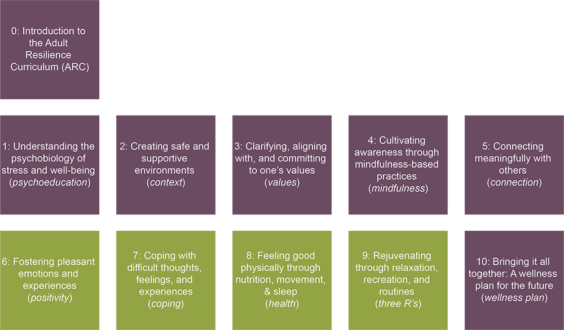
The ARC Modules
Notes:
This module is the first of the supplemental modules. “Supplemental” should not be confused with “unimportant.” Instead, think of the core modules – those that focused on context, values, mindfulness, and connection – as necessary for intentionally fostering pleasant emotions and experiences, and supplemental modules as enhancements that integrate the core modules.

Slide 13
MODULE 6: Fostering Pleasant Emotions & Experiences
Notes:
With this module, we are focusing on building that fire of positive emotions and experiences even in difficult times.

Slide 14
Positivity
Our Hopes for Today
Explain the science behind positive emotions and experiences, and the role
of attention, connection, gratitude, and flow in cultivating them
Know and apply discrete strategies for fostering pleasant emotions and experiences, and how to adapt them during crises
Create a personalized action plan to increase the frequency of pleasant emotions and experiences in your life
Notes:
Here are our hopes for today. First, we will unpack some of the science behind pleasant emotions and experiences. We’ll highlight the important role of things like selective or directed attention, connection, gratitude, and flow and the importance of cultivating them.
Then, we will help you learn and apply discrete strategies for fostering pleasant emotions. We will focus on how we can do this during difficult times, including a global pandemic.
Finally, we will help you to create a personalized action plan to experience more pleasant emotions in your daily life.

Slide 15
Positive Psychology
“
Positive psychology is the scientific study of what makes life most
worth living.
(Peterson, 2008)
“
PERMA Handout
Notes:
The goal of positive psychology is to help people flourish and live their best lives. To do so, there’s a focus on understanding concepts like optimism, life satisfaction, happiness, well-being, gratitude, compassion, self-esteem and hope.

Slide 16
Positive Psychology & the PERMA Model
Positive Emotion. Feeling good, positive emotions, optimism, pleasure and enjoyment
Engagement. Fulfilling work, interesting hobbies, "flow"
Relationships. Social connections, love, intimacy, emotional and physical interaction
Meaning. Having a purpose, finding a meaning in life
Accomplishments. Ambition, realistic goals, important achievements, pride in yourself
Notes:
Martin Seligman is considered a founding father of positive psychology. He created the PERMA theoretical model of happiness. The PERMA acronym includes Positive Emotion, Engagement, Relationships, Meaning, and Accomplishments.
PERMA emphasizes people being engaged in their work, developing positive relationships, finding meaning, and then setting and achieving goals within that meaning. You may notice that a lot of these elements of PERMA already overlap with the core modules of ARC. Relationships and connections are both emphasized. Engagement is as well, although we connect engagement with the research and practice on mindfulness. Meaning and achievement come through our values and goals. And so this module addresses positive experiences.

Slide 17
positive emotions go beyond “happy”
Joy
Inspiration
Relief
Contentment
Euphoria
Amusement
Love
Gratitude
Cheer
Awe
Admiration
Curiosity
Surprise
Affection
Enthusiasm
Interest
Serenity
Pride
Altruism
Satisfaction
Hope
Optimism
Notes:
Positive emotions go beyond “happy.” There are so many emotions and related experiences that fall under the umbrella of positivity. Beyond feeling “happy,” positive emotions...
Benefit us and those around us,
Are "contagious,"
Can be cultivated (even during stressful times),
And allow us to access "resources," (such as knowledge, strength, and creativity) that help us persist through life's challenges.
One way to cultivate pleasant emotions related to our work in the healthcare field is to focus on compassion satisfaction and celebrate the positives of helping others. “There can be terrible things going on, but focus on the wins,” suggests Dr. Kerry Schwanz, citing the celebrations health-care professionals hold when patients with COVID19 come off ventilators (Clay, 2020).
Working in healthcare can lead to compassion fatigue, or emotional and physical exhaustion that results from dealing with people in distress. Over time, that can lead to a diminished ability to empathize with or feel compassion for others (Ellwood et al., 2011).
Compassion Satisfaction is negatively correlated with and may actually counterbalance effects of compassion fatigue (Stamm, 2002). It includes (1) The level of satisfaction that a person derives from their job; (2) Levels of competency and control that health professionals feel they have over the traumatic material they are exposed to; and (3) the Level of positive support from colleagues that a person has (Stamm, 2002). Compassion Satisfaction is the perceived rewards of and gratification from caring for others.

Slide 18
Notes:
Language can be tricky and sometimes when we use words like “positive” and “negative,” we automatically associate them with good and bad. That is not necessarily the case.

Slide 19
Notes:
Remember in basic math when you first learned about positive and negative signs? A positive sign simply meant you added the number and a negative sign meant you subtracted the number. Positive and negative numbers were not good or bad. It is the same idea with emotions and how they affect behavior.

Slide 20
Broaden & Build
According to Fredrickson:
Positive
Emotions
Attention
Behavior
Notes:
Positive emotions add to, or broaden, our attention and behaviors. An example that works for me is thinking about finding new music; if I come across a song from a new artist and I really enjoy it, what am I likely to do? I am probably going to seek out more of that artist’s music. So my attention expands and I “do more.”

Slide 21
Broaden & Build
According to Fredrickson:
Negative
Emotions
Attention
Behavior
Notes:
Alternatively, negative emotion is one that motivates us to restrict our attention and behavior. We take away and “do less”.

Slide 22
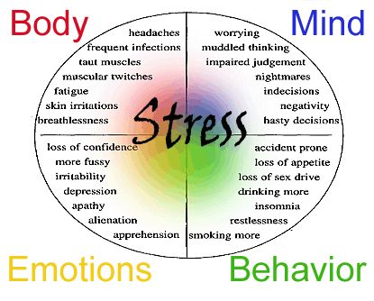
Broaden & Build
According to Fredrickson:
Negative
Emotions
Attention
Behavior
Notes:
Normally, this is a response to a stressor that we want to solve, and we need to focus our behavior toward that problem. We will talk more about negative emotions later, but think of the restriction of music that occurs when you hear a song that you don’t like. You will likely be less likely to seek out that artist’s music or be less open to listening to their other songs.

Slide 23
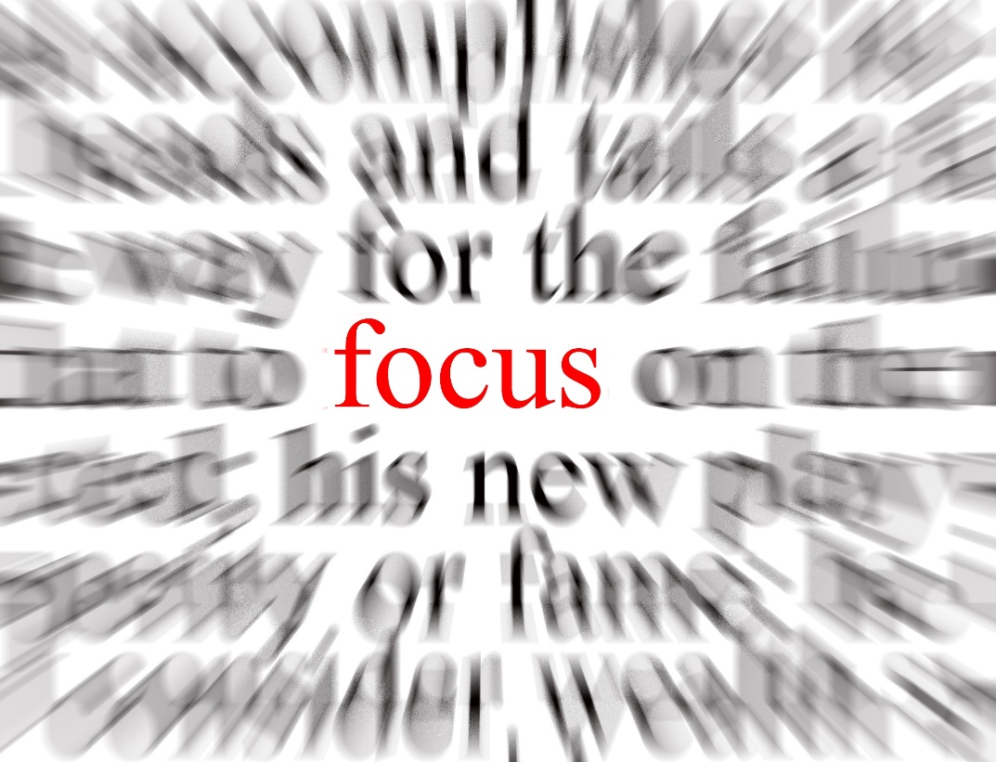
Attention + Gratitude
“That which takes possession of our mind”
We're hardwired to notice negatives
Results in behavior that is disconnected to our values
We are NOT victims of our attention
We can recalibrate our brains to attend more to positive
Notes:
Our attention is “hardwired” to notice negative things for the purpose of survival. We need to be able to focus on and react to something within our environment, whether through an immediate fight-or-flight response or using our brain’s incredible ability to predict and problem-solve long-term problems. If you feel like you are submerged in negativity, that’s actually normal brain functioning. It’s the opposite—seeing positives and attending to the good in our lives—that takes work.

Slide 24
Attention + Gratitude
Key Elements:
Mindfulness
Reflection
Notes:
You can exercise agency over where you put your attention. Practicing mindfulness in your daily life and attending to the positive can become habits. There are several ways to orient our attention toward positive experiences and one of the best ones is regular gratitude practice.
The two key elements of gratitude are being mindful and intentional while expressing gratitude and reflecting on how life would be different without that person, thing, or experience.
A basic practice approach is, at night perhaps as you go to bed, think of one person you interacted with that day and reflect on how your day would be different had you not interacted with them. After that is clear, then say a simple “thanks” to yourself.

Slide 25
Attention + Gratitude
Increases life satisfaction & well-being
Lowers levels of reported stress, anxiety, and depression
Associated with better physical health and lower rates of illness
Deeper processing → greater benefits
Notes:
The benefits of a practice like this and other gratitude acts include:
Feeling more satisfied with life,
Feeling more optimistic,
Better managing challenging situations,
Fewer illnesses
Better sleep
And the ability to think more clearly

Slide 26
Flow
“
…being completely involved in an activity for its own sake. The ego falls away. Time flies. Every action, movement, and thought follows inevitably from the previous one, like playing jazz. Your whole being is involved, and you’re using your skills to the utmost.
- Mihaly Csikszentmihalyi
“
Notes:
Let’s talk about a very special positive experience. If you have ever “been in the zone” while playing a sport, game, or instrument, or while writing, reading, cooking—really, any activity, you may have been experiencing flow. It is a real state of mind characterized by a loss of sense of self and time, low awareness of anxieties and concerns, lack of self-judgment, high contact with the present moment (or mindfulness), and high relative performance. We find our flow when doing something that is meaningful to us internally. There is a motivation that is not driven by external recognition and rewards like money and fame (although those might still be present). Our attention is on the act itself – because flow is experienced when whatever act we are doing is sufficiently challenging and requires our best selves. This match between challenge and our ability to meet that challenge is what creates flow. Watch a musician during their solo, eyes shut and soul being poured into their music, and you can see flow in action. We can all find flow with some planning and intent.

Slide 27
Strategies to Spark Joy
01.
02.
03.
04.
05.
06.
paying attention to the positive
practicing gratitude
doing acts of kindness
connecting with others
experiencing humor
doing flow activities
Notes:
Now that we’ve reviewed the main concepts of positive psychology and the potential that fostering positive experiences has for our lives, let’s actually discuss concrete practices to spark and give life to that positivity. We know some of these seem silly, fake, or weird, but that will be a fleeting feeling. With a bit of time and practice, some or all of these will become second nature and you will experience many benefits.

Slide 28
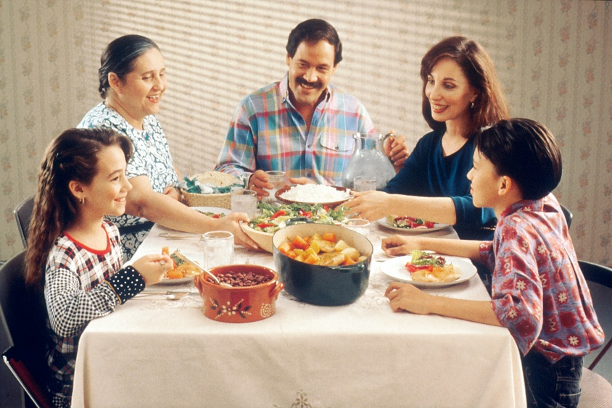
Paying Attention to the Positive
choose to see the positive in others
find a positive go-to staple
search for the silver lining
We have the ability to retrain train our brains to focus on the positive through a process called attention training
Notes:
The first broad strategy is to be mindful and use attention training to increase the frequency and ease with which you notice positives. It takes a bit of effort at first. This does not mean we are discounting the negative situations in our lives, or trying to ignore them. That doesn’t help us and, if you remember from the first module, can actually make things worse as we try to avoid acknowledging our situations, experiences, and emotions. Instead, we are trying to increase our baseline for positive experiences. If you completed the module on mindfulness, it is equivalent to training our sushi chef brain to create more delicious thoughts, although some bland or gross ones will still be on that train.
The three main techniques are:
Choosing to see the positive in others
Search for the silver lining
find a positive go-to staple
For the first two, a trick is to use the word “and” and eliminate the word “but” from your vocabulary. For example, let’s say someone seems to always find a way to annoy you. They also really encouraging and supportive. We could tell ourselves “they are so annoying BUT they are also encouraging” That’s okay. The word “but” though can make it feel like your feeling of annoyance is invalid or wrong and like we are trying to swat it away. Instead, we can accept both things using the word “and”: “They are so annoying and they are also encouraging”. It is a simple change to find the good in others or finding a silver lining.
To the last one, finding a staple thought or memory to go to is always helpful. I have a folder I call my “Rainy Day” folder of emails I’ve received with really positive affirming words to me.

Slide 29
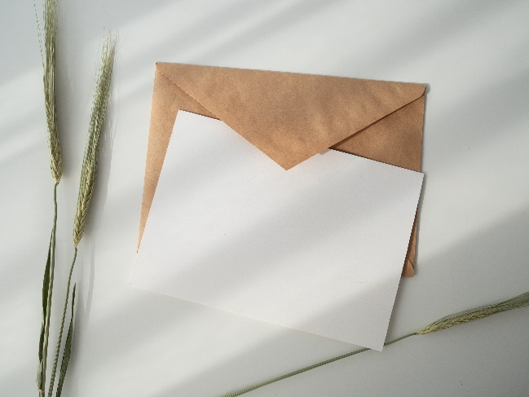
Ways to Practice Gratitude
03
02
01
Gratitude Letter + Visit
Thank-You Notes
Or share gratitude as a family or among staff
Weekly Journaling
Notes:
There are all sorts of ways to practice gratitude. You can do it in your head with a silent reflection on something and how life would be without it or them. We also encourage more active forms of gratitude. This might include things like...
Gratitude journaling on a somewhat regular basis by writing down 5 things you are grateful for.
Sending thank-you notes detailing what you appreciate about people, places, or things. Sometimes just writing these helps and then you can get rid of them. To really reap the benefits, send them!
Another strategy is pairing a gratitude letter with a visit. For this you write a letter to someone whom you have never properly thanked and then share in the letter how they have positively impacted your life. Arrange a time to visit (virtually or in person) to read them the letter
And sharing gratitude of appreciation as a family or staff. This last one is useful for developing a positive culture, and might involve reserving protected time during staff meetings or at dinner tables specifically for gratitude.

Slide 30
Acts of Kindness &Connecting with Others
Donate to a charitable cause
Send a care package
Clean the house (so your family doesn’t have to)
Get groceries for the elderly
Write positive messages in sidewalk chalk outside
Buy a ”suspended coffee”
Call someone to let them know they’re on your mind
Teach someone a new skill
Leave kind little notes around your home or office
Give someone a compliment
Volunteer in your community
Shop at local businesses
Acts of
Kindness
Smile at or wave to a stranger
Strike up a conversation with someone new​
Send snail mail (bonus: support the USPS!)​
Connecting with Others
Notes:
Acts of kindness are great ways to cultivate more positivity in our lives. Acts of kindness overlap with ways that we connect with others and build community, so if you completed that core module, you will recognize many of these. As a reminder, we are unsure why but we do know that doing acts of kindness stimulates our valgus nerve which leads to a warming sensation in the chest and expands the chest. We quite literally “feel good” doing some of these things. There are so many you can try so we recommend picking one or two and test them out. How did it feel? Is it something you want to make a consistent habit? What would you need to make it a habit for you in order for you to continue cultivating that positive experience?

Slide 31
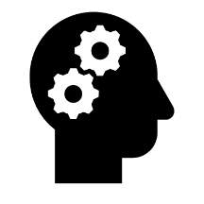
Regularly experiencing humor and laughter…
Enhances capacity for resilience
Reduces stress, depression & anxiety
Boosts circulation & immune system
Releases endorphins (even fake laughter)
Improves physical health & alleviates pain
Increases hopefulness & optimism
Notes:
Stress, difficult experiences and personal traumas, and the demands of adulthood can erode a person’s ability to hold things lightly. For many of us, humor becomes something that we have to practice, especially if we find our brains focused on negative emotions. Dr. Jennifer Aaker (Ay-ker?) at Stanford University has been recently researching what she calls the “humor cliff” of adulthood—a consistent pattern where, on average, adults experience humor less and less as they age. Allowing space for humor in our lives has numerous benefits even though it is such a simple and small thing. Even more amazing, forced laughter can be just as effective as real laughter. Physiologically, the body doesn’t distinguish between real and forced laughter, so although it may seem weird and uncomfortable, if you tell yourself, “I will laugh 5 times today” and force it to happen, you will likely experience the same benefits as 5 genuine spontaneous bouts of laughter.

Slide 32
Tips for Cultivating Humor
Seek things out that make you laugh
Put humor on your horizon
Find a good joke book + a joke buddy
Spend time with people who make you laugh
Reverse-engineer humor (fake laughter has the same health benefits as real laughter)
Consider trying laughter yoga
Know what isn’t funny
Where everyone is a doctor
Notes:
Here are some tips for cultivating humor
*These can be read or quickly reviewed.*
Tips for Cultivating Humor
Seek out things/situations that make you laugh (TV shows, movies, podcasts, SNL youtube videos) and do them regularly
Find some simple things (memes, comics, greeting cards, etc.) that make you chuckle, print them, and hang them up near your desk.
Seek out a good joke book or an online site for jokes.
Find a joke buddy and tell each other daily jokes (or involve your students) or funny stories
Spend time with friends or family members who make you laugh
Reverse-engineer humor by laughing first (remember, fake laughter is as beneficial as real laughter)
Consider trying laughter yoga. In laughter yoga, people practice laughter as a group. Laughter is forced at first, but it can soon turn into spontaneous laughter.
Know what isn't funny. Don't laugh at the expense of others. Some forms of humor aren't appropriate. Use your best judgment to discern a good joke from a bad or hurtful one.

Slide 33
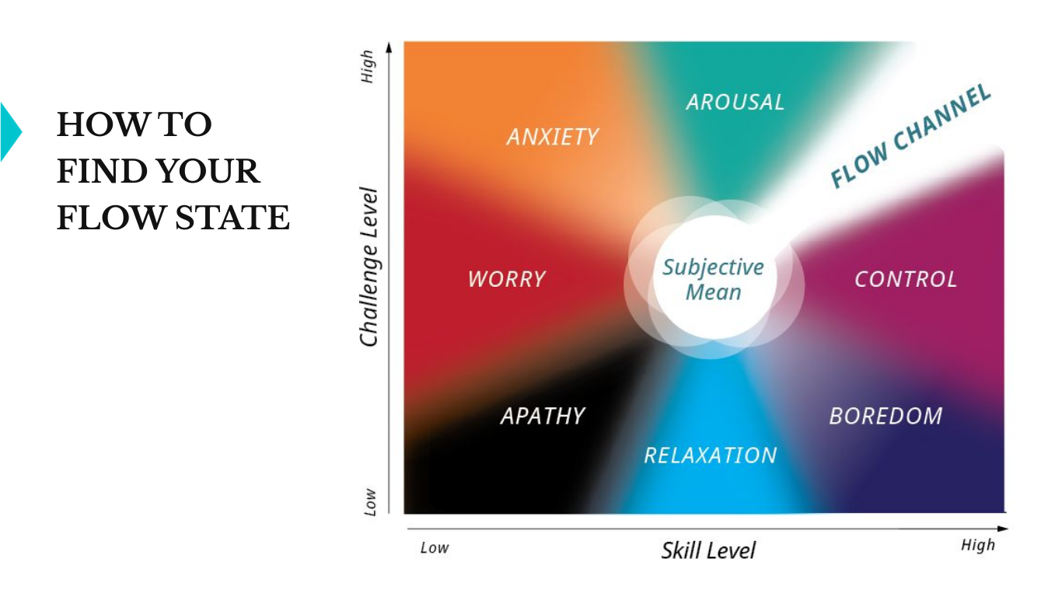
Find Your Flow State
Choose something you love
Decide on a task
Make sure it’s challenging
But not too hard
Find your peak time
Clear away distractions
Enjoy yourself
Keep practicing
Reap the rewards
Notes:
Flow can be purposefully sought after and achieved. If it doesn’t happen naturally for you yet, then we can be intentional about setting up our environment until it becomes more of a habit. The key is to make sure that your environment allows you to remain focused on your task without disruption, and that the task’s difficulty is appropriately matched to your skill level. Here are some step-by-step tips for creating flow in your life, and we have an activity with this module that also walks you through these steps.
Tips for Finding Flow
Choose something love to do.
Decide on a task (what you will work on)
Make sure it’s challenging, but not too hard.
Find your peak time (when you have energy and can concentrate)
Clear away distractions.
Enjoy yourself.
Keep practicing.
Reap the rewards (take the time to appreciate what you accomplished)

Slide 34
Strategies to Spark Joy
01.
02.
03.
04.
05.
06.
paying attention to the positive
practicing gratitude
doing acts of kindness
connecting with others
experiencing humor
doing flow activities
Notes:
These strategies are not mutually exclusive. Can you find an activity or project that cuts across all of these?
Here’s mine: noticing how nice and clean it was in my clinic (attending to the positive), I thought of the custodial staff and was grateful to them for all their hard work (gratitude) to get the building ready and how difficult it would be for me to work without their support. So I got a few colleagues together (connecting) and we baked cookies (flow) and wrote thank-you notes, which we then delivered to the custodial staff (kindness). We got to tell jokes and be silly together while we baked (humor).

Slide 35
Activities to Foster Pleasant
Emotions & Experiences
thank you notes
journaling exercise
share the humor
laughter
yoga
find your
flow
Notes:
We have included five activities with this lesson to help with fostering pleasant emotions and experiences. These include thank you notes, a journaling exercise, share the humor, laughter yoga, and find your flow.

Slide 36
Recommendations
Complete one activity
Notes:
We recommend three next steps to take this information and apply it to your own well-being. First, please choose and complete at least one of the accompanying activities.

Slide 37
Recommendations
Complete one activity
Identify one or more strategies to spark joy
Notes:
Second, identify one or more strategies to use to spark joy in your life.

Slide 38
Recommendations
Complete one activity
Identify one or more strategies to spark joy
Create an individual action plan for that connection
Notes:
Third, create an individual action plan for the strategy you identify. Rember, action planning is a critical step when we try to start something new. It helps us identify our barriers, our strengths, and how we can recover from setbacks when they inevitably happen.
Thank you again for watching and engaging with this lesson. Take care.

