Slide 1



Welcome to

Slide 2
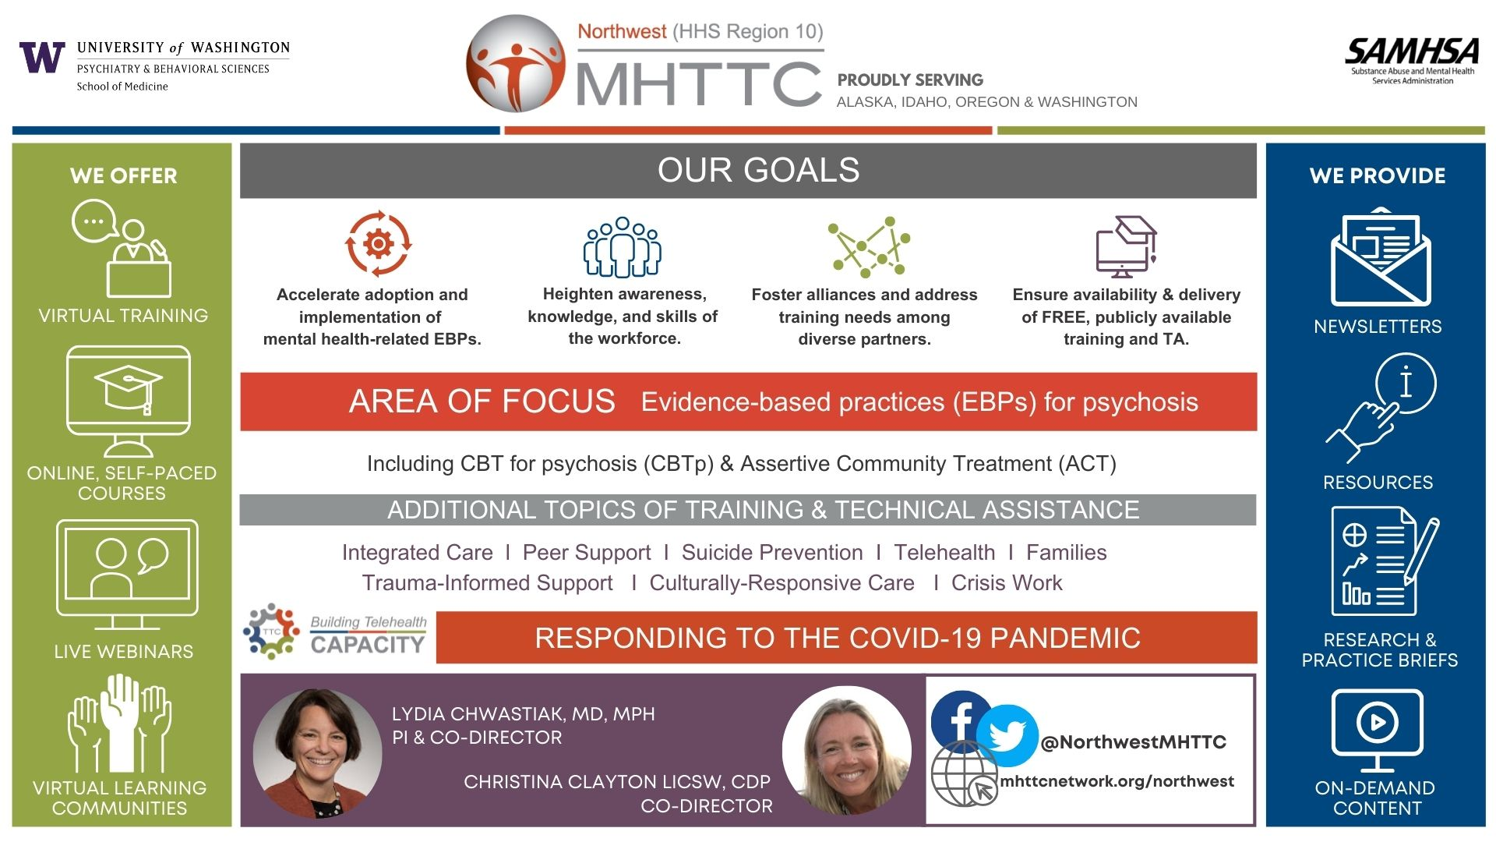
Notes:
We’d like to acknowledge the sponsors of this training, the Northwest MHTTC. The MHTTC Network is a nation-wide network that is supported by the Substance Abuse and Mental Health Services Administration.
The Northwest MHTTC covers Region 10, which includes Alaska, Idaho, Oregon, and Washington. The center is based in Seattle at the University of Washington in the Department of Psychiatry and Behavioral Sciences. Their target audience includes people working within mental health settings or providing mental health services and supports.
Their area of focus is evidence-based practices for serious mental health issues such as psychosis. However, they provide training on a variety of topics including integrated care, suicide prevention, diversity/equity issues, school mental health, peer support, trauma-informed approaches and others.
The Northwest MHTTC fulfills their mission by offering:
Free training and technical assistance
Free, self-paced online courses
Live events that they also record & post
Virtual learning communities
Monthly Newsletters
A Resource Library
Research and practice briefs
And other on-demand content

Slide 3

Welcome

Slide 4

Introductions

Slide 5

What is the STRIDE program?
Lifestyle intervention
For people with serious mental illnesses
Weekly group meetings (6 months)
Monthly maintenance (6 months)
Notes:
The core of this intervention program is a series of group meetings that encourage participants to lose weight by reducing total energy intake and increasing moderate-intensity physical activity. The STRIDE intervention is designed to achieve a minimum weight loss of 10-15 lbs over 6 months resulting from moderate calorie reduction, dietary change, and increased energy expenditure. This degree of weight loss is associated with significant improvements in cardiovascular disease risk factors, including diabetes risk.
As I mentioned earlier, the groups are designed to be led by two interventionists with complementary backgrounds: one who is trained as a mental health counselor, and one with a background or interest in nutrition (this person does not need to be a registered dietician). Ideally both interventionists would have experience conducting behavioral interventions and using motivational interviewing techniques. Additionally, they should be comfortable using strategies for presenting materials in a group setting to people with mental illnesses who might have cognitive or executive functioning deficits.
The group meets weekly for 6 months and then monthly for the following 6 months and the interventionists provide between session phone coaching support

Slide 6

DASH Diet
Focus on vegetables, fruits, whole grains
Include fat-free or low-fat dairy products
Limit saturated and trans fats such as fatty meats, full-fat dairy products, highly processed foods
Limit sugar-sweetened beverages and sweets
Aim for <2,300 mg of sodium per day
Notes:
DASH DIET
The nutrition component of the STRIDE intervention is based on the Dietary Approaches to Stop Hypertension (DASH) diet which includes a focus on…

Slide 7
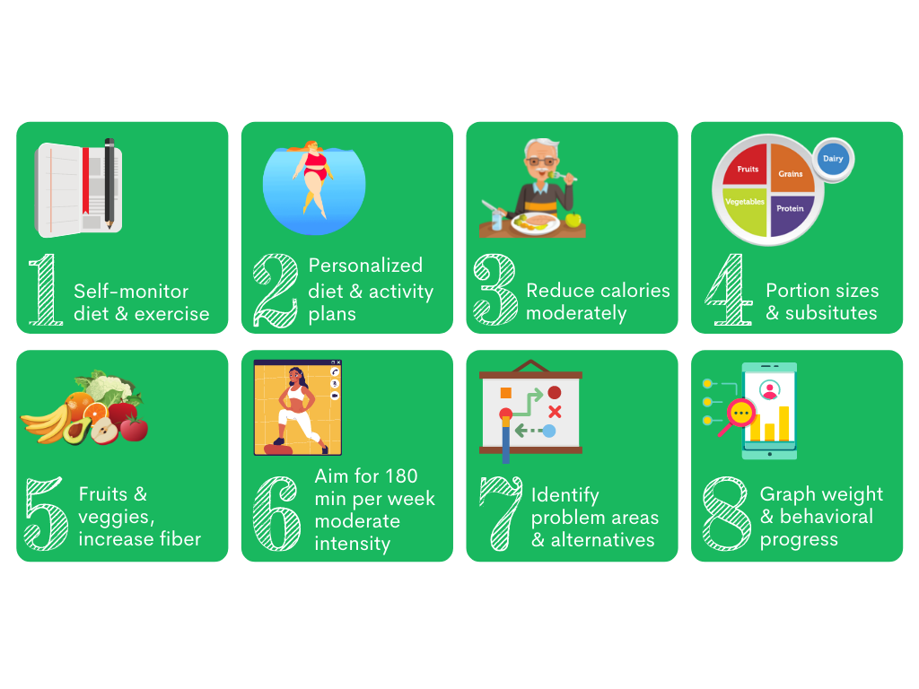
STRIDE Program Strategies
Notes:
The intervention also involves monitoring of diet, physical activity and sleep.
Developing personalized dietary and physical activity plans meeting each participant where they are and setting realistic goals to reduce calories moderately through reducing portion sizes and making healthier substitutions. The focus, as I mentioned is on increasing fruits, vegetables, and fiber; helping participants discover what they can eat for energy and health rather than focusing on restriction. We focus on moderately increasing physical activity, some participants begin with no physical activity and so we plan for that. The program target participants’ readiness to change, encourages group interactions that facilitate social support and problem solving, provides support for appropriate goal setting and self-negotiation, and facilitates the acquisition of new information and skills for behavior change. Group facilitators present examples of new behavioral options and decision-making approaches, and are expected to pay careful attention to the cultural appropriateness of the program for minority participants.
Our experience has shown that willingness to change behavior shifts frequently during long- term weight loss intervention programs. Recognizing this reality, interventionists help participants tailor their weekly goals and action plans to their current stage of change. Although group facilitators provide general guidelines for intervention components (daily self-monitoring of caloric intake, five or more days per week of physical activity, etc.), participants are encouraged to adjust their personal goals and action plans each week to their immediate situation. That is, participants set their own short-term goals each week in consultation with the facilitators.
We help participants graph their progress so they can observe measurable changes and focus on weight loss but also the many non-scale victories that come with making intentional lifestyle choices.

Slide 8


How will you identify group participants?
What makes a good candidate?
How will you identify group participants and outreach to them?
Who in your clinic is a good fit for the program?

Slide 9
STRIDE Participants
Clients in community mental health centers
Overweight or obese (BMI > 27)
Diagnosed with serious mental illnesses and taking antipsychotic medications
Age > 18; Mean age 47.2 years
72% identified as female
88% identified as white
31% high school/GED or less
45% receiving disability income
Many with limited mobility
Exclusions:
  Significant cognitive impairment that prevented consent or participation
  Pregnant/breastfeeding
  Recent psychiatric hospitalization, bariatric surgery, cancer, heart attack, or stroke
Notes:
Often when I talk with administrators and clinicians about bringing STRIDE into their clinics there are questions about whether or not clients will be a good fit for the program. Clinicians anticipate that their clients won’t continue to show up for the group, they won’t want to track their diet, they won’t want to eat healthy foods, or they can’t afford them, they will make excuses for exercising, etc. and there are some assumptions made about who we had in the trial, that we must have had very special participants who are different from the clients you all are used to working with. So let me address that right away.
Yes. All of those things will be challenges. You will have clients who are challenging, some who are so discouraged (even nihilistic) that they can’t even believe that a program like this might be helpful to them. And you will have to hold faith in them for them until they can begin to see their progress for themselves. We are going to try to share some anecdotes and success stories with you along the way throughout this training so you can begin to believe this is possible and so you can help your clients to believe it. We created this program because we were studying mental health recovery and when we asked people who described themselves as living “in recovery” from mental illness and/or substance use, what was missing they overwhelmingly focused on two things, both side effects of medication use: 1) lack of intimate and sexual relationships or libido, and 2) excessive weight gain and subsequent health conditions such as cardiovascular disease and diabetes. They said “I’ve finally got my mental health under control but now I’m overweight from these medications and nobody is helping me to manage that, they’re just telling me to take more medications to treat the problems that were caused by the medications.” They were asking for a program. They were motivated to make changes.

Slide 10
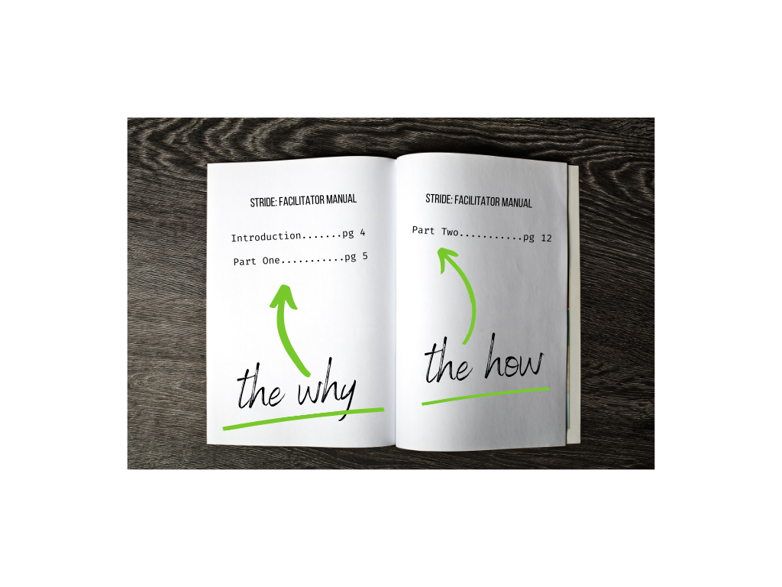
Overview of STRIDE manual
Notes:
Detailed agendas for each session with handouts/materials needed and facilitator notes
Detailed session content
Sample discussion approach indicated by
Suggested questions indicated by
OVERVIEW OF STRIDE MANUAL

Slide 11
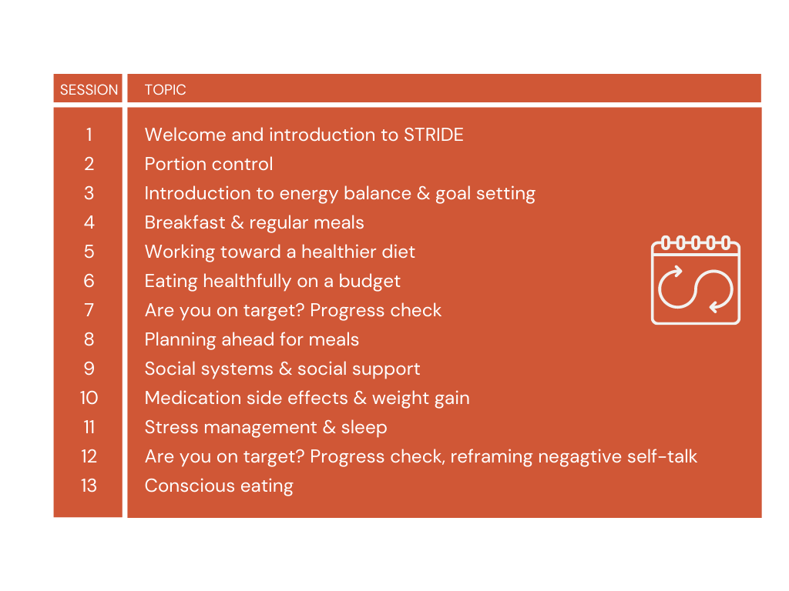
Facilitator Guide: The Sessions

Slide 12
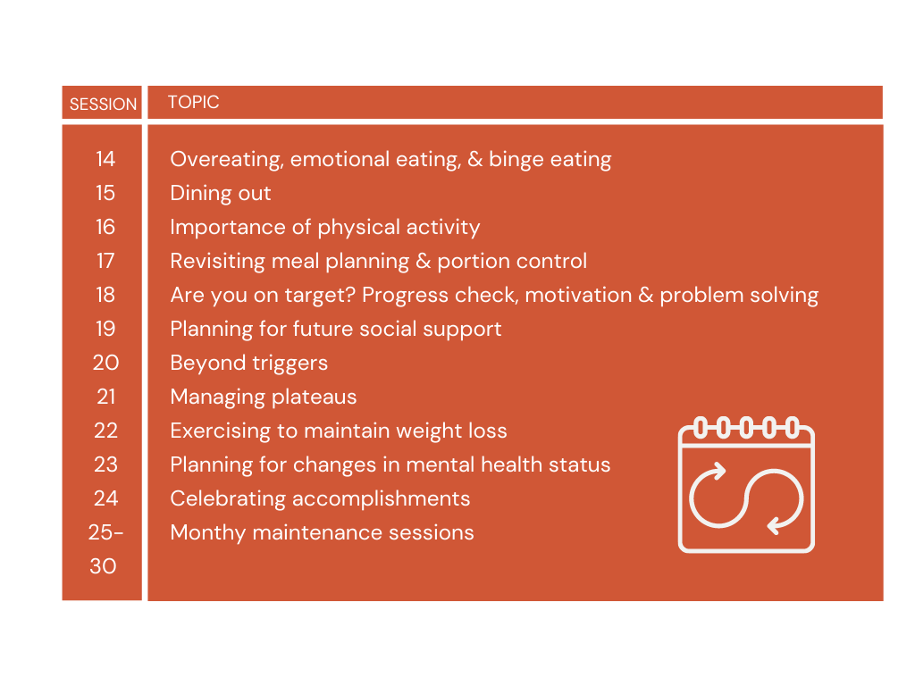
Facilitator Guide: The Sessions

Slide 13
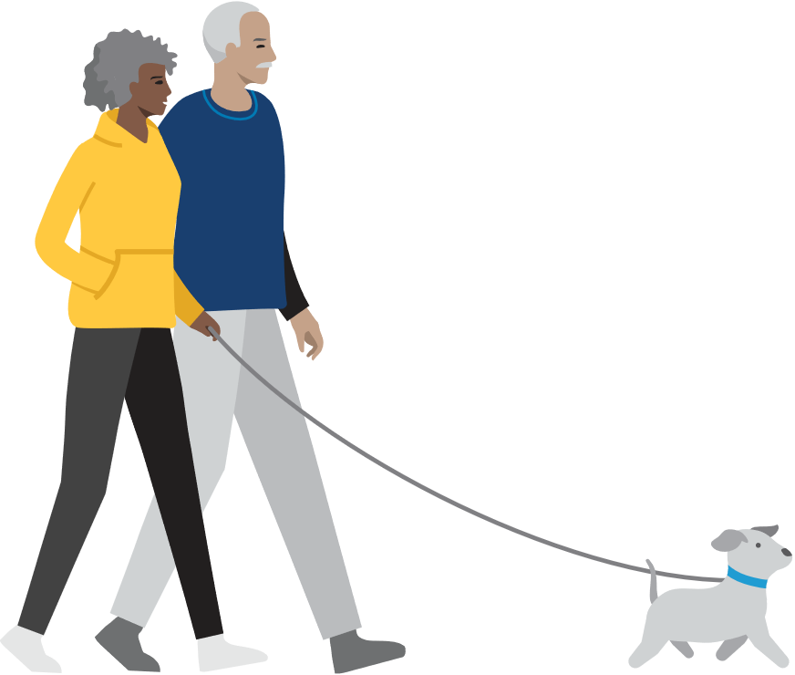
General Session Outline
Each session follows a general outline:
1. Greeting and weigh-in (pre-group)
1 facilitator weighs in, the other visits with group members as they arrive
2. Check-In (15-30 minutes)
1 facilitator leads check in, the other calls absent members to encourage to come
Check-In consistently rated as one of most important aspects of the group
3. Session Content (30-60 minutes)
4. Physical Activity (15-30 minutes)
1 facilitator leads, the other follows or stays back with members who can’t go out
Plan ahead for weather/daylight
5. Goal Setting (10 minutes)
Notes:
GENERAL SESSION OUTLINE
Groups meet weekly in the first 6 months, and monthly for another 6 months. Each session is 2 hours with at least 20 minutes of physical activity.
Weekly weighing is an important part of monitoring progress; weigh ins are conducted in a private setting.
STRIDE sets a target of 20-30 minutes daily of moderate physical activity (~180 minutes per week). Each group session incorporates 20-30 minutes of group physical activity—typically, walking. Facilitators encourage participants to develop individualized plans for increased physical activity—including activities of daily living, cardiovascular exercise, weight bearing exercise, and flexibility exercise—as well as decreased sedentary behaviors such as screen time. Leaders also ask participants to record daily physical activity in their weekly diaries and review progress at each group and individual contact.
Participants with no interest in physical activity are not forced to set an exercise goal, although those who decline to set a physical activity goal for several consecutive weeks are encouraged to meet with one of the facilitators for a brief counseling session using motivational interviewing techniques. The objective of this counseling session is to foster reflection on long-term goals and hopefully increase motivation to engage in more physical activity. Participants who are injured are encouraged to find alternative forms of exercise that accommodate their injury (for example, seated arm exercises with an exercise band).

Slide 14




Session 1: Welcome & Introduction to STRIDE
Welcome and Introductions
Orientation to Basic Intervention Goals
Food, Activity, & Sleep Log
Goals for next week

Slide 15
Setting the stage for STRIDE
Lifestyle changes for weight management and overall improved health
Small changes made over time
STRIDE will provide tools and information to help participants make their own choices
Group leaders will provide support and help with problem-solving
Each participant’s attendance is key to a successful group
Notes:
We are often asked whether one should focus on a few, simple, relatively small steps to improve their health or attempt to make drastic, wholesale changes across the board in a “lifestyle overhaul.” Our answer is yes! Our experience has taught us that different approaches work best for different people.
Multiple health behavior change can be produced either sequentially or simultaneously, and the order and magnitude of change in which individual behaviors ought to be addressed is unclear. In the absence of evidence to guide these treatment decisions, we take a personalized approach working with people to examine their goals as well as their resources, strengths, and limitations.
Emphasize the importance and impact of each participant’s presence in each of the sessions. Acknowledge that there may be challenging weeks (eg, ppt did not meet their goals, or overall feeling unsuccessful) but those are likely the weeks that attending the session is most important.

Slide 16
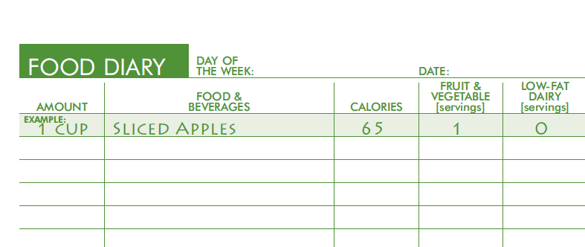
Orientation to Weekly Log– Food
Notes:
Session 1
The STRIDE Weekly Logs are a fixture of the program and is a self-monitoring tool for participants to track some key behaviors – diet, physical activity, and sleep. This is A LOT of information for participants to track and at first glance it may look overwhelming, particularly if someone has never used this type of process.
Allow participants time to get acclimated to the Weekly Logs. For the first week, have participants simply focus on completing the Food & Beverage column of the Food Diary portion. Encourage participants to “itemize” the foods as appropriate. For example, instead of “turkey sandwich”, list out: white bread, turkey, swiss cheese, lettuce, mayonnaise. The other columns will be discussed over the next few sessions.

Slide 17
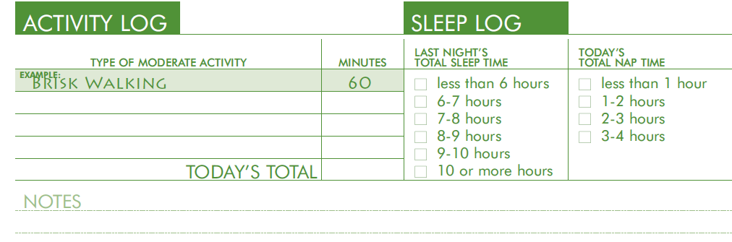
Orientation to Weekly Log– Fitness, Sleep
Notes:
Session 1
Participants will also be asked to track the amount of moderate physical activity and sleep that they get each day. Again, these topics will be covered over the upcoming sessions, however it would be fine to have them start tracking these behaviors now - if it’s not too overwhelming. Defining “moderate activity” will be discussed at Session 3. Tracking sleep is pretty straightforward.

Slide 18
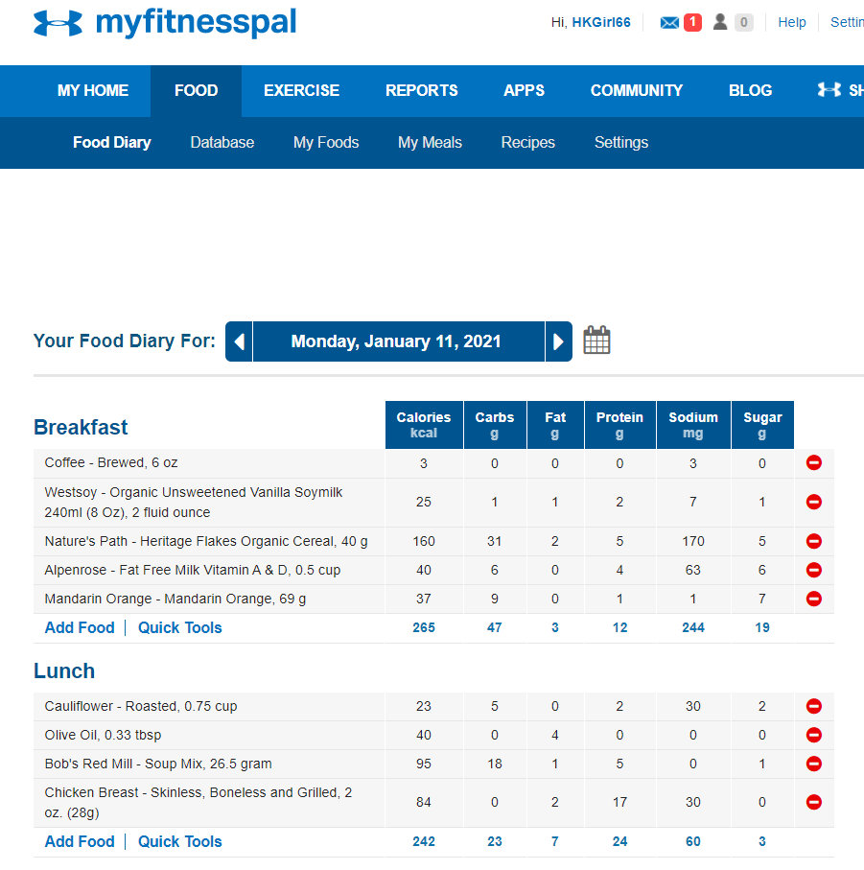

Using apps or websites for tracking
Notes:
Session 1
Participants may opt to use an app or website to track their foods. A few samples are listed on the supplemental resources handout. Many of these sites have a free version, as well as a more elaborate version that participants can pay for. We do not advocate for that, but of course if a participant is already using a paid version that’s fine. Many of these sites have a function that allows the daily record to be printed, so there may be times when it would be helpful for participants to print their records in order to share with the facilitator. Participants should still be asked to transfer their totals to the Daily Totals summary page of the STRIDE Weekly Log to turn in each session since these numbers are used to provide feedback to participants during periodic Progress Checks that are built into the program.

Slide 19



Session 2: Portion Control
Servings and Portions
Portion Control
Goals for next week
Check-in
Notes:
Session 2
At this session we will explain the difference between a “portion” and a “serving”, as well as talk about ways to manage portion sizes.
As with each session, we will start with a check in to see how things went during the past week. For Session 2 the focus is on exploring how participants did during the first week of keeping food diaries.

Slide 20
Check-in
How was your experience recording all of your foods and drinks?
Notes:
If you haven’t already completed a weekly log yourself, we highly suggest doing that prior to beginning your STRIDE group. This will give you some insight to the process and also help you become familiar with the tool itself.
For the check in, allow participants to identify their challenges as well as their successes with food diaries. There doesn’t necessarily need to be a lot of problem-solving at this point. One of the most valuable parts of the check in is for participants to hear how others are doing – whether they’re struggling a bit or if things are going smoothly. Often it can be reassuring for participants to hear that others are having experiences similar to their own and may inspire them to share their thoughts. Again, acknowledge that keeping food diaries will take some time to get used to, and encourage participants to be patient with themselves and the process.
If in-person training:
Let’s go ahead and go through a brief check-in right now on your experience with keeping food diaries. Prior to today’s training, we had encouraged you all to complete a week’s worth [or xxx day’s worth] of food diaries so that you would have some insight with the STRIDE Logs. I’m interested in hearing about your experiences, there’s no right or wrong. How did it go with keeping food diaries this week?
If needed: What were some of the challenges? What seemed to work well? What did you notice about your eating patterns? Summarize
Thank you for sharing. For many people, keeping food diaries is the key to successful weight management. It definitely takes some getting used to, but if you are consistent, it will start to feel a bit easier as time goes on and you will notice the benefits.

Slide 21
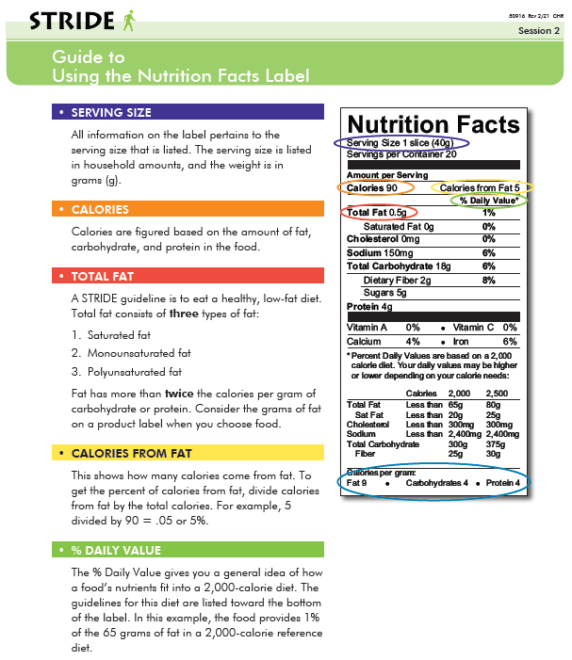
Using the Nutrition Facts Label
Notes:
Session 2
We will introduce participants to the Nutrition Facts Label. I’m sure we’ve all seen these labels on packaged foods. There is A LOT on these labels. The primary items to focus on are Serving Size and Calories. Participants should realize that the amount of Calories on the label, corresponds to the Serving Size. So, if you eat 3 servings, its 3x the calories.
Be clear that we are not asking participant to only consume the listed serving size, but rather to pay attention to their portions in order to more accurately determine calorie intake.

Slide 22

Serving Size vs Portion Size
A Serving is a standardized unit for a particular food
A Portion is the amount of food you consume
Notes:
Session 2
The terms “serving size” and “portion size” are often used interchangeably, but they really are two different things. A Serving Size is a standardized unit for a particular food, this is what you see on the Nutrition Facts Label. A Portion is what you actually consume.
The key thing to focus on is that a Serving Size is what should be used to record calories. A person’s Portion size may be different that a Serving Size.
On this slide, we see a serving size of spaghetti on the right side. The plate on the left, is likely a more realistic portion size of spaghetti that most of us might eat.
The manual outlines an interactive activity that gives participants a chance to explore portions and servings by pouring bowls of cereal. These hands on activities are of course the most impactful and fun for the group. However, if you are not able to do the activity, there are some brief video clips that you could show. We’ve included the links on the facilitator resources handout.
For virtual trainings, it may be helpful to show the following video clip describing portions vs. servings.
https://www.youtube.com/watch?v=6VmINhpg5CY
For in-person trainings, do the following demonstration:
Do a quick demo of two “pours” of cereal. Ask the group which one they think contains a SERVING of cereal. Use clear glass bowls, could have two different sizes to show how our eyes can be tricked by the size of the dishes we use. Or could use a “heavy” cereal and a “lighter” cereal to show that even though both are a SERVING, one fills a bowl more than the other. (e.g., granola vs. Cheerios)

Slide 23

Serving Size vs Portion Size
Notes:
Session 2
The terms “serving size” and “portion size” are often used interchangeably, but they really are two different things. A Serving Size is a standardized unit for a particular food, this is what you see on the Nutrition Facts Label. A Portion is what you actually consume.
The key thing to focus on is that a Serving Size is what should be used to record calories. A person’s Portion size may be different that a Serving Size.
On this slide, we see a serving size of spaghetti on the right side. The plate on the left, is likely a more realistic portion size of spaghetti that most of us might eat.
The manual outlines an interactive activity that gives participants a chance to explore portions and servings by pouring bowls of cereal. These hands on activities are of course the most impactful and fun for the group. However, if you are not able to do the activity, there are some brief video clips that you could show. We’ve included the links on the facilitator resources handout.
For virtual trainings, it may be helpful to show the following video clip describing portions vs. servings.
https://www.youtube.com/watch?v=6VmINhpg5CY
For in-person trainings, do the following demonstration:
Do a quick demo of two “pours” of cereal. Ask the group which one they think contains a SERVING of cereal. Use clear glass bowls, could have two different sizes to show how our eyes can be tricked by the size of the dishes we use. Or could use a “heavy” cereal and a “lighter” cereal to show that even though both are a SERVING, one fills a bowl more than the other. (e.g., granola vs. Cheerios)

Slide 24



Session 3: Introduction to Energy Balance and Goal Setting
Introduction to Energy Balance
Energy in (Calories)
Energy out (Physical activity)
Introduction to SMART Goals
Check-in
Notes:
Session 3
At this session we describe concept of “energy balance” and introduce the SMART goal-setting process.

Slide 25
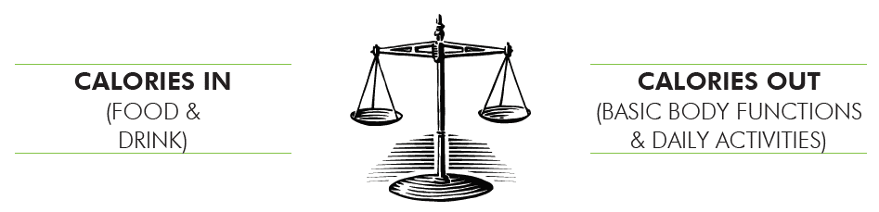
Energy Balance:
Notes:
Session 3
We introduce the idea of “energy balance” here. A calorie is simply a unit of measurement for energy. We get calories IN by the foods and drinks we consume, that is represented on one side of the scale. We get calories OUT through exercise and body functions such as digestion, respiration. Using this concept, for weight loss we would consume FEWER calories than we are expending. For weight gain, we would consume MORE calories than we are expending. For weight maintenance, both sides would be equal and the scale is balanced.
It will be important for participants to look up the calories of their foods and drinks so that they know their daily intake. They can use resources such as the Nutrition Facts Label, The Calorie King books or website, or a calorie tracking app or website. As participants get used to this process, they will start to notice how calorically dense certain foods and may choose to use that observation to begin to make small changes. For example, they may notice how calorically dense fried foods are compared to other choices (French fries vs. baked potato, fried chicken vs. grilled chicken).
Another way that foods can be calorically dense is due to water content. Foods that contain more water – soups, fruits, vegetables – tend to contain less calories per serving than other foods.
DEMONSTRATION ACTIVITY: Do “raisins vs grapes” demo here to illustrate energy density (ie, calories)
120 calories = 2 cups of grapes or ¼ cup of raisins

Slide 26
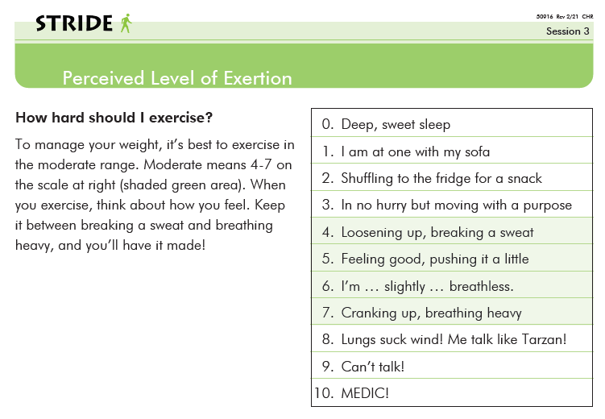
Perceived Level of Exertion
Notes:
Session 3
So we’ve talked about getting calories IN by consuming food. The other side of the scale is about getting calories out. The most efficient way to do that is through moderate intensity exercise. We are asking participants to log their minutes of “moderate intensity” level of exercise. This level provides a reasonable amount of calorie expenditure without asking participants to exert too much. To help them gauge that, we use the Perceived Level of Exertion chart. During physical activity, participants should periodically rate their level of exertion using this 0-10 scale. A level between 4-7 would be considered moderate. The scale is subjective for each participant. This is the level of exercise that we would like participants to record on their Weekly Log. We’ll talk about other types of physical activity later, but the focus of this session is to provide a definition of moderate intensity exercise and to help participants determine what that level is for each them.

Slide 27
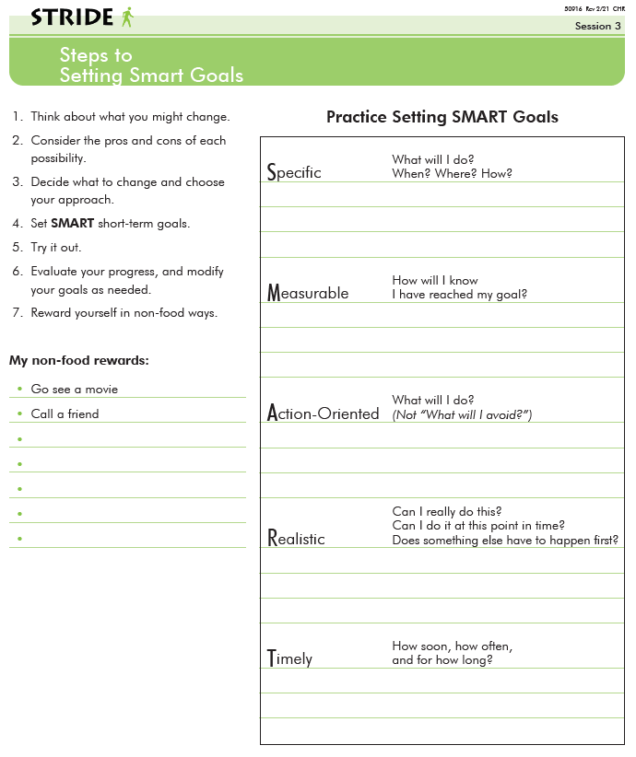
Steps to
Setting
SMART Goals
Notes:
Session 3
Steps to Setting SMART Goals
During each session we ask participants to create goals for the upcoming week(s). In order to help them formulate concrete goals, we use the SMART format. This is a well-known formula used for goal setting and we imagine that many of you attending this training are familiar with this process so we are not planning to delve into this hear, however, we encourage you to be sure to reserve enough time to introduce SMART goal setting with your participants.
Trainees are likely familiar with this process so may not need to go into too much detail. Review as needed
PLAN FOR A 5 MINUTE BREAK AFTER THIS SLIDE

Slide 28
Session 4: Breakfast and Regular Meals
Breakfast and Regular Meals
Finding Time for Physical Activity
Goals for next week
Check-in
Notes:
Session 4 - Planning to skip this session during training.
We won’t go into depth on Session 4 since it is fairly straightforward. The primary theme for this session is to help participants start to think about eating regularly throughout the day, starting with a healthy breakfast, as well as planning to incorporate physical activity into their daily routine.

Slide 29

Session 5: Working Toward a Healthier Diet
Evaluating Monitoring Records and Our Diets
Goals for next week
Check-in
Notes:
Session 5
During this session we continue to talk about the content of our foods and where the most calories are coming from, particularly fats and sugars. Again, the purpose is not to completely eliminate high fat/high sugar foods but to start to be aware of the caloric density of these foods and to think about ways to make changes.

Slide 30
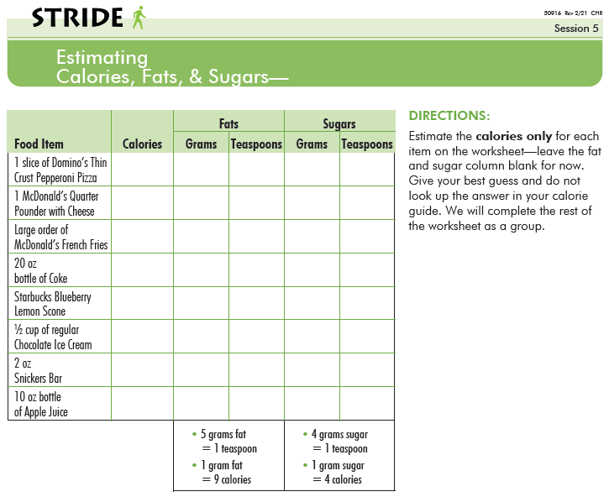
Estimating Calories, Fats, & Sugars
Notes:
Session 5
HANDOUT - Estimating Calories, Fats, & Sugars
This handout is used during the session to give participants a chance to look at the calories of different foods as well as the fat and sugar content. We’ll do a brief version of this activity now.
BREAKOUT ACTIVITY – Break out into small groups. Each group will make their best guess about the number of CALORIES for the food items on the worksheet. You can use whatever resources you may happen to have (phone, laptop) OR just make a guess. For the sake of time, just have the groups look up: McDonald’s Quarter Pounder with cheese, 20 oz bottle of regular Coke, ½ cup of chocolate ice cream, and 10oz 100% Apple juice.
Reconvene and provide actual calories along with the FAT and SUGAR content. Have actual fat and sugar models prepared to show for a few of the foods on this list.

Slide 31
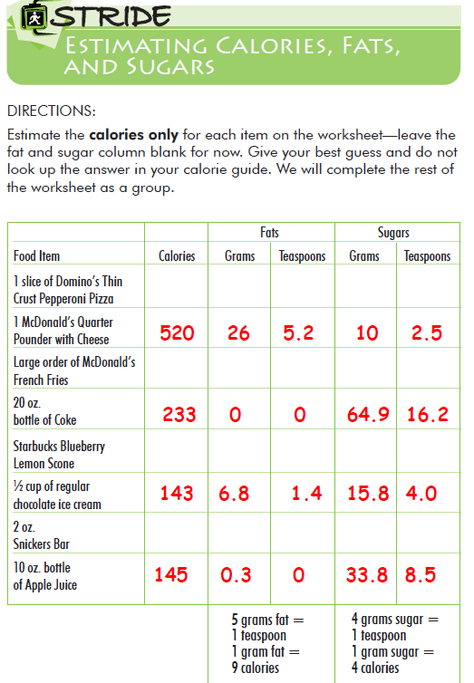
Estimating Calories, Fats,
& Sugars
Notes:
Session 5
Include answers for a few of the items on this slide:
McDonald’s Quarter Pounder with Cheese
20oz bottle of Coke
½ cup of regular chocolate ice cream
10oz bottle of Apple juice (100%, no added sugar)
Debrief, show answers along with real representations of actual fat & sugar.
The Quarter Pounder with Cheese contains a total of 520 calories with 26 grams from fat, which is about 5.2 teaspoons of fat. It also contains 10 grams from sugar which is about 2.5 teaspoons of sugar. This is what that amount of fat looks like and this is what that amount of sugar looks like.
We used Crisco/butter/whatever to represent fat, and then just regular sugar. We placed the correct amounts in clear plastic containers, a zip top baggie would work as well. We set up these fat/sugar displays ahead of time. Since we ran so many groups, we just stored these in the freezer until they were needed for this session. This may work for you as well, or…if it’s feasible, it would be fun to have a tub of fat, a bag of sugar, and measuring spoons and have participants measure out the actual amounts. Feel free to have fun with it.

Slide 32
Session 6: Eating Healthfully on a Budget
Review and Discuss Food Bank Materials
Goals for next week
Check-in
Notes:
Session 6
For Session 6, we partnered with the Oregon Food Bank and their representatives conducted cooking demonstrations for the group. We allotted them the full 2 hours and they prepared 3-4 meals for participants to sample. Their materials are part of the bundle of handouts in the STRIDE Participant Workbook. The materials have good information and could still be discussed as part of this session and, if feasible, group facilitators could do the cooking demos.
In lieu of cooking demos, it might work to see if any of the local grocery stores offer some type of education program, maybe someone to come in and talk about how to shop for nutritious foods while on a budget (e.g., shop the perimeter, take advantage of frozen F/V). Other ideas may be to show a cooking video or taking a “field trip” to a grocery store to explore the best way to shop for healthier foods.

Slide 33

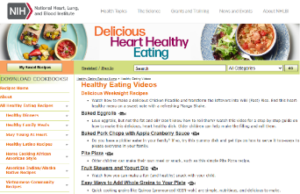

Sample Resources
1-minute clip from NIDDK: Eating Healthy on a Budget – YouTube
Short videos of recipes: NHLBI Healthy Eating Video Series (nih.gov)
Website with tips: How to Eat Healthy on a Budget | American Heart Association
Notes:
Session 6
The supplemental resource handout has links to some resources that you may want to explore (cooking videos, helpful tips, etc).

Slide 34
Session 7: Are You on Target?
Progress Check
Evaluating Monitoring Records and Our Diets, continued from Session 5
Goals for next week
Check-in
Notes:
Session 7
This is the first of 3 Progress Checks that are built into the weekly sessions. This is an opportunity for each participant to assess their progress and adjust their goals. It’s also important to acknowledge successes!
Ask participants to pull out the index cards that they filled out at Session 1. You would have photocopied the index cards, so if the participant doesn’t have it, provide them with the photocopy. Use as a tool to help participants reflect on their original goals and expectation for being in STRIDE, determine if they’re on track, and make any revisions that they’d like.
Also, provide participants with graphs of their own progress using the data collected from the Weekly Logs. [insert sample???]

Slide 35
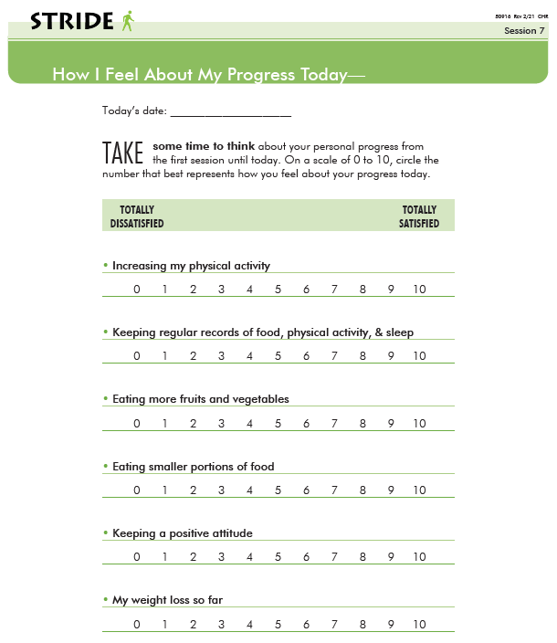
Notes:
Session 7
You’ll also give participants a few minutes to complete this worksheet, then discuss in small groups, then debrief as a large group.
This could also be a good opportunity for facilitators to gain feedback about changes they may want to make going forward (eg, how to best support the group, topics that ppts are struggling with)

Slide 36
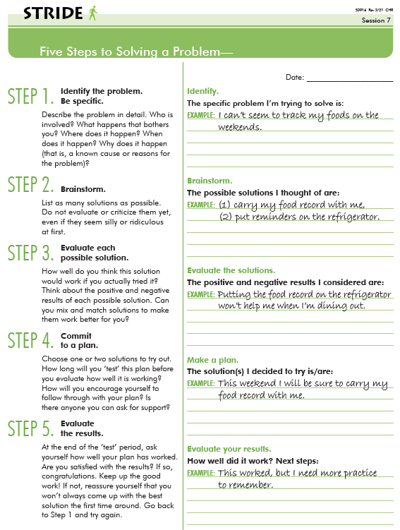
Five Steps to Solving a Problem
Notes:
Session 7
Five Steps to Solving a Problem

Slide 37






Facilitator Kit
It’s helpful to have general supplies gathered and in a portable container:
Blank name tags/ name tents
Blank food logs
Pens/pencils
Markers for flip chart or dry erase board
Highlighters
Calculators
Sticky notes
Blank paper or notepads
Reading glasses
Measuring spoons, measuring cups
Notes:
FACILITATOR KIT
Having general, routine supplies organized and ready to go was helpful. There may be the occasional stressful or unforeseen circumstance that occurs prior to a session, so having the basic supplies already assembled will help. This is a suggested list of items to have on hand, stored in something like a banker’s box, ready to grab & go.

Slide 38
Questions or Comments
For the next training session, please bring a bite-sized piece of food for one of the activities we will be doing. (Grape, almond, Dorito, etc.)
Notes:
END OF TRAINING SECTION 1

Slide 39
“New goals don’t deliver new results.
New lifestyles do.
And a lifestyle is a process, not an outcome.
For this reason, your energy should go into building better habits, not chasing better results.”
James Clear
Author of Atomic Habits

