Slide 1



Welcome to

Slide 2
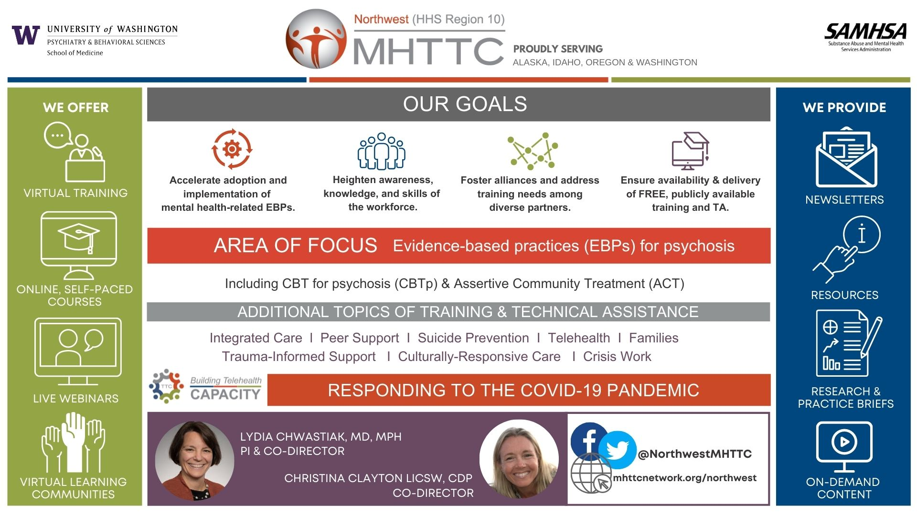
Notes:
Once again, acknowledging the support of the Northwest MHTTC to make this training possible.

Slide 3
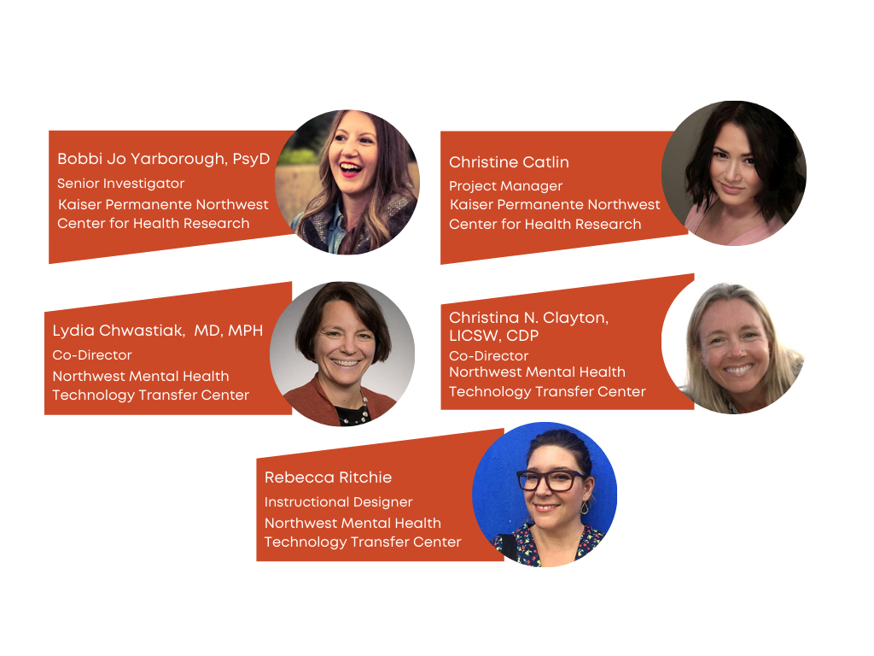
Welcome Back!

Slide 4
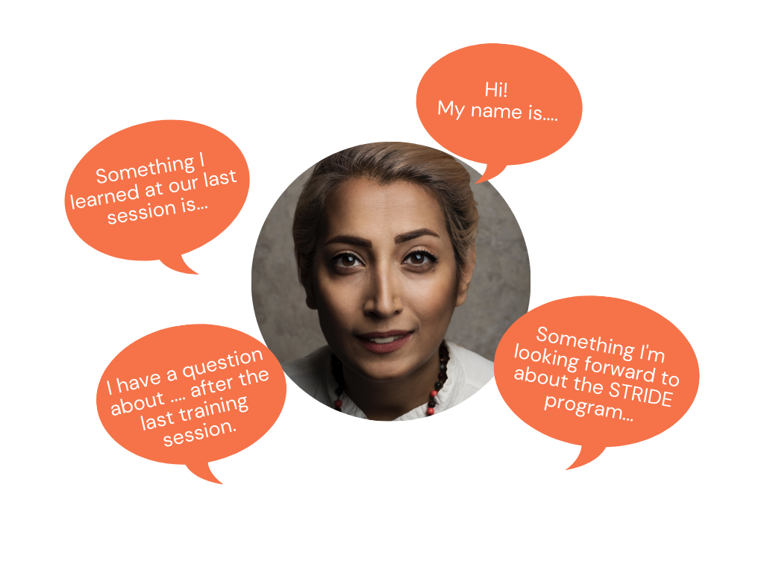
Welcome Back!

Slide 5
Reminder: STRIDE Program Guidelines for Participants
Record all _________ and ________
Reduce ________ intake
Increase _____ and ________ intake
Work toward averaging ___________ of moderate intensity activity per week
Find ways to get ____ ______ in everyday life
Notes:
PROGRAM GUIDELINES
Pop Quiz! There were 5 guidelines we talked about at our last training, these are the foundation of the program. Who can help us fill in the blanks?
Record all foods/beverages and exercise
Reduce caloric intake
Increase fruit and vegetable intake
Work toward averaging 180 minutes of moderate intensity activity per week
Find ways to get more active in everyday life

Slide 6
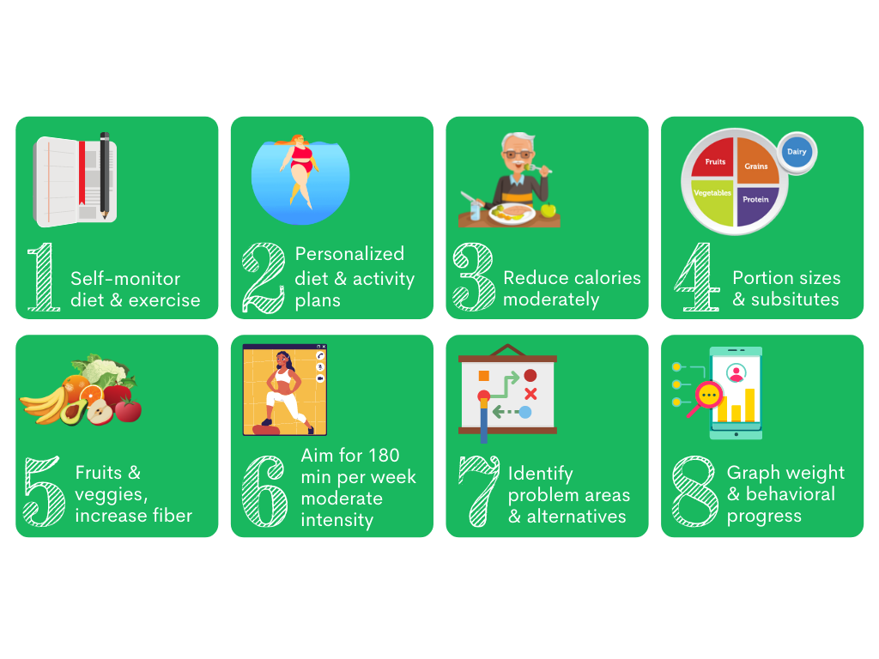
STRIDE Program Strategies
Notes:
And a quick reminder, these are the strategies the program is built around

Slide 7
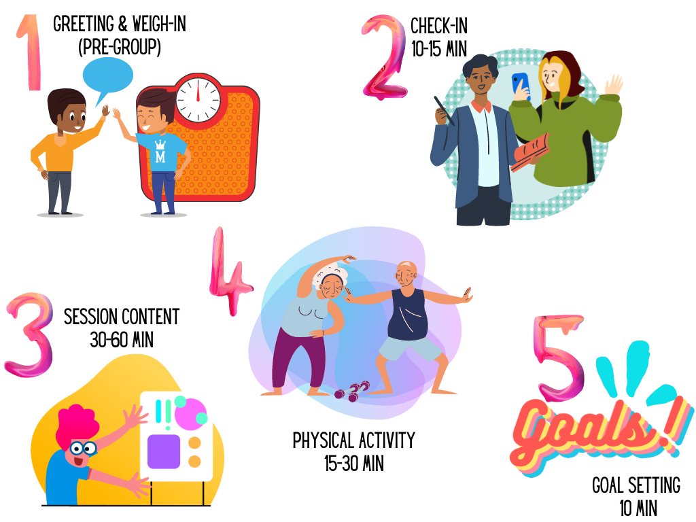
General Session Outline
Notes:
BOBBI
GENERAL SESSION OUTLINE
We’re going to dive right into the remaining sessions, covering most but not all of them. We’ve intentionally skipped those that we think you’re already pretty familiar with the content of, such as problem solving or other skills that aren’t unique to this program and are often part of mental health care so that we can focus on those that might be less familiar.
Remember that this is the general outline for each session: greeting and weighing in, a check in that can range from 15-30 minutes depending on the size of the group and how rich the conversation is, new content maybe broken up by some physical activity or saving the activity until the end depending on the content, and wrapping up with goal setting for the next week.

Slide 8

General Session Outline
Each session follows a general outline:
1. Greeting and weigh-in (pre-group)
1 facilitator weighs in, the other visits with group members as they arrive
2. Check-In (15-30 minutes)
1 facilitator leads check in, the other calls absent members to encourage to come
Check-In consistently rated as one of most important aspects of the group
3. Session Content (30-60 minutes)
4. Physical Activity (15-30 minutes)
1 facilitator leads, the other follows or stays back with members who can’t go out
Plan ahead for weather/daylight
5. Goal Setting (10 minutes)
Notes:
GENERAL SESSION OUTLINE
We’re going to dive right into the remaining sessions, covering most but not all of them. We’ve intentionally skipped those that we think you’re already pretty familiar with the content of, such as problem solving or other skills that aren’t unique to this program and are often part of mental health care so that we can focus on those that might be less familiar.
Remember that this is the general outline for each session: greeting and weighing in, a check in that can range from 15-30 minutes depending on the size of the group and how rich the conversation is, new content maybe broken up by some physical activity or saving the activity until the end depending on the content, and wrapping up with goal setting for the next week.

Slide 9



Session 8: Planning Ahead for Meals
Managing Mealtimes
Goals for Next week
Check-in

Slide 10
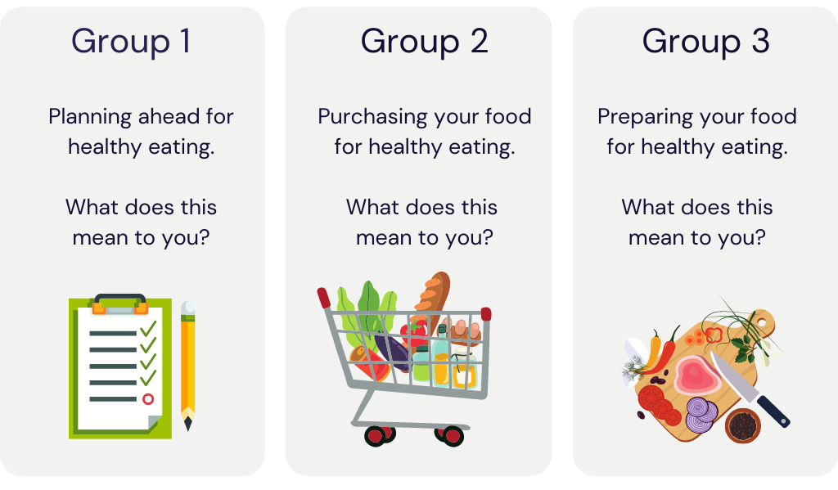
Session 8: Planning Ahead for Meals
Notes:
SESSION 8b
This session explores ways that participants can use meal planning and meal prep to help them work toward healthier eating patterns. Participants can share their ideas and tips to create a list of strategies they can try. We’re going to take a few minutes to do the activity included in this session.
We’ll break off into three groups. Each group will tackle one of the three topics for meal planning: Planning ahead, Purchasing your foods, and Preparing meals.
[ORGANIZE THREE GROUPS/BREAKOUT ROOMS]
Group 1 will take “Planning ahead”. Group 2 will take “Purchasing your food”, Group 3 will take “Preparing your food”. Let’s meet in our groups and take about 5 minutes to come up for a few tips or suggestions for our topic. We’ll then come back to hear what each group comes up with.
[RECONVENE, DEBRIEF]

Slide 11


Session 9: Social Systems and Social Support
Support Systems
Thoughts, Behaviors, and Emotions
Goals for Next week
Check-in
Notes:
SESSION 9a
There are two primary goals of this session– 1) to give participants a chance to think about how their lifestyle changes are helped or hindered by their support systems (if they have support), and 2) to give them a chance to think about how their thoughts, behaviors and emotions are inter-related and how they can change or shift in response to the environment around them, including in response to their support system but also other triggers
[MAY SKIP THIS SESSION IF RUNNING SHORT ON TIME]

Slide 12
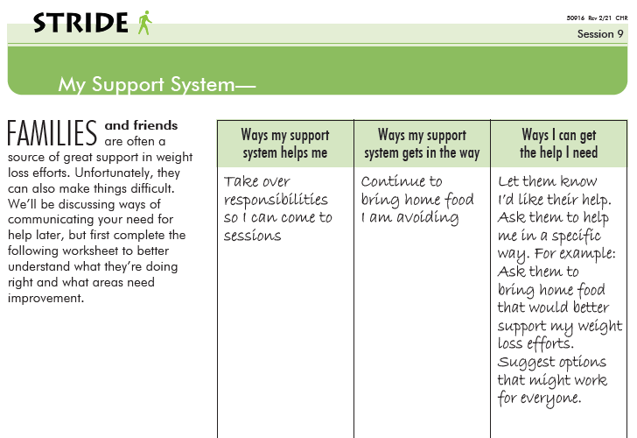
Session 9: Social Systems and Social Support
How has your support system reacted to any changes in your appearance?
How does your family or others at home manage during the times you are here or exercising?
Who has been most supportive?
How do your family and friends support you?
Who has been unhappy by the changes you’ve made?
How have you reacted when you felt someone was unhappy with changes you have made?
What changes have been most difficult for your family and/or friends to make?
What changes have you noticed in yourself?
Notes:
SESSION 9b
First, we use a worksheet as a warm-up to this issue, which can be sensitive– you can either assign it the week before as homework, hand it out as people are arriving or waiting for the group to begin (if you’re in person), or just give a few minutes to complete it before opening the discussion. The discussion can occur in break-out small groups or a whole-group check-in, depending on the characteristics of the group. Use your judgment. You’re giving people a chance to process discouragement from unsupportive family, friends, or co-workers and to hear how others have handled that– either by speaking up for themselves, asking for support, or by learning to persist in spite of a lack of support, sometimes through encouraging self-talk.
Part of addressing other people’s lack of support is understanding it’s impact on you– your thoughts, your reactions. So, in the second part of the session we take this a step further and talk about the interaction of thoughts, emotions, and behavior.

Slide 13
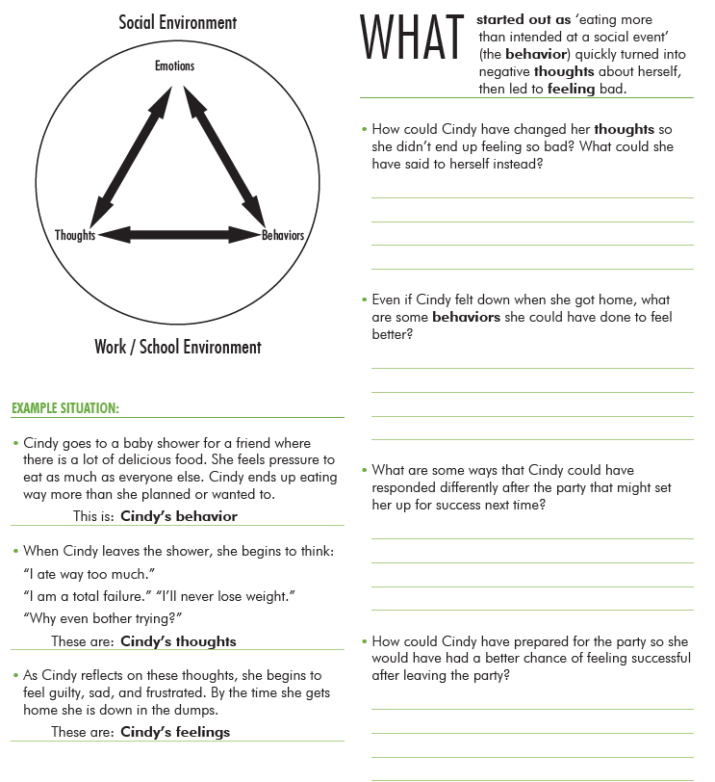
Session 9: Social Systems and Social Support
If Cindy had been able to resist eating more than she intended at the party, how might her thoughts be different? “I did really well at the party.” “I was really tempted to overeat but I didn’t.” “I am definitely going to be able to lose weight.” Relationship between behavior and thoughts
How might she feel differently? Relationship between thoughts and mood?
How could she have changed her thoughts so she didn’t end up feeling so bad? What could she have said to herself instead?
Even if Cindy feels down when she gets home, what are some behavioral changes she can do to feel better? Go for a walk, talk to a friend about the situation
What are some ways that Cindy could have responded differently to eating too much high calorie food at the party? “I have been doing pretty well and this was first time I have gone to a party since I have been trying to lose weight. Next time I will be more prepared for that kind of situation.”
How could Cindy have prepared for the party so she would have had a better chance of feeling successful after leaving the party?
Notes:
Again, we’re using a worksheet here, so participants interact with the content. We’re introducing this concept of the interrelatedness of behaviors, thoughts, and emotions, we’ll revisit this in Session 11 and in deeper detail in Session 12 when we talk about reframing negative self-talk. For now, we’re just planting the seeds for those later conversations to bloom. You’ll see that throughout the manual, it’s a strategy we use to introduce something and later revisit it and take it further– we know that repetition is important for learning. We’re giving participants space and time in the group to think through these connections that they might not otherwise think about. You work through a fictional example of “Cindy” who is invited to a party and ends up overeating and then finds herself in a shame spiral and feeling down. And you’re going to ask participants what she could do differently to potentially have a different outcome. You can have them fill out the worksheet at this session if there is time or you’ll see that in Session 11 there is dedicated time for filling it out in small group discussions so you have flexibility. You should at least review it in Session 9 and then you can revisit later if you’re short on time.

Slide 14

Session 10: Medication Side Effects & Weight Gain
Discuss Mental Health, Medications, and Weight Gain
Goals for Next week
Check-in
Notes:
Many people discontinue their mental health medications because of undesirable side effects, particularly increased appetite/thirst and associated weight gain or somnolence that makes it difficult to be active; we think it’s really important to empower our participants with the confidence and skills to have conversations with their prescribers about the benefits and disadvantages of their medications and to discourage them from abruptly discontinuing medication use because their discouraged about weight gain or difficulty with weight management. This session allows them to practice assertiveness in small groups, work out the language to use to express their concerns and partner in the decision making about their care. The goal is to equip them to have agency to participate in their care.
[MAY SKIP THIS SESSION IF ATTENDEES ARE COMFORTABLE WITH THIS TOPIC]

Slide 15
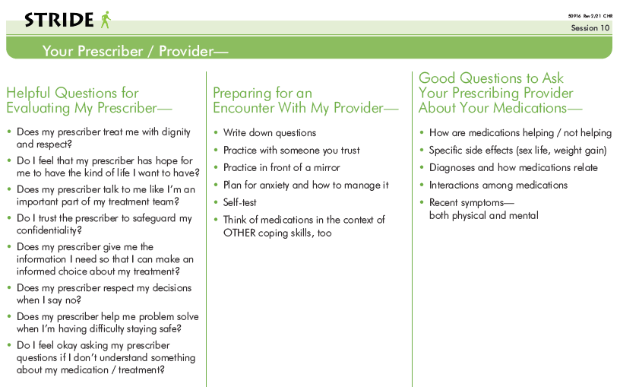
Session 10: Medication Side Effects & Weight Gain
Notes:
This is the worksheet we use to guide the small group discussions and to give tips for preparing to talk with medical personnel. These materials were developed in partnership with a patient advocate that we worked with in a larger body of mental health recovery and wellness research.

Slide 16

Session 11: Stress Management and Sleep
Stress
Management
Goals for Next week
Check-in
Notes:
SESSION 11a
[MAY SKIP THIS SESSION IF ATTENDEES ARE COMFORTABLE WITH THIS TOPIC]

Slide 17

Session 11: Stress Management and Sleep
Discuss definitions of stress and have participants discuss what they experience when they are stressed
Explore ways that stress affects diet, exercise and sleep.
Hand out “Thoughts, Behaviors and Feelings” activity and discuss stress management techniques
The Importance of Sleep
Discuss the impact that poor sleep has on overall health.
Discuss the benefits of good regular sleep
Hand out “Helpful Tips for Restful Sleep” and discuss
Notes:
This is the content for this session– this is where you can take more time to complete the worksheet from Session 9 tying together the behavior-thoughts-feelings triangle with stressful stimuli. If you’ve already completed that worksheet as part of session 9 there is an optional progressive muscle relaxation activity in this session so you can guide participants through that or use an app to do so.
In addition to stress we really want people to make the connection between the quality and quantity of their sleep and how that affects their energy and appetite. We encourage them to use their food diaries—where hopefully they are recording minutes of exercise and sleep– to really examine their own patterns and see when they feel better and worse. People can feel very hopeless over their sleep if insomnia is a factor so again, we’re trying to educate them about the importance of sleep and its relationship to their health, give them some tools for sleep hygiene, and try to help them take some control over the insomnia (or hypersomnia); they may need to talk with their doctor about the timing of their medication but they can use the skills from Session 10 to do that.

Slide 18


Session 12: Are You on Target? Progress Check, Reframing Negative Self-Talk
Reframing Negative Self-Talk
Using Positive Affirmations
Goals for next week
Check-in
Notes:
This is the 2nd of 3 progress checks, Session 12 is halfway through the program (not counting the maintenance sessions). You want to really focus on taking stock of progress and give plenty of time for people to talk about achievements as well as those things that are still difficult, and you may be hearing about plateaus which don’t come up in the session content until Session 18 but if you’re hearing a lot about them in the groups you have the flexibility to skip ahead to that content and come back where you left off– you can always feel free to customize the ordering of the sessions to be responsive to the group’s needs. This is why being familiar with the order is important, and that will come over time, but that way you know if you’re going to be covering something soon and can put that out there as an incentive (“Keep coming, we’re going to talk about that in two weeks”) or if you need to re-order to maintain engagement.
So in this session there is a progress worksheet– you can pair people up to interview one another if you’re looking for another way to keep things interactive.
A big part of the session is spent becoming familiar with negative thinking, reframing, and thinking spirals, which were previewed in sessions 9 and 11. Now you get to go deeper with that content, and if participants are already familiar with the concepts because they’ve had a lot of CBT, here they get the chance to apply that to this intimate part of their lives– shame around overweight and obesity. This can be really powerful.
This session includes the 2nd Progress Check which we covered in Session 7.

Slide 19
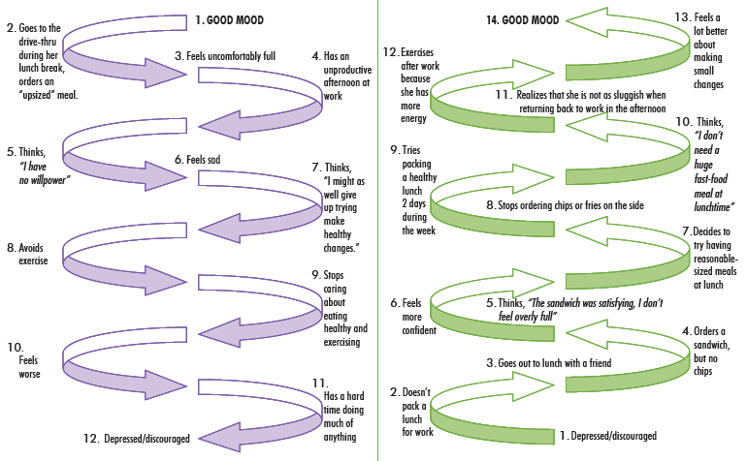
Session 12: Are You on Target? Progress Check, Reframing Negative Self-Talk
Negative Mood Spiral
Positive Mood Spiral
Notes:
This image is part of a worksheet focused on how to challenge negative thinking. You’ll see a positive mood spiral is juxtaposed with the downward spiral on the left. There is also time in this session spent on identifying types of thinking errors– the goal is not that people would know that one error is called “all-or-nothing” thinking and another is called “thinking the worst”, I’ve seen people get caught up on that and the labels are not important its exposure to different types of thoughts that can put someone in this negative thinking/mood spiral. You’re helping participants recognize these destructive thoughts so they can replace them. There is time spent generating alternative positive affirmations and I would encourage you do that as a group because some people are really unskilled at doing this and they need other people in the group to speak truth to them and help them learn how to speak it to themselves, they need it modeled for them repeatedly. This practice of replacing negative thoughts with more beneficial thoughts that are more likely to lead you toward the outcome you want than away from it, this is something you really want to reinforce in the groups. Model it, reinforce it when group participants model it, give more affirmation than you think you need to. And then give some more. It’s part of the secret sauce that makes the group successful.

Slide 20

Session 13: Conscious Eating
Eating Awareness /
Conscious Eating
Goals for next week
Check-in
Notes:
SESSION 13a
This session will explore ways for participants to be aware of their eating patterns, particularly around snacking. Including snacks throughout the day can help avoid hunger levels from getting too high in between meals. Snacks are also a good opportunity to fit in fruits and vegetables. It is important for participants to identify their snacking patterns to determine if they are using snacks to their advantage versus “mindless eating” or eating out of habit instead of hunger. I encourage ppts to differentiate between snacks and treats. A snack might be that apple that you have late in the afternoon, while a treat is the Frappuccino you grab after lunch. Treats are fine for a once in a while indulgence (“Treat treats as treats”).
One way to create awareness around eating is to practice “conscious eating”. This just means being aware of what, where, and how you’re eating. Are you putting your meal on a plate and eating at the dining table? Or eating takeout from a box while watching TV? Have you ever reached the bottom of a bag of chips and not realize that you had consumed the whole bag? Or eaten something that you really weren’t enjoying?
We’re going to do a conscious eating activity that is included in this session. We had asked you to bring a food item, so now is the time to reach for that. This activity is just to allow us to practice using all their senses to experience foods. I’m going to walk you through eating the food item that you brought. Go ahead and pick up the item, but do not put it in your mouth yet. Take a moment to observe it…how does it look, how does it feel, does it have an aroma? Go ahead and place the item in your mouth, but don’t chew it yet. See what you notice about the flavor, and the texture. Now go ahead and slowly chew the food. Chew the food at least 10 times before swallowing.
ALLOW A FEW MINUTES TO DEBRIEF There is no “right” or “wrong” with this activity. People may notice that they enjoyed a food more, or less, than they might have anticipated. They may notice things about the food that they hadn’t noticed in the past.
If STRIDE is being delivered virtually, it might work to have ppts provide their own two tasting items. It could be anything, just a small bite of something. [If doing this, give ppt’s a head’s up at the end of the previous session (12) so that they can be prepared.]

Slide 21
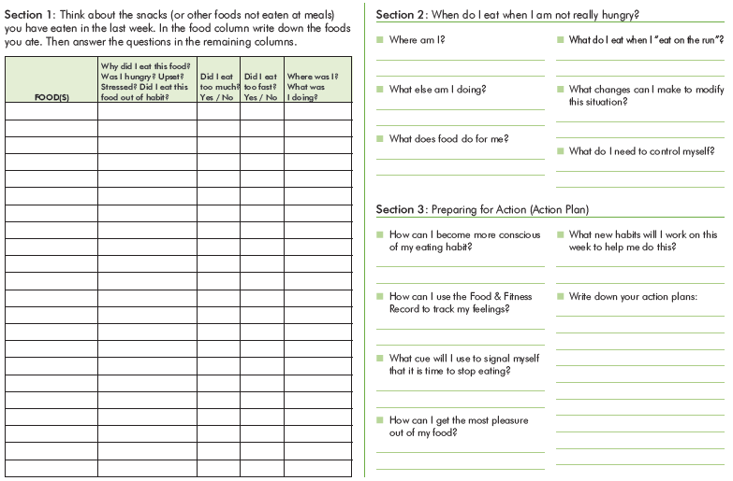
Session 13: Conscious Eating
Notes:
SESSION 13b
The handouts for this session will provide tools for participants to use to notice how they are eating their foods. Are they multi-tasking while eating? Are they eating when they’re not actually hungry? Are they enjoying their foods?

Slide 22

Session 14: Overeating and Emotional Eating
Overeating and
Emotional Eating
Goals for next week
Check-in
Notes:
SESSION 14a

Slide 23

Session 14: Overeating and Emotional Eating
Hunger – Fullness Scale
2 3 4 5
Hunger Fullness
Notes:
SESSION 14b
The “Hunger-Fullness Scale” is a simple tool that can be used anytime to evaluate how hungry we really are. Take a moment to rate your hunger from 1-5, a 1 would be extreme hunger, while a 5 would be extreme fullness. It’s best to stay right in the middle, around a 3. This scale can be used before, during, and after a meal or snack. This can help you to plan how much to eat as well as recognize when you are starting to feel full. For example, if it’s time for lunch and your hunger is about 1.5, you’ll probably want a heartier meal. If you’re at a comfortable 3, you could have a lighter lunch. If you’re contemplating a 2nd slice of pizza, you could use the scale to assess your hunger/fullness. Do you want another slice because it’s there? Or are you still a little hungry? If you’re already at a 3, would another slice push you to a 4 where you might start feeling a little uncomfortable?

Slide 24

Session 15: Dining Out
Dining Out and
Weight Loss
Goals for next week
Check-in
Notes:
SESSION 15a
This session explores strategies for making healthier choice when eating away from home (ie, restaurants, family gatherings, potlucks). Several menus from local restaurants will be needed for one of the activities. The intent of this session is to have participants think of ways to mitigate high calorie, processed foods. Avoid a “bad foods” vs. “good foods” approach, but rather help participants think of ways that they can still enjoy eating out in a sensible way. Remind participants about “energy balance”.
[MAY SKIP THIS SESSION IF RUNNING SHORT ON TIME]

Slide 25

Session 16: Importance of Physical Activity
Importance of
Physical Activity
Goals for next week
Check-in
Notes:
SESSION 16a
This session revisits the benefits of exercise and the benefits of different types of physical activity. We discuss strength training and provide resistance bands to participants and demonstrate some simple exercises.
This session is fairly light, especially if not doing the resistance exercises. Use extra time to revisit topics that participants may be struggling with or to really devote to setting SMART goals. Next “Are you on target?” session is Session 18, so this could be a good time to encourage participants to reflect on areas they would like to focus on during the next two weeks.
NOTE: The next several sessions are reviews of previous topics. There may be time during the session to review any areas/topics that participants may be struggling with, or to do a more in depth check-in, or longer walk, etc.
[MAY SKIP THIS SESSION IF RUNNING SHORT ON TIME]

Slide 26


Session 17:
Revisiting Meal Planning and Portion Control
Revisiting Meal Planning
Revisiting
Portion Control
Goals for next week
Check-in
Notes:
Session 17
This session is a review of past topics. Participants are often excited to share tips that they’ve discovered, tricks that work for them, a new favorite healthy food or restaurant. It could be fun to provide time for sharing and exchanging of ideas during this session.
[MAY SKIP THIS SESSION IF RUNNING SHORT ON TIME]

Slide 27


Session 18: Are You on Target?
Progress Check, Motivation, and Problem Solving
Assessing Motivation
Problem Solving
Goals for next week
Check-in
Notes:
Session 18
Assessing motivation is an important discussion to have at this point in the program. As needed, remind participants that while this is hard work, they have accomplished a lot. Even “just” attending the weekly groups is something to be proud of, they are making the choice to attend. Help participants reflect on where they were at Session 1 compared to today and acknowledge all the victories, big and small. Ask participants to think about what they want to focus on during next 6 weeks (ie, before transitioning to monthly sessions).
[MAY SKIP THIS SESSION IF RUNNING SHORT ON TIME] -- don’t skip???, just keep it brief

Slide 28


Session 19: Planning for Future Social Support
Planning for Social Support
Seeking an Exercise Buddy
Goals for next week
Check-in
Notes:
SESSION 19a
[MAY SKIP THIS SESSION IF RUNNING SHORT ON TIME]

Slide 29


Session 20: Beyond Triggers
Beyond Triggers and Managing Slips
Exercising During Busy Times
Goals for next week
Check-in
Notes:
Session 20
This session is a good opportunity to promote empowerment and self-efficacy. The activities will help participants to tailor what they have learned in STRIDE to help them troubleshoot challenges that come up in day-to-day life. The session addresses the importance of recognizing triggers and how they may lead us astray. It is also important to notice when we’re starting to slip into old habits. We acknowledge that these “lapses” are bound to happen and it’s OK, but having a plan in place will help to prevent “lapses” from becoming “collapses”. We also spend a bit of time thinking about ways to be sure we get exercise when life gets busy.

Slide 30
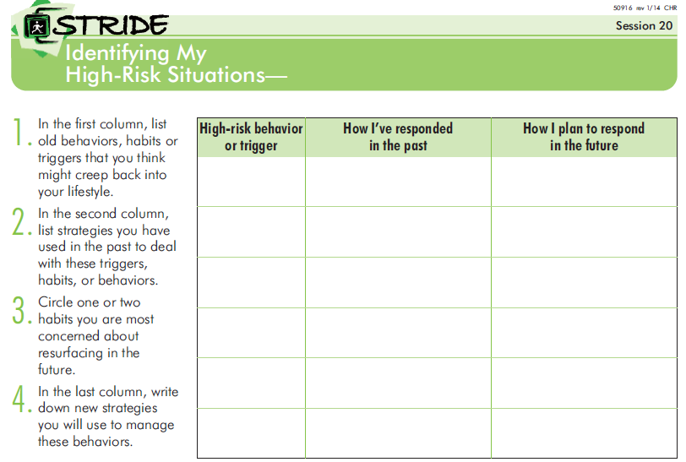
Session 20: Beyond Triggers
Notes:
Session 20
The handout for this session helps participants to set their own personal rules or “contracts” for self-accountability. It allows some wiggle room when making choices about the healthy habits they’re establishing and maintaining. Be sure to allow ample time for this particular handout. This activity really helps participants to think about those triggers or situations when they may be tempted to stray from their goals and plans. Have participants identify a few of their High-risk Behaviors. They’ll then jot down ways they have dealt with the trigger in the past, and then they’ll come up with a strategy for a new way to respond. So if someone is aiming to go for a walk outside everyday, a trigger for them maybe the weather. In the past if it has been too cold or rainy, they may have responded by not going out for a walk, and just skipping exercise that day. A new way to respond could be to have a back up plan, maybe staying indoors and doing an exercise video instead or go to the mall to walk inside.
We’re going to take a few minutes now to do the activity included in this session.
[ORGANIZE THREE GROUPS/BREAKOUT ROOMS]
We’ll break off into three groups. Once we’re in our groups, take 2-3 minutes to fill out the worksheet, particularly the first two columns. Then, as a group share your responses. If needed, help each other come up with some ideas for your third column. We’ll come back as a larger group in about 8-10 minutes.
[RECONVENE, DEBRIEF]
Help participants to explore all the tools that they have learned through STRIDE and encourage them to find the ones that work best for their situation. Having a plan, and maybe even a backup plan, in place will make it easier to get back on track after a lapse.

Slide 31
Session 21: Managing Plateaus
Managing Plateaus
Goals for next week
Check-in
Notes:
Session 21
Plateaus are a very real, very frustrating part of weight loss which can be discouraging for participants. A true plateau is when the scale doesn’t move – up or down – for several weeks, despite adhering to the same routines. Participants will often feel that they are plateauing if their weight stays the same after a couple of weeks, so encourage them to be patient and continue with their positive changes.
To address plateaus, participants should assess where they are at. Have they reached their weight loss goal? Is losing more weight realistic for them? Are they holding themselves accountable with their current behaviors? Has complacency set in? (eg, has there been any “portion” creep? Are they getting true moderate intensity exercise most days?)

Slide 32
Session 21: Managing Plateaus
Strategies for addressing a weight loss plateau:
Exercise – Switch up the type of physical activity, add resistance exercises, increase duration/frequency/intensity.
Calories – Review daily caloric needs, reassess portion sizes.
Body Composition – Notice how clothes are fitting.
Motivation – Reflect on accomplishments, remember your “why”.
Medical Problems or Medications – Work with your healthcare provider if there is concern about a potential issue or medication.
Notes:
Session 21
There are some helpful bullets in the Facilitator Manual that you can discuss with participants. A fairly easy strategy is to simply mix things up a bit with exercise and food choices.
Exercise - It is easy to get into a routine/rut with exercise, so switching up their pattern a bit can help, both for physical benefits and for the stimulation of doing something a bit different.
Calories - With food choices, it’s often easier to approach this as focusing on portion sizes and food choices rather than calories:
Order 8oz latte vs. 16 oz
Swap out cereal & milk, for yogurt & fruit for breakfast
Review food logs for any foods or portions that may be creeping back up
Body Composition – Notice on how clothes are fitting and reflect on how you’re feeling – do you have more energy, are you sleeping better, etc.
Motivation – Revisit why you chose to work toward a healthier lifestyle
Medical Problems or Medications – Encourage participants to check in with their provider if they are concerned about any medical issues
The topic of plateaus may come up earlier in the program, so feel free to content from this session when needed.
[THIS SLIDE JUST HITS THE HIGHLIGHTS FROM THE FACILITATOR MANUAL]

Slide 33
Session 22:
Exercising to Maintain Weight Loss
Also…
Start to prime participants for the transition from weekly to monthly sessions.
Ask the group how they would like to acknowledge their accomplishments at Session 24.
Check-in
Exercising to Maintain Weight Loss
Goals for Next week
Notes:
Session 22
This session takes a look at findings from the National Weight Control Registry. This is a registry of 10,000 members who have lost weight, and kept it off. The research findings offer some insight to characteristics of these members and the keys to their success.
Remind participants that there are two more weekly sessions before moving to monthly sessions. Have a group discussion about how they would like to celebrate their accomplishments. There’s a list of ideas on the Supplemental Resources handout that you could use if needed.

Slide 34

Session 23:
Planning for Changes in Mental Health Status
Planning for Changes in Mental Health Status
Goals for Next week
Check-in
Notes:
By design, the content of this session is less than previous sessions. Rather than being primarily psycho-educational in nature, this session is designed to be a process session. This session is meant to help participants anticipate barriers to maintaining healthy changes in diet and exercise during episodes of mental illness or recovery and create solutions for such situations.
It begins by acknowledging that episodic mental health issues are a threat to maintenance of healthy habits. Participants are encouraged to think about identifying some of the benefits of having a plan and staying on track with healthy diet and physical activity throughout episodes of mental illness. There is some group work (brainstorming benefits to having a plan and anticipated barriers). The goal of this exercise is to acknowledge and honor these very realistic barriers. Many people will have had failed experiences of trying to take better care of themselves during mental illness. Group leaders should allow sufficient time for participants to process the frustration that accompanies these failures without feeling the need to address these barriers. It is essential to end this exercise by summarizing the benefits rather than ending on the reasons participants might fail at maintenance
A worksheet guides them through creating a personalized plan…

Slide 35
Session 23:
Planning for Changes in Mental Health Status
WHAT are my triggers that I might be entering an episode of mental illness?
WHAT if I don’t notice these triggers? Who can I rely on and trust to inform me that I might be entering an episode of mental illness?
WHAT should I do when I notice these triggers or they are brought to my attention?
WHAT can I commit to doing to help maintain healthy eating habits when I have a change in my mental health status?
WHAT can I commit to doing to help maintain my current level of physical activity when I have a change in my mental health status?
Notes:
SESSION 23b

Slide 36



Session 23:
Planning for Changes in Mental Health Status
ARE my plans realistic? Are they reasonable?
WHAT barriers might get in the way of these plans?
WHAT can I do to overcome these barriers?
WHO can I rely on for support?
WHERE should I keep this plan so I have it when I need it?
Notes:
Some of the questions invoke the SMART goal setting they’ve been working on throughout the program to reinforce realistic expectation setting.

Slide 37

Session 24: Celebrating Accomplishments
Celebrating Accomplishments
Next Steps
Open
Notes:
Session 24
Acknowledge any trepidation participants may feel about this last weekly session, but try to keep the discussion upbeat. It’s helpful to gauge participants feeling about moving to monthly sessions, during the previous sessions.
If appropriate, suggest that participants exchange phone numbers, or arrange “meet ups” to go for walks. This could help with support and accountability during the monthly intervals.

Slide 38




Sessions 25-30:
Monthly Maintenance Sessions
Establish an agenda for remainder of meeting
Session Topic(s)
Goals for Next Month
Check-in
Notes:
Monthly Sessions
The check-in will likely be the most robust portion of these sessions. The Facilitator Manual includes a list of suggested topics to review for each of the monthly sessions, however prioritize the needs/requests of the participants.
Be sure to include a walk, or other physical activity, and allow plenty of time for goal setting and sharing.

Slide 39


Sessions 25-30:
Monthly Phone Maintenance Sessions
Check-In
  Assess how participant feels about their current status
  Review progress toward goal(s) set at previous session
  Troubleshoot any challenges, acknowledge successes
  Offer support
  Remind about next group session
Notes:
Monthly Phone Calls
These calls will help to keep participants engaged during the monthly intervals. It may help to schedule the calls in advance (ie, during the monthly session) so facilitator and participant can have it on their calendars. These one-on-one calls are a good opportunity for facilitators to have a more tailored interaction with each participant. Again, realize that this mode of contact may resonate more, or less, for some of your participants. Some may really like the individual conversations with you, and for others it may be more of a brief check in to review goals. Some participants may struggle during the monthly phase, others will continue to keep themselves on track and maintain their changes.

Slide 40
Maintaining engagement, problem-solving participant challenges
Utilize active listening and open-ended questions to seek to understand participant’s perspective.
Not all participants are driven the same way. Each participant with have their own needs, interests, and resources.
Session topics may not resonate with everyone, every time. Some participants enjoy large group discussions, while others prefer small group activities.
Encourage the group to be patient with each other and the process.
Underscore the importance of each participant’s presence in the group.
Notes:
CHRIS

Slide 41
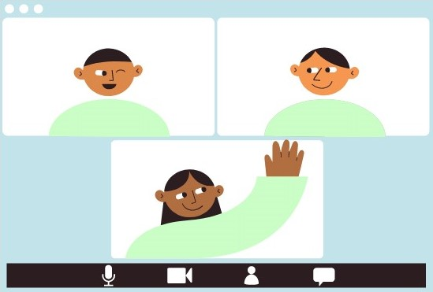
Delivering STRIDE virtually
Considerations for translating group sessions to virtual format.

