Slide 1
Adult Resilience Curriculum (ARC)
Values

Slide 2
Delivery & Tailoring Instructions
Prior to delivering, get information from audience about their current struggles and needs. Use that information to decide what should be tailored
To tailor, you can change the following:
Hook & Transition metaphors
Your “Who I Am” slide & credibility slides (referent, information, positive expert power)
Any of the background intro slides (if Module 1 has already been delivered)
The order of the slides (before activities)
Activities (based on time frame)
Knowledge Check questions
Discussion Questions
To make changes to the Activities, Knowledge Check Questions, and Discussion Questions, you can:
Hide the activities you do not want to do
Replace the knowledge check section of each final activity slide with the proper knowledge check question(s)
Delete whichever discussion questions you choose not to provide. Make sure these questions are provided in a follow up forum/document/delivered in-person by a member of the healthcare professional team after at least 1 week of practice.

Slide 3
Delivery & Tailoring Instructions
Make sure the tailoring is done to fit within the appropriate time frame
The structure and design of the powerpoint is actually based on a combination of successful TedTalks (that involved audience participation) and research on how to present to adults
This includes the Hook, Transition, Who I Am, and Audience Benefit slides
Limited text
Use of imagery
MINIMIZE reading text on slide; research indicates this actually disrupts audience comprehension
Set expectation for participation at the outset

Slide 4
Delivery & Tailoring Instructions
Things to remember
Expert power can be negative if audience portrays a) you are leveraging your expertise in one domain into another, b) if your expertise appears outdated, c) your expertise is impersonal (i.e., not recognizing the audience’s perspective), and d) if they portray you as having something to gain
What is comfortable for us, the presenter, is maybe not engaging for the audience.
Charismatic power is something; you are acting for your audience and that is encouraged. People will buy-in if you seem bought-in. Find the charisma personality that you can put on confidently.
Sell the “Why”, not the “what” or “how”. Those are ARC and the modules. But the “Why” is most important

Slide 5
Notes:
The Hook
*Use or replace with your own metaphor that illustrates values as observable actions*
Let me introduce you to this upcoming UK band—Jenny and the Socks. They are fire right now and they are very open with the public about what they care about. For them, life is music and socks.
They are hosting an audition for a fifth band member. And you just so happen to be an incredibly gifted musician. There is no instrument you cannot play—no melody too complex for you to nail with precision and emotion. This could be your real big moment to break into international fame.
But you care nothing for socks. If you were to rate yourself right now on how much the style of your sock means to you, what would it be? From 1-10, maybe a 2? Where is it in relation to eating a good meal? Above or below?
*Pause*
Yet, Jenny and the Socks live and breathe socks. Seems a little strange right? Maybe inconsequential? Maybe you are wondering why they care so much about socks? Whatever you are thinking, you know uou have got to convince them that socks are second only to music for you too. How do you do it?

Slide 6
Notes:
There are numerous things you can do. First, you might walk into the audition rocking your own pair of sweet socks. Someone who really cares about socks would certainly put in the time and effort to find a good, unique, comfortable pair and wear them to the audition.
You might also show them your own sock collection. If you don’t have one, maybe to prepare for the audition, you go and purchase some. Or you find abandoned socks from second-hand stores and give them a new home. You may even choose to share that story with Jenny and the Socks. I am sure they would be really impressed that you foster abandoned socks.
You might even spend several hours crafting a song that resonates with the majesty of socks.
If you did all these things, what do you think Jenny and the Socks would think? Would they know that you started out not caring for socks? I would be willing to bet they’d give you the band spot right away because, to them, you didn’t just talk the talk that you loved socks, you walked the walk in your socks.
And how do you think you would feel after all that effort? Socks may still not be the most important thing to you. But, I would be willing to bet that some part of you now has a small appreciation for them. Maybe you found a few that make you smile. Maybe the song you wrote gives you some sense of joy while listening to its playback.
And that is what happens when we focus on our actions and the values that underlie them. No matter how seemingly small and insignificant something may seem, when we engage in actions that are aligned with a value, we can find meaning and purpose in that action. Values and aligned actions are the canvas upon which we make sense of why we do certain things. And that gives us the ability to weather difficulties.

Slide 7
WHO WE ARE
Christian Klepper, PsyD, LP
Faculty Trainer
Notes:
Who I Am
*Replace with your photo, change name(s), make sure to highlight your credentials (expert), your area of expertise (expert, informational power)*

Slide 8
WHO WE ARE
Hannah West,
PhD, BCBA
Regional Trainer
Notes:
Who I Am
*Replace with your photo, change name(s), make sure to highlight your credentials (expert), your area of expertise (expert, informational power)*

Slide 9
The Adult Resilience Curriculum (ARC)
Notes:
As a quick reminder, the Adult Resilience Curriculum – or ARC – is transtheoretical and comprehensive, yet flexible. The ARC was originally developed in 2013 by Dr. Clayton Cook and Dr. Gail Joseph for pre-service and in-service teachers. It is designed to promote wellbeing and enhance people’s capacity for resilience. It builds upon the strengths of existing programs, while trying to make the content more accessible and feasible for real-world professionals in various disciplines. This curriculum is NOT designed to replace mental health services or treatment.

Slide 10
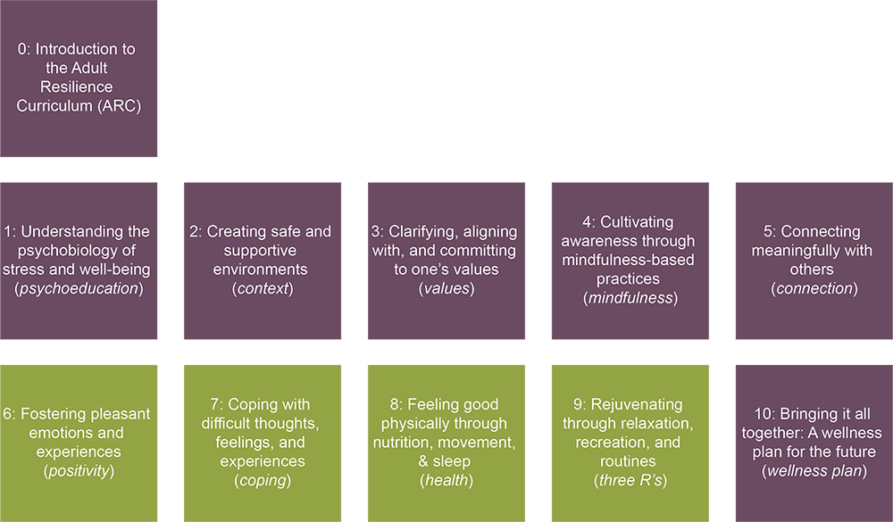
The ARC Modules
Notes:
The ARC program is broken into 10 modules, preceded by a brief, introductory module 0. Modules 1 through 5 and module 10 make up the "core" modules. Modules 6 through 9 are supplementary and provide additional opportunities to learn and practice resiliency skills. Finally, the 10th module brings the curriculum together. It is required at the end, regardless of if you do any or all of the supplementary modules.

Slide 11
Our Hopes for Today
Values
Determine the difference between values and goals.
Clarify your own values and identify goals that let you track your progress toward values.
Create an action plan to spend time deeply engaging with your values as a healthcare professional.
Notes:
This module is about clarifying, aligning with, and committing to our values. We hear about values a lot, especially in political discussions. Yet, in the modern world, we rarely take the time to sit down and reflect on our values and how they guide our lives. Reflecting on our values can help us determine if our lives are going the way we want them to be.

Slide 12
MODULE 3: Clarifying, Aligning with, and Committing to One’s Values
Notes:
Let’s start with a metaphor that may help us think a little differently about our values and how we can use them… I went camping recently. It is absolutely one of the most enjoyable experiences for me. And despite the modern age and all our modern technologies, there are always staple gear you take. One of these things, that has existed for millennia, is the compass.
A compass always points in one direction, even if we are walking in another direction. This is different than the modern GPS. GPS points to a specific location, not a direction. Once you get there, the GPS stops. But what does the compass do? It continues pointing North. It’s never ending in its usefulness.
Imagine you always have a little values compass in your head that you can refer to at any point in your life. That is, in short, what this module is about; remembering to pull out our values compass and get back in the direction of life that we want to be headed toward.

Slide 13
Values Components
What are Values?
Values vs. Goals
Values Clarification
Notes:
Here are the components of today’s lesson. We will talk about what values are. Then contrast them with goals. And finish with our clarification practices that help us set our compass to point North.

Slide 14
What are values?
Principles, ideas, things that are:
Chosen life directions/pursuits
Unobtainable & Ongoing
Of greatest importance
Known and unknown drivers of behavior
Core to who we are, often without an explicit “Why”
Notes:
So, what are Values? Simple question with a simple answer. Values are our chosen life paths. We use values to orient our behaviors. They help guide our daily actions and decisions. Our values make up our patterns of behavior and are unavoidable. They help us transform how we interpret our behaviors. Basically, when we think about values, we think about “what matters most” to us.
A key detail about values is that they are behavior in action.
And it is through our actions that we demonstrate those values to others. You know the saying, “practice what you preach”? This is it.
The challenging thing with values, though, is that we have to stay committed to them even when we face setbacks. Sometimes you get lost hiking. In those moments, you need to pull out your compass and see where it points. Worse, sometimes the compass points in the direction we want, but we turn to look that way, and all we see is a massive hill we are going to have to climb up. The same thing happens with values. Sometimes we have to stop, check in with them, and realize that to really be honest with our values, we are going to face challenges. We’ll talk in a later module about how to make that ‘stop’ and check-in process easier to do. But think how often you, friends, family, strangers talk about something they really care about and you find yourself wondering, well, why aren’t they going after that? Or why they do something that is completely opposite of what they say they care about. We all do it. But we rarely draw that same attention to our own struggles.

Slide 15
Be a good parent
Answering a never-ending stream of “why” questions
Be a loving partner
Doing favors that may annoy you
Showing interest in their passions even if you do not care as much
Be a supportive friend
Notes:
Some examples of going over our proverbial struggle hills in order to keep going in a valued direction are:
If we value being a good parent → that may look like answering a never-ending stream of “why” questions
If we value being a loving partner → that may include doing annoying favors
If we value being a good friend → we might be showing interest in our friends’ passions even if we don’t have the same passion
Notice that these statements all including a word ending in “-ing”— answering, doing, showing. That is because values are present-oriented and never-ending. They are constantly in action. And when we are not active, we are often not living according to our values. That is, saying what our values are is not necessarily enough to help us be the people we want to be; we have to act in accordance with them even if that makes things difficult. An example might be someone who commits to biking to work every day, regardless of weather and the lack of convenience, in order to reduce their carbon footprint.

Slide 16
Values
Goal
Value
Notes:
Let’s say you are camping and earlier in your trip you found a good campsite. You set up camp, left your supplies at the campsite, and went out hiking. You notice the sun is going down and you need to get back to camp.
Your compass can help point you in the right direction. And getting back to your campsite is the current goal. Along the way, you might also have smaller goals that let you know you are making progress toward your camp, such as finding a tree you remember laying across the path back. In the same way, you can use values and goals together; the value is a constant direction in life and goals are signposts along the way letting you know you are still working toward that value.
Another example is rock climbing. Rock climbing may be a value – something you enjoy doing. However, summitting a specific mountain peak—that is a goal.
People often mistake goals for values. We become focused on performance and demonstrating our accomplishments to others. But what happens when we fail to meet those goals? Often, we stop. Or when we meet those goals, we also stop because we were so focused on “getting there” that the thrill and excitement leaves once we got there. There isn’t an underlying current of purpose or value that drives us onward from goal to goal.

Slide 17
Notes:
Dr. Thayer joked earlier about children asking a lot of “why” questions. But, there is some remarkable wisdom in asking “why.” If I asked you what your favorite ice cream flavor is, you might say strawberry. And if I ask you why, you might say because of how fruity it is. If I keep asking why, you might be able to come up with some additional explanations but eventually your answer will simply be, “Just because it’s my favorite.” That’s a lot like a value. We engage in them just because. A goal might be to eat a scoop of strawberry ice cream from every ice cream shop in your city.

Slide 18
Notes:
This idea may help us understand the behaviors of other people, too. Take Rich Uncle Pennybags, the capitalist tycoon mascot from Monopoly, for example. Why is it that, in every shot with him, he is always smiling while surrounding by bags of cash, property he owns, and rows of houses and buildings? Sure, at first glance we might label him as greedy and we might even completely disagree with his approach. But if we look for the value underlying his massive wealth, what if, for him, it’s more about development? What if Rich Uncle Pennybags really enjoys building houses and apartment buildings people live in? Maybe there is some aspect of creativity or problem-solving that it fulfills. So although he might have plenty of money, for him, the value of buying and developing property is what keeps him in the game. And physicians that continue to work with their patients despite the incredible challenges they face during moments of crisis like a pandemic? Perhaps they value compassion satisfaction, or the perceived rewards of and gratification from caring for others, and have found a way to stay plugged into that value, too.

Slide 19
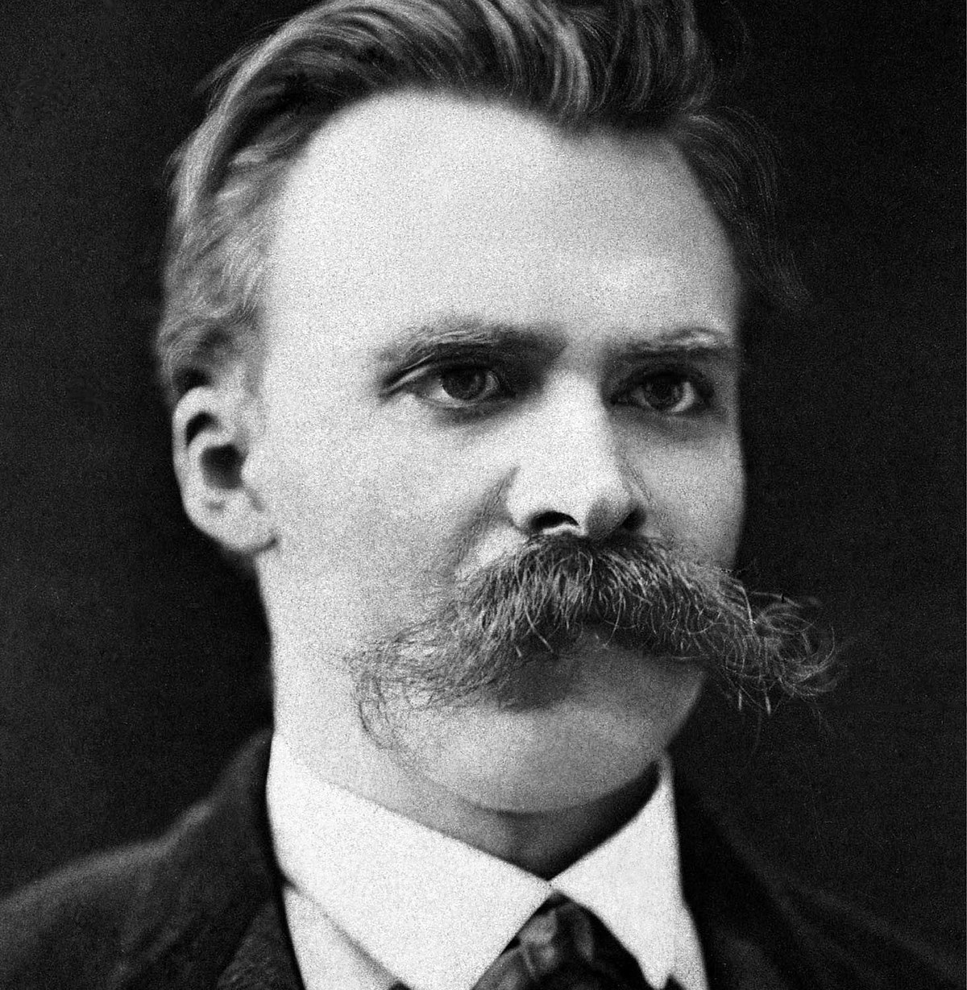
“Someone who has a why to live can bear almost any how”
-- Nietzsche
Notes:
Nietzsche “Nee-chee” is a controversial figure, yet we want to talk about one insight of his that is relevant and worthwhile. Interestingly, this insight isn’t just his; it appears across cultures, throughout history, and seems to go through cycles of resurgence.
That insight is “Someone who has a ‘why’ to live can bear almost any ‘how.’” Meaning, if you have a value and it is prominent in your life, you can overcome many things.
Healthcare workers are at increased risk for compassion fatigue, which results from chronic direct practice with trauma populations. When we forget our “why” it is easy to lose the sense of meaning in our work, potentially leading to sorrow, confusion, despair, withdrawal, emotional numbing, hopelessness, and even outrage. However, when we remember the “why” it gives us the reason to seek support and continue to find meaning and satisfaction in our “how.”

Slide 20
Values
Values Clarification
Value Domains
Value Statement
Committed Action
Notes:
This is the point we are going to reflect on our values. There are 3 steps: First, we identify the value domain, then our value statement, and then the committed action.
Value domains refer to the many hats we wear in life. Value domains include things like relationships, work and education, mental and physical health, religion and spirituality, and other things in our life that we value.
For example: I value my relationships and roles as a partner, friend, professor, sibling, aunt, and daughter
Value statements are specific and connected to a particular value domain—creating these statements requires that you turn inward
For example: I may ask myself “Who do I want to be as an adult daughter?” … “I want to be attuned to my parents’ needs; I want to be an attentive daughter.”
Values-committed behaviors are specific actions that you spend time thinking about or actions you want to engage in—these enable you to be the person you want to be.
For example: I might ask myself “What are the behaviors I can engage in daily that would enable me to bring to life the core value of being an attentive daughter?”
First, we identify a value domain (role as a daughter). Then, we create a statement that identifies a value within that domain (being attentive). And finally, we reflect on which behaviors will get us moving toward that value. These should be specific, measurable, and observable, like I will send daily text messages to my parents and call them at least once a week. We have developed activities that will be helpful for you in reflecting on your own value domains, value statements, and values-committed behaviors.

Slide 21
In-Session Activities
true north
bullseye
retirement party
my valued journey
life values inventory
Notes:
Your next steps are to get some practice with values clarification. Whether by yourself, with a partner, or in a team, select at least one or a combination of the following activities to reflect on your own value domains, value statements, and values-committed behaviors. These activities are paramount in fully developing the skills discussed in this module.
True North is an exercise that is brief and is best if you feel you are already clear with your values and just need to focus and reattune to the most important ones for now.
Bulls Eye is an exercise for focusing on broad value domains and helps you reflect on how you are doing overall in these areas.
Retirement Party is a fantastic imaginative exercise and is best if you are unsure of your values but know how you want to impact people; it will help you understand your values through that impact.
My Valued Journey encourages you to rank actions within certain domains, identify the most meaningful ones, and then identify new meaningful actions in those domains.
And last is the Life Values Inventory which is the most in-depth exercise for anyone who needs to deeply dive into values clarification.

Slide 22
Recommendations
Complete activity
Notes:
We recommend three next steps to take this information and apply it to your own well-being. First, please choose and complete at least one of the accompanying activities to identify your values. Do this so that you can experience how this process, the ongoing clarification and reaffirmation to your values, even when it’s hard, can actually be incredibly helpful.

Slide 23
Recommendations
Complete activity
Teach an activity
Notes:
Our second recommendation is that you take any one of these practices and teach it to your practice partner—whether that is a colleague, spouse, friend, or family member. Whoever you selected. Go over the activity with them too, and then work to use the strategy in everyday life. Get practice imbedding your values into your action.

Slide 24
Recommendations
Complete activity
Teach an activity
Create individual action plan
Notes:
The third and final step is to set an intentional action plan of your own. Action Planning is a critical step whenever we try to start something new. It helps us identify our barriers, our strengths, and how we can recover from setbacks when they inevitably happen.
Thank you again for watching and engaging with this lesson. Take care.

