Slide 1
Adult Resilience Curriculum (ARC)
Mindfulness

Slide 2
Delivery & Tailoring Instructions
Prior to delivering, get information from audience about their current struggles and needs. Use that information to decide what should be tailored
To tailor, you can change the following:
Hook & Transition metaphors
Your “Who I Am” slide & credibility slides (referent, information, positive expert power)
Any of the background intro slides (if Module 1 has already been delivered)
The order of the slides (before activities)
Activities (based on time frame)
Knowledge Check questions
Discussion Questions
To make changes to the Activities, Knowledge Check Questions, and Discussion Questions, you can:
Hide the activities you do not want to do
Replace the knowledge check section of each final activity slide with the proper knowledge check question(s)
Delete whichever discussion questions you choose not to provide. Make sure these questions are provided in a follow up forum/document/delivered in-person by a member of the education professional team after at least 1 week of practice.

Slide 3
Delivery & Tailoring Instructions
Make sure the tailoring is done to fit within the appropriate time frame
The structure and design of the powerpoint is actually based on a combination of successful TedTalks (that involved audience participation) and research on how to present to adults
This includes the Hook, Transition, Who I Am, and Audience Benefit slides
Limited text
Use of imagery
MINIMIZE reading text on slide; research indicates this actually disrupts audience comprehension
Set expectation for participation at the outset

Slide 4
Delivery & Tailoring Instructions
Things to remember
Expert power can be negative if audience portrays a) you are leveraging your expertise in one domain into another, b) if your expertise appears outdated, c) your expertise is impersonal (i.e., not recognizing the audience’s perspective), and d) if they portray you as having something to gain
What is comfortable for us, the presenter, is maybe not engaging for the audience.
Charismatic power is something; you are acting for your audience and that is encouraged. People will buy-in if you seem bought-in. Find the charisma personality that you can put on confidently.
Sell the “Why”, not the “what” or “how”. Those are ARC and the modules. But the “Why” is most important

Slide 6
Notes:
The Hook
*Use or replace with your own metaphor that illustrates thoughts being produced and you with the ability to observe them*
Let’s imagine you and your friends are at a sushi restaurant for your first time. This restaurant has a sushi train where different dishes are placed on a rotating conveyor belt that winds through the restaurant and moves past every table. So, you can see all the dishes moving along the belt like a train. All you have to do is choose what looks good, grab it off the conveyer belt, and enjoy. The chef is prepping a large variety of choices to replenish the train as diners choose their dishes.
You watch the dishes go by, deciding what you want. Some of the dishes are colorful and look very appealing. You find yourself drawn to those. Others have ingredients you have never seen before which leaves you curious but also unsure if you will like them. And others leave you with an empty, uninterested feeling. They don’t call to you but also do not make you feel anxious about trying something new to you.
As you watch the dishes go by, you start to daydream and wonder what type of dish you would be if you were sushi. Would you be one of the ones you find beautiful and appetizing? Or one of dishes that could be quite good but trying it makes you feel a bit anxious? Or maybe you would play it safe as a bland looking dish? You are suddenly very thankful that you are not a sushi dish. Instead, you have the luxury to simply watch all the dishes pass by and choose to pick up the dishes that you want. Who knows, you might even drum up the courage to try one of the newer dishes and find that there was little reason to be anxious—you actually like them.

Slide 7
Notes:
The Transition
The sushi train is much like how the brain and thoughts work, and your relationship with them. Your brain is like the sushi chef. It is constantly whipping up thoughts and passing them through your mind. Like the sushi, some of these thoughts are appealing to you. Maybe they are memories tied to strong positive emotions, or are about something you’re interested in. These types of thoughts you are happy to indulge in.
But your sushi chef brain is impartial to the type of sushi thoughts it makes; its only goal is to offer up a never-ending supply of thoughts. So, it also puts some negative thoughts on that sushi train—things that distress you, that you just don’t want, or that are paired with painful memories and emotions. It also throws in some bland thoughts that don’t affect you.
The trick is to realize that you are not your sushi chef brain or the sushi thoughts it creates. You know objectively that you are not a piece of sushi because you can see it. You can touch it, smell it, observe it, point to it and say, “That’s a Nigri or Sashimi or Spider roll.”
Similarly, you are a separate entity from the thoughts your brain serves up. You can notice your thoughts and identify them. You can point to one and even label it, “That is a self-defeating thought.” And therefore, you are not your thoughts. Instead, you can be a mindful consumer of your thoughts. Watching the sushi thoughts you do not want go by. And choosing to consume only the thoughts most helpful to you in the moment.

Slide 8
WHO WE ARE
Christian Klepper, PsyD, LP
Faculty Trainer
Notes:
Who I Am
*Replace with your photo, change name(s), make sure to highlight your credentials (expert), your area of expertise (expert, informational power)*

Slide 9
WHO WE ARE
Hannah West,
PhD, BCBA
Regional Trainer
Notes:
Who I Am (This is an example)
*Replace with your photo, change name(s), make sure to highlight your credentials (expert), your area of expertise (expert, informational power)*

Slide 10
The Adult Resilience Curriculum (ARC)
Notes:
As a quick reminder, the Adult Resilience Curriculum – or ARC – is transtheoretical and comprehensive, yet flexible. The ARC was originally developed in 2013 by Dr. Clayton Cook and Dr. Gail Joseph for pre-service and in-service teachers. It is designed to promote wellbeing and enhance people’s capacity for resilience. It builds upon the strengths of existing programs, while trying to make the content more accessible and feasible for real-world professionals in various disciplines. This curriculum is NOT designed to replace mental health services or treatment.

Slide 11
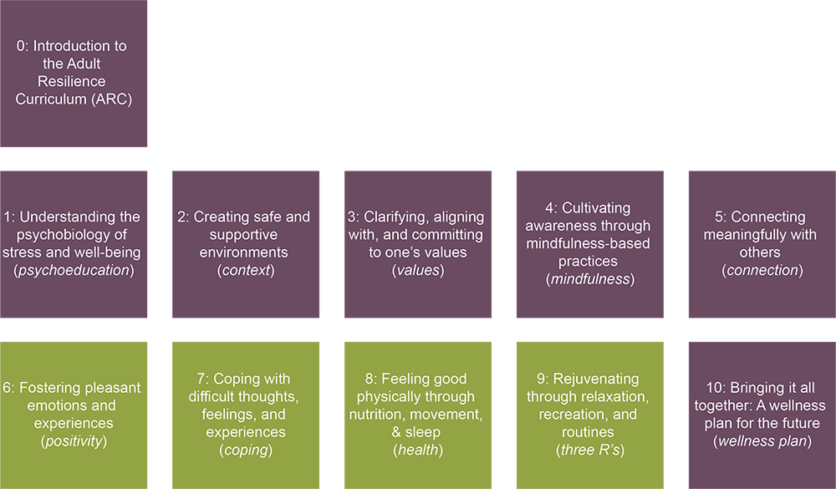
The ARC Modules
Notes:
The ARC program is broken into 10 modules, preceded by a brief, introductory module 0. Modules 1 through 5 and module 10 make up the "core" modules. Modules 6 through 9 are supplementary and provide additional opportunities to learn and practice resiliency skills. Finally, the 10th module brings the curriculum together. It is required at the end, regardless of if you do any or all of the supplementary modules.

Slide 12
MODULE 4: Cultivating Awareness Through Mindfulness-Based Practices
Notes:
What is the goal
This module is going to review mindfulness from the perspective that it is a skill that ultimately helps you build awareness. If you viewed module 3 on values, we briefly talked about how values are important for living the life that has the most meaning for us. And to do that, we need to be able to stop, reorient ourselves, and choose to engage in value-aligned actions.
Easier said than done. It is really hard to stop and notice when our actions are not aligned with our values, accept that, recognize the proverbial hills and difficulties that come with living a values-based personal and professional life, and then making a decision to act anyways. I am thinking of anytime we have to work with a student that frustrates us despite valuing being a mentor and model for children. Mindfulness is a way to create that space to reorient toward that value.

Slide 13
Our Hopes for Today
Mindfulness
Define the difference between mindfulness and mindlessness.
Know the elements of mindfulness and be able to apply them.
Evaluate the effectiveness of mindfulness strategies in the moment.
Notes:
The Audience Benefit
Here are our hopes for today. Mindfulness is a hot topic in psychology and even mainstream American culture these days. We want to make sure we are clear, though, on what it means to be mindful vs mindless, and to clarify what elements actually go into mindfulness. The caricature (care-ih-cat-ture) of mindfulness is that it is all about breathing and stoicism—those are certainly elements that are incorporated that you can adopt in your life, but it is also so much more interesting than that.
We will also give some guidance and space for you to evaluate how effective mindfulness is for you.

Slide 14
Value
Action
Be a supportive friend
Showing interest in their passions even if you do not care as much
Notes:
In this module we are going to review mindfulness from the perspective that it is a skill that ultimately helps you build awareness.
If you viewed module 3 on values, we briefly talked about how values are important for living the life that has the most meaning for us. And to do that, we need to be able to stop, reorient ourselves, and choose to engage in value-aligned actions. That is easier said than done.

Slide 15
Value
Action
Notes:
Connecting Values to Actions
It is really hard to stop and notice when our actions are not aligned with our values, accept that, recognize the proverbial hills and difficulties that come with living a values-based personal and professional life, and then make a decision to act anyway. I am thinking of any time we have to work with a difficult client that makes us want to throw our hands up in surrender even though we value the work that we do.

Slide 16
Mindfulness
Value
Action
Notes:
Mindfulness is a way to create space to reorient toward that value. And begin to engage in actions that are in line with our values.

Slide 17
Mindfulness Components
Background & Research
Elements of Mindfulness
Mindfulness Practices
Notes:
Components Overview
Here are the components of today’s lesson. We will briefly talk about some of the most critical background and research information on mindfulness, and define mindfulness based on its elements.

Slide 18
Mindfulness Components
Background & Research
Elements of Mindfulness
Mindfulness Practices
Mindful Breathing
Mindful Routines
Mindful Eating
Mindful Movement
Mindful Commute
Mindful
STOP
Notes:
Components Overview
Once we cover what mindfulness IS and IS NOT, we will review various practices you can use, from the traditional and always useful Mindful Breathing practice, to more active, everyday mindfulness practices you can do such as Mindful Eating and Mindful Commute.

Slide 19
Mindfulness
“
Paying attention, on purpose, in the present moment, and non-judgmentally.
- Jon Kabat-Zinn
“
Notes:
Defining it academically
To start, we will give a basic definition of what mindfulness is, and then embellish on it. Jon Kabat-Zinn “cab-it zin” is a prominent name in the modern mindfulness work and he defines mindfulness as,
“Paying attention on purpose, in the present moment, and non-judgmentally”
What does this mean?

Slide 20
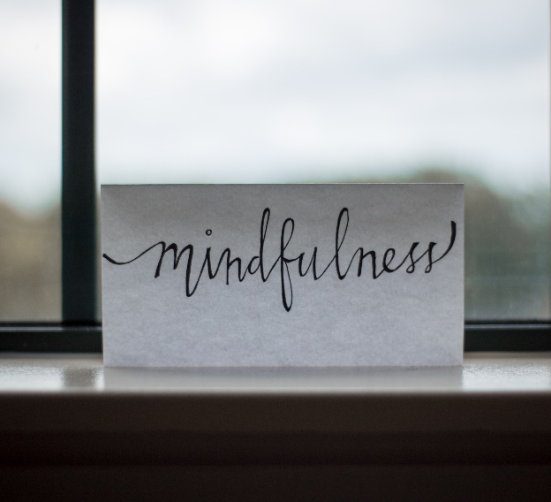
Mindfulness
“
Purposeful awareness
Paying attention, on purpose, in the present moment, and non-judgmentally.
- Jon Kabat-Zinn
“
Notes:
First, it means being fully immersed in the present moment. It is recognizing, for example, when it is 3pm, we’re hitting an energy slump, our stress has built up over the day, and we are tired. Instead of looking forward to the end of our shift and the relief it may bring us, mindfulness encourages us to not run from this moment. But instead to simply sit in and acknowledge that in that moment things are not feeling great. And that’s okay. That’s the non-judgmental component.

Slide 21
Mindfulness
“
Purposeful awareness
Open & gentle attitude
Paying attention, on purpose, in the present moment, and non-judgmentally.
- Jon Kabat-Zinn
“
Notes:
Mindfulness can be used when you are experiencing some of the effects of burnout or compassion fatigue. Mindfulness helps teach us it is okay to be tired. It is okay to be grumpy. It is okay to have negative thoughts and emotions. These do us no harm, just as it does no harm to sit in our favorite sushi restaurant and occasionally see an unwanted sushi dish pass before us. If we judge that as entirely bad and unwanted, it might encourage us to leave the sushi shop even if there are delicious sushi dishes coming down the train. Same with our thoughts. We can notice and be gentle with our thoughts and our experiences.

Slide 22
Mindfulness
Intentionality or agency
“
Purposeful awareness
Open & gentle attitude
Paying attention, on purpose, in the present moment, and non-judgmentally.
- Jon Kabat-Zinn
“
Notes:
The phrase “on purpose” from Kabat-Zin’s (cab-It-zinn)’s definition is one of the best parts of mindfulness. It gives you intentionality and agency in your actions, even if it seems actually beyond your control. It is choosing to engage with that moment. During the COVID19 pandemic, many people felt a complete lack of control or purpose. The days dragged on as people wondered when it would end. Yet, for mental health, one of the best things to do was to find purpose, or intention, in each given moment and stay present-aware.

Slide 23
Mindful vs. Mind Full
Notes:
Clarifying Mindfulness and Mindlessness
When I teach children and parents about mindfulness, they can sometimes get hung up with the name. They hear, mind + full, and therefore mindful must mean when you are completely lost in your mind!
Nope. It’s the opposite.

Slide 24
Mindful vs. Mind Full
Stuck in past or worried about future
Notes:
Mind+full with two “l’s” is actually mindlessness. That is what happens when we sit at the sushi train and eat literally everything that comes in front of us. Good, bland, disgusting—doesn’t matter. We are consuming it all and not paying attention. Unfortunately, the average human’s sushi chef brain really likes to craft thoughts that are really difficult to consume. They are painful. So if we just consume whatever comes in front of us, we might find that we are having a pretty horrendous meal. We are full, but still eating. And what we are consuming are negative thoughts.
How this happens is we get stuck in the past or future. Depression, for example, is characterized by a preoccupation with a hopeless future. And the interesting thing is the past and future are only in our minds; we can never actually visit the past in person again, or visit the future. So they exist never-ending in our thoughts. It’s exhausting.

Slide 25
Mindful vs. Mind Full
Stuck in past or worried about future
Purposefully present
Notes:
Being mindful, then, is focusing on the present. This is difficult to do, as the human brain is a prediction making machine. (we’ll talk more about the brain science of all this shortly). The brain is meant to look at the past, learn, and then make predictions. It is not particularly good at staying focused on the present. So you have to practice.

Slide 26
Mindful vs. Mind Full
Stuck in past or worried about future
Operating on “autopilot”
Reactive snap decisions
Purposefully present
Intentional decision-making
Notes:
We can also fall into mindlessness if we operate on autopilot. This is different than having macro and micro habits. Habits can help us to do things efficiently. But we still need to be intentionally engaging in the moment even while doing habits. For example, really phenomenal musicians operate almost entirely on a physical autopilot. But their minds are focused presently.
By being mindful, we do not have to make snap decisions. We can see a thought and choose to act on it or not which can be helpful when facing a difficult challenge at work or in our personal life.

Slide 27
Mindful vs. Mind Full
Stuck in past or worried about future
Operating on “autopilot”
Reactive snap decisions
Trying to multitask and missing what’s important
Continue feeling stressed
Purposefully present
Intentional decision-making
Fully experience what you are doing
Brain gets a break from endless chatter
Notes:
In short, mindful is about intentional orientation of our attention to our present experience and not running from it. It is not getting swept up in the endless chatter of our brains, consuming every thought. At first, mindfulness is difficult to do. But once you get it, you will notice that it “feels” different than your normal way of operating.
Developing a routine to make each day predictable has been suggested for good self-care. This routine should include healthy sleep, nutrition, physical activity, relaxation, and socializing as well as scheduling five minutes or so for a self-check-in each morning to assess worries you may have and tension in your body. This is one way to intentionally incorporate mindfulness (Clay, 2020)

Slide 28
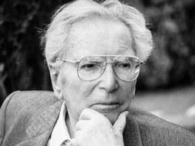
“
Between stimulus and response there is a space. In that space is our power to choose our response. In our response lies our growth and our freedom.
Vicktor E. Frankl
“
Notes:
An easy way to think of mindfulness comes from this quote from Vicktor Frankl.
If you are not familiar with Frankl, he was a Jewish prisoner of war in Nazi concentration camps. And, despite the horrible conditions under which he and his peers lived and experienced during this dark period of human history, Mr. Frankl was amazed to find that some people seemed to be thriving and doing well. He dedicated his life to understanding why. And although he did not term it mindfulness, he did find that one of the secrets of these individuals who still seemed to be thriving was this:

Slide 29
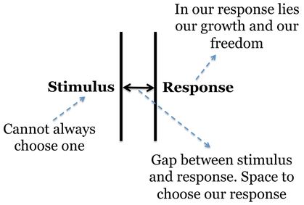
Notes:
Vicktor Frankl said, “Between stimulus and response there is a space. In that space is our power to choose our response. In our response lies our growth and our freedom”
In short, mindfulness is actually about giving you a bit of freedom back by preventing automatic thoughts and reactions from dictating your life, and allowing you to choose how to be.

Slide 30
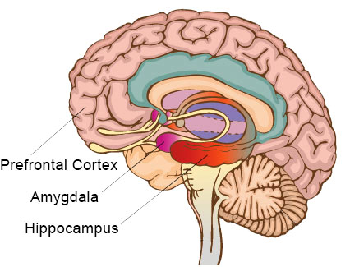
Your Brain on Mindfulness
Prefrontal Cortex
essential in focusing, analysis, short-term memory and decision-making
Hippocampus
cognition, learning, memory and the regulation of emotions
Amygdala
human “fight or flight” mechanism; responsible for generating feelings of fear, anxiety and stress
Image from mindfio.com
Notes:
Brain Science
You might be thinking mindfulness is all nonsense, or that it seems fluffy. I thought the same, too. And there is an element of that. But I propose that this feeling some of you might be experiencing is less about mindfulness as a genuine healthy practice ‘ and more about how it does or does not align with mainstream American culture. So let’s provide some explanation as to why it works.
Prefrontal Cortex
The prefrontal cortex of the brain is essential in focusing, analyzing, short-term memory and decision-making. Regular meditators have been found to retain the gray matter in this important brain region even as they age. Meditation (which has elements of mindfulness, but mindfulness is NOT meditation), is like a brain workout in that it exercises focus and decision-making.
Amygdala
The amygdala is located near the center of the brain and correlates with the human “fight or flight” mechanism. It is directly responsible for generating feelings of fear, anxiety and stress. Experienced meditators tend to have less active amygdalae, which are correlated with reduced stress levels. That’s because mindfulness is practicing being able regulate that part of the brain.
Left Hippocampus
The left hippocampus is responsible for cognition, learning, memory and the regulation of emotions. Meditators are stronger and more developed in this important area. One thing to know is that when we experience anxiety or a stressor, that signal flows through the amygdala and hippocampus. In other words, like we mentioned in module 1 about the difference between humans and zebras, humans can enter that high-stress “fight or flight” response simply through memory. We remember stress, even if there is not a real physical cause. So if you are better able to regulate this and stay present focused, you lessen your natural stress response.

Slide 31
Mindfulness Practices
The simplest way to practice mindfulness is in the things that you already do!
Notes:
How to practice
As we mentioned, meditation is a form of mindfulness but mindfulness is not meditation. Mindfulness is simply an intentional orientation to what you are doing in the present moment without judging that moment. So you can literally do it anytime.

Slide 32
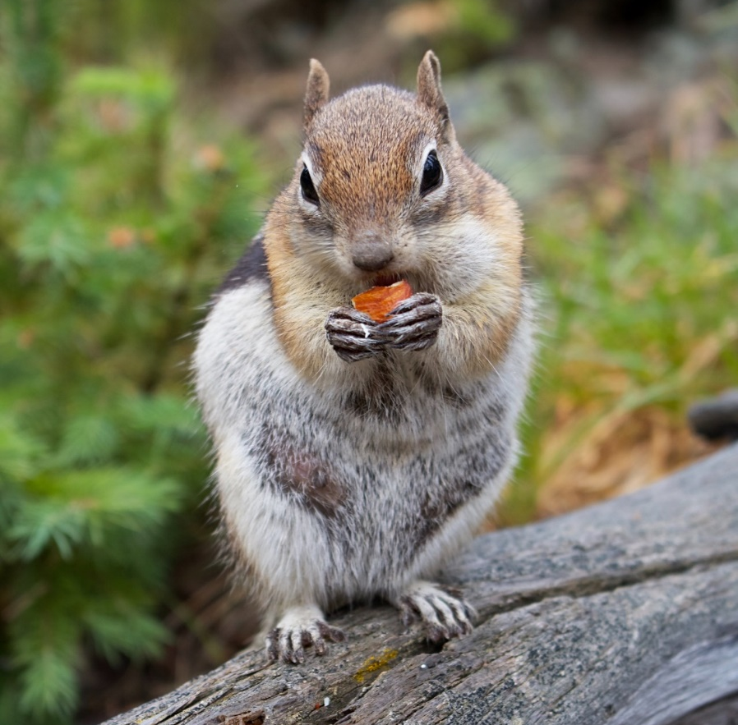
Mindfulness Practices
The simplest way to practice mindfulness is in the things that you already do!
eating
Notes:
When is the last time you truly just sat and enjoyed a good meal? With nothing on your mind? Just focusing on it? It might have been some time ago. Some cultures are really good about this. For example, meals are a protected time, with no other distractions, so that the meal can be enjoyed with complete attention. That is mindful eating.

Slide 33
Mindfulness Practices
The simplest way to practice mindfulness is in the things that you already do!
eating
hygiene routines
Notes:
You can be mindful while engaging in hygiene routines, focusing on the brushing of your teeth. The combing of your hair. Instead of rushing through it, become mindful of the smell of the toothpaste, the pull of the hairbrush through your hair.

Slide 34
Mindfulness Practices
The simplest way to practice mindfulness is in the things that you already do!
eating
hygiene routines
commuting
Notes:
While commuting, pay attention to the feel of the steering wheel, the song on the radio, the different colors you see in houses, buildings, and trees. Focusing on each block that you pass rather than on the things on your “To do” list that you need to finish is a way of being mindful.

Slide 35
Mindfulness Practices
The simplest way to practice mindfulness is in the things that you already do!
eating
hygiene routines
commuting
play & movement
Notes:
What about when you are playing? As an adult, when is the last time you played without worry of being judged by yourself or others? Maybe it is time for a good mindful wrestle.

Slide 36
Mindfulness Practices
The simplest way to practice mindfulness is in the things that you already do!
eating
hygiene routines
commuting
play & movement
BREATHING!!!
Notes:
And yes, you can practice mindful breathing. It is covert, comes with a built-in natural soothing response to stress, and is a great beginning step. Let’s actually review a way to remember how to use mindfulness in any given situation.

Slide 37
Mindful STOP
Notes:
Mindful STOP is great to use when you’re frustrated with work/emails, your family, your colleagues. It’s about cultivating that space that Frankl talks about between the stimulus and the response, so you are really free to choose how you respond, instead of reacting

Slide 38
Mindful STOP
Stop what you are doing
Take a few deep breaths
Observe your inner experience
Pause & proceed purposefully
Notes:
S - stop what you are doing, put things down for a bit
T – take 3-5 breaths or take a minute to breathe; follow your breath in and out of your nose; you can say to yourself “inhale”, “exhale”
O – observe your thoughts, feelings, sensations; be a noticer -- without judgment; pay attention to what your experience is in your body and what this says about your emotions; name them
P – pause and think about what action will support you in this moment and bring you closer to your values and goals
You can do this with anything. We were just talking about slowing down our eating and really enjoying it. You can use STOP with eating. Stop what you are doing, take a few deep breaths (or chews), and really observe your experience. Pause, and then proceed purposefully, with your intent being to stay focused again on the meal and all the delicious flavors you notice.

Slide 39
Mindful STOP
Notes:
You can even use this in during your work day. Are you preparing to transition from one patient or task to another? This is a great time to pause, breathe, reaffirm the value and purpose in that moment, and then proceed.

Slide 40
LET’S APPLY IT TOGETHER!
Let’s do an activity called Dropping an Anchor.
Use as a physical and cognitive strategy for difficult moment.
Follow along with the prompts. Practice first with a “light” thought.
Notes:
Let’s use STOP right now. We are going to use it in conjunction with some physical sensations to create a technique we call “dropping an anchor”. This activity works to anchor you in the present moment by focusing your attention on present sensations. We have very specific reasons to drop an anchor. We can use this activity as a physical and cognitive strategy when we are experiencing a difficult moment.
If we are feeling stressed and reacting to that emotion, then we are not in the moment. We are concerned about the past or the future, and our emotions are rising. Our bodies are getting primed by that sympathetic response that we talked about in module 1. Our body is doing what it needs to do when stressed by automating everything. We need to create space.
Breathing is directly connected to our parasympathetic response; that’s why it is a part of nearly every relaxation and mindfulness strategy you will find, including this one. It is our built-in way to switch our brain and body out of that fight, flight, or freeze mode. We will also use our pent up physical energy to create sensations that we can focus on. Finally, we will also “ground” ourselves by checking in with our surroundings. This gets us out of our head and away from whatever has our attention and gets us back to the present moment. In a later module, you will learn how to combine this grounding technique with some cognitive defusion strategies to create even more space between what is bothering you and the choices you make.

Slide 41
Drop an Anchor
Notes:
Dropping an Anchor
To drop an anchor, first think of a memory that is a little bit embarrassing or something “light” that has kind of bothered you recently. I will help you sit with that thought for a bit.
<Have 5 sec pause>
Push your feet hard into the floor, as if you are trying to push the ground away from you.
If you are sitting, also sit forward, and straighten your back.
<Have 3 sec pause>
Push the palm of your hands firmly together.
Take notice of your sensations as you remain aware of this slightly uncomfortable memory, thought, or feeling—what do you feel in your feet, hands, and back?
<Have 3 sec pause>
Now, look around the room and notice 5 things you can see. Focus on each and try to identify a unique detail about them.
<Have 5 sec pause>
Next, notice 4 things you can hear.
<Have 5 sec pause>
Now, notice 3 things that you can feel.
<Have 5 sec pause>
And notice that you are, at present, listening to this wherever you may be. There is a body in a room and a voice and a computer. Stay focused on that.
<Have 5 sec pause>

Slide 42
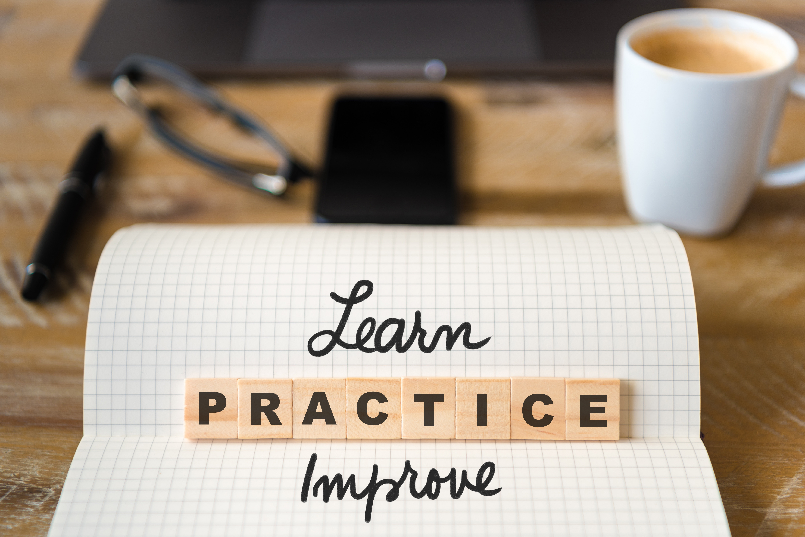
Drop an Anchor
Notes:
Now you have experienced the basic version of “Dropping an Anchor.” Additional practice will be needed to be able to apply this in challenging moments. The activity is one of the practice assignments available to you to download at the end of this lesson.

Slide 43
Adults who practice mindfulness experience…
Lower rates of stress, anxiety & depression
Greater life satisfaction & wellbeing
More self-compassion & empathy
Better relationships with friends & family
Better sleep and physical health
Higher ratings of job performance
Notes:
Why do this?
Mindfulness has existed as a practice in various cultures throughout history but research has only recently begun to explore its actual benefits to adults. The benefits are numerous.
Adults who practice mindfulness are less prone to fall into the hopelessness that is common with depression. We are also less focused on what we cannot control and instead are much more intentional with what we can control, which reduces the prevalence of stress and anxiety triggers.
We are better able to connect with others because we are fully immersed in their personhood, which leads to better relationships. We are also generally less responsive to stressors. And when you combine mindfulness with values-aligned actions, adults tend to perform better at their work.
Lastly, you can get better sleep and overall general physical health because mindfulness helps turn off that brain chatter that keeps you up at night, or tells you that you cannot take care of yourself right now. And with better sleep and physical health, you experience better concentration which means better mindfulness. They support one another.

Slide 44
Mindfulness Activities
dropping an anchor
Notes:
We have included four Mindfulness Activities with this lesson for you to consider practicing to help improve your well-being.
Dropping an Anchor is the practice we already did in this session. We recommend practicing this at home, work, and in public spaces so that it can become a natural mindful practice for you.

Slide 45
Mindfulness Activities
dropping an anchor
mindful breathing
Notes:
Mindful breathing is the traditional mindful practice that involves breathing in, holding that breath, and then controlling the exhale. Breathing is great for calming us down before we get too riled up. It may seem simple but is very effective.

Slide 46
Mindfulness Activities
dropping an anchor
mindful breathing
washing a plate/mindful chore
Notes:
Washing a plate or doing a mindful chore is an actual practice that professional athletes use to cultivate mindfulness in action. Professional football athletes, marathon runners, and even UFC fighters practice this because it teaches them how to maintain focus on something active. We recommend everyone try this strategy at least once.

Slide 47
Mindfulness Activities
dropping an anchor
mindful breathing
washing a plate/mindful chore
soles
of the feet
Notes:
Soles of the feet is an activity more in line with traditional meditation. It is brief and is something that can be used for mindful relaxation. You are also welcome to combine this with other meditation guides or apps if you want, especially if you have never tried something like this before.

Slide 48
QUESTIONS TO
CHECK FOR UNDERSTANDING
1
How would you define mindfulness?
2
What has research identified as the benefits of practicing mindfulness?
3
What are clues that you are being mindful vs. mindless?
4
What are different ways you can integrate mindfulness into your day?
5
What does it mean to be mindful in the (virtual or physical) classroom?
Notes:
Module X – Check for Understanding Questions

Slide 49
DISCUSSION
QUESTIONS
1
In what ways does our culture and current context make mindfulness difficult?
2
How did you notice mindfulness affecting your life? What were the positives and challenges?
3
One of the biggest difficulties with mindfulness is that there is no correct answer. It simply is about “being.” How well were you able to “be” in a given situation?
4
Mindfulness is important for values; it supports our ability to pause and engage with values. But we also have to value mindfulness? How can you support that value and practice?
5
Mindfulness is considered a core skill in ARC because it is vital to successfully implementing all other components. Look ahead at the later ARC modules. How does mindfulness underpin all those modules?
Notes:
Module X – Check for Understanding Questions

Slide 50
Recommendations
Complete activity
Notes:
We recommend three next steps to take this information and apply it to your own well-being. First, please choose and complete at least one of the accompanying activities to maintain your practice of mindfulness. Do these to get familiar with the act of being present-focused, and more importantly, staying present-focused. It is natural that our attention gets distracted; we instead want to get better at redirecting that attention.

Slide 51
Recommendations
Complete activity
Teach an activity
Notes:
Our second recommendation is that you take any one of these practices and teach it to your practice partner—whether that is a colleague, spouse, friend, or family member. Whoever you selected. Teach them the strategy too, and then work to use the strategy in everyday life. Get practice turning your day-to-day activities and interactions into mindful practices (like your commute, grocery shopping, or eating).

Slide 52
Recommendations
Complete activity
Teach an activity
Create individual action plan
Notes:
The third and final step is to set an intentional action plan of your own. Action Planning is a critical step whenever we try to start something new. It helps us identify our barriers, our strengths, and how we can recover from setbacks when they inevitably happen.
Thank you again for watching and engaging with this lesson. Take care.

