Slide 1
Note to Presenter
These materials were developed by the Mountain Plains MHTTC, Mid-America MHTTC, and the Mid-America ATTC for use by extension offices and other rural organizations to support community mental health efforts. Inserting local contact information and resources is encouraged; however, any co-branding efforts, such as adding organization logos, must adhere to TTC Network branding and style guidelines. For more information, please contact mountainplains@mhttcnetwork.org.
#TogetherWeFarm
Notes:
Speaker’s Notes:
Co-branding information.

Slide 2


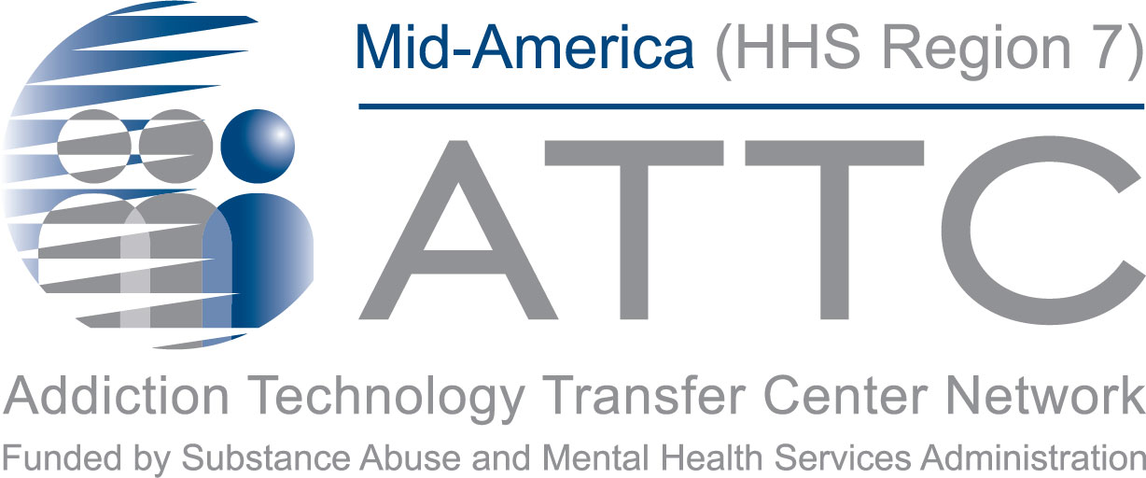


Alcohol Use Disorders: A Community Conversation
Farm Stress and Mental Health
#TogetherWeFarm
Mental Health Supports for Farmers and their Communities

Slide 3
Disclaimer and Funding Statement
These materials were prepared by the Mountain Plains Mental Health Technology Transfer Center, the Mid-America Mental Health Technology Center, and the Mid-America Addiction Technology Treatment Center under a cooperative agreement from the Substance Abuse and Mental Health Services Administration (SAMHSA). All material appearing in this presentation, except that taken directly from copyrighted sources, is in the public domain and may be reproduced or copied without permission from Mountain Plains MHTTC or the authors. Citation of the sources is appreciated. Do not reproduce or distribute this presentation for a fee. For more information on obtaining copies of this presentation please email gberry@wiche.edu.
At the time of this presentation, Miriam E. Delphin-Rittmon, Ph.D., serves as SAMHSA Assistant Secretary. The opinions expressed herein are the views of Mountain Plains MHTTC,
Mid-America MHTTC, and Mid-America ATTC and do not reflect the official position of the Department of Health and Human Services (DHHS), or SAMHSA. No official support or endorsement of DHHS, or SAMHSA, for the opinions described in this presentation is intended
or should be inferred. ​
​
The work of the Mountain Plains MHTTC, Mid-America MHTTC, and Mid-America ATTC is supported by grant H79SM081792 from the Department of Health and Human Services, Substance Abuse and Mental Health Services Administration.​

Slide 4
About the TTC Network
The Technology Transfer Center (TTC) Network is a national network of training and technical assistance centers serving the needs of mental health, substance use, and prevention providers. The work of the TTC Network is under a cooperative agreement by the Substance Abuse and Mental Health Services Administration (SAMHSA). For more information about the Technology Transfer Centers, please visit the TTC Information Center.
In response to mental health and substance use issues in farming communities in HHS Region
7 and 8 states, the Mountain Plains Mental Health Technology Transfer Center (MHTTC), the
Mid-America MHTTC, and the Mid-America Addiction Technology Transfer Center (ATTC) collaborated to produce these materials. For technical assistance and training, please contact
your regional TTC office at the email addresses below.
mhttcnetwork.org/mountainplains | mountainplains@mhttcnetwork.org
mhttcnetwork.org/midamerica | midamerica@mhttcnetwork.org
attcnetwork.org/midamerica | midamerica@attcnetwork.org

Slide 5
Language Matters
Notes:
Speaker’s Notes:
The words we use matter. This is especially true when talking about Mental Health and Mental Illness issues. Studies show that many people do not seek treatment due to the stigma attached to mental illness. Experts agree that the “single most important barrier to overcome in the community is the stigma and associated discrimination towards persons suffering from mental and behavioral disorders.”

Slide 6
Presentation Objectives
Increase awareness and understanding of
Alcohol Use Disorder (AUD)
Create a common language about mental health
Identify unique community assets and resources
#TogetherWeFarm
Notes:
Speaker’s Notes:
These presentations were designed to assist rural communities increase their awareness and understanding of the relationship between mental health and farm stress.
Thru the creation of a common language about mental health, communities can identify their unique resources and implement next steps in determining community-wide solutions.

Slide 7
Alcohol Use Disorder Definition
  Alcohol Use Disorder (AUD) is a medical condition. It is
  a chronic relapsing brain disorder characterized by an impaired ability to stop or control alcohol use despite adverse social, occupational, or health consequences.
  AUD can be mild, moderate or severe.
  AUD causes a negative emotional state when not using.
  Adolescents and adults can be diagnosed with AUD.
#TogetherWeFarm
Notes:
Speaker’s Notes:
Resources:
Shogren, M., Landwehr, R., Terry, D., Roach-Moore, A., & McLean, A. (2020, April). Depression, alcohol and farm stress: Addressing co-occurring disorders in rural America. SAMHSA, Mountain Plains ATTC, Mountain Plains MHTTC.
*This toolkit can be distributed during the Community discussion and offers additional information about AUD, Depression, C0-Occurring Disorders and farm stress.

Slide 8
Protective and Risk Factors for AUD
Risk Factors
Family hstory of AUD
High-stress levels
Mental health problems or trauma
Social and cultural factors
Protective Factors
Positive self-image
Early screening
Social competence
Strong social support
#TogetherWeFarm
Notes:
Speaker’s Notes:
Understanding the difference between risk factors and protective factors can help to educate a community about AUD and devise a more effective plan to address the problem.
Many factors influence a person’s chance of developing a mental and/or substance use disorder. Effective prevention focuses on reducing those risk factors, and strengthening protective factors, that are most closely related to the problem being addressed.
Resources:
Shogren, M., Landwehr, R., Terry, D., Roach-Moore, A., & McLean, A. (2020, April). Depression, alcohol and farm stress: Addressing co-occurring disorders in rural America. SAMHSA, Mountain Plains ATTC, Mountain Plains MHTTC.
*This toolkit can be distributed during the Community discussion and offers additional information about AUD, Depression, C0-Occurring Disorders and farm stress.
National Institute on Alcohol Abuse and Alcoholism. https://www.niaaa.nih.gov/alcohol-health/overview-alcohol-consumption/alcohol-use-disorders
https://www.samhsa.gov/sites/default/files/20190718-samhsa-risk-protective-factors.pdf
https://vertavahealthohio.com/alcohol/7-risk-factors/
A Public Health-Based Approach to Addressing Substance Use Disorders
https://www.ruralhealthinfo.org/toolkits/substance-abuse/1/public-health-based-approach
https://www.ruralhealthinfo.org/rural-monitor/alcohol-elixir-poison/

Slide 9
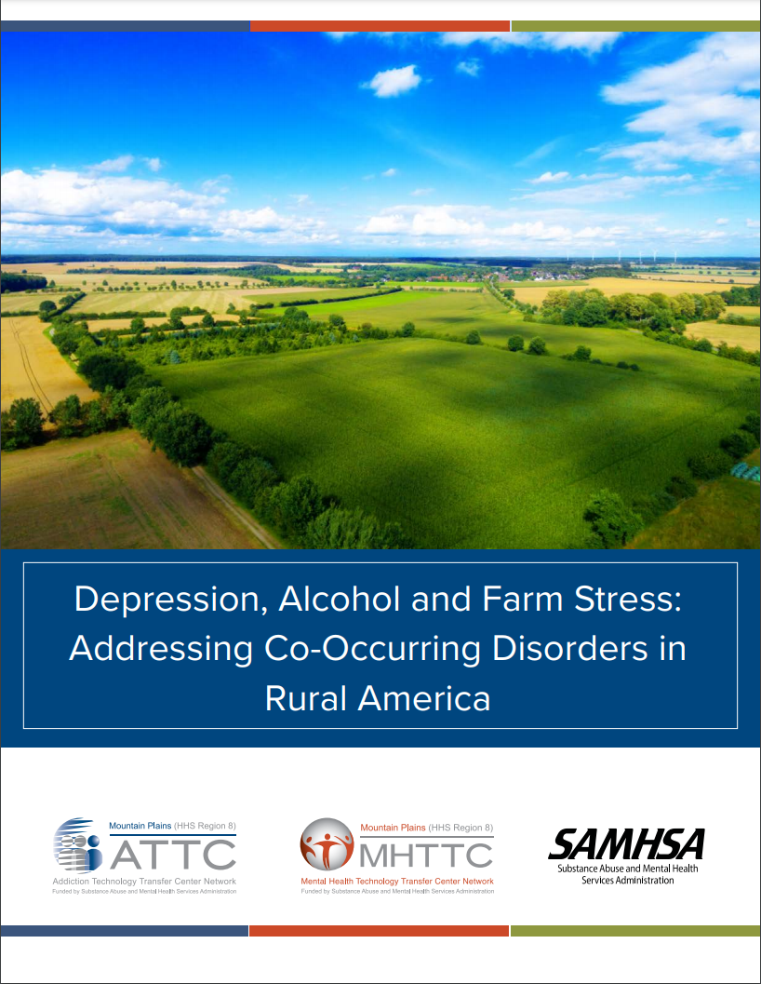
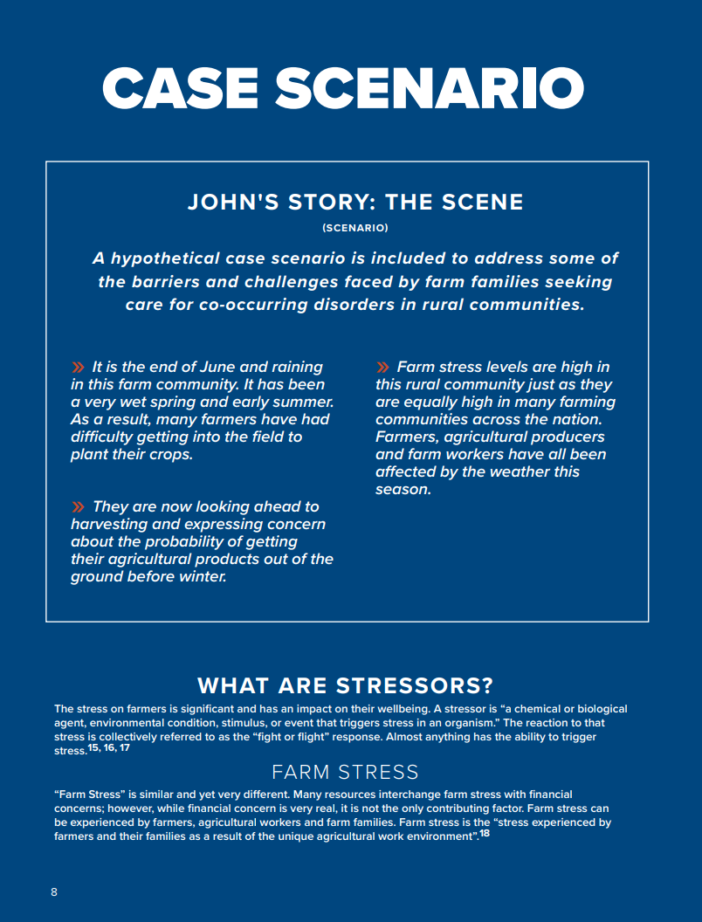
https://mhttcnetwork.org/centers/mountain-plains-mhttc/product/depression-alcohol-and-farm-stress-addressing-co-occurring
Notes:
Speaker’s Notes:
This is the toolkit referenced in resources for slides 6 and 7.

Slide 10
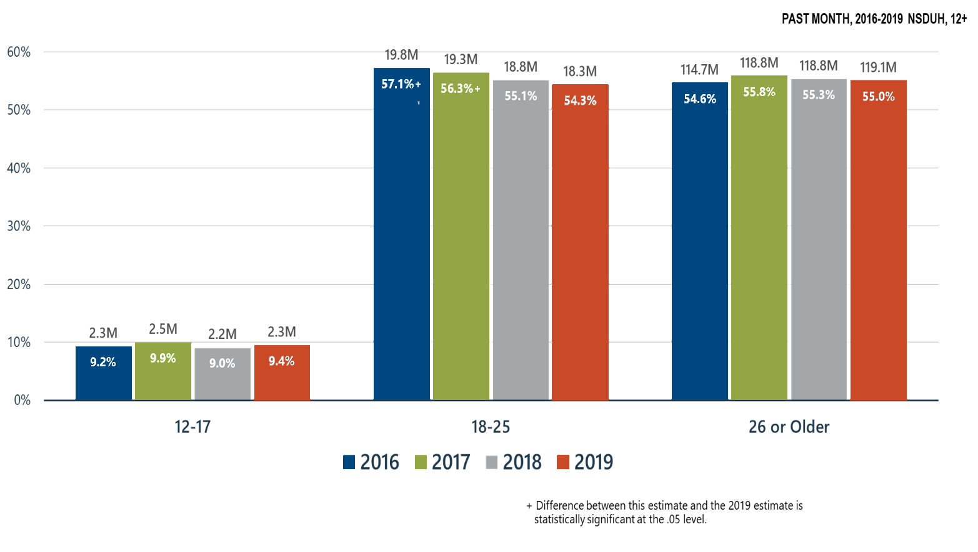
Alcohol Use in the United States
https://www.samhsa.gov/data/release/2019-national-survey-drug-use-and-health-nsduh-releases
Notes:
Speaker’s Notes:
SAMHSA’s National Survey on Drug Use and Health publishes information every year. The annual report focuses on substance use and mental health in the United States and examines trends over time to study changes in society and emerging issues. Information is collected through a comprehensive household interview survey. Approximately 67,500 persons in the United States are interviewed annually.
Resource:
SAMHSA. https://www.samhsa.gov/data/release/2019-national-survey-drug-use-and-health-nsduh-releases
Slide ID: Nat19-5
SOURCE: 2019 DT 7.6, 7.12, and 7.15

Slide 11
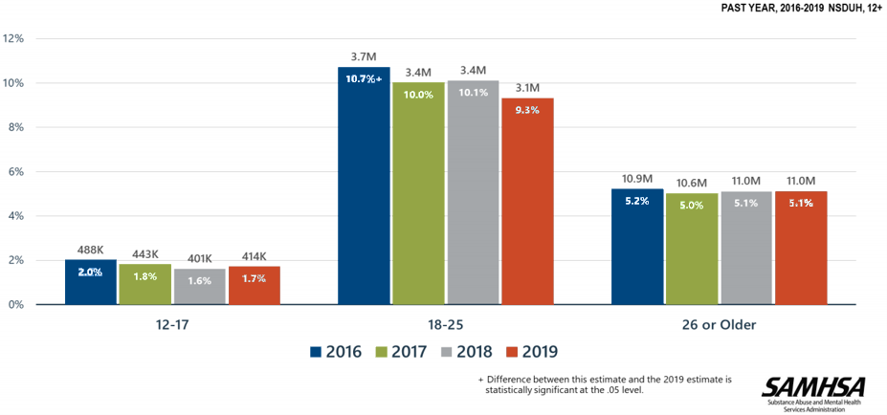
Alcohol Use Disorder in the United States
(SAMHSA, 2020)
https://www.samhsa.gov/data/release/2019-national-survey-drug-use-and-health-nsduh-releases
Notes:
Speaker’s Notes:
Resources:
SAMHSA. https://www.samhsa.gov/data/release/2019-national-survey-drug-use-and-health-nsduh-releases

Slide 12
Symptoms of AUD
Drinking more or longer than you intended.
A desire to cut down or stop drinking but can not.
Spending a lot of time drinking.
Drinking often interferes with taking care of your home or family or causes
problems with your job.
Giving up on activities that were once important or interesting to you.
Gotten into situations while, or after, drinking that increased your chances of
getting hurt.
Needing to drink much more than you once did to get the effect you want.
Withdrawal symptoms like shakiness, restlessness, nausea, sweating, racing heart that occur when the effects of alcohol are wearing off.
#TogetherWeFarm
Notes:
Speaker’s Notes:
Resources:
National Institute on Alcohol Abuse and Alcoholism. https://www.niaaa.nih.gov/alcohol-health/overview-alcohol-consumption/alcohol-use-disorders

Slide 13
Risks of Harmful Alcohol Use
Complicates chronic diseases like diabetes and high blood pressure
Can Lead to Other Health Concerns
Heart and liver disease
Stomach ulcers
Seizures
Stroke
Psychiatric disorders
Prenatal Consequences
Fetal alcohol syndrome
Fetal alcohol spectrum disorders
Stillbirth
Preterm labor
Maternal health complications
#TogetherWeFarm
Notes:
Speaker’s Notes:
Resources:
National Institute on Alcohol Abuse and Alcoholism. https://www.niaaa.nih.gov/alcohol-health/overview-alcohol-consumption/alcohol-use-disorders

Slide 14
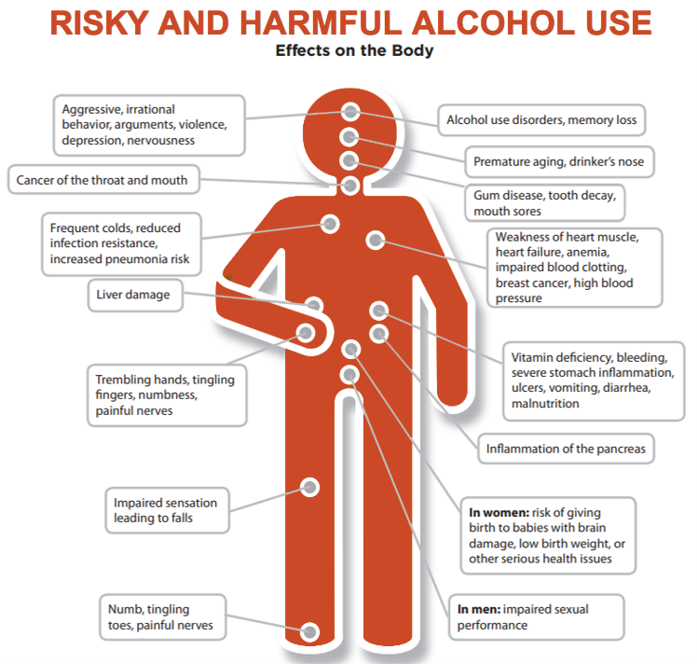
Alcohol Education Tools
sbirt.care/education.aspx
Notes:
Speaker’s Notes:
Resources:
University of Missouri Kansas City: SBIRT. Alcohol Patient Education. https://sbirt.care/education.aspx
*This infographic can be printed and distributed for education

Slide 15



A Standard Drink
5 ounces of wine
5 ounces of wine (12% alcohol)
12 ounces of beer (5% alcohol)
1.5 ounces of distilled spirits (40% alcohol)
8-9 ounces of malt liquor (7% alcohol)
12 ounces of beer
1.5 ounces of hard alcohol
https://www.ruralhealthinfo.org/rural-monitor/wp-content/uploads/2020/08/niaaa-standard-drink-large.jpg
Notes:
Speaker’s Notes:
One standard drink is:
5 ounces of wine=12% alcohol
12 ounces of beer= 5% alcohol
1.5 ounces of distilled spirits= 40% alcohol
8-9 ounces of malt liquor- 7% alcohol
https://www.ruralhealthinfo.org/rural-monitor/wp-content/uploads/2020/08/niaaa-standard-drink-large.jpg
https://www.niaaa.nih.gov/alcohols-effects-health/overview-alcohol-consumption/what-standard-drink

Slide 16
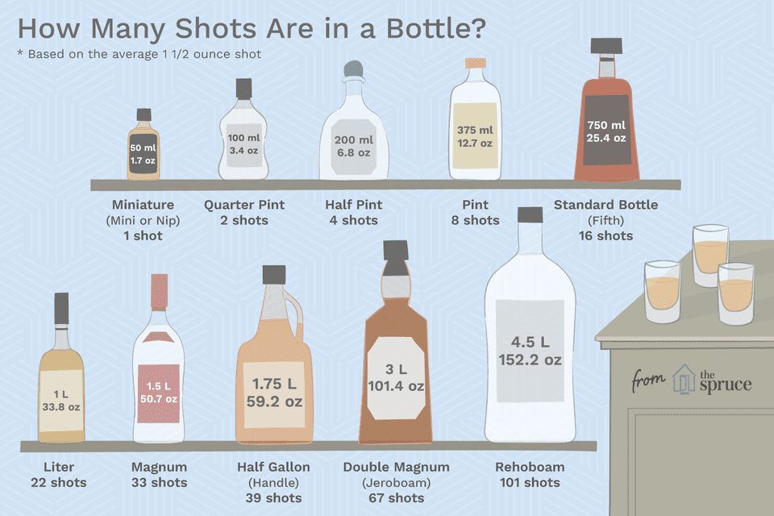
Notes:
Speaker’s Notes:
People often do not realize how much they are drinking in one sitting. This is a good place to discuss low-risk drinking parameters and helps bring awareness to standard drink sizes and use.
Resources:
University of Missouri Kansas City: SBIRT. Alcohol Patient Education. https://sbirt.care/education.aspx
*This infographic can be printed and distributed for education

Slide 17
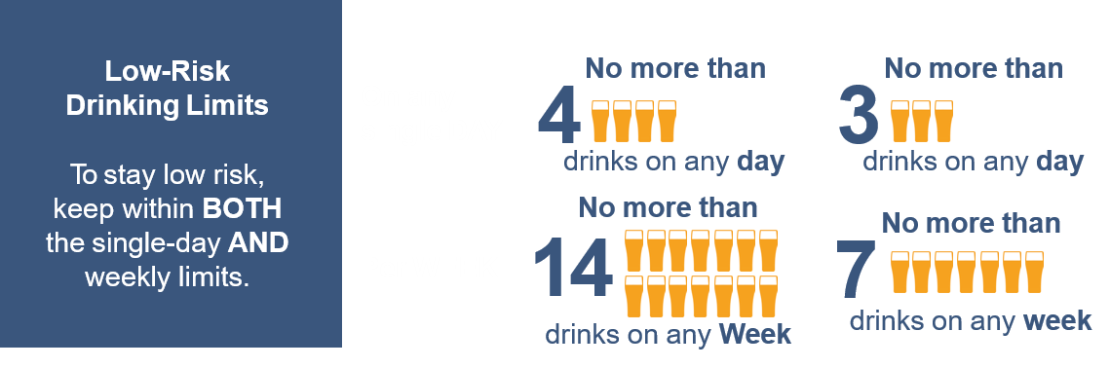

Low-Risk Drinking
For people over 65: low-risk limits are 3 drinks a day or
7 drinks a week.
Women who are pregnant or may become pregnant should not drink.
For healthy adults ages 65 and under:
MEN
WOMEN
sbirt.care/education.aspx
#TogetherWeFarm
Notes:
Speaker’s Notes: People often do not realize how much they are drinking in one sitting.
This is a good place to discuss low-risk drinking parameters and helps bring awareness to standard drink sizes and use.
At-Risk Drinking (Heavy Drinking) in Adults:
Drinking more than the recommended daily, weekly, or episodic amount of alcohol
Females: >3 standard drinks in one sitting or more than 7 drinks per week
Males: >4 standard drinks in one sitting or more than 14 drinks per week
Resources:
University of Missouri Kansas City: SBIRT. Alcohol Patient Education. https://sbirt.care/education.aspx
*This infographic can be printed and distributed for education

Slide 18
At-Risk Drinking vs. Binge Drinking
Binge Drinking in Adults:
Pattern of drinking that brings blood alcohol concentration (BAC)
levels to 0.08 g/dL.
Female: More than 4 drinks in one sitting
Male: More than 5 drinks in one sitting (CDC, 2019)
What’s risky or harmful drinking?
Risky alcohol use is drinking more than single-day or weekly amounts shown above.
Harmful alcohol use is drinking more than single-day or weekly amounts shown above, and having negative effects from drinking such as accidents, not being able to stop drinking, or not doing what you normally do (work, school, family) because of drinking.
Notes:
Speaker’s Notes:
People often do not realize how much they are drinking in one sitting. This is a good place to discuss low-risk drinking parameters and helps bring awareness to standard drink sizes and use.
At-Risk Drinking (Heavy Drinking) in Adults:
Drinking more than the recommended daily, weekly, or episodic amount of alcohol
Females: >3 standard drinks in one sitting or more than 7 drinks per week
Males: >4 standard drinks in one sitting or more than 14 drinks per week
Resources:
University of Missouri Kansas City: SBIRT. Alcohol Patient Education. https://sbirt.care/education.aspx
*This infographic can be printed and distributed for education

Slide 19
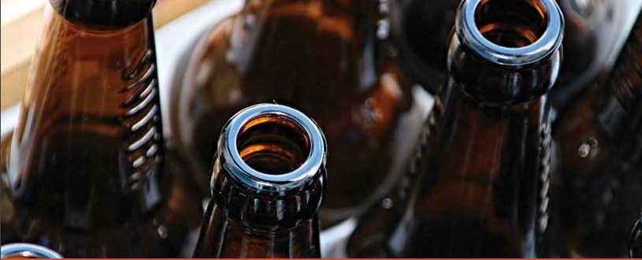
Alcohol Use in Rural Communities
In rural America, nearly 50% of treatment admissions for SUD treatment were for alcohol use disorder.
In more recent years, rates of alcohol-induced deaths were higher in rural areas than in urban areas; by 2018, rates were 18% higher for males and 23% higher for females in rural compared with urban areas.
Stigma and Alcohol Consumption
“Stigma if you do, stigma if you don’t. Along with stigma due to periodic or chronic misuse, stigma is encountered again when the misuser seeks treatment in order to regain well-being.”
Notes:
Speaker’s Notes: This is a good place to ask your audience about how they view alcohol use in their community. Are they aware of increased alcohol use concerns? Do they feel alcohol use is stigmatized in their community?
Resources:
https://www.ruralhealthinfo.org/rural-monitor/alcohol-use-disorder/
https://www.cdc.gov/nchs/data/databriefs/db383-H.pdf

Slide 20
Starting the Community Conversation
Almost universally, alcohol is a legal substance for adults and serves as the cultural beverage used for celebration, and often
for commiseration as well.
Questions to start the Conversation
  Is alcohol use culturally accepted in our community?
  What are our community’s cultural norms?
  Are we seeing an uptick in alcohol use because of farm stress?
#TogetherWeFarm
Notes:
Speaker’s Notes: These questions can start a community conversation about alcohol concerns. The resources below direct you to a toolkit to start this process
Resources:
A Public Health-Based Approach to Addressing Substance Use Disorders
https://www.ruralhealthinfo.org/toolkits/substance-abuse/1/public-health-based-approach
https://www.ruralhealthinfo.org/rural-monitor/alcohol-elixir-poison/

Slide 21
Community Conversations
Responding to the Issues
  Define the problem in our community.
  Identify risk and protective factors (see next slide).
  How can we work across the public and private sectors to develop effective prevention and treatment interventions?
  What do WE need?
  How will we know if we are making a difference?
#TogetherWeFarm
Notes:
Speaker’s Notes: These questions can start a community conversation about alcohol concerns. The resources below direct you to a toolkit to start this process
Resources:
A Public Health-Based Approach to Addressing Substance Use Disorders
https://www.ruralhealthinfo.org/toolkits/substance-abuse/1/public-health-based-approach
https://www.ruralhealthinfo.org/rural-monitor/alcohol-elixir-poison/

Slide 22
Adolescent Alcohol Use
Because NO amount of alcohol use in adolescence is acceptable, any drinking is considered unhealthy drinking.
National Institute on Alcohol Abuse and Alcoholism defines moderate- and high-risk use based on days of alcohol use in the past year, by age group.
Moderate Risk
Ages 12-15: 1 day
Ages 16-17: 6 days (every other month)
Age 18: 12 days (monthly)
High Risk
Age 11: 1 day
Ages 12-15: 6 day (every other month)
Age 16: 12 day (monthly)
Age 17: 24 day (twice monthly)
Age 18: 52 day (weekly)
Notes:
OPTIONAL SLIDE
Speaker’s Notes:
It is important to highlight that NO amount of alcohol use in adolescence is acceptable. This slide can be used to discuss any concerns about adolescent alcohol use in their community. The TTC trainers are available to offer specific training on adolescent alcohol use.
Resource:
National Institute on Alcohol Abuse and Alcoholism (NIAAA). Alcohol Screening and Brief Intervention for youth: A Practitioner’s Guide. https://www.niaaa.nih.gov/sites/default/files/publications/YouthGuide.pdf

Slide 23
Local Resources
Use this slide for local resources
#TogetherWeFarm
Notes:
Speaker’s Notes:
This slide is optional and provides the presenter with the opportunity to list local behavioral healthcare providers and other resources.

Slide 24
National Resources
Understanding Alcohol Use Disorder, a brief overview of AUD. National Institute on Alcohol Abuse and Alcoholism. https://www.niaaa.nih.gov/alcohol-health/overview-alcohol-consumption/alcohol-use-disorders
A Practitioner’s Guide: Alcohol Screening and Brief Intervention for youth: National Institute on Alcohol Abuse and Alcoholism (NIAA). https://www.niaaa.nih.gov/sites/default/files/publications/YouthGuide.pdf
A Public Health-Based Approach / Toolkit for Addressing Substance Use Disorders in Rural Communities. Rural Health Info. https://www.ruralhealthinfo.org/toolkits/substance-abuse/1/public-health-based-approach
The Alcoholic Beverage: An Elixir, and Yet a Poison? Rural Monitors news article. https://www.ruralhealthinfo.org/rural-monitor/alcohol-elixir-poison/
Alcohol Use Disorder: Addressing Stigma and Treatment Access in Rural America. Rural Monitor news article. https://www.ruralhealthinfo.org/rural-monitor/alcohol-use-disorder/
NCHS Data Brief. Rates of Alcohol-induced Deaths Among Adults Aged 25 and Over in Urban and Rural Areas: United States, 2000-2018. Centers for Disease Control and Prevention. https://www.cdc.gov/nchs/data/databriefs/db383-H.pdf
#TogetherWeFarm
Notes:
Speaker’s Notes:
This slide provides the presenter with national resources related to Co-Occurring disorders.

Slide 25
TTC Resources
SAMHSA National HELPLINE is a free, confidential, 24/7, 365-day-a-year treatment referral and information service
for individuals and families facing mental and/or substance use disorders.
https://www.samhsa.gov/find-help/national-helpline
  1-800-662-HELP (4357)
  SAMHSA. 2019 National Survey of Drug Use and Health (NSDUH) Releases. https://www.samhsa.gov/data/release/2019-national-survey-drug-use-and-health-nsduh-releases
  SAMHSA. Co-Occurring Disorders and Other Health Conditions. https://www.samhsa.gov/medication-assisted-treatment/medications-counseling-related-conditions/co-occurring-disorders
  Depression, alcohol and farm stress: Addressing co-occurring disorders in rural America: https://mhttcnetwork.org/centers/mountain-plains-mhttc/rural-mental-health-farm-stress
University of Missouri Kansas City: SBIRT. Alcohol Patient Education. https://sbirt.care/education.aspx
*This infographic can be printed and distributed for education
#TogetherWeFarm
Notes:
Speaker’s Notes:
The Technology Transfer Centers (TTC) offer free technical assistance and training on a variety of mental health and addiction topics. These are just a few of the resources that are free and available to the public.

Slide 26
Get in Touch
mhttcnetwork.org/mountainplains | mountainplains@mhttcnetwork.org
mhttcnetwork.org/midamerica | midamerica@mhttcnetwork.org
attcnetwork.org/midamerica | midamerica@attcnetwork.org
Notes:
Speaker’s Notes:
The Technology Transfer Centers offer free technical assistance and training on the topic presented here. Please visit:______________(insert url for farm stress grab-n-go–page)

