Slide 1
Culture as Prevention: Cultivating Health and Wellness in K-12 Lives Daily
Mindful Movement
Victoria Marie, Indigenous Lotus

Slide 3
Health vs Wellness
Balance & Medicine Wheel
Practicing in the classroom
Environment/ Space
Music
Land Acknowledgement
Self check-in
Movement
Breathwork
Meditation
Closing
Practice
Resources
Our mission is to support and motivate indigenous people to live healthier lives by learning to self-heal through mind-body connection.

Slide 4
Health vs Wellness
Health is the goal and refers to a state where the physical body is free from disease
Wellness is the process of achieving health and refers to an overall balance of a person’s physical, social, spiritual, emotional, intellectual, environmental and occupational well-being.

Slide 5
Wellness=Balance
Balance between all parts of Self.
Sense of connection to spirit, all living things and creator.
North: White, Elder, Winter, Night
East: Yellow, Adolescence, Summer, Morning
South: Red, Childhood, Spring, Noon
West: Black, Adulthood, Fall, Evening
Improve internal compass:
Label directions in the room/space

Slide 6
Practicing in the Classroom

Slide 7
Environment/ Space
Space/ room (gather in a circle if possible)
How does the energy feel in the room? Does energy need to be cleared?
Clearing space: smudging/ saying a prayer with students, preparing ahead of time.
Decor/ visual
Lighting
Dimmer light/ Less to no white lighting
Bright light should be natural
Smell
Smudging
Essential oils
Plants: rosemary, basil
Leading/Facilitator Responsibility
Creating a safe relationship with ourselves and others is important. Choosing how we speak can affect our environment and relationships.
Being mindful of our choice of words/phrases
Avoid using “don’t do that”, “you have to”.
Changing these to “how can I/we support you”, “give yourself permission”, “could I suggest these options”, “I appreciate you”.
Using “lets” & “we” vs. “I”
Student placement in room

Slide 8
Music
Using music to influence/ enhance mood and energy. Music is processed by the part of the brain called the amygdala which boosts the brain's production of dopamine, relieving stress, anxiety and depression.
Music to play in our practice space:
Natural Sounds - water, birds
Instrumentals - drums, flute
Positive affirmations in lyrics
Tribal (Upbeat)
Follow Indigenous Lotus on Spotify
Playlist: Culture is Prevention
Indigenous Music Artists:
Neon Nativez
Spur Pourier
Fawn Wood
DJ Shub
Halluci Nation (A Tribe Called Red)
Supaman
Anachind
TIa Wood
DKD Dancers
Kyreese Mountainhorse
Flying Down Under
Wanita Bird
Robbie Robertson

Slide 9
Land & Spiritual Lineage Acknowledgement
Acknowledgement supports connection.
The purpose of a Land Acknowledgement is to acknowledge and reflect on the attempted erasure of Indigenous people and the historic trauma caused by colonialism.
This practice opens opportunities for deep understanding and steps toward reconciliation.
Ex. “We honor and acknowledge the sacred land of the __________ people”.
Look to see what Native land you're on: https://native-land.ca/
Yoga's origins can be traced to northern India over 5,000 years ago and first mentioned in ancient sacred texts called the Rig Veda.
According to the Yoga Sutras, written between 400 BC and 200 BC by Patanjali, yoga is described as an eight-fold path to reach enlightenment:
Yama (Restraints), Niyama (Observances), Asana (Posture), Pranayama (Breath Control), Pratyahara (Withdrawal of the Senses), Dharana (Concentration), Dhyana (Meditation), Samadhi (Pure Contemplation)
Ex. “We honor and acknowledge the origins and sacred practice of yoga”.

Slide 10
Self Check-in: Observing
Check in with Self
As an instructor/ facilitator/ leader, working with other can be demanding of our overall well being.
Observation questions to ask yourself in reflection when working with students
How do we know each child’s strengths, and where more energy would be best spent?
How do we know if casual misuse of a material is due to boredom or too high of expectations?
Did you spill the water because you were being careless, or because I picked the wrong material to use?
Instruct Self and/or students to check in without judgment/ evaluation, becoming an observer.
Inner critic is usually that of others and not the actual Self
Allow for the student to be themselves in their own way
Honor emotions/ just don't live there
Check-in steps practice:
Close eyes or lower
Breathe through nose
Instruct to check in to the quality of breath
Then, quality of thoughts
Next, is to conduct a body scan from head to toe

Slide 11
Movement
Mind-Body connection and understanding dissociation as survivors
We carry trauma AND resiliency
Using words like “give yourself permission”
Many workouts and movement practices stem from yoga.
Movement allows for stagnant energy to flow, improves blood circulation and joint mobility.
Prevents fascia from hardening-a thin casing of connective tissue that surrounds and holds every organ, blood vessel, bone, nerve fiber and muscle in place.
“Issues live in our tissues”
Possum & The Wolf
Ways to physically move:
Seated
Chair or floor
Movement is more isolated to specific areas at one time
Upper body, center (mid-line), lower body
Standing
stretching, lengthening
qigong shaking
Flow
Linking poses together
Vinyasa/ hatha
Activity: Card Decks

Slide 12
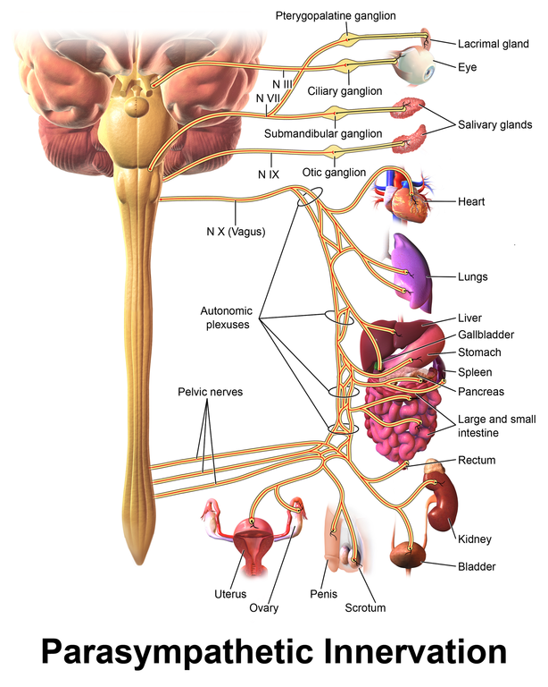
Breathwork
Breathwork plays a key role in the autonomic system, the vagus nerve.
Breathing exercises have the ability to stimulate the parasympathetic nervous system and suppress the sympathetic nervous system.
Retraining to breathe into the belly and not the chest.
Safe breathing practices:
4:6 Breathing
Calming/ reducing anxiety
Exhale is longer than the inhale
Feeling anxious- too much air.
Bumble Bee Breath (Bhramari)
Calming
Lowers blood pressure
Throat and vocal chords
Best practiced on an empty stomach
Dragon Fire Breaths
Increase energy and heat

Slide 13
Meditation
Meditation is a practice where an individual uses a technique such as mindfulness or focusing the mind on a particular object, thought, or activity to improve attention and awareness, and achieve a mentally clear and emotionally calm and stable state.
Self regulation
Finding comfort in silence and stillness
Positive self-talk gives us power
Beneficial before sleep
Improves our storytelling abilities
During meditation, bring ancestors and loved ones into the space.
Ways to bring meditation into the space:
Guided/ script
Storytelling
Instrumental music
Silence
Activities students can do:
Write their own short story
Write out 1-5 things they are grateful for
Draw. Even encourage drawing or coloring during lectures

Slide 14
Closing Circle/ Gathering
As we come to an end to practice, we close space with gratitude.
During closing, we would bring back the main points of what was brought up in practice.
Direction: Place hand on heart
Ex. “We close our circle/practice with honoring and acknowledging the land and the sacred practice of yoga. Expressing gratitude for showing up for one another and ourselves. And we’ll continue the day expressing gratitude for all living things and ourselves”

Slide 15
Practice: Sample Mindful Movement
Foundation:
Environment/ space
Music
Practice:
Acknowledgment
Self Check-in
Movement
Breathwork
Meditation
Closing Circle

Slide 16
Resources
Books:
Decolonizing Trauma Work: Indigenous Stories and Strategies - Renee Linklater
How to breathe - Ashley Nees
Your Body Speaks Your Mind - Deb Shapiro
Sovereign Self -Acharya Shunya
For Indigenous Minds Only: A Decolonization Handbook - Waziyatawin/Michael Yellow Bird
Tools:
Card Decks
Mindfulness
Yoga Poses
Affirmations
Sites:
Recovery Support: https://wellbrietymovement.com/
Kids Mindful Meditation - Breathing Practice: https://youtu.be/Bk_qU7l-fcU
Spotify Playlist: https://open.spotify.com/playlist/5RtajtUSsuHgRQ0Nda2kxg?si=fPtzqsNxSvKZcxy75B-aFw&utm_source=copy-link
Native land map: https://native-land.ca/

Slide 17
Pidamaya ye | Miigwetch | Mvto
Indigenouslotus.com

