Slide 1
Note for Presenter
These materials were developed by the Mountain Plains MHTTC, Mid-America MHTTC, and the Mid-America ATTC for use by extension offices and other rural organizations to support community mental health efforts. Inserting local contact information and resources is encouraged; however, any co-branding efforts, such as adding organization logos, must adhere to TTC Network branding and style guidelines. For more information, please contact mountainplains@mhttcnetwork.org.
#TogetherWeFarm
Notes:
Speaker’s Notes:
Co-branding information.

Slide 2
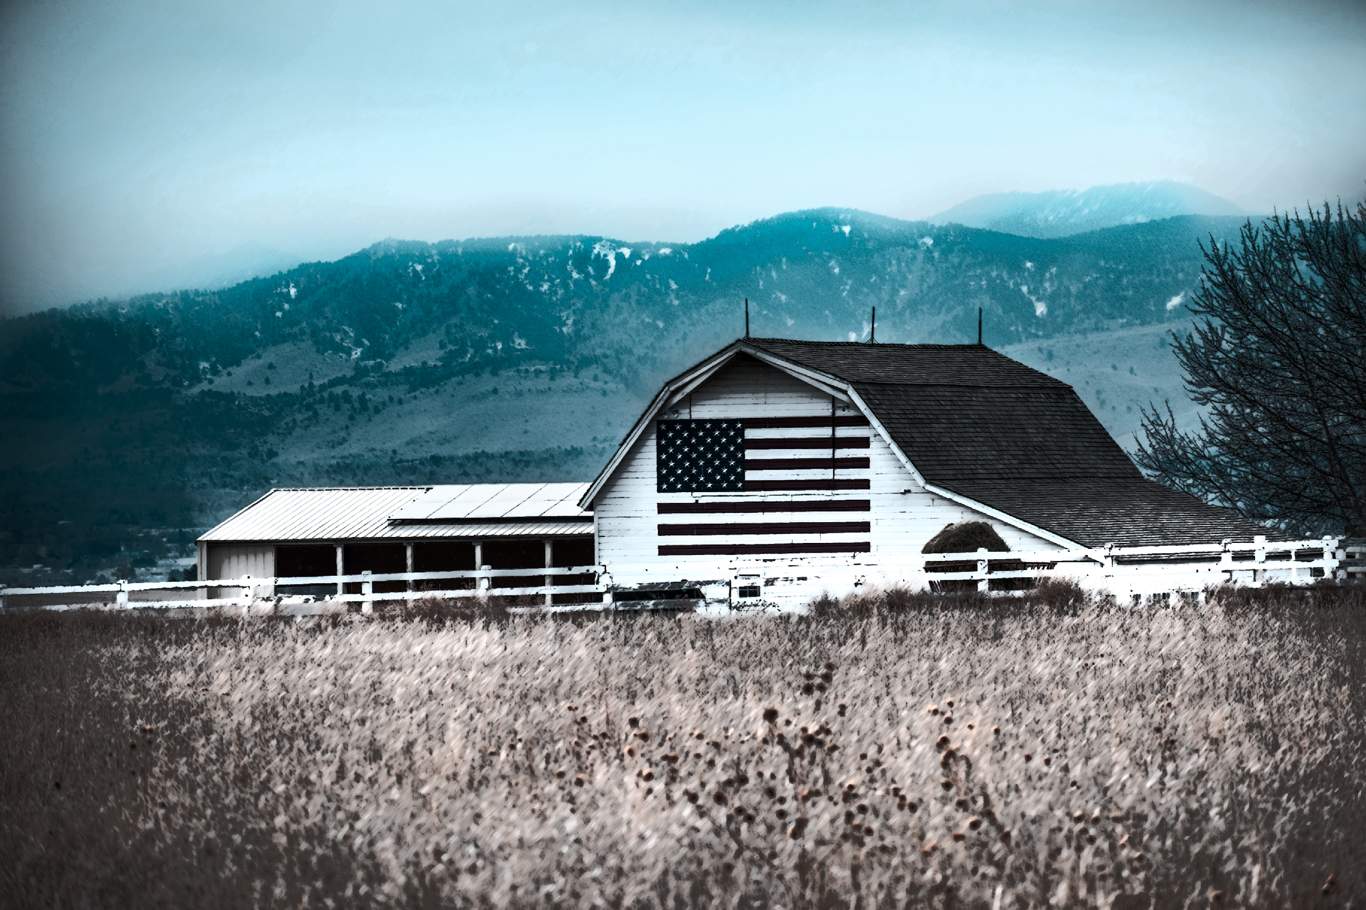




Death By Suicide: A Community Conversation
Farm Stress and Mental Health
#TogetherWeFarm
Mental Health Supports for Farmers and their Communities

Slide 3
Disclaimer and Funding Statement
These materials were prepared by the Mountain Plains Mental Health Technology Transfer Center, the Mid-America Mental Health Technology Center, and the Mid-America Addiction Technology Treatment Center under a cooperative agreement from the Substance Abuse and Mental Health Services Administration (SAMHSA). All material appearing in this presentation, except that taken directly from copyrighted sources, is in the public domain and may be reproduced or copied without permission from Mountain Plains MHTTC or the authors. Citation of the sources is appreciated. Do not reproduce or distribute this presentation for a fee. For more information on obtaining copies of this presentation please email gberry@wiche.edu.
At the time of this presentation, Miriam E. Delphin-Rittmon, Ph.D., serves as SAMHSA Assistant Secretary. The opinions expressed herein are the views of Mountain Plains MHTTC, Mid-America MHTTC, and Mid-America ATTC and do not reflect the official position of the Department of Health and Human Services (DHHS), or SAMHSA. No official support or endorsement of DHHS, or SAMHSA, for the opinions described in this presentation is intended or should be inferred. ​
​
The work of the Mountain Plains MHTTC, Mid-America MHTTC, and Mid-America ATTC is supported by grant H79SM081792 from the Department of Health and Human Services, Substance Abuse and Mental Health Services Administration.​

Slide 4
About the TTC Network
The Technology Transfer Center (TTC) Network is a national network of training and technical assistance centers serving the needs of mental health, substance use, and prevention providers. The work of the TTC Network is under a cooperative agreement by the Substance Abuse and Mental Health Services Administration (SAMHSA). For more information about the Technology Transfer Centers, please visit the TTC Information Center.
In response to mental health and substance use issues in farming communities in HHS Region 7 and 8 states, the Mountain Plains Mental Health Technology Transfer Center (MHTTC), the
Mid-America MHTTC, and the Mid-America Addiction Technology Transfer Center (ATTC) collaborated to produce these materials. For technical assistance and training, please contact
your regional TTC office at the email addresses below.
mhttcnetwork.org/mountainplains | mountainplains@mhttcnetwork.org
mhttcnetwork.org/midamerica | midamerica@mhttcnetwork.org
attcnetwork.org/midamerica | midamerica@attcnetwork.org

Slide 5
Language Matters
Notes:
Speakers Notes:
The words we use matter. This is especially true when talking about Mental Health and Mental Illness issues. Studies show that many people do not seek treatment due to the stigma attached to mental illness. Experts agree that the “single most important barrier to overcome in the community is the stigma and associated discrimination towards persons suffering from mental and behavioral disorders.”

Slide 6
Presentation Objectives
Increase awareness and understanding of death
by suicide
Create a common language about mental health
Identify unique community assets
and resources
#TogetherWeFarm
Notes:
Speaker’s Notes:
These presentations were designed to assist rural communities increase their awareness and understanding of the relationship between mental health and farm stress.
Thru the creation of a common language about mental health, communities can identify their unique resources and implement next steps in determining community-wide solutions.

Slide 7

Death by Suicide
90% of people who die by suicide have an underlying – and potentially treatable mental health condition.
American Foundation for Suicide Prevention
#TogetherWeFarm
Notes:
Speaker’s Notes:
People know what suicide is, they understand the loss and the impact. Many people do not know that 90% of people who die by suicide have an underlying – and potentially treatable – mental health condition.
According to the National Institute of Mental Health suicide is categorized according to the following definitions:
Suicide is defined as death caused by self-directed injurious behavior with intent to die as a result of the behavior.
A suicide attempt is a non-fatal, self-directed, potentially injurious behavior with intent to die as a result of the behavior. A suicide attempt might not result in injury.
Suicidal ideation refers to thinking about, considering, or planning suicide. Thoughts of suicide.
Suicide is referred to as death by suicide by mental health professionals. Suicide is a major public health concern. Suicide is among the leading causes of death in the United States. Based on recent nationwide surveys, suicide in some populations is on the rise.
https://www.nimh.nih.gov/health/statistics/suicide.shtml

Slide 8
United States Suicide Facts and Figures
Death by suicide is the
In 2019,
In 2018, there were an estimated
10th
47,511
1.38M
Leading cause of death in the US
Americans died by suicide
suicide attempts
Source: Centers for Disease Control and Prevention (CDC) Data & Statistics Fatal Injury Report
for 2019, retrieved February 9, 2021.
A 2017 Centers for Disease Control and Prevention (CDC) study found that farm owners and workers were three to five times as likely to kill themselves on the job compared with other occupations.
#TogetherWeFarm
Notes:
Speaker’s Notes:
A brief glance at these statistics, confirms what we already know, death by suicide is a prevalent problem throughout the country.
Farmers are among the most likely to die by suicide, compared with other occupations, according to a January study by the Centers for Disease Control and Prevention. The study also found that suicide rates overall had increased by 40% in less than two decades. Source: https://www.southbendtribune.com/story/news/2020/03/07/farmer-suicide-deaths-alarm-rural-communities-in-the-midwes/43905301/
These statistics are provided by American Foundation for Suicide Prevention and were retrieved on February 9, 2021 for the Centers for Disease Control and Prevention (CDC) Data & Statistics Fatal Injury Report for 2019.
3. CDC statistics – specific to farmers:
In 2016 The Centers for Disease Control and Prevention showed that “farming, fishing and forestry” occupational group suffered a higher rate of suicide than any other occupation.
Information was retracted, due to errors found in the initial data and mis-classification of occupations.
Notes about the Revised CDC data:
Only provides a snapshot for the years 2012 and 2015.
Limited to 17 states that participated in the National Violent Death Reporting System.
Those 17 states represent about ¼ of nation’s farms.
The “Triple-F” major occupational group (farming, fishing, and forestry) includes agricultural workers but doesn’t include self-employed farmers and ranchers or agricultural managers.
Farmers and ranchers are included in the “Management” major group, along with CEOs, elementary principals, and other management.
Updated CDC report showed:
Suicide rates for farmers were still high
From 2000 to 2015, the U.S. suicide rate among working aged (16-64) adults increased 34% from 12.9 per 100,000 population to 17.3.
For males in the Farmers, Ranchers, and Other Occupational Managers category the 2012 suicide rate was 44.9 per 100,000 civilian working persons compared to 32.2 in 2015.
For males in the Ag. Worker category, the 2012 suicide rate was 20.4 per 100,000 working persons compared to 17.3 in 2015.
4. Information on the 2017 CDC study quote can be found at:
Resources: https://brownfieldagnews.com/two-cents/suicides-in-farm-country/

Slide 9
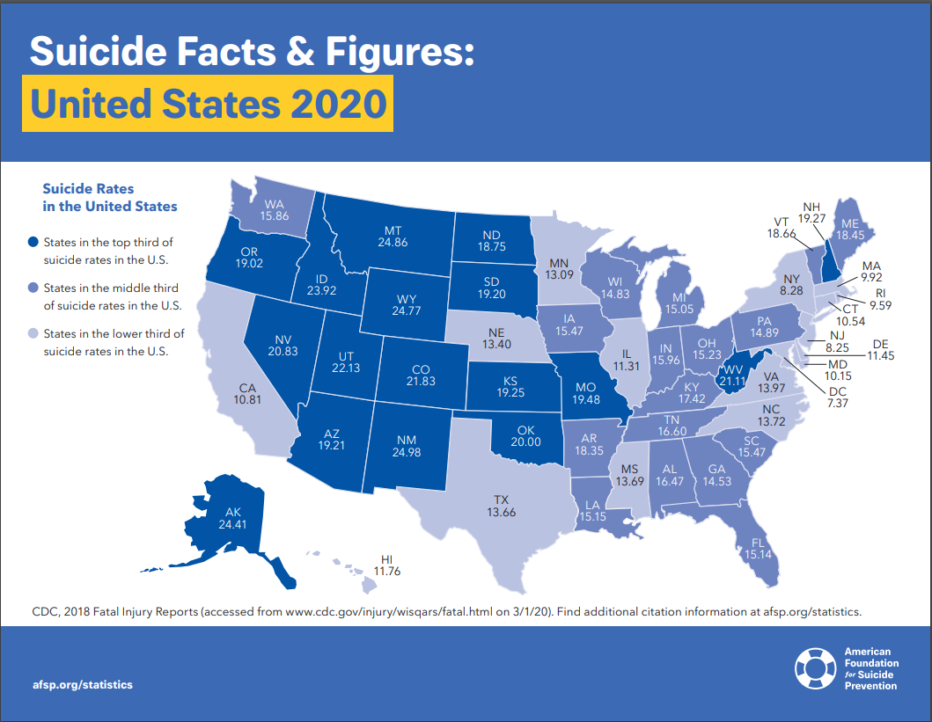
#TogetherWeFarm
Notes:
Speaker’s Notes:
*Speakers are encouraged to use a combination of slides 8, 9, 10, and 11 to highlight their community’s regional death by suicide statistics.
Looking at the rate of death by suicide highlighted on this map, it’s easy to see that most states in our region lay in the top third of suicidal rates in the US.
Speakers are
Regional statistics about suicide.
In Colorado, on average, one person dies by suicide every 7 hours.
In Iowa on average, one person dies by suicide every 18 hours.
In Kansas, on average, one person dies by suicide every 16 hours.
In Missouri, on average, one person dies by suicide every 8 hours.
In Montana, on average, one person dies by suicide every 33 hours.
In Nebraska, on average, one person dies by suicide every 32 hours.
In North Dakota, on average, one person dies by suicide every 60 hours. Suicide is the 1st leading cause of death for ages 10-24.
In South Dakota, on average, one person dies by suicide every 52 hours.
In Utah, on average, one person dies by suicide every 13 hours. Suicide is the 1st leading cause of death for ages 10-24.
In Wyoming, on average, one person dies by suicide every 60 hours.
Resources:
State-specific-fact sheets: https://afsp.org/state-fact-sheets
US Statistic Sheet
Signs and Symptoms

Slide 10
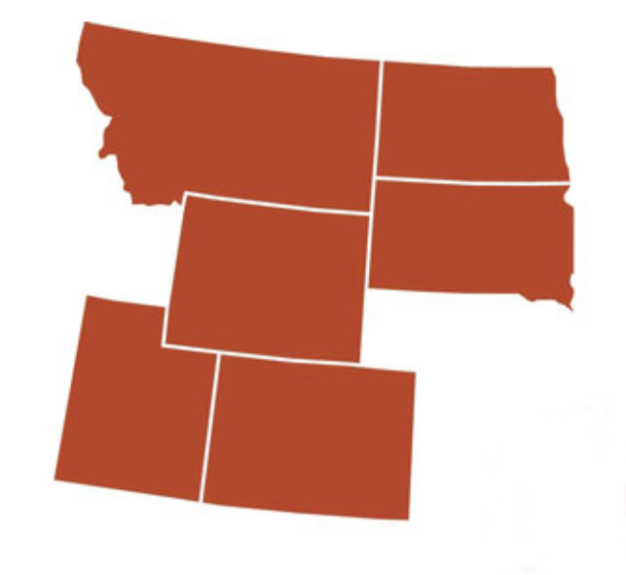
HHS Region 8 Death by Suicide Statistics
In Colorado, on average, one person dies by suicide every 7 hours.
In Montana, on average, one person dies by suicide every 33 hours.
In North Dakota, on average, one person dies by suicide every 60 hours.
In South Dakota, on average, one person dies by suicide every 52 hours.
In Utah, on average, one person dies by suicide every 13 hours.
In Wyoming, on average, one person dies by suicide every 60 hours.
Notes:
Speaker’s Notes:
*Please use either Slide 9 or 10, depending on which region you live in.
Suicide is the 1st leading cause of death for ages 10-24.
Resource: https://afsp.org/what-we-ve-learned-through-researchs

Slide 11
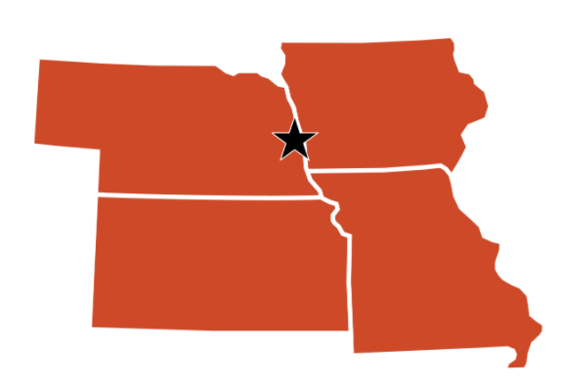
HHS Region 7 Death by Suicide Statistics
In Iowa on average, one person dies by suicide every 18 hours.
In Kansas, on average, one person dies by suicide every 16 hours.
In Missouri, on average, one person dies by suicide every 8 hours.
In Nebraska, on average, one person dies by suicide every 32 hours.
Notes:
*Please use either Slide 9 or 10, depending on which region you live in.
Suicide is the 1st leading cause of death for ages 10-24.
Resource: https://afsp.org/what-we-ve-learned-through-researchs

Slide 12
Fast Facts about Death by Suicide
90% of people who die by suicide have an underlying – and potentially treatable – mental health condition.
Depression, bipolar disorder, and substance use are strongly linked to suicidal thinking
and behavior.
Specific treatments used by mental health professionals – have been proven to help people
manage their suicidal ideation and behavior.
Suicide is related to brain functions that affect decision-making and behavioral control,
making it difficult for people to find positive solutions.
Limiting a person’s access to methods of killing themselves dramatically decreases suicide rates in communities.
#TogetherWeFarm
Notes:
OPTIONAL SLIDE: We have provided some additional facts about suicide on this slide and below. Please use what is most appropriate for your audience.
Speaker’s Notes:
No one takes their life for a single reason. Life stresses combined with known risk factors, such as childhood trauma,
substance abuse, economic pressures – or even chronic physical pain – can contribute to someone taking their life.
Asking someone directly if they’re thinking about suicide won’t “put the idea in their head” –
most will be relieved someone starts a conversation.
If someone can get through the intense, and short moment of active suicidal crisis, chances are they will not die by suicide.
Most people who survive a suicide attempt (85 to 95%) go on to engage in life.
Resource: https://afsp.org/what-we-ve-learned-through-researchs
The rate of suicide is highest in middle-aged white men.
In 2019, men died by suicide 3.63x more often than women.
White males accounted for 69.67% of suicide deaths in 2018.
On average, there are 130 suicides per day in the United States. ​
In 2019, firearms accounted for 50.39% of all suicide deaths.
93% of adults surveyed in the U.S. think suicide can be prevented.

Slide 13
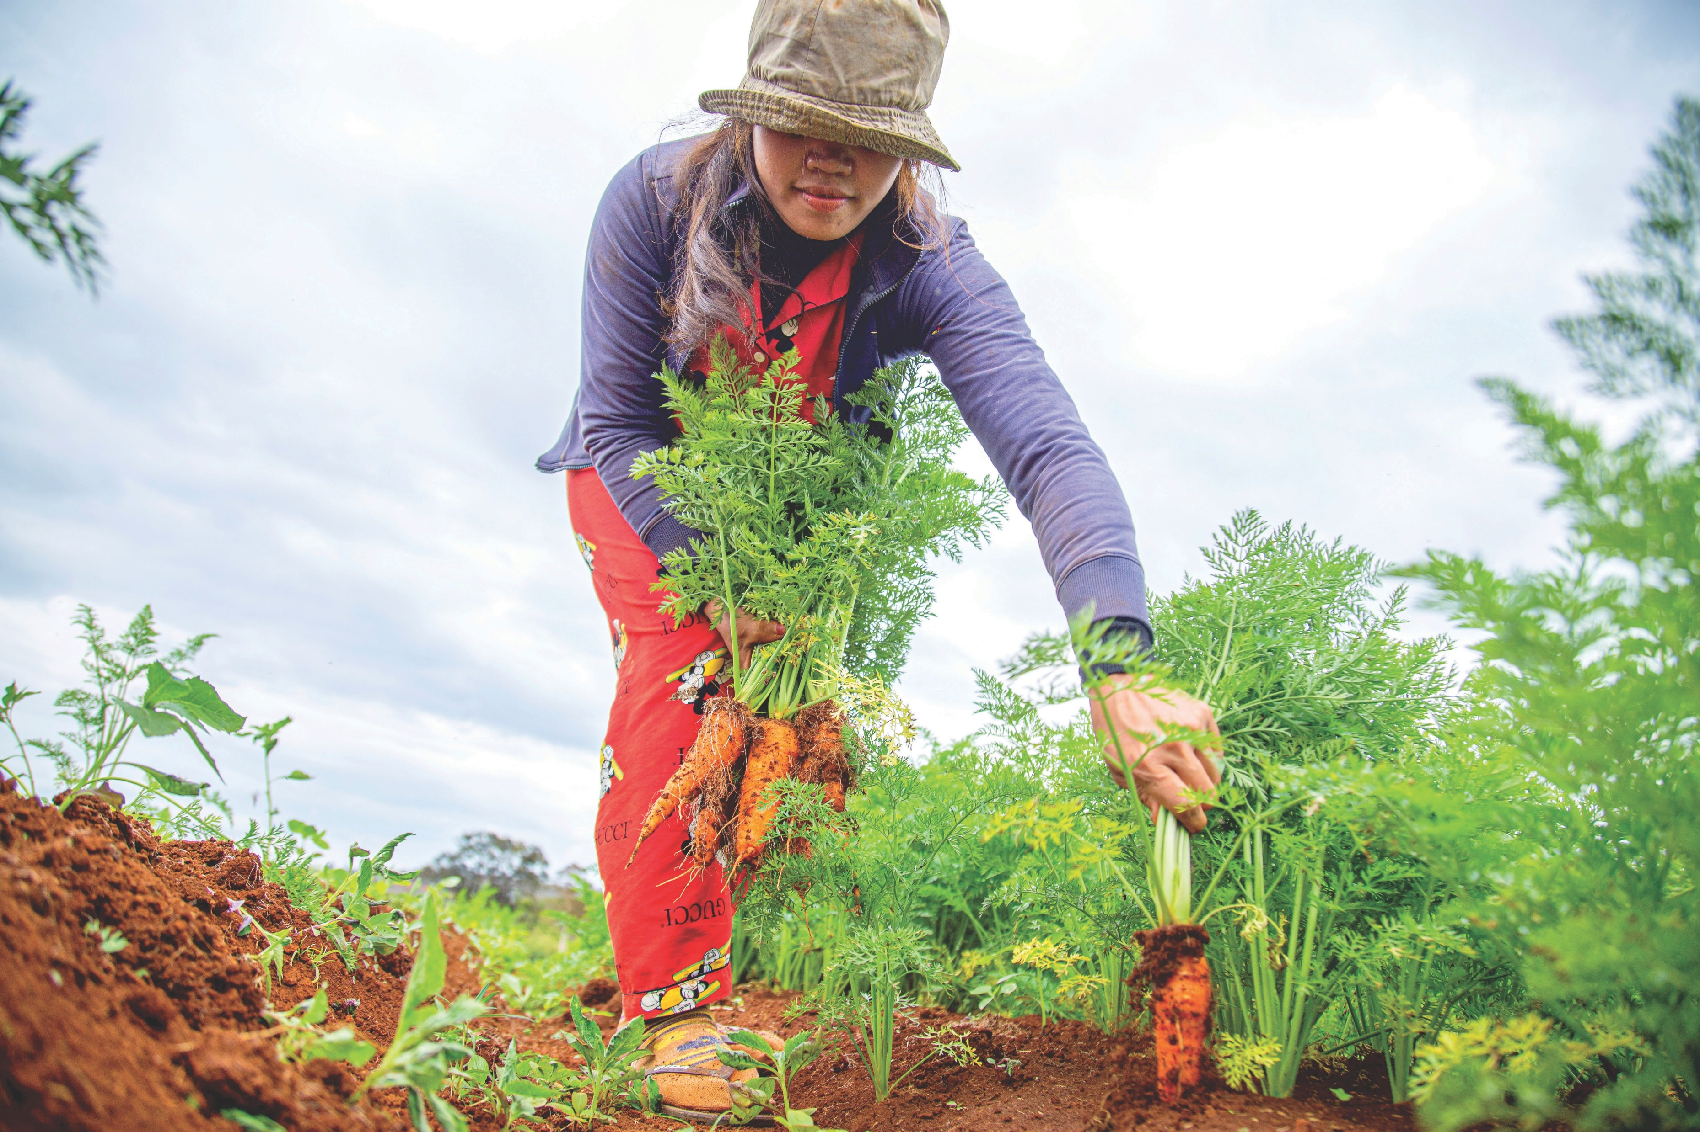
Warning Signs:
  Talking about suicide and history of suicide in family.
  Changes in sleep and/or eating patterns.
  Increased use of drugs or alcohol.
  Preoccupation with death.​
  Giving away possessions.
  Obtaining firearms.
  Withdrawing from family, friends, and routines that were pleasurable.
  BUT: Not all people who experience thoughts of suicide or die by suicide exhibit these signs.
Notes:
Speaker’s Notes:
These are some warning signs that indicate a person may be at risk to harm self or others. BUT: Not all people who experience thoughts of suicide or die by suicide exhibit these signs.
Additional warning signs may include
Talking about being a burden to others.
Feeling trapped – like there’s no way out.
Talking about being in unbearable pain.
These are common warning signs of suicidal ideation and/or behavior.
Emphasize that symptoms or diagnoses of anxiety, depression, bipolar disorder, etc. do not lead directly to someone engaging in suicidal behavior.
This discussion of signs and symptoms in terms of risk factors should lead into the discussion of farm stress being an increased risk factor on the following two slides.
Photo by Ny Menghor on Unsplash

Slide 14

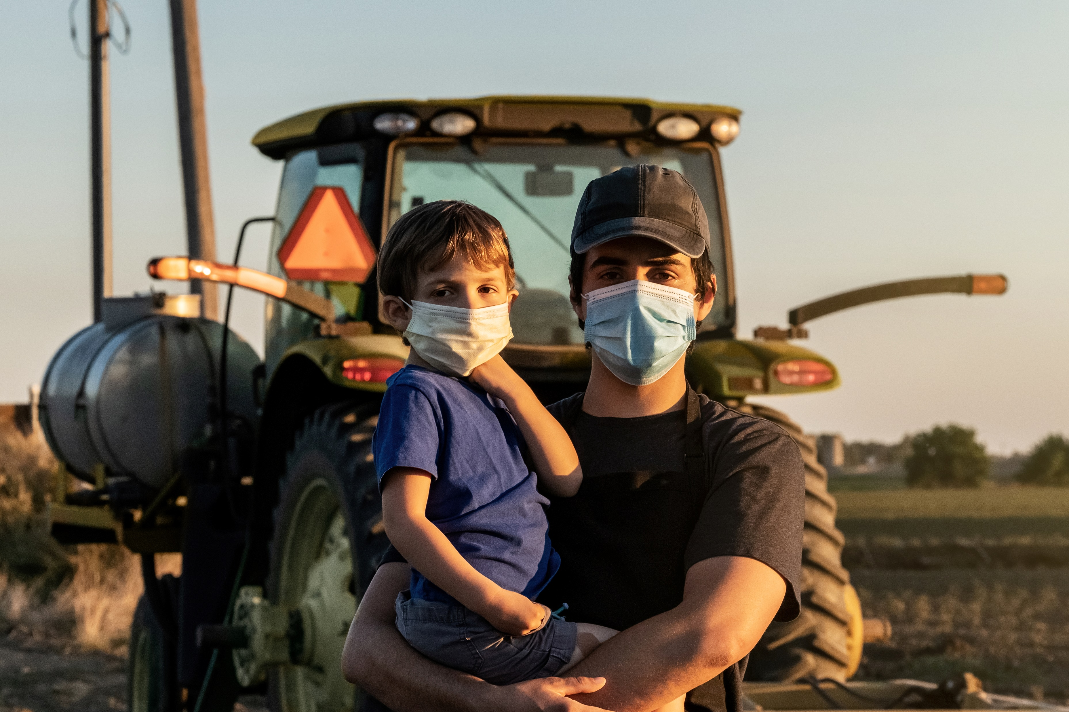
Stress on the Farm
“At its core, farming is both a profession and a cultural identity steeped in strength of character, self-reliance and independence that can make it difficult to first recognize and then seek help when needed.”
- Growing Stress on the Farm: The Expanding Economic and Mental Health Disparities in Rural Missouri
#TogetherWeFarm
Notes:
Speaker’s Notes:
Stress is common in agricultural jobs.
Farming is one of the most hazardous occupations (Freeman et al., 2008).
Physical health may be impacted due to the use of pesticides and other chemicals (Blair et al., 2015).
Other stressors include long days, isolation, heavy workload, technological innovation, business management, and farm administration.
External factors such as disease outbreaks, natural disasters, government regulations, climate changes, and market fluctuations are unpredictable.
Interpersonal stressors related to family roles (Hovey & Seligman, 2006)

Slide 15
Farm Stressors can Contribute to
Death by Suicide
Typical Stressors
  Constant responsibilities
  Location
  Multi-generations
  Stigma
  Access to relevant care
Extraordinary Stressors
  Weather
  Market prices and tariffs
  Debt and cash flow
  Health-care costs
Farm Stress and The Family
Women are more likely than men to experience stress
Children are not immune to farm stressors and the impact may be noted physically, emotionally, socially
Increased rates of suicidality have been seen over the past 15 years and are a major public health concern.
Notes:
Speaker’s Notes:
Farm Stress: the stress experienced by farmers, agricultural workers and their families as a result of the unique agricultural work environment.
A stressor is “a chemical or biological agent, environmental condition, stimulus, or event that triggers stress.” Many resources interchange farm stress with financial concerns; however, while financial concern is very real, it is not the only contributing factor.
Farm stress impacts the entire family. Farm women typically play a supportive role in helping husbands deal with their stress and frustration; however, they often do not get the same support in return. Farm children often work on the farm and identify closely with rural values.
Resource:
Shogren, M., Landwehr, R., Terry, D., Roach-Moore, A., & McLean, A. (2020, April). Depression, alcohol and farm stress: Addressing co-occurring disorders in rural America. SAMHSA, Mountain Plains ATTC, Mountain Plains MHTTC.

Slide 16
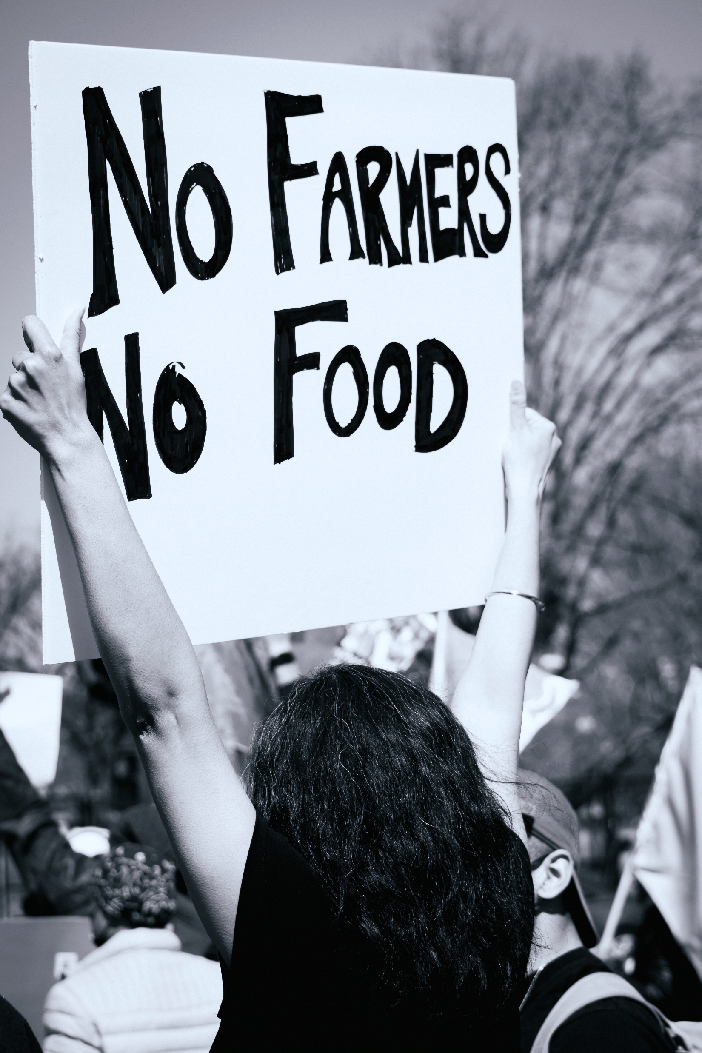
Starting the Community Conversation
What are our community strengths?
What resources and assets do we have to help support one another?
Notes:
Speaker’s Notes:
We recommend that you start this portion of the presentation by listing your community strengths, resources, and assets.
To develop a community response to mental illness and death by suicide we can begin by looking at our own community statistics and contributing environmental factors.
This slide allows you to customize with local statistics and concerns
Your Community’s “Cultural Norm” allows you to help community members consider the cultural norm or what is considered acceptable behavior especially regarding death by suicide and mental illness in your local community.
Resources:
Rural Prevention and Treatment of Substance Use Disorders Toolkit. https://www.ruralhealthinfo.org/toolkits/substance-abuse
Photo by Gayatri Malhotra on Unsplash

Slide 17
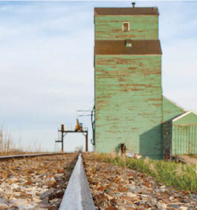
The Community Conversation
What is your community’s “Cultural Norm”?
  How does your community talk about
  mental illness?
  Is there easy access to/familiarity with lethal means (e.g., guns, illicit drugs, medications)?
Local Statistics and Concerns
  Prevalence of Suicide in our community
  What are we most concerned about?
#TogetherWeFarm
Notes:
Speaker’s Notes:
To develop a community response to suicide, we can begin by looking at our own community statistics and contributing environmental factors.
This slide allows you to customize with local statistics and concerns
Your Community’s “Cultural Norm” allows you to help community members consider suicide in the context of the supporting environment.
Additional questions – next steps
Resources:
Applying one definition to “rural” is complicated by changing community demographics, urban sprawl, and diverse geographies. Regardless of the definition, rural areas are commonly characterized by a combination of low population density (sparseness), isolation (distance from an urban center), and small size (total population).
“It’s Complicated…Why What’s Rural Matters.” The Rural School and Community Trust, 21 Nov. 2013, www.ruraledu.org/articles.php?id=3127

Slide 18
Local Resources
Use this slide for local resources
#TogetherWeFarm
Notes:
Speaker’s Notes:
This slide is optional and provides the presenter with the opportunity to list local behavioral healthcare providers and other resources.

Slide 19
National Resources – Crisis Lines
Farm Aid Hotline
800-FARM-AID (327- 6243)
National Suicide Prevention Lifeline
1-800-273-TALK (8255) or 1-888-628-9454 (Spanish) 24/7
Crisis Text Line - free 24/7 crisis counseling.
Text HOME to 741741 (for youth)
National Alliance on Mental Illness (NAMI)
1-800-950-6264 or email info@nami.org
#TogetherWeFarm
Notes:
Speaker’s Notes:
A listing of national resources and crisis lines for individuals and communities dealing with mental health issues, especially suicidal ideation and death by suicide.

Slide 20
National Resources
Understanding Alcohol Use Disorder, a brief overview of AUD. National Institute on Alcohol Abuse and Alcoholism. https://www.niaaa.nih.gov/alcohol-health/overview-alcohol-consumption/alcohol-use-disorders
A Practitioner’s Guide: Alcohol Screening and Brief Intervention for youth: National Institute on Alcohol Abuse and Alcoholism (NIAA). https://www.niaaa.nih.gov/sites/default/files/publications/YouthGuide.pdf
A Public Health-Based Approach / Toolkit for Addressing Substance Use Disorders in Rural Communities. Rural Health Info. https://www.ruralhealthinfo.org/toolkits/substance-abuse/1/public-health-based-approach
The Alcoholic Beverage: An Elixir, and Yet a Poison? Rural Monitors news article. https://www.ruralhealthinfo.org/rural-monitor/alcohol-elixir-poison/
Alcohol Use Disorder: Addressing Stigma and Treatment Access in Rural America. Rural Monitor news article. https://www.ruralhealthinfo.org/rural-monitor/alcohol-use-disorder/
NCHS Data Brief. Rates of Alcohol-induced Deaths Among Adults Aged 25 and Over in Urban and Rural Areas: United States, 2000-2018. Centers for Disease Control and Prevention. https://www.cdc.gov/nchs/data/databriefs/db383-H.pdf
#TogetherWeFarm
Notes:
Speaker’s Notes:
This slide provides the presenter with national resources related to Co-Occurring disorders, which are often present when someone experiences suicidal ideation or death by suicide..

Slide 21
TTC Resources
SAMHSA National HELPLINE is a free, confidential, 24/7, 365-day-a-year treatment referral and information service
for individuals and families facing mental and/or substance use disorders.
https://www.samhsa.gov/find-help/national-helpline
  1-800-662-HELP (4357)
  SAMHSA. 2019 National Survey of Drug Use and Health (NSDUH) Releases. https://www.samhsa.gov/data/release/2019-national-survey-drug-use-and-health-nsduh-releases
  SAMHSA. Co-Occurring Disorders and Other Health Conditions. https://www.samhsa.gov/medication-assisted-treatment/medications-counseling-related-conditions/co-occurring-disorders
  Depression, alcohol and farm stress: Addressing co-occurring disorders in rural America: https://mhttcnetwork.org/centers/mountain-plains-mhttc/rural-mental-health-farm-stress
University of Missouri Kansas City: SBIRT. Alcohol Patient Education. https://sbirt.care/education.aspx
*This infographic can be printed and distributed for education
#TogetherWeFarm
Notes:
Speaker’s Notes:
The Technology Transfer Centers (TTC) offer free technical assistance and training on a variety of mental health and addiction topics. These are just a few of the resources that are free and available to the public.

Slide 22
Get in Touch
mhttcnetwork.org/mountainplains | mountainplains@mhttcnetwork.org
mhttcnetwork.org/midamerica | midamerica@mhttcnetwork.org
attcnetwork.org/midamerica | midamerica@attcnetwork.org
Notes:
Speaker’s Notes:
The Technology Transfer Centers offer free technical assistance and training on the topic presented here. Please visit:______________(insert url for farm stress grab-n-go–page)

