Slide 1


Providers Secondary Traumatic Stress
Ashley Fortier
June 22, 2022
Notes:
Good morning, and welcome to today’s session [title of presentation]. My name is [Name] and I am a [title] for the Mountain Plains MHTTC.

Slide 2
Disclaimer and Funding Statement
This presentation was prepared for the Mountain Plains Mental Health Technology Transfer Center (Mountain Plains MHTTC) under a cooperative agreement from the Substance Abuse and Mental Health Services Administration (SAMHSA). All material appearing in this presentation, except that taken directly from copyrighted sources, is in the public domain and may be reproduced or copied without permission from SAMHSA or the authors. Citation of the source is appreciated. Do not reproduce or distribute this presentation for a fee without specific, written authorization from the Mountain Plains MHTTC. For more information on obtaining copies of this presentation please email casey.morton@und.edu.
At the time of this presentation, Tom Coderre served as acting SAMHSA Assistant Secretary. The opinions expressed herein are the views of Ashley Fortier and do not reflect the official position of the Department of Health and Human Services (DHHS), or SAMHSA. No official support or endorsement of DHHS, SAMHSA, for the opinions described in this presentation is intended or should be inferred.
The work of the Mountain Plains MHTTC is supported by grant H79SM081792 from the Department of Health and Human Services, Substance Abuse and Mental Health Services Administration.
Notes:
Today’s presentation is provided free of charge by the Mountain Plains Mental Health Technology Transfer Center. Today’s presentation is available in the public domain and should Not be distributed for a fee without the express written permission of the Mountain Plains MHTTC.
The views and opinions expressed during today’s presentation are those of our presenters and do not reflect the official position of the Department of Health and Human Services or SAMHSA. No official support or endorsement of DHHS or SAMHSA is intended or should be inferred. Please contact us with any questions you may have.

Slide 3

The Mountain Plains Mental Health Technology Transfer Center
The Mountain Plains Mental Health Technology Transfer Center (Mountain Plains MHTTC) provides training and technical assistance to individuals who serve persons with mental health concerns throughout Region 8 (Colorado, Montana, North Dakota, South Dakota, Utah and Wyoming).
We belong to the Technology Transfer Center (TTC) Network, a national network of training and technical assistance centers serving the needs of mental health, substance use and prevention providers. The work of the TTC Network is under a cooperative agreement by the Substance Abuse and Mental Health Service Administration (SAMHSA).
Notes:
The Mountain Plains Mental Health Technology Transfer Center is one of 12 centers that make up the larger MHTTC network. The MHTTC network is funded by the Substance Abuse and Mental Health Services Administration (SAMHSA) to provide training, resources, and technical assistance to individuals serving persons with mental health disorders. The Mountain Plains MHTTC serves the states of Colorado, Montana, North Dakota, South Dakota, Utah and Wyoming and has a particular focus on supporting providers working to meet the mental health needs of individuals living in rural communities. The Mountain Plains MHTTC is administered under a partnership between the University of North Dakota, and the Western Interstate Commission for Higher Education (WICHE). In our current grant year, the Mountain Plains MHTTC has received additional funding to support implementation of additional training and programs related to school mental health as well as provider well-being.

Slide 4

Land Acknowledgement Statement
Today, the University of North Dakota rests on the ancestral lands of the Pembina and Red Lake Bands of Ojibwe and the Dakota Oyate - presently existing as composite parts of the Red Lake, Turtle Mountain, White Earth Bands, and the Dakota Tribes of Minnesota and North Dakota. We acknowledge the people who resided here for generations and recognize that the spirit of the Ojibwe and Oyate people permeates this land. As a university community, we will continue to build upon our relations with the First Nations of the State of North Dakota - the Mandan, Hidatsa, and Arikara Nation, Sisseton-Wahpeton Oyate Nation, Spirit Lake Nation, Standing Rock Sioux Tribe, and Turtle Mountain Band of Chippewa Indians.
Notes:
The Mountain Plains MHTTC recognizes that today, the University of North Dakota rests on ancestral lands. We acknowledge the people who resided here for generations, and as a university community, we will continue to build upon our relations with the First Nations of the State of North Dakota.

Slide 5
Notes:
The MHTTC Network is committed to aligning our training and actions to support affirming, respectful, and recovery-oriented language in all of our activities. We recognize the important role that person-first, culturally responsive, inclusive language plays in supporting the mental health and healing of all individuals. We encourage you to visit our National Coordinating Office’s program website to learn more.

Slide 6

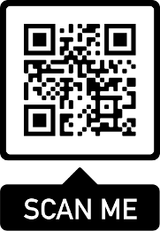





Scan this QR code to follow us on Instagram, LinkedIn, Twitter, and Facebook. You can also join our e-mail newsletter!
Notes:
We encourage you to engage with us on social media. This is the easiest way to learn about what we are doing and hear more about training and unique products like our [recent or related product]

Slide 7

Provider Secondary Traumatic Stress
Dr. Ashley Fortier
MHTTC-MP Workshop Wednesday
June 22, 2022
Notes:
PsyD, Psychologist Candidate in Colorado, Technical Assistance Associate within the Behavioral Health Program at WICHE.
She works with various stakeholders across states and organizations in the West to further behavioral health initiatives. Her professional mission is to increase service efficacy, accessibility, and workforce capacity in rural and frontier regions.
Teen & adult survivors of trauma and abuse, SA crisis/hosp accompany, SPMI in LA, PACT in rural WA, competency evals, adult & youth incarcerated, crisis intervention, college-age therapy, psychosis in geriatric
research, - youth suicide, gender & lethal means in suicide, LGBTQAI – transgender youth, gang intervention, male trauma focused on LGBTQ survivors & their partners, delivery on BH in rural, mobile crisis in rural

Slide 8
Today’s Overview
What is Secondary Traumatic Stress (STS)?
Why does it matter?
What does it look & feel like?
How to reduce & manage STS symptoms?
How do we build resilience?

Slide 9
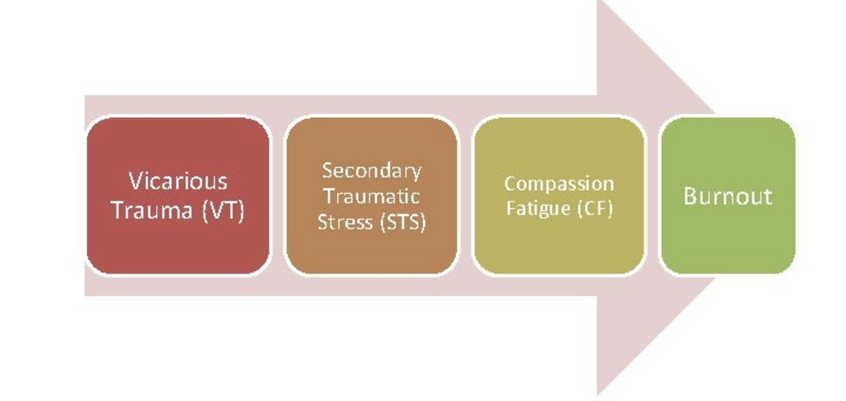

Slide 10
Secondary Traumatic Stress
“The natural, consequent behaviors and emotions resulting from knowledge about a traumatizing event”
“The indirect exposure to clients’ trauma material that leads to the providers’ PTSD-like symptoms of re-experiencing, avoiding, and hyperarousal, corresponding with criteria B, C, and D, respectively, of the DSM-IV-TR”
Notes:
VT = changes to cognitive schema, self-efficacy, core beliefs as a result of exposure to and engagement with the traumatic material presented by clients – sudden distruptions in clinicians relationship with trust, safety, dependence, power, esteem and intimacy
CF = derived from STS concept, distinctly characterized by the ‘reduced capacity of, or interest in, being empathic’ or ‘bearing the suffering of clients’; symptoms parallel those of PTSD direct trauma exposure
Professional burnout = exhaustion, cynicism
share similar definitions – and are often interchangeably used in the literature – there are important differences between them.

Slide 11
Vicarious Trauma vs. STS
Repeated exposure to client stories crisis or trauma experiences leads to a change in beliefs & worldview – esp. related to safety, trust, control
No PTSD symptoms
Increased cynicism
Increase disconnection
Increased use of unhelpful self-soothing behaviors
Diminished satisfaction & sense of personal accomplishment
Higher rates of physical illness
Greater use of sick leaves
Lower morale
Lower productivity at work
Difficulty coping with workload
Higher turnover rates within the organization
Repeated exposure to the person suffering from the effects of trauma
PTSD-like symptoms
Intrusive thoughts, images, nightmares of clients’ trauma event
Emotional numbing
Lower frustration tolerance
Increased outbursts of anger or rage
Feeling dread working with certain clients
Difficulty separating work & personal life
Increased blame
Depression
Diminished joy and interest

Slide 12
Symptoms & Outcomes
Intrusive images or thoughts
Avoidant behaviors
Increased startle response
Insomnia
Nightmares of client trauma
Chronic irritability
Emotional withdrawal in personal life
Physically & emotionally unavailable to family, friends
Reduced immune system, more sickness & time
Poorer clinical judgment
Poorer client outcomes
Reduced productivity
Higher job dissatisfaction

Slide 13
STS in Behavioral Health Workers
Daily exposure to client affects, problems, challenges
Direct, intensive work with traumas and severe cases
Repeated exposure to suicidality, crisis
Potential for own trauma to be triggered through work
Exacerbation of physical or mental health symptoms
Increased demand for services, increased caseloads
National shortage of providers, para-, support staff
Toll of COVID-19 on health, family, isolation, delivery of services
Notes:
-COVID-19 very multifaceted: some as essential workers, some in adjusting to tele-health, some in deal with COVID in their lives and simultaneously supporting clients with COVID

Slide 14
Monitoring & Assessment
Self inventory (unguided)
Pro QOL (Professional Quality of Life Scale)
MBI (Maslach Burnout Inventory)
CBI (Copenhagen Burnout Inventory)

Slide 15
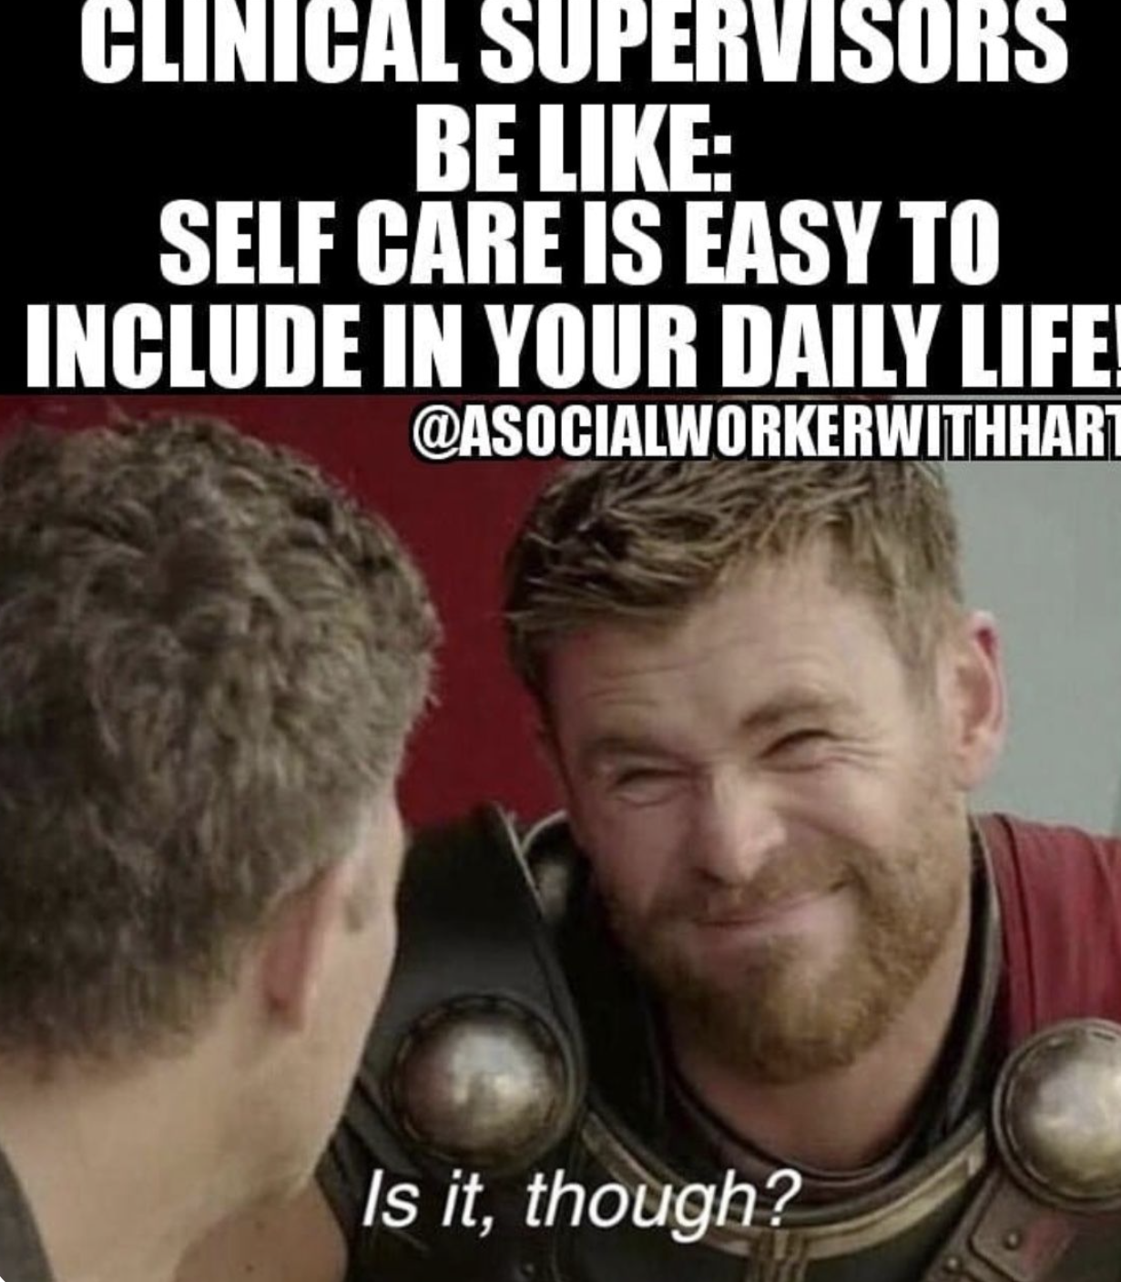

Slide 16
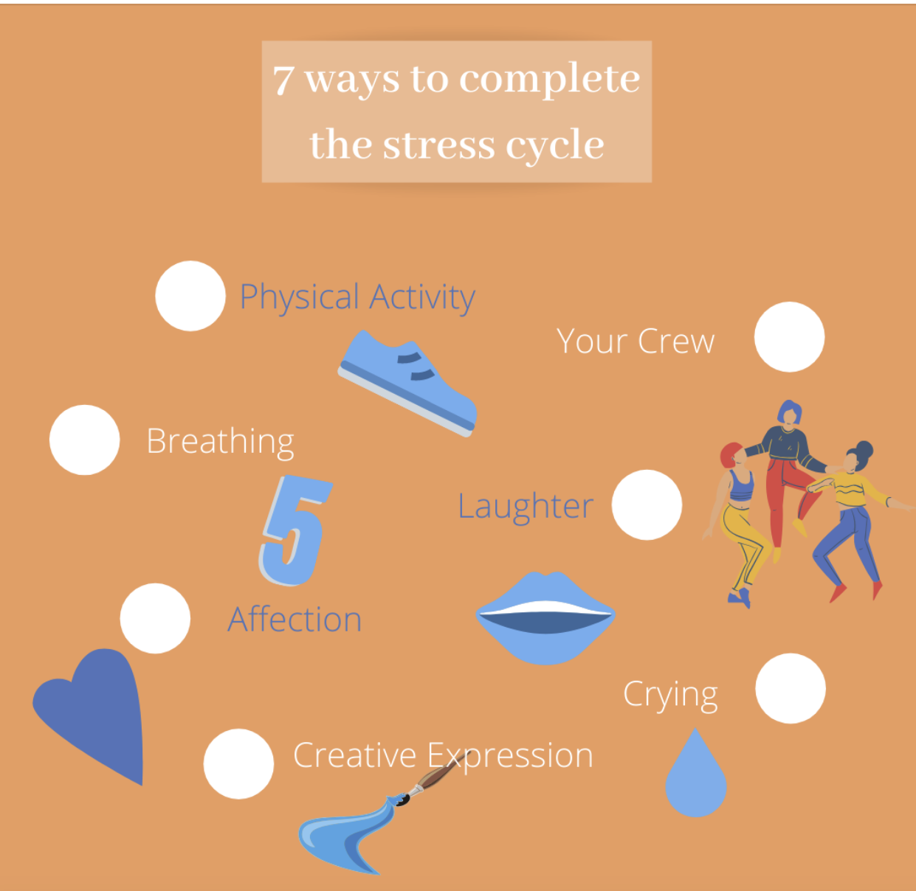
Management & Treatment
Self-care practices
Complete the Stress Cycle
Physical & mental health treatment providers
Scheduled socialization with friends, family, colleagues
Organizational-level support

