Slide 1
Note for Presenter
These materials were developed by the Mountain Plains MHTTC, Mid-America MHTTC, and the Mid-America ATTC for use by extension offices and other rural organizations to support community mental health efforts. Inserting local contact information and resources is encouraged; however, any co-branding efforts, such as adding organization logos, must adhere to TTC Network branding and style guidelines. For more information, please contact mountainplains@mhttcnetwork.org.
#TogetherWeFarm
Notes:
Speaker’s Notes:
Co-branding information.

Slide 2





Mental Health Awareness: A Community Conversation
Farm Stress and Mental Health
#TogetherWeFarm
Mental Health Supports for
Farmers and their Communities

Slide 3
Disclaimer and Funding Statement
These materials were prepared by the Mountain Plains Mental Health Technology Transfer Center, the Mid-America Mental Health Technology Center, and the Mid-America Addiction Technology Treatment Center under a cooperative agreement from the Substance Abuse and Mental Health Services Administration (SAMHSA). All material appearing in this presentation, except that taken directly from copyrighted sources, is in the public domain and may be reproduced or copied without permission from Mountain Plains MHTTC or the authors. Citation of the sources is appreciated. Do not reproduce or distribute this presentation for a fee.
For more information on obtaining copies of this presentation please email gberry@wiche.edu.
At the time of this presentation, Miriam E. Delphin-Rittmon, Ph.D., serves as SAMHSA Assistant Secretary. The opinions expressed herein are the views of Mountain Plains MHTTC,
Mid-America MHTTC, and Mid-America ATTC and do not reflect the official position of the Department of Health and Human Services (DHHS), or SAMHSA. No official support or endorsement of DHHS, or SAMHSA, for the opinions described in this presentation is intended
or should be inferred. ​
​
The work of the Mountain Plains MHTTC, Mid-America MHTTC, and Mid-America ATTC is supported by grant H79SM081792 from the Department of Health and Human Services, Substance Abuse and Mental Health Services Administration.​

Slide 4
About the TTC Network
The Technology Transfer Center (TTC) Network is a national network of training and technical assistance centers serving the needs of mental health, substance use, and prevention providers. The work of the TTC Network is under a cooperative agreement by the Substance Abuse and Mental Health Services Administration (SAMHSA). For more information about the Technology Transfer Centers, please visit the TTC Information Center.
In response to mental health and substance use issues in farming communities in HHS Region 7 and 8 states, the Mountain Plains Mental Health Technology Transfer Center (MHTTC), the Mid-America MHTTC, and the Mid-America Addiction Technology Transfer Center (ATTC) collaborated to produce these materials. For technical assistance and training, please contact your regional TTC office at the email addresses below.
mhttcnetwork.org/mountainplains | mountainplains@mhttcnetwork.org
mhttcnetwork.org/midamerica | midamerica@mhttcnetwork.org
attcnetwork.org/midamerica | midamerica@attcnetwork.org

Slide 5
Language Matters
Notes:
Speaker’s Notes:
The words we use matter. This is especially true when talking about Mental Health and Mental Illness issues. Studies show that many people do not seek treatment due to the stigma attached to mental illness. Experts agree that the “single most important barrier to overcome in the community is the stigma and associated discrimination towards persons suffering from mental and behavioral disorders.”

Slide 6
Presentation Objectives
Increase awareness and understanding about mental health awareness
Create a common language about mental health
Identify unique community assets and resources
#TogetherWeFarm
Notes:
Speaker’s Notes:
These presentations were designed to assist rural communities increase their awareness and understanding of the relationship between mental health and farm stress.
Thru the creation of a common language about mental health, communities can identify their unique resources and implement next steps in determining community-wide solutions.

Slide 7

Mental Health Awareness Definition
Mental health awareness is understanding how to obtain and maintain positive mental health. People with limited mental health literacy may be unable to recognize signs of distress in themselves or others, which can stop them from seeking support.
Notes:
Speaker’s Notes:
Resources:
Rural Prevention and Treatment of Substance Use Disorders Toolkit: https://www.ruralhealthinfo.org/toolkits/substance-abuse

Slide 8
Rural Communities
Rural areas are not homogenous
  Each has its own traditions, customs, geography
  *Add info here about your community
Independence and self-reliance instilled early
Lower population density, isolation, lack of privacy
  “Goldfish Effect”
    Aware of each other’s lives, illnesses, health events;
    community-wide gossip
    People know your vehicle, friends with clinic staff, you serve on committees/boards with providers
Dual relationships: Providers AND community members
#TogetherWeFarm
#TogetherWeFarm
Notes:
Speaker’s Notes:
Slama, K. (2004). Rural culture is a diversity issue. Minnesota Psychologist, 9-11, 13. Retrieved from https://www.apa.org/practice/programs/rural/rural-culture.pdf
Applying one definition to “rural” is complicated by changing community demographics, urban sprawl, and diverse geographies. Regardless of the definition, rural areas are commonly characterized by a combination of low population density (sparseness), isolation (distance from an urban center), and small size (total population).
“It’s Complicated…Why What’s Rural Matters.” The Rural School and Community Trust, 21 Nov. 2013, www.ruraledu.org/articles.php?id=3127
Rural communities are diverse, and their culture is shaped by many factors including weather, primary options for employment, heritage, access to health and behavior healthcare, and proximity to urban areas to access goods and services.
“If you’ve seen one rural town you’ve seen one rural town.” This adage reminds us that not all rural communities are the same and not all rural people are the same.
Schwartz, Brett. “The Good Ol’ Days Are Back: The Revival of the Potosi Brewery.” National Association of Development Organizations, 30 Nov. 2012, www.nado.org/the-good-ol-days-are-back-the-revival-of-the-potosi-brewery/.

Slide 9
What is the health of you and your neighbor?
Family farms make up nearly 98% of U.S. farms. These family farmers are not only caretakers of their livestock and land — they are also proud community members and parents.
Nearly half of the nation’s farmers and ranchers volunteer with a youth organization, compared with a national average of about 7%.
It’s in farmers' best interest to protect their physical and mental health as well as their kids’ and that of others in the area.
Human health is an issue important to every farm family. Research shows that animal agriculture and food production can co-exist with healthy neighbors and communities.
#TogetherWeFarm
Notes:
Speaker’s Notes:
To learn more: https://www.supportfarmers.com/human-health/

Slide 10

Know the Warning Signs of Mental Health Distress
Changes in routines or social activities
Decline in the care of domestic animals
Increase in illness or other chronic conditions
Increase in farm accidents
Decline in appearance of the farmstead
Signs of stress in children including struggles with school
Decreased interest in activities or events

Slide 11
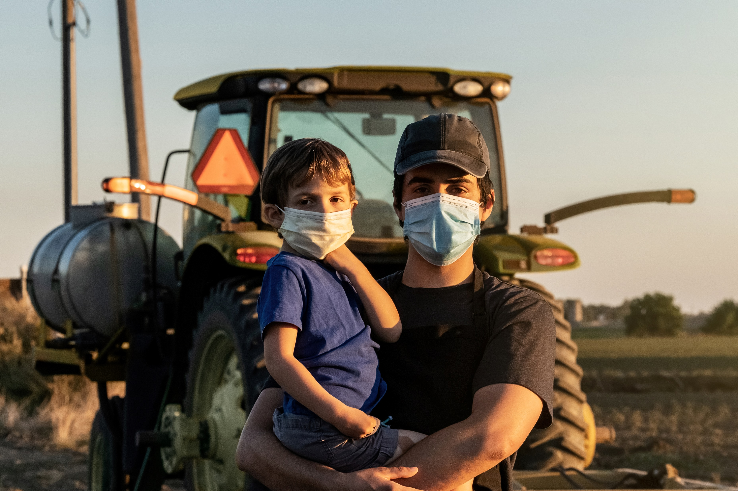

Stress on the Farm
“At its core, farming is both a profession and a cultural identity steeped in strength of character, self-reliance and independence that can make it difficult to first recognize and then seek help when needed.”
- Growing Stress on the Farm: The Expanding Economic and Mental Health Disparities in Rural Missouri
#TogetherWeFarm
Notes:
Speaker’s Notes:
Stress is common in agricultural jobs.
Farming is one of the most hazardous occupations (Freeman et al., 2008).
Physical health may be impacted due to the use of pesticides and other chemicals (Blair et al., 2015).
Other stressors include long days, isolation, heavy workload, technological innovation, business management, and farm administration.
External factors such as disease outbreaks, natural disasters, government regulations, climate changes, and market fluctuations are unpredictable.
Interpersonal stressors related to family roles (Hovey & Seligman, 2006)

Slide 12

Starting the Community Conversation
Define the problem in our community
Identify risk and protective factors
How can we work across the public and private sectors to develop effective prevention and treatment interventions
  What do WE need?
How will we know if we are making a difference?
Notes:
Speaker’s Notes:
We recommend that you start this portion of the presentation by listing your community strengths, resources, and assets.
To develop a community response to stigma and mental illness begin by looking at our own community statistics and contributing environmental factors.
This slide allows you to customize with local statistics and concerns
Your Community’s “Cultural Norm” allows you to help community members consider the cultural norm or what is considered acceptable behavior especially regarding mental illness in your local community.
A Public Health-Based Approach to Addressing Substance Use Disorders
https://www.ruralhealthinfo.org/toolkits/substance-abuse/1/public-health-based-approach

Slide 13
Local Resources
Use this slide for local resources
#TogetherWeFarm
Notes:
Speaker’s Notes:
This slide is optional and provides the presenter with the opportunity to list local behavioral healthcare providers and other resources.

Slide 14
National Mental Health Crisis and Information Lines
Farm Aid Hotline
  800-FARM-AID (327-6243)
  Monday-Friday 8-4 p.m. CT/7-3 p.m. MT
National Suicide Prevention Lifeline
  1-800-273-TALK (8255) or 1-888-628-9454 (Spanish) 24/7
2-1-1, a comprehensive hotline that connects callers with
local resources
National Alliance on Mental Illness (NAMI)
1-800-950-6264 or email info@nami.org
#TogetherWeFarm
Notes:
Speaker’s Notes:
This slide provides the presenter with national resources for individuals or communities experiencing crisis and other mental health resources.

Slide 15
TTC Resources
SAMHSA National HELPLINE is a free, confidential, 24/7, 365-day-a-year treatment referral and information service
for individuals and families facing mental and/or substance use disorders.
https://www.samhsa.gov/find-help/national-helpline
  1-800-662-HELP (4357)
  SAMHSA. 2019 National Survey of Drug Use and Health (NSDUH) Releases. https://www.samhsa.gov/data/release/2019-national-survey-drug-use-and-health-nsduh-releases
  SAMHSA. Co-Occurring Disorders and Other Health Conditions. https://www.samhsa.gov/medication-assisted-treatment/medications-counseling-related-conditions/co-occurring-disorders
  Depression, alcohol and farm stress: Addressing co-occurring disorders in rural America: https://mhttcnetwork.org/centers/mountain-plains-mhttc/rural-mental-health-farm-stress
University of Missouri Kansas City: SBIRT. Alcohol Patient Education. https://sbirt.care/education.aspx
*This infographic can be printed and distributed for education
#TogetherWeFarm
Notes:
Speaker’s Notes:
The Technology Transfer Centers (TTC) offer free technical assistance and training on a variety of mental health and addiction topics. These are just a few of the resources that are free and available to the public.

Slide 16
Get in Touch
mhttcnetwork.org/mountainplains | mountainplains@mhttcnetwork.org
mhttcnetwork.org/midamerica | midamerica@mhttcnetwork.org
attcnetwork.org/midamerica | midamerica@attcnetwork.org
Notes:
Speaker’s Notes:
The Technology Transfer Centers offer free technical assistance and training on the topic presented here. Please visit:______________(insert url for farm stress grab-n-go–page)

