Slide 1
Note for Presenter
These materials were developed by the Mountain Plains MHTTC, Mid-America MHTTC, and the Mid-America ATTC for use by extension offices and other rural organizations to support community mental health efforts. Inserting local contact information and resources is encouraged; however, any co-branding efforts, such as adding organization logos, must adhere to TTC Network branding and style guidelines. For more information, please contact mountainplains@mhttcnetwork.org.
#TogetherWeFarm
Notes:
Speaker’s Notes:
Co-branding information.

Slide 2





Mental Health Stigma: A Community Conversation
Farm Stress and Mental Health
#TogetherWeFarm
Mental Health Supports
for Farmers and their Communities

Slide 3
Disclaimer and Funding Statement
These materials were prepared by the Mountain Plains Mental Health Technology Transfer Center, the Mid-America Mental Health Technology Center, and the Mid-America Addiction Technology Treatment Center under a cooperative agreement from the Substance Abuse and Mental Health Services Administration (SAMHSA). All material appearing in this presentation, except that taken directly from copyrighted sources, is in the public domain and may be reproduced or copied without permission from Mountain Plains MHTTC or the authors. Citation of the sources is appreciated. Do not reproduce or distribute this presentation for a fee. For more information on obtaining copies of this presentation please email gberry@wiche.edu.
At the time of this presentation, Miriam E. Delphin-Rittmon, Ph.D., serves as SAMHSA Assistant Secretary. The opinions expressed herein are the views of Mountain Plains MHTTC, Mid-America MHTTC, and Mid-America ATTC and do not reflect the official position of the Department of Health and Human Services (DHHS), or SAMHSA. No official support or endorsement of DHHS, or SAMHSA, for the opinions described in this presentation is intended or should be inferred. ​
​
The work of the Mountain Plains MHTTC, Mid-America MHTTC, and Mid-America ATTC is supported by grant H79SM081792 from the Department of Health and Human Services, Substance Abuse and Mental Health Services Administration.​

Slide 4
About the TTC Network
The Technology Transfer Center (TTC) Network is a national network of training and technical assistance centers serving the needs of mental health, substance use, and prevention providers. The work of the TTC Network is under a cooperative agreement by the Substance Abuse and Mental Health Services Administration (SAMHSA). For more information about the Technology Transfer Centers, please visit the TTC Information Center.
In response to mental health and substance use issues in farming communities in HHS Region 7 and 8 states, the Mountain Plains Mental Health Technology Transfer Center (MHTTC), the Mid-America MHTTC, and the Mid-America Addiction Technology Transfer Center (ATTC) collaborated
to produce these materials. For technical assistance and training, please contact your regional
TTC office at the email addresses below.
mhttcnetwork.org/mountainplains | mountainplains@mhttcnetwork.org
mhttcnetwork.org/midamerica | midamerica@mhttcnetwork.org
attcnetwork.org/midamerica | midamerica@attcnetwork.org

Slide 5
Language Matters
Notes:
Speakers Notes:
The words we use matter. This is especially true when talking about Mental Health and Mental Illness issues. Studies show that many people do not seek treatment due to the stigma attached to mental illness. Experts agree that the “single most important barrier to overcome in the community is the stigma and associated discrimination towards persons suffering from mental and behavioral disorders.”

Slide 6
Presentation Objectives
Increase awareness and understanding of
mental health stigma
Create a common language about mental health
Identify unique community assets
and resources
#TogetherWeFarm
Notes:
Speaker’s Notes:
These presentations were designed to assist rural communities increase their awareness and understanding of the relationship between mental health and farm stress.
Thru the creation of a common language about mental health, communities can identify their unique resources and implement next steps in determining community-wide solutions.

Slide 7
Stigma Definition
Stigma is the process by which a negative attitude about mental illness leads to loss of opportunities. Beliefs about mental illness include:
persons are violent and should be kept out of the community,
persons are irresponsible because of their life choices, and
persons are like children and should be cared for.
These commonly held beliefs are not true.
#TogetherWeFarm
Notes:
Speaker’s Notes:
At the end of this presentation, you will:
Understand what stigma is and how it interferes with mental health
Be prepared to dispute common myths about mental illness
Understand the importance of social support and the importance of talking to others about mental health
Have resources to help with mental health
To understand stigma, we need to consider both the public expression of stigma and the personal.
Stigma occurs when people treat others differently because of their mental illness. This can take many forms, including:
withholding help,
avoiding contact,
coercive treatment and segregated institutions.
For example, friends and family might avoid contact with someone they know who has a mental illness, or someone with mental illness might be unable to find a good job and/or housing because of prejudice toward them.
Sometimes, personal or self-stigma can occur. This is when a person with mental illness internalizes commonly held negative beliefs about mental illness.
Personal stigma can:
Make some people feel less valued
Result in lower self-esteem and self-efficacy

Slide 8

Mental Illness Definition
Mental illness
  Conditions that affect a person’s thinking, feeling, mood or behavior.
  Impacts functioning.
  Mental health
  Our emotional, psychological, and social well-being.
  Affects how we think, feel, and act.
  (Centers for Disease Control and Prevention, 2018)
Notes:
Speaker’s Notes:
Mental Illness: A Very Common Experience in our Community
Mental illness
Conditions that affect a person’s thinking, feeling, mood or behavior.
May be occasional or long-lasting.
Affects someone’s social, occupational, or other important areas of functioning.
Mental health
Our emotional, psychological, and social well-being.
Affects how we think, feel, and act.
Helps determine how we can handle stress, relate to others, and make healthy choices.

Slide 9
Mental Illness Facts & Figures
Mental illness is a common experience
20.6 of the US population experienced a mental illness
in 2019
All age and race/ethnicity groups are affected
Women and young people are slightly more affected than
other groups
#TogetherWeFarm
Notes:
Speaker’s Notes:
To “Normalize” mental illness, let’s take a look at a few facts and figures about the prevalence of mental illness in the United States.

Slide 10
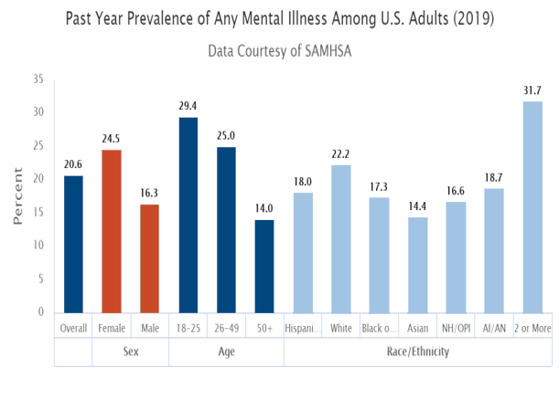
Mental Illness Facts & Figures
Notes:
Speaker’s Notes:
To “Normalize” mental illness, let’s take a look at a few facts and figures about the prevalence of mental illness in the United States. This graph reflects the information presented on slide 8.

Slide 11
Mental Illness Facts & Figures
Mental illness often goes untreated
Only 40.1% of persons with a mental illness received treatment in 2019
All age and race/ethnicity groups are affected
Men and older age groups are less likely to receive treatment for their mental illness
#TogetherWeFarm

Slide 12
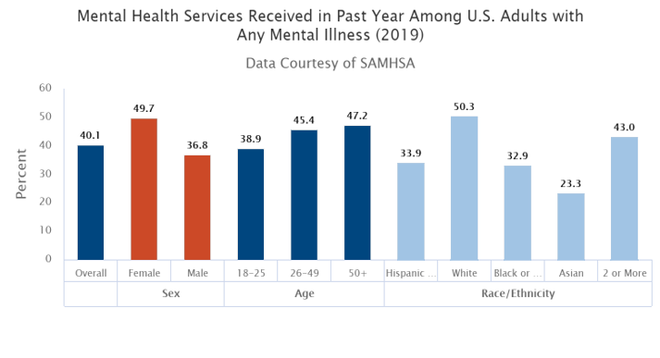
Mental Illness Facts & Figures
Notes:
Speaker’s Notes:
This graph reflects the information presented in slide 10

Slide 13

Normalizing Mental Illness
#TogetherWeFarm
Notes:
Speaker’s Notes:
Persons with mental illness are all around us
It is a “hidden” disability that most often we can’t see.
Most of us have a friend or family member who have a mental illness that we do not know about.
Because of stigma it is difficult to talk to others about a mental illness

Slide 14
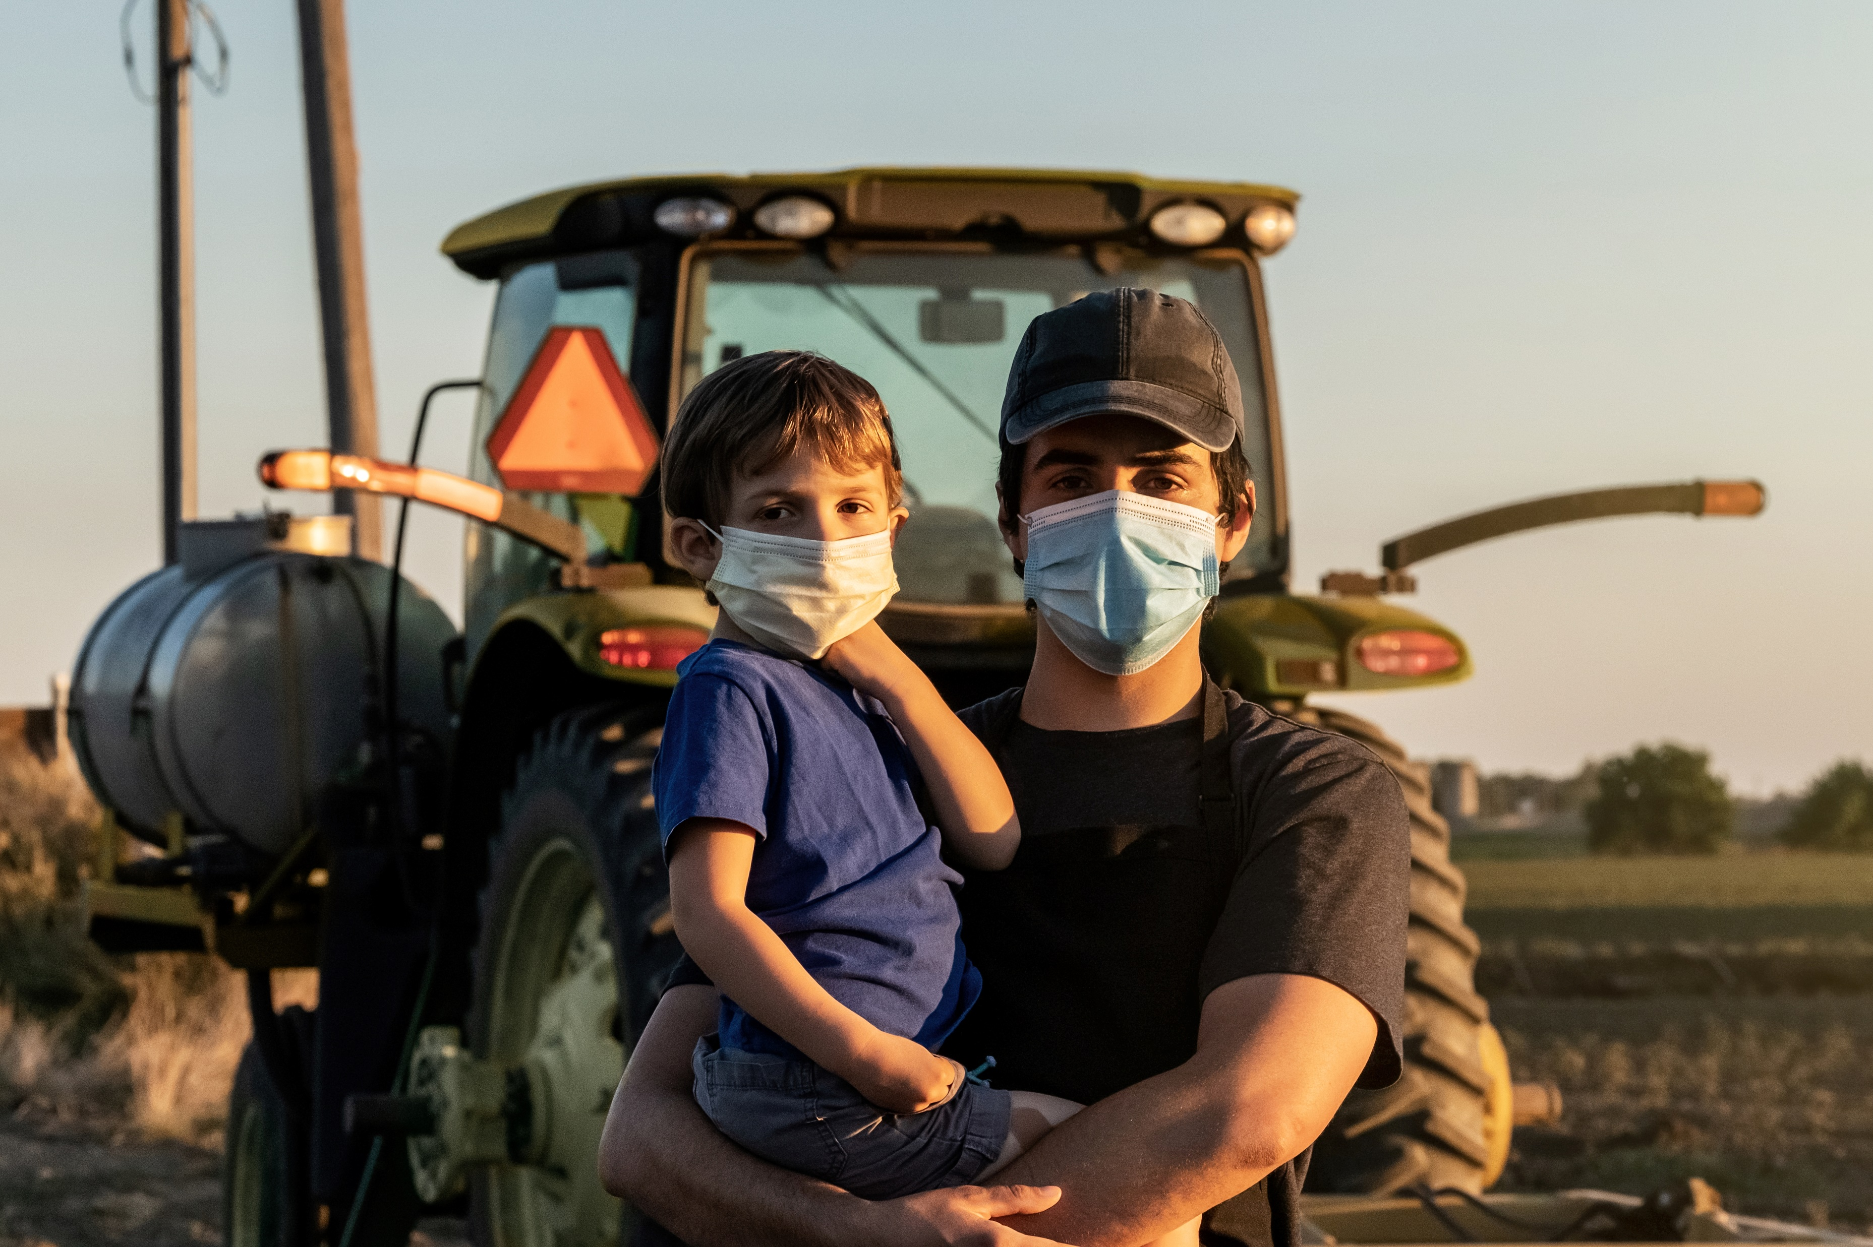

Stress on the Farm
“At its core, farming is both a profession and a cultural identity steeped in strength of character, self-reliance and independence that can make it difficult to first recognize and then seek help when needed.”
- Growing Stress on the Farm: The Expanding Economic and Mental Health Disparities in Rural Missouri
#TogetherWeFarm
Notes:
Speaker’s Notes:
Stress is common in agricultural jobs.
Farming is one of the most hazardous occupations (Freeman et al., 2008).
Physical health may be impacted due to the use of pesticides and other chemicals (Blair et al., 2015).
Other stressors include long days, isolation, heavy workload, technological innovation, business management, and farm administration.
External factors such as disease outbreaks, natural disasters, government regulations, climate changes, and market fluctuations are unpredictable.
Interpersonal stressors related to family roles (Hovey & Seligman, 2006)

Slide 15
How Farm Stress Impacts Mental Health
Agricultural workers have a higher risk of developing mental health illnesses (Fraser et al., 2005).
Rate of depression in agricultural workers has varied from 7.4% - 24% (Onwuameze et al., 2013).
#TogetherWeFarm
Notes:
Speaker’s Notes:
Agricultural workers have a higher risk of developing mental health illnesses as there is a risk for physical injury, exposure to chemicals, family pressures, long hours, and unpredictable external factors (Fraser et al., 2005).
Rate of depression in agricultural workers has varied from 7.4% - 24% (Onwuameze et al., 2013).

Slide 16
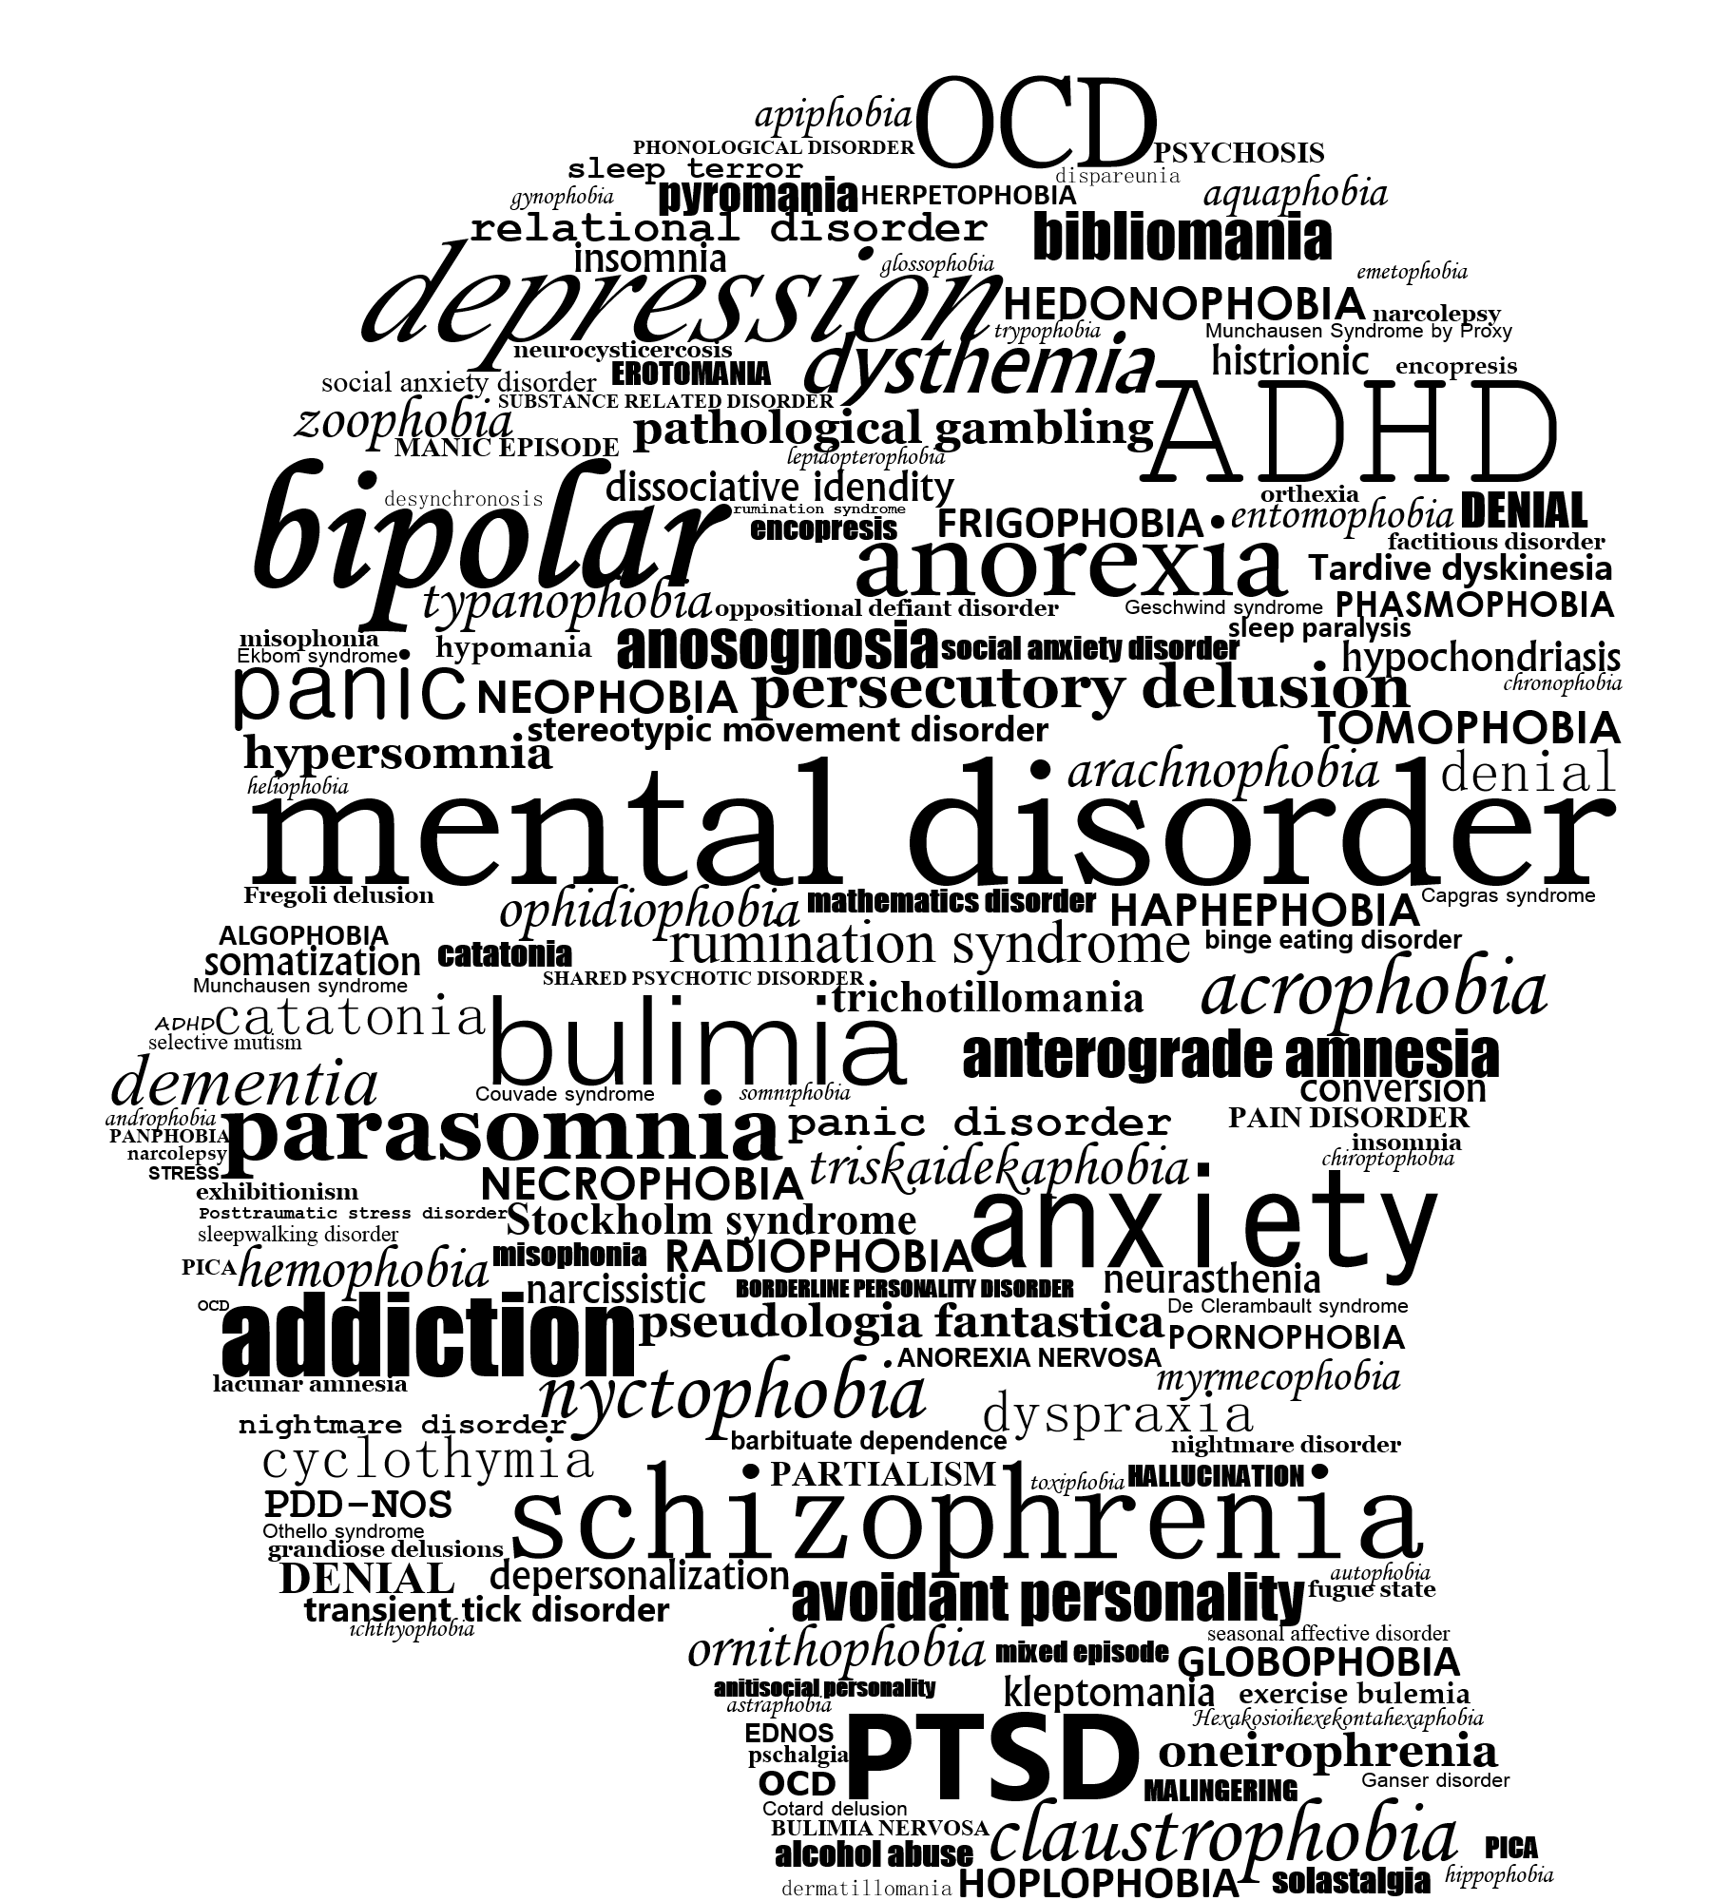
Starting the Community Conversation
Local Statistics and Concerns
  Prevalence of Mental Illness in our community.
  What are we most concerned about?
What is your community’s “Cultural Norm”?
How does your community talk about mental
illness?
  Is there easy access to care, providers, support networks?
Notes:
Speaker’s Notes:
Stigma makes it difficult to talk about mental health experiences. However, finding the right people to talk to is crucial to getting better and preventing a negative course of the illness.
We recommend that you start this portion of the presentation by listing your community strengths, resources, and assets.
To develop a community response to stigma and mental illness begin by looking at our own community statistics and contributing environmental factors.
This slide allows you to customize with local statistics and concerns
Your Community’s “Cultural Norm” allows you to help community members consider the cultural norm or what is considered acceptable behavior especially regarding mental illness in your local community.

Slide 17
Local Resources
Use this slide for local resources
#TogetherWeFarm
Notes:
Speaker’s Notes:
This slide is optional and provides the presenter with the opportunity to list local behavioral healthcare providers and other resources.

Slide 18
National Mental Health Resources
National Alliance on Mental Health
  Call 1-800-950-6264 or email info@nami.org
National Alliance on Mental Health: Nebraska Chapter
Nebraska Division of Behavioral Health Rural Response Hotline
National Suicide Prevention Lifeline
  Call 1-800-273-8255
#TogetherWeFarm
Notes:
Speaker’s Notes:
This slide provides the presenter with national mental health resources.
Academic References:
Hovey, J.D., & Seligman, L. D. (2006). The mental health of agricultural workers. In J.E. Lessenger (Ed.), Agricultural medicine (pp. 282-299). New York, NY: Springer.
Komossa, K., Rummel-Kluge, C., Hunger, H., Schmid, F., Schwarz, S., Duggan, L., Leucht, S. (2010). Olanzapine versus other atypical antipsychotics for schizophrenia. Cochrane Database of Systematic Reviews. doi:10.1002/14651858.cd006654.pub2
Lazarus, R. S., & Folkman, S. (1984). Stress, Appraisal and Coping. New York: Springer.
Mueser, K.T., Corrigan, P.W., Hilton, D.W., Tanzman, B., Schaub, A., Gingerich, S., Herz, M.I. (2002). Illness management and recovery: A review of the research. Psychiatric Services, 53(10), 1272–1284. doi:10.1176/appi.ps.53.10.1272
National Alliance on Mental Health. (2012). People with mental health enrich our lives. Retrieved from http://www.ccolife.org/wp-content/uploads/2013/05/mentalillness.gif
Onwuameze, O. E., Paradiso, S., Peek-Asa, C., Donham, K. J., & Rautiainen, R. H. (2013). Modifiable risk factors for depressed mood among farmers. Annals of Clinical Psychiatry, 25, 83-90.
Substance Abuse and Mental Health Services Administration. (2020). Key substance use and mental health indicators in the United States: Results from the 2019 National Survey on Drug Use and Health (HHS Publication No. PEP20-07-01-001). Rockville, MD: Center for Behavioral Health Statistics and Quality, Substance Abuse and Mental Health Services Administration. Retrieved from https://www.samhsa.gov/data/sites/default/files/reports/rpt29393/2019NSDUHFFRPDFWHTML/2019NSDUHFFR1PDFW090120.pdf
Bandelow, B., Sher, L., Bunevicius, R., Hollander, E., Kasper, S., Zohar, J. (2012). Guidelines for the pharmacological treatment of anxiety disorders, obsessive–compulsive disorder and posttraumatic stress disorder in primary care. International Journal of Psychiatry in Clinical Practice, 16(2), 77–84. doi:10.3109/13651501.2012.667114
Blair, A., Ritz, B., Wesseling, C., & Beane Freeman, L. (2015). Pesticides and human health. Occupational and Environmental Medicine, 72, 81-82.
Blanch, A. K., Carling, P. J., & Ridgway, P. (1988). Normal housing with specialized supports: A psychiatric rehabilitation approach to living in the community. Rehabilitation Psychology, 33(1), 47–55. doi:10.1037/h0091686
Bond, G. R., Drake, R. E., & Becker, D. R. (2008). An update on randomized controlled trials of evidence-based supported employment. Psychiatric Rehabilitation Journal, 31(4), 280–290. doi:10.2975/31.4.2008.280.290
Centers for Disease Control and Prevention (2018). Mental health. Retrieved from https://www.cdc.gov/mentalhealth/learn/index.htm
Corrigan, P. W., & Watson, A. C. (2002). Understanding the impact of stigma on people with mental illness. World psychiatry : official journal of the World Psychiatric Association (WPA), 1(1), 16–20.
Corrigan, P., & Wassel, A. (2008). Understanding and influencing the stigma of mental health. Journal of Psychosocial Nursing and Mental Health Nursing, 46, 42-48.
Corrigan, P. (2004). How stigma interferes with mental health care. American Psychologist, 59, 614-625.
Fraser, C. E., Smith, K. B., Judd, F., Humphreys, J. S., Fragar, L. J., & Henderson, A. (2005). Farming and mental health problems and mental illness. International Journal of Social Psychiatry, 51, 340-349.
Freeman, S. A., Schwab, C. V., & Jiang, Q. (2008). Quantifying stressors among Iowa farmers. Journal of Agricultural Safety and Health, 14, 431-439.

Slide 19
National Resources – Crisis Lines
Farm Aid Hotline
800-FARM-AID (327- 6243)
National Suicide Prevention Lifeline
1-800-273-TALK (8255) or 1-888-628-9454 (Spanish) 24/7
Crisis Text Line
Text HOME to 741-741 (for youth)
National Alliance on Mental Illness (NAMI)
1-800-950-6264 or email info@nami.org
#TogetherWeFarm
Notes:
Speaker’s Notes:
This slide provides the presenter with national resources for individuals or communities experiencing crisis and other mental health resources.

Slide 20
TTC Resources
SAMHSA National HELPLINE. https://www.samhsa.gov/find-help/national-helpline
  1-800-662-HELP (4357)
  SAMHSA. https://www.samhsa.gov/data/release/2019-national-survey-drug-use-and-health-nsduh-releases
  SAMHSA. https://www.samhsa.gov/medication-assisted-treatment/medications-counseling-related-conditions/co-occurring-disorders
  Depression, alcohol and farm stress: Addressing co-occurring disorders in rural America: https://mhttcnetwork.org/centers/mountain-plains-mhttc/rural-mental-health-farm-stress
University of Missouri Kansas City: SBIRT. Alcohol Patient Education. https://sbirt.care/education.aspx *This infographic can be printed and distributed
for education
#TogetherWeFarm
Notes:
Speaker’s Notes:
The Technology Transfer Centers (TTC) offer free technical assistance and training on a variety of mental health and addiction topics. These are just a few of the resources that are free and available to the public.

Slide 21
Get in Touch
mhttcnetwork.org/mountainplains | mountainplains@mhttcnetwork.org
mhttcnetwork.org/midamerica | midamerica@mhttcnetwork.org
attcnetwork.org/midamerica | midamerica@attcnetwork.org
Notes:
Speaker’s Notes:
The Technology Transfer Centers offer free technical assistance and training on the topic presented here. Please visit:______________(insert url for farm stress grab-n-go–page)

