Slide 1
Adult Resilience Curriculum (ARC)
Introduction

Slide 2
Delivery & Tailoring Instructions
Prior to delivering, get information from audience about their current struggles and needs. Use that information to decide what should be tailored
To tailor, you can change the following:
Hook & Transition metaphors
Your “Who I Am” slide & credibility slides (referent, information, positive expert power)
Any of the background intro slides (if Module 1 has already been delivered)
The order of the slides (before activities)
Activities (based on time frame)
Knowledge Check questions
Discussion Questions
To make changes to the Activities, Knowledge Check Questions, and Discussion Questions, you can:
Hide the activities you do not want to do
Replace the knowledge check section of each final activity slide with the proper knowledge check question(s)
Delete whichever discussion questions you choose not to provide. Make sure these questions are provided in a follow up forum/document/delivered in-person by a member of the education professional team after at least 1 week of practice.

Slide 3
Delivery & Tailoring Instructions
Make sure the tailoring is done to fit within the appropriate time frame
The structure and design of the powerpoint is actually based on a combination of successful TedTalks (that involved audience participation) and research on how to present to adults
This includes the Hook, Transition, Who I Am, and Audience Benefit slides
Limited text
Use of imagery
MINIMIZE reading text on slide; research indicates this actually disrupts audience comprehension
Set expectation for participation at the outset

Slide 4
Delivery & Tailoring Instructions
Things to remember
Expert power can be negative if audience portrays a) you are leveraging your expertise in one domain into another, b) if your expertise appears outdated, c) your expertise is impersonal (i.e., not recognizing the audience’s perspective), and d) if they portray you as having something to gain
What is comfortable for us, the presenter, is maybe not engaging for the audience.
Charismatic power is something; you are acting for your audience and that is encouraged. People will buy-in if you seem bought-in. Find the charisma personality that you can put on confidently.
Sell the “Why”, not the “what” or “how”. Those are ARC and the modules. But the “Why” is most important

Slide 5
Delivery & Tailoring Instructions
SPECIAL INSTRUCTIONS FOR THIS MODULE (HIDE ONLY AFTER READING)
This module will require a great deal of modification to fit your audience
Much of the commentary can remain the same but you may need to make some adjustments to images and examples beforehand to match your audience
This is important in order get buy in from different professions; they need to know that the information to learn in ARC is relevant to their roles, identity, and will immediately be effective

Slide 6
Flight safety instructions…
Notes:
Whenever you get on a plane, flight teams are required to provide flight safety instructions. These instructions have largely remained the same with only slight adjustments over the last several decades. You’re told how to put on your seat belt, how the walkway lights up in an emergency, where the exists are. Critically, the flight attendants—whether live or over video—demonstrate how to properly locate and fasten your oxygen mask in an emergency. And what do they always say after this demonstration? Make sure to put on your own mask before assisting others.

Slide 7
How do we best support our students?
Notes:
Thinking of those oxygen masks, if we look to education, how do we provide the best support and care to our students?

Slide 8
By supporting the educators that work with them.
Notes:
…by supporting the adults—the educators—who work with them. If you will allow me to divert a little from the metaphor airplane metaphor, educators are not so much the passengers on an airplane that need their own oxygen mask but instead the flight attendants. When experiencing turbulence on a plane, they are the ones whom we reference to figure out how in the world we should react. When they remain calm, follow safety steps, and work together, the passengers can be secure in their own safety.

Slide 9
The Adult Resilience Curriculum (ARC) MODULE 0: Introduction
Notes:
That is what the ARC is about. It is a transtheoretical, comprehensive yet flexible curriculum designed to promote well-being (and thereby enhance people’s capacity for resilience).

Slide 10
Acknowledgements
This framework and its supporting research is the result of ongoing collaboration between the University of Washington, University of Minnesota, and community partnerships. The following individuals are co-developers of the ARC:
Clayton Cook, PhD
Gail Joseph, PhD
Aria Fiat, PhD
Andrew Thayer, PhD
Notes:
The ARC was originally developed in 2013 by Dr. Clayton Cook and Dr. Gail Joseph for pre-service and in-service teachers. In this space, the goal was to build upon the strengths of existing programs, while trying to make it more accessible and feasible for real-world professionals. It has since expanded beyond teachers because the principles, supports, and concepts are universal. It is not meant to replace mental health services or support for professionals but is meant to provide a foundation for people.

Slide 11
WHO WE ARE
Christian Klepper, PsyD, LP
Faculty Trainer
Notes:
Who I Am
*Replace with your photo, change name(s), make sure to highlight your credentials (expert), your area of expertise (expert, informational power)*

Slide 12
WHO WE ARE
Hannah West,
PhD, BCBA
Regional Trainer
Notes:
Who I Am (This is an example)
*Replace with your photo, change name(s), make sure to highlight your credentials (expert), your area of expertise (expert, informational power)*

Slide 13
Sources of educator stress (pre & post COVID)
not enough time!
personal health concerns
frustrated parents
de-funding of schools
distance learning
efforts to improve educator wellbeing
educational inequities
insufficient funding & resources
policy & accountability measures
administrative demands
challenging student behaviors
worries about loved ones
Notes:
*Only include if addressing COVID*
And then COVID threw more onto the scale

Slide 14
There is no such thing as a “one size fits all” approach to well-being.
Notes:
Well, first, too often organizations try to slap a one-size-fits-all solution to the problem and then wonder why more people are not reaping benefits. We don’t have the solution for how to solve the problem of professional stress & burnout
There IS NO one size fits all solution and the issue is COMPLEX. It is a mixture of personal histories and circumstances, personal assets, but also systemic barriers and inadequacies and inefficiencies.
In ARC, what we can offer is insight from a decade of researching stress & well-being that gives a certain perspective, skill set, and environmental support and guidance that enables people to be flexible with their personal approach to well-being.

Slide 15
Self care is important, yes, and so is community care. People cannot self care themselves out of issues that need community support. One without the other can strain and create imbalance.
“
Self care is important, yes, and so is community care. People cannot self care themselves out of issues that need community support. One without the other can create strain and imbalance.
“
Notes:
But we do not have to do it all alone. If you have heard the phrase, “It takes a village to raise a child”, that isn’t just about children. It’s more accurate to say, “It takes a village to raise each other.” Self-care can only be achieved when we have a culture that values it and a community that supports it.
For example, consider the community of support that is needed to engage in some of the most commonly and critically important well-being practices, like physical exercise for vitality. What all is needed for this to be a success? Some factors include:
A workplace with a flexible schedule or at least one that affords time for activity
Help navigating the medical system to get a doctor’s appointment for a check-up
Someone to watch their dog or their kids to be able to go out and do something active
An accountability partner for motivation and support and fun, plus maybe knowledge about how to do some activity
Although it’s possible to still be active and not have these community factors, they certainly make it far easier.

Slide 16
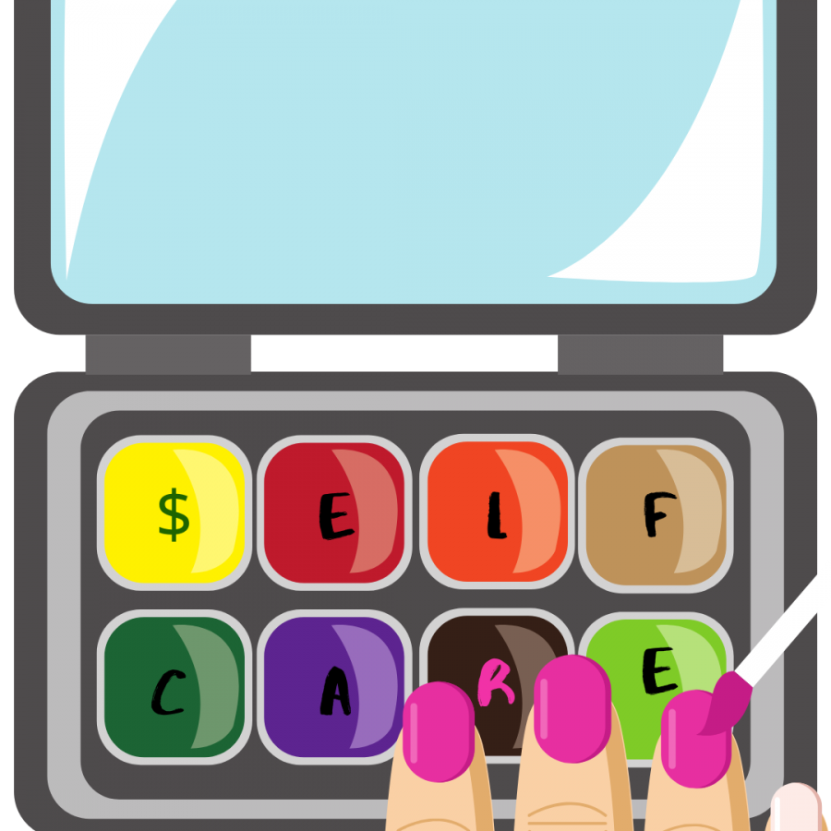
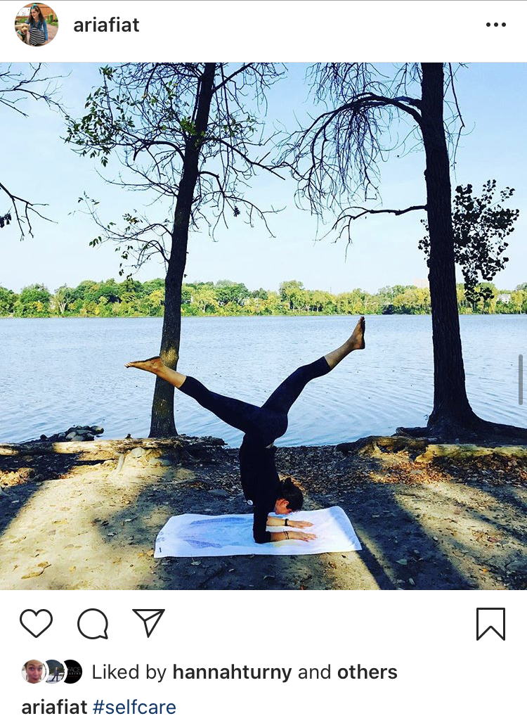
Reflections on the idea of self care
Notes:
Unfortunately, this effort to create a community around self-care has created a #self-care culture that is a carefully curated lifestyle choice to show off and demonstrate status and privilege. Self-care culture is replacing true mental health care with “obsessive consumerism” in which companies are profiting off of a loose collection of practices like “take more bubble baths, “drink this latte”, “do more yoga and for some reason only yoga”. It’s not that these practices are bad but that self-care used to mean something much differently. Audre Lorde (au-dree lord) once said: “Caring for myself is not self-indulgence, it is self-preservation, and that is an act of political warfare.' In short, self-care was a rally against inequitable systems and not a call to consume more. ARC returns to this original idea; rally together to push back against inequitable systems and do what you can for yourselves and each other to be well while changing those systems.

Slide 17
Self care video
What are your initial reactions to this video?
Notes:
*only show this as an example of this self-care culture that is well-intended but again, devoid of any real philosophy of a well life and instead pushes very narrowly focused specific practices*
SHOW first minute
https://www.youtube.com/watch?v=YKS1MoDSe70
though treating yourself to a starbucks or a manicure might momentarily improve your mental state, labeling these things as “self care” have diminished the term’s original meaning and purpose
self-care culture is also replacing regard for mental health care with “obsessive consumerism”
leading people to believe that a bath bomb and a coffee drink can replace the working on mental health - a quick fix
companies are using self-care as a marketing ploy and making money off of it
you can buy self-care nail decals and cute “self-care kits”
a line of massage chairs has the tagline “the science of self-care”

Slide 18
It’s crucial that when addressing the social-emotional competence of patients and professionals, we do so not in a vacuum, but in the larger socio-political context.
Notes:
As such, ARC is only part of the equation. It is a universal approach to well-being for individuals, and must be part of a larger movement within an organization to change the culture and context. To do that, we must recognize the context in which people find themselves in. To put it simply, people cannot self-care themselves out of bad situations. ARC cannot change those contexts. No one person or action can. But ARC can be a springboard for personal and community well-being that enables for greater systems change.

Slide 19
PHYSICAL
Wellness is a holistic integration of physical, mental, and spiritual well-being, fueling the body, engaging the mind, and nurturing the spirit.
(Stoewen, 2017)
EMOTIONAL
PROFESSIONAL
SOCIAL
WELLBEING
SPIRITUAL
Notes:
As a universal program, ARC defines wellness, or well-being, along multiple dimensions with various processes that we can engage in to realize those dimensions. Well-being isn’t about just feeling good and being stress free but instead considers it a more wholistic concept with flexibility to emphasize and de-emphasize certain dimensions. In short, being well doesn’t require we do it all every day all day, but that we identify what dimensions we need more of in the current moment, have the knowledge of what well-being processes actualize those dimensions, and what practices within those processes help us more.

Slide 20
An integrative
approach
Dialectical Behavior
Therapy
(DBT)
Cognitive Behavioral Therapy
(CBT)
Positive Psychology
(PERMA)
Integrative approaches involve distilling effective interventions into overlapping active ingredients and blending them in intentional ways to create additive, synergistic effects.
Acceptance & Commitment Therapy
(ACT)
Notes:
The theoretical basis of ARC is an integration of multiple psychological theories of human behavior and flourishing, and their resulting therapeutic practices. Importantly, the therapy techniques included are those that have some of the most research supporting their efficacy for most people, and demonstrate adaptability to different cultural and social contexts. Since these practices are integrated, individuals using ARC can draw from a variety of process-focused practices that can benefit them.

Slide 21
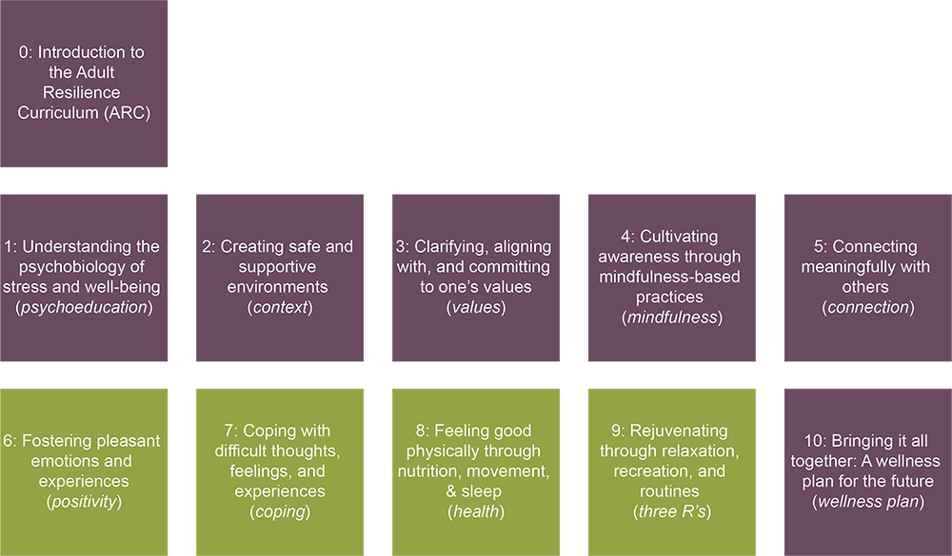
The ARC Modules
Notes:
The ARC program is broken into 10 modules, preceded by this brief, introductory module 0. Modules 1 through 5 and module 10 make up the "core" modules. Modules 6 through 9 are supplementary and provide additional opportunities to learn and practice resiliency skills. Finally, the 10th module brings the curriculum together. It is required at the end, regardless of if you do any or all of the supplementary modules.

Slide 22
The ARC Core Skills
1. Understanding the psychobiology of stress and wellbeing (psychoeducation)
2: Creating safe and supportive environments (context)
3: Clarifying, aligning with, and committing to one’s values
(values)
4: Cultivating awareness through mindfulness-based practices (mindfulness)
5: Connecting meaningfully with others
(connection)
Notes:
The ARC Core Skills are encompassed in modules 1 through 5. The core modules provide the foundational skills for enhancing well-being and the supplemental skills build off those. So although all modules are deemed important, the core modules are considered necessary to really engage well with the supplementary modules. At the same time, you may only need the core modules for your current goals. We still recommend all supplementary

Slide 23
The ARC Wellness Plan
Module Review
Wellness is Action and Ongoing
Wellness Plan
Notes:
The ARC Wellness plan, or module 10, is a brief module. There will be time to review each module and its recommended strategies, finding which one(s) you need most, and then create a wellness plan that will guide your immediate changes. We will review the skills within each module, engage in some reflection, rate them, and spend the majority of the time creating a plan for skills.

Slide 24
Basic Steps for Proceeding Through ARC
Notes:
In order to be successful, let’s talk about how to use ARC including the general structure of the modules, tasks that need to be completed, and tips for delivery. As a reminder, ARC is a universal support program and is recommended to be implemented alongside other organizational supports and change efforts. However, ARC was designed to be effective independently, and can even be done entirely on your own. To do that, there are some key ingredients that are necessary for ARC to be successful.

Slide 25
Step 1
Get a Practice Partner (PP)/Team
Notes:
The first major ingredient for success is to get a practice partner. If you are going through the modules on your own, this can be another colleague, a life partner, family member, friend. Someone whom you are willing to give permission to check in on you, encourage your efforts, and maybe even problem-solve when you hit barriers.
If using ARC in your organization or in a team, you can still have a dedicated practice partner. Or organize into teams where you all are each other support and accountability partner. It is critical that you feel safe in this team.
One participant in a trial of ARC found that keeping a journal for these meetings with their PP really helped. They could take notes during the module, jot down reflections during their practice, and then bring things up during the meeting. While this is not required but we encourage that you give it a try.

Slide 26
Step 2
Engage in Experiential Learning
Gather all materials
Watch/listen to the didactic portion
Try at least 1 activity
Answer knowledge check questions
Live facilitation
Video facilitation
Develop your action plan
(at least 1 week after didactic) Check in with PP/Team using Discussion Questions
(Optional) Try any incomplete activities
Proceed with your action plan
Notes:
Here you can see the flow of each module. Before each module, you will have some materials to gather, such as those needed for various activities. These are hosted on the website, and each module comes with a guide so you know what to download.
Then there is the didactic portion which can be delivered with a live facilitator or over video. This portion of each module is to make sure that you have the understanding of why certain concepts, skills, and practices are being discussed. Even if you are already familiar with the ideas of the module, you may learn about them with a different perspective or insight, or the didactic portion serves as a useful reminder and “booster”. It is important that you complete these with minimal distractions. After the didactic portion there will be a collection of activities for you to select from that address some component of the module. Some of these activities are a one-time reflection-type practice, some are a little more involved at the time, and others challenge you to do things until your next meeting. Sometimes these activities are completed in session if there is live facilitation and time.
There are also knowledge check questions. Complete these on your own or with your practice partner or team right after the didactic portion. Sometimes these are completed in session if you are completing them as a team and have time.
Following the knowledge check questions is the action plan, which is one of the most important parts so we will actually zoom in on that in a moment.
With the action plan in place, the next challenge is to follow through with it. If you wrote in to try some of the skills or practices in the module, or find some way to apply a concept in a way that fits into your life, this is the time to do so. Most of the work of ARC is done in the time not in the module. During this time, you can also return to some of the other activities with the module and complete them if they can help you.
Finally, at least 1 week after the main part of the module is complete and you are a week into your action plan, meet with your practice partner or team to review your progress, answer discussion questions that come with each module, and use that time to problem-solve any issues you have with that module’s content.

Slide 27
Step 3
Set Aside Structured Time
Gather all materials
~ prior to watching or listening to the module
Module Content
~ 60 minutes total
Exploration
~ discussion about 1 week later
Discussion
Notes:
Let’s be honest. If we do not have the time dedicated to ARC, we are likely to be distracted. Here are the rough time commitments. A majority of the content is delivered the same day. How long it takes depends on your set up but on average it will take 60 minutes.
We encourage you to dedicate at least 1 week to the module’s content. Allow yourself to focus on that for at least 1 week and see how it felt. If you liked the content and noticed an improvement, even slightly, note that in the discussion. As we said, there is no expectation that our well-being process have every practice all the time. But by focusing intensely on one module and its related practices for at least a week, you can determine how useful it is for you right now.
After that minimum 1-week period, you’ll meet and discuss, which takes a variable amount of time.
This whole process repeats generally every 2-4 weeks. After the discussion, if there is time before the next module, incorporate any changes from the discussion time into your practice. If you are going through ARC on your own, we recommend at least a 2-week space between sessions.

Slide 28
Step 4
Complete Evidence-Based Action Planning
Notes:
And the last and one of the most critical components of ARC: the action plan. To be clear, having a practice partner or team, completing all the experiential steps of the modules, and keeping a structured time are all important. This component is the one that often gets pushed aside, though, so we want to emphasize it.
We all begin efforts to improve ourselves with the best of intentions. If only that were enough. What often gets in the way of our best intentions are barriers and how we view struggles and even failures.
In ARC, we use an action planning strategy after each module that is grounded in research on how to help support people’s health actions. It has a very specific structure and is meant to target the very things that hold us up. You will learn about the structure in Module 1. And it is important that this action plan be completed as it will guide your intentions for the rest of the module.

Slide 29
Take Care
Notes:
This concludes the introduction to the progress through ARC. You are welcome to start the modules as soon as you or your team, or your organization, is ready to go.
Take care,

