Slide 1
Using Science-Backed Strategies to Thrive in a Life with
Multiple Demanding Roles
Yael Schonbrun, PhD
New England MHTTC
February 15th, 2o23
Notes:
DO NOT CHANGE THE FORMAT OF THIS TEMPLATE. If you are creating MHTTC-branded slides, you must use this template or one of the other approved templates in the Shared Folder.

Slide 2




Housekeeping Information
Participant microphones will be muted at entry
If you have questions during the event, please use the chat
This session is being recorded and it will be emailed to all participants once available.
If you have questions after
this session, please e-mail:
newengland@mhttcnetwork.org.
At the end of the month, we will send you a certificate of completion that you can submit to your particular board for continuing education credit. Please contact ifisher@c4innovates.com for more information on CEs after the event.

Slide 3
Acknowledgment
Presented in 2022 by the Mental Health Technology Transfer Center (MHTTC) Network.
This presentation was prepared for the New England Mental Health Technology Transfer Center (MHTTC) Network under a cooperative agreement from the Substance Abuse and Mental Health Services Administration (SAMHSA). All material appearing in this publication, except that taken directly from copyrighted sources, is in the public domain and may be reproduced or copied without permission from SAMHSA or the authors. Citation of the source is appreciated. Do not reproduce or distribute this publication for a fee without specific, written authorization from New England MHTTC. For more information on obtaining copies of this publication, email us at newengland@mhttcnetwork.org.
At the time of this publication, Miriam E. Delphin-Rittmon, Ph.D, served as Assistant Secretary for Mental Health and Substance Use in the U.S. Department of Health and Human Services and the Administrator of the Substance Abuse and Mental Health Services Administration.
The opinions expressed herein are the view of TTC Network and do not reflect the official position of the Department of Health and Human Services (DHHS), SAMHSA. No official support or endorsement of DHHS, SAMHSA, for the opinions described in this document is intended or should be inferred.
This work is supported by grants #1H79SM081775 from the Department of Health and Human Services, Substance Abuse and Mental Health Services Administration.
Presented 2022
Notes:
Always use acknowledgment slide on the 2nd slide and add your center’s information

Slide 4
Notes:
Always use Language Matters graphic as your third slide.

Slide 5
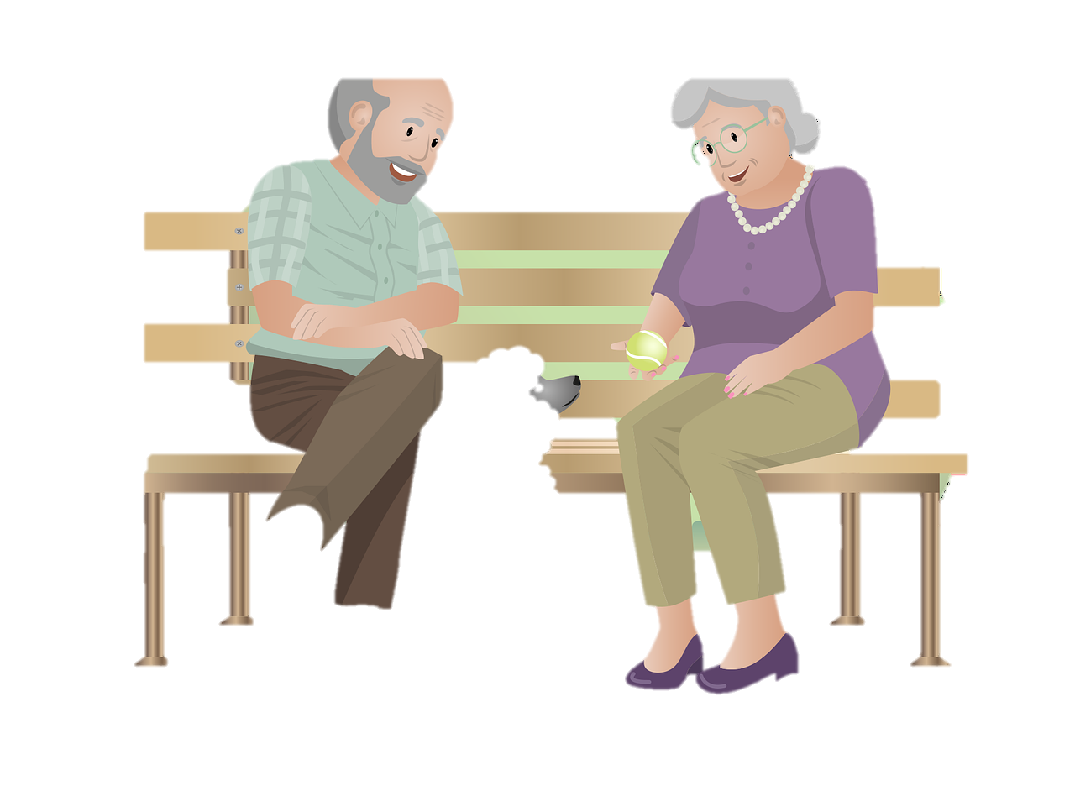
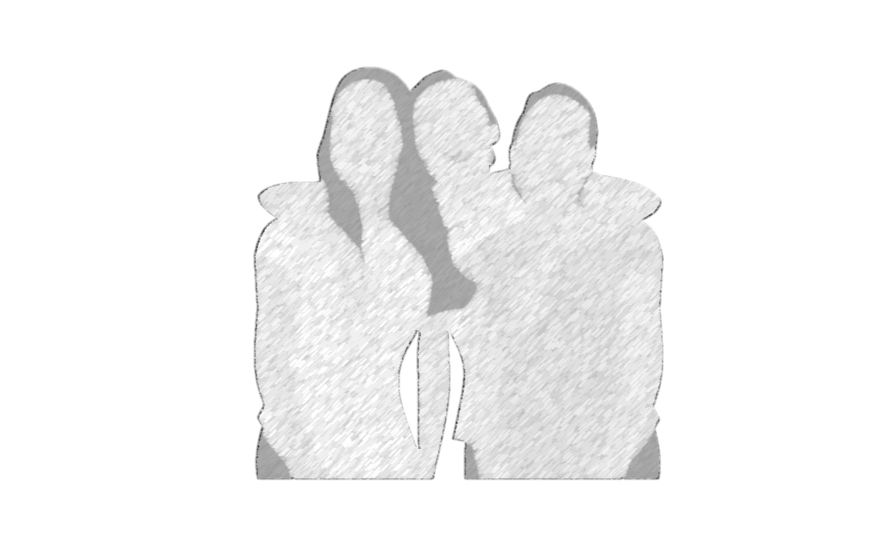
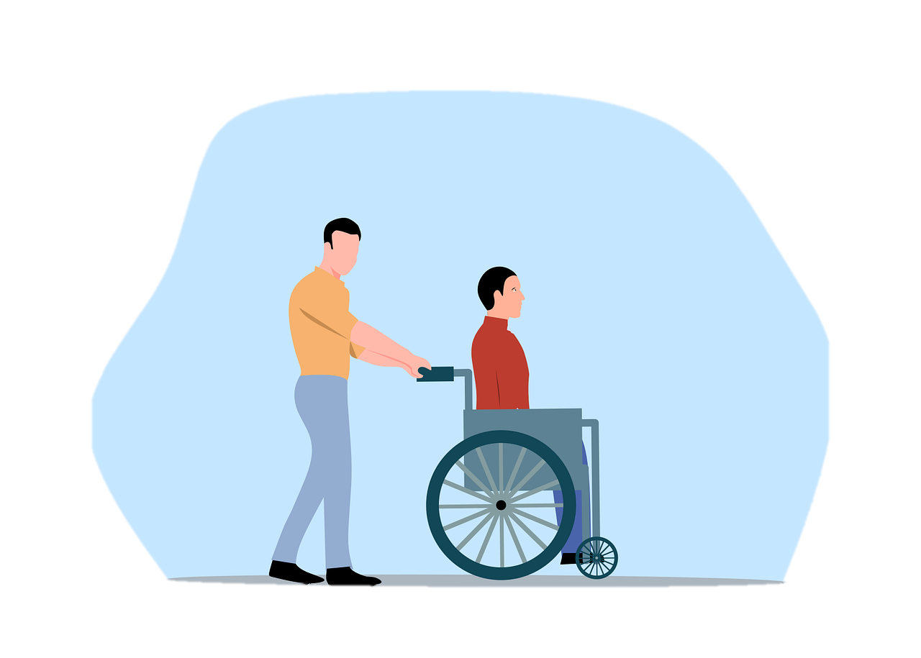
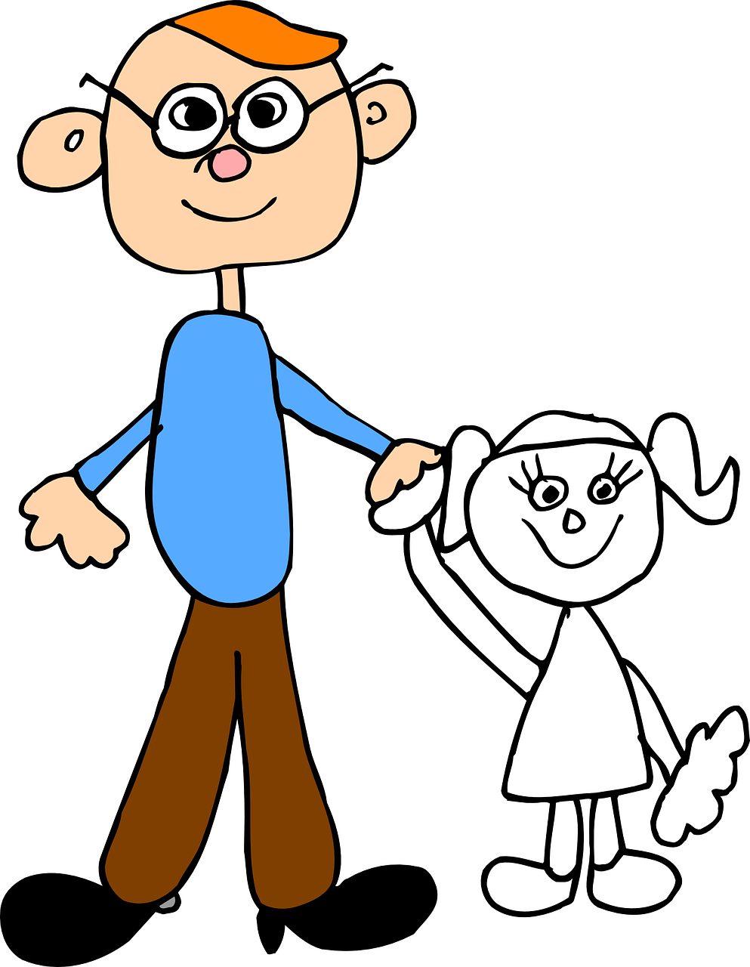
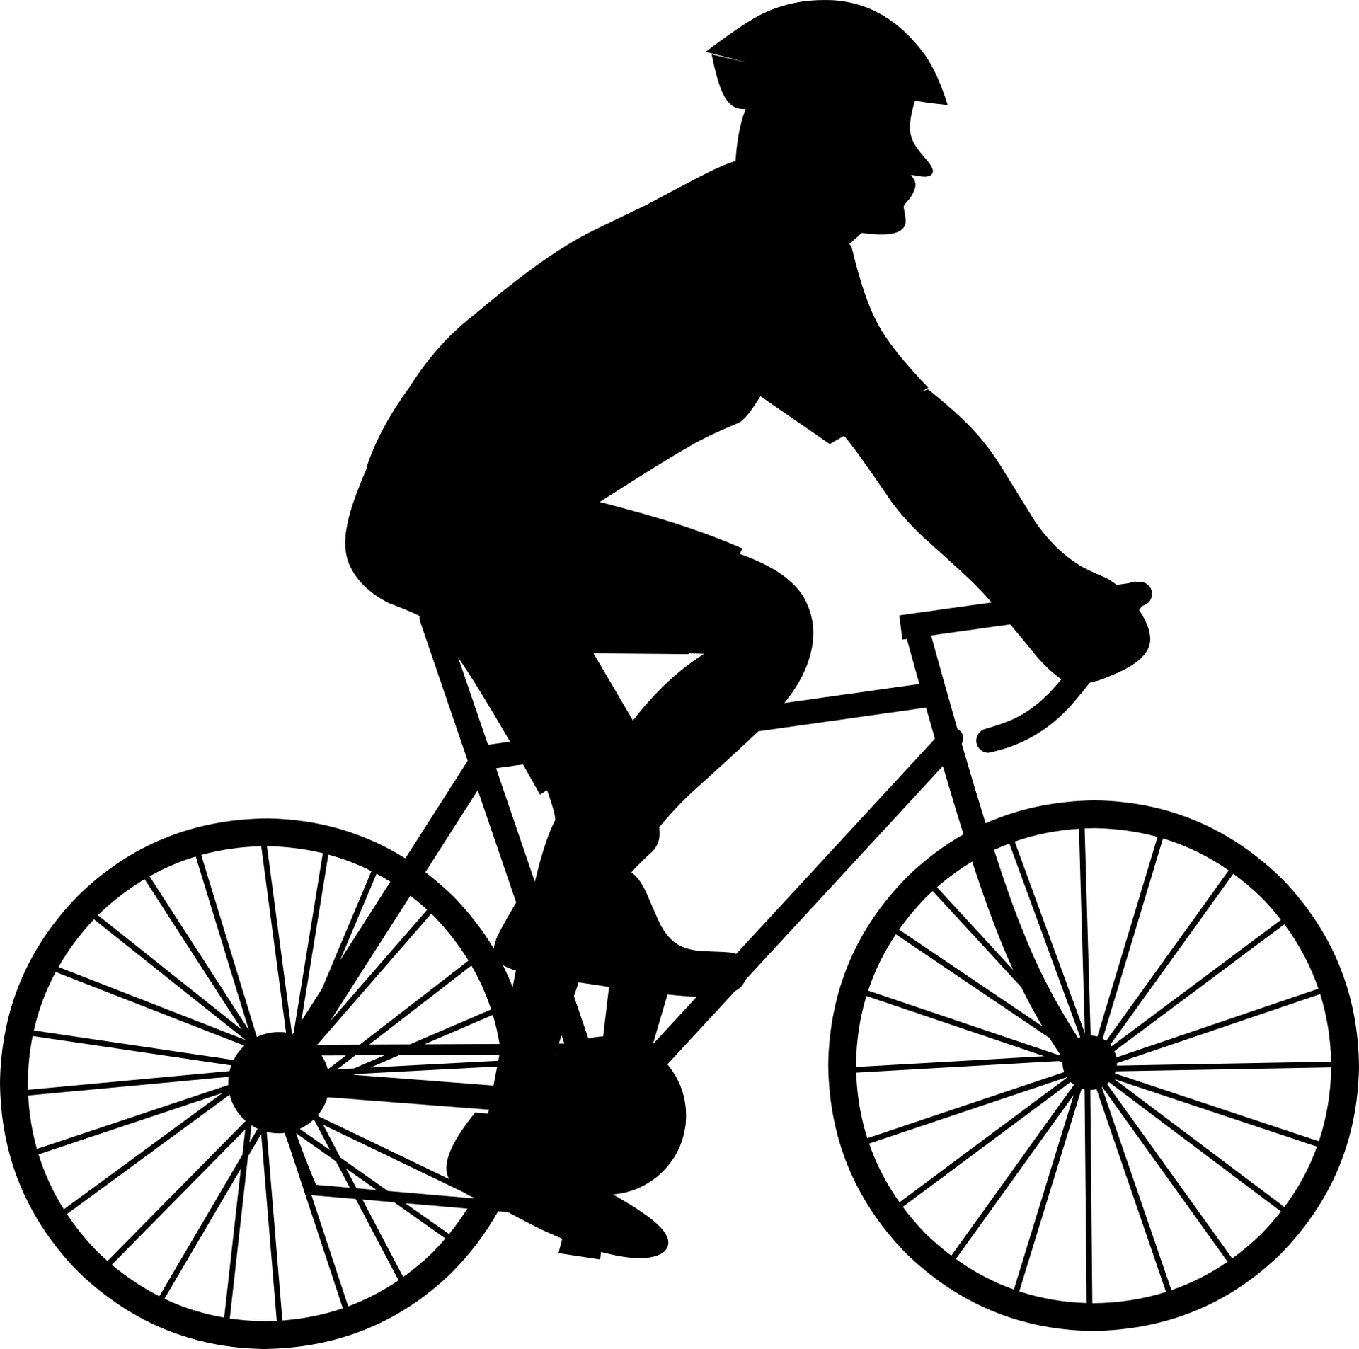
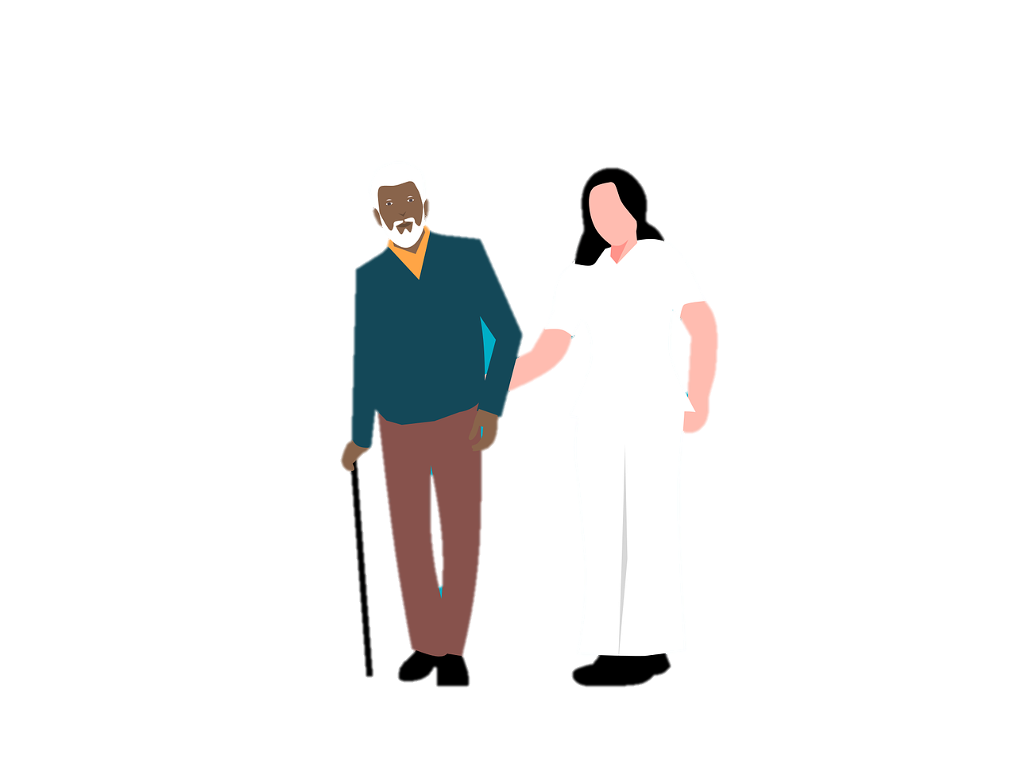

Using Science-Backed Strategies to Thrive in a Life with
Multiple Demanding Roles

Slide 6
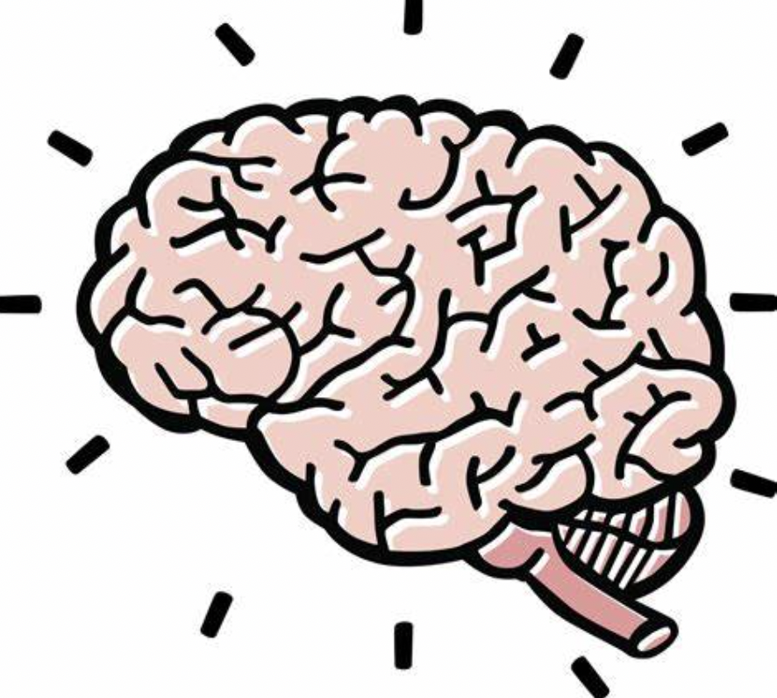
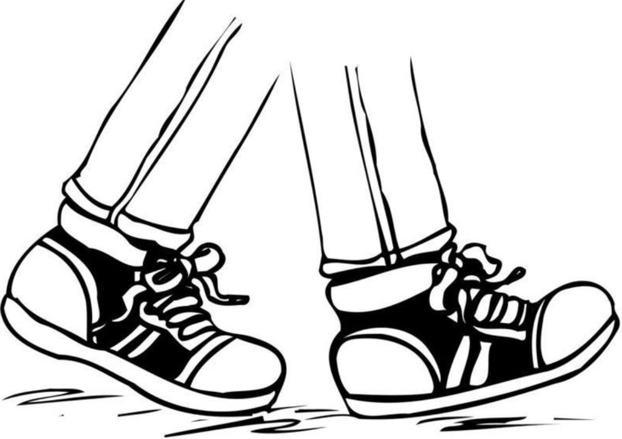

Road Map of Talk
From the Head
From the Feet
From the Heart

Slide 7
Road Map of Talk
From the head: The value of rethinking the relationship between demanding roles
From the feet: Using social science to guide behaviors
From the heart: Using positive psychology science to help us cultivate greater happiness in lives of multiple demanding roles

Slide 8
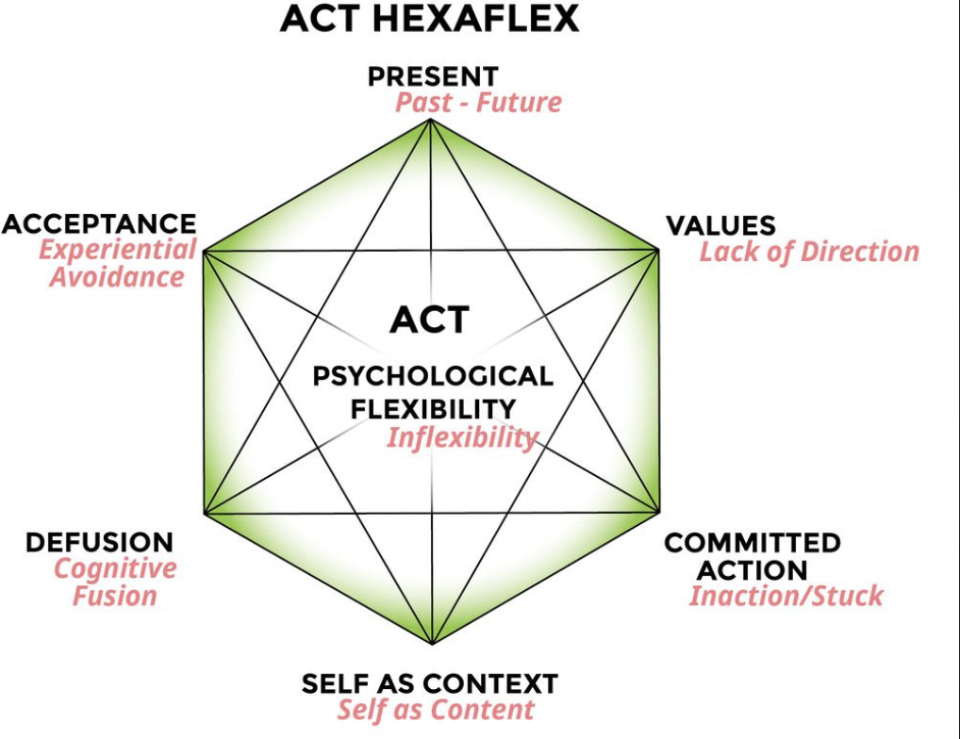
A Clinical Framework

Slide 9
Road Map
From the Head
From the Feet
From the Heart

Slide 10
What do you think of when you think of straddling multiple roles?

Slide 11
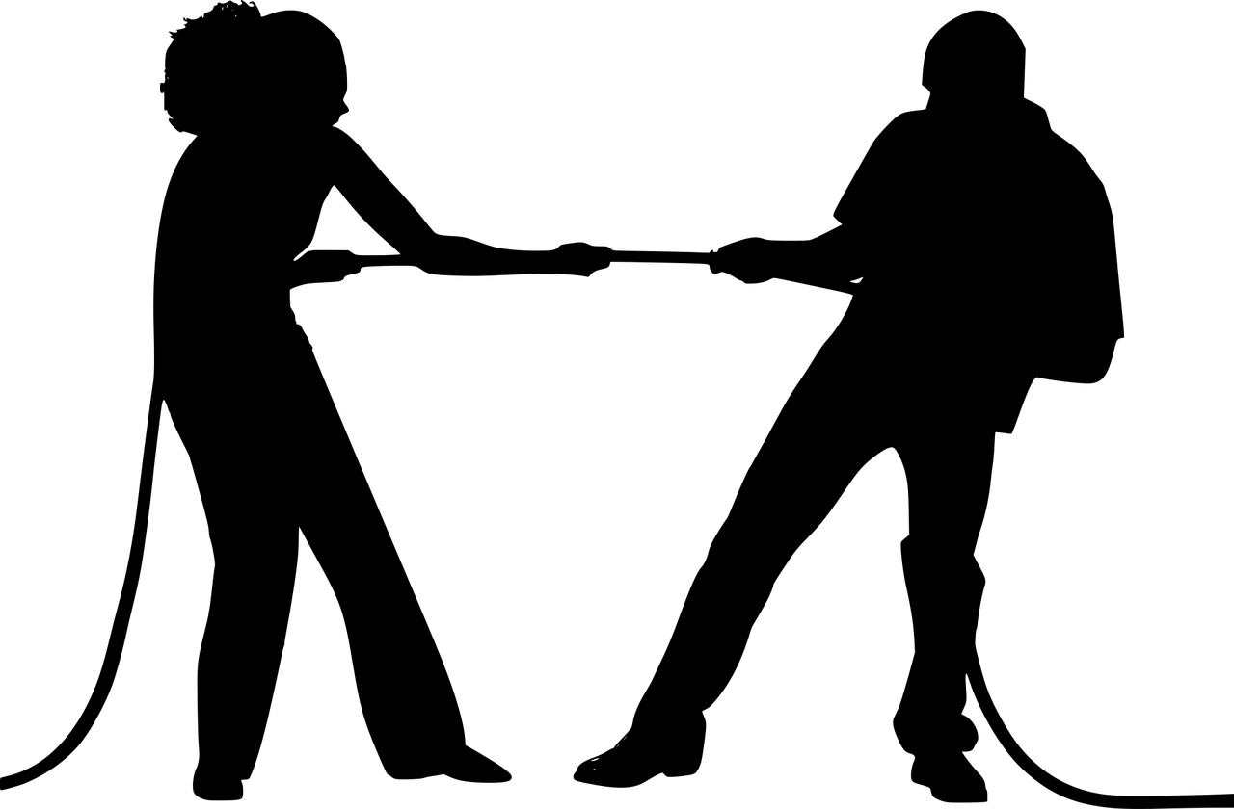
When we think of work and family roles, we mostly think of conflict…

Slide 12
The Problems of Working Parenthood
Work-family conflict is a public health concern
Parents face ever-increasing pressure
As remote technology for work increases our availability, conflict leaks into all areas of our lives
Gender inequality
Workplace inflexibility
Inadequate social policy
e.g., Chandler (2021). Work-family conflict is a public health concern, Public Health in Practice, 2.

Slide 13
But conflict is just a part of the picture

Slide 14


But conflict is just a part of the picture
A Fixed Pie Ideology

Slide 15

But conflict is just a part of the picture
A Fixed Pie Ideology
An Expandable Pie Ideology

Slide 16
Work-Life Ideologies
“Fixed Pie” can also be thought of from a scarcity perspective:
  Roles compete with each other for our finite resources
“Expandable pie” can also be thought of from an expansionist perspective
  Roles enrich each other
Leslie, King, Claire (2019). Work-life ideologies: The contextual basis and consequences of beliefs about work and life. Academy of Management Review, 44, 72-98.

Slide 17
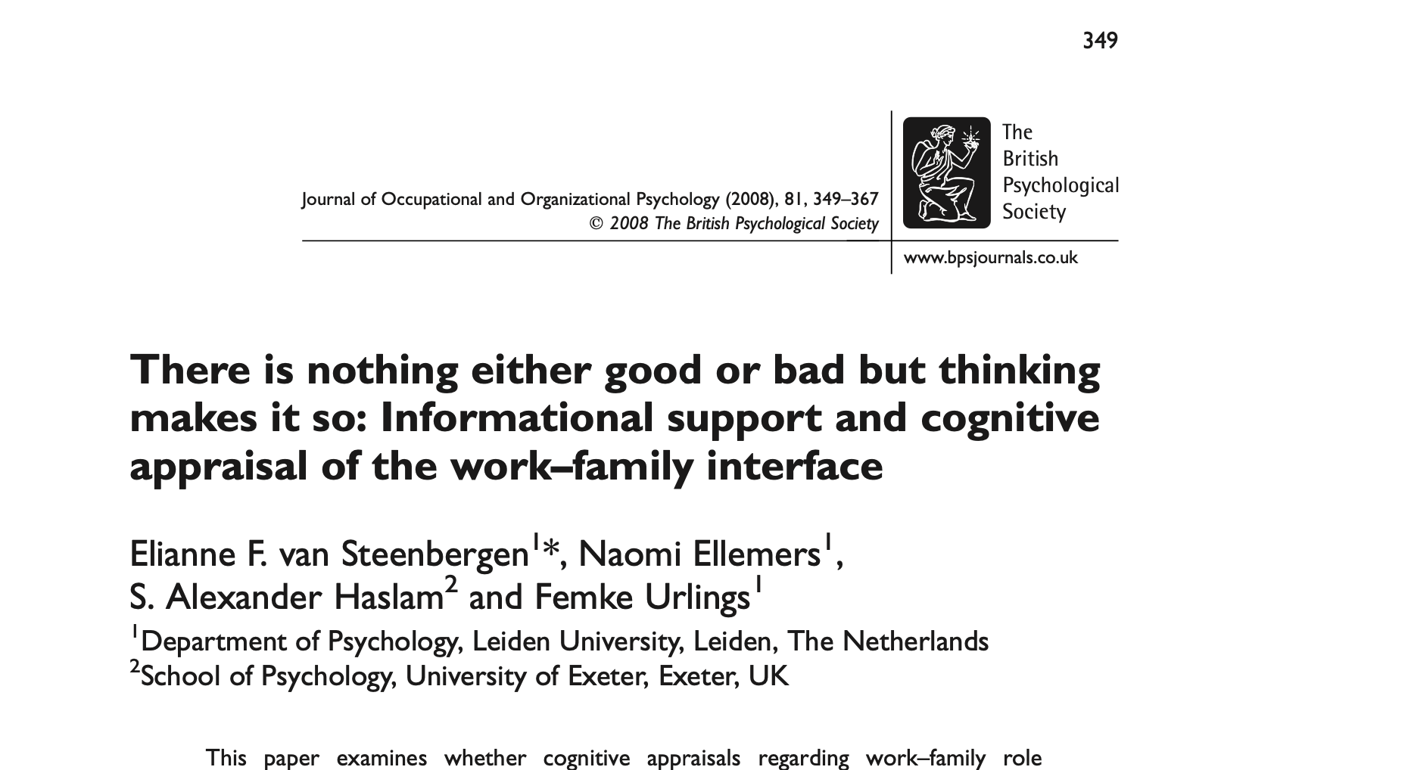
Mindset Matters

Slide 18
Road Map
From the Head
ç
From the Feet
From the Heart

Slide 19
Using ACT Strategies,
We Are Better Able to Use Tension Between Roles To…
Enhance:
  Creativity
  Rest practices
  Ability to tend to our happiness needs

Slide 20
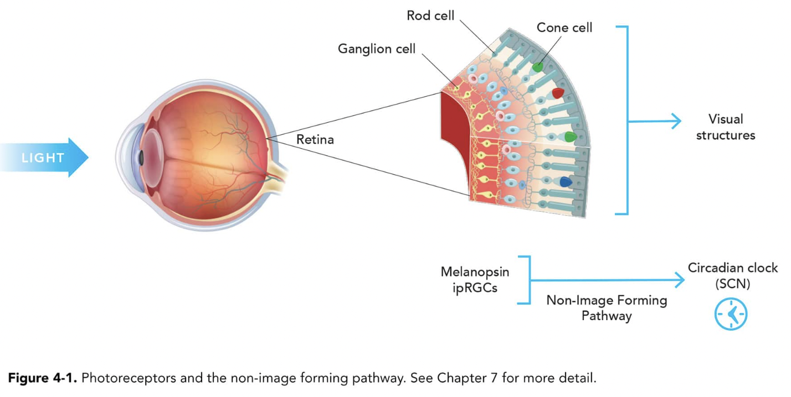
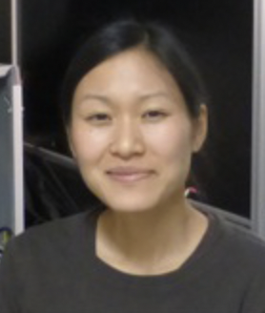
Turning Constraints Into Creativity
Story of Neuroscientist, Dr. Dunn

Slide 21
Turning Constraints Into Creativity
Story of Neuroscientist, Dr. Dunn
  With less time, we can activate other creativity processes
    Incompatible roles to get fresh perspectives
    Access more effective incubation

Slide 22
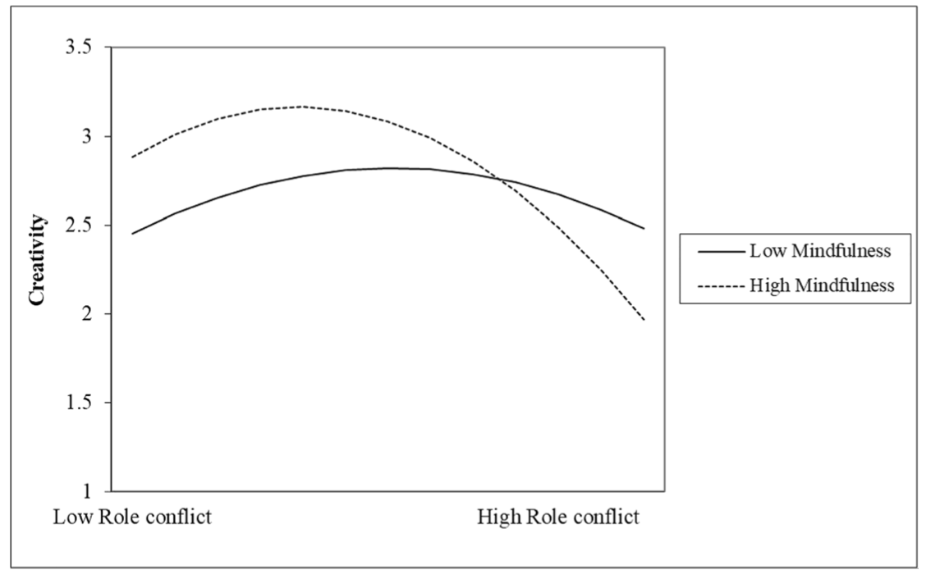
Turning Constraints Into Creativity
Mindfulness can amplify the creative effects of role conflict
Montani et al. (2019). Who responds creatively to role conflict? Evidence for a curvilinear relationship mediated by cognitive adjustment at work and moderated by mindfulness.

Slide 23

Rethink Your Rest

Slide 24

Rethink Your Rest

Slide 25
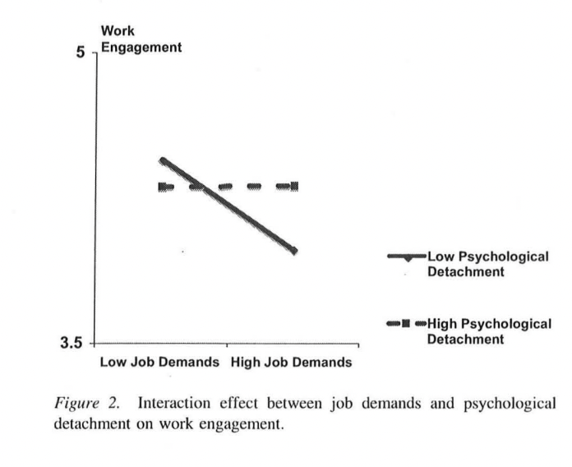
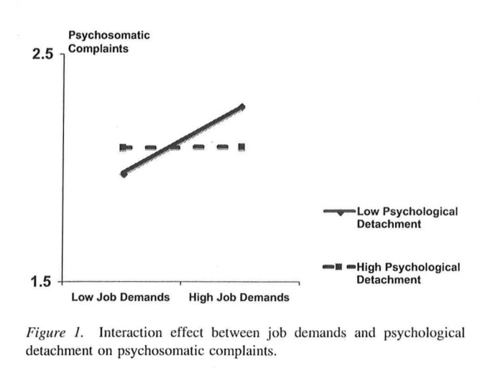
Rethink Your Rest
Switching “off”
Psychological detachment moderates the association between job demands and both work engagement and psychosomatic complaints
Sonnentag et al., (2010). Staying well and engaged when demands are high: The role of psychological detachment.

Slide 26
Rethink Your Rest
But how do we detach when we are so busy?

Slide 27
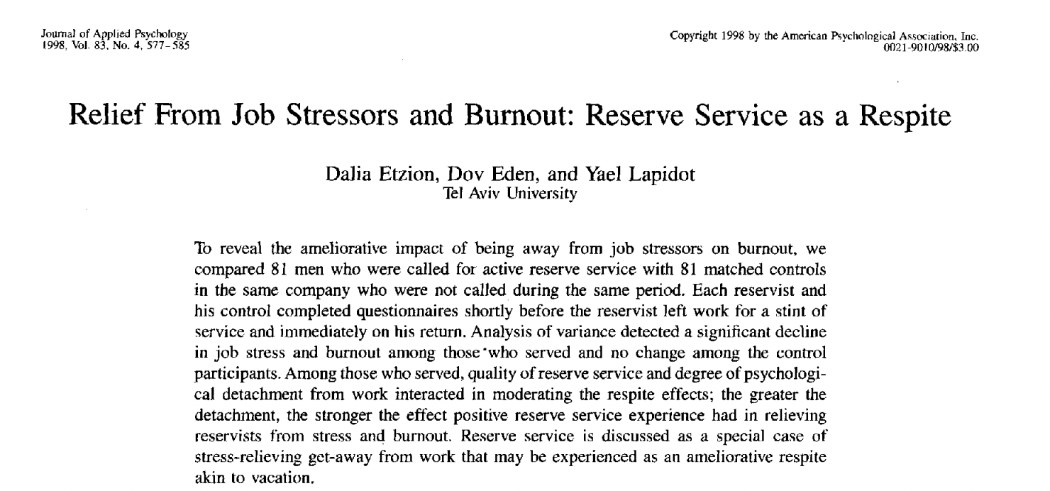
Rethink Your Rest
Israeli reservist study
  Etzion, Eden, Lapidot-Raz (1998). Relief from job stressors and burnout: Reserve service as a respite. Journal of Applied Psychology 83, p. 577–85.
    “Among those who served, quality of reserve service and degree of psychological detachment from work interacted in moderating the respite effects; the greater the detachment, the stronger the effect positive reserve service experience had in relieving reservists from stress and burnout.”

Slide 28
Rethink Your Rest
Israeli reservist study
  Etzion, Eden, Lapidot-Raz (1998). Relief from job stressors and burnout: Reserve service as a respite. Journal of Applied Psychology 83, p. 577–85.
    “Among those who served, quality of reserve service and degree of psychological detachment from work interacted in moderating the respite effects; the greater the detachment, the stronger the effect positive reserve service experience had in relieving reservists from stress and burnout.”
Pressure between roles can help us to “turn off” each role, in turn.

Slide 29
Remember to Rethink Your Rest

Slide 30
Road Map
From the Head
From the Feet
ç
From the Heart

Slide 31

  Tending to Happiness Needs
Necessary Nutrients

Slide 32
  Tending to Happiness Needs
Necessary Psychological Nutrients
  Experiences of…
    Agency
    Competency
    Connection
Ryan, R. M., Huta, V., & Deci, E. L. (2008). Living well: A self-determination theory perspective on eudaimonia. Journal of happiness studies, 9(1), 139-170.

Slide 33
  Tending to Happiness Needs
Necessary Psychological Nutrients
  Experiences of…
    Agency
    Competency
    Connection
More roles → More places to meet needs

Slide 34
  Tending to Happiness Needs
Positivity Ratios of 3:1
More roles → More places to deliberately access positive experiences that counterbalance negative ones
Frederickson, B (2013). Updated thinking on positivity ratios. American Psychologist 68, 814-822.

Slide 35
Beginning to See How Work and Family Roles Can Help Each Other
There's no question: something gets lost when you wear a lot of hats. You have less time and energy to devote to any one endeavor.

Slide 36
Beginning to See How Work and Family Roles Can Help Each Other
There's no question: something gets lost when you wear a lot of hats. You have less time and energy to devote to any one endeavor.
And... At the very same time, there are ways that being involved in many roles can serve those roles well.

Slide 37
Beginning to See How Work and Family Roles Can Help Each Other
There's no question: something gets lost when you wear a lot of hats. You have less time and energy to devote to any one endeavor.
And... At the very same time, there are ways that being involved in many roles can serve those roles well.
We can strive to appreciate more how competing demands can help each of our roles, as well as our overarching happiness.

Slide 38

Podcast:
Psychologists Off the Clock
offtheclockpsych.com
Writer’s website:
workparentthrive.com
Book:
Work, Parent, Thrive: 12 Science-Backed Strategies to Ditch Guilt, Manage Overwhelm, and Grow Connection (When Everything Feels Like Too Much)
Email:
yael_chatav_schonbrun@brown.edu

Slide 39
The purpose of the MHTTC Network is technology transfer - disseminating and implementing evidence-based practices for mental disorders into the field.
Funded by the Substance Abuse and Mental Health Services Administration (SAMHSA), the MHTTC Network includes 10 Regional Centers, a National American Indian and Alaska Native Center, a National Hispanic and Latino Center, and a Network Coordinating Office.
Our collaborative network supports resource development and dissemination, training and technical assistance, and workforce development for the mental health field. We work with systems, organizations, and treatment practitioners involved in the delivery of mental health services to strengthen their capacity to deliver effective evidence-based practices to individuals.
Our services cover the full continuum spanning mental illness prevention, treatment, and recovery support.
MHTTCnetwork.org
Sign-Up for Newsletter
MTTC News

