Slide 1
Diagnosis and Treatment of Psychosis in Autism Spectrum Disorder
Jean A. Frazier, MD
New England MHTTC, MAPNET
March 24th, 2023
Notes:
DO NOT CHANGE THE FORMAT OF THIS TEMPLATE. If you are creating MHTTC-branded slides, you must use this template or one of the other approved templates in the Shared Folder.

Slide 2




Housekeeping Information
Participant microphones will be muted at entry
If you have questions during the event, please use the chat
This session is being recorded and it will be emailed to all participants once available.
If you have questions after
this session, please e-mail:
newengland@mhttcnetwork.org.
At the end of the month, we will send you a certificate of completion that you can submit to your particular board for continuing education credit. Please contact ifisher@c4innovates.com for more information on CEs after the event.

Slide 3
Acknowledgment
Presented in 2022 by the Mental Health Technology Transfer Center (MHTTC) Network.
This presentation was prepared for the New England Mental Health Technology Transfer Center (MHTTC) Network under a cooperative agreement from the Substance Abuse and Mental Health Services Administration (SAMHSA). All material appearing in this publication, except that taken directly from copyrighted sources, is in the public domain and may be reproduced or copied without permission from SAMHSA or the authors. Citation of the source is appreciated. Do not reproduce or distribute this publication for a fee without specific, written authorization from New England MHTTC. For more information on obtaining copies of this publication, email us at newengland@mhttcnetwork.org.
At the time of this publication, Miriam E. Delphin-Rittmon, Ph.D, served as Assistant Secretary for Mental Health and Substance Use in the U.S. Department of Health and Human Services and the Administrator of the Substance Abuse and Mental Health Services Administration.
The opinions expressed herein are the view of TTC Network and do not reflect the official position of the Department of Health and Human Services (DHHS), SAMHSA. No official support or endorsement of DHHS, SAMHSA, for the opinions described in this document is intended or should be inferred.
This work is supported by grants #1H79SM081775 from the Department of Health and Human Services, Substance Abuse and Mental Health Services Administration.
Presented 2022
Notes:
Always use acknowledgment slide on the 2nd slide and add your center’s information

Slide 4
Notes:
Always use Language Matters graphic as your third slide.

Slide 5
Diagnosis and Treatment of Psychosis in Autism Spectrum Disorder
Jean A. Frazier, MD
Professor of Psychiatry and Pediatrics
3-24-23 Webinar- Massachusetts Psychosis Consortium and the SAMSHA Mental Health Technical Transfer Center

Slide 6
Disclosures
Source | Research Funding
Autism Cares Network- Autism Speaks | X
Healx Ltd. | X
National Institutes of Health | X
Quadrant, Inc. | X
Tetra Discovery Partners, LLC | X

Slide 7
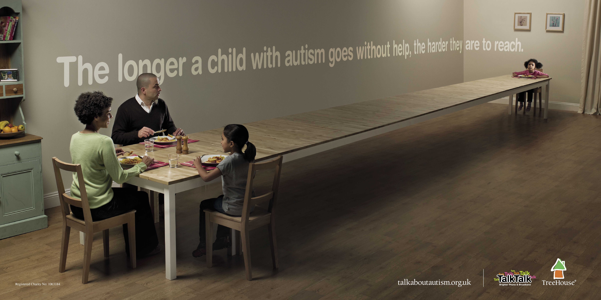
Objectives
At the conclusion of this presentation the participant should be able to:
1. Understand what is known about ASD and psychiatric comorbidities
2. Have a systematic approach to the diagnosis of psychosis in ASD
3. Recite the recommended approach to Treatment of psychosis in ASD

Slide 8
DSM-II - 1968
Schizophrenia, childhood type
“This category is for cases in which schizophrenic symptoms appear before puberty. The condition may be manifested by autistic, atypical, and withdrawn behavior; failure to develop identity separate from the mother’s; and general unevenness, gross immaturity and inadequacy in development. These developmental defects may result in mental retardation, which should also be diagnosed.”

Slide 9
DSM-III 1980
Childhood Onset Pervasive Developmental Disorder
Gross and sustained impairment in social relationships, e.g., lack of appropriate affective responsivity, inappropriate clinging, asociality, lack of empathy
At least 3 of the following:
  Sudden excessive anxiety manifested by such symptoms as free-floating anxiety, catastrophic reactions to everyday occurrences, inability to be consoled when upset, unexplained panic attacks
  Constricted or inappropriate affect, including lack of appropriate fear reactions, unexplained rage reactions, and extreme mood lability
  Resistance to change in the environment (e.g., upset if dinner time is changed), or insistence on doing things in the same manner every time (e.g., putting on clothes always in the same order)
  Oddities of motor movement, such as peculiar posturing, peculiar hand or finger movements, or walking on tiptoe
  Abnormalities of speech, such as questionlike melody, monotonous voice
  Hyper- or hypo-sensitivity to sensory stimuli, e.g. hyperacusis
  Self-mutilation, e.g. biting or hitting self, head banging
Onset of full syndrome after 30 months of age and before 12 years of age
Absence of delusions, hallucinations, incoherence, or marked loosening of associations

Slide 10
DSM-III-R 1987
Schizophrenia
F. If there is a history of Autistic Disorder, the additional diagnosis of Schizophrenia is made only if prominent delusions or hallucinations are also present.
In text of schizophrenia description:
“Schizophrenia occurring in a child preempts the residual diagnosis of Pervasive Developmental Disorder NOS.”

Slide 11
DSM-IV (1994) and –IV-TR (2000)
Schizophrenia
F. Relationship to a Pervasive Developmental Disorder: If there is a history of Autistic Disorder or another PDD, the additional diagnosis of Schizophrenia is made only if prominent delusions or hallucinations are also present for at least a month (or less if successfully treated).

Slide 12
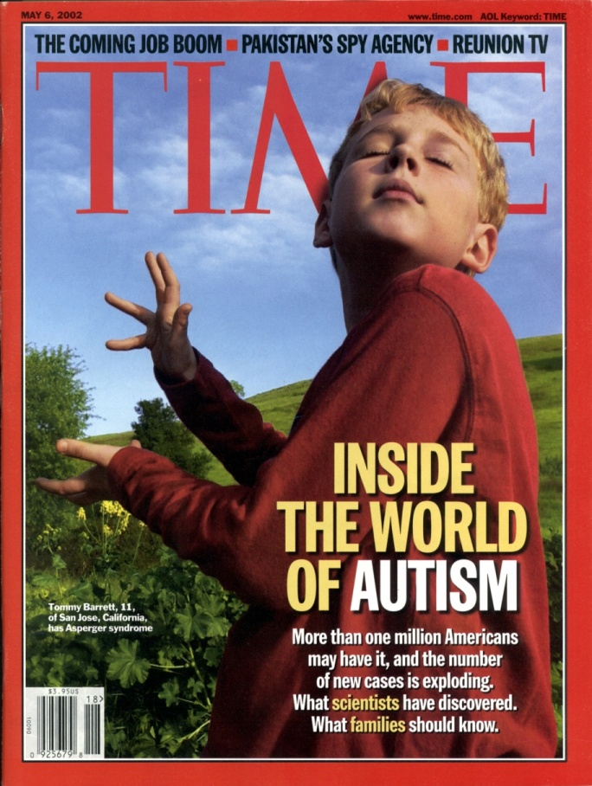
Autism as an Exemplar of Neurodevelopmental Disorders
1:36 children have the diagnosis
1:2000 in 1987
Restricted, repetitive patterns of behavior, interests, or activities
Deficits in social communication and social interactions
Poor outcomes in social functioning
No current medical therapies to target core social communication deficits in ASD

Slide 13
Autism Spectrum Disorders
Male-to-female ratio is about 4:1
Prevalence: 1:36 (CDC, 2023)
Increasing prevalence for possibly many reasons

Slide 14
Reasons for Increasing Prevalence
Diagnostic Substitution
/ Reclassification
Better Population Sampling
Increasing Prevalence of ASD
Environmental Exposures
Better Diagnostic Methods
(especially within lower and higher IQ children)

Slide 15

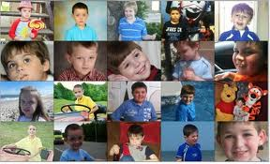
Diversity in Autism Spectrum Disorders
Intellectual level
Communication level
Behavioral level
Notes:
Co-Existing Developmental and Behavioral Conditions:
Typically worsen symptoms of autism
Common
Cognitive impairment
Emotional regulation disorders
Sensory processing disorder (sensory integration dysfunction)
Maladaptive behavior (such as aggression or self-injury)

Slide 16
Extent of the Challenge
    75% of individuals with an ASD require treatment for emotional, physical or behavioral problems
One of the most challenging disorders for families and providers
Notes:
Behavioral = anxiety, ADHD, mood disorder, speech and language, sensory processing
Physical = sleep, gastrointestinal (GI), seizures
Emotional toll – “my child is in there somewhere”, strained relationships, increased stress on siblings and other family members
Financial Costs - $1.4 million to care for person with autism over their lifetime; $2.3 million if they also have an intellectual disability

Slide 17
Psychiatric Comorbidities
Communication Disorders
(Thought Disorder,
Disordered Pragmatics)
Attention Deficit Hyperactivity
(Executive Dysfunction, Hyperactivity, Impulsivity, Inattention)
Mood Disorders
(Mood Dysregulation, Anxiety, Depression, Mania)
Anxiety Disorders
(Social Interaction/“Empathy”:
?Shyness/Social Phobia,
Disinterest/Schizoid,
“Hostile Intent”/Schizotypal)
Obsessive Compulsive Disorder
(Restricted interests, Rigid behavior,
Stereotypic behavior, Compulsions)
Autism

Slide 18
Prevalence of Psychiatric Conditions in Adults with ASD vs Adults without ASD
Croen, Lisa A., et al. "The health status of adults on the autism spectrum."
Autism 19.7 (2015): 814-823.

Slide 19


Autism Spectrum
& psychosis

Slide 20
Nature of the Problem
Core features of Autism Spectrum Disorders (ASD) can be misinterpreted as psychosis
Epidemiological, clinical, neurobiological and genetic evidence for a connection between autism and schizophrenia
Subset of complex neurodevelopmental disorders with symptoms across multiple domains of functioning (varying degrees of social communication deficits and thought disorder)

Slide 21
ASD and Bipolar Disorder
27% (14/52) of youth with ASD also had BD or 12% of all children in the overall sample who had BD (Wozniak et al, 1997).
Youth with ASD + family history of BD compared to those without a FH had extremes of affect, cyclicity, intense obsessive interests, neurovegetative symptoms, and regression (Herzberg, 1996;Delong, 1994)
Notes:
Some studies suggest that individuals on the spectrum may have higher Family history of affective disorder (1/3)
DeLong and Dwyer found that 4.2% of relatives of folks with ASD had BD (1988)
Piven and colleagues found a higher rate of MDD in family members, but not BD
16-605 of youth with BD have psychotic symptoms
50-75% of adults with BD have psychotic symptoms

Slide 22

ASD and Bipolar Disorder
Symptoms of Bipolar disorder may be masked by symptoms associated with ASD
Baseline behaviors may become more intense or exaggerated during manic or depressive episodes
The key is to look for a distinct change from baseline and for episodes
(Frazier et al, 2002)
Notes:
Deterioration in cognition, language, behavior or activity

Slide 23

Autistic Features in Childhood-Onset Schizophrenia (COS)
Up to 55% of COS patients have prepsychotic developmental disorders with similarities to autism
  Language delays
  Motor development abnormalities (including transient motor stereotypies)
  Deficits in communication and
  social relatedness
NIMH study of COS – 28%
had comorbid COS and ASD
Notes:
Four studies were meta-analysed, showing that 11.6% of CHR-P individuals have an ASD diagnosis. Symptoms of prodromal psychosis may be present in individuals with ASD. The transition from CHR-P to psychosis is not affected by ASD. (Vaquerizo-Serrano et al, 2022)

Slide 24
Psychotic, Anxiety & Mood Disorders in ASD
Anxiety and psychotic symptoms in 6-12 year olds w/&w/o ASD:
  Psychotic symptom severity correlated with anxiety level in both groups
  ASD: ↑ both anxiety and psychotic symptom
Psychotic symptoms that only present under extreme stress/anxiety: ?primary anxiety d/o
Mood d/o can present w/ psychotic symptoms
Most epidemiological studies indicate ↑incidence of mood d/o (w/&w/o psychosis) in ASD
Weisbrot et al, J Child Adolesc Psychopharmacol 2005

Slide 25
Core Symptoms of ASD Mistaken for Psychosis
Developmental History indicates presence of symptoms stable from early childhood
Disorganized thought process without clear history of delusions or hallucinations
“Delusions” consistent with abnormal preoccupation with stereotyped interests
No decline in overall functioning from baseline

Slide 26
Comorbidity of
Schizophrenia Spectrum Disorder
New onset of delusions and/or hallucinations (from external source) lasting more than one month
Disorganization of thought or behavior that is a clear change from baseline
Degree of magical thinking or inability to distinguish fantasy from reality that is a clear change from baseline
Also consider comorbidity of mood and/or anxiety disorder that coincide with onset of psychotic symptoms
Significant decline in overall functioning
Notes:
Nonverbal=
Delusions difficult as requires some lanague
Halluciantions- staring off into space, appears to be responding to something that is not there – nodding head, waving hands, putting hands over eyes and ears.
Observation- change in behavior, decline in functioning
Medial Work up is indicated.

Slide 27
Diagnostic Rating Scales & Standardized Assessments for Autism
Name | Instrument type/Purpose | Age | Time
ADOS | Standardized behavioral observation and coding | 2nd edition: 12 months-adulthood | Training to administer Admin: 40-60 min
ADI-R | Standardized caregiver interview and response coding |  | Training to administer Admin: 1.5-2.5 hrs
SCQ | Parent questionnaire with 40 yes/no items; Current and Lifetime forms available |  | Admin: 10 min
SRS | Parent and/or teacher rating scale; assessment of impairment severity in various subdomains | 2.5-18 years | Admin: 15-20 min
Notes:
CARS-2

Slide 28
Rating Scales that may be useful in diagnosing psychosis-autism
PANSS- Positive and Negative Syndrome Scale- 30-item clinical scale which evaluates general psychopathology, positive and negative symptoms. Each item is rated on a 7-point symptom severity scale, ranging from 1 (absent) to 7 (extremely severe).
Brief Psychiatric Rating Scale- one of the most widely-used instruments enabling the clinician to quickly gather information about the possible presence and severity of various psychiatric symptom
Aberrant Behavior Checklist (ABC) is one of the few empirically developed scales designed to measure psychiatric symptoms and behavioral disturbance exhibited by individuals with IDD across 5 domains: Irritability, Agitation, & Crying; Lethargy/Social Withdrawal; Stereotypic Behavior; Hyperactivity/Noncompliance
The Positive and Negative Syndrome Scale for Schizophrenia Autism Severity Scale (PAUSS) some evidence for the reliability and validity of PAUSS scores for quantifying autism symptom severity transdiagnostically and to identify ‘‘autistic phenotypes” in schizophrenia (Pina-Camacho et al, 2022)

Slide 29
↓Nonverbal communication
↓ Reciprocity
Stereotyped language
Self dialoguing/scripting
↓ Spontaneous play
Preoccupation
Stereotypies
↓ Social communication
Social withdrawal
Affective flattening
Disorganized speech
Auditory hallucinations
Disorganized behavior
Delusions
Catatonia
Negative symptoms
Autism ↔ Schizophrenia
Notes:
Diagnostic Confusion – Where Does it Come from

Slide 30
PSYCHOSIS
Starling & Dossetor (2009)
Thought disorder and bizarre behavior –unreliable due to the fact that they are also core PDD symptoms.
Delusions -more reliable but cautiously useful as “unusual world view” and idiosyncratic obsessions also seen commonly in ASDs
Auditory hallucinations should be differentiated from self-talk or pseudo-hallucinations
Delusions and Hallucinations= hallmark of psychosis

Slide 31
Treatment of Autism Spectrum Disorders
Multi-Modal Approach
Target Appropriate Developmental Stage
Behavioral
Educational
Pharmacological
Treatment
Early Assessment & Intervention
Ongoing Therapy
Notes:
Multi-Modal Approach
Behavioral
Educational
Pharmacological
Target Appropriate Developmental Stage
Early Assessment and Intervention
Ongoing Therapy

Slide 32
“Mainstay” Treatments:
ASD specific, interaction-based therapy
Applied Behavioral Analysis (ABA)
Many others
Speech/language therapy
SCERTS (Social, communication, emotional regulation, transactional support)
Social skills group (“Lunch Bunch”, other)

Slide 33
Common Additional Treatments
Occupational Therapy
Overall level of adaptive functioning
Sensory processing integration
Physical Therapy
Activities (swimming, music group, massage)
Animal (therapeutic horseback riding, service dogs)
Fine motor skills
Cognitive Behavioral therapy
Behavioral Interventions
Other
Dietary

Slide 34

Target of Medication
Core Features of Autism
  Impaired social interaction and
  communication
  Repetitive behavior/ restricted
  interests
Specific Behavioral Problems
  Aggression, Irritability, Self-injury
  Hyperactivity
  Anxiety (stereotypy/repetitive behaviors)
  Sleep
There are currently no medications that are FDA approved for treating core features of ASDs.

Slide 35

Antipsychotics and Autism
FDA-Approved Treatments:
  Risperidone – Irritability associated with autistic disorder, Children and Adolescents (5-16 years)
  Aripiprazole – Irritability associated with autistic disorder, Children and Adolescents (6-17 years)

Slide 36
Treatments for ASD and Psychosis
A variety of psychosocial and educational interventions that support children with COS and children with ASD exist to address core deficits in socialization, communication, and behavior and the associated developmental and medical conditions
Atypical antipsychotics are the mainstay of pharmacotherapy for schizophrenia at any age, and they have also been used to manage certain symptoms, particularly irritability, associated with ASD

Slide 37
Effect size of mood stabilizers with YMRS
 | youth |  | adult
 | ES | CI | ES | CI
DVP-IR/ER | .28 | .0-.5 | .61 | .4-.8
Lithium | .31 | -.12-.73 | .50 | .4-.6
Oxcarbazepine | .11 | -.12-.5 | n/a
Topiramate | .51 | .0-1.0 | .05 | -.1-.18
carbamazepine | n/a | n/a | .58 | .4-.8
Weighted w/o topiramate | .20 |  | .46 | .4-.6
(Correll et al, Bipolar Disorders, 2010)

Slide 38
Effect size from YMRS change
Atypical Antipsychotics
 | youth |  | adult
 | ES | CI | ES | CI
Aripiprazole | .69 | .4-.9 | .36 | .1-.6
Olanzapine | .75 | .4-1.1 | .48 | .2-.7
Quetiapine | .60 | .4-.9 | .52 | .2-.7
Risperidone | .81 | .5-1.1 | .71 | .6-.9
Ziprasidone | .48 | .2-.8 | .42 | .3-.6
haloperidol |  |  | .62 | .5-.8
Weighted SGAs | .65 | .5-.8 | .48 | .4-.6
(Correll et al, Bipolar Disorders, 2010)

Slide 39
FDA-Approved Treatments for Pediatric Bipolar Disorder
Acute Mania
Year/ Drug
1970 Lithium (Age ≥ 7–17)
2007 Risperidone (Age 10–17)
2008 Aripiprazole ^{(Age 10–17),(}*^{->e)}
2009 Quetiapine (Age 10–17)
Olanzapine (Age 13–17)
2015 Asenapine (Age 10–17)
Acute Bipolar Depression
Year/ Drug
Olanzapine+fluoxetine
combination (Age 10–17)
2018 Lurasidone(Age 10–17)
Longer-Term
Year/ Drug
Lithium (Age ≥ 7–17)
2008 Aripiprazole ^{(Age 10–17, ->e)}
Unmet
Need
Unmet
Need
*Adjunctive (as well as monotherapy);
^{(->e)}Extrapolated indication
Important unmet needs—well-tolerated treatments for acute depression and maintenance
Adapted from Ketter TA (ed). Advances in the treatment of bipolar disorder, Am Psych Pub, Inc., Washington, DC; 2015; Roley-Roberts ME, Fristad MA. J Clin Child Adolesc Psychol 2021;50(4):464-77.

Slide 40
Efficacy and Safety Studies in Adolescent Schizophrenia
SGA | Participant Characteristics and Study Design | Efficacy | Most Common Adverse Events | Reference
Aripiprazole | 13-17 y/o; 6-week double blind placebo-controlled (DBPC) trial; 10- and 30-mg/day doses of aripiprazole versus placebo | Aripiprazole > Placebo on PANSS total; 10 mg at week 6 and 30 mg at weeks 1, 3-6; both doses showed improved CGI-S and P-QLES-Q | Akathisia, extrapyramidal symptoms, somnolence, tremor | Findling RL et al. Am J Psychiatry. 2008;165(11):1432-41.
Paliperidone XR | 12-17 y/o; 6-week DBPC trial; randomized to weight-based fixed dose groups; low (1.5 mg/d), medium (3 and 6 mg/d), or high (6 and 12 mg/d) or placebo | Paliperidone > Placebo on PANSS CGI-S and CGAS in medium dose (3 and 6 mg) groups. | Somnolence, akathisia, insomnia, headache, and tremor | Singh J et al. Biol Psychiatry 2011;70:1179-1187.
Paliperidone XR Vs Aripiprazole | 12-17 y/o; 3-week or less screening and washout period, then 8-week DBPC acute treatment period and an 18-week double blind maintenance (total duration, 26 weeks) | Paliperidone XR = Aripiprazole on PANSS | Paliperidone ER: akathisia, headache, somnolence, tremor, weight gain; increased prolactin Aripiprazole: were schizophrenia and somnolence. | Savitz AJ et al. JAACAP, 2015 Feb;54(2):126-137.e1.
Lurasidone | 13-17 y/o; 6-week DBPC trial followed by 2 year open-label extension | Lurasidone > Placebo on PANSS, PQ-LES-Q and the clinician-rated CGAS for both 40 and 80 mg doses | Nausea, akathisia, somnolence, and vomiting | Goldman R et al. JCAP. 2017;27(6):516-525.
Risperidone | 13-17 y/o; 6-week, randomized, DBPC study, randomized to placebo, flexible doses of risperidone 1–3 mg/day, or risperidone 4–6 mg/day. | Risperidone > Placebo on PANSS, CGAS. | 1-3 mg: somnolence, agitation, and headache; 4-6 mg, extrapyramidal disorder, dizziness, and hypertonia; dose-dependent increase in mean prolactin levels | Haas M et al. JCAP. 2009;19(6):611-21
Olanzapine | 13-17 y/o; 6-week, DBPC trial; randomized to flexible doses of olanzapine (2.5-20.0 mg/day) or placebo. | Olanzapine > Placebo on BPRS-C and PANSS | Increased weight, somnolence, headache, sedation, and dizzine | Kryzhanovskaya L et al. JAACAP;2009;48:60-70.
Quetiapine | 13-17 y/o; 6 weeks DPPC trial of quetiapine 400 mg/d, quetiapine 800 mg/day or placebo. | Quetiapine > Placebo on PANSS, CGAS. | Somnolence, headache, and dizziness | Findling RL et al. JCAP; 2012;22(5):327-342.
Legend: PANSS = Positive And Negative Symptom Scale; CGAS = Children’s Global Assessment Scale; CGI-S = Clinical Global Impression-Severity; PQ-LES-Q = Pediatric Quality of Life Enjoyment and Satisfaction Questionnaire; BPRS-C= Brief Psychiatric Rating Scale for Children; NB: aggression must be inferred

Slide 41
Systematic Review and Network Meta-analysis of Acute Antipsychotic Treatment in Youth
Assessed comparative efficacy and safety of antipsychotics for youth with early onset schizophrenia in 12 studies (6-12 weeks)
2,158 youth between 8-19 years.
8 antipsychotics (aripiprazole, asenapine, paliperidone, risperidone, quetiapine, olanzapine, molindone and ziprasidone)
Comparable efficacy among antipsychotics except for ziprasidone which was inferior and unclear for asenapine
Aripiprazole and quetiapine had the best tolerability.
Pagsberg et al, 2017

Slide 42
Efficacy:
No substantial differences between antipsychotics except clozapine for treatment-resistant patients.
Ziprasidone not recommended due to lack of superiority to placebo
Safety:
Olanzapine is not a good choice due to significant weight gain. Clozapine and quetiapine increase weight; only molindone, lurasidone and ziprasidone may be benign.
Most drugs are sedating and even comparably safe antipsychotics (i.e., aripiprazole and quetiapine) may produce EPS
Risperidone, haloperidol, olanzapine and paliperidone have high propensity for prolactin increase.
Conclusion:
Because there are few efficacy differences between drugs, treatment choice should be guided by side-effects
Krause M et al. European Neuropsychopharmacology. 2018; 28, 659-674
Notes:
MAIN POINT: ALL EFFECTIVE WITH CLOZAPINE BEING MOST EFFECTIVE BUT SAVED FOR REFRACTORY PTS; TOLERABILITY DIFFERENCES HAVE BEEN COMPARED IN NETWORK META-ANALYSES – ALL MEDS ARE SEDATING, WEIGHT GAIN/HYPERPROLACTINEMIA MOST PROBLEMATIC. FEW STUDIES FOCUS ON QUALITY OF LIFE/GLOBAL FUNCTIONING WHICH MAY BE MORE IMPORTANT.
Conclusions:
As there were few efficacy differences between drugs, treatment choice should be guided primarily by side-effects.
Clozapine, which is reserved to treatment-resistant patients, was better than most drugs, ziprasidone is not recommendable due to lack of superiority compared to placebo
Due to high risk of weight gain, olanzapine is not a good choice for the treatment of schizophrenia in children and adolescents, but clozapine and quetiapine also had high effect sizes compared to placebo and only molindone, lurasidone and ziprasidone may be benign.
Most drugs are sedating and even comparably safe antipsychotics, such as aripiprazole and quetiapine, may produce extrapyramidal symptoms in this vulnerable population.
Also problematic is treatment with risperidone, haloperidol, olanzapine and paliperidone due to their high propensity for prolactin increase.
The efficacy findings are remarkably similar to those of a previous network meta-analysis in adult patients with schizophrenia which included 212 RCTs and 43,049 participants (Leucht etal.,2013). In both NMAs clozapine had the highest effect size compared to placebo concerning overall symptoms, and both effect sizes were large (SMD 1.60, CI 2.34, 0.86 in children and adolescents; and SMD –0.88, CI –1.03,–0.73 in adults). Moreover, clozapine was significantly more efficacious than most other drugs in both analyses. In the current NMA clozapine also outperformed placebo with regard to positive and negative symptoms, which had not been analysed in (Leucht etal., 2013). The rankings in overall efficacy of those antipsychotics that were included in both NMAs were also similar. In children and adolescents, the next most efficacious drugs compared to placebo after clozapine were olanzapine (SMD compared to placebo: (SMD 0.74), risperidone (SMD 0.62), lurasidone (SMD 0.48), haloperidol (SMD 0.42), aripiprazole (SMD 0.43), quetiapine (SMD 0.42), paliperidone (SMD 0.42), asenapine (SMD 0.38) and ziprasidone (SMD 0.14). In adults the hierarchy was olanzapine (SMD – 0.59), risperidone (SMD –0.56), paliperidone (SMD –0.50), haloperidol (SMD –0.45), quetiapine (SMD –0.44), aripiprazole (SMD –0.43), ziprasidone (SMD –0.39), asenapine (SMD – 0.38), lurasidone (SMD –0.33)). Thus, except for lurasidone (which ranked better in children than in adults) and paliperidone (which ranked better in adults), these sequences were remarkably similar. Moreover,as haloperidol, trifluperazine, loxapine, and ziprasidone were not significantly more efficacious than placebo, these drugs, at present, cannot be recommended for children and adolescents with schizophrenia.
Concerning weight gain, we can confirm the previously reported weight decrease for molindone in the adult population (Gardos andCole,1977). In addition,as molindone was the best antipsychotic in terms of weight gain, we feel that it should be considered as an option in overweight adolescents. As lurasidone was meta-analysed for the first time in the current report it should be noted that it was better than risperidone, paliperidone, clozapine, quetiapine and olanzapine. Olanzapine was associated with the highest weight gain in both children and adults. Therefore, we recommend to avoid olanzapine in these vulnerable populations.
In terms of prolactin, aripiprazole showed a significantly lower increase of prolactin level compared to placebo. Asenapine did not produce significantly increased prolactin concentrations compared with placebo, and it produced significantly less prolactin increase than paliperidone, haloperidol and risperidone. In contrast to the adult population asenapine, together with lurasidone, also produced less prolactin than olanzapine in children. Risperidone was associated with significantly more prolactin increase than all other drugs except haloperidol in children. We would thus recommend aripiprazole and asenapine to avoid prolactin increase. In contrast, risperidone, olanzapine and paliperidone should be avoided. Haloperidol also should not be used if there are concerns about prolactin increase.
In terms of sedation, the major finding was that most drugs produced this side-effect more frequently than placebo. Apart from this result there were few significant differences between drugs, except that clozapine was more sedating than haloperidol and quetiapine. An evidence-based message for clinicians therefore is that they should be aware that most antipsychotics increase sedation.
There were few significant differences in the use of anti-parkinson medication or the occurrence of at least one extrapyramidal side-effect. In at least one analysis, haloperidol, loxapine, paliperidone, risperidone, and quetiapine produced more such side-effects than placebo, but only aripiprazole was worse than quetiapine.
One limitation is that few studies reported on quality of life and social functioning. It is possible that these outcomes are more important for patients than the mere reduction of positive symptoms (Arango, 2015), and they are also increasingly sought by payers. This gap should be closed by future studies.

Slide 43
Omega IIIs
Evidence for
  Treating ADHD
  Depression
  Adjunctive for Bipolar Disorder
  Prodrome
Open label study in ASD (Ooi et al, 2015)
  12 week study
  41 children with ASD, ages 7-18
  Improved all subscales on Social Responsiveness scale and the social and attention problems syndrome scales on CBCL.
  Baseline blood fatty acid levels predicted response.
Double blind study in children ages 2-5 was negative
  1.5 grams of EPA and DHA

Slide 44
Electroconvulsive Therapy
Objective and confirmatory data are sparse in youth
Average response rates are 80% for catatonia, 80% for mania, 63% for depression and 42 % for schizophrenia
Average ratio for adult to minor use is 65:1
No national standard with regards to minimum age (age 16 in Texas and Colorado, age 14 in Tennessee, age 12 in California)
ECT is safe and beneficial procedure with high response rates
More training is needed so that physicians are educated about ECT.
Sachs &Madaan, 2012
Notes:
To be considered for ECT, an adolescent must meet criteria involving diagnosis, severity of symptoms, and lack of treatment response. Indicated diagnoses include severe depression with or without psychosis, schizoaffective disorder, schizophrenia, catatonia, and neuroleptic malignant syndrome (NMS). Intensity of symptoms must be severe, persistent, and life threatening, and such examples include refusal to eat or drink, uncontrollable mania, and florid psychosis. Except in the case of utmost urgency, the psychiatrist must document failure of response to at least two adequate trials of psychotropic medications. There are no absolute medical contraindications for ECT for adults or adolescents, and ECT has been successfully used even in patients with cardiac and neurological conditions. Relative contraindications include CNS tumors with increased CSF pressure, recent myocardial infarction, and active pulmonary infection. The presence of mental retardation is not a contraindication, and there are reports of successful ECT use across all spectrums of the MR
A full psychiatric evaluation must be performed, which should include a detailed clinical interview, collateral information from parents and/or other sources, and target symptom-rating scales, if available. A review of previous treatments should document all pharmacotherapy trials, reasons for discontinuation, consideration of patient non-compliance, and any psychotherapeutic interventions like cognitive behavioral therapy, family therapy, or case management.

Slide 45

Determining Etiology of Dysfunction
Timeline
GAF 61
Neuropsych-
average
to above
average
Onset of SMI
GAF 41
Neuropsych- Very Low to
Average
years
0
3.5
12
17
Notes:
Great thing is most individuals with ASD come with prior assessments. The majority have been identified during school age. Often they have seen PCPs or prescribers
Assessment of overall functioning such as Vineland (measures personal and social skills from birth through adulthood- four domains communication, daily living skills Socialization, Motor Skills, with an optional Maladaptive Behavior module, Neuropsychological testing, or GAF or CGI usually exists predating onset of SMI.
Most typically they is a significant decline in functioning after onset of SMI. Some achieve response and functioning may return to baseline. Others only achieve partial response or are refractory with ongoing impairment due to the SMI.
Here is an example. History of 17 yo young man.
Passive infant, soothed with difficulty, had moderate response to change, some difficulties with sleep. He was Diagnosed with ASD at age 3. 5-had speech delay, odd intonation, obsessions, difficulties with repetitive behaviors and with social cues. He had some social anxiety in school age. Had an IEP but was able to attend some main stream classes with neurotypical peers. He was functioning well in school. Had one good friend and was a Good student. CGI Vineland. Neuropsych before onset of SMI average to above average.
At age 12 he had an extreme decompensation in mood, behavior and cognition: with social isolation, intrusive thoughts, paralyzing anxiety and hallucinations. He was depressed, agitated, had delusions, was hearing voices severely, highly distractible, tense, anxiety, and had sleep disturbance. Diagnosed with Schizoaffective Disorder. Score on the Young Mania Rating scale was 32, on Childhood Depression rating scale was 67. Multiple med trials including risp, abilify, Haldol, Seroquel – he had two psychiatric hospitalizations. Neuropsych after onset of SMI Very Low to Average scores. GAF at his worst was 25. When I saw him it was 41. He had improved but was not at his baseline level of functioning -prior to the onset of his SMI and he remained psychiatrically symptomatic.
FH Positive for depression: Maternal GM and cousin committed suicide. Cousin was on Lithium, Another cousin had a ? Psychosis, ? AS. Also there was anxiety on maternal side and Alcoholism on Paternal side- GP
When I evaluated him he continued to be quite symptomatic with his psychiatric symptoms and only partially treated. He was inattentive, crying easily, was tired, had early morning awakening, intense worries, obsessive thoughts and paranoia as well as hallucinations.
Current Meds and treatments: Seroquel 500mg, Prozac 20mg, Cogentin 2mg.
Attends special school, has group CBT, individual CBT, psychopharmacology.

Slide 46

Takeaway Points
ASD and schizophrenia may present as 2 separate disorders that need to be differentiated, or as comorbid conditions
What differentiates between ASD and schizophrenia and determines if a youth with ASD has psychosis are 1. Δ from baseline with a decline in functioning & 2. the onset of delusions and hallucinations
Some individuals may have both disorders which has implications when thinking about a treatment plan

Slide 47
Child and Adolescent NeuroDevelopment Initiative - CANDI Department of Psychiatry, UMass Chan Medical School http://www.umassmed.edu/psychiatry/candi
Staff
Julie Bates
Lindsey Cincotta
David Cochran
Noreen Dillon
Ann Foley
Jean Frazier
Isha Jalnapurkar
Christian Haselgrove
Steve Hodge
David Kennedy
Sohye Kim
Julie Lemoine
Arline Mata
Taylor Merk
Sophia Moroney
Lauren Venuti

Slide 48

Thank You!

Slide 49
Questions?

Slide 50
The purpose of the MHTTC Network is technology transfer - disseminating and implementing evidence-based practices for mental disorders into the field.
Funded by the Substance Abuse and Mental Health Services Administration (SAMHSA), the MHTTC Network includes 10 Regional Centers, a National American Indian and Alaska Native Center, a National Hispanic and Latino Center, and a Network Coordinating Office.
Our collaborative network supports resource development and dissemination, training and technical assistance, and workforce development for the mental health field. We work with systems, organizations, and treatment practitioners involved in the delivery of mental health services to strengthen their capacity to deliver effective evidence-based practices to individuals.
Our services cover the full continuum spanning mental illness prevention, treatment, and recovery support.
MHTTCnetwork.org
Sign-Up for Newsletter
MTTC News

