Slide 1
The role of psychotherapy and new ways of prescribing medication to improve medication non-adherence
Raul Condemarin, MD
New England MHTTC
March 8th, 2023
Notes:
DO NOT CHANGE THE FORMAT OF THIS TEMPLATE. If you are creating MHTTC-branded slides, you must use this template or one of the other approved templates in the Shared Folder.

Slide 2




Housekeeping Information
Participant microphones will be muted at entry
If you have questions during the event, please use the chat
This session is being recorded and it will be emailed to all participants once available.
If you have questions after
this session, please e-mail:
newengland@mhttcnetwork.org.
At the end of the month, we will send you a certificate of completion that you can submit to your particular board for continuing education credit. Please contact ifisher@c4innovates.com for more information on CEs after the event.

Slide 3
Acknowledgment
Presented in 2022 by the Mental Health Technology Transfer Center (MHTTC) Network.
This presentation was prepared for the New England Mental Health Technology Transfer Center (MHTTC) Network under a cooperative agreement from the Substance Abuse and Mental Health Services Administration (SAMHSA). All material appearing in this publication, except that taken directly from copyrighted sources, is in the public domain and may be reproduced or copied without permission from SAMHSA or the authors. Citation of the source is appreciated. Do not reproduce or distribute this publication for a fee without specific, written authorization from New England MHTTC. For more information on obtaining copies of this publication, email us at newengland@mhttcnetwork.org.
At the time of this publication, Miriam E. Delphin-Rittmon, Ph.D, served as Assistant Secretary for Mental Health and Substance Use in the U.S. Department of Health and Human Services and the Administrator of the Substance Abuse and Mental Health Services Administration.
The opinions expressed herein are the view of TTC Network and do not reflect the official position of the Department of Health and Human Services (DHHS), SAMHSA. No official support or endorsement of DHHS, SAMHSA, for the opinions described in this document is intended or should be inferred.
This work is supported by grants #1H79SM081775 from the Department of Health and Human Services, Substance Abuse and Mental Health Services Administration.
Presented 2022
Notes:
Always use acknowledgment slide on the 2nd slide and add your center’s information

Slide 4
Notes:
Always use Language Matters graphic as your third slide.

Slide 5
The role of psychotherapy and new ways of prescribing medication to improve medication non-adherence
Raul Condemarin, MD
Attending Psychiatrist
Massachusetts Mental Health Center

Slide 6
Medication Non- adherence
Patient nonadherence to a wide variety of psychiatric and medical treatments is highly prevalent, with noncompliance rates in adults ranging from 13 to 93%.
Empirical studies indicate high nonadherence rates, ranging between 20 and 68%, (ADHD).
One study found that 55.2% of patients with a severe mental disorder were non-adhere with their medication. This finding was in line with global non-adherence rates among patients with severe mental illness between 30 and 65%.
Noncompliance is a major source of failure in pharmacological treatments and may have major implications
Nonadherence is the result of complex interactions between actual drug response, psychosocial variables, poor insight, side effects, and individual and family psychodynamics- in children.

Slide 7
Nonadherence among outpatients with schizophrenia
Rates of medication nonadherence among outpatients with schizophrenia have been found to approach 50% during the first year after hospital discharge.
The actual rate of nonadherence may be even higher( refuse, drop out).
Little evidence that progress has been made in increasing adherence, despite the advent of newer antipsychotic medications with less severe and disabling side effects.
Poor adherence with antipsychotic medications increases the risk of relapse.
Nonadherent patients have an average risk of relapse that is 3.7 times greater than that of adherent patients.
Relapse due to nonadherence may also be more severe and dangerous (potential for assault).

Slide 8
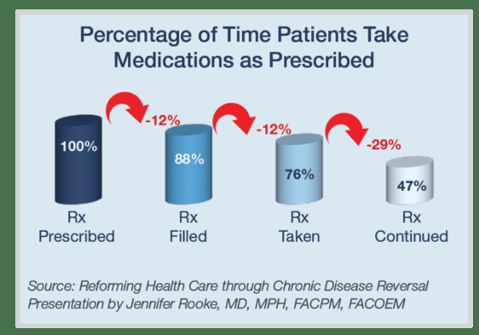

Slide 9
Medication Non-adherence.
Patients who had no insight into their disorder and treatment were significantly associated with medication non-adherence. This result is also similar to the study reported in Nigeria, India, the USA, and Germany
. The possible explanation for this might be having no or little insight into the disease, and their treatment plays an important role in medication adherence.
This study revealed that participants who were taking their medication twice daily were significantly associated with non-adherence. This might be due to forgetting to take their medication, fear of side effects, and the discomfort arising from the high ‘pill burden’ fear of pill overload

Slide 10
Therapeutic alliance
The fact that patients often fail to respond to medication for several reasons including ongoing use of problematic defense mechanisms, hidden use of alcohol and/or other drugs, and nonadherence, is a further claim in favor of a supportive therapeutic alliance with the prescribing doctor (Kaplan,2014)
Confirms the importance of a strong Psychotherapy/medical-patient relationship (Alfonso,2009; Ramos,2013).

Slide 11
Early Predictors of Nonadherence to Antipsychotic Therapy in First-Episode Psychosis
Significant role of social and family support in achieving adherence to medications very early during treatment of FEP, in addition to the influence of early acceptance or rejection of medication.

Slide 12
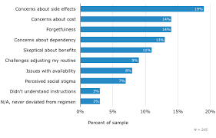

Slide 13
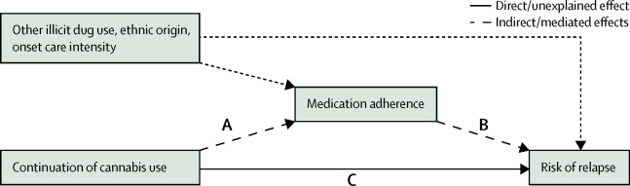

Slide 14
Psychological and psychodynamic antecedents of nonadherence

Slide 15
Risk factors for nonadherence
There are multiple and interacting risk factors for medication nonadherence, with no single profile for high risk for nonadherence. Conceptually, these can be divided into:
patient-related, medication-related, and provider-related risk factors.
Patient-related risk factors.
Among patient characteristics that appear to be risk factors for nonadherence, the strongest support appears to be for comorbid substance use, younger age, lower education level, and cognitive impairment.

Slide 16
Psychological and psychodynamic antecedents of nonadherence
Cohen and colleagues have written extensively on the connection between early childhood trauma and nonadherence or resistance to care in adult patients with posttraumatic stress disorder and comorbid depression.
They postulated that traumatized patients’ sense of a foreshortened future may be related to failure to engage in or accept medical treatment, which suggests that early childhood trauma is a psychological risk factor for adult nonadherence.
Psychodynamic determinants and adaptive (and maladaptive) defenses related to nonadherence in psychiatric patients include :
Limited or no understanding of the illness
Denial, rationalization, and isolation of affect
Feeling coerced, disrespected, or infantilized by the physician
Feeling deceived or manipulated

Slide 17
Attachment issues
Dismissing individuals, such as infants who do not protest when separated from parents and who are indifferent to their return and are inhibited at play, as adults become compulsively self-reliant and difficult trusting others.
Avoidant attachment types are independent, self-directed, and often uncomfortable with intimacy.
They regularly complain about feeling “crowded” or “suffocated” when people try to get close to them.
Adults with secure attachment experienced consistently responsive caregiving parents, while adults with dismissing attachment had avoidant parents who were consistently emotionally unresponsive.
Adults with secure attachments are comfortable depending on others and are readily comforted by them. Adults with dismissing style become compulsively self-reliant, describe themselves as independent and self-sufficient and are uncomfortable being close to or trusting of others.

Slide 18
Therapeutic implications
Awareness of dismissing attachment behaviors-DAT- in our nonadherent patients can help us reframe our psychotherapeutic work.
Wallin_ describes the process of therapeutic interventions with dismissing individuals as “moving from isolation to intimacy.”
Psychotherapy interventions informed by the contributions of attachment theory could help adults with dismissing attachment behaviors who are nonadherent to treatment by stressing the importance of collaborative relationships, relinquishing excessive self-reliance and control, and promoting trust.

Slide 19
Accumulative trauma
Individuals with a history of poly-traumatization have been shown to continue to experience additional victimization and severe and persistent biopsychosocial impairment and are at increased risk of developing negative behavioral patterns such as delinquency and substance abuse compared to individuals with few or no trauma experiences.
The link between trauma experiences and substance use disorders (SUD) is well established.
In surveys of adolescents receiving treatment for substance abuse, between 60% and 87% of patients reported a history of exposure to trauma.
Moreover, studies show that 37% to 52% of SUD patients have a lifetime diagnosis of PTSD
. In particular, the literature has focused on experiences of childhood abuse as an underlying risk factor for substance use behaviors.
For instance, treatment may lead to exposure to cues related to traumatic events. This may, if unaddressed, produce symptoms of anxiety or anger, in turn leading to patient attrition, or reinitiating substance use to cope with intruding memories and avoidance symptoms.
“Wherever possible, emphasis should be placed on the deep-rooted connection between trauma, mental health, and addiction”

Slide 20
Failure of empathy
Sensing that the psychiatrist is tentative or ambivalent when presenting the information
As prescribers, our failure of empathy often stems from an unconscious need to feel separate from our patients-to defend ourselves against overwhelming distress and maintain a safe space and emotional distance-consequently, abstinence and neutrality are overemphasized.
A collaborative stance promotes adherence, while paternalistic or categorical medication advice could be perceived as coercive and could result in partial or non-adherence.
Sensitivity, availability, and responsiveness are at the core of all psychotherapeutic interventions and enduring life-enhancing relationships.

Slide 21
Model to enhance adherence in bipolar disorder
Model to enhance adherence in bipolar disorder which includes three components:
Education, motivational interviewing, and compensatory skills training.
Education
The primary goal, is to increase knowledge about the properties of medications and awareness of the patient's role in managing medication
At a minimum, educational interventions should include printed information about, the basic properties of mood stabilizers, antipsychotics, and antidepressants, such as their purposes, dosages and instructions, and factors that, affect the medication effectiveness.
Coupled with medication-related education, the causes and consequences of bipolar disorder, and particularly useful to draw parallels to other chronic medical illnesses such as diabetes.

Slide 22
Optimal psychiatric treatment: Target the brain and avoid the body

Slide 23
Optimal psychiatric treatment: Target the brain and avoid the body
Most psychiatric medications must be taken daily for years, even a lifetime, to avoid a relapse of the illness.
Psychiatrists frequently must manage adverse effects or switch the patient to a different medication if a tolerability or safety issue emerges, which is very common in psychiatric practice.
A significant part of psychopharmacologic management includes ordering various laboratory tests to monitor adverse reactions in major organs, especially the liver, kidney, and heart.
Additionally, psychiatric physicians must be constantly cognizant of medications prescribed by other clinicians for comorbid medical conditions

Slide 24
"Treatment-resistant : depression".
Auvelity works by combining two other drugs into one medication. Dextromethorphan is an older drug that has some modulating effects. The other drug in the combination, bupropion, the purpose of bupropion in this medication is to slow the metabolism of dextromethorphan.
The FDA has approved Auvelity, a new antidepressant that may treat symptoms faster than other medications.
The drug may be especially effective for individuals with treatment-resistant depression.
Auvelity works on changing the levels of the neurotransmitter glutamate by acting on NMDA receptors.
Auvelity joins ketamine as a potential new wave of faster-acting antidepressants.

Slide 25


Slide 26


Slide 27


Slide 28
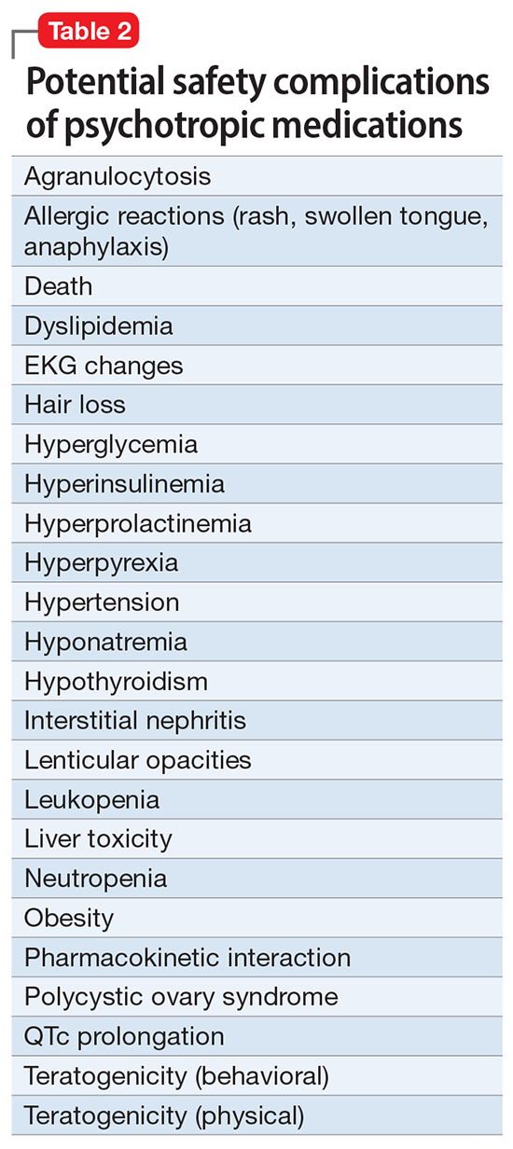

Slide 29
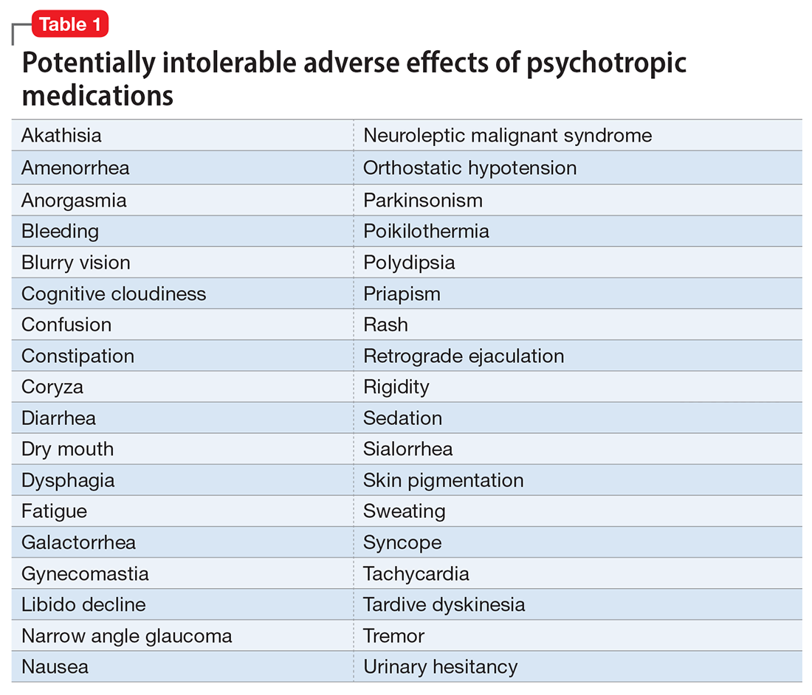

Slide 30


Slide 31
Nonpharmacologic treatments
Psychotherapy’s many benefits: improving insight, enhancing adherence, improving self-esteem, reducing risky behaviors, guiding stress management and coping skills, modifying unhealthy beliefs, and ultimately relieving symptoms such as anxiety and depression) are achieved without any somatic adverse effects!.
Psychotherapy has also been shown to induce neuroplasticity and reduce inflammatory biomarkers.
Neuromodulation may very well be the future of psychiatric therapeutics. It targets the brain and avoids the body, thus achieving efficacy with minimal systemic tolerability. ECT, TMS, VNS.

Slide 32
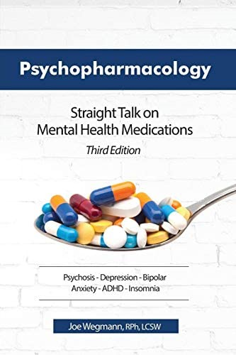

Slide 33


Slide 34
Measures of adherence,
Blood levels and pill counts are more direct but unless they are a part of routine clinical care, they are impractical in many clinical and research settings.
Furthermore, it still is possible to “fake” either of these measures, such as by throwing pills away in the case of pill counts or in taking medication on the day of the blood test.
A newer technology, Micro Electronic Monitoring Systems (M.E MS), involves tiny sensors placed in pill bottles that record a time stamp upon opening the bottle.

Slide 35
Motivational interviewing
MI is a complex clinical style for eliciting the client’s own values and motivations for change.
It is far more about listening than telling, about evoking rather than instilling. MI communicates not, “I have what you need,” but instead, “You have what you need, and together we will find it.”
Several psychiatrists who are leading researchers in psychopharmacology have also undertaken research validating medical psychotherapy.
. There is an inevitable in psychiatry, and the meaning ascribed to the prescription of drugs has an impact on the doctor-patient relationship.erstanding the psychodynamic issues is crucial for the success of psychopharmacology.
Psychodynamic psychopharmacotherapy represents an integration of biological psychiatry and psychodynamic insights and techniques.

Slide 36
Motivational Pharmacotherapy on Treatment Retention among Depressed Latinos
Compared to non-Latino Whites, US racial/ethnic minority groups show higher non-adherence with outpatient antidepressant therapy, including lower retention, despite adjusting for sociodemographic and insurance covariates.
Culturally salient concerns about antidepressants leading to ambivalence about treatment engagement may contribute to this discrepancy.
Outcome measures further support the usefulness of Motivational Pharmacotherapy, which resulted in significant improvement in symptoms, functioning, and quality of life, and in high rates of response and remission for our participants.
This is consistent with previous research showing that for antidepressant trials Latino completers have had high response rates

Slide 37
Motivational Pharmacotherapy
Psychiatrists explored antidepressant therapy-related concerns and addressed them in line with patients’ cultural illness constructions.
For example, lists derived from our previous qualitative work with low-income Latinos provided illustrations of potential concerns about antidepressant therapy, Lewis Fernandez, 2003, and medication choices were negotiated taking into account patients’ treatment expectations about cultural syndromes: (e.g., nervios [nerves]),
Other such as low initial doses, very slow dose increases, and brief drug holidays as requested to enable nerves “to adjust or recover on their own.”
Weeks 4 and 8 focused on issues commonly threatening retention, including side effects, fear of addiction, and doubts about the need for ongoing medication.
Affirmation of patients’ progress and their desire to remain free of depression were used to reinforce treatment retention.
During all sessions, the psychiatrist affirmed patient’s willingness to continue with the treatment and asked about adherence to the medication.

Slide 38
Motivational Pharmacotherapy (MP) approach
MP uses a Motivational Interviewing approach (i.e., counseling skills, respecting autonomy, equality in the treatment relationship, focus on building motivation to continue) to pace with the patient, not pushing but guiding him to take the medication home just in case, and how the patient's statements about feeling better on the medication are selectively reflected.
Avoiding a right vs. wrong dynamic.
Thus, when the patient notices the return of depressive symptoms, he is more willing to re-start the medication.
Motivational Pharmacotherapy is therefore consistent with recommendations for personalization and shared decision-making in clinical care , and with interventions aimed at empowering the patient to be a more active partner in mental health treatment.

Slide 39
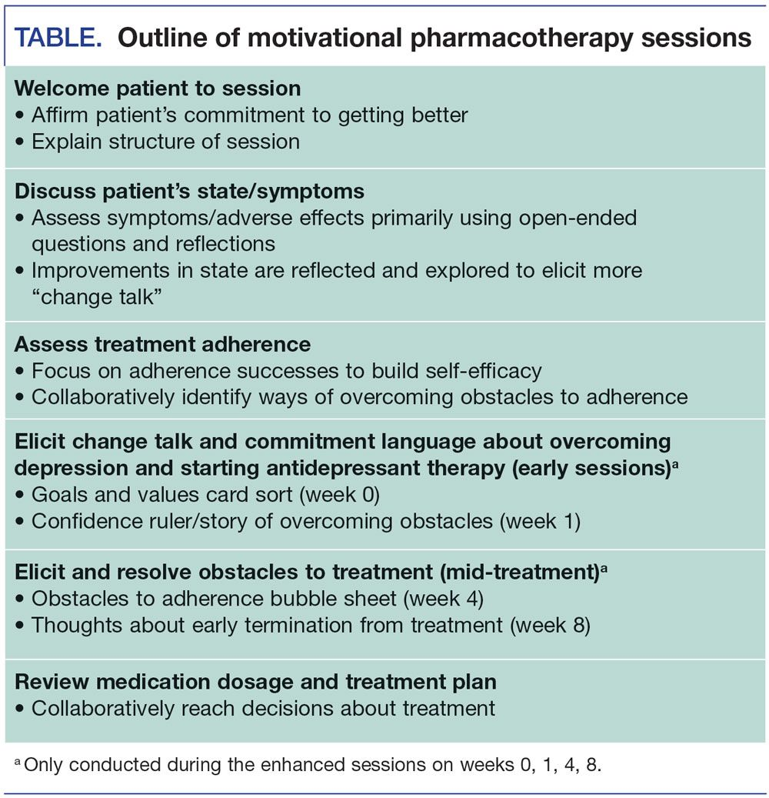

Slide 42
Motivational Pharmacotherapy
Motivational Pharmacotherapy does not consist of adding a series of Motivational Interviewing techniques to what occurs in the standard pharmacotherapy sessions; instead, Motivational Pharmacotherapy requires that the Pharmacotherapist limit some of his/her typical activities and replace them with interactions that are more consistent with Motivational Interviewing.
Understanding the patient's treatment experience and responding accordingly. This approach fosters improved communication and engagement and allows the clinician to clarify any barriers to adherence and the patient’s strengths that can be used to overcome them.
The focus on understanding the patient helps to build a therapeutic alliance, which is an important but often overlooked, component of effective pharmacotherapy.

Slide 43

HOW vs WHAT
“HOW we prescribe sometimes is more important than WHAT we prescribe in terms of medication adherence”.

Slide 44


Slide 45
THANKS/ GRACIAS

Slide 46
REFERENCES
Prosser A, Helfer B, Leucht S. Biological v. psychosocial treatments: a myth about pharmacotherapy Br J Psychiatry. 2016;208(4):309-311.
Miklowitz DJ, Efthimiou O, Furukawa TA, et al. Adjunctive psychotherapy for bipolar disorder: a systematic review. JAMA Psychiatry. 2021;78(2):141-150.
Alfonso C. A. (2009). Dynamic psychopharmacology and treatment adherence. J. Am. Acad. Psychoanal. Dyn. Psychiatry 37, 269–285. 10.1521/jaap.2009.37.2.269.
Kaplan M. (2014). “Psychoanalysis and psychopharmacology: art and science of combining paradigms,” in TextBook of Biological Psychiatry, ed. Panksepp J. (Hoboken, NJ: Wiley-Liss, Inc.), 549–569.
Mintz D. (2006). Psychodynamic Trojan horses: using psychopharmacology to teach psychodynamics. J. Am. Acad. Psychoanal. Dyn. Psychiatry 34, 151–161. 10.1521
Ramos M. A. (2013). Drugs in context: a historical perspective on theories of psychopharmaceutical efficacy. J. Nerv. Ment. Dis. 201, 926–933. Lewis-Fer, R et al,

Slide 47
Greil W., Kleindiens N. Concepts in the treatment of bipolar disorder. Acta Psychiatr Scand. 2003;108:S41–S46.
Lingam R., Scott J. Treatment non-adherence in affective disorders. Acta Psychiatr Scand. 2002;105:164–172
Johnson RE., McFarland B. Lithium use and discontinuation in a health maintenence organization. Am J Psychiatry. 1996;153:993–1000. 38. Scott J., Pope M. Self-reported adherence to treatment with mood stabilizers, plasma levels, and psychiatric hospitalization. Am J Psychiatry. 2002;159:1927–1929. 39.
McDonald HP., Garg AX., Haynes RB. Interventions to enhance patient adherence to medication prescriptions: scientific review. JAMA. 2002;288:2868–2879. 68.
Miller WR., Conforti K., Rollnik S. Motivational interviewing: Preparing People for Change. 2nd ed. New York, NY: The Guilford Press; 2002 69.
Patterson TL., Mausbach BT., McKibbin C., Goldman S., Bucardo J., Jeste DV. Functional adaptation skills training (FAST): a randomized trial of a psychosocial intervention for middle-aged and older patients with chronic psychotic disorders. SchizophrP.es. 2006;86:291–299. 70.

Slide 48
Brancu M, Mann-Wrobel M, Beckham J, Wagner H, Elliott A, Battles A, et al. Subthreshold posttraumatic stress disorder: a meta-analytic review of DSM-IV prevalence and a proposed DSM-5 approach to measurement. Psychol Trauma Theory Res Pract Policy. 2015;8:222-32. 4. Finkelhor D, Ormrod RK, Turner HA. Poly-victimization: a neglected component in child victimization. Child Abuse Negl. 2007;31(1):7–26
. Finkelhor D, Ormrod RK, Turner HA. Re-victimization patterns in a national longitudinal sample of children and youth. Child Abuse Negl. 2007
. O'Donnell ML, Schaefer I, Varker T, Kartal D, Forbes D, Bryant RAA, et al. A systematic review of person-centered approaches to investigating patterns of trauma exposure. Clin Psychol Rev. 2017;57:208–225.
7. Appleyard K, Egeland B, van Dulmen MH, Sroufe LA. When more is not better: the role of cumulative risk in child behavior outcomes. J Child Psychol Psychiatry. 2005;46(3):235–245

Slide 49
Schraufnagel TJ, Wagner AW, Miranda J, Roy-Byrne PP. Treating minority patients with depression and anxiety: What does the evidence tell us? General Hospital Psychiatry. 2006;28:27–36.
Swanson KA, Bastani R, Rubenstein LV, Meredith LS, Ford DE. Effect of mental health care and shared decision-making in-patient satisfaction in a community sample of patients with depression. Medical Care Research Review. 2007;64:416–430.
Velligan D, Sajatovic M, Valenstein M, Riley WT, Safren S, Lewis-Fernández R, et al.Jamison J. Methodological challenges in psychiatric treatment adherence research. Clinical Schizophrenia & Related Psychoses. 2010;4:74–91
Weiss M, Gaston L, Propst A, Wisebord S, Zicherman V. The role of the alliance in the pharmacologic treatment of depression. Journal of Clinical Psychiatry. 1997;58:196–204.
Zygmunt A, Olfson M, Boyer CA, Mechanic D. Interventions to improve medication adherence in schizophrenia. American Journal of Psychiatry. 2002;159:1653–1664

Slide 50
Kupfer DJ. The increasing medical burden in bipolar disorder. JAMA. 2005;293:2528–2530.
Cuijpers P, Karyotaki E, Reijnders M et al. World Psychiatry 2018;17:90‐101.
Olarte SW, Teo DCL, Alfonso CA. Psychodyn Psychiatry 2020;48:314‐36
Cuijpers P. World Psychiatry 2019;18:276‐85.
Driessen E, Abbass AA, Barber JP et al. BMJ Open 2018;8:e018900.
Wienicke FJ, Driessen E. Psychodyn Psychiatry 2021;49:3.

Slide 51
The purpose of the MHTTC Network is technology transfer - disseminating and implementing evidence-based practices for mental disorders into the field.
Funded by the Substance Abuse and Mental Health Services Administration (SAMHSA), the MHTTC Network includes 10 Regional Centers, a National American Indian and Alaska Native Center, a National Hispanic and Latino Center, and a Network Coordinating Office.
Our collaborative network supports resource development and dissemination, training and technical assistance, and workforce development for the mental health field. We work with systems, organizations, and treatment practitioners involved in the delivery of mental health services to strengthen their capacity to deliver effective evidence-based practices to individuals.
Our services cover the full continuum spanning mental illness prevention, treatment, and recovery support.
MHTTCnetwork.org
Sign-Up for Newsletter
MTTC News

