Slide 1
Transcultural Psychiatry
J Raul Condemarin, MD
New England MHTTC
April 19th, 2023
Notes:
DO NOT CHANGE THE FORMAT OF THIS TEMPLATE. If you are creating MHTTC-branded slides, you must use this template or one of the other approved templates in the Shared Folder.

Slide 2




Housekeeping Information
Participant microphones will be muted at entry
If you have questions during the event, please use the chat
This session is being recorded and it will be emailed to all participants once available.
If you have questions after
this session, please e-mail:
newengland@mhttcnetwork.org.
At the end of the month, we will send you a certificate of completion that you can submit to your particular board for continuing education credit. Please contact ifisher@c4innovates.com for more information on CEs after the event.

Slide 3
Acknowledgment
Presented in 2022 by the Mental Health Technology Transfer Center (MHTTC) Network.
This presentation was prepared for the New England Mental Health Technology Transfer Center (MHTTC) Network under a cooperative agreement from the Substance Abuse and Mental Health Services Administration (SAMHSA). All material appearing in this publication, except that taken directly from copyrighted sources, is in the public domain and may be reproduced or copied without permission from SAMHSA or the authors. Citation of the source is appreciated. Do not reproduce or distribute this publication for a fee without specific, written authorization from New England MHTTC. For more information on obtaining copies of this publication, email us at newengland@mhttcnetwork.org.
At the time of this publication, Miriam E. Delphin-Rittmon, Ph.D, served as Assistant Secretary for Mental Health and Substance Use in the U.S. Department of Health and Human Services and the Administrator of the Substance Abuse and Mental Health Services Administration.
The opinions expressed herein are the view of TTC Network and do not reflect the official position of the Department of Health and Human Services (DHHS), SAMHSA. No official support or endorsement of DHHS, SAMHSA, for the opinions described in this document is intended or should be inferred.
This work is supported by grants #1H79SM081775 from the Department of Health and Human Services, Substance Abuse and Mental Health Services Administration.
Presented 2022
Notes:
Always use acknowledgment slide on the 2nd slide and add your center’s information

Slide 4
Notes:
Always use Language Matters graphic as your third slide.

Slide 5


TRANSCULTURAL PSYCHIATRY
J Raul Condemarin, MD
Attending Psychiatrist
Massachusetts Mental Health Center
April-2023

Slide 6
Cross-Cultural Psychiatry
In a report by the Population Division of the United Nations in 2007, it was estimated that the total number of immigrants in the world in 2005 numbered 191 million (3% of the world’s population)-an increase from 155 million in 1990. The United States had the largest percentage of the world’s immigrants in 2005, equaling 12.86% of the total US population.
The current global estimate is that there were around 281 million international migrants in the world in 2020, which equates to 3.6 of the global population.
Mexico and Central America still remain major sources of migration to the U.S., too, according to the CBP data.Dec, 2022.
Since 1980, there has been more diversity in race, ethnicity, and religion among people who have immigrated to the United States. The total US population has increased by 29% from 1980 through 2005. During those years, the Asian-Pacific component has grown 219%; the Hispanic component, 174%; the African American component, 37%; and the white component, 9%.

Slide 7
Practical applications of cultural psychiatry to clinical practice
One of the most practical applications of cultural psychiatry to clinical practice in all fields of medicine is the open-ended questioning of patients and their families about their personal and family background characteristics. This includes identifying race, ethnicity, religion, socioeconomic class features, relevant immigration history, experiences of acculturative stress, and personal and family aspirations.
Consider idioms of distress.
Open-minded
Ask questions for clarification.

Slide 8
Principles of cultural psychiatry that are of central importance to clinicians:
(1) Cultural considerations in the assessment and treatment of children and youth.
(2) Religion, spirituality, and mental health
(3) Cultural and ethnic issues in psychopharmacology. ½ TAB VS 1 TAB, small vs big
Treatment for psych conditions by a neurologist NOT A PSYCHIATRIST.
CANCER DIAGNOSIS ??

Slide 9
Cultural Difference, Universalism and Social Psychiatry in the Age of Decolonization
In the early phases of transcultural psychiatry, a large number of psychiatrists were very keen to determine how cultural and social environments shaped the basic traits of human psychology, and ‘psy’ practitioners and anthropologists from all over the world sought to re-define the relationship between culture, race, and individual psyche.
Importantly, the emergence of transcultural psychiatry corresponded chronologically with the rise to prominence of social psychiatry in the Western world, but the two disciplines tended to remain separate throughout the second half of the twentieth century: even though they were deeply interconnected, they were marked by significant differences in their methodologies, core preoccupations, and conceptual frameworks.
.

Slide 10
Transcultural Psychiatry: Cultural Difference, Universalism and Social Psychiatry in the Age of Decolonisation
Ana Antić
For psychotherapy to be effective in any culture or society, it needed to provide an aetiological theory that could be in line with the socio-cultural context/assumptions and accepted by the society at large (El-Mahi 1960).
A mental health worker … ‘must support the values of his community and of his day…you must love that community and you must love its culture.
Out of our love for our culture, we have been able to understand that many of the demoniacal states, the possessional states, have extremely valuable therapeutics for the patient himself… a really therapeutic basis’ (WFMH 1959: 20)
.Moreover, he warned Western practitioners that ‘psychiatry is inseparable from the community and must follow it as a shadow.’

Slide 11
Kleinmann
In their critique of the idea of cultural competency, Arthur Kleinman and Peter Benson identified some very similar trends in present-day psychiatric clinics, where ‘cultural competency’ is imagined as a technical set of skills that can be acquired relatively easily precisely because ‘culture’ is defined as static, homogeneous and isolated, and regularly made identical with ethnicity or race.
(Kleinman and Benson 2006)
Culture is life

Slide 12
Emil Kraepelin
“Insanity is then a part of the price we pay for civilization. The causes of the one increase with the developments and results of the other” (Jarvis, 1851).
while visiting Southeast Asia at the turn of the century, noted the absence of depression among various Asian populations.
He believed that mental disorders were organic diseases for which specific pathogens would ultimately be found.
Despite the cultural variations in mental disorders he observed during his world trip in 1904, he considered mental disorders to be universal: “Mental illness in Java showed broadly the same clinical picture as we see in our country … The overall similarity far outweighed the deviant features.”

Slide 13
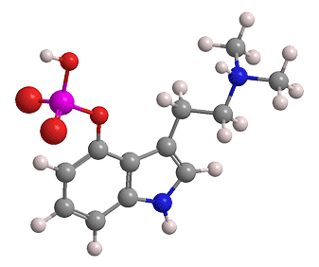

Slide 14
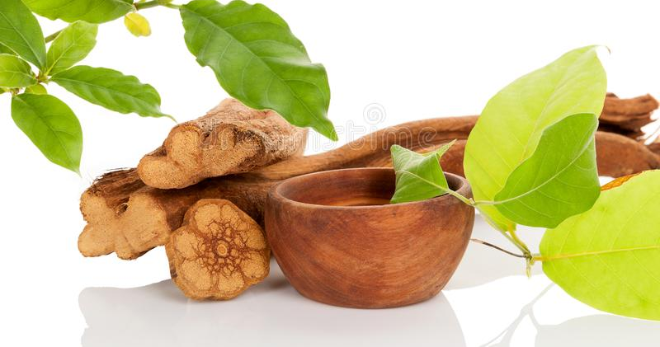

Slide 15
Ayahuasca-
is a psychedelic brew made by combining a number of plants, though exact recipes vary from region to region. The main intoxicating chemical in ayahuasca is DMT, or dimethyltryptamine. In order for DMT to produce its intense psychoactive effects, it needs to be taken in combination with an MAO inhibitor.
The psychoactive ingredients in ayahuasca (DMT) and magic mushrooms (psilocybin) are very similar. In fact, DMT is a functional analog and structural analog of psilocybin
The term ayahuasca comes from the Quechua “ayawaska” and it’s a traditional spiritual brew originating from indigenous Amazonian communities. Its use dates back to 1,000 AD and was first encountered by Western Christian mercenaries in the 16th century in modern-day Peru/Ecuador.
Today, ayahuasca has received a lot of attention and is still a central part of modern religions in Brazil

Slide 16
Ayahuasca Ceremony for Healing
An Ayahuasca Ceremony is an opportunity to receive treatment for the spirit and take part in your own healing. Ayahuasca ceremony participants arrive in the early evening, as ceremonies are held at night. Participants arrive before the ceremony begins to show respect for the healer, or curanderos, leading the ceremony.
The Maestro curanderos first prepare for the ceremony, after introductions, if necessary. Preparation includes cleaning of the space and implements with mapacho tobacco, prayers, and other blessings. The ceremony begins after preparation of the space and ceremonial tools.
Beginning the Ayahuasca Ceremony
The ceremony begins in silence as the curanderos calls each participant up to take a cup of ayahuasca. The curandero may also speak to each participant about intention, dosage, or other recommendations.
The curandero then drinks a cup as well, after each participant has received a cup of ayahuasca. The ceremony continues with lights extinguished, and after a brief time as the ayahuasca medicine begins working, the curandero starts to sing.

Slide 17
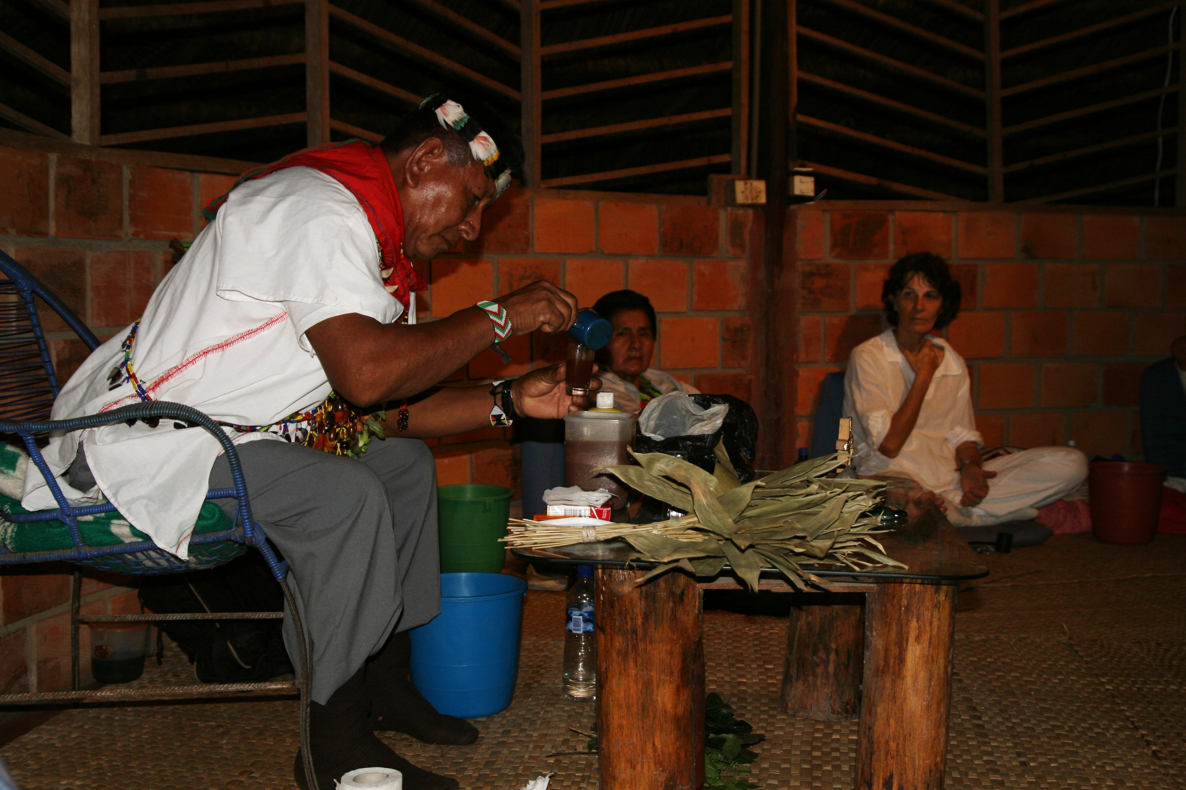

Slide 18
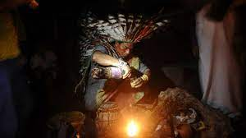

Slide 19
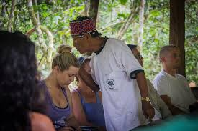

Slide 20

Stigma
Mental health stigma is the largest community barrier to improving global mental health, and in Latin American cultures, this stigma may be more prevalent.
Mental health stigma refers to negative attitudes or beliefs that lead to the “devaluing, disgracing, and disfavoring by the general public of individuals with mental illnesses.”
There are three commonly recognized types of mental health stigma:
Social or public stigma: This refers to the negative discriminatory beliefs or attitudes about mental health conditions promoted in one’s cultural group or broader society.
Self-stigma: This occurs when a person internalizes negative societal attitudes about mental health conditions.
Institutional stigma: This refers to governmental or private institutional policies that unintentionally or intentionally discriminate against people with mental health conditions.
Some research indicates that in many countries, around 80–90% of people with a mental health condition experience the negative impact of stigma.
These beliefs are usually due to a combination of ignorance and misinformation, negative attitudes or prejudice, and discrimination.

Slide 21
Stigma II
Familismo
Several studies suggest that the cultural value of Familism- Familismo-, or the collective value of family unity, can play a role in shaping and enforcing mental health stigma.
Some researchers claim that this value is associated with increased rates of emotional closeness and openness within the family, which may reduce the impact of mental health stigma.
On the other hand, some research cites family as a major source of discrimination against people with mental health conditions in several Latin American countries. Examples of negative family factors include hostile .Another study found that most Latin and Hispanic families would deny the presence of depression or another mental health condition in a family member unless they were unable to cope or the symptoms of the condition were life-threatening.
In the same study, many of the survey participants believed that children’s mental health conditions are due to the sinful behaviors of their parents.
Furthermore, a 2013 study found that the value of Familismo can lead people to hide their condition in order to protect their family.
Family members may also discourage people from seeking treatment or taking medications due to a lack of education or spiritual or cultural beliefs.

Slide 22
RELIGION AND MENTAL HEALTH
Religion
Faith also seems to play a large role in shaping the stigma that Latin American people may hold about mental health conditions. This makes sense, given that these communities tend to rely on religious institutions as an important spiritual, educational, and social resource.
According to one 2019 study exploring beliefs about mental health conditions in faith-based Latin communities in the United States, religious beliefs may contribute to stigmas by enforcing the misconceptions that:
Mental ill-health is a moral failing or spiritual dilemma.
Mental ill-health is a spiritual, rather than a medical, condition.
Mental ill-health is a punishment or form of divine justice.
Depression is due to a lack of faith, not praying enough, sinful behaviors toward parents or others, or demonic influence.
Praying and having faith in God can help reduce the risk of or treat mental health conditions.
Self-harming acts, such as cutting or suicide, are due to a lack of true faith.

Slide 23

Faith and Religious Coping Mechanisms
Results of ,Preguntas con Cartas , CARDS WITH QUESTIONS) and the subsequent discussions indicated that prayer and faith played a large role in recovery from depression.
Given the prompt, “If a person prays more they could be cured,” almost half of the participants (44%) agreed or strongly agreed.
Several participants volunteered that they had cured themselves with pray and faith:
Some people battle with depression or sadness or anxiety over a problem but Christians feel we can battle negative sentiments with our faith, with prayers, and with the bible. (Female, 29, Dominican).
Consistent with past research, participants believed not dwelling on negative feelings and having more faith in God could cure depression (Cabassa, Lester, & Zayas, 2007; Vargas et al., 2015).
Caplan, S. (2019). The intersection of Cultural and Religious Beliefs About Mental Health: Latinos in the Faith-Based Setting. Hispanic Health Care International.

Slide 24
Denial of Depression and Taboo
In response to the question “What does depression mean to you?” participants responded that the experience of suffering from trauma, such as sexual abuse or domestic violence, or personal losses, could contribute to depression, which, if it became severe, could lead to mental illness.
Consequences of mental illness and depression were an inability to support the family, lack of marriageability, crime, poverty, substance abuse, and premature death.
It is worse than being sick. With a sickness you can be operated on, you recover, but not with depression. (Female, 47, Dominican)
To prevent these dire consequences, most families would deny the existence of illness within the family. The subject was taboo and never discussed, as well as SI,particularly for children.

Slide 25
Question | No. of votes | Agree/strongly agree | Neutral | Disagree/strongly disagree
Question 1: The problem with people with depression is lack of faith in God
Church 1 | 6 | 2 | 0 | 4
Church 2 | 10 | 6 | 0 | 4
Church 3 | 12 | 2 | 1 | 9
Total votes, n (%) | 28 | 10 (36) | 1 (4) | 17 (60)
Question 2: If one prayed more he/she could be cured
Church 1 | 6 | 4 | 1 | 1
Church 2 | 10 | 5 | 3 | 2
Church 3 | 11 | 3 | 3 | 5
Total votes, n (%) | 27 | 12 (44) | 7 (26) | 8 (30)
Question 3: The main cause of suicide is a lack of faith in God
Church 1 | 9 | 7 | 0 | 2
Church 2 | 6 | 2 | 0 | 4
Church 3 | 7 | 6 | 0 | 1
Total votes, n (%) | 22 | 15 (68) | 0 | 7 (32)
Votes.
OPEN IN VIEWER
Data Analysis

Slide 26
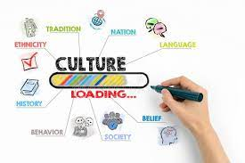

Slide 27
Idioms of Distress
Mark Nichter
The term “idioms of distress,” as used in medical anthropology, directs attention to socially and culturally mediated ways of experiencing and expressing distress.
In any given culture, a variety of ways exist to communicate distress.
These range from forms of behavior such as shifts in food consumption to somatic complaints that have cultural significance, health care seeking and medicine taking, and spirit possession and fear of witchcraft.
Idioms of distress are culturally constituted in the sense that they initiate particular types of interaction associated with culturally pervasive norms, values, and health concerns.
Idioms of distress are dynamic and subject to contingencies.

Slide 28
Voodo: Africa- Haiti
Kiev concluded that ‘It seems not unlikely then that mental illness is manifested in certain basic structural mechanisms and processes that recur together with a certain regularity in the different clinical syndromes, providing a substratum on top of which the different cultures impose differences in content.
There is little evidence to suggest that mental illnesses differ from culture to culture in any different way’ (Kiev 1964: 19).
Edward Margetts, Canadian psychiatrist heading the Mathari hospital in Kenya, who appeared to believe that the ‘primitive’ peoples of Eastern Africa possessed bizarre cultures and mentalities, fundamentally different from those of the ‘civilized’ world, still confessed that ‘in my studies of African psychiatry, I have accepted diagnoses and treatments more or less as practiced in the civilized area.
The results, in general, are quite comparable to those one would expect in a civilized population’ (Margetts 1958b).

Slide 29
. Cultural Idioms of Distress
Cultural Idioms of Distress, ways of expressing distress that may not be linked to symptoms and syndromes, but are shared ways of experiencing and communicating individual and social concerns; and Cultural Explanations of Distress or Perceived Distress, labels and characteristics of an explanatory model related to culturally recognized meaning and etiology for symptoms, illness, and distress.
What are the cultural idioms of distress DSM-5?
DSM-5 Cultural Concepts of Distress. Commonly reported symptoms to include uncontrollable shouting, attacks of crying, trembling, heat in the chest rising into the head, and verbal or physical aggression.
Mark Nichter’s (1981) seminal paper introducing idioms of distress has become a cynosure for psychological anthropology and transcultural psychiatry. 2010 publication of a special issue in the journal Culture, Medicine and Psychiatry organized by Devon Hivnton and Roberto Lewis-Fernández.
Analysis showed that These were illness categories that were believed to be specific to certain societies; classic examples include susto, dhat syndrome, hwa-byung, and nervios are important idioms of distress, associated with socio-economically vulnerable populations and comorbidities with other psychiatric conditions, particularly post-traumatic stress disorder. More studies are needed on their relation with stress

Slide 30
ATAQUES DE NERVIOS
The main culture-bound syndromes studied are Nervios, Ataques de Nervios and Susto.
Nervios is described as episodes, usually chronic, of extreme sadness or anxiety associated with somatic symptoms such as headaches and/or muscle pain, nausea, loss of appetite, fatigue, insomnia and decreased reactivity.
It is more common in women and associated with stress, emotional imbalance and low self-esteem.
Ataques de Nervios are described as culturally acceptable responses to acute stressful experiences, particularly the loss of loved ones and family conflict or threat.
It is characterized by tremors, a feeling of heat that starts in the chest and rises to the head, fainting and epileptic episodes.
It is also accompanied by a sense of loss of control and may present a significant degree of agitation, suicidal gestures and auditory hallucinations.

Slide 31
What is the evil eye?
The evil eye, according to popular wisdom, is one that is thrown through the eyes of a person.
This always denotes that the intention of this subject is to resent oneself for the great achievements one has in life.
This should not be taken too lightly since what tells you that in your environment there is someone has a lot of envy, jealousy and hatred towards you.
He would also seek to harm you and this is reflected in his look.

Slide 32
the evil eye
"What are the typical symptoms of an evil eye?
Fatigue.
Crying without apparent cause.
Very bad headache.
Difficulty sleeping.
Loss of appetite.
Permanent sadness and anguish.
Loss of vitality.
The egg is almost 100 percent protein and has its own electrical charge.
We, according to our emotions, have a variation of charges,
So that modifies the contents of the egg.

Slide 33
MAL DE OJO : EVIL’S eye
La limpia de huevo es uno de los rituales, es el más fuerte para eliminar el "mal de ojo", ya que ayudar a espantar las malas energías, y que muchas veces causan daños en nuestra salud. Sin embargo, algunas personas no saben las palabras exactas que deben utilizar para poder sacar todas esas energías negativas del cuerpo.
PRAYERS.

Slide 34
Why is the egg used as a ritual?
Since ancient times, the egg has been seen by different cultures as a symbol related to life and development.
It is not yet clear what the exact origin of this ritual is, but it is known that it mixes pre-Hispanic Mesoamerican traditions with rituals of the religions that arrived with the Spaniards.
Therefore, they explain, the symbolism of the egg "is directly associated with the ideas of fertility, creation, renewal and resurrection, that is, all related to the birth and development of life."
Another symbolic definition of the egg, provided by the writer and artist Shaheen Mirom, points out that this object "has long been considered a symbol of life, it is related to the absorption of energies".

Slide 35
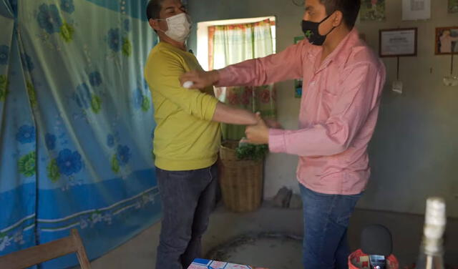

Slide 36
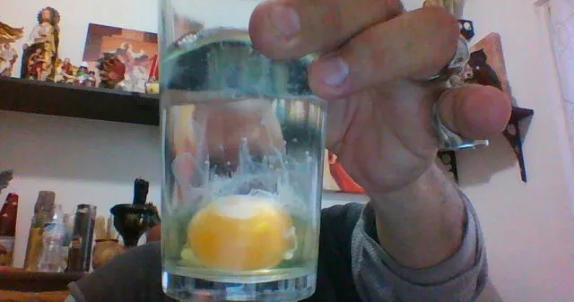

Slide 37
Susto
Susto- (Scart, Fright-) is described as chronic somatic symptoms attributed to “soul loss” and induced by an episode of intense fear experienced by the individual, usually related to a supernatural perspective.
In some cases, Susto can be induced by witnessing others who are affected by this illness.
Symptoms include fever, diarrhea, loss of appetite, restlessness, insomnia, mental confusion, apathy, depression, and introversion.
The contributions of Latin America on psychiatric diagnoses and in particular the main local culture-bound syndromes Susto, Nervios and Ataques de Nervios, may contribute to the development of a more comprehensive and valid diagnostic process in Latin America.

Slide 38
Clinical case
50 y/o Latina woman, HIV + for 4 years on ART treatment. She carries the Dx of Gen Anx D/o, Panic D/O, PTSD, MDD, and recurrent Suicidal ideations.
Brief History:
Catholic with 4 grown children
Married young, worked at home, and raise 4 kids.
Hx of domestic violent by the husband who also was a drinker.
She left her family and went to PR, to work, and later move to the USA where she had family.
New Life in PR
Start a new romantic relationship with a man in PR for 3 years, then move to NY.
No hx of other sexual partners
No abuse of alcohol, drugs, or nicotine
DX: HIV + accidentally through a routine test before a scheduled surgery.

Slide 39

TX Course.
Started ART with 3 drugs.
CD4 count: between 200-300 c/ml
HIV: VIRAL- load above normal
No opportunistic diseases
Recurrent panic attacks, moderate depression, recurrent and severe suicidal ideations with plans, also nightmares.

Slide 40
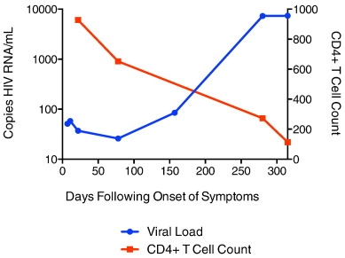

Slide 41
CD4 / T-cells, T-lymphocytes
CD4 cells are white blood cells that play an important role in the immune system. Body’s natural defense system against pathogens, infections, and illnesses.
CD4 cells are sometimes also called T-cells, T-lymphocytes, or helper cells.
The CD4 cell count of a person who does not have HIV can be anything between 500 and 1500.
People living with HIV who have a CD4 count over 500 are usually in pretty good health.
People living with HIV who have a CD4 cell count below 200 are at high risk of developing serious illnesses.
Once you start taking HIV treatment, and your viral load starts to fall, your CD4 cell count should gradually increase, over several years.

Slide 42
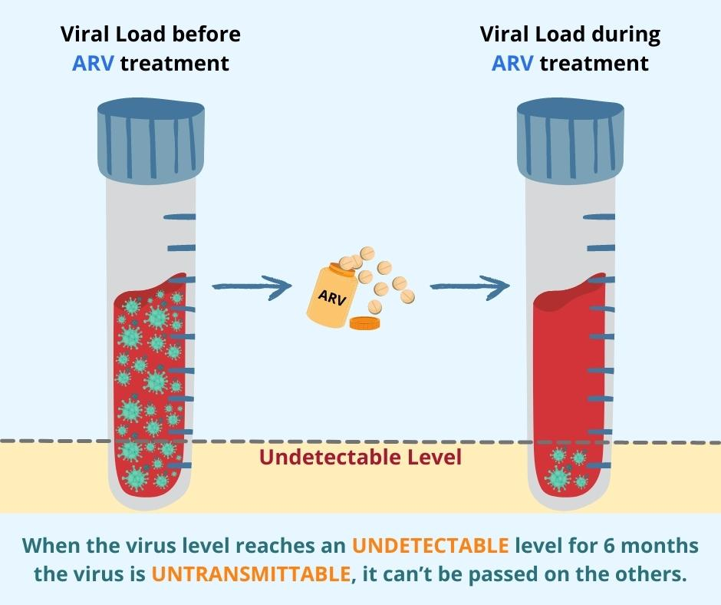

Slide 43
Treatment
BIO-Psycho-Socio-Cultural
Medication: HIV and MDD
Psychotherapy: Weekly-then Biweekly.
Problems:
Suic Ideations:
“ GOD punishment”
Guiltyness
Isolation: “Bad woman”.

Slide 45


Slide 46


Slide 69
Reference
1. Group for the Advancement of Psychiatry. Cultural Assessment in Clinical Psychiatry. Arlington, VA: American Psychiatric Publishing; 2002.

Slide 70
The purpose of the MHTTC Network is technology transfer - disseminating and implementing evidence-based practices for mental disorders into the field.
Funded by the Substance Abuse and Mental Health Services Administration (SAMHSA), the MHTTC Network includes 10 Regional Centers, a National American Indian and Alaska Native Center, a National Hispanic and Latino Center, and a Network Coordinating Office.
Our collaborative network supports resource development and dissemination, training and technical assistance, and workforce development for the mental health field. We work with systems, organizations, and treatment practitioners involved in the delivery of mental health services to strengthen their capacity to deliver effective evidence-based practices to individuals.
Our services cover the full continuum spanning mental illness prevention, treatment, and recovery support.
MHTTCnetwork.org
Sign-Up for Newsletter
MTTC News

