Slide 1
Motivational Interviewing for Loved Ones
Emily Kline, PhD
MAPNET, New England MHTTC
April 28th, 2023
Notes:
DO NOT CHANGE THE FORMAT OF THIS TEMPLATE. If you are creating MHTTC-branded slides, you must use this template or one of the other approved templates in the Shared Folder.

Slide 2




Housekeeping Information
Participant microphones will be muted at entry
If you have questions during the event, please use the chat
This session is being recorded and it will be emailed to all participants once available.
If you have questions after
this session, please e-mail:
newengland@mhttcnetwork.org.
At the end of the month, we will send you a certificate of completion that you can submit to your particular board for continuing education credit. Please contact ifisher@c4innovates.com for more information on CEs after the event.

Slide 3
Acknowledgment
Presented in 2022 by the Mental Health Technology Transfer Center (MHTTC) Network.
This presentation was prepared for the New England Mental Health Technology Transfer Center (MHTTC) Network under a cooperative agreement from the Substance Abuse and Mental Health Services Administration (SAMHSA). All material appearing in this publication, except that taken directly from copyrighted sources, is in the public domain and may be reproduced or copied without permission from SAMHSA or the authors. Citation of the source is appreciated. Do not reproduce or distribute this publication for a fee without specific, written authorization from New England MHTTC. For more information on obtaining copies of this publication, email us at newengland@mhttcnetwork.org.
At the time of this publication, Miriam E. Delphin-Rittmon, Ph.D, served as Assistant Secretary for Mental Health and Substance Use in the U.S. Department of Health and Human Services and the Administrator of the Substance Abuse and Mental Health Services Administration.
The opinions expressed herein are the view of TTC Network and do not reflect the official position of the Department of Health and Human Services (DHHS), SAMHSA. No official support or endorsement of DHHS, SAMHSA, for the opinions described in this document is intended or should be inferred.
This work is supported by grants #1H79SM081775 from the Department of Health and Human Services, Substance Abuse and Mental Health Services Administration.
Presented 2022
Notes:
Always use acknowledgment slide on the 2nd slide and add your center’s information

Slide 4
Notes:
Always use Language Matters graphic as your third slide.

Slide 5
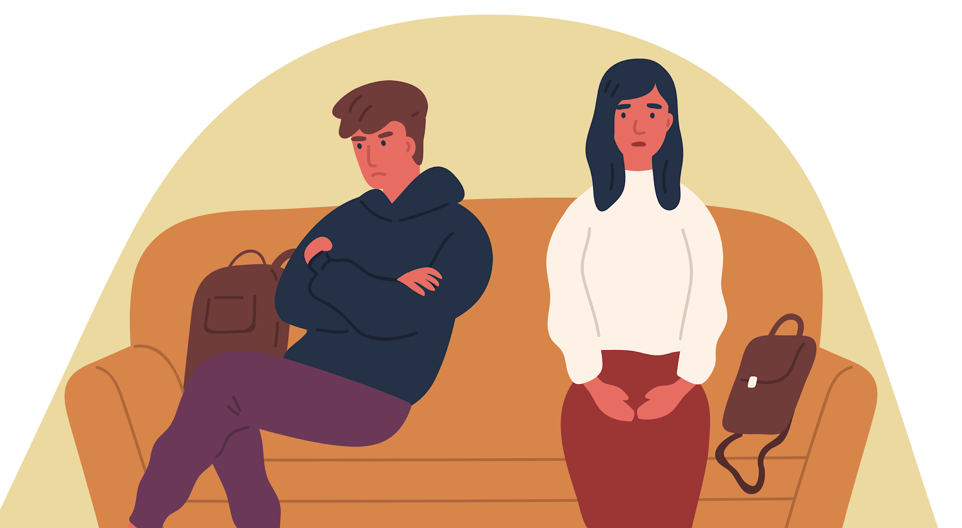

Motivational Interviewing for Loved Ones
Emily Kline, PhD

Slide 6
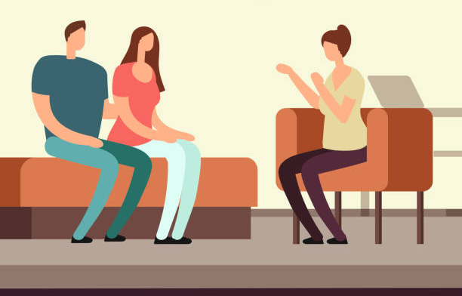
About Me
Psychologist (Boston Medical Center) & faculty (Boston University)
Director of Psychological Services at Wellness and Recovery After Psychosis (WRAP) Program
MI has been the best tool in my toolbox
Funding from MA Dept of Mental Health and National Institute of Mental Health to develop and pilot this content
    No commercial interest
Notes:
Have you heard of MI before this?

Slide 7
What is “Motivational Interviewing”?
“MI” is a communication style widely used by health professionals to talk about making healthy changes – research shows it works!
Developed with the goal of increasing motivation for treatment among people with substance use disorders
MI is based on the idea that the best way to influence another person’s behavior is by respecting their independence and creating space for them to explore their own motivation for change.
Notes:
Have you heard of MI before this?

Slide 8
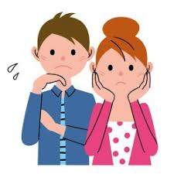
Why would caregivers want to learn MI?
“Putting your foot down” isn’t getting the result you want
Though we can’t control others, we can control ourselves – we can try new behaviors to “clean up our side of the street”
Great way to work on connection, even if we don’t get the behavior change we want right away
Motivational Interviewing for Loves Ones (“MILO”) is an adapted MI curriculum for family caregivers
Notes:
A lot of parents carry around this shame about not being able to control their teen or young adult child. If you get anything out of this talk, I hope it’s this: let that shame go. You can’t control them. The best you can do is to be the kind of person who they might actually want to take advice and guidance from.

Slide 9
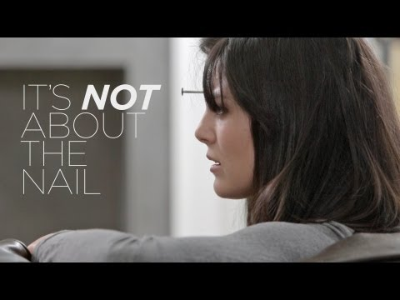
MILO 101
When we see someone we care about struggling, we want to help them…
But for some reason, they don’t appreciate it!!!

Slide 10
The Righting Reflex
The impulse to help others by
  FIXING their problem
  GIVING them advice
  MINIMIZING their issue

Slide 11

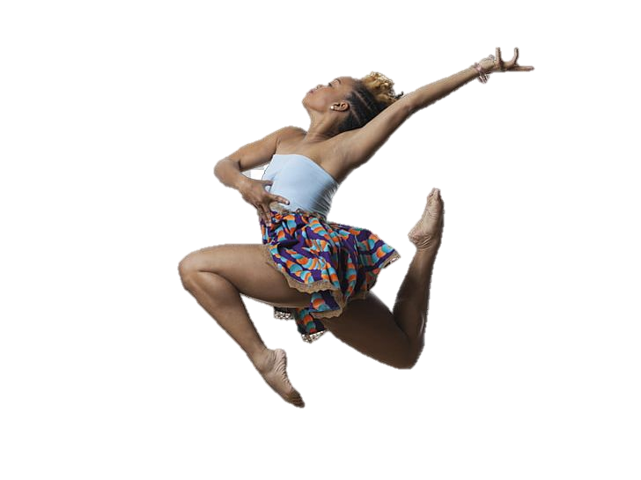
You might sound like this…
Notes:
Let me set this up for you. When we work with parents, one of our teaching tools is called a “real play.” In a real play, we tell parents about a real dilemma that we’re facing or a goal we’re trying to reach. We ask the parent to do their best at trying to help us resolve the dilemma, and we respond to them authentically – whatever happens, happens. The audio you’re about to hear is from a mom who was about to start MI training, and she’s talking to Simone, who is one of my colleagues and currently a PhD student at Georgia state.

Slide 12
In order to consider a healthy choice or a change, people need to feel:
Understood
“My therapist never judges… he tries to see my point of view”
Confident
“I know I can quit smoking this time”
In Control
“No one can make me take medicine – I’ll decide for myself”
Notes:
Even though that mom was so warm and encouraging, I don’t think that Simone was feeling understood, confident, or in control during that conversation

Slide 13
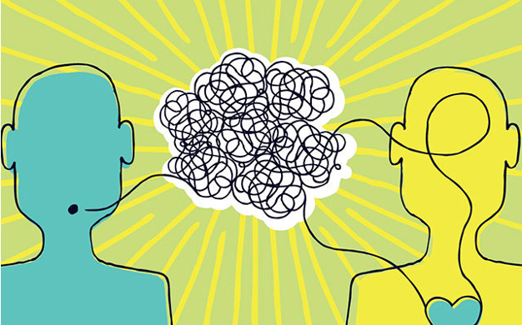
Building Understanding
Confidence
& Autonomy
Notes:
So if now you’re feeling self-conscious about your RR, I’m here to show you that there is another way. Today I’m going to share a couple tools with you that you can use to help your child feel understood, confident, and in control. These are all techniques that can feel a little awkward to the first time you try it, but over time they become very natural. And by the way I do this with my own kids.

Slide 14

Tool #1: Reflections
Convey empathy and careful listening
Notes:
Reflections are a simple action someone can do to “mirror” what the individual is feeling back to them. Reflections show that we can listen – REALLY listen – without focusing on what we want to say next or trying to cut off a conversation because it makes us nervous or mad. Actually, when someone make you nervous or mad, reflections become an especially useful way to slow down and change lanes.

Slide 15
What is a Reflection?
A Statement, Not a question
Specific – not generic
Repeat back what you heard the person say, or guess at the feelings beneath
Helps the person:
  Feel understood and accepted,
  Hear their words think a little deeper about what they meant.

Slide 16
Types of reflections
Simple: repeat back what you heard
Complex: reflect the “gist” or overall meaning
Feeling: name the emotion you’re hearing
2-sided: On the one hand... but on the other...

Slide 17
Reflections Don’t Judge
Reflections are different from praise – they don’t evaluate whether someone met expectations
Reflections don’t indicate whether you agree/disagree
As we get older, we like appreciation (“thank you”) more than evaluation (“good job”)

Slide 18
Reflection ExampleS
All my friends do it. So, it’s not a big deal. Just get off my back, okay?
Simple: You feel like it’s not a big deal.
Complex: Smoking seems normal to you.
Feeling: My concerns are annoying to you.
I hate school.
Simple: You hate school.
Complex: School has been tough lately.
Feeling: You’re feeling down.
Notes:
You might worry that using a reflection will make it seem like you’re agreeing with or accepting the other person’s version as the “whole truth.” But a reflection won’t do that – you’re simply showing that you’re interested in hearing side of the story, even if your perspective is different.

Slide 19
Reflections Practice
Type a reflection into the chat:
Therapy is dumb.
Marijuana is an organic remedy.

Slide 20
Tool #2: Asking Curious Questions
Get curious about another’s perspective and values
Notes:
Asking nonjudgmental questions shows that you respect and want to hear their perspective.

Slide 21
Question Examples
I’m not going to see that doctor again.
What happened last time you met with her?
Help me understand where you’re coming from.
What do you see as the pros and cons?
OPEN ENDED QUESTIONS get people talking
Notes:
These are NOT “socratic” questions that you are asking to prove a point. In order for this to work, you have to be coming from a place of genuine curiosity.

Slide 22
Open vs. Closed Questions
Instead of this (Closed)
Are you feeling better today?
Did you take your medications?
Are you going to go to your therapy appointment today?
Try THIS (Open)
What did you do today?
What’s going on with your medications?
How has therapy been lately?
What do you see as the pro’s and con’s of meeting with your therapist today?
Notes:
So, imagine you need to have a conversation about whether IP has been attending therapy appointments and taking medications that their doctor prescribed. Not a fun conversation. Start with a no-judgment, open-ended question to get them talking. Remember, we want them to feel understood, confident, in control. They won’t feel understood until they have a chance to let us know, from their own perspective, what’s going on.

Slide 23
Questions Practice
Type an open-ended question into the chat:
Therapy is dumb.
Marijuana is an organic remedy.

Slide 24
Time to Practice!
Tell me more about why you quit dancing.

Slide 25
Listen as this Parent:
Reflects key points and values
Asks an open-ended question
Listens as Simone finds some unexpected motivation!
Encourages her to pursue her own idea
Notes:
BY the way I’ve listened to Simone have this basic conversation with maybe 20 people – her enthusiasm here is 100% real here. Often the conversation ends with her kind of getting a little annoyed and going, “Okay, well, I’ll think about that I guess.”

Slide 26
Research Results

Slide 27
Research Questions
Will caregivers want to learn these skills?
Is this kind of training feasible using remote technology?
Can this program help parents to feel less stressed and better about themselves as parents?
Can this program help families have less conflict and more fun?
Can a brief program make a lasting difference?

Slide 28
Participants (n = 131)
82% women (moms, grandmas, a few sisters), 18% dads
78% White, 6% Asian, 8% Black, 8% other or more than one race
7% Hispanic/Latino
Average age of 53 (kids ranged from 14-30)
54% reported that their child had experienced psychosis
60% reported their child had at least one previous psychiatric hospitalization
49% reported that child was abusing drugs or alcohol

Slide 29
MILO for Early Psychosis: 2-Phase Trial
Phase 1: Feasibility
30 participants “open label” MILO
May - Dec 2020
Phase 2: Efficacy
40 participants “mini RCT”
20→ immediate intervention
20→ 6-week waitlist (crossover design)
Jan 2021-April 2022

Slide 30
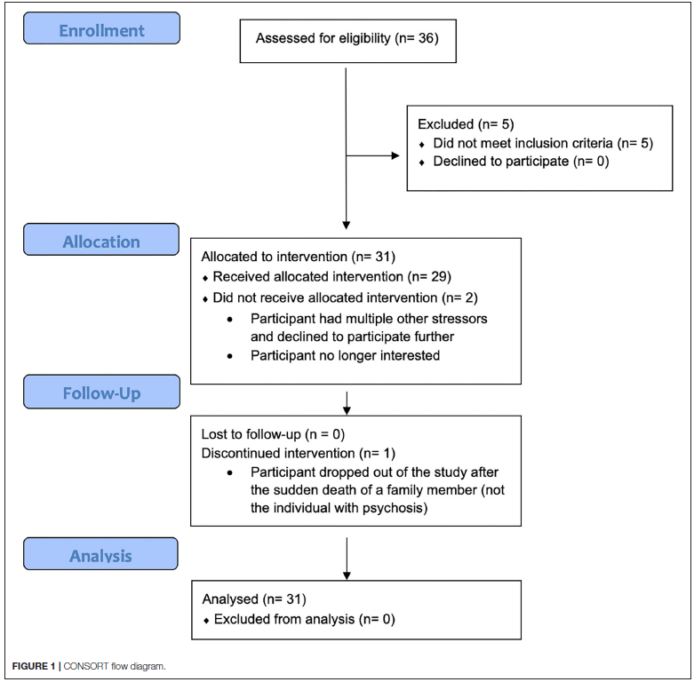
Study 1: Feasibility
Aims: learn whether caregivers would sign up for MILO, attend multiple sessions, find the content relevant and useful, and get their suggestions for improvement

Slide 31
Feasibility
High interest from parents
Telehealth expanded accessibility for many
No one dropped out after 1 session, and almost everyone attended the full course
Of the 29 participants who did 3+ sessions, 28 did post-MILO assessments

Slide 32
Satisfaction
Twenty-five of the 28 participants who completed post-intervention assessments reported that they had used the skills they learned
Twenty-six out of 28 participants who completed post-intervention assessments reported that they would “definitely” recommend the service to a friend in need of similar help
  And a lot of them did!

Slide 33
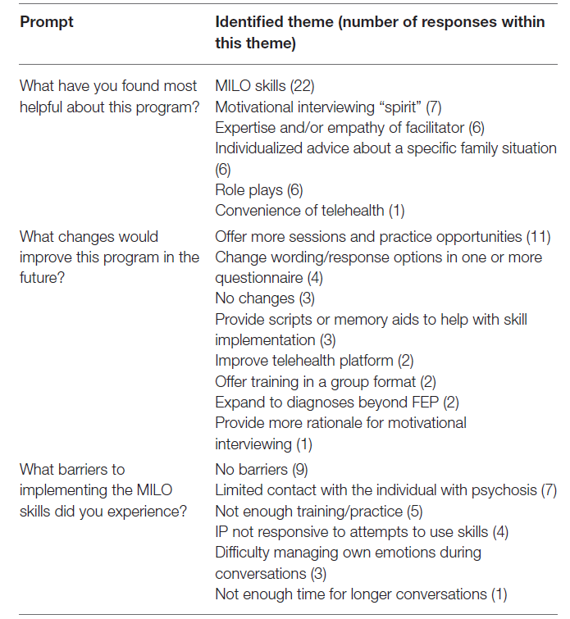
What did participants think about MILO?

Slide 34
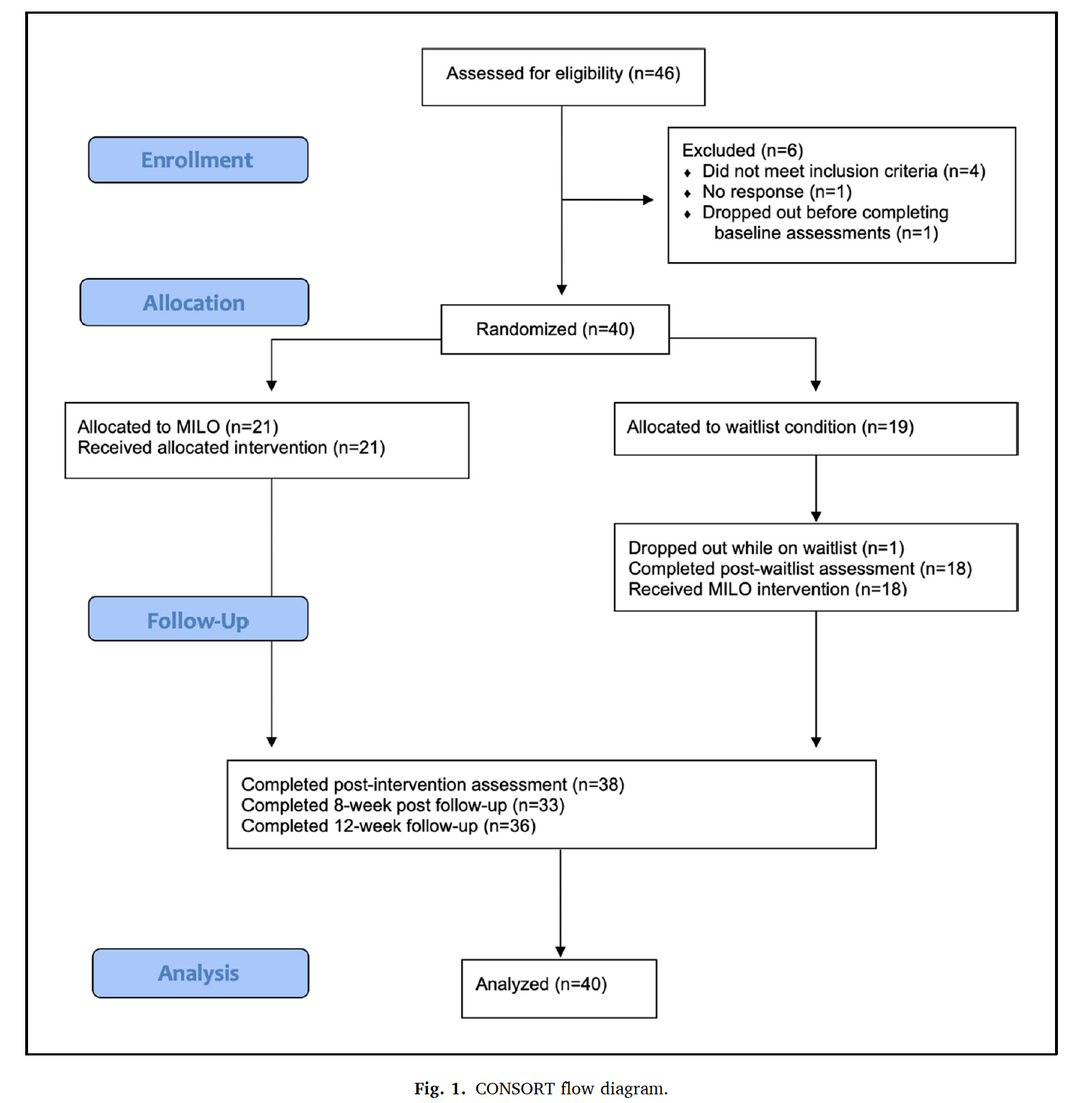
Study 2: Efficacy
Aim: compare MILO to waitlist control

Slide 35
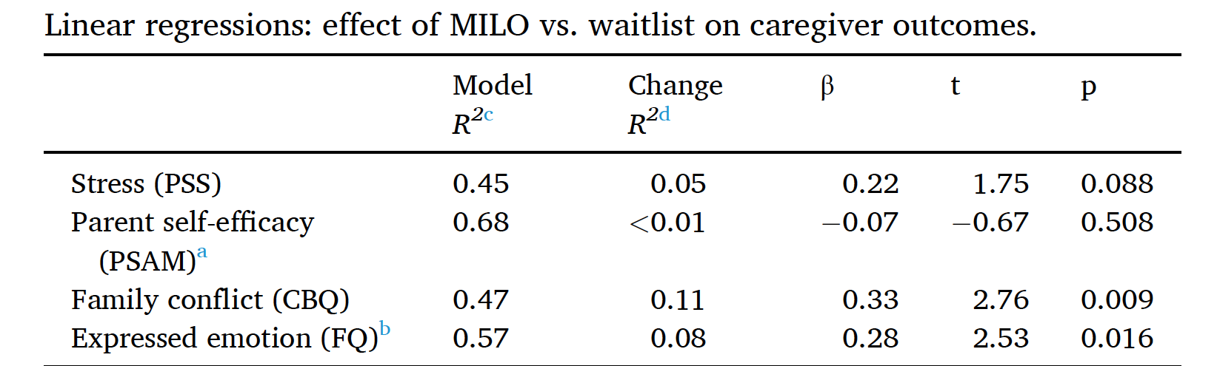
MILO vs. Waitlist
Caregivers who did MILO reported significantly less conflict and expressed emotion than those who did waitlist.
Trend effect for stress.

Slide 36
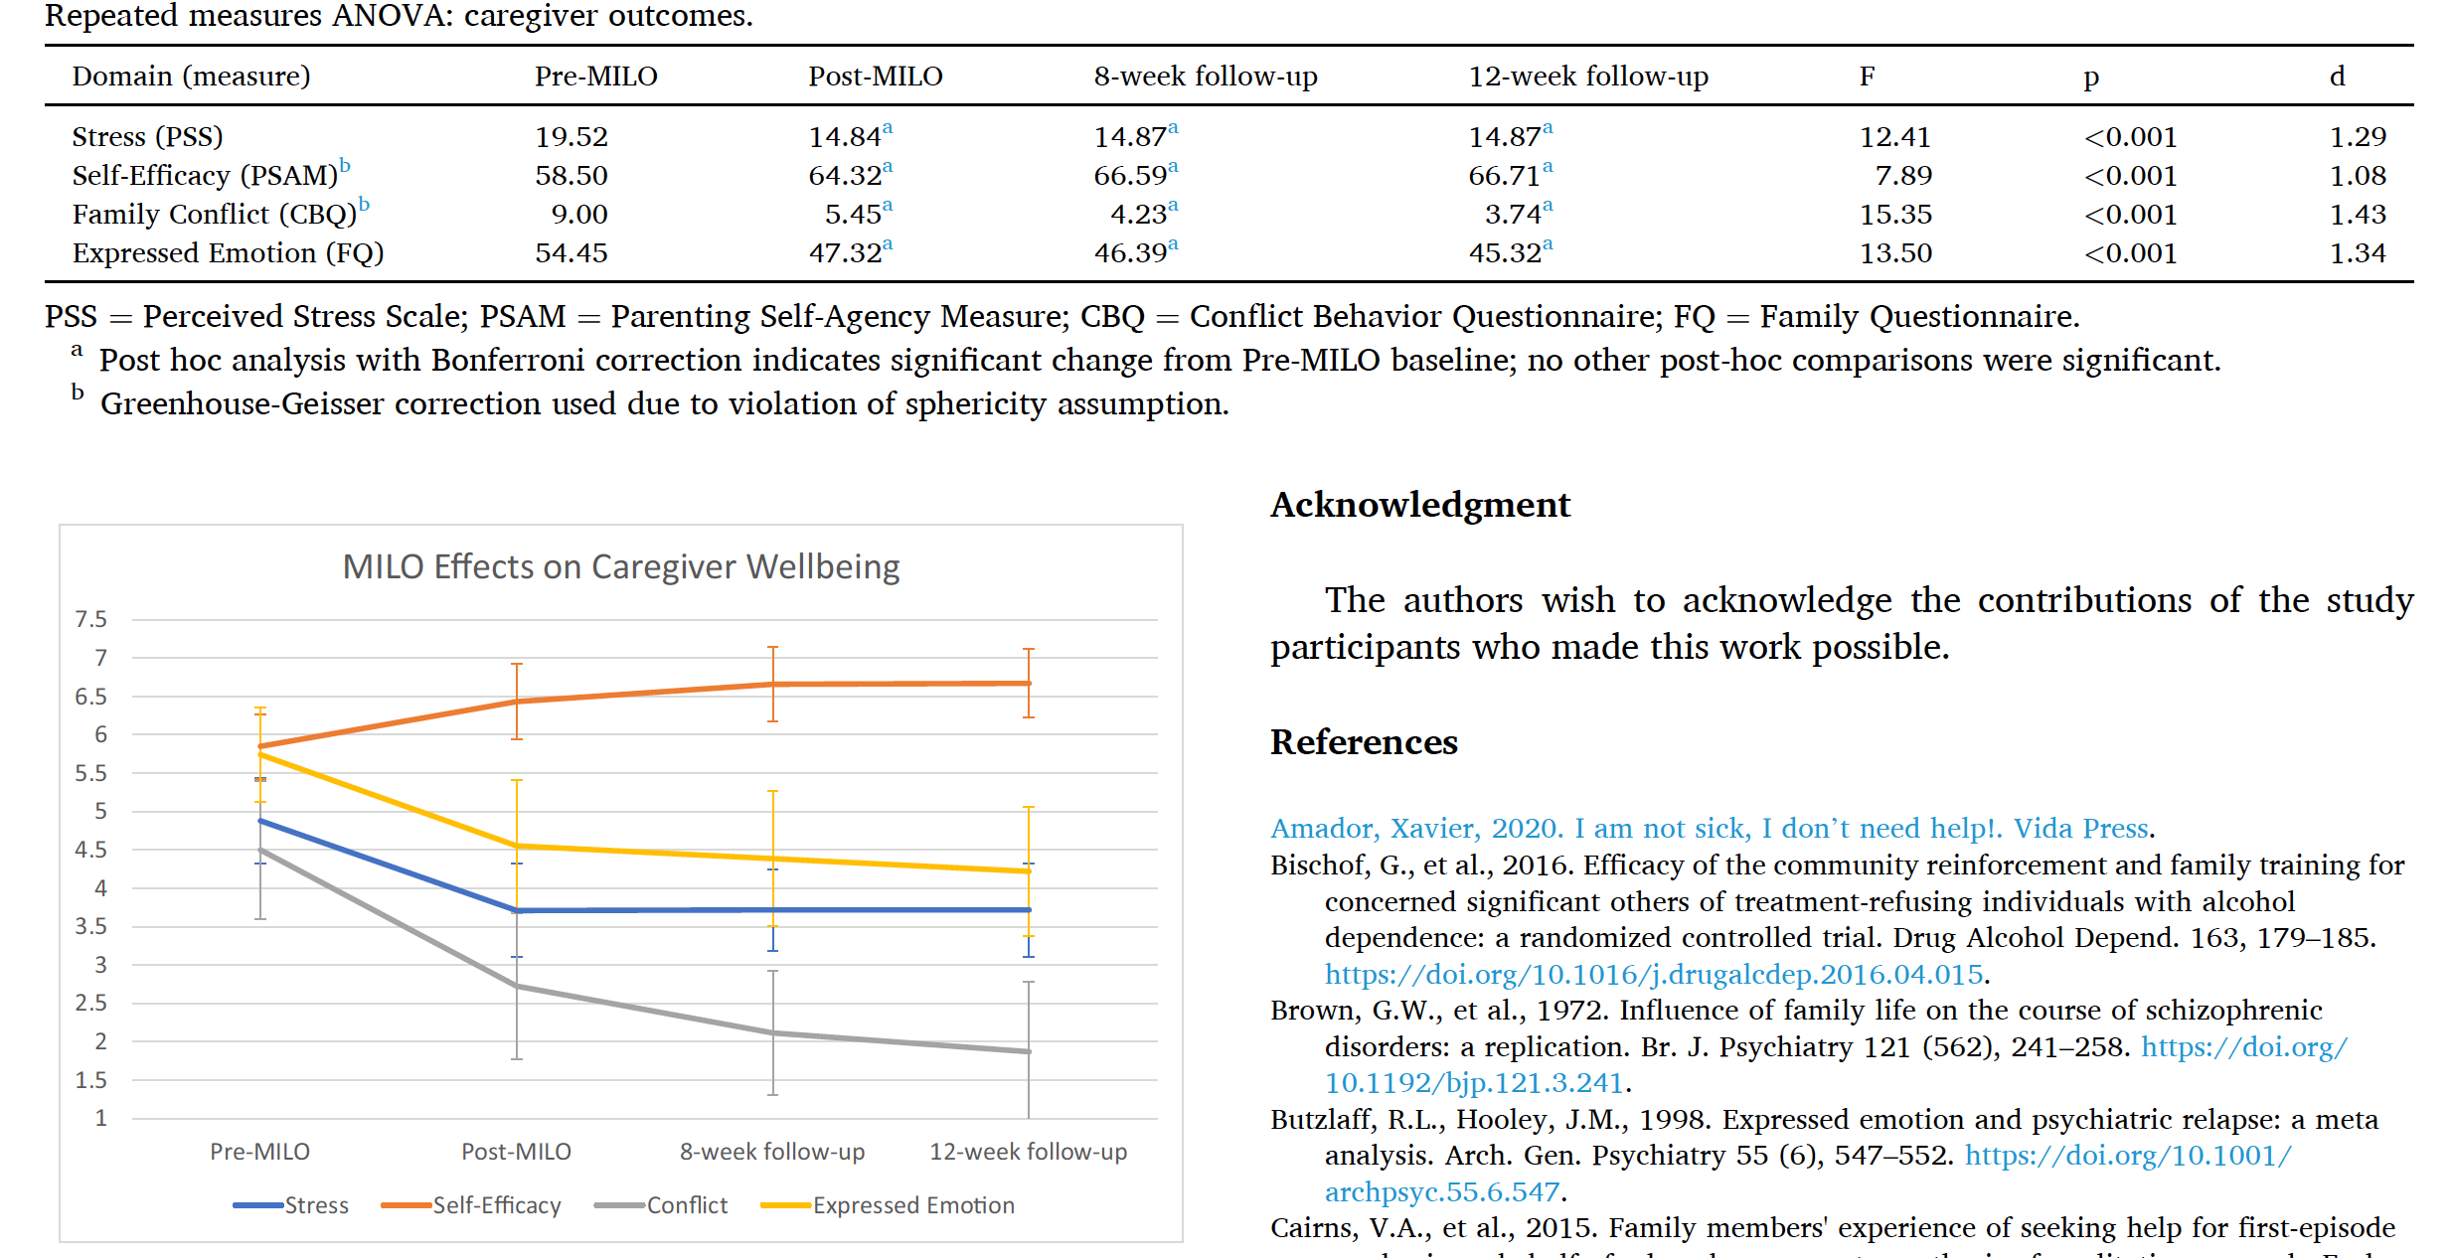
IMPACT OVER TIME
Large effects in all caregiver domains
Effects stable or continuing to improve after 8,12 weeks

Slide 37
Study #3
Group format (6-10 participants x 8 hours)
Transdiagnostic population
Hybrid feasibility-effectiveness design

Slide 38
Participants (N = 62)
Caregivers of youth ages 14-24 with a wide range of psychiatric diagnoses were invited to participate in this pilot trial
The top behavioral concerns were defying rules (64%), substance use (41%), and difficulty with schoolwork (38%).
Regarding psychiatric diagnosis, 20% reported that their child had no diagnosis and 80% reported one or more diagnoses (including anxiety disorders, uni- and bi-polar mood disorders, ADHD, and PTSD)
Nearly half (43%) reported that their child had at least one prior overnight admission to a psychiatric unit for treatment, and nearly all (97%) reported that their child had received some form of therapy for mental health concerns

Slide 39
Participants
93% Mom/Stepmom/Grandma, 7% Dad
56% Married/Cohabiting, 44% Single
79% White, 2% Asian, 11% Black, 8% other or more than one race
10% Hispanic/Latino
Average age of 53 (range 34-77)
92% lived with child at the time of the training
43% reported their child had at least one previous psychiatric hospitalization
31% received DMH services for their child

Slide 40
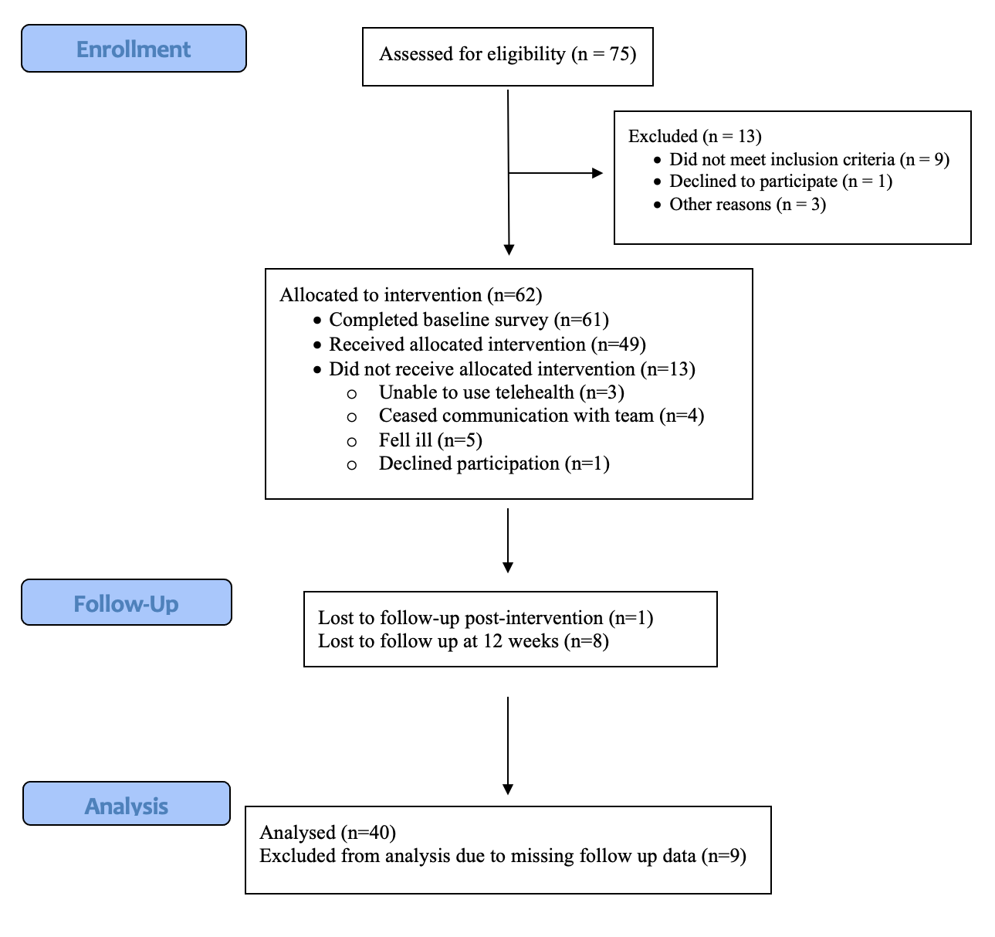
Retention/Feasibility
80% of participants who enrolled attended at least five hours of group training and 59% attended all eight hours.

Slide 41
Quantitative Outcomes
Participants’ motivational interviewing skills (assessed via direct observation) improved significantly
A repeated measures ANOVA indicated significant and large effects on all four outcomes of interest (stress: F [2,78] = 13.15, p<.001; confidence: F [2,62] = 10.70, p<.001; expressed emotion: F [2,64] = 20.09; p<.001; and conflict: F [2,78] = 13.20, p<.001).

Slide 42
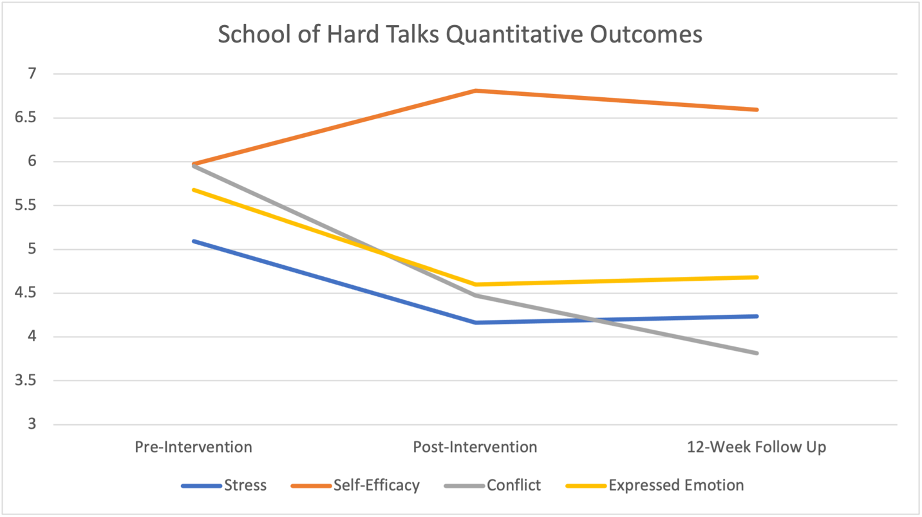

Slide 43
“What’s the most important change you’ve noticed since [learning MILO skills]?”
The children are willing to listen to me, not just dismiss what I am saying.
Conversations are not as intense or volatile. I have skills that help me cope and thus, help my children.
I find that I hold back on criticizing my child for her decisions and instead I try to find out from her what her motivations are by asking "curious questions" rather than "judging".
I think I have more productive discussions with my children and that makes me feel better about myself and as a parent.

Slide 44
Did participants master the skills?
For the most part, yes! (75% attained “proficiency”)

Slide 45
Sample Items
Expressed Emotion: My child does not appreciate everything I do for them.
Stress: In the last month, how often have you felt that you were unable to control the important things in your life?
Confidence: I know I am doing a good job as a parent.
Conflict: For the most part, my child likes to talk to me.

Slide 46
RESEARCH Conclusions (so far)
After a brief training, family caregivers can master some basic MI skills that will give them more confidence in handling challenging conversations
MI helps parents manage their role as caregivers to teens and young adults struggling with mental health
Often the young person is ambivalent about involvement with mental health services – but we can be more creative in finding ways to support those who are motivated (parents, caregivers, partners)

Slide 47
Want to learn more?

Slide 48

Resource #1: Book

Slide 49
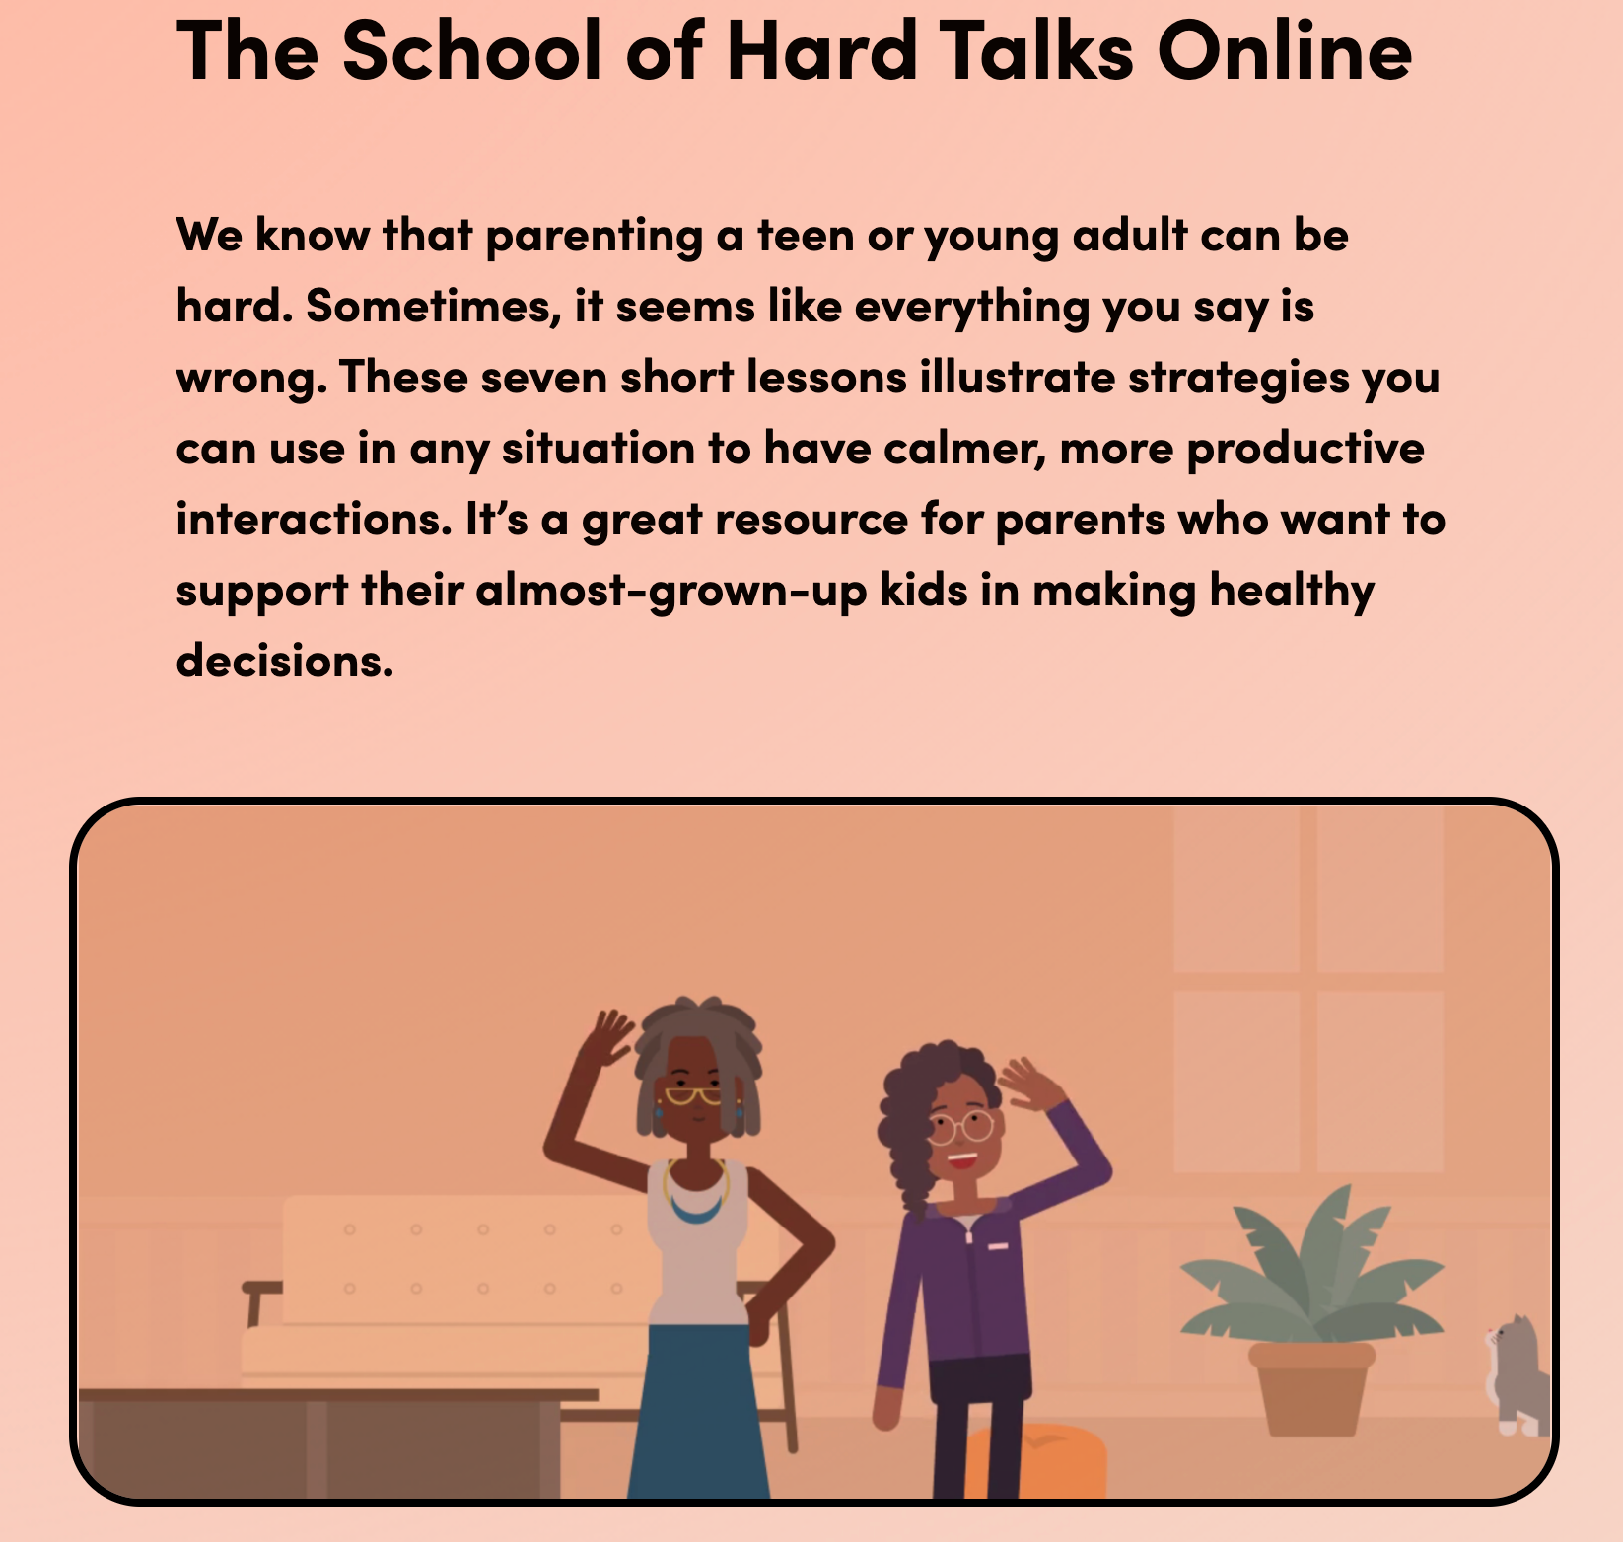
Resource #2: E-Course
FREE E-Course at: https://handholdma.org/what-can-i-do/the-school-of-hard-talks-online-lessons-from-motivational-interviewing-for-everyday-families
(Or just google “School of Hard Talks Online”)
Seven interactive 10-minute e-lessons + take home points

Slide 50
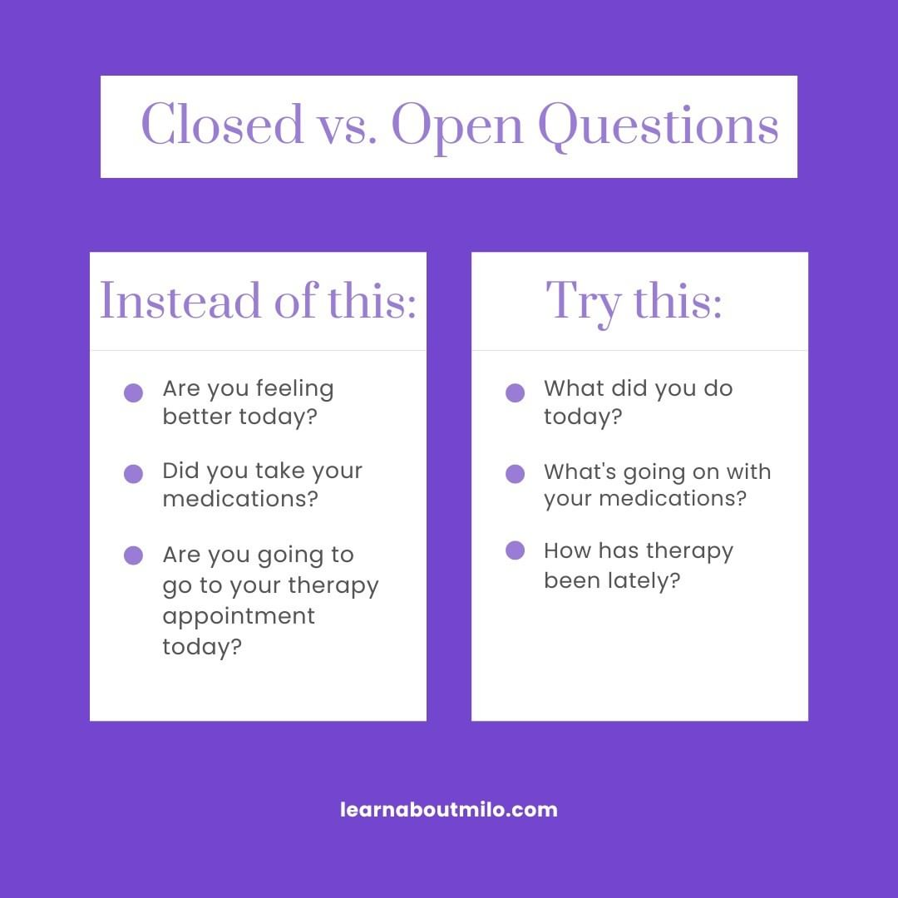
Resource #3: Instagram
Follow @learnaboutMILO to see my students and I demonstrate MI skills, see MI skill flashcards, and learn the results of our research studies

Slide 51
Resource #4: MILO Clinic
Piloting at Boston Medical Center learnaboutmilo@bmc.org

Slide 52
Thank you!
MAPNET
MILO team: Heather Thibeau, A. Simone Sanders, Beshaun Davis, Alicia Fenley, Emily Barnard, Bediha Ipekci, Jada Gibbs, Vicky Zheng
BIDMC Mentors: Matcheri Keshavan, Shirley Yen
DMH partners: Kelly English, Theresa McIntyre, Margarita O’Neill-Arana
UMass Donohue Institute: Dana Remian
DMH parent partners & Home for Little Wanderers
And most of all… the amazing caregivers who participated in this research!

Slide 53
References
Davis, B. J., Fenley, A., Sanders, A., Ipekci, B., Thibeau, H., Khan, T., ... & Kline, E. (2023). Development of the motivational interviewing for loved ones skills assessment (MILO‐SA). Early Intervention in Psychiatry.
Kline, E. R., Thibeau, H., Davis, B. J., Fenley, A., Sanders, A. S., Ipekci, B., ... & Keshavan, M. S. (2022). Motivational interviewing for loved ones: Randomized controlled trial of brief training for first episode psychosis caregivers. Schizophrenia Research, 250, 43-49.
Kline, E. R., Thibeau, H., Sanders, A. S., Davis, B. J., Fenley, A., McIntyre, T., ... & Keshavan, M. S. (2022). The School of Hard Talks: A telehealth parent training group for caregivers of adolescents and young adults. Early Intervention in Psychiatry.
Kline, E. R., Thibeau, H., Sanders, A. S., English, K., Davis, B. J., Fenley, A. R., & Keshavan, M. S. (2021). Motivational interviewing for loved ones in early psychosis: development and pilot feasibility trial of a brief psychoeducational intervention for caregivers. Frontiers in Psychiatry, 12, 659568.
Kline, E. The School of Hard Talks: How to Have Real Conversations with Your (Almost Grown) Kids. (2023). Seattle: Sasquatch Books.

Slide 54
The purpose of the MHTTC Network is technology transfer - disseminating and implementing evidence-based practices for mental disorders into the field.
Funded by the Substance Abuse and Mental Health Services Administration (SAMHSA), the MHTTC Network includes 10 Regional Centers, a National American Indian and Alaska Native Center, a National Hispanic and Latino Center, and a Network Coordinating Office.
Our collaborative network supports resource development and dissemination, training and technical assistance, and workforce development for the mental health field. We work with systems, organizations, and treatment practitioners involved in the delivery of mental health services to strengthen their capacity to deliver effective evidence-based practices to individuals.
Our services cover the full continuum spanning mental illness prevention, treatment, and recovery support.
MHTTCnetwork.org
Sign-Up for Newsletter
MTTC News

