Slide 1
Helping Youth on the Path to Employment
Debbie Nicolellis, Michelle G. Mullen
UMass Chan Medical School
MAPNET, New England MHTTC
May 26th, 2023
Notes:
DO NOT CHANGE THE FORMAT OF THIS TEMPLATE. If you are creating MHTTC-branded slides, you must use this template or one of the other approved templates in the Shared Folder.

Slide 2




Housekeeping Information
Participant microphones will be muted at entry
If you have questions during the event, please use the chat
This session is being recorded and it will be emailed to all participants once available.
If you have questions after
this session, please e-mail:
newengland@mhttcnetwork.org.
At the end of the month, we will send you a certificate of completion that you can submit to your particular board for continuing education credit. Please contact ifisher@c4innovates.com for more information on CEs after the event.

Slide 3
Acknowledgment
Presented in 2022 by the Mental Health Technology Transfer Center (MHTTC) Network.
This presentation was prepared for the New England Mental Health Technology Transfer Center (MHTTC) Network under a cooperative agreement from the Substance Abuse and Mental Health Services Administration (SAMHSA). All material appearing in this publication, except that taken directly from copyrighted sources, is in the public domain and may be reproduced or copied without permission from SAMHSA or the authors. Citation of the source is appreciated. Do not reproduce or distribute this publication for a fee without specific, written authorization from New England MHTTC. For more information on obtaining copies of this publication, email us at newengland@mhttcnetwork.org.
At the time of this publication, Miriam E. Delphin-Rittmon, Ph.D, served as Assistant Secretary for Mental Health and Substance Use in the U.S. Department of Health and Human Services and the Administrator of the Substance Abuse and Mental Health Services Administration.
The opinions expressed herein are the view of TTC Network and do not reflect the official position of the Department of Health and Human Services (DHHS), SAMHSA. No official support or endorsement of DHHS, SAMHSA, for the opinions described in this document is intended or should be inferred.
This work is supported by grants #1H79SM081775 from the Department of Health and Human Services, Substance Abuse and Mental Health Services Administration.
Presented 2022
Notes:
Always use acknowledgment slide on the 2nd slide and add your center’s information

Slide 4
Notes:
Always use Language Matters graphic as your third slide.

Slide 5

Helping youth on the path to employment
Preventing Long-term Disability in Youth and Young Adults through a Specified Career Development Model
Debbie Nicolellis, Michelle G. Mullen
UMass Chan Medical School

Slide 6





Acknowledgements
The mission of the Transitions to Adulthood Center for Research is to promote the full participation in socially valued roles of transition-age youth and young adults (ages 14-30) with serious mental health conditions. We use the tools of research and knowledge translation in partnership with this at risk population to achieve this mission.
Visit us at: https://www.umassmed.edu/HYPE
http://www.umassmed.edu/TransitionsACR
The contents of this presentation were developed under a grant with funding from the National Institute on Disability, Independent Living, and Rehabilitation Research, United States Department of Health and Human Services (NIDILRR grant number A-90DP0063). NIDILRR is a Center within the Administration for Community Living (ACL), Department of Health and Human Services (HHS). The contents of this presentation do not necessarily represent the policy of NIDILRR, ACL, HHS, and you should not assume endorsement by the Federal Government.

Slide 7

Let me introduce myself
Debbie Nicolellis, she/her/hers
Rehabilitation Counselor by trade
Psychiatric Rehabilitation and Supported Employment-trained (BU)
35 years in field
My main focus: career development, valued roles for adults and young adults with mental health conditions
Current role: Training Director for HYPE/Transitions ACR

Slide 8

Representing our team
Dr. Maryann Davis, ED, Transitions ACR, iSPARC
Dr. Michelle G. Mullen, HYPE clinical developer, PI
Dr. Kathryn Sabella, Co-I
Maya Ingram, RPD
Samantha Hersh, RC
Vanessa Wagner, TC
Mei Pearlstein, RC

Slide 9

What we’ll cover today
A short history of HYPE
Foundations and Research
HYPE works to prevent L-T disability
A Specified Model
HYPE’s Executive Functioning Focus
Current research and programs
& lots of Q&A

Slide 10
Helping Youth on the Path to Employment
A Short History

Slide 11
(But first…) What is HYPE?
Helping Youth on the Path to Employment
Comprehensive, intentional service model
Focused on career development for young adults, ages 18-30, living with mental health conditions.
Brings together the best of supported employment and supported education to help young adults maximize their capacity for success in vocational environments

Slide 12
HYPE’s History
Practice-based
HYPE’s “parent” began in 2008 (LEARN: Learning Enhancement and Resource Network)
Integrated SEd into existing SE services
Research-informed
RCT of LEARN began in 2008
NIDILRR funded in 2011/2012
Focused on refining for young adults
Dev’t of Exec. Functioning curriculum (FSST)
Dev’t. and pilot of HYPE Manual in SE svcs

Slide 13
The Development of HYPE
Scoping Review
Survey of Innovative Practices
Qualitative Interviews
HYPE Development Meeting (Consensus Conference)
HYPE Manual & Community of Practice
PAC
NAC

Slide 14

Involving Young Adults
Consensus Conference
Young Adult Advisory Board
Hiring of YA’s with lived experience to team

Slide 15
Further research and development
FSST early studies (Mullen, et.al., 2017; Mullen, in prep) have shown great effect on persistence in school for students with mental health conditions.
HYPE on Campus: Randomized Controlled Trial (RCT) (in analysis): trained graduate students to offer complex intervention to young adult college students with severe mental health conditions on large campus
FSST at Work (current study): studying effect of FSST on young adults who are working at least 20 hours/week to help address barriers to success.

Slide 16
Foundations of HYPE
What inspires us and informs HYPE

Slide 17
Planned Happenstance:
“Creating and transforming of unplanned events into opportunities for learning”
Two components:
Exploration generates chance for opportunities
Skills enable people to take advantage of opportunities
Critical values:
Curiosity: exploring new learning opportunities
Persistence: exerting effort despite setbacks
Flexibility: changing attitudes and circumstances
Optimism: viewing new opportunities as possible and attainable
Risk-taking: taking action in the face of uncertain outcomes (Mitchell, Levin, & Krumbolz, 1999)

Slide 18

Development of Human Capital
Unique set of personal abilities and skills:
  higher education,
  advanced training, and
  special skills.
Typically only gained through employment & education
Associated with both increased labor participation and earnings over time.
A resume is a summary of a person’s human capital.

Slide 19

Rate of Return Education → Earnings
“Rate of return” measures the effect of each extra year of education on earnings.
Each additional year of education returned averages of 9% increase in earnings.
Investing in education at an early age realize greater lifetime earnings.
Particular relevance to transition age youth and young adults, whose education is often interrupted or delayed.

Slide 20
Choose-Get-Keep-Leave Framework
Choose
Get
Keep
Leave
Support decision-making
  Factors Assoc. w/ Change, Goal Plan
Connection/app. to work & school
Keep jobs & schooling through:
  Skill development
  Resource dev’t & coordination
  Accommodations & Assistive Technology
Support leaving environments to enhance earning capacity, human capital development
Employment support approach developed at Boston University (e.g., Danley & Anthony, 1987; Rogers, et al., 2006)

Slide 21
Rationale for Developing HYPE Model
Existing supported employment models achieve only moderate success
Many young adults with mental health conditions become reliant on Supplemental Security Income (SSI)
Existing Supported Employment and Vocational Rehabilitation programs emphasize employment over education
Higher education and working are vital to cultivating human capital
For young adults, being a student and working are age-appropriate roles/activities, yet present unique challenges

Slide 22
Prevention of Long-Term Disability
In young adults with severe mental health conditions

Slide 23
HYPE Prepares YA’s for the
Primary Labor Market
Primary Labor Market
Secondary Labor Market
Higher pay
Benefits
Flexibility
Vacation time
Sick time
Career Mobility
Entry level jobs
Short job tenure
Low pay
No benefits
No vacation time
Typically little flexibility
Tertiary labor markets or “gig” economy offer flexibility, but lack the benefits of the primary market (aka **self-employment)

Slide 24

HYPE: Not your typical supported employment service!
Emphasis on career development – and the fluid movement from work → school
Support higher education pursuits as early as possible.
  Education may become the primary vocational pursuit as compared to rapid job pursuit.
Education is a meaningful and often long process. It is the mechanism by which a person is able to:
  secure the position they want;
  in a field they have chosen; and
  with a salary that can support an adult lifestyle.
  (Mullen et al., in preparation)

Slide 25
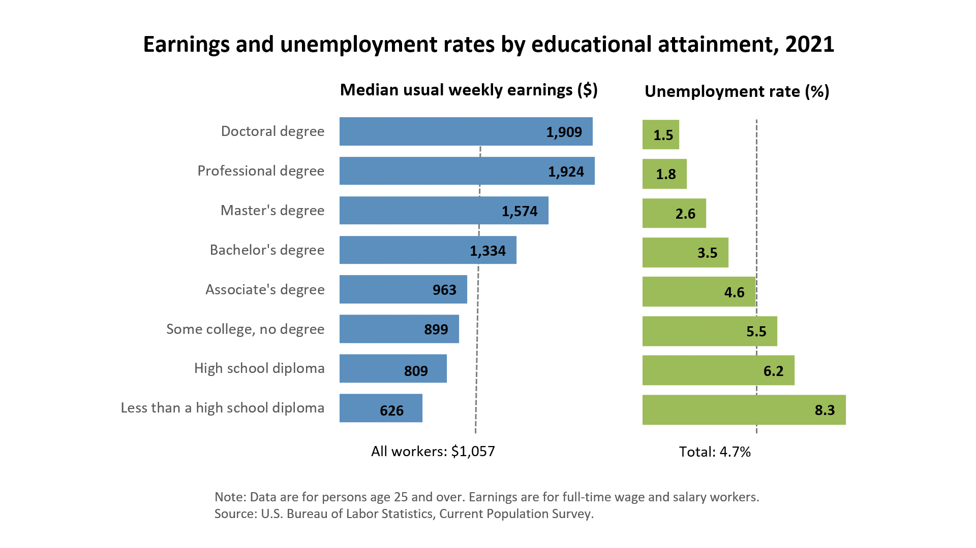
Education Pays (BLS)

Slide 26
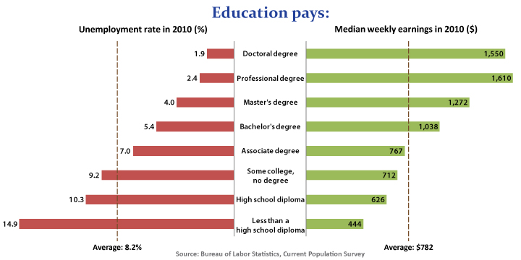
Compare it to 2010

Slide 27
Barriers for Young Adult College Students e.g., YA College students have the highest rate of attrition:
Estimated dropout rate of 86%.
Barriers include:
Mental health symptoms
Poor grades
Lack of support
Financial aid issues
Lack of adequate accommodations
Avoidance of disclosure due to fear of discrimination
Lack of access to specialized services
Mullen et al., 2017; Markoulakis & Kirsh, 2013; Collins & Mowbray, 2005; Mowbray et al., 2001; Manthey, et al., 2015; Kessler, et al., 1995; Salzer, et al., 2008

Slide 28

HYPE Focus
Focuses on maintaining young adult, student and/or worker identity
Actively works against the development of a disability identity
  Aims to prevent the application to/ enrollment in disability benefits
Develops skills and mindset to persist in school and work
  Highly specialized support + executive functioning skill development

Slide 29
A Specified Model
What providers actually do in HYPE

Slide 30
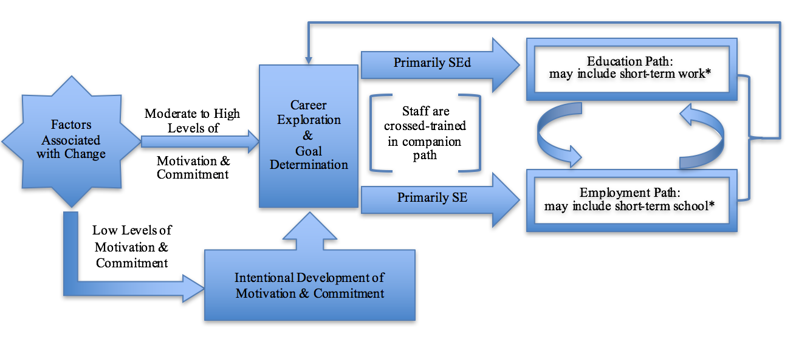
HYPE’s Approach to Service Planning in Community Mental Health

Slide 31
Helping Youth on the
Path to Employment
Skill Development: Executive Functioning + Self-management & self-regulation (persistence) skills
Support Strategies: Emotional Support + Instrumental Support + Informational Support
Self-Assessment: Values Clarification + Exploring Interests & Preferences + Discovering Strengths & Talents
Engagement & Authentic Relationship Development
Critical Factors Associated with Long-Lasting Change: Motivation + Commitment + Awareness
Methodological Focus: Transtheoretical Model + Motivational Interviewing + Choose-Get-Keep-Leave
Emphasis on Educational Development: Degree Attainment is Key for Long-Term Success
Foundation: Supported Emp/Ed ; Psychiatric Rehabilitation

Slide 32
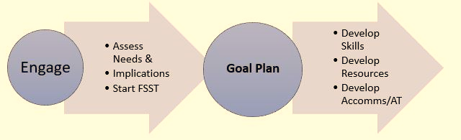
A Simplified “Map” of Services

Slide 33
Assessments of Needs
Student / Worker Needs Checklist
Critical Skills Checklists
Common Resources Assessments
Functional Implications of a MHC
Factors Associated with Change Assessment
  Motivational Factors
  Commitment Factors
  Awareness – Environment
  Awareness – Self
  Support for the Change

Slide 34

Goal Planning
SMART Goal-setting
Goal Planning
  Goal Attainment Scaling
  Milestones
  Tracking
Service Planning
  Provider’s Plan for supporting YA Goals

Slide 35

Development of Skills, Res., Accomms
Specified Skill Dev’t tools and guides:
  Skill teaching lesson plans for common skills
  Supporting Skill Use
  Executive Functioning curriculum with extensive provider guides
Resource Coordination
Supporting the Use of Accommodations

Slide 36
HYPE’s Executive Functioning Focus
Focused Skill and Strategy Training (FSST)
(Mullen, et.al., 2023)

Slide 37
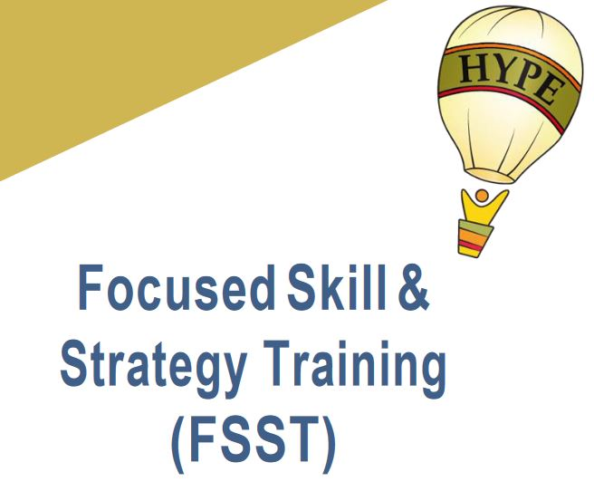
Focused Skill and Strategy Training (FSST)
Manualized compensatory cognitive remediation intervention
  Teaches skills and strategies to compensate for cognitive barriers through coaching
  Reduce impact of impairment and enhancing performance on real-world cognitive tasks
  Modification of Compensatory Cognitive Training intervention for employment (Twamley et al., 2012)

Slide 38

Barriers Endorsed by students in multi-site Supported Ed. Study
Over 70% of respondents:
Concentration (85%),
Time management (77%),
Stamina (75%),
Organization (71%),
Prioritizing tasks (70%)
Over 50% of respondents:
Difficulty memorizing information
Managing psychiatric symptoms
Studying for exams
Taking exams
Preparing for class
Writing papers
Taking notes
Researching information
Meeting deadlines
(Gill, Mullen, et al., 2022)

Slide 39
YA’s Crash & Burn without Executive Functioning Support
With underdeveloped EF skills & strategies, students cannot keep up with the constant demands of student life → prolonged cognitive overload
Results in two potential pathways:
  “Holding on” – “White-knuckling it”
    Finishes semester by sheer will and determination (+supports?)
  “Crash & burn”:
    difficulty finishing semester (e.g., incompletes, poor grades, not finishing final assignment)

Slide 40
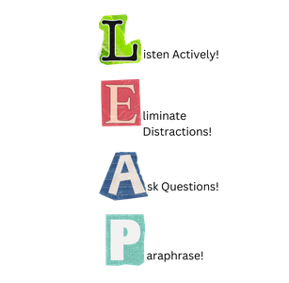
FSST:
Focused Skill and Strategy Training
Gamified, exercise- and discussion-based, facilitated curriculum
12 sessions divided into 4 units, 1 hour per week
  Time and Task Management (Prospective Memory)
  Focus/Attention
  Verbal Learning & Memory
  Cognitive Flexibility & Problem-Solving
Home exercises to support practice and habit formation

Slide 41
FSST’s impact on Academic Persistence
(Mullen, 2022)
Odds of academic persistence were significant (p < .05)
FSST had a very large estimated effect on academic persistence. (d=1.025)
86.52% increased relative odds FAST participants would academically persist (β= 1.895)

Slide 42
HYPE Spinoffs
The HYPE Course – supported by MA DMH

Slide 43

The HYPE Course
Virtual or in-person course series for young adults
6-7 week courses, 1.5 hrs/week
Individual Sessions to help operationalize learnings
Designed similarly to topical seminars

Slide 44
The HYPE Courses
HYPE Career
Decisions
Choosing a career direction with personal and standardized assessment/ planning
HYPE School Prep
Preparing to Choose, Get, and Keep School/ Education
HYPE Work Prep
Preparing to Choose, Get and Keep a job

Slide 45
Sample HYPE Course Topics
Career Decisions:
Career Assessment (SDS) or My Next Move
Conducting Career Research (i.e., Info Interviews.)
School Prep:
Choosing a School, Program, Area of Study
Disability Services and Academic Accommodations
Work Prep:
Your Network and Elevator Pitch
Creating a Work Plan

Slide 46

New Research and Directions:
FSST at Work RCT currently in open trial
Creation of Digital FSST – in beta-test now
FSST for marginalized populations (foster care, etc.)
Training and Technical Assistance

Slide 47

Free online course now available:
Success in Work and School: HYPECareers.org
Engaging Young Adults in Work and School
Coming soon:
Work and School Resources for (You)ng Adults

Slide 48

Questions/Comments/Thoughts

Slide 49

Do Contact us!
Email HYPE@umassmed.edu
OR go to our website: https://www.umassmed.edu/hype/

Slide 50
The purpose of the MHTTC Network is technology transfer - disseminating and implementing evidence-based practices for mental disorders into the field.
Funded by the Substance Abuse and Mental Health Services Administration (SAMHSA), the MHTTC Network includes 10 Regional Centers, a National American Indian and Alaska Native Center, a National Hispanic and Latino Center, and a Network Coordinating Office.
Our collaborative network supports resource development and dissemination, training and technical assistance, and workforce development for the mental health field. We work with systems, organizations, and treatment practitioners involved in the delivery of mental health services to strengthen their capacity to deliver effective evidence-based practices to individuals.
Our services cover the full continuum spanning mental illness prevention, treatment, and recovery support.
MHTTCnetwork.org
Sign-Up for Newsletter
MTTC News

