Slide 1
New England Mental Health Technology Transfer Center (New England MHTTC) SAMHSA #1H79SM081775-01
Yale Program for Recovery and Community Health
in partnership with
C4 Innovations,
Harvard University, Department of Psychiatry, and the Center for Educational Improvement

Slide 2
Competencies for Peer Workers on Crisis Triage Teams
Presented by:
Rowan Willis- Powell (she/they)
& Kris Locus (they/she)
Monday, July 31st, 2023
1:00-4:00pm EST

Slide 3
Who are we?
Rowan Willis-Gorman (She/They) is an experienced behavioral health advocate who is passionate about ensuring that everyone receives appropriate and equitable services when they are experiencing a crisis. They have 10 years of experience working as a peer and using their lived expertise to create and run creative youth programming, lead trainings and advocate. She is considered a Subject Matter Expert in suicide prevention and intervention, behavioral health services, youth work, crisis services, peer support, and rural youth engagement.
Kris Locus (They/She) is a Certified Peer Recovery Specialist and Certified Trauma Recovery Coach. Kris worked as one of the first youth peers for Prince George’s mobile crisis team. They supported the expansion and implementation of new best practices and played a critical role in helping to create a safe and equitable workplace for other peers. In addition to this, Kris also worked in assisting youth and young adults in long-term recovery and stabilization after the initial crisis period by leaning into mutuality and empowerment through a trauma informed lens. During Kris’s involvement, this program went from zero consumers to consistently on or over capacity.

Slide 4
Housekeeping Information
Participant microphones will be muted at entry – you will be able to unmute during the discussion portion of our webinar.
Closed captioning is available for this event. Click on the closed captioning (CC) icon at the bottom of your Zoom screen to select a transcription option.
This session is being recorded and it will be available on the MHTTC website within 24 hours of the close of this presentation.
Information about Certificates of Completion will be sent in a follow-up e-mail.
If you have questions during the webinar, please use the chat or use the “raise hand” feature during discussion to have your microphone unmuted.
If you have questions after
this session, please e-mail:
newengland@mhttcnetwork.org.
Notes:
Part of opening script

Slide 5
Disclaimer:
This publication was prepared by the New England Mental Health Technology Transfer Center under a cooperative agreement from the Substance Abuse and Mental Health Services Administration (SAMHSA). All material appearing in this publication, except that taken directly from copyrighted sources, is in the public domain and may be reproduced or copied without permission from SAMHSA or the authors. Citation of the source is appreciated. Do not reproduce or distribute this presentation for a fee without specific, written authorization from New England Mental Health Technology Transfer Center.
At the time of this release, Dr. Miriam Delphin-Rittmon served as Assistant Secretary for Mental Health and Substance Use at SAMHSA. The opinions expressed herein are the views of the speakers, and do not reflect the official position of the Department of Health and Human Services (DHHS), or SAMHSA. No official support or endorsement of DHHS, SAMHSA, for the opinions described in this presentation is intended or should be inferred. This work is supported by grant #1H79SM081775 from the DHHS, SAMHSA.

Slide 7
Land Acknowledgement
As a committed ally, New England MHTTC recognizes that the New England area is home to the ancestral land of many Native tribes. Consistent with our values of community and inclusion, we acknowledge that all the places our distributed staff live and work, as well as where we provide services and hold events, are Indigenous lands.
To learn which Indigenous tribe(s) to acknowledge for your geographic location, use Native Land Digital.
Adapted from Dekibaota, Elleh Driscoll, Meskwaki and Winnebago Nations Ttakimaweakwe, Keely Driscoll, Meskwaki and Winnebago Nations Keokuk, Sean A. Bear, 1st. Meskwaki Nation
for the Native Center for Behavioral Health
Notes:
Rowan Kris and I are both currently in Piscataway and Susquehannock, and Lee resides on Nipmuc/Pocumtuck/Wabanki Confederacy land.

Slide 8
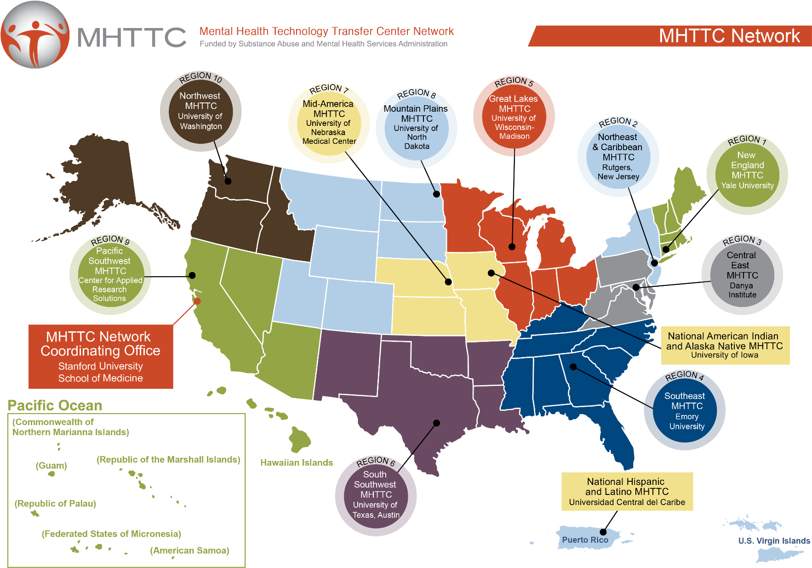
Notes:
Here’s the map showing the location of the regional centers. Note that some of them are co-located with other TTCs, either within the same office and group, such as the National American Indian and Alaska Native ATTC, MHTTC, and PTTC, or at the same institution, such as with the Region 10 TTCs located at the University of Washington.

Slide 9
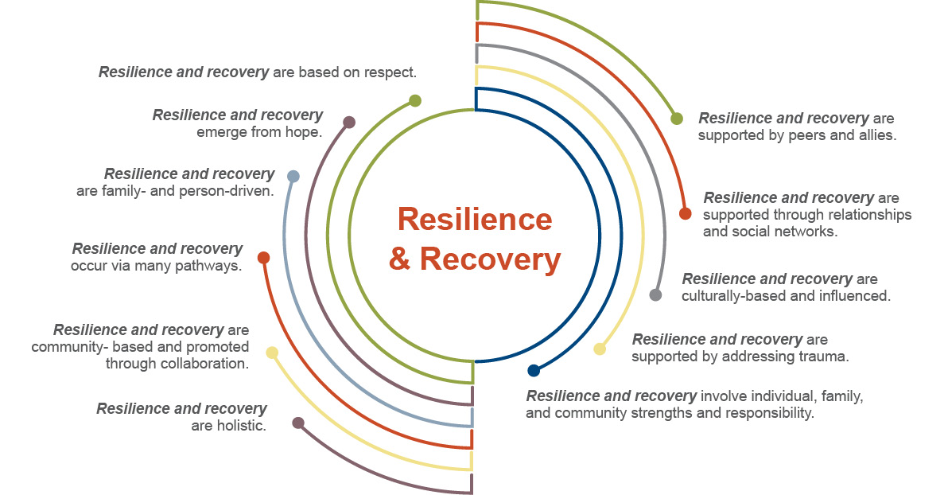

Slide 10
Agenda
Introduction
Overview of Crisis Services and Crisis Competencies
Discussion of where the competencies show up
Case Studies and Breakout Groups
Debrief
Notes:
Good Afternoon Everyone! Thank you so much for joining us! As Lee said I’m Rowan and this is my friend and colleague, Kris Locus. We are both so thrilled to have you here with us to discuss a topic near and dear to our hearts. Collectively Kris and I have 13 years of experience working in peer support.
To introduce yourselves you everyone put in the chat where they’re located, their pronouns and what your favorite self care activity is!
We want this to be a very interactive presentation so please feel free to ask a question when something pops into your mind or come off mute when we ask y’all questions!

Slide 11
What is crisis?
A behavioral health crisis is a subjective experience that can vary depending on many factors. It is important that individuals be given the autonomy to define crisis for themselves, so they can own the experience, direct the service delivery, and maintain their own recovery.
Notes:
Kris

Slide 12
Notes:
Kris

Slide 13
9-8-8 Overview
The 9-8-8 law requires states to enhance the current system’s ability to respond to those experiencing a behavioral health crisis by providing:
Someone to Talk To
Someone to
Go To
Somewhere
to Go
Available 24/7 for calls, text & chat
Peer-run warm lines offering callers emotional support, staffed by volunteers who are in recovery themselves
Mobile crisis response available statewide
Coordination with 9-1-1/ EMS as appropriate
Outpatient community provider response
Crisis receiving and stabilization units
Peer crisis respite (living room models)
Substance Use Disorder (SUD) treatment
Inpatient treatment
Outpatient crisis
Notes:
Kris

Slide 14
How does our crisis system currently work?
Regional Crisis Call Centers (Someone to Talk To)
These centers run 24/7 and provide crisis intervention services via call, text or chat. They support people in immediate crisis and if necessary, offer coordination of crisis care in real time.
Crisis Mobile Team (Someone to Respond)
Mobile Crisis Teams respond to crisis calls in individuals' homes, workplaces, and any community-based location. They provide crisis de-escalation services and connect individuals with additional and ongoing crisis services.
Stabilization Facilities (Someplace to Go)
Crisis Stabilization Facilities provide short-term observation and crisis stabilization services to any and all referrals in a safe and comfortable, non-hospital environment.
Notes:
Rowan- Talk about how peers are involved in every step,
Ask the audience- Do they see elements of al lthese steps in their communitites? Is there anything additional they see in their communitities?

Slide 15
Crisis “System” Past and Present
Over-reliance on law enforcement
Over-reliance on hospital emergency departments
“Psychiatric boarding” in emergency departments
Potentially traumatizing for all involved
Increases risk for violence
Lack of effective responses to crisis
Lack of available needed services & support
Lack of follow-up
Notes:
Rowan-
We still see a lot of these negative aspects popping up- Kris and I are both from Maryland where we see devastating ER wait times for people in crisis, especially children. And we see our system overrelying on hospitals to fill all the cracks. Our foster care system has taken to placing foster youth that they are struggling to place or support in the hospital and then practically abandoning them.
Talk about madeline being in crisis and going to the er for a referal and her traumatic experience
Do any of you still see these elements exist within your local crisis systems?

Slide 16
Principles of Crisis Services
Embracing recovery
Significant role for peers
Trauma-informed care
Suicide-safer care
Safety/security for staff and consumers
Crisis response partnerships
with law enforcement
National Guidelines for Behavioral Health Crisis Care, SAMHSA, 2020, p. 26
Notes:
Rowan

Slide 17
Peer Roles in Crisis Services
Peer support specialist/recovery coach in ED
Peer support provider on inpatient unit
Peer support on a crisis warmline/hotline
Staff in peer-run residential respites
Peer support provider on mobile crisis teams
Peer support provider in crisis care center
Outreach/Harm reductionist
Outreach team member
Staff in peer-run drop-in centers
Notes:
Kris

Slide 18
Peer Roles in the Crisis Care Continuum
Notes:
Kris

Slide 19
Peer Roles in the Crisis Care Continuum
Crisis Prevention | Crisis Response | Post-Crisis Care
Individual peer support Peer support groups Peer-run residential respite Peer drop-in center | Crisis Call Centers Mobile Crisis Services Crisis Receiving and Stabilization Programs Peer-run Respite Programs | 1-to-1 peer support Peer support groups Peer navigation services Community participation
Notes:
We can organize peer support roles across the continuum of crisis care from crisis prevention services, through crisis responses and post-crisis support. Not every behavioral health care system has the whole continuum of care for people experiencing crisis but that is the goal –that people in every community in the US has access to crisis care along the continuum of prevention-response-and post-crisis care.
PREVENTION
Peer support can help a person learn strategies for preventing or managing crisis. Some peers help people build a wellness toolkit or a wellness plan –these plans can include harm reduction strategies in addition to self-care
CRISIS RESPONSE
These services are activated when a person experiences a crisis-most communities have or are developing mobile crisis teams to take pressure off law enforcement and hospital emergency departments.
POST-CRISIS CARE
Post-crisis care may also include clinical and treatment services for the person. Peer support also plays a big role by providing support and navigation services. People are vulnerable post-crisis and often need additional support and resources to recover

Slide 20
What qualities do you think peers bring to crisis work?
Notes:
We can organize peer support roles across the continuum of crisis care from crisis prevention services, through crisis responses and post-crisis support. Not every behavioral health care system has the whole continuum of care for people experiencing crisis but that is the goal –that people in every community in the US has access to crisis care along the continuum of prevention-response-and post-crisis care.
PREVENTION
Peer support can help a person learn strategies for preventing or managing crisis. Some peers help people build a wellness toolkit or a wellness plan –these plans can include harm reduction strategies in addition to self-care
CRISIS RESPONSE
These services are activated when a person experiences a crisis-most communities have or are developing mobile crisis teams to take pressure off law enforcement and hospital emergency departments.
POST-CRISIS CARE
Post-crisis care may also include clinical and treatment services for the person. Peer support also plays a big role by providing support and navigation services. People are vulnerable post-crisis and often need additional support and resources to recover

Slide 21
What qualities do Peers bring to crisis work?
Empathy
Hope
Shared Experiences
Example of Recovery
Knowledge of Behavioral Health Systems
Knowledge of Recovery Pathways
Notes:
Talk about how peers are involved in every step

Slide 22
What ethical guidelines do you think are a priority when working as a Peer in crisis services?
Notes:
Rowan

Slide 23
Ethics in Peer Crisis Work
Prioritize the choice and voice of the Peer I am supporting
Ensure that my team is providing focusing on autonomy
Identify and recognize personal issues and topics that may impact my ability to act as a peer in a crisis setting
Maintain a self-care practice
Practice creating healthy boundaries with Peers
Advocate for continued education on crisis topics among my team
National Guidelines for Behavioral Health Crisis Care, SAMHSA, 2020, p. 26
Notes:
Rowan- Talk through each. Give examples
What is an element of your self care practice?
Talk about expereicne with Annabel in the hospital with autonomy and the doctor interactions
What are topics that may impact your ability to act in a crisis setting? – I know that when hospitalization is involved I can be a bit biased so I have to check myself with that

Slide 24
Core Competencies for Peers in Crisis Work
Notes:
Rowan

Slide 25
Core Competencies for Peers in Crisis Work
Engaging people in crisis in empathic and supportive relationships
2. Developing connection
3. Supporting people experiencing crisis to participate in making decisions
4. Advocating for self-determination
5. Promoting team resiliency
Notes:
Give overview of how these core competencies were created
We conducted a thorough literature review on peer support in crisis service settings, conducted expert panel of 18 peer leaders from across the expert and spoke about their perspectives on peer support roles within the continuum of crisis care environments, conducted 15 interviews with people working as peers in crisis service environemtns. These interviews were focused on actual tasks and skills used by the peers in their roles. Drafted the core competencies out of all of that work.

Slide 26
Engaging people in crisis in empathic and support relationships
Core peer support skills
Listening
Empathetic responding
Expressing curiosity
Non-judgmental stance
Calming strategies
Non-coercive language
Non-threatening body language
Centering yourself
Demonstrating positive regard
Notes:
Kris

Slide 27
Engaging people in crisis in empathic and support relationships
Where might this core competency
show up in practice?
During intakes or when first meeting a Peer, using empathic body language and facial expressions to ensure they feel supported and heard.
Asking supportive and curious questions when trying to learn more about a Peer and what circumstances may have led them to be in crisis.
Ensuring that you focus on the needs and wants of the Peer you are supporting and try to meet their goals and needs.
Notes:
Kris

Slide 28
Developing Connection
Developing the skills to quickly build rapport and connection in a short time frame
Using active listening to fully understand a person and their unique situation
Sharing your story when appropriate
Focusing on strengths and skills
Notes:
Kris

Slide 29
Developing Connection
Where might this core competency
show up in practice?
When first meeting a new peer, whether that
be on a crisis call in the community or at a stabilization center.
When attempting to help someone stabilize and calm down.
Notes:
Kris

Slide 30
Supporting people experiencing crisis to participate in making decisions
Listening for understanding
Person’s preferences, needs, and resources
Expanding options
Brainstorming options
Natural supports
Planning for resolution
Notes:
Rowan

Slide 31
Supporting people experiencing crisis to participate in making decisions
Where might this core competency
show up in practice?
Advocating for a peer’s choices and
goals in recovery as they navigate the crisis system.
Ensuring that other members of the crisis team acknowledge and try to work towards the peer’s goals.
Supporting the peer in brainstorming options when seeking services, sharing your knowledge about the crisis system to help them find the best fit for them.
Notes:
Rowan- Does anyone have an example of where they’ve seen this competency show up in a crisis scenario they’ve been in?

Slide 32
Advocating for self-determination
Expressing curiosity about team choices
Upholding person-centered principles and peer practices
Presenting other options
Notes:
Rowan- Talk about how my mother really highlighted this skill when I was in crisis as a kid

Slide 33
Developing Connection
Advocating for self-determination
Where might this core competency
show up in practice?
Reminding team members that choice and voice needs to be the priority when providing services
Support your team in focusing on person-centered principles and educate them on peer best practices.
Ensure that all options are presented to a peer when they are making a choice.
Notes:
Rowan

Slide 34
Promoting Team Resiliency
Engage in excellent self-care for work
Connect with colleagues
Participate in team meetings, including debriefings
Notes:
Kris

Slide 35
Promoting Team Resiliency
Where might this core competency
show up in practice?
Talk about self-care openly and often as a team and encourage team members to bring up self-care with peers.
Building rapport with team members can make collaboration when supporting peers easier and more fruitful.
Notes:
Kris

Slide 36
Knowledge into practice
Read the Case Study as a group and discuss where the competencies show up and how
Breakout groups
of 3
Notes:
Rowan

Slide 37
1. Toulouse is 29 years old and has struggled with passive and active suicidal ideation for most of their life. They’ve spoken about this at length with their current therapist and have set up ways to check in with their partner and mother about when they need additional help. They’ve been struggling more recently as they’ve begun a new job, which is a night shift at a tech support company. Their suicidal ideation has become more active and intense as they’ve been having a hard time adapting to a new sleep schedule, and a recent fight with their partner has caused them to spiral and make a plan to end their life. Toulouse decided to reach out to their therapist, who then called mobile crisis to come and check in on them. Toulouse is firm that they do not want to go to a hospital but agree that they need some kind of support.
How would you support Toulouse through this crisis?

Slide 38
2. Charlise is a 50-year-old woman who works as a lawyer, has a wife and two children. As one of her children has recently started to experience some behavioral health struggles in school and it’s been stressful for the entire family. Charlise in particular has been struggling and has been having a difficult time finding healthy coping skills. She’s begun drinking and has started to self harm in moments of intense stress. These coping skills calm her down immensely but make her feel incredibly guilty and shameful afterwards. After drinking to excess and cutting herself to a potentially dangerous degree, Charlise asks her wife to take her to the emergency room to receive medical care. You are called in to meet them at the emergency room.
How would you support Charlise through this crisis?

Slide 39
3. Devon is a new team member on a mobile crisis team. He has been working as a certified Peer Support Specialist for 5 years and recently finished a training on crisis situations. Since he started work 8 weeks ago his team has engaged in numerous high stress and triggering situations, including one which involved an individual in an intense state of crisis that was very verbally combative with the team. Devon is very aware that his team is approaching burn out and is worried that another high stress crisis situation could push them all too far.
How would you support Devon and his team in this situation?

Slide 40
4. Sarah is 67 years old and has been homeless for 25 years. Before becoming homeless she worked as a teacher and was married to her husband since she was 23. During most of the year she avoids the shelters due to a previous trauma that had occurred at one when she first started experiencing homelessness. It’s the middle of the summer and it’s reached a dangerous heat. A homeless outreach worker has called your mobile crisis team to ask that you help her convince Sarah to go somewhere indoors with air conditioning. When you arrive, Sarah is very activated and upset, and seems unwilling to speak to your team. She is insisting that she cannot go to a homeless shelter.
What can you and your team do to help Sarah?

Slide 41
5. Alden responds to a crisis situation with his team where there are multiple individuals who are experiencing high levels of distress and fear due to a sudden loss of a family member. When they arrive on the scene there are multiple emergency personnel including Police, EMT’s and Firefighters there as well as many bystanders watching near by. Alden and his team can hear one of the individuals screaming at bystanders for watching, clearly upset by the large number of people involved and the chaos of the scene.
How would you recommend Alden proceed in this situation?

Slide 42
Debrief
Where did you notice the competencies showing up?
Did you feel like you could
utilize the competencies
in these scenarios?

Slide 43
What tools and practices do you think could help you increase your skills in these competencies?

Slide 44
Tools and Practices
Roleplaying crisis scenarios with teammates.
As a team practice communication skills via roleplaying or games.
Practice explaining your role to family members and friends. Orient them to what role you play.
Network with other providers, increase your ability to be the connector and navigator.
Further develop your understanding of the service system in your area, and what virtual options exist.

Slide 45
Slide: Incoming Listening Sessions

Slide 46
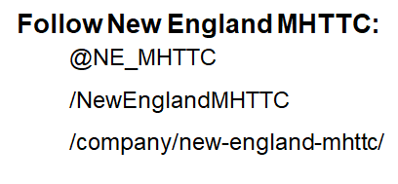
Sign up for our newsletter!
Complete Our Evaluation
Scan the QR Code or follow the link below:
https://ttc-gpra.org/GPRAOnline/GPRASurvey.
aspx?id=412990&type=PostEvent

Slide 47
Contact New England MHTTC
Website: https://mhttcnetwork.org/centers/content/new-england-mhttc
Email: newengland@mhttcnetwork.org

