Slide 1
Medical Comorbidities & Strategies to Support Physical Health for FEP Clients
Kim T. Mueser, PhD
Professor of Occupational Therapy,
Psychology
Center for Psychiatric Rehabilitation
Boston University
[Thanks to Sarah Pratt for use of some slides in this presentation]

Slide 2
Disclosure
All my clothes were made by my son, J. Mueser
Bespoke Hand Tailored Suits and Shirts, with stores in New York City:
J. Mueser
19 Christopher St.
New York, NY 10014
(347) 982-4382
http://jmueser.com

Slide 3
Physical Health in FEP Clients
Correll et al. (2015) study of RAISE-ETP baseline sample (N=404)
Primary focus on cardiometabolic risk in FEP
Average age: 22 years, 71% male, < 3 months prior antipsychotic treatment
Evaluated body composition and fasting lipid, glucose, and fasting parameters
Compared physical parameters with norms from general population

Slide 4
Findings from Correll et al. (2015)
26% overweight, 22% obese
51% smokers (M>F)
40% prehypertension (M>F); F more likely than M to be prescribed antihypertensive medications (7% vs. 2%)
10% hypertension
57% dyslipidemia
16% prediabetes, 3% diabetes (F>M)
13% metabolic syndrome

Slide 5
Findings from Correll, cont’d
Duration untreated psychosis (DUP) correlated with body mass measures (weight, BMI, fat %)
Duration antipsychotic treatment correlated with abnormal lipid metabolism (i.e., pre-diabetes)
Antipsychotic naïve vs. exposed FEP clients:
Higher obesity
Higher metabolic syndrome
Lower hypertension

Slide 6
Factors Contributing to Poor Health in FEP
High rates of smoking (>50%)
High rates of substance use disorder (50% lifetime)
Sedentary lifestyle
Lack of exercise
Poor diet
Lack of preventive healthcare
What are the implications of poor health in FEP?

Slide 7
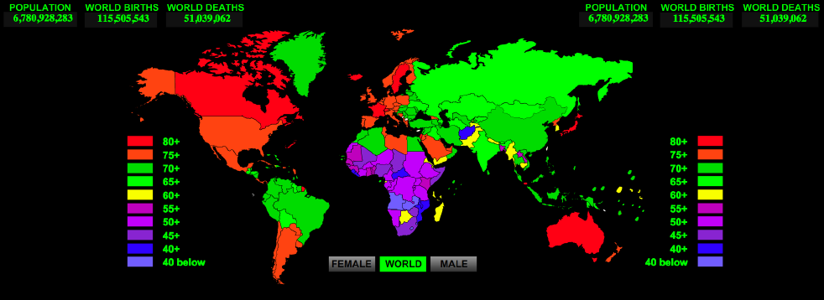
Global Life Expectancy Disparities: US (79 yrs) vs. Ethiopia (55 yrs)
Notes:
Variability in life expectancy

Slide 8
Longevity: Life Expectancy on the Rise
Life Expectancy At Birth
In the year: | Men | Women
1900 | 47.1 | 50.7
1990 | 71.8 | 78.8
2020 | 75.7 | 82.3
2050 | 79.7 | 85.6
Source: National Center for Health Statistics, U.S. Decennial Life Tables for 1989-91, vol. 1, no. 3, Some Trends and Comparisons of United States Life Table Data: 1900-91. Hyattsville, MD; 1999, p. 2, Table A.

Slide 9
Persons with Serious Mental Illness have not Benefitted in Improved Longevity
The average life expectancy in the US has steadily increased to 77.9 years (increasing by almost 5 years since the 90s alone) At the same time……….
For people with serious mental illness:
The average life expectancy is 53 yrs. “50 is the New 75”

Slide 10
The Differential Mortality Gap for Schizophrenia Has Increased Over Recent Decades
P<.03
Saha, S. et al. Arch Gen Psychiatry 2007;64:1123-1131.

Slide 11
Cardiovascular Disease Is Primary Cause of Death in Persons with Mental Illness*
Percentage of deaths
*Average data from 1996-2000.
Colton CW, Manderscheid RW. Prev Chronic Dis [serial online] 2006 Apr [date cited].
Available at URL: http://www.cdc.gov/pcd/issues/2006/apr/05_0180.htm

Slide 12
Cardiovascular Disease (CVD) Risk Factors
Modifiable Risk Factors | Estimated Prevalence and Relative Risk (RR)
 | Schizophrenia |  | Bipolar Disorder
Obesity |  | 45–55%, 1.5-2X RR¹ |  | 26%⁵
Smoking |  | 50–80%, 2-3X RR² |  | 55%⁶
Diabetes |  | 10–14%, 2X RR³ |  | 10%⁷
Hypertension |  | ≥18%⁴ |  | 15%⁵
Dyslipidemia |  | Up to 5X RR⁸
1. Davidson S, et al. Aust N Z J Psychiatry. 2001;35:196-202. 2. Allison DB, et al. J Clin Psychiatry. 1999; 60:215-220. 3. Dixon L, et al. J Nerv Ment Dis. 1999;187:496-502. 4. Herran A, et al. Schizophr Res. 2000;41:373-381. 5. MeElroy SL, et al. J Clin Psychiatry. 2002;63:207-213. 6. Ucok A, et al. Psychiatry Clin Neurosci. 2004;58:434-437. 7. Cassidy F, et al. Am J Psychiatry. 1999;156:1417-1420. 8. Allebeck. Schizophr Bull. 1999;15(1)81-89.
Notes:
Key Points:
There is growing evidence that patients with major mental disorders (on this slide, schizophrenia is shown as an example) have a higher prevalence of key cardiovascular risk factors; this may explain the observation of higher rates of cardiovascular disease in mental health populations

Slide 13
Increased Medical Comorbidity in Psychotic Disorders
Odds
Ratio
All significant compared to non-psychosis groups
Dickey et al. , 2002, Psychiatric Services

Slide 14
Summary and Implications
FEP clients have compromised physical health when presenting for CSC treatment, but rates of actual medical conditions are relatively low
Individuals with schizophrenia (and other SMI) have high rates of medical comorbidity and are prone to premature mortality
Intervention at FEP to address lifestyle has potential to prevent emergence of comorbid medical conditions
Individuals with FEP and comorbid medical disorders need 1

Slide 15
Summary, cont’d
Individuals with FEP and comorbid medical disorders need:
Integrated training in illness self-management (e.g., I-IMR program: psychoeducation, self-management skills)
Help modifying lifestyle factors to facilitate management of both disorders
Coordinated physical and mental healthcare

Slide 16
Mental Health – Physical Health Interactions
Unawareness/increased pain threshold may interfere with recognizing physical signs of medical problems
Difficulties communicating with health providers may reduce ability to obtain appropriate treatment
People with mental illness less likely to be believed by health care professions, receive inferior treatment
Poor self-management skills and medication non-adherence may worsen health conditions
Self-medication of symptoms and reciprocal effects of substance use

Slide 17
Physical – Mental Health Interactions, cont’d
Poor health contributes to or worsens symptoms
Poor health may contribute to worse cognitive functioning, interfere with psychosocial functioning
Treatment of some health conditions may expose people to substances with high addiction potential

Slide 18
Lifestyle Interventions
Primary Targets
Healthier diet
Smoking cessation
Increased exercise
Effects on symptoms
Potential impact on cognitive functioning

Slide 19
Cognitive Enhancement from Exercise
Meta-analyses 29 studies
(Smith et al., 2010)
Control group: wait-list, or, less frequently, stretching and toning, health education, or relaxation
PA trials ranged in duration from 6 weeks to 18 months
Median/modal length of 12/10 weeks
Modest benefits in health adults
Greater benefits in those with impairment
Meta-analysis indicates physical activity can improve cognitive abilities and living skills among those with dementia and Parkinson’s disease.
Some indication of greater benefit with combined aerobic and weight training

Slide 20
Critical Factors in Effective Lifestyle Interventions for SMI
Support and build self-determination, resilience, self-efficacy
Provide information about:
Interactions between mental health, substance use, and physical health
Benefits of improved physical conditioning
How to get in shape
Guidance on health diet and nutrition
Facilitate access to experts in health lifestyles (e.g., coaches)
Teach skills related to healthy living
Create opportunities for people to experience new, healthier behaviors
Engineer social supports for lifestyle changes

Slide 21
Examples of Lifestyle Intervention Programs for SMI
Whole Health Action Management (WHAM)
Consumer-led health and fitness program
Well standardized
Behavioral Weight Loss Intervention (Daumit)
Exercise program conducted by trainers in day treatment setting
Modifications in diet, nutrition training
Most impressive weight losses reported to date
STRIDE (Green)
Exercise program adapted for SMI population
Nutrition and Exercise for Wellness and Recovery (NEW-R) Program (Razzano & Cook)
In Shape Program (Bartels & Pratt): following

Slide 22
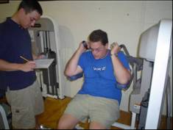
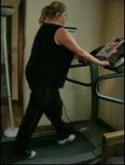
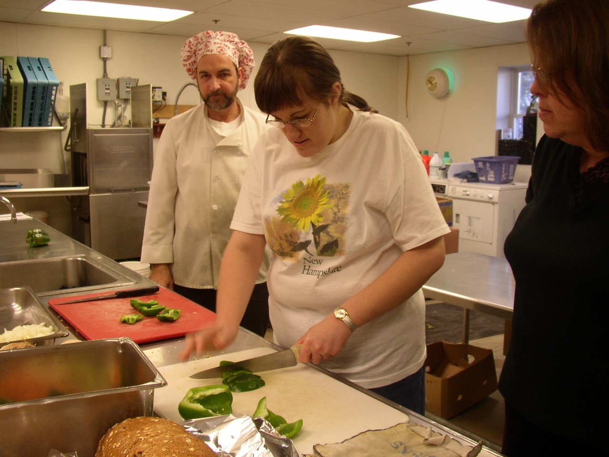
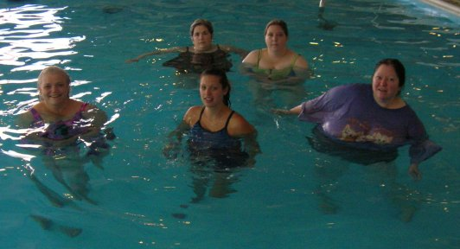
In SHAPE: Individualized Self Health Actualization Plan for Empowerment

Slide 23
Fitness Promotion In SHAPE: A Program with Several Components
Individualized fitness and healthy lifestyle assessment
Individual meetings (weekly) with a “Health Mentor” (certified fitness trainer)
Free membership to local fitness centers (YMCA; Dance-exercise center; Women’s fitness center)
Group Exercise and Healthy Eating Education
Group health educational/motivational “Celebrations”

Slide 24
Comorbid Physical-Mental Illness Interventions
Primary Targets
Knowledge of disorders
Integration of physical and mental health treatment, including routine preventive care
Illness self-management strategies
Skills for improving interactions with healthcare providers
Lifestyle change (diet, exercise, smoking)

Slide 25
Example: I-IMR
Integrated Illness Management and Recovery (I-IMR)
Standardized curriculum (10 topics) based on IMR delivered in weekly group or individual sessions for 3-10 months
Education on psychiatric and medical problems and how they influence and are related to each other
Training on self-management skills
Assistance with establishing goals and steps towards recovery and wellness
Notes:
Integrated Illness Management and Recovery’s roots stem from Illness Management and Recovery. IIMR is an adaptation of IMR which offers a standardized curriculum addressing psychiatric and medical self management and education. There is a consistent emphasis on recognizing and honoring the influence and connection of mind on body/mind body.

Slide 26
History of I-IMR
2004: Joint RFP (SAMHSA & NIMH) to adapt EBPs for older people
2005-2008: Pilot tested addition of physical health self-management training to IMR (Manchester & Nashua, n=70 & Chicago, n=50)
2012-2015: Included in CMMI study in Boston and Health Home Project in MD
2014: Major revision of IIMR to fully integrate self-management curriculum
2014-2019: Evaluation in RCT in Boston (n=300)
Currently offered in 7 states (and counting)
Notes:
IIMR was based on IMR. IMR was adapted in 2004 in response to an RFP asking for adaptations of evidence based practices for older people with smi. In 2005, the adaptation was tested in a pilot and about 60 people received I-IMR (pilot was randomized in both Nashua and Chicago). In 2012, I-IMR was evaluated as one of the interventions in a Centers for Medicare and Medicaid Innovations grant. In 2014, Sarah Pratt, Meghan Santos along with support from Kim Mueser at BU and Piper Meyer at University of Minnesota, revised the curriculum to make the curriculum more integrated and focused on integrated health. Other modifications were streamlining the practitioner guidelines and incorporating the discussion prompts into the participant handouts. In 2014, a randomized trial comparing I-IMR to Telefriend for mental and physical health compared to usual care began and is in the follow-up phase for data collection (January 2019).

Slide 27
General Structure of I-IMR Session or Group
Set the Agenda for Session Review of Progress Towards Goal or Home Practice/Weekly Objective
Review of Previous Session
Establish Rationale for Topic or Skill
Engage Participants in Materials and Topic
Practice Skill
Develop Home Practice
Notes:
Eventhough the agenda will generally remain the same each time because you are following a general format, it is helpful to set an agenda with the consumer or group, take about 10-15 of time to review goals the consumer may be working towards. Home practice is more likely to happen if a specific plan is made.

Slide 28
Overarching Principles
“Ask Don’t Tell”
Have a conversation
Listen more than you talk – Be CURIOUS
Use the handouts but relate material to person’s life
Have flexibility regarding order
Emphasize autonomy and empowerment
Be EMPATHIC and VALIDATNG
Notes:
I-IMR being a recovery oriented intervention, emphasizing the client as the expert on themselves…..being curious is incredibly important to learning more

Slide 29
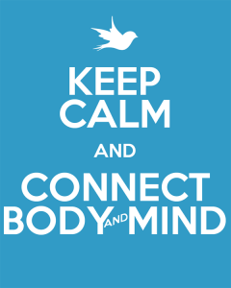
The I-IMR Curriculum
Recovery
The Brain – Body Connection
Practical Facts on Physical and Mental Health*
Healthy Lifestyle*
Using Medications Effectively
Social Support
Managing Stress
Managing Persistent Physical and Mental Health Symptoms
Relapse Prevention
Getting Your Needs Met in the Health Care System
*Tobacco education in “Healthy Lifestyle,” and any of the topics in “Practical Facts on Physical and Mental Health,” may or may not be covered depending on relevance to the participants.
Notes:
Although we will look at the material in much more detail later in the training, here are the topics that are covered in the I-IMR curriculum.

Slide 30
I-IMR Curriculum Materials
Practitioner guidelines for each session containing:
Information about what to emphasize in session
Specific suggestions for discussing the topic
Suggested additional resources
Ideas for practice (in-class and at home)
Sessions primarily rely on participant handouts (one for each session)
Homework Half-sheet
Notes:
It is important to prepare briefly for each session. This can be done by briefly reviewing the practitioner guidelines. In the guidelines, there are suggestions about what the main points to emphasize in the session are as well as ways you could discuss the topic and ideas for practice and home practice. The handouts should also be reviewed briefly before each session by the facilitator. In total, it should not take more than 15 minutes or so to prepare for covering a topic after you are familiar with the material. Have a mechanism to share handouts (particularly in the remote environment). It is a lot of material to give people up front, better to do it by module if possible. Home work half sheet should be used at the end of each session.

Slide 31
I-IMR Focus on Integration
Every Topic in the Program Relates to the Interplay Between Physical and Mental Health
Deliberate, Repeated Efforts to Connect Physical and Mental Health (including how managing, or not managing, one can affect the other)
Notes:
You will notice that each of the topics covered in the handouts is approached with attention to the interplay between physical and mental health.

Slide 32
Recovery-Oriented Treatment
Growth-Promoting
Emphasis on Autonomy
According to Anthony, “Recovery involves the development of new meaning and purpose in one’s life as one grows beyond the catastrophic effects of [mental] illness.”
Mastery over management of symptoms so that meaningful life goals can be pursued.
Notes:
The purpose of I-IMR is to empower clients with the knowledge and skills needed to better manage their conditions and communicate effectively with providers. The ultimate goal is for people to develop mastery in these areas so that meaningful life goals can be pursued.

Slide 33
Promoting Recovery by Eliciting Vision
Uncovering/discovering deeper meaning and purpose
The uncovering is a process that takes time – need to re-visit often
Motivation naturally waxes and wanes
Creates foundation on which to build ongoing commitment to personally meaningful, recovery-oriented goals
Notes:
The beginning sessions will focus largely on discovering what is important and meaningful to the person and how managing conditions could help facilitate progress towards that goal.

Slide 34
Creating Vision
What is your vision for yourself?
Why does this vision matter to you?
What brings meaning to your life?
What is the gap between here and your vision?
What strengths can you use to reach your vision?
What successful experiences have you had that you could build on?
What are the key challenges?
What would need to be in place in order to help you achieve your vision?
What are you willing to do as a next step in moving toward your vision?
Notes:
Some open-ended questions to ask clients when exploring creating a vision for oneself….

Slide 35
Four Main Techniques in I-IMR
Psychoeducation/Health Education
Motivational Interviewing
Cognitive Behavior Therapy
Skills Training
Other techniques: behavioral tailoring and relapse prevention planning
Notes:
Psychoeducation is the primary way to for clients to learn about their conditions. Education can help to increase engagement or motivation in management and is the foundational technique used in I-IMR. There may be many opportunities to use these other techniques, particularly skills training and CBT. Motivational interviewing may come up in the context of shift in motivation around a goal, or perhaps someone is having difficulty completing a home practice they identifed and planned. We will talk about these in more detail over the next hour.

Slide 36
Strategies to Promote Lifestyle Change
Link lifestyle changes to personal goals
Integration of goal work with all treatment providers
Understanding the “Why” behind motivation to change health behaviors
Psychoeducation about mental illness, mind-body connection, physical illness
Motivational interviewing to establish discrepancy between personal goals and current behavior
Behavioral experiments to explore health behavior change
Experiential opportunities to try out changes with client

Slide 37
Link Recovery Goals to Potential Lifestyle Changes
Explore how lifestyle changes could help person achieve goals set in CSC program
Desire to return to school, work, make friends, get closer to people, reduce feelings of loneliness, develop new leisure and recreational activities
Use of Socratic method of asking questions more than giving answers

Slide 38
Integration of Individual Work with Other Interventions
Support of client’s goals provided by all members of CSC team
Potential link between client goals and lifestyle change understood by all CSC team members
CSC intervention providers on lookout to support work on goals and connection between goals and lifestyle change
Medical health providers included in integration

Slide 39
Understanding the “Why?” Behind Motivation to Change
People often have behavioral health desires (e.g., lose XX lbs, stop smoking, cut down on snacks, eating more balanced meals, get out for a daily walk, start jogging/going to the gym, etc.)
Brief exploration about the reasons underlying these desires often yields broad goals (e.g., looking better better, feeling fewer aches and pains, improving one’s health and vigor)
The mental image of better YOU and all that entails may be enough to initiate a change in lifestyle, but is often insufficient to sustain over the long haul
More specific, personally meaningful goals are needed to sustain lifestyle change efforts

Slide 40
Understanding the “Why?” (Cont’d)
Take time to explore the meaning behind the changes the person is contemplating by tapping into their mental images about those changes
Get the person to imagine and talk about what their life would be like if the change occurred
Ask follow-up questions to understand as specifically as possible what changes the person cares most about
Pay attention to the person’s affect and enthusiasm as they imagine their new life, now freed of the current health-related obstacles, to zero in on the most important change

Slide 41
Understanding the “Why?” (Cont’d)
Get them to spell out how life would be so different by asking questions such as:
“So let’s imagine that you have suddenly and automatically lost those 50 lbs and you are now your desired weight. How would things be different than they are now? What would you be doing that you are not doing now? What would that be like? What else might you be doing? How would that feel?”
Delve into specifics as needed

Slide 42
Psychoeducation
Provision of basic information about mental illness, mind-body connection, physical illness using standardized educational materials
Interactive teaching style, tailored to individual
Critical to facilitating informed decision-making
Respects individual as having the right to accurate information related to care of their conditions
Provided to family whenever possible

Slide 43
Motivational Interviewing
Goal:
To create a salient dissonance or discrepancy between the person’s current health behaviors and important personal goals.
Core Principles
1. Express empathy
2. Establish personal goals
3. Develop discrepancy
4. Roll with resistance
5. Support self-efficacy

Slide 44
Expressing Empathy
Goal:
To understand the person’s world
Strategies
Active listening skills
Good eye contact
Responsive facial expression
Body orientation
Verbal and non-verbal “encouragers”
Reflective listening
Asking clarifying questions
Avoiding challenges, expressing doubt, judgment, and unsolicited advice

Slide 45
Establishing Personal Goals
Goal:
To establish personal, meaningful goals that the person wants to work towards
Strategies
Talk with person about their:
Aspirations
Thoughts about how things could be different
Fantasies

Slide 46
Get to know what the person was like in the past, such as:
Preferred activities
Admired people
Personal ambitions
Don’t discourage ambitious goals!

Slide 47
Developing Discrepancy
Explore person’s goals
Consider steps that need to be taken to achieve those goals
Ask person to describe possible consequences of not changing
Use reflective listening selectively to reinforce person’s recognition that not changing interferes with goal attainment

Slide 48
Developing Discrepancy (Cont’d)
Actively collaborate with person on helping them achieve their goal
Expect that discrepancy between problem area and goal attainment will develop through experience of trying to work on goal, not just anticipation and talk
Avoid directly confronting client with discrepancy; rather, use session to process interference and ask questions, using Socratic method

Slide 49
Rolling with Resistance
Goal:
To overcome resistance to change in health behaviors
Strategies
Avoid over-pathologizing: resistance is normal
Rather than opposing resistance, explore it
Identify specific concerns about attaining sobriety and problem solve about these concerns

Slide 50
Supporting-Efficacy
Goal:
To foster hope in people that they can achieve desired changes
Clinical Strategies
Express optimism that change is possible
Note that change typically follows multiple efforts to change—consider analogy to climbing of Recovery Mountain as a reframe to setbacks and challenges
Review prior accomplishments
Reframe past failures as examples of personal strengths

Slide 51
Behavioral Experiments
Frequently used in CBT (especially CBT for psychosis) to help people go out and get more information about a particular belief they have, but need more evidence to evaluate
Nature of experiment collaboratively agreed upon in advance
Focuses on thoughts or beliefs the person has at least some doubt about
Interpretation of findings agreed upon IN ADVANCE of “experiment”

Slide 52
Behavioral Experiments (Cont’d)
New application of behavioral experiments to undercut fear associated with commitment to a health behavior change
Commitment to health behavior change often thought to be critical to successful change
People are ambivalent about change because they don’t know what it’s going to be like—if they don’t have the experience of changing, how could they?
Exploring change, contemplating it, may be futile as it doesn’t shed any information on the process of change itself

Slide 53
Behavioral Experiments (Cont’d)
Behavioral experiments are a way of breaking through the ambivalence by NOT requiring commitment to change in health behavior
Instead, work with person to try “experiments” in behavior change, designed to shed light on what changes are like and inform subsequent decision-making
Process experiments with person, explore what was learned, use new information to plan new experiments
Focus on facilitating behavior change towards goals, even in light of ambivalence, by experimenting with potentially acceptable (even if minor) changes in health behavior: anything that changes behavior provides opportunity for new insights

Slide 54
Creating Experiential Opportunities
Create opportunities for clients to experience minor lifestyle changes with clinician or peer support specialist:
Taking a walk together
Sharing a healthy meal
Preparing a healthy meal
Going to the gym
Introduces some variety into routine therapy meetings
Opportunity to discuss and process experience

Slide 55
The Big Picture: Reversing Early Mortality in Persons with Mental Illness
Underlying
Risk Factors
Proximal
Risk Factors
Cardiometabolic
Risk Factors
Client
Symptoms & Life style Poor health behaviors
Poverty, Uninsurance Lack of self management
Provider
Lack of knowledge
Competing demands Therapeutic nihilism
System
Limited onsite capacity
Lack of medical home
Lack of reimbursement for prevention & health promotion programs
Poor Quality Detection, Treatment
Lifestyle: Inactivity, poor diet, smoking
Medications
↑ Weight
⁭ Glucose
↑ Lipids
↑ BP
CAD
DM
Integrated Wellness: Diet, Exercise
Smoking Cessation
Medication Switching
Routine Health Screening
Integrated: Disease Mangmt.
Care Management
Self-Management
Notes:
55
The lifestyle issues are all problems are all problems in the general population, but they have each been shown to be elevated in mental health consumers.

