Slide 1
Lived Experience as Expertise : How NAMI Can support patients and families
Ken Duckworth, MD
New England MHTTC, MMHC Grand Rounds
September 13th, 2023
Notes:
DO NOT CHANGE THE FORMAT OF THIS TEMPLATE. If you are creating MHTTC-branded slides, you must use this template or one of the other approved templates in the Shared Folder.

Slide 2




Housekeeping Information
Participant microphones will be muted at entry
If you have questions during the event, please use the chat
This session is being recorded and it will be emailed to all participants once available.
If you have questions after
this session, please e-mail:
newengland@mhttcnetwork.org.
At the end of the month, we will send you a certificate of completion that you can submit to your particular board for continuing education credit. Please contact ifisher@c4innovates.com for more information on CEs after the event.

Slide 3
Acknowledgment
Presented in 2022 by the Mental Health Technology Transfer Center (MHTTC) Network.
This presentation was prepared for the New England Mental Health Technology Transfer Center (MHTTC) Network under a cooperative agreement from the Substance Abuse and Mental Health Services Administration (SAMHSA). All material appearing in this publication, except that taken directly from copyrighted sources, is in the public domain and may be reproduced or copied without permission from SAMHSA or the authors. Citation of the source is appreciated. Do not reproduce or distribute this publication for a fee without specific, written authorization from New England MHTTC. For more information on obtaining copies of this publication, email us at newengland@mhttcnetwork.org.
At the time of this publication, Miriam E. Delphin-Rittmon, Ph.D, served as Assistant Secretary for Mental Health and Substance Use in the U.S. Department of Health and Human Services and the Administrator of the Substance Abuse and Mental Health Services Administration.
The opinions expressed herein are the view of TTC Network and do not reflect the official position of the Department of Health and Human Services (DHHS), SAMHSA. No official support or endorsement of DHHS, SAMHSA, for the opinions described in this document is intended or should be inferred.
This work is supported by grants #1H79SM081775 from the Department of Health and Human Services, Substance Abuse and Mental Health Services Administration.
Presented 2022
Notes:
Always use acknowledgment slide on the 2nd slide and add your center’s information

Slide 4
Notes:
Always use Language Matters graphic as your third slide.

Slide 5

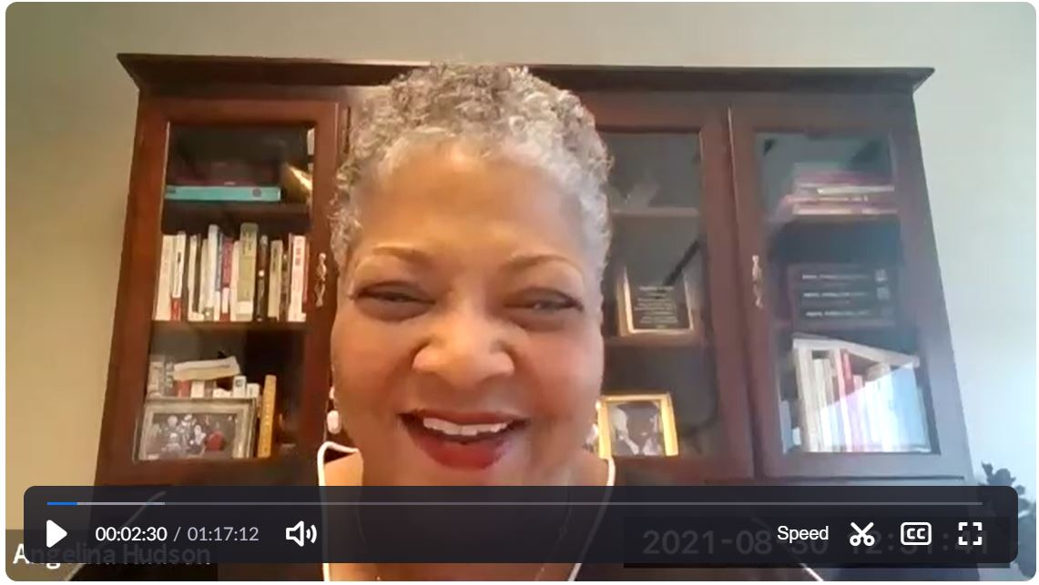
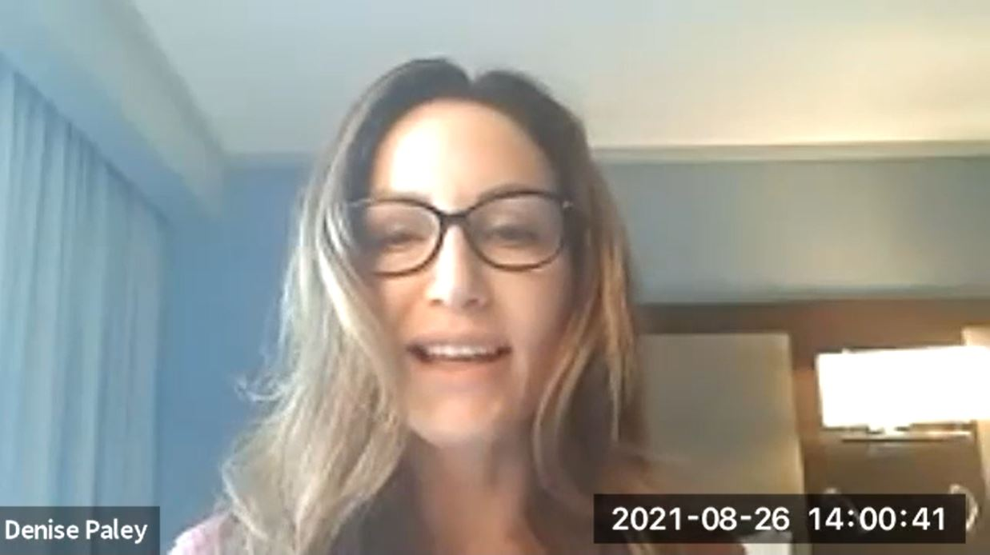
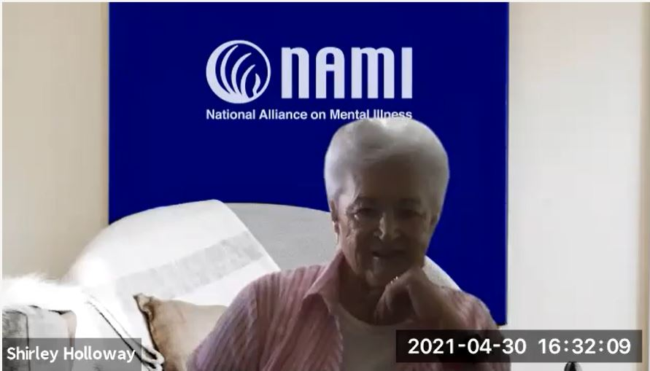
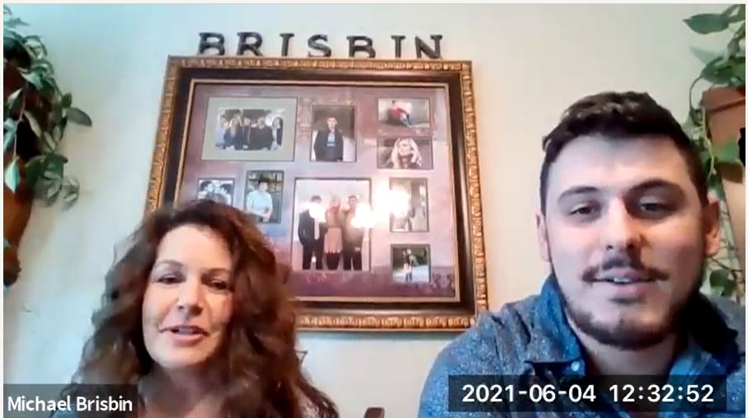

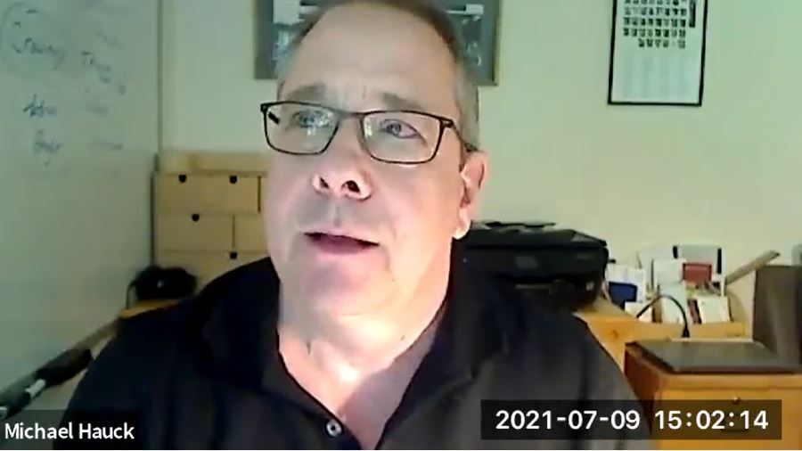
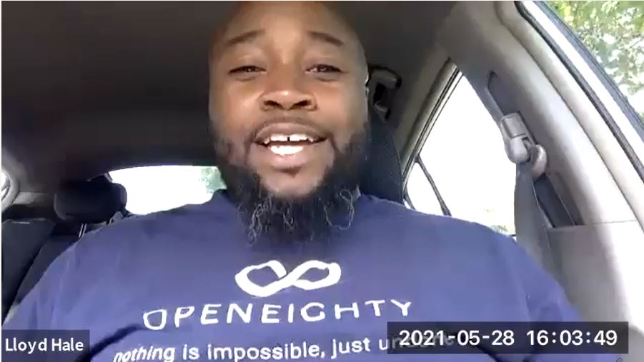
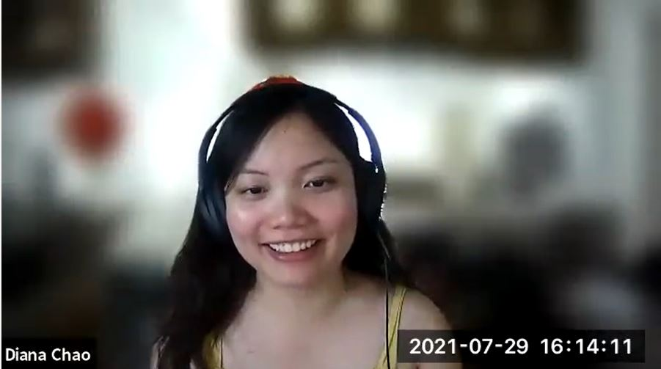
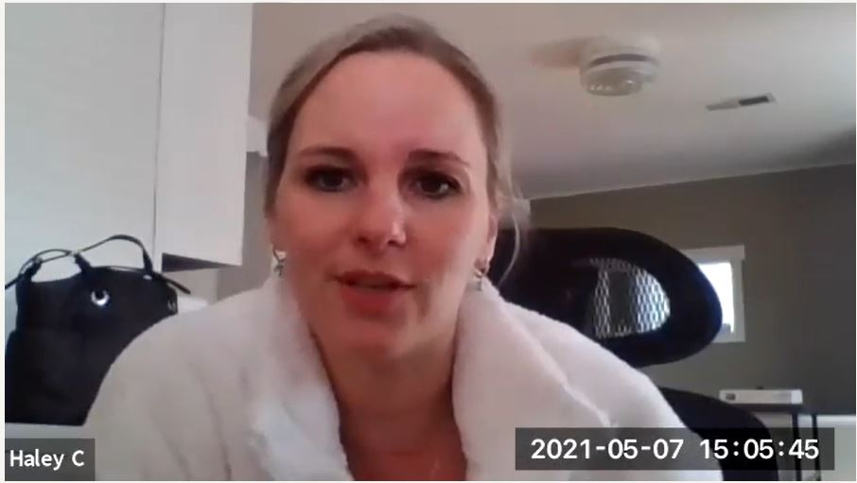
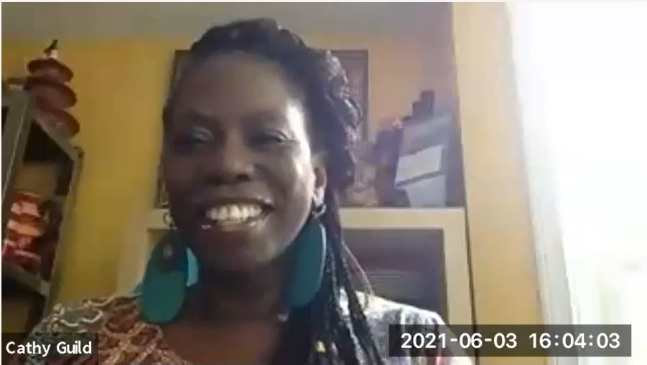
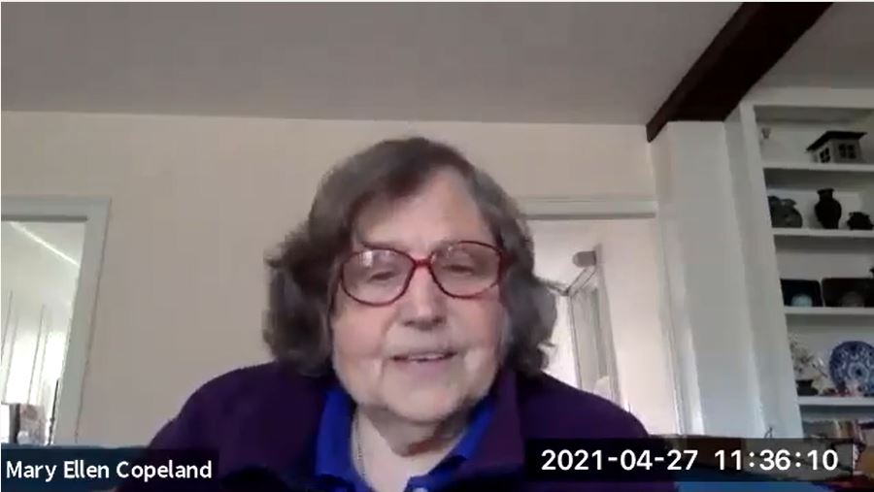
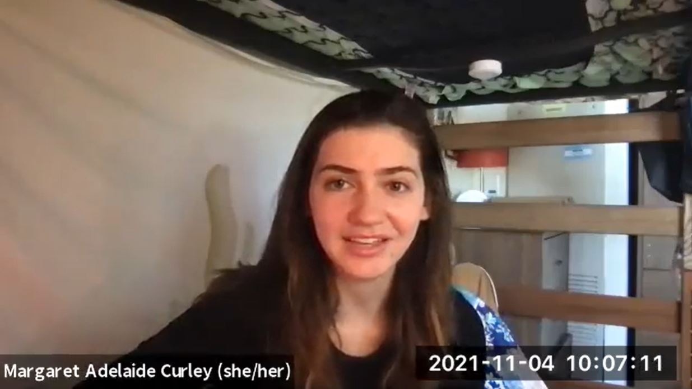
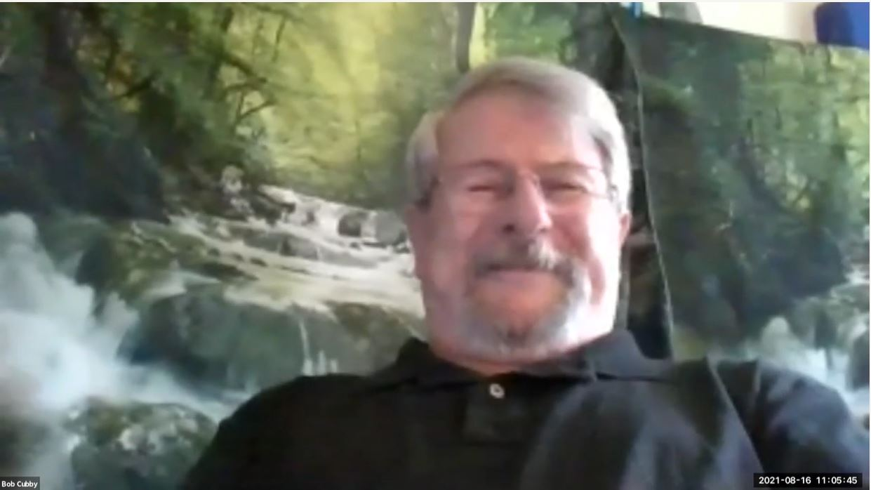
What is ?
EDUCATION
SUPPORT
AWARENESS
ADVOCACY
What started as a small group of families gathered around a kitchen table in 1979 has blossomed into the nation's leading voice on mental health.
Today, we are an alliance of more than 600 local affiliates who work in your community to raise awareness and provide support and education that was not previously available to those in need.

Slide 6
Helplines for support and navigation
NAMI National 800 950 NAMI
150 volunteers take 75,000 calls texts and chat
NAMI Massachusetts
Namimass.org
Compass helpline for troubleshooting in MA
617-704-6264 or 1-800-370-9085

Slide 7

600plus affiliates and growing
McKenzie Scott $30 Million unrestricted grant 9 /22
Individual donations up 200% over 3 years
NAMI National 80 to 135 employees in 3 years
NAMI Provider Program in medical school and residency education

Slide 8
NAMI Advocacy
988 --new 3 digit number for national suicide prevention lifeline 7/22
Mobile crisis care advocacy –state and federal
Coordinated Specialty Care – in state block grants by SAMSHA
First person voice in advocacy
Mental Health Parity 1.0
NAMI Research
AMP Schizophrenia FNIH $100 million to work to discover new biological targets for psychosis medications
Started by NAMI and Broad Institute 7 years ago
Identification of biological markers in early psychosis to promote drug discovery
Co led by NIMH and NAMI Carlos Laurrarai who lives with schizophrenia

Slide 9

















Programs, Classes & Initiatives
Please consider reaching out to the NAMI Helpline at
Call: 1-800-950-NAMI (6264) Email: helpline@nami.org
Text: 62640 Chat: NAMI.org/help
If you need support while hearing a story today or at any time, remember
you are not alone.

Slide 10
NAMI Family to Family :
Service to Science
RTC hope and empowerment increased after Fam to Fam
Results remained at 9 months
Psychiatric Services PAPERS
Did not change family members symptoms
Can be found across the USA in person and zoom for free

Slide 11

Evidence-based
research
Experience-based
evidence

Slide 12

HOW TO WRITE A BOOK WITH REAL PEOPLE AS EXPERTS …..
IRB Approved protocol informed consent discussion
Signed consent
Recurrent option to opt out
No guardians or in Hospital zoom interviews (with transcripts ) all quotes reviewed and approved

Slide 13
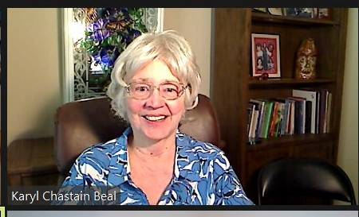
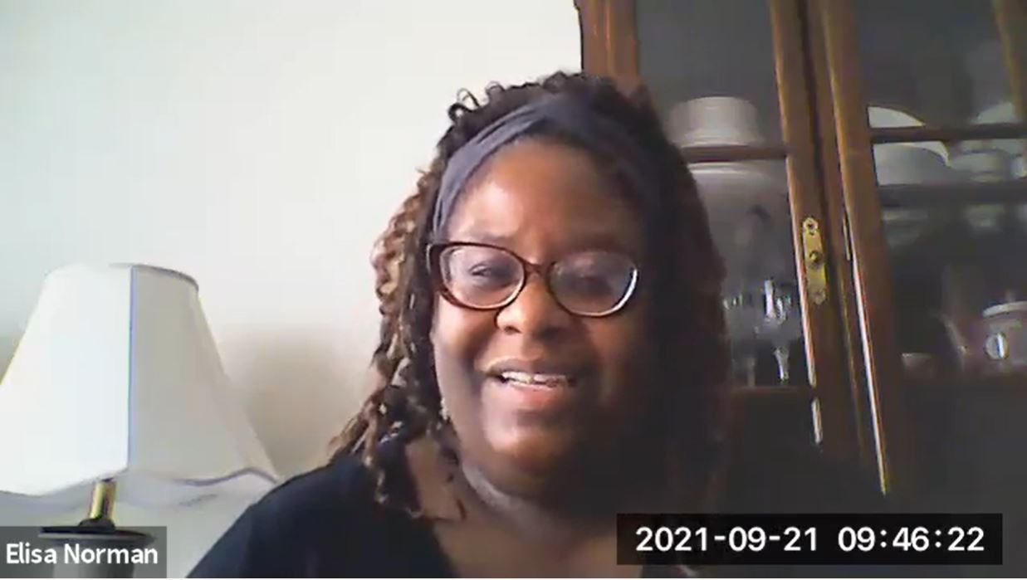
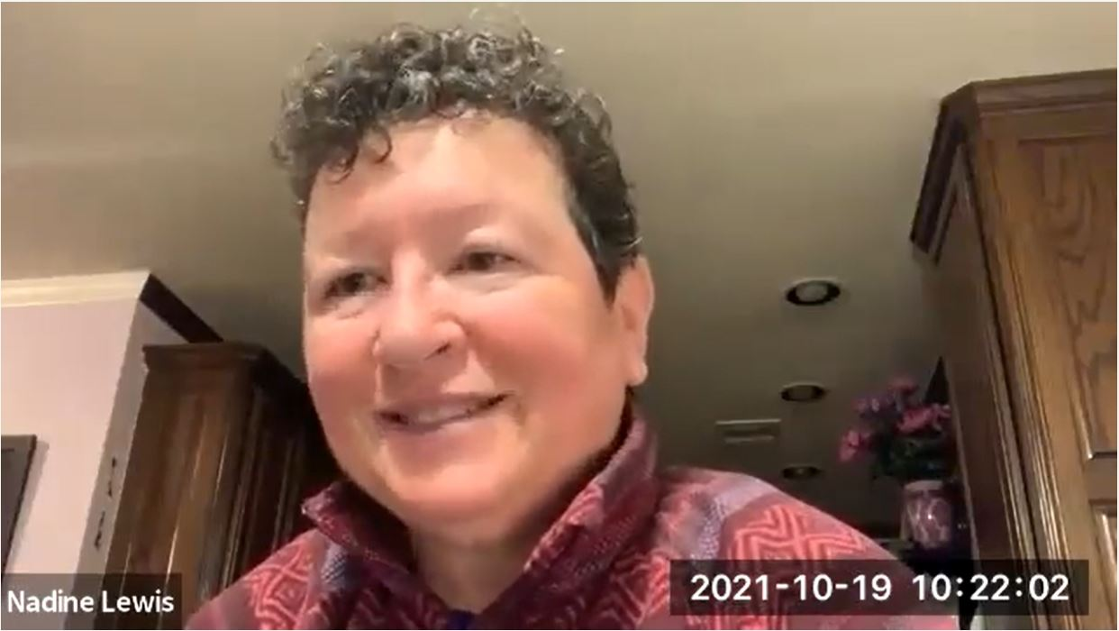
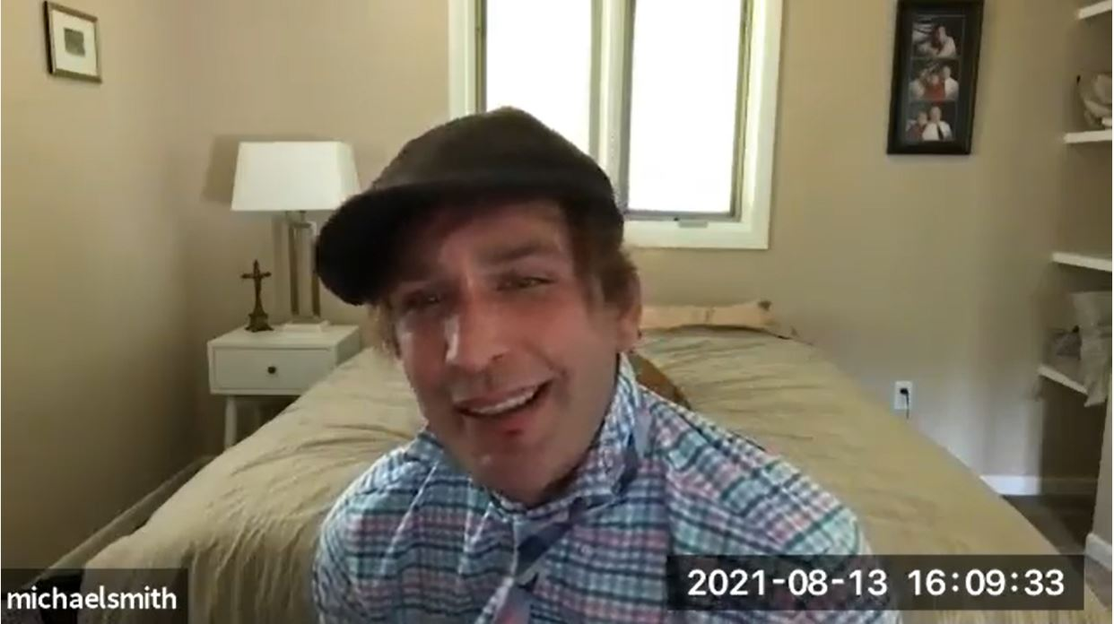
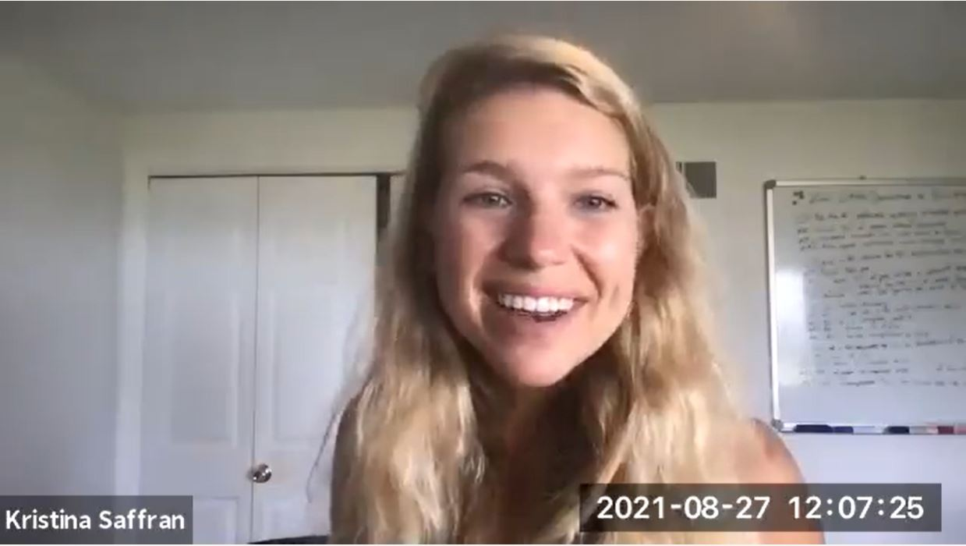
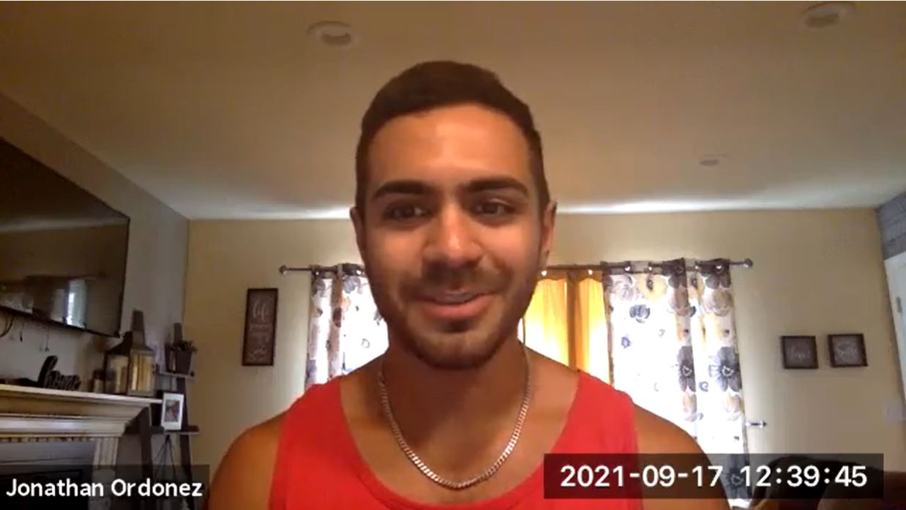
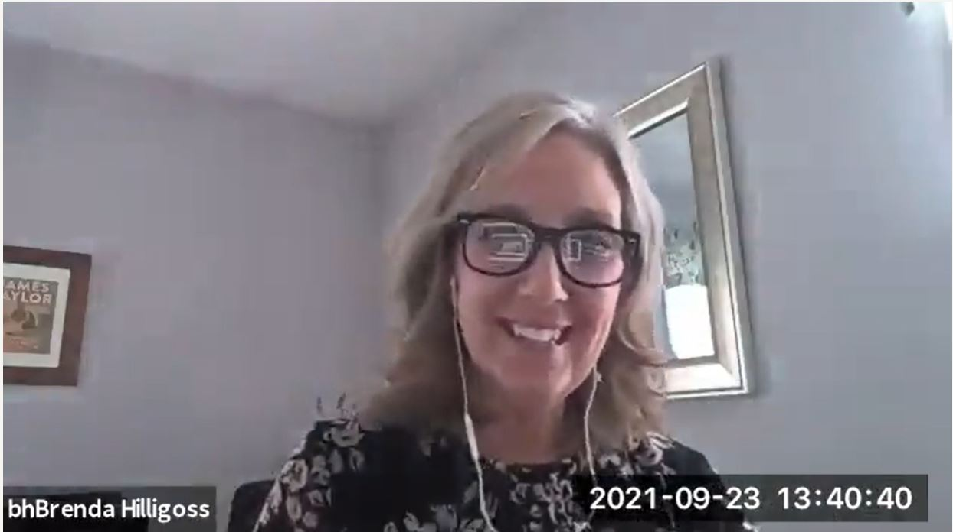
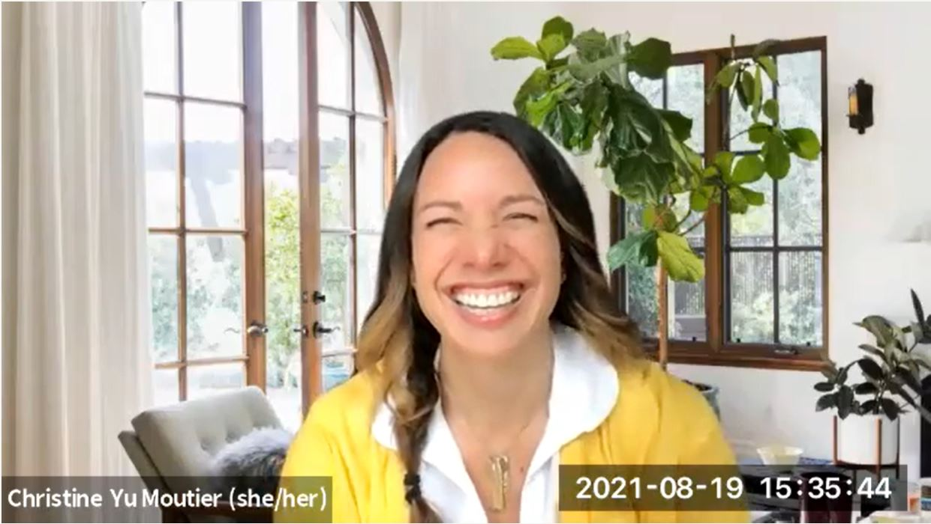
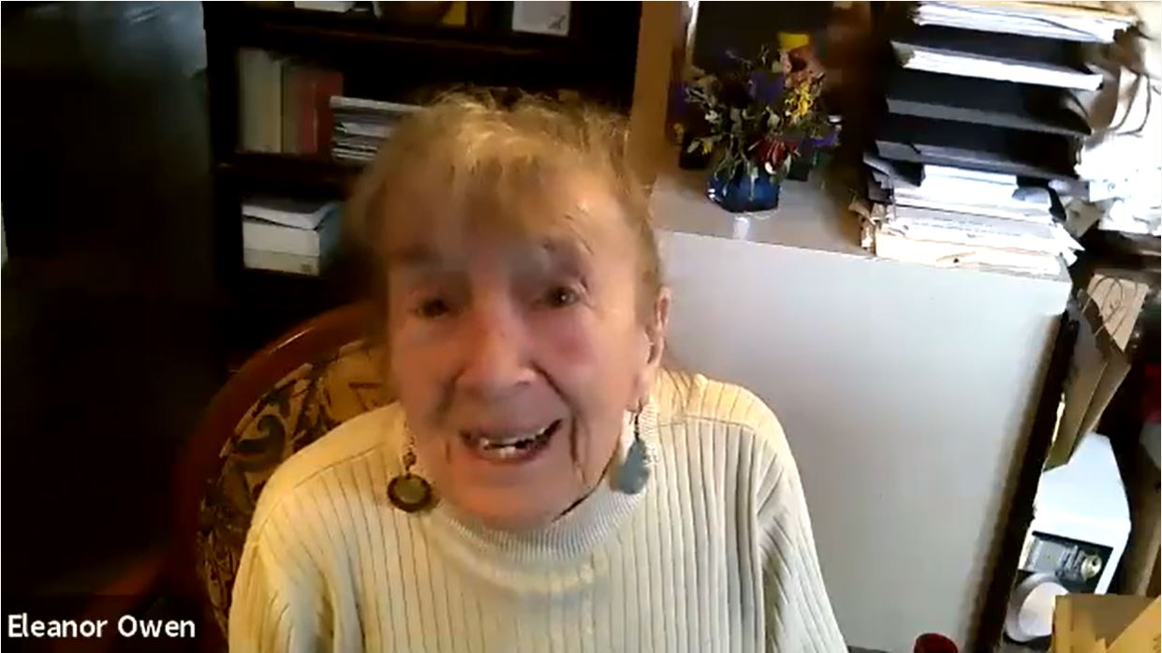
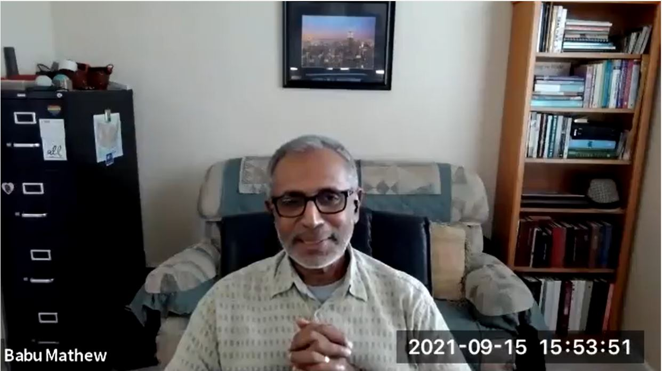
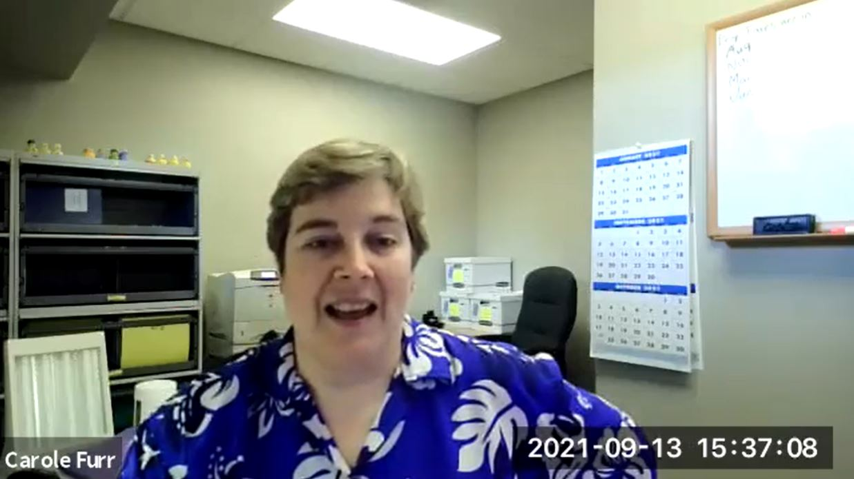
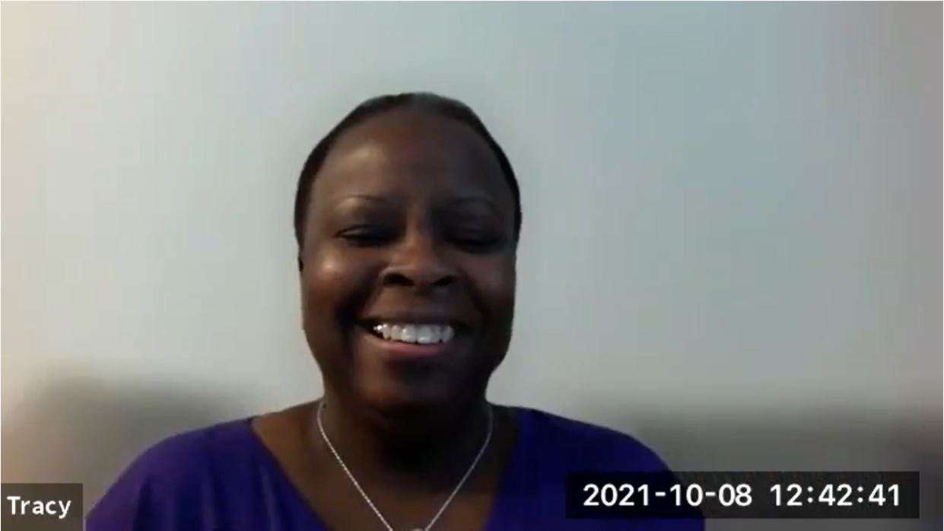
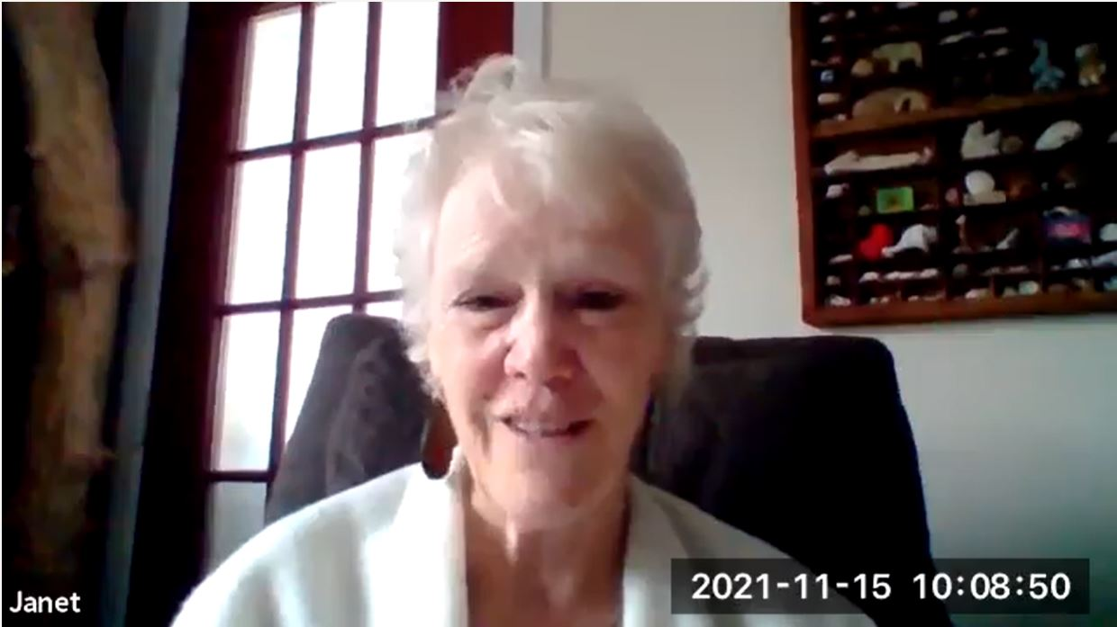
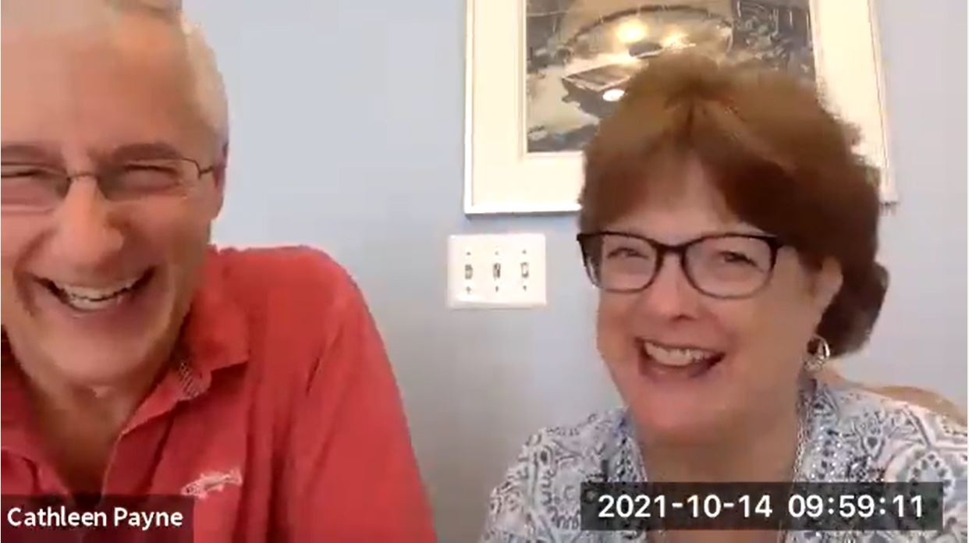
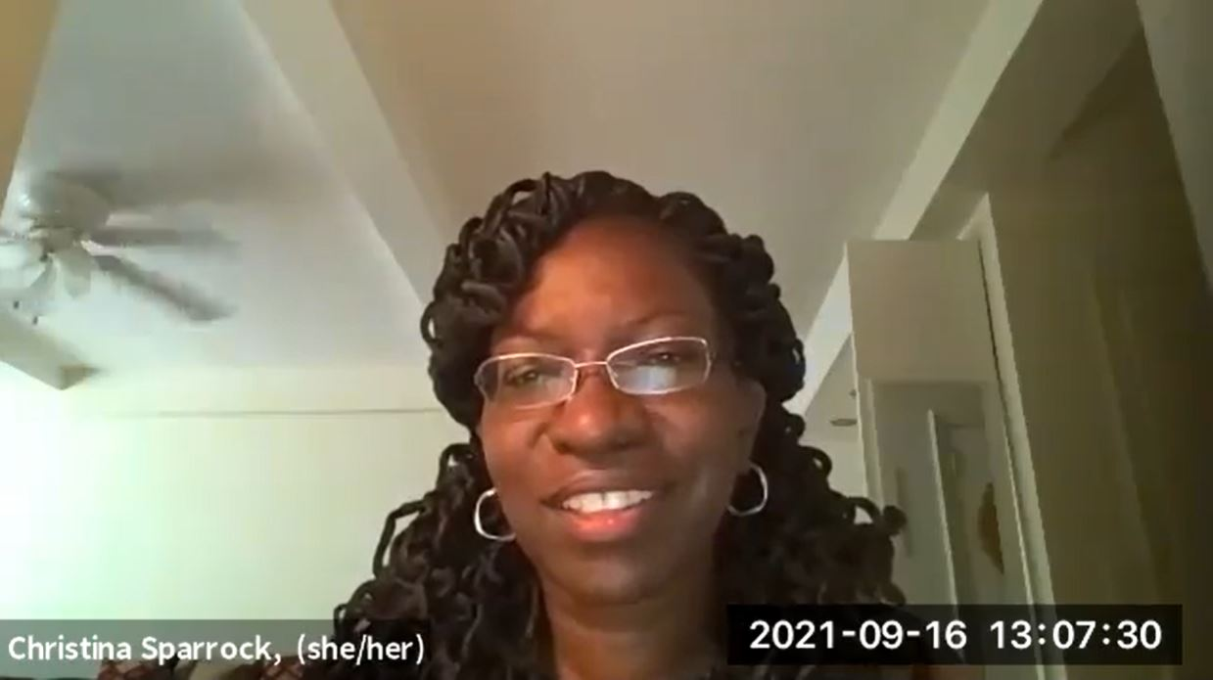
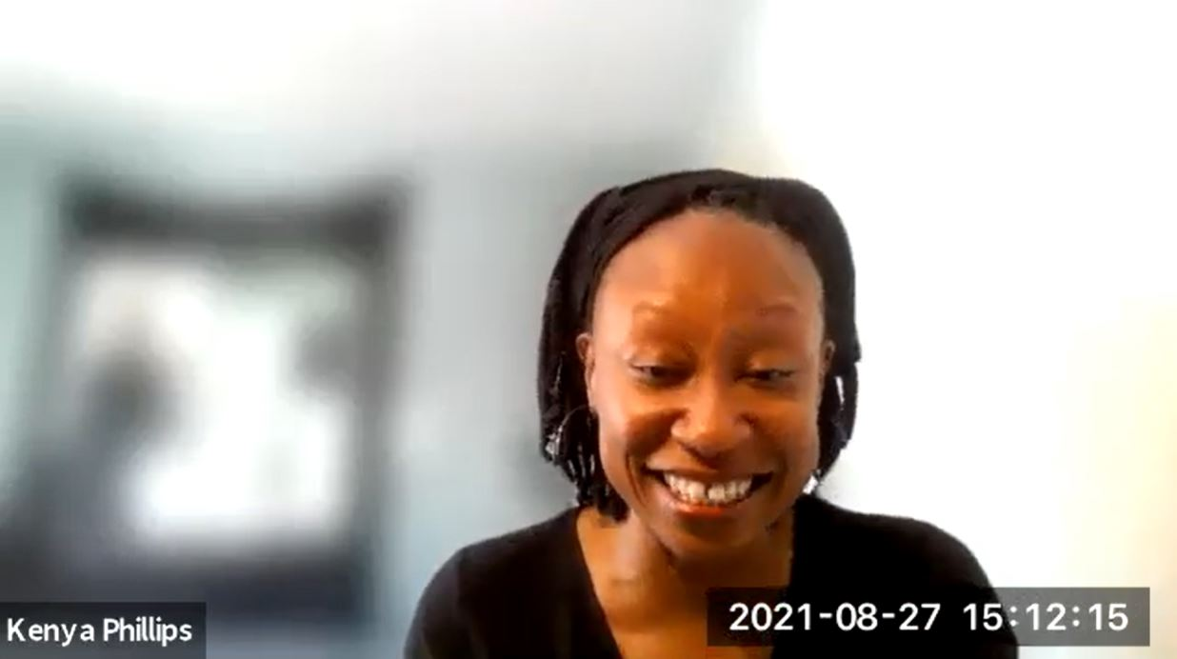
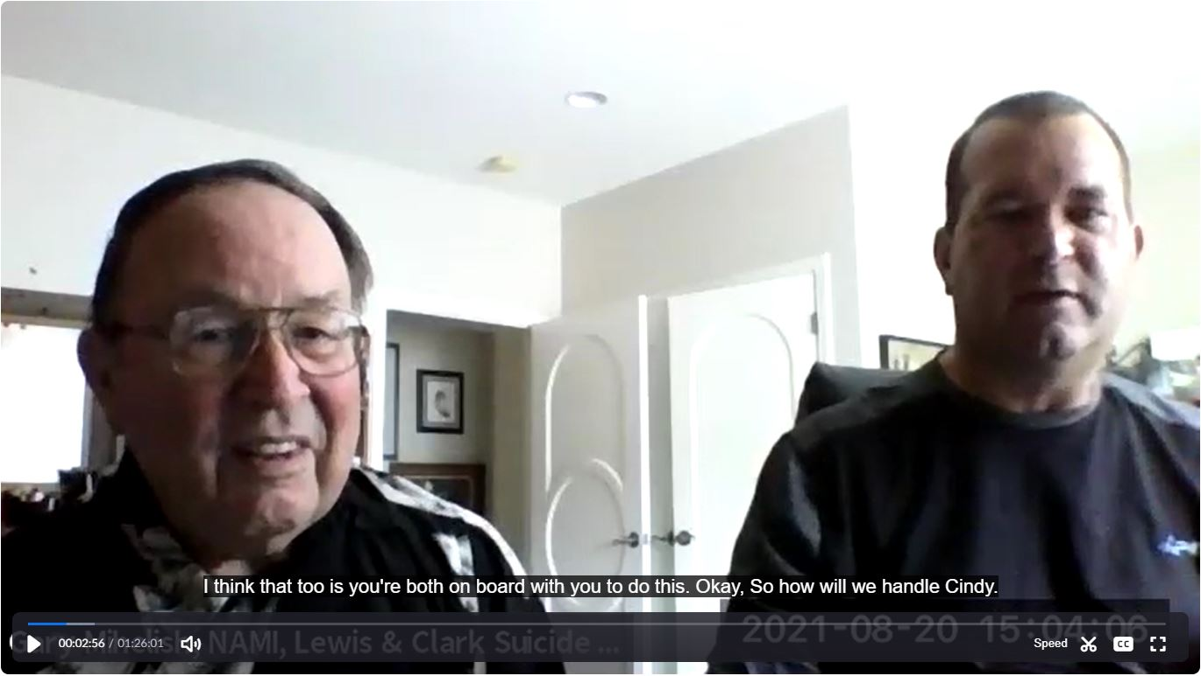
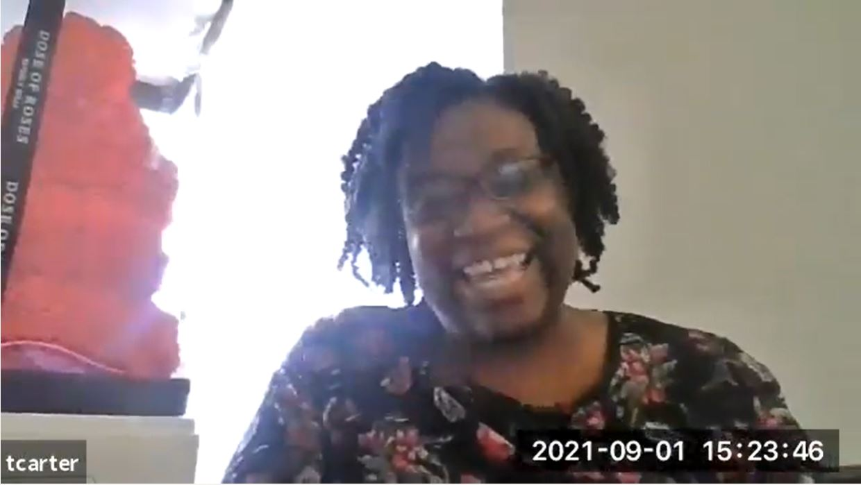
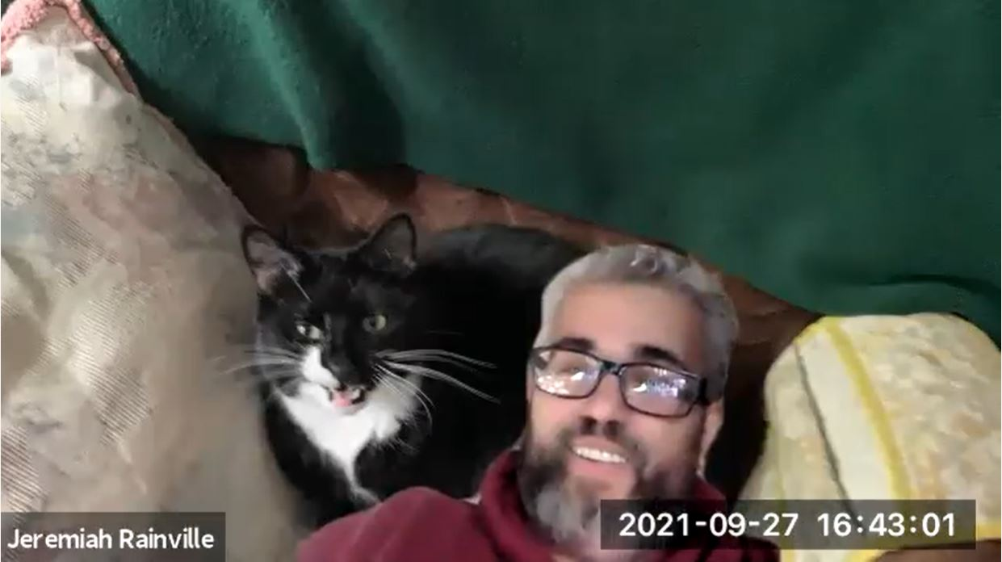
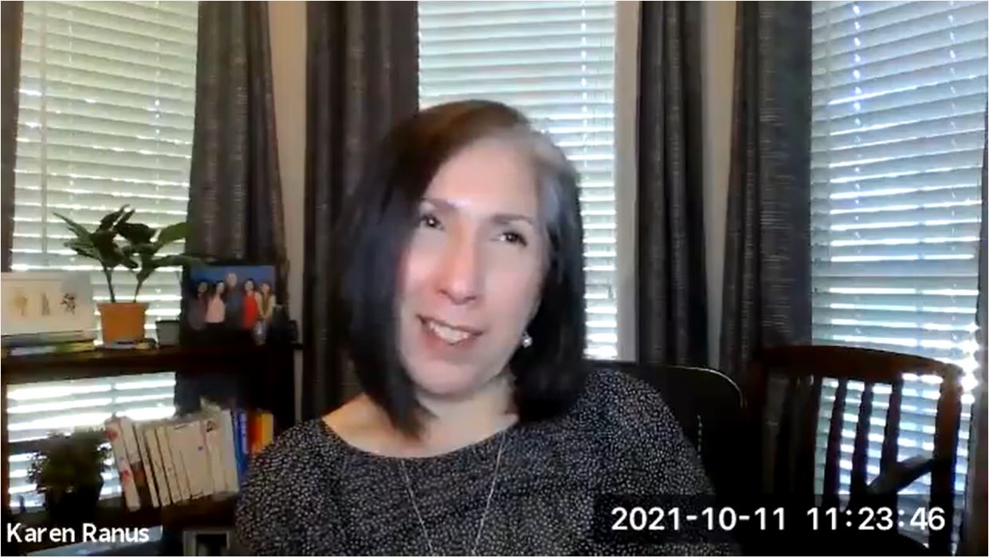
YOU ARE NOT ALONE

Slide 14
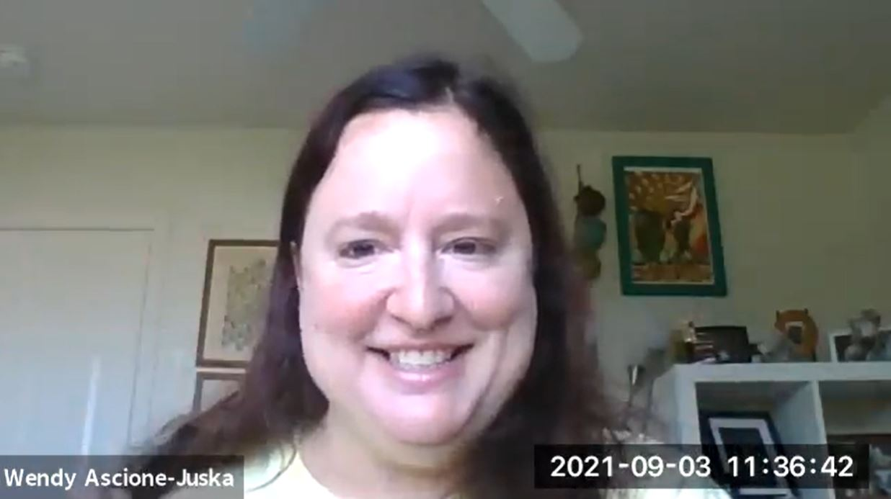
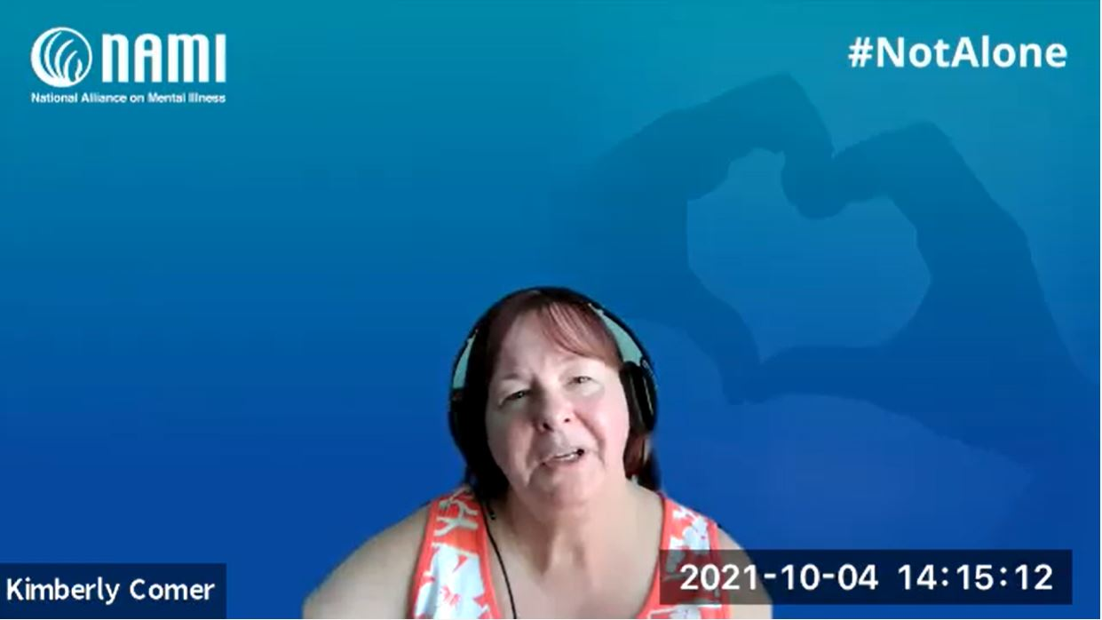
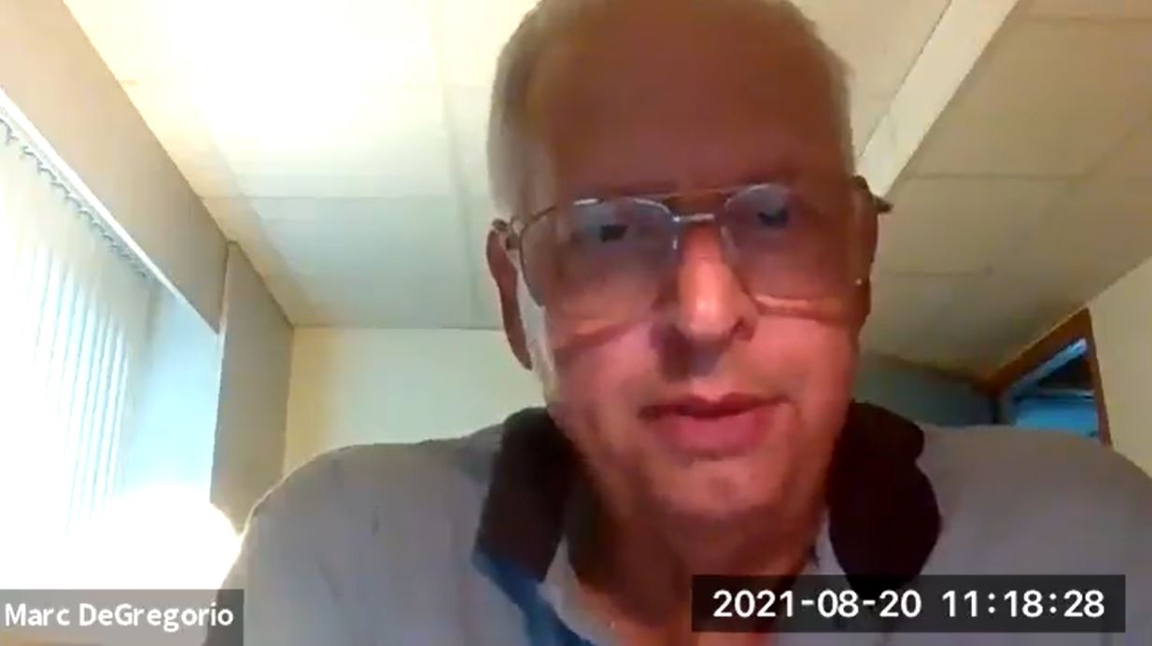
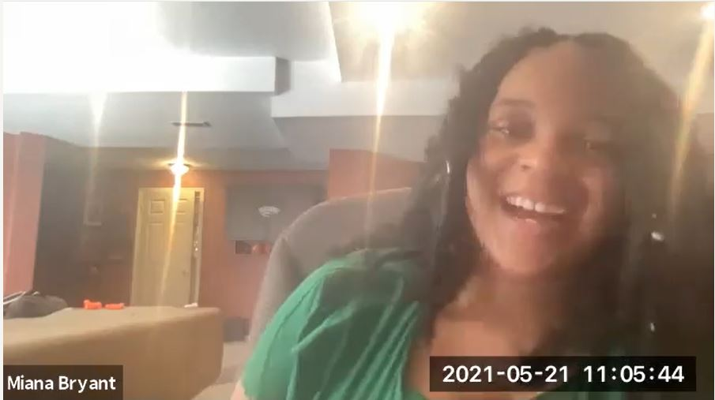
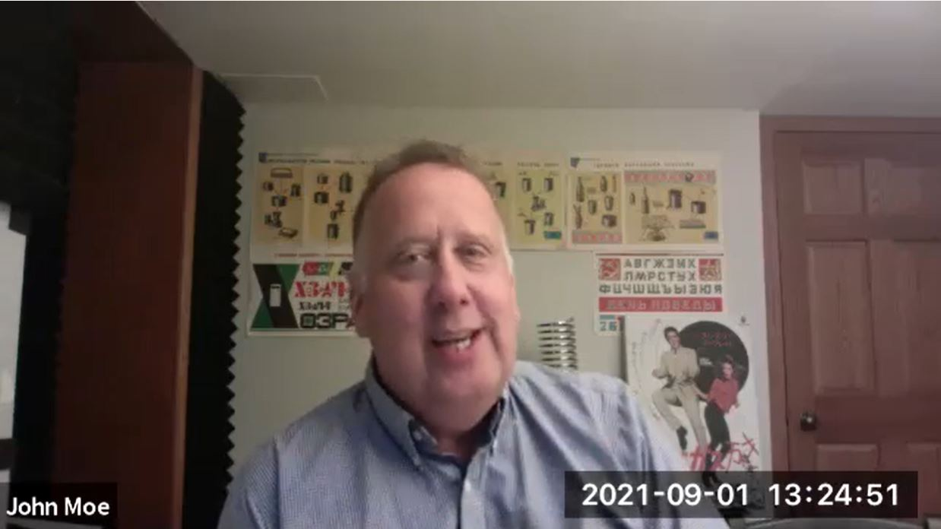
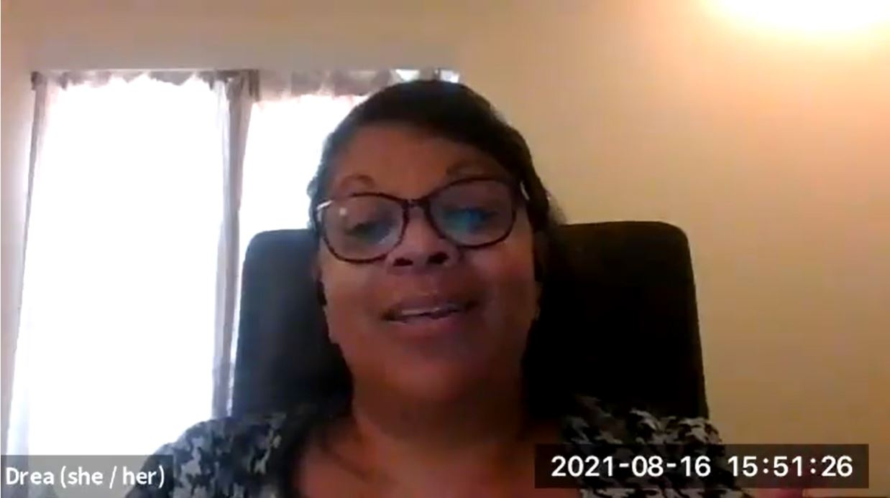
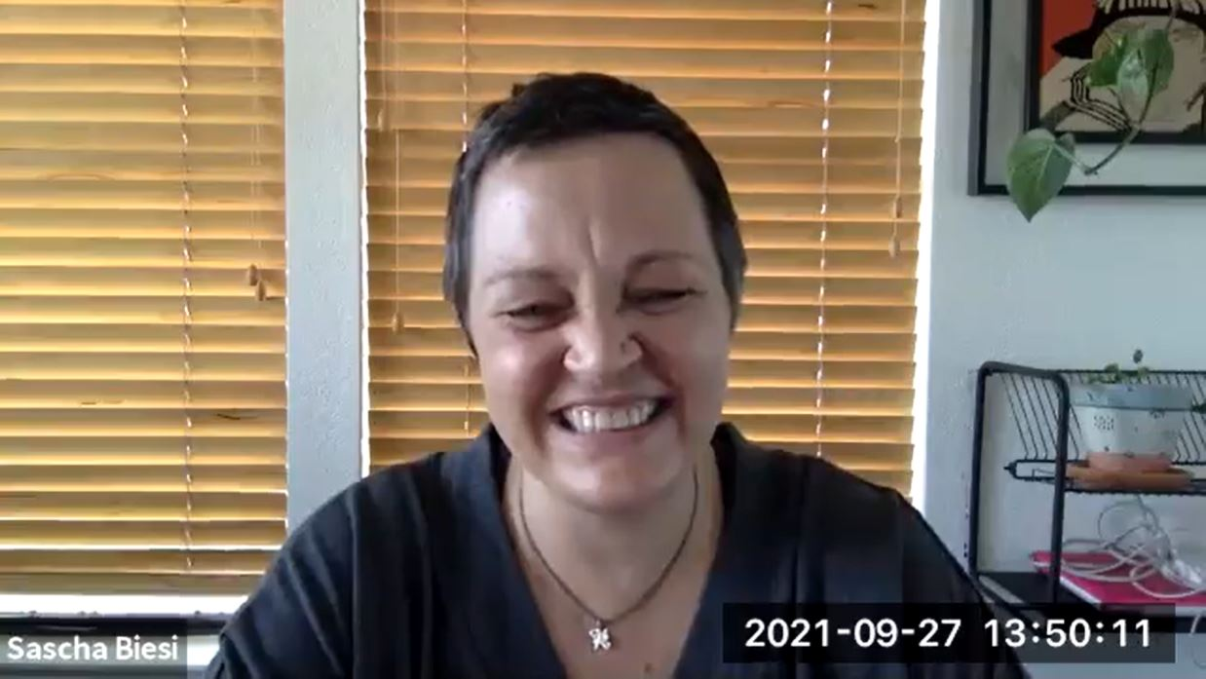
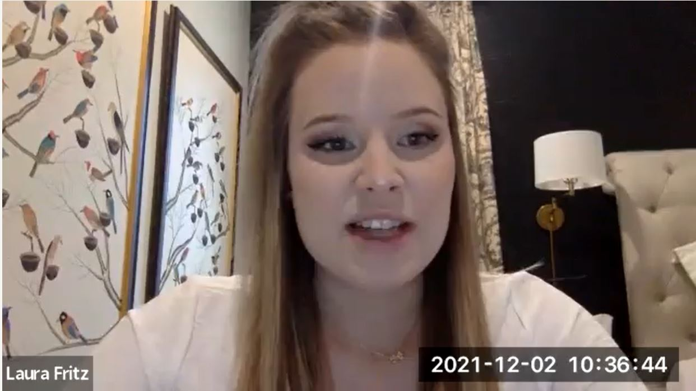
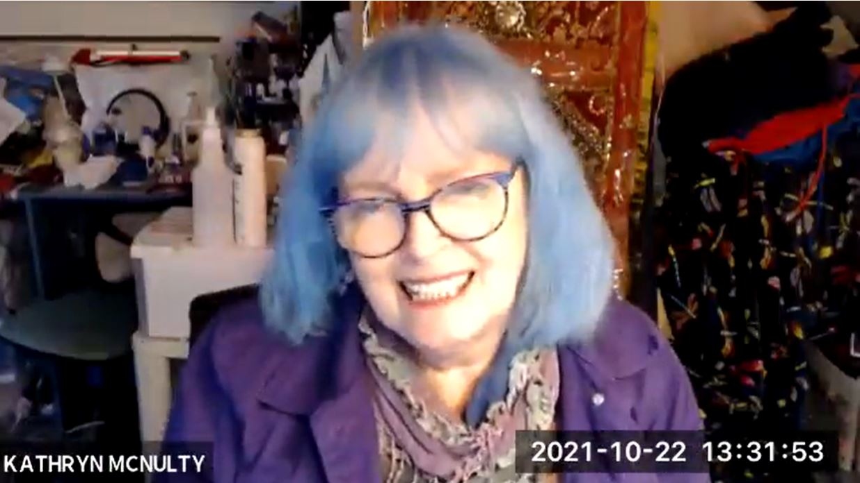
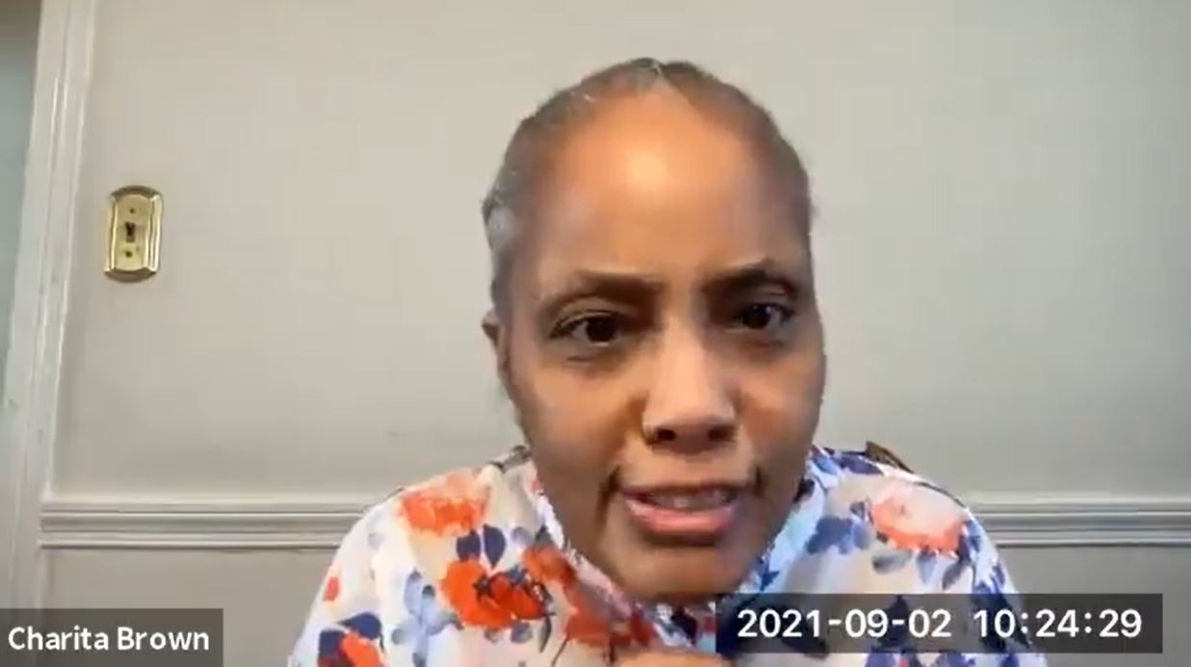
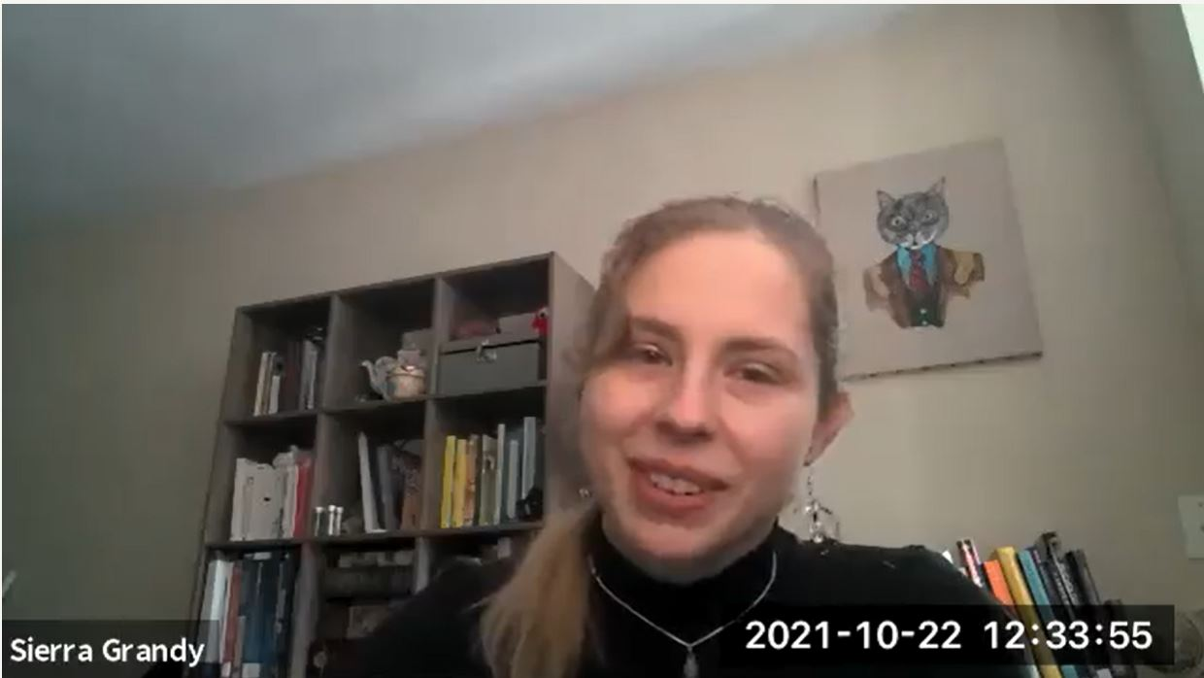
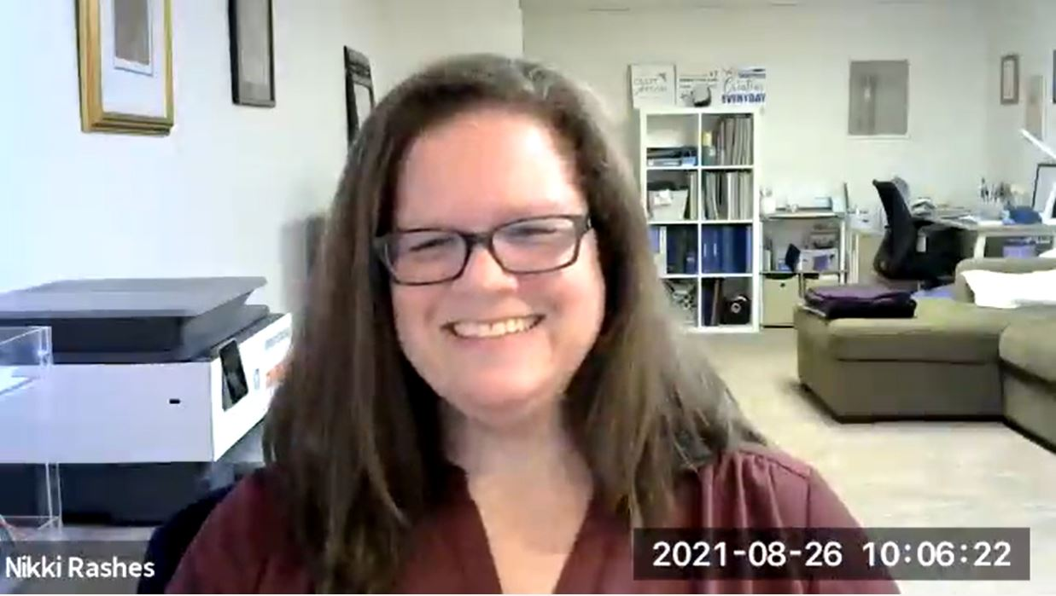
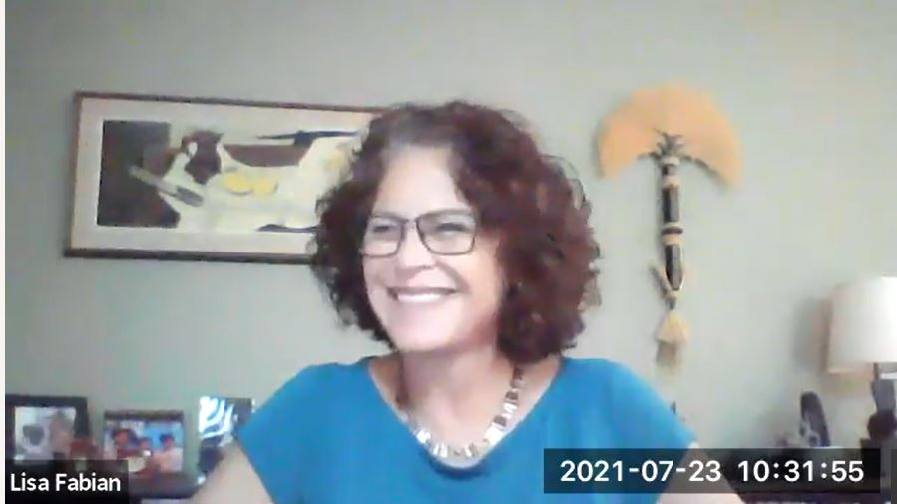
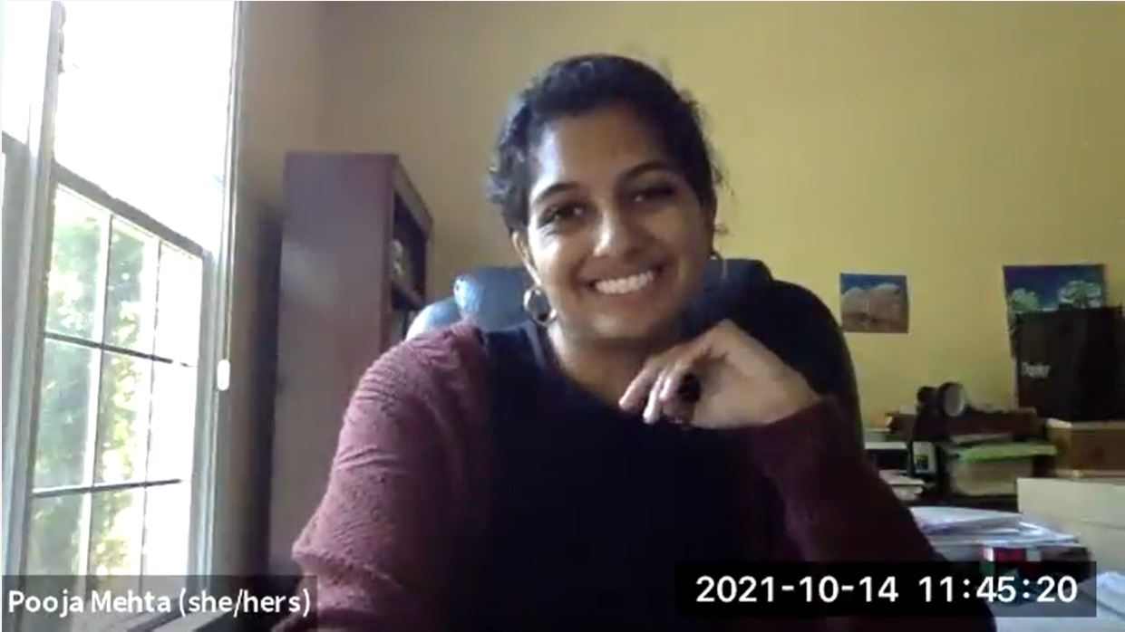
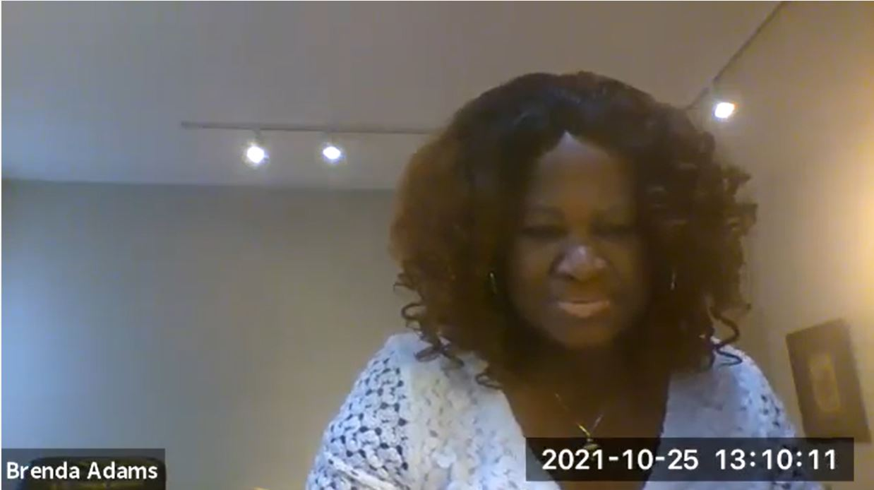
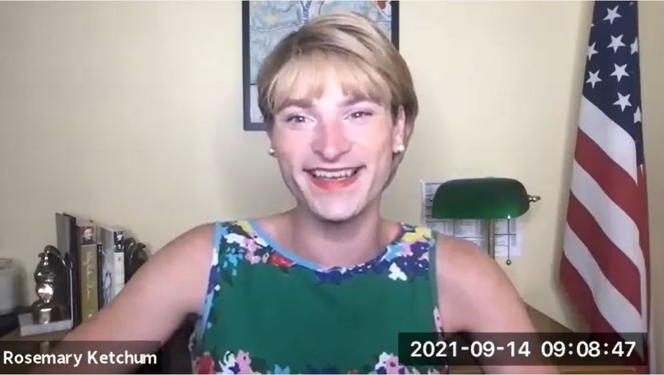
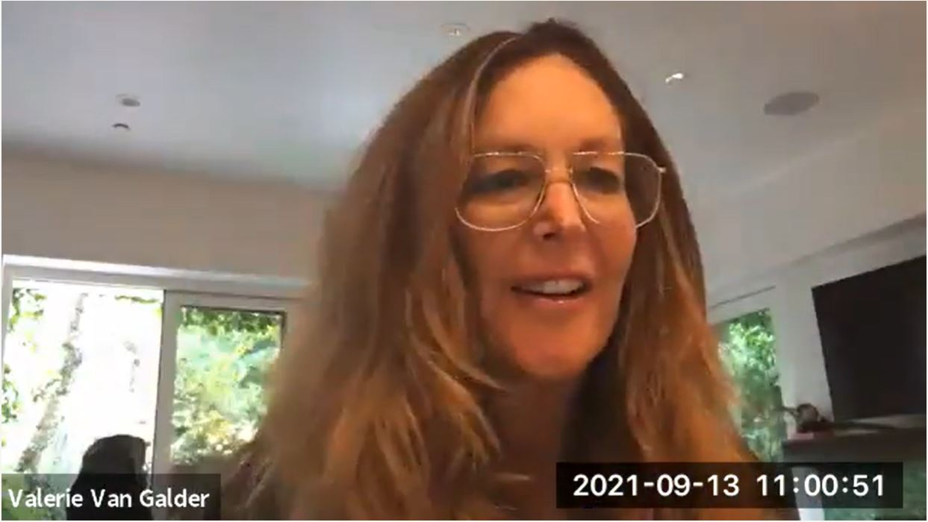
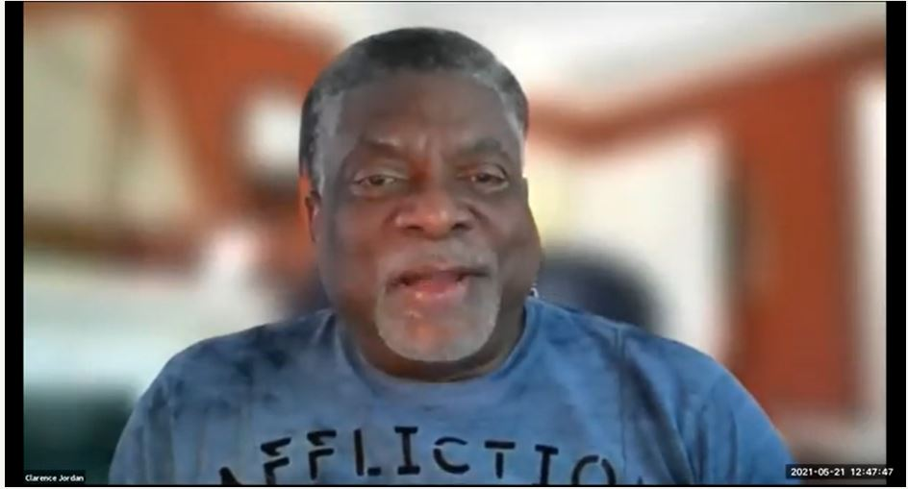




Project Overview
130 interviews with individuals living with a mental health condition and families—using their real names & stories
35 Frequently Asked Questions answered
by experts from across the field
All proceeds go to NAMI

Slide 15













Contributors joined us from:
38 States
11 races and ethnicities
Across the spectrums of gender & sexuality
25 different faith orientations
Over 50 occupations
Ages 16 – 100 (Or as one reported, “Older than Dirt”)

Slide 16























Chapters & Themes
Part I
Mental Health & Mental Health Conditions
  Do I Need Help?
  The Paradox of Diagnosis
  How Do I Find Help? Minding the Many Gaps
  The Path to Recovery: First Steps
  Added Complexity: Substance Use Conditions
  The Impact of Trauma
  Children, Teens, and Young Adults
Part II
The Recovery Journey: Evidence from Lived Experience
  Themes of Recovery
  The Power of Peers
  Culture and Identity: Barriers and Opportunities
  Becoming an Advocate
Part III
Family Matters
  Family Communication
  Navigating the Legal System
  The Hardest Family Questions
  Making Meaning of Loss by Suicide
  Family Advocacy
Part IV
Best Practices
  Experts Answer the Most Frequently Asked Questions
  State of the Art Care and Research for Specific Conditions

Slide 17
























Part IV: Best Practices
  17. Experts Answer the Most Frequently Asked Questions
  18. State of the Art Care and Research for Specific Conditions
Seeking Help
How do I find a therapist?
Jen Leggett LICSW
Can technology help me manage my symptoms?
John Torous MD
Recovery Tools
What is WRAP and how does it work?
Mary Ellen Copeland
Is a job a mental health intervention?
Bob Drake MD PhD
Family
How do I help my family member see they need help?
William Miller
I want to have a baby but I have bipolar disorder.
How do I approach that?
Marlene Freeman MD
Treatment/Research
Do I really have to take these meds forever?
Andy Nierenberg MD
Is there a better way to approach early psychosis
Kesh MD
What is the best approach to OCD ?
Sabine Wilhelm PhD

Slide 18
Acknowledgments – Contributors
Brenda Adams
Haley Amering
Danny Anastasi
Wendy Ascione-Juska
Sukhmani Kaur Bal
Diane Banks
Chrissy Barnard
Cynthia Berkowitz
Janet Berkowitz
Sascha Biesi
Ronald Braunstein
Angela Brisbin
Michael Brisbin
Charita Cole Brown
Dawn Brown
Miana Bryant
Joyce Burland
Tera Carter
James Chambliss
Diana Chao
Karyl Chastain Beal
Kimberly Comer
Haley Comerford
Mary Ellen Copeland
Robert Cubby
Margaret Curley
Kevin Dedner
Marc DeGregorio
Alexander Donahoe
John Donahoe
Nancy Donahoe
Roselin Dueñas
Matt Edwards
Carolyn Edwards
Nick Emeigh
Lisa Fabian
Joseph Feaster, Jr.
Sally Fitlow
Laurie Flynn
Corinne Foxx
Laura Fritz
Carole Furr
Brad Gage
Pam Goldman
Sierra Grandy
Tracy Green
Sarah Greulich
Cathy Guild
Ray Lay
Nadine Lewis
Philip A. Lederer
Trish Lockard
Kumi Macdonald
Pranita Mainali
Lloyd Hale
Judy Harris
Michael Hauck
Alice Henley
John Henley
Anita Herron
Brenda Hilligoss
Shirley Holloway
Angelina Hudson
Peggy Huppert
Clarence Jordan
George Kaufmann
Patrick Kaufmann
Rosemary Ketchum
George Kohn
Jutta Kohn
Drea Landry
Carlos A. Larrauri
Babu George Mathew
Danna Mauch
Nancy-Lee Mauger
Trevor McCauley
Kathryn Cohan McNulty
Pooja Mehta
Gary Mihelish
Kurt Mihelish
Lynn Miller
John Moe
Christine Yu Moutier
Chastity Murry
Dante Murry
Elisa Norman
Betsey O’Brien
Jonathan Ordonez
Norman Ornstein
Eleanor Owen
Monique Owens
Denise Paley
Marty Parrish
Kelly Pavelich
Cathleen Payne
Jim Payne
Kenya “The Visionaire” Phillips
Jeanne Porter
Ky Quickbane
Jeremiah Rainville
James Ramirez
Karen Ranus
Nikki Rashes
Kristen Roper
Snake Sabo
Kristina Saffran
Josh Santana
Phil & Donna Satow
Susie Seligson
Susan Smiley
Brad Smith
Nancy Smith
Eric Smith
Richard Smith
Sheryl Smith
Mike Smith
Stephen Smith
Christina Sparrock
Kaitlyn Tollefson
Valerie Van Galder
Suzanne Vogel-Scibilia
Caroline Whiddon
Emma Winters
Liam Winters
Bethany Yeiser
Karen Yeiser

Slide 19
The purpose of the MHTTC Network is technology transfer - disseminating and implementing evidence-based practices for mental disorders into the field.
Funded by the Substance Abuse and Mental Health Services Administration (SAMHSA), the MHTTC Network includes 10 Regional Centers, a National American Indian and Alaska Native Center, a National Hispanic and Latino Center, and a Network Coordinating Office.
Our collaborative network supports resource development and dissemination, training and technical assistance, and workforce development for the mental health field. We work with systems, organizations, and treatment practitioners involved in the delivery of mental health services to strengthen their capacity to deliver effective evidence-based practices to individuals.
Our services cover the full continuum spanning mental illness prevention, treatment, and recovery support.
MHTTCnetwork.org
Sign-Up for Newsletter
MTTC News

