Slide 1
Advancing Health Equity for Individuals with Serious Mental Illness
Kelly Irwin, MD, MPH
MAPNET, New England MHTTC
September 22nd, 2023
Notes:
DO NOT CHANGE THE FORMAT OF THIS TEMPLATE. If you are creating MHTTC-branded slides, you must use this template or one of the other approved templates in the Shared Folder.

Slide 2




Housekeeping Information
Participant microphones will be muted at entry
If you have questions during the event, please use the chat
This session is being recorded and it will be emailed to all participants once available.
If you have questions after
this session, please e-mail:
newengland@mhttcnetwork.org.
At the end of the month, we will send you a certificate of completion that you can submit to your particular board for continuing education credit. Please contact ifisher@c4innovates.com for more information on CEs after the event.

Slide 3
Acknowledgment
Presented in 2022 by the Mental Health Technology Transfer Center (MHTTC) Network.
This presentation was prepared for the New England Mental Health Technology Transfer Center (MHTTC) Network under a cooperative agreement from the Substance Abuse and Mental Health Services Administration (SAMHSA). All material appearing in this publication, except that taken directly from copyrighted sources, is in the public domain and may be reproduced or copied without permission from SAMHSA or the authors. Citation of the source is appreciated. Do not reproduce or distribute this publication for a fee without specific, written authorization from New England MHTTC. For more information on obtaining copies of this publication, email us at newengland@mhttcnetwork.org.
At the time of this publication, Miriam E. Delphin-Rittmon, Ph.D, served as Assistant Secretary for Mental Health and Substance Use in the U.S. Department of Health and Human Services and the Administrator of the Substance Abuse and Mental Health Services Administration.
The opinions expressed herein are the view of TTC Network and do not reflect the official position of the Department of Health and Human Services (DHHS), SAMHSA. No official support or endorsement of DHHS, SAMHSA, for the opinions described in this document is intended or should be inferred.
This work is supported by grants #1H79SM081775 from the Department of Health and Human Services, Substance Abuse and Mental Health Services Administration.
Presented 2022
Notes:
Always use acknowledgment slide on the 2nd slide and add your center’s information

Slide 4
Notes:
Always use Language Matters graphic as your third slide.

Slide 5







Advancing Health Equity for Individuals with Serious Mental Illness
Kelly Irwin, MD, MPH
Assistant Professor of Psychiatry, Harvard Medical School
Collaborative Care and Community Engagement Program
Center for Psychiatric Oncology and Behavioral Sciences
Massachusetts General Hospital Cancer Center
ENGAGE: The Cancer and Mental Health Collaborative

Slide 6

“Everyone who is born holds dual citizenship, in the kingdom of the well and in the kingdom of the sick.
Although we all prefer to use the good passport, sooner or later each of us is obliged…to identify ourselves as citizens of that other place.”
- Susan Sontag

Slide 7
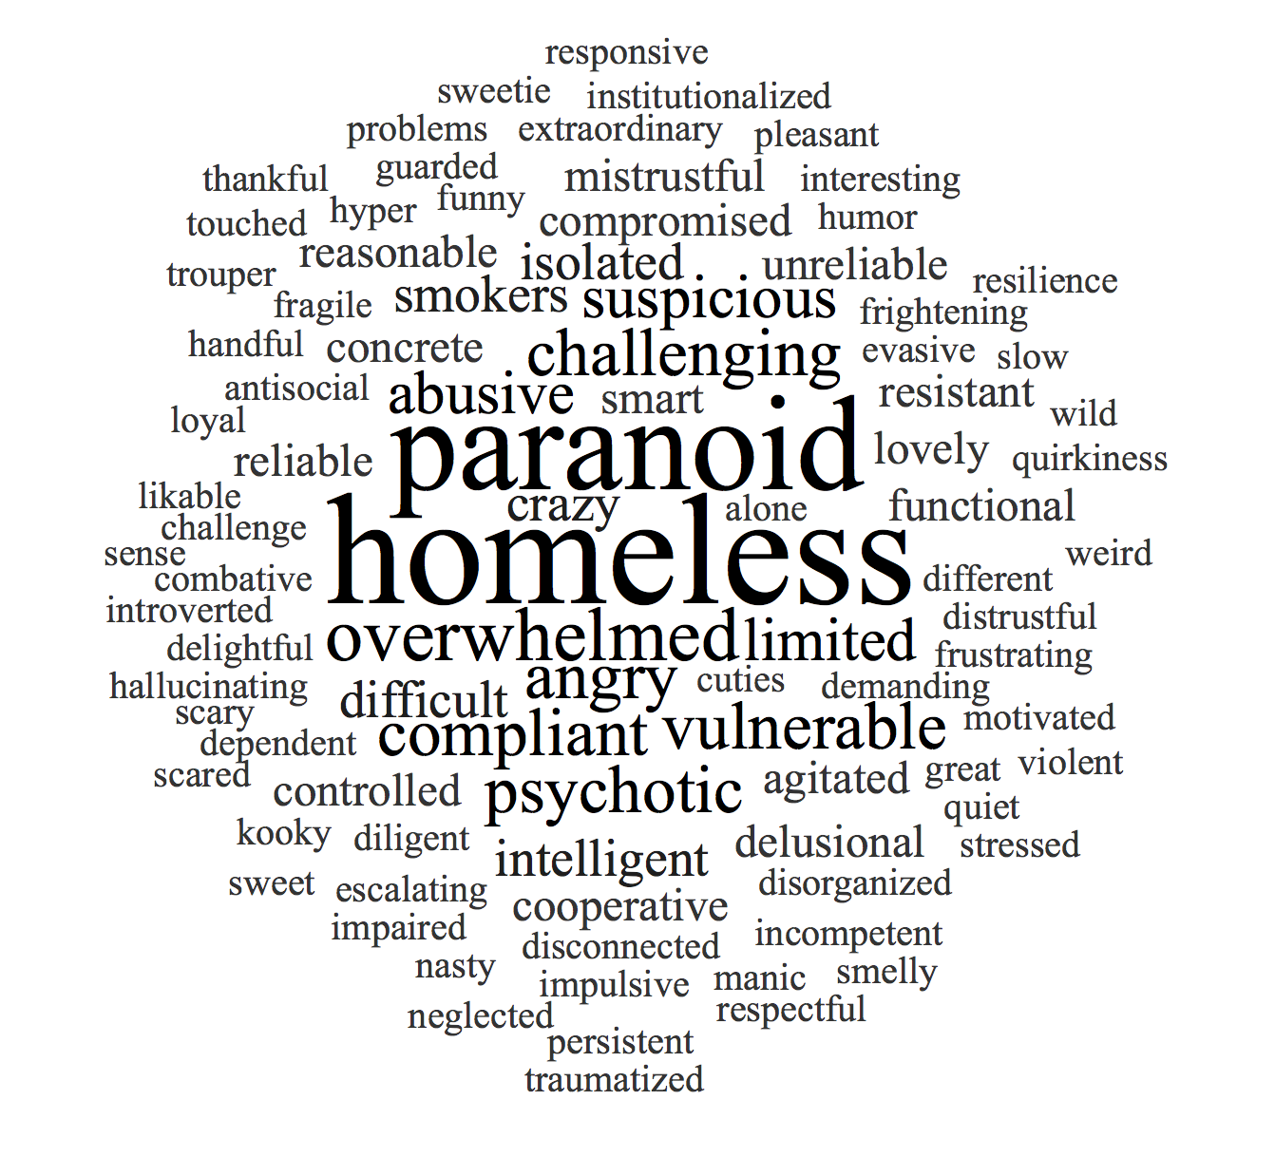
Words matter.
Notes:
Start off with reading quote
Tie into reflection about the importance of being quiet at times, helping other voices be heard
Reflection about stakeholder board/opening up dialogue related to person-centered language (Latino/a/x example, patient/client)
All had times where we did not say what we were thinking, were not fully able to share our experiences/chose not to.
Could have shut down community building/an idea being shared, felt silenced…think about language that may have worked better. Some research around gender/not using people’s titles (ER physicians and gender assumptions)
Open with broader example about not knowing what people are bringing into the room, do not know people’s background → Kelly will ask Samar to share thoughts
Acknowledge access issues/we we all may need something different to be able to participate meaningfully (captions, increased sound…)
Example of consequences of language w/ anti-Asian violence
“Research suggests that when people see Asian Americans as being more ‘foreign,’ they are more likely to express hostility toward them and engage in acts of violence and discrimination,” Rucker Johnson, a public policy professor at the University of California, Berkeley, and co-author of the study, told NBC Asian America.
For the study, entitled “After ‘The China Virus’ Went Viral,” researchers looked at “implicit Americanness bias,” or the ease with which respondents linked Asian American and European American faces with American or foreign symbols. It found that from 2007 through early 2020, the subconscious belief that European Americans are more “American” than Asian American individuals steadily declined.
However researchers observed a trend reversal on March 8, the day Rep. Paul Gosar, R-Ariz., tweeted about the “Wuhan virus.” The timing also coincided with Secretary of State Mike Pompeo’s interview the day before on "Fox and Friends," in which he referred to the “China virus." In February, the World Health Organization had cautioned against using such language, warning that it could stigmatize an entire people.”
Sources:
https://www.nbcnews.com/news/asian-america/anti-asian-bias-rose-after-media-officials-used-china-virus-n1241364
https://news.utexas.edu/2018/03/30/name-use-matters-for-transgender-youths-mental-health/
Counterpoint: Patrick Corrigan

Slide 8

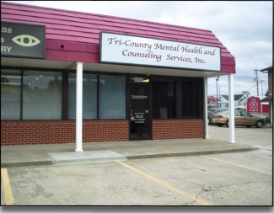
Cancer Center
Mental Health Clinic

Slide 9
Individuals with serious mental illness are dying prematurely; cancer is the 2nd leading cause of death.
A Woman in Massachusetts
82
80% of mortality gap is from medical illness.
…with Serious Mental Illness served by Department of Mental Health
52

Slide 10
Women with schizophrenia experience increased cancer mortality.
Breast cancer mortality has improved due to early detection and advances in treatment…
…however women with Schizophrenia are 2-3x more likely to die from breast cancer
SEER 9 Incidence & U.S. Mortality 1975-2010, All Races, Females, Age-Adjusted
Tran, 2009

Slide 11

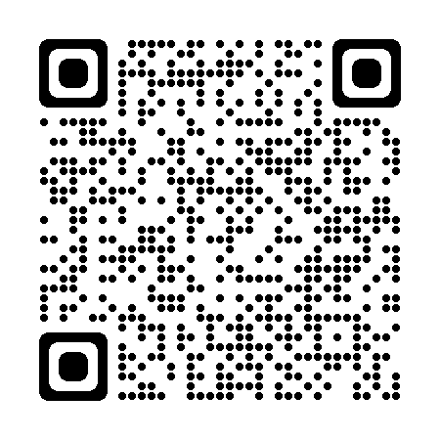
Patient, clinician, and systems-based factors contribute to inequities in cancer care, premature mortality and increased suffering for people with serious mental illness.
System
Discrimination
Clinician
Patient
Prevention & screening
Diagnosis
Treatment
Surveillance
End-of-life care
Irwin et al, Cancer 2014
Quality of Life
Survival
Bergamo, C. et al, Psychosom Med, 2014
Kisely, S., et al, JAMA Psychiatry, Abudullah KN, et al, Am J Surg, 2015
Chan et al, BMJ Open, 2014, Foti, Psychiatric Services, 2005, Huang, BMJ, 2017, Chochinov, 2012

Slide 12
System
Untreated symptoms impact illness understanding and communication.
“It’s extremely difficult because she doesn’t have insight into the risk if she doesn’t get treatment.” – Mental health nurse
Discrimination
Patient
Clinician

Slide 13
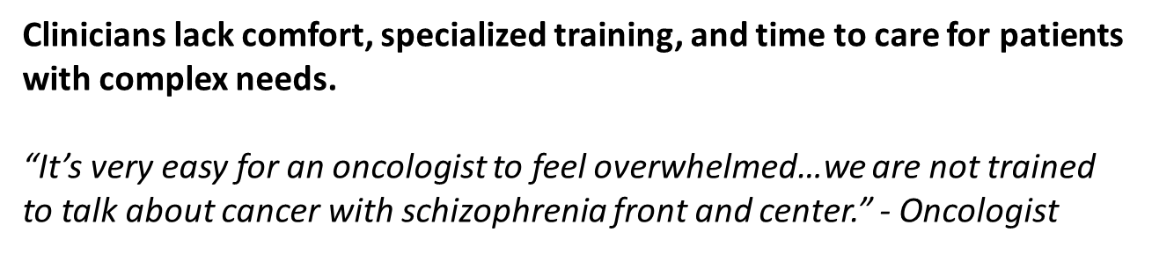
System
Untreated symptoms impact illness understanding and communication.
“It’s extremely difficult because she doesn’t have insight into the risk if she doesn’t get treatment.” – Mental health nurse
Discrimination
Clinician
Patient

Slide 14
System
Untreated symptoms impact illness understanding, communication, and follow-up.
“It’s extremely difficult because she doesn’t have insight into the risk if she doesn’t get treatment.” – Mental health nurse
Discrimination
Clinician
Patient
Mental health care and cancer care are fragmented; psychosocial care is inadequate.
“One of the biggest barriers is lack of access to psychiatry, and with cancer care, we can’t wait.”
- Medical Oncologist

Slide 15
Individuals with mental illness have been systematically excluded from clinical trials.
“There are people who falsely assume that patients can't give informed consent or won't understand…people kind of write off this population.”
-Medical Oncologist
Humphreys et al, Journal of Psychiatric Research, 2015
Irwin, Moy, et al, Journal of Clinical Oncology, 2019

Slide 16

Challenge: Mental health discrimination is pervasive.
Brain illness too often remains invisible and unspoken.
Patients experience shame and isolation which contributes to delays, preventable suffering, and death.
Clinicians feel helpless.
We do not invest adequately in mental health services, training, or research.
We lack evidence to guide treatment.
L. Rosenbaum, Unlearning Helplessness, NEJM, 2016
K. Irwin, The Patients We Don’t Want To See, The Oncologist, 2017

Slide 17

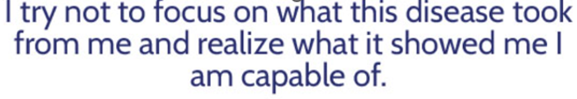
Carmen’s story: https://engageinitiative.org/blog/the-call-that-changed-my-life/
“Doctors too can be prejudiced. Doctors need to listen more to the intuitive nature of their patients.
White coats to me became a synonym with fear and distrust.
I was to get a port for chemo and was told it was a quick and painless same day procedure.
Day 5: I explained I felt like an elephant was sitting in my chest, I called my doctor and was told that it would soon go away.
Day 8: I went in crying to be seen urgently and told them something is wrong. I cannot bare this. Please take it out. PLEASE! They told me to bare it, gave me a prescription for oxys and sent me home.
Day 10: I went into cardiac failure, contracted sepsis; it had spread through my heart and pulmonary emboli.
I spent many days with no returned calls as I lay sick in bed, unable to breathe, and in pain without being able to think clearly. How was I supposed to make life-saving decisions? I was on the phone to follow up, only to realize they had forgotten all about me. The system is broken… I was just a number.
I learned that left in long periods of agony, fear and stigma can make even the most sane insane.”

Slide 18

We apply a person-centered lens to cancer care and research for people with serious mental illness.
Developed and successfully piloted BRIDGE: Person-Centered Collaborative Care for individuals with serious mental illness in collaboration with community partners
2. Led first randomized trial examining the impact of Bridge on cancer care
  Building Systems to Identify and Engage Marginalized Populations
  Designing for Equity: Modifying Inclusion Criteria
3. Created the Engage Initiative (The Cancer and Mental Health Collaborative) to build partnerships and infrastructure for community engaged participatory research
4. Adapted model for implementation and dissemination: Cancer and Mental Health Tumor Board

Slide 19
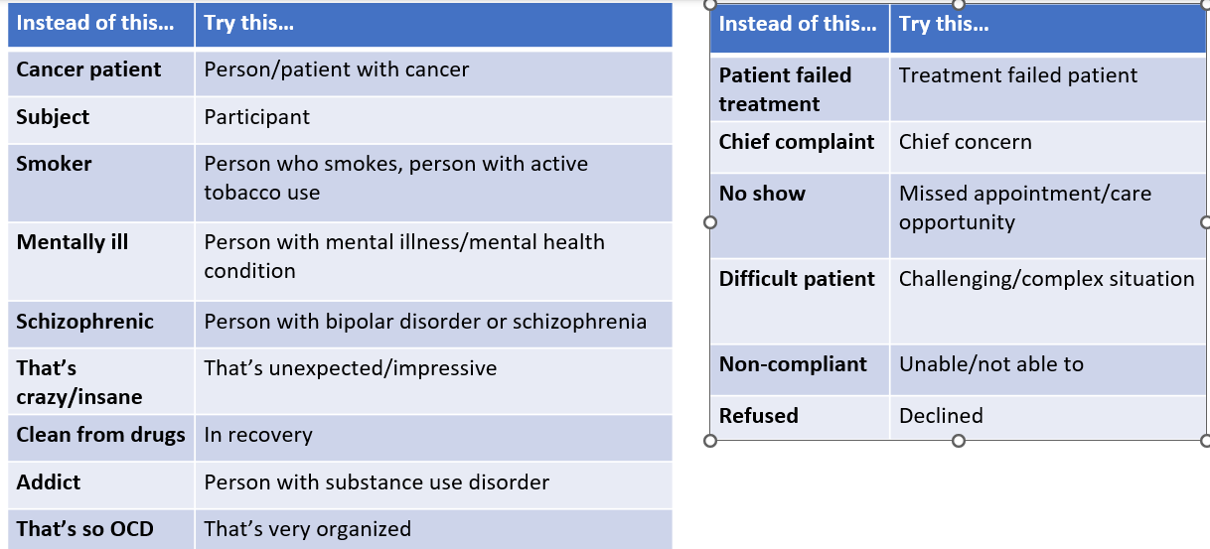
Beginning with person-first language can decrease shame and strengthen connection.

Slide 20
When we consider each person’s strengths, we can think creatively.
Loud voices telling him to end his life
Depression and hopelessness
Stops medications
Isolated, alone
Drinking alcohol every day
Trauma
On leave from work
Agitated, yelling
Banned from the bus
Does not call back
Profound suffering
Showed up
Built long-term relationships with partner and with clinicians
Shared vulnerability
Concerned about others
Well-dressed
Bilingual
Curious
Worked at the airport

Slide 21
Access to psychiatric treatment at cancer diagnosis may promote equitable cancer care for individuals with schizophrenia.
Irwin et al, The Oncologist, 2017

Slide 22
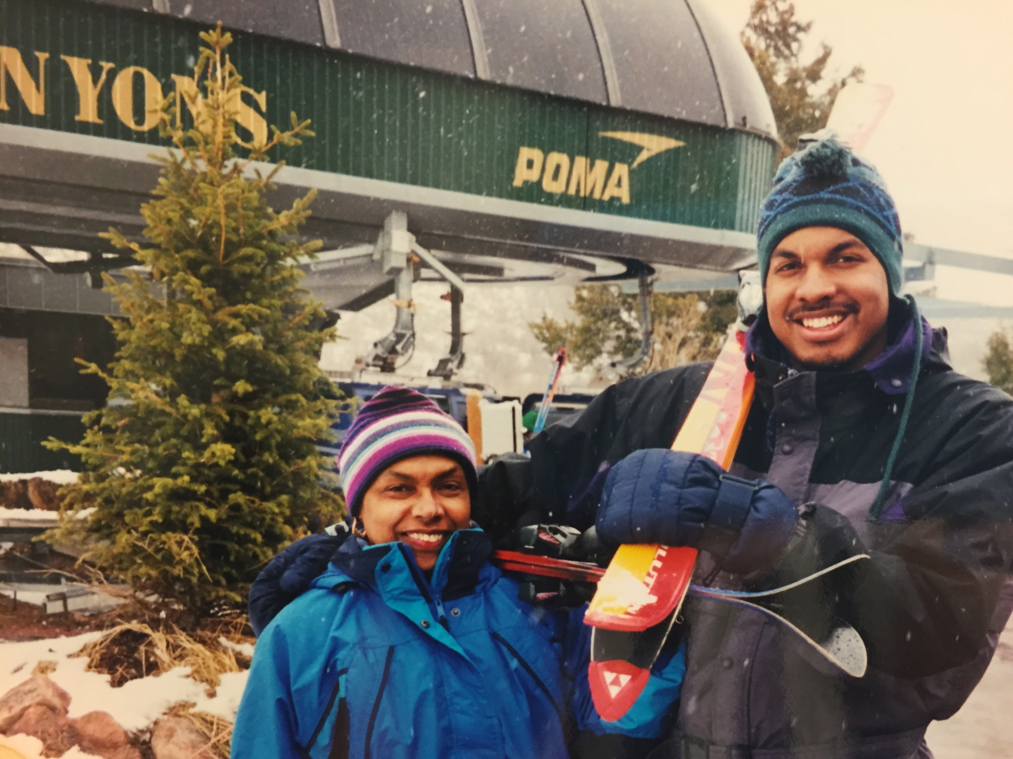

Slide 23
BRIDGE is person-centered collaborative care that addresses barriers to cancer care proactively and engages a diverse team to improve cancer outcomes.
Proactive
Person and caregiver-centered
Team-Based
Systematic weekly case review
Evidence-based interventions for cancer and mental illness
Caregiver
Person
Oncologist
Case Manager
Psychiatrist
Irwin et al, NEJM, 2016
Notes:
Discuss what we did in this case and how it might be extended/disseminated acknowledging differences in resources and access to services in different systems of care. (always have a patient and an oncologist)

Slide 24
We developed targeted study procedures for patients with SMI and cancer.
Barrier | Strategy
Cognitive deficits Fear, paranoia, mistrust | Verbal consent process using concrete examples and repetition
Structural discrimination | Built coalition engaging community partners and individuals with lived experience
Need for protection from coercion | Clinician assesses consent with validated tool
Fragmented care | Person-centered approach across settings and systems including recruitment from community partners from coalition
Burden of medical and psychiatric symptoms | Joint visits with oncology

Slide 25
Feasibility Trial: Person-Centered Collaborative
Care for Individuals with Serious Mental Illness and Cancer
Person
Caregiver
Onc.
Case Manager
Aim: To assess the feasibility and acceptability of the care model for patients with SMI and a new cancer
Psy
Inclusion Criteria
Procedures
Schizophrenia, bipolar disorder, major depression w/prior hospitalization
Within 8 weeks of initial oncology consultation for GI, breast, lung, or head/neck cancer
Can complete self-report measures
12 week intervention individualized to patient, caregiver, and clinician needs
Interdisciplinary assessment of barriers to cancer care, co-management with oncology, and patient engagement across settings
Patient, caregiver, and clinician exit interviews re: acceptability and usefulness
Assessment of psychiatric symptoms (BPRS, CGI)
Chart review of cancer treatment at 6 months

Slide 26
The Bridge intervention was feasible and there was significant unmet need.
Caregiver
Person
Onc.
Case Manager
Psy
Goal
Enroll 30 patients in 15 months
50% of approached patients consent to enroll in study
75% of enrolled patients complete all assessments
Result
30 patients enrolled in 4 months
90% of eligible patients consented
100% had comprehensive assessment 88% completed all self-report measures
5/6 patients who previously declined cancer treatment received all recommended cancer care during the trial.
Irwin et al, The Oncologist, 2019

Slide 27
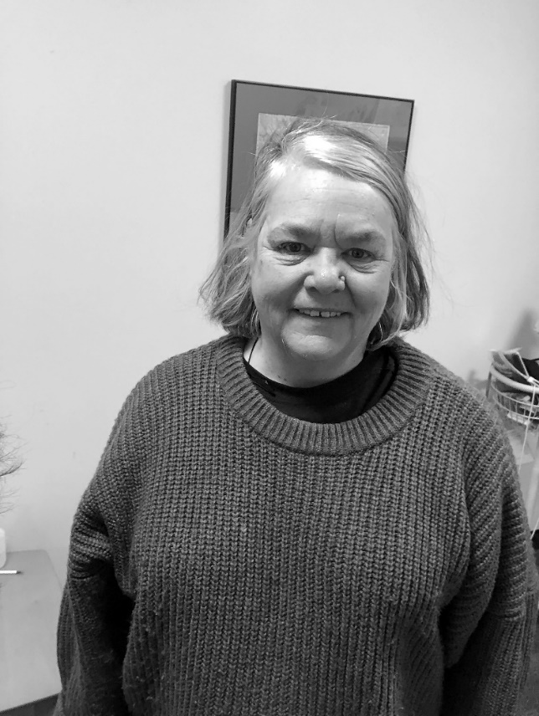
“I didn’t feel wanted. I had a lump for 6 months, and I could feel them dismissing me. The team listened to me and that was the difference between life and death.”
- Ady, woman with breast cancer and bipolar disorder
Caregivers valued combined mental health and oncology expertise:
“She came from oncology, understood schizophrenia, and could tell us what to expect. I’ve never had a provider with both perspectives.”
- Adult daughter of woman with schizophrenia and GI cancer
Oncologists valued the proactive
approach and availability of psychiatry
“She would not have received care otherwise.” – Medical Oncologist

Slide 28
What are your worries?
Default approaches worsen disparities.
During the pandemic, escalating mental health needs have disproportionately impacted adults with serious mental illness and cancer.
Resident, skilled nursing | “Sometimes, I think it’s just a matter of time. I see more bodies coming in than going out. I am tested by God.”
Nurse Practitioner | “I worry clinicians don’t have time, and my clients with mental illness are likely falling through the cracks. People are less likely to seek help for their cancer and clinicians are less likely to notice that someone is physically ill.”
Social worker | “I’m always on alert. I worry about everyone’s safety.” “I worry most about the people we aren’t reaching.”
Navigator | “I worry about my patients dying alone.” “Not everyone has broadband or the internet.”
Family members | “People get lonely in group homes too.”
Psychiatrist | “I feel like I’m failing at everything I do.”

Slide 29
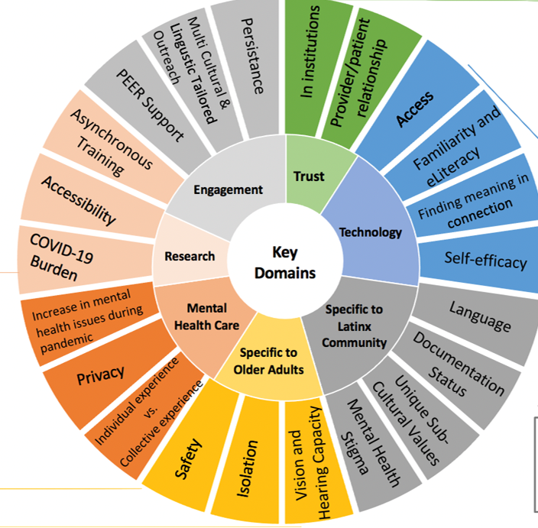
Barriers and Facilitators to Use of Technology for Older Adults with Serious Mental Illness
“It’s a little harder [for the patient] to understand why they need the service… It’s the paranoia kicking in…. That’s my difficulty getting them to engage and trust in the service.”
“I’ve spent half of my visits teaching people how to use technology and asking why it matters to them”
‘‘How could this be helpful in your life, not just your healthcare?”
“Some of our older persons in the group home were going to a program Monday to Friday, 6 hours a day. And now they’re cooped up and fearful in their rooms.”
“How do we tell people to engage in technology… that is not available in their language?”

Slide 30
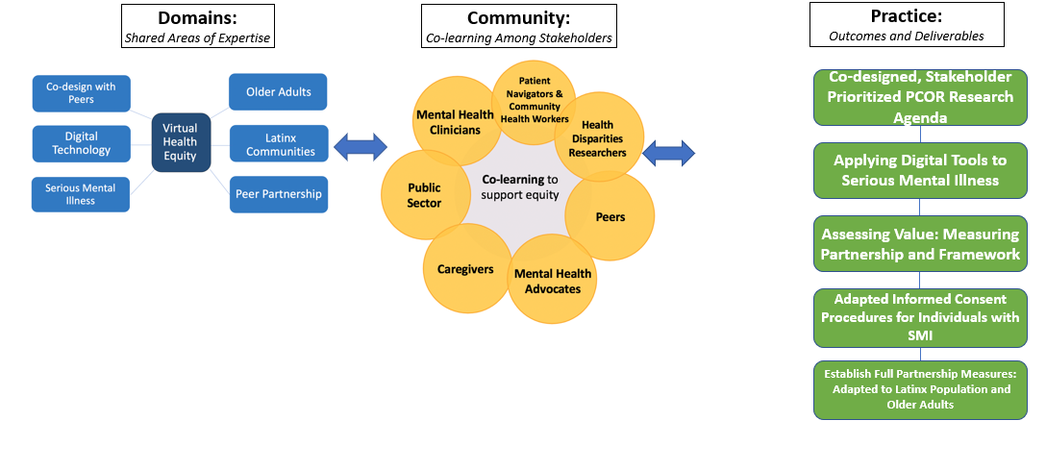
We established a Community of Practice to Advance Health Equity for Older Adults with Serious Mental Illness during COVID-19.

Slide 31
How do we design research and clinical care for equity during the pandemic?
What was lost?
Home and community-visits
Joint visits with oncology
Caregiver accompaniment
What was gained?
Comfort asking why not
New approaches to telehealth
Key questions:
How do we reach our population?
How do we build trust?
How do we partner with clinicians?
When is in-person care necessary?
Establish safety and a common language
Start with the why: Begin with patients and caregiver priorities, underscore need to learn together to develop new solutions
Assess access to technology and preferences for use, offer multiple modalities
Build capacity to use technology, ask who can we partner with
Creative persistence and a call for teams and coalitions
Design for sustainability in partnership with communities

Slide 32
BRIDGE: Randomized Trial of Person-Centered Collaborative Care
Aim 1: To investigate the effect of Bridge on cancer care
Aim 2: To assess the effect of Bridge on patient and caregiver-reported outcomes
Aim 3: To identify barriers and facilitators to implementing and disseminating the Bridge intervention in the community
Inclusion Criteria:
Patients: New invasive breast, lung, gastrointestinal, or head and neck cancer that can be treated with curative intent
Caregivers: Relative, friend, or community mental health staff who accompany patient to appointments.
Procedures: 120 patients randomized 1:1 to Bridge or Enhanced Usual Care, stratified by caregiver.
Outcomes: Primary: Cancer care disruptions evaluated by blinded oncologist consensus panel
Secondary: Psychiatric symptoms & illness severity, participant and caregiver-reported outcomes, acute care utilization
Learn More: https://clinicaltrials.gov/ct2/show/NCT03360695

Slide 33
We conducted a pragmatic trial of person-centered collaborative care for patients with SMI and cancer and their caregivers.
Caregiver
Person
Onc.
Case Manager
Psy
Goal
Enroll 120 patients in 36 months
60% of approached patients consent to enroll in study
75% of caregivers consent to enroll in the study
Result
120 patients enrolled in 30 months
83% of eligible patients consented
91% of eligible caregivers consented
American Psychosocial Oncology Society, 2023

Slide 34
Trial participants were primarily white and had high rates of poverty, disability, and low rates of living with a partner. Substance use was prevalent.
 | BRIDGE Trial Population n=120 (%)
No caregiver enrolled | 55 (45.8%)
Mean Age (SD) | 61.3 (12.4)
Female Gender | 80 (66.7%)
White Race Non-Hispanic Ethnicity | 105 (87.5%) 112 (93.3%)
Education Less than High School HS Diploma/GED Graduate Degree | 9 (7.5%) 35 (29.2%) 22 (18.3%)
Income <25K | 63 (52.5%)
Lived alone Lived with partner or spouse Congregate housing | 40 (33.3%) 23 (19.2%) 13 (10.8%)
Ever lacked housing Lacked housing at enrollment | 29 (24.2%) 6 (5%)
Unemployed due to disability | 46 (38.3%)
 | BRIDGE Trial Population
In past 12 months: Worried no place to stay Forego care due to transportation Difficulty reading hospital materials Discrimination in Healthcare Settings Sometimes/mostly/always: MD/RN acted like better than you Feel like MD/RN did not listen Rarely/sometimes/mostly/always MD/RN acted afraid of you | 17 (14.2%) 19 (15.8%) 28 (23.3%) 20 (16.6%) 38 (31.7%) 11 (9.2%)
Tobacco use documented at baseline Current Smoker Former Smoker | 47 (39.2%) 47 (39.2%)
Alcohol or opioid use disorder at baseline | 55 (45.8%)

Slide 35
 | BRIDGE (n=60) | Enhanced Usual Care (n=60) | Overall
Cancer Type Breast Cancer Gastrointestinal Cancer Head and Neck Cancer Lung Cancer | 20 (33.3%) 10 (16.7%) 14 (23.3%) 16 (26.7%) | 14 (23.3%) 20 (33.3%) 14 (23.3%) 12 (20%) | 34 (28.3%) 30 (25%) 28 (23.3%) 28 (23.3%)
Psychiatric Diagnosis Bipolar Disorder Major Depressive Disorder (with psych hospitalization) Schizophrenia Spectrum Disorder | 23 (38.3%) 26 (43.3%) 11 (18.3%) | 26 (43.3%) 22 (36.7%) 12 (20%) | 49 (40.8%) 48 (40%) 21 (17.5%)

Slide 36
Person-centered collaborative care decreases cancer care disruptions.
Caregiver
Person
Onc.
Case Manager
Primary Outcome: Cancer Care Disruptions evaluated by oncology consensus panel
50% lower odds of clinically significant cancer care disruptions*
BRIDGE: 10 participants had disruptions (17.3%)
EUC: 20 participants had disruptions (35%)
*P<0.035 after adjusting for cancer type, gender, caregiver status
Psy
Exit Survey Data from 83 oncology clinicians who cared for patients on BRIDGE
Large pos impact on cancer care Small pos impact on cancer care No impact Neg impact | 60 (74.1%) 20 (24.7%) 1 (1.2%) 0
Impacted cancer treatment plan | 23 (27.4%)
Impacted relationship w/pt | 36 (43.4%)
Impacted pt communication | 36 (44.4%)
Helped you as an oncologist care for pt | 70 (81.4%)
Having proactive psychiatry involvement was critical in helping the patient navigate her new diagnosis of cancer, treatment options. She wouldn’t have been able to have had cancer care without it.

Slide 37


Person-centered collaborative care decreases psychiatric illness severity and anxiety at 24 weeks.
Caregiver
Person
Onc.
Case Manager
Psy
 | Baseline mean (SD) | 6 weeks | 12 weeks | 24 weeks
PHQ Bridge EUC | 9.05 (6.62) 9.67 (6.02) | 7.88 (5.43) 9.55 (6) | 7.72 (5.77) 9.71 (6.25) | 6.89 (5.51) 8.05 (6.35)
GAD Bridge EUC | 8.73 (5.92) 7.43 (5.89) | 6.98 (5.42) 7.07 (6.21) | 6.02 (5.51) 7.47 (6.08) | 5.78 (5.14) 6.47 (5.56)
BPRS Bridge (total) Bridge (verbal) EUC total EUC verbal | 41.10 (14.12) 33.50 (10.3) 41.43 (12.5) 34.75 (8.69) |  | 36.47 (9.18) 28.88 (4.42) 37.66 (12.5) 31.86 (9.51) | 33.64 (8.59) 27.33 (4.8) 35.17 (11.9) 27.3 (4.16)
Linear mixed effects model at 24 weeks adjusting for gender, cancer, caregiver status

Slide 38
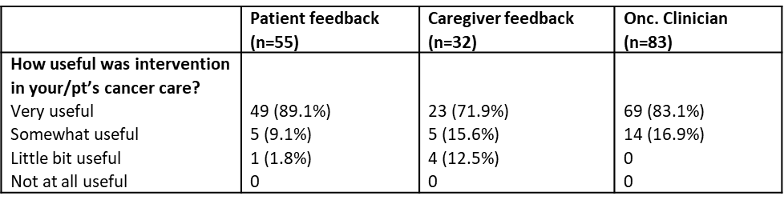
Even though she got sicker because of her cancer, she got healthier because of the study - Primary Care Clinician
Having help to guide me through emotional journey of having cancer, good to have someone there coordinating with my cancer team , felt less isolated, helped manage my thoughts-Patient with head/neck cancer and major depression.

Slide 39
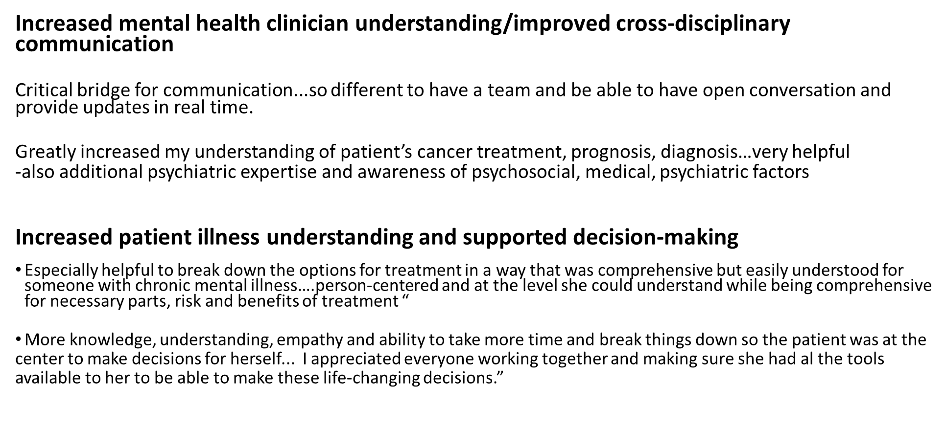
Mental health clinicians valued the collaborative model and recognized the positive impact on patient decision-making.

Slide 40
Patients valued the proactive, pragmatic, collaborative approach
It was early in my cancer care and integrated into other treatment. It was proactive.
This cancer diagnosis affected me more than I thought. I was keeping a strong face for the people around me. Meanwhile, I was internally at odds with it…got me in touch with the fact that I don't have to be so strong; I can address my mental health again.“
They call you back to see if you're ok. Very helpful with The Ride (transportation)...
They helped me quit smoking.
Having my daughter involved…There would be things that she would pick up on that I hadn’t. She brings things up.

Slide 41
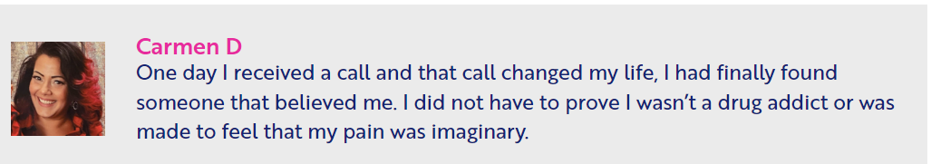
Or better yet, because of my tattoos, piercings, and color of my skin I wanted to exploit the system.
I am a proud, educated ,Latina and my complaints fell on deaf ears. I now know the truth and walking away has never been an option for me.
My community is suffering and being left behind due to lack of personal or systematic education, language barriers, awareness of rights, and affordability in the medical field.

Slide 42

We need bridges to bridge the divide between mental health and specialty care.
Approach: Person-centered care across settings
Prevention: Same-day mammography
Psych NPs prescribe tobacco cessation medications
Embedded shared decision making for lung screening
Treatment Virtual Equity Tumor Board: Hub and Spoke model
Adapting tele-psychiatry

Slide 43
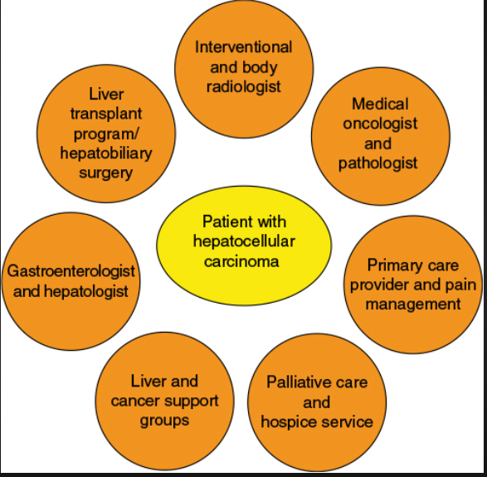



We developed the Virtual Equity Tumor Board to promote access to clinical trials and integrated cancer and mental health care.
Person-Caregiver
Psychiatric Oncology
Social Work
Navigator/CHW
Medical, Radiation, Surgical Oncologists
Community Mental Health
Equity Nurse Practitioner
Respite

Slide 44
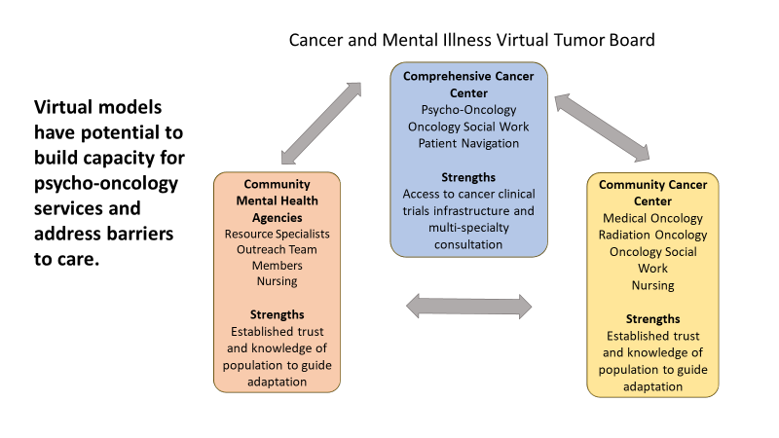
Irwin et al, JOP, 2022

Slide 45
The Virtual Cancer and Mental Health Tumor Board
Challenge: Lack on-site psycho-oncology care and navigation at community cancer site
Context: High poverty and mental illness, high demand on time for oncology/nursing, staffing crisis post covid-19
Strengths:
- Community hospital with commitment to cancer screening, inpatient care, psychiatry
- Mental health agencies serving shared population, commitment to closing mortality gap
- Long-term nurses and residential staff with deep knowledge of community organizations
- Dedicated oncology champion, culture of participating in tumor boards
Shared Purpose: Increase access to mental health/oncology expertise on North Shore
Who is Community of Practice? (group with expertise, get better at something by coming together)

Slide 46
Core elements of the Cancer and Mental Health Tumor Board
Assess Context: Build Community of Practice
Proactive approach: Patients identified by population-based registry/oncology and mental health referrals
Pragmatic use of technology: HIPAA-compliant video-conference x 45 minutes every 2-4 week
Co-Learning: Collaborative case discussion and sharing of ideas across disciplines, roles, and sectors
  Begin with what matters to participants, establish shared purpose, be attentive to power dynamics
  Brief best practices integrated into sessions by facilitators
  Address barriers to accessing psycho-oncology expertise and specialty oncology care
Person-Centered, strengths-based assessment
  Frame in terms of whole person including values and strengths
  Address social determinants/resource-related barriers to care
  Create integrated cancer and mental health treatment plan
Track outcomes that matter: Consider patient, clinician, systems, implementation

Slide 47
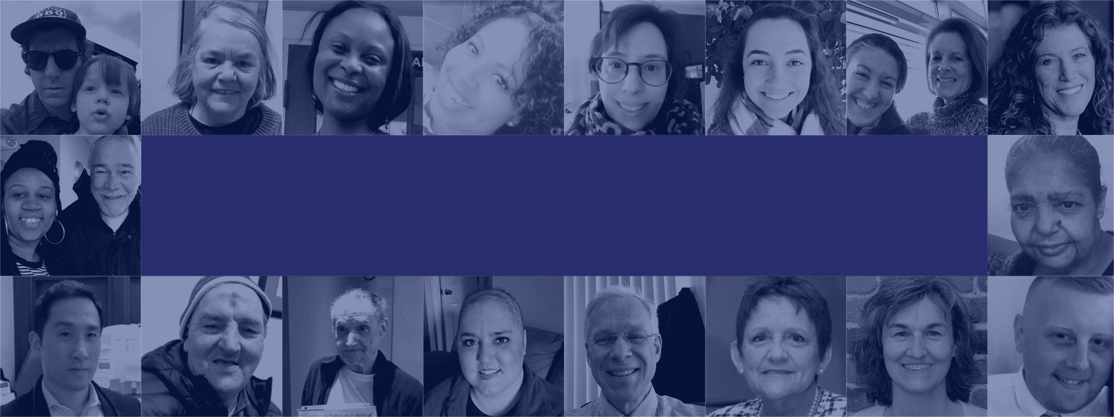






We are a coalition that engages diverse voices to promote equity in cancer care and research for people with mental illness.
This collaborative was partially funded through a Patient-Centered Outcomes Research Institute (PCORI) Eugene Washington PCORI Engagement Award (#7219-MGH).

Slide 48
To advance equity, we need more than bridges.

Slide 49

We need to nurture untapped strengths and create networks.
The Mother Tree Project

Slide 50



I pledge to ensure mental illness is never a barrier to cancer care.
http://engageinitiative.org
EndTheInequity
KellyIrwin_MD
Engageinitiative.org
MGHEngage@partners.org
Engage Initiative

Slide 51
Summary and next steps
Individuals with serious mental illness experience premature cancer mortality due to inequities in cancer treatment
Proactive psychiatry consultation and case management is feasible, acceptable, and showed promise at improving cancer care
Individuals with serious mental illness can participate in clinical trials with targeted procedures; we need to reexamine exclusion due to mental illness
Randomized trials and community engagement are needed to advance equity in cancer care and research for people with SMI

Slide 52
Innovative, multi-level approaches are needed to build capacity to deliver integrated cancer and mental health care.
CHALLENGES
Mental health discrimination is pervasive.
Mental health care remains inadequate and fragmented from specialty and primary care.
Default approaches worsen disparities.
LESSONS LEARNED
Be transparent.
Build person-centered, strengths-based teams.
Use technology pragmatically and flexibly.
Create and sustain Communities of Practice beyond the cancer center and health system.
Adapt evidence-based models guided by implementation science.
Apply social justice and human rights frameworks to guide best practices.

Slide 53









Join Us!
EndTheInequity
KellyIrwin_MD
Engageinitiative.org
MGHEngage@partners.org
Engage Initiative

Slide 54


Slide 55
APPENDIX: CLINICAL PEARLS FROM OUR TEAM
6. Question HIPAA
7. Do a home visit at a key clinical turning point
8. Choose medications with minimal interactions & use side effects to your advantage: sertraline, venlafaxine, mirtazapine, olanzapine
9. Know you can get or give psychiatry (or oncology or palliative care) input even if patient declines referral
10. Never worry alone: Create a team with shared trust
1. Find common ground as a human
Identify and engage an ally: Family, Visiting nurse, Community staff, Church, Landlord, clinician
3. Consider texting: it’s efficient (that’s why we do it)
Question the meaning of autonomy
Acknowledge and ask what you don’t know:
EndTheInequity
KellyIrwin_MD
Engageinitiative.org

Slide 56
Henry
67-year old man with schizophrenia and gastric cancer
He has lived in a Department of Mental Health group home for more than 10 years, has a guardian, and a supportive sister
Initially declined chemotherapy and comes for a second opinion
It’s challenging to know how much he understands about his cancer and to communicate effectively.
Where would you start?

Slide 57
Case Example: John
54 year old man with an alcohol use disorder, depression, schizoid personality style, and a new diagnosis of esophageal cancer
Prefers to live outside rather than staying within the shelter system
Scientist and concrete thinker, well supported by the street team
Has metastatic cancer, significant symptom burden, and limited life expectancy.

Slide 58
Case example: Jenny
Jenny is a 26-year-old woman with bipolar disorder, bulimia, and invasive breast cancer
New mother to an infant daughter. Her father died from suicide when she was an infant and her mother died from an opiate overdose when she was a teenager.
Well-supported by her husband and her outpatient therapist.
Plans chemotherapy closer to her home in another part of the state.

Slide 59
Case example: Susan
Susan is a 68-year old woman with schizophrenia and ovarian cancer
She experienced delays coming to cancer treatment
Referred to us by her group home team
After second opinion and meeting with our team, she determined that she would start chemotherapy treatment

Slide 60
The purpose of the MHTTC Network is technology transfer - disseminating and implementing evidence-based practices for mental disorders into the field.
Funded by the Substance Abuse and Mental Health Services Administration (SAMHSA), the MHTTC Network includes 10 Regional Centers, a National American Indian and Alaska Native Center, a National Hispanic and Latino Center, and a Network Coordinating Office.
Our collaborative network supports resource development and dissemination, training and technical assistance, and workforce development for the mental health field. We work with systems, organizations, and treatment practitioners involved in the delivery of mental health services to strengthen their capacity to deliver effective evidence-based practices to individuals.
Our services cover the full continuum spanning mental illness prevention, treatment, and recovery support.
MHTTCnetwork.org
Sign-Up for Newsletter
MTTC News

