Slide 1

Optimal Treatment of Psychotic Disorders: Clozapine, Engagement, and Community
Robert Laitman, MD
MAPNET & New England MHTTC
December 15th, 2023
Notes:
DO NOT CHANGE THE FORMAT OF THIS TEMPLATE. If you are creating MHTTC-branded slides, you must use this template or one of the other approved templates in the Shared Folder.

Slide 2




Housekeeping Information
Participant microphones will be muted at entry
If you have questions during the event, please use the chat
This session is being recorded and it will be emailed to all participants once available.
If you have questions after
this session, please e-mail:
newengland@mhttcnetwork.org.
At the end of the month, we will send you a certificate of completion that you can submit to your particular board for continuing education credit. Please contact ifisher@c4innovates.com for more information on CEs after the event.

Slide 3
Acknowledgment
Presented in 2022 by the Mental Health Technology Transfer Center (MHTTC) Network.
This presentation was prepared for the New England Mental Health Technology Transfer Center (MHTTC) Network under a cooperative agreement from the Substance Abuse and Mental Health Services Administration (SAMHSA). All material appearing in this publication, except that taken directly from copyrighted sources, is in the public domain and may be reproduced or copied without permission from SAMHSA or the authors. Citation of the source is appreciated. Do not reproduce or distribute this publication for a fee without specific, written authorization from New England MHTTC. For more information on obtaining copies of this publication, email us at newengland@mhttcnetwork.org.
At the time of this publication, Miriam E. Delphin-Rittmon, Ph.D, served as Assistant Secretary for Mental Health and Substance Use in the U.S. Department of Health and Human Services and the Administrator of the Substance Abuse and Mental Health Services Administration.
The opinions expressed herein are the view of TTC Network and do not reflect the official position of the Department of Health and Human Services (DHHS), SAMHSA. No official support or endorsement of DHHS, SAMHSA, for the opinions described in this document is intended or should be inferred.
This work is supported by grants #1H79SM081775 from the Department of Health and Human Services, Substance Abuse and Mental Health Services Administration.
Presented 2022
Notes:
Always use acknowledgment slide on the 2nd slide and add your center’s information

Slide 4
Notes:
Always use Language Matters graphic as your third slide.

Slide 6
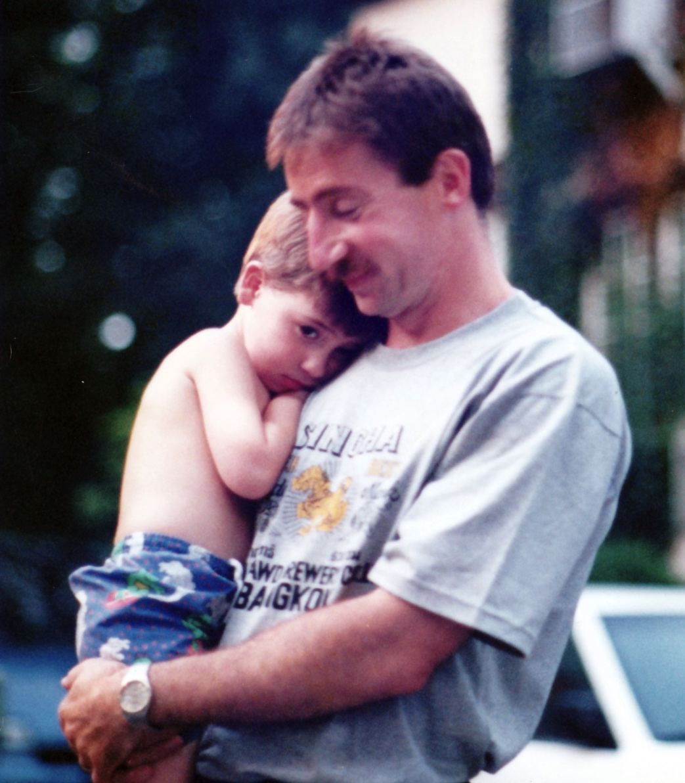
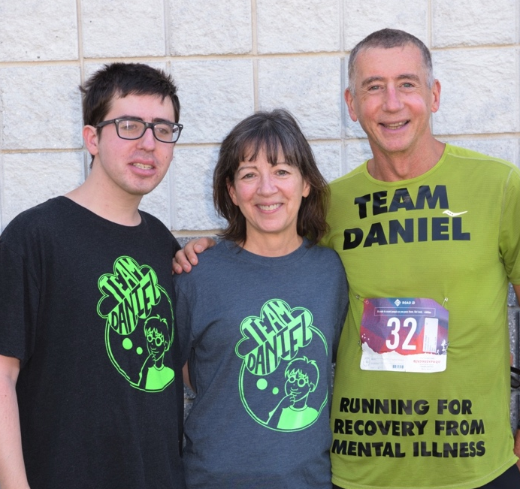
Our Daniel
1993
2019

Slide 7

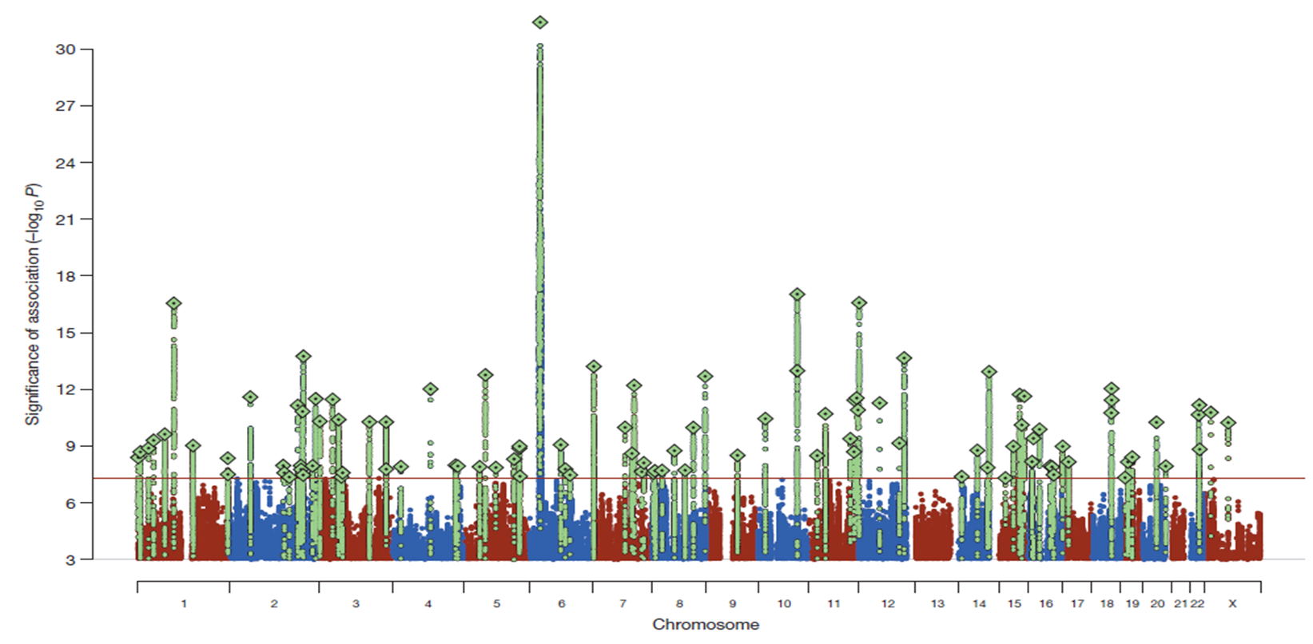
Pruning C4A & Schizophrenia
SCHIZOPHRENIA RISK ASSOCIATED WITH 108 GENOMIC REGIONS
Schizophrenia Working Group of the Psychiatric Genomics Consortium. Nature 2014;511(7510):421–427.

Slide 8
Clinical Features of Psychosis
Salience Pathway
Default Mode Network
Positive symptoms
Delusions
Hallucinations
Disorganized speech
Catatonia
Negative symptoms
Affective flattening
Alogia
Avolition
Anhedonia
Social withdrawal
Social /occupational
dysfunction
Work
Interpersonal relationships
Self care
Reward Network
Executive Network
Mood symptoms
Depression
Hopelessness
Suicidality
Anxiety
Agitation
Hostility
Cognitive deficits
Attention
Memory
Executive functions
Processing speed
Comorbid substance abuse
Maguire 2002

Slide 9
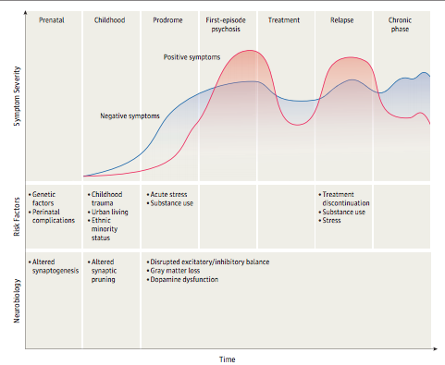
THE CLINICAL COURSE OF SCHIZOPHRENIA
Schizophrenia—An Overview
Robert A. McCutcheon, MRCPsych;
Tiago Reis Marques,\
PhD; Oliver D. Howes, PhD
Published online October 30, 2019.

Slide 10
Clozapine: An Historical Perspective
Clozapine has always challenged the mental health system
1953: FDA approved first Pharma “Blockbuster” Thorazine.
1958: Clozapine Synthesized by Schmutz.
1960: Clozapine was patented; patients and family loved it.
    Unfortunately, psychiatry avoided clozapine; most were preoccupied with the dopamine model for psychosis.
1989: Clozapine was FDA approved but held to an unprecedented standard.
    Demonstrated marked improvement in treatment refractory population when compared to standard of care.
    Sandoz bundled clozapine with the required blood monitoring; significantly increasing costs.
    Clozapine was heavily restricted and rationed.

Slide 11
Clozapine Risks
Agranulocytosis - Dangerously low neutrophils (white blood cells)
Seizures
Intractable weight gain in over 80% and diabetes
Unremitting sedation
Drooling
Intractable constipation
Myocarditis and heart failure
Rebound psychosis if withdrawn
Venous Thromboembolism (VTE)
Pulmonary Infection

Slide 12
Clozapine Benefits
FDA indicated for treatment-resistant schizophrenia, however:
IT IS THE MOST EFFECTIVE MEDICATION IN ALL SETTINGS.
Reduces suicide (FDA indicated).
Reduces violent behavior.
Reduces substance abuse
Allows patients to robustly participate and succeed in physical, social and cognitive rehabilitation.
Best acceptance, lowest discontinuation, and best survival.

Slide 13
Major Benefit: Lowers Risk of Death
First year of psychotic illness the risk of death 24 to 89 times for ages 16-30.
Suicide risk in psychotic spectrum illness:
    50% attempt, 10% completion (3-5 % in the first year).
    Clozapine reduces this risk by 70-90% compared to other antipsychotics.
    380 to 900 more survive for every 10,000 treated with clozapine.
Agranulocytosis risks, for comparison:
    Only 0.3% to 0.8% occurrence, with overall mortality of 1 to 2.5 per 10,000.
    90- 95% of this risk occurs in the first 18 weeks.
    After 6 months the risk of death is no more than other antipsychotics.
    Context: Iceland does not monitor;1/10 of this 2/10,000.
Psychosis cuts life short by 20-25 years, mostly due to cigarette and drug use.
    Clozapine significantly reduces smoking and substance use disorders.

Slide 14
Characterization of Agranulocytosis (Taylor, 2022)
A 14-year study of ~3500 patients in clozapine registry
16 events of ANC falling below 0.5 were reported (0.46%)
7 of the 16 were excluded (4 normal on repeat, 1 was off clozapine, 1 on chemo, 1 lab error)
9 events in 8 patients considered life-threatening agranulocytosis (LTA) (0.23%)
6 of the 8 had previous neutropenia
0 deaths (0%)
Mean duration of clozapine: 48 days, with a range of 21 to 105 days.
Median age at initiation of treatment: 51 years, with a range of 25 to 72 years.
No events beyond that time frame.
Taylor, D et al. Distinctive pattern of neutrophil count change in clozapine-associated, life-threatening agranulocytosis. Schizophrenia 8, 21 (2022).

Slide 15
Characterization of Agranulocytosis (Taylor, 2022)
Most cases of agranulocytosis are not life-threatening
May not even be clozapine-related
Association with neutropenia is a result of surveillance bias
Intensive blood monitoring reveals random, clinically silent, and non-pathological episodes of neutropenia
Mandatory Monitoring Causes More Harm Than Good.
Taylor, D et al. Distinctive pattern of neutrophil count change in clozapine-associated, life-threatening agranulocytosis. Schizophrenia 8, 21 (2022).

Slide 16
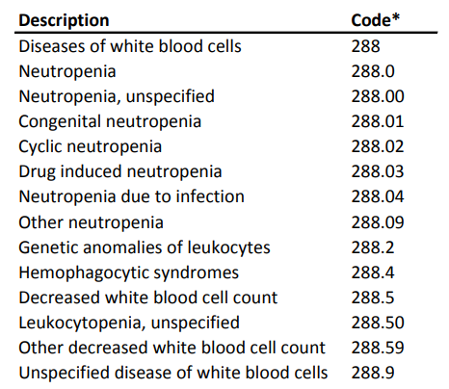
FDA’s Mini-Sentinel Distributed Database: Query
The FDA’s Database of 94M insurance plan subscribers from 2000 to 2013:
All EVENTS with primary diagnoses of neutropenia and related conditions
Note: “agranulocytosis” is not a named condition in the ICD-9-CM

Slide 17
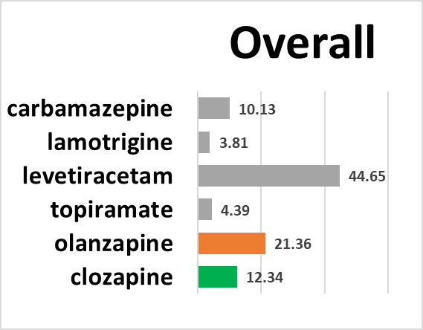
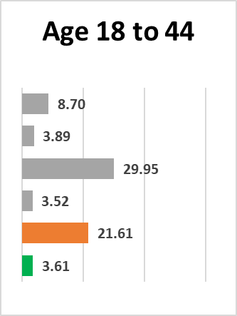
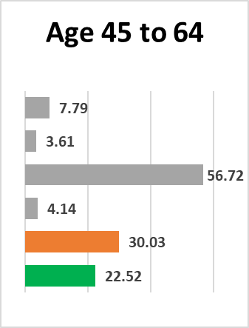
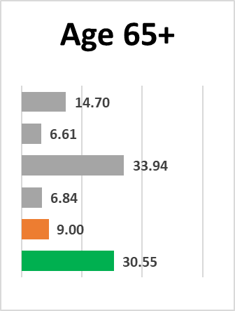
FDA’s Mini-Sentinel Distributed Database: Results
Neutropenia Events per 10k Years at Risk (2000 – 2013)
In the age group 18 to 44 the incidence is
FIVE TIMES HIGHER for olanzapine than clozapine

Slide 18
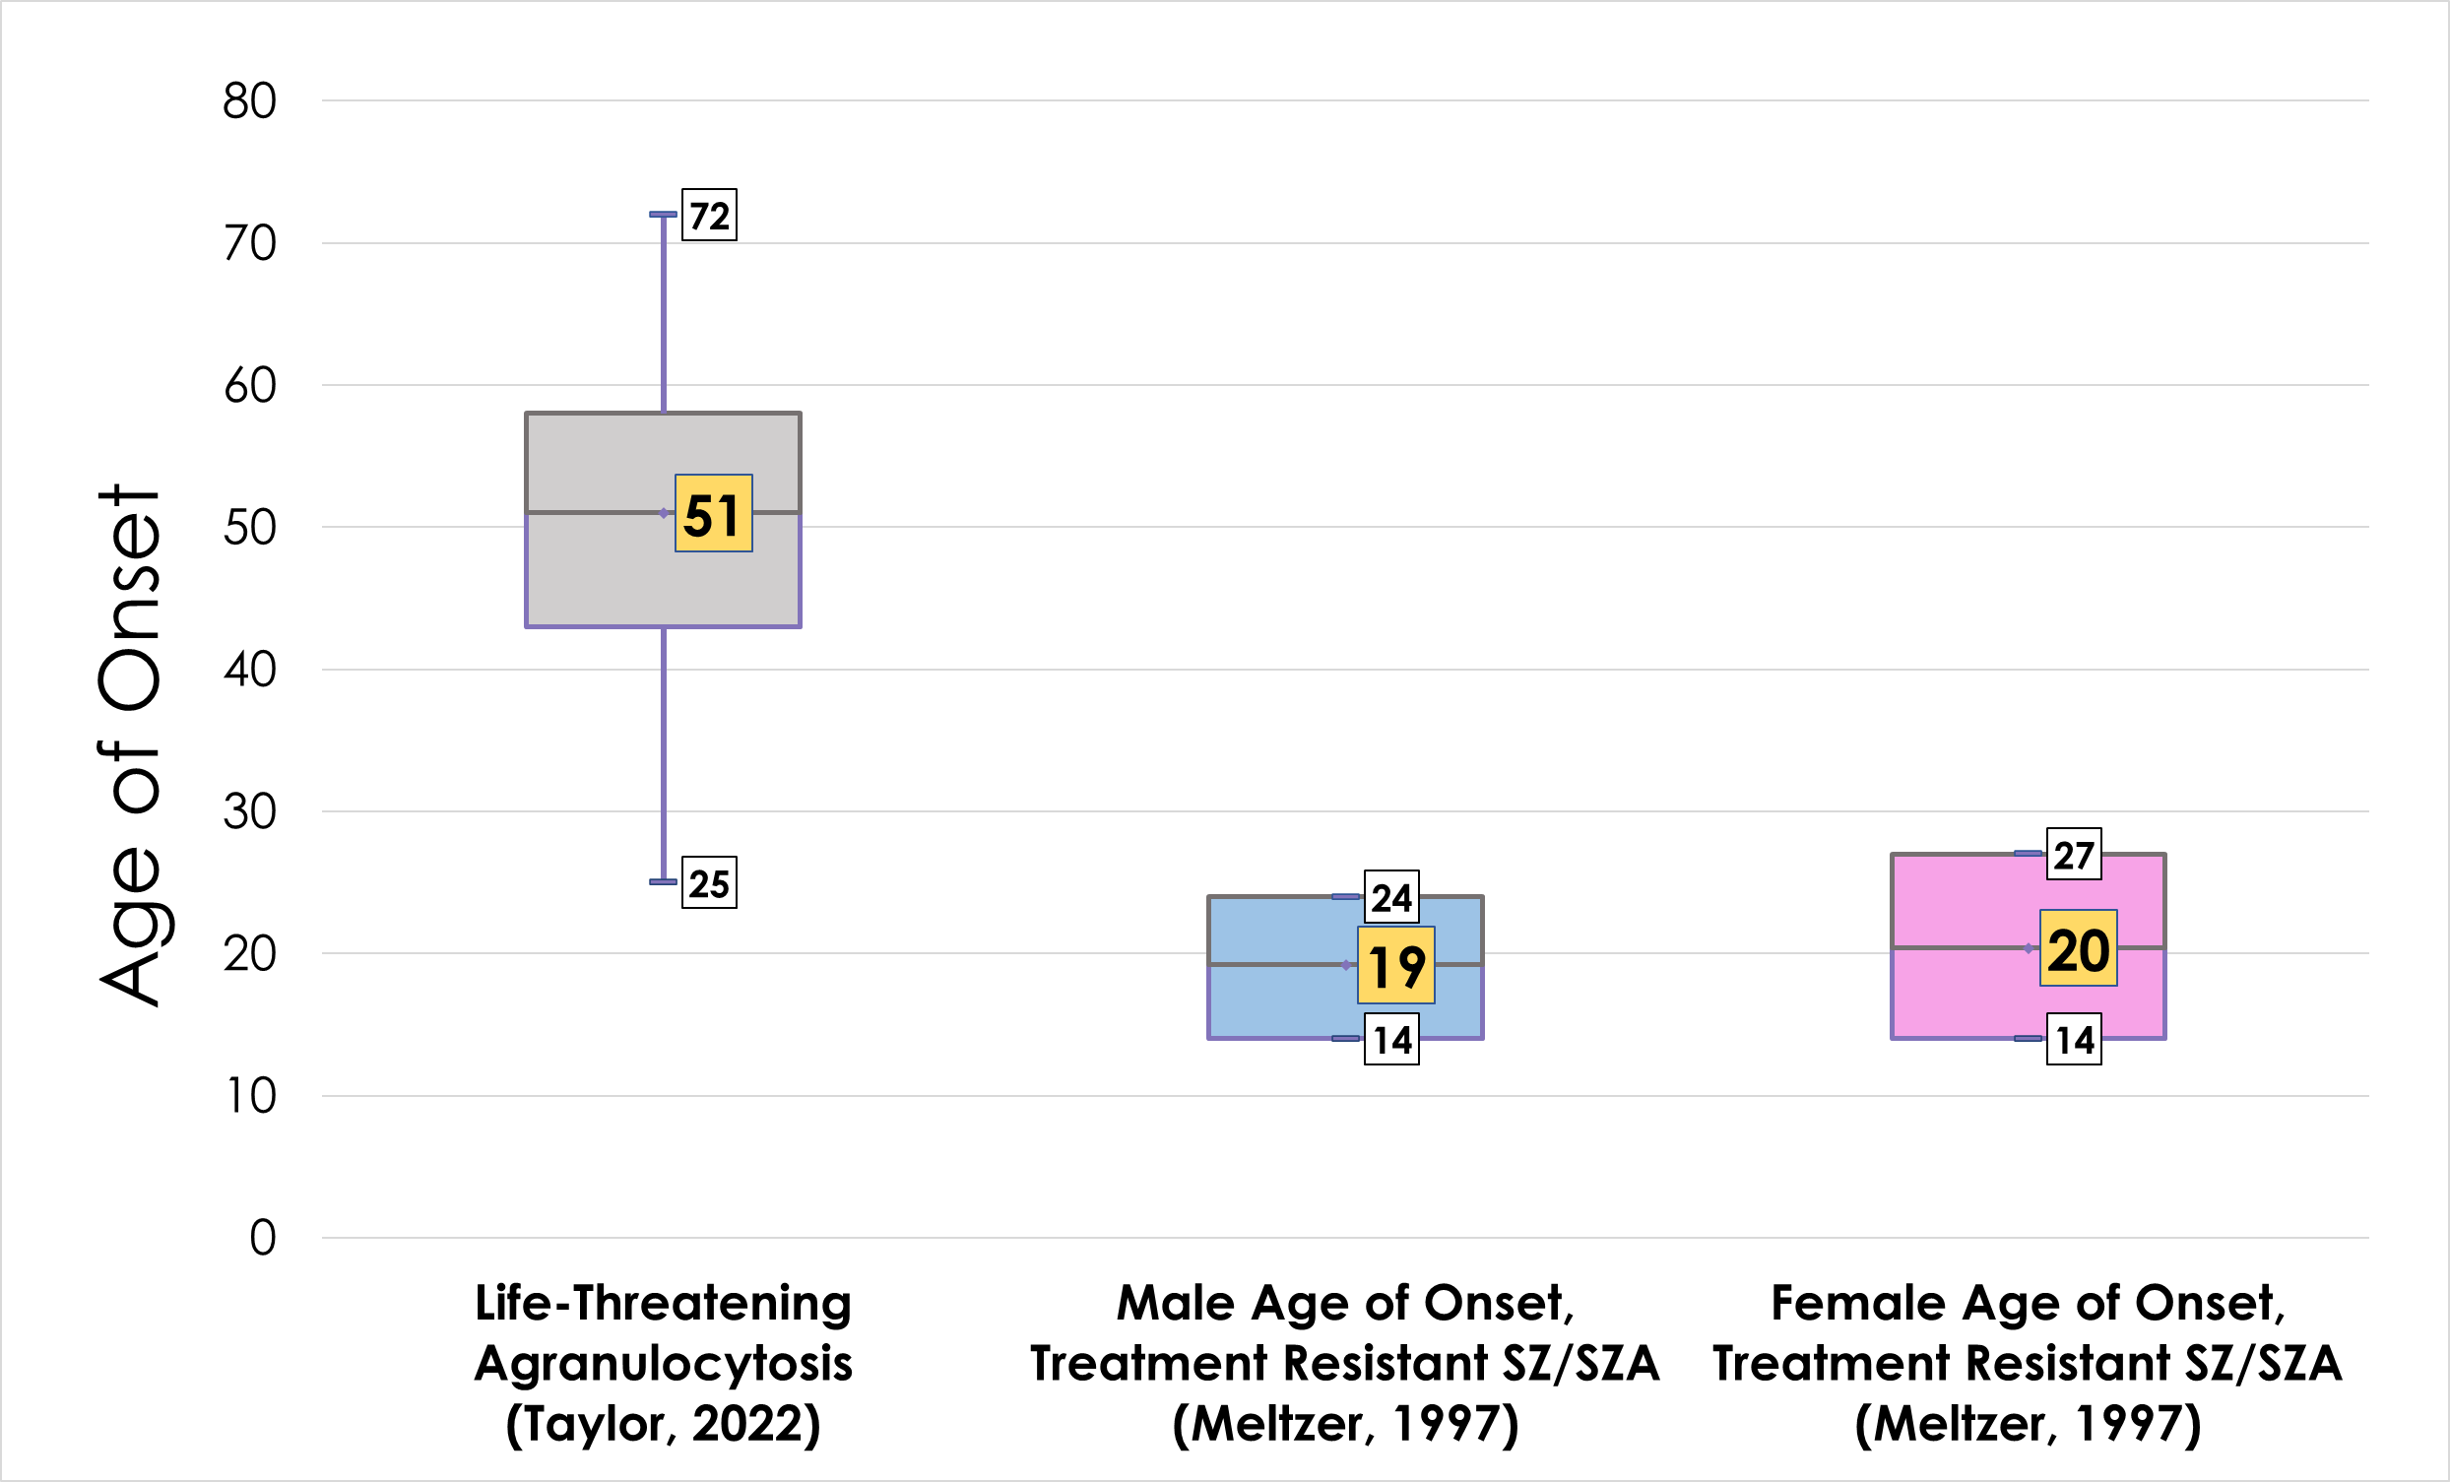
Life-Threatening Agranulocytosis
Risk Factors:
Age
First 18 weeks
Depakote
Female
(Taylor, D et al, 2022)

Slide 19
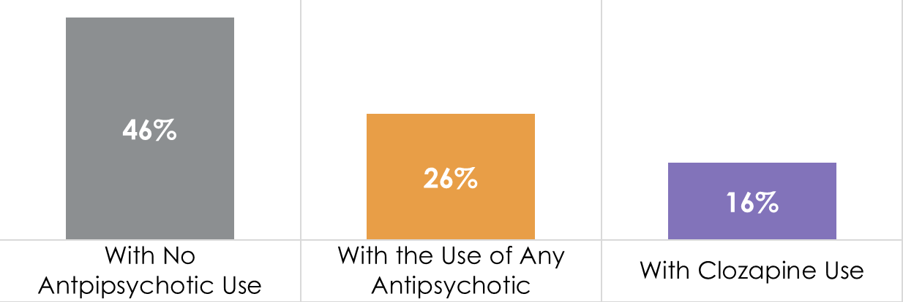
Live Longer on Clozapine
A Finnish 20-year Study of >62,000 Patients with Schizophrenia
65% less likely to die than untreated patients with schizophrenia
25% to 50% less likely to die compared patients on other antipsychotics.
45% reduction in cardiovascular deaths
(Vermeulen JM, et al, 2019; Taipale H, et al (FIN20), 2020; Hayes RD, et al, 2015; Wimberley T, et al, 2017)

Slide 20
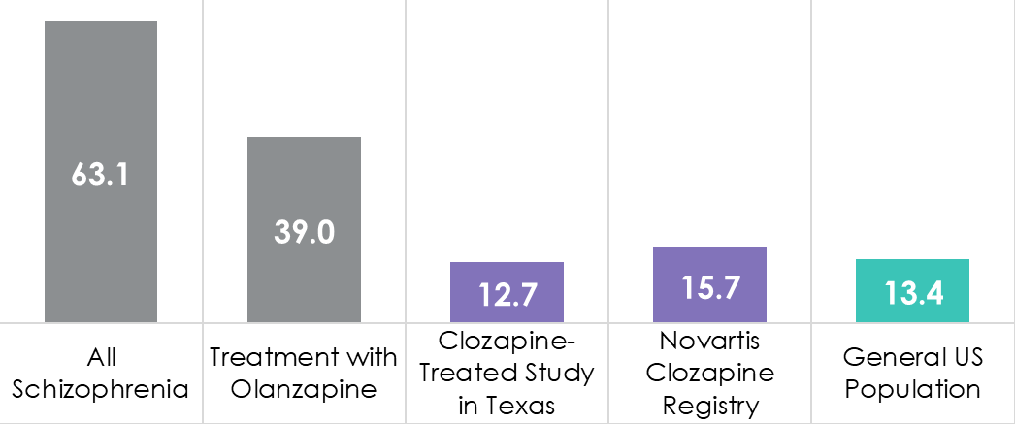
70% - 90% Reduction in Suicide
CLOZAPINE REDUCES SUICIDE RATE IN PATIENTS WITH SCHIZOPHRENIA
Annual Suicides Per 100,000
(Reid WH, et al, 1998; Meltzer HY, et al. 2003)

Slide 21
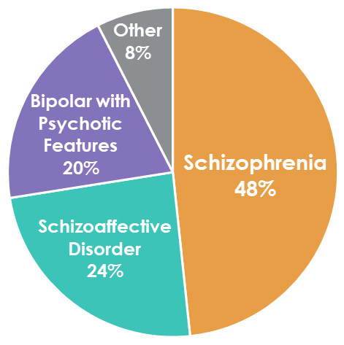
The “Team Daniel” Practice – Clozapine Centered
Over 180 clozapine patients with 94% rate of continuance
Not a “first episode clinic”
(Only 5% are truly “clozapine first”)
54% are already on clozapine at intake
46% are new to clozapine
Dr. Robert Laitman and Dr. Ann Mandel specialize in both “treatment-resistant” and clozapine-resistant patients.

Slide 22
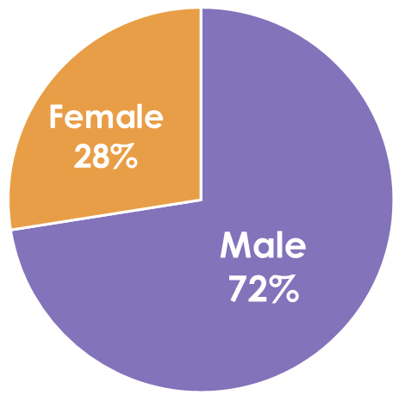
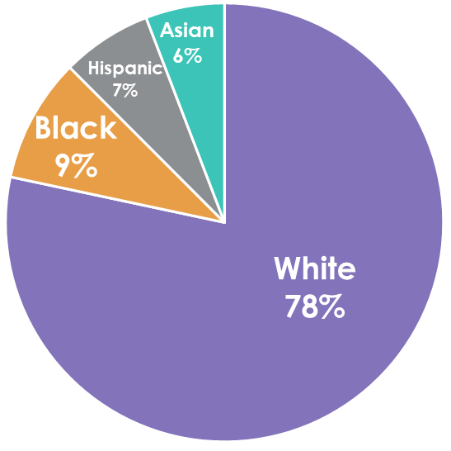
The “Team Daniel” Cohort
120 patients that have received a clozapine-centered treatment approach for 1 year or longer
Average age: 34 years old
Youngest: 17
Oldest: 75
Longest patient on clozapine:
31 years (and counting)
59% with anosognosia (poor insight)
9 patients on Assisted Outpatient Treatment (AOT)
“Team Daniel Extended Family” represents hundreds of families that we consult and that join our weekly zoom.

Slide 23
Not Every Patient is a “Clozapine Success”
18 Refused or never started treatment; unable to obtain an AOT (8%)
  Anosognosia is a significant barrier, representing 8% of patients.
10 Discontinued treatment or transitioned to other medications.
  Other antipsychotic, mood stabilizer or cognition medications.
  1 clozapine adverse effect: cardiomyopathy in an elderly transplant patient.
2 Deaths
  1 elderly patient
  1 suicide
24 Lost to follow up, dismissed or transferred to another practice (11% attrition).

Slide 24
How is Team Daniel Different?
We use Clozapine First… NOT as a last resort!
We believe patients have a Right to Be Well and encourage the use of LEAP and if needed court-ordered Assisted Outpatient Treatment (AOT).
We do not tolerate side effects, including weight gain, and we aggressively use adjunctive medications, ultra-slow titrations, diet and exercise to treat and prevent them.
Our goal is Meaningful Recovery and returning patients to their pre-illness baseline level of functioning and well-being.
We promote a sense of community and engage and communicate with the patient’s Family. After learned helplessness and hopelessness we restore optimism.

Slide 25
Why Clozapine First?
  Early treatment leads to best outcomes: Including survival.
  Shorten the duration of untreated psychosis (DUP) by early treatment with clozapine; the earlier it is used the better.
  Better compliance and faster and more robust recovery.
  Decrease early suicide (24X increased mortality the first year).
  Decrease early aggression (12% serious violence.)
  Superior in adherence, quality of life, and patient satisfaction.
  Reduces drug and cigarette abuse.
  Patients respond better to psychosocial support.
  Patients achieve robust Meaningful Recovery.

Slide 26
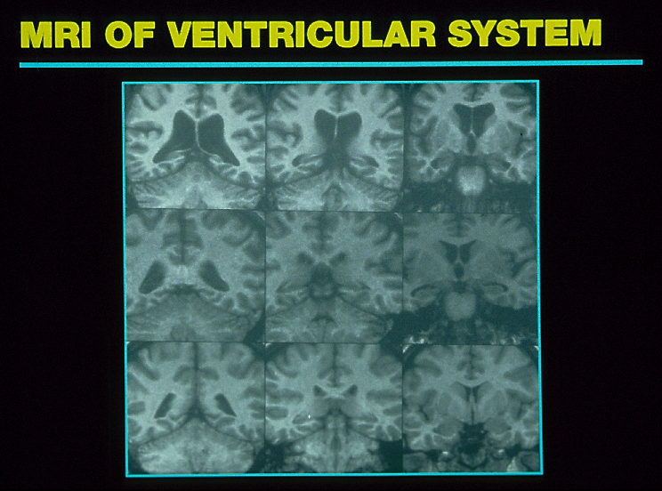
PROGRESSIVE MRI CHANGES OVER THREE RELAPSES IN A MALE WITH SCHIZOPHRENIA
After 8 Relapses
Worsening Progression
After 3 Relapses
First psychotic episode
Nasrallah, HA. personal files

Slide 27
Our “Meaningful Recovery” Definition
  Employed or Engaged for 20 hours per week or more:
  Attending school full-time, or part-time with other activities.
  Responsibly maintaining a homemaker and/or parenting role.
  Participating in a vocational rehabilitation program.
  Engaged in consistent volunteer activity

Slide 28
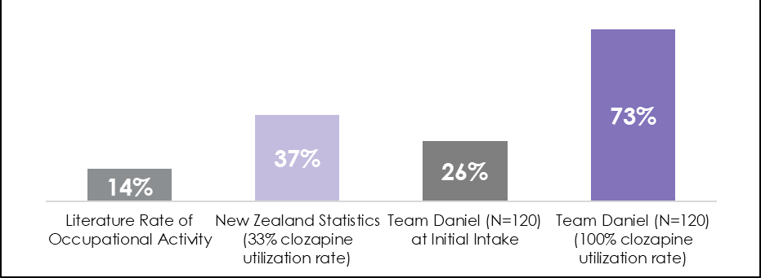
Meaningful Rate of Recovery
Rate of Meaningful Recovery
20+ Hours Per Week of School, Work or Meaningful Activity
Increased Clozapine Utilization = More Meaningful Recovery

Slide 29
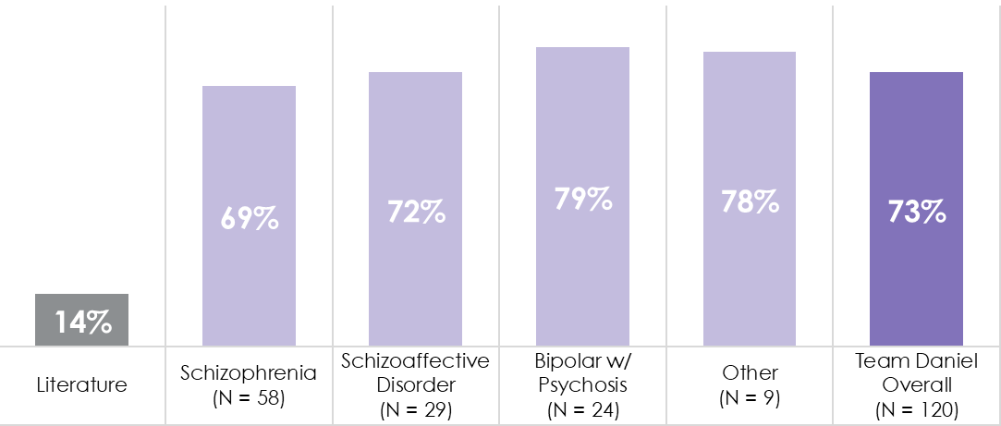
Meaningful Recovery By Diagnosis
Rate of Meaningful Recovery

Slide 30
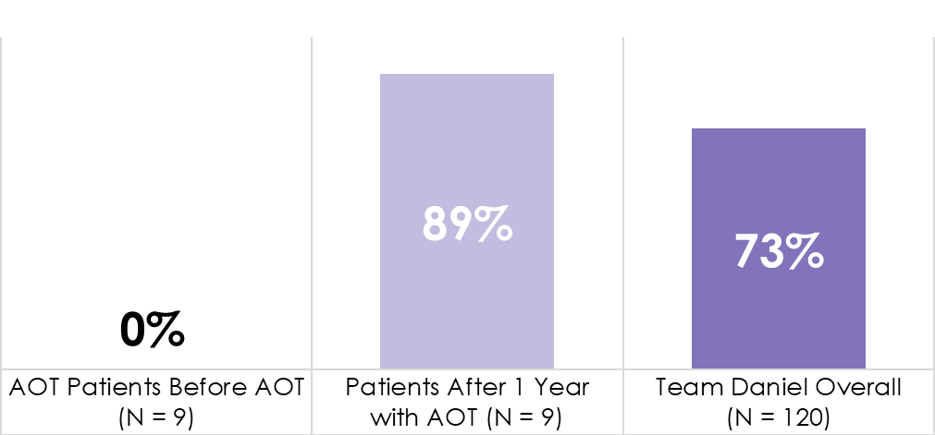
“AOT” Saves Lives and Livelihoods
100% Significant Improvement in Quality of Life.
No hospitalizations!
MEANINGFUL RECOVERY WITH ASSISTED OUTPATIENT TREATMENT (AOT)
“AOT” may be called “COT” for Court-Ordered Treatment or “MOT” for Mandatory Outpatient Treatment. The intent is court-mandated participation in treatment, with hospitalization enforced for non-compliance.

Slide 31
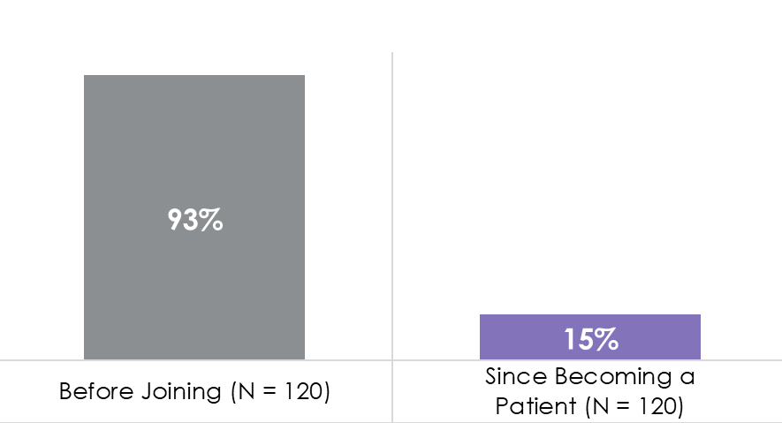
85% Have Not Returned to the Hospital
18 Hospitalizations:
9 patients for mental health
1 for Substance Use
4 for Adverse effect:
  2 Seizures
  1 Pneumonia
  1 Lithium toxicity
3 for Medical reasons
1 Age-related decline
% OF PATIENTS WITH ONE OR MORE HOSPITALIZATIONS

Slide 32
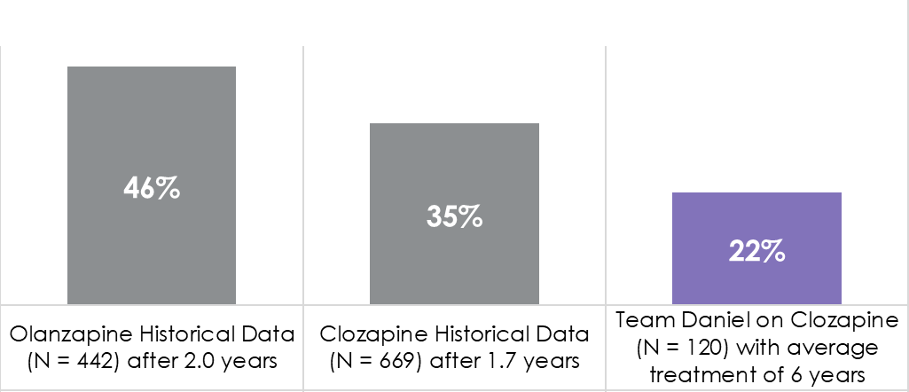
Less Weight Gain
PROPORTION OF PATIENTS WITH MORE THAN 7% INCREASE IN BODY WEIGHT

Slide 33
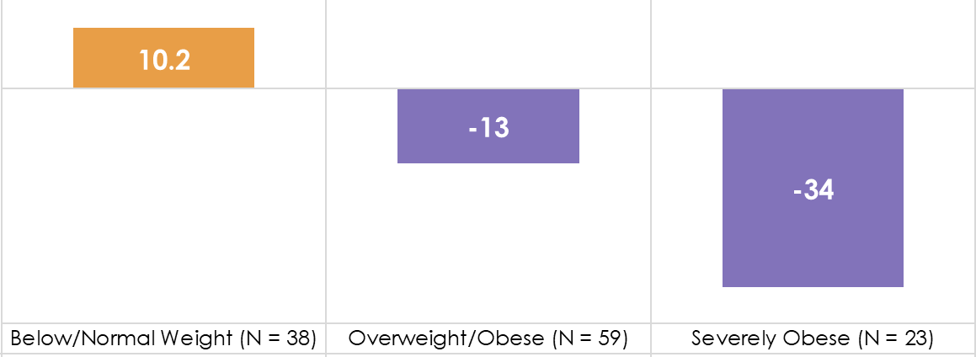
Impressive Weight Change
Team Daniel Weight Change (lb) by BMI Class at Initial Intake

Slide 34
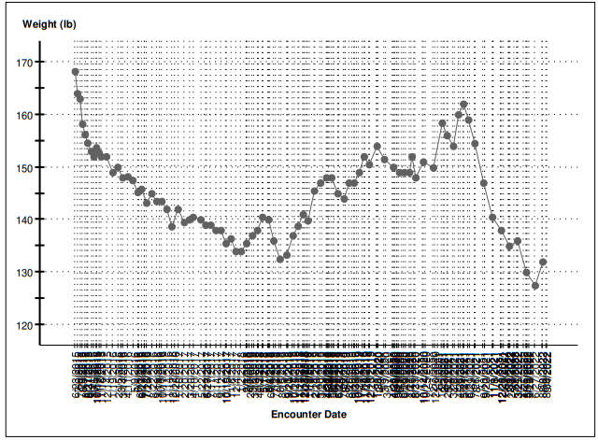
Patient Weight Over Time: GLP-1 Agonists
Added Trulicity
Female Patient

Slide 35
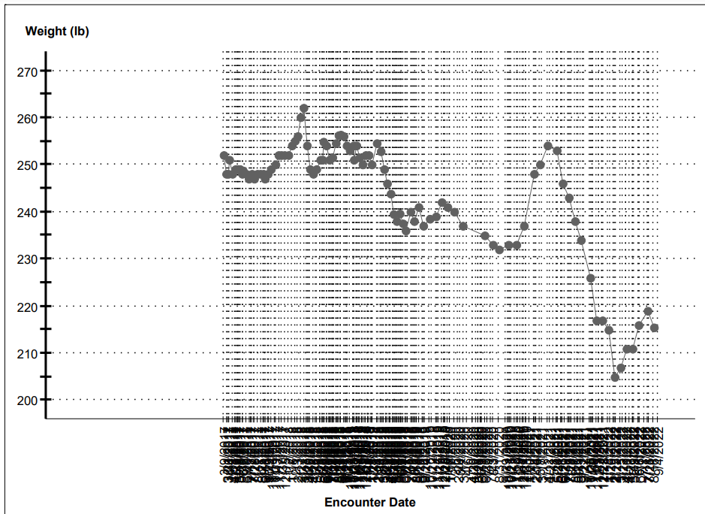
Patient Weight Over Time: GLP-1 Agonists
Added Trulicity
Male Patient

Slide 36
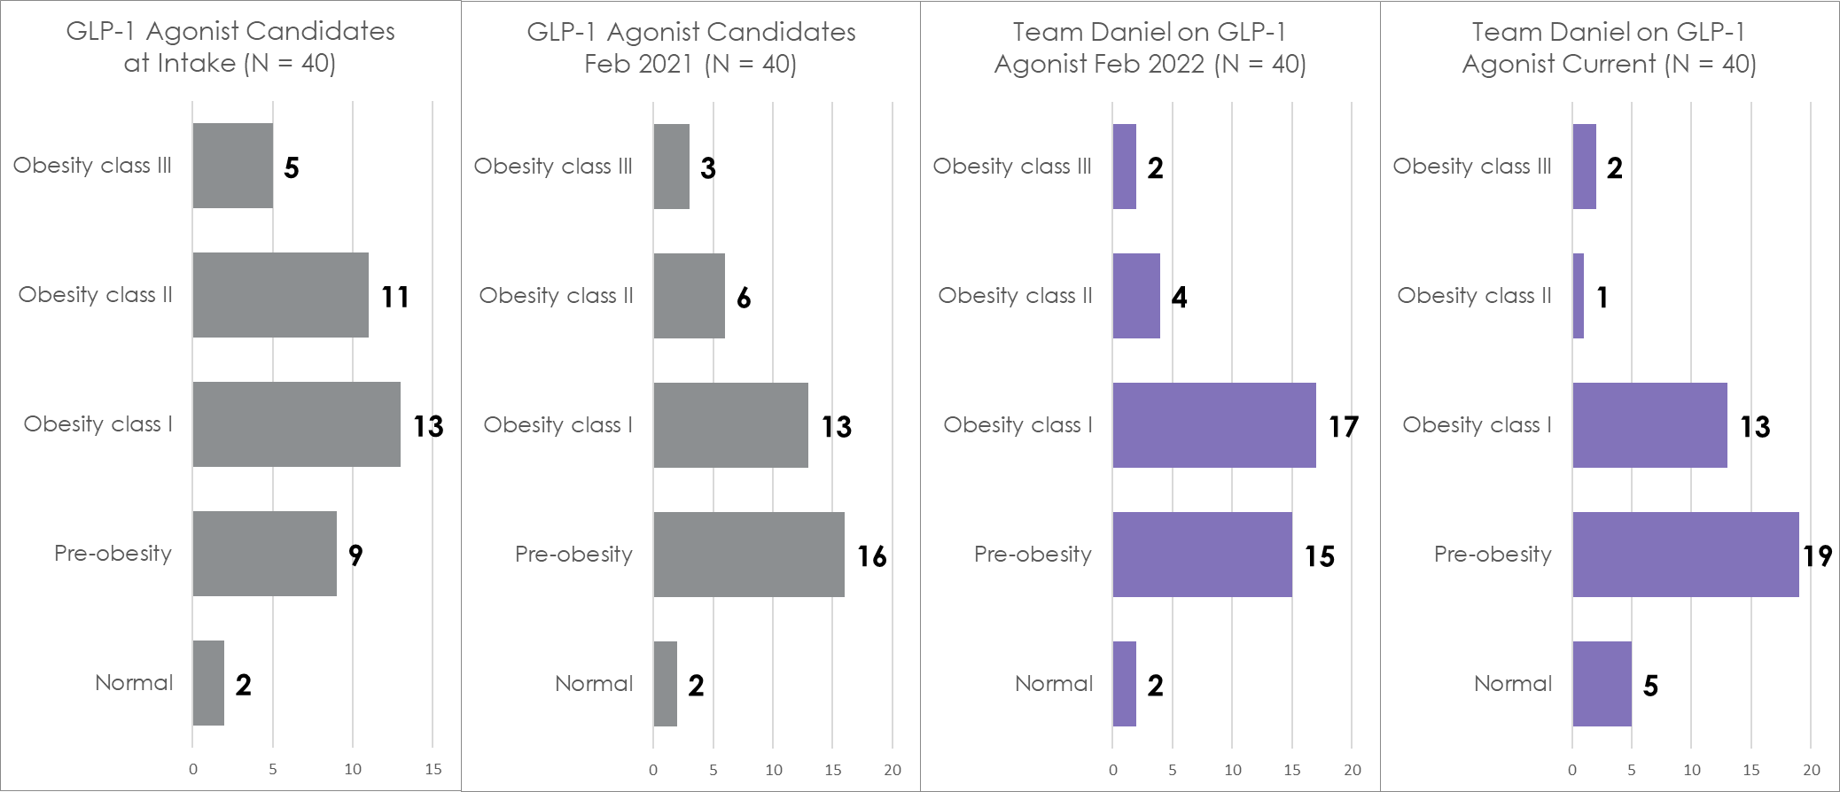
Team Daniel on GLP-1 Agonist BMI Class Distribution Progress
Before GLP-1 Agonist
GLP-1 Agonist Added
Intake
Year 1
Year 2
Current
73%
Obese
55%
Obese
58%
Obese
40%
Obese

Slide 37
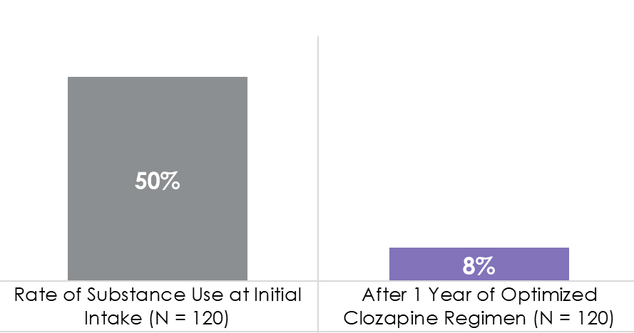
SUD Recovery Rate Unprecedented
82% Recovery from Substance Use
82% Recovery from Cannabis Use Alone
RATE OF SUBSTANCE USE DISORDER
Cannabis was the primary drug in 85% of patients

Slide 38
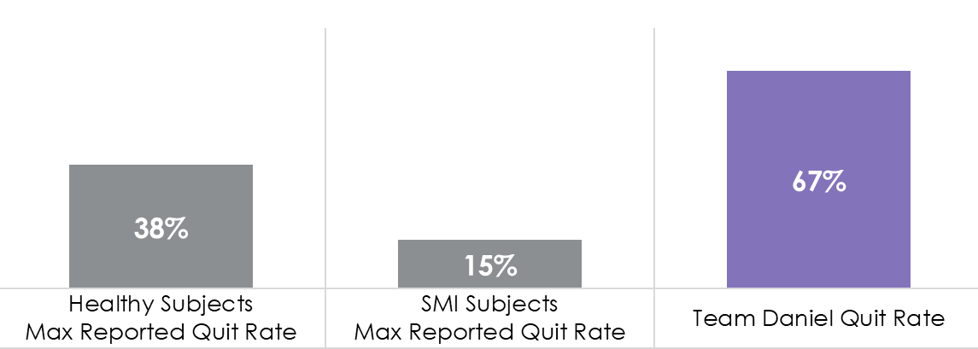
Cessation Rate Beats the Odds
31 of 46 Smokers Quit
Most used
combination therapy:
87% Chantix
50% NRT
63% Bupropion
RATE OF TOBACCO CESSATION
(N=46 Team Daniel Smokers)

Slide 39
Team Daniel Notable Adverse Events (N=120*)

Slide 40
Team Daniel Notable Adverse Events (N=120)

Slide 41
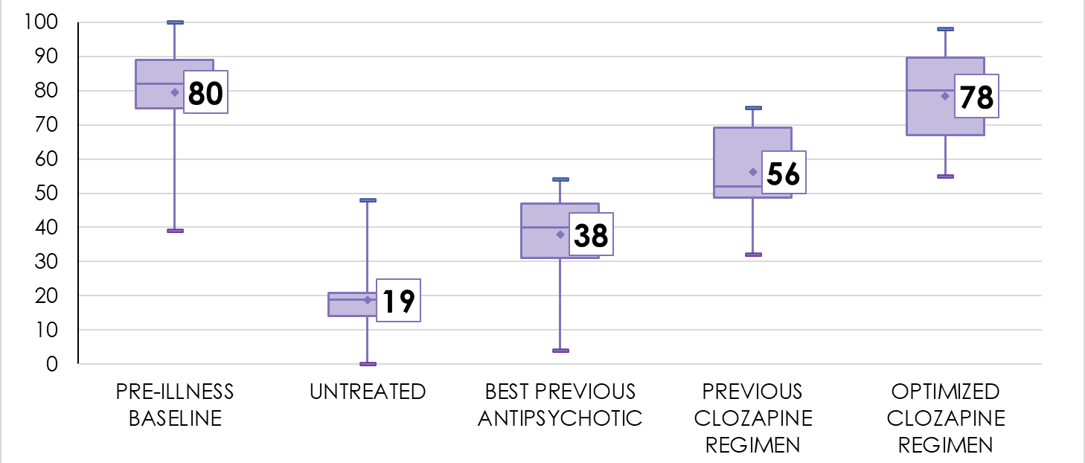
Most Patients Return to Baseline
TEAM DANIEL
Returns to Baseline Functioning &
Well-being
GLOBAL ASSESMENT OF FUNCTIONING SCORES
Preliminary Data (N=14)

Slide 42
Achieving Goals
Critical first step: know the sufferer and hopefully engage family.
Often patients are in a lot of pain - no barriers - hugs help.
Be an active cheerleader and be a friend.
Use Xavier Amador’s LEAP approach for patients with anosognosia (unawareness of Illness):
Listen – Empathize – Agree – Partner
Engage the patient in every way possible, using AOT if necessary.
Ensure the patient feels safe and accepted; we have few boundaries.

Slide 43
Achieving Goals - 2
Acknowledge the road to recovery will always have a few detours.
  This helps everyone relax and know that even if they “screw up” you will never abandon them.
Always be available and make sure patient has information.
  All patients and families get our cell phone #’s and e-mail.
Compassion and Availability really goes a long way.
Everyone leaves our office with the treatment note. We also share with the family.
Optimism is essential: Your belief combats learned hopelessness.

Slide 44
Clozapine Routine Monitoring
Therapeutic Drug Monitoring (TDM) is critical!
  Blood serum levels of clozapine and norclozapine to guide dosing.
Thorough physical with a body mass index (BMI) and orthostatic blood pressures.
Baseline echo, EKG, HSCRP, troponin (periodically follow up), serum BNPs in patients with tachycardia (elevated heart rate).
Baseline and follow CBC with absolute neutrophil counts, chem panels including renal and liver function test, lipids, thyroid function, Glyco-hgb, and urine toxicology, immune/infection workup.
Dual diagnosis: urine and serum tox screens and cotinine levels every visit.

Slide 45
Avoid Predictable Side Effects
Weight Gain: Add diet and Metformin early; consider SGLT2 inhibitors and Incretin mimetics. (GLP-1 receptor agonists)
High Triglycerides: Statins, omega 3 and fibrates (fenofibrate).
Metabolic Syndrome and Diabetes: Metformin, SGLT2 inhibitors, high-dose ranitidine or famotidine, plant-based diet, exercise and Incretin mimetics.
Sinus Tachycardia: Add Beta Blocker (Propranolol) or in those with pulmonary disease Metoprolol or atenolol (if anxiety is already well controlled).
Seizure Prevention: Lamotrigine, Gabapentin, Topiramate or Valproate (if violent).
Drooling: Add .06% Ipratropium Nasal Spray, or 0.1% atropine eye drops under the tongue. Consider Glycopyrrolate and botox. Elevate the head of the bed.

Slide 46
Avoid Predictable Side Effects - 2
Constipation: Hydrate! Cathartics (Dulcolax and Senna), stool softeners (Colace), laxatives (MOM, lactulose, Miralax), Linaclotide (Linzess), and Acarbose.
  Remedy the problem: clozapine causes a slow transit time!
Neutropenia:
  Draw blood in the afternoon and exercise beforehand.
  Consider adding lithium and granulocyte colony stimulating factor (CSF).
  Recognize Benign Ethnic Neutropenia (BEN) and confirm with genetic testing.
Nighttime Urination: Behavior changes, DDAVP or Myrbetriq.
Hypotension: Florinef (fludrocortisone), midodrine in severe cases.
Nausea and Vomiting: Early use of ondansetron (Zofran).

Slide 47
Enhancing Clozapine
Cognitive enhancement: donepezil, bupropion, famotidine, memantine, modafinil, armodafinil, amantadine, and consider fluvoxamine.
  Presently investigating pitolisant (Wakix).
Concomitant mood disorder and OCD: SSRI (i.e. escitalopram)and cognitive behavioral therapy(CBT), carefully consider fluvoxamine or buproprion.
Support: Socialization skills, educational, vocational, psychosis-informed CBT, dialectical behavioral therapy (DBT), family therapy, speech therapy and cognitive enhancement programs.
Treat co-occurring addictions

Slide 48
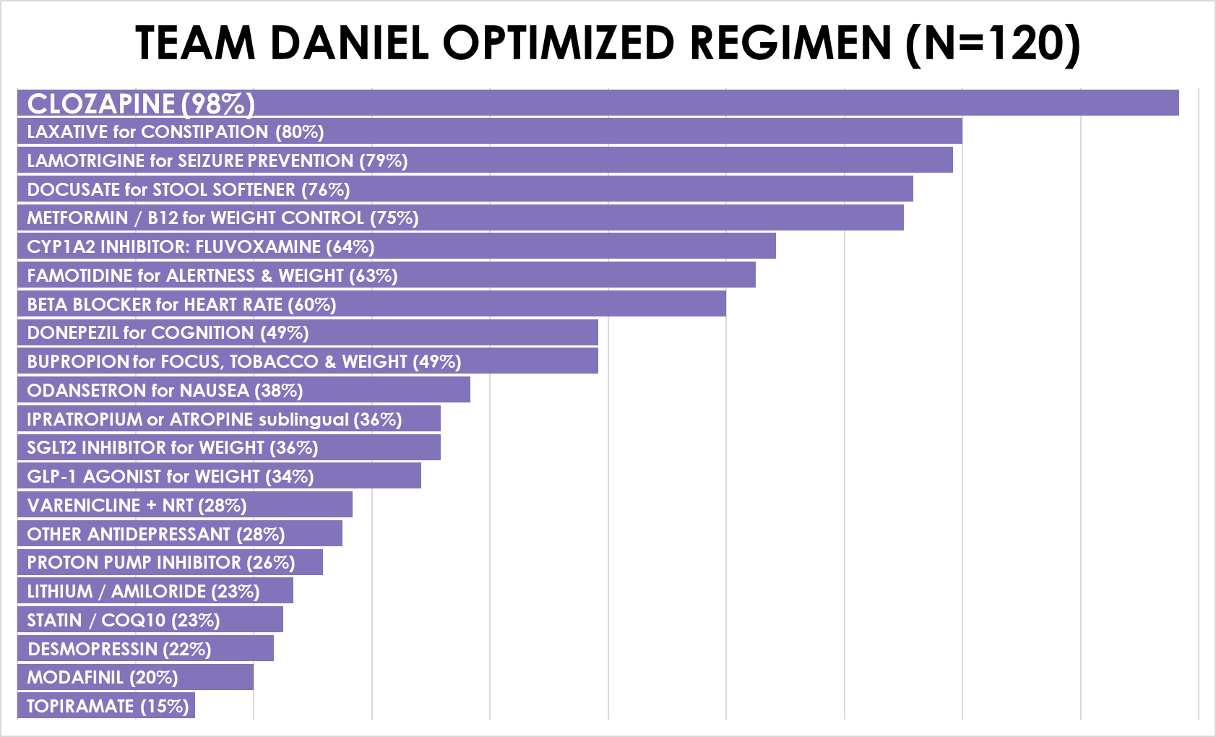
Average Number of Prescriptions: 11

Slide 49
Other Common Medications
  LORAZEPAM OR ALPRAZOLAM 14%
  KLONOPIN 14%
  LINZESS OR TRULANCE 13%
  SYNTHROID 11%
  WAKIX (PITOLISANT) Investigational 10%
  MEMANTINE 8%
  OTHER ANTIPSYCHOTIC 7%
  GABAPENTIN 6%
  BENZTROPINE 5%
  NALTREXONE 5%
  DEPAKOTE 4%
  HYDROXYZINE 4%
  GLYCOPYRROLATE 3%
  FLUDROCORTISONE 3%
  BUSPIRONE 2%
  AMANTADINE 2%
  Supplements: CoQ10, B12, Vitamin D3, Fish Oil, melatonin, caffeine
Never:
Stimulants / ADHD medications
Rare:
Depakote
Benztropine
Hydroxyzine
Multiple antipsychotics
Only As Needed:
Benzodiazepines

Slide 50
Exercise and Engagement
SMI is a team sport.
Every Saturday morning, we have our willing patients and families come to our house for a run and seasonally swim.
The House is magic in fostering acceptance, engagement, and trust. It has taken the therapeutic relationship to another level.
Normalization, socialization, and befriending in a non-medical environment value cannot be overestimated.
Zoom Session’s Every Saturday:
  A family/caregiver zoom led by Team Daniel Staff
  A zoom for patients led by Daniel Laitman (TEAM DANIEL’S inspiration).

Slide 51
Exercise Benefits Meta-Analysis
In 29 studies, 1,109 patients statistically significant improvement in:
  Total symptom severity
  Positive symptoms
  Negative symptoms
  General psychopathology
  Quality of life
  Global functioning
  Depressive symptoms

Slide 52
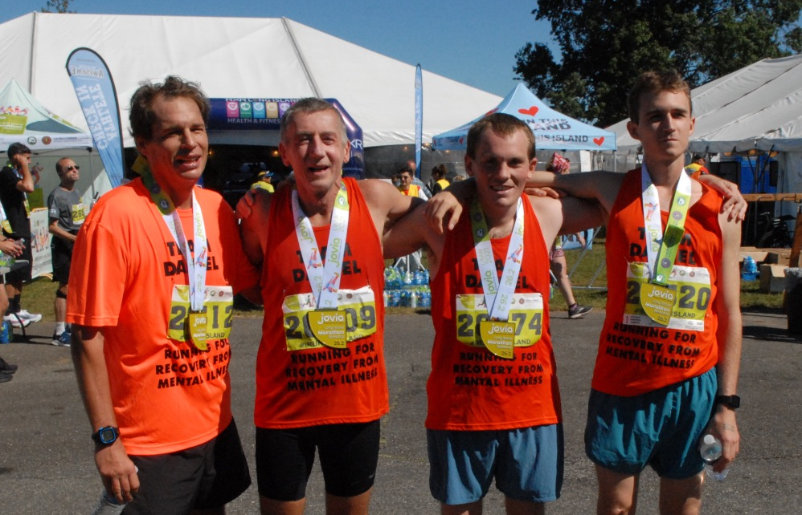
Teamwork
In July, 2021, Team Daniel ran the Long Island Jovia Marathon: Michael Orth, Commissioner at WC, DCMH; Dr. Rob Laitman, Jasper Bresolin, Malachy Friel.

Slide 53
The Diet
Eat 3 meals a day – Do NOT drink your calories
Avoid all simple processed carbohydrates:
  NO cookies, candy, chips, dips, cakes, ice cream, donuts
  Minimize bread, pasta (whole grain only)and rice (small portion brown rice only)
BREAKFAST
High fiber cereal or
Eggs, (Veg omelet) or
Oatmeal with raisins
Coffee or tea
Milks: Almond or Skim
Sweeteners: Stevia, Splenda
LUNCH
Non tropical fruit
Blueberries, strawberries, blackberries, apples, plums or pears.
Greek yogurt 100-160cal
DINNER
Garden salad with only vegetables & a light low salt dressing spritzed on.
Vegetable like broccoli, brussel sprouts, string beans, spinach, or cauliflower.
Protein 6-8 ounce of fish, poultry, pork, tofu, setain. or a legume : lentils, chick peas etc.
Non tropical fruit
SNACK
Nuts or fruit
Blueberries, strawberries, blackberries, apples, plums or pears.

Slide 54
Clozapine Initiation
Slow titration.
Get to therapeutic levels (using TDM).
See the patient every week.
Shift majority of dose to bedtime dosing,
once positive symptoms are better.

Slide 56
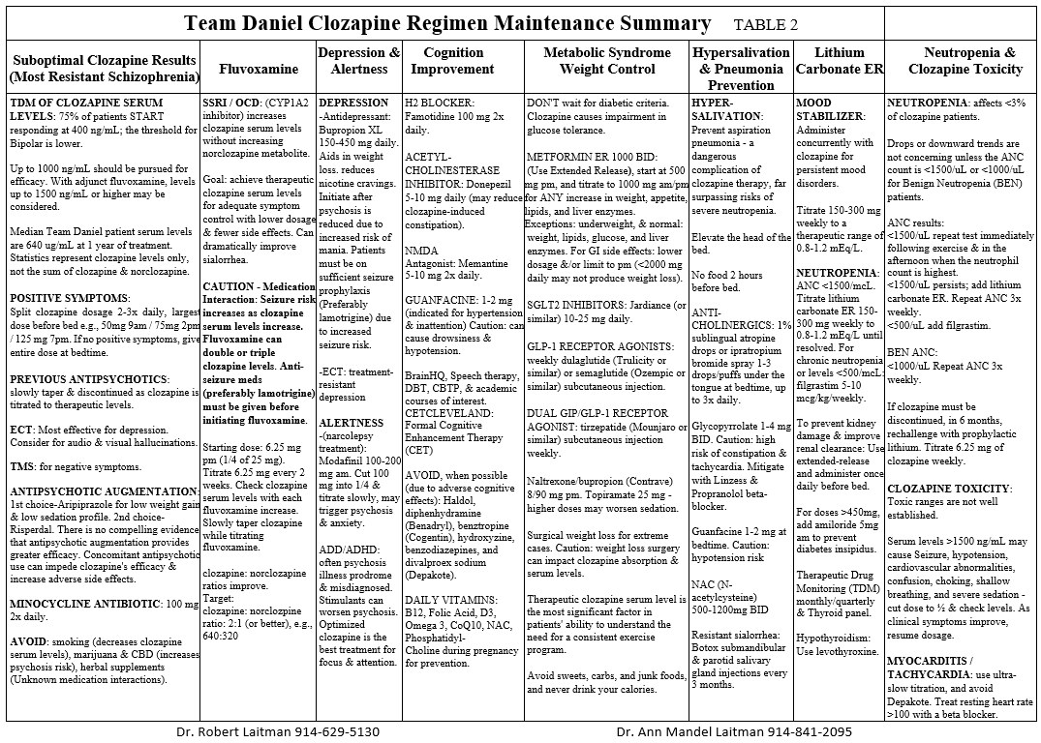

Slide 57
Benefits of Ultra-Slow Titration
Identify lowest effective dose.
Minimize and proactively treat predictable early side effects:
  Sedation Orthostasis (dizziness & low blood pressure)
  Constipation Tachycardia (rapid heart rate)
  Weight gain Sialorrhea (over-salivation)
  Reduced risk of cardiomyopathy and myocarditis.
Significantly more likely to have success and compliance.
Expect a long cross-taper from the previous antipsychotic.

Slide 58
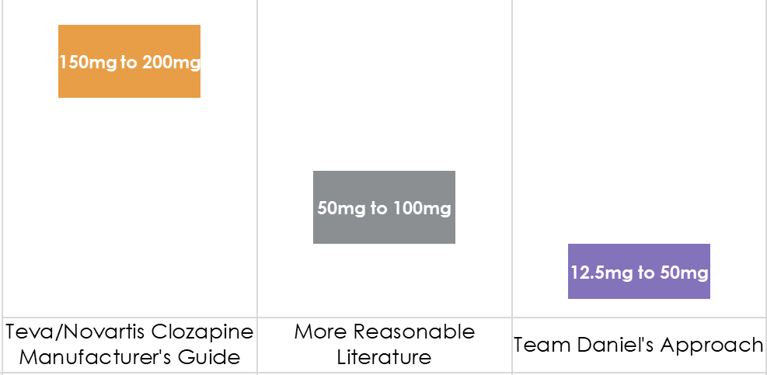
Total Daily Dose (mg) Increases Per Week
Clozapine Titration Schedule – Go Slow!

Slide 59
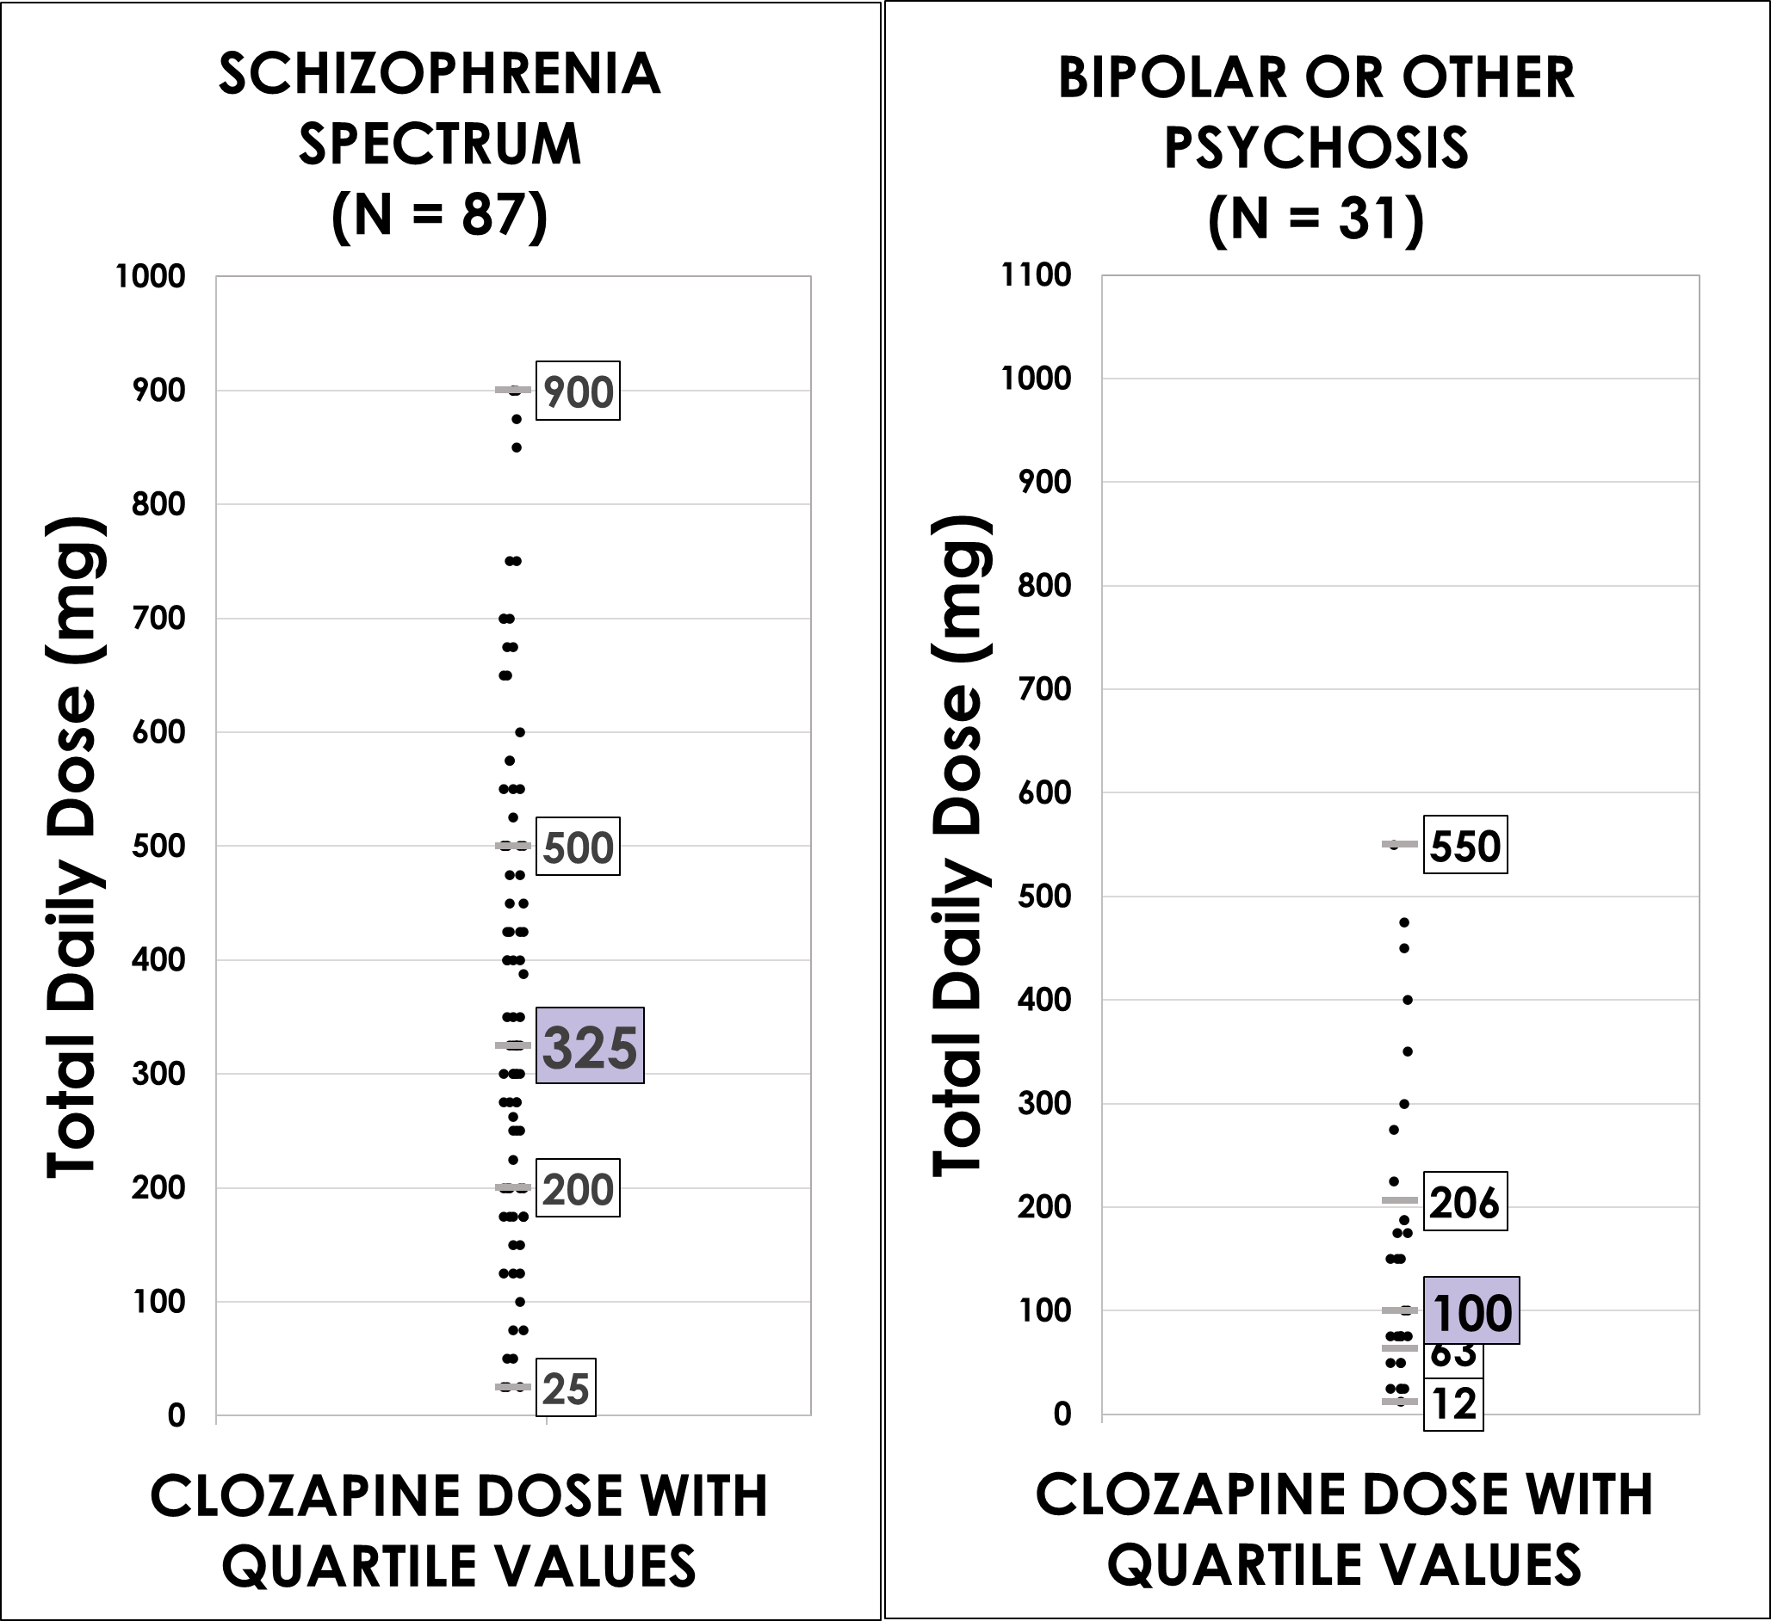
TOTAL DAILY CLOZAPINE DOSE (mg) AFTER 1 YEAR (N = 118)*
*2 patients symptoms resolved
Note:
Many patients have clozapine levels augmented with fluvoxamine which allows a lower dose to be used.
There is no standard dose:
Use TDM and patient symptoms to determine dose.

Slide 60
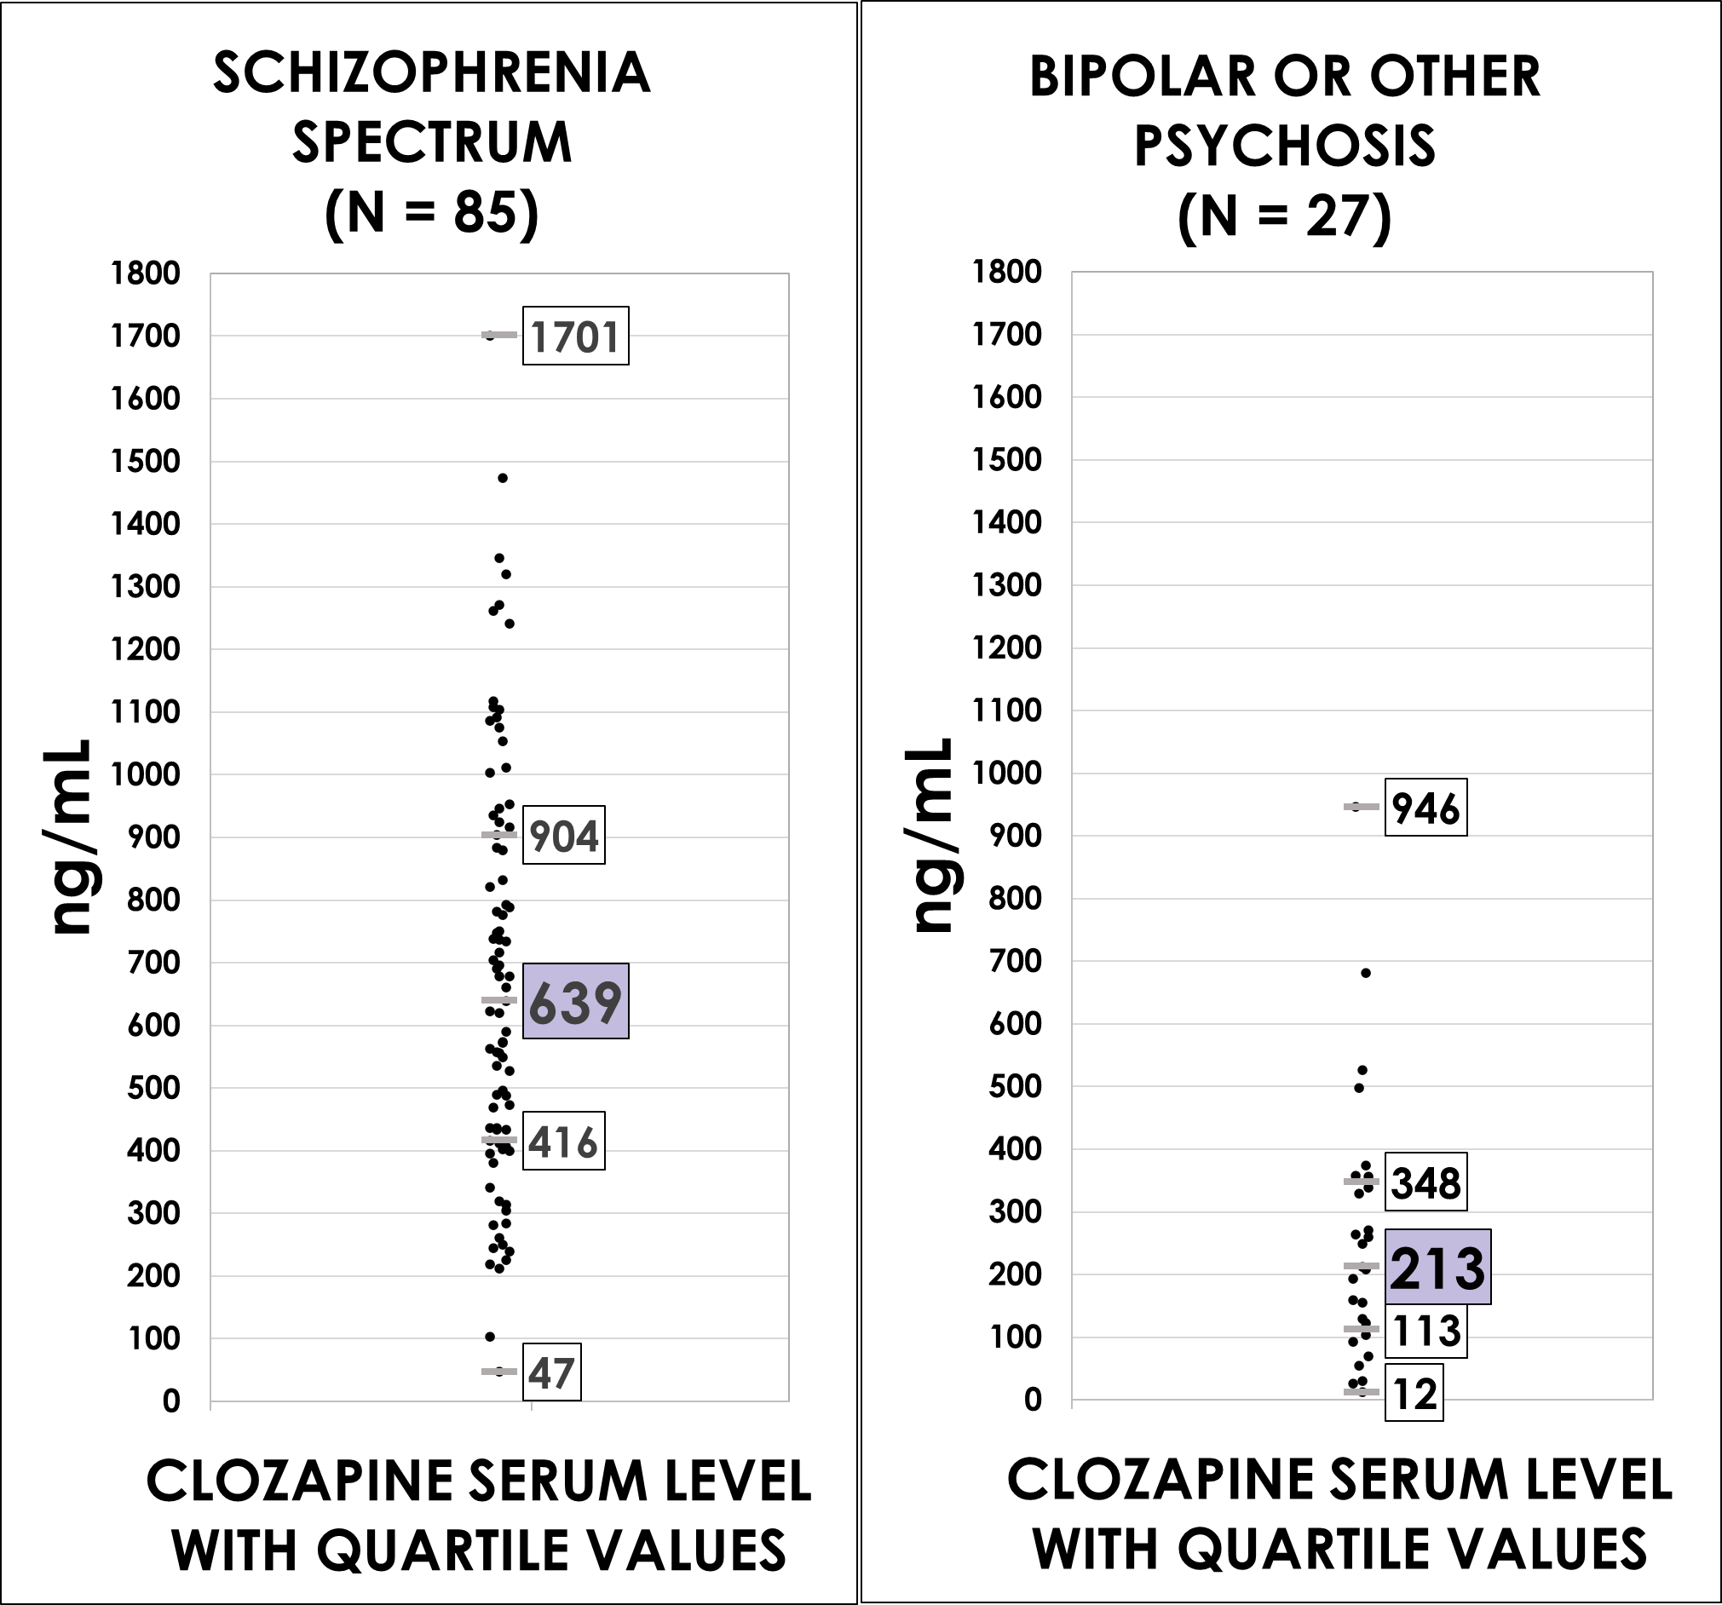
THERAPEUTIC CLOZAPINE SERUM LEVELS (ng/mL) AFTER 1 YEAR IN PATIENTS WITH DETECTABLE LEVELS (N = 112)*
*8 patients with no detectable levels
Push Boundaries:
Literature therapeutic range:
350 to 650 ng/mL
Traditional Upper Limit:
1000 ng/mL
Most TEAM DANIEL patients are on anti-seizure medications.

Slide 61
Clozapine Metabolism Via CYP1A2
Cigarettes: dramatically lowers clozapine
  Stopping dramatically raises levels
  Hydrocarbons & coal tars stimulate metabolism
  Nicotine has no affect
Caffeine: increases the levels - Keep it steady!
Be aware of drug interactions!
  Some quinolones increase levels (Ciprofloxacin)
Inflammation dramatically increases levels.
  With serious illness, reduce dose by 67% until the fever resolves.

Slide 62
Clozapine & Fluvoxamine With TDM
Clozapine metabolizes into clozapine and norclozapine with CYP1A2.
Fluvoxamine: Blocks the CYP1A2 enzyme to increase ratio of clozapine/norclozapine for better efficacy and less side effects.
  Baseline ratio of clozapine/norclozapine: about 1.3
  After adding fluvoxamine: 2.6
Benefits: Improve sedation, sleep time, weight, sialorrhea (over-salivation), positive and negative symptoms.
Risks: Higher levels of clozapine can cause seizures. ALL patients on the fluvoxamine-clozapine combo are maintained on Lamotrigine or other seizure prophylaxis.
CAUTION: Fluvoxamine must be added VERY slowly with TDM at each increase!
Start slowly at 6.25mg per day at bedtime!

Slide 63
The Clozapine Clinic
The General Model:
  Psychiatric MD or NP adept in medicine.
  Full time internist, or neurologist adept in clozapine.
  Psychologist or psychiatric social worker for P-CBT.
  Social workers for case management and housing and frequent legal interface.
  Peer specialist who is on clozapine.
  Work and social opportunities, befriending, normalizing: create a community!

Slide 64
The Clozapine Clinic - 2
The General Model:
  Exercise training and nutrition support.
  Family support and education – the LEAP method.
  CBT-P, DBT, cognitive enhancement therapy and job training.
  Full supported therapeutic housing.
  Substance abuse intervention for cigarettes, drugs and alcohol.
  Pet therapy (dogs do matter).
  Full biopsychosocial model: The Goal is Meaningful Recovery.

Slide 65
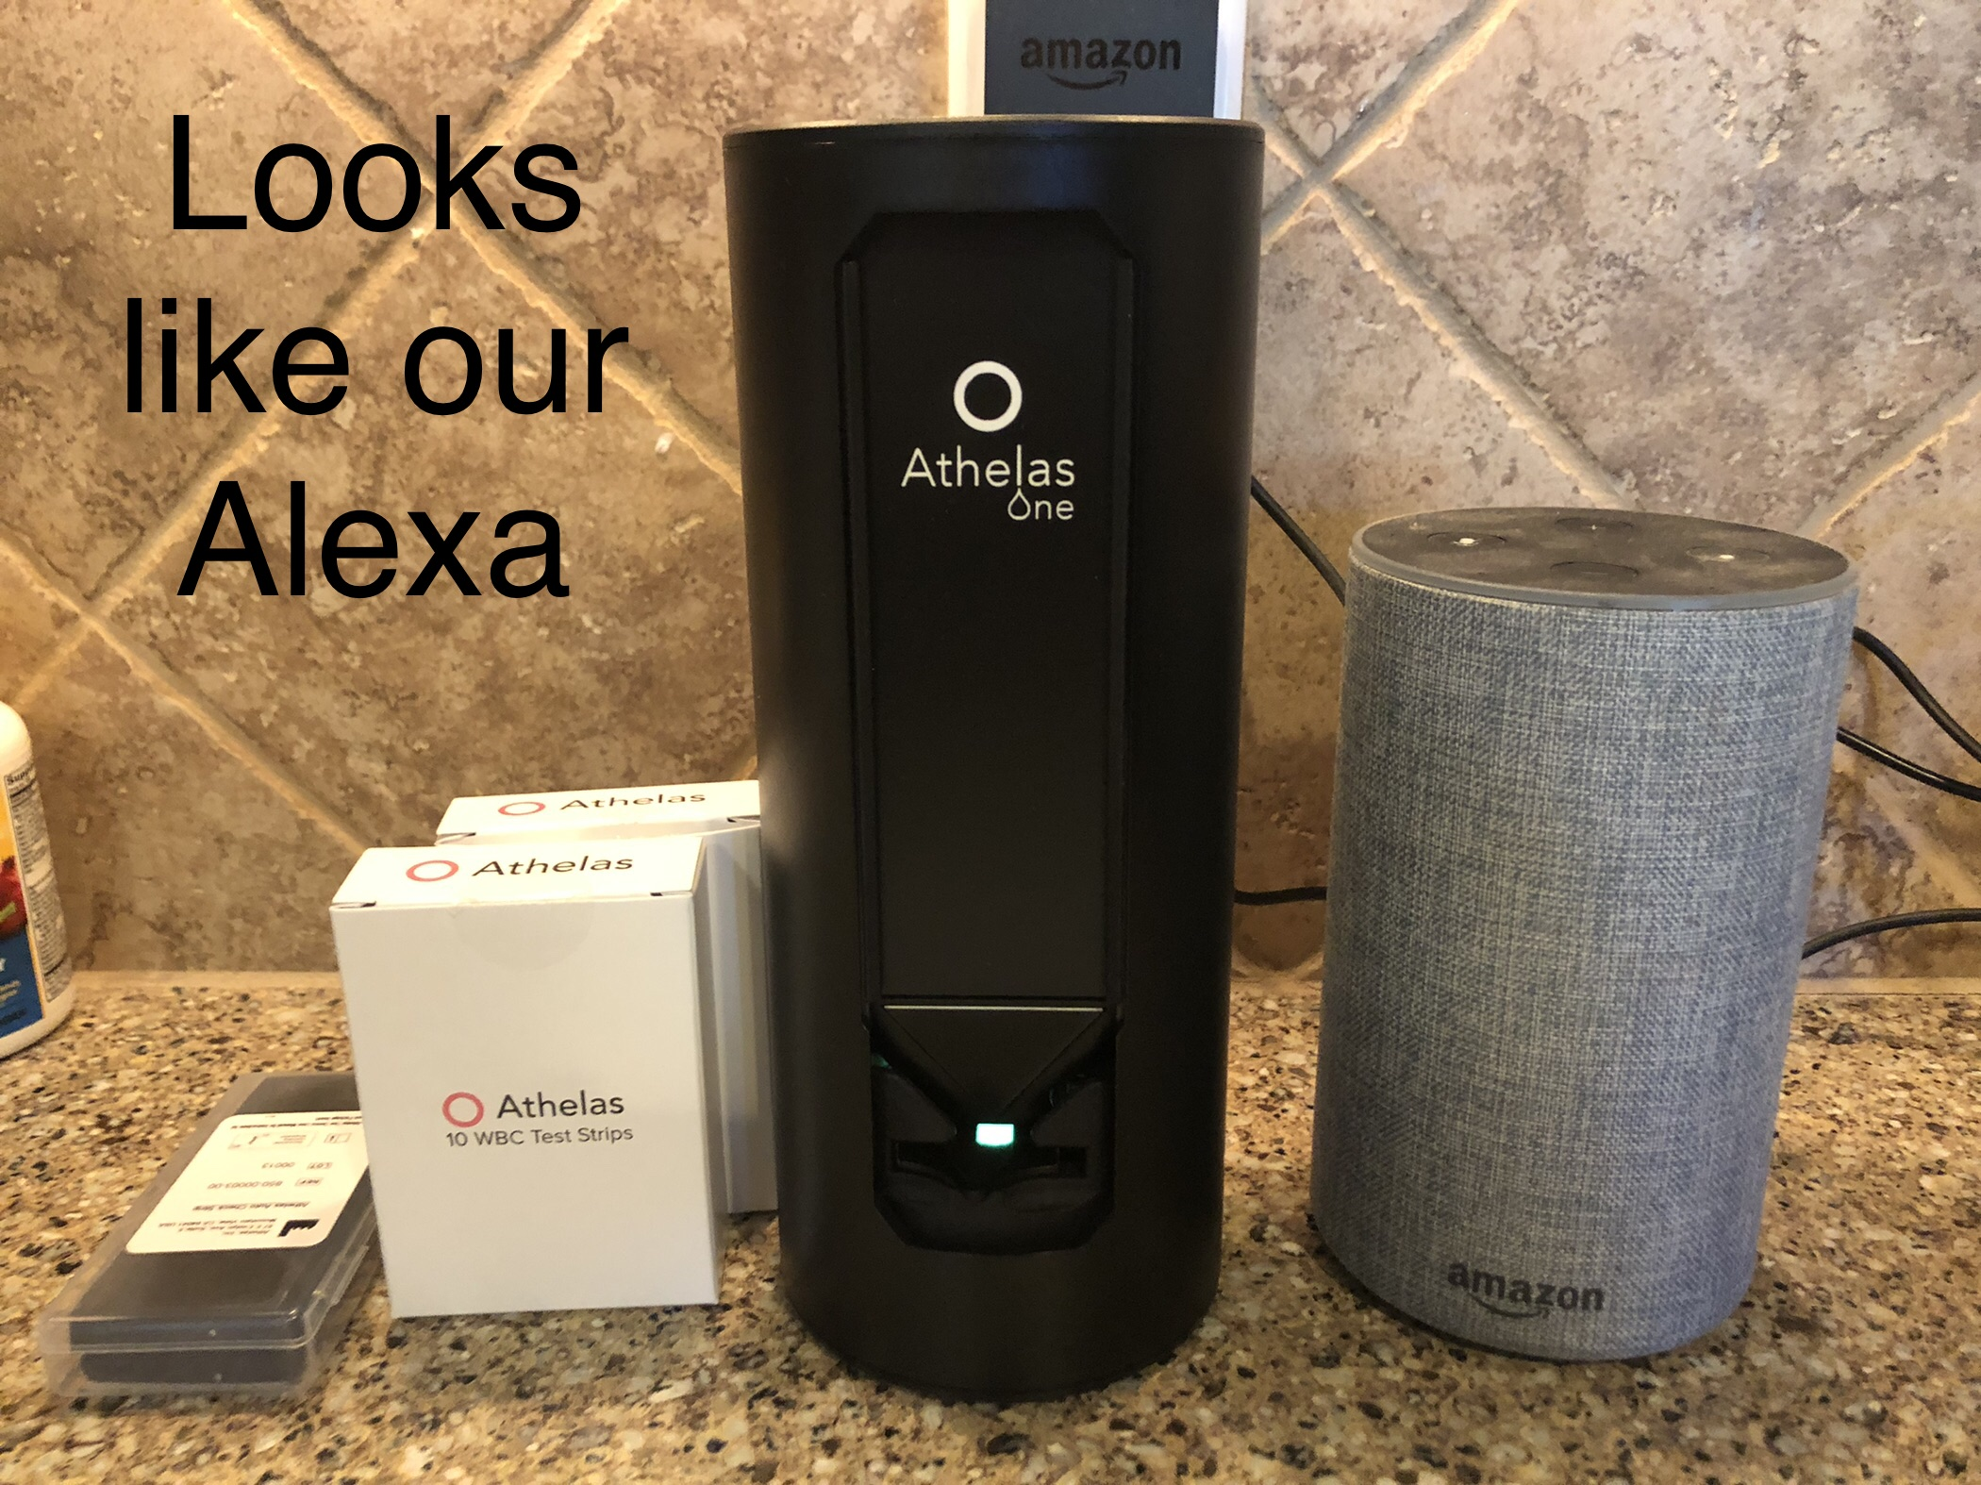
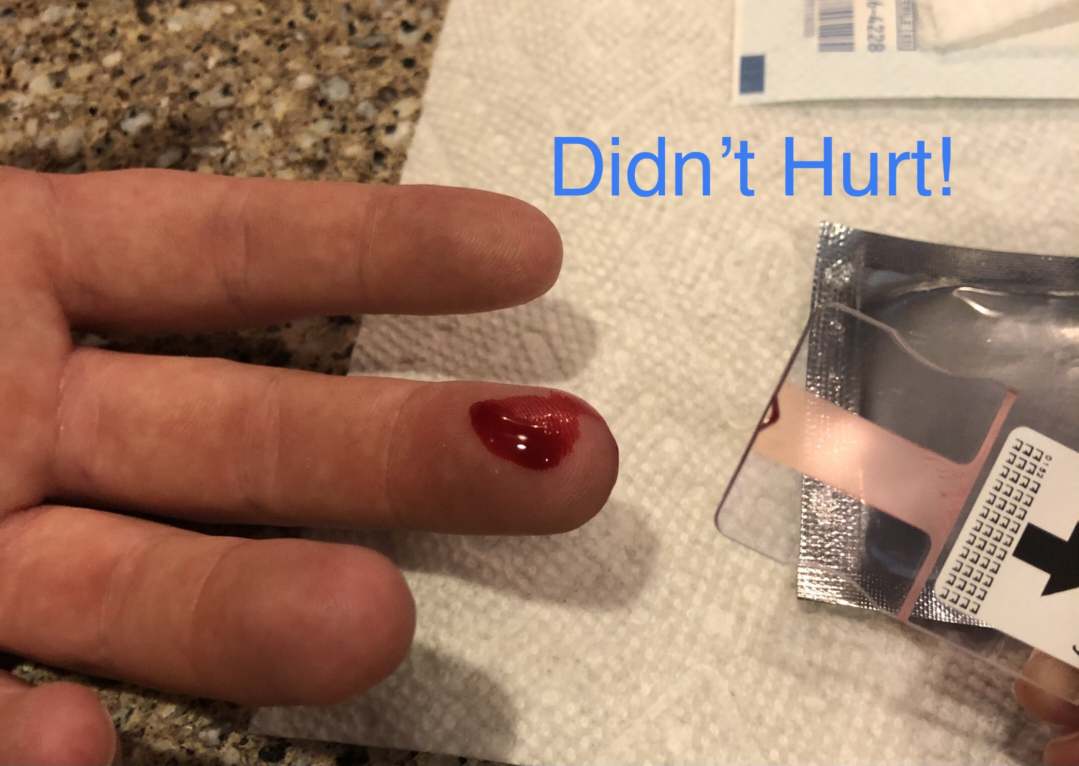
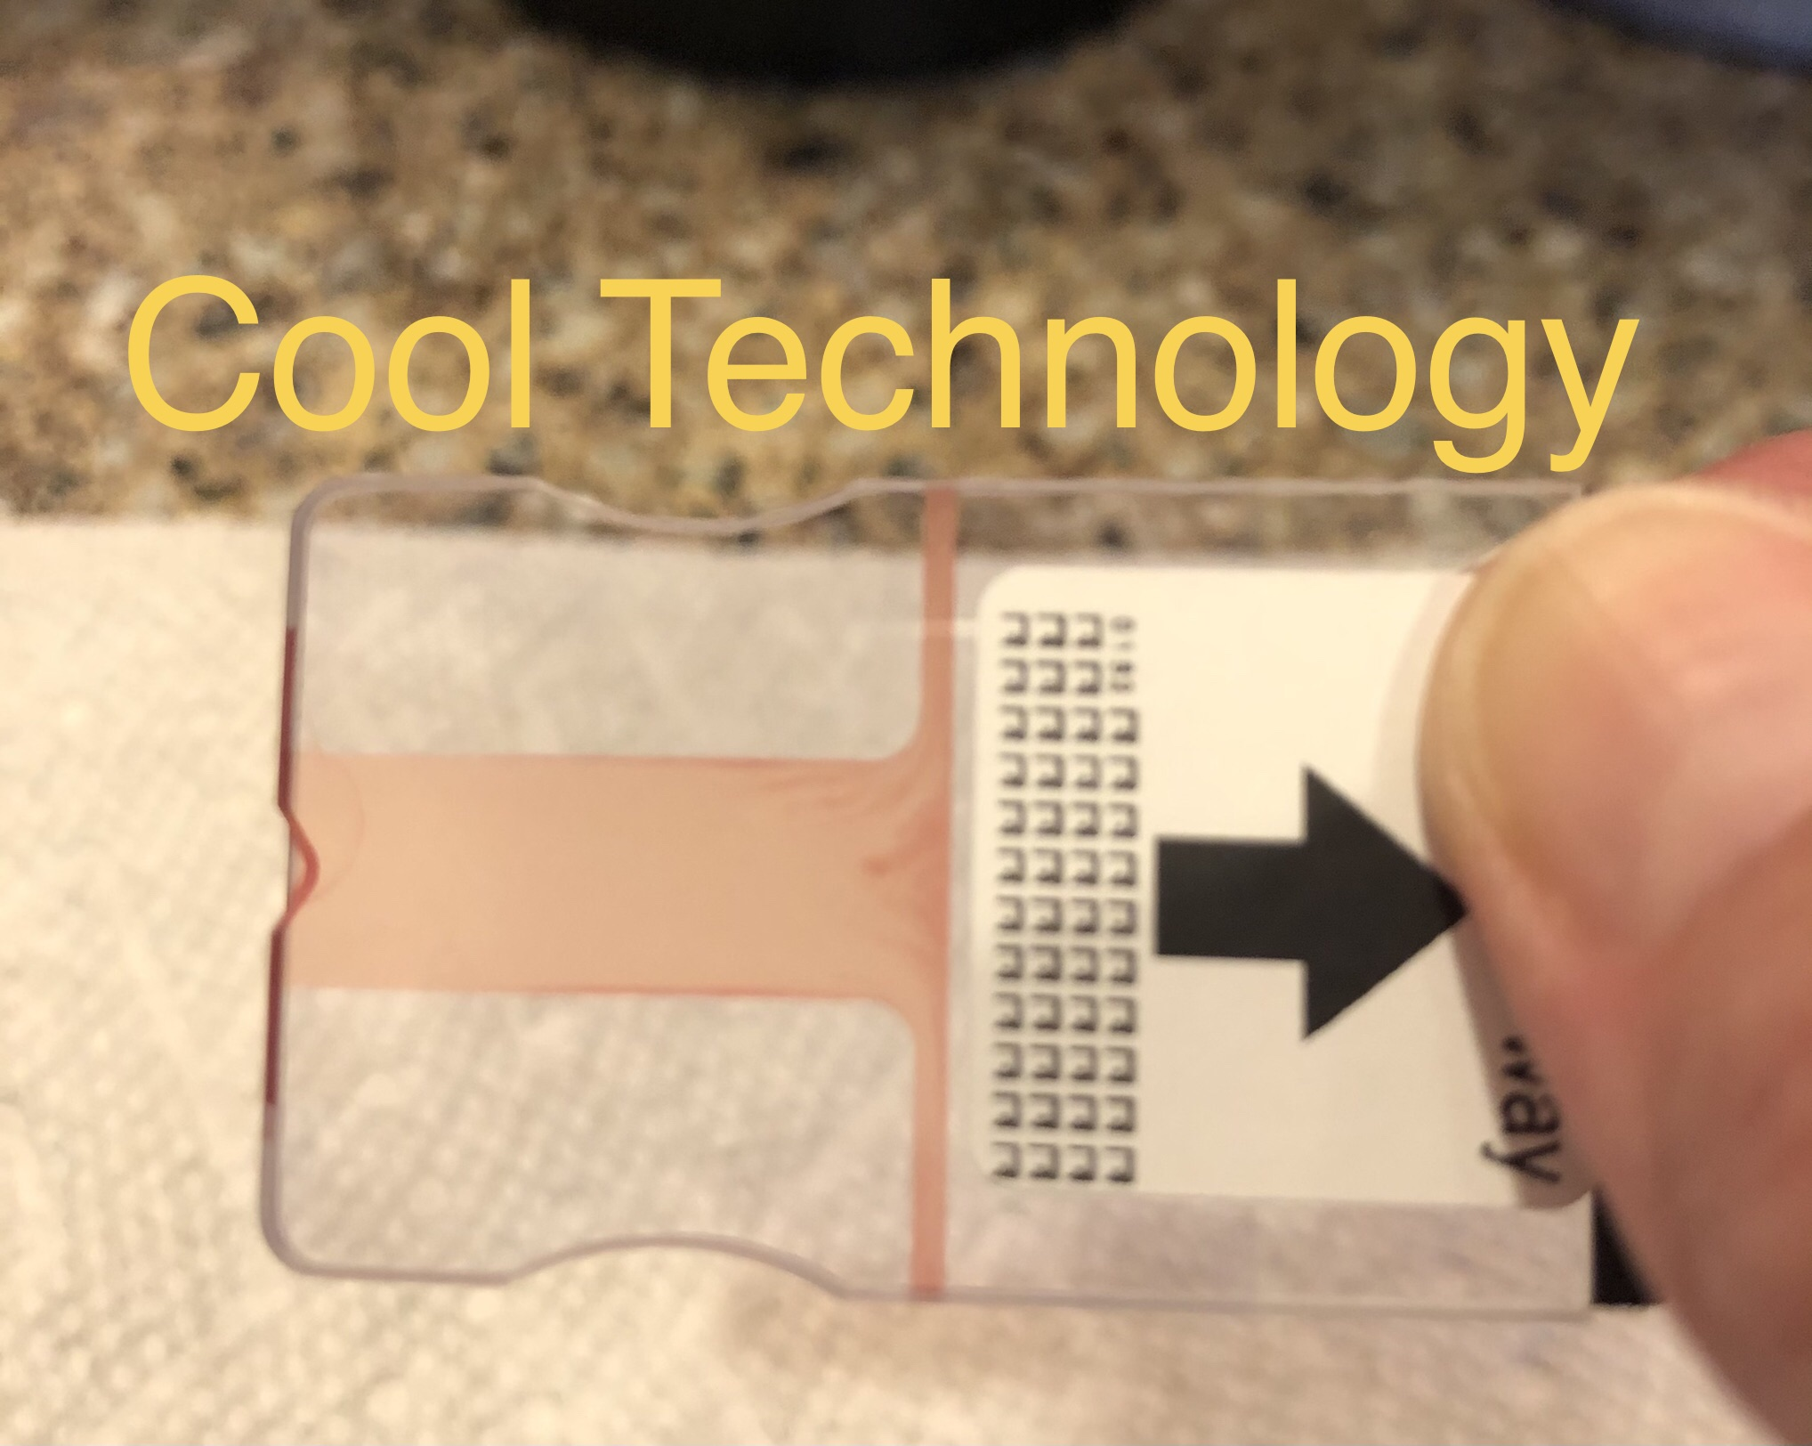
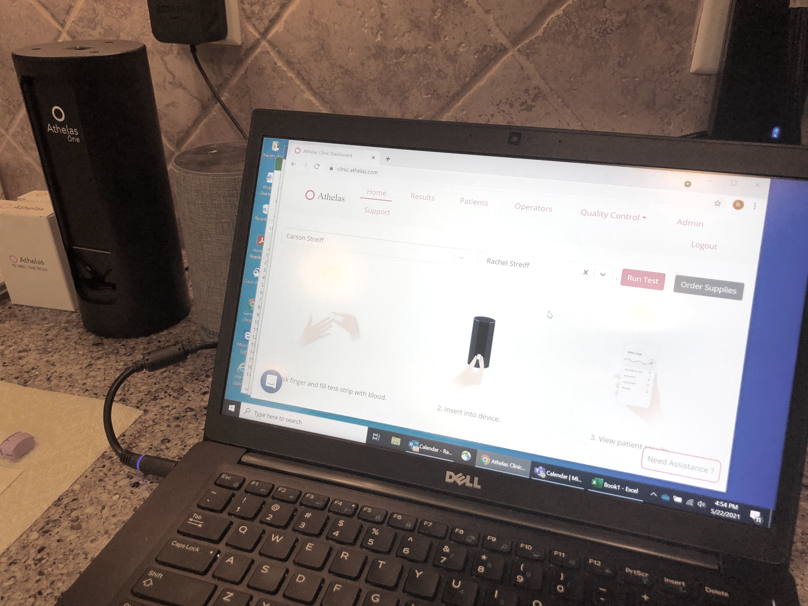
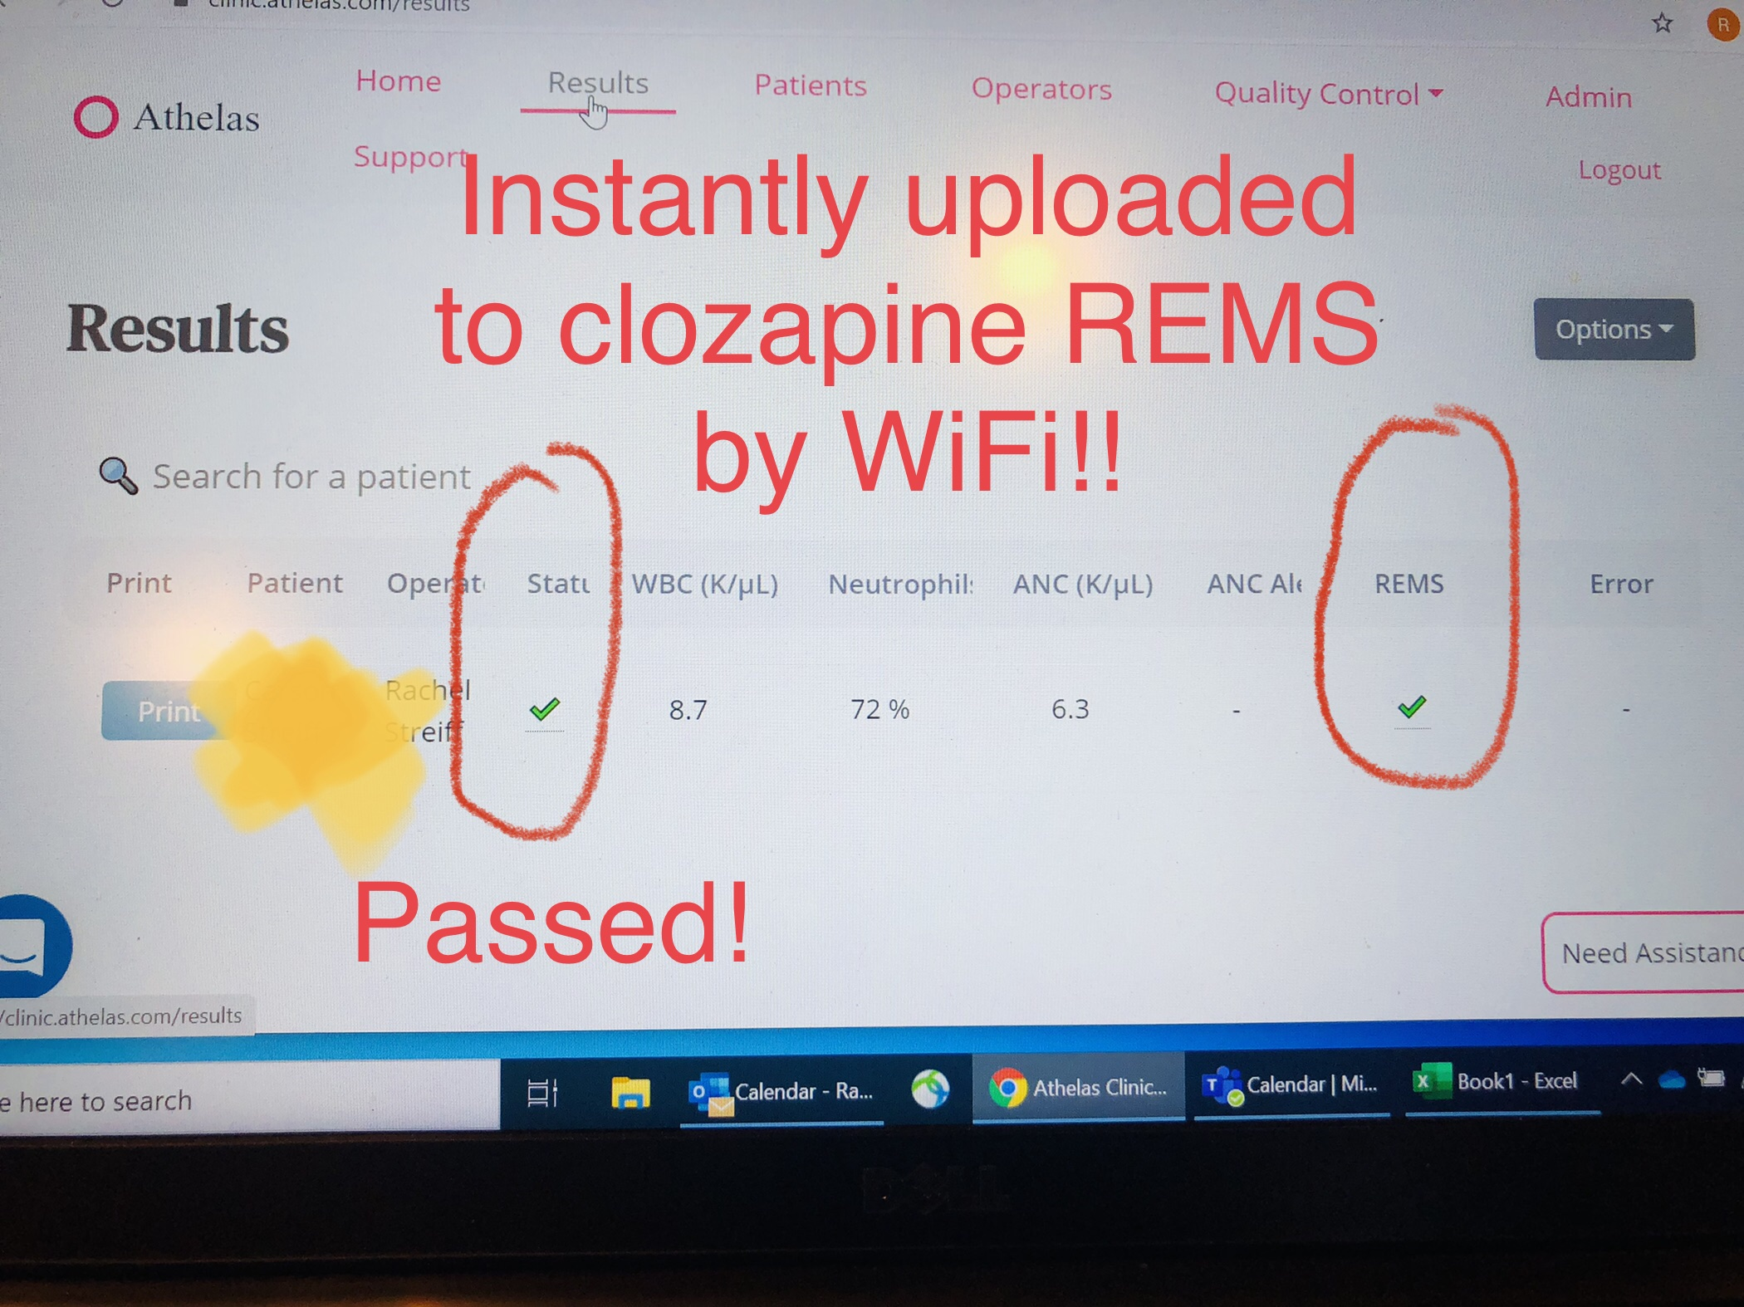

The Clozapine Clinic
Finger Prick Testing Real Photos from a Very Excited Patient!

Slide 66
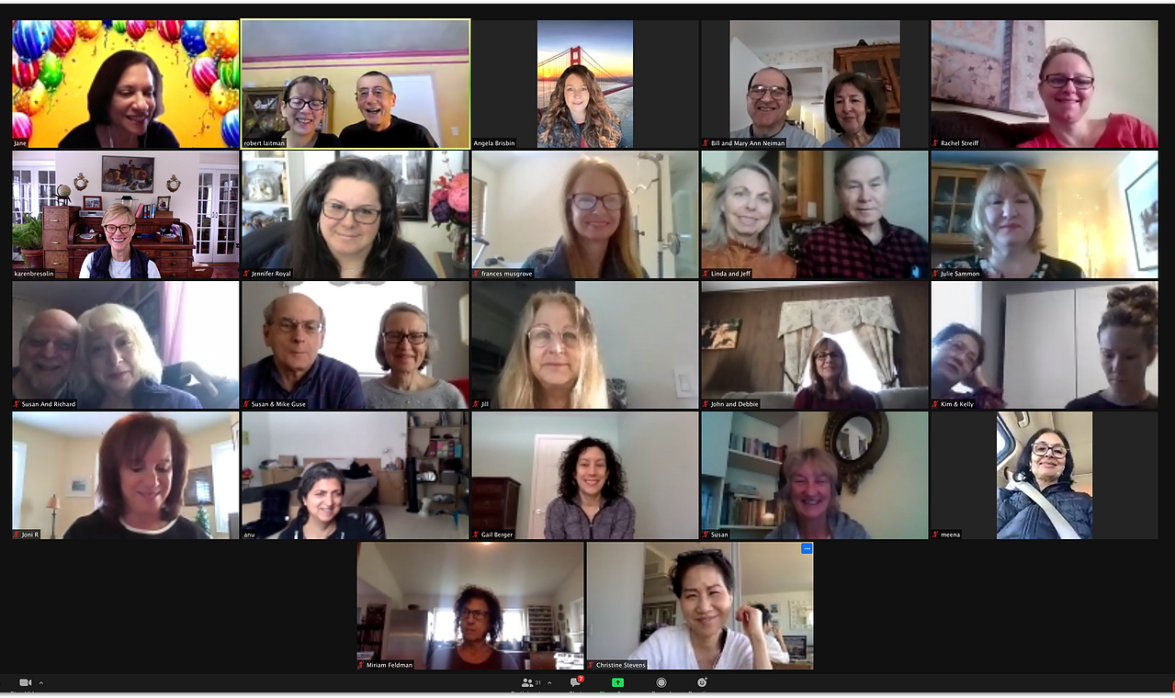
Zoom With Team Daniel

Slide 67
What Team Daniel Families Are Saying…
“We were told to grieve, and that our child would never return to their former self - those doctors were wrong.”
“Other than sleeping more hours than the
average person, our child is recovered,
perhaps even better than before the illness.”
“Clozapine quieted my mind instead of deadening it.”
“Kids on clozapine look normal and act normal.”
“Clozapine turned the light back on in their eyes…”
“The Awakening Phenomenon”
has been well-documented in observational studies of clozapine in patients with schizophrenia.
Dr. Stephen Stahl called it
“the restoration of lost souls to
near normal existence”

Slide 68

KD in Art School – Before Illness

Slide 69
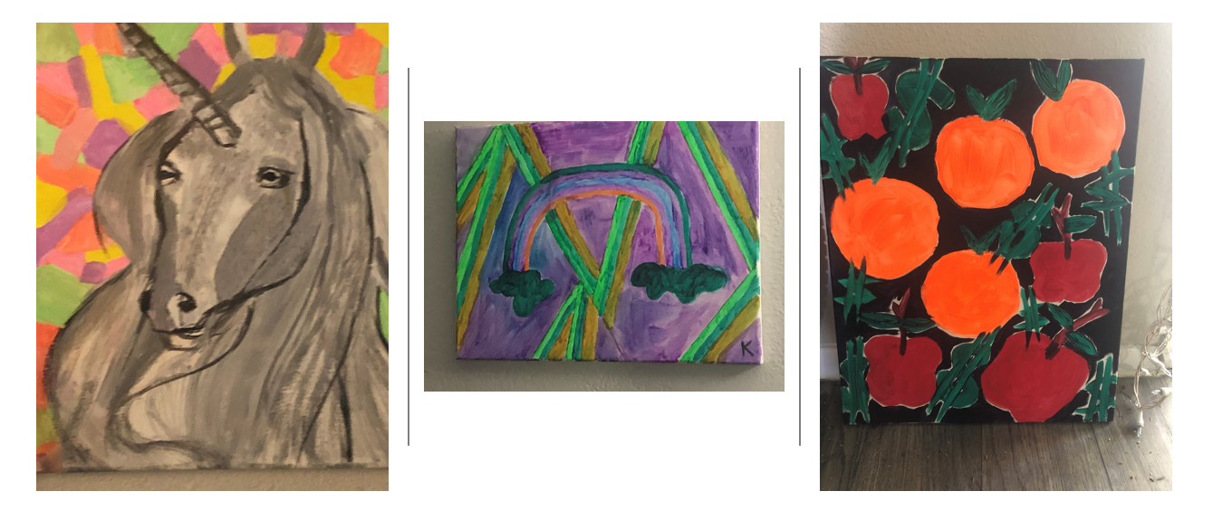
KD on olanzapine, nonclozapine-APs, and LAI’s

Slide 70
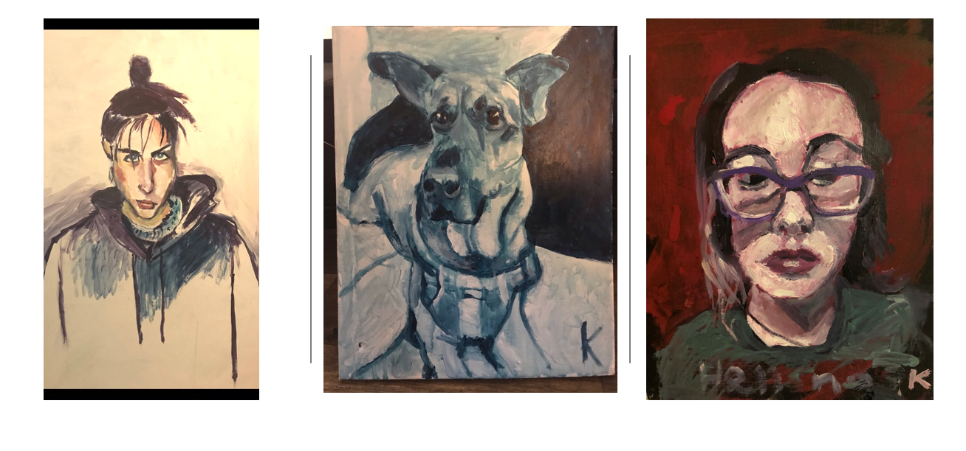
KD after 5 months on Clozapine
(still subtherapeutic)

Slide 71
Harsh Realities
Cerebral: A serious brain disease.
Common: 1.1% schizophrenia/2.2% severe bipolar of population.
Cognitive: Impairment is a central problem.
Costly: 2% of GNP, nearly $340 Billion in direct and indirect costs.
Chronic: Lifelong morbidity and increased mortality.
Crippling: One of 10 leading causes of disability in world (WHO).
Circuitry Disorder: Neuro-circuitry due to a combination of genetic and environmental factors

Slide 72
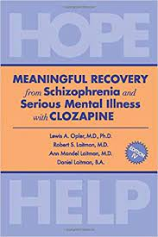
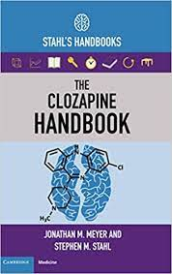
Important References

Slide 73
References
Ingimarsson O, MacCabe JH, Haraldsson M, Jónsdóttir H, Sigurdsson E. Clozapine treatment and discontinuation in Iceland: A national longitudinal study using electronic patient records. Nord J Psychiatry. 2016 Aug;70(6):450-5
Taipale H, et al. 20-year follow-up study of physical morbidity and mortality in relationship to antipsychotic treatment in a nationwide cohort of 62,250 patients with schizophrenia (FIN20). World Psychiatry. 2020 Feb;19(1):61-68.
Myles N, et al. A meta-analysis of controlled studies comparing the association between clozapine and other antipsychotic medications and the development of neutropenia. Australian & New Zealand Journal of Psychiatry. 2019;53(5):403-412
Hayes RD, et al. The effect of clozapine on premature mortality: an assessment of clinical monitoring and other potential confounders. Schizophrenia Bulletin. 2015 May;41(3):644-55.
Leucht S, et al. Comparative efficacy and tolerability of 15 antipsychotic drugs in schizophrenia: a multiple-treatments meta-analysis. Lancet. 2013 Sep 14;382(9896):951-62
Wimberley T, et al. Mortality and Self-Harm in Association With Clozapine in Treatment-Resistant Schizophrenia. Am J Psychiatry. 2017 Oct 1;174(10):990-998.
Kinon, B.J., et al. "Influence of Neuroleptic Dose and Class in Treatment-Resistant Schizophrenia Relapse." Presented at the 32nd Annual Meeting of the New Clinical Drug Evaluation Unit, Key Biscayne, FL, May 1992.
Siskind D, et al. Clozapine Response Rates among People with Treatment-Resistant Schizophrenia: Data from a Systematic Review and Meta-Analysis. Can J Psychiatry. 2017 Nov;62(11):772-777
Messamore, E. “This One Fix Could Prevent 50,000 Suicide Deaths” www.erikmessamore.com blog. 2021 Nov 2.
Meltzer HY, et al. Age at onset and gender of schizophrenic patients in relation to neuroleptic resistance. Am J Psychiatry. 1997 Apr;154(4):475-82.
Taylor, D et al. Distinctive pattern of neutrophil count change in clozapine-associated, life-threatening agranulocytosis. Schizophrenia 8, 21 (2022).
Mizuno, Y et al. Heterogeneity and efficacy of antipsychotic treatment for schizophrenia with or without treatment resistance: a meta-analysis. Neuropsychopharmacology. 45, 622–631 (2020).
de la Chapelle A, Kari C, Nurminen M, Hernberg S. Clozapine-induced agranulocytosis. A genetic and epidemiologic study. Hum Genet. 1977 Jun 30;37(2):183-94.
Kalaria SN, Kelly DL. Development of point-of-care testing devices to improve clozapine prescribing habits and patient outcomes. Neuropsychiatric Disease and Treatment. 2019 Aug 20;15:2365-2370.
Palmblad, J et al. Age-related prevalence and clinical significance of neutropenia - isolated or combined with other cytopenias: Real world data from 373 820 primary care individuals. Am J Hematology. 2020; 95: 521– 528
FDA Sentinel Initiative. “Diagnosis of Agranulocytosis Following New Use of Anti-epileptic Drugs, Clozapine, and Olanzapine.” Mini-Sentinel Distributed Database (MSDD) March 21, 2018 link: MS_Brief_Report_1_to09y05_mpr_wp26_v01.pdf (sentinelinitiative.org)

Slide 74
References
Reid WH, et al. Suicide prevention effects associated with clozapine therapy in schizophrenia and schizoaffective disorder. Psychiatric Services. 1998 Aug;49(8):1029-33.
Girardin FR, et al. Monitoring white blood cell count in adult patients with schizophrenia who are taking clozapine: a cost-effectiveness analysis. Lancet Psychiatry. 2014 Jun;1(1):55-62.
Vermeulen JM, et al. Clozapine and Long-Term Mortality Risk in Patients With Schizophrenia: A Systematic Review and Meta-analysis of Studies Lasting 1.1-12.5 Years. Schizophrenia Bulletin. 2019 Mar 7;45(2):315-329.
Dubois R, “Cost–effectiveness thresholds in the USA: are they coming? Are they already here?” Future Medicine Ltd
Journal of Comparative Effectiveness Research, Volume 5, Issue 1, January 2016, Pages 9-12
Lieslehto J, et al. Primary Nonadherence to Antipsychotic Treatment Among Persons with Schizophrenia. Schizophrenia Bulletin. 2022 May 7;48(3):655-663.
Masuda T, et al. Association With Hospitalization and All-Cause Discontinuation Among Patients With Schizophrenia on Clozapine vs Other Oral Second-Generation Antipsychotics: A Systematic Review and Meta-analysis of Cohort Studies. JAMA Psychiatry. 2019 Oct 1;76(10):1052-1062.
Meltzer HY, et al. International Suicide Prevention Trial Study Group. Clozapine treatment for suicidality in schizophrenia: International Suicide Prevention Trial (InterSePT). Arch Gen Psychiatry. 2003 Jan;60(1):82-91.
Treatment Advocacy Center. RESEARCH WEEKLY: Hurdling the Clozapine Barriers. 2016 Nov 1; https://www.treatmentadvocacycenter.org/fixing-the-system/features-and-news/3677-research-weekly-hurdling-the-clozapine-barriers-
Laitman RS, Optimal Treatment of Psychotic Disorders: Clozapine/Engagement/Community. 2022 Mar 16; www.teamdanielrunningforrecovery.org
Warnez, S and Alessi-Severini, S. “Clozapine: a review of clinical practice guidelines and prescribing trends.” BMC Psychiatry 14 (2014): 102 - 102.
Howes OD, et al. Adherence to treatment guidelines in clinical practice: study of antipsychotic treatment prior to clozapine initiation. Br J Psychiatry. 2012 Dec;201(6):481-5.
Nielsen J, et al. Geographical and temporal variations in clozapine prescription for schizophrenia, European Neuropsychopharmacology. 2012 Nov; 22:818-824.
Gören JL, et al. Antipsychotic prescribing pathways, polypharmacy, and clozapine use in treatment of schizophrenia. Psychiatric Services, 2013 64(6), 527–533.
Gallego JA, et al. Prevalence and correlates of antipsychotic polypharmacy: a systematic review and meta-regression of global and regional trends from the 1970s to 2009. Schizophrenia Research, 2012 Jun;138(1):18-28.
Masuda T, et al. Association With Hospitalization and All-Cause Discontinuation Among Patients With Schizophrenia on Clozapine vs Other Oral Second-Generation Antipsychotics: A Systematic Review and Meta-analysis of Cohort Studies. JAMA Psychiatry. 2019 Oct 1;76(10):1052-1062.
Schizophrenia Working Group of the Psychiatric Genomics Consortium. Nature 2014;511(7510):421–427.

Slide 75
Connect With Team Daniel
Website: Teamdanielrunningforrecovery.org
Email: Robert S. Laitman: rslaitman@aol.com
Cell: 914-629-5130 Personal Cell Phone
Facebook: Team Daniel and the Clozapine Community
Where there is help there is hope!

Slide 76
The purpose of the MHTTC Network is technology transfer - disseminating and implementing evidence-based practices for mental disorders into the field.
Funded by the Substance Abuse and Mental Health Services Administration (SAMHSA), the MHTTC Network includes 10 Regional Centers, a National American Indian and Alaska Native Center, a National Hispanic and Latino Center, and a Network Coordinating Office.
Our collaborative network supports resource development and dissemination, training and technical assistance, and workforce development for the mental health field. We work with systems, organizations, and treatment practitioners involved in the delivery of mental health services to strengthen their capacity to deliver effective evidence-based practices to individuals.
Our services cover the full continuum spanning mental illness prevention, treatment, and recovery support.
MHTTCnetwork.org
Sign-Up for Newsletter
MTTC News

