Slide 1


New England Mental Health Technology Transfer Center
(New England MHTTC)
SAMHSA #1H79SM081775-01
Yale Program for Recovery and Community Health
in partnership with
C4 Innovations,
Harvard University, Department of Psychiatry, and the Center for Educational Improvement

Slide 2





Housekeeping Information
Participant microphones will be muted at entry. You will be able to unmute your microphone at designated times during our event.
Closed captioning, in Spanish, is available for this event. Click on the closed captioning (CC) icon at the bottom of your Zoom screen to select a transcription option.
This session is being recorded and it will be available on the MHTTC website within 48 hours of the close of this presentation.
If you have questions during the event, please use the chat or the “raise hand” feature. Our Technical Support Manager will ensure your question/concern is addressed.
If you have questions after
this session, please e-mail:
newengland@mhttcnetwork.org.
Notes:
Ingrid: Housekeeping Script

Slide 4
Impact of Incarceration and Re-Entry on Women
Daisy M Hernandez, MSW, LCSW
Steven K. Samra, MPA
December 15, 2023
Yale Program for Recovery and Community Health in partnership with C4 Innovations,
Harvard University, Department of Psychiatry, and the Center for Educational Improvement

Slide 5

Objectives
Understand the impact landscape.
Identify challenges and barriers to re-entry.
Discuss strategies for improving success to re-entry.
Review trauma informed care.
Define wellness recovery-oriented systems of care (WROSC).
Increase awareness of the power of peer support services.

Slide 6



Impact Landscape
This Photo by Unknown Author is licensed under CC BY-NC
This Photo by Unknown Author is licensed under CC BY-SA-NC
Notes:
Women’s incarceration has grown at twice the pace of men’s incarceration in recent decades, and has disproportionately been located in local jails.
A staggering number of women who are incarcerated are not even convicted: Moreover, 60% of women in jails under local control have not been convicted of a crime and are awaiting trial.
Aside from women under local authority (or jurisdiction), state and federal agencies also pay local jails to house an additional 8,875 women. For example, ICE and the U.S. Marshals Service, which have fewer dedicated facilities for their detainees, contract with local jails to hold roughly 3,200 women.

Slide 7
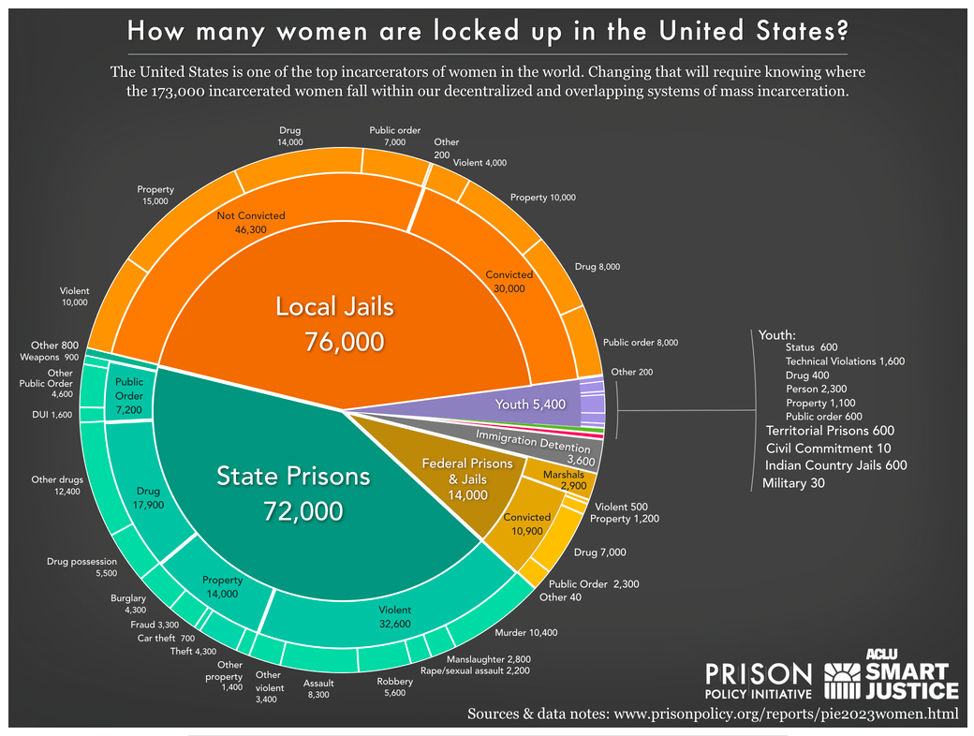
Impact Landscape - Women
Notes:
Women’s MA Incarceration: The Whole Pie 2023
https://www.prisonpolicy.org/reports/pie2023women.html

Slide 8
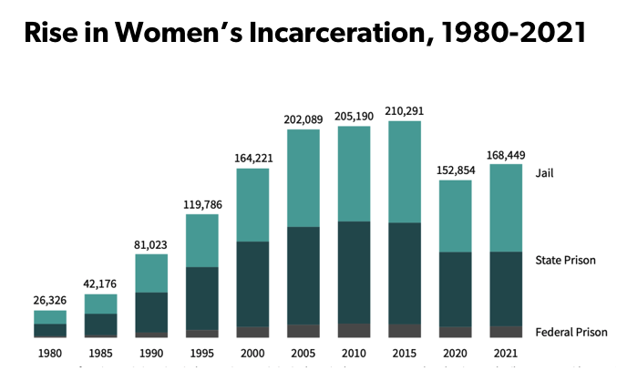
Incarceration Rates
Sources: Bureau of Justice Statistics: Historical Corrections Statistics in the United States 1850-1984 (1986); Prison and Jail Inmates at Midyear Series (1997- 2021), Prisoners Series (1980-2021). Washington, DC.
Notes:
Women’s incarceration rates have grown dramatically since the late 1980s. But in contrast to the total incarcerated population — which is overwhelmingly male — women’s jail rates have grown about equally to their state prison rates.
Women in state prisons are more likely than men to be incarcerated for a drug or property offense. Twenty-five percent of women in prison have been convicted of a drug offense, compared to 12% of men in prison; 19% of incarcerated women have been convicted of a property crime, compared to 13% among incarcerated men.
The proportion of imprisoned women convicted of a drug offense has increased from 12% in 1986 to 25% in 2020.
The rate at which women are incarcerated varies greatly from state to state. At the national level, including both state and federal imprisonment, 47 out of every 100,000 women were in prison in 2021. The state with the highest rate of female imprisonment is Idaho (127) and the state with the lowest incarceration rate of women is Massachusetts (6).
Incarcerated Women and Girls – April 3, 2023
https://www.sentencingproject.org/fact-sheet/incarcerated-women-and-girls/#:~:text=State%20Variation&text=At%20the%20national%20level%2C%20including,women%20is%20Massachusetts%20(6).

Slide 9
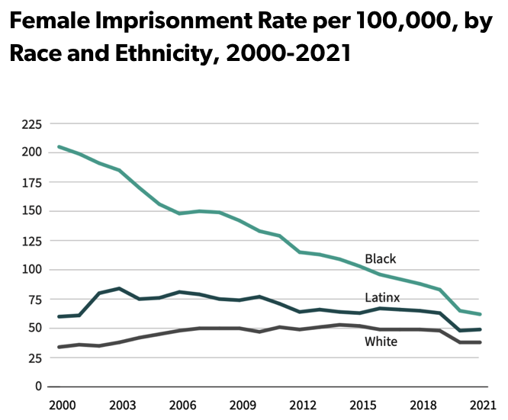
Incarceration Rates
Source: Prisoners Series. Washington, DC: Bureau of Justice Statistics
Notes:
Anyone who lives in or works within heavily policed and incarcerated communities intuitively knows that certain neighborhoods disproportionately experience incarceration.
Prison gerrymandering (the practice of counting individuals where they are incarcerated, rather than where they call home) — actively works against the notion of equal representation that is foundational to our democracy.
California, Colorado, Connecticut, Delaware, Maryland, Montana, Nevada, New Jersey, New York, Pennsylvania, Virginia, and Washington — are among the twelve states that have ended prison gerrymandering.
The need for this type of reform is crucial for ending the siphoning of political power from disproportionately Black and Latino communities to pad out the mostly rural, predominantly white regions where prisons are located. ~ Prison Gerrymandering, Explained https://www.democracydocket.com/analysis/prison-gerrymandering-explained/
Incarcerated Women and Girls – April 3, 2023
https://www.sentencingproject.org/fact-sheet/incarcerated-women-and-girls/#:~:text=State%20Variation&text=At%20the%20national%20level%2C%20including,women%20is%20Massachusetts%20(6).

Slide 10
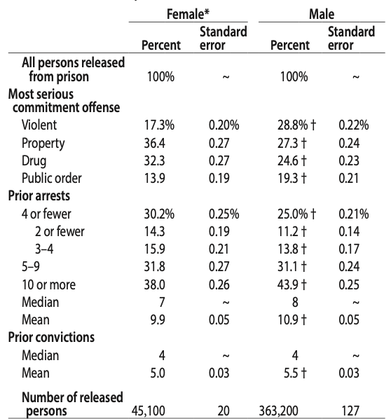
Recidivism
Source: Bureau of Justice Statistics, Recidivism of State Prisoners Released in 2012 data collection, 2012–2017.
Notes:
Recidivism rates in the U.S. are some of the highest in the world with almost 44% of individuals released returning to prison within their first year out.
The median number of prior arrests among females was seven, compared to eight among males.
Females were less likely than males to be arrested, convicted, and returned to prison within 5 years of their 2012 release.
The percentage of females who returned to prison within 5 years was higher among those serving time for a property offense (38%) than a violent offense (27%).
Statistics Brief - April 2023
Recidivism of Females Released from State Prison, 2012 - 2017
https://bjs.ojp.gov/document/rfrsp1217.pdf

Slide 11

Incarceration Challenges & Barriers
This Photo by Unknown Author is licensed under CC BY

Slide 12
Challenges
Uprooting of children / breaking up of families
Women have a higher mortality rate
Hindering family communication
Experience homelessness & Joblessness
Medical issues
Mental health problems and / or serious mental illness
Co-Occurring disorders and / or Substance Use Disorder
Sexual victimization
Trauma and / or serious psychological distress
https://www.prisonpolicy.org/reports/pie2023women.html
Notes:
Women are more likely to be parents of minor children (58%), more likely to be single parents, and more likely to have been living with their children prior to their imprisonment — making it more likely that incarceration would uproot their children and lead to termination of parental rights, permanently breaking up their families.
while stays in jail are generally shorter than in stays in prison, jails can be especially deadly for women. Women have a higher mortality rate than men in jails, dying of drug and alcohol intoxication at twice the rate of men, the number of deaths by suicide among women in jails increased by almost 65% between the periods of 2000-2004 and 2015-2019.
Over a quarter of women (26%) experienced homelessness in the year before the arrest that led to their incarceration — a higher rate than among men (16%).
Women are more likely to be jobless (53%) than to be employed in the month before their arrest.
Women are more likely than men to enter jail with a medical problem or a serious mental illness and while incarcerated, women are more likely to suffer from mental health problems and experience serious psychological distress. Women report disabilities (50%) and physical and mental healthproblems at higher rates than men. Over half (58%) of women met the criteria for a substance use disorder the year before they went to prison, and over three-quarters (76%) had some indication of a past or current mental health problem — both significantly higher rates than among men. Yet just 47% had received treatment for a substance use disorder and just 43% had received professional mental health care since they went to prison.
while incarcerated, women are 3 times as likely as men to be sexually victimized by prison or jail staff.
https://www.prisonpolicy.org/reports/pie2023women.html

Slide 13
Barriers
Stigma
Access to resources
Gender specific pathways
Physical and mental health needs
Family reconnections / parental reunification
Connection to recovery community
Trauma and self – care support
Housing
Employment
https://www.prisonpolicy.org/reports/pie2023women.html
Notes:
Intersectional stigma is the convergence of multiple stigmatized identities and can be additive impacting behaviors, mental, and physical health.
Transitioning into the Community: Perceptions of Barriers and Facilitators Experienced By Formerly Incarcerated, Homeless Women during Reentry - A Qualitative Study
https://www.ncbi.nlm.nih.gov/pmc/articles/PMC8514107/

Slide 14

Improving Success in Re-Entry
This Photo by Unknown Author is licensed under CC BY-NC

Slide 15
Gender Responsive Programming
Designed to provide interventions that address issues at the intersection of trauma and mental health disorders, substance abuse, and socioeconomic inequity
Incorporates elements of gender- neutral programming, such as cognitive behavioral and skills-based methods, but is trauma-specific and considerate of the gendered pathways to criminal behavior
Underpinned by four theoretical perspectives
https://www.urban.org/sites/default/files/2023-04/Gender-Responsive%20Programming%20in%20Womens%20Prisons.pdf
Notes:
Gender-Responsive Programming in Women’s Prison (April 2023)
https://www.urban.org/sites/default/files/2023-04/Gender-Responsive%20Programming%20in%20Womens%20Prisons.pdf
Men and women experience different pathways to crime and addiction, as well as alternative trajectories of drug use.[5] Women’s drug use and associated criminal behavior are more likely to transpire within interpersonal relationships and are strongly associated with the behavior of romantic partners.[6]Histories of childhood maltreatment and abuse, co-occurring psychiatric disorders, familial dysfunction, and negative self-concept are also more common among criminally involved females compared to males.[7]
Women in the criminal justice system are more likely than the general population to suffer from a number of mental health disorders, including depression, anxiety, borderline personality disorder, and especially, post-traumatic stress disorder (PTSD).[8]Similarly, females who commit crimes are more likely than males to report both substance use and prior mental illness and to be diagnosed with co-occurring conditions, which has significant implications for reentry, as both conditions are predictive of higher recidivism and relapse rates.[9, 10]
Given the documented gender differences in etiology (or causes of disease), disease progression, motivation for treatment, and self-efficacy (or belief in one’s ability to execute necessary behaviors), practitioners and researchers have called for gender-responsive programming in prisoner reentry and rehabilitation.
Female Reentry and Gender – Responsive Programming: Recommendations for Policy and Practice (May 19, 2021)
https://nij.ojp.gov/topics/articles/female-reentry-and-gender-responsive-programming
After Incarcertion: A Guide to helping Women Reentr the community
https://store.samhsa.gov/sites/default/files/pep20-05-01-001.pdfij.ojp.gov/topics/articles/female-reentry-and-gender-responsive-programming

Slide 16
Gender Responsive Programming: Theoretical Perspectives
Pathways: suggests women’s paths to incarceration often triggered by gendered experiences of abuse and socioeconomic disadvantage rather than criminogenic behavior
Relational: posits that women’s experiences in the criminal legal system are more likely than men’s to be based on violence and exploitation, and that gender-responsive practice should therefore work to build a sense of connection with others
Addiction: understands that addictions not inherently criminal behaviors, rather diseases reflecting complex emotional, psychological & sociocultural challenges, and that gender- responsive programming must target the person holistically to eliminate the substance abuse behavior
https://www.urban.org/sites/default/files/2023-04/Gender-Responsive%20Programming%20in%20Womens%20Prisons.pdf
Notes:
Gender-responsive programming is underpinned by four theoretical perspectives: pathways theory, relational theory, trauma theory, and addiction theory (Petrillo, Thomas, and Hanspal 2019).
Pathways theory:
suggests that women’s paths to incarceration are often triggered by gendered experiences of abuse and socioeconomic disadvantage rather than criminogenic behavior
Relational theory:
posits that women’s experiences in the criminal legal system are more likely than men’s to be based on violence and exploitation, and that gender-responsive practice should therefore work to build a sense of connection with others
Addiction theory:
understands that addictions are not inherently criminal behaviors, but rather diseases that reflect complex emotional, psychological, and sociocultural problems, and that gender- responsive programming must target the person holistically to eliminate the substance abuse behavior
Gender-Responsive Programming in Women’s Prison (April 2023)
https://www.urban.org/sites/default/files/2023-04/Gender-Responsive%20Programming%20in%20Womens%20Prisons.pdf
Female Reentry and Gender – Responsive Programming: Recommendations for Policy and Practice (May 19, 2021)
https://nij.ojp.gov/topics/articles/female-reentry-and-gender-responsive-programming
After Incarcertion: A Guide to helping Women Reentr the community
https://store.samhsa.gov/sites/default/files/pep20-05-01-001.pdfij.ojp.gov/topics/articles/female-reentry-and-gender-responsive-programming

Slide 17
Gender Responsive Programming: Theoretical Perspectives
Trauma: argues that because incarcerated women are more likely than incarcerated men to have experienced physical and sexual trauma in adolescence and adulthood, programs must take that trauma into account and understand the impact of trauma on people’s thoughts, feelings, and behaviors. Programs should therefore strive to be trauma-informed, trauma- responsive, and trauma-specific
https://www.urban.org/sites/default/files/2023-04/Gender-Responsive%20Programming%20in%20Womens%20Prisons.pdf
Notes:
Trauma theory:
argues that because incarcerated women are more likely than incarcerated men to have experienced physical and sexual trauma in adolescence and adulthood, programs must take that trauma into account and understand the impact of trauma on people’s thoughts, feelings, and behaviors. Programs should therefore strive to be trauma-informed, trauma- responsive, and trauma-specific
Female Reentry and Gender – Responsive Programming: Recommendations for Policy and Practice (May 19, 2021)
https://nij.ojp.gov/topics/articles/female-reentry-and-gender-responsive-programming
After Incarcertion: A Guide to helping Women Reentr the community
https://store.samhsa.gov/sites/default/files/pep20-05-01-001.pdfij.ojp.gov/topics/articles/female-reentry-and-gender-responsive-programming

Slide 18
Trauma Informed Care (TIC)
Trauma is the exposure to an extraordinary experience that presents a physical or psychological threat to oneself or others and generates a reaction of helplessness and fear (American Psychiatric Association, 2013).
Not the Exception
The Expectation
Trauma-informed care (TIC) seeks to support the recognition of adverse childhood events as well as those experienced as adults.
https://www.ncbi.nlm.nih.gov/pmc/articles/PMC9041395/
Notes:
There is great significance in the understanding of trauma-informed care (TIC) when working with incarcerated women, and it’s impact on recidivism rates.
There is strong evidence associating lower recidivism rates for those who participate in TIC and trauma programs than for those who do not.
For many decades since the first ACE Study was completed back in 1998, evidence has continued to grow demonstrating the connection between childhood trauma and adverse impacts on life, including chronic disease, criminal activity, and even death.
Cycles of abuse, neglect, and dysfunction continue and can often be predicted. Stigma, lack of empathy, and fear further perpetuate these tragedies.
Trauma-Informed Care: The Importance of Understanding the Incarcerated Women – June 2021
https://www.ncbi.nlm.nih.gov/pmc/articles/PMC9041395/

Slide 19
Trauma Informed Care (TIC):
Six Decisive Features
TIC
Safety
Trust
Choices
Collaboration
Empowerment
Cultural & Historical factors
https://nij.ojp.gov/topics/articles/addressing-trauma-womens-prisons
Notes:
It supports mindfulness, ownership, and forgiveness. TIC leads those treated to the identification of impactful events and empowers them to reclaim control of their lives emphasizing physical, psychological, and emotional safety.
The Substance Abuse and Mental Health Services Administration identifies six key principles that are fundamental to a trauma-informed approach for service systems and stakeholder groups:[4]
Physical and psychological safety
Trustworthiness and transparency
Peer support (choices)
Collaboration and mutuality
Empowerment, voice and choice
Cultural, historical and gender issues.
Addressing Trauma in Women's Prisons – May 11, 2022
https://nij.ojp.gov/topics/articles/addressing-trauma-womens-prisons
Trauma-Informed Care: The Importance of Understanding the Incarcerated Women – June 2021
https://www.ncbi.nlm.nih.gov/pmc/articles/PMC9041395/

Slide 20
Post Traumatic Growth: “positive psychological changes experienced as a result of the struggle with trauma or highly challenging situations”.
PTG
Stronger Relationships
Awareness of New Possibilities
Increased Personal Strengths
Greater Appreciation for Life
Spiritual Enhancement
BENEFITS OF
POST TRAUMATIC GROWTH
https://www.ncbi.nlm.nih.gov/pmc/articles/PMC9807114/#:~:text=.%2C%202022).-,Tedeschi%20et%20al.,et%20al.%2C%202022).
Notes:
Life after a traumatic experience is never easy. This is certainly the case for victims. For many offenders, committing a crime might be a traumatic experience as well, and incarceration may confront them even more with the consequences of their deeds.
Should be considered not as an alternative, but as a parallel process with respect to negative psychological consequences. PTG may feature positive changes in self-perception, interpersonal relationships and philosophy of life, leading to increased self-awareness and self-confidence, a more open attitude towards others, a greater appreciation of life and the discovering of new possibilities
A greater appreciation of life: appreciating the value of life, or appreciating each day in a way you didn’t before
Improved relationships with others: you might develop a sense of closeness with others, increased compassion, or the knowledge that you can count on others in times of crisis
New possibilities: such as developing new interests, a new life path, or a willingness to change things that need changing
Personal strength: the knowledge that you can handle difficult things, that you’re stronger than you thought, or an increased sense of self-reliance
Spiritual change: A deeper understanding of spirituality, or stronger faith than before
Posttraumatic growth can be achieved during incarceration and psychotherapy encour- ages this development.
The initial shock of incarceration challenged these prisoners’ assumptive worlds, but they managed to overcome this crisis by finding meaning in the prison experience and using it as an opportunity for personal development. This facilitates a positive reconstruction of their identity.
5 benefits of post-traumatic growth
https://www.hprc-online.org/mental-fitness/mental-health/5-benefits-post-traumatic
Post Traumatic Growth (PTG) in the Frame of Traumatic Experiences – Dec 2022)
https://www.ncbi.nlm.nih.gov/pmc/articles/PMC9807114/#:~:text=.%2C%202022).-,Tedeschi%20et%20al.,et%20al.%2C%202022).

Slide 21
Fostering Post Traumatic Growth
Community support
Therapy
Learning about trauma
https://psychcentral.com/health/post-traumatic-growth#how-to-get-it
Notes:
Positive change that comes from what you’ve been through initiates post traumatic growth. An individual might notice more clarity or meaning surrounding the trauma events and the sense of moving forward in their life despite hardships. An individual might even feel able to integrate the event or events as a contributor to their identity.
There is a level of willingness to acknowledge the traumatic event that has happned - which can be harder than it sounds.
There are many ways one can go about this, the most common are;
Therapy: One of the biggest factors encouraging post-traumatic growth is being able to emotionally process grief and other feelings related to the traumatic event
Learning about trauma: The impact of trauma is complex, from how it affects an individuals brain and body, to emotions and even their relationships.
It is helpful to keep educating oneself on the topic. With each new resource, an individual could unearth another layer of awareness to help navigate their own trauma recovery process.
Some useful books may include:
“Trauma & Recovery” by Judith Lewis Herman, MD
“The Body Keeps the Score” by Bessel van der Kolk, MD
“What Happened to You? Conversations on Trauma, Resilience, and Healing” by Bruce D. Perry, MD, PhD, and Oprah Winfrey
Community support: There is much research out there that shows that socializing with your loved ones and others who have been through similar experiences can help support a trauma recovery process as well as recovery from substance and mental health. There is great value in joining support groups with other trauma survivors who are essentially peers who “get what an individual is going through.”
Trauma can be life-altering. While commonly associated with painful outcomes, such as PTSD, there may be benefits as well, like the lesser-known post-traumatic growth.
What is post traumatic growth?
https://psychcentral.com/health/post-traumatic-growth#how-to-get-it

Slide 22
Wellness – Recovery Oriented System of Care
ROSC: “a coordinated network of community-based services and supports that is person-centered and builds on the strengths and resilience of individuals, families, and communities to achieve abstinence and improved health, wellness, and quality of life for those with or at risk of alcohol and drug problems.” ~ SAMHSA / CSAT
Recovery: “A process of change through which individuals improve their health and wellness, live a self- directed life, and strive to reach their full potential.” ~ SAMHSA
Wellness: a Whole-Person, Strength-Based Approach, SAMHSA envisions wellness not as the absence of disease, illness, and stress, but as the presence of a positive purpose in life, satisfying work and play, joyful relationships, a healthy body and living environment, and happiness.
https://www.samhsa.gov/sites/default/files/rosc_resource_guide_book.pdf
Notes:
A ROSC provides a network of services and supports to address the full spectrum of substance use problems, from harmful use to chronic conditions. Through education, communities are strengthened by recovery-oriented activities that can prevent inappropriate substance use before it occurs. Traditionally, recovery-oriented services have been viewed as long-term recovery related activities that occur after a formal substance use treatment episode. However, recovery-oriented activities and approaches are also part of the full continuum of care available to persons within a ROSC.
Before I get into how Wellness has its inherent place in ROSC’ lets look at the working definition of recovery offered by SAMHSA
A process of change through which individuals improve their health and wellness, live a self- directed life, and strive to reach their full potential.
Promoting Wellness for Better Behavioral and Physical Health
https://mfpcc.samhsa.gov/ENewsArticles/Article12b_2017.aspx
Recovery-Oriented Systems of Care (ROSC) Resource Guide – Sept. 2010
https://www.samhsa.gov/sites/default/files/rosc_resource_guide_book.pdf
SAMHSA’s Working Definition of Recovery
https://store.samhsa.gov/sites/default/files/pep12-recdef.pdf

Slide 23
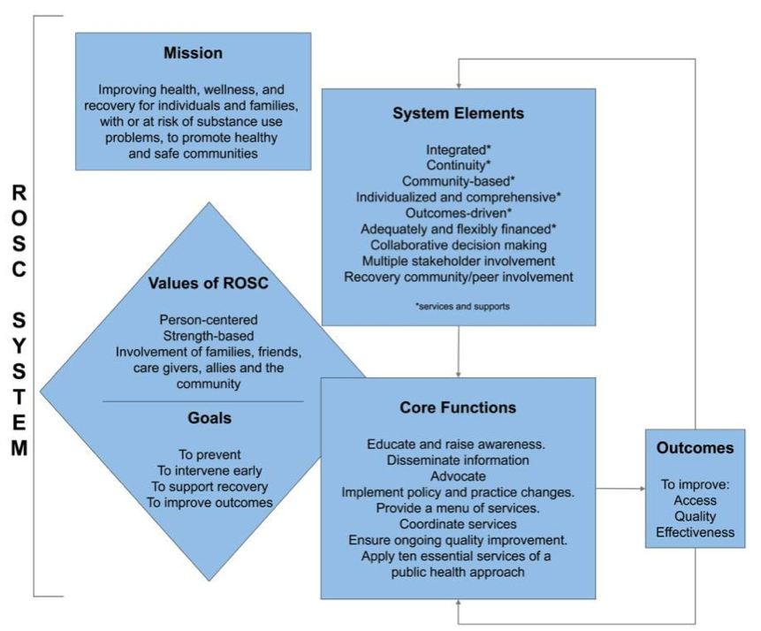
Framework of a ROSC
https://www.samhsa.gov/sites/default/files/rosc_resource_guide_book.pdf
Notes:
The diagram pictured illustrates a ROSC framework that includes the mission, values, goals, system elements, core functions, and outcomes of the systems. The principles of a ROSC and health care are closely aligned—for example, invest in prevention and wellness, expand coverage, guarantee choice, and improve quality of care. A major component of a ROSC is implementing the provisions of health care reform to provide high-quality substance use services. To achieve reform, integration of substance use services will need to occur within primary care settings. Primary care providers will likely require additional education and training on how to screen and intervene with at-risk populations, and on how to refer individuals with more severe conditions to specialty settings. Additionally, specialty providers may be required to establish new partnerships, enhance technology, establish quality improvement systems, expand capacity, recruit and train staff, and work with health insurance plans.
Recovery – Oriented Systems of Care (ROSC) Resource Guide – Sept 2010
https://www.samhsa.gov/sites/default/files/rosc_resource_guide_book.pdf

Slide 24

Power in Peer Recovery Support Services
Peer recovery support is characterized by the provision of non-clinical peer support, which can include activities that engage, educate and support the individual as they make the necessary changes to recover from substance use disorder.
https://www.recoveryanswers.org/research-post/what-is-the-evidence-for-peer-recovery-support-services/
Notes:
Each of the partners in a ROSC can play a role in the provision of recovery support services.
When RSS are provided across the continuum of care, they support resiliency, open doors to service access and engagement, and support long-term recovery. Person-centered supports bolster successful individual and family outcomes.
While typically viewed as available post-treatment, recovery support services within the construct of ROSC can be offered before, during, or even in lieu of treatment. This approach and its supports are inclusive of pre-treatment, as well as promotion of resiliency in prevention and early or brief interventions.
Recovery – Oriented Systems of Care (ROSC) Resource Guide – Sept 2010
https://www.samhsa.gov/sites/default/files/rosc_resource_guide_book.pdf
What is the Evidence for Peer Recovery Suppoort Services
https://www.recoveryanswers.org/research-post/what-is-the-evidence-for-peer-recovery-support-services/

Slide 25
Peer Recovery Support
Peer Mentoring and Coaching
Resource Connecting
Facilitating and Leading Recovery Groups
Building Community
Activities/ Task
https://store.samhsa.gov/sites/default/files/sma09-4454.pdf
Notes:
Peer providers offer valuable guidance by sharing their own experiences recovering from SUD and MH by helping to build skills, assisting and addressing specific needs that someone with SUD is faced with as they are in early recovery and by improving social connectedness and helping to identify new positive social environments.
Building Connection: Mentoring or coaching refer to a one-on-one relationship in which a peer leader with more recovery experience than the person served encourages, motivates, and supports a peer who is seeking to establish or strengthen his or her recovery. The relationship of the peer leader to the peer receiving help is highly supportive, rather than directive.
The purpose of resource connecting services is to connect the peer with professional and nonprofessional services and resources available in the community that can help meet his or her individual needs on the road to recovery. The peer leader working in a peer setting to provide recovery resource connecting services often has had personal experience navigating the service systems and accessing the resources to which referral is being made, and can bring those personal experiences to bear.
Peer leaders facilitate or lead recovery-oriented group activities. Some of these activities are structured as support groups, while others have educational purposes. Many have components of both.
The group activities that are structured as support groups typically involve the sharing of personal stories and some degree of collective problem-solving. Many of these groups are formed around shared identity, such as belonging to a common cultural or religious group, or shared experience related to the substance use disorder, such as the need to re-enter the community following incarceration, being HIV positive, or facing challenges in parenting.
A person in early recovery is often faced with the need to abandon friends and/or social networks that promote and help sustain a substance use disorder, but has no alternatives to put in their place that support recovery. Peers support individuals in make new friends and begin to build alternative social networks. Peer leaders often organize recovery-oriented activities that range from opportunities to participate in team sports to family-centered holiday celebrations. The intention of peer led recovery activities provide a sense of acceptance and belonging to a group, as well as the opportunity to practice new social skills.
The Four Tasks of Intentional Peer Support Building Connection
Helping each other understand how we've come to know what we know (worldview)
Re-defining help as a co-learning and growing process (mutuality)
Moving towards what we want, rather than away from what we don't want.
What are peer recovery support services?
https://store.samhsa.gov/sites/default/files/sma09-4454.pdf
What is the Evidence for Peer Recovery Suppoort Services
https://www.recoveryanswers.org/research-post/what-is-the-evidence-for-peer-recovery-support-services/

Slide 26




Complete Our Evaluation
Scan the QR Code or follow the link below: https://ttc-gpra.org/P?s=573930
Sign up for our newsletter!

Slide 27


Contact New England MHTTC
Website:
https://mhttcnetwork.org/centers/content/new-england-mhttc
Email:
newengland@mhttcnetwork.org

