Slide 5
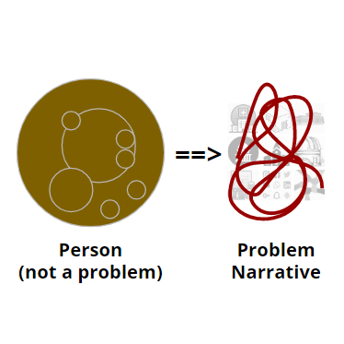
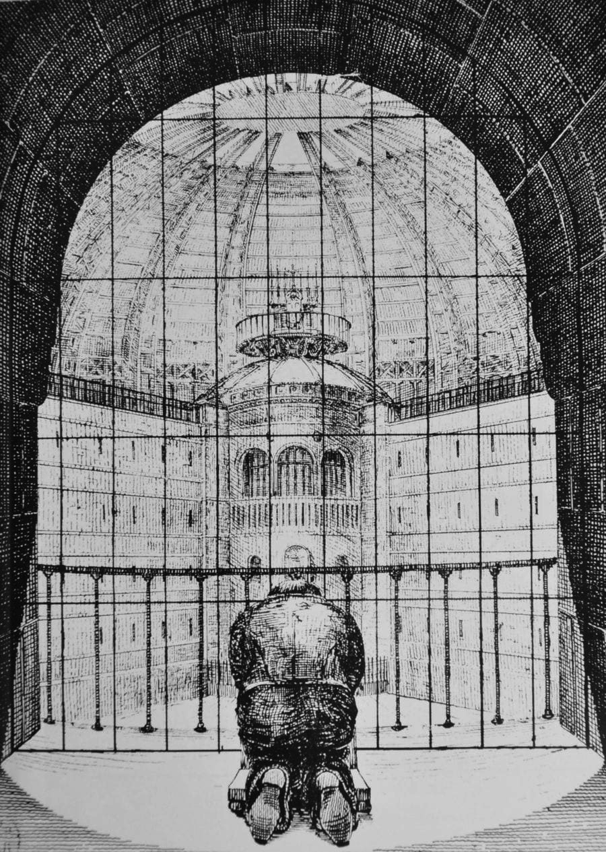
Narrative Therapy:
Poststructural & Culturally Sensitive Interviewing
Mental Health Technology Transfer Center
Massachusetts Mental Health Center
M. Mookie. C. Manalili, LICSW
Greetings: Maligayang pagdating… Bem-vinda, Benvenuta/o, Bienvenida/o, Bienvenu/e, Eoseo osibsio, Herzlich Willkommen, Hotep, Huanying, Sawubona, Shalom, Wuneekeesuq, Yokoso… (and let me know how folks say hello from your tradition) - Welcome, your story is welcome here!

Slide 6
Welcome to Narrative Therapy!
Manalili, MMC (2024)
Welcome to Narrative Therapy - students, colleagues, friends!
I'm honored to introduce you each to “narrative therapy” - and the ways it may be of help and empowerment to those we accompany. Simply put, how narrative therapy might “help others feel like they matter” (Gaddis, 2021).
When I think about each of you orienting your practices, to helping folks affected by societal injustices, towards a having a voice in “rich story development”... I feel hopeful, grateful, and inspired. If you’d like to continue the dialogue, do let me know how I can be of service to you: manalili@bc.edu

Slide 7
Road-Map: Outline
Manalili, MMC (2024)
Part 1: Introduction: Theory, History, and Worldview
Part 2: Externalizing: Power-Knowledge / “Statement of Position”
Part 3: Reauthoring*: Towards Rich Story Development
Questions and Dialogue?
Note: We may only get to Part 1 and Part 2 - due to the limitation of time and Zoom platform. However, I’ve attached the more slides and material at the end of this presentation (if you are interested) and happy to chat more another time!

Slide 8
Chapter 1: Introductions
Manalili, MMC (2024)
Introductions to “Me” and “You” Introduction to “Narrative Therapy”
Value Narrative
Therapist
Problem
Narrative
Person

Slide 9
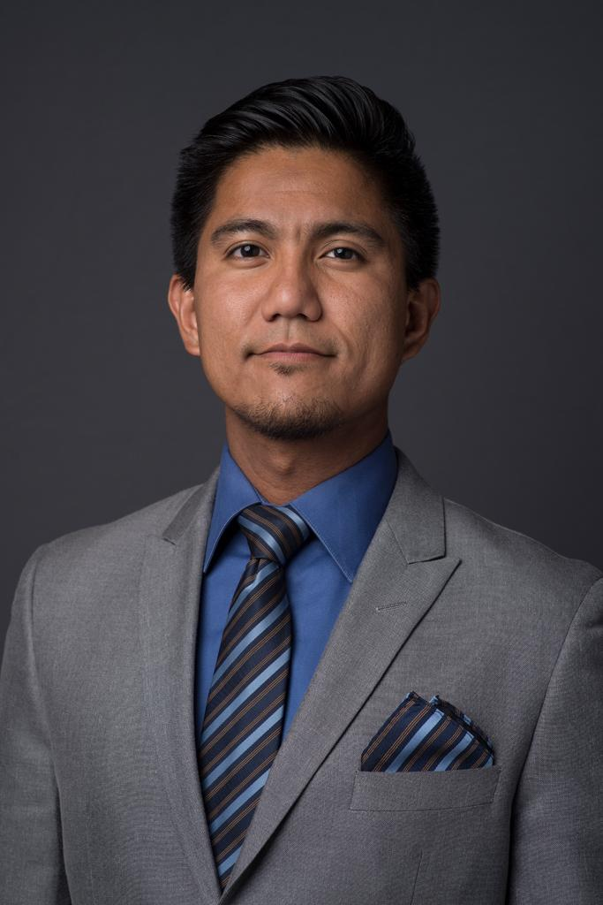
Introduction: to “Professor Manalili, LICSW”
Manalili, MMC (2024)
Educational Formation - Curriculum Vitae:
B.S.E. in Civil Engineering - Loyola Marymount University
M.A. in Theology - University of Notre Dame
M.T.S. (Systematic Theology) - Boston College
M.S.W. (Clinical, Mental Health) - Boston College
Professor & Researcher - Boston College:
Part-Time Faculty, School of Social Work & Psychology & Neuroscience
Research Consultant, Morality Lab
Research Consultant, Center for Psychological Humanities & Ethics
Psychotherapist - Private Practice:
Narrative therapy, meaning-oriented (logotherapy), psychoanalytic, stress-neuro/trauma informed, and mindfulness practices
Other involvements…
Co-Chair - Psychology and the Other Conference
Ministry - Kairos retreat, Echo (Notre Dame), etc

Slide 10
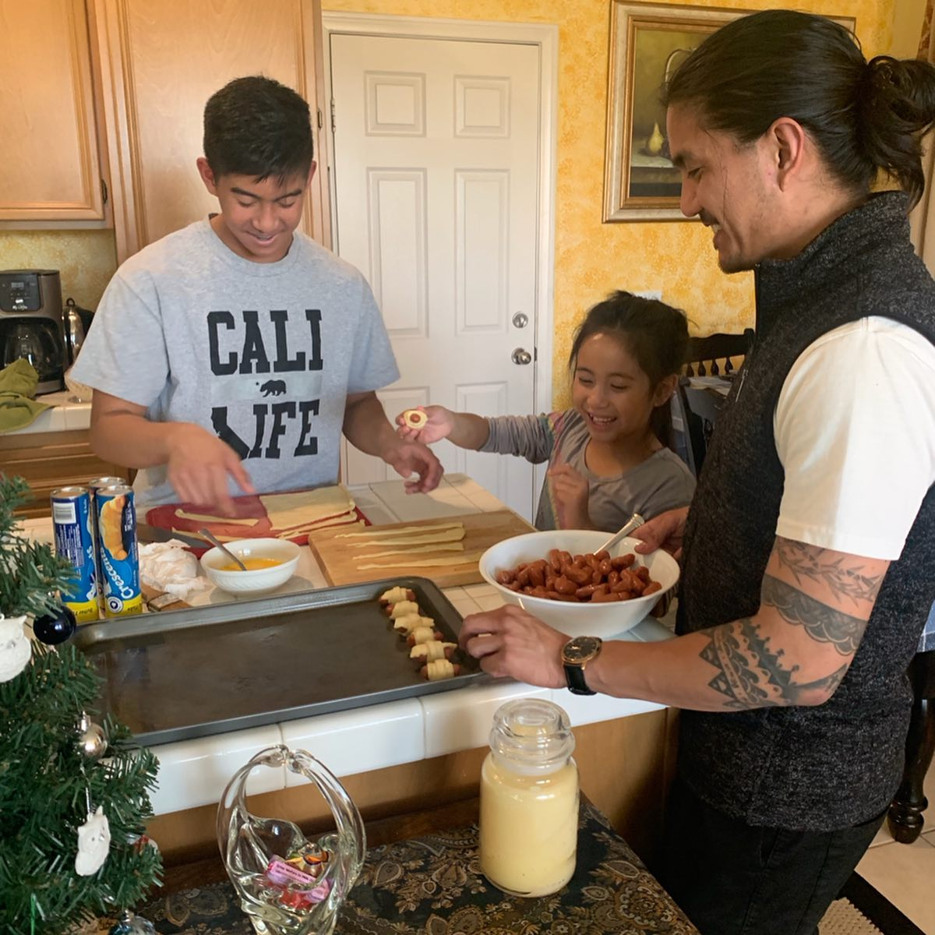
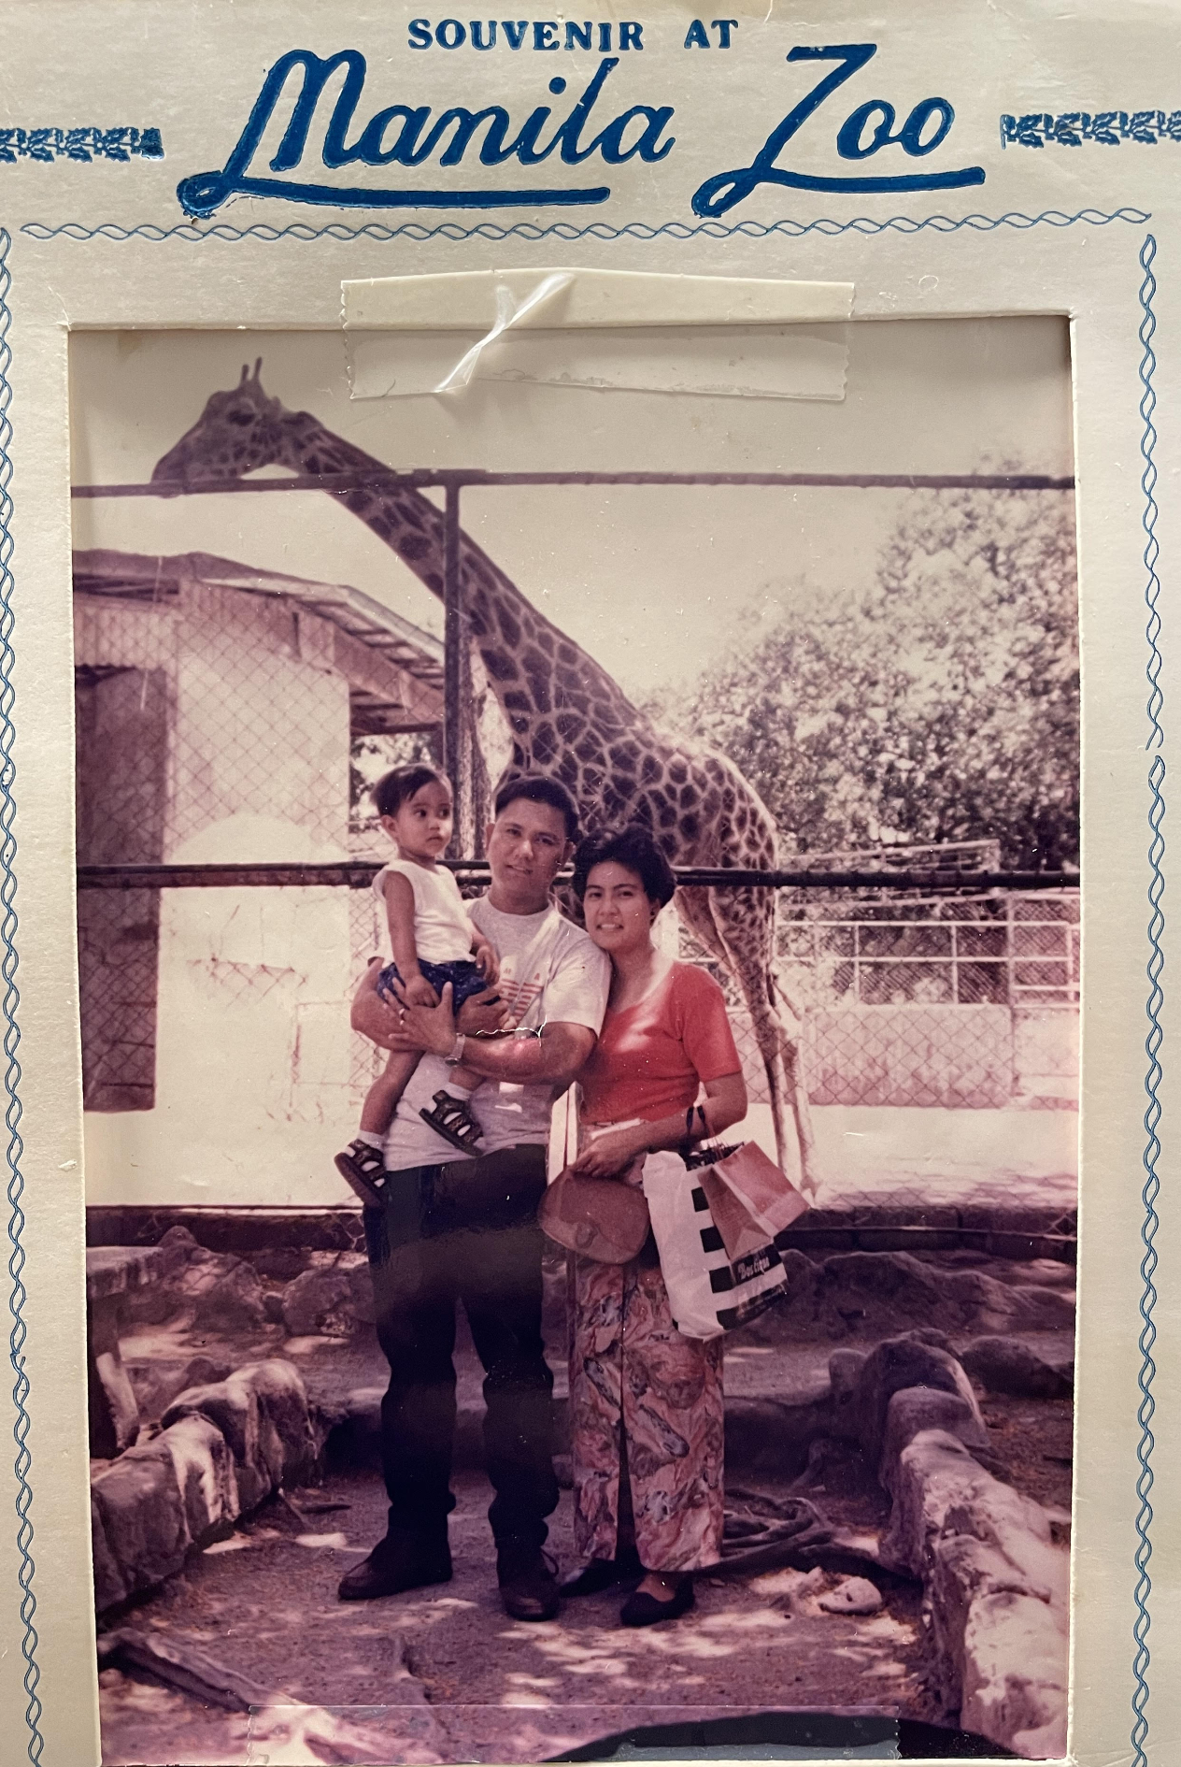
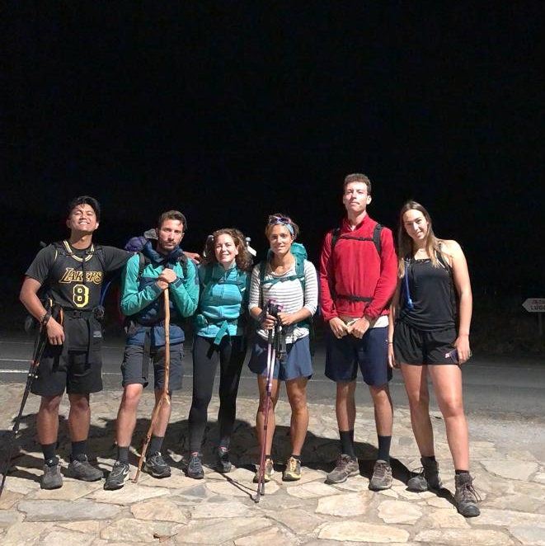
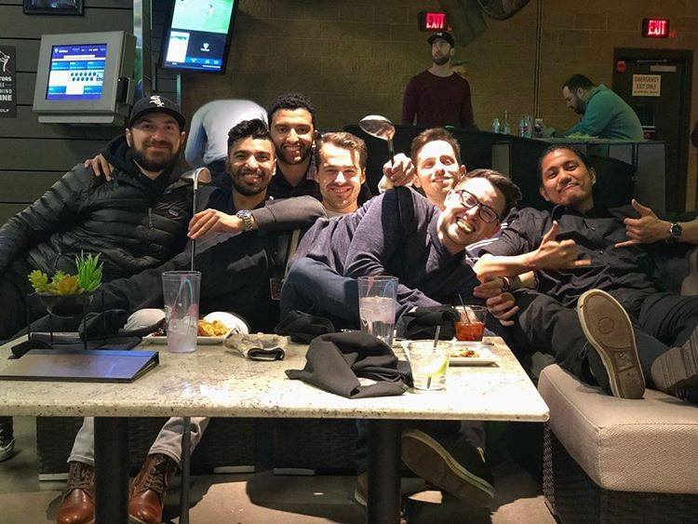
Introduction: to “Mookie”
Manalili, MMC (2024)
Who am I (really)?
An immigrant Filipino-Californian who loves learning; a pilgrim and a voyager - with lots of villages now.
What story do I want to tell with my life?
I hope to be of service to others around me, especially our siblings who are suffering.
And to make each space I’m at more hospitable, especially for the next generation.
What value(s) do I hold precious?
Responsibility, Mahal (Love in Tagalog), Hospitality
NOTE: The differences in signals of power-dynamic present even in introductory discourse

Slide 11
Introduction: to Each Other!
Manalili, MMC (2024)
Zoom Activity:
First, take ~1-min to think about the following questions… Then, take 2-3min to write the following in the Zoom chat:
(1) Name. Roles. Place (Zooming from).
(2) What are you valuing in tuning into 'narrative therapy'?
(3) Which moments in your life do you enact this 'value'?
(4) Who might be least surprised that you value this?
Afterwards, we’ll take few minutes to scroll up and view answers… And we can share about general themes that are arising herein.

Slide 12
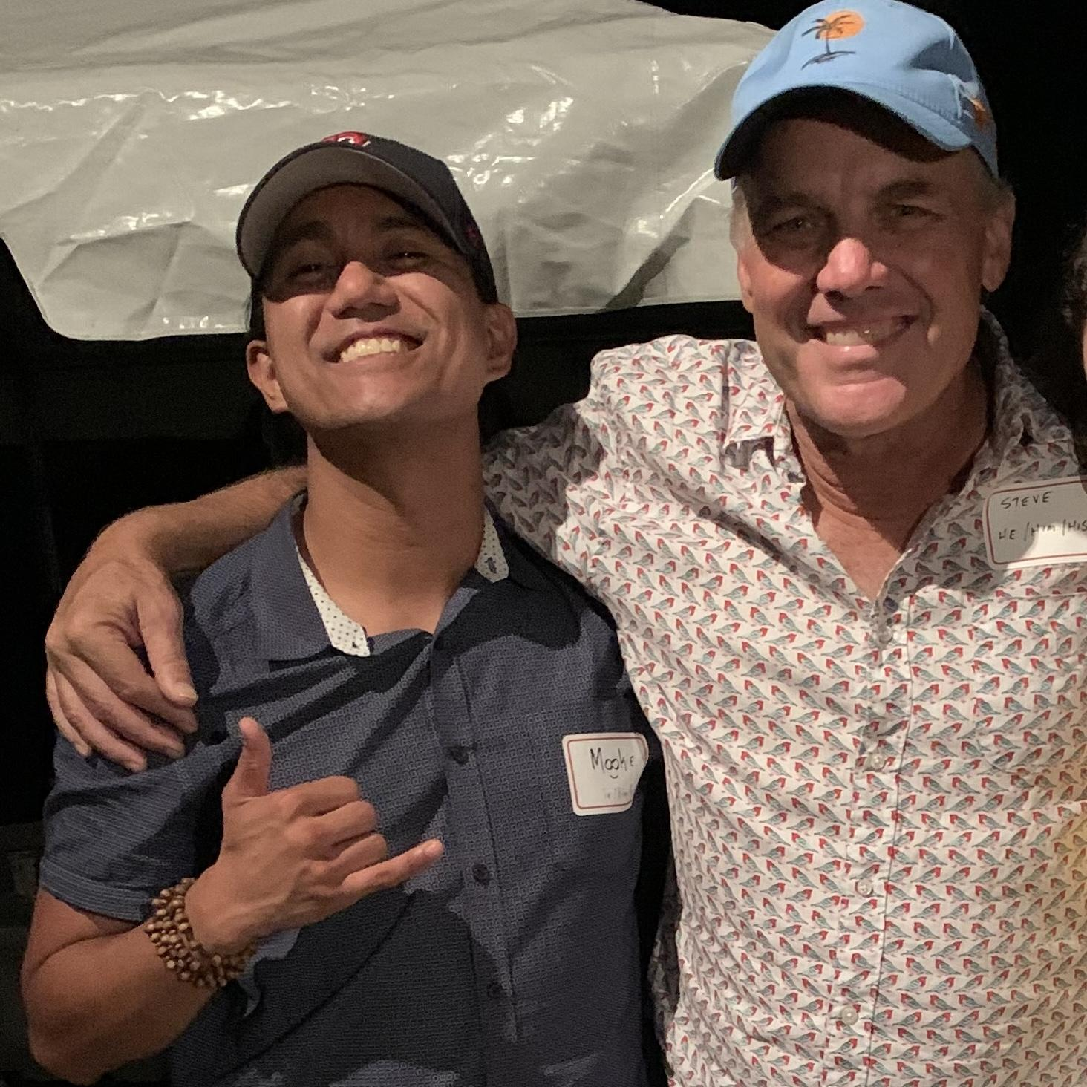
Lecture: “Narrative Therapy” history and spaces
Narrative therapy traces itself back to 1970’s and 1980’s in Australia. As a part of the postmodern therapies, NT shares kinship (but differences) in solution-focused brief therapy, collaborative therapy, and other models built upon skepticism toward grand narratives, social construction of knowledge, and reflexivity/subjectivity.
Dulwich Centre in Adelaide, Australia (on Kaurna Land), is one of the key ‘homes’ of narrative practice. We are involved in narrative therapy, community work, training, publishing, supporting practitioners in different parts of the world, and co-hosting international conferences.
Narrative Therapy Initiative is aligned with the principle that meaning-making through stories shapes lives, relationships, and communities. Our mission supports this Narrative Worldview and associated considerations of power in all relational and helping contexts.
Other spaces: Evanston Family Therapy Center (Chicago) | Narrative Initiatives San Diego (California)

Slide 13
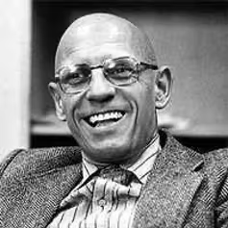
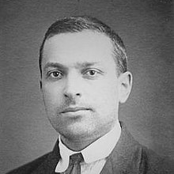
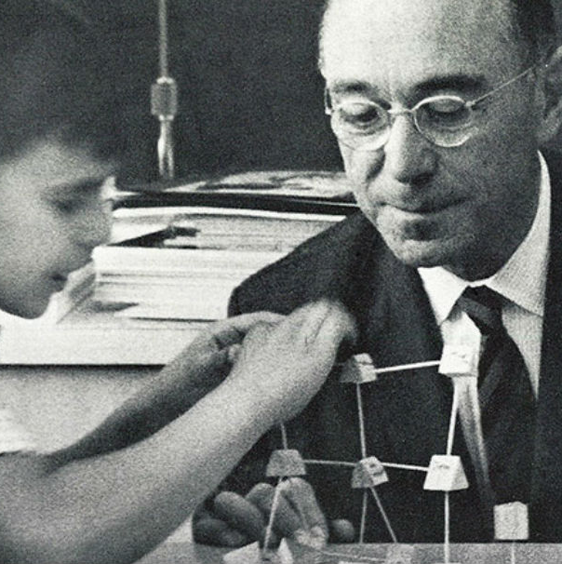
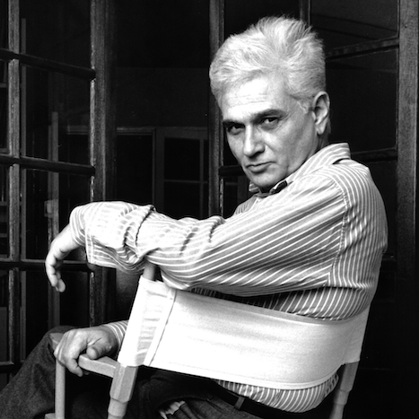
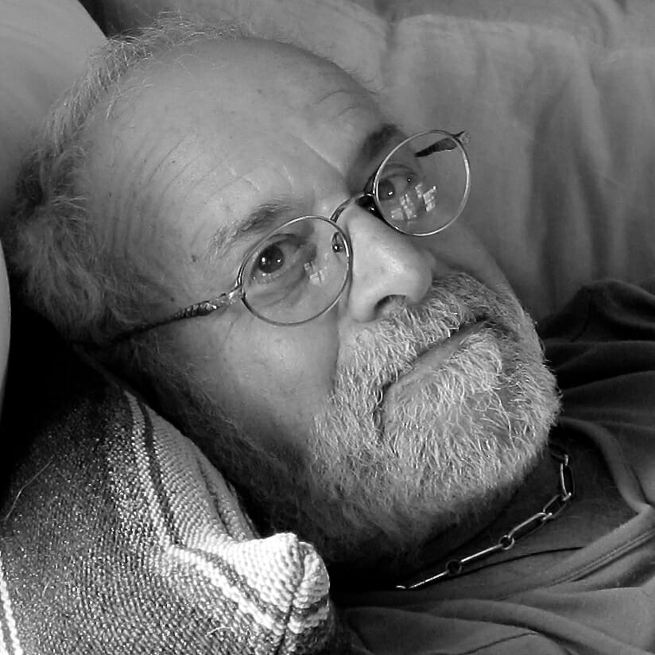
Lecture: “Narrative Therapy” predecessors and definition
“Is this work better defined as a world-view? Perhaps… but even this is not enough. Perhaps, it’s an epistemology, a philosophy, a personal commitment, a politics, an ethics, a practice, a life, and so on.” (White, 1995, p.37)
Narrative therapy is a non-pathologizing, person-centered approach - with its roots in post-structural, social construction, and literary philosophies… as well as family systems and social work practices and values. What does this actually look like?

Slide 14
Lecture: Life as “events in duration”
Person
Each person has with them - a unique duration of their experiences, heritages, cultures, relationships, etc - their past memories and future hopes, in each present moment.
Events
Time (Duration of Life)

Slide 15
Lecture: Problem-saturated narratives
“I am [X] (insert a dominant, problem saturated story).”
“What does [X] have you doing?
When did [X] first appear in your life?
What is your position on [X]’s relation to you?”
(Externalizing)
Events
Dominant, problem-saturated narrative
Time (Duration of Life)

Slide 16
Lecture: Multiple narratives
(Subordinated) value narratives
“What do you value? What do you hold precious and dear to you?”
(Re-authoring)
Events
Dominant, problem-saturated narrative
Time (Duration of Life)

Slide 17
Lecture: Thickening intentional narratives
or… “Who in your life might care to know you value this?” (Re-membering)
Thickened value-based narrative
or… “How might you put this into action?” (Scaffolding)
Events
or in group… “Where are you transported to in witnessing?” (Outsider Witness)
Dominant, problem-saturated narrative
Time (Duration of Life)

Slide 18
Lecture: Towards future possibilities
Thickened value-based narrative
A person’s unique outcomes and future possibilities are opened up for consideration -- through thickening value-based intentional (or alternative) narratives.
Events
Dominant, problem-saturated narrative
Time (Duration of Life)

Slide 19
Part 2: Externalizing
Manalili, MMC (2024)
Philosophy of “Power/Knowledge” and “Internalizing” Externalizing - Statement of Position Map
==>
Person (not a problem)
Problem Narrative

Slide 20
Externalizing: “Power/Knowledge” - Inseparable + constitutive
Manalili, MMC (2024)
Paul-Michel Foucault (1926-1984) is a French philosopher, “historian”, and critic of social structures, sciences, etc.
Etymology: savoir/pouvoir - knowledge/power
Roots: sapiens, gnosis - to know; posse - to be able to
Metaphor of power as “electricity” rather than “force”
To create a simple contrast (Gaddis, 2016, p.10):
power/force represses action through the threat of harm
power/knowledge produces “reality” through truth claims
“There can be no possible exercise of power without a certain economy of discourse of truth, which operates through and on the basis of this association” (Foucault, 1980, p.93)
Foucault is “referring to [power] in the sense that power is constitutive or shaping of persons’ lives…. These “truths” are “normalizing” in the sense that they construct [social] norms around which persons are incited to shape and constitute their lives” (White & Epston, 1990, p.20)

Slide 21
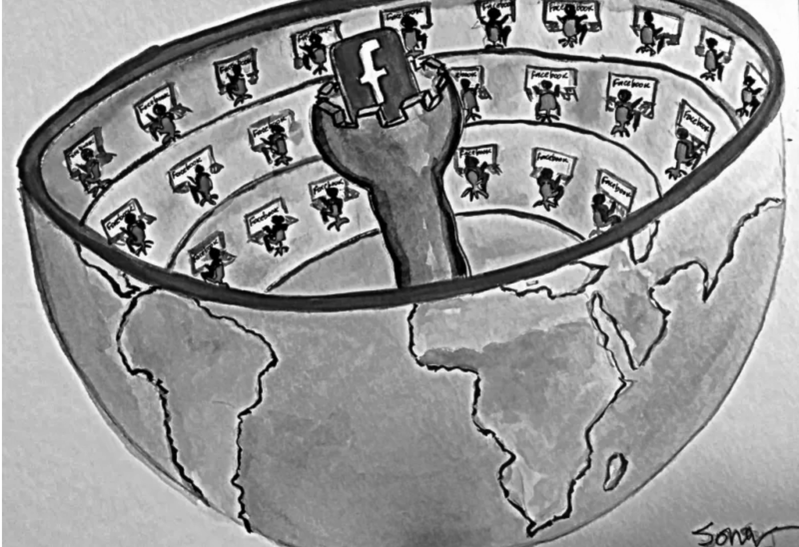
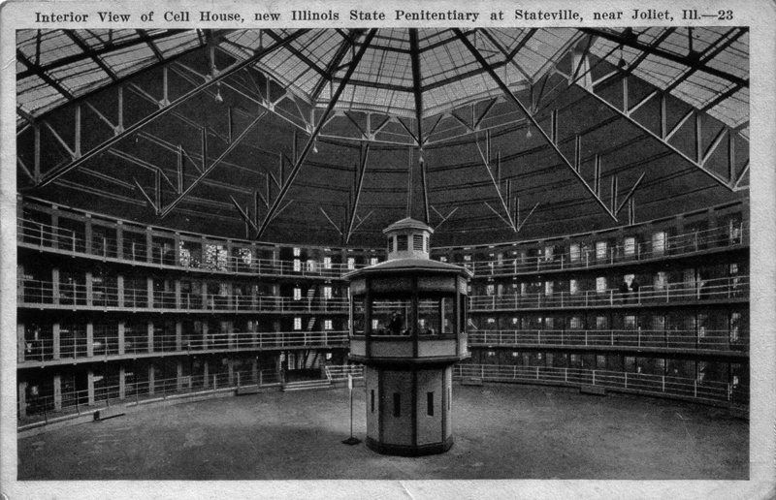
Externalizing: “Internalizing” - Panopticonism in our Society
Manalili, MMC (2024)
Our social structures (i.e. cultures, religions, healthcare, politics, schools) have their own normalizing discourses. For better or worse, they each have “truths” - which change. The panopticon can be seen as metaphor for this effect - on the folks that we work with:
Panopticon: “The Building circular – an iron cage, glazed – a glass lantern about the size of Ranelagh – The Prisoners in their Cells, occupying the Circumference – The Officers, the Centre. By Blinds, and other contrivances, the Inspectors concealed from the observation of the Prisoners: hence the sentiment of a sort of invisible omnipresence. – The whole circuit reviewable with little, or, if necessary, without any, change of place.” (Bentham, 1791)
Interalization: “He (sic) who is subjected to a field of visibility, and knows it… he inscribes himself in the power relation in which he simultaneously plays both roles [as jailor and as subject]; he becomes the principle of his own subjugation” (Foucault, 1979, p.202).
Power/Knowledge: “In fact power produces; it produces reality; it produces domains of objects and rituals of truth. The individual and the knowledge that may be gained from him[/her/their] belong to this production.” (Foucault, 1979, p.194).
For now… how might we investigate effects of internalized narratives?
Person as a problem

Slide 22
Person or...
What does normality (i.e. “Norm”) have us believe about the world and human persons (i.e. our patients)?
When do we wield this type of discourse? What’s helpful/harmful about this?

Slide 23
Externalizing: Statement of Position Map
Manalili, MMC (2024)
(4) Justify
(3) Evaluate
(4)
(2) Effects
(2)
(3)
(1) Problem
==>
(1)
Time in Session
Next, let’s investigate the statement of position map (White, 2007) - One of way to have externalizing / deconstructing conversations!

Slide 24
Externalizing: SOP Step 1 (Problem)
Manalili, MMC (2024)
Inquiry Category 1:
Negotiating a Particular, Experience-Near Definition of the Problem
“In this first stage, the therapist supports people in the negotiation of the definition of the predicaments and problems for which they are seeking therapy” (White, 2007, p.40)
Would it be okay to call it [problem]?
Would it be okay to explore [problem]?
What does the [problem]...?
Think: Naming the problem, experience-near descriptions, initial externalizing, etc etc
(4) Justify
(3) Evaluate
(2) Effects
(1) Problem
Time in Session
(4)
(2)
(3)
==>
(1)

Slide 25
Externalizing: SOP Step 2 (Effects)
Manalili, MMC (2024)
Inquiry Category 2:
Mapping the Effects of the Problem
“Externalizing conversations features an inquiry into the effects/influence of the problem in the various domains of living in which complications are identified. This can include…” (Ibid, p.43)
Home, workplace, school, peer contexts
Relationships with self, family, friends
Identity - including effects on one’s purpose, hopes, dreams, aspirations, values, futures
Think: History of the problem, Deconstructing conversations, effects on ‘ecomaps’, etc etc
(4) Justify
(3) Evaluate
(2) Effects
(1) Problem
Time in Session
(4)
(2)
(3)
==>
(1)

Slide 26
Externalizing: SOP Step 3 (Evaluation)
Manalili, MMC (2024)
Inquiry Category 3:
Evaluating Effects of the Problem’s Activities
“Therapist supports people in evaluating the operations and activities of the problem, as well as its principal effects on their lives” (Ibid, p.44)
Are these activities okay with you?
How are these developments for you?
Where do you stand on these outcomes?
What is helpful and harmful here for you?
Is this development positive and/or negative?
Think: Metaphors, Relationship to the problem, Person’s stance to problem, etc etc
(4) Justify
(3) Evaluate
(2) Effects
(1) Problem
Time in Session
(4)
(2)
(3)
==>
(1)

Slide 27
Externalizing: SOP Step 4 (Justify)
Manalili, MMC (2024)
Inquiry Category 4:
Justifying the Evaluation
“The fourth stage features an inquiry into the ‘why’ of people’s evaluations. This inquiry is usually initiated with questions like…” (Ibid, p.48)
Why is / isn’t this okay for you?
Why do you feel this way about this development?
Why are you taking this stand/position on this?
NOTE: These “why” questions should not be associated with moral judgment - but investigating the role of what a person might be valuing in taking this stand.
Think: What a person is valuing, what problem might be transgressing, value and motivations, etc etc
(4) Justify
(3) Evaluate
(2) Effects
(1) Problem
Time in Session
(4)
(2)
(3)
==>
(1)

Slide 28
Part 3: Reauthoring (Extra?)
Manalili, MMC (2024)
Narrative Metaphor and Unique Outcomes Reauthoring - Landscapes of Identity/Action Map
Identity
<==>
==>
Other (Important Relation)
Action
Person
Therapist

Slide 29
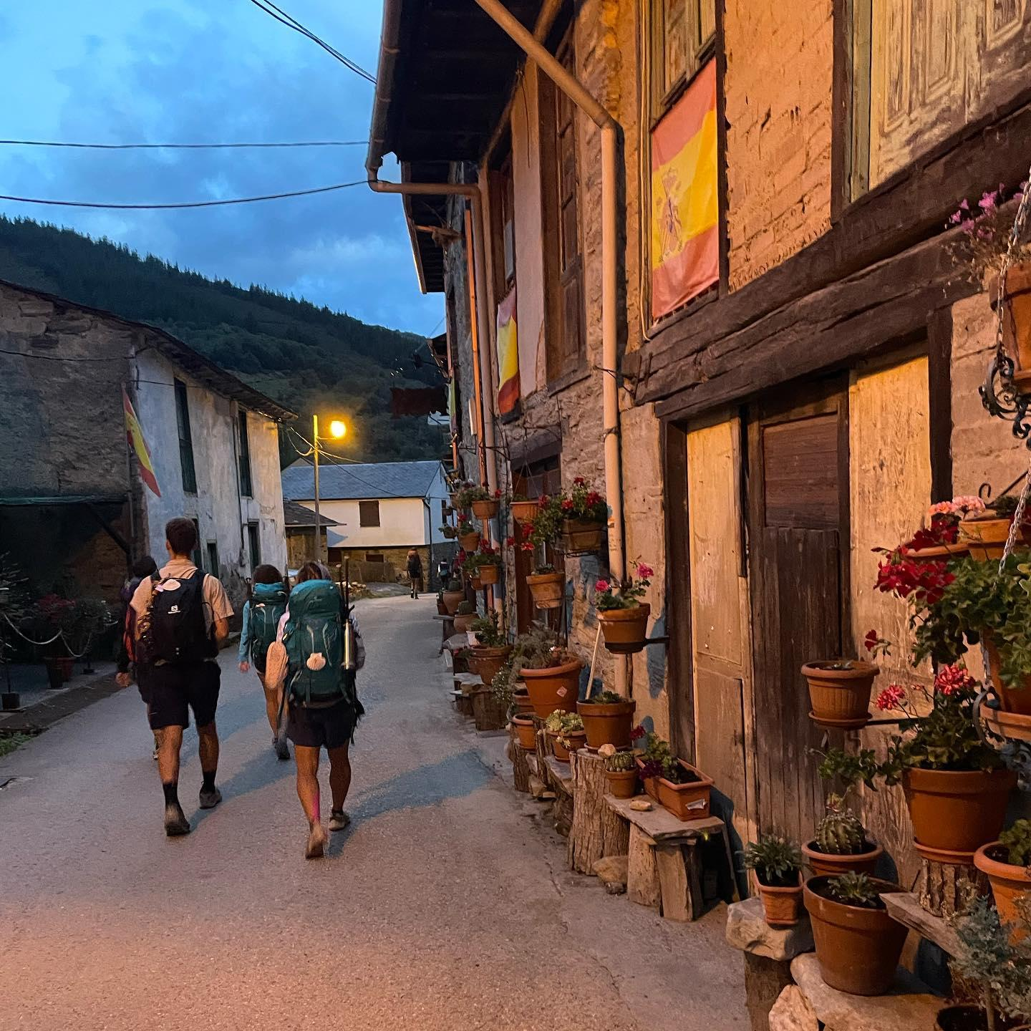
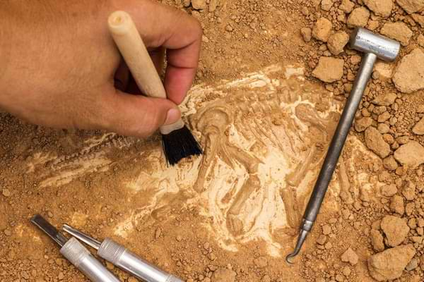
Reauthoring: Discovering “Unique Outcomes”
Manalili, MMC (2024)
Unique Outcomes… are events and experiences that do not fit into the thread of the dominant, problem-saturated narrative (Morgan, 2000, p.51)
Unique outcomes (i.e. the blue memory dots) could be richly developed into value-based narratives beyond problem’s grasp.
Rich story development (like re-authoring)... invite people to continue to develop and tell stories about their lives, but they also help people to include some of the more neglected but potentially significant events and experiences that are “out of phase” with their dominant storylines. (White, 2007, p.62)
Note: Unique outcomes might be “buried underneath” other memories. Negative memories (i.e. red memory dots) that are more salient could be recruited by dominant, problem-saturated narratives. (Stay curious and pay attention as you explore!)

Slide 30
Reauthoring: Landscapes of Identity/Action Map
Manalili, MMC (2024)
Identity
==>
Action
We’ll elaborate on Landscapes (of Action/Identity) Map -
One of the possible way to have reauthoring conversations!

Slide 31
Reauthoring: Landscape Map (Action)
Manalili, MMC (2024)
Landscape of Action:
“The landscape of action is the ‘material’ of the story and is composed of the sequence of events that make up the plot (sjuzet) and the underlying theme (fabula)...” (White, 2007, p.78)
Events
Circumstances
Sequence
Time
Plot
(Some) Reauthoring Questions (Landscape of Action):
Could you tell me a time when the [problem] was not as present?
What events in your life don’t fit with [problem]?
Is there a memory you can recall that highlights this [identity]?
What experiences help support [identity] as something that matters to you?
What does this action you are taking reflect about what you know about life?
How do they go about trying to do that? Who was supportive of this?
<Engage in descriptive questions>
Hint: Be curious about memories, unique outcomes, and lived experiences here!
values, intentions, realizations, learnings, knowledges
Remote | Distant | Near Past | Present | Near Future
Identity
==>
Action

Slide 32
Reauthoring: Landscape Map (Identity)
Manalili, MMC (2024)
Landscape of Identity* (or Consciousness*):
“This landscape features the consciousness (or identity*) of the protagonist of the story and is significantly composed of their reflections on the events of the landscape of actions”.... of their attribution of meaning, deductions of intentions, conclusions of character and identity (White, 2007, p.78)
Intentional understandings
Understanding about what is accorded value
Internal understandings
Realizations, learnings, knowledges, insights, etc
(Some) Reauthoring Questions (Landscape of Identity):
I’m curious… what might you be valuing by doing [action]?
How would you name this [action]? What step is this towards?
What does this suggest to you about what is being valued?
Based on this [action], what might you be holding precious?
What might this say about what’s important to you?
What are you giving value to with this action?
<Engage in interpretive questions>
Hint: Be curious about values, intentions. Use “subjunctive” (i.e. possible, might, etc).
values, intentions, realizations, learnings, knowledges
Remote | Distant | Near Past | Present | Near Future
Identity
==>
Action

Slide 33
Conclusion: Recapitulation of NT Theory and Practice
Manalili, MMC (2024)
Value Narrative
=/=
Person
Problem
Therapist
Problem
Narrative
Thus, we have narrative therapy’s maxim: “The person is not the problem; the problem is the problem’” (White, 1988/9) We assume that each person has values and is the expert-knower of their life.
Person
As narrative therapists, we practice a stance that is… decentered (person’s knowledges are privileged in the conversion) & influential (help foster relational space and develop their stories; Latin: to flow) (Gaddis, 2016)

Slide 34
Wrap-Up: Until next time “hullo again” :)
Recapitulating with the Opening Letter:
Honored to have introduced you to “narrative therapy” - and ways it may be of help and empowerment to those we accompany. Simply put, how narrative therapy might “help others feel like they matter” (Gaddis, 2021).
Cheering for your next chapters…
Relationship to Narrative Therapy: You each helped reshape what I find meaningful, challenging, precious with “narrative therapy” for folks we accompany - thank you!
Other Villages: If you’d like to continue your narrative journey… here are some spaces: Narrative Therapy Initiative (Boston)| Dulwich Center (Australia) | Evanston Family Tx (Chicago)
Saying “Hullo Again”: If you’d like a further relationship with NT - feel free to join us at NTI or look for more BC offerings, you have my email: Manalili@BC.edu
Thank you each -- you each matter!! I’m excited for how you each write the stories of your lives!!

Slide 36
References
Carey, M., & Russell, S. (2002). Externalizing: Commonly asked questions. The International Journal of Narrative Therapy and Community Work, 2, 76-84.
Carey, M., Walther, S., & Russell, S. (2009). The absent but implicit: A map to support therapeutic enquiry. Family Process, 48(3), 319-331. https://doi.org/10.1111/j.1545-5300.2009.01285.x Combs, G., & Freedman, J. (2012). Narrative, Poststructuralism, and Social Justice. The Counseling Psychologist, 40(7), 1033–1060. https://doi.org/10.1177/0011000012460662
Gaddis, S. (2004). Repositioning traditional research: Centering clients' accounts in the construction of professional therapy knowledge. International Journal of Narrative Therapy and Community Work, 2, 29-36.
Gaddis, S. (2016). Poststructural inquiry: De-centered and influential stance. In V. Dickerson (Ed.), Poststructural and narrative thinking in family therapy. Switzerland: Springer International Publishing, 9-27. https://doi.org/10.1007/978-3-319-31490-7
Foucault, M. (2012). Discipline and punish: The birth of the prison. Vintage.
Foucault, M. (2013). Politics, philosophy, culture: Interviews and other writings, 1977-1984. Routledge.
Freedman, J., & Combs, G. (1996). Narrative therapy: The social construction of preferred realities. W. W. Norton & Company, Inc.
Morgan, A. (2000). What is narrative therapy? An easy-to-read introduction. Dulwich Centre Publications.
Pratt, B., Hixson, L., & Jones, N. (2015). Measuring race and ethnicity across decades: 1790-2010. US Census Bur.
White, M. (2007). Maps of narrative practice. W. W. Norton & Company, Inc.
White, M., & Epston, D. (1990). Narrative means to therapeutic ends. W. W. Norton & Company, Inc.

Slide 37
Extra Slides (for you as resources)!

Slide 38
Externalizing: Narrative Convo & Therapeutic Stance (Extra)
Manalili, MMC (2024)
Externalizing conversations are… “ways of speaking that separate problems from people…. It is an attitude and orientation in conversations.” (Morgan, 2000, p.17)
Deconstruction conversations… “help people to ‘unpack’ the dominant stories and view them from a different perspective. Dominant stories become situated culturally and historically.” (Morgan, 2000, p.50)
Therapeutic Stance:
“De-centered and Influential” stance (Gaddis, 2016)
“Investigative Reporter” metaphor (White, 2007, p.27)
Note: “These practices make it possible for people not only to redefine their relationship with the problems of their lives, but also to redefine their relationships with each other in ways that acknowledge each other’s voices in the development of their sense of identity.” (White, 2007, p.59)
==>
Person (not a problem)
Problem Narrative

Slide 39
Externalizing: Applying the Narrative Worldview (Extra)
Manalili, MMC (2024)
Remember, these conversations are contextual in a “narrative worldview”, not just a technique or skill to intervene.
From our previous sessions on theory, philosophy, worldview of narrative - The assumptions of “externalizing conversations” follow more easily.
Some examples from folk’s stories …
Internalised Conversations
See the person as the problem
Locates the problems inside the person.
Look for what is ‘wrong’ or ‘deficient’ with individuals.
Make invisible the social practices that promote, sustain, and nurture the life of the problem.
Language used is often “I am…”
Externalised Conversations
See the problem as the problem
The problem is spoken of as outside of the person. This creates “spaces” for discussion about the person’s relationship with the problem.
Locate problems in a context that is external or outside of the person and their identity.
Make visible the social practices that promote, sustain, and nurture the life of the problem.
Language used is often “It is…”
==>
Person (not a problem)
Problem Narrative
(Morgan, 2000, p.29-31)

Slide 40
Externalizing: Practice Conversation (Extra Slides)
Manalili, MMC (2024)
Think-Pair-Share (in your duos):
Think:
Insights from the “externalizing” lecture
A “problem” you may want to explore?
Pair-Share:
What do you want to call the [problem]?
What effects does [problem] have on your life?
What relationship do you want with [problem]?
==>
Person (not a problem)
Problem Narrative

Slide 41
Reauthoring: Importance of Metaphors (Extra Slides)
Manalili, MMC (2024)
Metaphor… is a figure of speech by which a characteristic of one object is assigned to another, different but resembling it or analogous to it; comparison by transference of a descriptive word or phrase
Etymology: meta “over, across” + pherein “to carry, bear”
“The metaphors that we use influences what we look, listen, and feel for…” (Freedman & Combs, 1996, p.2)
“The matter of metaphor is highlight significant. All metaphors that are taken up in the development of externalizing conversations are borrowed from particular discourses that invoke specific understandings of life and identity…” (White, 2007, p.31)
For narrative therapy, we tune in not only for the “problem” - but the type of “relationship” that a person wants to have with the problem. Tune in for the particular metaphors that imply this type of relationship!

Slide 42
Reauthoring: Some considerations for metaphors (Extra)
Manalili, MMC (2024)
When we engage in “externalizing conversations” - we must be aware of the following regarding combat, totalizing, and responsibility:
Combat: “If metaphors within externalizing conversations constrict success in terms of vanquishing or defeating the problem, and then later the person finds themself experiencing a reemergence of the problem, he/she[/they] may view this reemergence as tantamount to personal failure.” (Ibid, p.31)
Totalizing: “It is important for therapists to be wary of contributing to the totalizing problems - that is, defining problems in terms that are totally negative… founded upon the dualistic either/or habits of thought that have become quite pervasive in Western culture.” (Ibid, p. 34-35)
Responsibility: “Practices do not separate persons from responsibility for the extent to which they participate in the survival of the problem…. These practices help persons become aware of and describe their relationship with the problem.” (White & Epston, 1990, p.65)
As can be seen… The aboves points are why we maintain a “decentered and/yet influential” stance as therapists when engaging in externalizing conversations.

Slide 43
Reauthoring: Reauthoring - Narrative Metaphor (Extra)
Manalili, MMC (2024)
Jerome Seymour Bruner: American psychologist (1915-2016) who contributed to cognitive and educational psychology
Narrative Metaphor: When folks consult us for therapy, they tell stories. We may think of therapy in “narrative metaphor”:
Landscape of Action: material in the timeline of one’s life; sequence of events (sjuzet) and underlying theme (fabula)
Landscape of Identity*: “what those involved in the action know, think, or feel, or do not know, think, or feel” (Bruner, 1986, p.14)
Sjuzet: chronological, raw material events of the story
Fabula: underlying theme, way a story is organized
Organizing our Reauthoring: “The fabula of a story - its timeless underlying theme - seems to be a unity…. What gives story its unity is the manner in which plight, characters, and consciousness* (or identity*) interact to yield a structure that as a start, development, and a ‘sense of ending’.” (Bruner, 1986, p.21)
Identity
==>
Action

Slide 44
Ethics: Deconstructing dominant discourses (Extra Activity)
Manalili, MMC (2024)
Let’s analyze the ways our social structures relate to human beings through their own discourse and truth claims.
Pay attention to the structure’s possible links to Foucault’s understanding of power/knowledge.
Small Groups (Pair with another duo):
Pick: Randomized social structure from the bag!
Small Group:
(1) What does this structure “say” about persons?
(2) What may be helpful/harmful about this knowledge?
Large Group:
Share with a brief insight on each of the point above!

Slide 45
Ethics: Deconstruction - Example Race (Extra Slides)
Manalili, MMC (2024)
(US Census, 2015)

