Slide 1

Harm Risk in Early Psychosis: Psychotherapy Strategies and Case Discussion
Michelle L. West, PhD
MAPNET & New England MHTTC
February 23rd, 2024
Notes:
DO NOT CHANGE THE FORMAT OF THIS TEMPLATE. If you are creating MHTTC-branded slides, you must use this template or one of the other approved templates in the Shared Folder.

Slide 2




Housekeeping Information
Participant microphones will be muted at entry
If you have questions during the event, please use the chat
This session is being recorded and it will be emailed to all participants once available.
If you have questions after
this session, please e-mail:
newengland@mhttcnetwork.org.
At the end of the month, we will send you a certificate of completion that you can submit to your particular board for continuing education credit. Please contact ifisher@c4innovates.com for more information on CEs after the event.

Slide 3
Acknowledgment
Presented in 2022 by the Mental Health Technology Transfer Center (MHTTC) Network.
This presentation was prepared for the New England Mental Health Technology Transfer Center (MHTTC) Network under a cooperative agreement from the Substance Abuse and Mental Health Services Administration (SAMHSA). All material appearing in this publication, except that taken directly from copyrighted sources, is in the public domain and may be reproduced or copied without permission from SAMHSA or the authors. Citation of the source is appreciated. Do not reproduce or distribute this publication for a fee without specific, written authorization from New England MHTTC. For more information on obtaining copies of this publication, email us at newengland@mhttcnetwork.org.
At the time of this publication, Miriam E. Delphin-Rittmon, Ph.D, served as Assistant Secretary for Mental Health and Substance Use in the U.S. Department of Health and Human Services and the Administrator of the Substance Abuse and Mental Health Services Administration.
The opinions expressed herein are the view of TTC Network and do not reflect the official position of the Department of Health and Human Services (DHHS), SAMHSA. No official support or endorsement of DHHS, SAMHSA, for the opinions described in this document is intended or should be inferred.
This work is supported by grants #1H79SM081775 from the Department of Health and Human Services, Substance Abuse and Mental Health Services Administration.
Presented 2022
Notes:
Always use acknowledgment slide on the 2nd slide and add your center’s information

Slide 4
Notes:
Always use Language Matters graphic as your third slide.

Slide 5
Harm Risk in Early Psychosis: Psychotherapy Strategies and Case Discussion
MAPNET Community Call
February 23, 2024
Michelle L. west, PhD
Licensed Clinical Psychologist
Director, Program for Early Assessment, Care, & Study (PEACS)
Assistant Professor, Department of Psychiatry
University of Colorado School of Medicine

Slide 6
Disclosures
I have no relevant disclosures to the content of this talk

Slide 7
Agenda
Brief overview of harm risk (suicide and self-injury) in early psychosis
Introduce case example
Review assessment tools
Review therapy strategies: functional analysis, distress tolerance skills, Collaborative Assessment and Management of Suicidality (CAMS)
Discussion

Slide 8
Terms
Clinical high risk for psychosis (CHR or CHR-p)
First episode psychosis (FEP)
Self-harm: intentional injury of self (often without intent to die), also called non-suicidal self-injury (NSSI)
Suicide attempt: intentional injury of self with intent to die (even partially)

Slide 9
Harm Risk Overview

Slide 10
General Suicide Risk Conceptualization
Many theories explaining suicidality
Interpersonal Theory of Suicide (Joiner, 2005)
Dialectical Behavioral Therapy (DBT; Linehan, 1993)
Cognitive Model of Suicidality (Wenzel & Beck, 2008)
Many acronyms describing suicide risk factors (see next slide)
Can be a bit overwhelming in the moment with a particular client!

Slide 11
Example of Suicide Risk Factors
SAD PERSONS (Paterson et al., 1983)
  S: Sex (male)
  A: Age less than 19 or greater than 45 years
  D: Depression
  P: Previous suicide attempt or psychiatric care
  E: Excessive alcohol or drug use
  R: Rational thinking loss
  S: Separated, divorced, or widowed
  O: Organized plan or serious attempt
  N: No social support
  S: Stated future intent
Additional Suicide Risk Factors
  Family history of suicide
  Access to firearms/lethal means
  Serious or chronic medical condition
  Prolonged stress
  Agitation
  Sleep deprivation
  Recent loss or tragedy

Slide 12
How to Organize Factors/Theories?
Model Integrating Theories of Suicidality
Ideation to Action: 3-Step Theory (3ST; Klonsky & May, 2015)
Step 1: SI results from combo of pain (usually psychological pain) + hopelessness
  DBT: Desire to immediately stop overwhelming unpleasant emotional state (Linehan, 1993)
  CBT: Cognitive triad – hopeless thoughts about self, others, & future (Wenzel & Beck, 2008)
Step 2: Further escalation in ideation if the person feels disconnected/like a burden
  Interpersonal Theory of Suicide: Thwarted connectedness (feeling you don’t belong)& thwarted effectiveness (feeling like a burden) (Joiner, 2005)
Step 3: Progress to attempts through dispositional, acquired, & practical contributors to capacity to attempt suicide (e.g., exposure to suicide methods, agitation)
  Imminent Risk: rapid escalation in suicidality, profound alienation, & profound hopelessness

Slide 13
Acute vs. Chronic Suicide Risk
Acute Suicidal Affective Disturbance (ASAD; Joiner)
  considered for DSM diagnosis
  “Geometric” (rapid) increase in suicidal intent (hours to days)
  One (or both) of the following:
    Marked social-alienation (severe social withdrawal, perceived liability to others, etc.)
    Marked self-alienation (views that one’s selfhood is an onerous burden, self-disgust)
  Perception that it is hopeless to improve the above
  2/more signs of over-arousal (insomnia, nightmares, agitation, irritability)
Chronic suicide risk: risk factors that are more generally present

Slide 14
Early Psychosis & Self-Harm Risk

Slide 15
Early Psychosis & Increased Suicide Risk
Large prospective study of adolescents (age 13-16) in Ireland (Kellerer et al., 2013)
  7% endorsed psychotic symptoms
  34% who had psychosis symptoms plus other psychopathology attempted suicide within a year
  Those endorsing psychotic symptoms had ~10x increased odds of any suicidal behavior
  Those with comorbid depression had ~14x increased odds of suicide plans/acts compared to youth with depression but no psychosis
About 18% of participants with FEP attempted suicide prior to treatment (Challis et al., 2013)
82.5% of females and 54.6% of males at CHR-p endorsed SI (Lindgren et al., 2017)
Community sample: 34.6% of CHR-p and 73.3% of FEP endorsed SI (Haining et al., 2021)

Slide 16
Early Psychosis & Self-Harm Risk
Similarly, self-harm behavior is common in early psychosis: in CHR-p 28.5%, in FEP 60% (Haining et al., 2021)
Self-harm is associated with suicide risk in adolescents (Duarte et al., 2020)

Slide 17
Psychosis Directly Related to Harm Risk
Suicidality as a reaction to psychosis
Meaning of psychotic symptoms for the person (e.g., expect worsening symptoms, interference with future goals)
Social impact (stigma, psychosis makes me a burden, social withdrawal)
Harm-related content in psychosis symptoms
Ex: command hallucinations to harm self
Violent content fairly common; 71% of an early psychosis sample had had self-directed violent experiences (Marshall et al., 2016)

Slide 18
Psychosis Unrelated to Harm Risk
Like anyone, people with psychosis may exhibit self-harm risk for reasons separate from psychosis
  Arguments with family
  Depression/despair
  Etc.

Slide 19
Considering Comorbid Depression
Comorbid depression is very common in early psychosis, & it appears to interact to increase harm risk for people with psychosis
48% of FEP clients experienced at least 1 major depressive episode (Romm et al., 2010)
  17% before onset of psychosis
  30% during or after onset of psychosis
Longitudinal study of FEP, depression, & suicidality (Upthegrove et al., 2010)
  Clinically significant depression occurred in 80% of clients at least once during the study period
  Combined depression + suicidal ideation present in 63%
  Depression in the CHR-p phase (present for 56%) was the most significant predictor of future depression & self-harm

Slide 20
Early Psychosis Suicidality Drivers
Most research so far has been with FEP, highlighting features associated with suicidality:
  Hopelessness (Klonsky et al., 2012)
  Longer duration of psychotic symptoms (Verdoux et al., 2012)
  Self-injury (Fedyszyn et al., 2012)
  Prior history of self-harm, SI, better insight, depressed mood, substance misuse, younger age of onset, & DUP (Challis et al., 2013)
Insight has a complex relationship with suicidality among people with psychosis
  May increase suicidality among people with schizophrenia (Schwartz & Peterson, 2000)
  Intensified positive symptoms may be a suicide risk factor for CHR-p (Ventriglio et al., 2016)
Social disconnection, feeling like a burden may also be a driver (Heelis et al., 2016; Joiner, 2005)

Slide 21
Assessment Tools

Slide 22
Clinician Level Considerations
Discussing suicidality is often difficult → urge to avoid (event for clinicians)
Clinicians cannot fully predict who will die by suicide, and no one can prevent suicide attempts except for the client
  Clients commonly do not communicate suicide intentions to providers (Busch et al., 2003; Robins et al., 1959)
Both under-reacting and over-reacting may be problematic
  Under-reacting: may communicate to the client that you don’t care, miss opportunities for reducing risk for attempts
  Over-reacting: may lead client to not report suicide risk to you, drop out of outpatient treatment, interfere in life roles
Useful to have a guide: evidence-based assessments & interventions

Slide 23
Case Example: “Laurie”
Laurie is a 16 year-old White, heterosexual, cis-female
Episodes of moderate to severe depression (sadness, numbness, negative thoughts of self, thoughts that others dislike her)
Attenuated psychosis spectrum symptoms, including AH (hearing name called, negative comments about her), VH (seeing shadows), & suspicious thoughts (thoughts people may be watching / want to hurt her)
Increasing suicidality over the past 2 months, including:
  First instances of suicidal behavior; took non-lethal pills with hopes of dying, then told parent; preparing pilling to take but interrupted by parent
  Persistent SI, with intense wishes to die in moments of distress (varying frequency), some instances of not seeking help from parents

Slide 24
Suicide Risk Assessment Tools
What are your / your program’s go to self-harm assessment tools?
Recommend use of evidence-based measures of suicidality (e.g., as part intake & tool for ongoing treatment)
  There is increased urgency to assess for suicidality in healthcare
Examples:
  Columbia Suicide Severity Rating Scale (C-SSRS) – also a brief self-report version
  Collaborative Assessment and Management of Risk (CAMS)
    https://www.mycasat.org/wp-content/uploads/2017/05/CAMS-care_SSF-4.pdf
  Linehan Risk Assessment & Management Protocol (L-RAMP)

Slide 25
How to Ask: Style, General Considerations
Style
  Be direct (don’t avoid), calm demeanor
Start general (i.e., common experiences), get more specific
  Check recent & lifetime
  Content of ideation (passive/vague, specific strategies, planning, intent)
  Urges to act (intensity, response to them)
  Actions (preparation behaviors, harm behaviors)
  Details, context related to any endorsed experiences
Consider whether risk is acute (crisis intervention) versus non-acute (ongoing treatment target)

Slide 26
How to Ask: History of Ideation & Behavior
Ideation
  Have you ever wished to be dead?
  Have you ever had thoughts about hurting yourself?
Behavior
  How close have you gotten to acting on these thoughts?
  Have you ever taken steps preparing to act?
  Have you ever attempted kill yourself?
  When was the last time? What did you do? What was the outcome?
  How many times in your life?

Slide 27
How to Ask: Core Areas for Current Risk
Intent
  How likely are you to act on these thoughts to end your life?
  What keeps you from acting on your thoughts? What do you do instead?
Plan
  What have you thought about doing? Have you done anything to prepare?
Means
  Many suicide attempts occur with little planning → reduce/slow down access to quick means
  Do you have access to a gun? Do you keep things at home that you think about using to harm yourself?

Slide 28
Psychotherapy Strategies

Slide 29
Acute Suicide Risk
Outpatient:
  Assess risk, likelihood of harm before next clinical appointment
  Reduce access for means
  As much as clinically appropriate, include support system (e.g., family)
Inpatient
  If not possible to arrange for safety on outpatient
  Verify clinic procedures for arranging for clients to go to the ED

Slide 30
Non-Acute Suicide Risk: Treatment Planning
Assess factors that contribute to risk for harm
  Regularly assess for change in risk
  Prioritize treatment targets collaboratively with client - which factors are key?
Target drivers of suicidality; enhance strengths & coping skills
  Engagement in appropriate treatment is key factor in reducing risk!!
  Identify & reduce access to means for harm, especially highly lethal means
  Identify & enhance strong social connections (family, friends, community)
  Practice & reinforce skills: distress tolerance, cognitive restructuring, problem solving
  Reinforce cultural/religious beliefs that discourage suicide
  Highlight hope for improvement (while validating & avoiding minimization of distress)

Slide 31
Suicide Interventions
Any favorite treatment approaches from the group?
Safety Planning Intervention (SPI; Stanley & Brown, 2012; Stanley et al., 2018)
  1-session
  Strategies: brief problem-solving/coping skills, enhance social support, emergency contacts, means restriction, motivate further treatment
Collaborative Assessment and Management of Suicide (CAMS)
  Outpatient, suicide-specific, focus on developing other means of coping/problem-solving, aim to eliminate need for suicidal coping, targets suicide ‘drivers’
  Initial & follow-up session forms
DBT:
  Comprehensive DBT (e.g., skills group, individual therapy, phone coaching)
  DBT skills (distress tolerance); functional analysis (verbally, in writing)

Slide 32
Functional Analysis: General
Multiple terms
  Functional analysis
  Behavioral analysis
  Behavioral chain analysis
Process of gathering specific details about target behaviors
Can be done informally (questions), formally (with worksheets)

Slide 33

FA: Purposes
Gather information
Build client and therapist together
Increase awareness/memory
Identify areas for learning/practicing skills
May function as a defusion exercise
Aversive consequence of engaging in problematic behavior (sometimes)

Slide 35
DIALECTICAL BEHAVIOR THERAPY FUNCTIONAL ANALYSIS WORKSHEET
What is the PROBLEM BEHAVIOR you want to understand? (Example: losing your temper, missing an appointment, cutting, using substances, not doing homework or not filling in diary card, etc.) Think of behaviors targeted on your Treatment Plan or on your Diary Card. Describe in enough detail so an actor could recreate your behavior.
What was the PROMPTING EVENT that started the behavior? Why did the behavior happen on that day and not the day before? What was going on when the problem started? What were you doing, thinking and feeling?
What made you VULNERABLE to this prompting event? What made this prompting event so powerful? Examine illness (mental and physical), diet, sleep, injury, intense emotions (mad, glad, sad, etc.), stressors, use or misuse of substances, and previous behaviors.
What are THE LINKS IN THE CHAIN OF EVENTS that hooked the Prompting Event to the Problem Behavior? Describe your thoughts, feelings, and actions and events that led to problem behavior. What exact thought, feeling, or action followed the Precipitating Event? What next?
What are the immediate and long term CONSEQUENCES of this behavior? What happened that may have REINFORCED this behavior?
Describe in detail different more skillful SOLUTIONS to the problem.
Describe in detail a PREVENTION strategy. What could you have done differently to avoid this problem behavior?

Slide 36
Distress Tolerance Skills (DBT)
TIPP
Pros/Cons
Distract with wise mind ACCEPTS
Self-soothe with six senses
Improve the moment

Slide 37
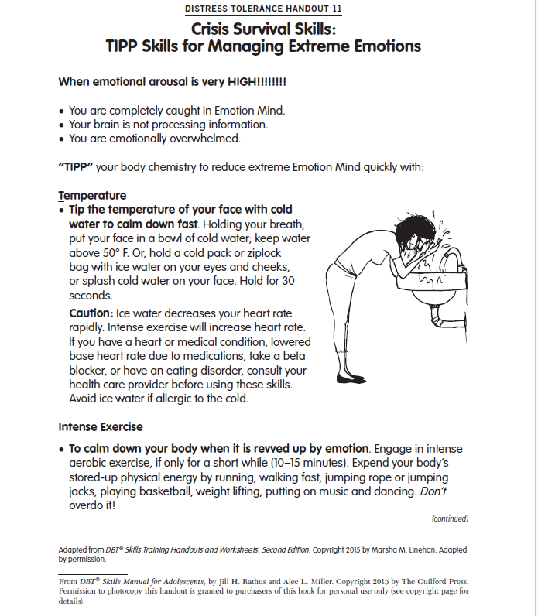

Slide 38
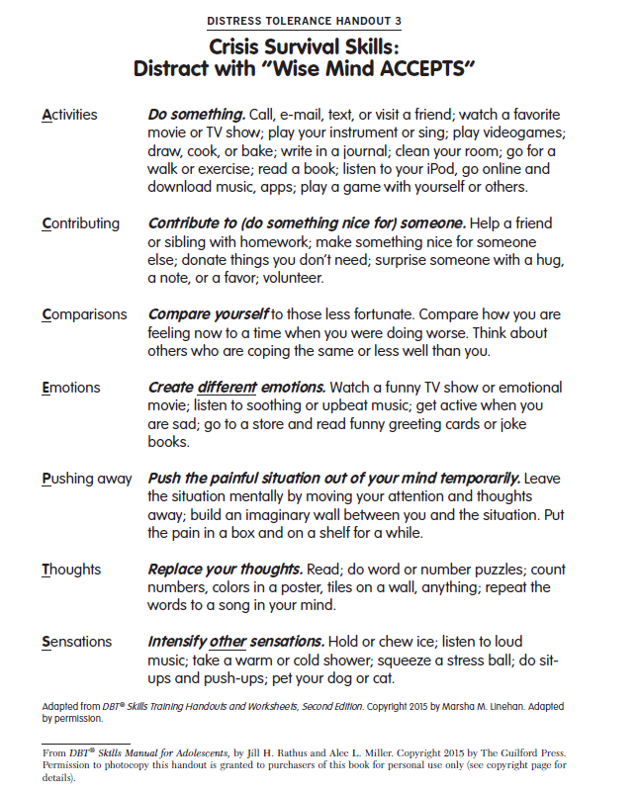

Slide 39
Case Example: “Laurie”
Thorough initial assessment + ask about SI/SH each session
Assess/remove access to deadly means (include parents)
Identify reasons for not acting / for living
  Impact on loved ones like parents/siblings
Identify what client has tried / what has worked before (include parents)
Functional analysis of relevant events
Identify suicidality drivers
  Intensity of sadness
  Feeling like a burden or that people dislike her
  AH saying to die (more compelling / harder to dismiss when distressed)

Slide 40
Case Example: “Laurie” Challenges & Questions
Difficulty arranging for client to complete homework or practice skills in moments of distress
Difficulty remembering details of periods of intense SI / distress
Very fused with negative thoughts/beliefs about herself & how other people perceive her

Slide 41

Discussion
Other case examples, consultation questions?

Slide 42
Take Home Points
Essential to screen for suicide risk in this population
Engaging clients in treatment at this stage is key
When present, regularly asses suicide & self-harm risk factors
Consider acute versus longer-term suicide risk
Collaboratively identify & target identified drivers of suicidality

Slide 43
Suicide Hotline Support
National
  Suicide prevention lifeline: 1-800-273-8255, https://suicidepreventionlifeline.org/
Local (research in your region):
  24/7 Colorado Crisis Services: 1-844-493-8255, text “TALK” to 38255, or https://coloradocrisisservices.org
  Massachusetts: Samaritans Statewide Helpline: 1-877-870-4673; available to anyone in MA who is need of emotional support, call or text; Massachusetts high school and college students can also get online support through the IMHear_ program

Slide 44
References
Challis S, Nielssen O, Harris A, et al. (2013). Systematic meta-analysis of the risk factors for deliberate self-harm before and after treatment for first-episode psychosis. Acta Psychiatrica Scandinavica, 127(6), 442-54.
Duarte, T.A., Paulino, S., Almeida, C., Gomes, H.S., Santos, N., & Gouveia-Pereira, M., (2020). Self-harm as a predisposition for suicide attempts: A study of adolescents' deliberate self-harm, suicidal ideation, and suicide attempts. Psychiatry Research, 287, https://doi.org/10.1016/j.psychres.2019.112553.
Gill, K.E., Quintero, J.M., Poe, S.L., ... & Girgis, R.R. (2015). Assessing suicidal ideation in individuals at clinical high risk for psychosis. Schizophrenia Research, 165(2-3), 152-156.
Haining, K., Karagiorgou, O., Gajwani, R., Gross, J., Gumley, A. I., Lawrie, S. M., Schwannauer, M., Schultze-Lutter, F., & Uhlhaas, P. J. (2021). Prevalence and predictors of suicidality and non-suicidal self-harm among individuals at clinical high-risk for psychosis: Results from a community-recruited sample. Early intervention in psychiatry, 15(5), 1256–1265. https://doi.org/10.1111/eip.13075
Hutton, P., Parker, S., Bowe, S., Ford, S., 2012. Prevalence of violence risk factors in people at ultra-high risk of developing psychosis: a service audit. Early Interv Psychiatry, 6(1), 91–96.
Kelleher, I., Corcoran, P., & Keeley, H., ... (2013). Psychotic symptoms and population risk for suicide attempt: A prospective cohort study. JAMA Psychiatry, 70(9), 940-948
Large, M.M., Dall, B., & Nielssen, O.B. (2014). Risk assessment for violence and self-harm in first episode psychosis and the need for early psychosis intervention services. Australian and New Zealand Journal of Psychiatry, 48(1), 94-95.
Lindgren, M., Manninen, M., Kalska, H., … & Therman, S. (2017). Suicidality, self-harm and psychotic-like symptoms in a general adolescent psychiatric sample. Early Intervention in Psychiatry, 11(2), 113-122.
Marshall, C., Deighton, S., Cadenhead, K.S., … & Addington, J. (2016). The violent content in attenuated psychotic symptoms. Psychiatry Research, 242, 61-66.
Romm, K.L., Rossberg, J.I., Berg, A.O., Barrett, E.A., Faerden, A., … & Melle, I. (2010). Depression and depressive symptoms in first episode psychosis. Journal of Nervous and Mental Disease, 198(1), 67-71.
Spidel, A., Lecomte, T., Greaves, C., Sahlstrom, K., & Yuille, J.C. (2010). Early psychosis and aggression: Predictors and prevalence of violent behaviour amongst individuals with early onset psychosis. International Journal of Law and Psychiatry, 33(3), 171-176.
Upthegrove, R.; Birchwood, M.; Ross, K.; Brunett, K.; McCollum, R.; Jones, L. (2010). The evolution of depression and suicidality in first episode psychosis. Acta Psychiatrica Scandinavica, 122(3), 211-218.

Slide 45
The purpose of the MHTTC Network is technology transfer - disseminating and implementing evidence-based practices for mental disorders into the field.
Funded by the Substance Abuse and Mental Health Services Administration (SAMHSA), the MHTTC Network includes 10 Regional Centers, a National American Indian and Alaska Native Center, a National Hispanic and Latino Center, and a Network Coordinating Office.
Our collaborative network supports resource development and dissemination, training and technical assistance, and workforce development for the mental health field. We work with systems, organizations, and treatment practitioners involved in the delivery of mental health services to strengthen their capacity to deliver effective evidence-based practices to individuals.
Our services cover the full continuum spanning mental illness prevention, treatment, and recovery support.
MHTTCnetwork.org
Sign-Up for Newsletter
MTTC News

