Slide 1
Older Black Americans and Mental Health
New England MHTTC
Martha Crowther, PhD, MPH &
Danielle McDuffie, PhD
February 28th, 2024
Notes:
DO NOT CHANGE THE FORMAT OF THIS TEMPLATE. If you are creating MHTTC-branded slides, you must use this template or one of the other approved templates in the Shared Folder.

Slide 2




Housekeeping Information
Participant microphones will be muted at entry
If you have questions during the event, please use the chat
This session is being recorded and it will be emailed to all participants once available.
If you have questions after
this session, please e-mail:
newengland@mhttcnetwork.org.
At the end of the month, we will send you a certificate of completion that you can submit to your particular board for continuing education credit. Please contact ifisher@c4innovates.com for more information on CEs after the event.

Slide 3
Acknowledgment
Presented in 2022 by the Mental Health Technology Transfer Center (MHTTC) Network.
This presentation was prepared for the New England Mental Health Technology Transfer Center (MHTTC) Network under a cooperative agreement from the Substance Abuse and Mental Health Services Administration (SAMHSA). All material appearing in this publication, except that taken directly from copyrighted sources, is in the public domain and may be reproduced or copied without permission from SAMHSA or the authors. Citation of the source is appreciated. Do not reproduce or distribute this publication for a fee without specific, written authorization from New England MHTTC. For more information on obtaining copies of this publication, email us at newengland@mhttcnetwork.org.
At the time of this publication, Miriam E. Delphin-Rittmon, Ph.D, served as Assistant Secretary for Mental Health and Substance Use in the U.S. Department of Health and Human Services and the Administrator of the Substance Abuse and Mental Health Services Administration.
The opinions expressed herein are the view of TTC Network and do not reflect the official position of the Department of Health and Human Services (DHHS), SAMHSA. No official support or endorsement of DHHS, SAMHSA, for the opinions described in this document is intended or should be inferred.
This work is supported by grants #1H79SM081775 from the Department of Health and Human Services, Substance Abuse and Mental Health Services Administration.
Presented 2022
Notes:
Always use acknowledgment slide on the 2nd slide and add your center’s information

Slide 4
Notes:
Always use Language Matters graphic as your third slide.

Slide 5


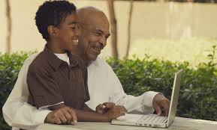

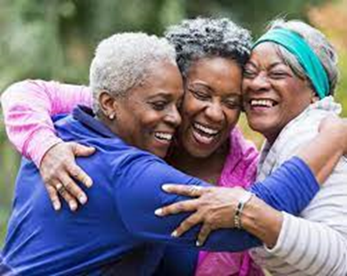
Older Black Americans and Mental Health
Martha Crowther, PhD, MPH &
Danielle McDuffie, PhD

Slide 6
Learning Objectives
Recognize the importance of understanding the historical context of the lives of older Black Americans
1
Recognize the importance of eliciting the older Black American’s perspective of his/her mental and physical health problems.
2
Elicit socio-cultural and spiritual beliefs that could influence older Black American’s health care choices and access to care.
3
Enhance knowledge of assessment, diagnosis, and treatment of major mental health disorders when working with older Black Americans.
4

Slide 7
Older Black Americans
Older Black Americans are a diverse group (Taylor & Chatters, 2020)
  Caribbean Blacks (Anderson & Lopez, 2018)
    Jamaica & Haiti: Major metropolitan areas in the Northeast and Southeast
  Blacks of African Descent

Slide 8
Older Black Americans
The current cohort of older Black Americans was told stories during childhood about slavery, the Civil War, and the Reconstruction period.
  Those time periods in American history are highlighted by racial violence and social upheaval.

Slide 9
Older Black Americans
The childhood and young adulthood of the current cohort occurred during the “Great Migration.”
  The Great Migration was the period following Reconstruction in which a large number of Black Americans left the South due to financial and racial hardship (Burton & Dilworth-Anderson, 1991).

Slide 10
Older Black Americans
Older Black Americans fought in or supported the war efforts for WWII.
  During WWII Black Americans fought for peace abroad and returned home to face inequality and segregation in education, housing, employment, and health.

Slide 11
Older Black Americans
Today’s Black American elders were middle aged (or approaching it) in the late 1960s.
  The 1960’s, the era of the Civil Rights Movement, has been considered “the most profound, revolutionary period in Black American history since Emancipation.”
  (Bennett, 1993)

Slide 12
Older Black Americans
The 1960’s is also a significant time period for the documented health disparities between Black Americans & Caucasians despite economic advances and increased access to educational opportunities.
(Jackson, Chatters and Taylor, 1993)

Slide 13
Older Black Americans
During these significant periods in Black American history, organizations such as the National Association for the Advancement of Colored People (NAACP) were formed and churches played a major role in social and political activities.
(Coke & Twaite, 1995)

Slide 14

Black Lives Matter Movement / Protests
Political Divide
Capital Riots (Insurrection)
Who is an ally?
What to say?
COVID-19
* Face Masks
* Vaccine Hesitancy
* Health Disparities
Abortion Rights
Gun Incidences
Economic Insecurity

Slide 15
Black Americans
Constitute 36% of low-income older adults (8%)
More likely to receive only minimum Social Security benefits
Less likely to receive pension income
More reliant on SSI
Chronic Disease is twice as high
More likely to perceive themselves as poor in health

Slide 16
Black Americans
More Hypertension
More strokes
Obesity in women
Kidney failure, diabetes
More completely incapacitated
Less access to health care
More likely to use emergency room as an entrance to hospitalization

Slide 17
Black Americans
More likely to use home remedies, lay consultations and folk medicine
Higher death rates for lungs, prostate than any other ethnic group
Least likely to enter nursing home, but once admitted are less likely to be discharged
More affected by social stressors than financial strain

Slide 18
Role Of Church
Have a greater sense of satisfaction in their lives due to higher levels of spirituality and support of families and church groups
Role of Church
  Place to engage in religious practices
  Agent for social reform (Cooke & Twaite, 1995)
    Partly as a result of the social and political injustices, group solidarity, and racial identification, religion and spirituality have been consistent themes in the life course development of older Black Americans.

Slide 19
Role of Church
Being “Raised in the church”
  Opportunity to address health disparities.
    Many problems begin as children and young adults.
    Combine spirituality with healthy living.
    More preventative messages than Alcohol and Abstinence--glutney, smoking, physical activity.

Slide 20
Life Course Perspective: Black Elders
Cohort Issues for Black American seniors
  Civil Rights cohort 55-70 years of age
  Religion was woven in this movement
  What about the next cohort?
    Positive correlation between age and religious participation (older adults go more often than younger)

Slide 21
Older Black Americans
Reaching old age is viewed as an accomplishment considering the unique history of Black Americans, given their disproportionate risk for physical, social and psychological harm (APA, 2020; Chatters, Taylor & Taylor, 2021; Jackson, Chatters, & Taylor, 1993)

Slide 22
Profile – Education & Health
Joe, an 85 year old Black American, was diagnosed with hypertension 15 years ago.
Joe exhibits dramatic fluctuations with his blood pressure due to noncompliance with prescribed treatment regimens.
Joe’s physician is unaware of the effects of using the word “hypertension” versus “high blood pressure” among Black American elders.
Using the term “high blood pressure” will more likely lead to better adherence.

Slide 23
Economic Issues
In 2019, not having enough food was reported three times more frequently by Black persons and two times more frequently by Hispanic persons than by White persons (Coleman-Jensen, Rabbitt, Gregory & Singh, 2019)
While older adults overall typically have extremely modest retirement savings & investments, minority households have even fewer financial resources to rely upon
Example: Older Black American households, have an estimated median net worth of just $13,000, compared with a median $181,000 for older white households. As a result, for most older minority women, Social Security has become the most important, and too-often sole, source of retirement income. In fact, without Social Security benefits, 62% of black women and 57% of Hispanic women would be destitute (Hounsell & Humphlett, 2003)

Slide 24
Economic Issues-Practice
Given the relation between poverty & health clinicians should:
  Develop strategies to provide low income older adults with needed financial information such as how to find assistance with medications
    Often older adults don’t know what resources are available to help meet their needs.
  Understand the similarities & differences between urban & rural poverty.
    Transportation, health care, resources

Slide 25
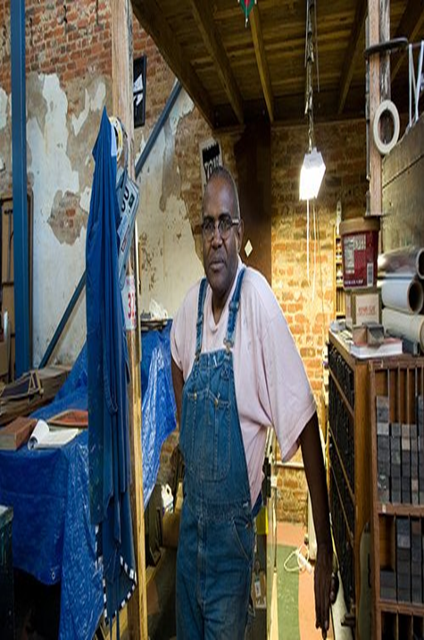
Rural Older Blacks
25% of the 65-year-old and over population live in rural areas
Rural elders are becoming isolated
The proportion of older adults in rural communities is larger than the proportion in urban areas primarily because of younger populations moving to larger urban areas
Along with the out-migration of younger people is an in-migration of retired elderly

Slide 26
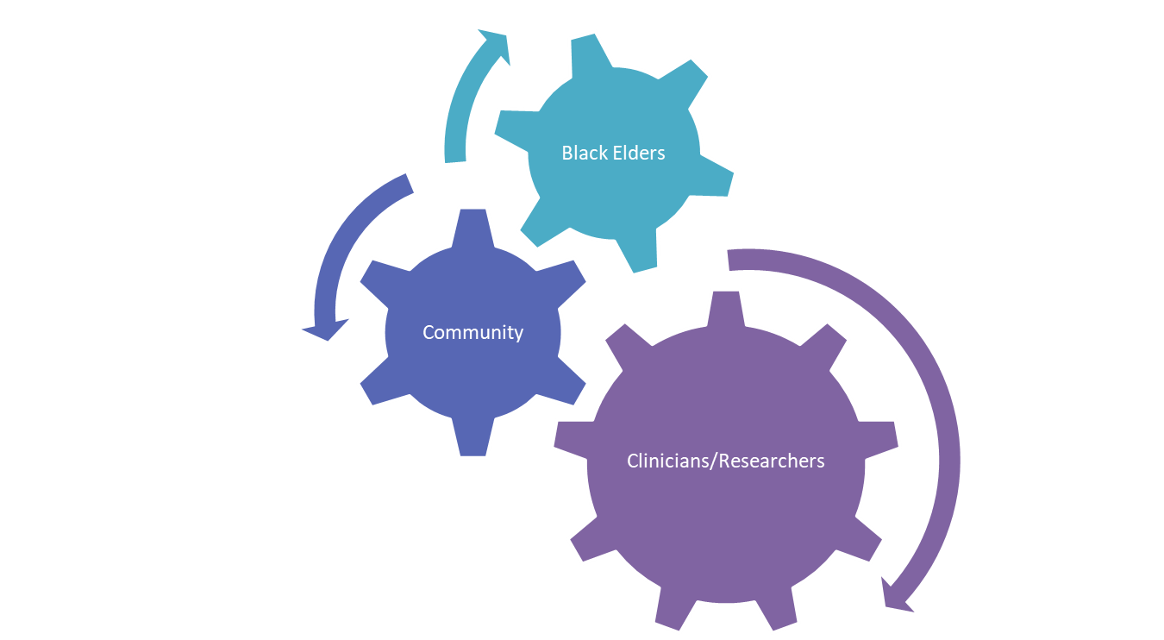
Building Collaborative Ties

Slide 27
Bereavement
Overall, there is a deficit in the literature examining bereavement among Black American populations in a noncomparative manner to other groups (Granket & Peleg-Sagy, 2015)
Over 70% of older adults experience loss within a 2.5-year period (Williams et al., 2007)
  This rate is likely higher among Black older adults
  Black Americans have a higher risk of experiencing the untimely loss of a loved one (Rosenblatt & Wallace, 2005)
Stoicism also might play a key role in Black grief
  Bereaved Black Americans might be less likely to report their symptoms of distress throughout their bereavement (Hunter & Schmidt, 2010)

Slide 28
Bereavement
Black Americans may grieve differently than other groups (Holloway, 2003; Rosenblatt & Wallace, 2005a; Rosenblatt & Wallace, 2005b)
  One example of this difference includes the effects racism might have in how bereaved Black Americans conceptualize their loss and how racism in the bereaved’s lives might impact their grieving (Rosenblatt et al., 2005b)
  Histories of poverty, racism, discrimination, and oppression represent additional stressors that could impact Black grief compared to other groups (Holloway, 2003; Rosenblatt et al., 2005b)
  These factors are particularly relevant for older Black American adults
Notes:
Remember to tie this back to older adults

Slide 29
Bereavement
Despite the relative dearth in literature, there are some identified ways Black American bereaved populations have been found to cope with their loss:
  Religion/spirituality (Harrison, Kahn, & Hsu, 2005)
    Compensatory strategies & meaning making
    Greater acceptance (Kalish et al., 1981)
    Social support (Billingsley, 1992; Boulware & Bui, 2016; Somhlaba & Wait, 2009)
    Resilience (Harrison et al., 2005)

Slide 30
Cognitive Impairment
Cognitive status is generally associated with activities of daily living like using a telephone, taking public transportation, and managing finances (Avlund & Fromholt, 1998; Barberger-Gateau et al., 1999)
Capacity, as an extension of this, is the combination of cognitive status and behavior in effectively accomplishing activities of daily living and making important autonomous decisions (Moye, Marson, & Edelstein, 2014)
In assessments of cognitive status, education is often a major determining factor in assessment performance (Schaie, 1996)

Slide 31
Disparities in Cognitive Impairment Diagnosis
Systemic and institutional racism among Black older adults (particularly those in the Deep South) place Black older adults at a disadvantage on cognitive measures (Loewenstein et al., 1994; Whitfield & Wiggins, 2003; Manly et al., 2002)
Biased examiners and systemically biased education could also have grave impacts
Around 27% of Black people live below poverty levels in the U.S. (U.S. Census Bureau, 2016) and might be living in areas limited to health care (Green et al., 2005; Morrison et al., 2000)

Slide 32
Health Disparities in Cognitive Impairment
Susceptibility to cognitive impairment between racial/ethnic groups has been attributed to lifestyle factors, health, and SES (Barber et al., 2016; LaVeist, 2005; Sachs-Ericsson & Blazer, 2005)
Conflicting evidence on whether health conditions more prevalent among Black American older adults (seizures, TBIs, thyroid disease, diabetes, HBP, high cholesterol, congestive heart failure) contribute to risk for cognitive impairment (Barber et al., 2016)

Slide 33
Testing Disparities
There is a fundamental lack of cultural sensitivity within psychological assessment tools
  Norming and standardization populations (Olmedo, 1981; Reynolds, 1982)
  Dictations of “normality” (Sue et al., 1992)
When comparing older adults administered the same cognitive tests, Black American older adults perform worse (Hilgeman et al., 2019; Manly et al., 1998; Manly et al., 2002; Patton et al., 2003; Unverzagt et al., 1996)
Using dementia test batteries, Black American older adults are judged as cognitively impaired more often than NHWs (Carlson et al., 1998; Inouye et al., 1993; Manly et al., 1998; Marcopulos et al., 1997; Ripich et al., 1997; Unverzagt et al., 1996)
Are older Black adults just more cognitively impaired? Evidence suggests not.

Slide 34
Systemic Disparities in Cognitive Impairment
Education plays a key role in explaining between groups cognitive status disparities (Schaie, 1996)
Black people have been found to receive less education than NHWs irrelevant to cohort differences (Harper & Alexander, 1990; Adams-Price, 1993)
Black American older adults who attended school during Jim Crow encountered less educational expenditures, shorter academic years, and more students per teacher in classroom settings (Loewenstein et al., 1994; Whitfield & Wiggins, 2003; Manly et al., 2002)
  This coincides with lower reading attainment, which has been found to have the greatest effect on neuropsychological test performance (Manly et al., 1999)

Slide 35
Rates of Depression in Black Older Adults
There is a wide range in rates of reported depression symptoms among Black older adults:
  Some reports as high as 12.8% of clinical depressive symptoms
  Other reports between 5.4-10.4% (Murrell et al., 1983, Blazer et al., 1998, Williams et al., 2007a, Woodward et al., 2012)
  Some estimates between 6-33% (Baker et al., 1995, Baker, 1995, Aranda et al., 2011)
  Ambulatory care rates between 27.2-30% (Rosenthal et al., 1987, Agarwal et al., 2010)

Slide 36
Different Manifestations of Depression
However, some of these disparities in the rates of depression among older Black adults might be attributable to culturally biased testing measures
Depression among Black Americans may not coincide with the “typical” presentation
Non-traditional manifestations include:
  Hypertension (Pickering, 2000)
  General somatization (Carrington, 2006)
  Increased physical distress (Brown et al., 1996)
  Increased sleep disturbance (Bazargan, 1996)

Slide 37
Depression
In line with Black American communalism, low levels of perceived social support have been linked to higher risk for depression (Miller et al., 2004)
  Black Americans who felt objectively isolated (i.e., no tangible connections) were twice as likely to meet criteria for MDD (Nguyen et al., 2020)
Facing discrimination has also been associated with higher levels of depression, particularly among Black American women (Gibbons et al., 2014)
The stoicism that is prevalent among Black older adults might also lead to an underreporting of symptoms of depression (Hunter & Schmidt, 2010)

Slide 38
Anxiety
Among African Americans with 12-month MDD, 44.9% had a lifetime anxiety disorder, 29.6% had lifetime dysthymia, 27.4% had a lifetime substance disorder, and 25.5% reported lifetime suicidal ideation
Older African Americans and African Americans across the adult have lower prevalence rates of psychiatric disorders than non- Latino white
Older African Americans have lower rates of psychiatric disorders than younger African Americans
(Taylor & Chatters, 2020)

Slide 39
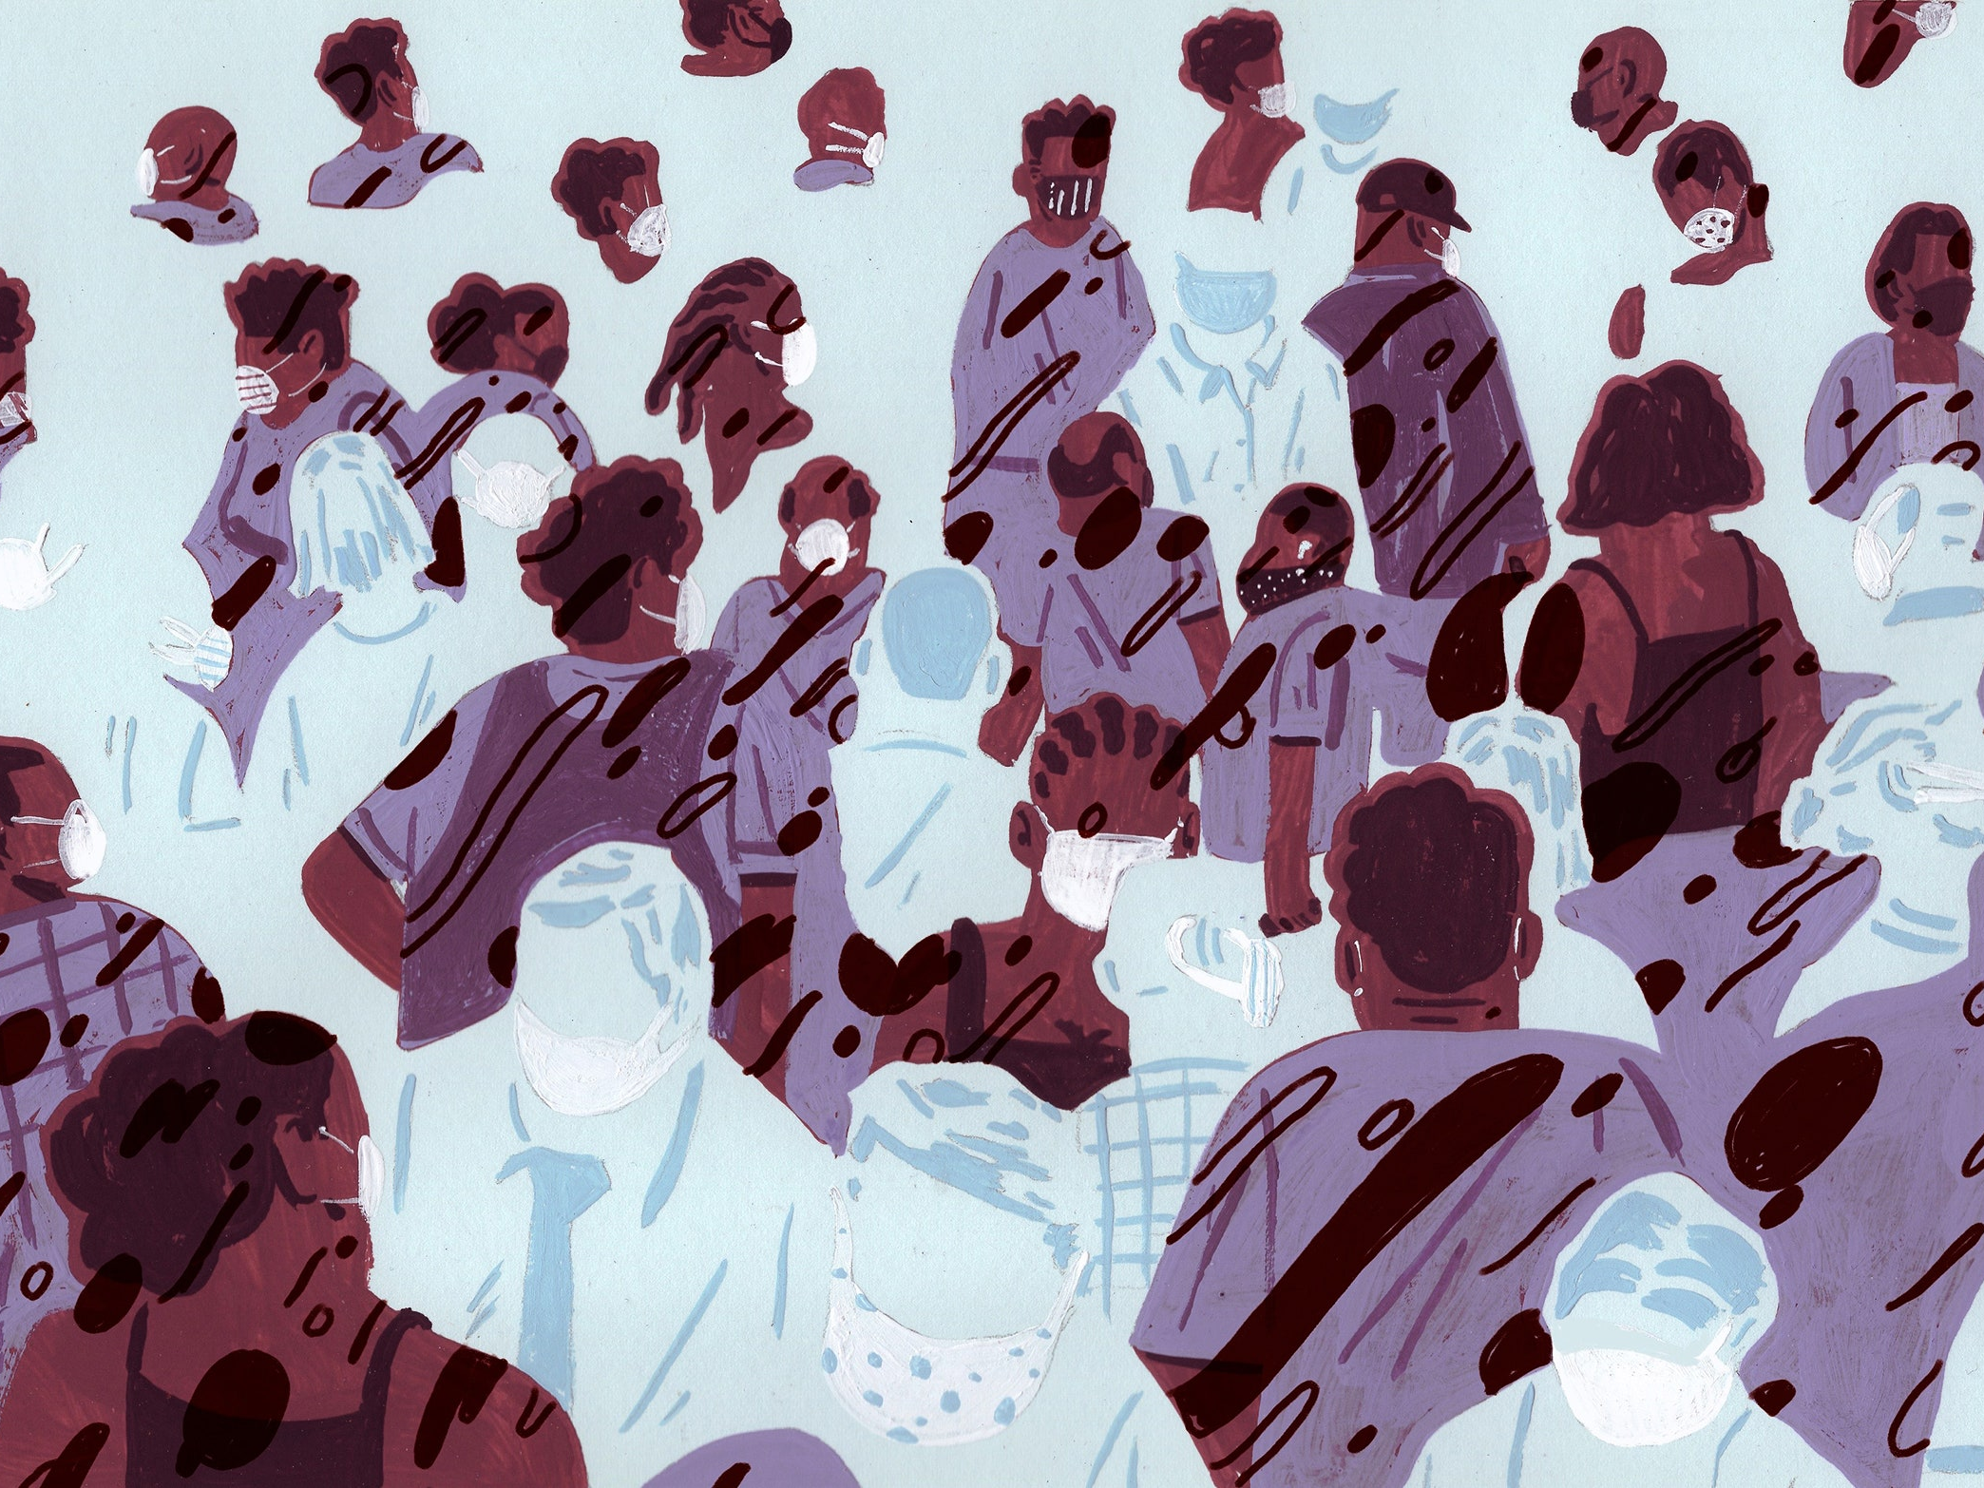
Covid-19: The Impact on Older Black Adults

Slide 40
COVID: The Impact on Black Older Adults
COVID-19 disproportionately affected two groups: older adults and POC (CDC, 2020a)
Black older adults (65+) had disturbingly high mortality rates from COVID-19 during the height of the pandemic (CDC, 2020a)
  In March 2021, Black people were found to have died from COVID-19 1.4 times more than NHWs (The Atlantic, 2021)
Compounding this was systemic racism
  CDC sited poor living conditions, occupational hazards, and negative health circumstances as key factors influencing COVID-related mortality (CDC, 2020a)

Slide 41
COVID & Systemic Racism
Discrimination affects physical and mental health outcomes (Meyer, 2003)
Discrimination is further linked to a mistrust of the medical field (Corbie-Smith et al., 1999; Goodin et al., 2013; Williams et al., 2003)
Black older adults are influenced by: 1) systemic factors making them more susceptible to COVID-19, and 2) lived experiences that make them more likely to fall ill and less likely to receive treatment (McDuffie, 2021)
Tuskegee Syphilis Study + vaccine hesitancy

Slide 42
COVID & Black Older Adult Mental Health
Black older adults are likely to rely predominantly on two things during times of distress: religion and social support (Billingsley, 1992; Hill, 1972; Stack, 1974; Sudarkasa, 1997; Taylor, 1993)
  Due to COVID-19, there was a greatly impaired ability to commune
  Social separation could exacerbate or encourage the developmental of mental illness
  Black religious institutions also have their basis in community (Taylor et al., 2013, 2016)
Loneliness in older adults exacerbates a multitude of illnesses (Kastenbaum, 1986)
Social isolation is a risk factor for physical illness, mental illness, and death (Lubben et al., 2015)

Slide 43

Main Points
Older Blacks are not a monolithic group
Assessment of depression, anxiety, and cognitive impairment are complex based on different symptom presentation
  Somatic complaints
  Food as a coping mechanism
Assessing family functioning is an important part of mental health diagnosis & treatment
Providing information about formal mental health services in “non-traditional” settings can increase the number of older Blacks that utilize services

Slide 44
Main Points
Understanding AND Acknowledging the impact of past and current racism on mental health can positively impact diagnosis & treatment
Be mindful of triggers. Encourage limiting exposure to social media. There is often a news loop repeated discussing stressful events and incidents related to discrimination, income disparities etc.

Slide 45

RESOURCES

Slide 46
Resources
  Clinical Gerontologist, Special Issue on Older African Americans
  Black Aging Matters: How to Better Address Racism-Related Stress in African American Older Adults (Webinar, APA Office on Aging, 2018): youtu.be/DqvF_7O0lSY
  Black and African American Elders (Diverse Elders Coalition, 2018): www.diverseelders.org/who-we-are/ diverse-elders/black-elders/
  Facing the Divide: Psychology’s Conversation on Race and Health (APA Office of Ethnic Minority Affairs, 2018): on.apa.org/facing-the-divide
  Health and Healthcare of African American Older Adults (V.J. Periyakoil & Rita Hargrave, 2010): geriatrics.stanford.edu/wp-content/uploads/2014/10/ african_american.pdf
  Mechanisms of Racial/Ethnic Disparities in Cognitive Aging and Alzheimer’s Disease (Jennifer Manly, 2016): wai.wisc.edu/pdf/ADUpdate2016/Manly%20 presentation-6SLIDESPERPAGE.pdf
  Multicultural Aging Efforts at APA: on.apa.org/multicultural-efforts
  Psychological and Physical Effects of Race Related Stress (Association of Black Psychologists, 2018): youtu.be/NPYpYC6xCLg

Slide 47
SAGE: Sistahs Aging with Grace & Elegance https://www.sankofastories.com/partners
Borne out of the personal experiences of its Co-Founders, Carlene Davis and Kiara Harris, Sistahs Aging with Grace & Elegance was created to empower Black women with knowledge, strategies, tools and community support to thrive at every stage of the aging journey. Through education, advocacy, information-sharing and action-planning, the goal of Sistahs Aging with Grace & Elegance is for Black women to:
Maintain optimal levels of physical and mental well-being throughout their aging journey
Have the resources needed to be financially secure
Live in safe and stable housing that enables them to age-in-place and community for as long as desired and possible
Establish trust, estate and advanced health care plans that articulate their wishes in life and death
Experience caring and supportive family and community relationships
Remain active, engaged, and connected to a community of Sistahs who are Celebrating the Aging Journey together

Slide 48
Resources
Council of National Psychology Association for the Advancement of Ethnic Minority Interests (CNPAAEMI)
  https://www.apa.org/about/governance/bdcmte/ethnic-minority-interests
  https://www.apa.org/pi/oema
APA Multicultural Guidelines, 2017
  http://www.apa.org/about/policy/multicultural-guidelines.pdf

Slide 49
References
Adams-Price, C. E. (1993). Age, education, and literacy skills of adult Mississippians. The Gerontologist, 33, 741–746.
Agarwal, M., Hamilton, J. B., Moore, C. E., & Crandell, J. L. (2010). Predictors of depression among older BlackAmerican cancer patients. Cancer Nursing, 33, 156-163.
Aranda, M. P., Chae, D. H., Lincoln, K. D., Taylor, R. J., Woodward, A. T., & Chatters, L. M. (2011). Demographic correlates of DSM-IV major depressive disorder among older BlackAmericans, Black Caribbeans, and non-Hispanic Whites: Results from the National Survey of American Life. International Journal of Geriatric Psychiatry, 27, 940-947.
The Atlantic (2021). The COVID racial data tracker: COVID-19 is affecting Black, Indigenous, Latinx, and other people of color the most. https://covidtracking.com/race
Avlund, K., & Fromholt, P. (1998). Instrumental activities of daily living: The relationships to self-rated memory and cognitive performance among 75-year-old men and women. Scandinavian Journal of Occupational Therapy, 5, 93-100.
Baker, F. M. (1995). Mental-health issues in elderly African-Americans. Clinics In Geriatric Medicine, 11, 1-13.
Baker, F. M., Parker, D. A., Wiley, C., Velli, S. A., & Johnson, J. T. (1995). Depressive symptoms in African-American mental patients. International Journal of Geriatric Psychiatry, 10, 9-14.
Barber, S., Hickson, D. A., Kawachi, I., Subramanian, S. v., & Earls, F. (2016). Double-jeopardy: The joint impact of neighborhood disadvantage and low social cohesion on cumulative risk of disease among BlackAmerican men and women in the Jackson Heart Study. Social Science & Medicine, 153, 107-115.
Barberger-Gateau, P., Fabrigoule, C., Helmer, C., Rouch, I., & Dartigues, J. F. (1999). Functional impairment in instrumental activities of daily living: An early clinical sign of dementia. Journal of the American Geriatrics Society, 47, 456-462.
Bazargan, M. (1996). Self-reported sleep disturbance among African-American elderly: The effects of depression, heath status, exercise, and social support. International Journal of Aging and Human Development, 42, 143-160.
Billingsley, A. (1992). Climbing Jacob’s ladder: Enduring legacy of BlackAmerican families. New York, NY: Simon & Schuster.
Blazer, D. G., Landerman, L. R., Hays, J. C., Simonsick, E. M., & Saunders, W. B. (1998). Symptoms of depression among community-dwelling elderly African-American and white older adults. Psychological Medicine, 28, 1311-1320.
Boulware, D. L., & Bui, N. H. (2016). Bereaved BlackAmerican adults: The role of social support, religious coping, and continuing bonds. Journal of Loss and Trauma, 21, 192-202.
Brown, C., Schulberg, H. C., & Madonia, M. J. (1996). Clinical presentations of major depression by BlackAmericans and whites in primary medical care practice. Journal of Affective Disorders, 41, 181-191.
Carlson, M. C., Brandt, J., Carson, K. A., & Kawas, C. H. (1998). Lack of relation between race and cognitive test performance in Alzheimer’s disease. Neurology, 50, 1499–1501.
Carrington, C. H. (2006). Clinical depression in BlackAmerican women: Diagnoses, treatment, and research. Journal of Clinical Psychology, 62, 779-791. doi: 10.1002/jclp.20289
Centers for Disease Control and Prevention (2020a). COVID-19 in racial and ethnic minority groups. https://www.cdc.gov/coronavirus/2019-ncov/need-extra-precautions/racial-ethnic-minorities.html
Corbie-Smith, G., Thomas, S. B., Williams, M. V., & Moody-Ayers, S. (1999). Attitudes and beliefs of BlackAmericans toward participation in medical research. Journal of General Internal Medicine, 14, 537-546.
Gibbons, F. X., Kingsbury, J. H., Weng, C., Gerrard, M., Cutrona, C., Wills, T. A., & Stock, M. (2014). Effects of perceived racial discrimination on health status and health behavior: A differential mediation hypothesis. Health Psychology, 33, 11.
Granket, L., & Peleg-Sagy, T. (2015). Representations of BlackAmericans in the grief and mourning literature from 1998 to 2014: A systematic review. Death Studies, 39, 605-632. doi: 10.1080/07481187.2015.1047059
Green, C. R., Ndao-Brumblay, S. K., West, B., & Washington, T. (2005). Differences in prescription opioid analgesic availability: Comparing minority and white pharmacies across Michigan. The Journal of Pain, 6, 689-699.
Goodin, B. R., Pham, Q. T., Glover, T. L., Sotolongo, A., King, C. D., Sibille, K .T.,…Fillingim, R. B. (2013). Perceived racial discrimination, but not mistrust of medical research, predicts the heat pain tolerance of BlackAmericans with symptoms of knee osteoarthritis. Health Psychology, 32, 1117-1126.
Harper, M. S., & Alexander, C. D. (1990). Profile of the black elderly. In M. S. Harper (Ed.), Minority aging: Essential curricula content for selected health and allied health professions (pp. 193–222). DHHS Publication No. HRS-R-DV 90−4.

Slide 50
References Cont.
Harrison, T., Kahn, D. L., & Hsu, M. (2005). A hermeneutic phenomenological study of widowhood for African-American women. Omega, 50, 131-149.
Hilgeman, M. M., Boozer, E. M., Snow, A. L., Allen, R. S., & Davis, L. L. (2019). Use of the Montreal Cognitive Assessment (MoCA) in a rural outreach program for military veterans. Journal of Rural Social Sciences, 34, 1–16.
Hill, R. B. (1972). The strengths of Black families. New York, NY: Emerson Hall.
Holloway, K. F. C. (2003). Passed on: BlackAmerican mourning stories. Durham, NC: Duke University Press.
Hunter, L. R., & Schmidt, N. B. (2010). Anxiety psychopathology in BlackAmerican adults: Literature review and development of an empirically informed sociocultural model. Psychological Bulletin, 136, 211-235.
Inouye, S. K., Albert, M. S., Mohs, R., Sun, K., & Berkman, J. F. (1993). Cognitive performance in a high-functioning community-dwelling elderly population. Journals of Gerontology. Series A, Biological Sciences and Medical Sciences, 48, 146–151.
Kalish, R. A., & Reynolds, D. K. (1981). Death and ethnicity. Amityville, NY: Baywood.
Kastenbaum, R. J. (1986). Death, society, and human experience (3rd ed.). Columbus, OH: Charles E. Merrill Publishing Company.
LaVeist, T. A. (2005). Disentangling race and socioeconomic status: A key to understanding health inequalities. Journal of Urban Health, 82, iii26-iii34.
Loewenstein, D. A., Arguelles, T., Arguelles, S., & Linn-Fuentes, P. (1994). Potential cultural bias in the neuropsychological assessment of the older adult. Journal of Clinical and Experimental Neuropsychology, 16, 623–629.
Lubben, J., Gironda, M., Sabbath, E., Kong, J., & Johnson, C. (2015). Social isolation presents a grand challenge for social work. American Academy of Social Work & Social Welfare. https://aaswsw.org/wp-content/uploads/2015/03/Social-Isolation-3.24.15.pdf
Manly, J. J., Jacobs, D. M., Sano, M., Bell, K., Merchant, C. A., Small, S. A., & Stern, Y. (1998). Cognitive test performance among nondemented elderly BlackAmericans and whites. Neurology, 50, 1238–1245.
Manly, J. J., Jacobs, D. M., Sano, M., Bell, K., Merchant, C. A., Small, S. A., & Stern, Y. (1999). Effect of literacy on neuropsychological test performance in nondemented, education-matched elders. Journal of the International Neuropsychological Society, 5, 191–202.
Manly, J. J., Jacobs, D. M., Touradji, P., Small, S. A., & Stern, Y. (2002). Reading level attenuates differences in neuropsychological test performance between BlackAmerican and European American elders. Journal of the International Neuropsychological Society, 8, 341–348.
Marcopulos, B. A., McLain, C. A., & Giuliano, A. J. (1997). Cognitive impairment or inadequate norms: A study of healthy, rural, older adults with limited education. The Clinical Neuropsychologist, 11, 111–131.
McDuffie, D. L. (2021). Addressing the mental health of Black older adults during the COVID-19 pandemic. GeroPsych. Epub ahead of publication. doi: 10.1024/1662-9647/a000275
Meyer, I.H. (2003). Prejudice, social stress, and mental health in lesbian, gay and bisexual populations: Conceptual issues and research evidence. Psychological Bulletin, 129, 674-697. doi:10.1037/0033-2909.129.5.674
Miller, D. K., Malmstrom, T. K., Joshi, S., Andresen, E. M., Morley, J. E., & Wolinsky, F. D. (2004). Clinically relevant levels of depressive symptoms in community-dwelling middle-aged BlackAmericans. Journal of the American Geriatrics Society, 52, 741-748.
Morrison, R. S., Wallenstein, S., Natale, D. K., Senzel, R. S., & Huang, L. L. (2000). “We don’t carry that”-Failure of pharmacists in predominantly nonwhite neighborhoods to stock opioid analgesics. New England Journal of Medicine, 342, 1023-1026.
Moye, J., Marson, D. C., & Edelstein, B. (2014). Assessment of capacity in an aging society. American Psychology, 68, 158-171. doi: https://doi.org/10.1037/a0032159
Murrell, S. A., Himmelfarb, S., & Wright, K. (1983). Prevalence of depression and its correlates in older adults. American Journal of Epidemiology, 117, 173-185.
Nguyen, A. W., Taylor, R. J., Taylor, H. O., & Chatters, L. M. (2020). Objective and subjective social isolation and psychiatric disorders among BlackAmericans. Clinical Social Work Journal, 48, 87-98.
Olmedo, E. L. (1981). Testing linguistic minorities. American Psychologist, 36, 1078–1085.

Slide 51
References Cont.
Patton, D. E., Duff, K., & Schoenberg, M. R. (2003). Performance of cognitively normal Black Americans on the RBANS in community dwelling older adults. The Clinical Neuropsychologist, 17, 515–530.
Pickering, T. G. (2000). Effects of stress and behavioral intervention in hypertension, headache and hypertension: Something old, something new. Journal of Clinical Hypertension, 2, 345-346.
Reynolds, C. R. (1982). Methods for detecting construct and predictive bias. In R. A. Berk (Ed.), Handbook of methods for detecting test bias (pp. 192–227). Baltimore, MD: Johns Hopkins University Press.
Ripich, D. N., Carpenter, B., & Ziol, E. (1997). Comparison of African-American and white persons with Alzheimer's disease on language measures. Neurology, 48, 781–783.
Rosenblatt, P., & Wallace, B. R. (2005a). BlackAmerican grief. New York: Brunner-Routledge.
Rosenblatt, P., & Wallace, B. R. (2005b). Narratives of grieving BlackAmericans about racism in the lives of deceased family members. Death Studies, 29, 217-235.
Rosenthal, M. P., Goldfarb, N. I., Carlson, B. L., Sagi, P. C., & Balaban, D. J. (1987). Assessment of depression in a family practice center. The Journal of Family Practice, 25, 143-149.
Sachs-Ericsson, N., & Blazer, D. G. (2005). Racial differences in cognitive decline in a sample of community-dwelling older adults: The mediating role of education and literacy. American Journal of Geriatric Psychiatry, 13, 968-975.
Schaie, K. W. (1996). Intellectual development in adulthood. In J. E. Birren, K. W. Schaie, R. P. Abeles, M. Gatz, & T. A. Salthouse (Eds.), Handbook of the psychology of aging (pp. 266–286). Academic Press.
Somhlaba, N. Z., & Wait, J. W. (2009). Stress, coping styles, and spousal bereavement: Exploring patterns of grieving among black widowed spouses in rural South Africa. Journal of Loss and Trauma, 14, 196-210. doi: 10.1080/15325020802537443
Stack, C. B. (1974). All our kin. New York, NY: Basic Books.
Sudarkasa, N. (1997). BlackAmerican families and family values. In H.P. McAdoo (Ed.), Black families. Thousand Oaks, CA: Sage.
Sue, D. W., Arredondo, P., & McDavis, R. J. (1992). Multicultural counseling competencies and standards: A call to the profession. Journal of Counseling and Development, 70, 477–486.
Taylor, R. J. (1993). Religion and religious observances. In J. S. Jackson & L. M. Chatters (Eds.), Aging in Black America (pp. 101–123). Newbury Park, CA: Sage.
Taylor, R. J., Chatters, L. M., Woodward, A. T., & Brown, E. (2013). Racial and ethnic differences in extended family, friendship, fictive kin, and congregational informal support networks. Family Relations, 62, 609-624.
Taylor, R. J., Mouzon, D. M., Nguyen, A. W., & Chatters, L. M. (2016). Reciprocal family, friendship and church support networks of BlackAmericans: Findings from the National Survey of American Life. Race and Social Problems, 8, 326-339.
United States Census Bureau. (2016). U.S. Census Bureau quick facts selected: United States. www.census.gov
Unverzagt, F. W., Hall, K. S., Torke, A. M., & Rediger, J. D. (1996). Effects of age, education, and gender on CERAD neuropsychological test performance in an BlackAmerican sample. The Clinical Neuropsychologist, 10,180–190.
Whitfield, K. E., & Wiggins, S. (2003). The impact of desegregation on cognition among older BlackAmericans. Journal of BlackAmerican Psychology, 29, 275–291.
Williams, B. R., Sawyer Baker, P., Allman, R. M., & Roseman, J. M. (2007). Bereavement among BlackAmericans and White older adults. Journal of Aging and Health, 19, 313-333.
Williams, D. R., Gonzales, H. M., Neighbors, H., Nesse, R., Abelson, J. M., Sweetman, J., & Jackson, J. S. (2007). Prevalence and distribution of major depressive disorder in BlackAmericans, Caribbean Blacks, and non-Hispanic whites: Results from the National Survey of American Life. Archives of General Psychiatry, 64, 305-315.
Williams, D. R., Neighbors, H. W., & Jackson, J. S. (2003). Racial/ethnic discrimination and health: Findings from community studies. American Journal of Public Health, 93, 200-208.
Woodward, A. T., Taylor, R. J., Bullard, K. M., Aranda, M. P., Lincoln, K. D., & Chatters, L. M. (2012). Prevalence of lifetime DSM-IV affective disorders among older BlackAmericans, Black Caribbeans, Latinos, Asians, and non-Hispanic White people. International Journal of Geriatric Psychiatry, 27, 816-827.

Slide 52


Slide 53
The purpose of the MHTTC Network is technology transfer - disseminating and implementing evidence-based practices for mental disorders into the field.
Funded by the Substance Abuse and Mental Health Services Administration (SAMHSA), the MHTTC Network includes 10 Regional Centers, a National American Indian and Alaska Native Center, a National Hispanic and Latino Center, and a Network Coordinating Office.
Our collaborative network supports resource development and dissemination, training and technical assistance, and workforce development for the mental health field. We work with systems, organizations, and treatment practitioners involved in the delivery of mental health services to strengthen their capacity to deliver effective evidence-based practices to individuals.
Our services cover the full continuum spanning mental illness prevention, treatment, and recovery support.
MHTTCnetwork.org
Sign-Up for Newsletter
MTTC News

