Slide 1
Awareness, Agency and Advocacy
Beyond Burnout
Through a Polyvagal Lens
S.Rebekah Demirel 2023
www.traumaprograms.com

Slide 2
Why These Three Things?
Awareness of how we think and feel is the first step in having…
Agency is what we cultivate when we take the time to notice and then our…
Advocacy is more inclusive more meaningful, and more powerfully life-altering for everyone
S.Rebekah Demirel 2023
www.traumaprograms.com

Slide 3
Breathe 6, 1, 8

Slide 4
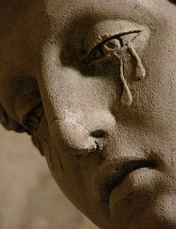
Being Trauma Informed
Taking a broad perspective of the whole situation
Being interested in what happened, vs what is wrong with someone
Asking questions and attending to needs in the moment
Is for ourselves and others
S.Rebekah Demirel 2023
www.traumaprograms.com

Slide 5
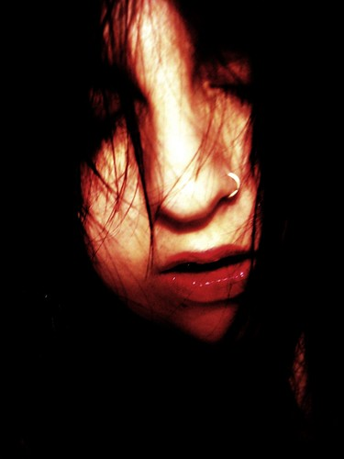
A Word About Trauma
Trauma is a Greek word for “wound” which is painful, we avoid touching it, we try to cover it and when it is deep, the wound leaves a scar
We carry our scars in our nervous systems and that affects how we relate to the world
S.Rebekah Demirel 2023
www.traumaprograms.com

Slide 6
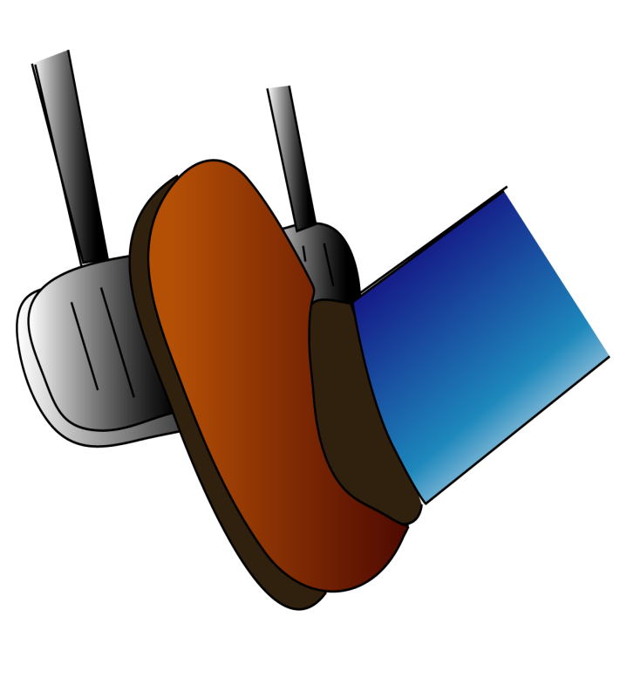
Reviewing What We Know
Gas pedal = Sympathetic NS response – Fight or Flight
Brakes = Parasympathetic NS response – Rest and Digest
Both responses are Autonomic (automatic) NS
S.Rebekah Demirel 2023
www.traumaprograms.com

Slide 7
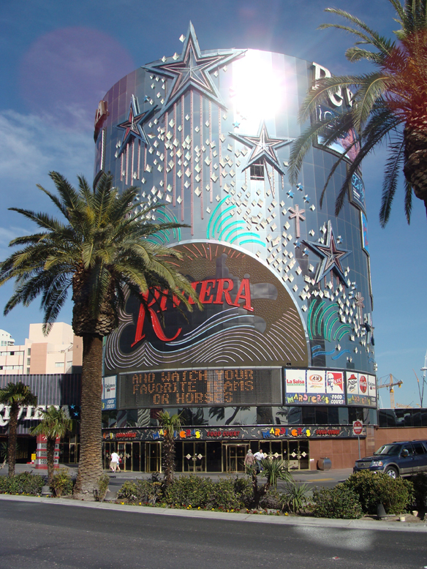
Vagus Baby! (But not that kind…)
The Vagus Nerve is the tenth and longest cranial nerve, starting at the base of the skull, running through the face, throat, and all our visceral organs, ending at the end of the digestive tract. It is part of the autonomic nervous system.
S.Rebekah Demirel 2023
www.traumaprograms.com

Slide 8
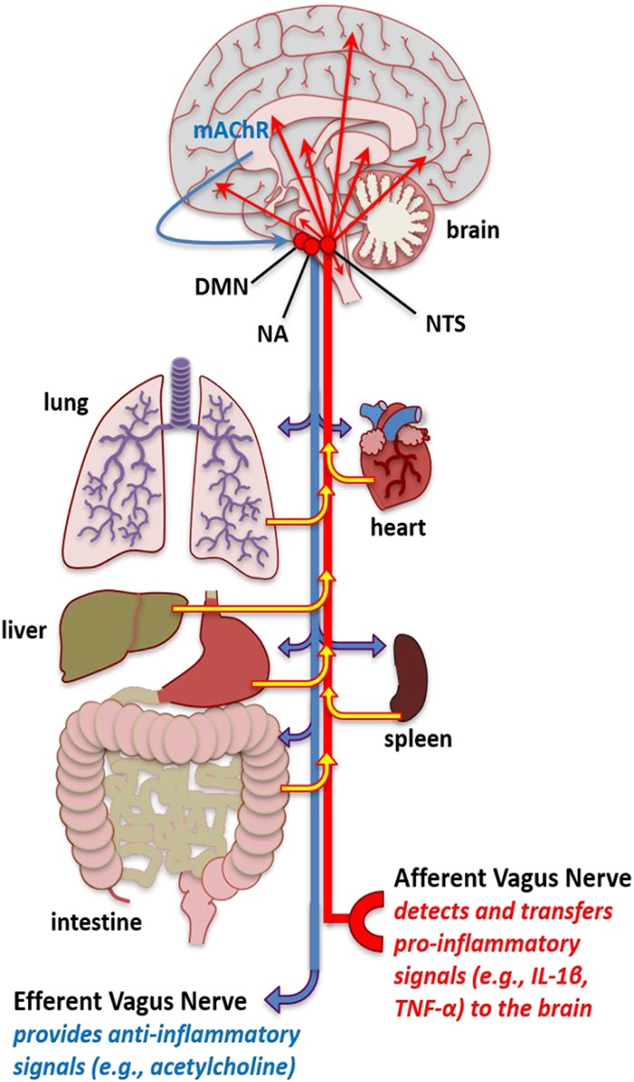
What Does the Vagus Nerve Do?
Responsible for the regulation of internal organ functions - digestion, heart rate, respiratory rate, blood pressure, and certain reflex actions - coughing, sneezing, swallowing, and vomiting
Moderates and downregulates stress response
S.Rebekah Demirel 2023
www.traumaprograms.com

Slide 9
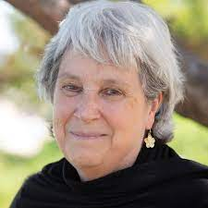
Polyvagal Theory (the science of safety)
“If we do not feel safe, we are chronically in a state of evaluation and defensiveness”
“We are wired for connection. Trauma compromises our ability to engage with others.”
Dr.Stephen Porges
Deb Dana
S.Rebekah Demirel 2023
www.traumaprograms.com

Slide 10
S.Rebekah Demirel 2023
www.traumaprograms.com

Slide 11
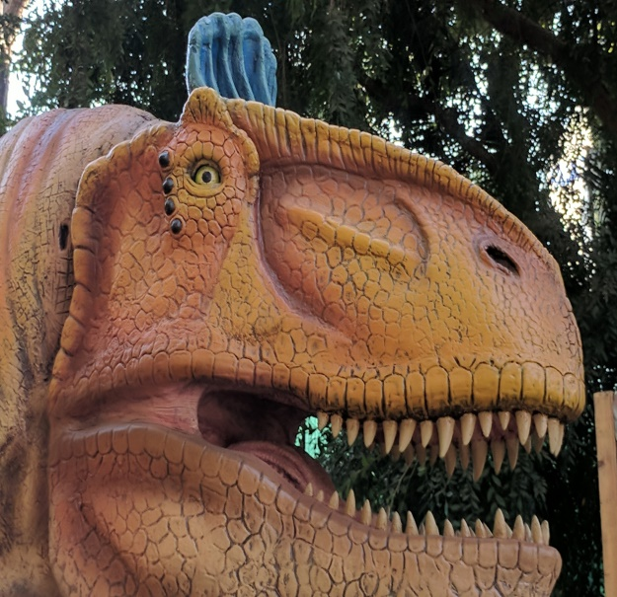
Befriending Our Nervous System
Dorsal- Controls below the diaphragm for digestion, reproduction Freeze response
Sympathetic – Controls above the diaphragm. Motivates movement , heart rate, circulation escape, attack
Ventral- Connection, engagement, safety, curiosity, possibility, breathing, heart rate, blood pressure, higher brain functions
S.Rebekah Demirel 2023
www.traumaprograms.com

Slide 12
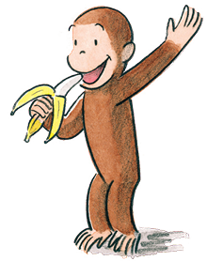
Curiosity Is A Ventral Vagal State
When our nervous system is anchored in ventral vagal we are curious and open to learning
When either sympathetic or dorsal is running the show, there is no room for curiosity and there is only shut down or the urge to run or fight
S.Rebekah Demirel 2023
www.traumaprograms.com

Slide 13
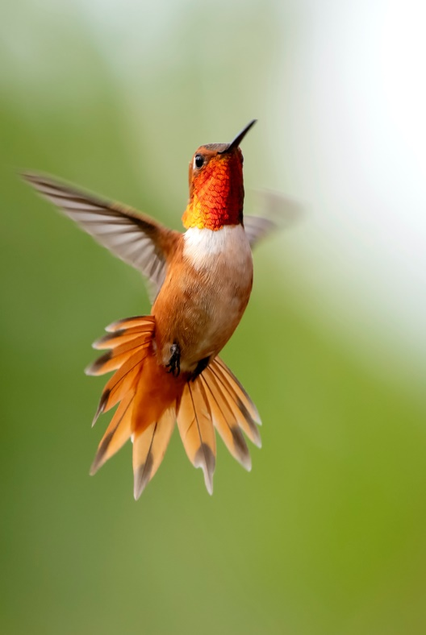
Awareness = Agency
It takes courage to deeply inquire into our suffering
By making a practice of awareness, new possibilities emerge
When we see what may be possible agency and healing is restored to our nervous system
S.Rebekah Demirel 2023
www.traumaprograms.com

Slide 14
Advocacy
What does it mean to you?
What is your style of advocacy?
Has your style of advocacy changed over the years?
What does it look like?
What would you want it to look like?
S.Rebekah Demirel 2023
www.traumaprograms.com

Slide 15
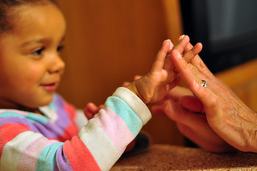
Touching In
What is it like to allow a small dip into the various vagal phases?
Can you imagine a time when you felt: shutdown (dorsal) angry or afraid (sympathetic) or safe, nurtured and connected (ventral)?
S.Rebekah Demirel 2023
www.traumaprograms.com

Slide 16
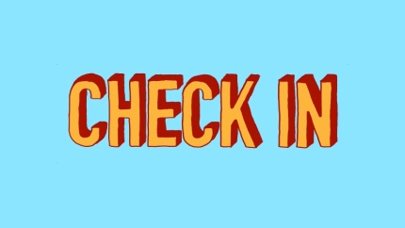
The World Is and I Am…
Dorsal – when the feeling is collapsed, shut down, isolated…
Sympathetic – when the feeling is angry, afraid, anxious…
Ventral – when the feeling is open, curious, friendly, engaged, connected, safe…
S.Rebekah Demirel 2023
www.traumaprograms.com

Slide 17
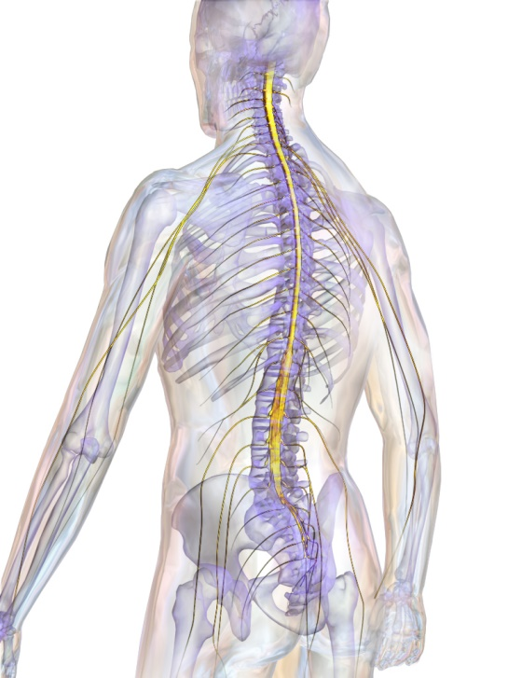
Neuroception
Neuroception describes the physiological process of the nervous system evaluating risk without requiring conscious awareness
Though we may be aware of a shift in bodily awareness, the shift automatically happens without conscious control and it does always accurately identify danger
S.Rebekah Demirel 2023
www.traumaprograms.com

Slide 18
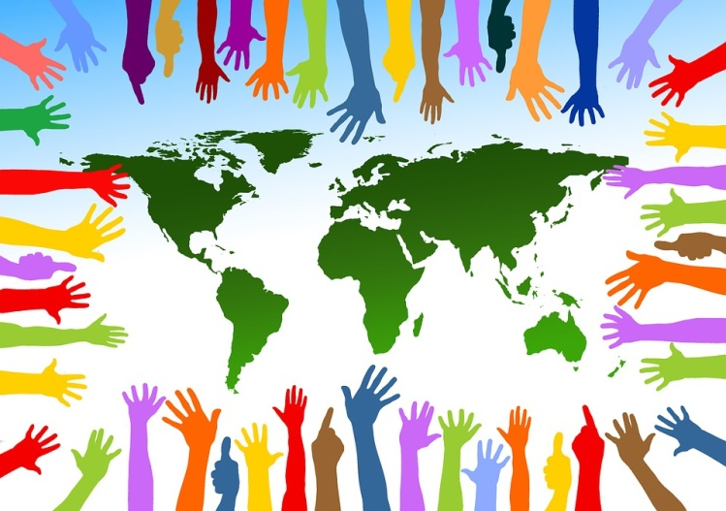
Mapping Our Nervous System
When we “map” our adaptive nervous system responses we begin to gain a perspective on how we habitually respond to life’s challenges
When we gain this awareness of the ways our nervous system has adapted, we can begin to shape it differently
S.Rebekah Demirel 2023
www.traumaprograms.com

Slide 19
Safety or Protection
Our nervous system tells us through neuroception, whether we sense danger or safety
Sights, sounds, smells inform our adaptive nervous system
Safety is defined by feeling safe, not by the removal of a threat
S.Rebekah Demirel 2023
www.traumaprograms.com

Slide 20
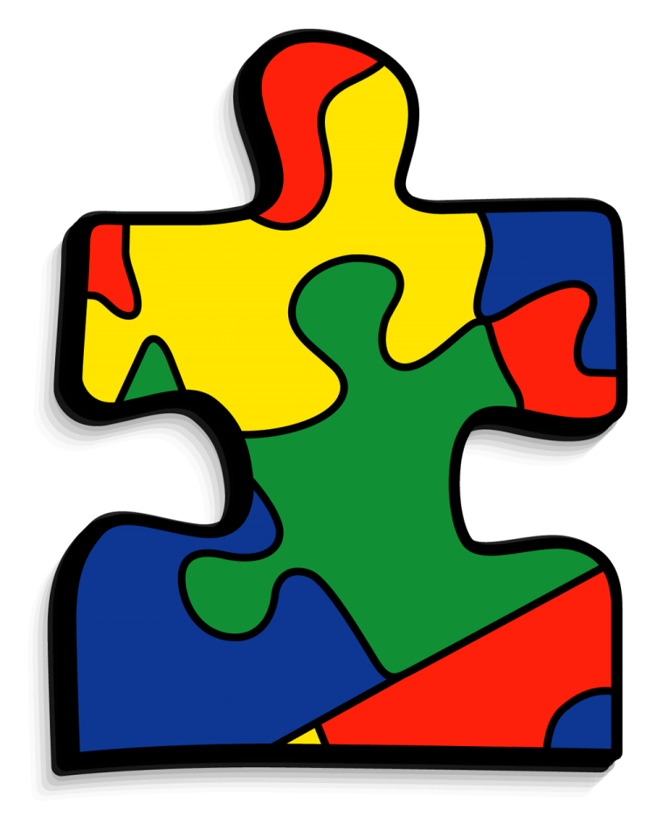
Neuroshapes
Experiences in our lives shape our nervous system in certain ways and we continue to respond in those ways…
Until we bring conscious awareness to our nervous system responses
S.Rebekah Demirel 2023
www.traumaprograms.com

Slide 21
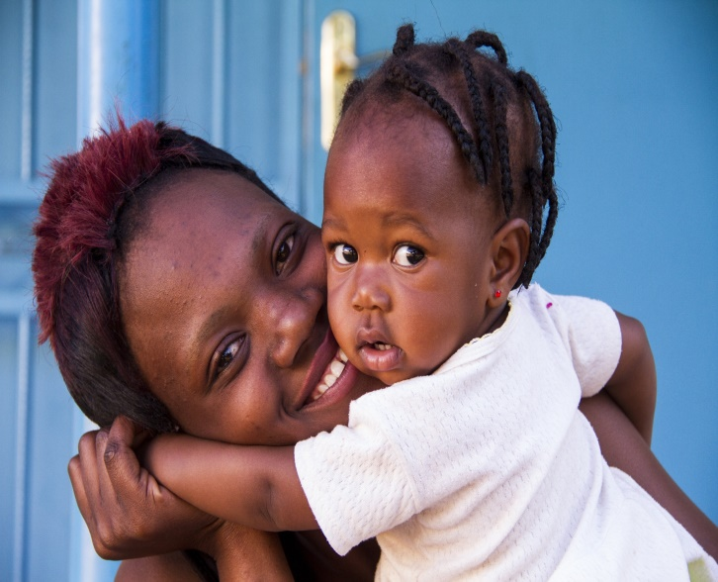
Co- Regulation
When we are anchored in ventral vagal energy we can connect and help others feel calm, relaxed and most of all safe = Co-Regulation
And when we co-regulate, we also feel calm, relaxed and safe
S.Rebekah Demirel 2023
www.traumaprograms.com

Slide 22
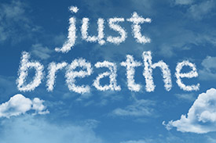
The Vagal Break
Inhalation speeds up the heart rate and engages the sympathetic nervous system
Exhaling longer than inhaling helps the parasympathetic nervous system engage
Singing, sighing, humming, savoring, celebrating help to engage the vagal break
S.Rebekah Demirel 2023
www.traumaprograms.com

Slide 23
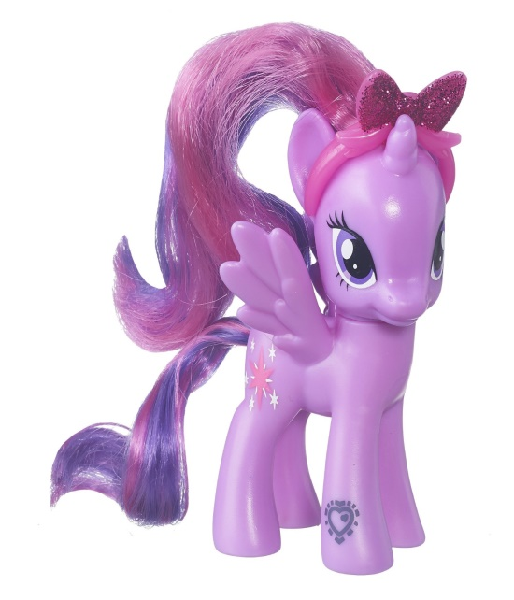
Glimmers
“Glimmers" refers to small moments when our biology is in a place of connection or regulation, which cues our nervous system to feel safe or calm
We notice these moments when we are anchored in ventral vagal
We can miss these moments but when we make a habit to notice them, we increase our vagal tone
S.Rebekah Demirel 2023
www.traumaprograms.com

Slide 24
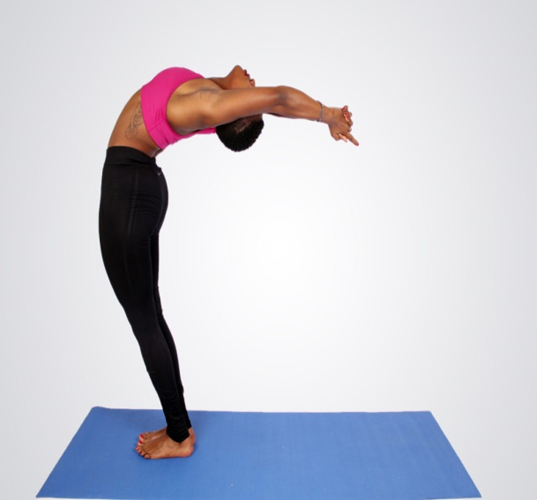
Vagal Tone
Nervous systems can become rigid from following the same ways of relating to the world
When we try new things to strengthen nervous system flexibility and resilience, we can increase vagal tone
S.Rebekah Demirel 2023
www.traumaprograms.com

Slide 25
What Enlivens You?
What makes you feel alive, calm, able to get things done, while staying connected?
These things are resilience anchors, bringing in renewed ventral energy
Bring your own colors, names and images to soothe and strengthen vagal tone
S.Rebekah Demirel 2023
www.traumaprograms.com

Slide 26
Savoring and Celebrating
When we see, smell, taste, feel something beautiful, good, sweet…
And we savor and celebrate what we are noticing…
We lock it into our nervous system…
And that increases vagal tone
S.Rebekah Demirel 2023
www.traumaprograms.com

Slide 27
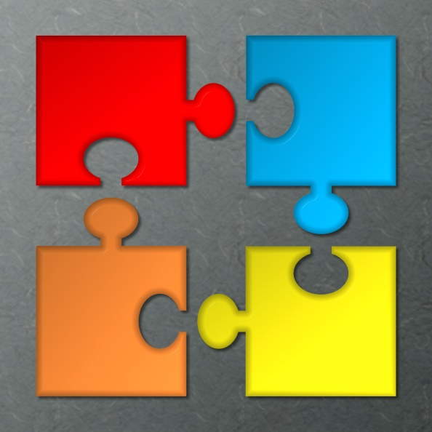
Nervous System Reshaping
Continued awareness (not vigilance) vagal toning, nurturing connection and support…
Reshapes our nervous system over time…
We notice ourselves noticing ourselves and that brings a spark of healing ventral energy
S.Rebekah Demirel 2023
www.traumaprograms.com

Slide 28
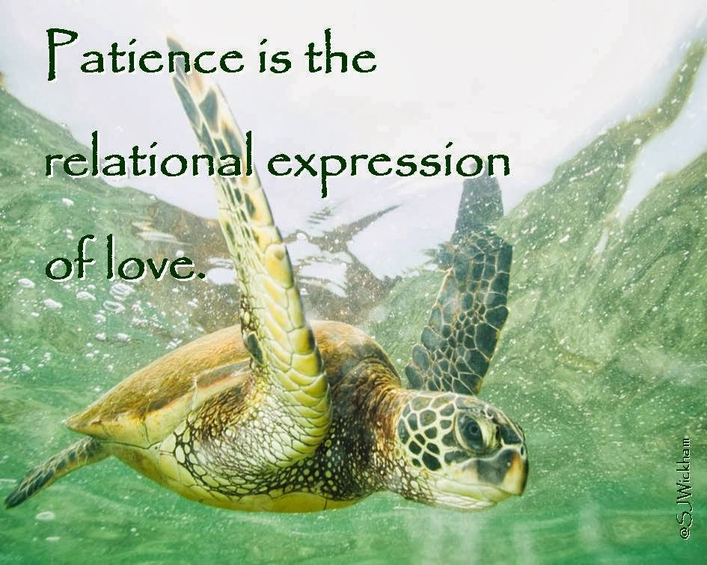
I Might Not Be There…Yet
When we notice impatience or self criticism in ourselves or others
We can recognize this as a protection state
And we can remember the word “Yet” to help bring us back to connection
S.Rebekah Demirel 2023
www.traumaprograms.com

Slide 29
Continuing The Conversation
Please come join the upcoming learning community to continue this conversation
Thank you for your presence today
We are all teachers for one another
S.Rebekah Demirel 2023
www.traumaprograms.com

