Slide 1
Being Assertive or Not Assertive Enough: Navigating an Important but Challenging Space Within ACT
Lorna Moser, Ph.D.
Christine Powers, LICSW, MLADC

Slide 2
“In some respects, ACT is a worse fate than being in hospital, where there is solidarity and patients help each other. When you’re inside, you only have one problem: How to get out. When you’re out, you have to deal with ACT, which leads to a host of other problems. ACT members tend to be intrusive and authoritarian. It’s chilling to know that anything I do or say will be judged and duly noted in my chart. There is little incentive to tell the truth, as the very real possibility of a mental-health “apprehension” is always present.”
Reflections on a Decade of Assertive Community Treatment - Mad In America

Slide 3
Notes:
Poll Title: ACT has been criticized as being inherently coercive. Why? What are some reasons for these claims? https://www.polleverywhere.com/free_text_polls/RwrQo5vTuBe1Rk1hE7J7x

Slide 4
How might this young woman feel about mental health care after this experience?
“One participant described how, in her first experience with involuntary hospitalization, her personal items were taken away. They took away her clothes, schoolbooks and notes. She was essentially stripped of everything and anything familiar, of anything that would keep her calm. The hospital focused on rigid rules and procedures rather than on her needs and what she was experiencing as a terrified young woman. There was no attempt to engage her in care”
(Source: NAMI).
Notes:
Stigma. What are some common terms you hear about mental illness? Why would people show up…

Slide 5
Notes:
Poll Title: Do not modify the notes in this section to avoid tampering with the Poll Everywhere activity. More info at polleverywhere.com/support How might this young woman feel about mental health care after this experience? https://www.polleverywhere.com/free_text_polls/ls8asArnR03OYJgnKqwJ9

Slide 6
How Assertive Do you Get?
Reducing Safety Concerns within Least Restrictive Environments
Promoting Autonomy

Slide 7
Who ACT Serves - “Clients in greatest need”
Significant and persistent challenges with symptoms
Schizophrenia-Spectrum Disorders and Bipolar I – Priority Clinical Population
Severe impairments in day-to-day living/ adulting
Higher rates of using crisis and inpatient service
Common occurring challenging with substance use, being unhoused, justice involvement
Higher risks to experiencing negative consequences when not receiving any treatment or inadequate treatment
For some, “clients in greatest need” are in part due to lack of consistent treatment, including medications
Some due to not seeing themselves as needing or wanting of treatment, including medications
7
Notes:
ACT is an expensive service to fund – when doing so to fidelity. To be cost-effective, ACT should be

Slide 8
Fixed Point of Responsibility
ACT Teams Meet 4 to 5 Days Per Week (In Person) for
Daily Team Meeting
COD Specialist
Employment Specialist
Care Coordination
Therapist
Psychiatrist
Notes:
Important to remember that ACT is designed to be the fixed point of responsibility – we must do right by offering a full range of services to meet needs and do so in a coordinated manner using the team approach

Slide 9
ACT is a way of organizing best practices
ACT
Treat-ment
Support
Rehabilit-ation
Outreach and Engage-ment
Motivational Interviewing
Assertive engagement
Person-centered assessment and planning
Medications
Psychotherapy
Physical health interventions
Integrated substance use treatment
Case management
Crisis services
Transportation
Coordination with hospitals and criminal justice system
Family education and support
Supported employment
Skill-building
Wellness management and recovery
Supportive Housing
Notes:
Finally – I as a one stop treatment shop, so to speak, ACT is to provide a rather full array of treatment and support. Often overlooked is the emphasis on providing more rehab services in ACT. Many individuals enrolling in ACT, or even those who have been getting ACT for years, vacillate in how motivated and interested they are in receiving services at all – outreach and engagement are also important skillset of ACT.
Sometimes this engagement is key to helping people stay out of more restrictive settings, as we take a look at next. Where ACT is situated within a broader system.
Org platform that undergoes periodic updates to reflect best practices – Windows 11

Slide 10
Service Retention is Important -
We can’t help people move into (and keep) an apartment, get a job, girlfriend, cat, recreational hobby, address legal charges, etc. if they drop out of services (prematurely).

Slide 11
Percent of ACT Team’s Clients who were Discharged Due to:
Unable to locate
(Mean (Standard Deviation))
Lower Fidelity Teams: 2.45% (3.32)
Higher Fidelity Teams: 0.95% (1.33)
Refused treatment/ requested discharge
(Mean (Standard Deviation))
Lower Fidelity Teams: 3.99% (3.30)
Higher Fidelity Teams: 2.51% (2.77)
Source: National ACT Study
Lower Fidelity teams (n = 42)
rated a 3.51 or lower on TMACT
Higher Fidelity teams (n = 51 )
rated a 3.98 or higher on TMACT

Slide 12
Why do we persist?
Because people can and do recover!
“Our job is not to judge who will and who will not recover. Our job is to establish strong, supportive relationships in order to maximize chance of recovery.”
“People need to have the dignity of risk and the right to fail.”
- Patricia Deegan
Because people are at higher risk when they disengage.
“Risk of further deterioration, relapse, and hospital readmission”
(Mitchell & Selmes, 2018).

Slide 13
Assertive Engagement What does “Engagement” even mean?
Showing up / being present for planned appointments?
Arguably a necessary condition for “engagement,” but not sufficient
Have you ever been with a person who was physically present, but not really receiving anything you were offering?
Being willing to receive support and/or treatment?
Yes, but this will be tailored to what support/treatment they are interested in
They accepted ACT as a service. They did not accept all things that ACT has to offer.

Slide 14
ACT is a Marathon, Not a Sprint
Take your time with engagement when you have the time to engage.
Having time to engage depends on knowing individuals, their histories, margin for risk, etc.

Slide 15
Notes:
Poll Title: Do not modify the notes in this section to avoid tampering with the Poll Everywhere activity. More info at polleverywhere.com/support What are some reasons for why people who are enrolled in ACT to be minimally engaged/ disengaged? https://www.polleverywhere.com/free_text_polls/owlc9vwPqIlT8JttEewAI

Slide 16
Reasons for Disengagement / Treatment Refusal
Poor Quality of Provider Relationships - Low Therapeutic Alliance
Stage of Treatment not Matching Stage of Change
Previous Negative Experiences in MH Services (distrust)
STIGMA
Logistical Inconveniences: Time, Location, Etc.
Forgetting / No Reminders Provided / Cognitive Challenges
Provider not strengths-based but deficit-based
Not attending to more immediate needs (i.e., hierarchy of needs, such as housing)
Integral to the Symptoms / Substance Use
Lack of representation / connection / cultural insensitivity
Neurological (Anosognosia – Lack of Insight)

Slide 17
Take Time to Understand
Understanding Reasons for Disengagement is Key to Developing the Team’s Approach to Engagement!

Slide 18
Types of Engagement & Outreach
Individualized care components
Tending to practical needs
Logistical approaches
Team-based strategies
Using outside resources
Consider evidence-based practice strategies
Legal mechanisms
Review clients who need outreach on a regular basis during ACT meetings
ACT clients should not be removed from services due to dis-engagement
Notes:
Hand out “Engagement Strategies Evidenced-based” handout

Slide 19
Taking out to coffee
Don’t mention meds
Educate self on / take interest in Kenya
Drop off Gatorade and brief note
Show up on time
Strategically use Peer Spec
Help fight legal charges
Take them to store. Each. Week.
Help find an apt
Listen more than talk
Show humility
Psych Advance Directive
Notes:
SR- What have YOU done to engage your clients?

Slide 20
“If people are treated as capable, they often surprise everyone and live up to expectations.”
- Ken Steele, The Day the Voices Stopped

Slide 21
Creating Value in Services Offered
What is important to this person?
What it is that he or she needs/wants, and offer assistance in meeting those needs/wants.
Be creative
Small gestures matter
Need to get your foot in the door literally and figuratively
Avoid what they don’t want from you
Be aware of how they view you/ previous experiences with mental health services

Slide 22
Notes:
Poll Title: Examples of creative and effective engagement strategies -- where you built up intrinsic motivation to engage with team? https://www.polleverywhere.com/free_text_polls/DIubJsJ5sB99g0WtZovyg

Slide 23
Building on Extrinsic Motivation (Use very thoughtfully and limited capacity!)
This involves using some power and control – only use when lack of treatment is clearly going to result in undesired and more restrictive outcomes
Resort to these strategies when collaborative approaches have failed and risks are increasing
Risk of harm to self and/or others (including grave disability / self-neglect)
Invoking position of power out of care and concern
Notes:
SR- what about this makes you uncomfortable?
Threat or Use of Force
Involuntary commitment to treatment
Violation of parole or probation
Contact DSS
Control of Resources
Access to housing contingent on treatment participation or adherence
Money used as leverage
to increase adaptive behaviors (e.g., taking medications, going to group)
decrease maladaptive behaviors (e.g., substance use, poor hygiene)
Interpersonal pressures
Close observation of medication receipt
Nonverbal and verbal behaviors associated with medication drops (e.g., not leaving apartment until meds swallowed)
Accessing family to employ their own interpersonal pressures

Slide 24
Close Observation Oral Meds/IM
Leveraging Family
Housing Contingencies
Petition for/ Revoking Commitment
Leveraging DSS or Probation
Using Inducements to Encourage Treatment

Slide 25
National ACT Study – Individuals on Outpatient Commitment
7%
On average, the percentage of ACT Team Clients are on an involuntary outpatient commitment
(n = 170 teams undergoing TMACT fidelity review)
61% of survey participants reported no more than 10% of clients served by their ACT team were on a civil or criminal commitment order ACT Team Leader Survey (n = 306)

Slide 26
Be Very Thoughtful About the Use of Assertive Engagement!
ACT has been criticized for being coercive and paternalistic for good reason!
Create a system to identify those *not* engaged and clearly needing ACT services
Eye towards reducing use of regulatory interventions that can be experienced as coercive
Use Daily Team Meeting to Assess, Plan, Track
Track approaches being used – effective or not?
Periodic Clinical Reviews and use of ITTs

Slide 27
Questions to Consider (This is not an exhaustive list!)
Does the person really need ACT?
Is their refusal appear to be due to symptoms of the illness itself? e.g., paranoia, severe depression, significant impairments in insight. Is it representing informed decision?
What are the consequences of not receiving services from ACT/or no services at all? Historical information is critical here. How bad does bad get and how quickly?
What are the consequences of us using assertive engagement tactics?
Potential for total service drop-out (lose opportunity to refer to another provider)? Potential harm to staff?

Slide 28
Your toolbox should be tangible!
Develop a written list of outreach & engagement strategies.

Slide 29
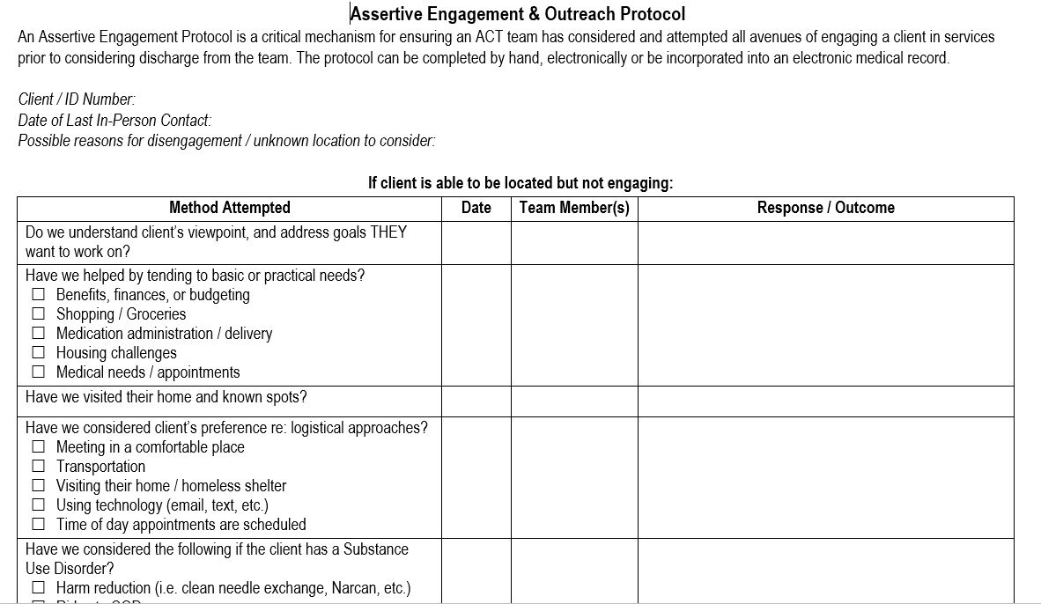
Notes:
ISNs!!!!!!!!!!!!!!!!!!!!!!!!!!!!!

Slide 30
What’s the Secret to Recovery-Based Assertive Engagement?
“People are generally better persuaded by the reasons which they have themselves discovered than by those which have come into the mind of others.”
—Blaise Pascal
Notes:
Blaise Pascal mathematician, physicist, inventor

Slide 31
Critical Resource
https://www.commongroundprogram.com/

Slide 32
Engagement toolbox should have a range of strategies and tools
When not willing to use strategies leveraging extrinsic motivation – potential for clinical negligence
When there is limited motivational/ collaborative approach) – potential for paternalism and coercion.

Slide 33
A message from a person with lived experience…
“Don’t generalize about people based on their symptoms and mental health issues. Figure out what their goals are and what they want to do in life. Then… cheer them on and tell them that it is possible. Listen to their whole story and cheer them on.”
- Maggie

