Slide 1

Today’s webinar is based on the “Supervising Clinical Mental Health Providers” guide published by the University of Washington’s CoLab for Community & Behavioral Health Policy and informed by both the research literature and experiences of community providers, behavioral health leaders, and systems partners.
Naomi Leong, LMHC, RYT-500
Minu Ranna-Stewart, LICSW

Slide 2
In many ways, a supervisee-supervisor relationship mirrors the interpersonal and therapeutic process between a clinician and a client.
Word Cloud Activity

Slide 3
Crucial Elements of Clinical Supervision
Trauma Informed
Intersectionality, Cultural Responsivity, and Racial Equity
Strengths-Based and Empowerment Based Approaches
Mindfulness of Power Dynamics
Cross-Racial
Racial Self-Awareness
Gender and Sexuality
Repair of Relational Harm
Defining Roles and Expectations

Slide 4

Engagement (Structuring Supervision)
Foundation for a valuable and positive working relationship
Build rapport
Develop positive relationship
Promote supervisory working alliance
Lessen supervisee anxiety

Slide 5

Initial Supervision Session, Step 1
Lay out your expectations:
  What to bring
  Different expectations for new vs. experienced therapist
  Discuss measurement of benchmarks
  Consider different formats you might supervise in and supervise accordingly
Notes:
Describe process, structure, and content
What to bring (progress notes, worksheets, standardized measures, session recordings, etc.)
Different expectations for new vs. experienced therapists (if so, address this), discuss measurement of benchmarks
Consider different formats you might supervise in and supervise accordingly

Slide 6

Initial Supervision Session, Step 2
Provide supervisees with an opportunity to discuss their expectations:
  What are your goals in this work and in this position?
  How can I support you in your broader professional goals?
  What has worked well in supervision in past supervision and what has not worked well?
  Do you have any concerns about supervision?
  Ask about preferred learning style, “How do you learn best?”

Slide 7
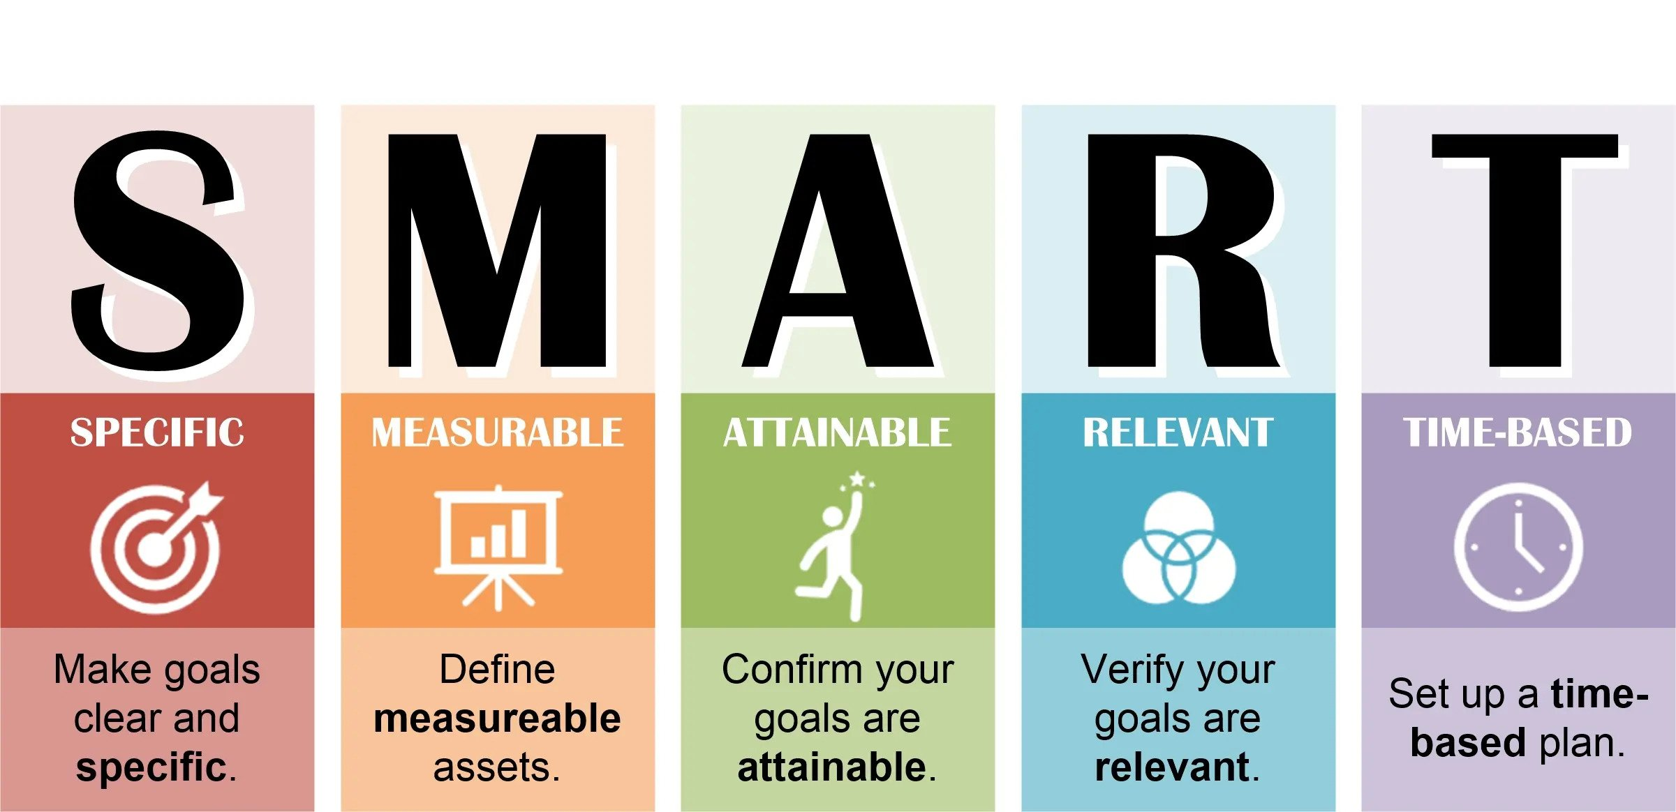
Initial Supervision Session, Step 3
Ask supervisees about their specific short-term and long-term goals:
  SMART
  Document and review regularly
  Consider ways to measure progress such as self-assessments, performance evaluations, etc.

Slide 8

Initial Supervision Session, Step 4
/
Describe and explain your supervisory style and approach to supervision:
  Models – orientation specific, developmental, integrative
  Approaches – directive, non-directive, collaborative

Slide 9
Initial Supervision Session, Step 5
Establish clear guidelines for conducting supervision:
  What is the supervisor’s role, what you can expect from you in a supervisor’s relationship?
  Describe the various roles of a supervisor – teacher, consultant, mentor, evaluator
  Strongly consider a supervision contract signed by both the supervisor and supervisee

Slide 10

Initial Supervision Session, Step 6
Initiate a conversation about multicultural and racial equity considerations:
  How does this affect both therapeutic and supervision relationships
  Set expectations around these discussions being an expected part of supervision

Slide 11

Encouraging Self Care
Supporting Supervisees with Trauma Exposure and Vicarious Trauma

Slide 12
Introduction
“Many behavioral health providers come to the work with their own trauma history, with research suggesting that at least one-third of behavioral health practitioners are trauma survivors.”
“Clinicians working in the public behavioral health field, who are often relatively early in their careers, are holding incredibly high caseloads that may involve chronic exposure to trauma.”
Signs and symptoms mimic those of post-traumatic stress disorder
Vicarious trauma, secondary trauma, compassion fatigue, burnout
6% to 26% of therapists are at risk
Provide supervisees with information and strategies to cope with vicarious trauma so they can be present and compassionate
(Supervising Clinical Mental Health Providers, pg 37, 38)

Slide 13
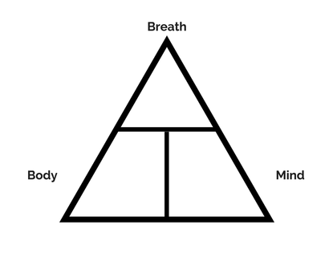
Self-Care
Talk about how self-care might be incorporated specifically at work. Helpful questions to ask your supervisee might include:
  How can self-care be implemented throughout your workday?
  What times or moments throughout your day feel heaviest?
  What would feel supportive during those moments?
  Is there anything else I can do to support your self-care?”
  Modeling
  Mindfulness Practices
  Nervous System Regulation
  Affirm, Breathe, Choose (ABC)
  (Supervising Clinical Mental Health Providers, p 40)

Slide 14

Quality Supervision
  Supervisors may have some ability to support their supervisee’s self care through these structures:
  Monitor caseload sizes and types
  Encourage use of vacation time, flex time
  Alternative schedules
  Provide training in EBPs such as CBT
  Normalize, validate, provide hope

Slide 15

Vicarious Resilience
Positive growth and change associated with trauma exposure, 7 Domains:
  Client-inspired hope
  Increased recognition of clients’ spirituality as a therapeutic resource
  Increased self-awareness and self-care practices
  Increased consciousness about power and privilege relative to the social location of those you work with
  Increased capacity for resilience and resourcefulness
  Increased capacity to remain present during the trauma narratives of those you work with
  Changes in life goals and perspective

Slide 16

Power Dynamics and
Cross-Racial and
Racial Equity Considerations in Supervision

Slide 17

Power Dynamics Around Identity
Power dynamics are inherent, can be amplified with other aspects of identity, and are impossible to remove.
BUT…one can move towards equalizing or flattening by:
  Facilitating open dialogue
  Inviting and being receptive to feedback
  Inviting authenticity
  When possible, giving decision making

Slide 18

Cross-Racial Supervision
A supervisory relationship in which the supervisor and supervisee are from racially different groups
Common cross-racial consideration: white supervisor and a BIPOC supervisee
Considerations:
  Having a person with shared identity outside of the supervision relationship for support
  Shared supervision spaces with people with shared identity or other BIPOC clinicians

Slide 19

Cross-Racial Supervision
For cross-racial supervision where the supervisor is BIPOC:
  Stereotypical transference enactments can emerge in supervisor relationships
  Consider pursing peer-to-peer consultation and utilizing their own supervision places to identify and process stereotypical transference enactments

Slide 20
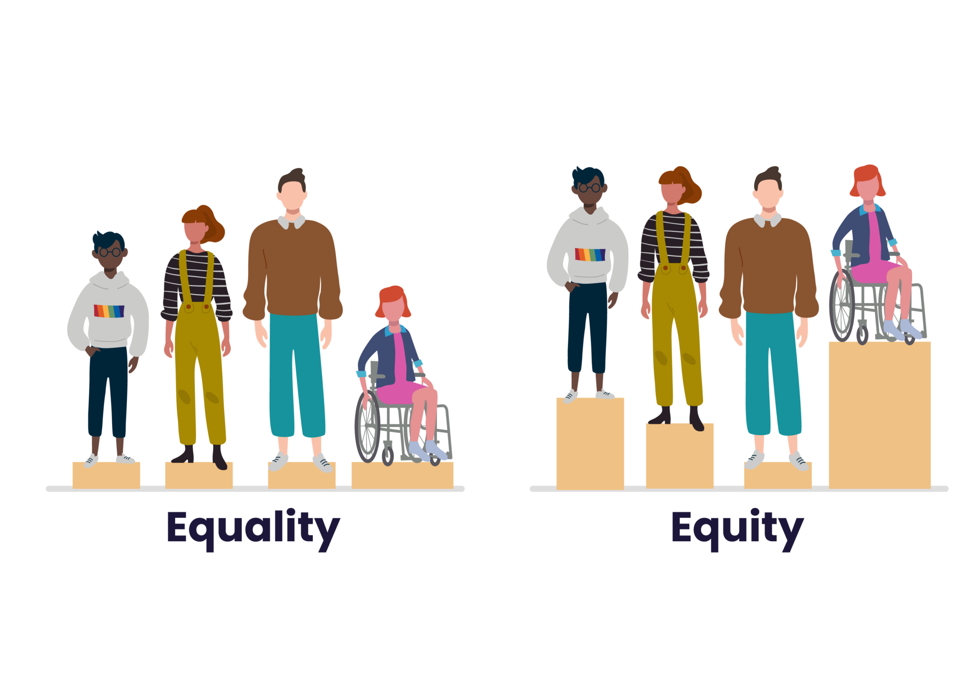
Race Equity in Supervision
It is common for supervisors and supervisees to have different racial, ethnic, and cultural backgrounds
It is critical for supervisors to provide supervision in a culturally response and anti-racist way:
  Supervisory relationships should be grounded in values of intersectionality and equity
  Racial trauma and harm are not caused
  Culturally relevant supervision supports supervisees in providing more culturally relevant care to clients
  Discussing and attending to race and identity in the supervisory relationship increases trust, strengthens the supervisory relationship, and likely promotes higher quality of care

Slide 21

Gender Identity
Supervision As An Interpersonal Practice:
Building Relational Safety with Your Supervisee

Slide 22

Introduction
The Human Rights Campaign estimates more than two million transgender and non-binary people across the US.
Terminology:
  Transgender/Gender Diverse
  Cisgender
  Gender identity vs gender expression
  Non-Binary
  Intersex

Slide 23

Power Dynamics
“It is important to consider how power dynamics around gender identity exist in supervision and to consider how these dynamics may impact relational safety or comfort.”
Cisnormativity
Binary Gender Norms
Minority Stress Theory
Intersectionality
Disclosure
(Supervising Clinical Mental Health Providers, p 18)

Slide 24
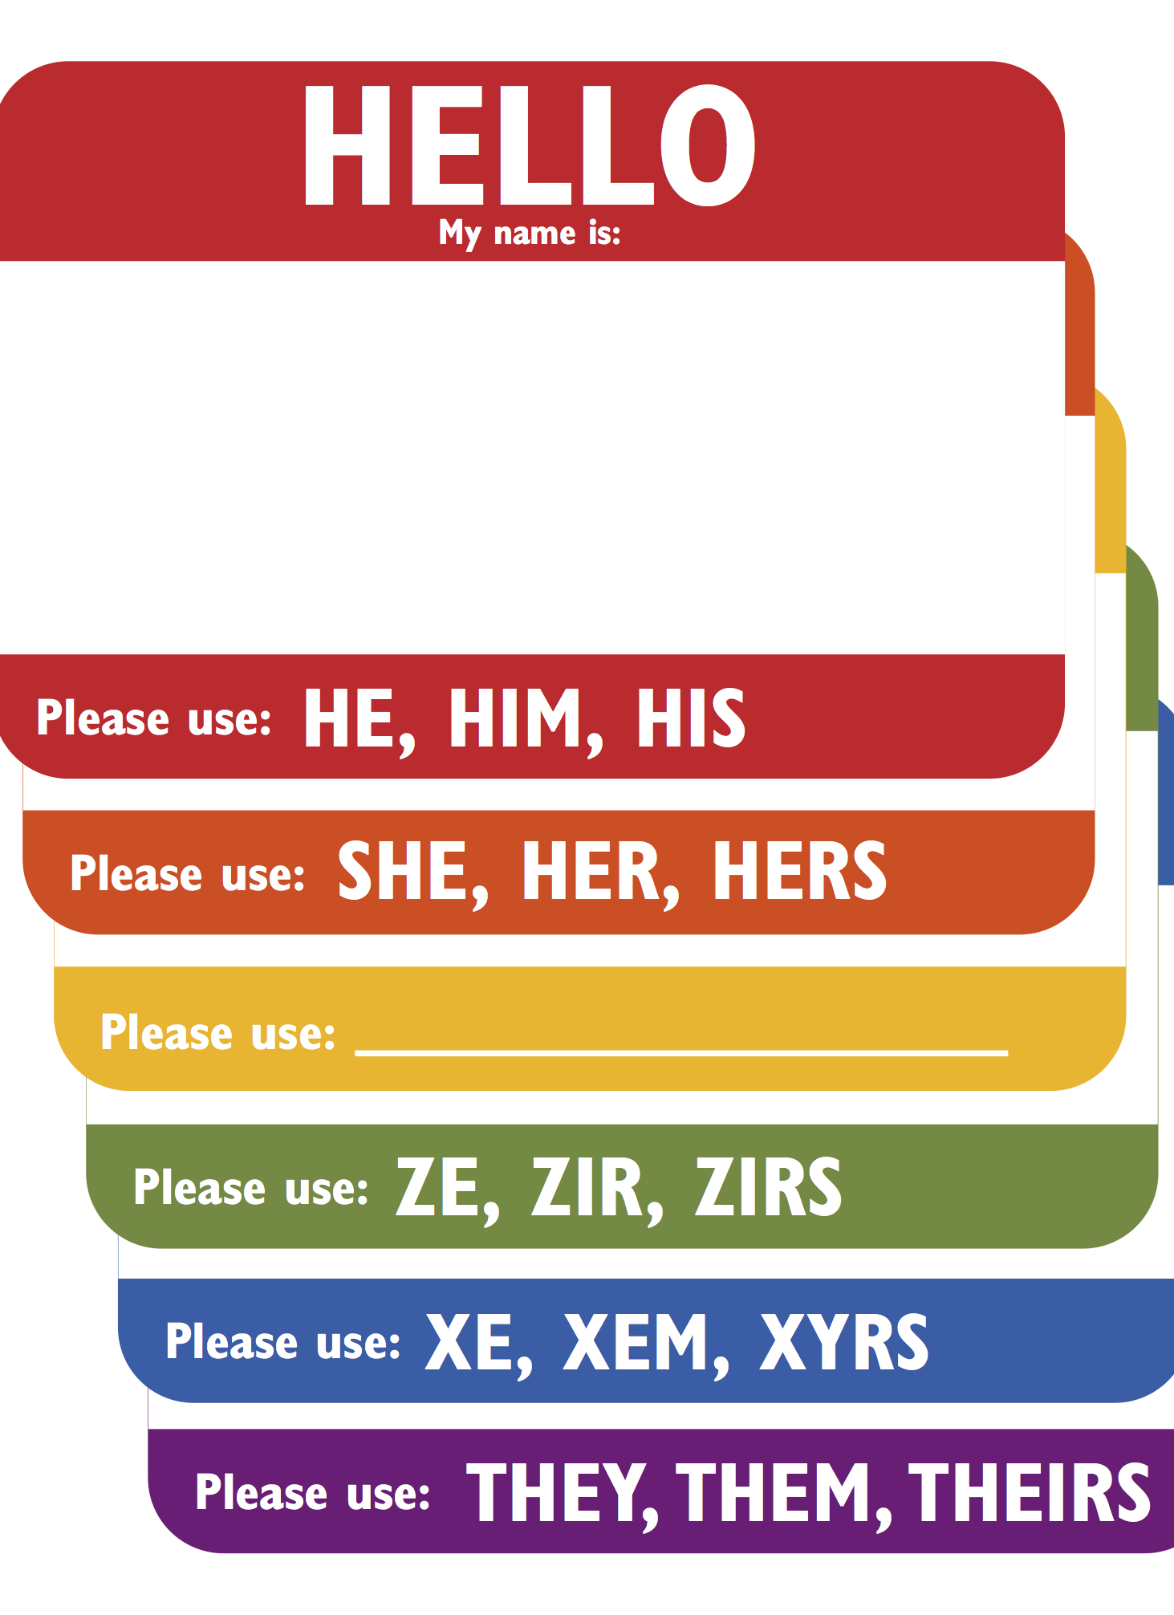
Pronouns
“It is important not to assume someone’s gender identity or pronouns.”
Pronouns
Respectfully invite someone to share their pronouns with you. “My pronouns are _________. What pronouns do you respond to?”
Misgendering
They/Them Pronouns
(Supervising Clinical Mental Health Providers, p 19)

Slide 25

Quality Supervision
  Continually monitor and update terminology/language
  Cultural intelligence
  Work to unwind implicit bias
  Secondary trauma and transgender/gender diverse clinicians
  Self-Disclosure to clients

Slide 26

Takeaways

